Slide 1
The Year in Baseball:
1976

Slide 2
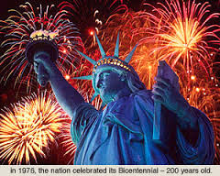
United States Bicentennial (1776 – 1976)

Slide 3
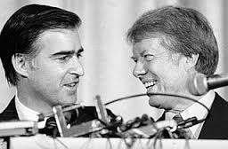
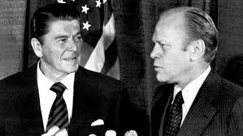
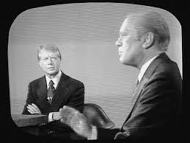
Election Year
Democrats
Republicans

Slide 4
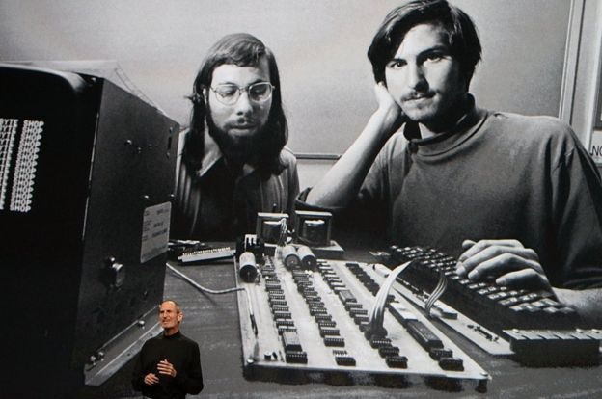
Apple, Inc. Founded

Slide 5
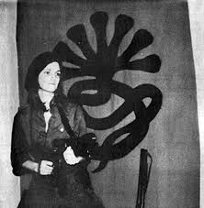
Patty Hearst Found Guilty

Slide 6
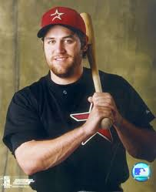
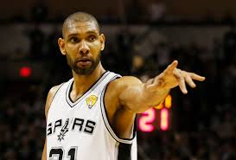
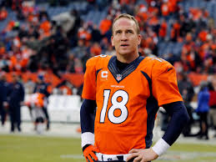
Born in 1976

Slide 7
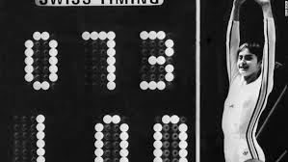
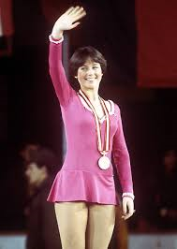


Winter and Summer Olympics

Slide 8
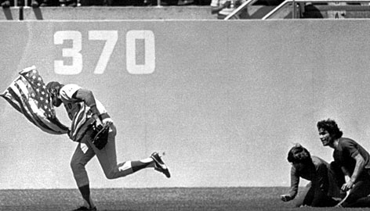
1976 – On the Field
Notes:
Click picture to view video at hyperlink https://www.youtube.com/watch?v=lJe2Ew-rhx8

Slide 9

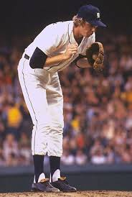
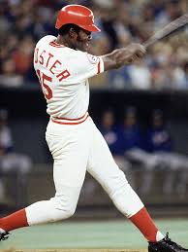
1976 – On the Field
All-Star Game
Notes:
Held in Philadelphia (1776) – also hosted NBA All Star game, NHL All Star game and NCAA Final Four.

Slide 10
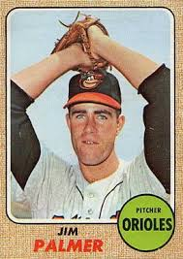
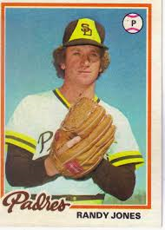
1976 -- On the Field
Cy Young Winners

Slide 11
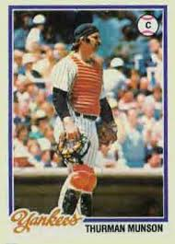
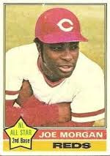
1976 -- On the Field
MVP Winners
Notes:
Mickey Mantle hit 37 homers to lead the AL. He also led the league in triples, walks, and SLG.

Slide 12
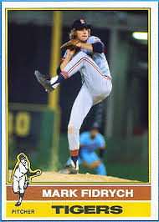
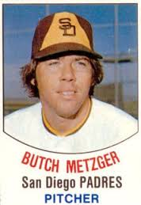
1976 -- On the Field
Rookie of the Year Winners
Notes:
Mickey Mantle hit 37 homers to lead the AL. He also led the league in triples, walks, and SLG.

Slide 13
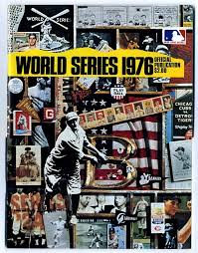

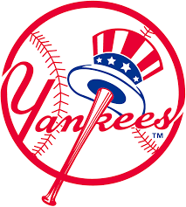
1976 World Series
Big Red Machine
VS
Bronx Bombers

