Slide 1
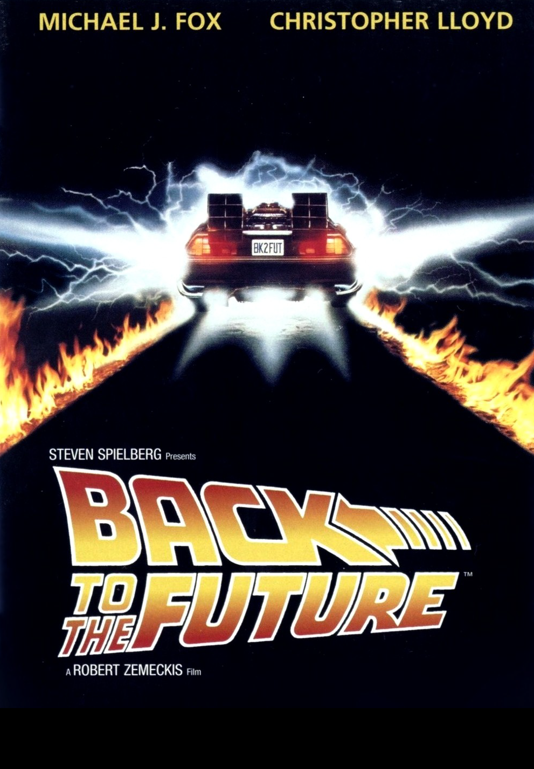
Back to the Future
1985
https://www.youtube.com/watch?v=qvsgGtivCgs
https://www.youtube.com/watch?v=ADXs2C4Vmho

Slide 2
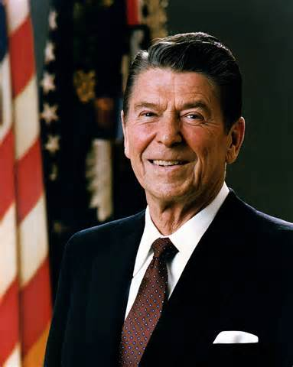
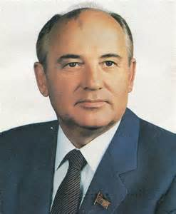
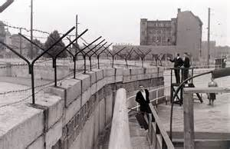
1985 -- Off the Field:
“Mr. Gorbachev, …. “

Slide 3
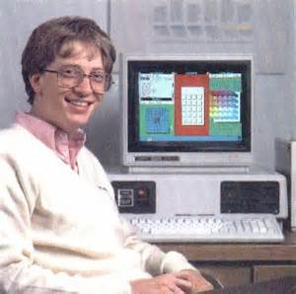
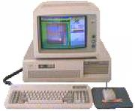
1985 -- Off the Field:
The Latest and Greatest in Technology
The
IBM
PC-AT
512K memory
$2,095 list price
… running
Microsoft
“Windows”

Slide 4
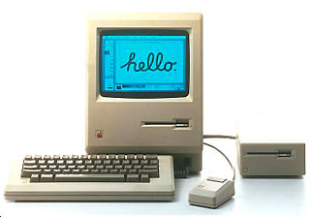
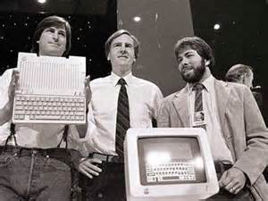
1985 -- Off the Field:
The Latest and Greatest in Technology
… but, some preferred the Mac
128K memory
$2,495 list price

Slide 5
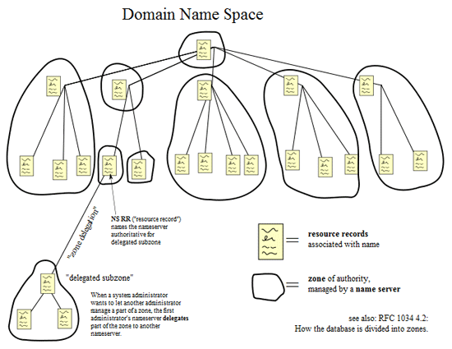
1985 -- Off the Field:
The Latest and Greatest in Technology
ARPAnet
and other
computer
networks
were
interconnecting to become ….
the
INTERNET
56Kbs was standard speed
DNS (.com .edu .org) was adopted
In 1985 the ‘net had 2,000 sites
Today, there are 644,000,000 sites !

Slide 6
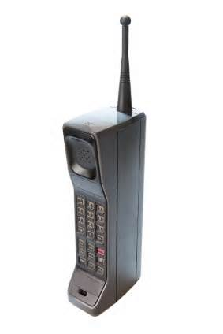
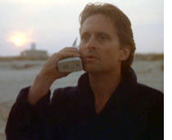
1985 -- Off the Field:
The Latest and Greatest in Technology
Motorola
DynaTAC 8000X
aka “The Brick”
First commercially available
cellular phone
It was one foot long
Weighed 2 pounds
1 hour of battery life
Cost: $3,995

Slide 7
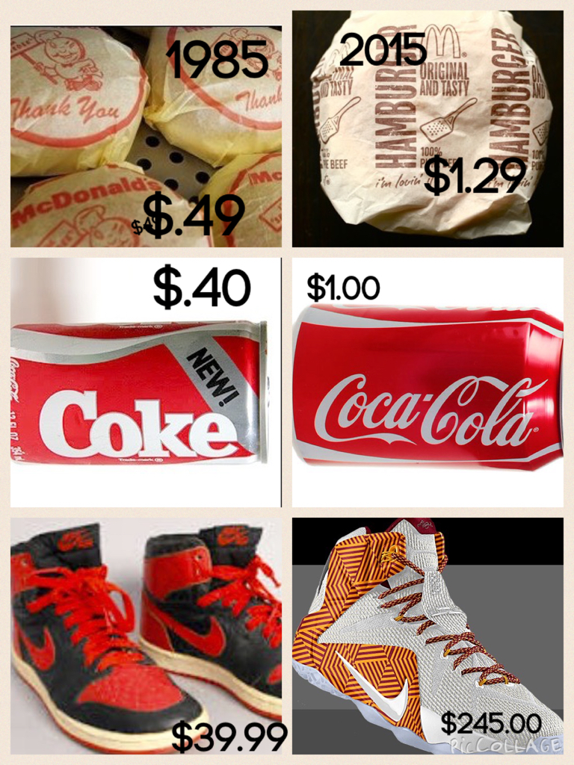
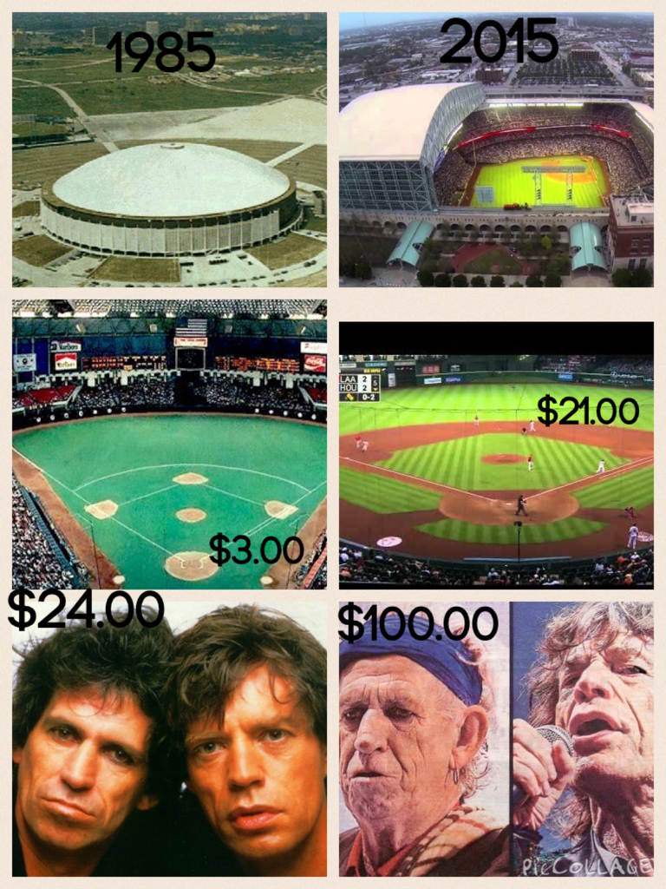
1985 – Off the Field
Some Consumer
Prices
Then and Now

Slide 8
1985 -- On the Field:
Some Highlights
Rod Carew became the 16th player to achieve 3,000 hits
Comiskey Park in Chicago celebrated its 75th anniversary. It was the oldest ballpark in the majors in 1985.
Nolan Ryan became the first ML pitcher to record 4,000 strikeouts
Pete Rose surpassed Ty Cobb as the all-time hits leader
Lou Brock (1st ballot) and Hoyt Wilhelm (8) are elected to the Hall of Fame

Slide 9


1985 -- On the Field:
League MVPs:
Willie McGee
led NL with .353 batting avg, 216 hits, 18 triples
Don Mattingly
led AL with 145 RBI and 48 doubles

Slide 10


1985 -- On the Field:
Cy Young Award
Pitching Leaders:
Dwight Gooden 24-4
led league in wins, ERA 1.53,
IP 276, and strikeouts 268
Bret Saberhagen 20-6
ERA 2.87, IP 235

Slide 11



1985 – On the Field:
Some New Players
Calvin Schiraldi
Ozzie Guillen
Vince Coleman
Notes:
Mickey Mantle hit 37 homers to lead the AL. He also led the league in triples, walks, and SLG.

Slide 12
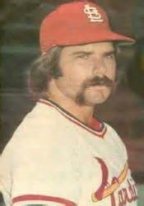
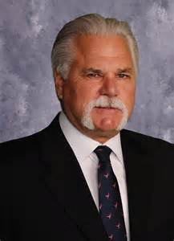
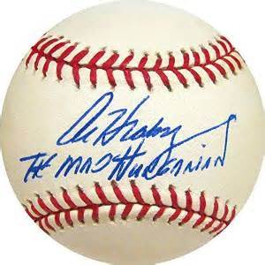
1985 – On the Field:
Dave’s favorite ball player had recently retired
The “Mad Hungarian” … then and now …
Notes:
Mickey Mantle hit 37 homers to lead the AL. He also led the league in triples, walks, and SLG.

Slide 13
1985 -- On the Field:
Final Regular Season Standings
1985 National League Team Standings
East | Wins | Losses |  | GB
Cardinals | 101 | 61 |  | -
Mets | 98 | 64 |  | 3
Expos | 84 | 77 |  | 16 1/2
Cubs | 77 | 84 |  | 23 1/2
Phillies | 75 | 87 |  | 26
Pirates | 57 | 104 |  | 43 1/2
West | Wins | Losses |  | GB
Dodgers | 95 | 67 |  | -
Reds | 89 | 72 |  | 5 1/2
Padres | 83 | 79 |  | 12
Astros | 83 | 79 |  | 12
Braves | 66 | 96 |  | 29
Giants | 62 | 100 |  | 33
1985 American League Team Standings
East | Wins | Losses |  | GB
Blue Jays | 99 | 62 |  | -
Yankees | 97 | 64 |  | 2
Tigers | 84 | 77 |  | 15
Orioles | 83 | 78 |  | 16
Red Sox | 81 | 81 |  | 18 1/2
Brewers | 71 | 90 |  | 28
Indians | 60 | 102 |  | 39 1/2
West | Wins | Losses |  | GB
Royals | 91 | 71 |  | -
Angels | 90 | 72 |  | 1
White Sox | 85 | 77 |  | 6
Twins | 77 | 85 |  | 14
Athletics | 77 | 85 |  | 14
Mariners | 74 | 88 |  | 17
Rangers | 62 | 99 |  | 28 1/2

Slide 14
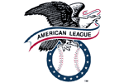
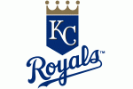
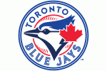
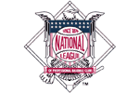
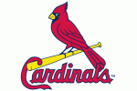
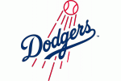
1985 League Championship Series
This was the first year that the LCS was a Best-of-Seven match-up
4 - 3
4 - 2
https://www.youtube.com/watch?v=nVVAf_fY5a0
https://www.youtube.com/watch?v=KCG5krQPyXQ

Slide 15
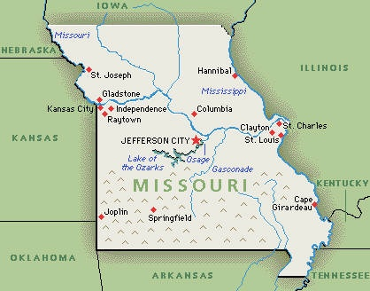
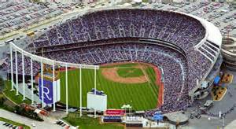
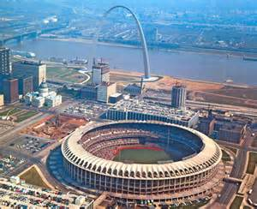
1985 World Series
The “I-70” World Series
The 2nd all- Missouri
World Series
I-70
https://www.youtube.com/watch?v=JRBCo6IMPKk

