Slide 1
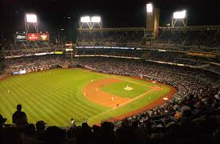
UNBREAKABLE
RECORDS
(I think.)

Slide 2
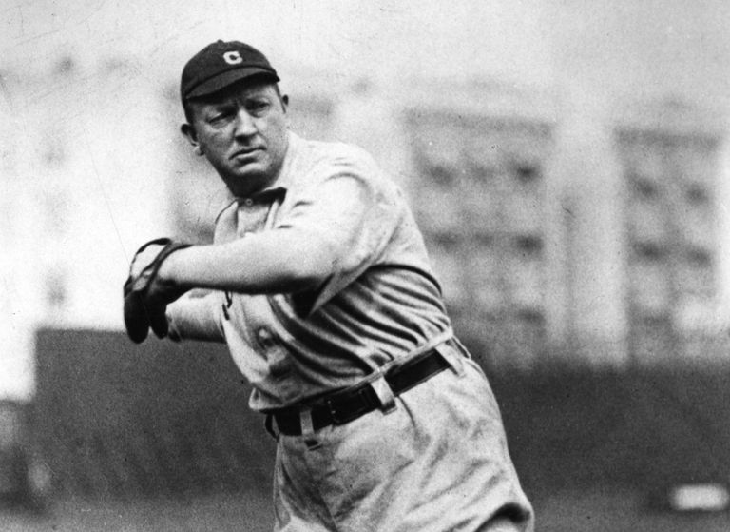
MOST CAREER WINS
Cy Young
511 wins from 1890 to 1911
Second Place: 417, Walter Johnson
Current Leader: 240, Bartolo Colon (Young has over twice as many wins.)
Player Starting Now: Win 25 games for 20 ½ years

Slide 3
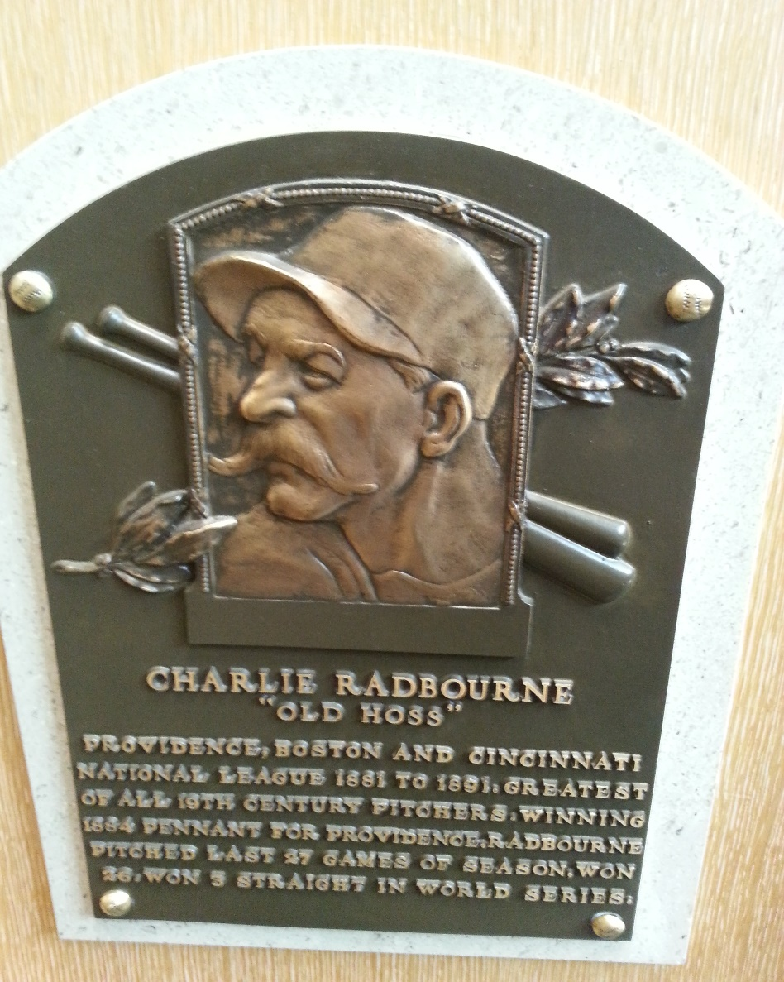
MOST WINS IN A SEASON
Old Hoss Radbourne
59 wins in 1884
Second Place: 53, John Clarkson
Most in 2017: 18 (by 4 pitchers)
Last pitcher to win even 30 (31) was Denny McLain in 1968

Slide 4
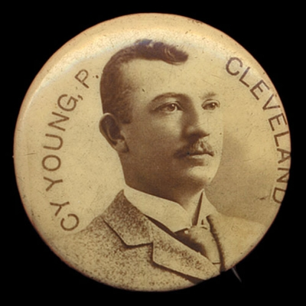
MOST CAREER COMPLETE GAMES
Cy Young
749 complete games from 1890 to 1911
Second Place: 646, Pud Galvin
Current Leader: 38, CC Sabathia
(Young has almost 20 times as many complete games.)
Player Starting Now: Pitch 30 complete games for 25 years

Slide 5
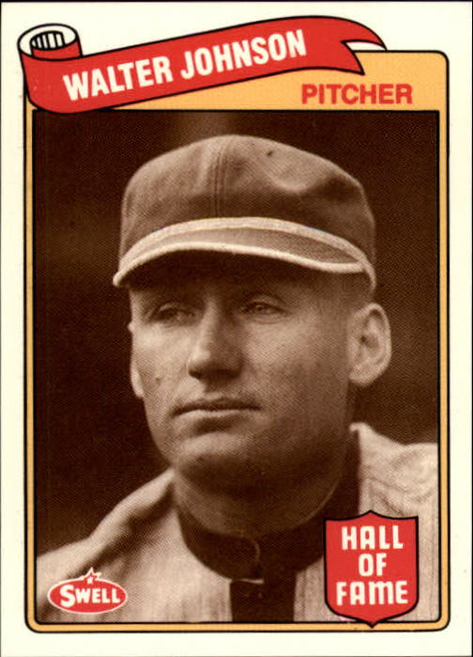
MOST CAREER SHUTOUTS
Walter Johnson
110 shutouts from 1907 to 1927
Second Place: 90, Pete Alexander
Current Leader: 15, Clayton Kershaw
(Johnson has 7 ½ times as many shutouts.)
Player Starting Now: Throw 10 shutouts for 11 years

Slide 6
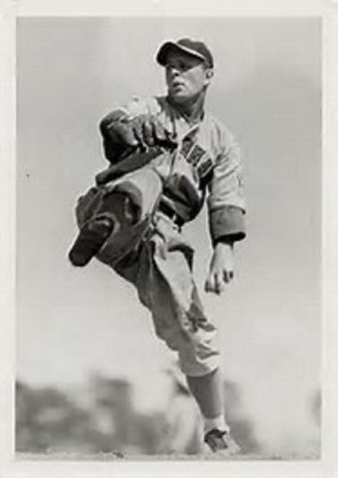
TWO NO-HITTERS IN A ROW
June 11, 1938. Beat Boston Bees 3-0.
Johnny Vander Meer
June 15, 1938. Beat Dodgers 6-0.

Slide 7
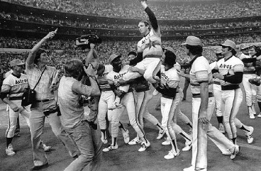
MOST NO-HITTERS IN A CAREER
Nolan Ryan
7 no-hitters from 1966 to 1993
Second Place: 4, Sandy Koufax
Current Leader: 2, Justin Verlander
(Ryan has 3 ½ times as many no-hitters.)
Notes:
Nolan Ryan also had 11 one-hitters, and 24 no-hitters broken up in the 7th inning or later.

Slide 8
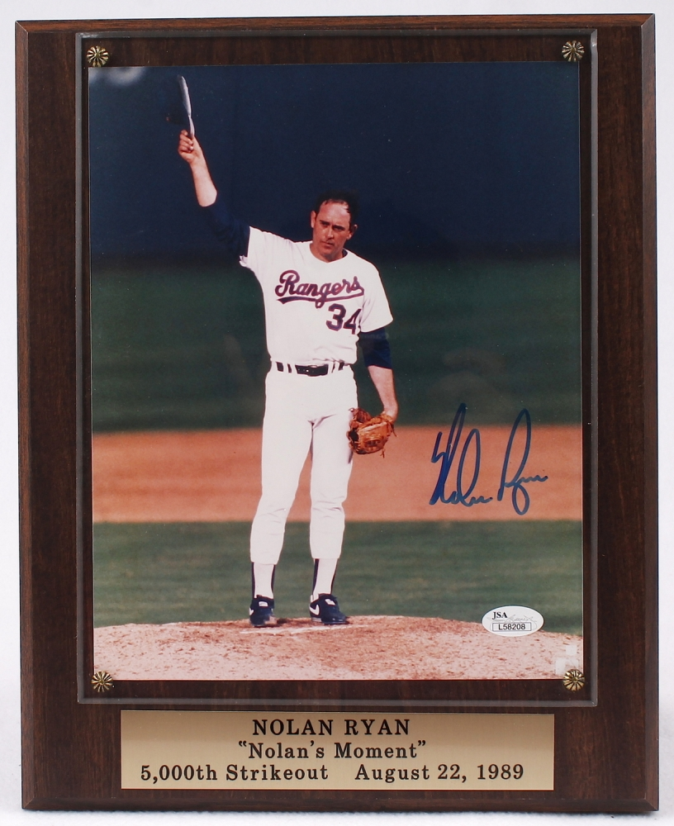
MOST CAREER STRIKEOUTS
Nolan Ryan
5,714 strikeouts from 1966 to 1993
Second Place: 4875, Randy Johnson
Current Leader: 2846, CC Sabathia
(Ryan has twice as many strikeouts.)
Player Starting Now: 250 strikeouts for 23 years
(Ryan also holds the record for walks with 2795. Steve Carlton is 2nd with 1833. Current leader is CC Sabathia with 1009.)
Notes:
(also walks, 2795; 2nd = Steve Carlton, 1833)

Slide 9
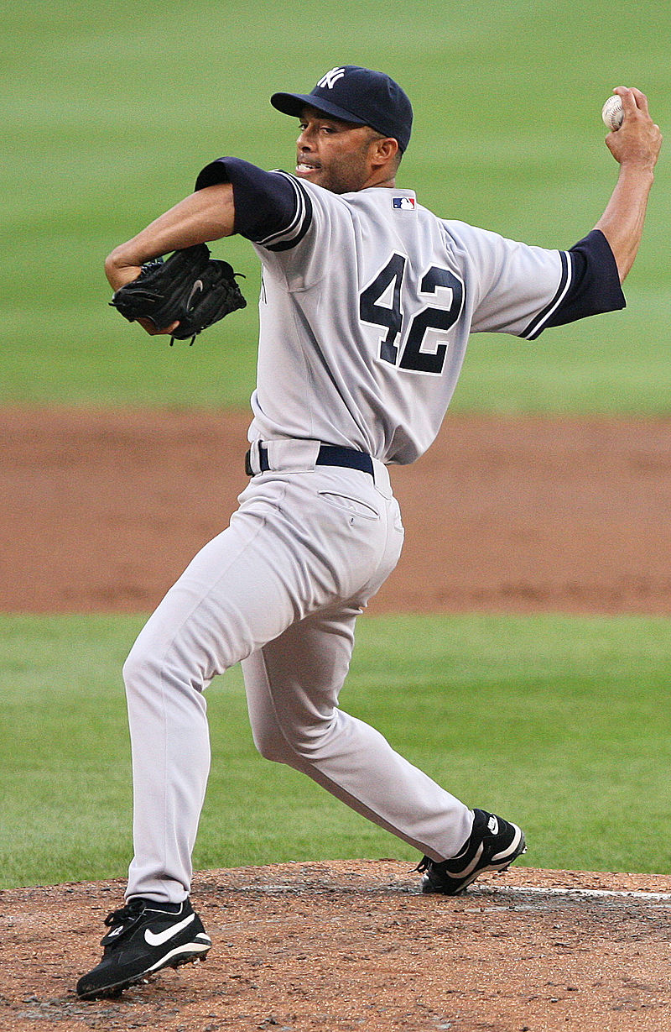
MOST CAREER SAVES
Mariano Rivera
652 saves from 1995 to 2013
Second Place: 601, Trevor Hoffman
Current Leader: 437, Francisco Rodriguez
(Rivera has 1 ½ times as many saves.)
Player Starting Now: 40 Saves for 16 ½ years

Slide 10
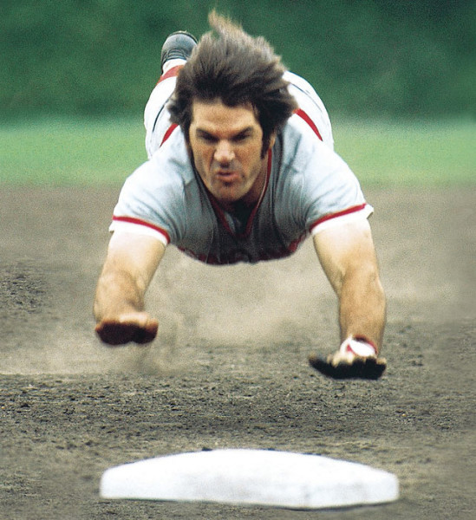
MOST CAREER HITS
Pete Rose
4,256 hits from 1963 to 1986
Second Place: 4189, Ty Cobb
Current Leader: 3080, Ichiro Suzuki
(Rose has 1 1/3 times as many hits.)
Player Starting Now: 200 hits for 21 ½ years

Slide 11
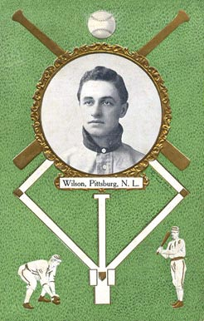
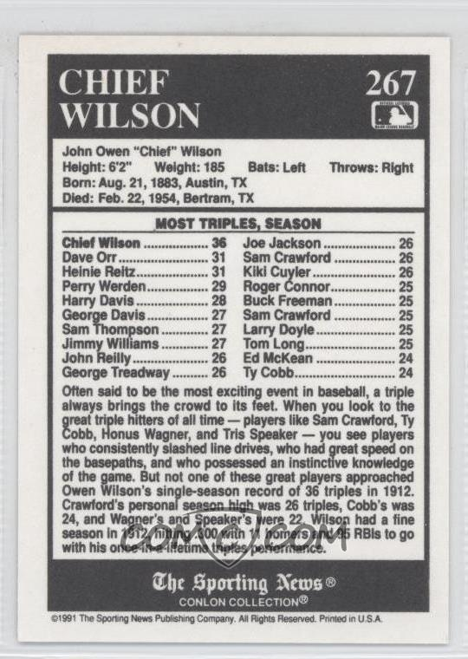
MOST TRIPLES IN A SEASON
John “Chief” Wilson
36 triples in 1912
Second Place: 31, Dave Orr
2017 Leader: 14, Charlie Blackmon
(Wilson has 2 ½ times as many triples.)

Slide 12
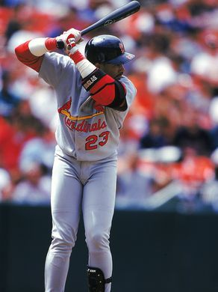
MOST GRAND SLAMS IN 1 INNING
Fernando Tatis
2 grand slams on April 23, 1999
Also holds the record for most RBIs in an inning: 8
Only 12 other players have ever hit 2 grand slams in a game. Over 50 players have hit 2 home runs in a single inning, but nobody has ever hit 3 home runs in 1 inning.

Slide 13
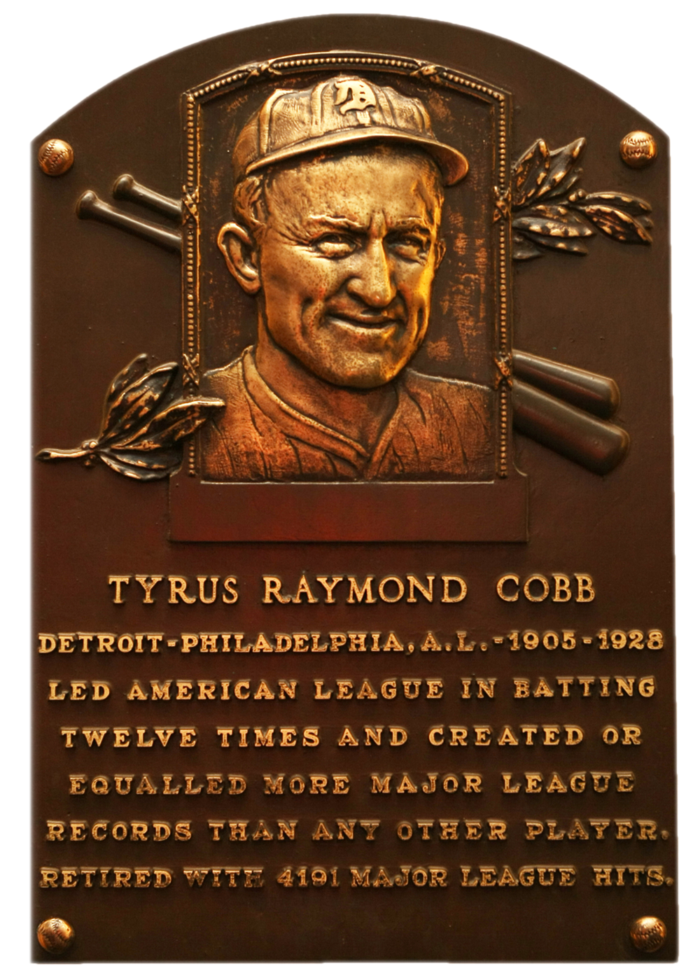
HIGHEST CAREER BATTING AVERAGE
Ty Cobb
.367 batting average from 1905 to 1928
Second Place: .358, Rogers Hornsby
Current Leader: .317, Miguel Cabrera
(Cobb’s average is 50 points higher.)

Slide 14
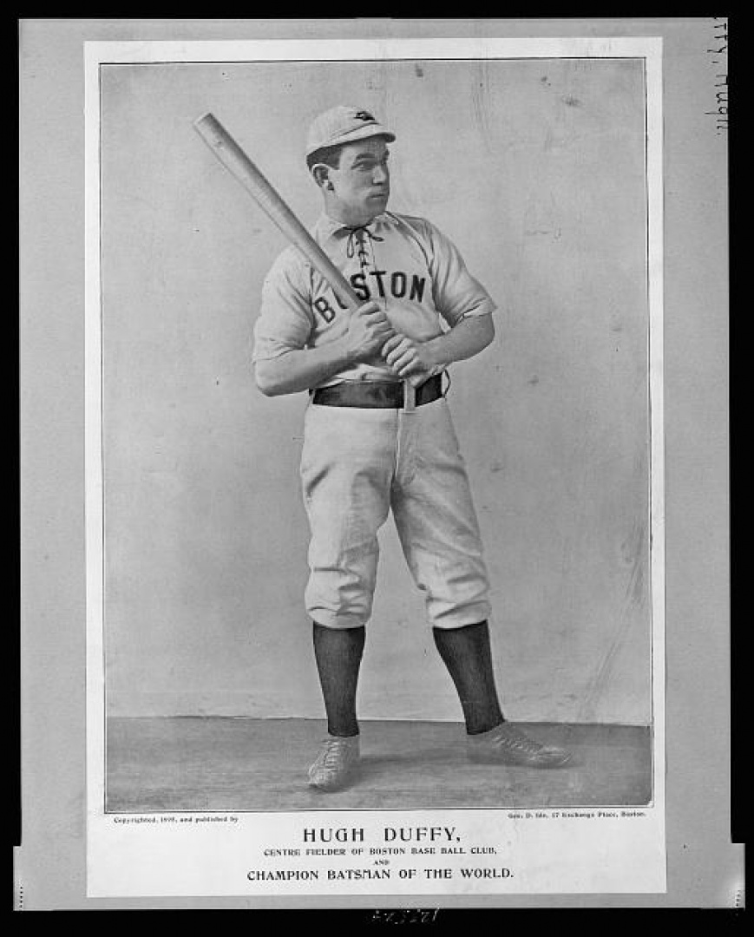
HIGHEST AVERAGE IN A SEASON
Hugh Duffy
.440 batting average in 1894
Second Place: .435, Tip O’Neill
2017 Leader: .346, Jose Altuve
(Duffy’s average is 89 points higher.)

Slide 15
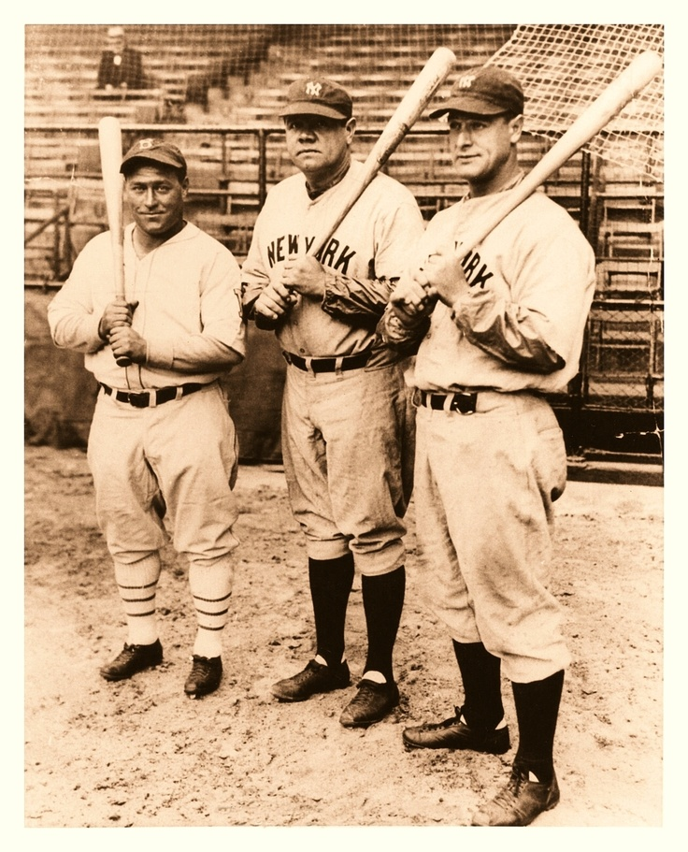
MOST RBIS IN A SEASON
Hack Wilson
191 RBIs in 1930
Second Place: 185, Lou Gehrig
2017 Leader: 132, Giancarlo Stanton
(Wilson has almost 1 ½ times as many RBIs.)

Slide 16
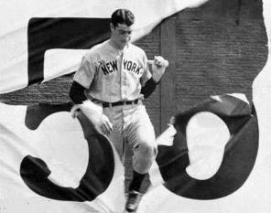
LONGEST HITTING STREAK
Joe DiMaggio
56 games in 1941
The game after his streak ended, he hit in another 16 straight games
Second Place: 45 (over 2 years), Willie Keeler
44 (same season), Pete Rose
2016 Leader: 30, Freddie Freeman
(DiMaggio hit safely in almost twice as many games.)

Slide 17
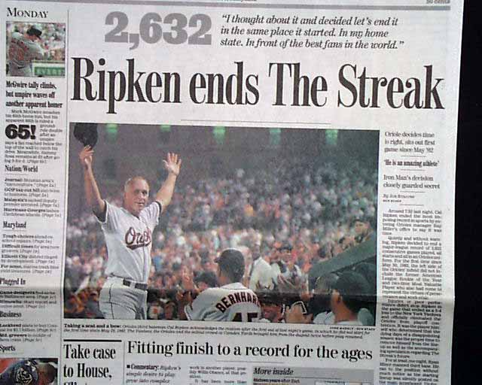
MOST GAMES PLAYED IN A ROW
Cal Ripken, Jr.
2,632 consecutive games played from 1982 to 1998
Second Place: 2,130, Lou Gehrig
Current Leader: 333, Alcides Escobar
(Ripken played in almost 8 times as many games.)
Player Starting Now: 162 games a year for 16 ¼ years

Slide 18
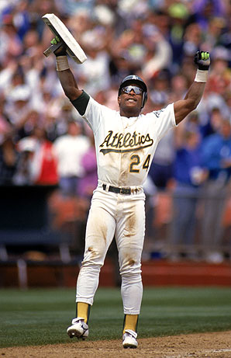
MOST CAREER STOLEN BASES
Rickey Henderson
1,406 stolen bases from 1979 to 2003
Henderson also has the single-season record: 130
Second Place: 938, Lou Brock
Current Leader: 512, Jose Reyes
(Henderson has stolen 2 ¾ times as many bases.)
Player Starting Now: 50 stolen bases for 28 years

Slide 19
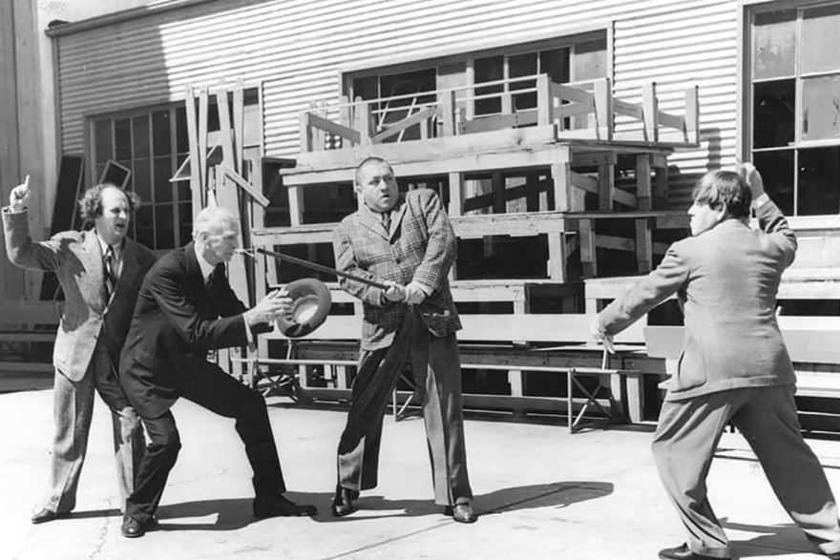
MOST WINS (AND LOSSES AND GAMES) BY A MANAGER
Connie Mack
3,731 wins; 3,948 losses; 7,755 games
Current Leader: Bruce Bochy with 1,853 wins,
1,855 loses, and 3,708 games
(Mack has twice as many wins.)
Mack managed for 53 years
Manager Starting Now: 100 wins for
over 37 years

Slide 20
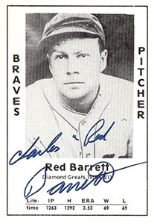
MOST EFFICIENT GAME PITCHED
Red Barrett
On August 10, 1944, Red Barrett threw a 2–0 shutout against the Cincinnati Reds. He faced 29 batters and gave up two 2 hits, no walks, and no strikeouts.
In his 9-inning game, he threw only 58 pitches, an average of exactly 2 pitches per batter.
This is the fewest pitches ever thrown in a complete, 9-inning game.

Slide 21
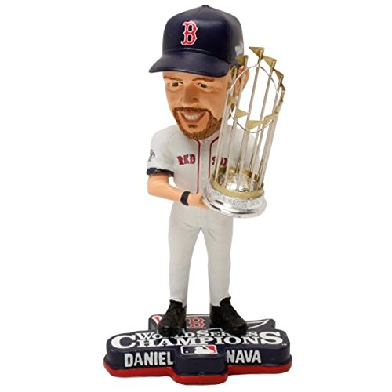
MOST SUCCESSFUL 1ST PITCH FOR A HITTER
The first pitch that was ever thrown to Daniel Nava in the Major Leagues.
Notes:
https://www.youtube.com/watch?v=-9BLMdRRZ-s

