Slide 1

Great Polish Ballplayers

Slide 2
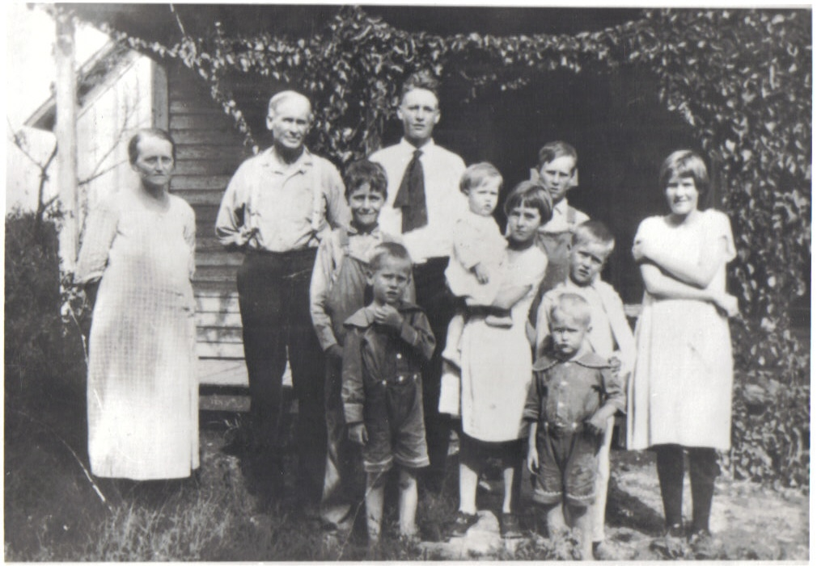
My Heritage
50% Texan

Slide 3
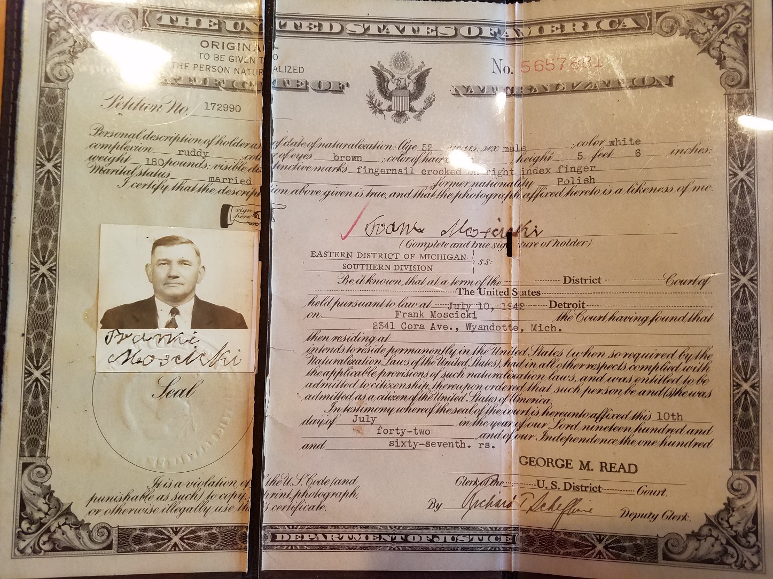
50% Polish
Grandparents: Frank & Helen Moscicki
Mother: Leocadia (Lillian) Miller

Slide 4
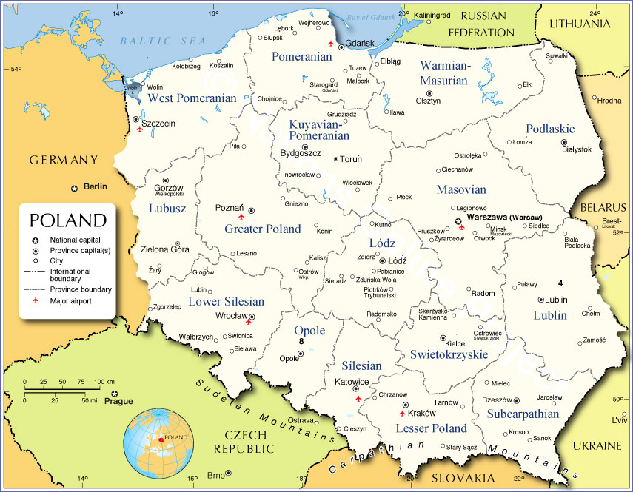
Quick facts about Poland:
• Current population 38.5 million (sixth among European Union). Polish state dates back to the year 966.
• There are an estimated 9.5 million Americans of Polish descent (approximately 3% of the country, the eighth largest ethnic group in the U.S.
• Chicago has the largest Polish-speaking population outside Poland. Other U.S. cities with large communities: New York, Detroit, Cleveland, and Buffalo.

Slide 5
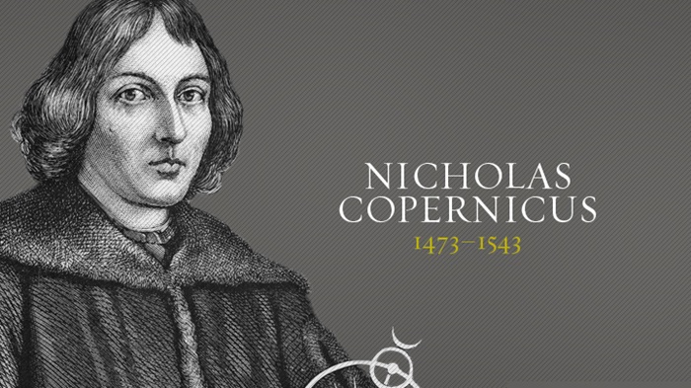
Famous Poles who were not great ballplayers
Copernicus

Slide 6
Ron Jaworski
QB, Eagles, Rams, Dolphin & Chiefs
“The Polish Rifle”

Slide 7
Karol Wojtyla
Noted Polish soccer player

Slide 8
Also known as:
Saint Pope John Paul II

Slide 9
Other great Polish-American athletes and coaches:
Mike Ditka
Wayne Gretzky
Mike Krzyzewski
Tara Lipinski

Slide 10
The first Polish-American ballplayer:
Oscar Bielaski
1872-76, Washington Nationals, Washington
Blue Legs, Baltimore Canaries, and Chicago
White Stockings (won first-ever National
League pennant in 1876).

Slide 11
Other great Polish-American ballplayers:
Pitchers
Moe Drabowsky
• One of only four major leaguers actually born in Poland. Son of American mother who fled to the U.S. in 1938.
• Famous for his pranks, including giving a “hot foot” to Bowie Kuhn during 1970 World Series celebration.
• Pitched six scoreless innings of relief for the Orioles in Game 1 of the 1966 World Series against the Dodgers (the first WS game I ever attended). His 11 strikeouts for a reliever and six straight strikeouts are still World Series records.

Slide 12
Casimir “Jim” Konstanty
• Ace reliever for 1950 NL champion Phillies (aka the “Whiz Kids”).
• First relief pitcher to win MVP award.

Slide 13
Ron Perranoski
• Ace reliever for 1963 and 1965 World Champion Dodgers. Won 16 games in relief in 1963.
• Long-time Dodgers pitching coach and pitching coach for 1981 and 1988 World
Series champions. Coached two Cy Young winners (Valenzuela and Hershisher).

Slide 14
Johnny Podres
• Won Game 7 of the 1955 World Series with 2-0 shutout of the Yankees, bringing Brooklyn its first and only title.
• Second Sports Illustrated Sportsman of the Year.

Slide 15
Others include:
Eddie Lopat
Mark “The Bird” Fidrych
Frank Tanana

Slide 16
Catchers:
A.J. Pierzynski

Slide 17
First basemen:
Ted Kluszewski (owner of most famous bicepts in baseball history)
Bill “Moose” Skowron (Six time All Star,
won five World Series with
Yankees and Dodgers)

Slide 18
Second basemen:
Mark Grudzielanek
(or, as he was called in my scorecard,
“G’z’l’n’k”)

Slide 19
Shortstops:
Troy Tulowitski

Slide 20
Freddie Patek
• One of only two shortstops (the other being Ernie Banks) to hit three home runs in a game. And he was only 5 foot, 5 inches tall! The Jose Altuve of his day.
• Famous quote: “I’d rather be the shortest player in the major leagues than the tallest player in the minor leagues.”

Slide 21
Tony Kubek
• Played in six World Series and started 37 WS games in career that lasted only nine years. Bad hop single off his throat in Game 7 of the 1960 World Series is blamed by many for allowing Pirates to rally and win the game and the Series.
• Long-time color man to Curt Gowdy and Bob Costas on NBC “Game of the Week” telecasts.
• One of only 51 players to hit a home run in his last major league at-bat.

Slide 22
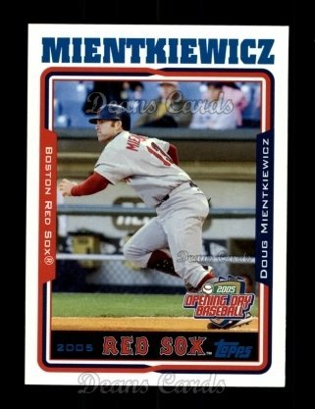
Third basemen:
Whitey Kurowski
Doug Mientkiewicz

Slide 23
Outfielders:
Greg “The Bull” Luzinski
• Hit 307 Major League home runs.
• Owns “Bull’s Barbecue” at Citizens Bank Ballpark.
• Easily one of the worst defensive outfielders I have ever seen.
• Won DH of the Year award in 1981 and 1983 (White Sox were smart enough not to let him play the field). Won Roberto Clemente award for off-field service in 1978.

Slide 24
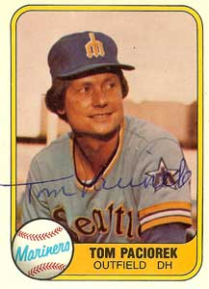
DH: Richie Zisk and Tom Paciorek
Manager: Danny Ozark
(Daniel Leonard Orzechowski)

Slide 25
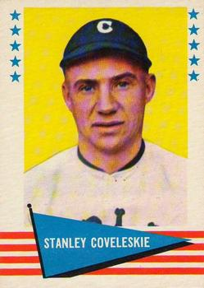
Polish-Americans in the Hall of Fame:
Stan Coveleski, P
• Won 214 games for A’s, Indians, Senators, and Yankees.
• Older brother killed in Spanish- American War; another older brother, Henry, won 20 games three times.

Slide 26
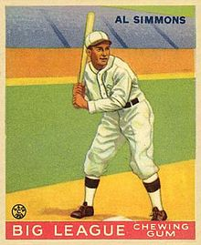
Al Simmons ( nee Alois Szymanski)
• Nicknamed “Bucketfoot” for unusual batting stance.
• .334 lifetime average, with 2,927 hits.
• Member of great Connie Mack- led Philadelphia A’s teams of 1920s-30s.

Slide 27
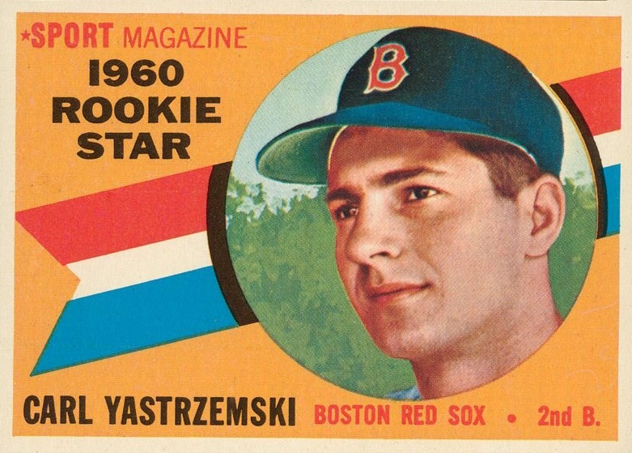
Carl Yastrzemski,
OF/1B/DH
• Holds record for 23 seasons with same team (tied with Brooks Robinson).
• First American Leaguer with 400 home runs and 3,000 hits.
• Three straight BoSox left fielders in HOF (Williams, Yaz, Rice).
• Led 1967 “Impossible Dream” Red Sox with one of the greatest seasons in baseball history (.326 BA, 44 home runs, 121 RBIs). Was last Triple Crown winner for 45 years, until Miguel Cabrera in 2012.

Slide 28
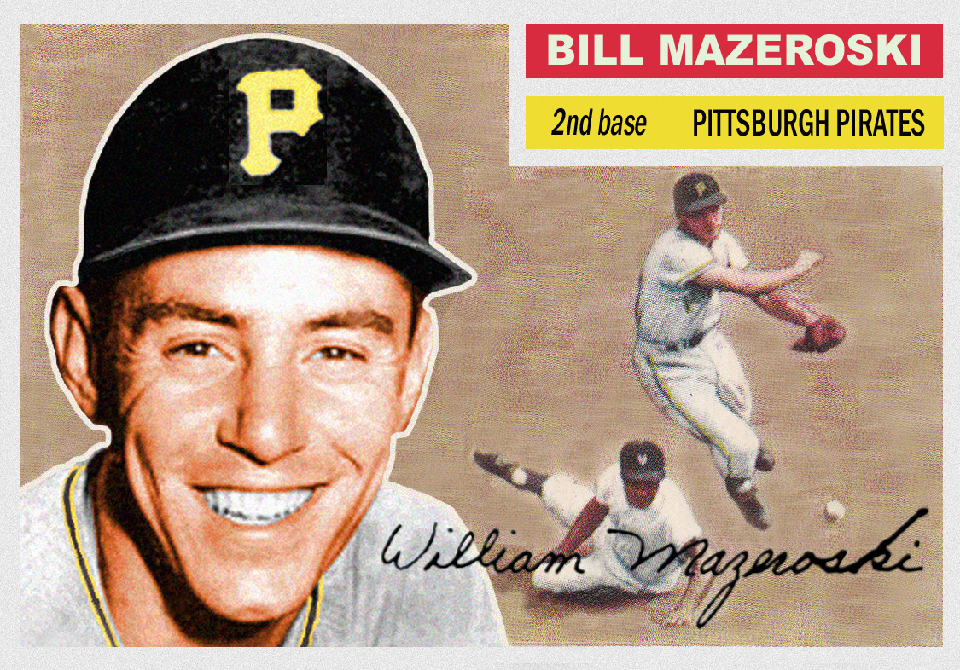
Bill Mazeroski, 2B
• Ninth inning homer in 1960 World Series remains only Game 7 “walk off” HR in WS history.
• Seven time All Star, eight time Gold Glove winner, and regarded as one of the greatest defensive players in history.
• Hit into a fictional triple play that Felix Unger made Oscar Madison miss in the movie “The Odd Couple.” (This resonates with me, since I once missed a triple play by leaving a game early).

Slide 29
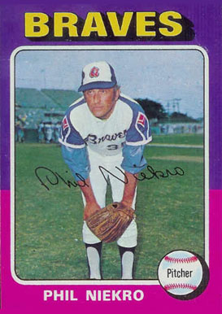
Phil Niekro, P
• Along with Hoyt Wilhelm, only true knuckleballers to reach the Hall of Fame.
• He and brother Joe have 539 combined wins, most by a brother combination in history (Phil has 318 of them). Prior record was Christy (373) and Hank (one) Mathewson.
• Last pitcher to both win and lose 20 games in a season.

Slide 30
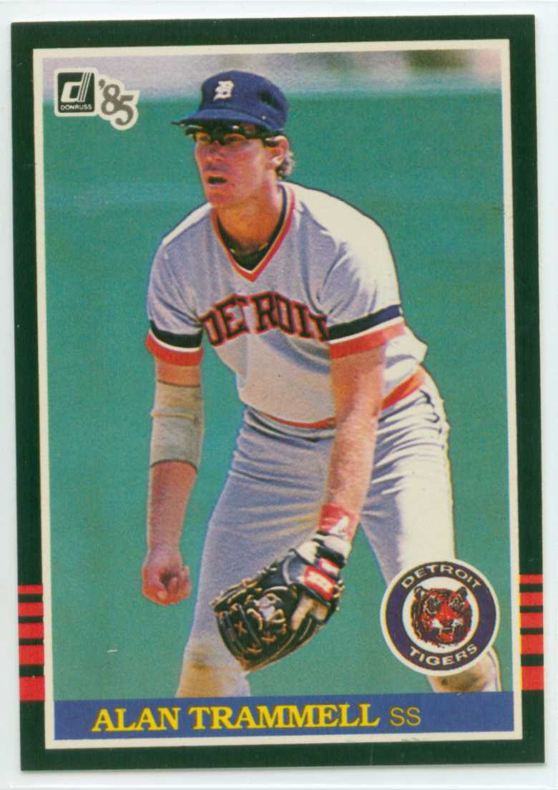
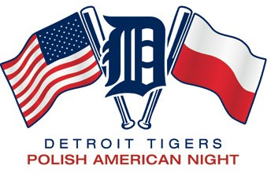
Alan Trammell, SS
(mother’s maiden name Panczak)
• He and Lou Whitaker formed longest running double play combination in MLB history (19 seasons).
• World Series MVP in 1984, going 9 for 20 with two home runs.
• One of my favorite ballpark memories: Polish-American night at Tiger Stadium, 1988.

Slide 31
And the greatest Polish-American ballplayer of all time
. . . .

Slide 32
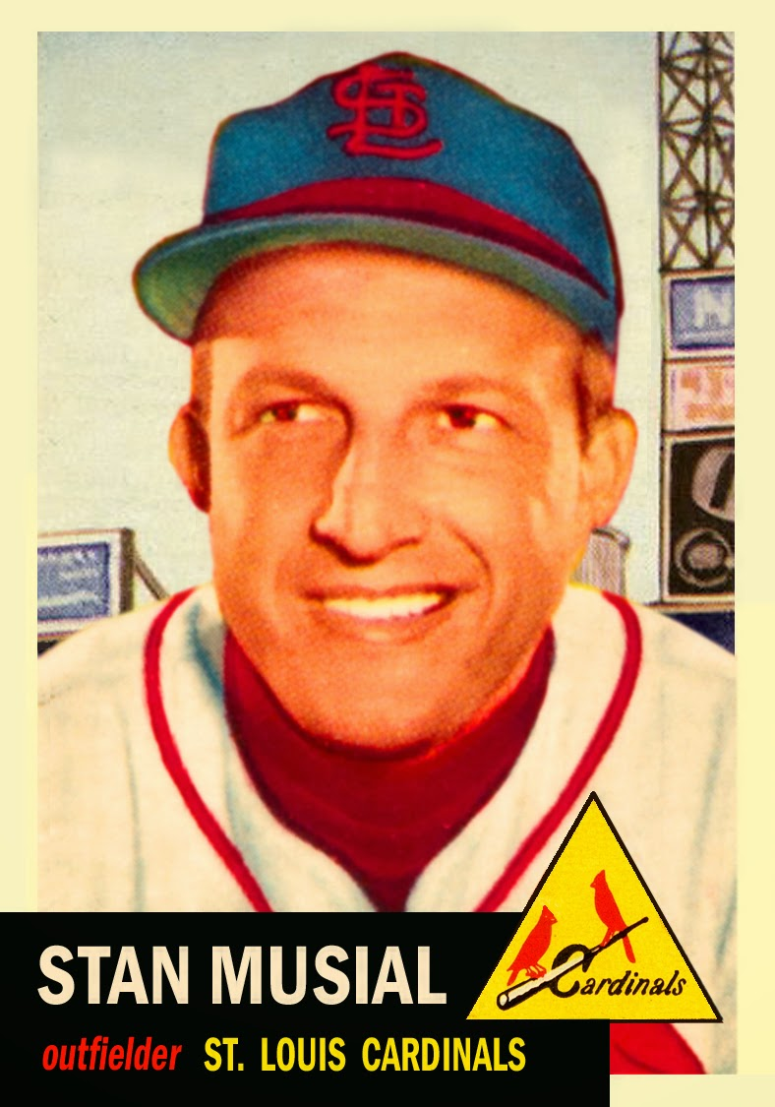
Stan “The Man” Musial, OF/1B

Slide 33
Stan “The Man” Musial
Where do I start? One of the finest and in my opinion most underrated ballplayers of all time.
• Born Stanislaw Franciszek Musial in 1920 in Donora, PA. Nicknamed by Brooklyn Dodgers fans, who would moan when he stepped up to bat “Here comes that man again.”
• Played 22 seasons with St. Louis Cardinals, most with one team in NL history.
• .331 lifetime BA, 475 home runs, 3,630 career hits (fourth all time behind Rose, Cobb, and Aaron). 3 time MVP, 7 time batting champion, 3 time World Series champion.

Slide 34
• The model of consistency: 1,815 hits at home, 1,815 hits on the road.
• Holds or held NL records for games, at-bats, hits, runs, RBIs, total bases, and doubles. Held 17 MLB records and 29 NL records when he retired.
• One of only two players to hit five home runs in a doubleheader.
• Was originally a pitcher, before an injury forced him to play the outfield.
• His last major league hit went just past a diving Pete Rose, who would go on to break his NL record for hits.
• Accomplished harmonica player who entertained at numerous HOF inductions.
• Died at age 92 on the same date as fellow Hall of Famer Earl Weaver.

Slide 35
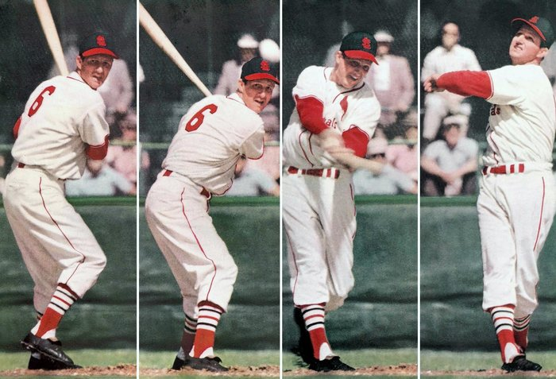
Unique, crouched batting stance, described by pitcher Ted Lyons as "a kid peeking around the corner to see if the cops were coming."

Slide 36
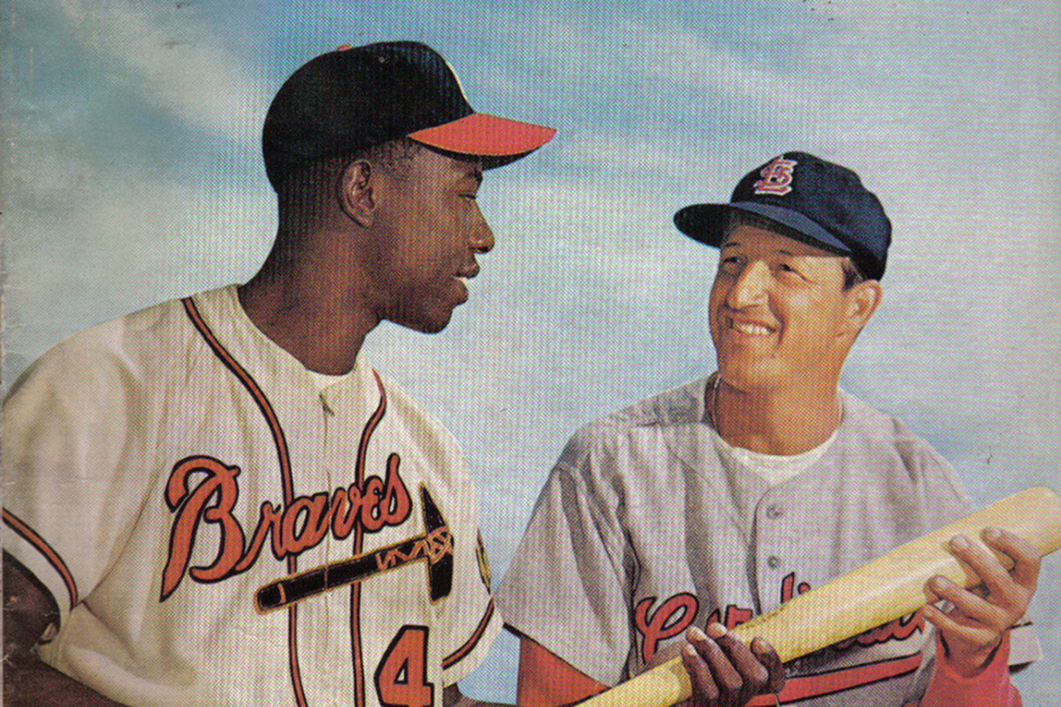
Universally respected; was known for his tolerance and friendship toward African-American players. He was the 1957 Sports Illustrated Sportsman of the Year and was awarded Medal of Freedom by President Obama in 2011.
"All Musial represents is more than two decades of sustained excellence and complete decency as a human being."
— St. Louis Broadcaster Bob Costas

Slide 37
Trivia question: name the other Hall of Famer born in Donora, PA (Hint: definitely not Polish).

Slide 38
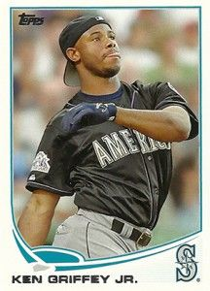
Answer: Ken Griffey, Jr.

