Slide 1
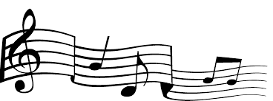
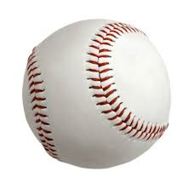
Baseball and Music
melodies made in baseball heaven

Slide 2
Greatest Baseball Songs Scott Kendrick – the Thought Co. - 2017
1.
2. ?????
3. Glory Days – Bruce Springsteen
4. Say Hey – the Treniers
5. All the Way – Eddie Vedder
6. Did You See Jackie Robinson Hit That Ball? – W. Johnson
7. Talkin’ Baseball – Terry Cashman
8. Tessie – the Dropkick Murphys
9. Cheap Seats - Alabama
10. Joltin’ Joe DiMaggio – Les Brown Orchestra

Slide 3
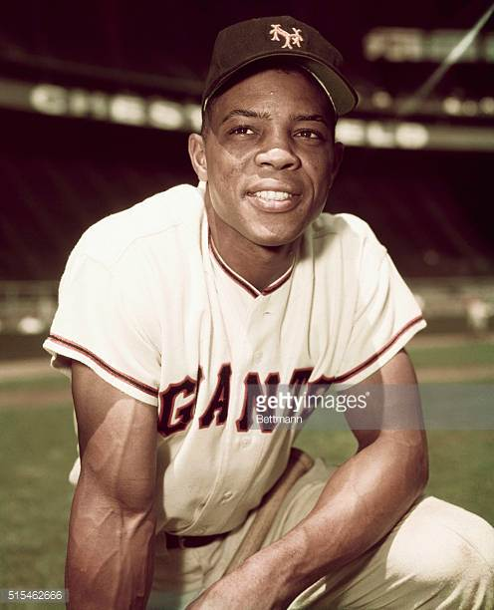
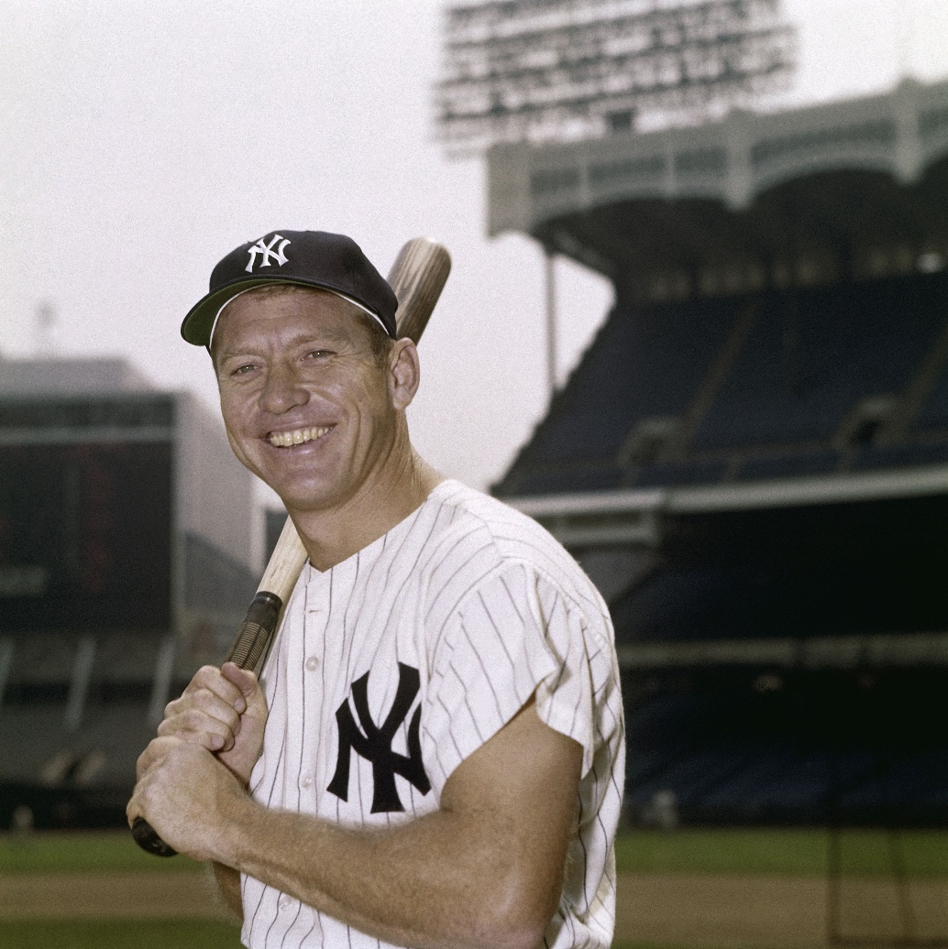
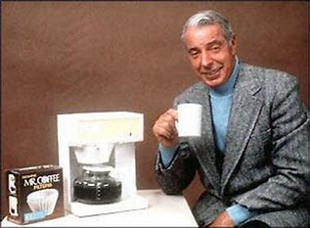
Centerfield – John Fogerty (1985)
https://www.youtube.com/watch?v=04KQydlJ-qc

Slide 4
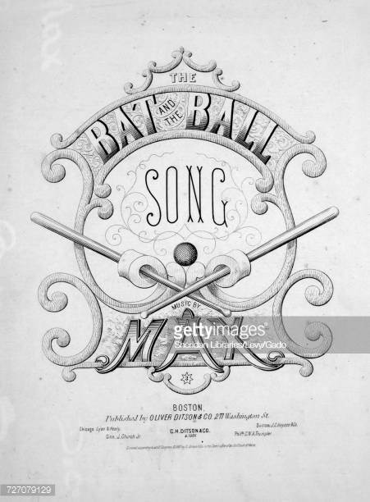
The Bat and the Ball
Johnson & Max
(1867)
Historians say this is the first song, with lyrics,
written about baseball.
It was popular in the immediate aftermath of the
Civil War.

Slide 5
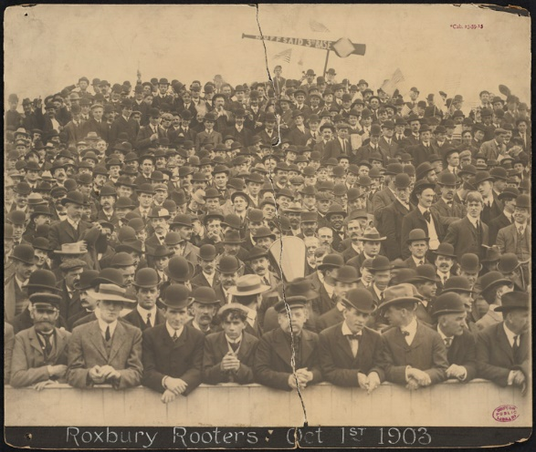
Tessie
Will Anderson
(1902)
The song “Tessie” was from a Broadway
musical “The Silver Slipper” that opened
in 1902.
The song was about a woman singing to
her pet parakeet, named Tessie.
The song was adopted as a rallying cry by
the Boston Royal Rooters during the first
modern-era World Series in 1903.
The Royal Rooters added verses to the
song to heckle Pittsburgh Pirates’ players.

Slide 6
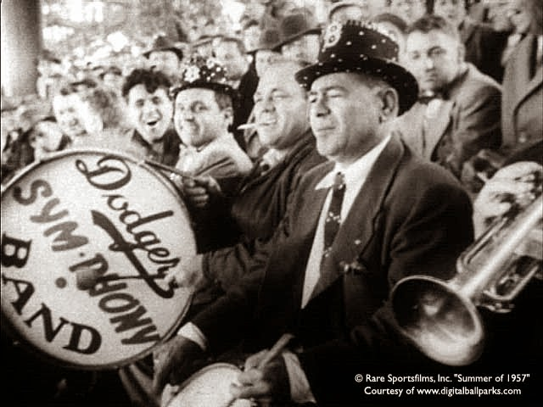
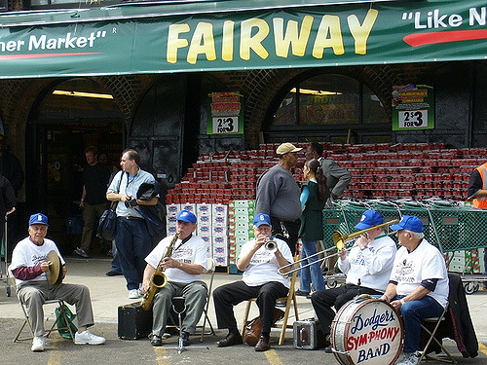
Bands in the Stands
The Dodgers’ “Sym-Phony” Band played at Ebbets
Field from 1939 until the team left for L.A. after the
1957 season.
They still perform today at Brooklyn Cyclones games
and around the NYC area.

Slide 7
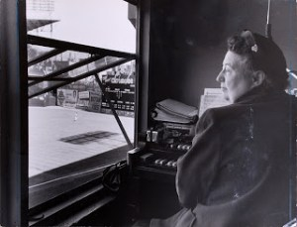
The Ballpark
Organist
The first organs appeared at sporting events
in Chicago. A massive organ was built in
Chicago Stadium in 1929 for Chicago Blackhawks
hockey. Organ music quickly caught on at other
NHL rinks during the 1930s.
The first organ at a major league baseball game
was a temporary organ moved into Wrigley Field
in 1941.
The first permanent baseball organ was installed
at Ebbets Field in Brooklyn for the 1942 season.
The Dodgers’ organist, Gladys Goodding, was also
the organist at Madison Square Garden for
New York Rangers hockey and Knicks basketball
games.
https://www.youtube.com/watch?v=DNjzf8TvCVA
https://www.youtube.com/watch?v=NulFtMxqQEE

Slide 8
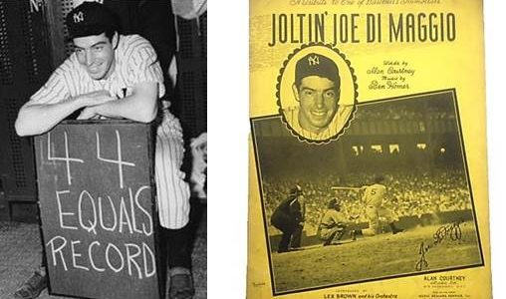
Joltin’ Joe DiMaggio
Les Brown(1941)
https://www.youtube.com/watch?v=FtA_w0HtvR8

Slide 9
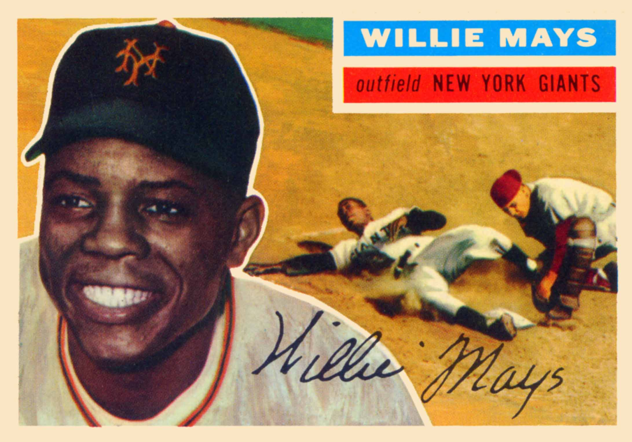
Say Hey
The Treniers with Willie Mays (1954)
https://www.youtube.com/watch?v=BFT1TcT5YQo

Slide 10
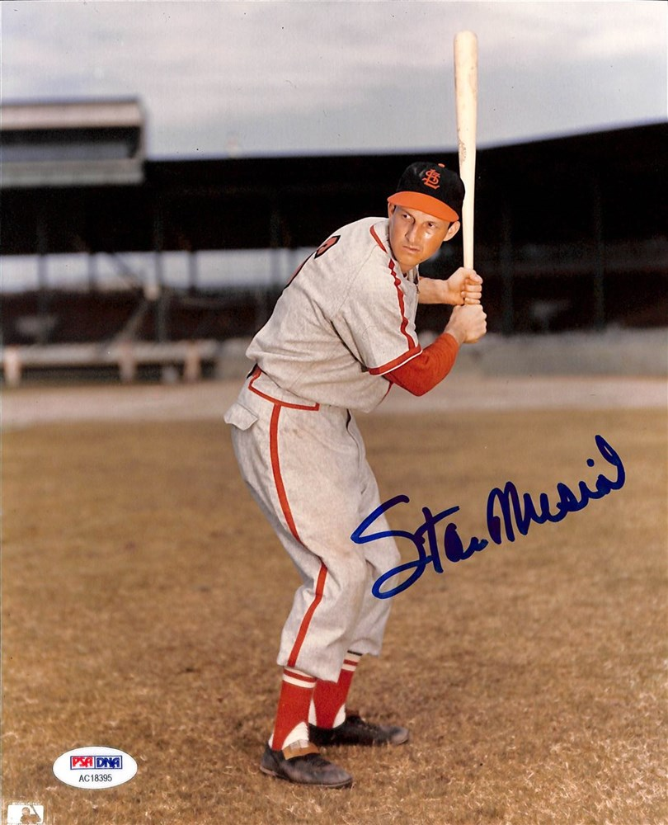
Swingin’ Stan the Man
unattributed (1959?)
https://www.youtube.com/watch?v=zjBbSeKVHPo

Slide 11
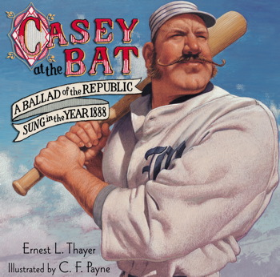
Casey at the Bat
Ernest Lawrence Thayer (1888)
https://www.youtube.com/watch?v=3SUEUscZ2QA

Slide 12
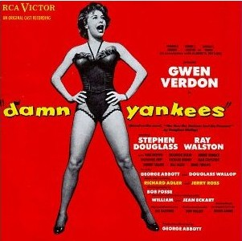
Damn Yankees
Adler & Ross (1955)
Debuted on Broadway in May 1955
Ran for 1,019 performances
Won seven Tony Awards, including:
Gwen Verdon (Lola) as Best Leading Actress in a Musical
Ray Walston (Mr. Applegate) at Best Leading Actor
in a Musical
Was released as a movie musical in 1958
Roy Sievers, Yogi Berra, Mickey Mantle, Moose Skowron,
and umpire Art Passarella all made uncredited
movie appearances via archival footage.

Slide 13
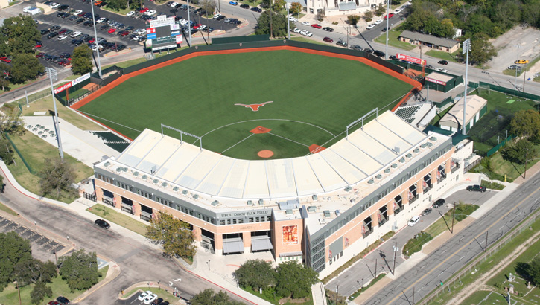
The Eyes of Texas Are Upon You
John Sinclair (1903)
Disch-Falk
Field
https://www.youtube.com/watch?v=efRTosGodyU&feature=youtu.be

Slide 14
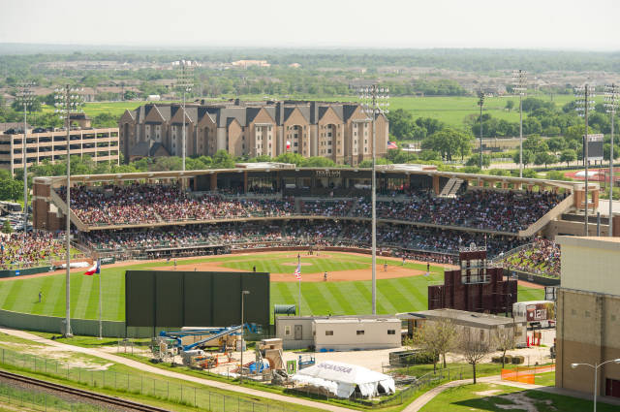
Aggie War Hymn
J.V. “Pinky” Wilson (1918)
Olsen Field
https://www.youtube.com/watch?v=rWxcwB40GS4

Slide 15
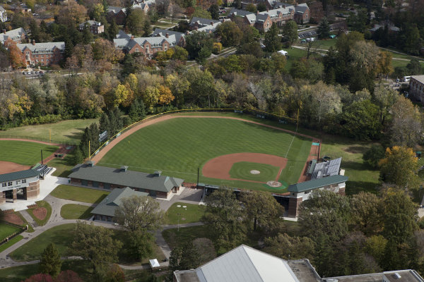
Victory for MSU
Lankey/Sayles (1915)
McLane Baseball
Stadium
at
Kobs Field
https://www.youtube.com/watch?v=hC4Tc3nyhLg

Slide 16
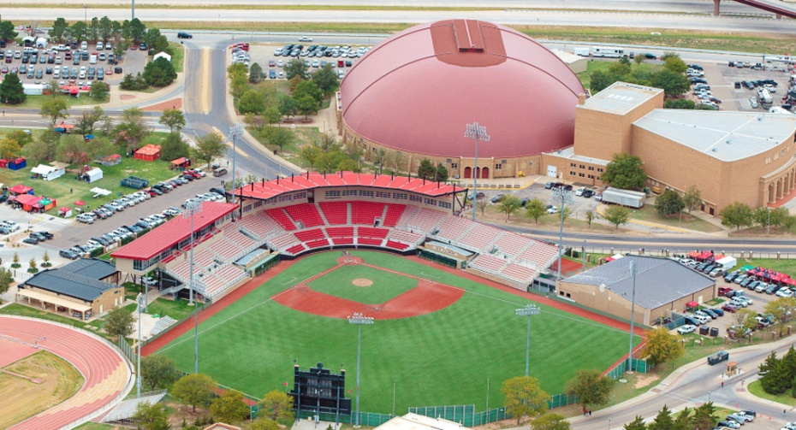
Fight Raiders Fight!
McMath/Nevins (1936)
Dan Law
Field
at
Rip Griffin
Park
https://youtu.be/r5BRXtYPnIE

Slide 17
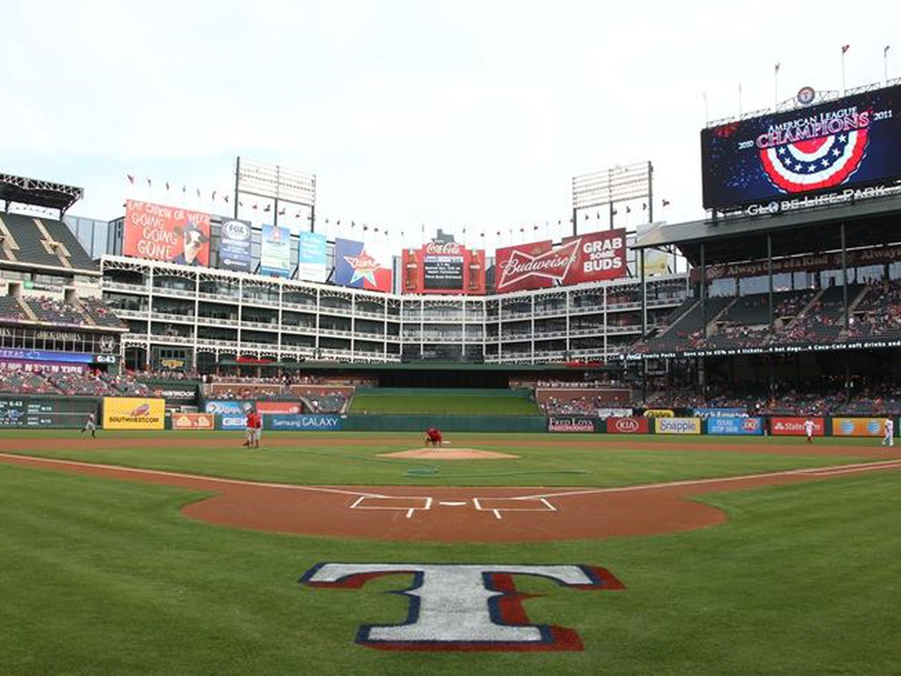
That’s the Way Baseball Go
Merle Haggard (2011)
https://www.youtube.com/watch?v=9JNqL8Drt3E&list=RD9JNqL8Drt3E

Slide 18
Greatest Baseball Songs
1. ?????
2. Centerfield – John Fogarty
3. Glory Days – Bruce Springsteen
4. Say Hey – the Treniers
5. All the Way – Eddie Vedder
6. Did You See Jackie Robinson Hit That Ball? – W. Johnson
7. Talkin’ Baseball – Terry Cashman
8. Tessie – the Dropkick Murphys
9. Cheap Seats - Alabama
10. Joltin’ Joe DiMaggio – Les Brown Orchestra

Slide 19
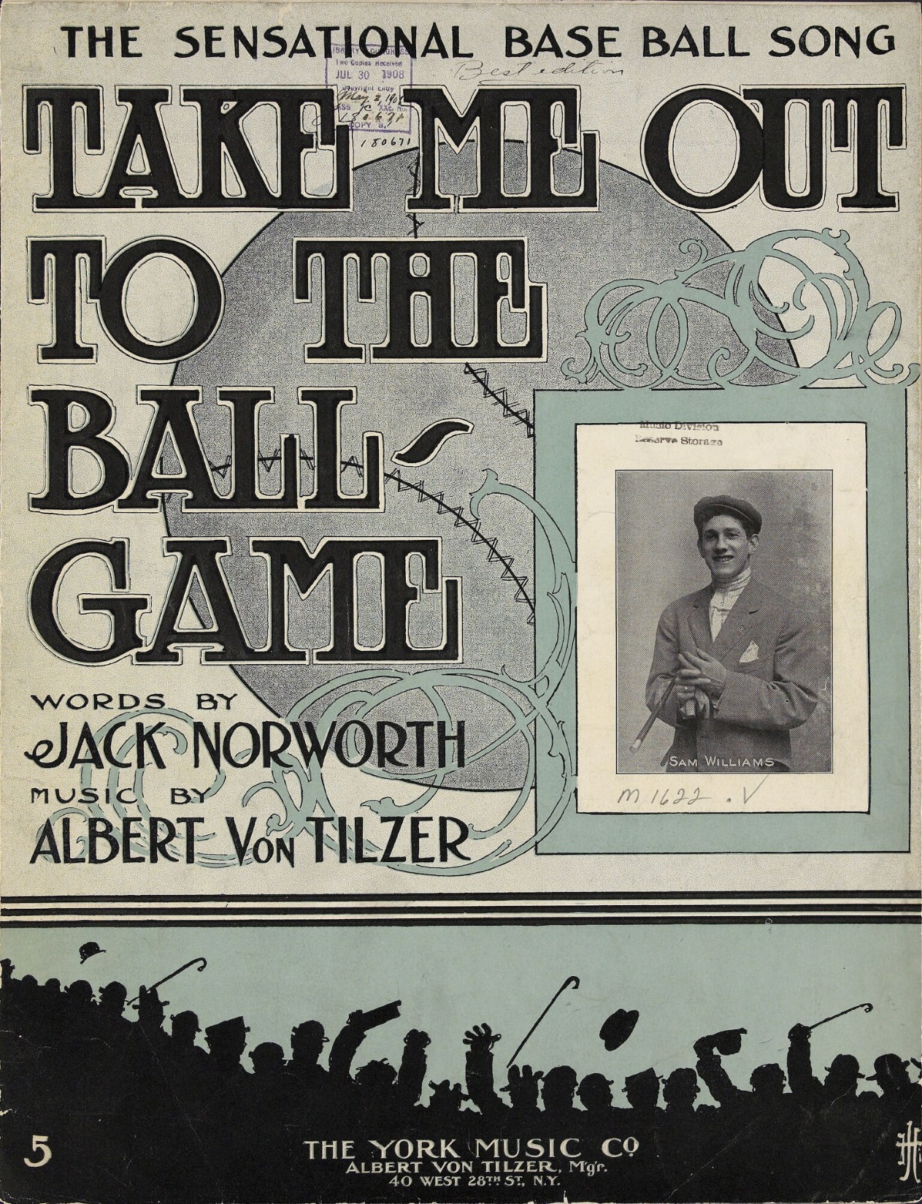
Take Me Out
to the
Ball Game
Norworth & von Tilzer (1908)

Slide 20
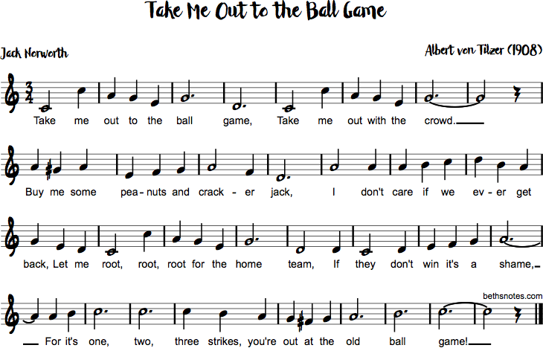

Slide 21
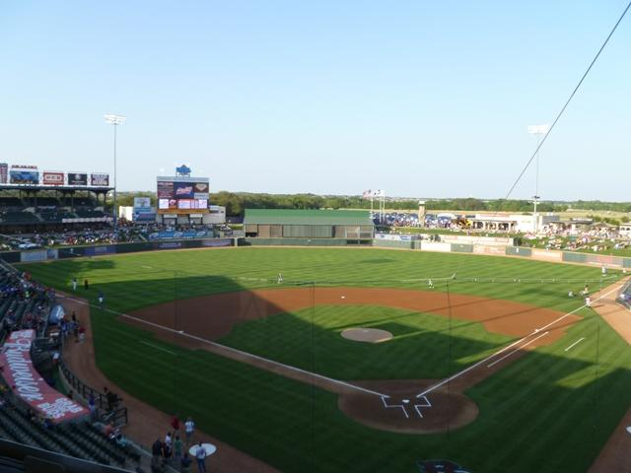
Deep in the Heart of Texas
Hershey/Swander (1941)
https://www.youtube.com/watch?v=VGF4ibgcHQE

Slide 22
Keep Singing !

