Slide 1
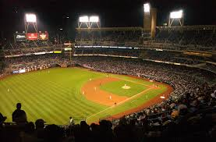
Baseball - Basketball

Slide 2
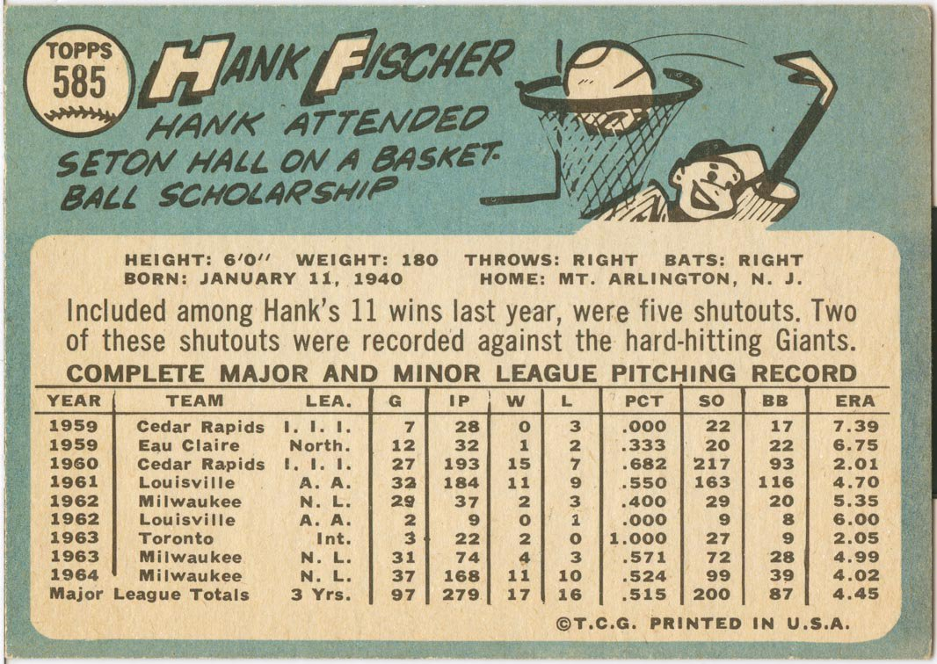
Many Baseball Players had a Basketball Background
Notes:
Hank Fischer was a not too famous pitcher in the ‘60s. As you can see from the back of his baseball card, he went to Seton Hall on a basketball scholarship.

Slide 3
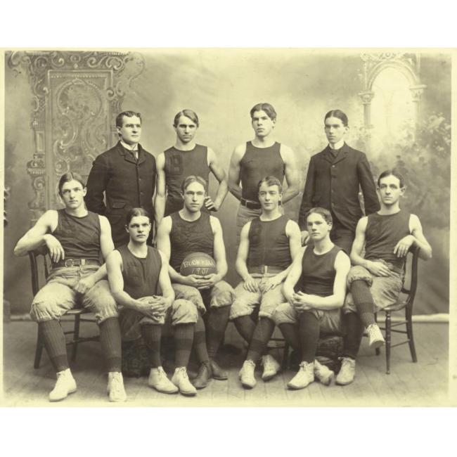
1898 Bucknell University Basketball Team
Notes:
We’re going way back to the 19th century - starting with one of the most famous pitchers in baseball history. Hint: he’s one the front row, second from the left.

Slide 4
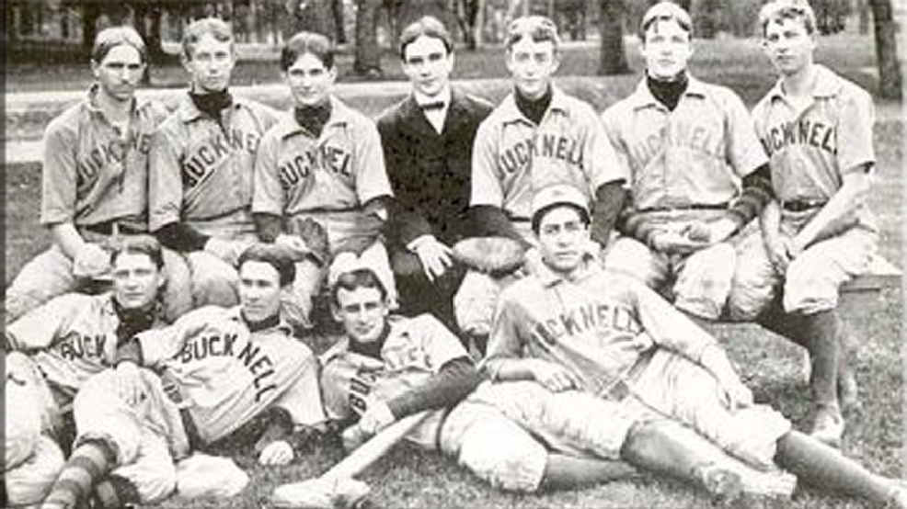
1898 Bucknell University Baseball Team
Notes:
He also played baseball at Bucknell (he’s on the top row, second from the right). Can anyone guess who he is?

Slide 5
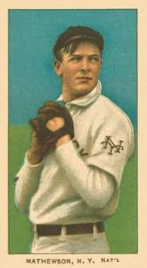
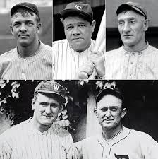
Christy Mathewson, Hall of Fame Pitcher
Notes:
Christy Mathewson, one of the first five players elected to the Baseball Hall of Fame.

Slide 6
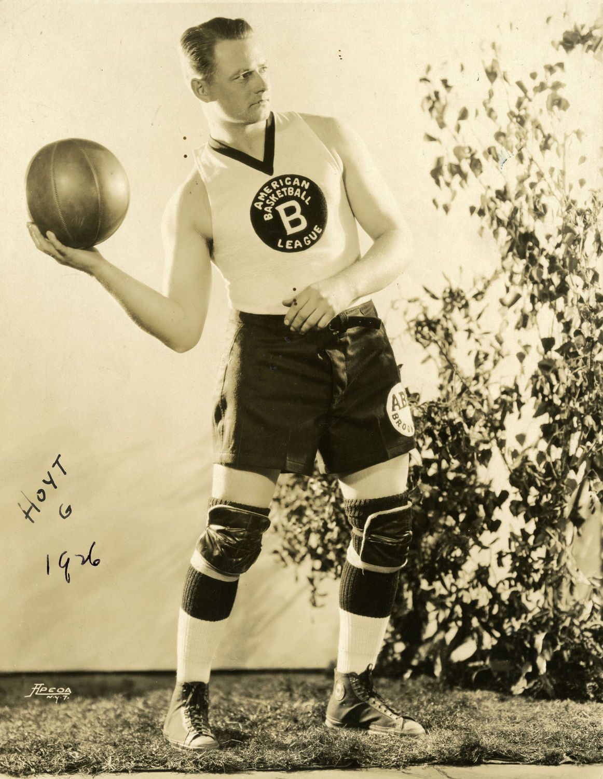
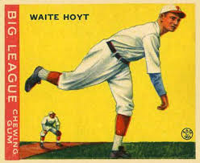
Waite Hoyt, Hall of Fame Pitcher
Notes:
Here’s Waite Hoyt, another HOF pitcher, shown playing basketball in the American Basketball League. – the first pro basketball league in US. Hoyt had a 20 year career as a pitcher, most notably with Yankees.

Slide 7
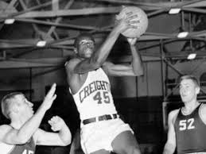
Who is this Hall of Fame Pitcher?
Notes:
Can you guess who this HOF pitcher is (from his college days)? He played basketball at Creighton Univ. in Kansas, and later pitched for the Cardinals.

Slide 8
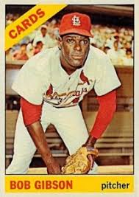
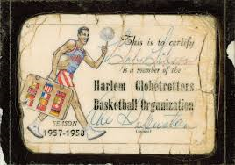
Hall of Fame Pitcher
Notes:
Bob Gibson. He was the first black player to receive a scholarship to Creighton – in basketball. As you can see, he also played a short time with the Harlem Globetrotters.

Slide 9
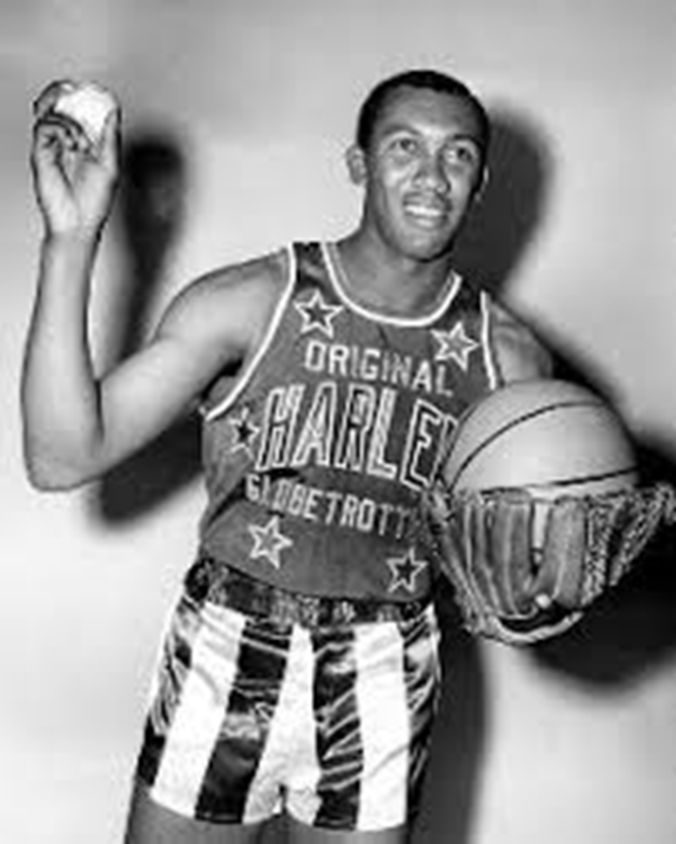
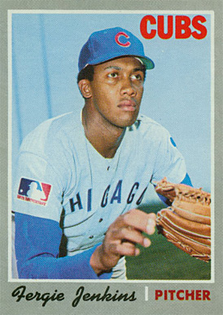
Who is this Hall of Fame Pitcher ??
Notes:
Ferguson Jenkins show in his Harlem Globetrotters uniform. He was a rookie with Cubs in 1966, and toured with Globetrotters after his rookie season. Jenkins pitched 19 years in majors, primarily for Cubs and Rangers.

Slide 10
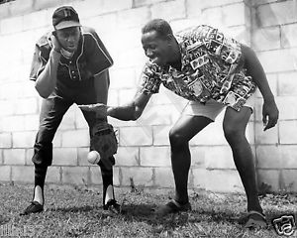
Who is this Hall of Fame Pitcher?
Notes:
Here’s another HOF pitcher (the guy on the left) who played for the Globetrotters. The guy on the right is famous Harlem Globetrotter, Goose Tatum.

Slide 11
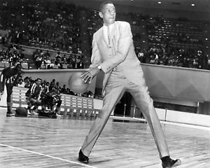
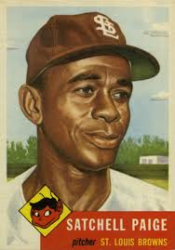
Satchel Paige, Hall of Fame Pitcher
Notes:
Satchel Paige. Great career in the Negro leagues, finally got a shot in majors in 1948 at the age of 41.

Slide 12
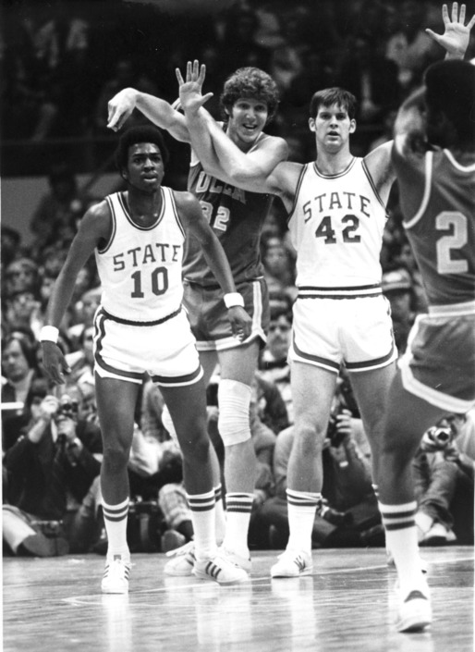
1974 NCAA Champions North Carolina State
Notes:
This one’s a lot harder. Number 42 became a relief pitcher in the majors after his college basketball career. He played on the NCAA National Champion North Carolina State. They guy in the middle of the picture – Bill Walton. NC State beat UCLA in the semi-finals to get to the championship game.

Slide 13
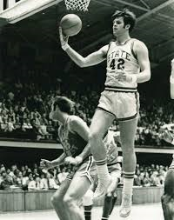
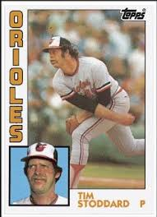
Tim Stoddard
Notes:
Tim Stoddard – At 6’7” was a starting forward for No. Carolina St. when they won the NCAA championship in 1974. Signed a major league contract the following year, and had a pretty good career as a relief pitcher – notably with the Baltimore Orioles.

Slide 14
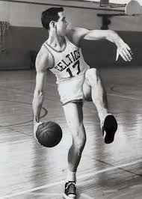
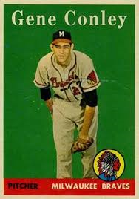
Gene Conley
Notes:
Gene Conley – 6’8” played pro basketball with the Boston Celtics (1952-53, 58-61) and NY Knicks. Pitched for 11 years, notably for the Braves. One of two people to win a championship in two of the major pro leagues – Milw. Braves in ‘57, and Celtics in ‘59-’61.

Slide 15
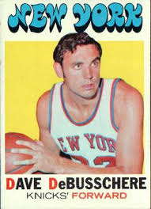
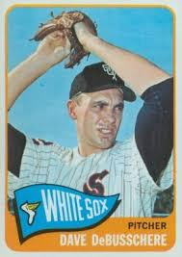
Dave DeBusschere
Notes:
Dave DeBusschere – named one of the 50 greatest players in NBA history. Pitched 2 seasons with White Sox, 1962-63 - had a 2.90 ERA in 102 IP, but decided to concentrate on basketball.

Slide 16
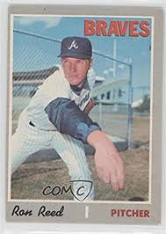
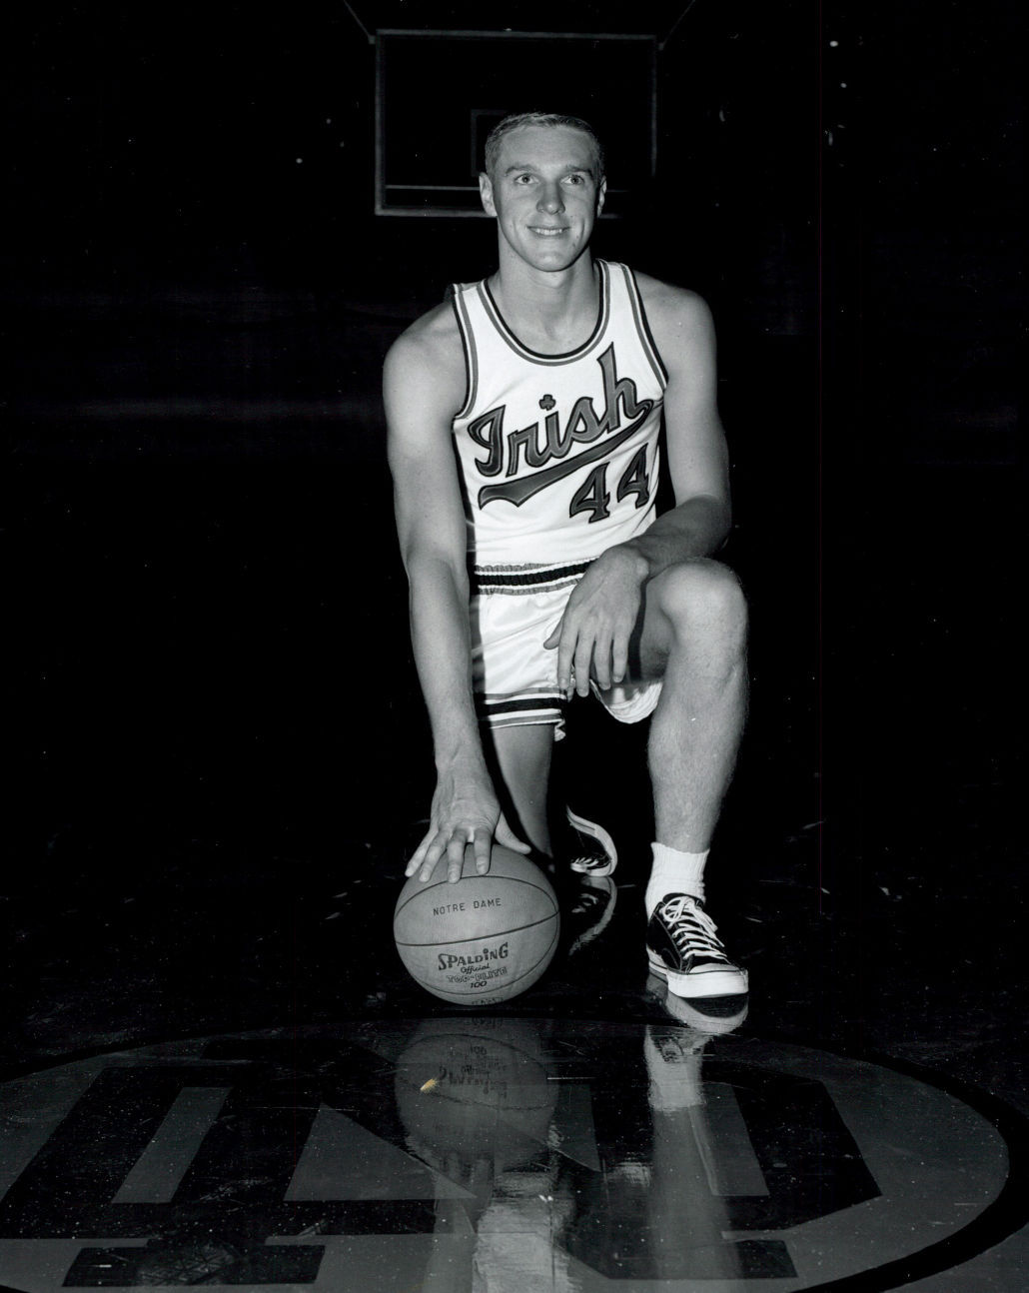
Ron Reed
Notes:
Ron Reed was a teammate of Dave DeBusschere on the Detroit Pistons from 1965-7. But, went opposite direction of DeBusschere and decided on baseball. Had a long and notable career with Braves and Philles. Won 146 games, and 103 saves in a 19 year career.

Slide 17
Not all were Pitchers
Notes:
Not all baseball/basketball players were pitchers

Slide 18
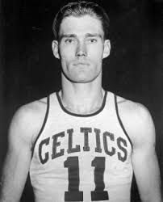
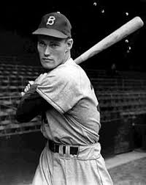
Notes:
Chuck Connors played for the Brooklyn Dodgers (1 game in 1949) and Chi Cubs (66 games in ‘51) and Boston Celtics. However, we know him for

Slide 19
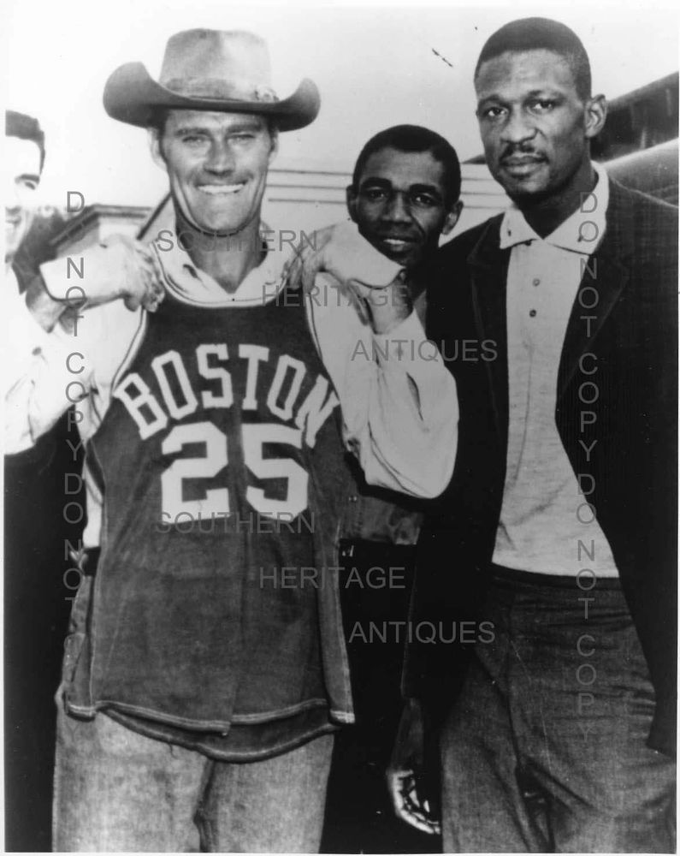
Chuck Connors
Notes:
He starred as “The Rifleman” on TV. Here he is pictured with NBA HOFer Bill Russell. Connors spent part of 1946 season with the Celtics, and is credited as the first player to break a basketball backboard.

Slide 20
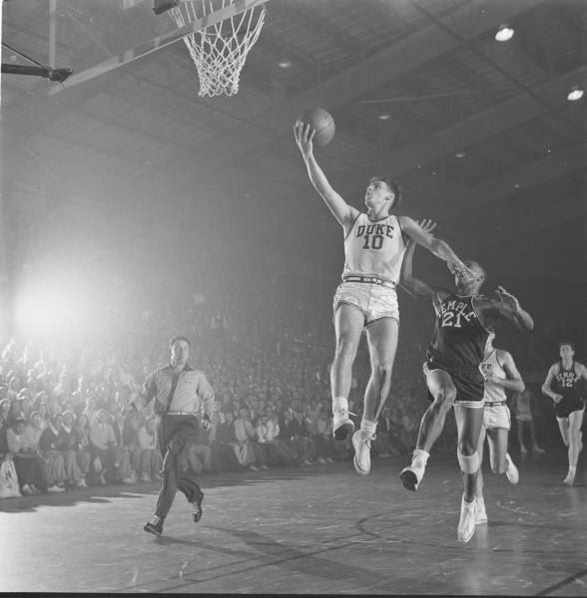
Name This HOF* Infielder (not Cooperstown)
* Only person in NCAA Baseball and Basketball Hall of Fames
Notes:
This guy played on a World Series champion in the 60’s. He’s not in the Baseball Hall of Fame, but he is the only player in both the College Basketball HOF and the College Baseball HOF

Slide 21
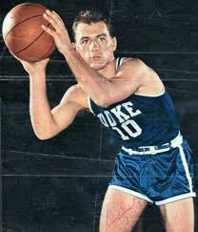
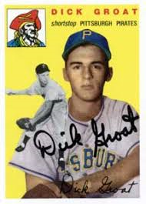
Dick Groat
Notes:
First person in both National College Baseball and Basketball Hall of Fames. WAS NL MVP in 1960 when he led league in batting.

Slide 22
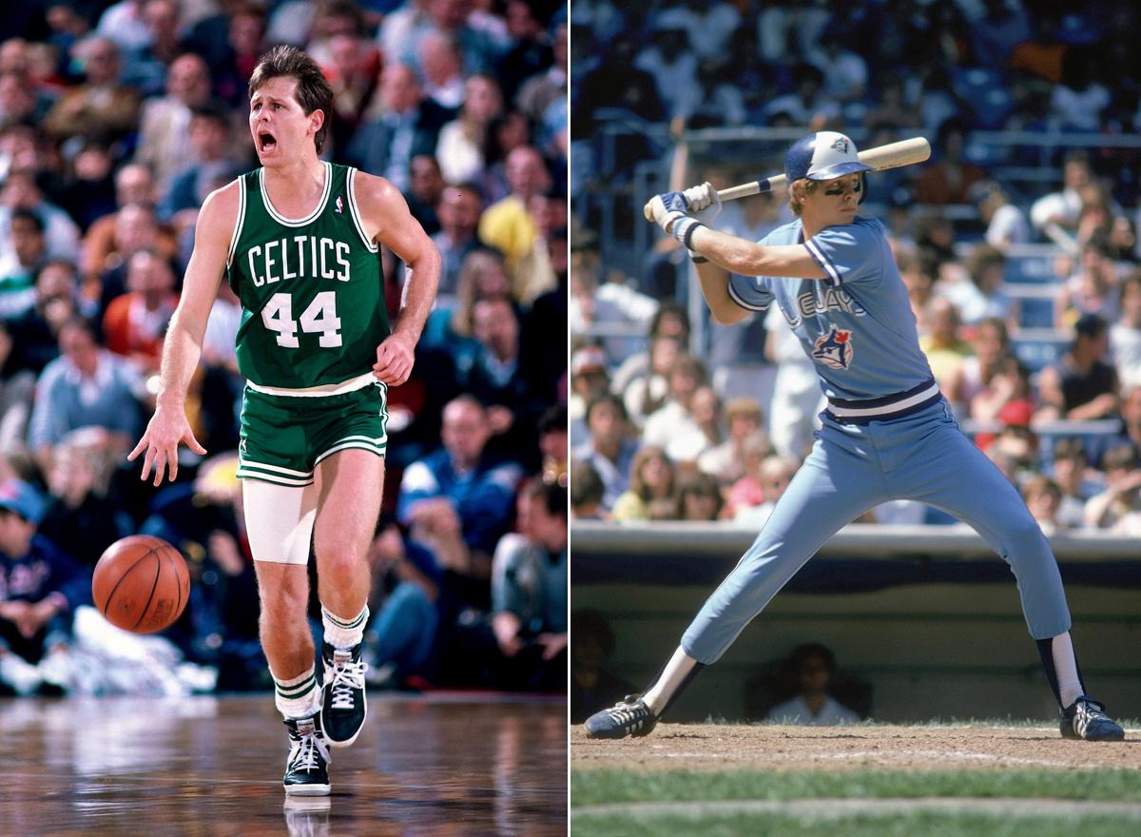
Danny Ainge
Notes:
The only person to be named a high school all-american in football, baseball and basketball. Drafted by the Toronto Blue Jays in 1977, and played pro baseball while he was attending BYU on a basketball scholarship. He made it to the Major leagues while he was still in college, and played 3 seasons 1979-81. In 1981 he was also named College player of the year in basketball, and began his NBA career with the Celtics.

Slide 23
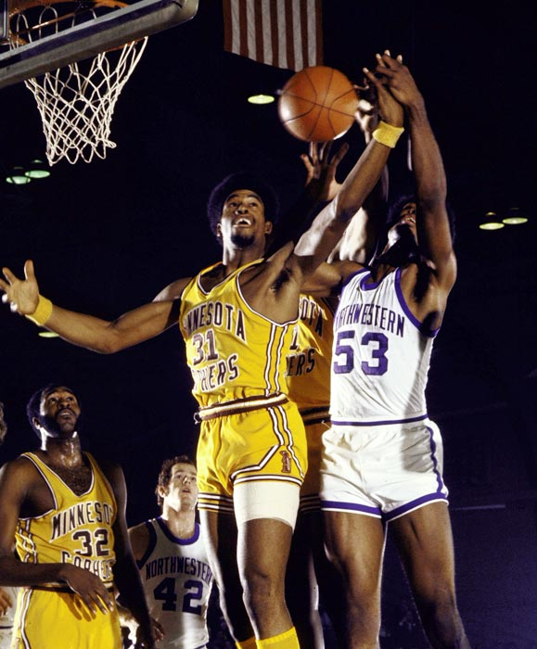
Name This HOF Outfielder
Notes:
Who is this HOF Outfielder? Besides baseball and basketball, he was also drafted by a team in the NFL Here he is at the Univ. of Minnesota.

Slide 24
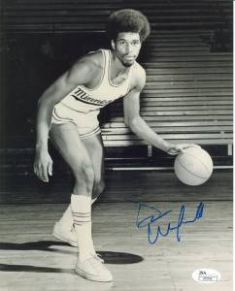
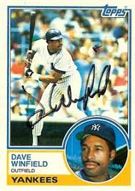
Dave Winfield
Notes:
Dave Winfield

Slide 25
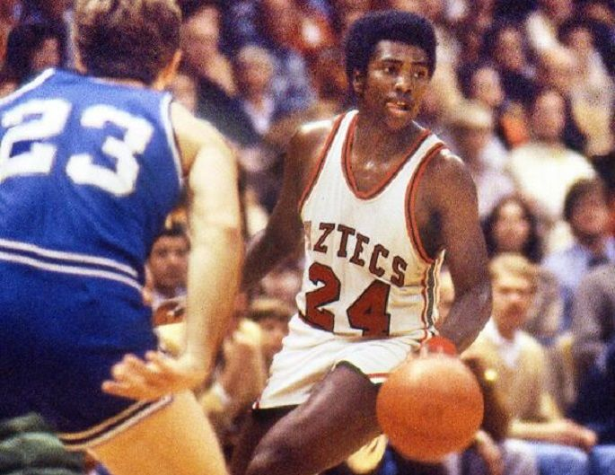
Name This HOF Outfielder
Notes:
Who is this HOF Outfielder? At San Diego State, he was all-conference in both baseball and basketball.

Slide 26
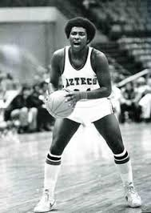
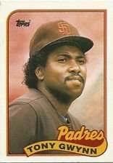
Tony Gwynn
Notes:
Tony Gwynn, great hitting outfielder for the San Diego Padres. Won 8 NL batting titles.

Slide 27
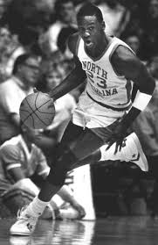
Name This HOF Outfielder (not Cooperstown)
Notes:
Trick question…………..this is an outfielder who was elected to the Pro Basketball HOF, not the baseball HOF

Slide 28
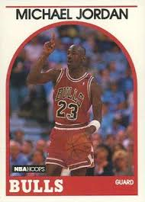
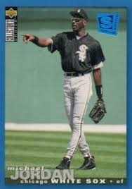
Michael Jordan, Basketball Hall of Fame
Notes:
Michael Jordan

Slide 29
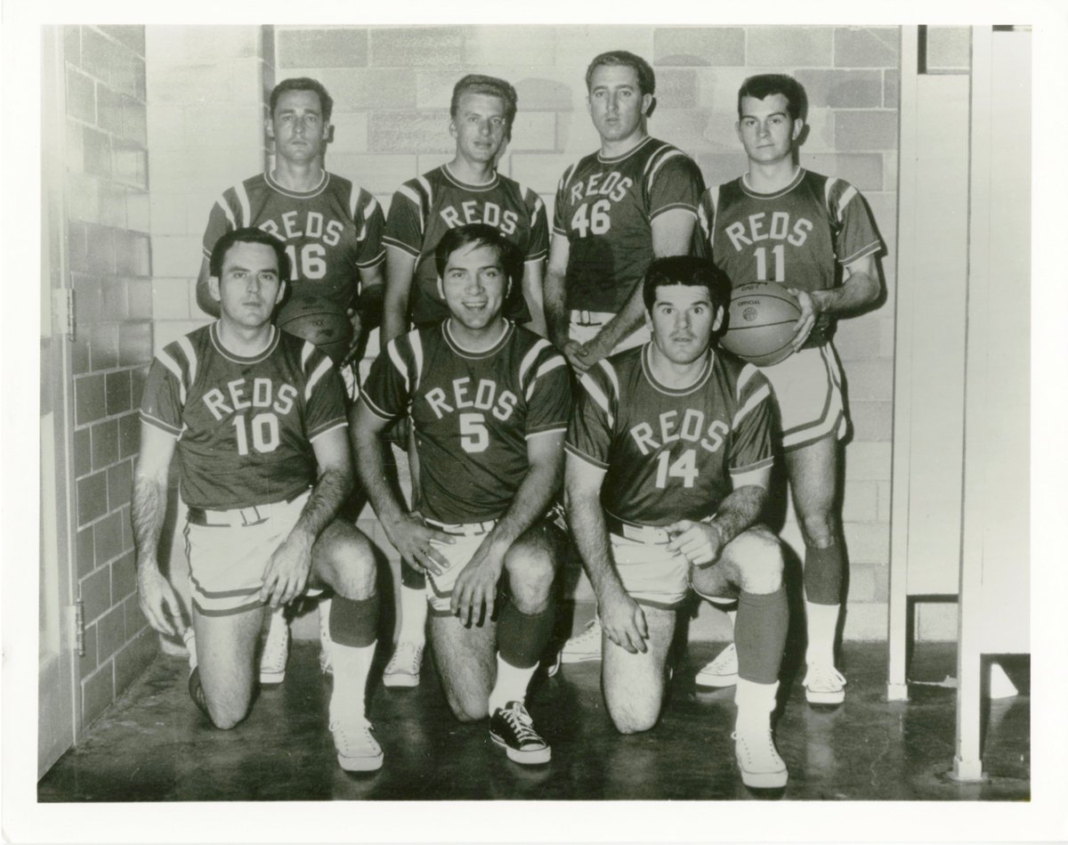
Cincinnati Reds
Notes:
The Cincinnati Reds used to have a basketball team that played charity events in the Cincinnati area………………until their players started getting hurt. Who can you recognize in this picture? I identified Johnny Bench (5) and Pete Rose (14). Jimmy Stewart (16), Jim Maloney (46),

