Slide 1
Cubaball
A journey into the alternate universe of
Cuban baseball
Sept. 20-27, 2017

Slide 2
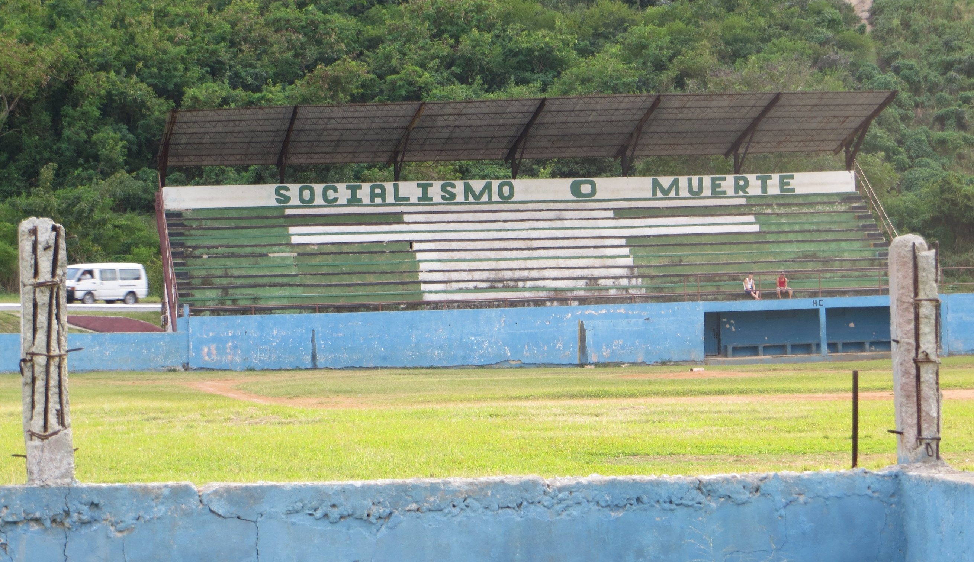
Politics divide our governments,

Slide 3
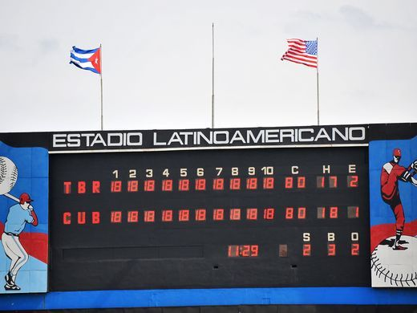
but the baseball field is common ground
for Cubans and Americans

Slide 4
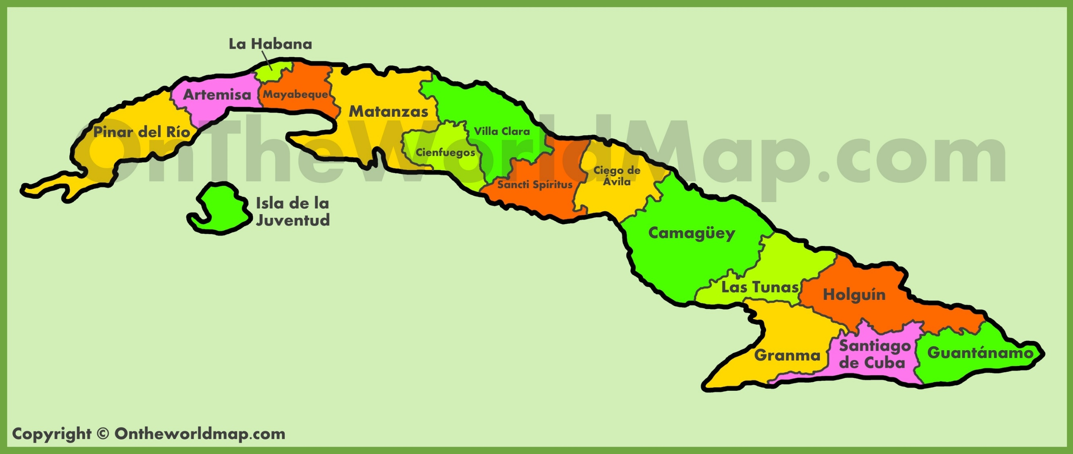
Béisbol Socialista
Sixteen administrative units – each has their own team in the Serie Nacional
Notes:
Players are from that province, and are very rarely traded/moved. So the fans identify with the players on their SN team.

Slide 5
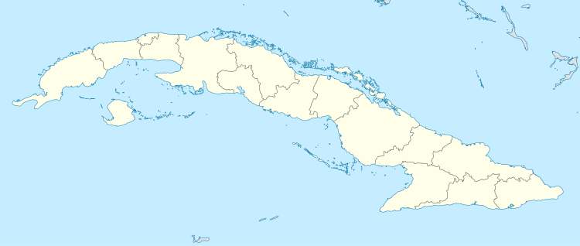
Day One arrived in Havana from Miami
La Habana

Slide 6
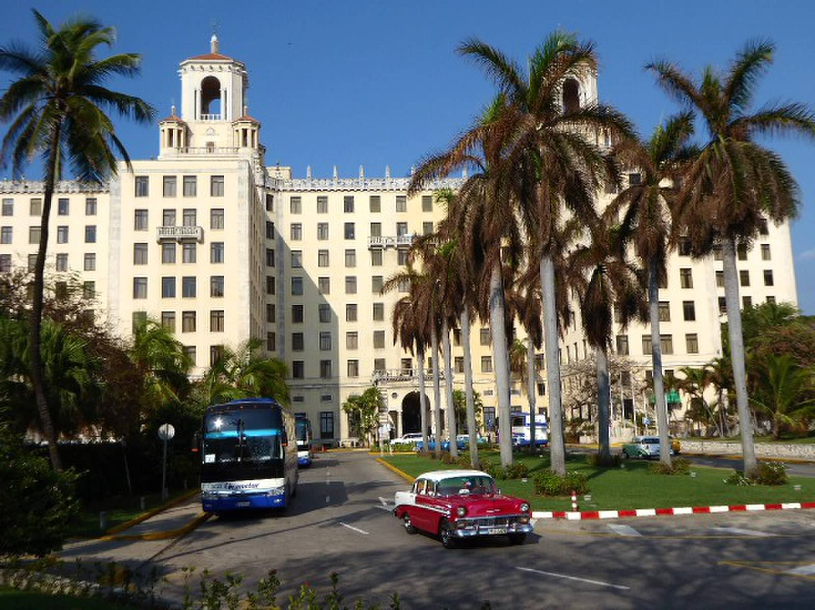
Day One – we stayed at the historic Hotel Nacional
Notes:
Built in 1930 with U.S. investment. In December, 1946 – the heads of U.S. organized crime held a summit conference here. This meeting was dramatized in the movie Godfather Part II.

Slide 7
Day Two -- traveled to Cienfuegos
La Habana
Cienfuegos

Slide 8
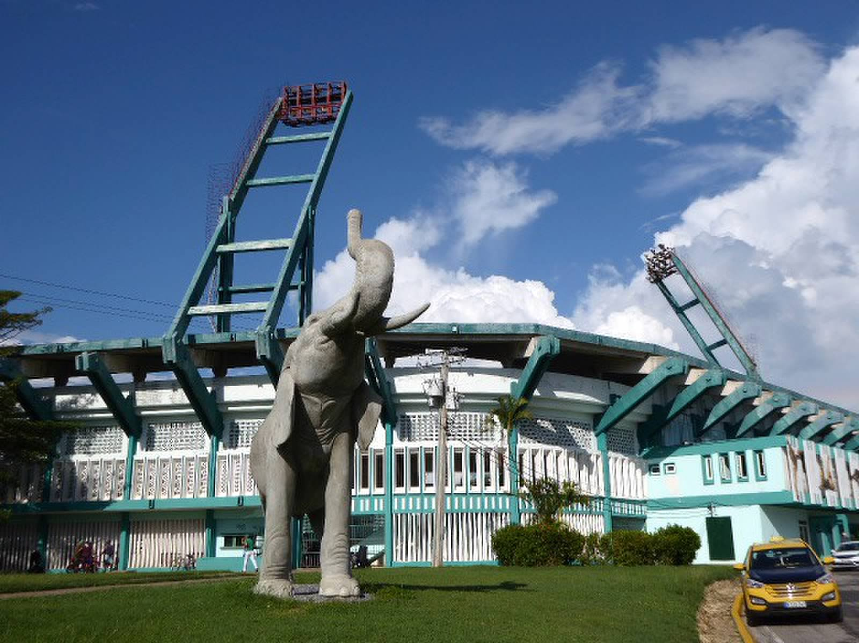
In Cienfuegos – ballgame at Estadio 5 de Septiembre
Notes:
Sept. 5, 1957 commemorated revolt in Cienfuegos where revolutionaries seized armory and transported arms to Castro’s revolutionaries. Rebels could not hold the city. Stadium built in 1977, seats 30,000.

Slide 9
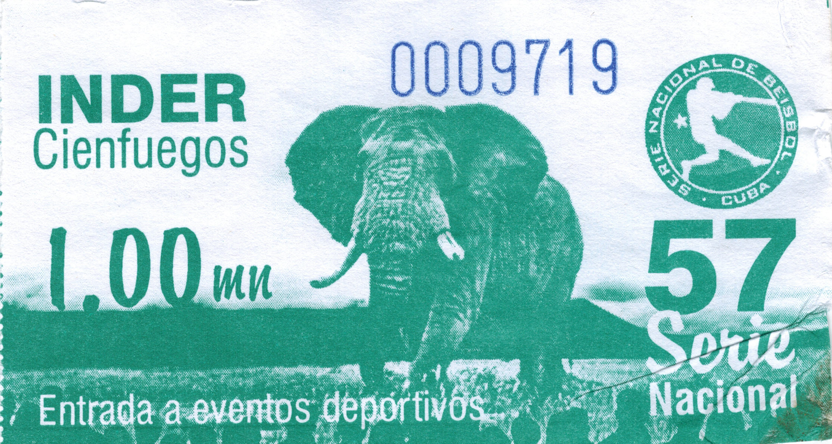
Notes:
INDER – Instituto Nacional de Deportes, Educacion Fisica y Recreacion (National Institute of Sports, Physical Education & Recreation) – the socialist sports authority.

Slide 10
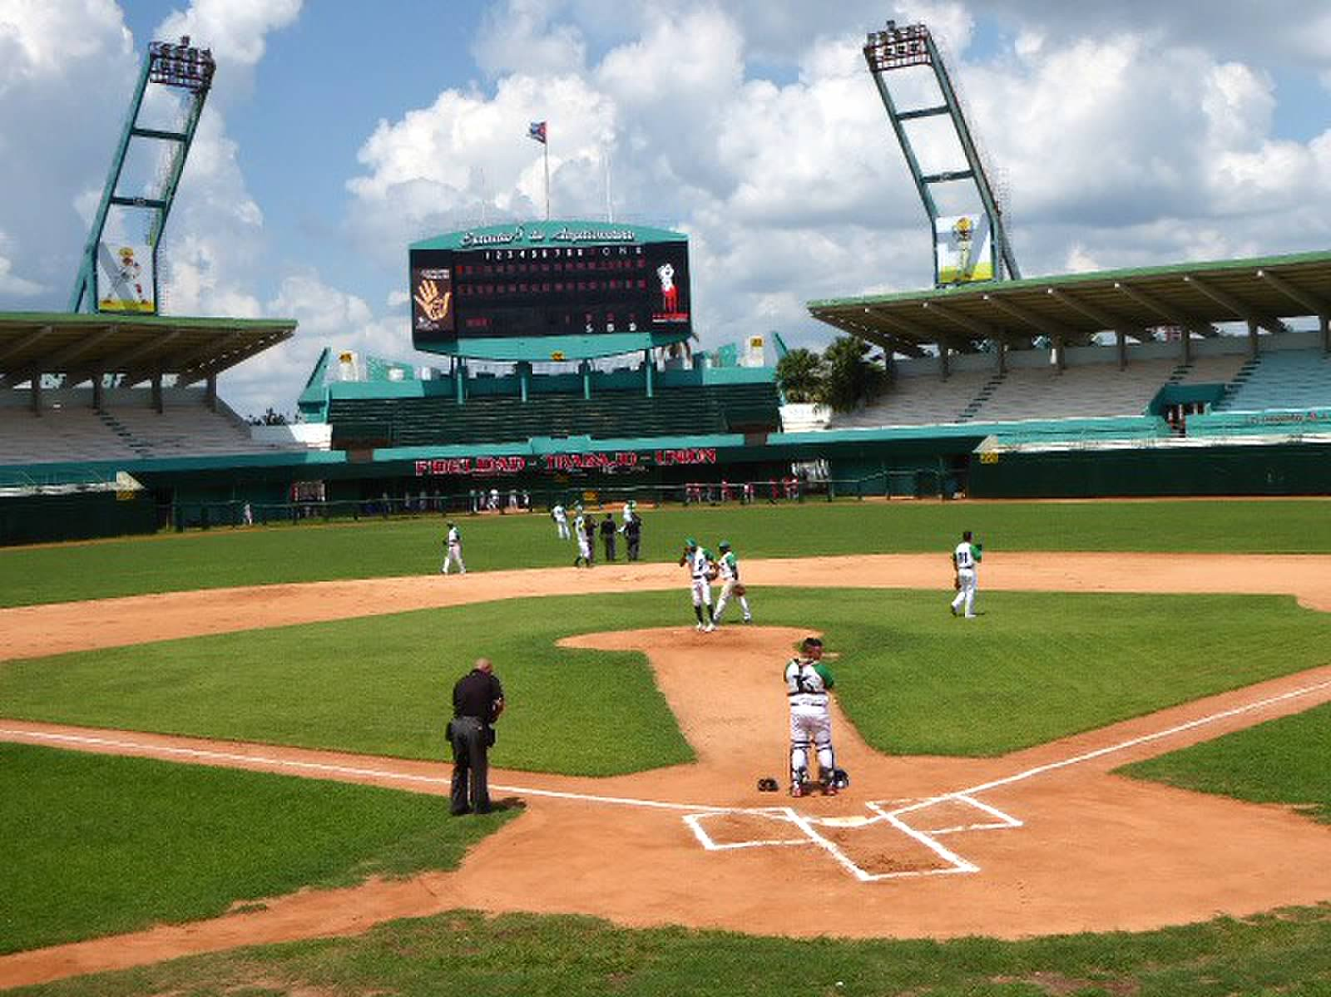
Interior of Cienfuegos ball park
Notes:
Architecture is similar to many of the stadiums built in the ’60s and ‘70s in Cuba. Mostly used student labor during summers to build the facilities.

Slide 11
Day Three -- traveled to Cruces
La Habana
Cruces
Cienfuegos

Slide 12
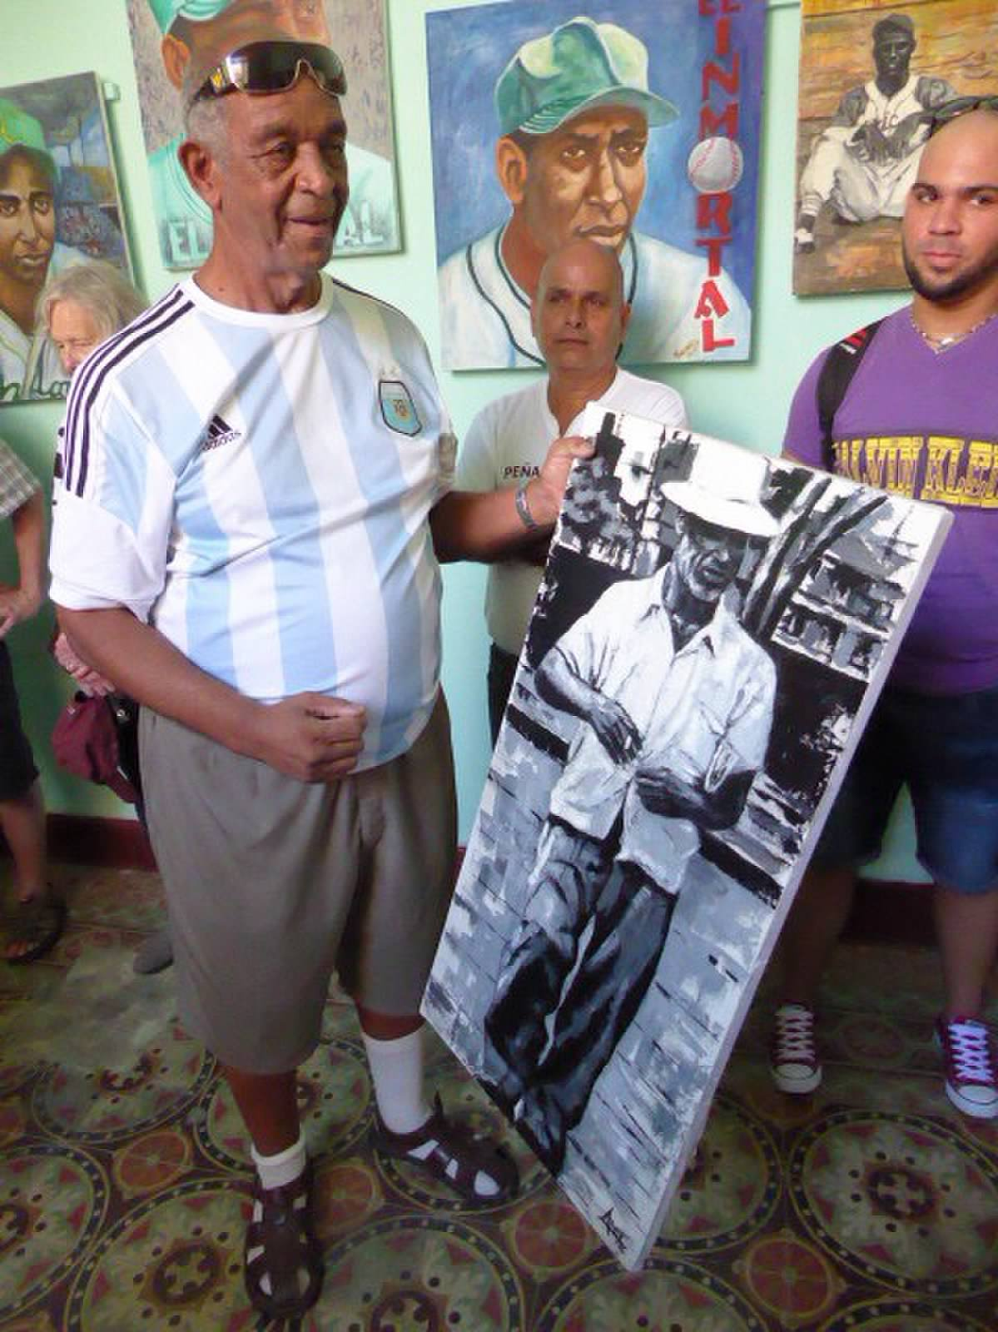
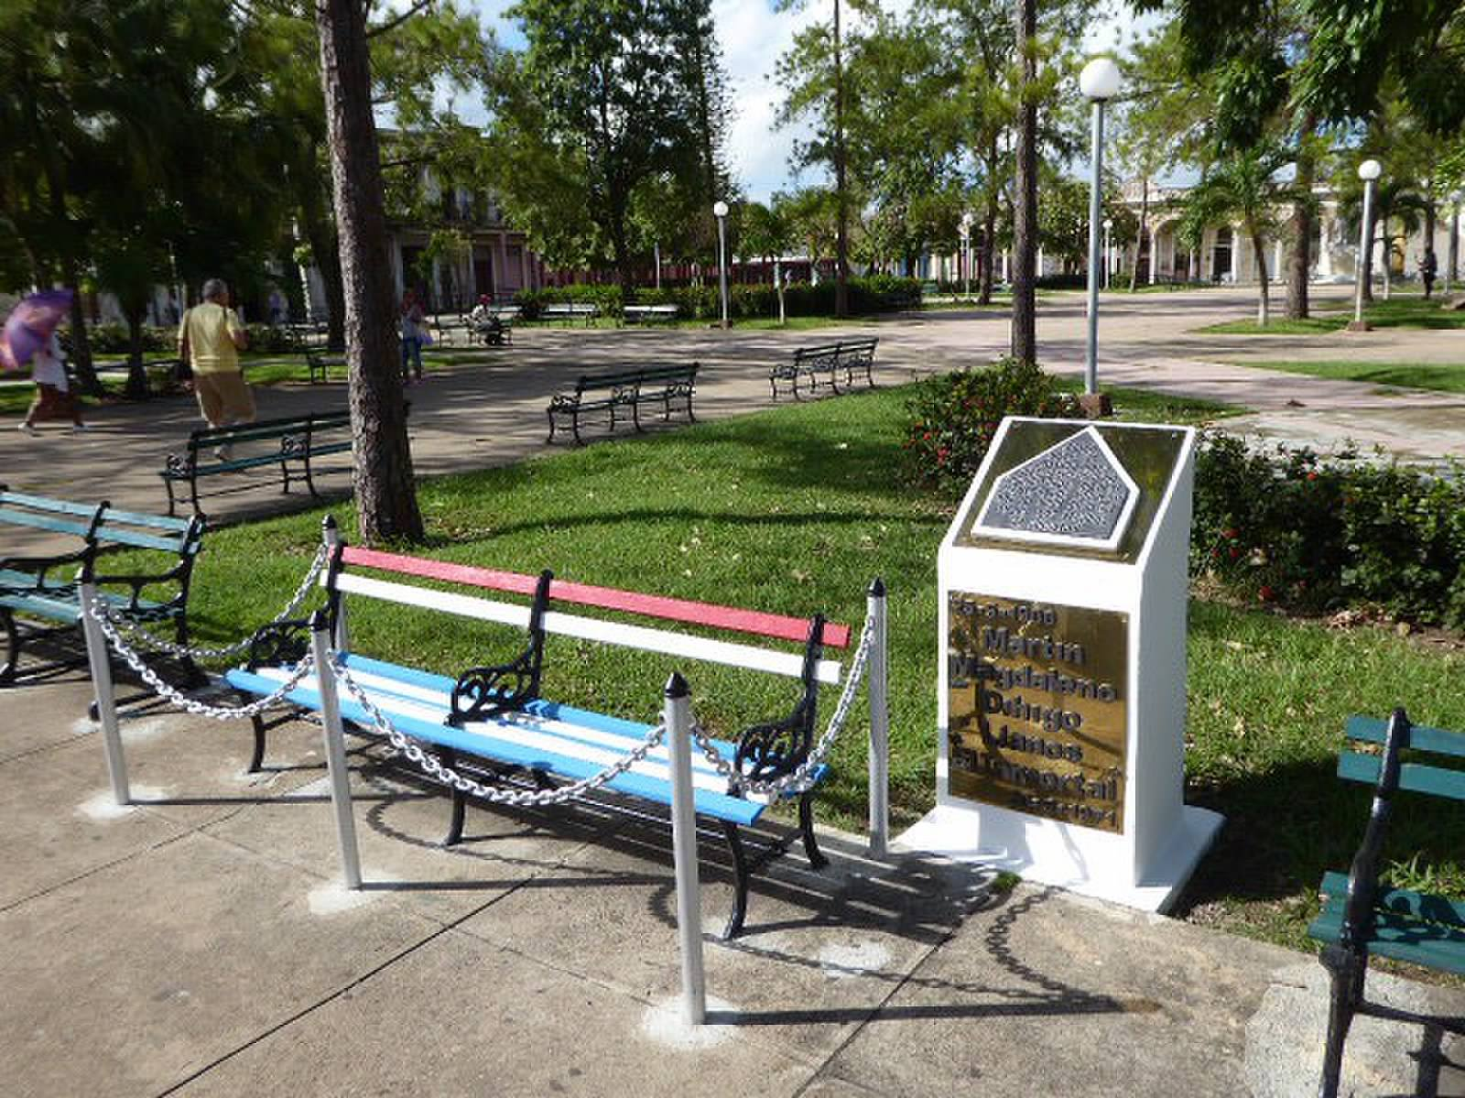
Cruces is the hometown of El Inmortal – Martin Dihigo

Slide 13
Day Four -- traveled to Santa Clara
La Habana
Santa Clara
Cienfuegos

Slide 14
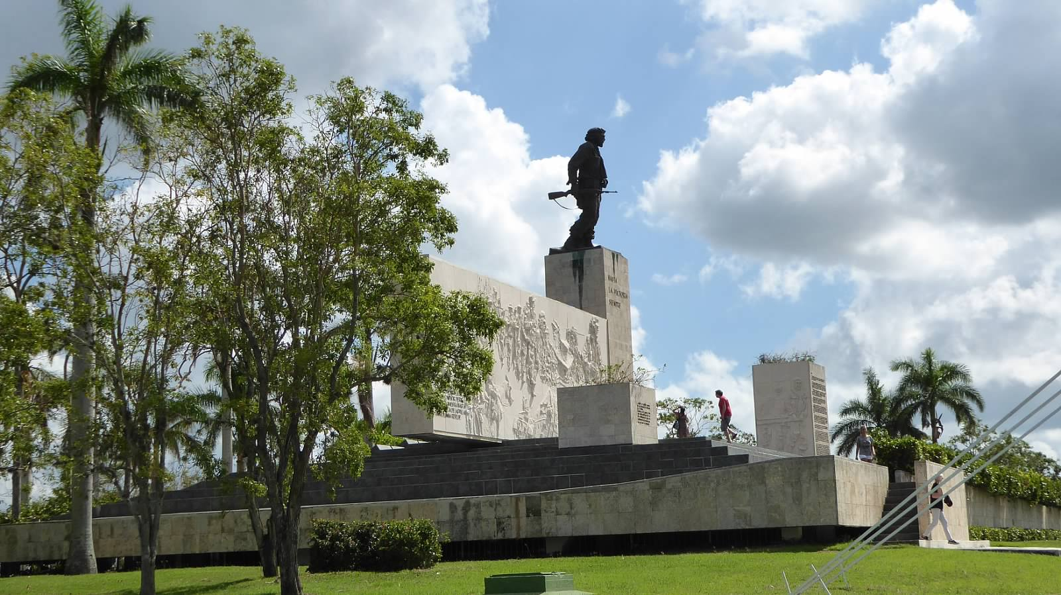
Santa Clara is the site of Che’s Memorial & Mausoleum

Slide 15
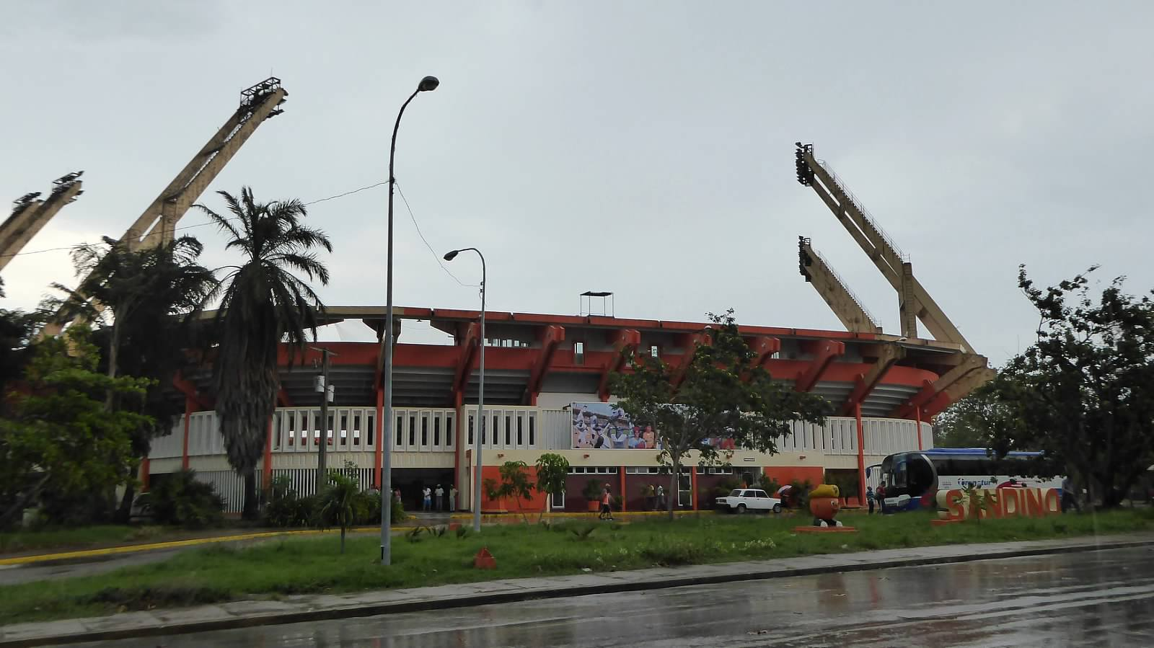
Ballgame at Estadio Augusto Cesar Sandino in Santa Clara
Notes:
Sandino was a Nicaraguan nationalist who fought against the U.S.-supported regime in Nicaragua in the ‘30s. The “Sandinistas”, who gained control and were opposed by the U.S. supported Contras (Oliver North, Reagan, arms with Iranians) were named after him. Built in 1966 and seats 20,000.

Slide 16
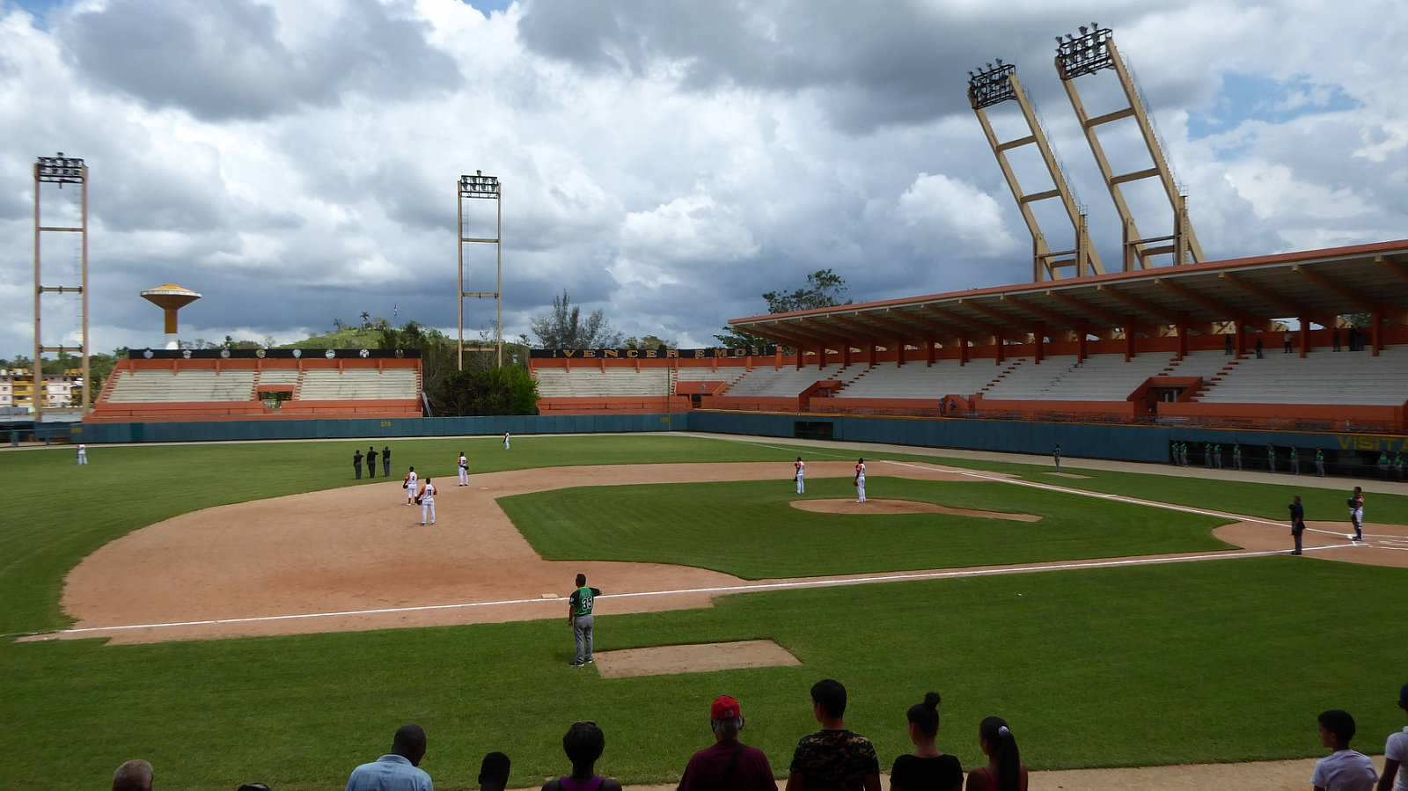
Interior of Estadio Sandino in Santa Clara

Slide 17
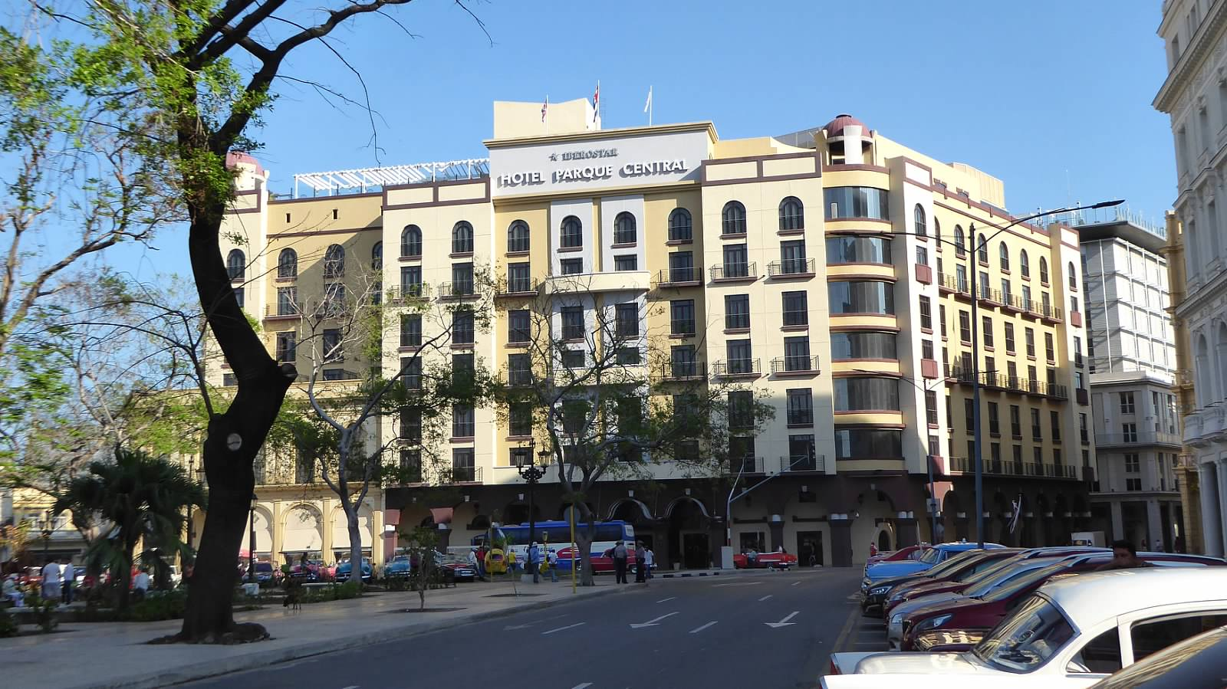
We then returned to Havana …

Slide 18
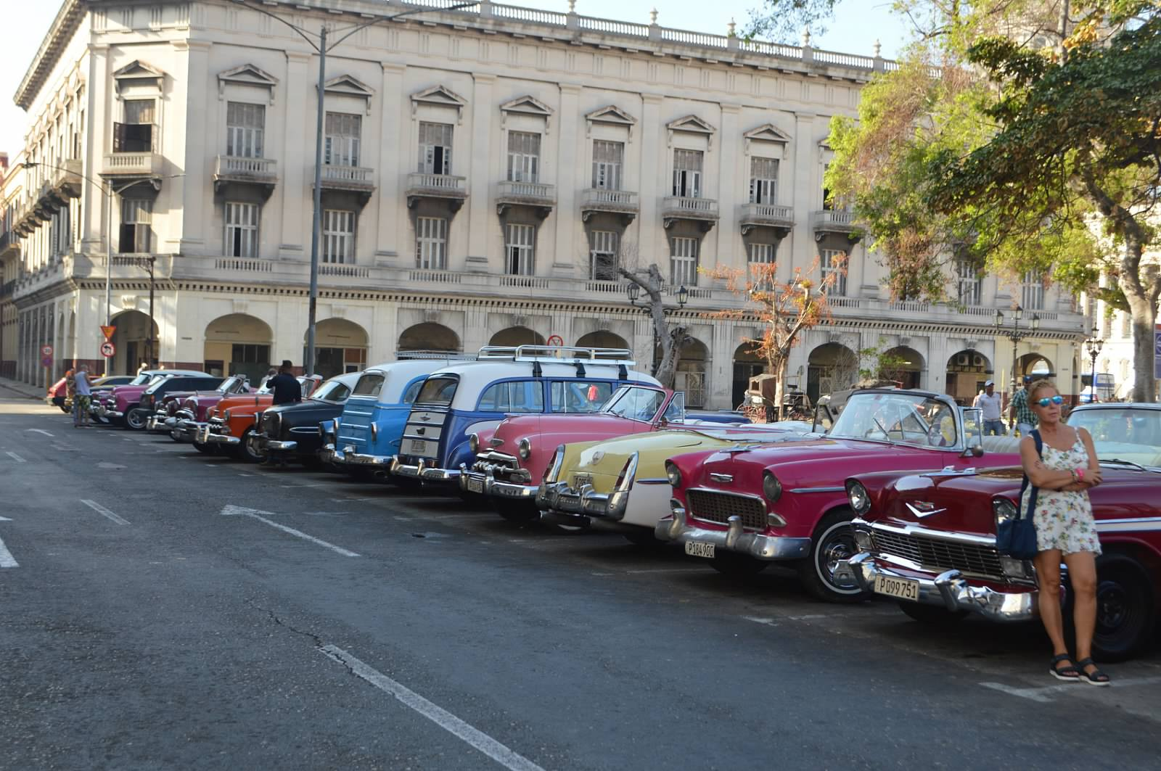
This may look like a classic car show,
but it’s also the taxi line

Slide 19
Day Five -- traveled to Artemisa
La Habana
Artemisa

Slide 20
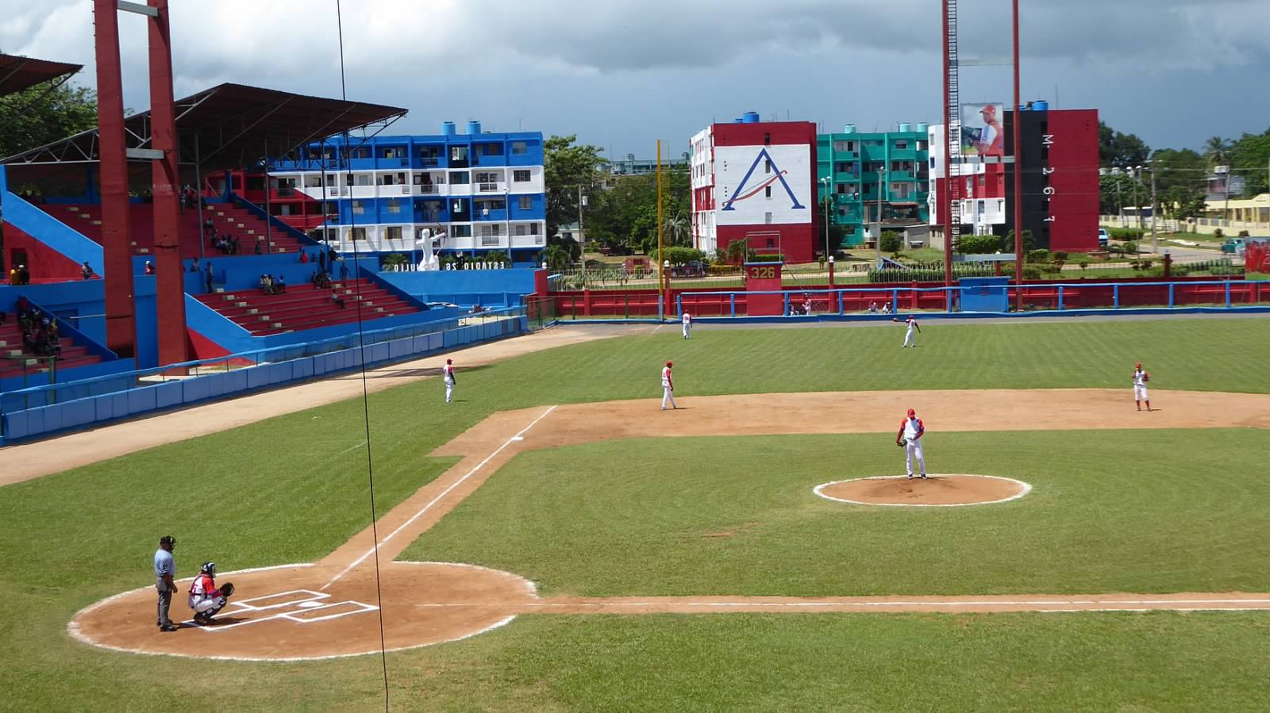
Ballgame at Estadio 26 de Julio in Artemisa
Notes:
July 26, 1953 commemorated the start of the Cuban Revolution – rebels led by Fidel Castro himself stormed the army barracks in Santiago, Cuba. The revolution took the name the 26th of July Movement. Stadium built in 1978 and seats 6000. Is a departure from the general architecture of the other stadiums we visited.

Slide 21
Day Six -- traveled to Pinar del Rio
La Habana
Pinar del Rio

Slide 22
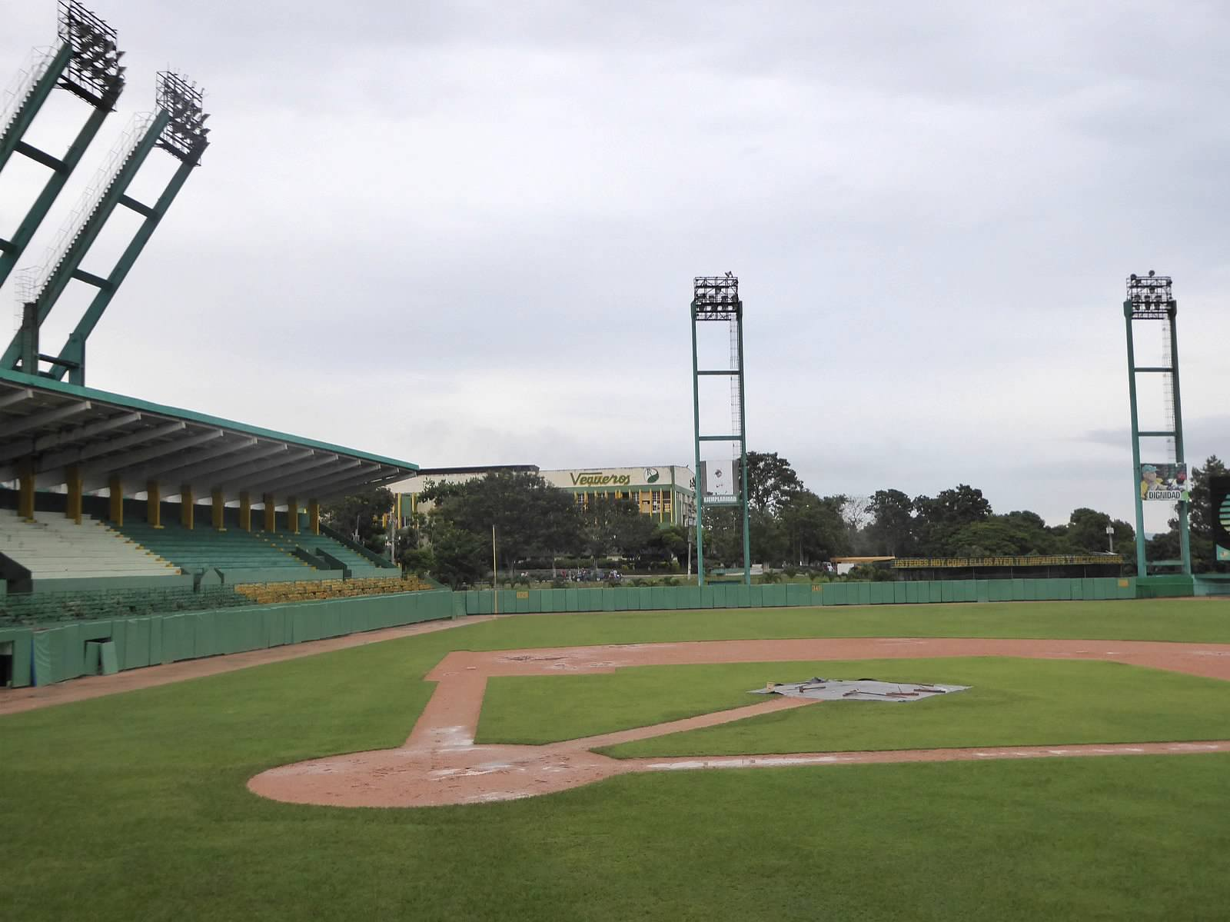
Rained out! at Estadio Capitan San Luis in Pinar del Rio
Notes:
Capitan San Luis was name of a Cuban revolutionary leader who went to Bolivia with Che and was eventually killed in action there. Stadium built in 1969 – cap. 8000.

Slide 23
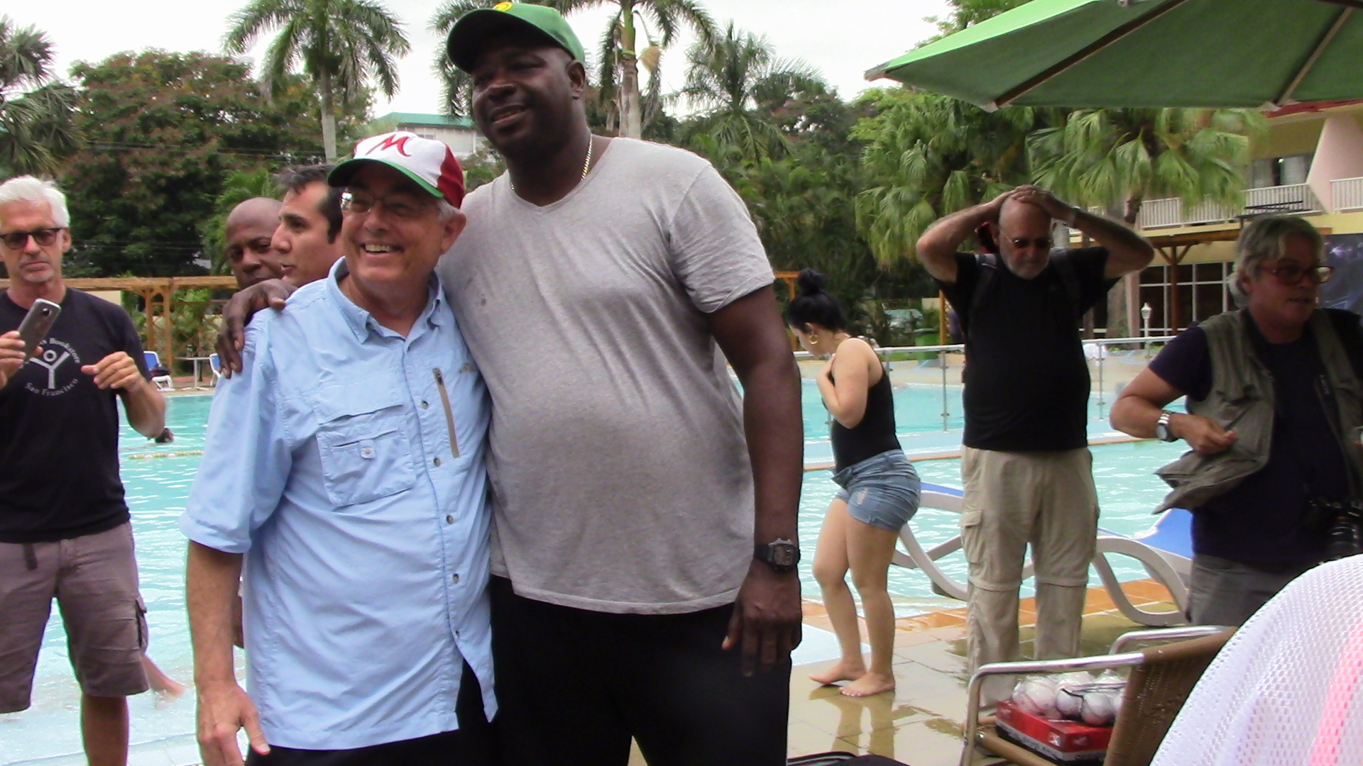
I had a close encounter with a famous Cuban pitcher
Pedro Luis Lazo – star Cuban National Team pitcher and current manager of Pinar del Rio

Slide 24
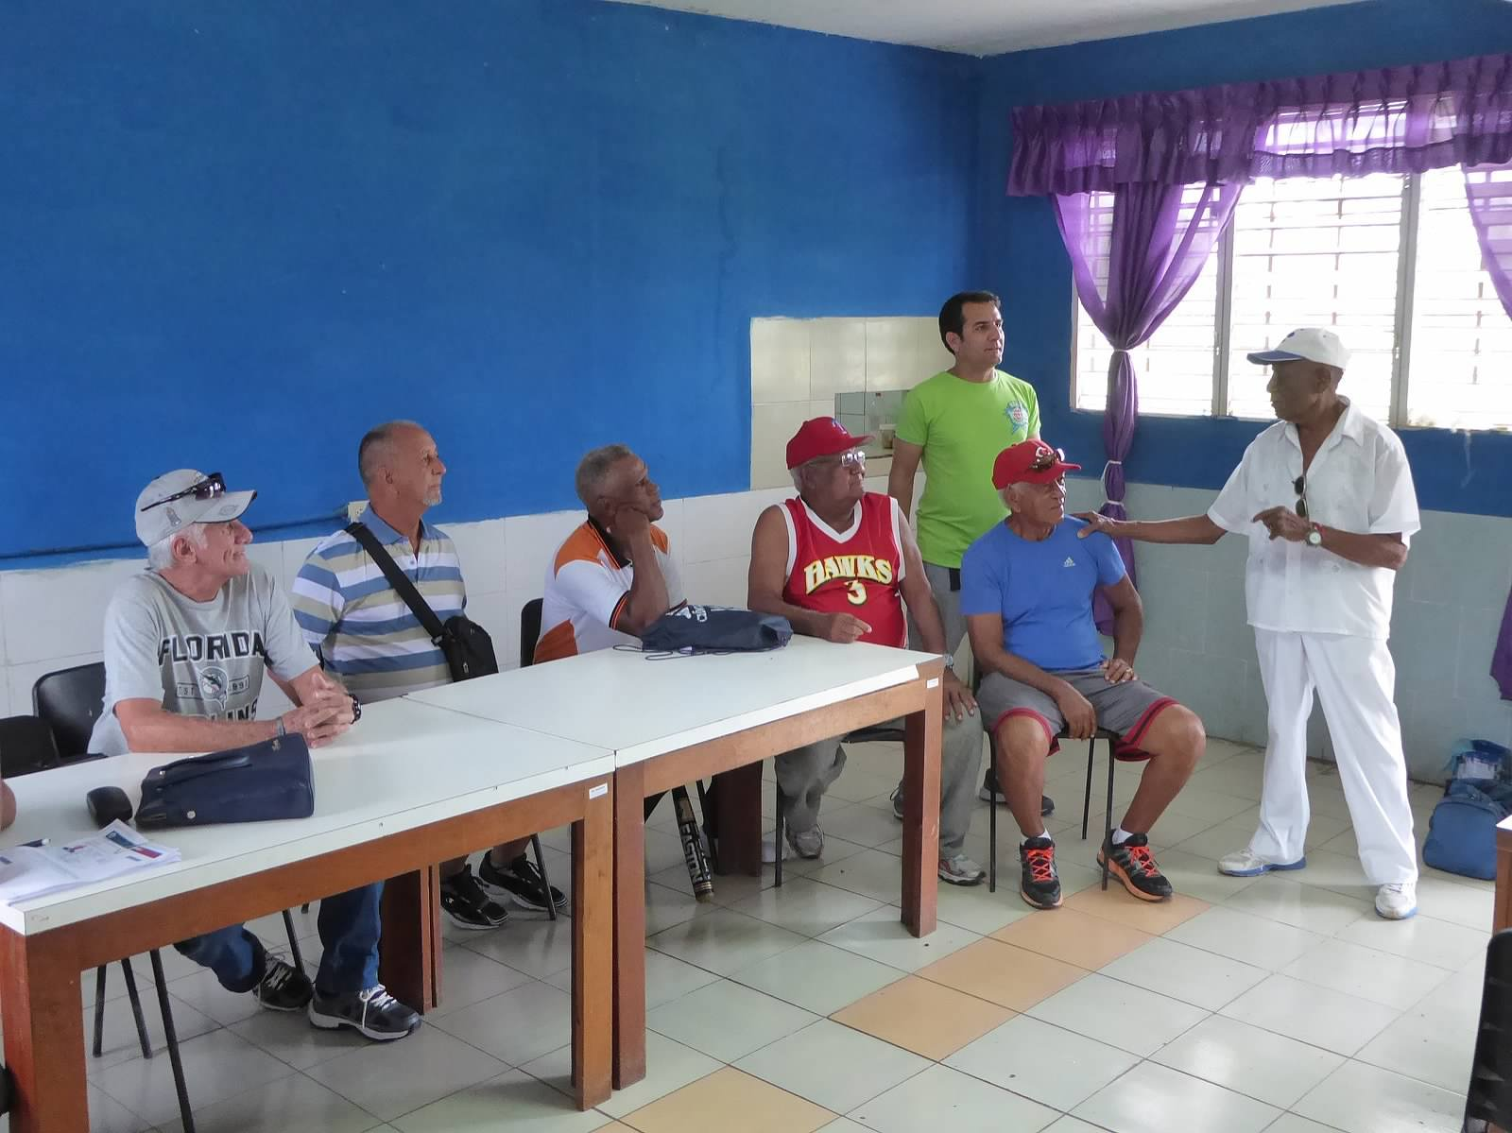
Day Seven – toured Havana and met with baseball groups

Slide 25
Béisbol Cubano
Some observations of Cuban baseball:
The players are very athletic
The quality of play has suffered
Defections at the highest level
Defections of younger players
Fundamentals seem lacking among weaker teams
Differences on the field
“Small ball” tactics
Mercy rule
Schiller rule beginning in 11th inning
“Stretch” occurs at end of 5th inning
One female umpire – with three on the way
Notes:
Pitching is especially impacted. The poor pitching was very obvious in the games we attended. Training (and maybe trainers) seems to be lacking.

Slide 26
Béisbol Cubano
Some observations of Cuban baseball:
Differences on the field (cont.)
Batter shakes hands with catcher & umpire – first time up
Standardized uniforms
The stadiums
Single deck - most seating on wide concrete steps
Few concessions
No advertising – revolutionary slogans/pictures instead
Fútbol is gaining in popularity!

Slide 27
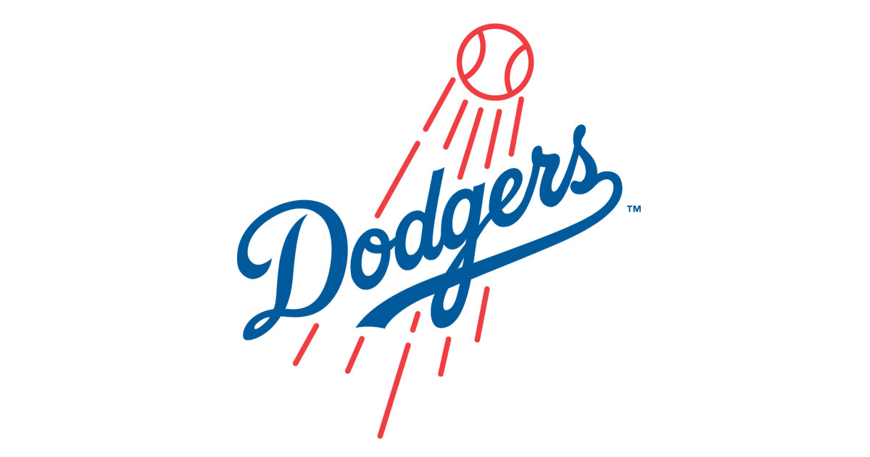
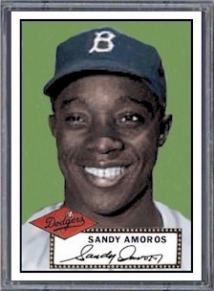
Béisbol Cubano
Name that Cuban player:
Played for the Dodgers from 1952 through 1960 seasons
Was an outfielder and used often as a pinch-hitter
Entered Game 7 of the 1955 World Series as a defensive replacement
Made a game-saving catch in LF to preserve Johnny Podres’ shutout

Slide 28
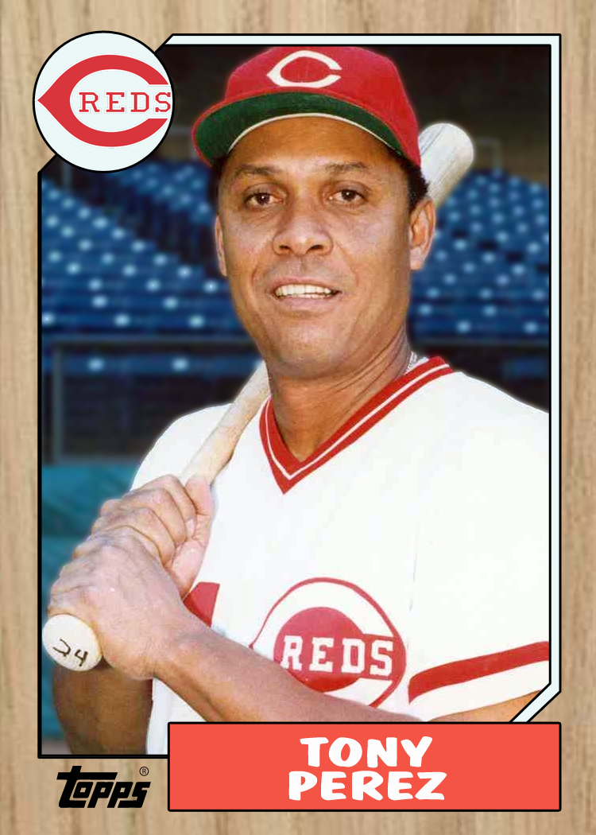
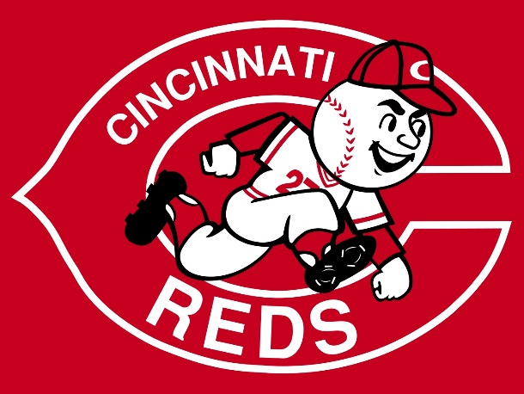
Béisbol Cubano
Name that Cuban player:
Played with the AAA Cuban Sugar Kings in 1960
Left Cuba to play minor-league ball for the Reds, just prior to Castro restricting emigration
Was called up to the Reds in 1964
Hit a key home run in Game 7 of the 1975 World Series off Bill “Spaceman” Lee
Was elected to the U.S. Baseball Hall of Fame in 2000

Slide 29
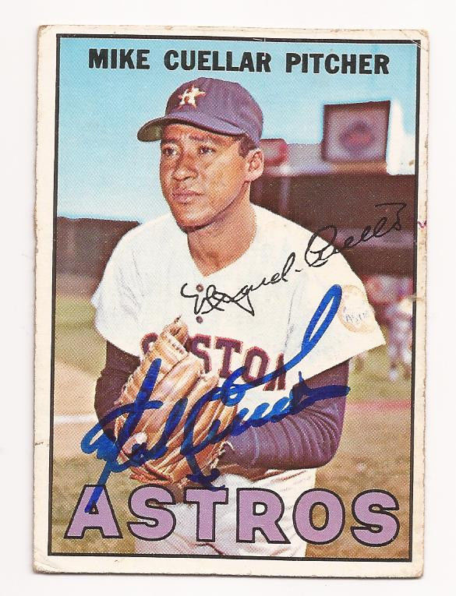
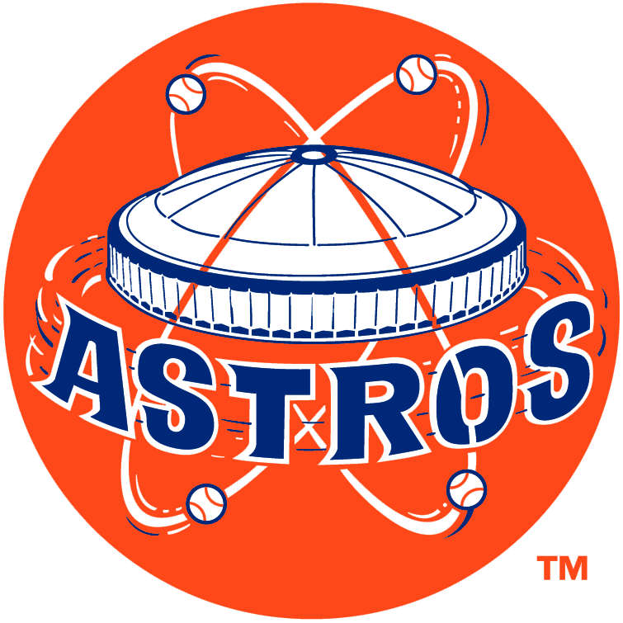
Béisbol Cubano
Name that Cuban player:
He joined the Cuban army in 1954 so he could pitch for their team on the weekends
After his discharge, he played in Nicaragua, for the AAA Cuban Sugar Kings, and for the Reds
He was dealt to the Cardinals in 1964 and then to the Astros during the 1965 season
He pitched for the Astros for four seasons, and was an all-star in 1967
He had his greatest success with the Orioles, winning 20 games four times and a Cy Young

Slide 30
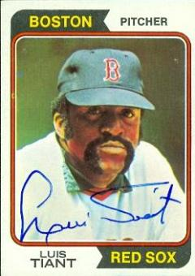
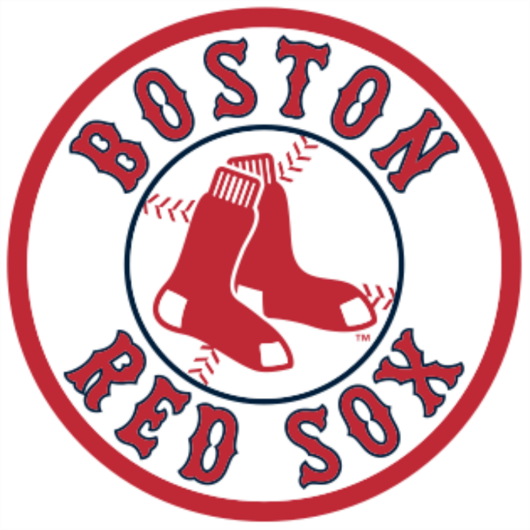
Béisbol Cubano
Name that Cuban player:
He started his professional career in 1959 with the Mexico City Tigers
In 1961 his contract was sold to the Cleveland Indians
When brought up to the majors in 1964, he won his first start in NY against Whitey Ford
He signed as a free agent with Boston in 1971, where he had great success – winning 20 games three times
Red Smith once said “he looks like Pancho Villa after a tough week of looting and burning.”

Slide 31
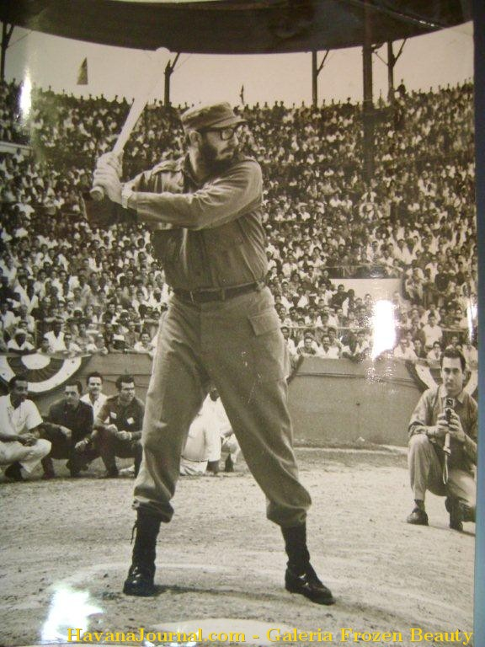
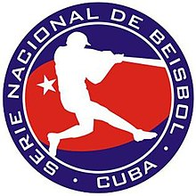
Béisbol Cubano
Name that Cuban player:
He was a star pitcher for his prep academy baseball team
He played college basketball, but felt that swimming was his best sport
He was a life-long baseball player, fan, and activist
He is considered one of the most influential forces on baseball in Cuba and internationally

Slide 32
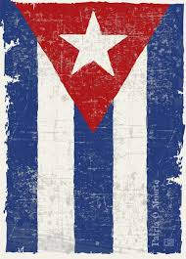
El Pueblo Cubano
A proud, independent, and resilient people,
they continue on their way “Always onward to victory”

Slide 33
El Pueblo Cubano
Some thoughts on Cuba and the Cuban people:
Very friendly
Very helpful
Want to know more about the U.S.
Split economy – two currencies
Cuban peso (CUP) – everyone paid by government – most Cubans
Peso convertible (CUC) – tied to U.S. dollar, Euro, etc. – those working
in tourism and hospitality; some import/export
This leads to counter-intuitive “haves” and “have nots” in Cuban society
“Within the revolution, everything. Outside of the revolution, nothing.”
Notes:
Supposedly going to single currency 1/1/18, but unsure how this will work (check if this is happening???

Slide 34
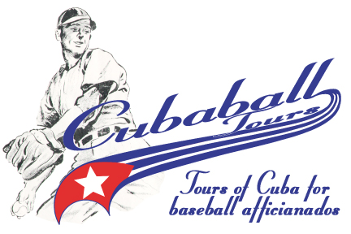
¡ Gracias !

