Slide 1
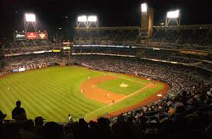
Mickey Mantle

Slide 2
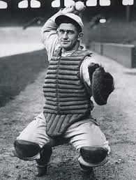
Named for HOF Catcher Mickey Cochrane
Notes:
His father’s favorite player and the best catcher in MLB in 1931. Real first name was Gordon. Gordon Mantle?

Slide 3
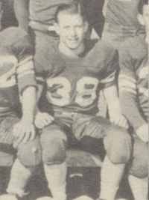
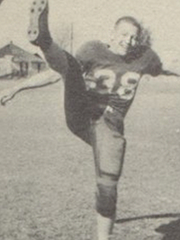
Doctors wanted to amputate his leg in High School
Notes:
Kicked in shin – leg became infected. Doctors discovered osteomyelitis (potentially fatal bone disease). Second opinion – 8 shots of penicillin a day.

Slide 4
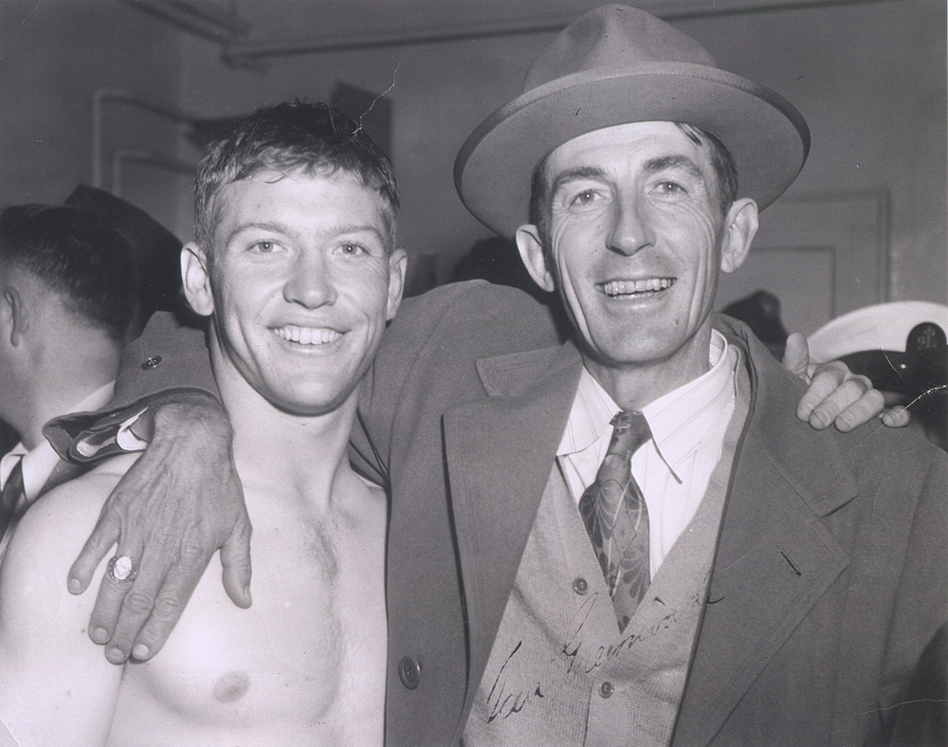
Signed for a $1,100 Bonus
Notes:
Scout Tom Greenwade signed him for $1,100 bonus and $140/month to play at Independence MO.

Slide 5
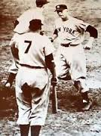
What’s Wrong with this Picture?
Notes:
Mantle after home run. Cliff Mapes, #7, greets him at the plate.

Slide 6
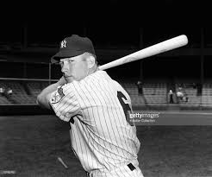
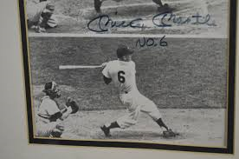
Mantle wore #6 as rookie in 1951
Notes:
Cliff Mapes was not with Yankees in 1952, so Mantle was given the now-famous #7

Slide 7
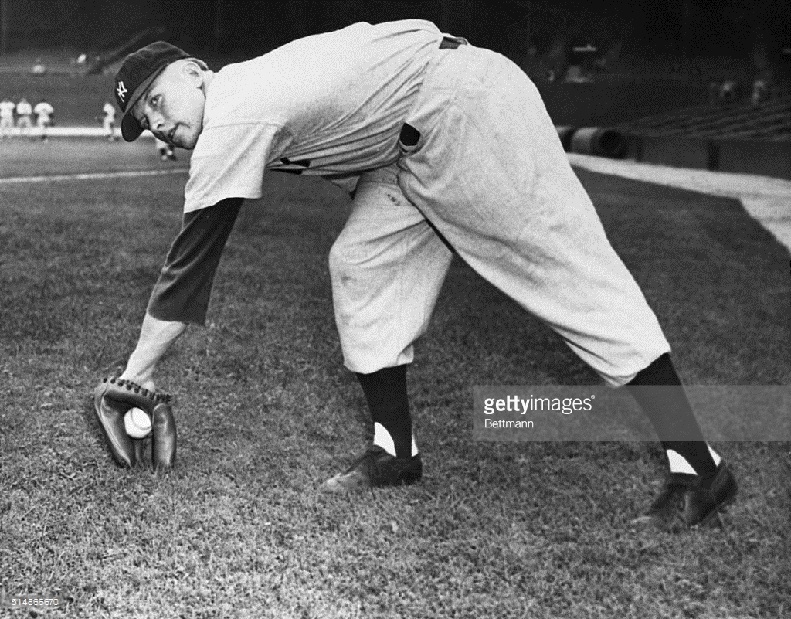
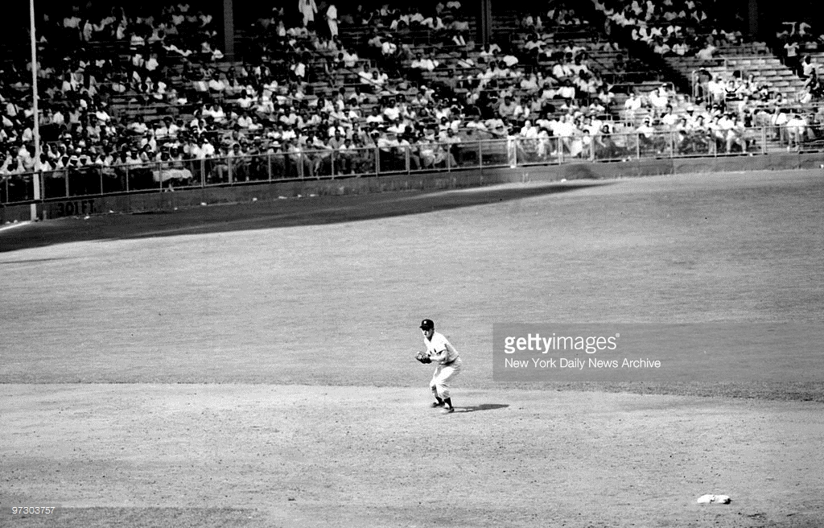
Mantle originally played Shortstop
Notes:
He made 102 errors in his last two years in the minors – NYY moved him to outfield. Did play SS in seven games from1953 - 1955.

Slide 8
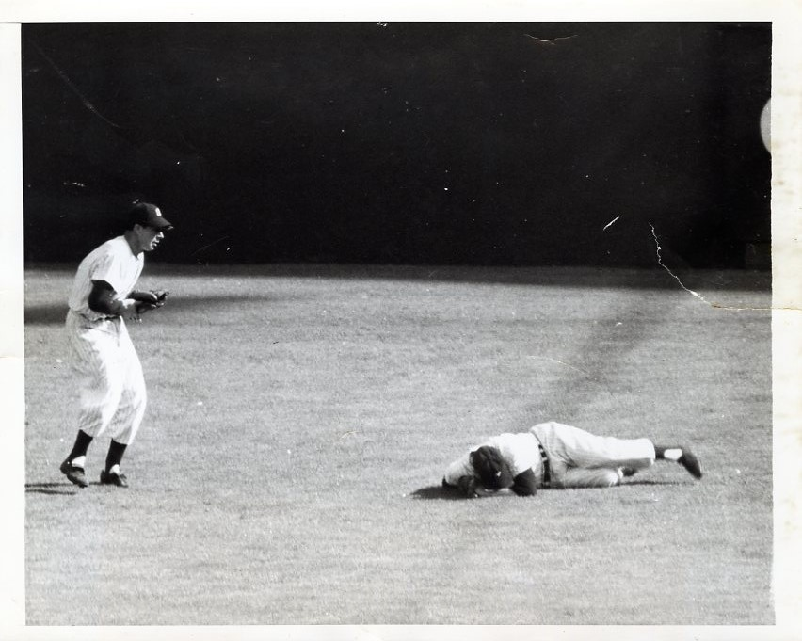
First Conversation with Joe DiMaggio
Notes:
Mantle claimed his first real conversation with Joe DiMaggio is when Joe was consoling him waiting on stretcher in 1951 World Series

Slide 9
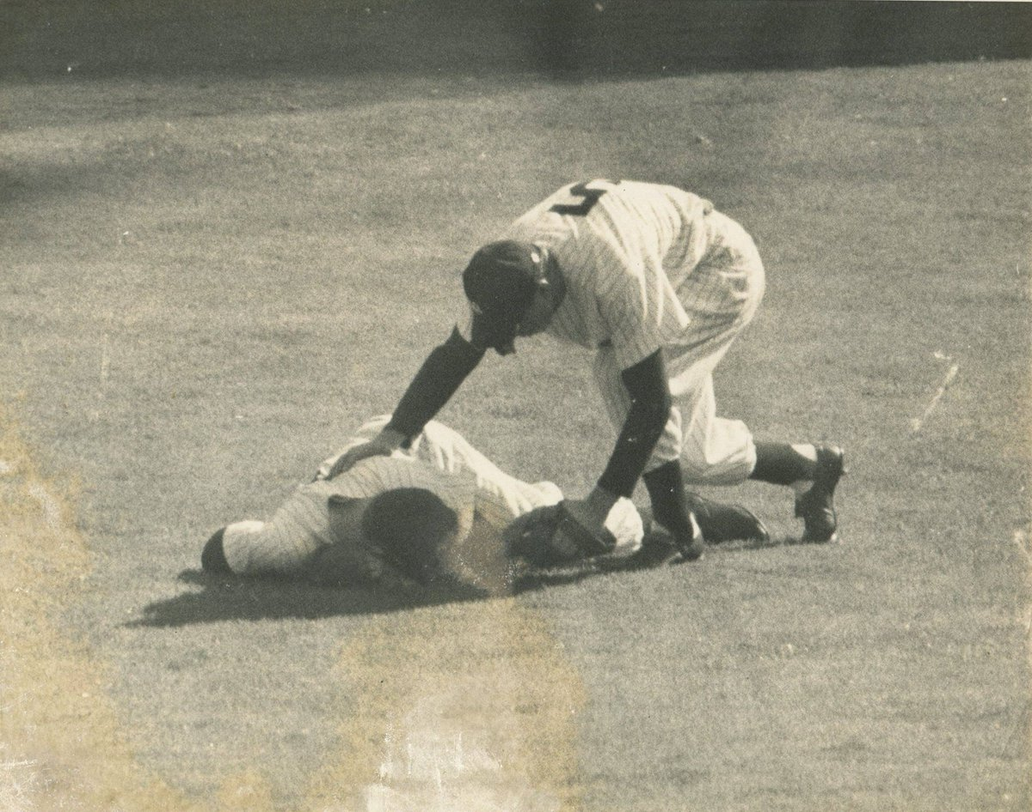
First Conversation with Joe DiMaggio
Notes:
Mantle claimed his first real conversation with Joe DiMaggio is when Joe was consoling him waiting on stretcher in 1951 World Series

Slide 10
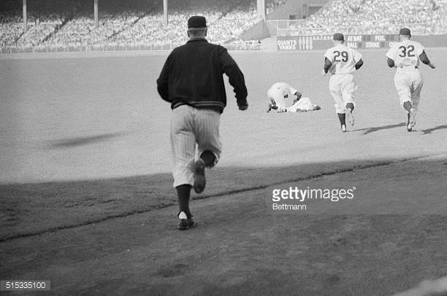
First Conversation with Joe DiMaggio
Notes:
Mantle’s cleats got caught in rubber drainage cover – tearing ligaments.

Slide 11
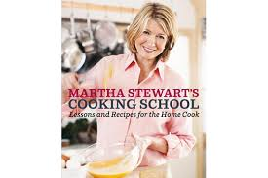
Martha (Kostyra) Stewart used to babysit his children
Notes:
Stewart used to babysit Mantle’s kids in early 50’s (babysat for other Yankees too).

Slide 12
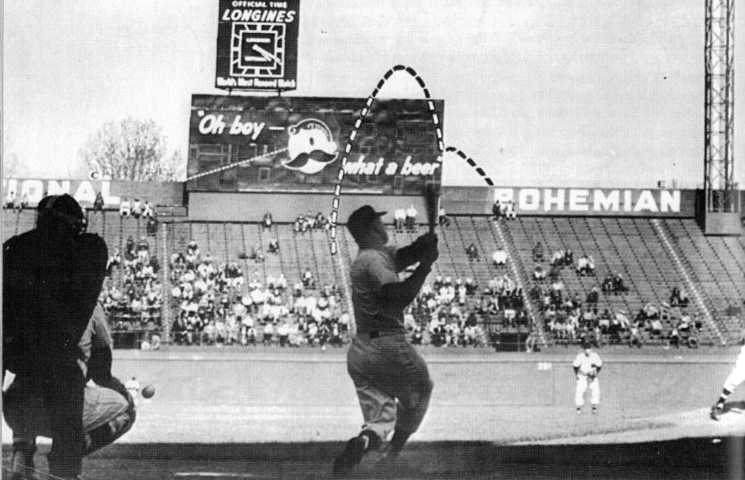
Hit ball out of Griffith Stadium
Notes:
Off of Chuck Stobbs – ball hit Bohemian sign (460’ from home plate), then ended up 105’ behind stadium wall.

Slide 13
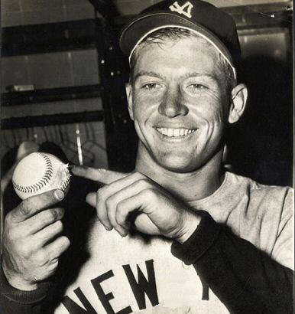
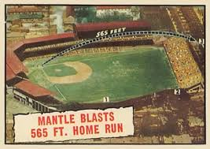
Hit ball out of Griffith Stadium
Notes:
Ball was nicked up after hitting scoreboard.

Slide 14
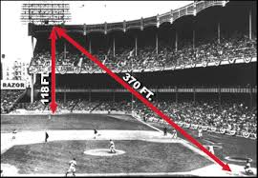
Hit facade at Yankee Stadium
Notes:
Two feet from going out of Stadium. Pitcher Bill Fischer said that the ball “was still going up” when it hit the façade.

Slide 15
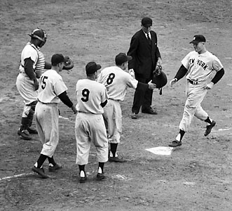
Holds World Series record for most HRs (18) and RBIs (40)
Notes:
Also Total Bases, Walks and Most Strikeouts. Picture is of grand slam hit in 1953 World Series.

Slide 16
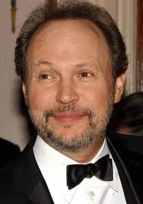
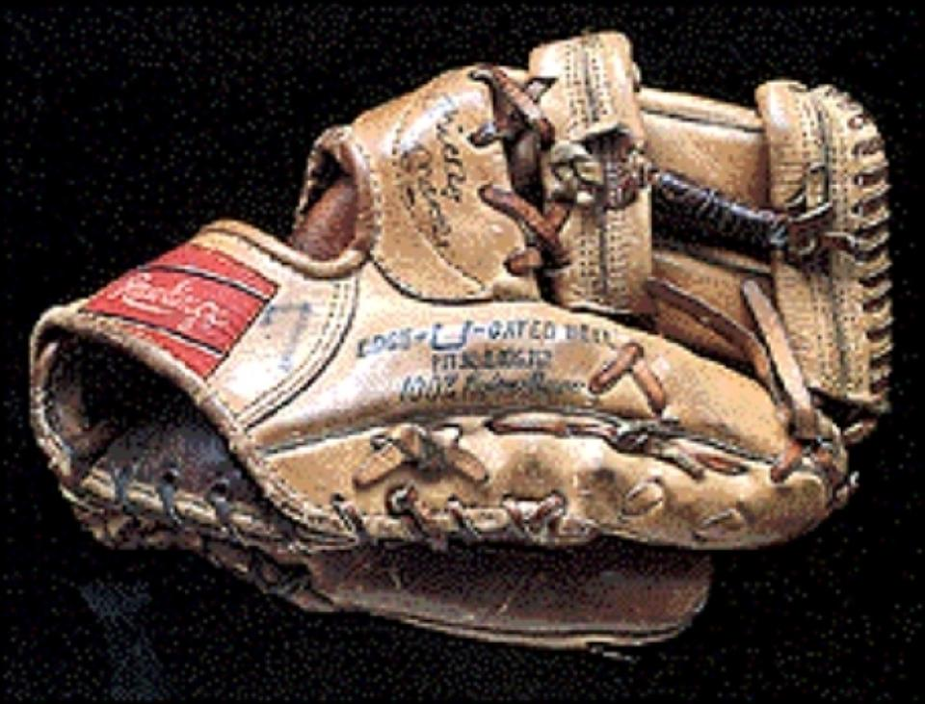
Billy Crystal bought a used Mantle glove for $239,000
Notes:
Crystal claims to value the glove more than a Picasso painting he owns

Slide 17
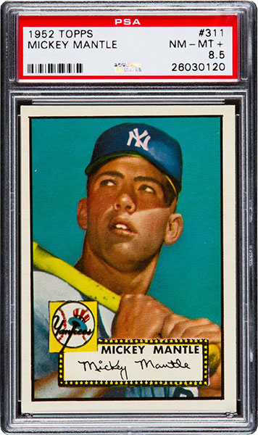
Mantle 1952 Topps card sold for $1,135,520
Notes:
In November 2016.

