Slide 1
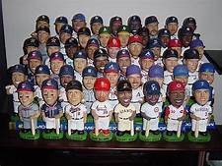
Bobbleheads!

Slide 2
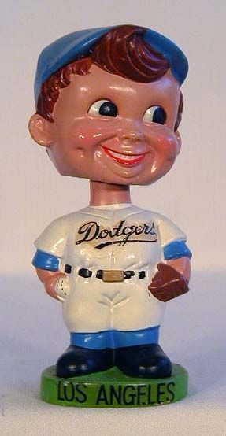
The Definition Of “Bobbleheads”
Bobbleheads (also known as “nodders” or “wobblers”), are a collectible toy whose head is usually over oversized compared to its body. It is generally connected to the body by a spring or hook, so that a light tap will cause the head to move up or down or “bobble.”

Slide 3
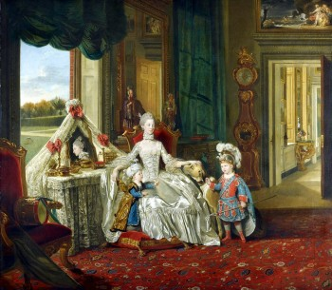
History of Bobbleheads (yes, there is such a thing)
Derives from the seventeenth century, when figurines of Buddha and other religious figures called "temple nodders" were produced in Asia. (Portrait depicts Queen Charlotte of England in 1765, with two figures in the background).

Slide 4
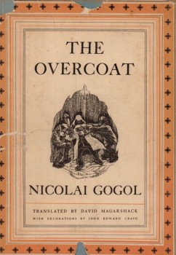
Earliest known Western reference to a bobblehead is believed to be in Nikolai Gogol's 1842 short story "The Overcoat,” in which the main character's neck was described as "like the necks of plaster cats which wag their heads.”
During the nineteenth-century, bobbleheads were being made in limited quantities for the U.S. market, many of which were produced in Germany. Imports increased during the 1920s and 30s, and by the 1950s, they surged in popularity, with items made of either plastic or bisque, a type of porcelain.

Slide 5
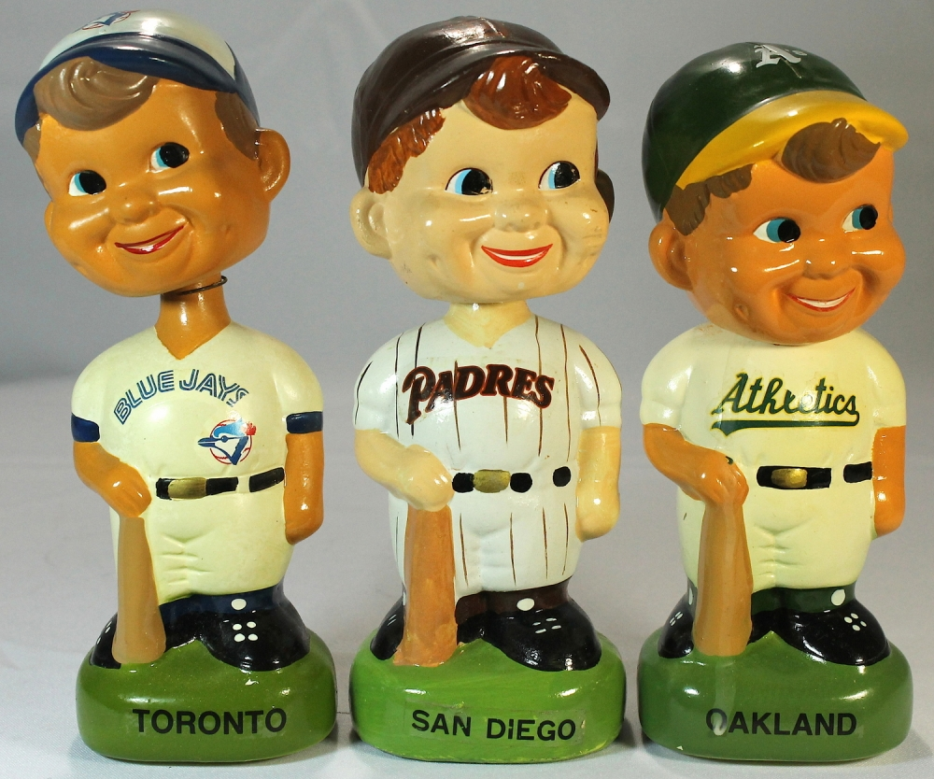
Baseball and Bobbleheads
In the late 50s and early ‘60s, MLB produced a series of papier-mâché dolls, one for each team, all with the same cherubic face. Later, different ethnicities emerged, as did player specific dolls, including for Roberto Clemente, Mickey Mantle, Roger Maris, and Willie Mays, still all with the same face.

Slide 6
Later dolls were produced for other sports, as well as for cartoon characters. One of the most famous bobbleheads of all time is The Beatles set, which is estimated to be worth approximately $800.00.

Slide 7
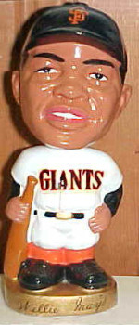
An Explosion (Figuratively Speaking) Of Bobbleheads
During the late 1990s, manufacturers developed cheaper and more durable means of producing bobbleheads, including switching from ceramics to plastic. This enabled them to be sold at ballparks or given away as promotions.
First promotional bobblehead night was on August 2, 1997, when the minor league Birmingham Barons gave them away. The first major league baseball team to offer a bobblehead giveaway was the San Francisco Giants, when they gave away a Willie Mays doll on May 9, 1999.

Slide 8
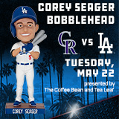
Other major league teams followed suit. Today, the Dodgers have a total of 11 bobblehead nights on their promotional schedule. According to the National Bobblehead Hall of Fame and Museum, there were a total of 437 planned bobblehead giveaways in major and minor league ballparks in 2016 and 2017.

Slide 9

January 7, 2015 marked the inaugural National Bobblehead Day, and in 2016, it was announced that the National Bobblehead Hall of Fame and Museum would open in Milwaukee, Wisconsin. The HOF is expected to display up to ten thousand dolls at a time. It also has an online data base of over 6.600 sports bobblehead giveaway promotions, and is working on a data base of every bobblehead doll ever produced.

Slide 10
Notable Bobblehead Collections
The Miami Marlins’ new stadium includes a Bobblehead Museum featuring 588 bobbleheads, representing every team in baseball. The display slightly vibrates so the bobbleheads are perpetually bobbing.

Slide 11
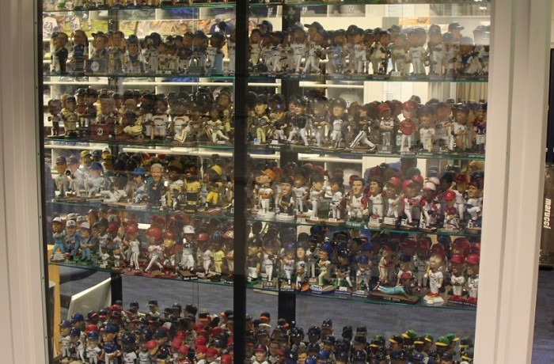
Mitch Poole, longtime Dodger Stadium clubhouse manager (known as the bat boy charged with telling Tommy Lasorda that Kirk Gibson wanted to pinch hit in the 1988 World Series) has an extensive collection of approximately 700 bobbleheads, which is now on display at the stadium’s LF entrance.

Slide 12
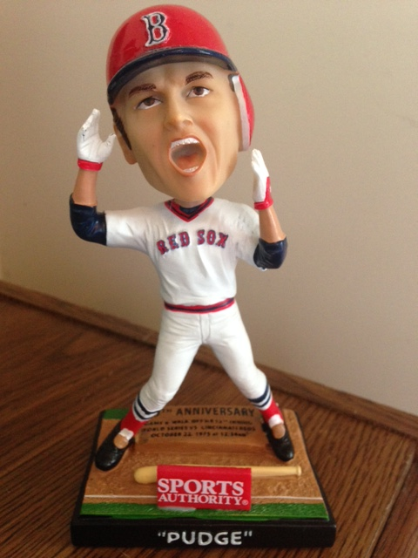
Noteworthy Events, According To Bobbleheads
Carlton Fisk’s Game 6 HR

Slide 13
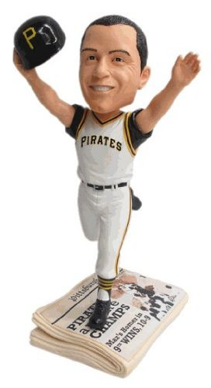
Maz’s HR Wins 1960 World Series

Slide 14
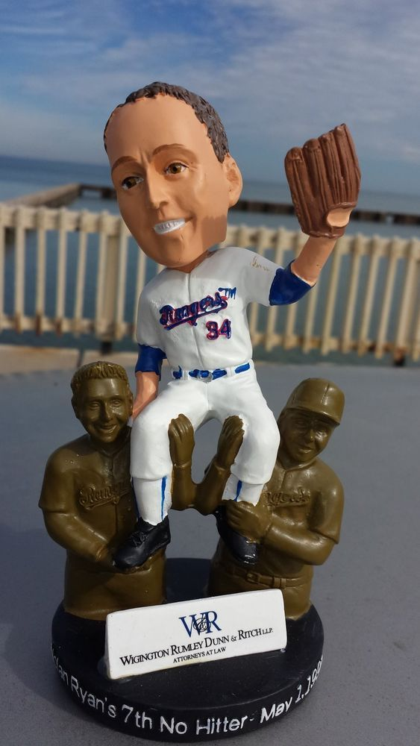
Nolan Ryan’s 7th No-Hitter

Slide 15
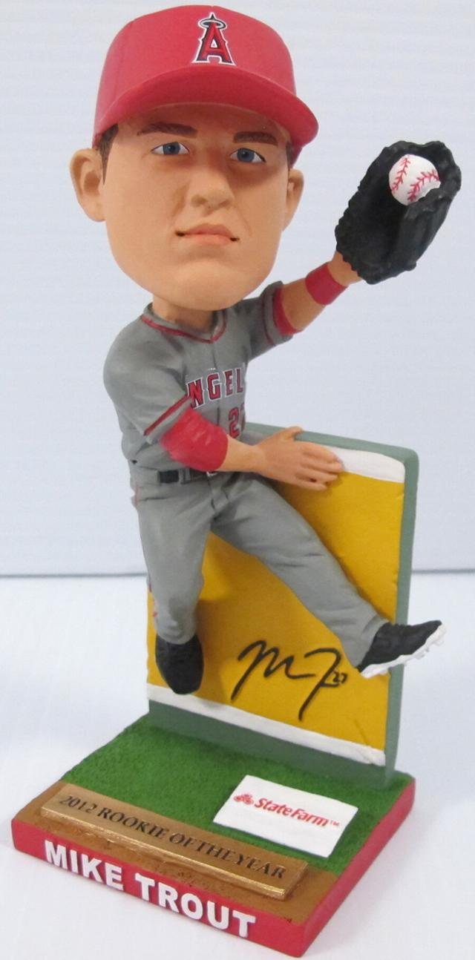
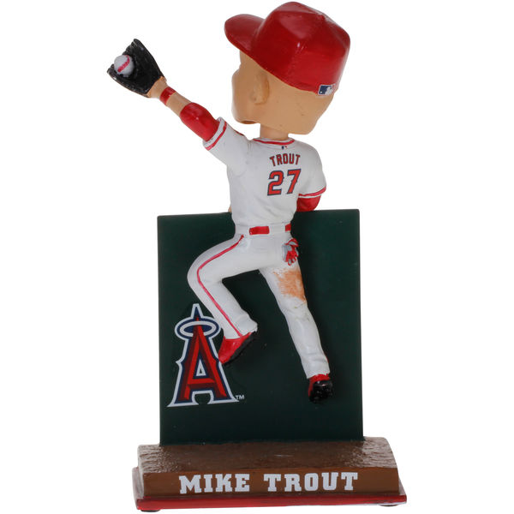
Mike Trout’s Great Catch(es)

Slide 16
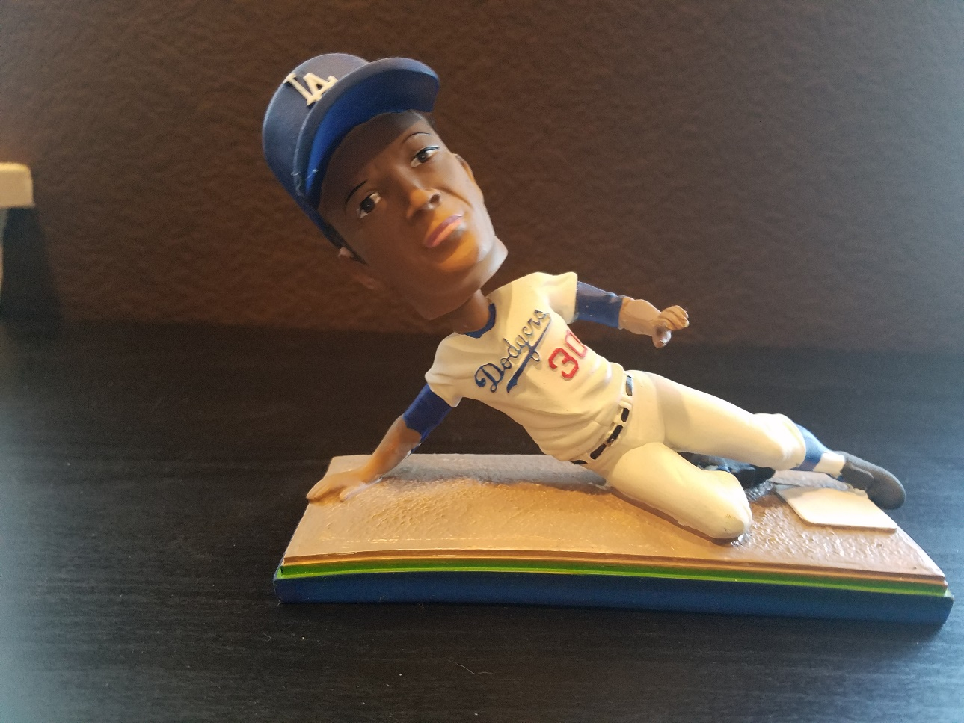
From my own personal collection (of approximately 40 bobbleheads):
Maury Wills steals his 104th base in 1962

Slide 17
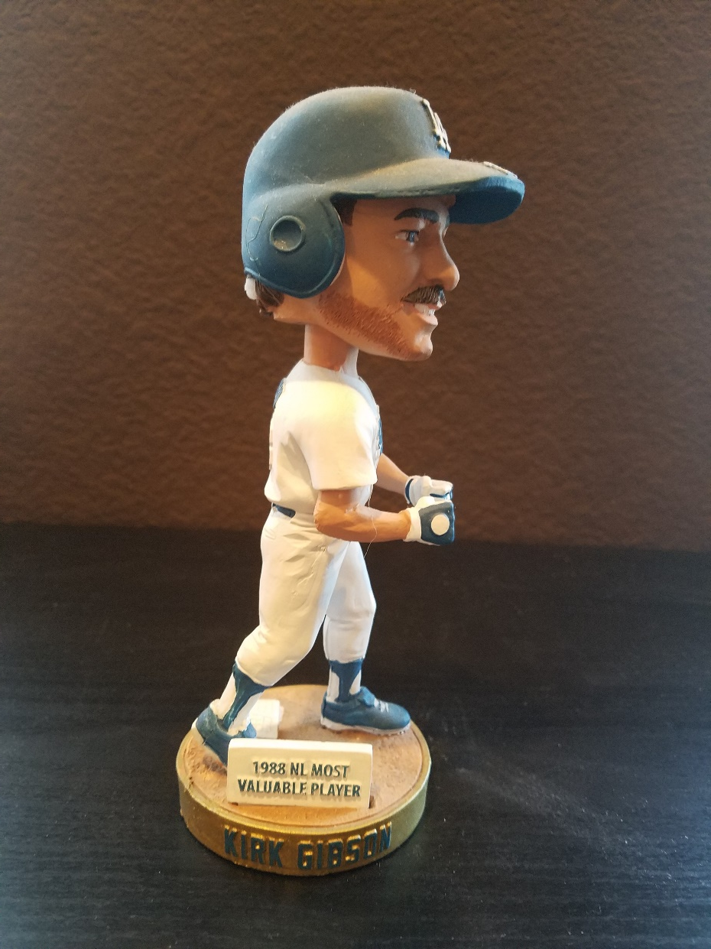
Kirk Gibson World Series HR (complete with fist pump)

Slide 18
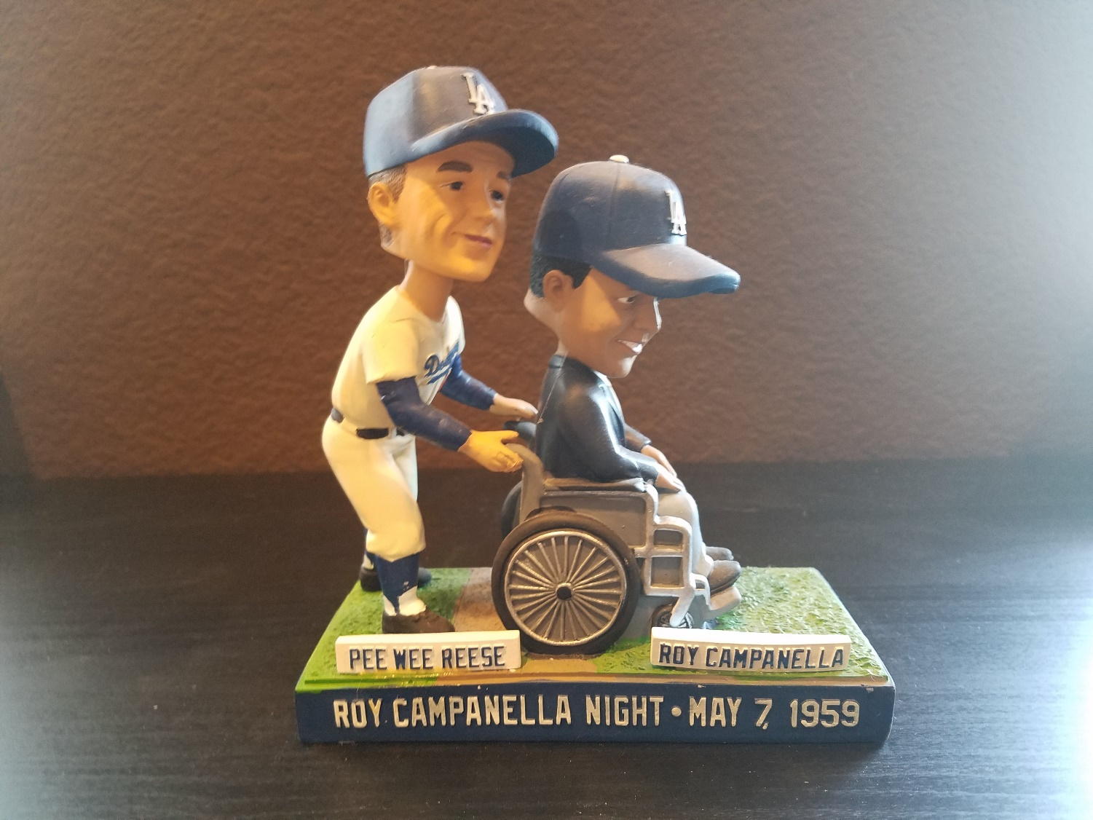
Roy Campanella Night at the L.A. Coliseum (with Pee Wee Reese)

Slide 19
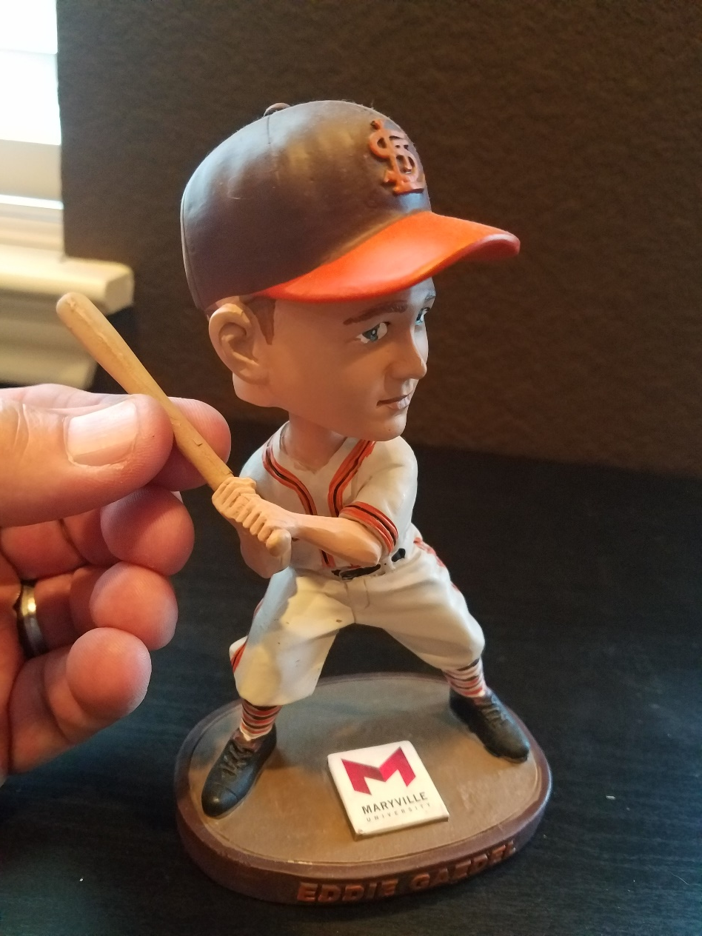
Baseball midget Eddie Gaedel (and his toy bat)

Slide 20
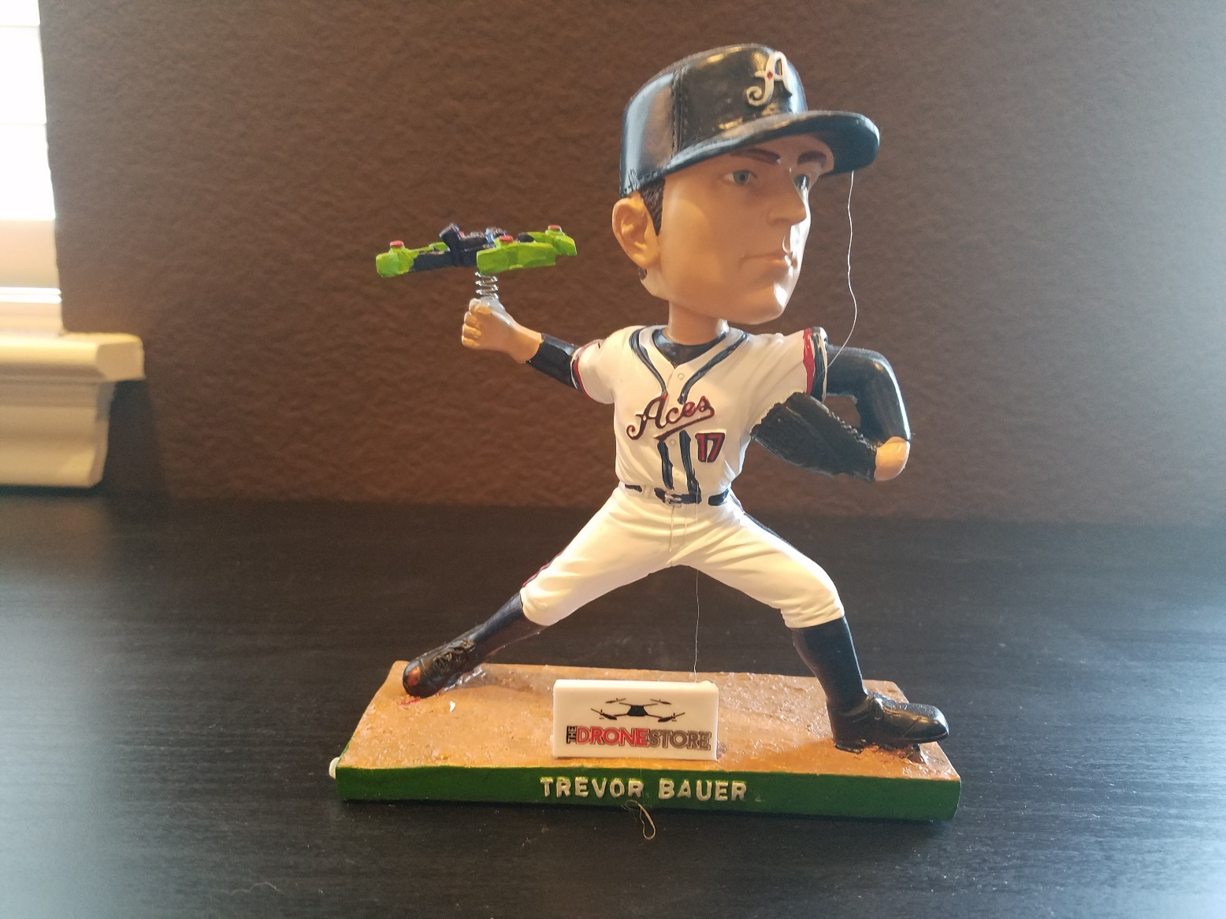
Trevor Bauer Drone Mishap (sponsored by Reno Aces, for whom Bauer never played; sent to me by a friend from Reno)

Slide 21
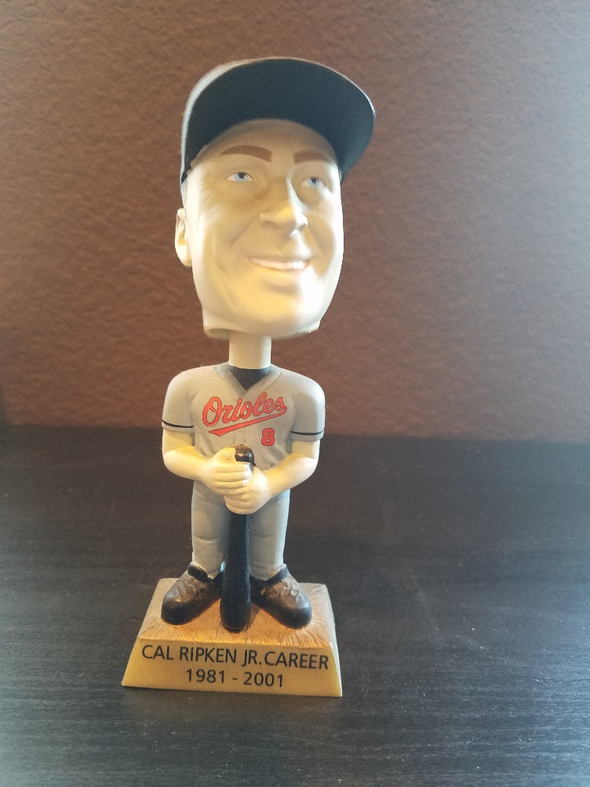
Some Other Favorites
The Iron (Or In This Case Plastic) Man

Slide 22
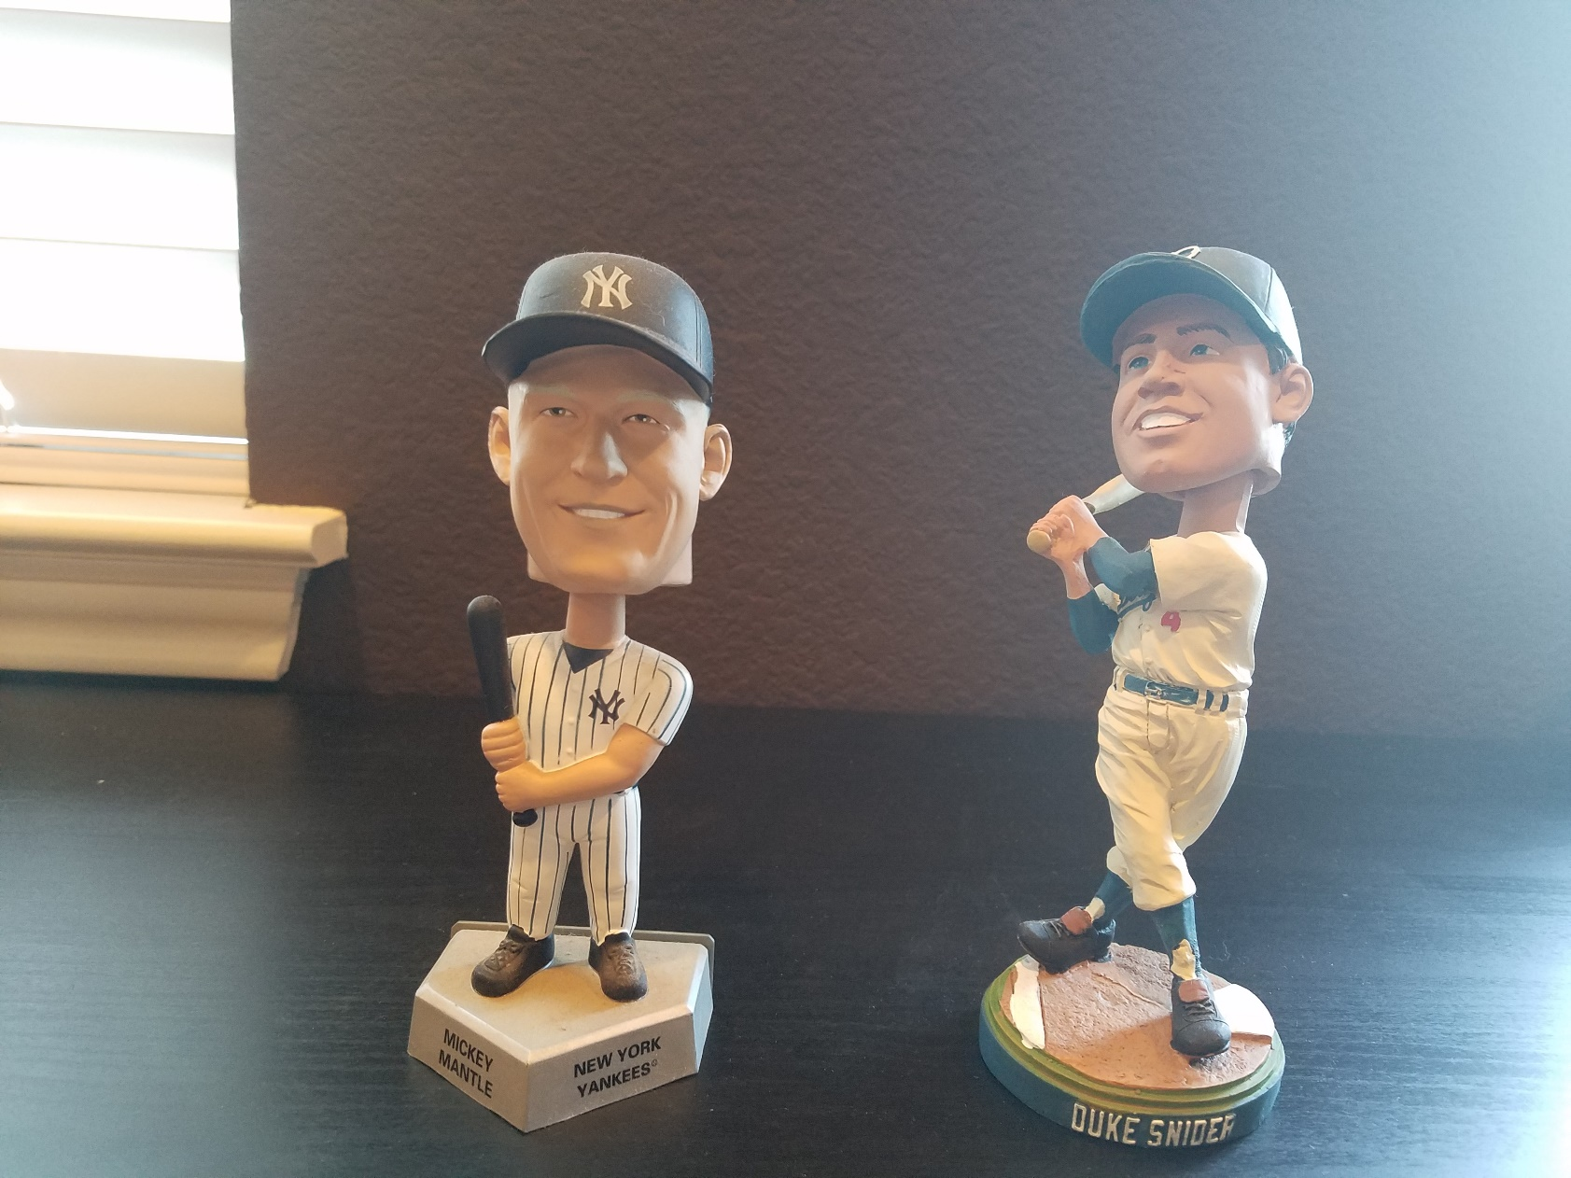
Mickey and the Duke (Still Looking for Willie)

Slide 23
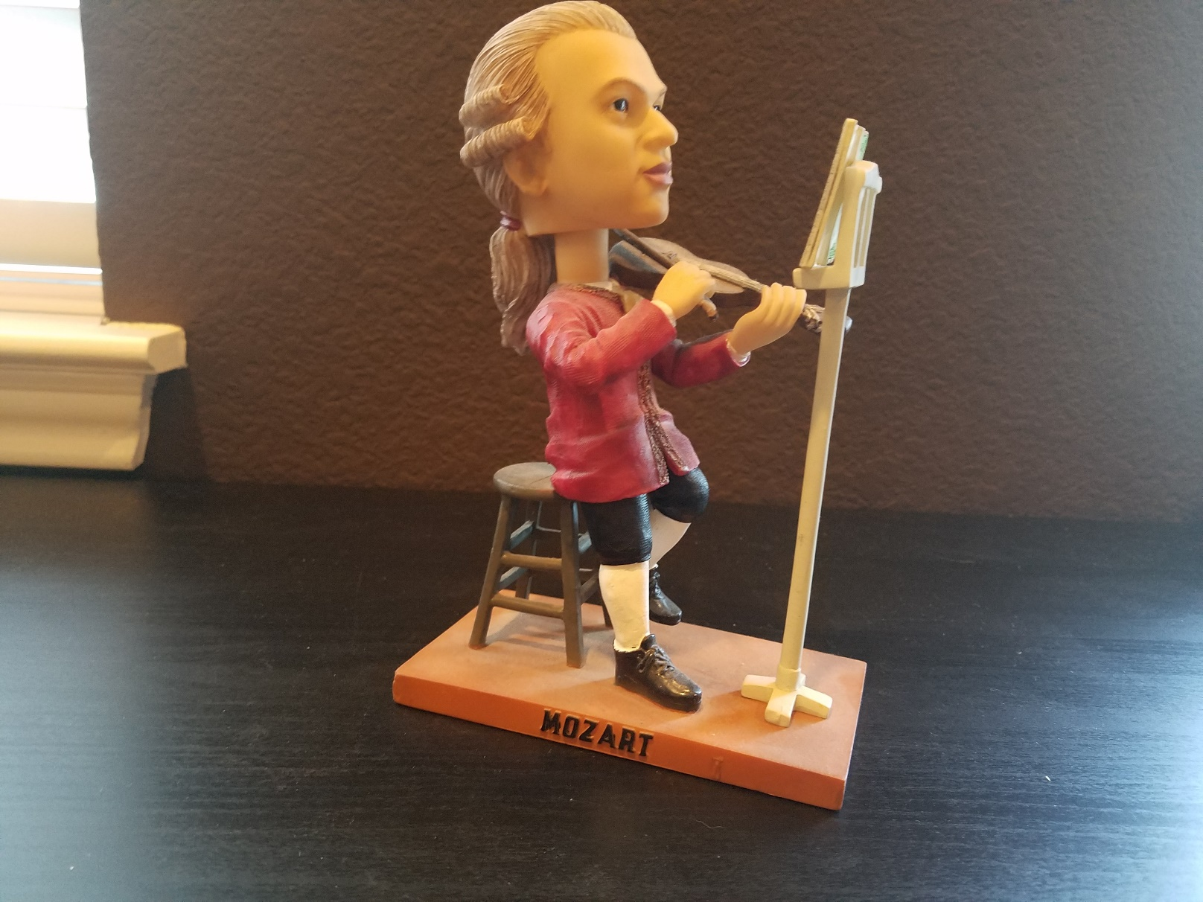
Wolfgang Amadeus Mozart (great composer, but couldn’t hit the curve ball)

Slide 24
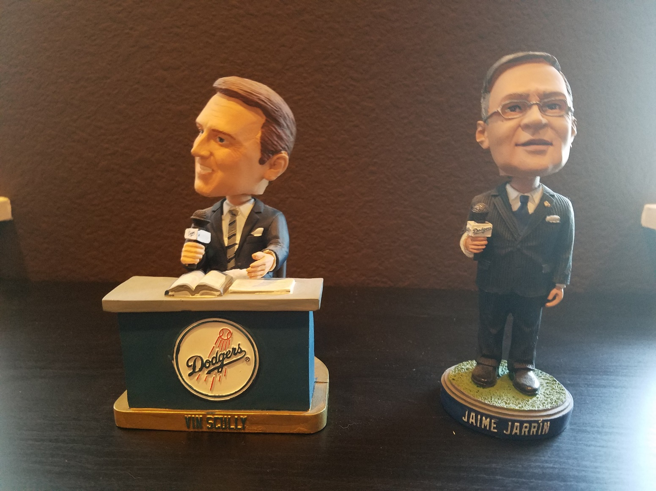
Bilingual Dodger Broadcasters (Vin Scully and Jaime Jarrin)

Slide 25
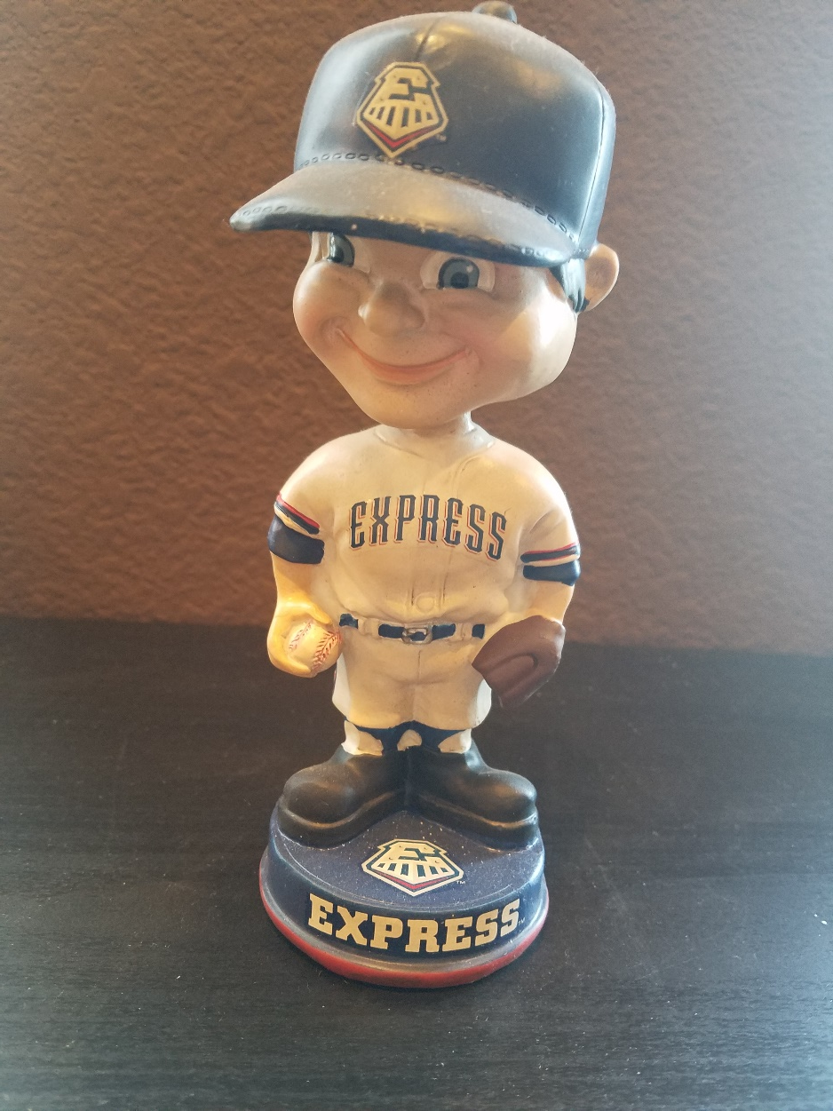
A local favorite

Slide 26
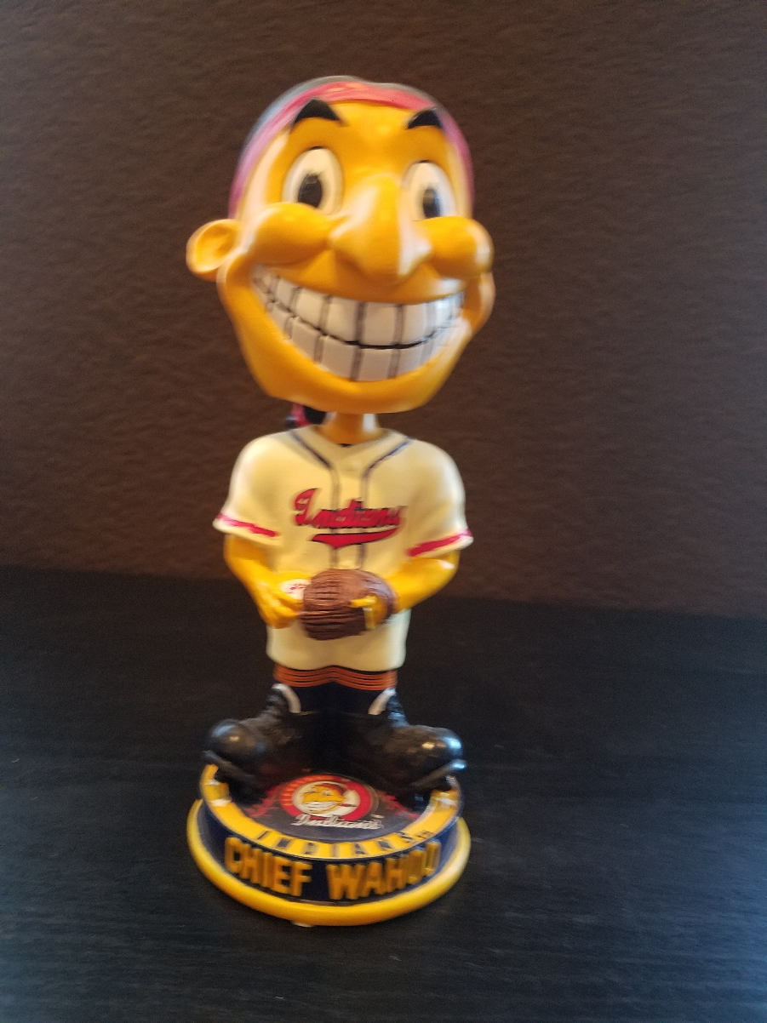
My Most Politically Incorrect Bobblehead

Slide 27
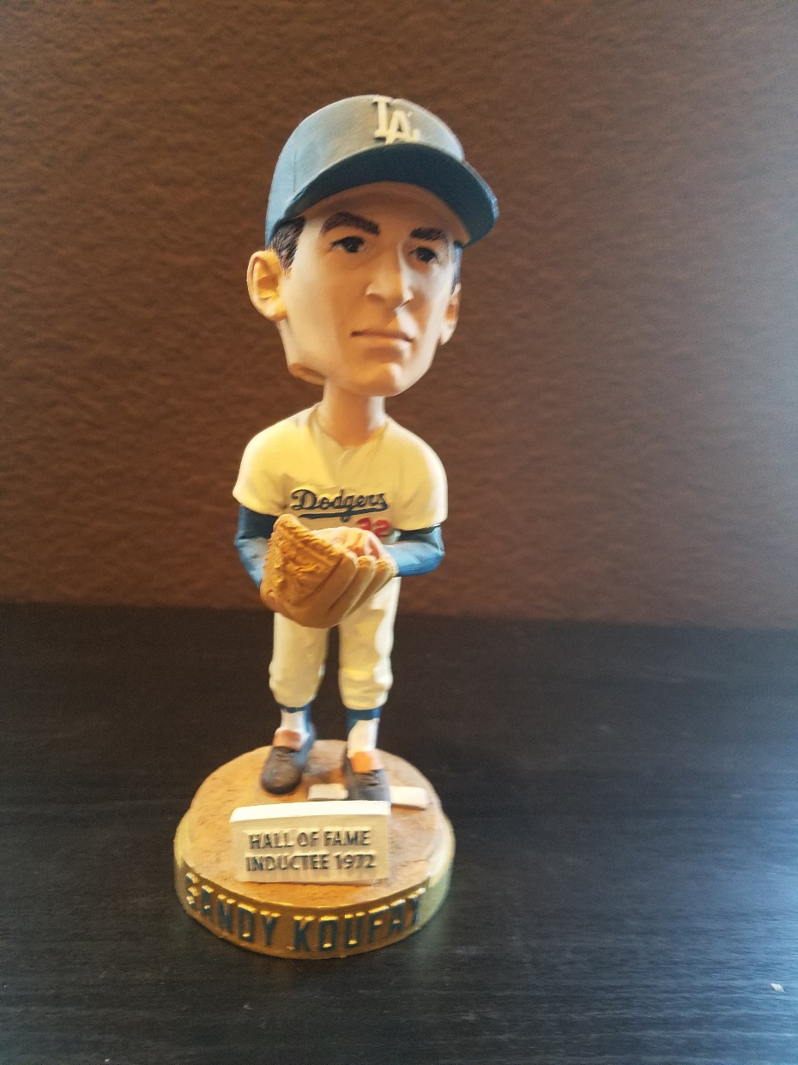
And finally, The Left Arm Of God

Slide 28
The End

