Slide 1
St. Louis Browns vs. Detroit Tigers
August 19, 1951
Sportsman’s Park, St. Louis MO

Slide 2
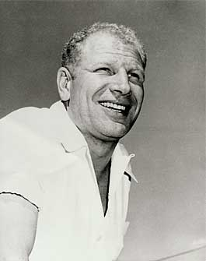
Bill Veeck
General Manager, St. Louis Browns
August 19, 1951 featured a double header between the last place Browns and the fifth place Detroit Tigers
To honor the 50th Anniversary of the American League, Veeck promised fans free Falstaff beer, ice cream and cake
18,369 fans showed up – the largest Browns home crowd in over four years (they drew 1,871 fans the day before)
They got more than beer and cake!

Slide 3
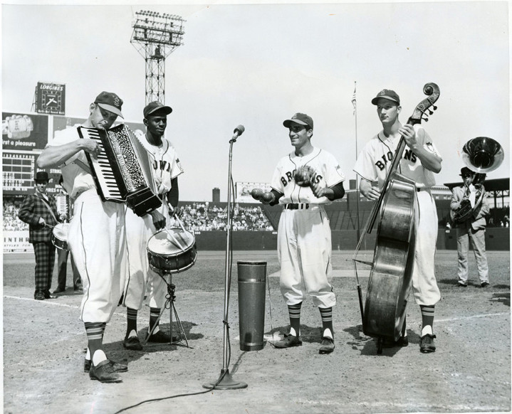
Between games, the St. Louis Browns band played – featuring Satchel Paige on drums

Slide 4
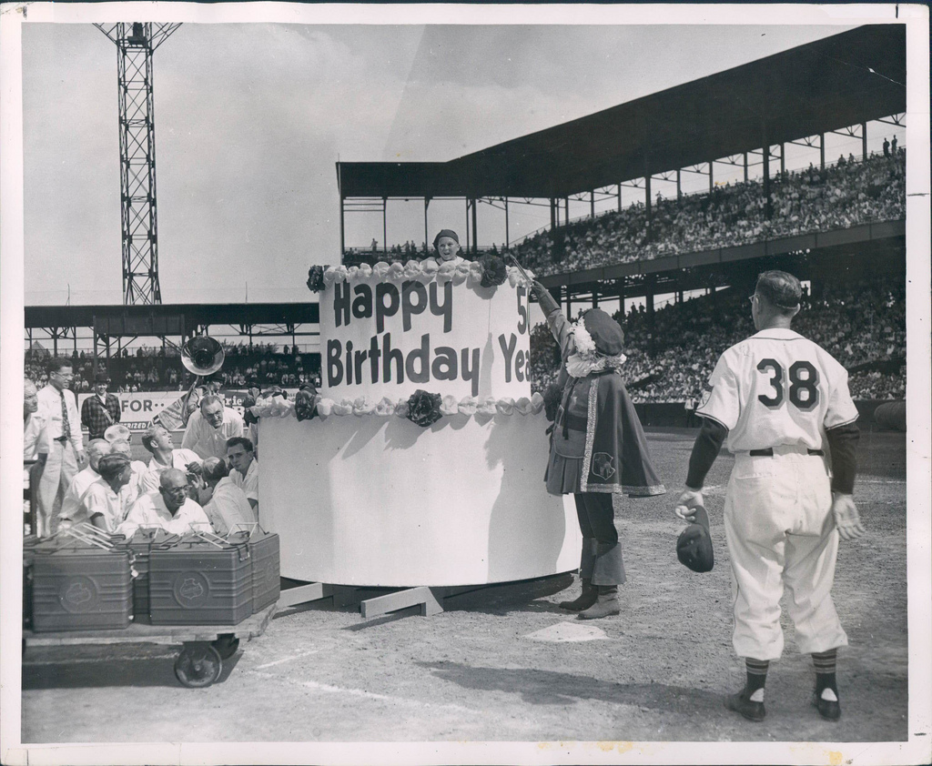
A seven foot birthday cake (honoring the 50th birthday of the American League) was pulled out on to the field
Notes:
Note figure of John Falstaff beside the cake (remember, free Falstaff beer). You can also see a head popping out of the cake.

Slide 5
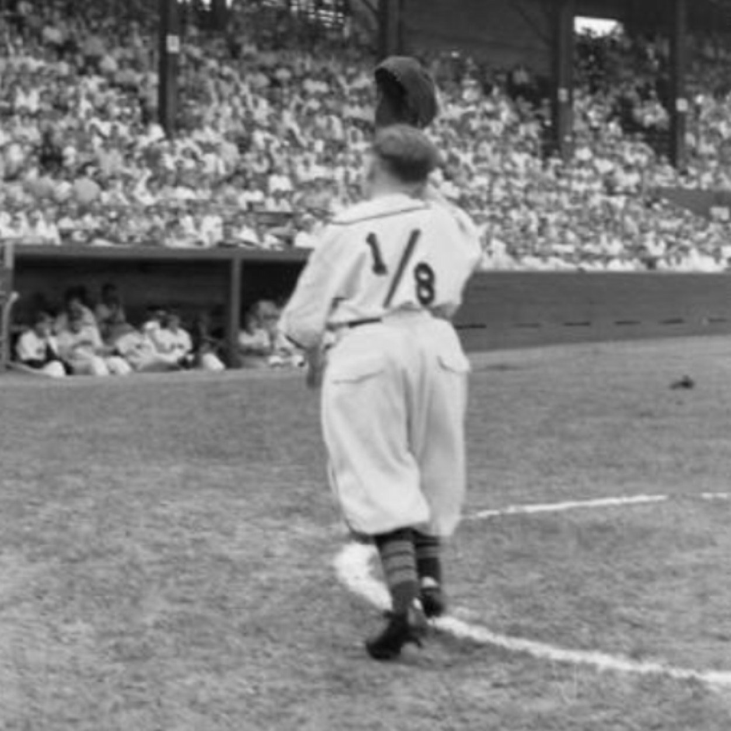
A 3’7” young man, dressed in a Browns uniform, jumped out of the cake – waved to the crowd – then ran into the dugout
Notes:
The fans thought it was the batboy

Slide 6
Browns starting lineup for Game 2 of the August 19, 1951 doubleheader
Notes:
The fans were shocked that Saucier was leading off since he was hitting only .111. The normal leadoff hitter, Jim Delsing, was available and had an average of .270.

Slide 7
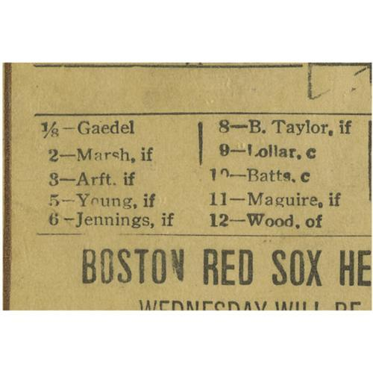
Very few people commented on the Brown’s scorecard that was distributed that day. Those that did were told it was a printing mistake.
Notes:
A copy of the program from this game recently sold for $1,100

Slide 8
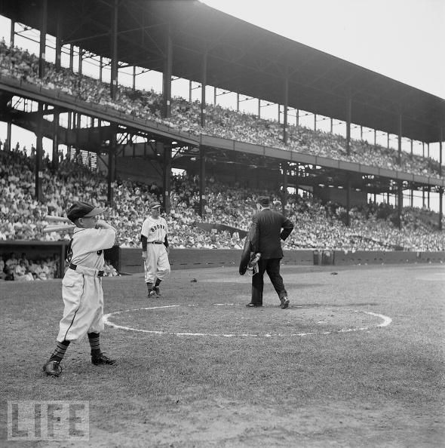
“For the Browns……. number 1/8, Eddie Gaedel batting for Saucier.”
- Stadium Announcer, Bernie Ebert
Notes:
Home plate umpire, Eddie Hurley, called out Browns manager, Zack Taylor, to find out what was going on. Taylor produced a signed contract indicating that Gaedel was truly on the team. However, league rules required that all contracts be approved by the AL President, Will Harridge. Veeck, knowing that Harridge would object – placed the signed contract in the mail on Friday afternoon – knowing that it would not reach the league office until later the following week. As expected, Harridge voided the contract the next day (Monday)! Veeck also sent a telegraph to Harridge early that Sunday morning. Unexpectedly, Harridge went to the office on Sunday, saw the telegram and immediately tried to contact Veeck. Veeck ignored his calls until after Gaedel batted.

Slide 9
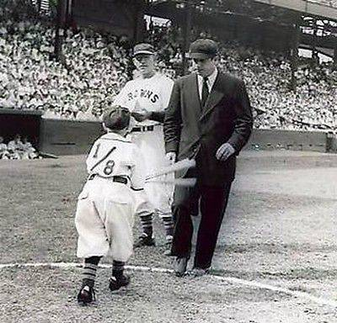
Home plate umpire, Eddie Hurley, called out Browns manager, Zack Taylor, to find out what was going on.
Notes:
Taylor produced a signed contract indicating that Gaedel was truly on the team. However, league rules required that all contracts be approved by the AL President, Will Harridge. Veeck, knowing that Harridge would object – placed the signed contract in the mail on Friday afternoon – knowing that it would not reach the league office until later the following week. As expected, Harridge voided the contract the next day (Monday)! Veeck also sent a telegraph to Harridge early that Sunday morning. Unexpectedly, Harridge went to the office on Sunday, saw the telegram and immediately tried to contact Veeck. Veeck ignored his calls until after Gaedel batted.

Slide 10
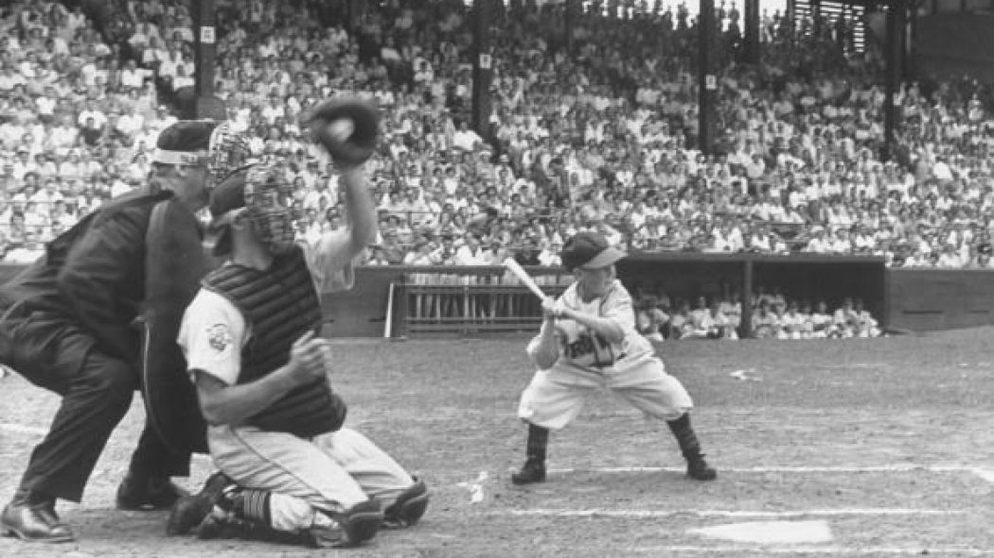
“Eddie, I'm going to be up on the roof with a high-powered rifle watching every move you make. If you so much as look as if you're going to swing, I'm going to shoot you dead.”
- Bill Veeck, “Veeck as in WrecK”
Notes:
Veeck took out a $1,000,000 life insurance policy on Gaedel to protect himself in case something went wrong. Gaedel was paid $100 for his appearance.

Slide 11
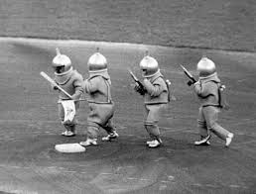
Gaedel made one more appearance on a major league field.
Comiskey Park, 1960
Notes:
In 1960, Veeck dressed up Gaedel and three other small people to portray Martians kidnapping White Sox stars Nellie Fox and Louie Aparicio. We will talk about more Bill Veeck promotions next week.

Slide 12
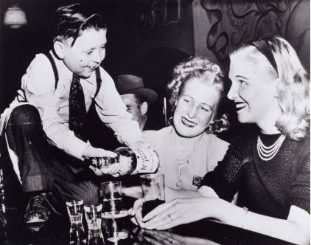
Gaedel had a hard time finding steady employment, often working as a bar tender in his Chicago neighborhoods.
Notes:
Worked as a bar tender at Chicago’s Midget Bat

Slide 13
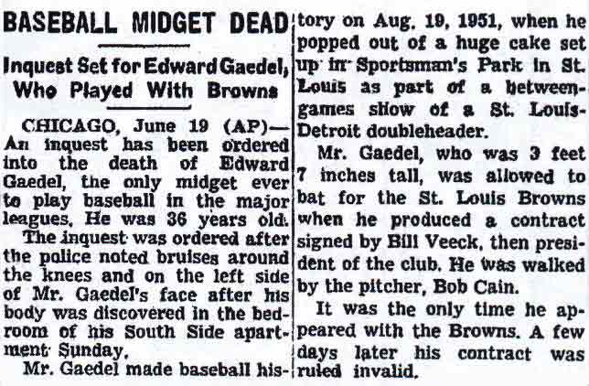
Front page of New York Times – June 20, 1961
Notes:
Gaedel spent the latter part of his life working in a bar. Tragically, as he was walking home one night after work, he was beaten and died. Bob Cain, the Tigers pitcher that eventful day, was the only representative from Major League Baseball to attend his funeral.

Slide 14
“And, now, the rest of the story!”
Memorabilia

Slide 15
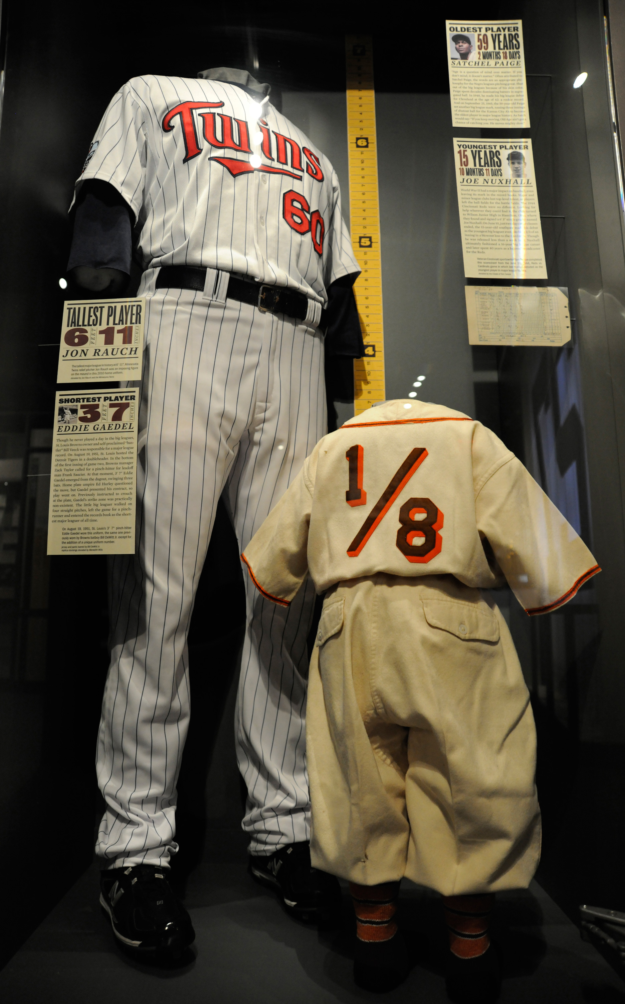
Gaedel’s appearance lives on in baseball history. His uniform is in the Baseball Hall of Fame in Cooperstown NY.
Notes:
Juxtaposed next to the uniform of 6-foot-11 pitcher Jon Rauch, the tallest player in major league history

Slide 16
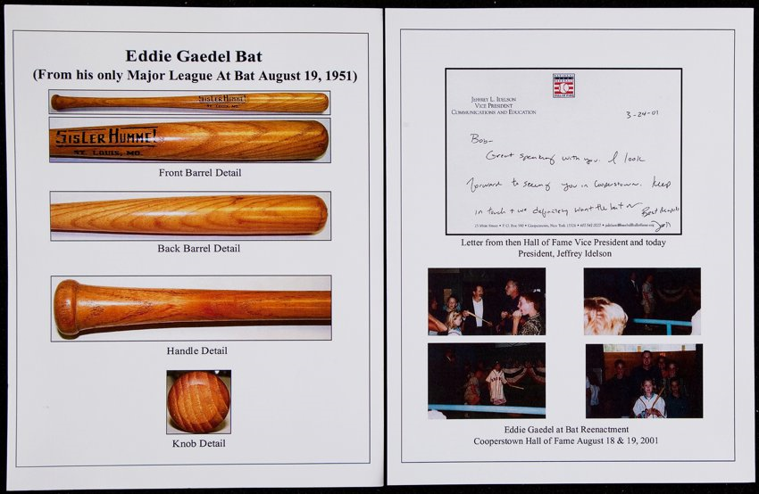
Eddie’s bat went up for auction in August 2017
Notes:
He had kept all three of the 18” bats that he swung warming up. The game used bat was given to his brother

Slide 17
Eddie’s bat sold for $45,600
Notes:
He had kept all three of the 18” bats that he swung warming up. The game used bat was given to his brother

Slide 18
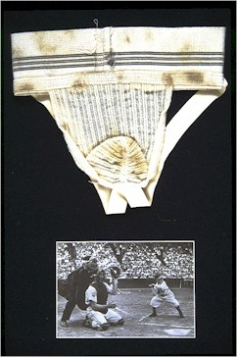
His jock strap is in the Baseball Reliquary museum in Monrovia, California.
Notes:
Along with Dock Ellis’ hair curlers and a replication of Mordecai Brown’s amputated index finger and other unique baseball memorabilia.

Slide 19

Today Gaedel's autograph is considered the most coveted rarity of all post-war Major Leaguers, with just a handful of examples surfacing in the hobby market
Notes:
A postcard photo of EG sold at auction a few years ago ( ~2009) for almost $7,000 in very , very poor condition

Slide 20
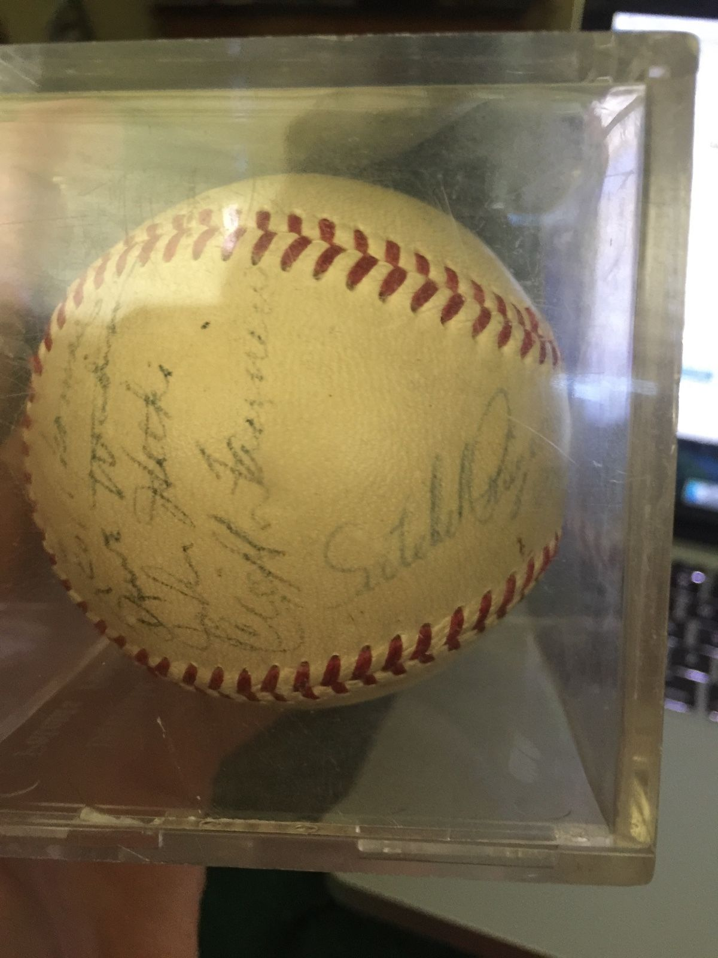
1952 St. Louis Browns team ball currently listed on eBay for $1,900 (it includes signatures of HOFers Rogers Hornsby and Satchell Paige)

Slide 21
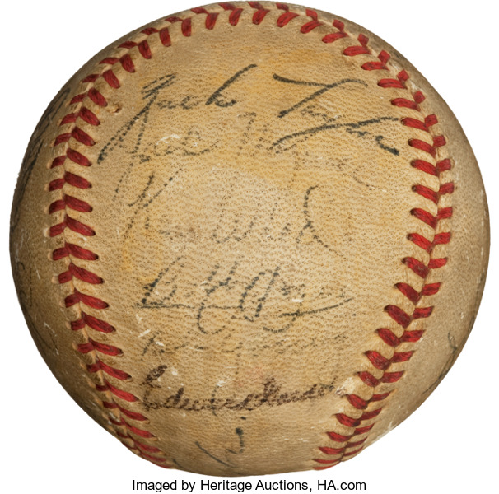
St. Louis Browns team ball sold for $11,900 with Gaedel autograph (bottom)

Slide 22

Eddie Gaedel Society in Spokane Washington
Notes:
An Eddie Gaedel Society was formed to keep Eddie’s memory alive. The President of the Society, Mr. Tom Keefe, was kind enough to send you some mementos from previous meetings of his group.

