Slide 1
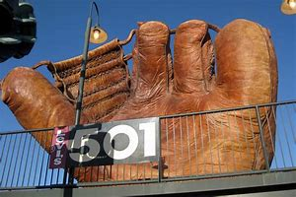
Evolution of the Glove
The “Giant
Old Time
Four-
Fingered
Baseball
Glove”
at
AT&T Park in
San Francisco
Notes:
Is a 36:1 scale model of a four-fingered glove.

Slide 2
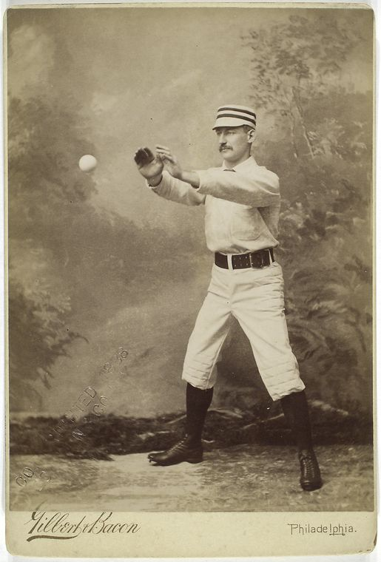
In the Beginning - there were no gloves
Baseball evolved in the early 1800s from Rounders and Cricket
Cricket players began wearing thin India rubber gloves mid-century, but adoption in base ball was slower
Early base ball players considered the use of a glove “un-manly”

Slide 3
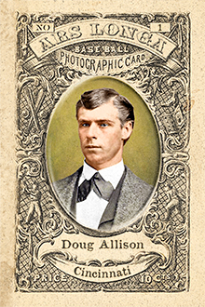
Early Adopters - 1870s
Cincinnati Red Stockings catcher Doug Allison used buckskin mittens on June 28, 1870 due to an injury to his left hand. This was first recorded use of a glove in a professional game.
St. Louis Brown Stockings OF/1B Charlie Waitt was first confirmed major league non-catcher to use a glove in 1875.
When Albert Spalding moved from P to 1B in 1877, he popularized use of gloves at that position.
“Gloves” in this era were usually leather cold/snow gloves with the fingertips cut out

Slide 4
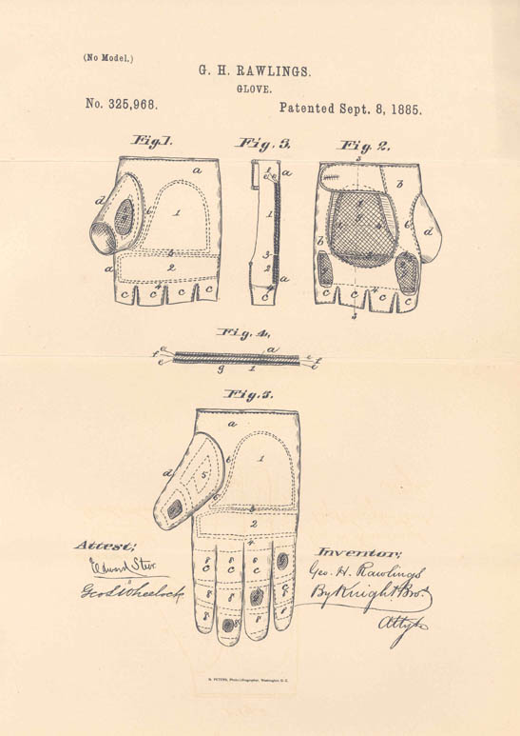
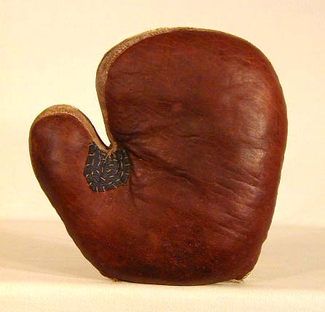
Gradual Acceptance 1880s – 1890s
Catchers and first baseman wore gloves to protect their hands
Gloves could be worn on both hands – a finger-less glove on throwing hand and larger glove on catching hand
By the mid-1890s it was common for all fielders to wear gloves
Rawlings glove patent
Spalding catcher’s mitt

Slide 5
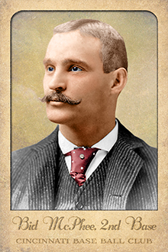
1896
Future Hall of Fame 2B John Alexander “Bid” McPhee was the last holdout refusing to use a glove
He was quoted as saying “This glove business has gone too far… those hot-hit balls may sting a bit early in the season … but you get used to it … “
However, late in his career (1896) he began using a glove and his fielding average jumped from .955 to .978

Slide 6
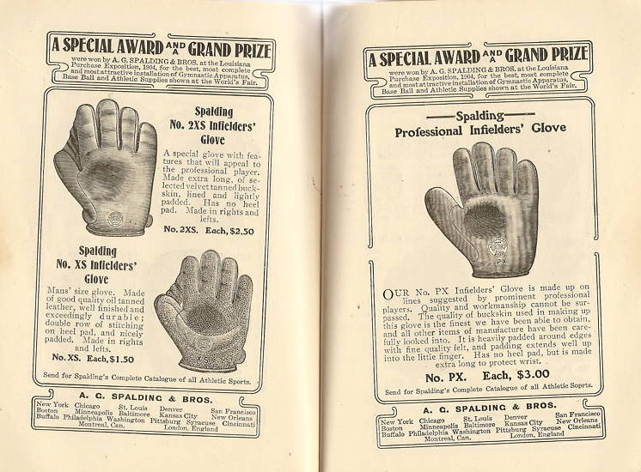
Gradual Improvements 1900s – 1910s
Gloves, along with other baseball equipment, became a manufacturing business.
Some of the brands still exist today – such as Spalding and Rawlings.
Gloves gradually became larger and with more padding
Spalding catalog – 1905
“Won a special award and grand prize at the 1904 Louisiana Purchase Exposition (aka the St. Louis Worlds Fair)”

Slide 7
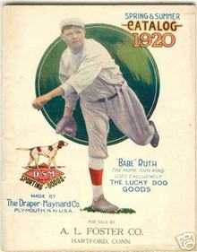
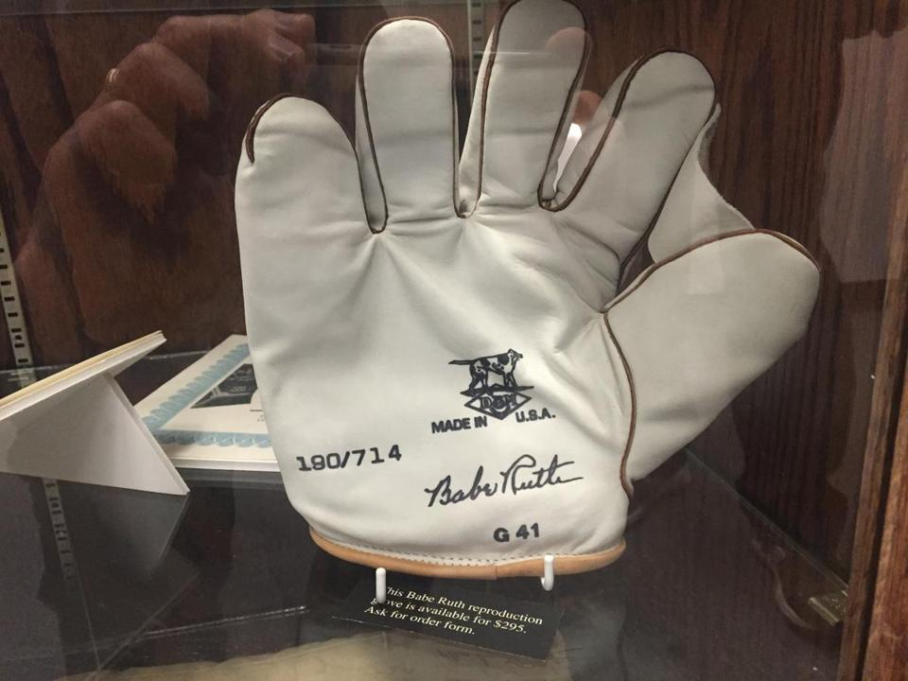
1919
Babe Ruth was one of the first prominent endorsers of baseball gloves.
Early in his career he used a white suede glove made by Draper & Maynard of Plymouth, NH.

Slide 8
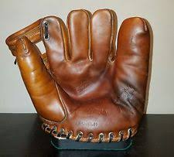
1920s
Pitcher Bill Doak approached Rawlings with the idea for a “web” and deeper pocket in the glove.
The Rawlings Bill Doak “Model H” glove was a major design improvement.
It was manufactured, almost unchanged, from 1922 to 1953.
This was the forefather of all modern fielder’s gloves

Slide 9
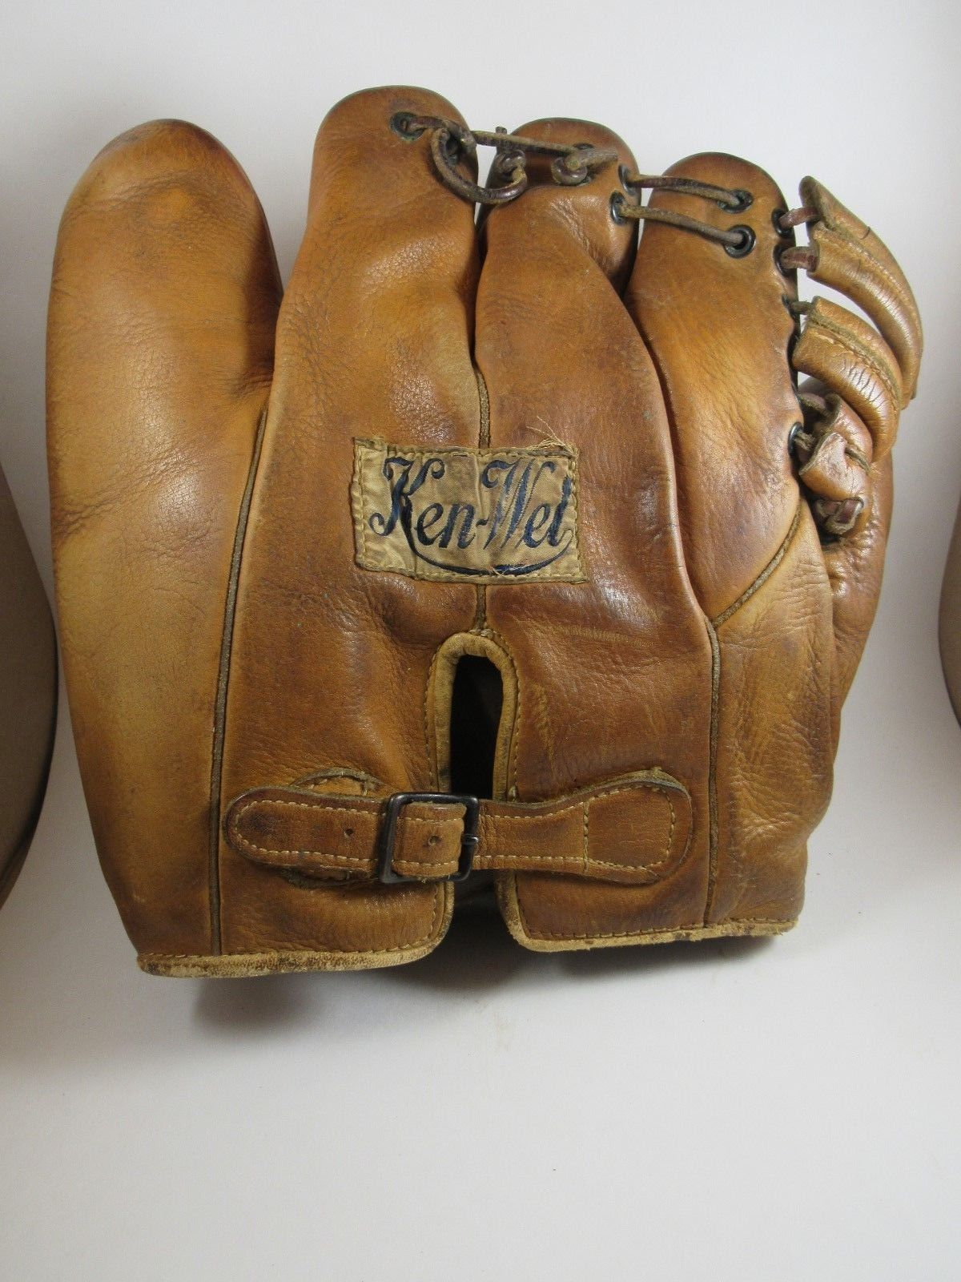
1930s
The Ken-Wel company introduced the “Dazzy Vance” model in the early 1930s
This was the first widely-produced glove with the fingers laced together. (note that the pinky finger was still not laced)
Most players still preferred non-laced gloves, feeling that they conformed better to the human hand
Finger-laced gloves were not widely accepted until the 1940s

Slide 10
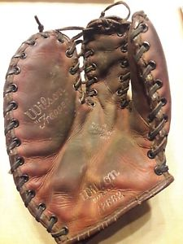
1940s
In 1940, Rawlings glove designer Harry Latina developed the “Trapper” first baseman’s mitt.
The design was so successful that Rawlings licensed it to other glove manufacturers prior to the patent expiring.
It was also marketed as “The Claw”
Former President George H.W. Bush used this model glove as a first baseman at Yale University - 1946-48. He later kept the glove in the top drawer of his Oval Office desk at the White House.

Slide 11
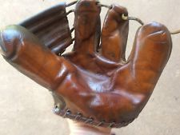
1940s
Rawlings “Playmaker” glove
This glove was a big seller after World War II. It was very popular for the youth market.
Price range - $2.45 - $9.95
The most popular model was endorsed by Stan Musial, there were other “player endorsed” models including a Mort Cooper from the 1940s and Eddie Mathews and Duke Snider models in the ‘50s
Also commonly referred to as the “three finger” glove

Slide 12
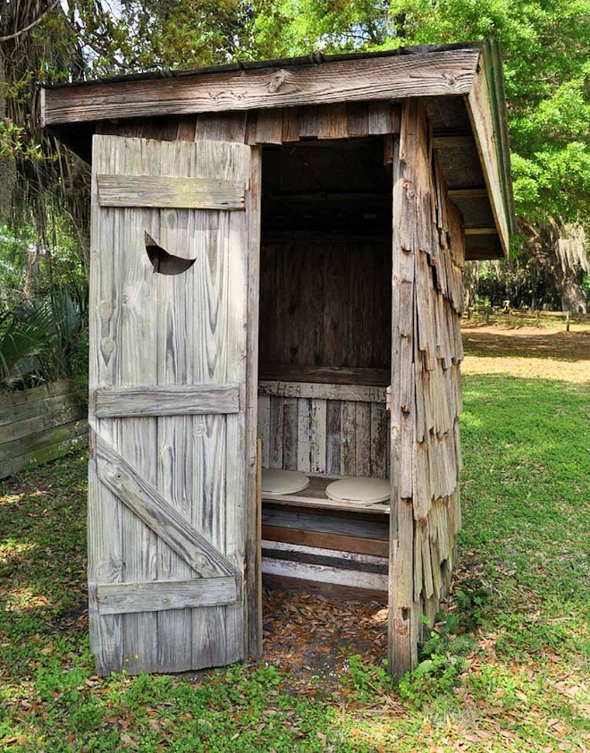
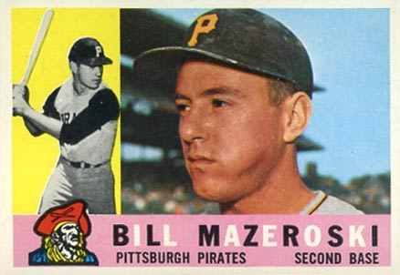
Earning Money to Buy Your Glove
Hall of Fame 2B Bill Mazeroski’s first glove was a Rawlings Playmaker. He dug an outhouse for his uncle to earn the money to buy it.
How did you earn money for your baseball gear ?

Slide 13
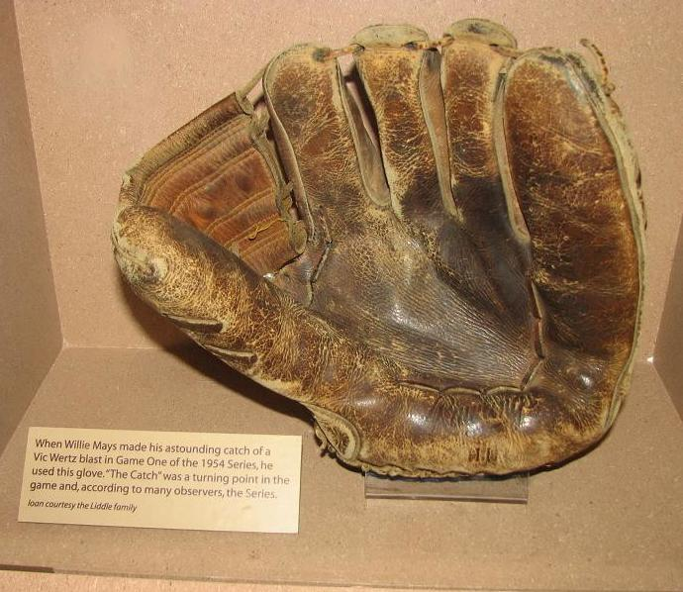
1950s
The Most Famous Glove in Baseball History?
This is the glove that made “The Catch” in the 1954 World Series
Watch:
https://www.mlb.com/video/bb-moments-willie-mays-catch/c-3218956
The batted ball was estimated to have traveled 425 feet – over the fence in any ballpark today

Slide 14
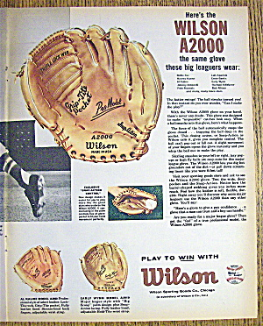
1950s
The Wilson A2000 model was introduced in 1957. It was a significant change in design with a bigger web, longer thumb, the “Snap Action” hinge, and better distribution of the padding inside.
Wilson’s designers said they decided to “stop making a glove that looked like a hand” and instead improve “catch-ability”
The A2000 became the pattern for every glove designed since.
The A2000 is still made and sold today!

Slide 15
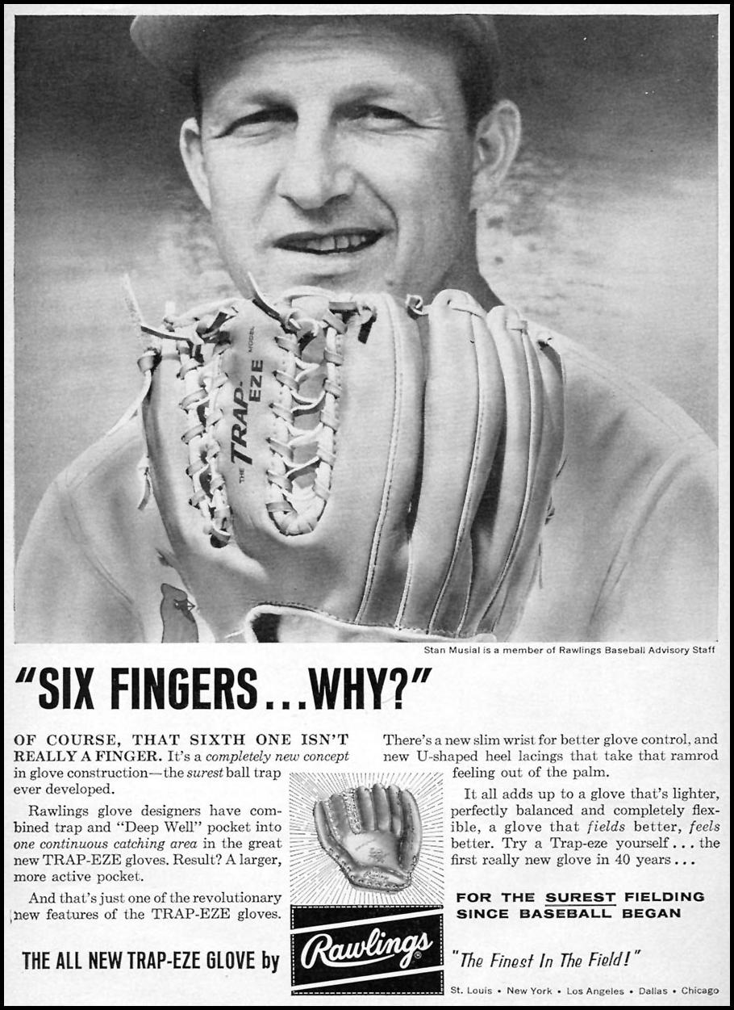
1950s – 1960s
The “Six-finger” Trap-Eze glove was invented in 1959 for Stan Musial so that he could use the same glove playing outfield or first base.
Ken Boyer was also a star that used this style of glove.
Ozzie Smith preferred the Trap-Eze glove and ordered a dozen per year from Rawlings.

Slide 16
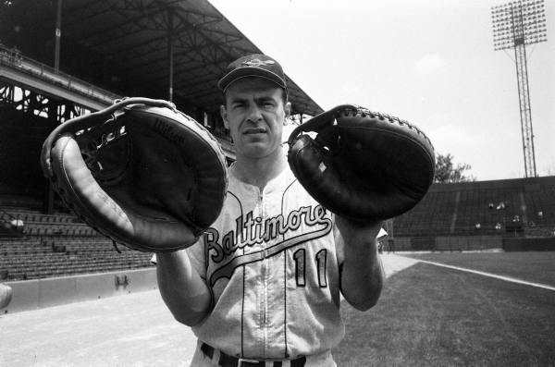
A bigger tool of ignorance
In 1959, Orioles manager Paul Richards developed the oversized catcher’s mitt to try to help his catchers handle Hoyt Wilhelm’s knuckleball.
However, using the huge mitt caused as many problems as it solved. Orioles catchers Gus Triandos and Joe Ginsburg (pictured) both allowed three passed balls in an inning in games a week apart.
The “Big Bertha” mitt grew to as much as 45 inches in circumference before being regulated to a max of 38 inches in 1965.

Slide 17
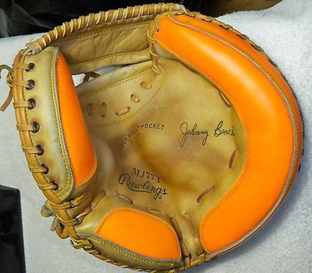
A brighter tool of ignorance
In 1975, former Dodgers’ executive Al Campanis introduced the fluorescent “target mitt”.
It was supposed to help pitchers concentrate better on the catcher’s setup target.
It was a success and was used for many years. Campanis was issued a patent for this glove design.

Slide 18
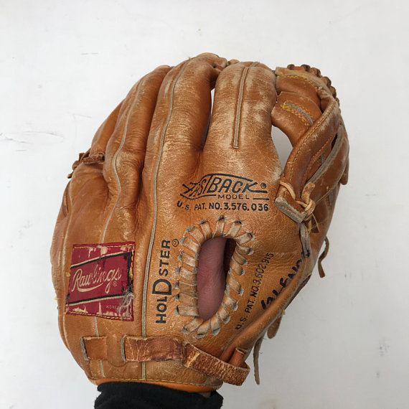
1970s – 1980s
Rawlings “Fastback” with “HolDster” design.
This was introduced in 1971 and Rawlings held patents protecting the design for 17 years.

Slide 19
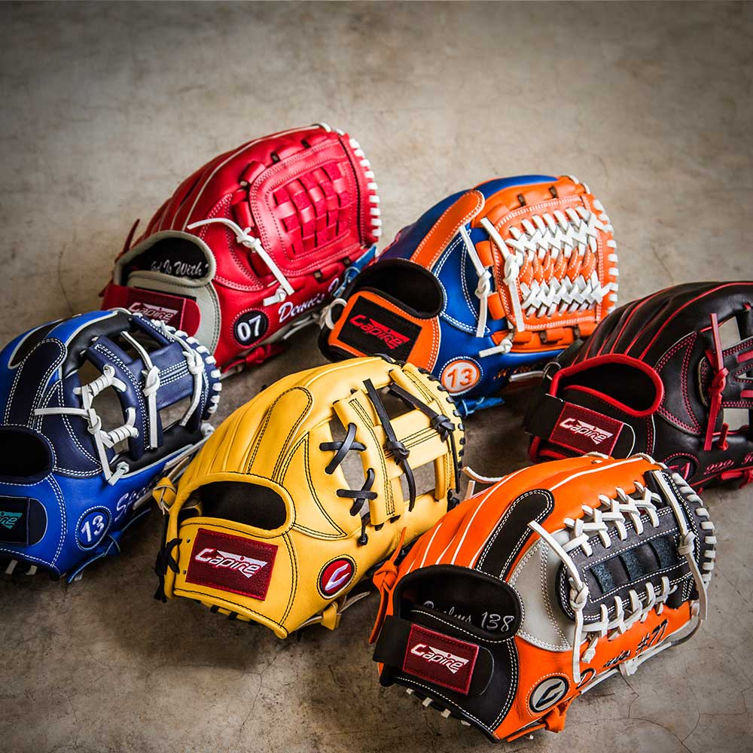
Today
The maximum sizes of gloves are regulated by MLB Rules – Section 3, Equipment & Uniforms:
Catcher’s mitt – 38” in circumference,
15 ½” top-to-bottom
First baseman’s mitt – 13” by 8”
Fielder’s gloves – 13” by 7 ¾”
Pitcher’s gloves – may not be white or grey
Gloves are highly customized by position and player’s tastes.
Anyone buying a glove today can customize it to meet their wishes as to size, color, cost, feel, position played, etc.

Slide 20
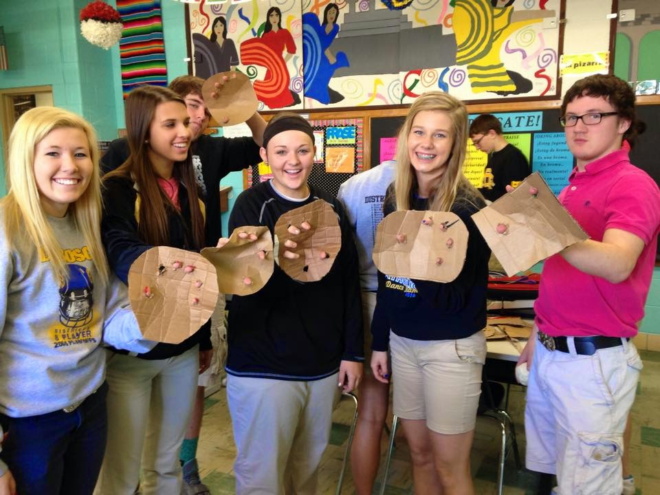
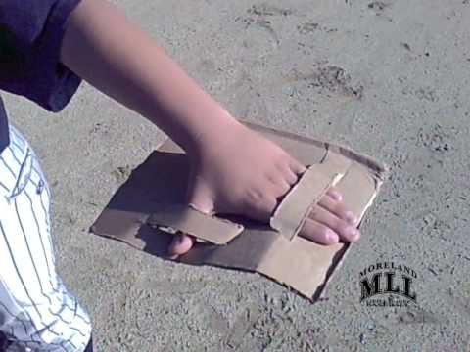
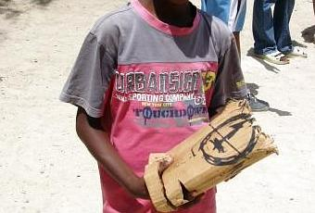
Today
Kids in some parts of the world cannot afford a leather baseball glove. So, they improvise with cardboard, milk cartons, or plastic jugs.
Future HOF closer Mariano Rivera shows us how:
http://thefw.com/mariano-rivera-cardboard-baseball-glove-video/

Slide 21
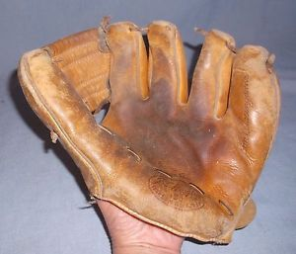
Glove stories
--
hi-jinks,
anecdotes,
and quotes
A 1958 J.C. Higgins “Don Blasingame” model glove

Slide 22
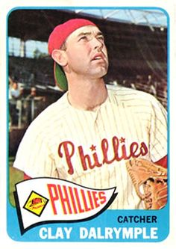
You can only use one glove
at a time !
As a backup catcher for the Orioles late in his career (1969), Dalrymple had an oversized pocket sewn onto the back of his game pants. He attempted to play with a fielder’s glove in that pocket, which he intended to use for any throws to the plate.
The umpires noticed this and called manager Earl Weaver onto the field for a conference. They asked that Dalrymple not use the extra glove until they could consult with the league office. The AL office then ruled against the veteran catcher.

Slide 23
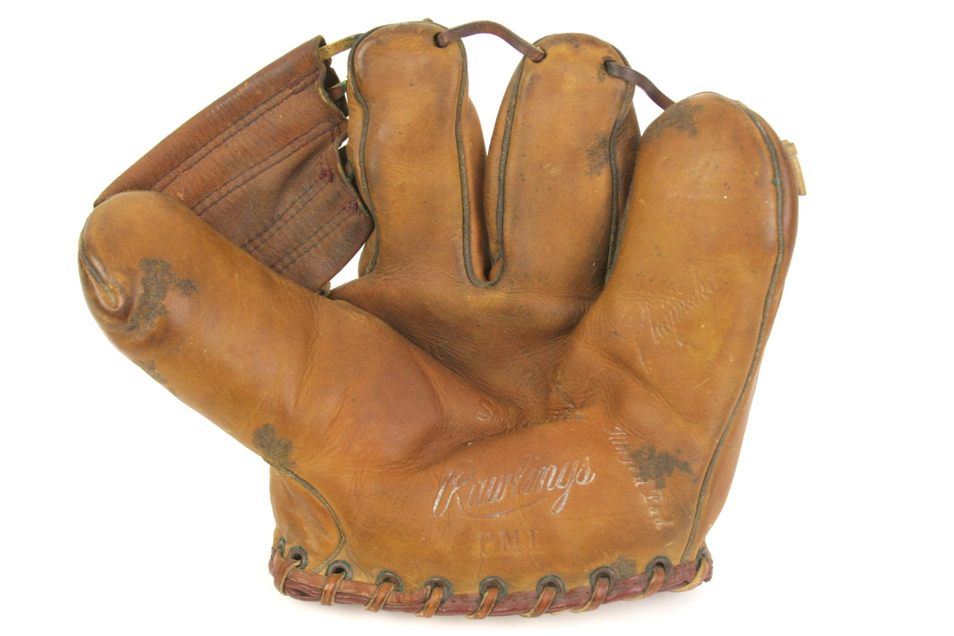
He could play the harmonica
A limited number of Stan Musial-endorsed 1949 Rawlings Playmaker gloves had The Man’s
stenciled autograph misspelled as:
Stan Musical

Slide 24
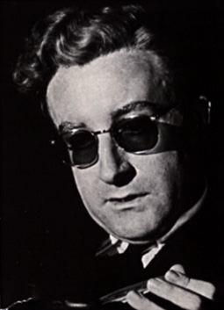
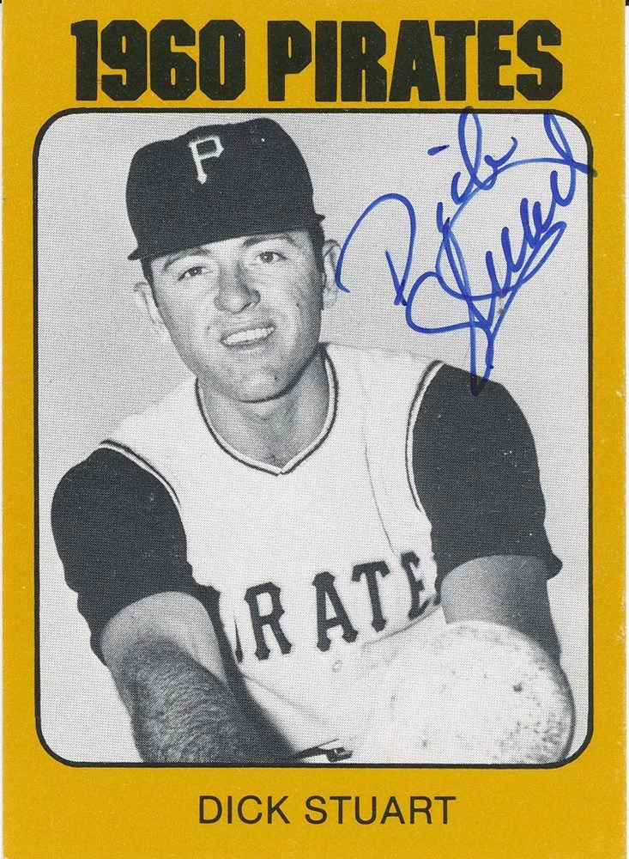
What’s in a name ?
Dick Stuart played 1B on the 1960 Pittsburgh Pirates World Series champs
In a 10-year career he hit 228 homers and led the league in RBI in 1963.
He was not a good fielder.
Peter Sellers as “Dr. Strangelove”
Dick Stuart →
as “Dr. StrangeGlove”

Slide 25
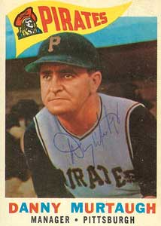
His Manager Should Know!
Danny Murtaugh was manager of the Pirates in the late ‘50s through the ‘60s.
He was Dr. StrangeGlove’s manager on the 1960 Pirates World Series winner.
When a fan once told him that he’d seen Dick Stuart’s bronzed glove at Cooperstown, Murtaugh replied,
“It was bronzed while he was using it !”

Slide 26
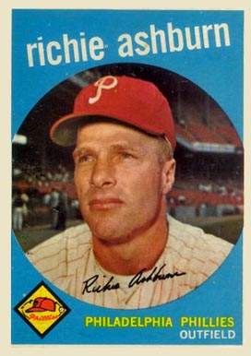
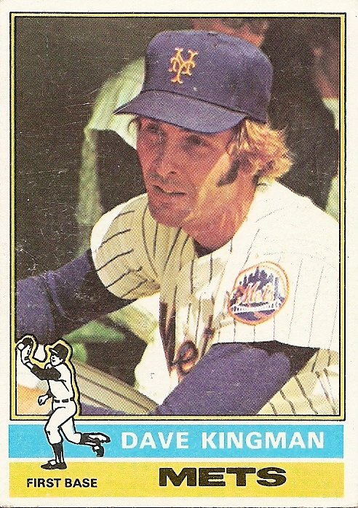
An Iron Glove ?
After his Hall-of-Fame playing career as the Phillies’ CF, Richie Ashburn turned to broadcasting.
He was known for his dry wit.
Dave “King Kong” Kingman was a power hitter not known for his fielding. In 1974, after committing 12 errors in 59 chances at 3B, the Giants sold him to the Mets.
One day, observing a club house attendant repairing Kingman’s glove, Ashburn commented:
“They should have called a welder.”

Slide 27
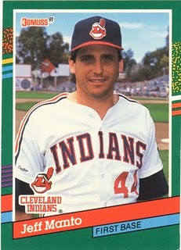
Need a glove ?
Journeyman ballplayer Jeff Manto played parts of 9 seasons in the majors.
He could play any position, and he had 13 gloves in his locker: two catcher’s mitts, two first-baseman’s mitts, big out field gloves, and small infielders gloves.
He took all 13 gloves with him on road trips. When a reporter asked him about his gloves, he said:
“The guys call me ‘The Store’, but the clubhouse man and equipment manager hate me.”

Slide 28
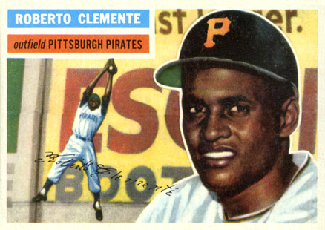
Doesn’t anybody want this glove?
Bill Mazeroski was known for using a glove until it was literally falling apart.
One day at Forbes Field, teammate Roberto Clemente grabbed Maz’s well-worn glove and threw it to some kids in the stands.
The kids threw it back.
At the end of a another season, Maz lost track of one of his gloves. Clemente showed up with it at spring training the following year. When asked what happened, Clemente said he tried to give it away but …
even the poor kids in Nicaragua didn’t want it!

Slide 29
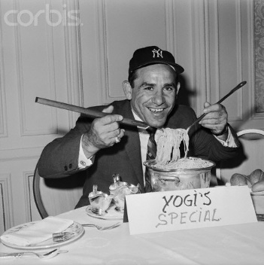
They didn’t play baseball in the old country
Yogi Berra tells this story about his childhood growing up on “The Hill” – the Italian neighborhood in St. Louis:
“My pop was from the Old World and he didn’t understand about sports. When I was 11 or 12, he asked me what I wanted for Christmas. I told him I wanted a soccer ball, sneakers, and a baseball glove. He said ‘Well, which one?’, so I told him I wanted the baseball glove most of all.
“When Christmas finally arrived, I got a new pair of trousers.”

Slide 30
Evolution of the Glove
Remember!
You can’t spell
G-L-O-V-E
without
LOVE !!

