Slide 1
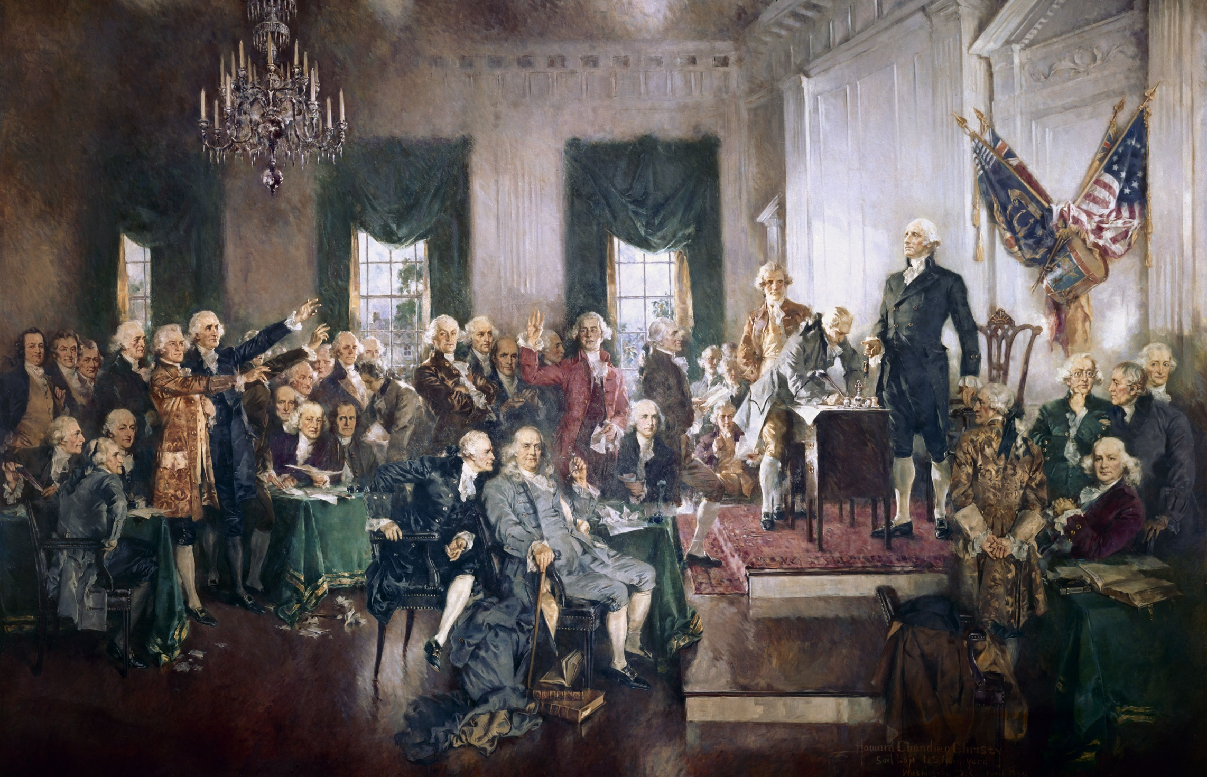
Founding Fathers Baseball Team

Slide 2
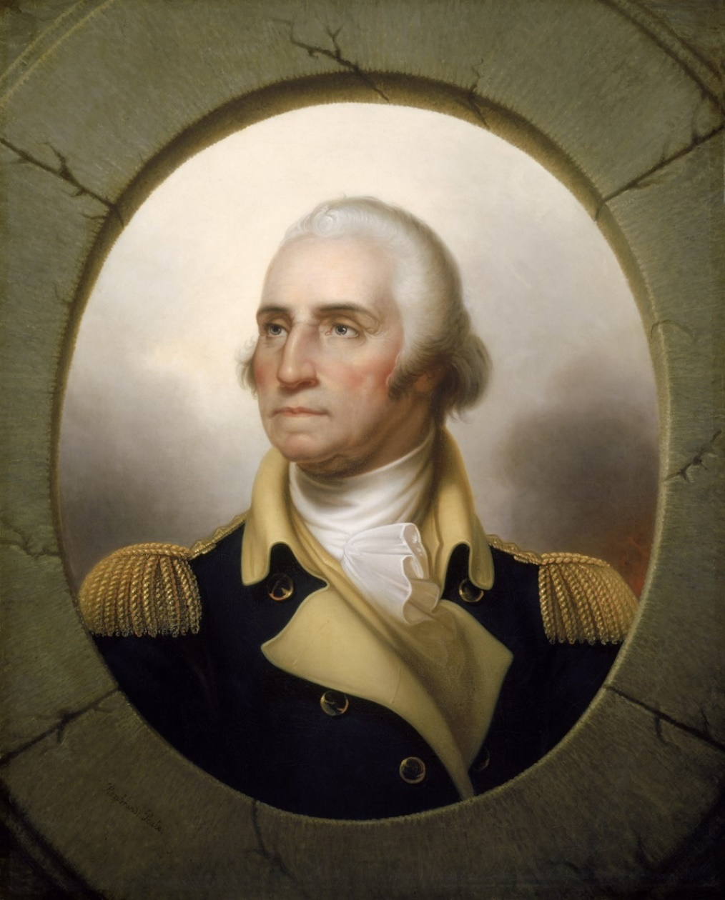
First Father
Team Manager
He was Commander-in-Chief of Continental Army, chair of the Constitutional Convention, and 1st President
He managed the Texas Rangers for 8 seasons
His teams won 664 games, two AL pennants, and were within one out of winning the 2011 World Series
George Washington
Ron Washington

Slide 3
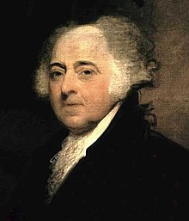
Second Father A solid pitcher
He co-authored Declaration of Independence; was U.S. minister to France, Holland, and England; was our first Vice-President
Pitched for nineteen seasons, 1909-1926; all but one with Pittsburgh Pirates
Won 194 games in the majors; won three games in the 1909 World Series
John Adams
Babe Adams

Slide 4
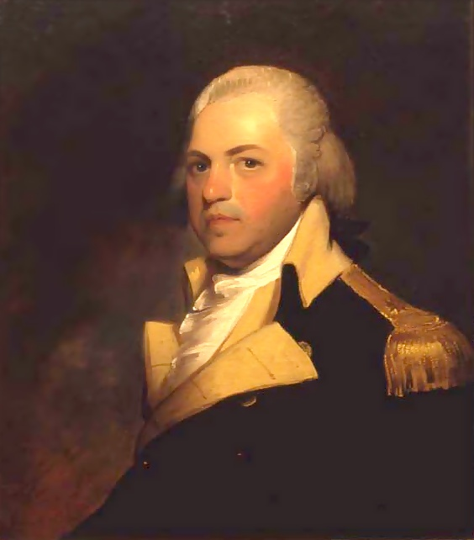
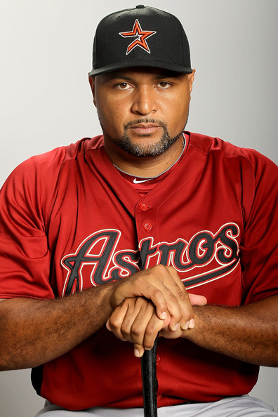
Cavalry Officer Slugging Outfielder
Revolutionary general known as “Light Horse Harry”; at Washington’s funeral, he eulogized the 1st President as “first in war, first in peace, and first in the hearts of his countrymen”
Played 16 years in the majors, hit 358 HR and was a 3-time All Star
Played for the Astros 2007-2012
His nickname was “El Caballo”
Henry Lee III
Carlos Lee

Slide 5
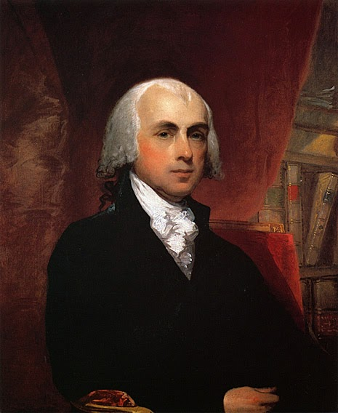
Father of the Constitution Powerful Pitcher
Wrote primary drafts of U.S. Constitution and championed the Bill of Rights. Was Secty.of State before becoming Fourth President
Has won 104 major league games plus four World Series games.
Is a four-time All Star
Is known as a good hitter with power
He is still an active player
James Madison
Madison Bumgarner

Slide 6
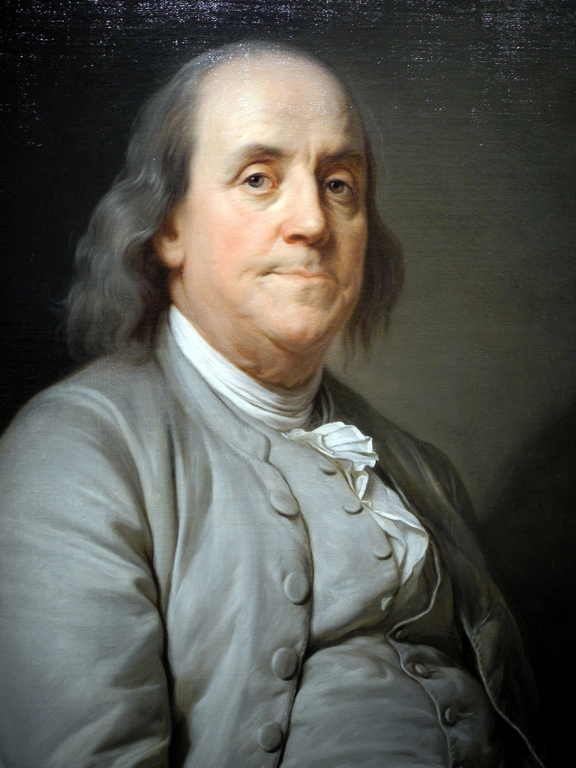
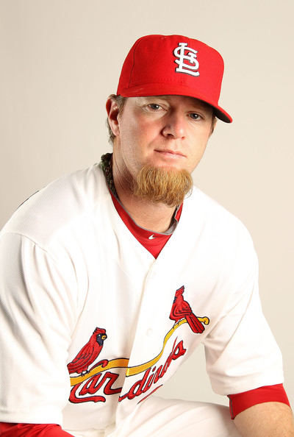
First Scientist Bullpen Help
Co-authored Declaration of Independence; leading 18th century scientist; one of only six men to sign both Declaration of Independence and Constitution
Pitched for 12 years, 1999-2011, mostly with Mariners and Cardinals
Pitched for gold-medal winning U.S. Olympic baseball team in 2000
Used mostly in bullpen
Was a 2009 all-star with 38 saves
Benjamin Franklin
Ryan Franklin
Notes:
Franklin (PA), James Wilson (PA), Roger Sherman (Conn), George Read (Del), Robert Morris (PA), and George Clymer (PA) were the six that signed Decl of Indepen. and USConst.

Slide 7
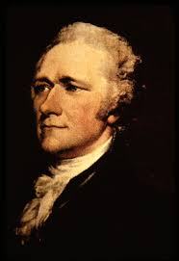
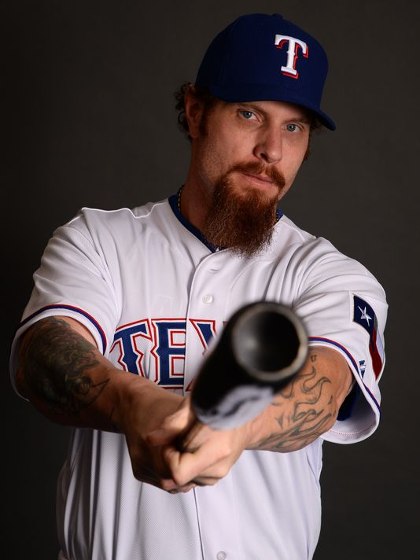
First Banker Power hitting OF
Was strong proponent of the Constitution and co-author of Federalist Papers supporting ratification; a close confidante of Washington; first Secretary of the Treasury.
Hit 200 HR in a 9-year career
Was a 5-time All Star and American League MVP in 2010
Spent best years with the Texas Rangers
Alexander Hamilton
Josh Hamilton

Slide 8
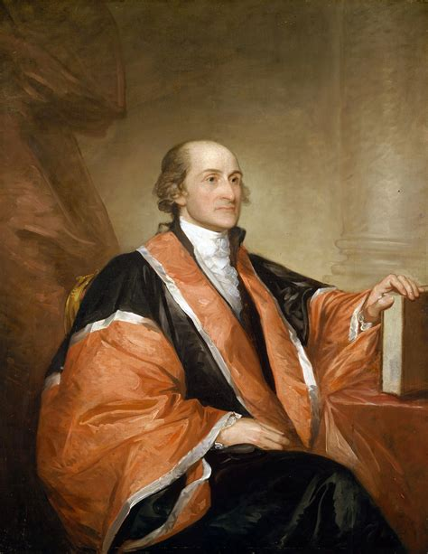
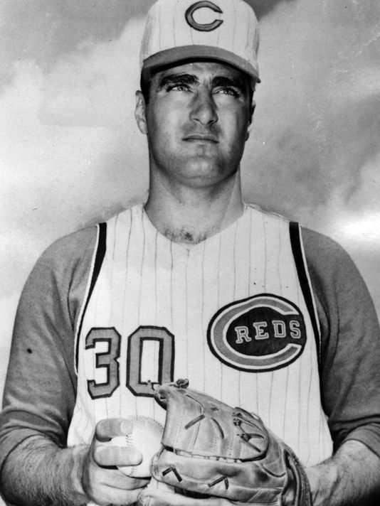
First Judge Reliable Starter
Was a negotiator of the Treaty of Paris, formally ending the Revolution; co-authored the Federalist Papers; was appointed as our first Chief Justice of the Supreme Court
Was an original “bonus baby” and the first alumnus of Little League to make the majors
Pitched for 13 seasons in the majors with Braves and Reds
Led the NL in wins (21) in 1961 while leading Reds to the pennant
John Jay
Joey Jay

Slide 9
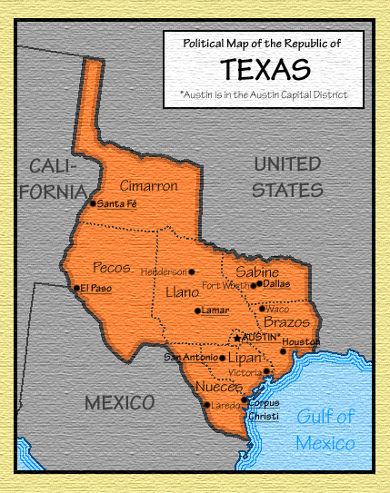
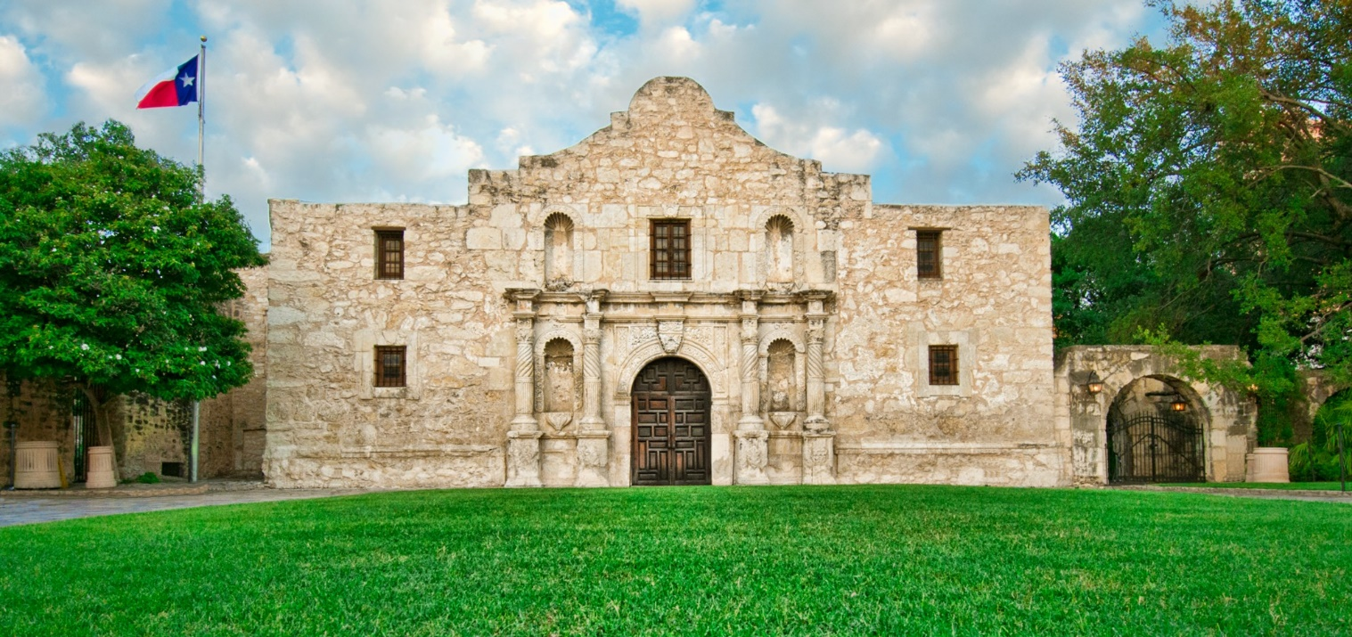
Here in Texas, we have another set of Founding Fathers

Slide 10
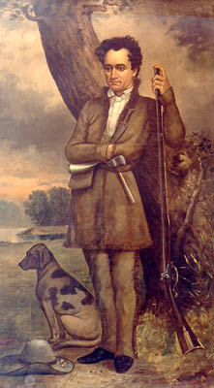
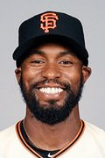
Early Settler Centerfielder
Brought “The Three Hundred” families to Texas in 1825; led Texas forces at Siege of Bexar; was first minister to the U.S. government and first Secretary of State of the Republic of Texas
Led the AL in triples in 2011 and 2012 with the Tigers
Is still active, playing for the Giants in his 9th MLB season
Native of Denton, Texas
Stephen F. Austin
Austin Jackson

Slide 11
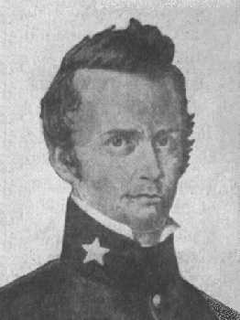
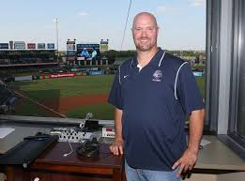
First Defender Local Pitcher
Arrived in Mexican Texas in 1831; was Texan commander at the Alamo; known for drawing “the line in the sand” with his sword and writing the “Victory or Death” letter.
Graduated from Anderson High School in Austin and attended Blinn College and Texas Tech
Played part of five seasons in the majors, two with the Astros
He has been a pitching coach in the Astros minor league system and also broadcast Round Rock Express games with Mike Capps
William B. Travis
Travis Driskill

Slide 12
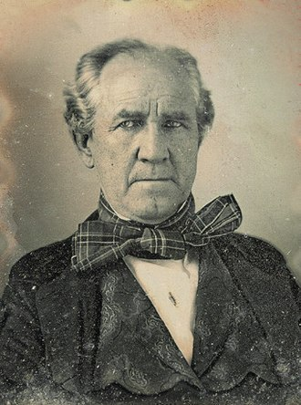
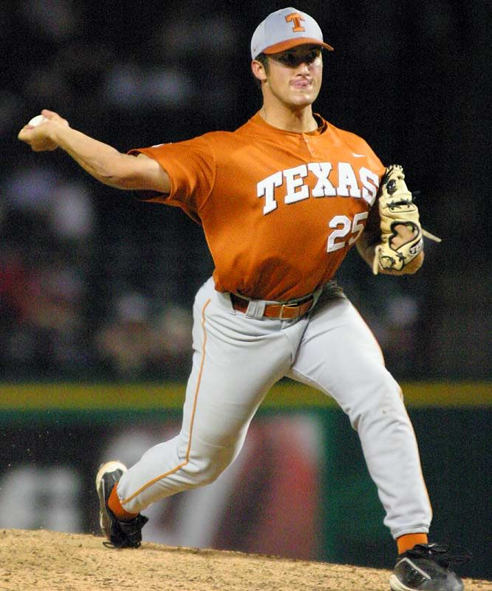
First Leader Closer
Texas commander who defeated Mexican army at San Jacinto; first president of Republic of Texas and senator and governor of State of Texas; only southern governor to oppose secession
Graduated from Westlake HS and University of Texas
1st round draft pick in 2004 and AL Rookie of Year in 2005 with Athletics
Pitched 13 years in majors, was a 2-time all-star with 324 career saves
Sam Houston
Huston Street

Slide 13
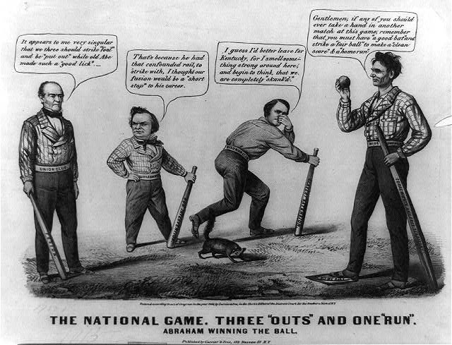
Who was the first President to play base ball?
Notes:
A pro-Lincoln satire, deposited for copyright weeks before the 1860 presidential election. The contest is portrayed as a baseball game in which Lincoln has defeated (left to right) John Bell, Stephen A. Douglas, and John C. Breckinridge. Note the skunk, indicating the other three would be “skunked”. Also – Lincoln’s foot is on “home”, which was a square at that time.

Slide 14
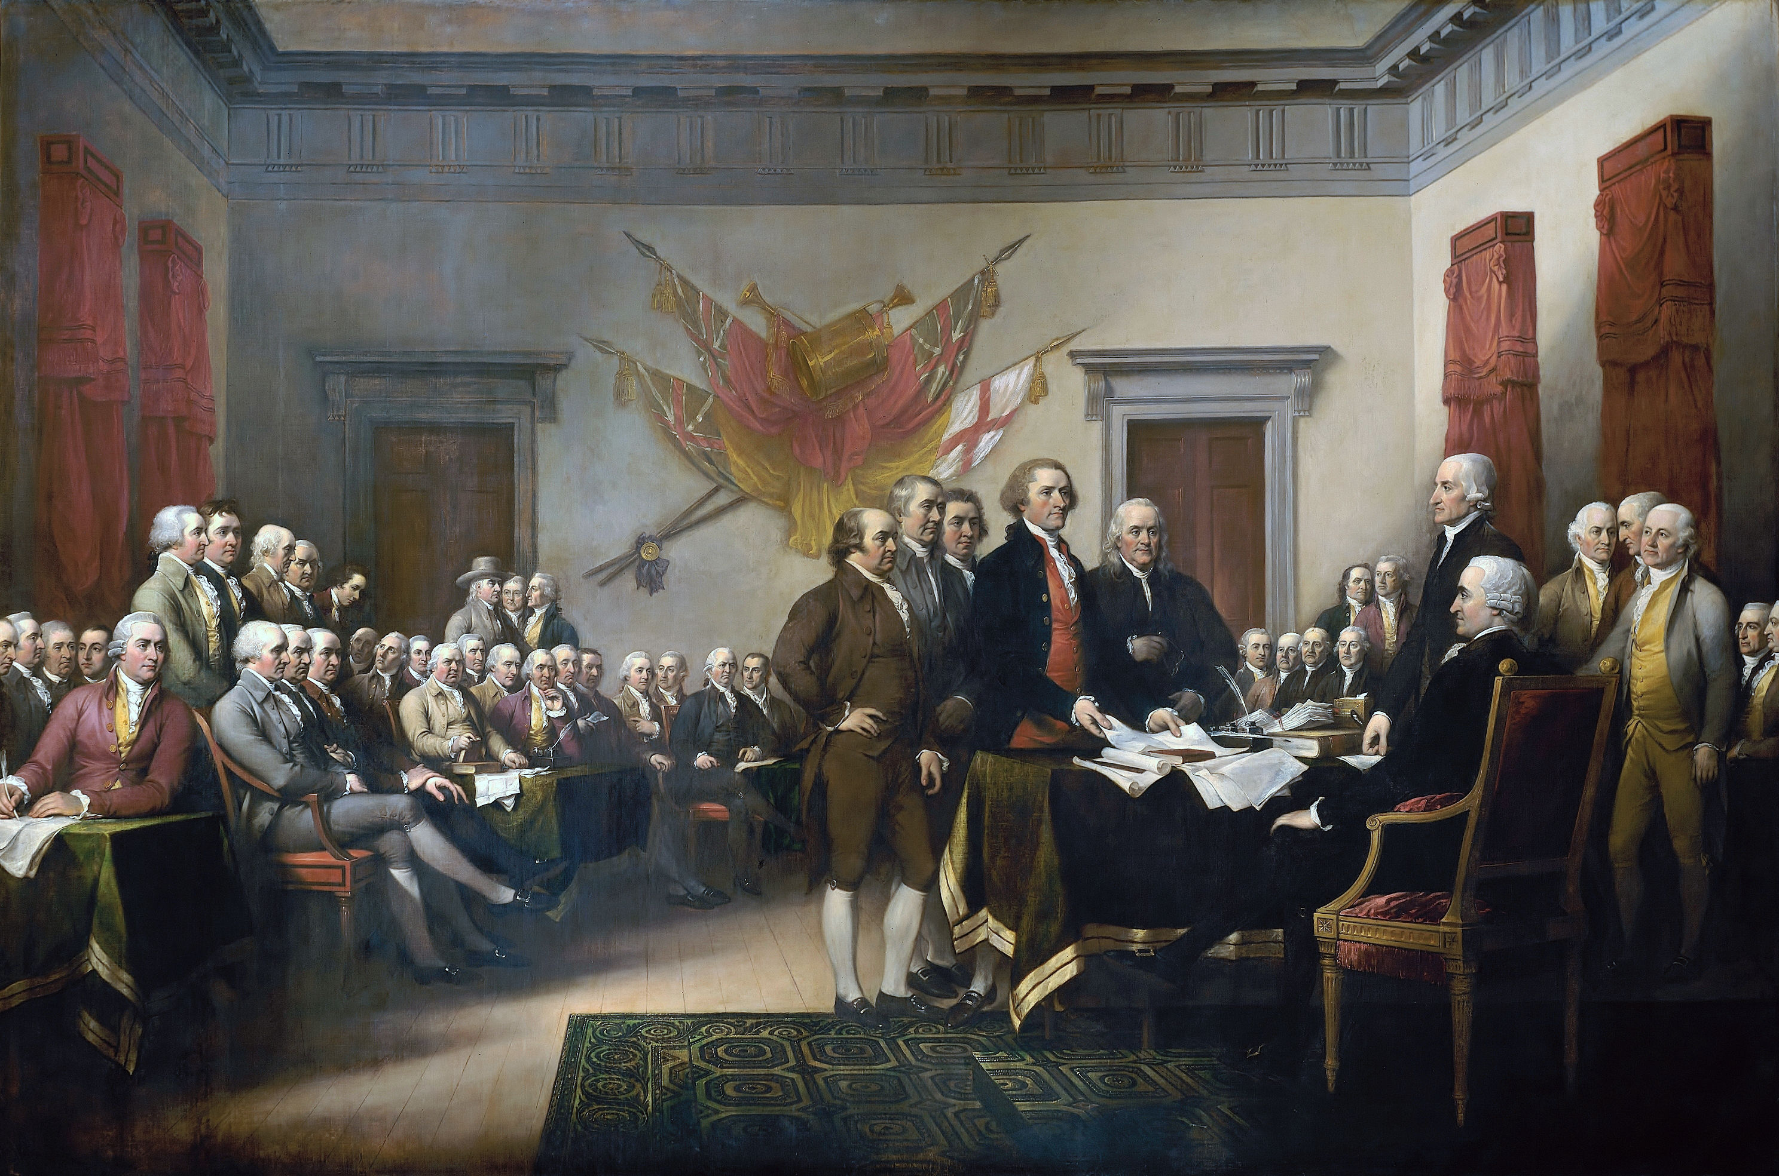
Life, Liberty, and the Pursuit of Happiness
and a revolutionary era song:
https://www.youtube.com/watch?v=rKgstp9PnJU
Notes:
John Hancock in the chair as President of the Continental Congress. Here he receives a draft of the Declaration of Independence from the Committee of Five – Adams, Jefferson, Franklin, Sherman, and Livingston. The Founding Fathers would have been familiar with the song Yankee Doodle, although probably earlier versions written by British officers mocking the colonial militia-men that fought under their command in the French and Indian Wars in the 1750s. The lyrics were re-written by a Harvard graduate who served as a minute-man and verses were added mocking the Redcoats and praising George Washington. It is the state anthem of Connecticut.

