Slide 1
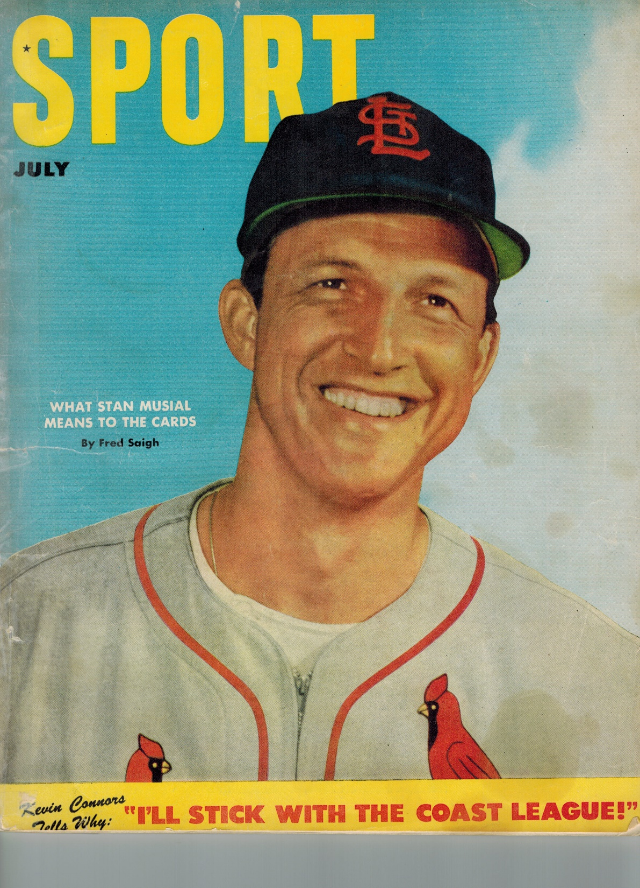
July, 1952
A great month!
The cover of the July, 1952 issue of Sport Magazine

Slide 2
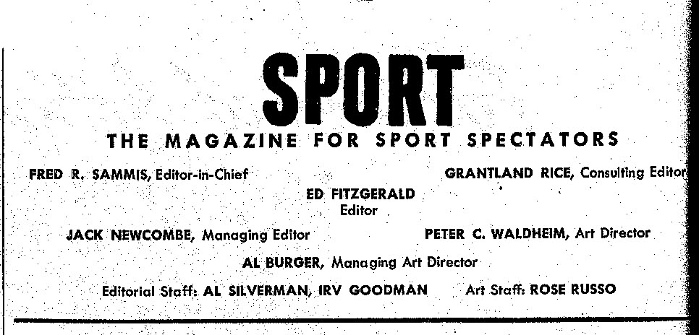
SPORT was launched in September, 1946 by Mcfadden Publications in New York City.
It was a monthly magazine that pioneered extensive use of color photography.
In 1954, Time Inc. tried to purchase the trademark “SPORT” for its new weekly sports magazine.
Mcfadden turned down an offer of $200,000. Time used the title “Sports Illustrated”.
In 1955 it began the SPORT Award, given annually to the outstanding player in the World Series.
The Dodgers’ Johnny Podres was the inaugural winner.
SPORT was published continuously until August, 2000.
In 1952, a copy at the newsstand was 25¢. An annual mail subscription was $3.00.

Slide 3
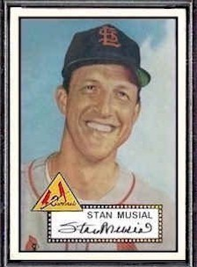
What Stan Musial Means to the Cards
by Fred Saigh
Sub-title: “In the last five years we have examined the world’s greatest
ballplayer from many angles, but here is a unique employer’s eye view of him.
Read what his boss thinks about THE MAN.”
In 1952, at age 31, Musial was at the mid-point of his Hall of Fame (first ballot) career. Already – through 1951 - nine full seasons - his credentials included:
Three NL MVP Awards Eight All-Star Game selections
Five NL Batting Titles, plus led NL in SLG and OPS five times
Career average through the 1951 season was .357 !
Led NL in Runs Scored three times and RBI once
In February, 1952, Cardinals owner Fred Saigh arranged a press conference at
which he gave Musial a blank contract, allowing The Man to “name his own price”.
After assurance that his contract amount would not decrease salaries for any of his
teammates, Musial decided to fill in last season’s salary amount ($75,000 - $80,000).
“Musial is as much of an institution in St. Louis as our Symphony.”
1952 Topps Musial card

Slide 4
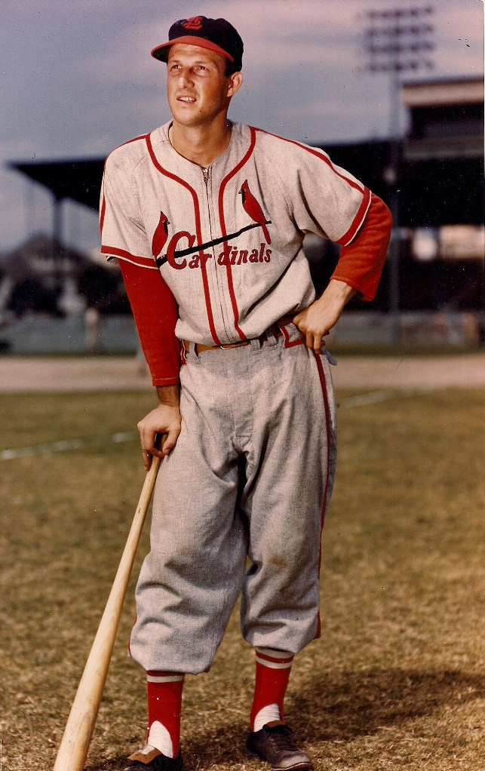
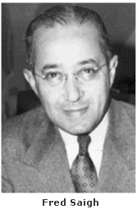
What Stan Musial Means to the Cards
by Fred Saigh
“I plan to be with the St. Louis Cardinals until I die. And I could have no fonder hope than to have Stanley Musial with me through the future years.
“That’s what Musial means to the Cardinals … and to me!”
Unfortunately, things didn’t work out that way for Cardinals’ owner Fred Saigh. In early 1953, he pleaded “no contest” to two charges of income tax evasion and was sentenced to 15 months in prison. He was forced to sell the Cardinals. To keep the team in St. Louis, he accepted an offer of $3.75 million from Anheuser-Busch brewery.
Saigh’s fortunes did improve after his release. His estate (1999) was $500 million !
Musial played his entire career with the Cardinals, retiring after the 1963 season and serving as GM to the 1967 World Series winners.

Slide 5
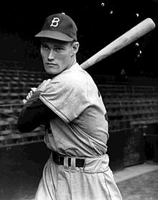
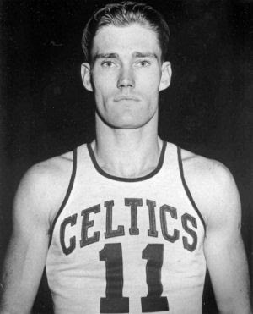
I’ll Stick with the Coast League.
by Kevin Connors
Kevin Connors played briefly with the Brooklyn Dodgers and Chicago Cubs.
He is one of only twelve athletes to play in both MLB and the NBA. He was on the NBA champion Boston Celtics team in 1946.
During the 1951 season, the Cubs sent him to their top farm team, the Los Angeles Angels in the Pacific Coast League.
In 1952, as part of a bid for major league status, the Coast League was granted “open” status – a step above AAA. Part of the new league charter allowed players to designate that they did not want to be drafted/traded to major league clubs.
The article explains Connors’ reasons for opting for “no trade/no draft” status.

Slide 6
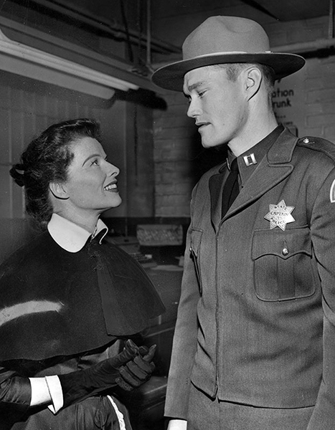
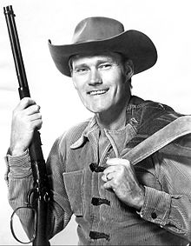
I’ll Stick with the Coast League.
by Kevin Connors
In the SPORT magazine article, he states that his major reasons for declining the major league draft option were: A stable home for his family and desire to develop business opportunities in LA.
“It costs a lot less to live in LA than in major league cities.”
He was interested in public speaking and acting. One of his favorite early speaking engagements was reciting “Casey at the Bat”.
In 1952, he debuted as an actor in a bit part in the Spencer Tracy/Katherine Hepburn comedy “Pat and Mike”.
But – his major role came in 1958 on TV.
He appeared in 135 movies and TV shows.
https://www.youtube.com/watch?v=8fMN8a3ZRUY

Slide 7
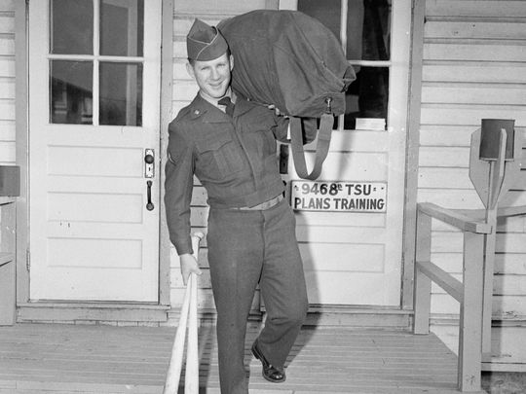
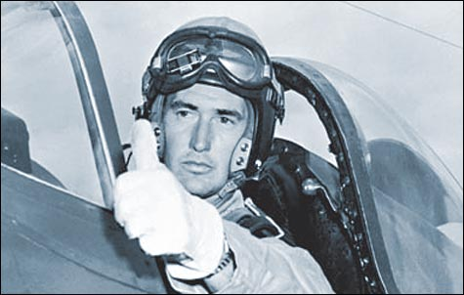
War in Korea – Major Leaguer Call-ups
Pfc. Edward C. Ford – Army Signal Corps
After his 1951 rookie season, Whitey Ford was drafted.
He was stationed at Ft. Monmouth, NJ – USASC HQ
He took a big pay cut – his military total was $162/mo
“I have no complaints about the army, but I wouldn’t want to make a career out of it.”
Capt. Theodore S. Williams – USMC pilot
He was a Navy pilot and flight instructor during World War II
He was recalled early in the 1952 season and assigned to a Marine Corps fighter squadron. He flew 39 combat missions.
At the time of his military recall in ‘52, Williams questioned whether he would ever return to baseball.

Slide 8
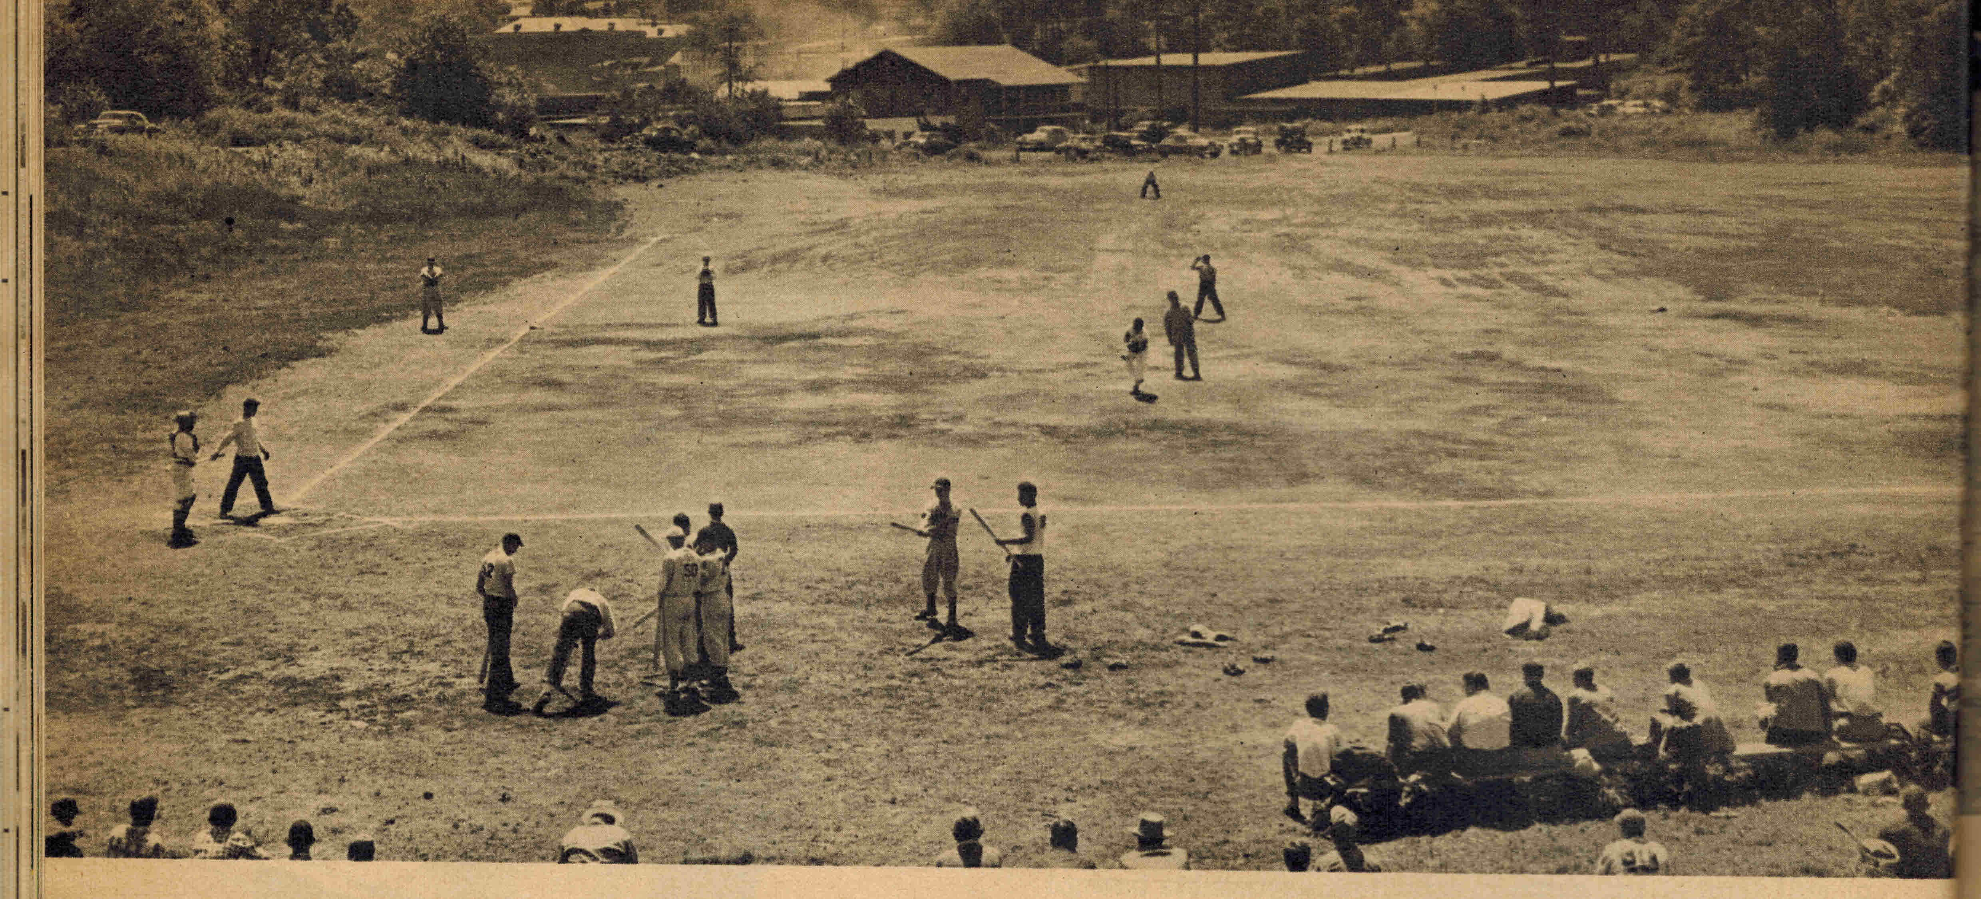
Tryout Camps
If you are one of 200,000 boys who will be gunning for a baseball contract this summer, here’s what you can expect …

Slide 9
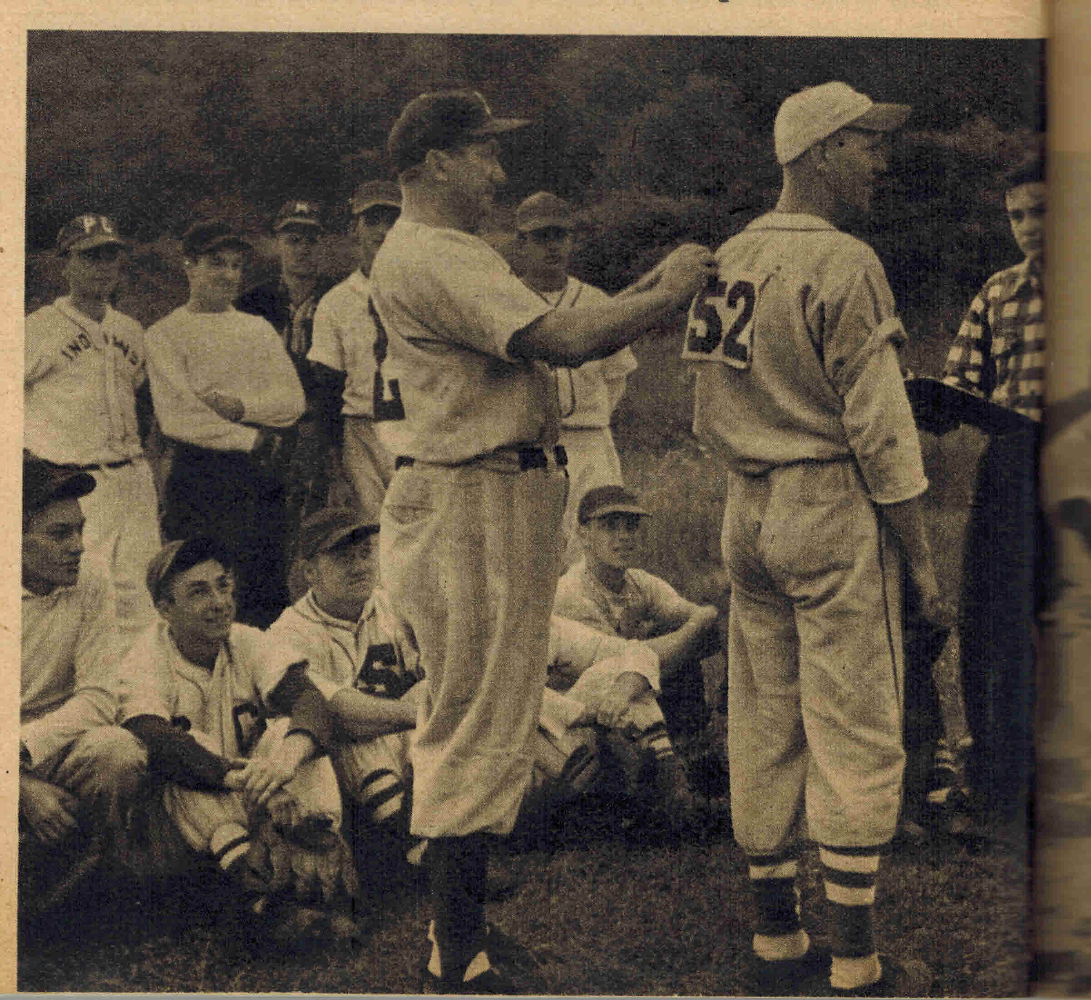
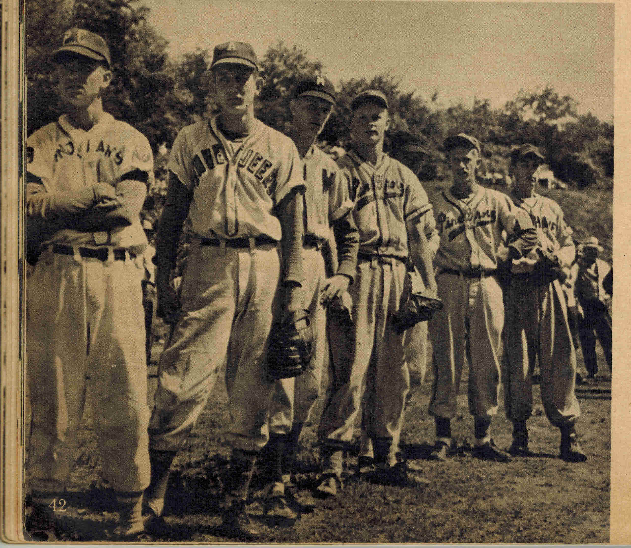
Tryout Camps
Turnouts are usually 150 – 300 players
Tryouts usually last three days
About 1 of 250 players are signed to
Class D (rookie league) contracts
Good prospects are either signed on the spot or
invited to the major league stadium
Tryout camps are the source for about 1/2 of a
team’s new talent each year

Slide 10
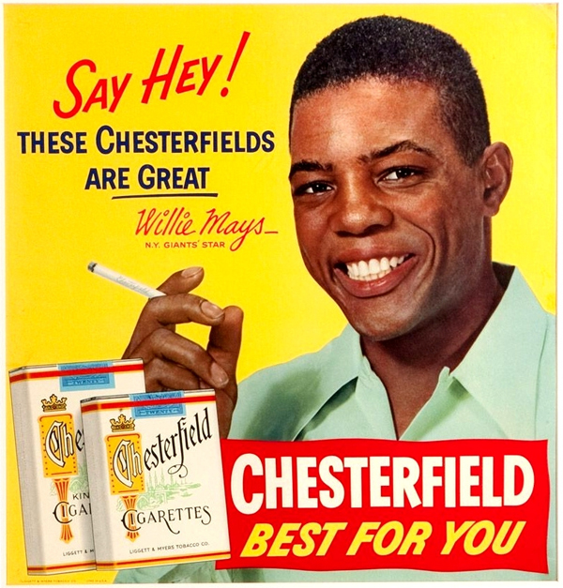
Advertisements

Slide 11
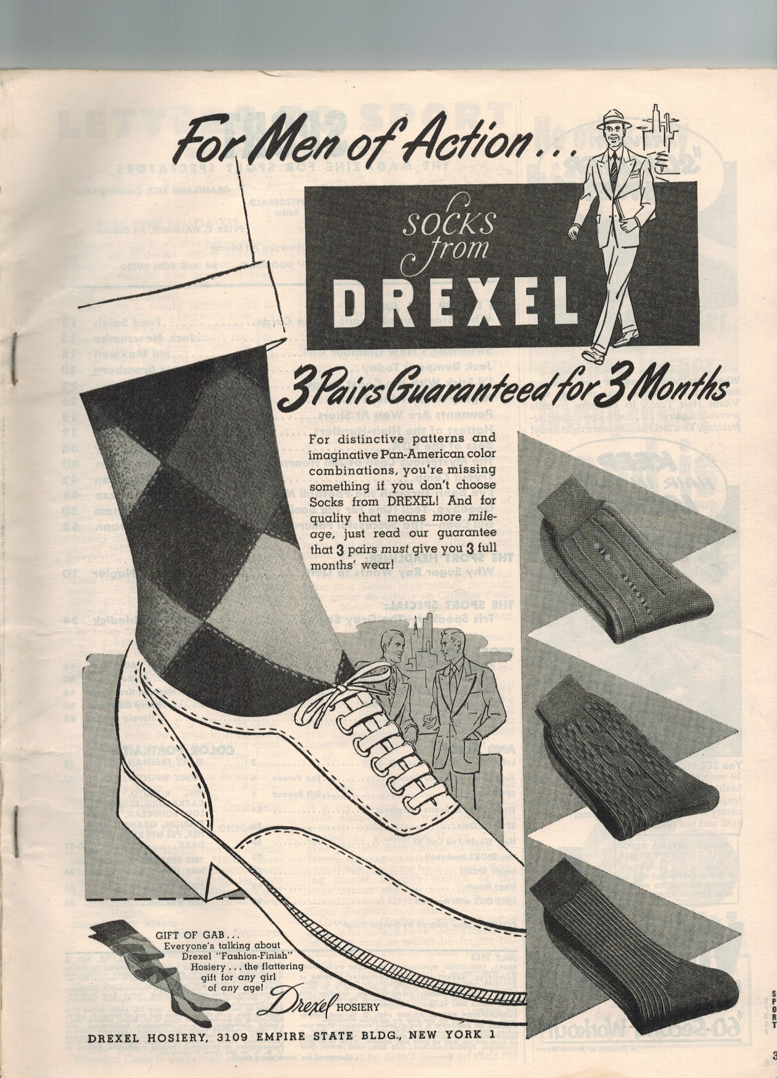
Drexel Hosiery
Note the business address:
3109 Empire State Building
New York 1, New York

Slide 12
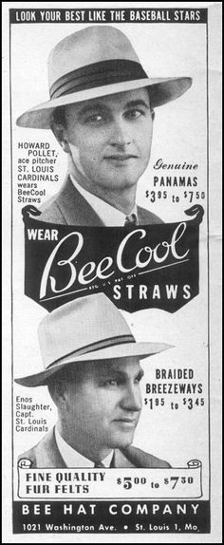

Slide 13
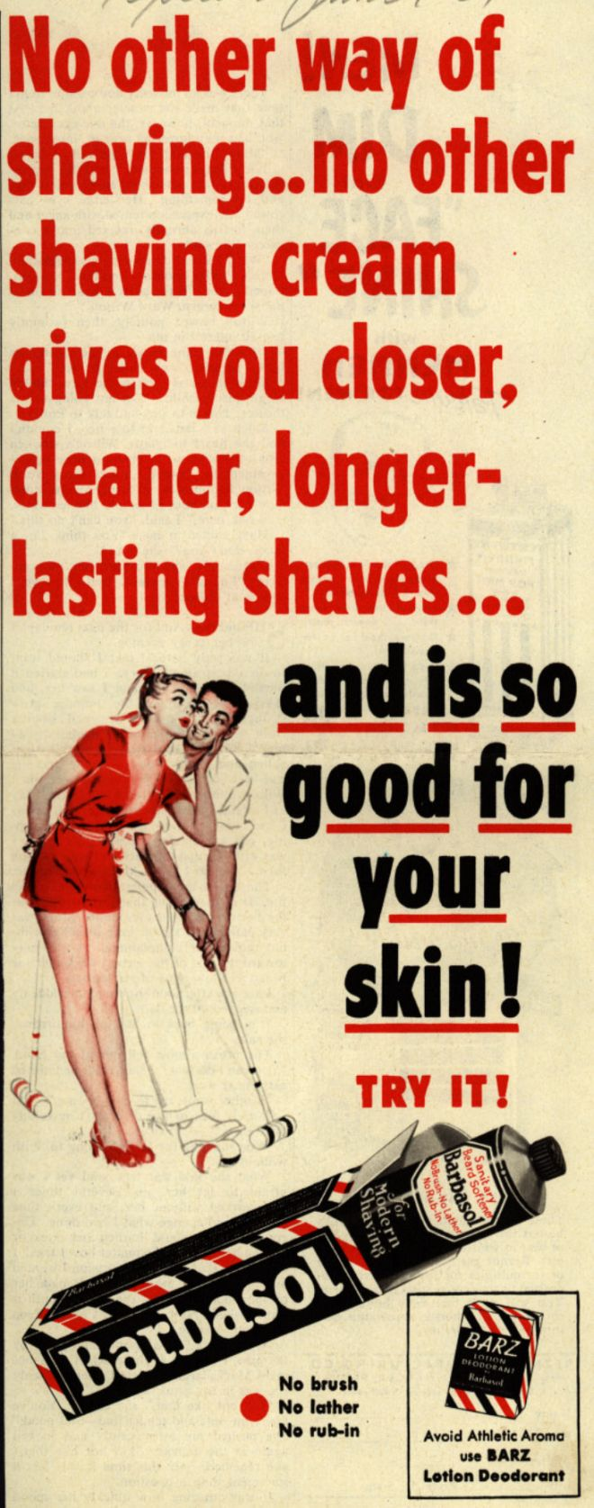
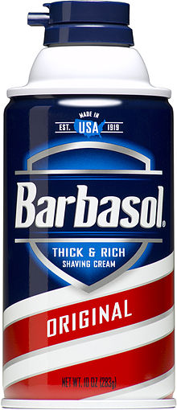
Was invented in 1919 by MIT professor
Frank Shields
The original product was a thick cream, but
when the aerosol can was enhanced
in the mid-1950s to handle crème/foams,
Barbasol changed their formula to produce a
thick foam.
Baseball players Babe Ruth and Rogers Hornsby both
endorsed Barbasol, along with football legend
Knute Rockne.
It is still popular today, with an estimated market share
of 25% in the U.S.

Slide 14
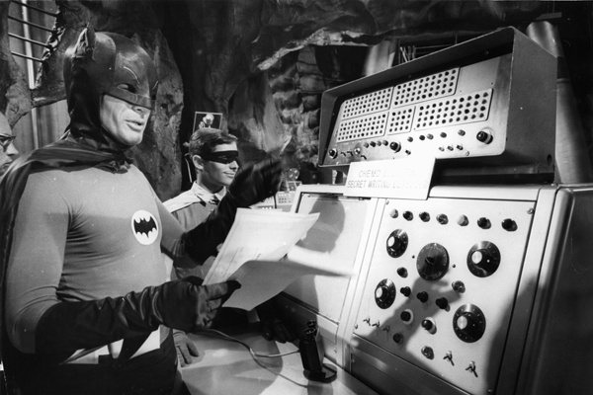
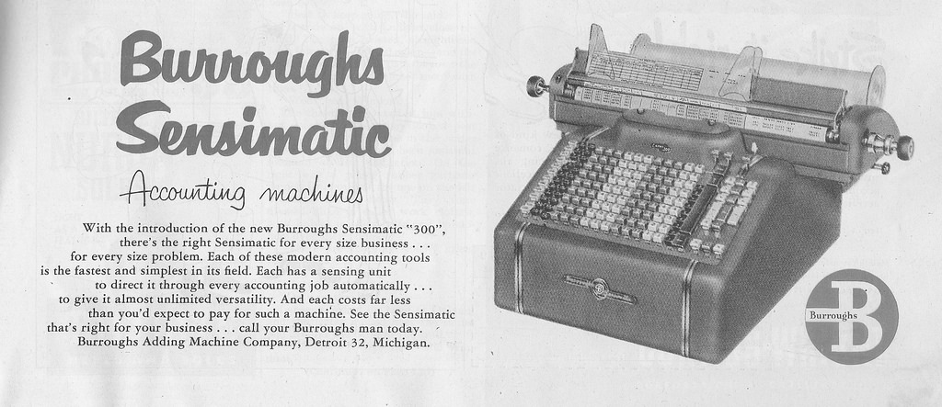
The first Burroughs Adding Machine was patented in 1885
The company was a major producer of business machines and competitor of IBM
Burroughs manufactured computer systems in the 1950s – 1970s.
A Burroughs B205 console was often shown in the 1960s TV series Batman, as the Bat-Computer
Burroughs merged with Sperry-Rand in 1986 to become Unisys

Slide 15
