Slide 1
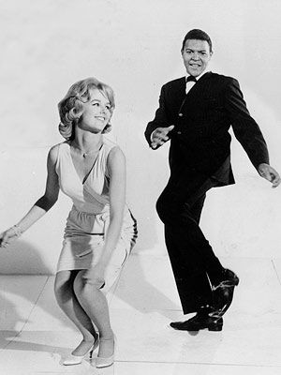
Let’s Do the Twist

Slide 2
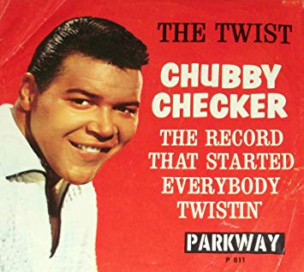
The Twist
Ernest Evans – aka “Chubby Checker” - 1960
https://www.youtube.com/watch?v=pHGXwQeUk7M

Slide 3
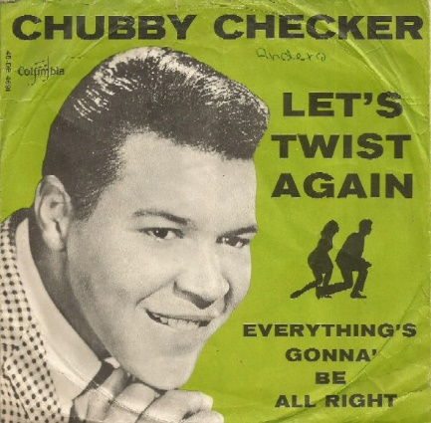
Let’s Twist Again
Chubby Checker - 1961
https://www.youtube.com/watch?v=eh8eb_ACLl8

Slide 4
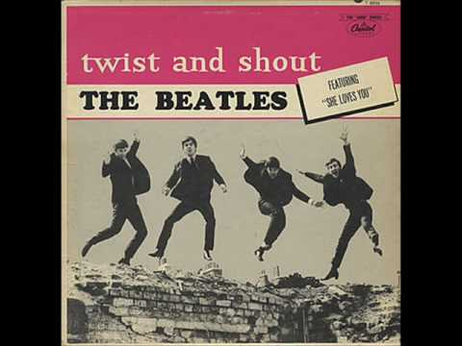
Twist and Shout
The Beatles - 1963
https://www.youtube.com/watch?v=b-VAxGJdJeQ

Slide 5
Other Twist Songs
Wikipedia lists 47 “Twist” songs, some of which are:
Kissin’ and Twistin’ – Fabian
The Peppermint Twist – Joey Dee and the Starliters
The Spanish Twist – Bill Haley and the Comets
The Alvin Twist – Alvin and the Chipmunks
Twist, Twist, Señora – Gary “U.S.” Bonds
Note – Hank Ballard wrote “The Twist” and recorded it in 1959
with his group The Midnighters. Dick Clark felt Ballard’s group was
“ too risqué ” to appear on American Bandstand, so he arranged to
have Chubby Checker make a version of the song.

