Slide 1
Some Baseball Lingo

Slide 2
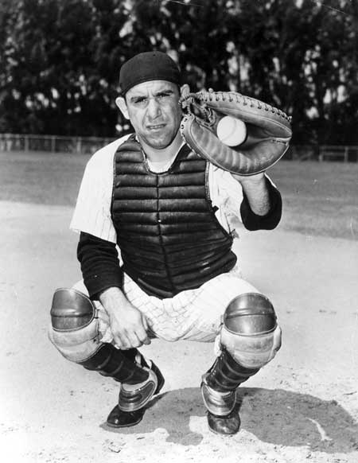
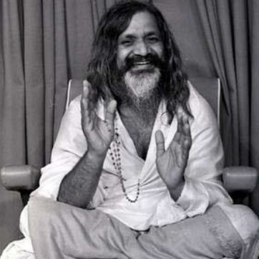
A Yogi The Yogi

Slide 3
Outs Out!

Slide 4
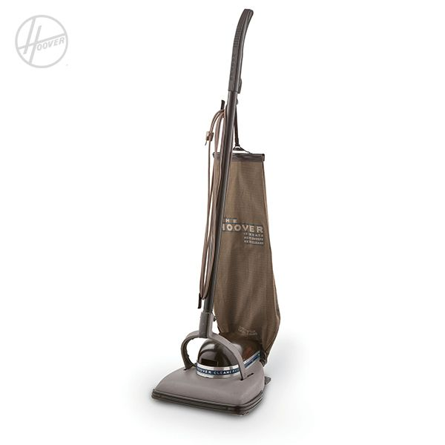
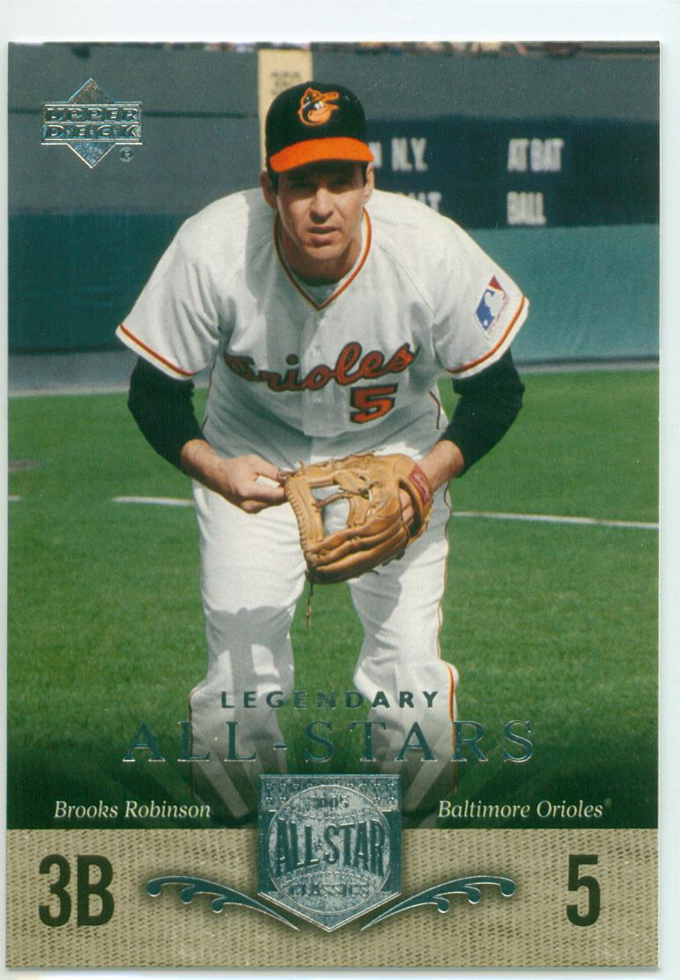
A Vacuum Cleaner Human Vacuum Cleaner

Slide 5
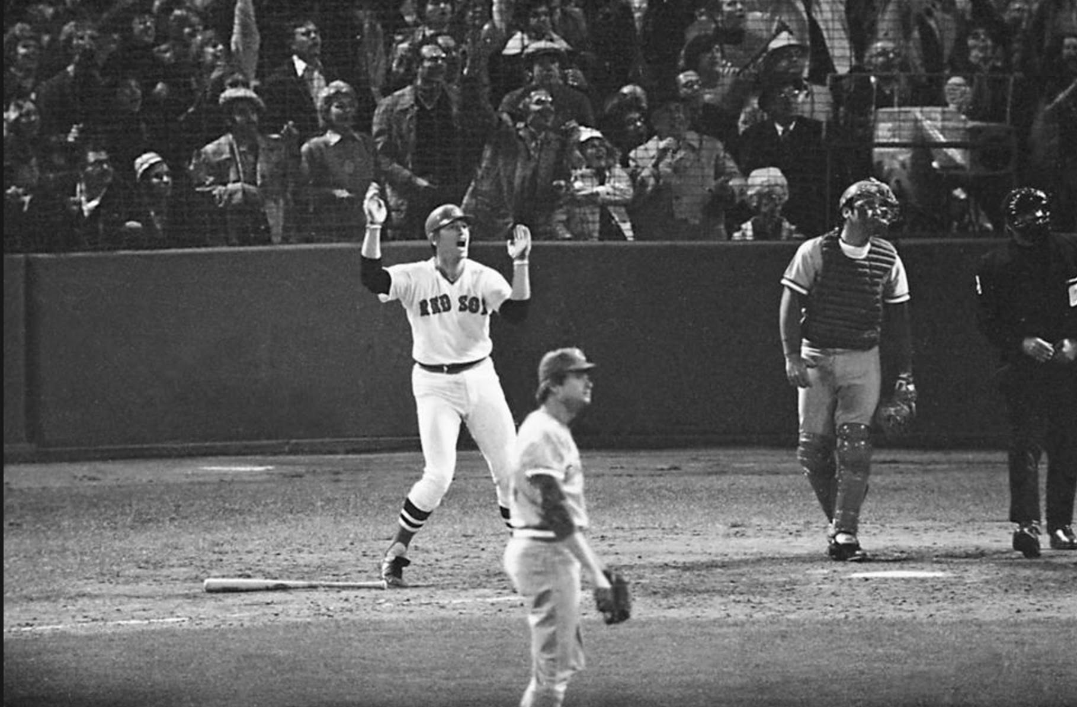
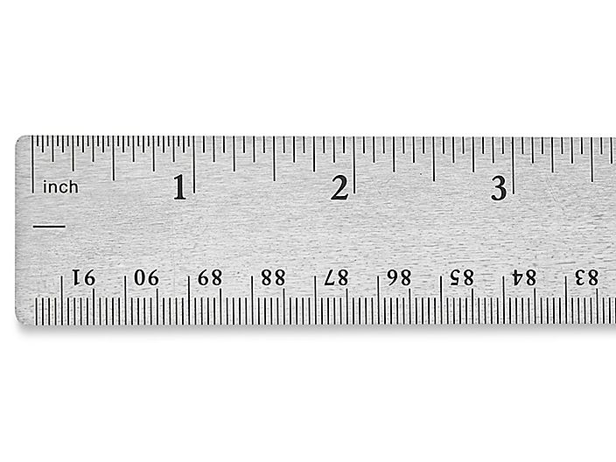
Inches A Game of Inches

Slide 6
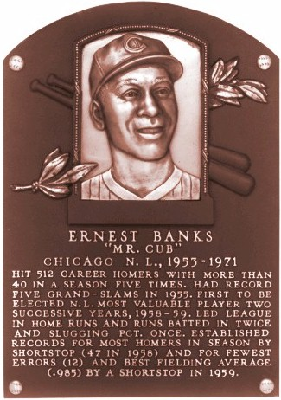
A cub Mr. Cub

