Slide 1
The National Anthem and Baseball
Notes:
The performance of the national anthem is a well-established part of american athletic competitions. How did the Star Spangled Banner become entrenched in our sports identity? The answer goes back to… baseball.

Slide 2
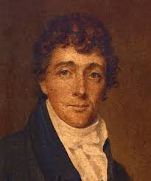
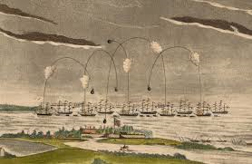
The Defence of Fort M’Henry
Francis Scott Key
Battle of Baltimore, 1814
Notes:
The song we know as the Star Spangled Banner began as poem written by Francs Scott Key in September 1814. Key witnessed the British bombardment of Ft. McHenry in Baltimore, and penned a poem titled “The Defence of Fort M’Henry”. The poem has four stanzas, whereas we only sing wrds from the first stanza.

Slide 3
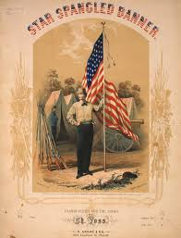
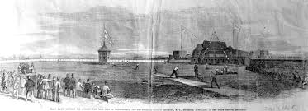
Star Spangled Banner
Earliest performance at baseball game at Union Grounds in Brooklyn, NY - May 15, 1862
Notes:
During the 195th century, Key’s poem gained popularity as a song, set to the tune of another popular song. It was performed at eent like parades, Independence day, and occasioally at sporting events. The earliest documented performance at a baseball game was at the Union Baseball Grounds in Brooklyn on May 15, 1862. This was also the inaugural game played at Union Grounds; and, over time, playing the song on opening day of the baseball season became a widespread practice.

Slide 4
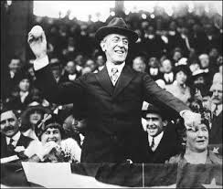
The Star Spangled Banner
Benjamin Tracy, Scty. Of Navy
President Woodrow Wilson
Notes:
In 1889, Secretary of Navy Benjamin Tracy signed an order making “The Star Spangled Banner” the official tune to be played at the raising of the flag. Remember, at this time the United States did not have an official national anthem.
In 1916, President Wilson ordered that the Star Spangled Banner be played at military and other appropriate occasions. However, the ong was not officially adopted as our national anthem until 1931.

Slide 5
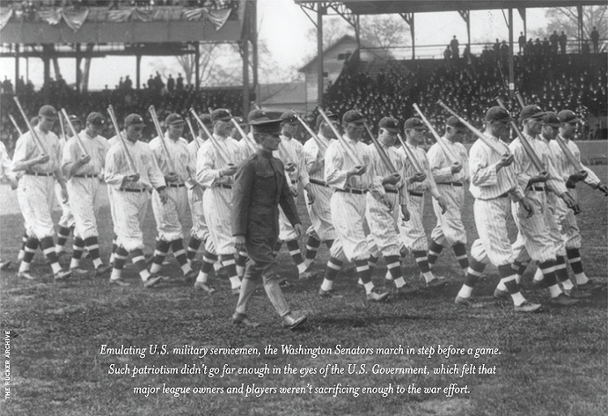
Baseball in World War I
Notes:
In 1918, we were in the mids of World War I. The public mood was very somber- the war had strained the economy and the workforce. Baseball owners were receiving criticism for not doing enough towards the war effort, as many ballplayers were reciving exemptions from military service, and then would continue playing baseball for their teams. This photo shows Washington Senators players emulating US servicemen by marching instep before a game – - with baseball bats on their shoulders. The gov’t. began drafting major league ballplayers that summer, and Pres. Wilson ordered baseball to end the regular seaso by Labor Day.

Slide 6
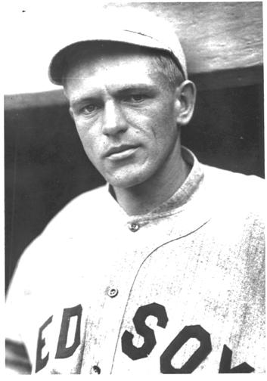
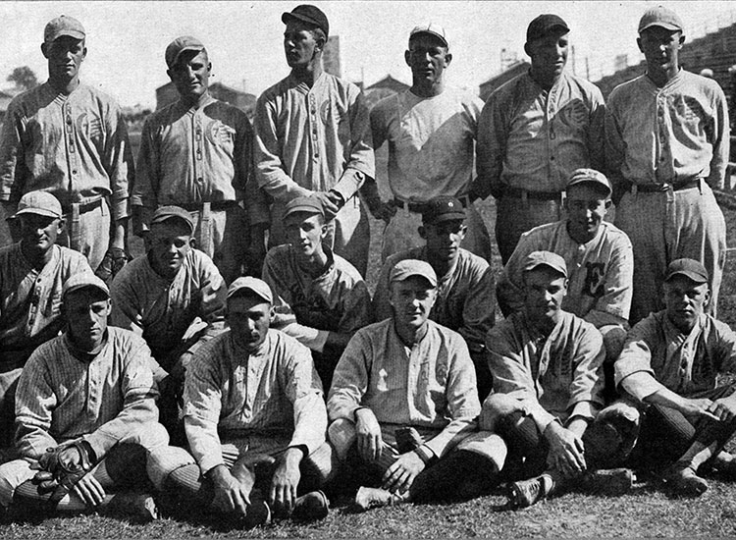
Baseball in World War I
Fred Thomas, Red Sox 3B
Great Lake Naval Station Baseball Team
Notes:
Let’s talk about Fred Thomas - a 25 year old rookie and starting 3B for the Boston Red Sox. The Red Sox were AL champions in 1918, and used 9 different players at 3B. The best of them was Thomas, but he only played the first half of the season because he joined the Navy in July. Actually, he was drafted by the Army, but was rejected because he was a diabetic. Thomas didn’t want to return to the Red Sox because of the negative publicity ballpayers were reciving, so he went to the Navy and was accepted without a physical exam. He was sationed at the Great Lakes Naval Station outside of Chicago, and what did he do at Great Lakes? He played baseball! The Great Lakes commander was a big baseball fan and he actively recruited ballplayers to play for Navy baseball team. The photo on the right shows some of their palyers in 1918, which included George Halas (back row, 2nd from left)

Slide 7
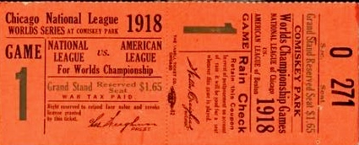
1918 World Series Red Sox vs Cubs
Game 1 at Comiskey Park
Ruth pitches 1-0 Shutout
Notes:
The Chicago Cubs were NL chapions, and the Wrld Series opened in Chicago on Sept. 5. The game was played at Comiskey Park (home field of theAL White Sox). The Cubs rented Comiskey from the White Sox, where they could seat 32,00 fans – versus Wrigley Field which had a capacity below 20,000. However, the game drew only about 10,000 fans; and Babe Ruth tossed a 1-0 shutout to beat the Cubs. One newspaper report said “Yesterday’s game … was perhaps the quietest (World Series game) on record” .. Except during the 7th inning stretch.

Slide 8
1918 World Series
Notes:
Here’s what happened during the 7th inning stretch: This takes us back to Red Sox third baseman Fred Thomas. Although Thomas was in the Navy, when the Red Sox heard that he was stationed nearby, they asked the Navy if Thomas could get furlough to play for the Red Sox in the World Series. Navy gave their okay. So now – Thomas is on the field at his 3B position during the 7th inning stretch, and a military band fires up “The Star Spangled Banner”(TSSB). As soon as Thomas hears the music, he snapped to attentio with a military salute. Other players on the field followed suit. Then the crowd began a spontaneous sing-along of the song. The NY Times opened its recap f the game not with a description of the baseball action, but with an account of the impromptu singing: “Jackie Fred Thomas of the U.S. Navy was at attention.. erect, with his eyes on the flag… When the final notes came, a great volume of melody rolled across the field… onlookers exploded into thunderous applause and rent the ar with a cheer that marked the highest point of the day’s enthusiasm.”
The Cubs front office, realizing they had witnessed something unique, had the band play “TSSB” during the 7th ing. For the next two games in Chivago. Not to be outdone, the Red Sox ratcheted up the pageantry when the Series moved to Boston for the next three games. At Fenway Park, “TSSB” was moved from the 7th ing. to pregame festivities.

Slide 9
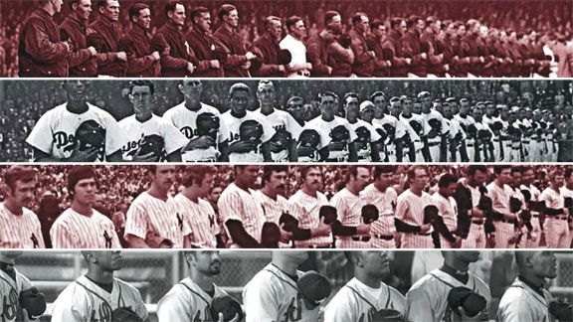
The National Anthem
In 1931, Congress officially adopted “The Star Spangled Banner” as our national anthem.
It was played at baseball games sporadically through the 1920’s and 30’s, and became a tradition during World War II.
Notes:
It wasn’t until 13 years later (1931) that “TSSB” was officially adopted as our national anthem. During the 1920’s and 30’s it was sporadically played at baseball games. During World War II, playing the song before baseball and football games became the norm. After the war ended in 1945, it was the NFL that stated their intent to make “TSSB” a permanent part of every football game. MLB also adopted the tradition. However, not everyone in the baseball world agreed with the playing of the national anthem. In a954, the Baltimore Orioles GM Arthur Ehlers (a WW1 vet) decided not to paly the music before all games, opting to save it for special occasions. Ehlers said that frequent repitition “Tends to cheapen the song and lessen the thill of response”, and he complained about fans not behaving respectfully during the anthem. Under public pressure, Ehlers eventually changed his mind. The Chicago Cubs owner felt similarly, and the song was not a standard element a Cub home games until the 1960’s; and, at one time, they replaced “TSSB” with God Bless America.

Slide 10
The National Anthem
Notes:
Regardless of what tune you think we should be singing, I ask that you please stand for our national anthem.

Slide 11
PLAY BALL!

