Slide 1
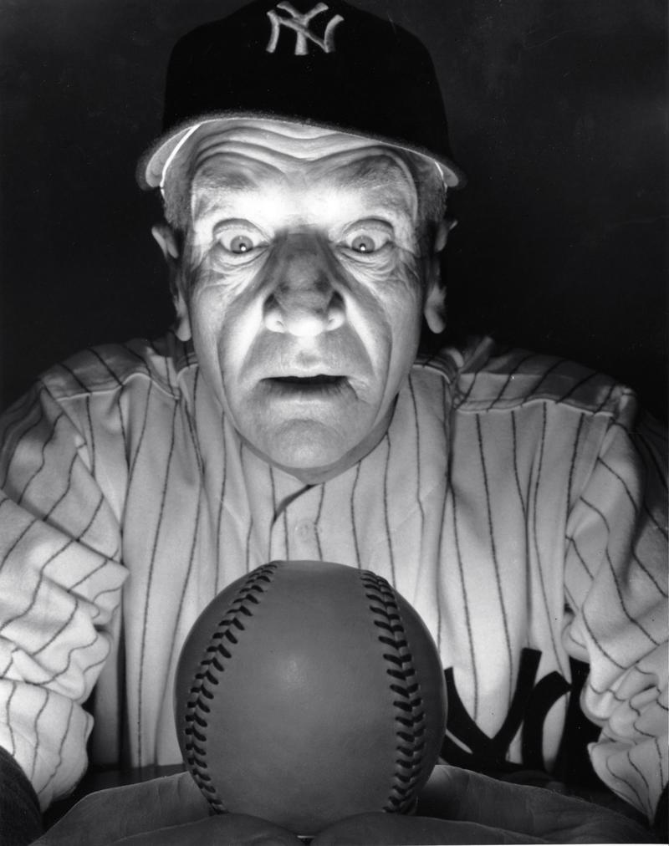
Baseball
Superstitions

Slide 2
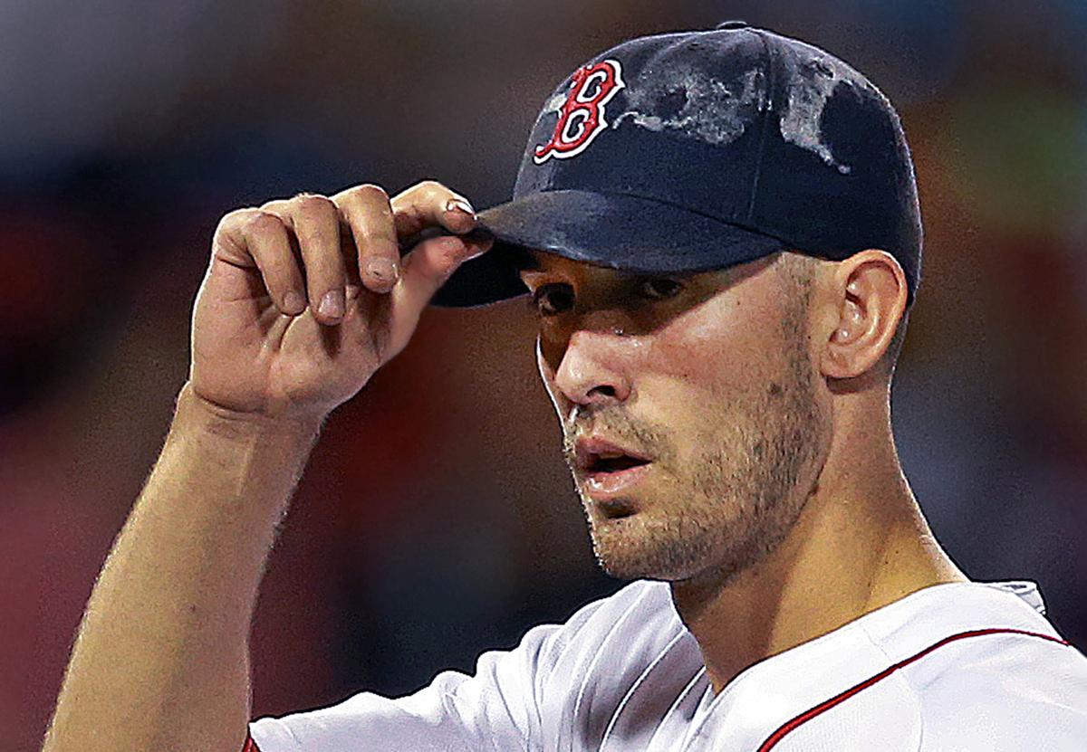
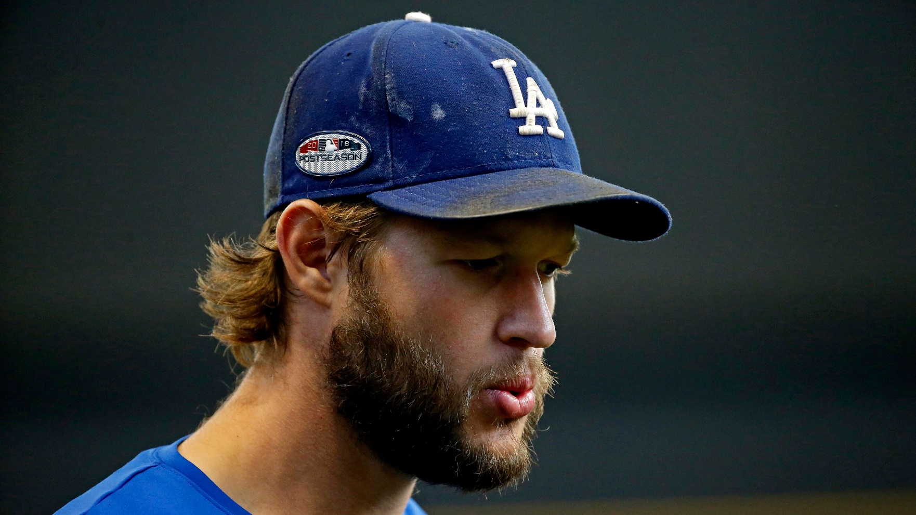
Your “game lid” should last all season
Especially if you’re playing well !
Notes:
Rick Porcello, Clayton Kershaw; born of necessity – as a kid, you only got one team cap for the entire summer. Old-time hats were all wool, so you didn’t want to wash them!

Slide 3
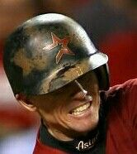
Even longer for your game helmet
Notes:
Craig Biggio

Slide 4
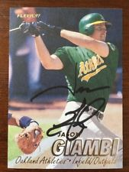
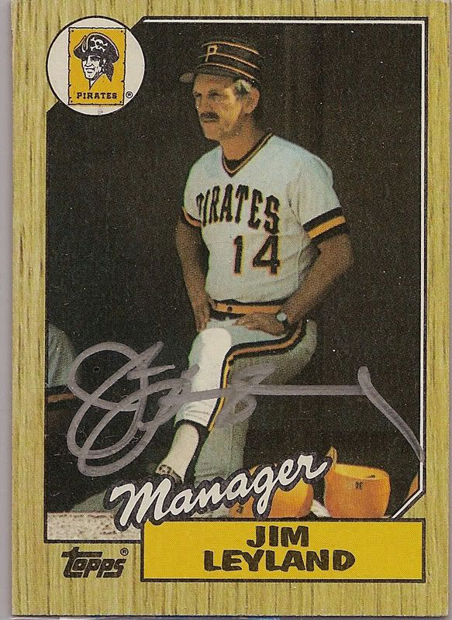
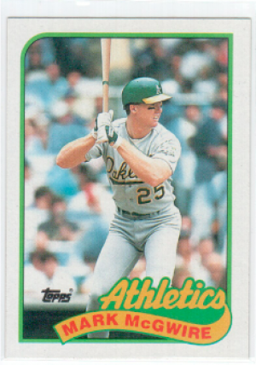
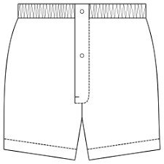
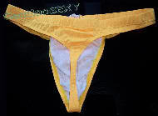
Clothing superstitions – NOT recommended
Would wear a gold thong under
his uniform pants to break slumps
Would wear the same pair of
boxer shorts during a win streak
Wore the same protective cup
from high school onwards

Slide 5
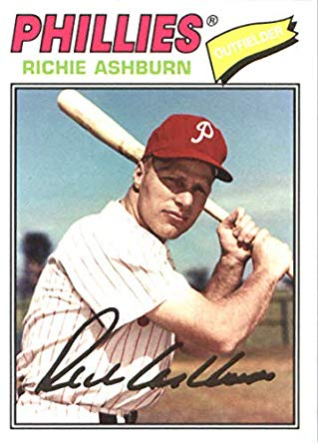
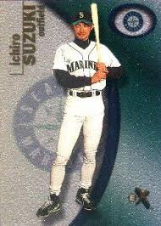
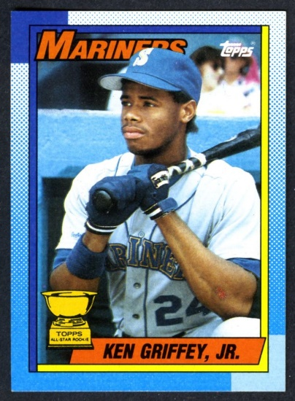
Players are superstitious about their bats
Slept with his bats when he was
on a hitting streak
Once sold his Mercedes auto because
“It didn’t have any hits left in it!”
Kept his bats in a silver case
Notes:
Richie Ashburn admitted “Yeah, I slept with a lot of old bats!”

Slide 6
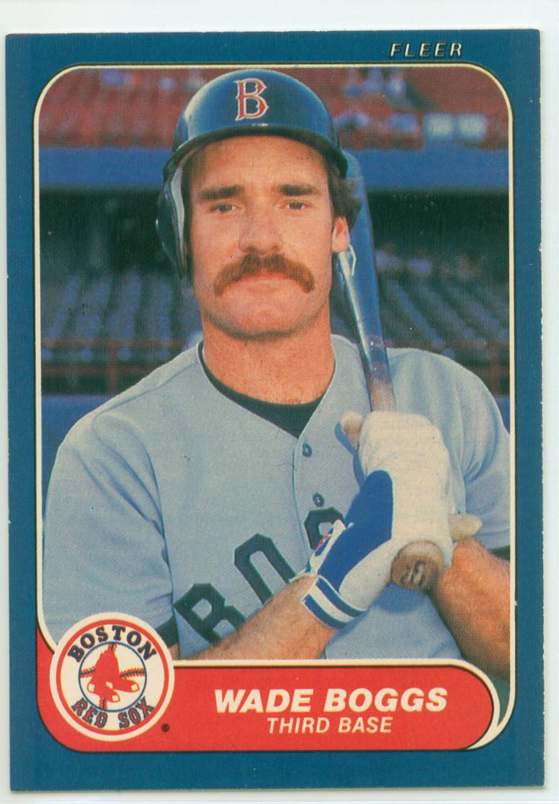
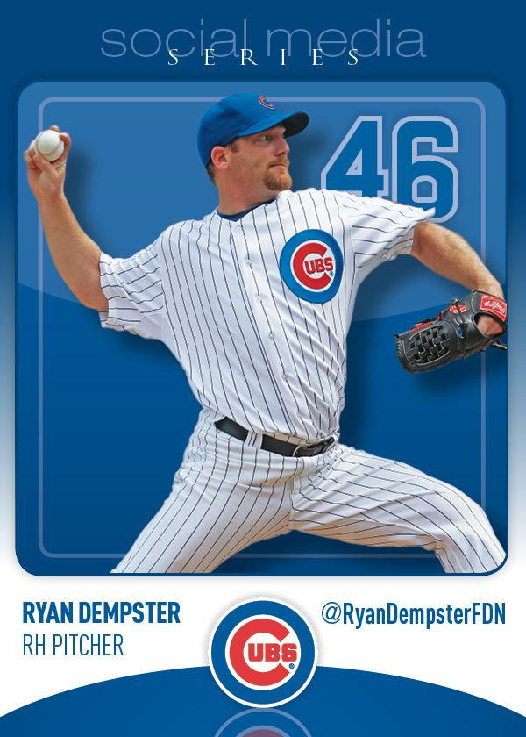
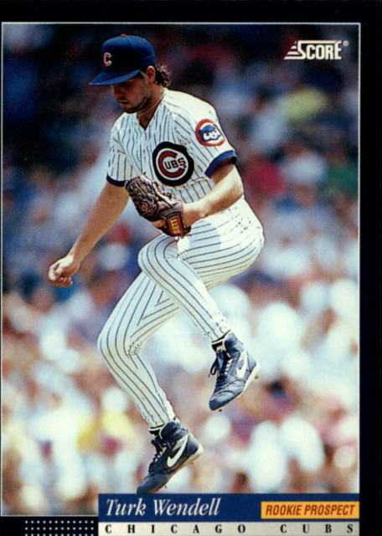
Pre-game food rituals
Ate chicken before EVERY game!
Ate at the same Italian restaurant
before each home start
Chewed four pieces of black licorice and then brushed his teeth in the dugout
Notes:
Boggs played in over 2400 games – that’s a lot of chicken !

Slide 7
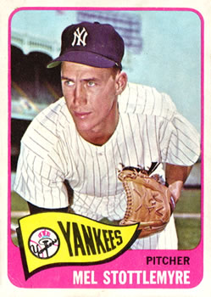
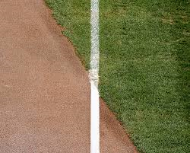
Don’t step on the foul line !
Notes:
Yankees pitcher (later Mets-Yanks pitching coach) Mel Stottlemyer always avoided stepping on the foul line when pitching. His bullpen coach, JIm Hegan, once convinced him it was nonsense – so Stottlemyer stepped on the line on his way to start a game against the Twins. The first batter – Ted Uhlaender hit a line drive off Stottlemyer’s shin; Rod Carew, Tony Oliva, and Harmon Killebrew followed with hits. Stottlemyer allowed 5 earned runs in that half inning. He said after the game “I’ll never step on the foul line again!!”

Slide 8
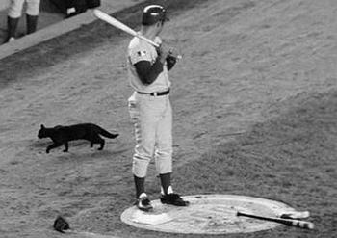
Animals on the Field
Bad
Luck
September 9, 1969 – Cubs at Mets – Black Cat appears in front of Cubs’ dugout at Shea Stadium
Notes:
Ron Santo – on deck – hit an RBI single when he got to the plate in top of 4th inning; but it was only run the Cubs scored in 7-1 loss to Tom Seaver and Mets – cutting their NL East lead to ½ game. The Mets went on to win the NL East, the pennant, and the 1969 World Series.

Slide 9
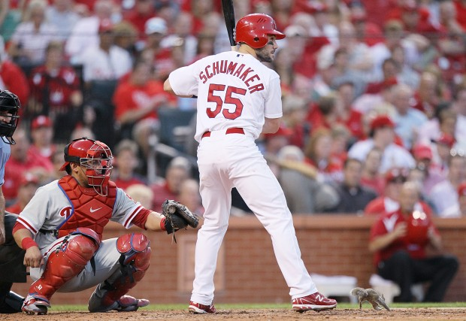
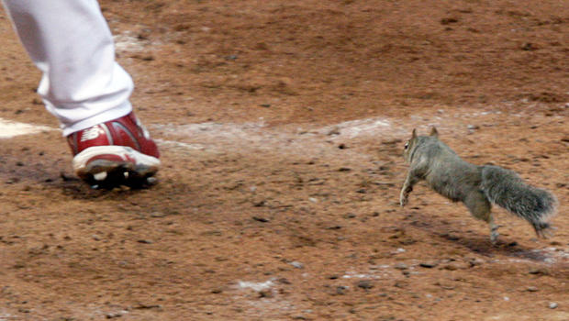
Animals on the Field
Good Luck
October 5, 2011– Phillies at Cardinals– the Rally Squirrel appears at Busch Stadium
Notes:
Rally squirrel – appeared at Busch Stadium during the 5th inning of Game 4 of the NLDS. Ran across batters box while Roy Oswalt was pitching to Skip Schumacher. The Cardinals went on to win the World Series later that October.

Slide 10
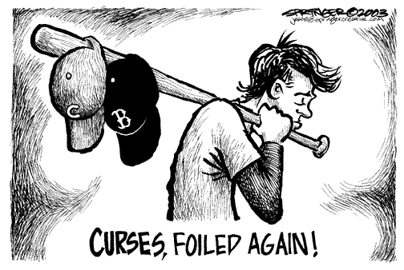
Baseball has had some long-standing “Curses” – some have been lifted in the 21st Century

Slide 11
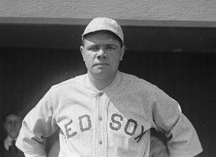
Curse of the Bambino
Curse originated when Boston Red Sox
owner Harry Frazee sold Babe Ruth to
the Yankees on January 3, 1920.
The Red Sox had been highly successful,
winning 5 of the first 15 “modern era”
World Series. Ruth was a member of
1915, ‘16, and ’18 winners.
Over the next 85 years, the Red Sox
could not repeat. A book and Yankees
fans popularized the saying in 1990.
The Red Sox came back from an 0-3
deficit in 2004 ALCS vs Yankees and then
swept Cardinals in the World Series.
Boston won World Series in ‘07, ‘13, ‘18.
CURSE BROKEN

Slide 12
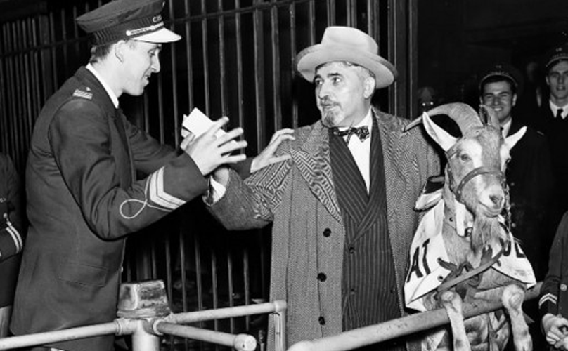
Curse of the Billy Goat
William Sianis owned the Billy Goat Tavern in Chicago. He also owned a goat, “Murphy”.
Sianis and his mascot goat
were denied admission to
Game 4 of the 1945 World
Series at Wrigley Field.
The goat had a paid ticket.
Upon being denied entry,
Sianis reportedly told ushers,
“You are never going to win a
World Series again.”
The “Curse of the Billy Goat”
held for 71 years, until the
Chicago Cubs won the Fall
Classic in 2016.
CURSE BROKEN

Slide 13
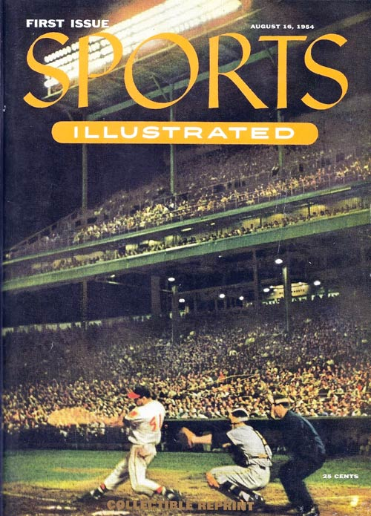
Sports Illustrated Jinx
This “jinx” says that a player (or team) appearing on the front cover of Sports Illustrated will incur some bad luck.
Milwaukee Braves’ slugger (and future Hall-of-Famer) Eddie Mathews appeared on the very first S.I. cover in August, 1954.
The week after this issue hit the newsstands, the Braves had a 10-game winning streak snapped and Mathews broke his hand.

Slide 14
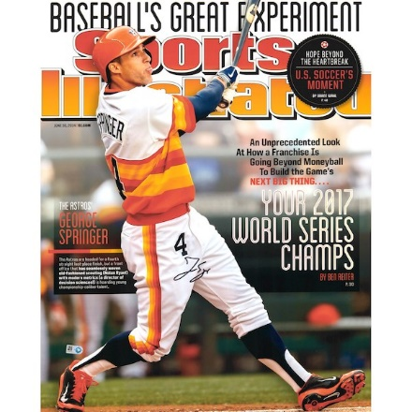
Sports Illustrated
Jinx
In 2014, S.I. ran a cover featuring Astros’ outfielder George Springer – and boldly predicted that the Astros would win the World Series three years later in 2017.
Not only did the Astros win it all in 2017, but George Springer was the World Series MVP !
CURSE BROKEN

Slide 15
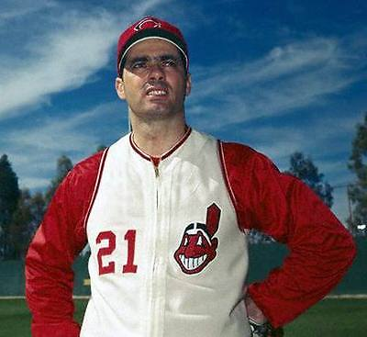
Colavito was a popular Cleveland Indians player in the late 1950s.
He led the A.L. in slugging in 1958 and led in home runs (42) in 1959.
In April, 1960 he was traded to the Detroit Tigers for Harvey Kuenn (who had led the A.L. with .353 average).
Fans in Cleveland were outraged and demanded that GM Frank “Trader” Lane be fired.
The Indians have not won a World Series since this “curse” has been in force.
CURSE
STILL
ACTIVE
Curse of Rocky Colavito
Notes:
This curse was popularized in Cleveland sportswriter Terry Pluto’s 1994 book “The Curse of Rocky Colavito”.

Slide 16
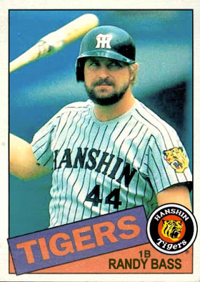
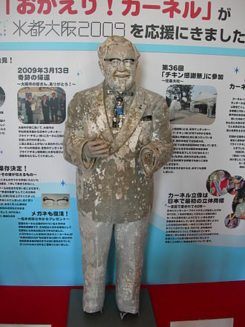
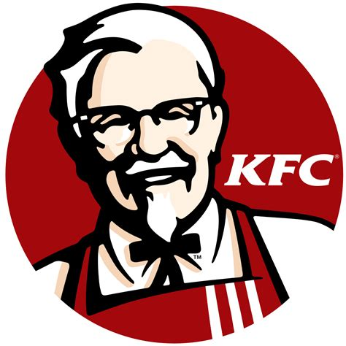
Curse of Colonel Sanders
Upon winning the 1985 Japanese Championship Series, fans of the Hanshin Tigers celebrated at the Ebisu canal bridge.
Per tradition, they shouted out team members’ names, and a fan that resembled that player jumped into the canal.
When they came to Series MVP Randy Bass, none of the fans resembled the American. So they grabbed a statue of Colonel Sanders from a nearby KFC and threw it in the canal.
Supposedly, Col. Harlan Sanders placed a curse on the Tigers, and they have not won a Japan Series title since.
CURSE
STILL
ACTIVE

Slide 17
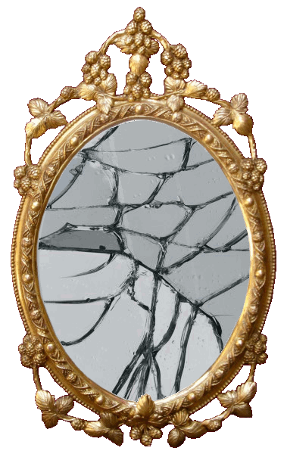
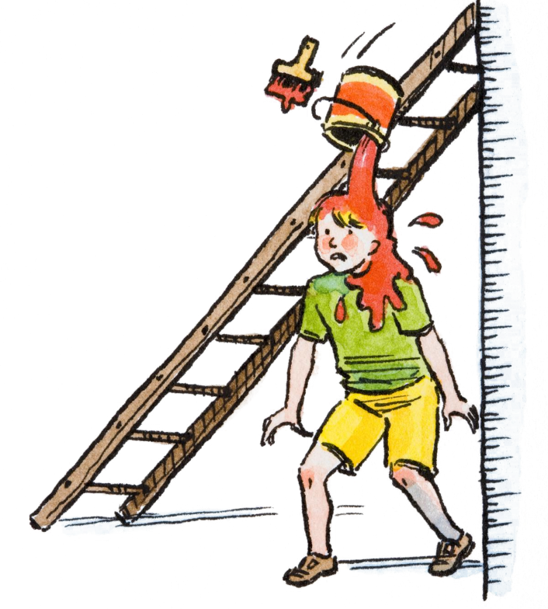
Superstition ain’t the way !
13
https://www.youtube.com/watch?v=VoYV4YWXbAM
https://youtu.be/CzsmbxPHgnA
Notes:
Stevie Wonder - #1 on the pop charts in January 1973; also dance number for Get Up and Move

