Slide 1
The Irish in Baseball

Slide 2
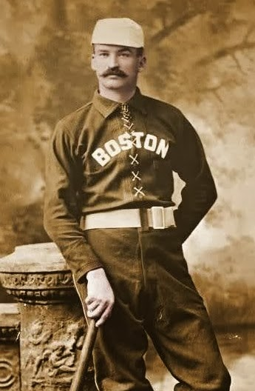
Early Baseball and the Irish
It’s estimated that in the first couple of decades of organized ball in America, at least 30% of the players were either born in Ireland or just one generation removed. Many of the biggest stars at the turn of the 20th century were either immigrants or their first-born, including Michael “King” Kelly, Roger Connor (Home Run King before Babe Ruth), Eddie Collins, Big Ed Walsh, and managers Connie Mack and John McGraw.

Slide 3
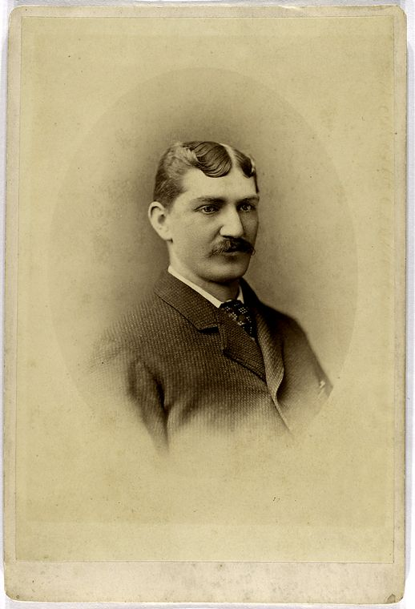
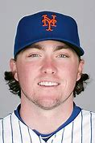
Players Born In Ireland
There have been 49 players born in Ireland. The first player – Tommy Bond – was born in Granard, Ireland, and debuted in 1876. He played 8 years. The Irish Baseball League’s award for the best pitcher is called the Tommy Bond Award.
The most recent player – P.J. Conlon – was born in Belfast, Northern Ireland, and debuted in 2018. Until he played, there hadn’t been an Irish-born player since 1945 (Joe Cleary from Cork).

Slide 4
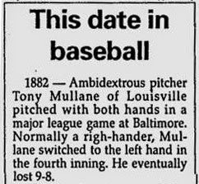
Best Irish-Born Players At Each Position
(according to “Hardball Times”)
Pitchers
Tony Mullane (pitched lefty and righty)
Tommy Bond (umped after he retired)
Catcher
Jimmy Archer (Canadian Baseball Hall Of Fame member)
First Base
Jack Doyle (nicknamed “Dirty Jack” because of how he ran the bases)
Second Base
Reddy Mack (started at age 19)
Shortstop
Andy Leonard (.299 hitter, played pro cricket in Ireland after he retired)
Third Base
Mike Muldoon (great glove, no hit, .199 in his last season)
Left Field
Curry Foley (first major leaguer to hit for the cycle)
Center Field
Patsy Donovan (played 17 years, .301 lifetime average)
Right Field
Jimmy Walsh (2 world Championships, speed on the bases)
July 18, 1882

Slide 5
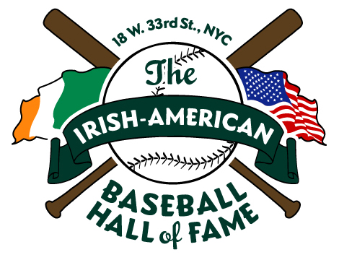
Irish-American Baseball Hall Of Fame
The Irish-American Baseball Hall of Fame recognizes players, managers, executives, journalists, and entertainers of Irish descent who have significantly and positively impacted the game of baseball. It was started in 2008 by amateur baseball historian Shaun Clancy inside Foley’s NY Pub & Restaurant (“An Irish Bar with a Baseball Attitude”).
With the blessing of the National Baseball Hall of Fame, Foley’s is a popular destination among baseball players, executives, umpires, and fans. Inductees are chosen based on a combination of factors, including impact on the game, popularity on and off the field, contributions to society, connections to the Irish community, and ancestry.

Slide 6
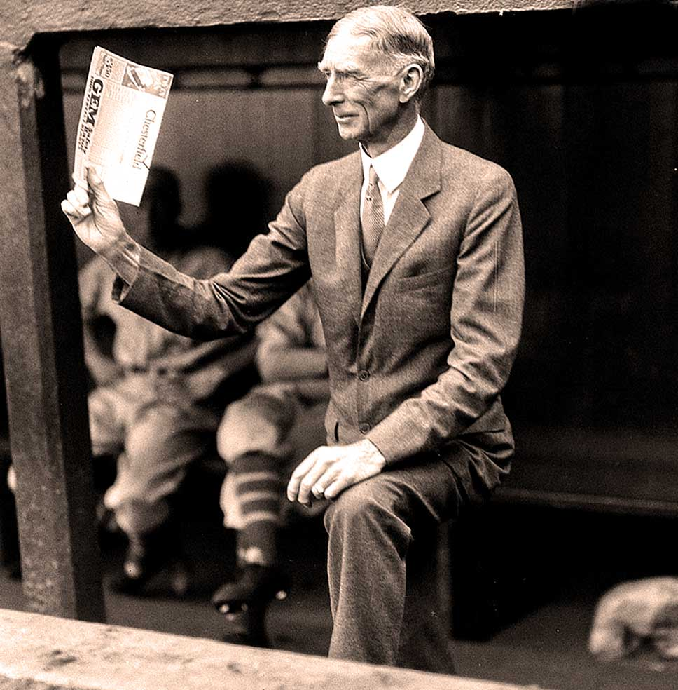
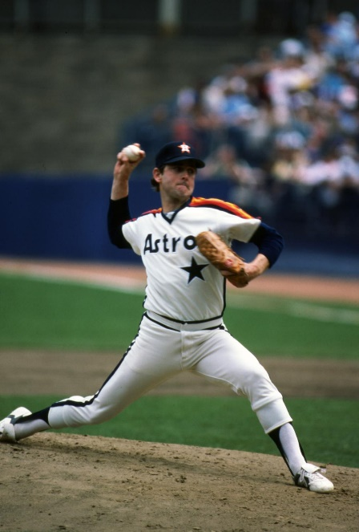
Irish-American Baseball Hall Of Fame Inductees
2008
Connie Mack
Kevin Costner
Sean Casey
Mark McGwire
Tug McGraw
2010
Tim McCarver
Brian Cashman
Bill James
Michael “King” Kelly
2009
Steve Garvey
Walter O’Malley
Paul O’Neill
Jim Joyce
2011
Big Ed Walsh
John McGraw
Terry Cashman
Nolan Ryan

Slide 7
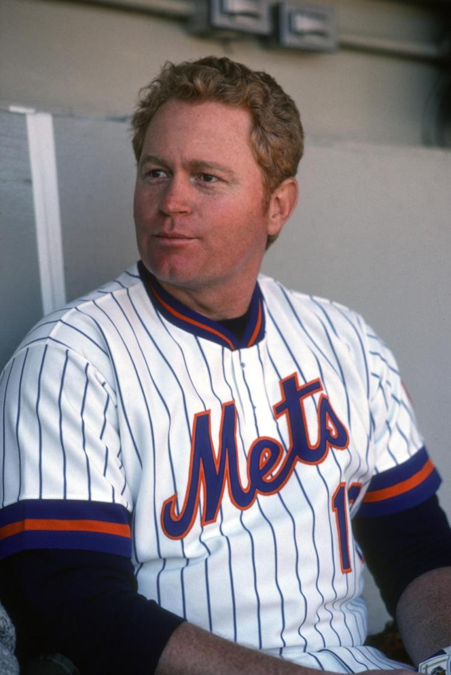
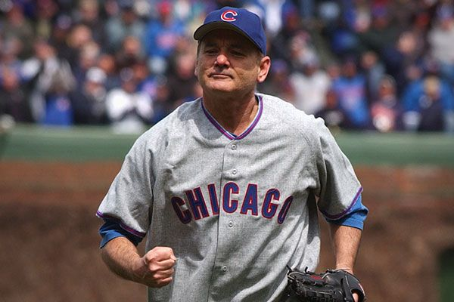
Irish-American Baseball Hall Of Fame Inductees
2012
Jeff Nelson
“Wee” Willie Keeler
Gene Michael
Tom Kelly
Joe Morgan
2013
Rusty Staub
“Super Joe” McEwing
Peter O’Malley
Dan Shaughnessy
2015
Mike Sweeney
Jack McKeon
Bill Murray
2014
David Cone
Tom Gorman

Slide 8
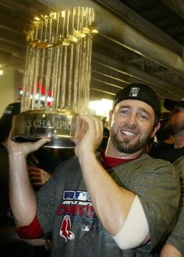
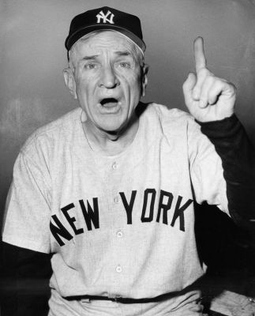
Irish-American Baseball Hall Of Fame Inductees
2016
Kevin Millar
Andy Leonard
2018
Adam Dunn
Eric Byrnes
Cub Feeney
2017
Al Leiter
Casey Stengel
Mike, Jack, Steve, and Jim O’Neill
2018 “I Didn’t Know He Was Irish” Award
Umpire Dan Iassogna
Previous Winners:
Pete Caldera, Duke Castiglione,
Mike Vaccaro, Mike Slano, Don Wakamatsu

Slide 9
Foley’s NY Pub & Restaurant

Slide 10
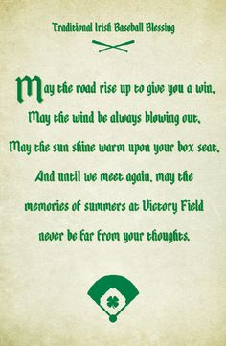
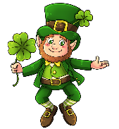
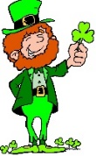
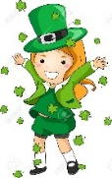
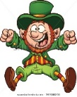
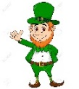
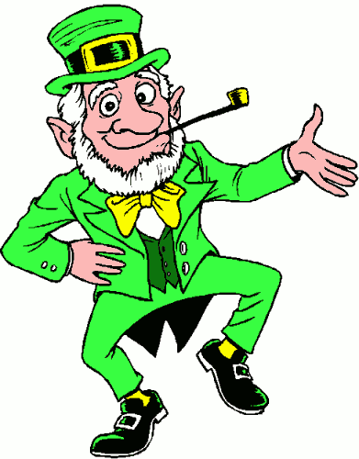
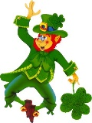
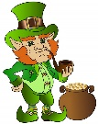
Happy St. Patrick’s Day from
Jim O’Kenton
Monte & Linda McCely
Jerry O’Miller
Bob and Diane McCaruthers
Ira O’Siegel
Dan McWalsh
Mike O’McNulty
Notes:
Indianapolis Indians Victory Field (Pittsburgh Pirates AAA team)

