Slide 1
This Day in History April 8

Slide 2
History

Slide 3
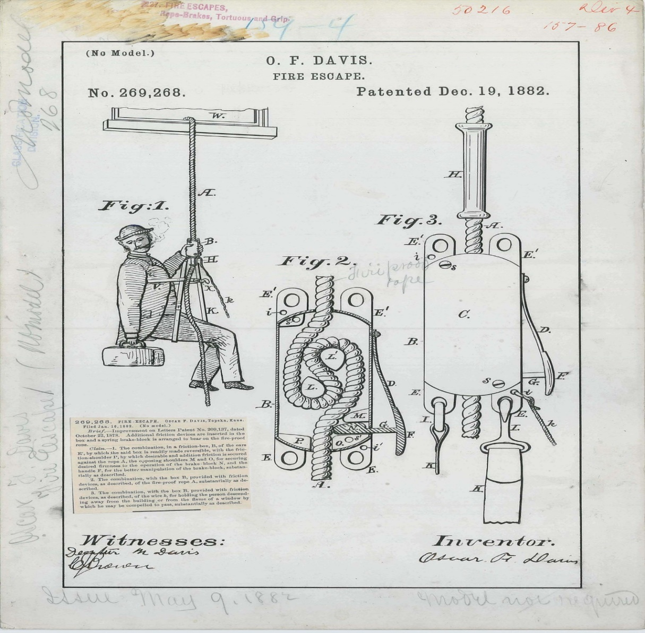
April 8, 1766 - 1st Fire Escape Patented
Notes:
First one was a wicker basket attached to a pulley and chain.

Slide 4
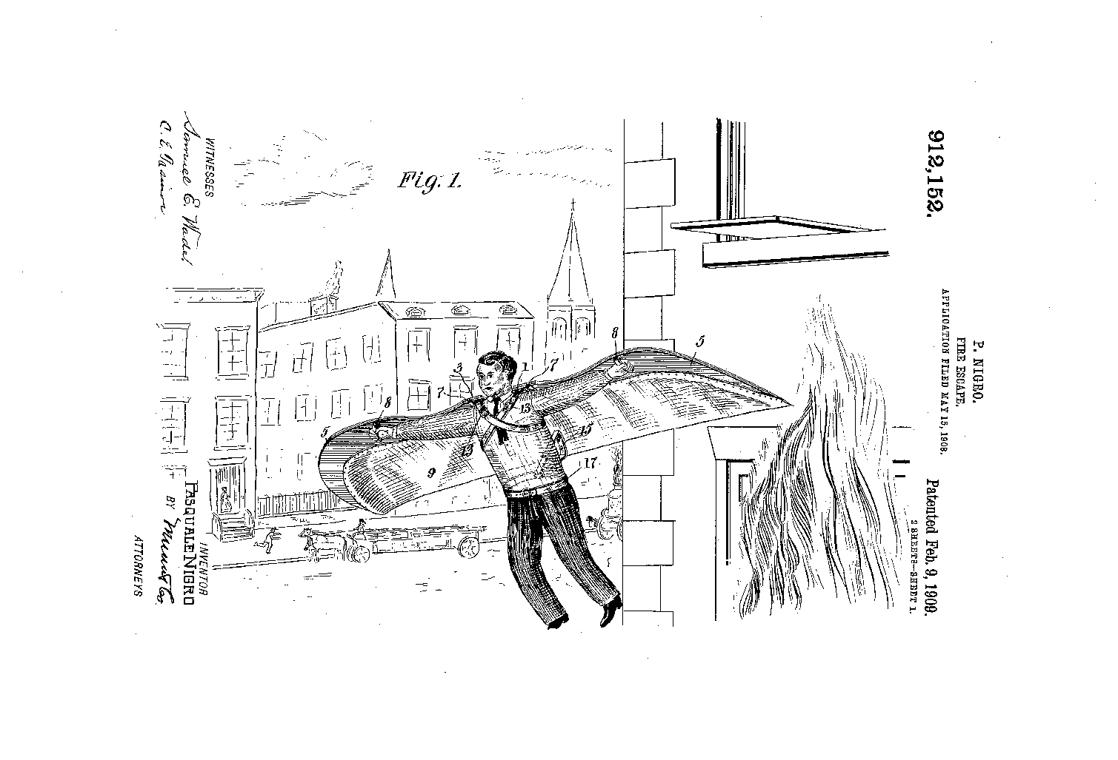
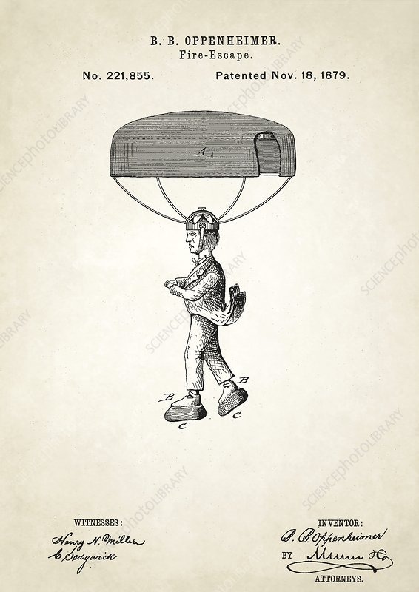
Other Early Fire Escape Patents
Notes:
Parachute – 1879. Wings = 1909

Slide 5
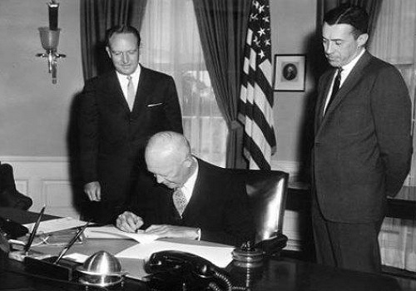
April 8, 1960
Senate Passes The Civil Rights Bill
Established federal inspection of voter registration polls. It was designed to deal with discriminatory laws and practices in the South, which had disenfranchised blacks and Mexican-Texans since the late 19th into the 20th century.
Notes:
Eisenhower signs into law.

Slide 6
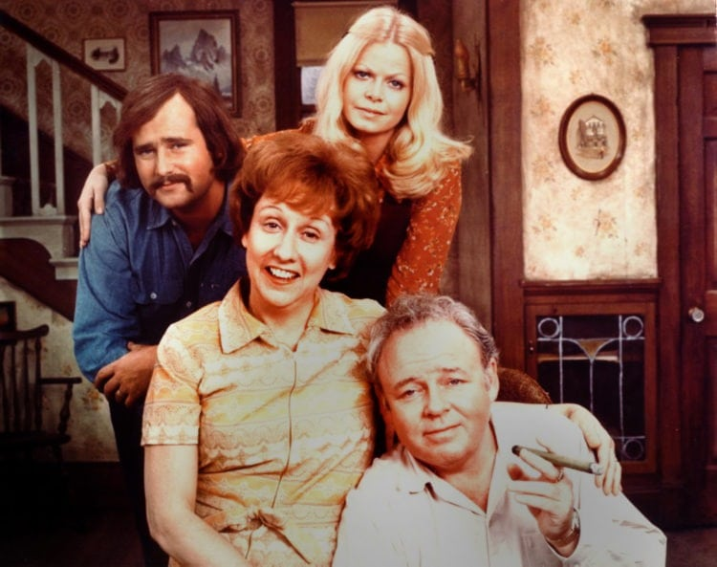
April 8, 1979
Final Episode of All In The Family Airs
204 episodes over 9 seasons.
Number 1 in ratings from 1971 to 1976.
TV Guide ranked it the #4 best series ever.
First primetime show where all 4 actors won Emmys.
Spinoff Archie Bunker’s Place ran 4 more seasons.
Notes:
#1-4: Seinfeld, I love Lucy, The Honeymooners.

Slide 7
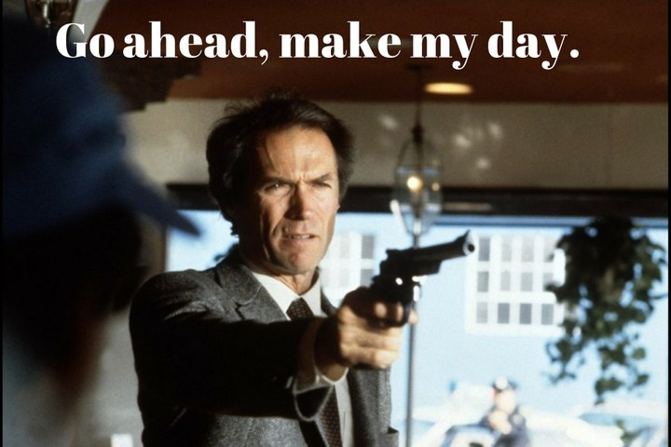
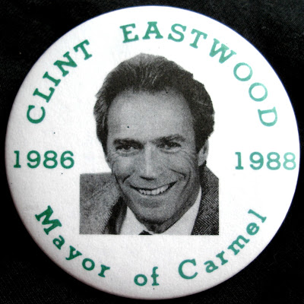
April 8, 1986
Carmel-by-the-Sea Makes Clint Eastwood’s Day
Notes:
Harry Callahan, “Sudden Impact”

Slide 8
Sports

Slide 9
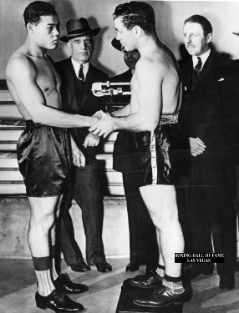
April 8, 1941 - Joe Louis TKOs Tony Musto
Louis was heavyweight champion an unprecedented 12 years. 25 successful title defenses.
In 2005, was named the best heavyweight of all time by the International Boxing Research Organization. Also named the number one greatest punchers of all time by Ring magazine's.
Regarded as the first African-American to achieve national hero status in the United States.
Was instrumental in integrating the game of golf, breaking the sport's color barrier in America by appearing in a PGA event in 1952.^{[6][7][8]}
Notes:
Musto = “Blue Island Tank” 37-30-3.

Slide 10
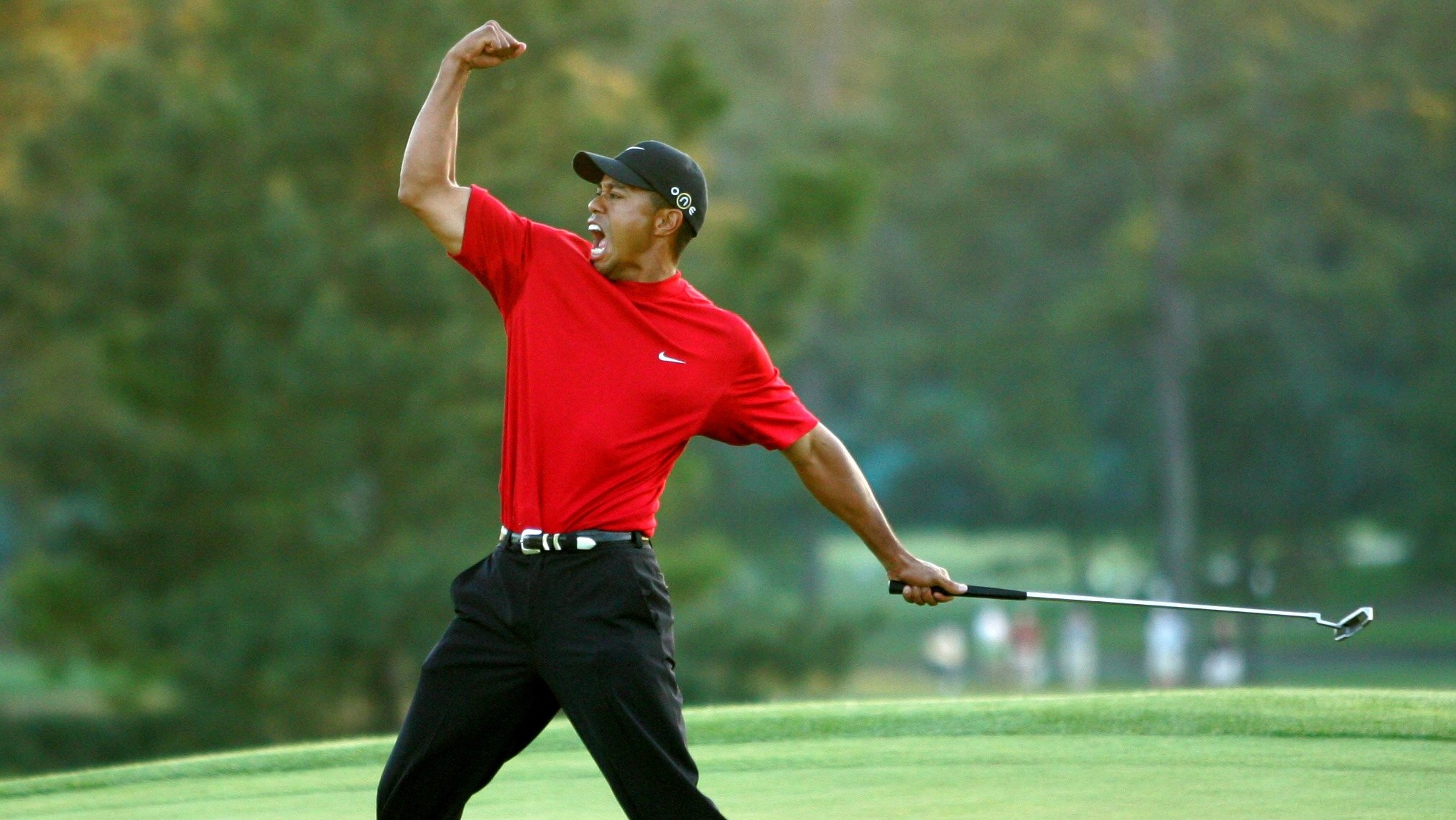
April 8, 2001
Tiger Wins The Masters
Went 16 under par and beat runner-up David Duval by 2 strokes.
His 2nd Masters and 6th Major. Now has 4 Masters and 14 Majors.
This was his 4th Major in a row, completing what’s now called “The Tiger Slam”.

Slide 11
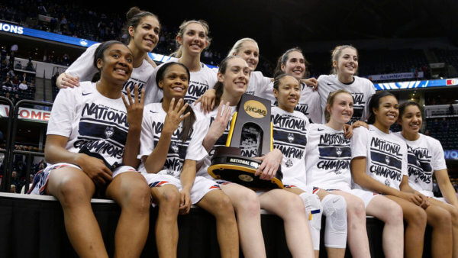
April 8 – A Big Day For UConn
2003. Defeats Tennessee, 73-68.
37-1 Season.
70-game winning streak over 2 seasons.
2014. Defeats Notre Dame, 79-58.
40-0 Perfect Season.
3rd Championship in a Row.
Notes:
11 National Championships and a women's record 4 in a row. 111 wins in a row from 2014 to 2017. Another streak of 90 in a row and this 70 in a row.

Slide 12
Baseball

Slide 13
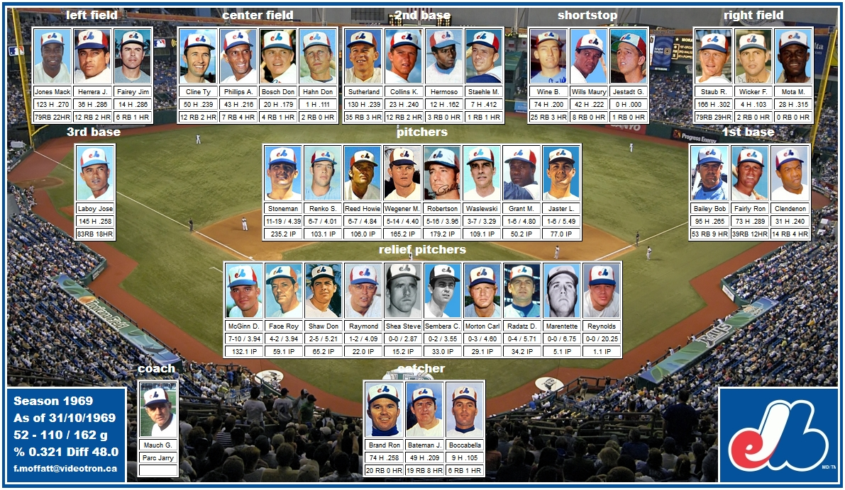
April 8, 1969 – 1st International MLB Game
Notes:
Montreal Expos Beat NY Mets in Shea Stadium, 11-10. Mudcat Grant started against Tom Seaver. Don Dhaw got the win.

Slide 14
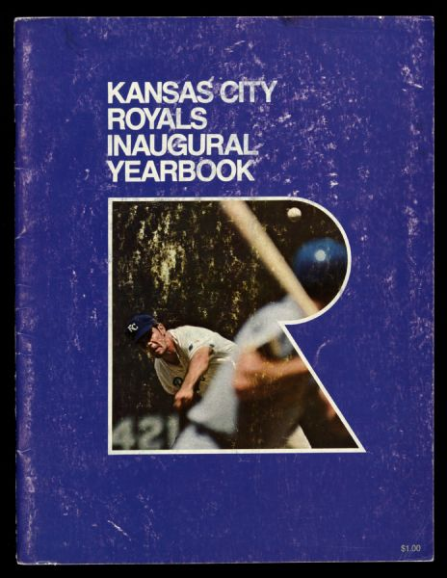
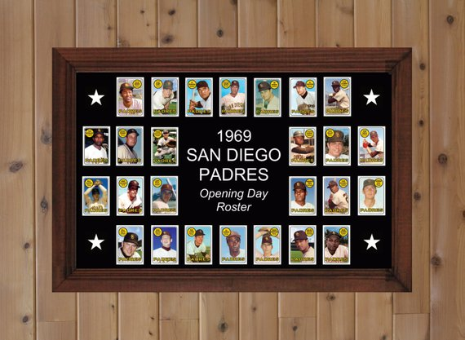
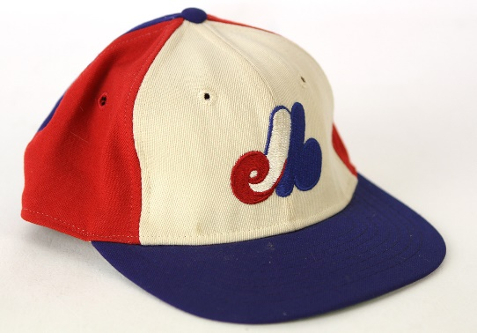
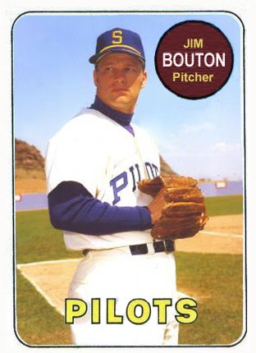
April 8, 1969
All 4 Expansion Teams Win Their 1st Game
KC Royals beat the Twins, 4-3. Ended up 69-93.
SD Padres beat the Astros, 2-1. Ended up 52-110.
Seattle Pilots beat the Angels, 4-3. Ended up 65-97.
Expos beat the Mets, 11-10. Ended up 59-103.

Slide 15
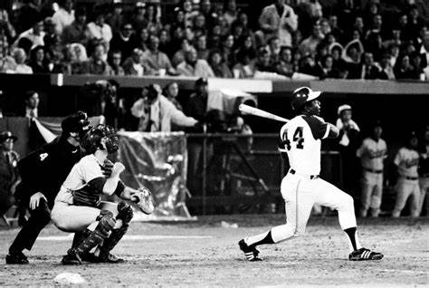
April 8, 1974 – Henry Aaron Hits His 715th Home Run
Real all-time home run leader ended up with 755.
Notes:
4th game of the season. 4th inning off Dodgers Al Downing. Hit one on opening day in Cincinnati to tie. Sat out the next game. Bowie Kuhn made him play game 3, but no homers. Returned home to hit 715.

Slide 16
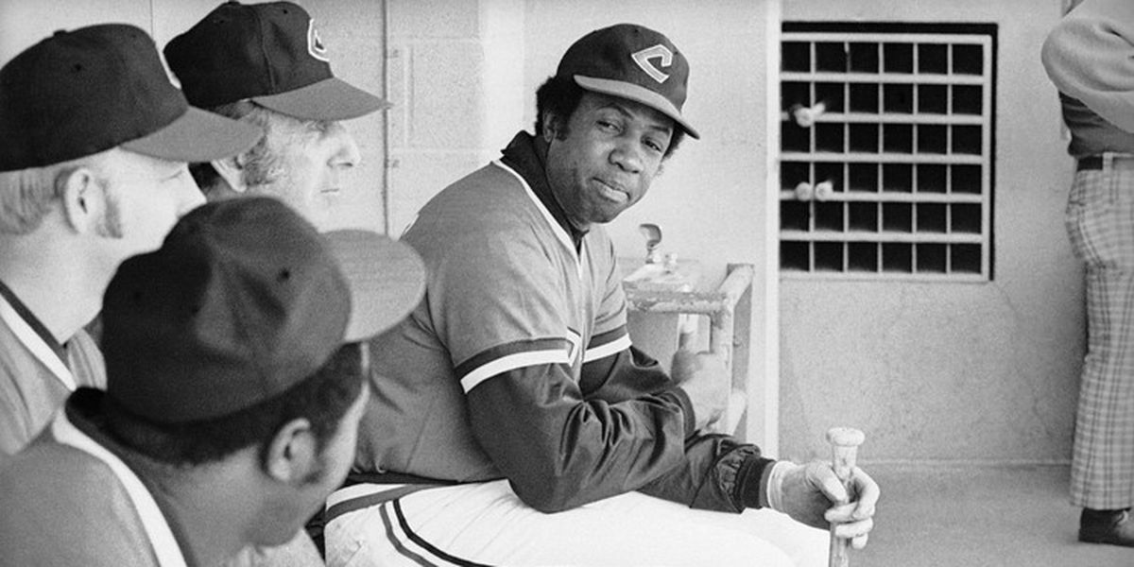
April 8, 1975 – Frank Robinson Becomes 1st African-American Manager in MLB
Cleveland beat the Yankees, 5-3.
Was player/ manager in 1975 and 1976.
Team went 79-80.
Notes:
Managed the Indians, Giants Orioles, and Expos/Nationals. 1065-1176 lifetime.

Slide 17
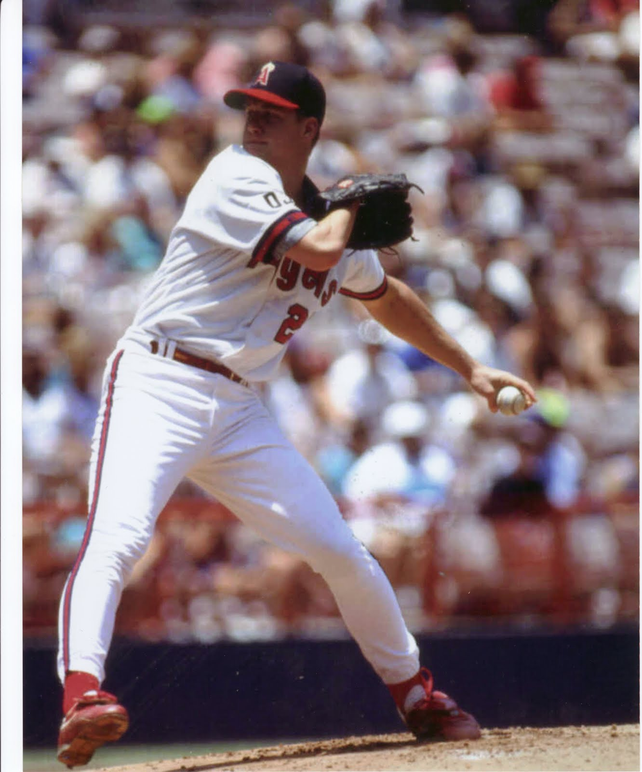
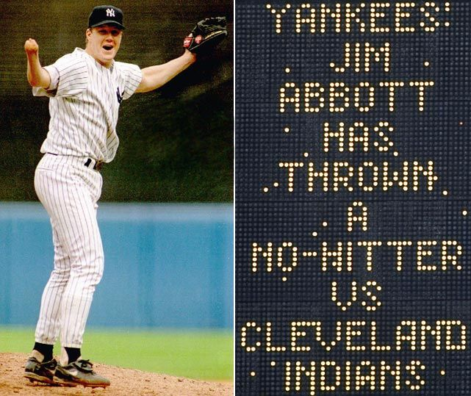
April 8, 1989 – Jim Abbott Makes His MLB Debut
Notes:
Never played in the Minors. Pitched from 1989 to 1999. Went 87-108, 4.25 ERA. Best year was 1991 = 18-11, 2.89 ERA.

Slide 18
April 8th Birthdays

Slide 19
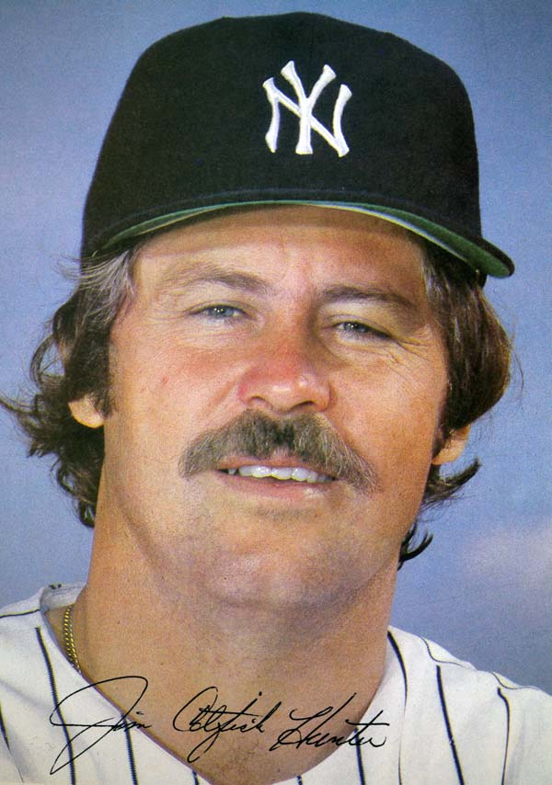
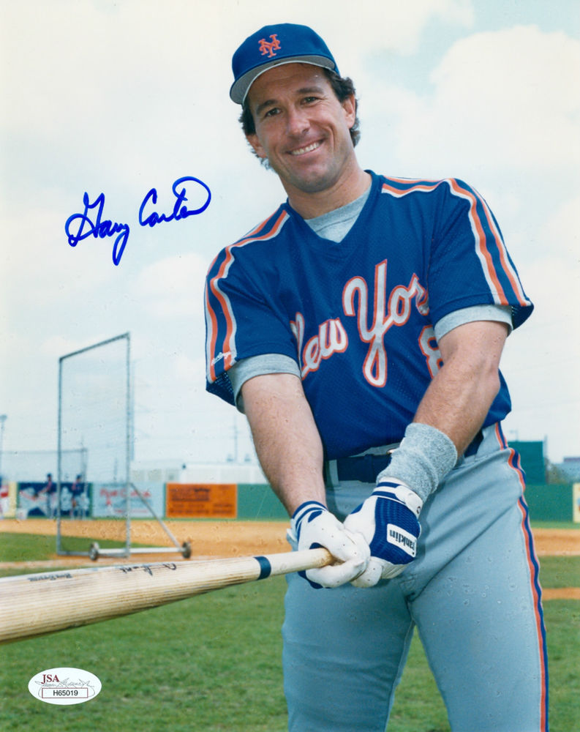
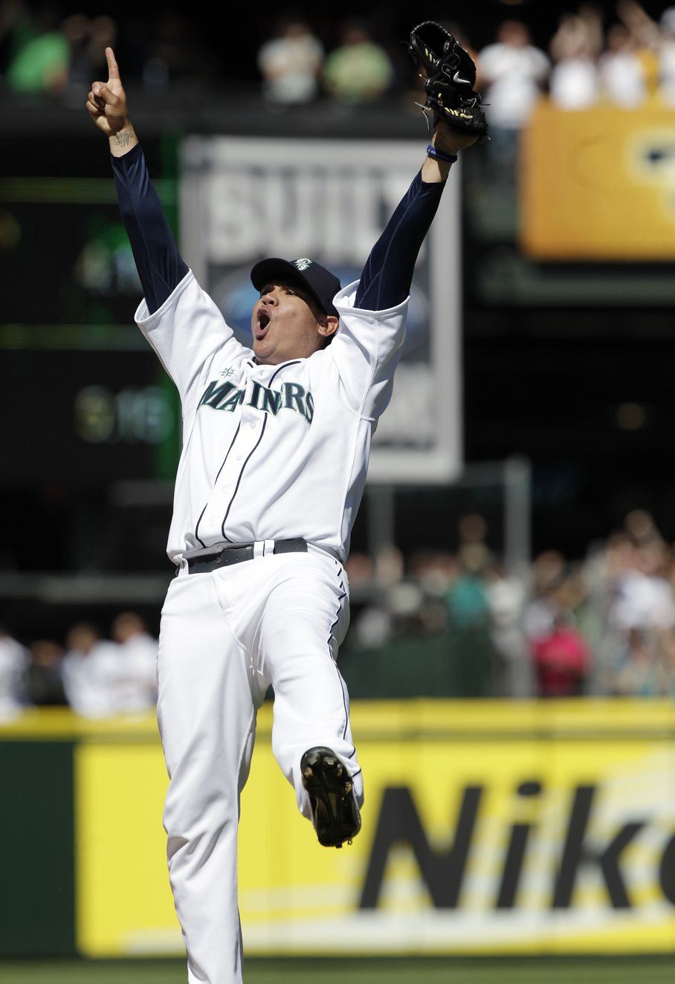
Baseball Birthdays
1946 – Catfish Hunter
1954 – Gary Carter
1986 – Felix Hernandez
Notes:
CH: Never played in the Minors. Hall Of Famer. Won 5 World Series. Threw a Perfect Game in 1968 with Oakland. Given nickname by Charlie Finley just because he wanted him to have a nickname. GC: 11 A.S. teams. Great catcher. Hall of Famer. First player shown as an Expo in the HoF.
FH: King Felix. Perfect game on August15, 2012. Immaculate Inning on June 17, 2008. 6 A.S. teams. 2010 Cy Young Award

Slide 20
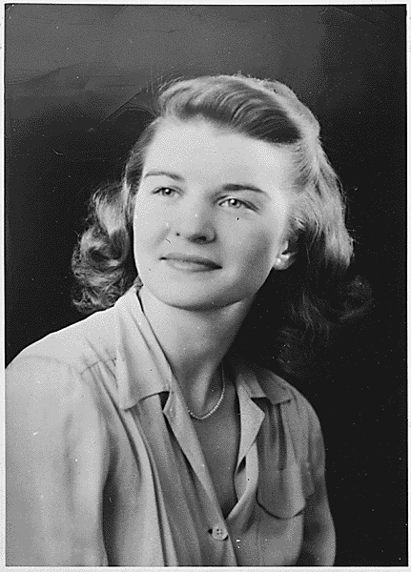
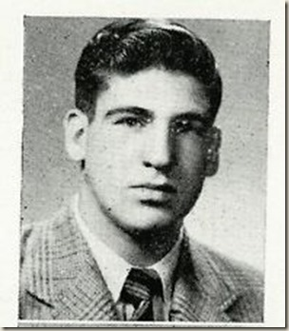
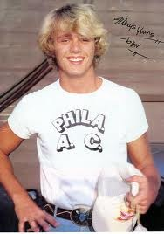
Recognize Me?
1918
1925
1941
Notes:
Elizabeth Bloomer (at 18). Fred Greenfield. TV star

Slide 21
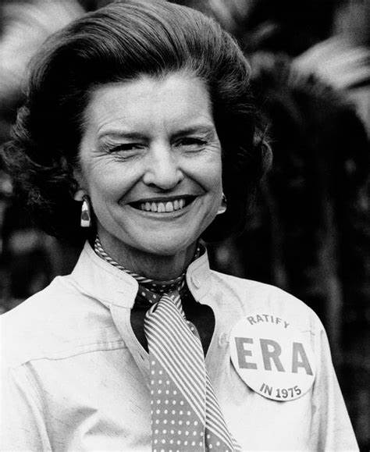
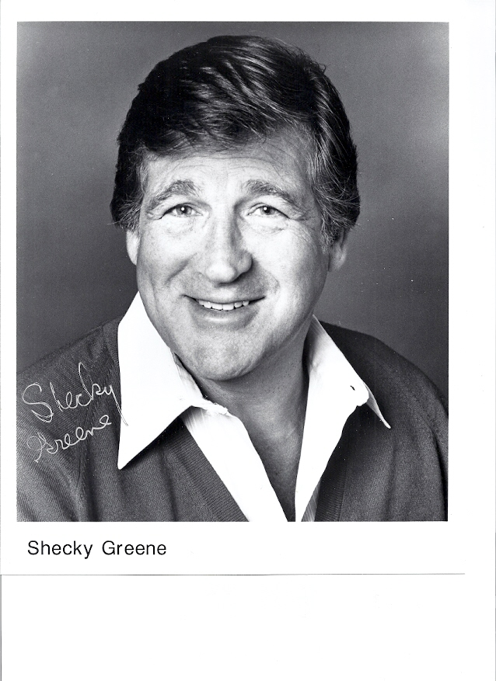
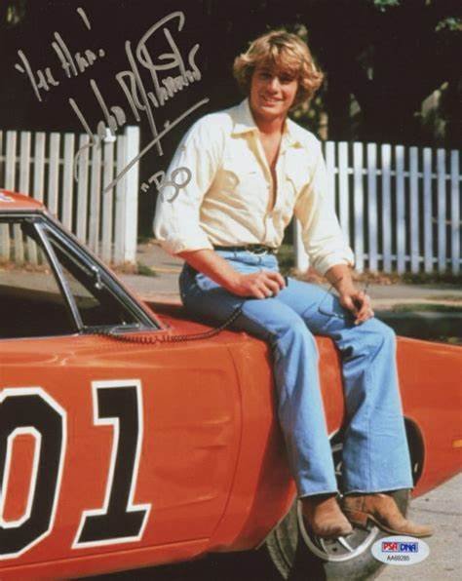
Notes:
Betty Ford, Shecky Greene, John Schneider

Slide 22
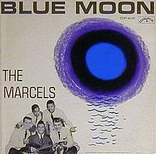
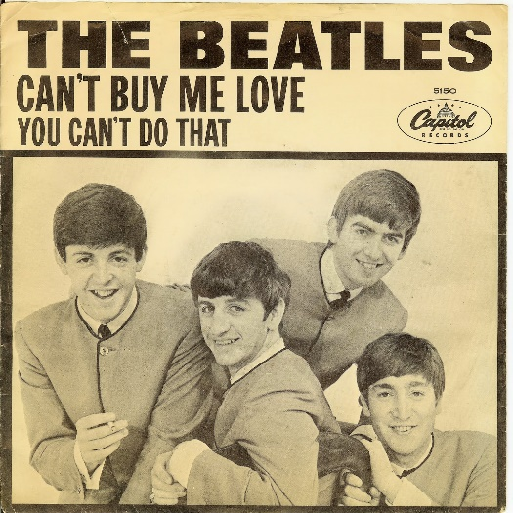
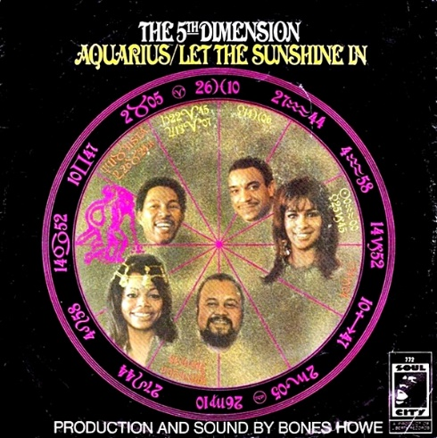
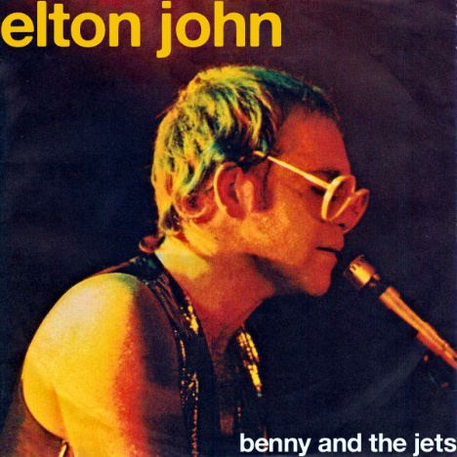
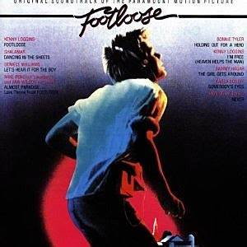
April 8th Number 1 Hits
1961
1964
1969
1974
1984

Slide 23
April 8, 2019 – A Very Special Day
The 100th meeting of our Talking Baseball memories Program is held.
Thanks to everyone!

