Slide 1
This Day in History February 11

Slide 2
Sports

Slide 3
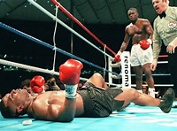
February 11, 1990 – Buster Douglas KOs Mike Tyson
Notes:
Was fought in Tokyo. 42-1 underdog. “I’ll be here about 90 seconds”

Slide 4
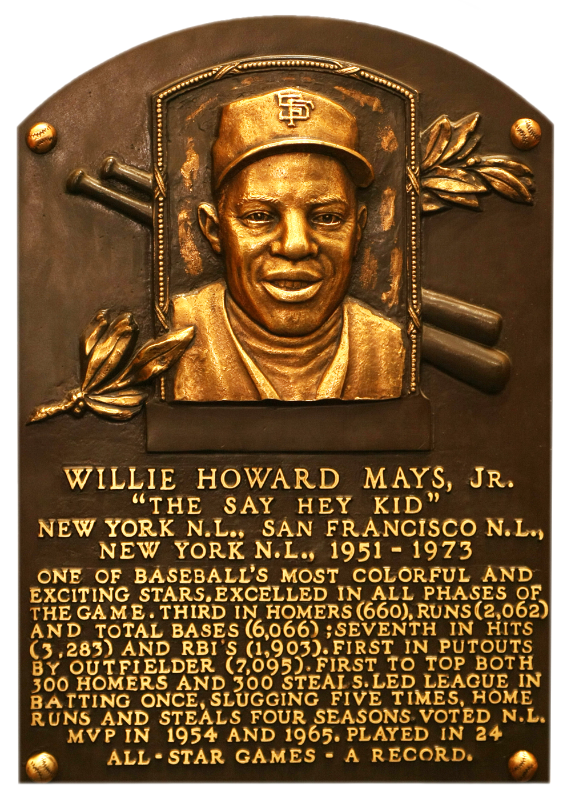
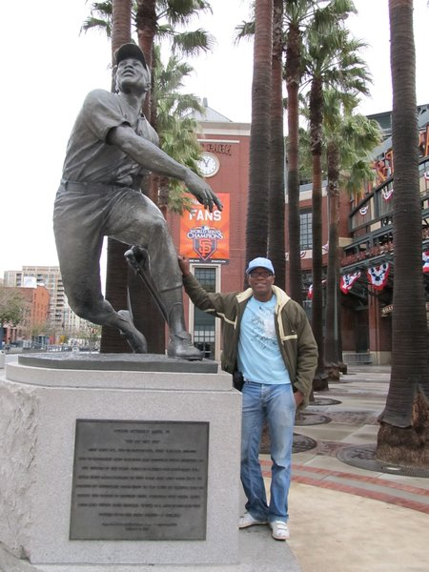
February 11, 1966
Willie Mays Signs Largest Contract Ever In Baseball - $130,000
Notes:
Minimum salary today is $545,000. In 1965, he hit .317, 52 home runs, and 112 RBIs. Won the MVP. In 1966, he hit .288, 37 homers, and 103 RBIs. Was 3rd in MVP. Won Gold Glove both years. All Star both years.

Slide 5
February 11, 1905 - Highest Non-Perfect Bowling Score Ever
In 1905, Seattle’s James Blackstone had bowled 11 strikes in a row and after he threw his 12th ball, the only thing still standing was the broken bottom part of a pin.
Officials gave him a score of 299 ½.

Slide 6
February 11th Birthdays

Slide 7
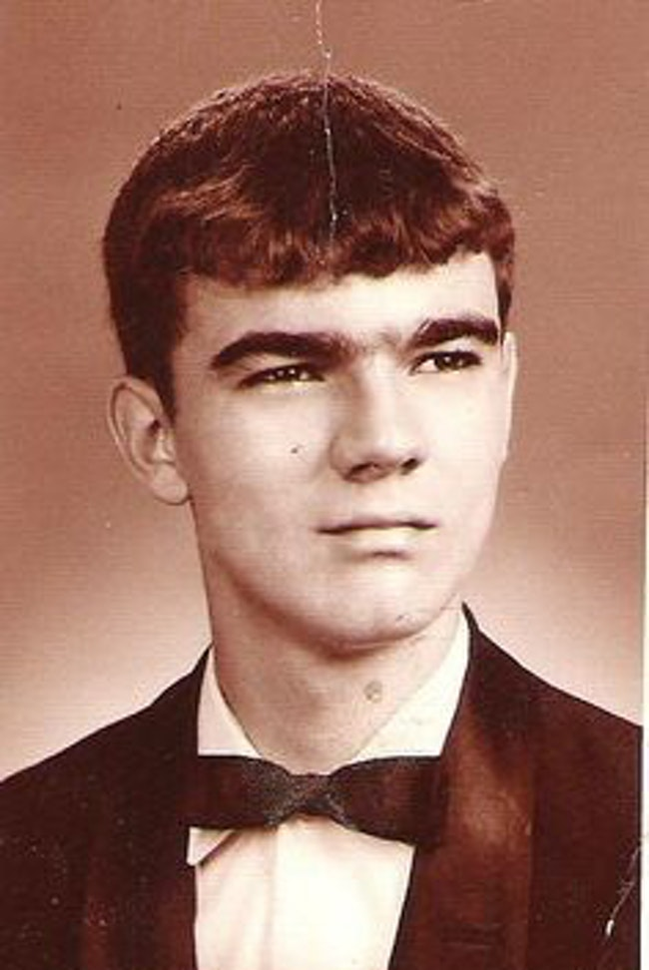
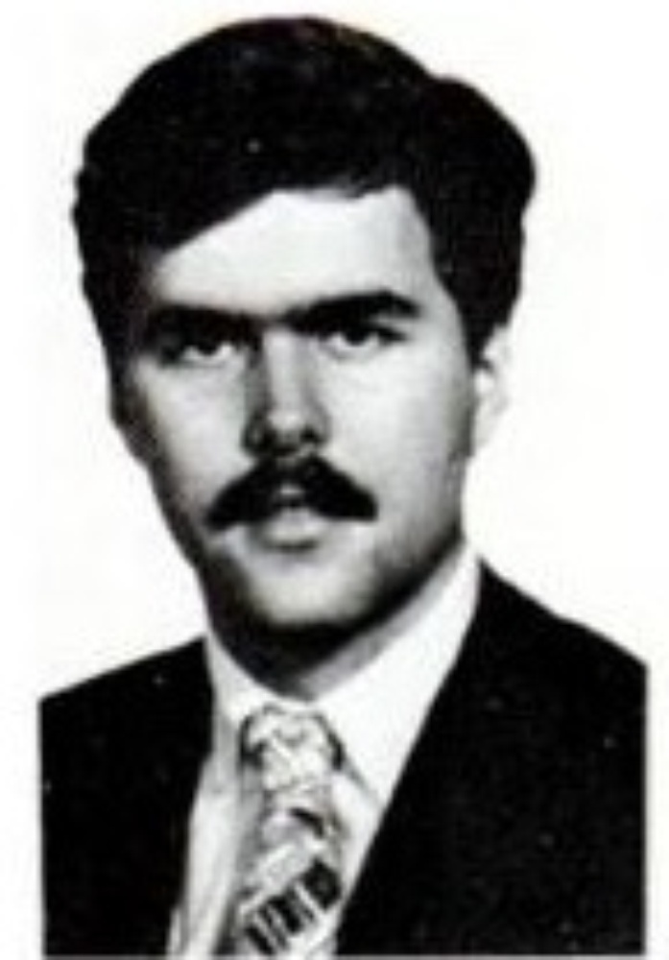
1919
1936
1953
Notes:
Had famous sisters (Eva Gabor). Played football at Florida State (Burt Reynolds). Had famous brother and Dad (Jeb Bush)

Slide 8
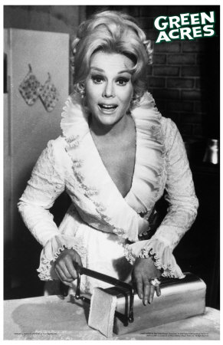
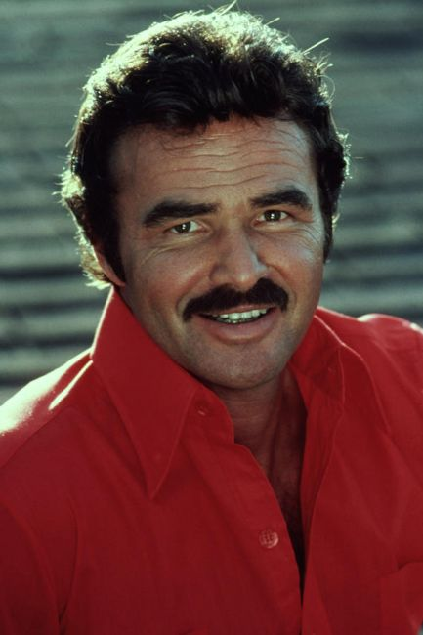
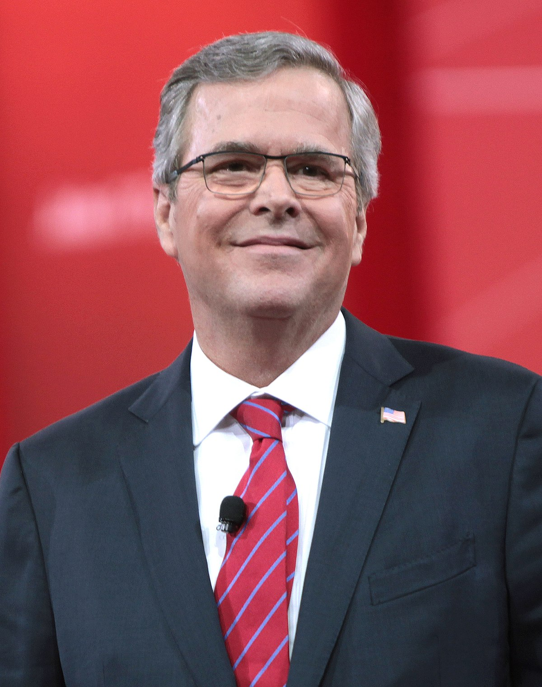
Notes:
Eva Gabor, Burt Reynolds, Jeb Bush

Slide 9
History

Slide 10
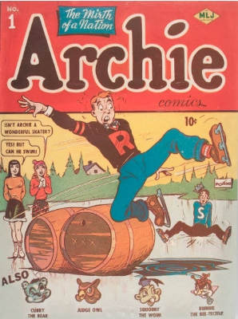
February 11, 1942 – Archie Andrews Is Born
The first edition of “Archie Comics” is released.
Sells for about $150 now.
Notes:
As the years went on, they did use February 11th as his birthday.

Slide 11
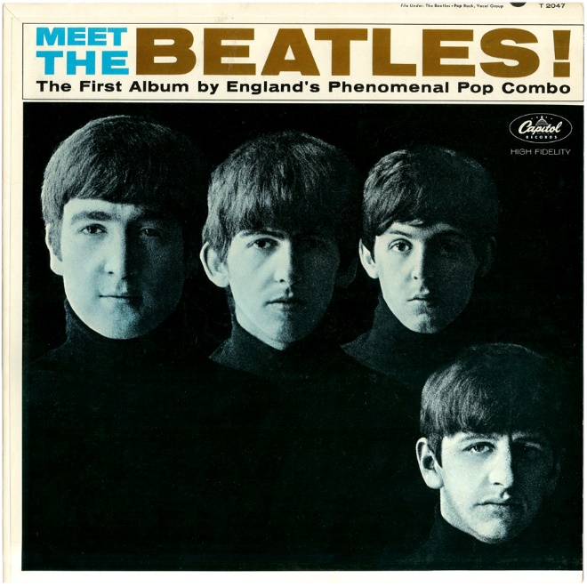
February 11 – Big Day For The Beatles
1962 – Record “Please, Please Me”.
1963 – Start recording 10 songs for what will be their first album.
1964 – First concert in the United States at the Washington Coliseum.

Slide 12
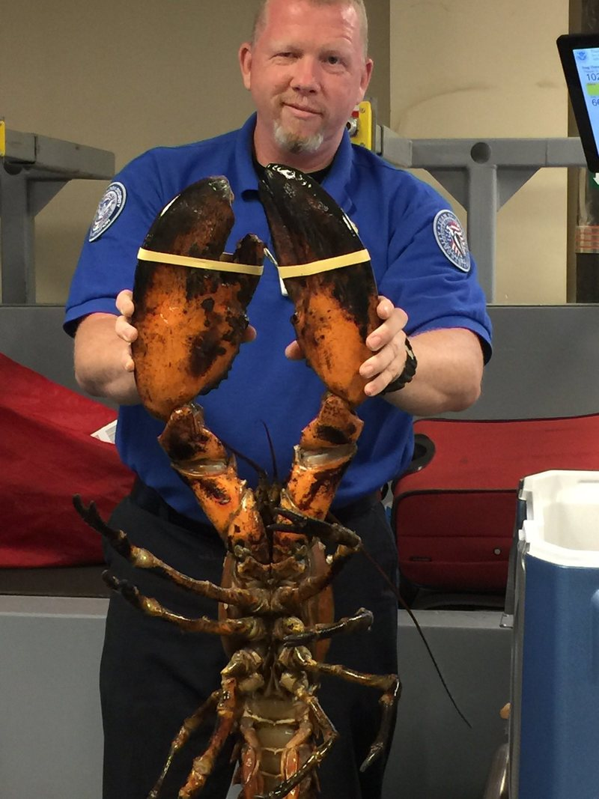
February 11, 1977
Largest Lobster Ever Caught
44 pounds, 6 ounces
3 feet 5 inches from the tip of its largest claw to the end of its tail.
Notes:
Verified by the Guinness Book of World Records. It was caught off the coast of Nova Scotia. The one in this picture was just over 20 pounds.

Slide 13
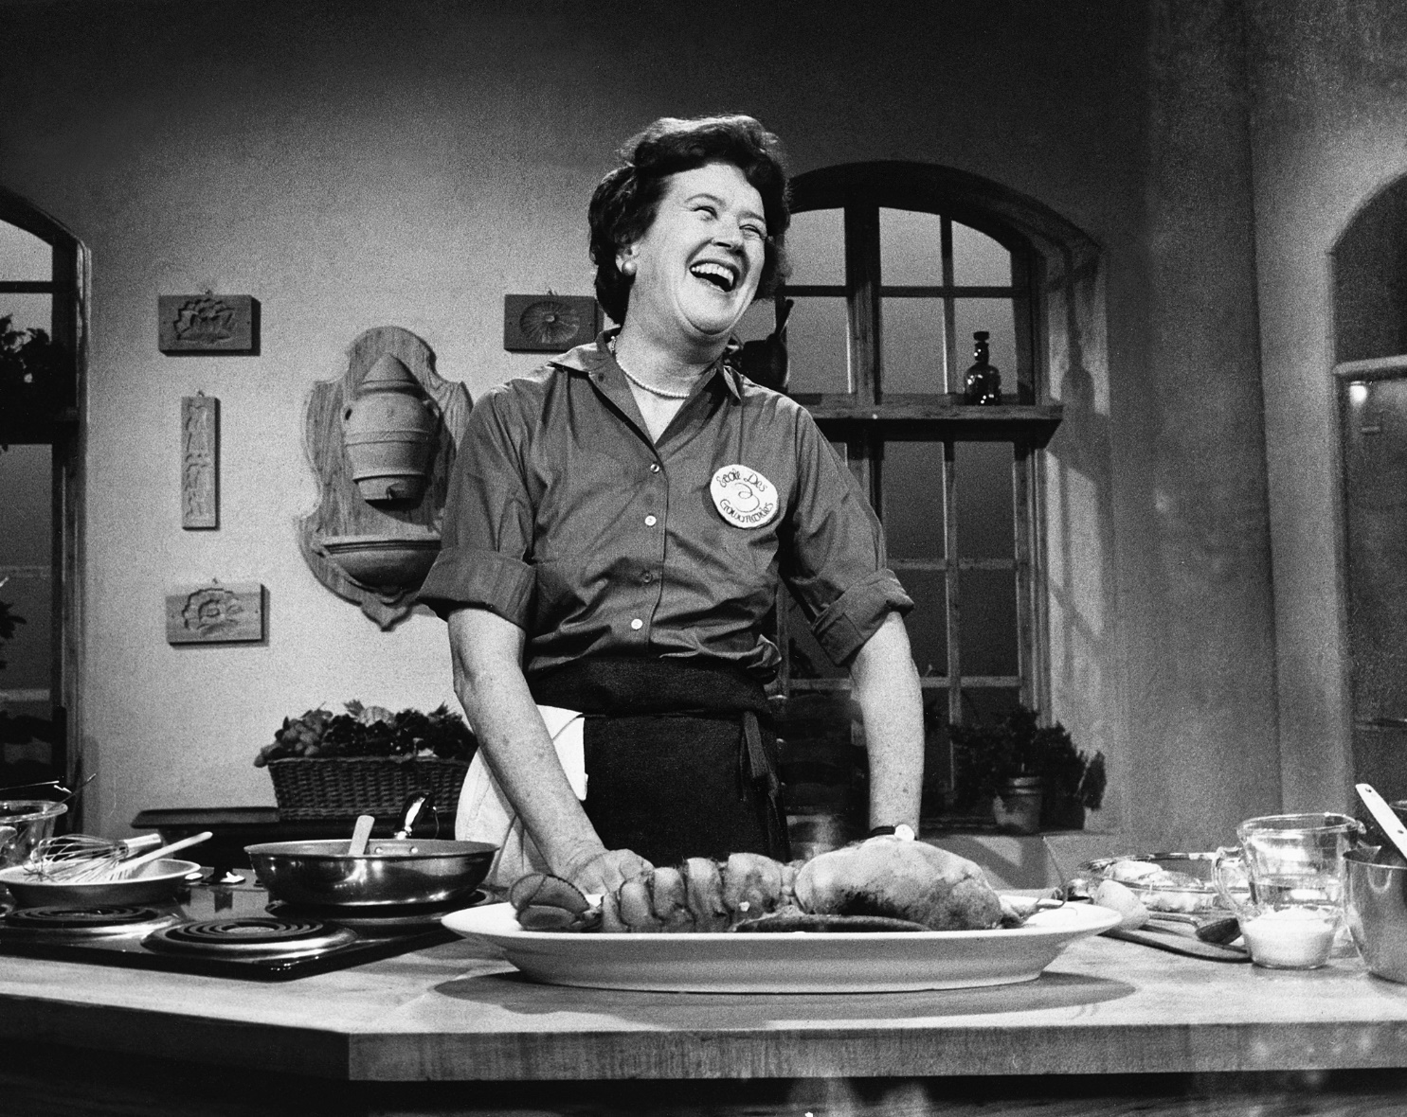
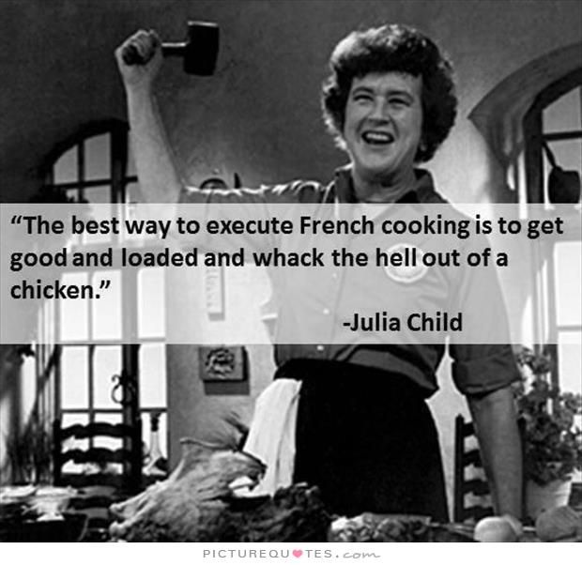
February 11, 1963
“The French” Premieres

