Slide 1
This Day in History February 25

Slide 2
Sports

Slide 3
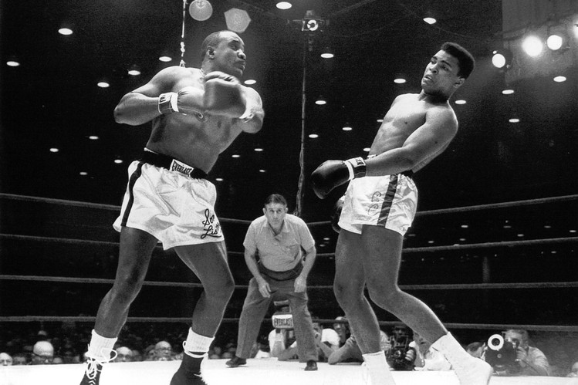
February 25, 1964
Cassius Clay (Later Muhammad Ali) Defeats Sonny Liston
Notes:
Miami Beach. Liston didn’t come out for the 7th round. TKO victory. Sports Illustrated listed this in the top 25 sports moment of the 20th century. Great photograph.

Slide 4
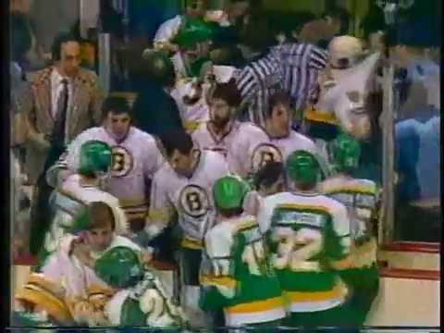
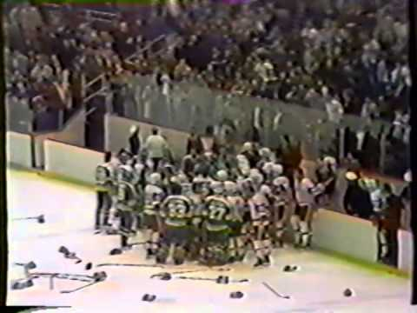
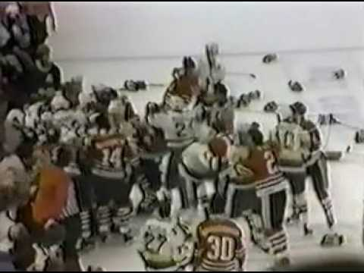
February 25, 1981
Most Penalty Minutes In An NHL Game
Boston Bruins vs. Minnesota North Stars
The first fight broke out 7 seconds into the game. In the 1st period alone, there were 341 penalty minutes, and 12 players (7 North Stars and 5 Bruins) were ejected. The 67 penalties in the period are an NHL record.
By the end of the game, there were 84 penalties for a total of 406 minutes, an NHL record. Minnesota was penalized a record 211 minutes -- 18 minors, 13 majors, 4 10-minute misconducts, and 7 game misconducts.
On their way back to the dressing room after the game, the 2 coaches had to be pulled apart by the police.

Slide 5
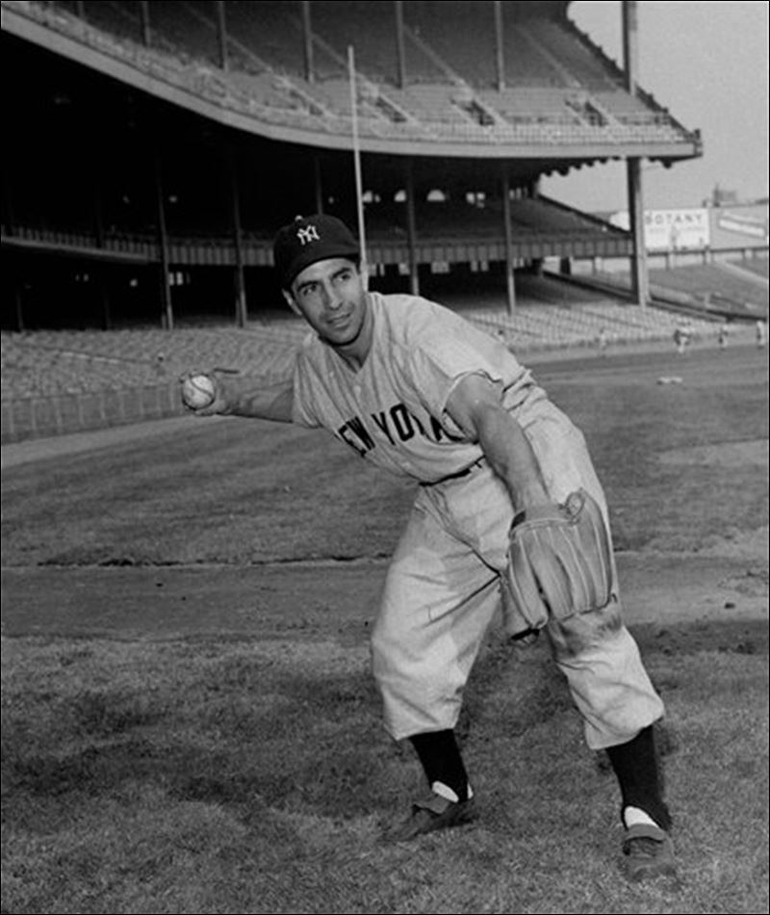
February 25, 1994 – Phil Rizutto Elected To The Hall Of Fame
“Scooter”. 5’ 6”, 150 pounds.
13 years with the Yankees. Won 7 World Series.
One of greatest bunters, baserunners, and shortstops in baseball history.
5-time all-star. Won AL MVP in 1950.
Yankees announcer for 40 years.
“Holy cow!”

Slide 6
February 25th Birthdays

Slide 7
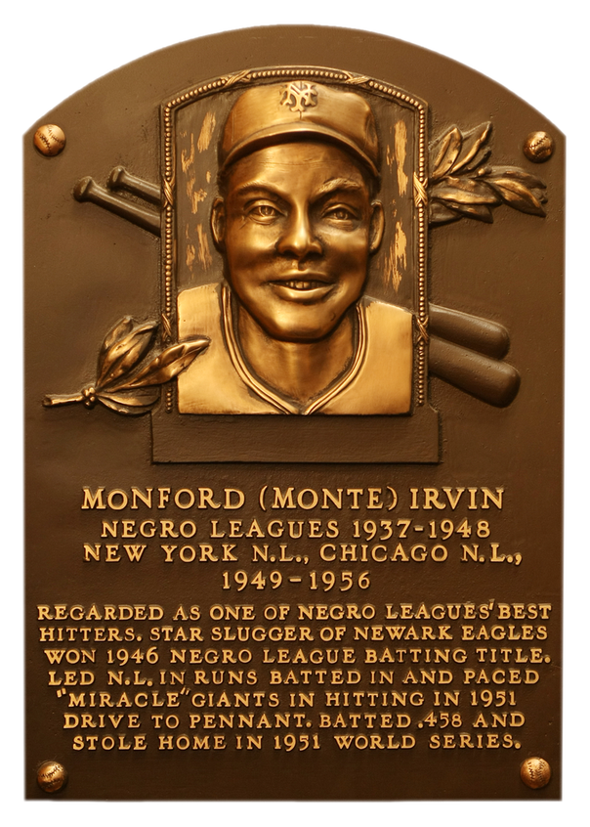
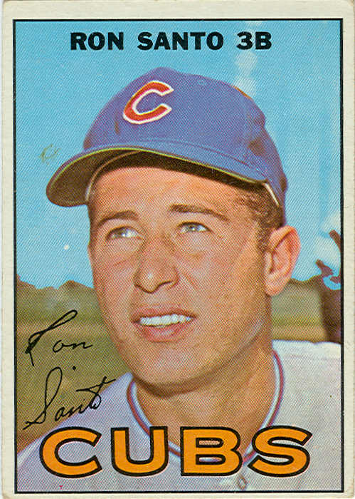
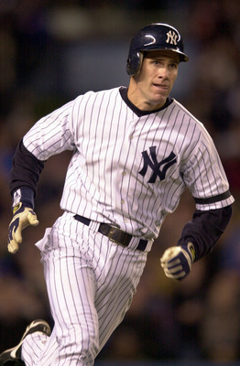
1919
1940
1963
Notes:
Irvin: After 4 years in the Negro League and 1 in the Mexican League, he served 3 years in the army. Was in a secondary infantry line at WWII’s Battle of the Bulge. Returned to baseball but had continual ringing in his ears from the war, which affected his balance and dexterity. Made the majors at age 30.
Santo: 9-time all star; 5 Gold Gloves at 3rd base; Hall of Fame in 2012.
O’Neill: 5-time all star; 5-time World Series champ; only player to play on the winning team in 3 perfect games. Tom Browning's (Reds) perfect game in 1988; David Wells' in 1998; David Cone's in 1999. Was on “Seinfeld”.

Slide 8
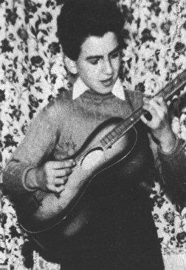
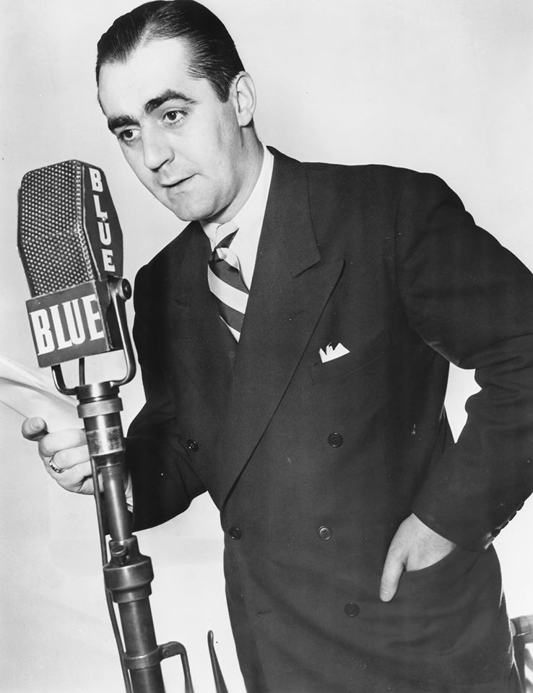
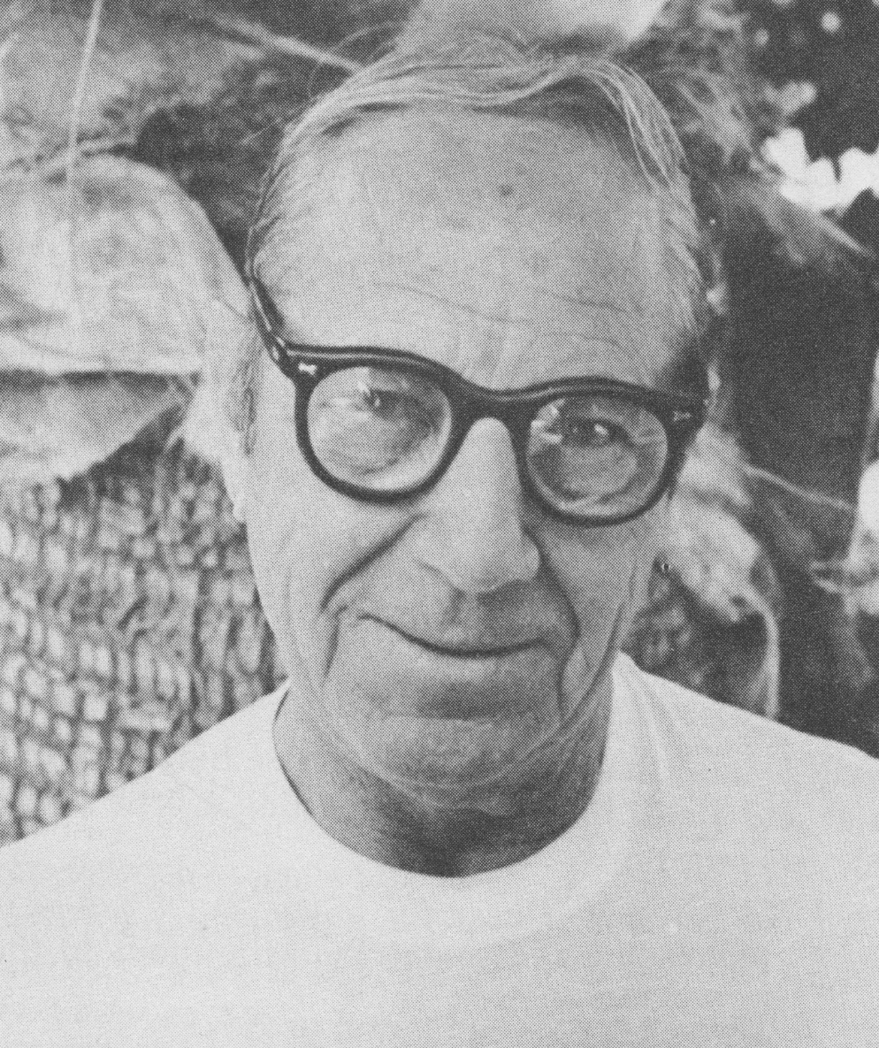
1943
1913
1901
Notes:
Part of a group. TV, radio, movies, vaudeville, cartoons Broadway. Part of a group.

Slide 9
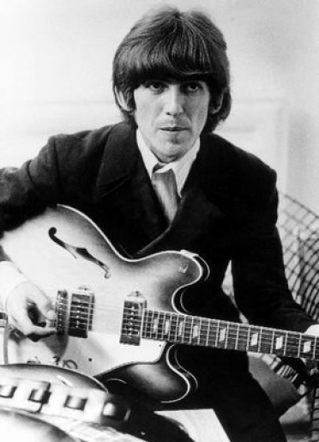
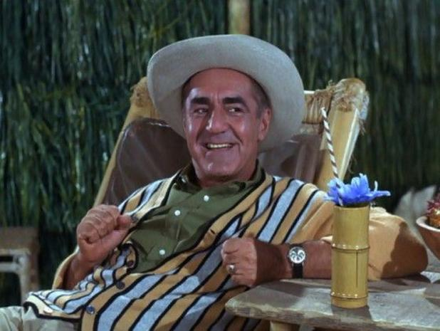
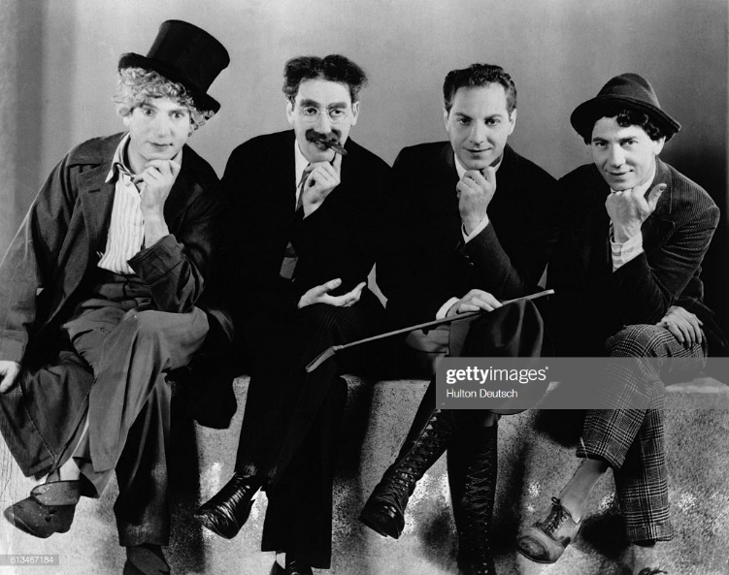
Notes:
George Harrison, Jim Backus, Zeppo Marx (Herbert)

Slide 10
History

Slide 11
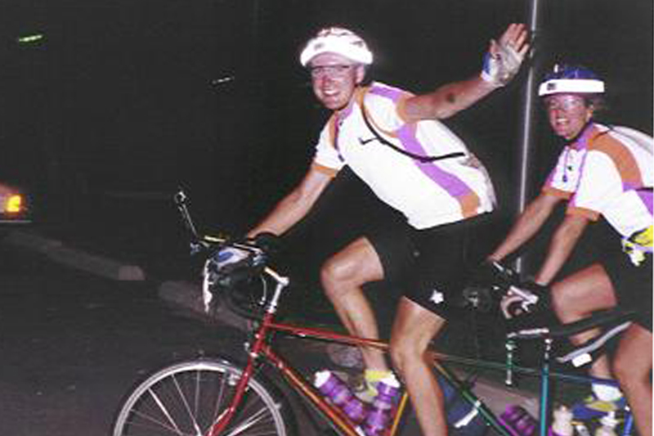
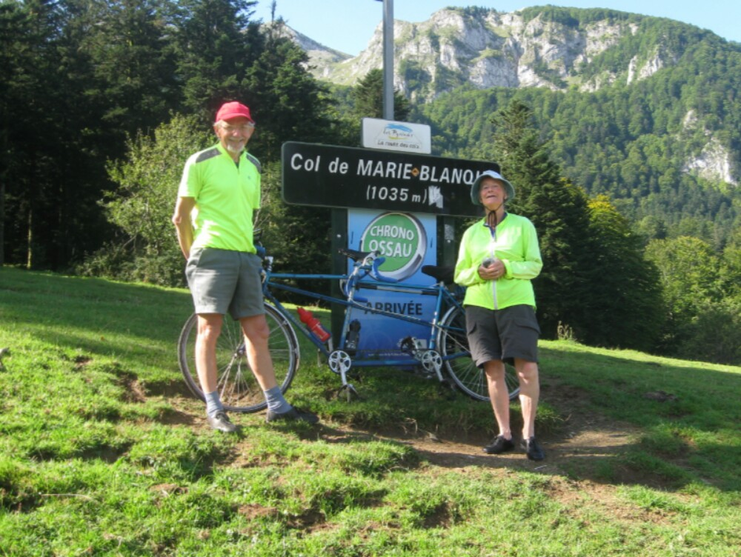
February 25, 1974 – A Long Bike Ride Starts
Veronica and Colin Scargill of England begin a tandem bike ride, which goes a record 18,020 miles around the world. They finish on August 27, 1975. Surprisingly, they’re still married!

Slide 12
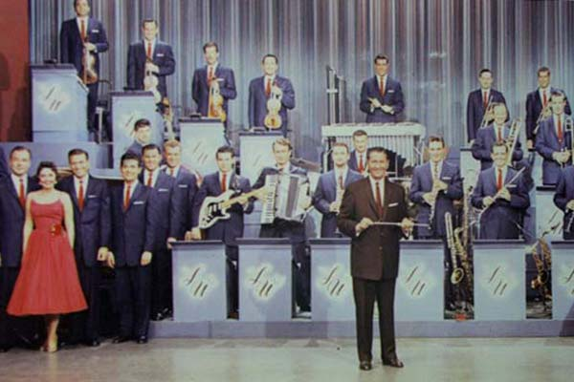
February 25, 1982
Final Lawrence Welk Show Airs
First aired in 1951 in LA.
When it went national in 1955, it was called “The Dodge Dancing Party”. From 1956 to 1958, it was called “Lawrence Welk Presents Top Tunes and New Talent”. From 1958 to 1959, it was “Lawrence Welk's Plymouth Show”.
“A 1 and a 2 and a 3.”
Notes:
25 years before stereo TV, they used 2 audio channels, and broadcast 1 over ABC radio and 1 over ABC television. So people turned on the radio and the TV and got a version of stereo.

Slide 13
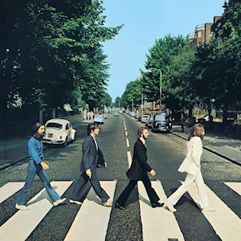
February 25 – Another Big Day For The Beatles
1963 – Release their first U.S. single “Please, Please Me”.
1969 – Begin Recording “Abbey Road”.
1972 – Paul McCartney releases single, “Give Ireland Back To The Irish”.
Notes:
London is 6 hours ahead.

