Slide 1
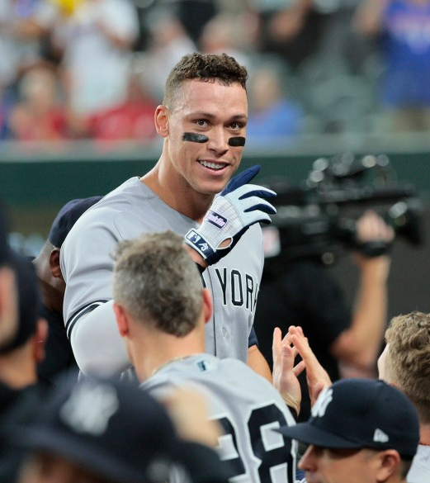
Baseball Memories 2022

Slide 2
Ira Siegel
Aaron Judge’s 62nd Home Run
October 4, 2022
Globe Life Field, Arlington

Slide 7
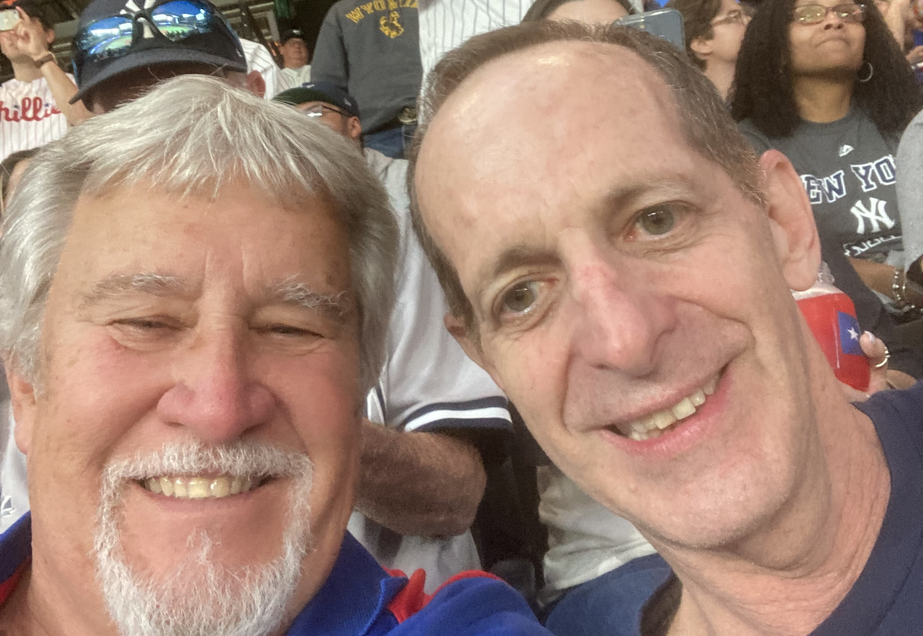

Slide 8
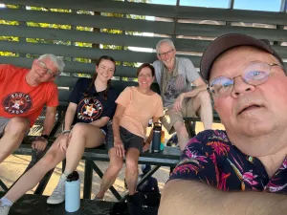
Jan Larson

Slide 9
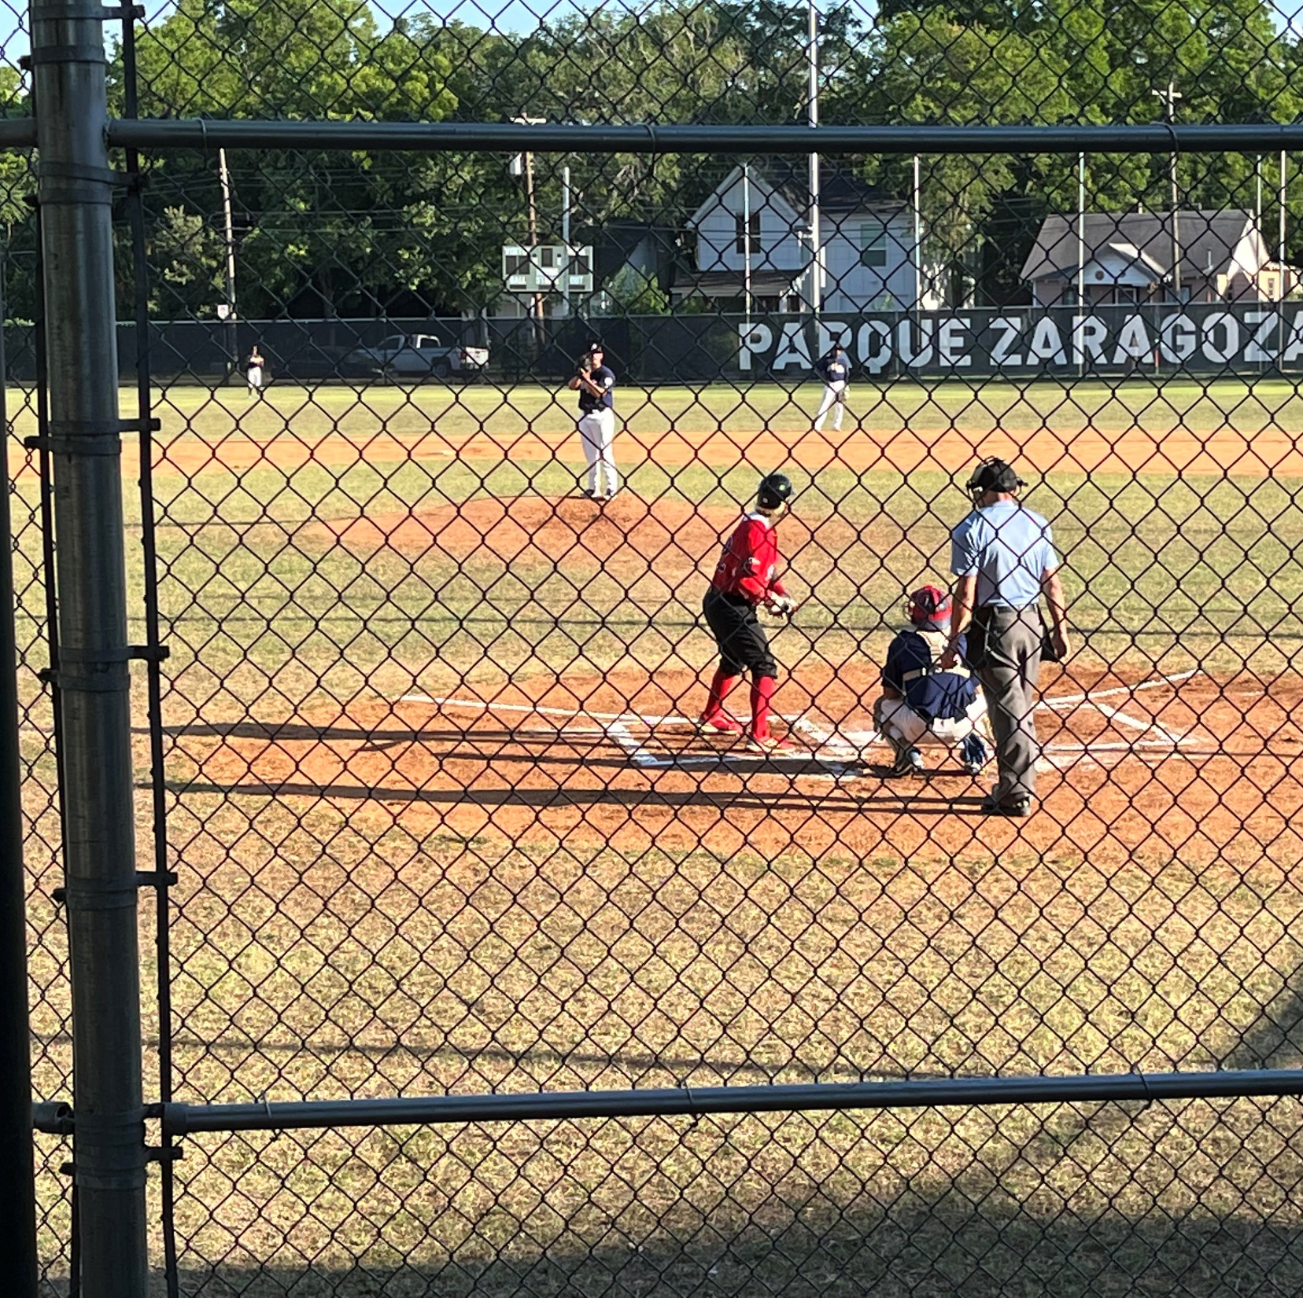
The “Austin Weirdos”

Slide 10
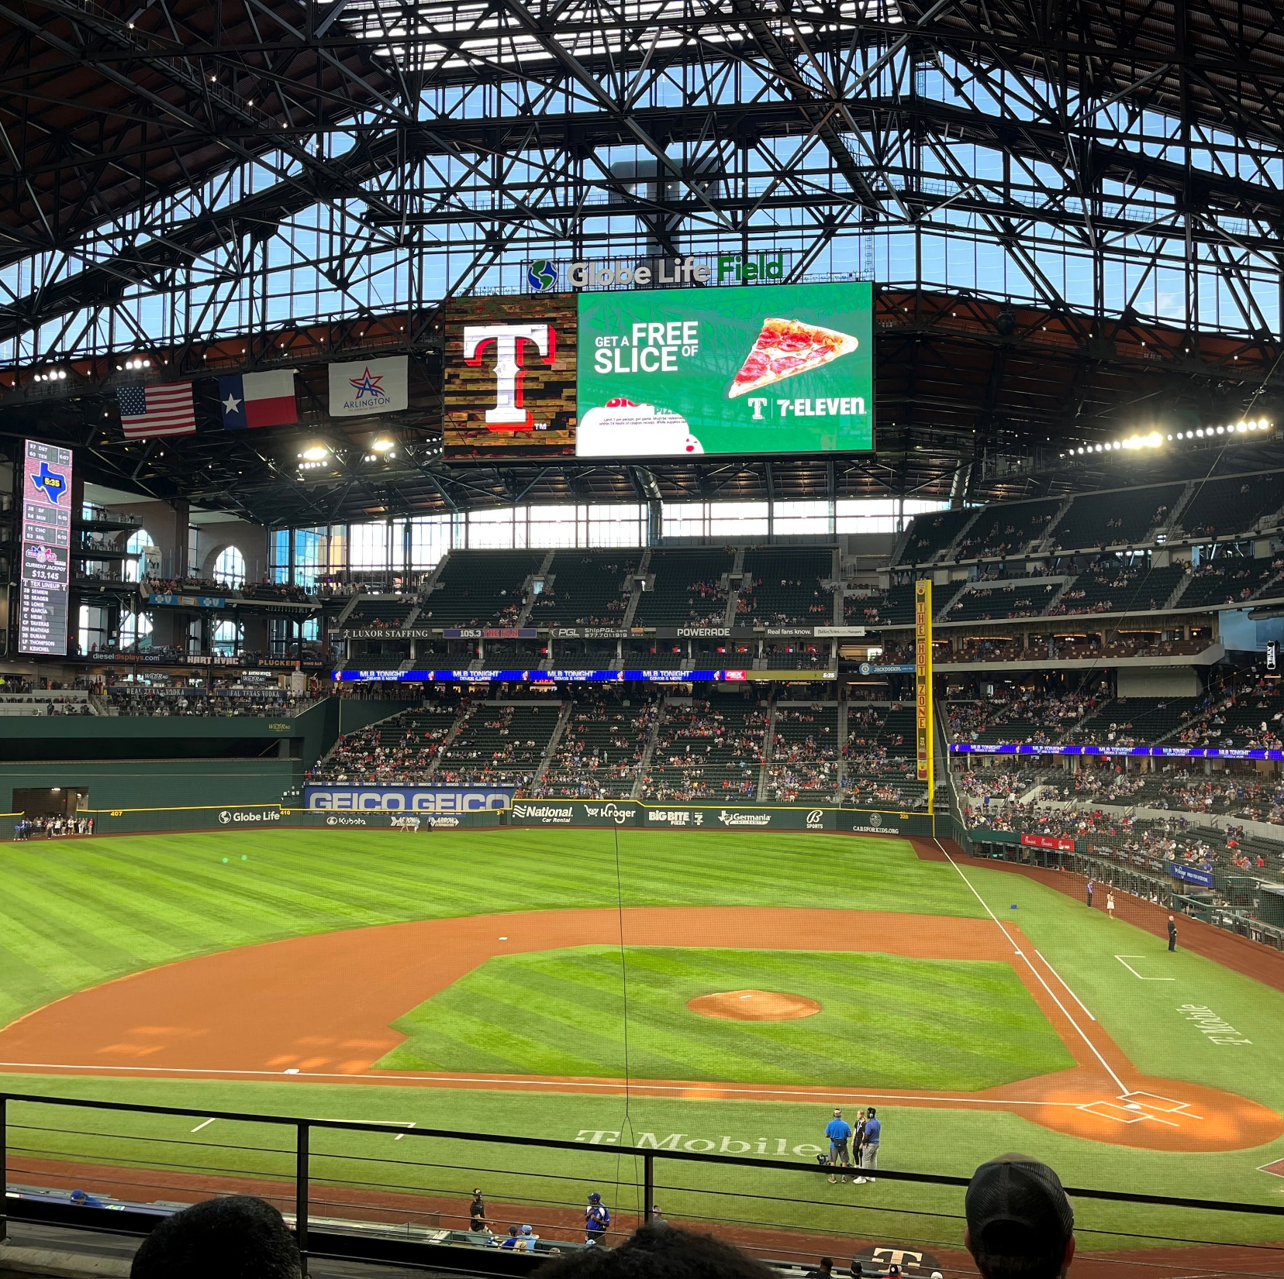
At Last -- The 30th Stadium

Slide 11
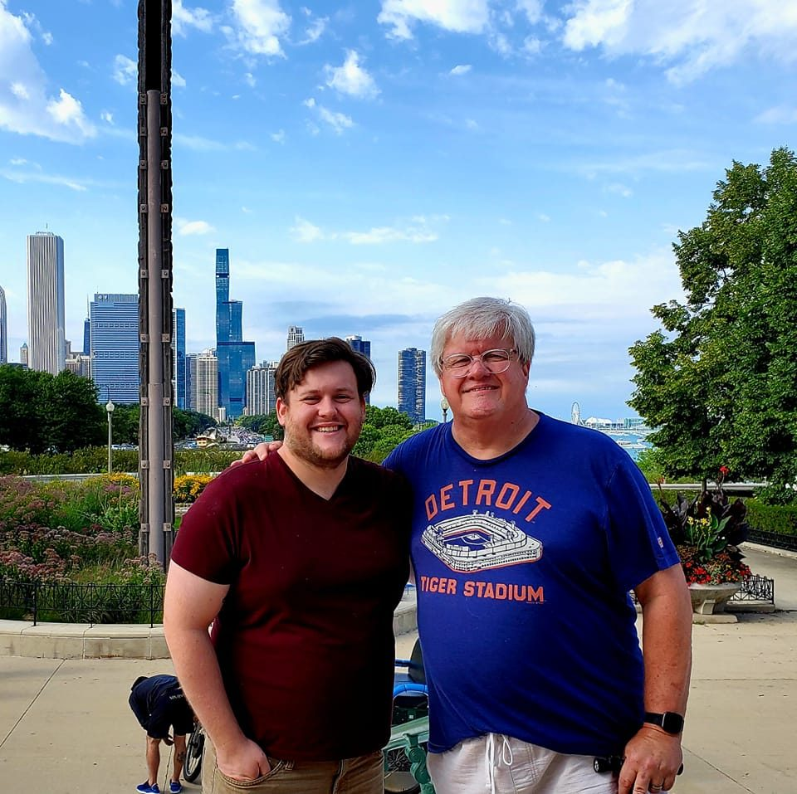
Jerry Miller

Slide 12
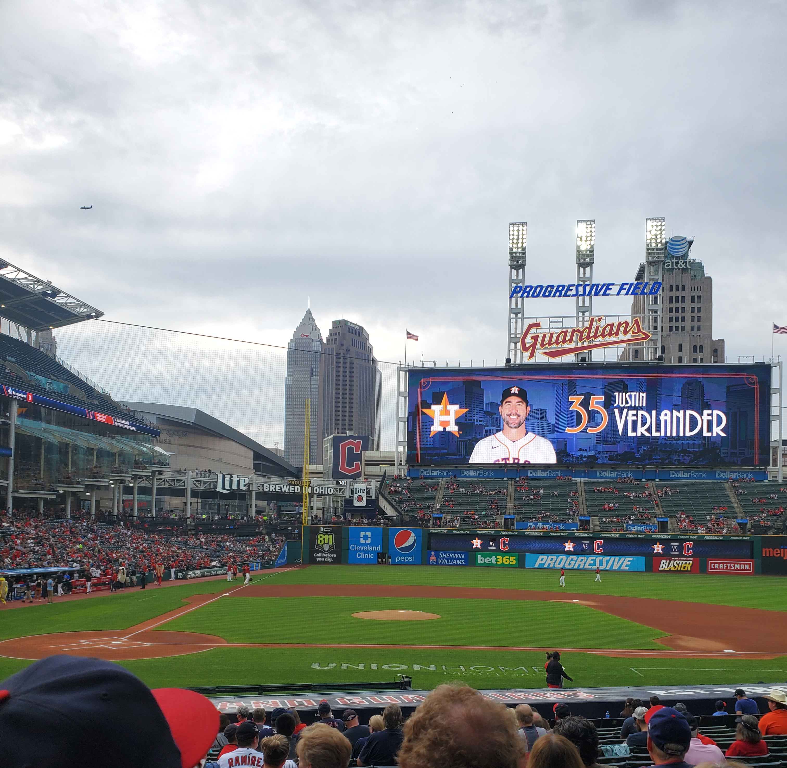
August 4, 2022
Progressive Field, Cleveland
Justin Verlander Carves Up The Guardians
Houston 6, Cleveland 0

Slide 13
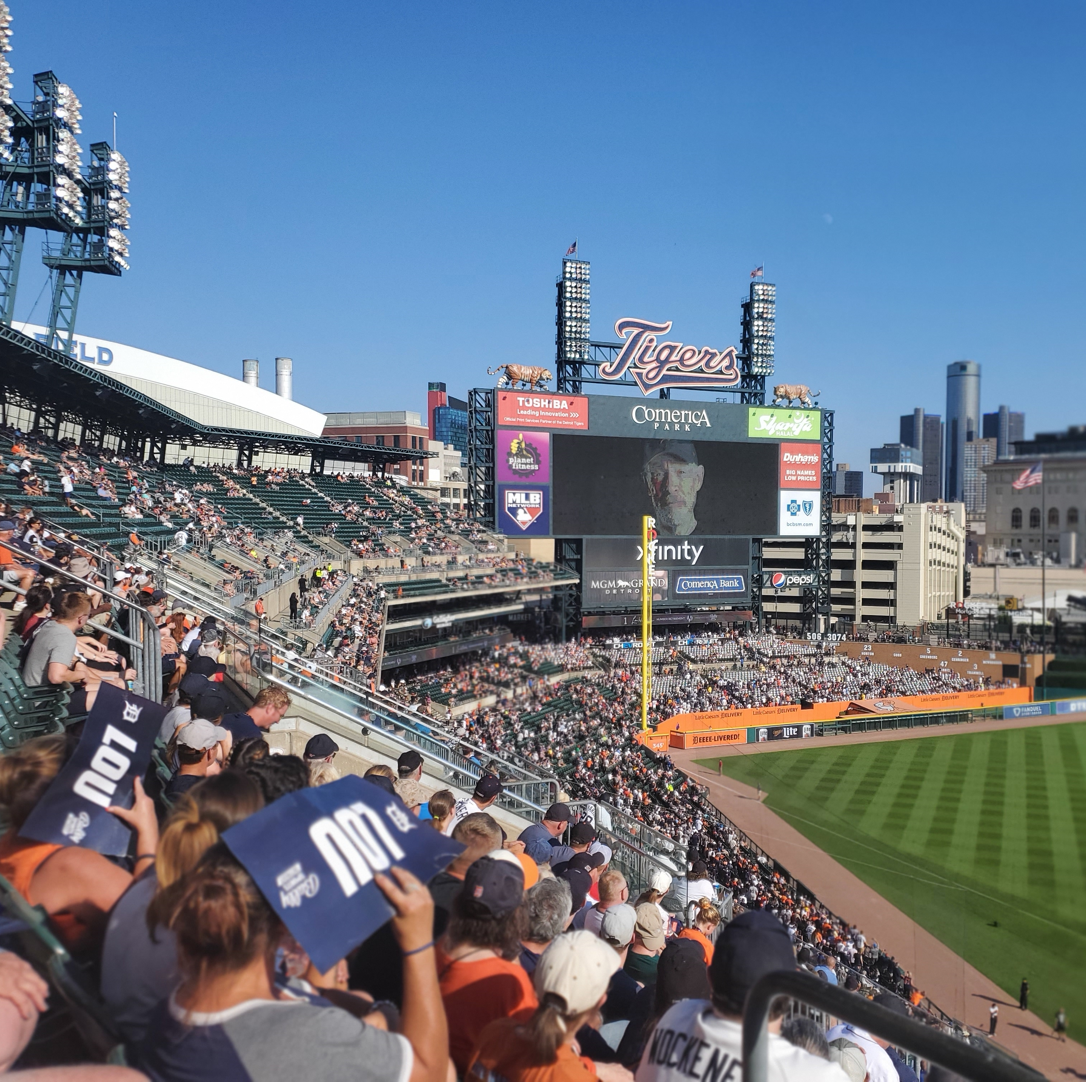
August 6, 2022
Comerica Park, Detroit
Lou Whitaker Jersey Retirement
Detroit 9, Tampa Bay 1

Slide 14
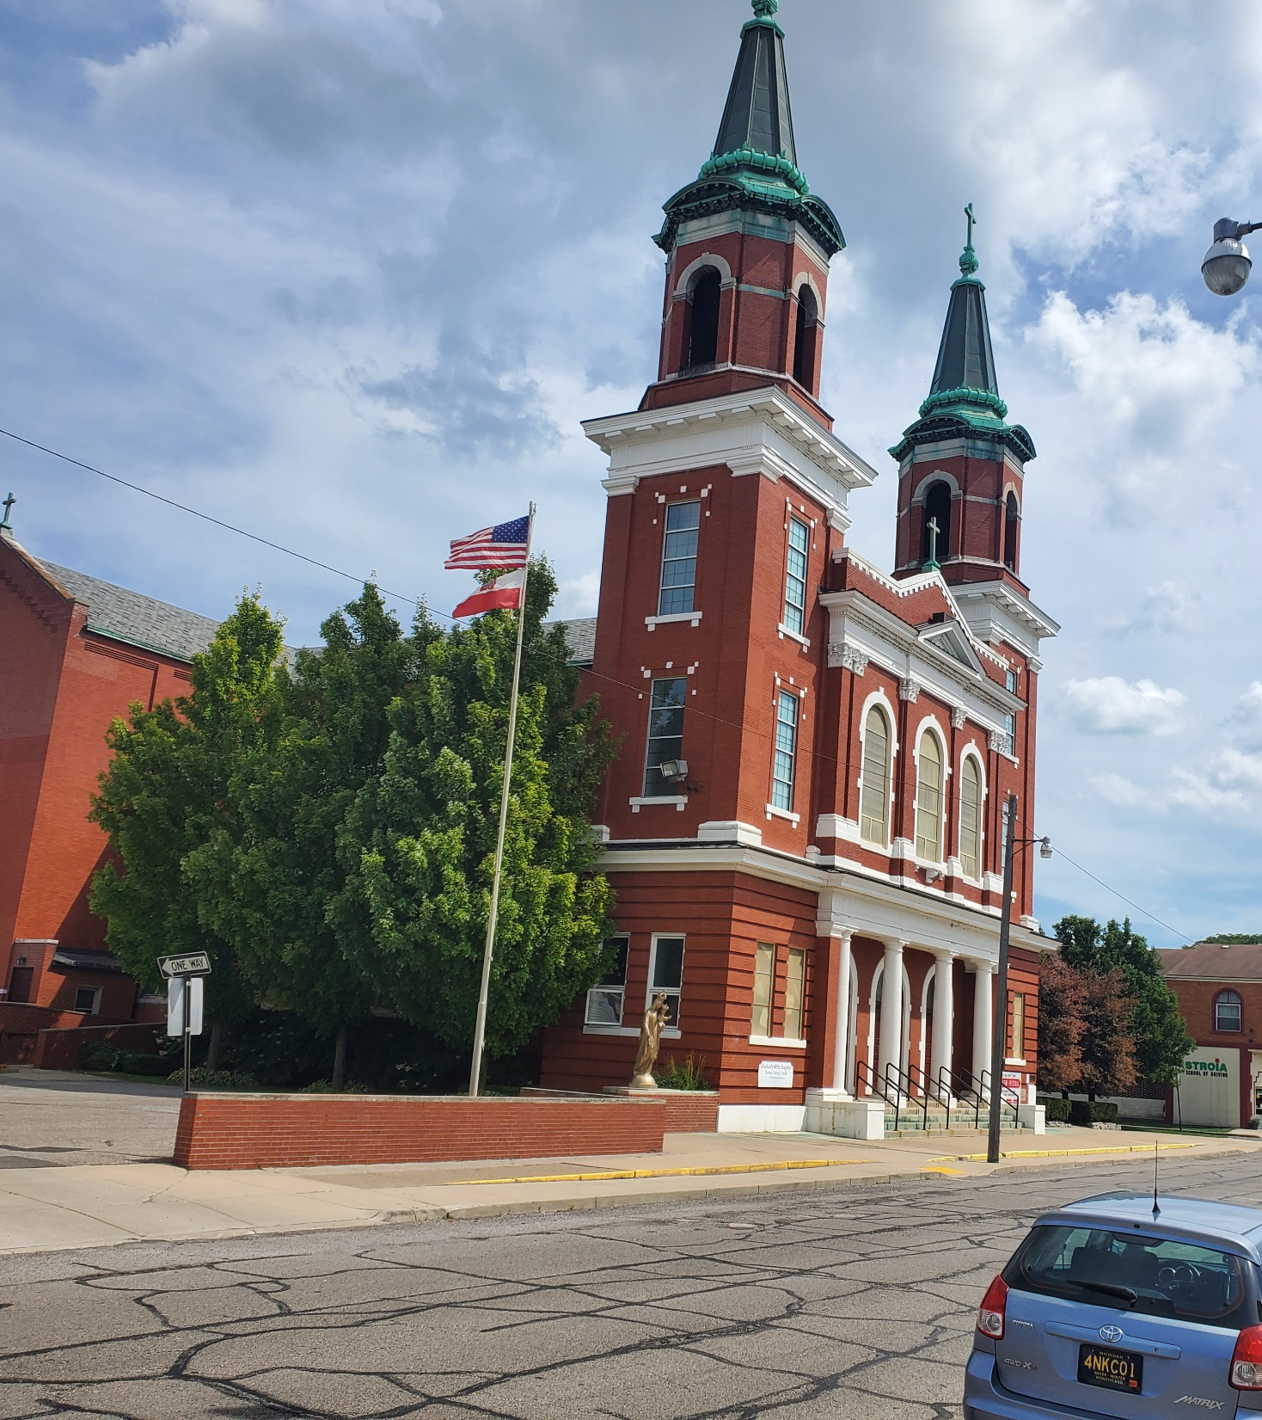
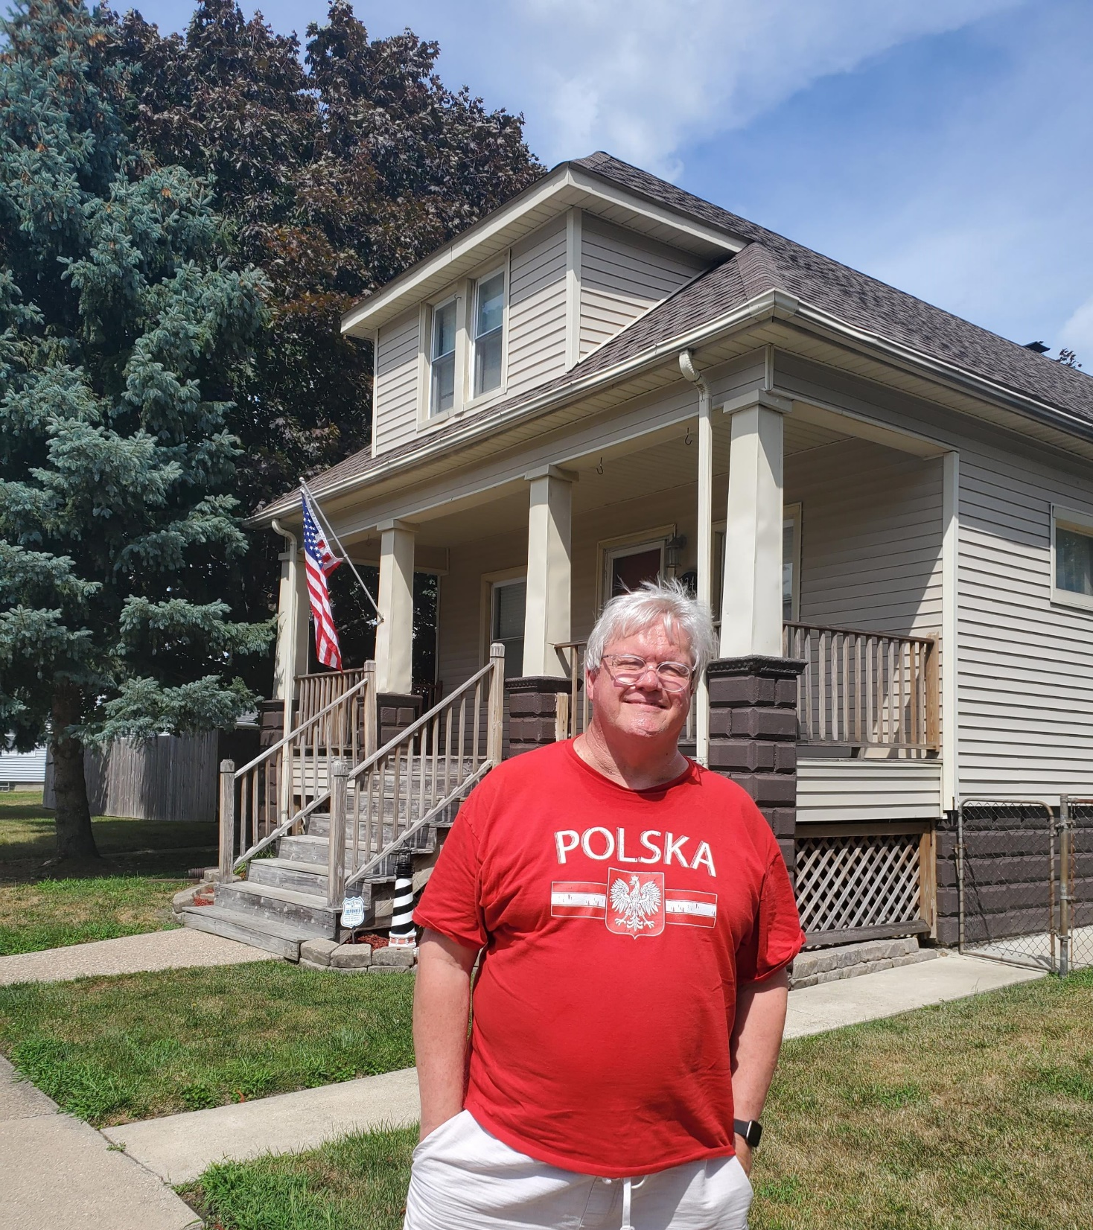
August 7, 2022
Wyandotte, MI

Slide 15
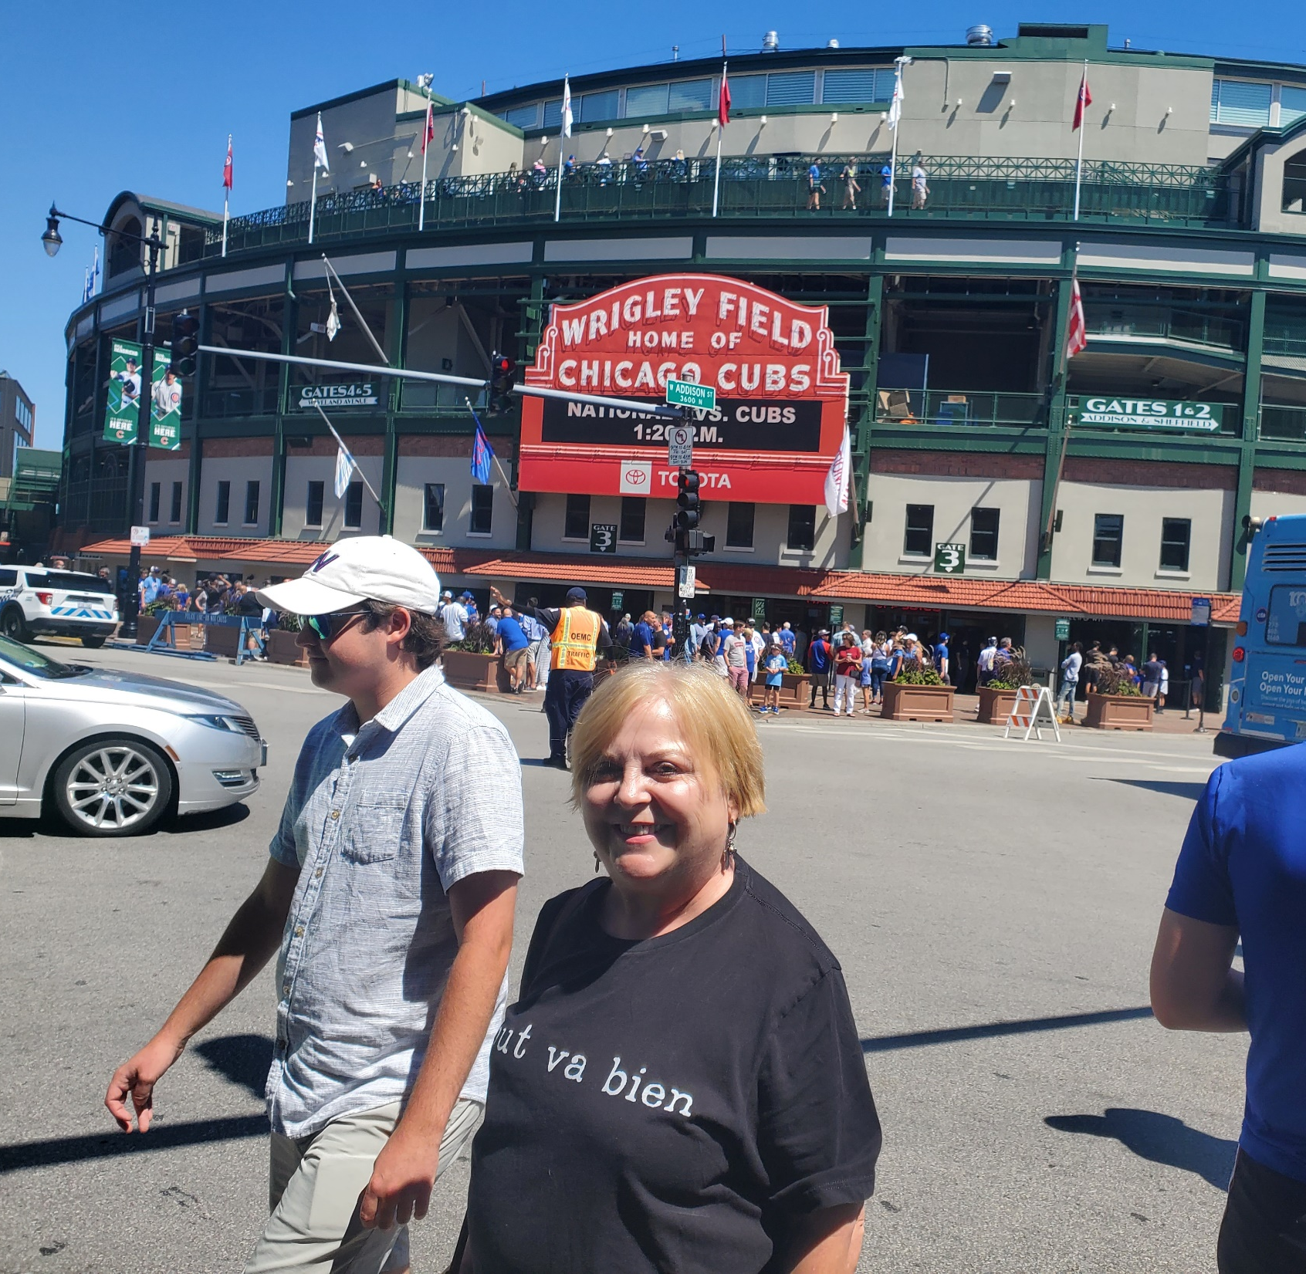
August 10, 2022
Wrigley Field, Chicago
Chicago Cubs 4, Washington 2

Slide 16
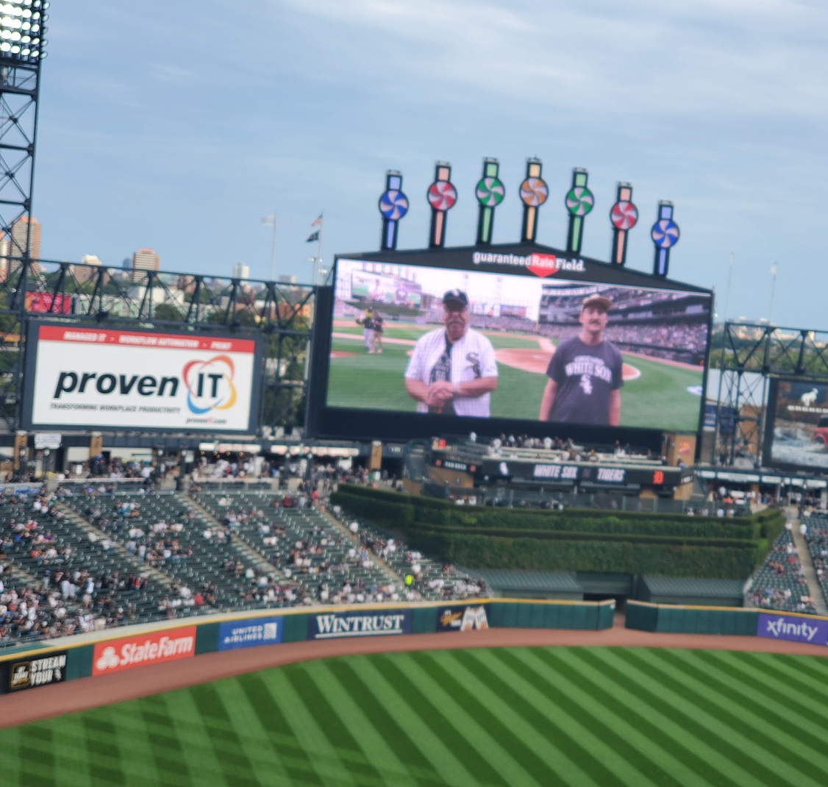
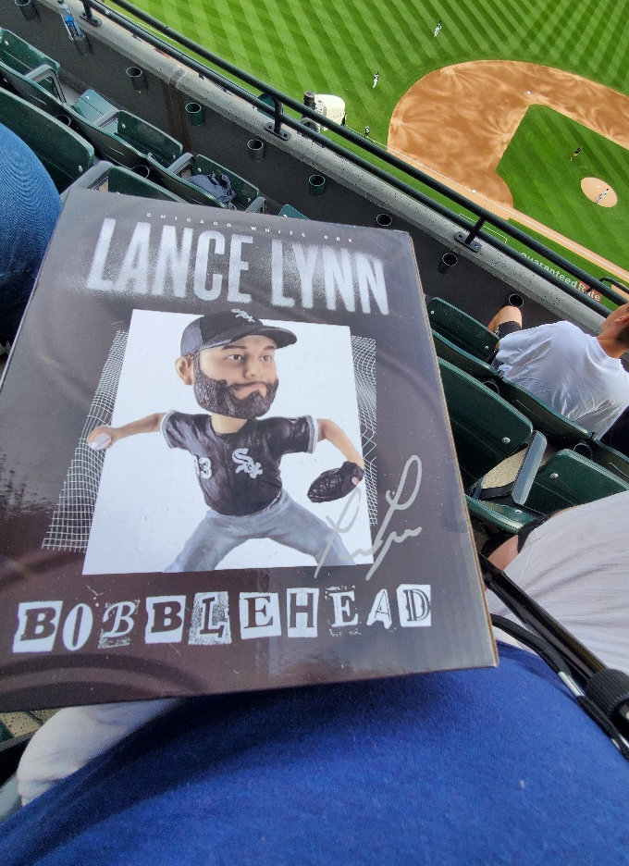
August 13, 2022
Guaranteed Rate Field, Chicago
Lance Lynn Bobblehead Night
Chicago White Sox 6, Detroit 4

Slide 17
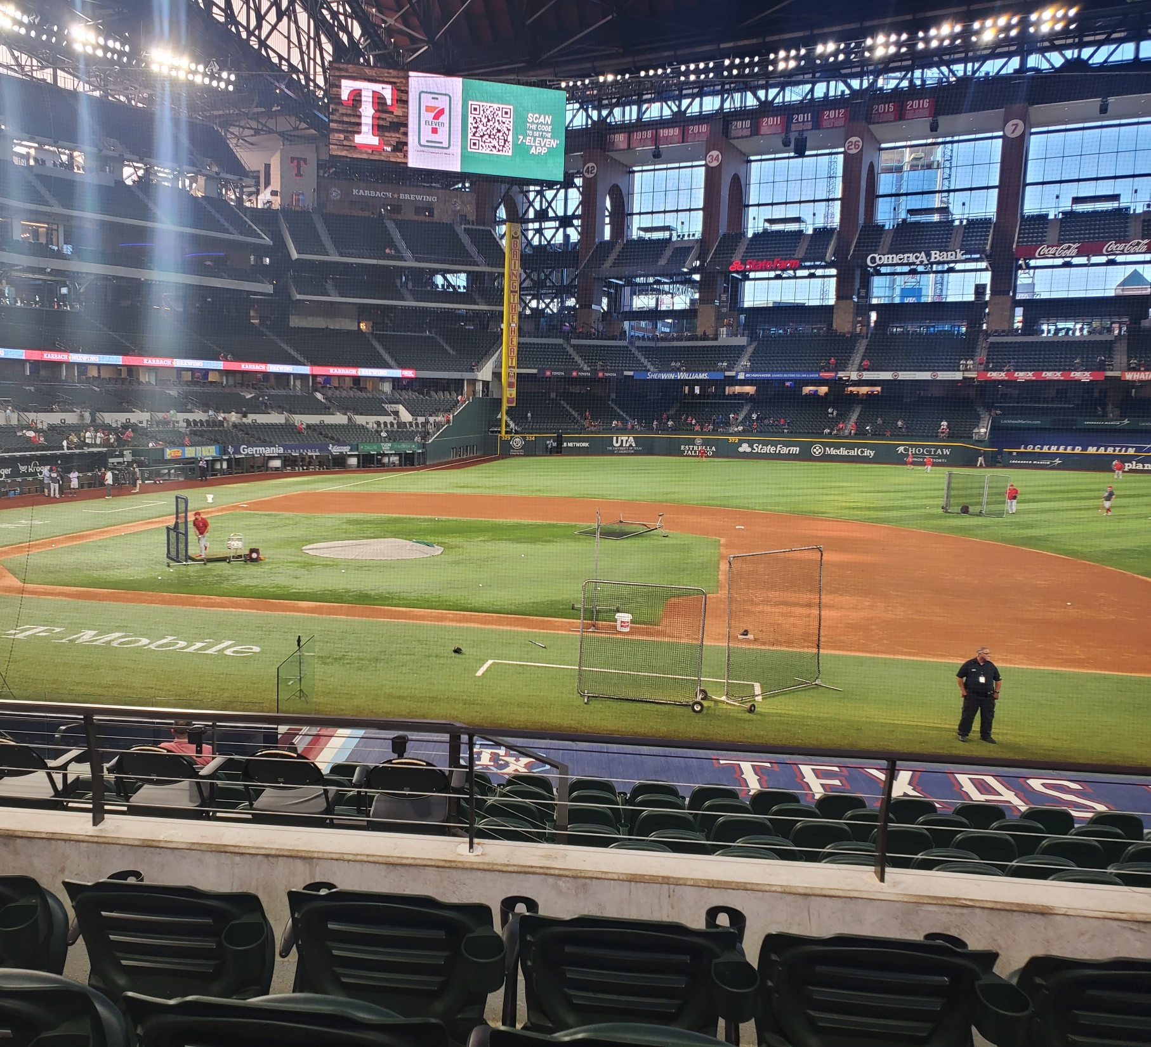
September 21, 2022
Globe Life Field, Arlington
Texas 7, L.A. Angels 2

Slide 18
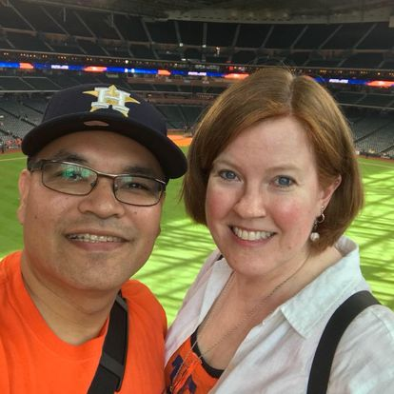
Gilbert Martinez

Slide 19
Jeremy Peña’s walkoff home run off Jordan romano on April 24, 2022

Slide 20
Jeremy peña’s walkoff home run off ryan tepera on July 3, 2022

Slide 21
Yordan Alvarez’s walkoff home run off Robbie Ray in ALDS Game 1 on Oct. 11, 2022

Slide 22
Astros win ALCS game 2 on my birthday, Oct. 20, 2022!

Slide 23
Astros win world series game 2 on Oct. 29, 2022

