Slide 1
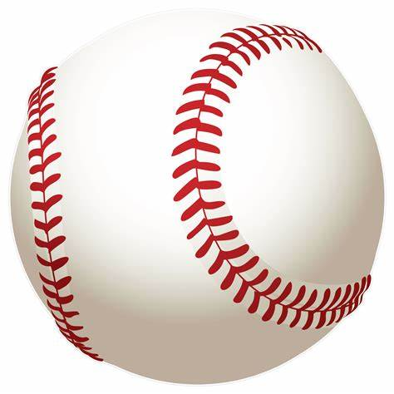
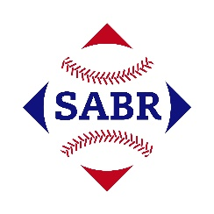
AGE Thrive with Baseball Memories
February 15, 2023
Agenda
Warm-up - Introductions
What is your favorite baseball team? Who is your favorite player?
Gametime – The Year in Baseball – 1960
Seventh Inning Stretch - “Take Me Out to the Ball Game”
Extra Innings – More stuff from the ‘60s
Extra Innings - Memorabilia
Next Time – What would you like to talk about?

Slide 2
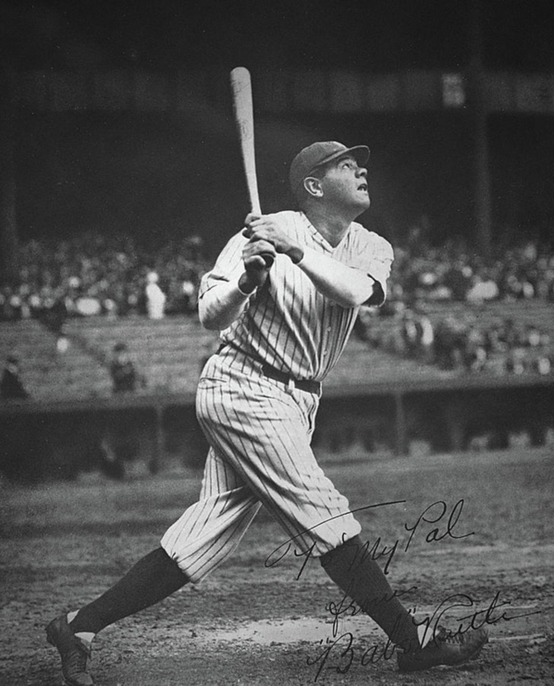
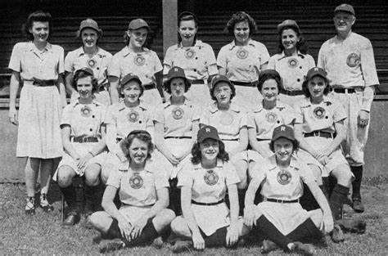
AGE Thrive with Baseball Memories
What is your favorite team?
Who is your favorite player?

Slide 3
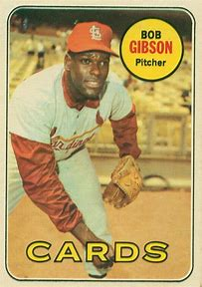
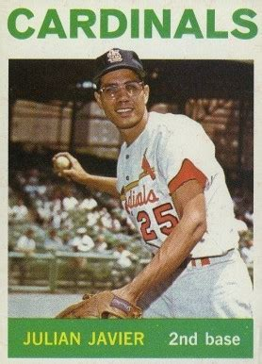
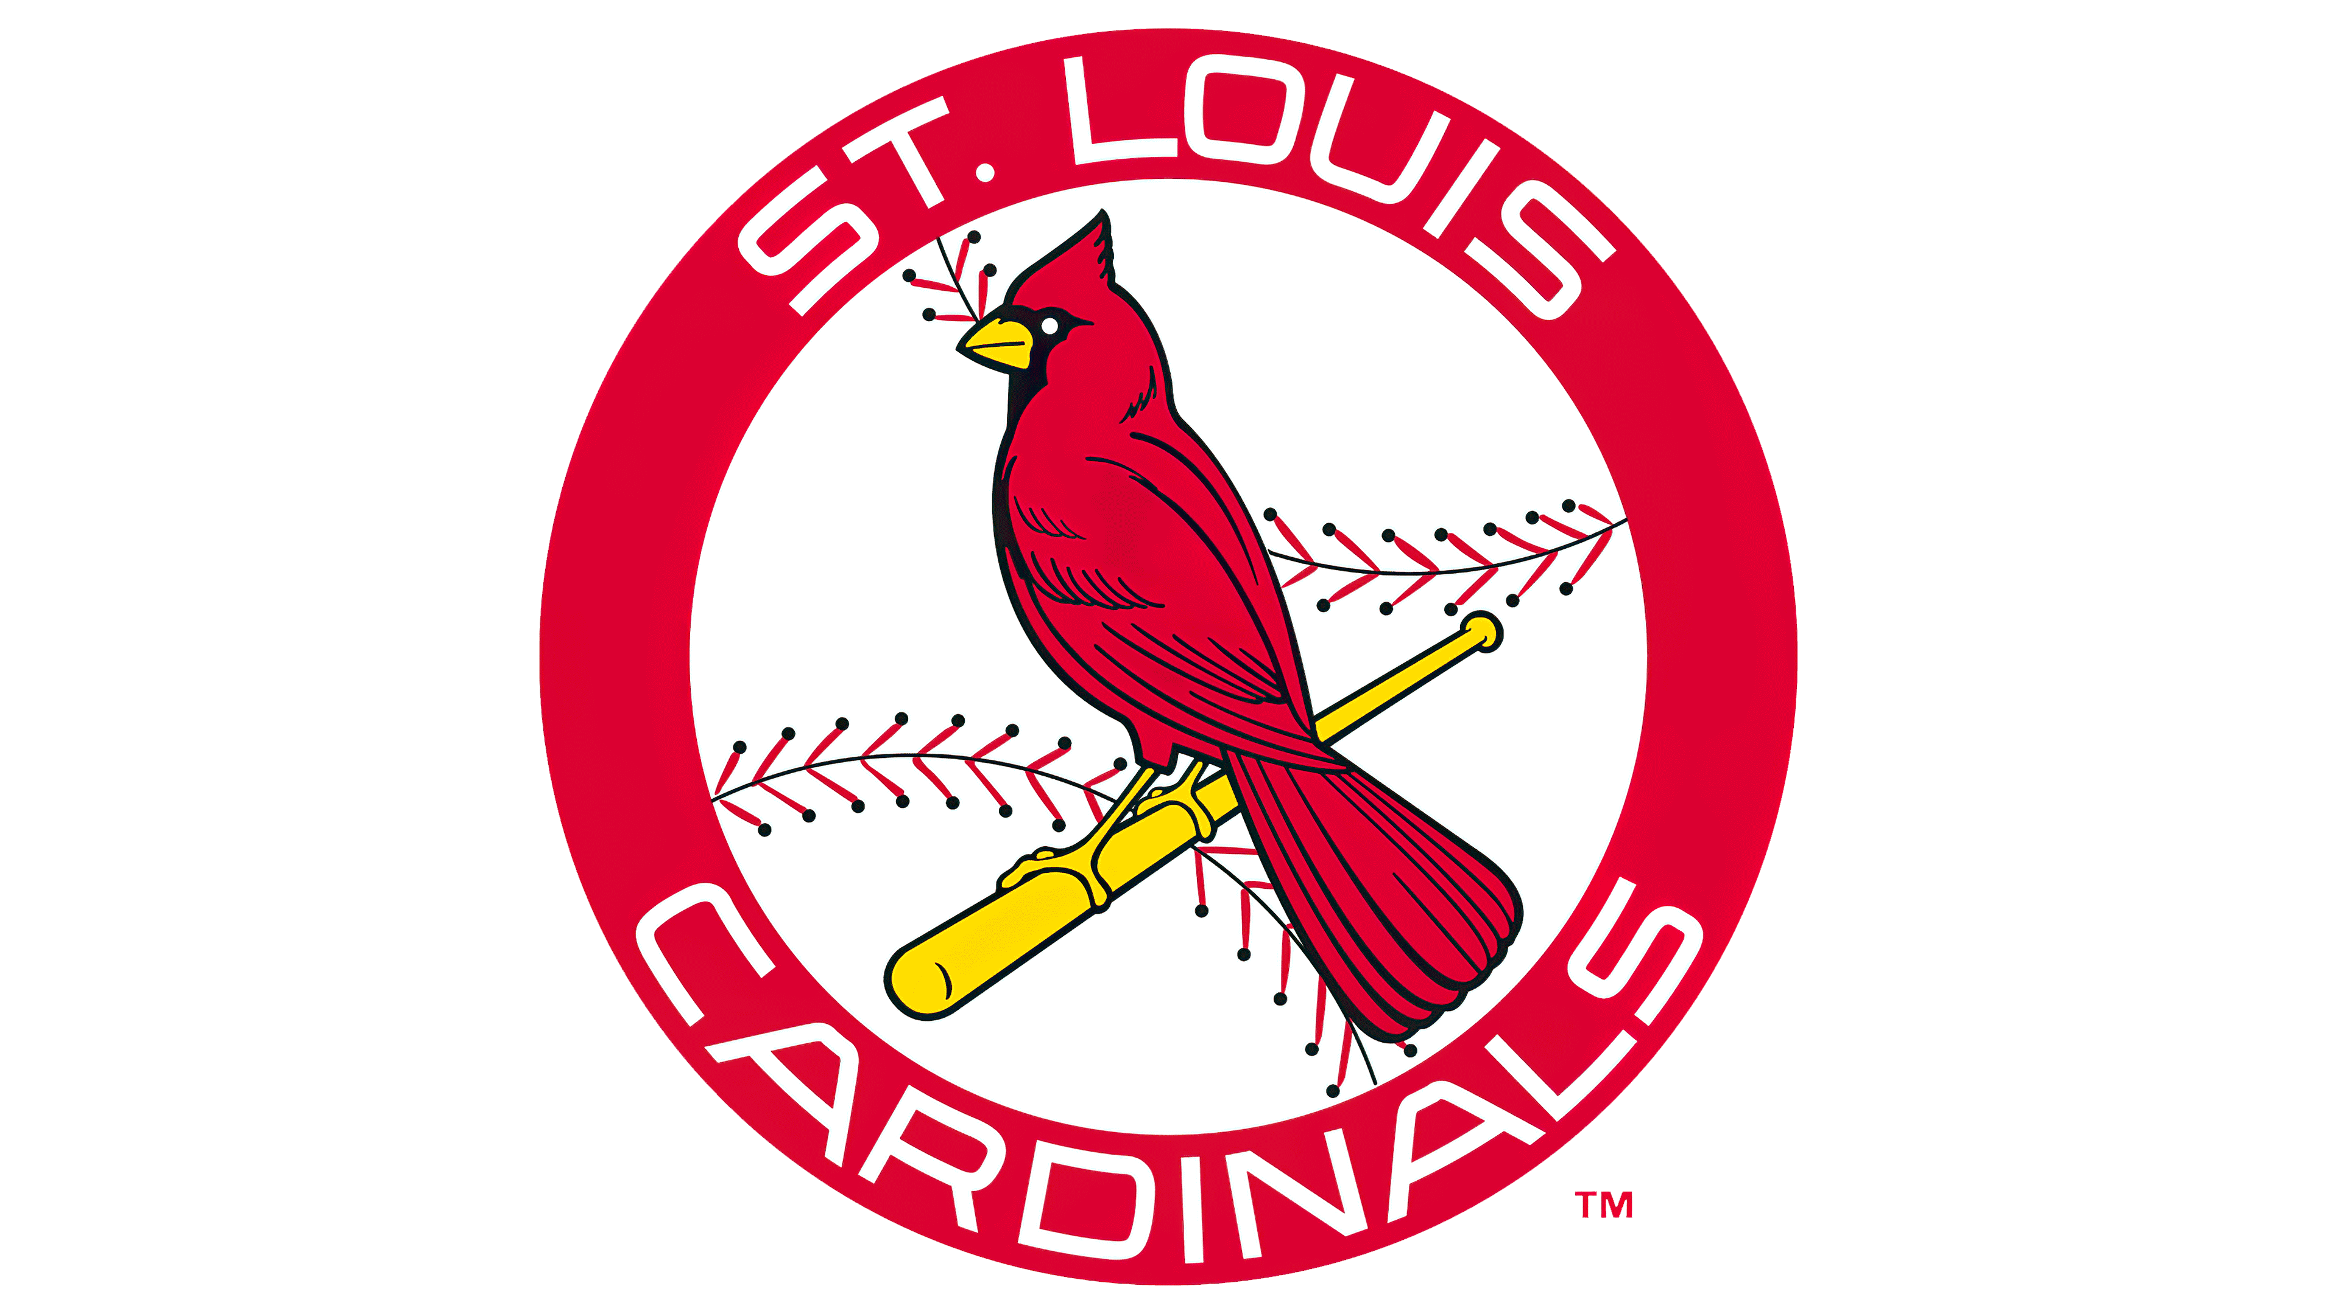
AGE Thrive with Baseball Memories
Monte and Linda’s Favorite:
Team Player(s)

Slide 4
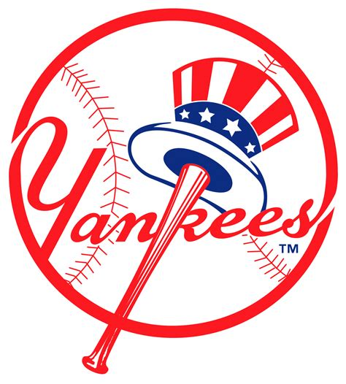
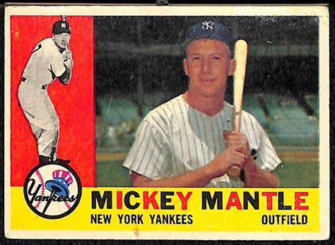
AGE Thrive with Baseball Memories
Ira’s Favorite:
Team Player

Slide 5
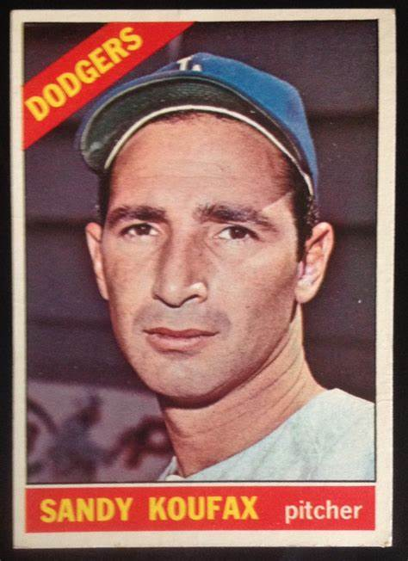
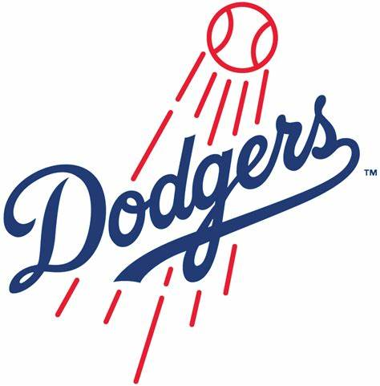
AGE Thrive with Baseball Memories
Jerry’s Favorite:
Team Player

Slide 6
The Year in Baseball: 1960

Slide 7
1960 -- Off the Field:
Presidential and VP candidates
Notes:
Kennedy (Mass.) and LBJ (Tex) running for the Democrats – emphasizing “New Leadership” . VP Nixon (California) and Henry Cabot Lodge (Mass.) running for the Republicans, stressing “Experience”. With allegations of dead people voting in Chicago and cattle voting in Texas, JFK won in a very close contest.

Slide 8
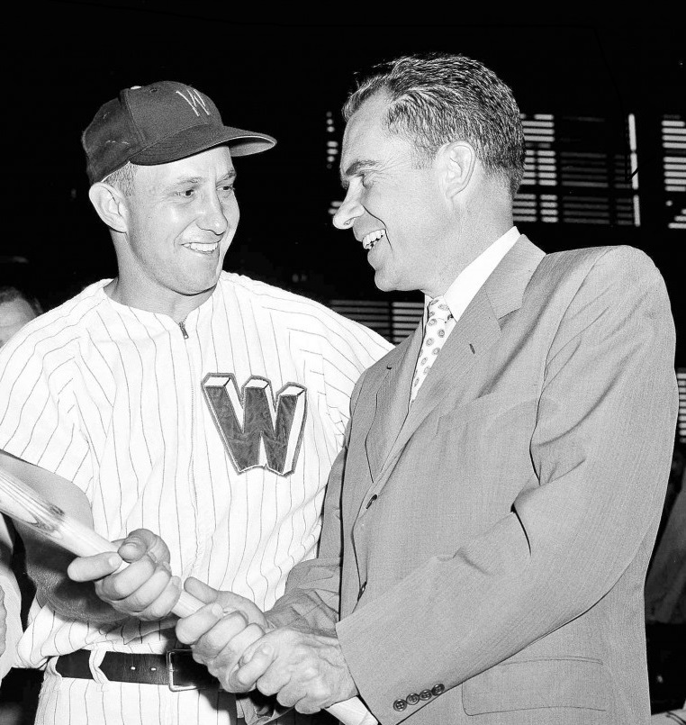
Vice President Nixon
with his
favorite
ball player
Notes:
Nixon was a big baseball fan. Here’s a picture with his favorite Washington Senators player – who just recently passed away … who is he ??

Slide 9
Roy Sievers
AL Rookie of Year in 1949
Led AL with 42 HR and 114 RBI in 1957
318 HR in 17-year career
Notes:
Roy Sievers – AL rookie of year in ’49 with his hometown St. Louis Browns. Was a big slugger. Graduated from same high school as Bob and my Mom – Beaumont HS in St. Louis.

Slide 10
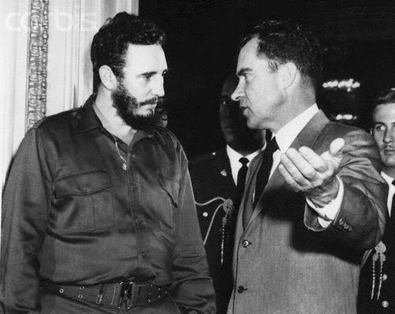
These two leaders did not have much in common …
Notes:
Met in April, 1959 when Castro visited the U.S.

Slide 11
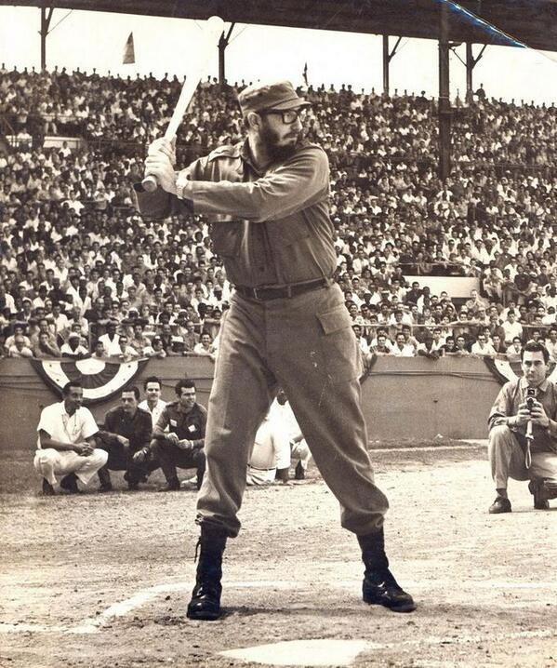
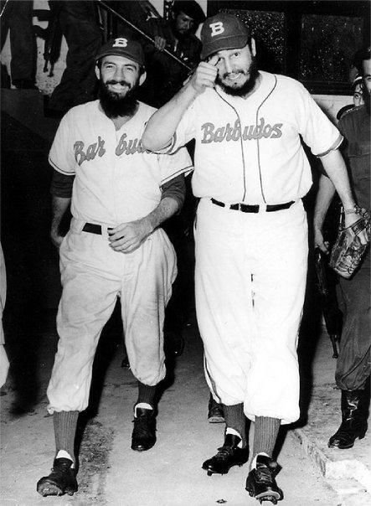
but … “El Jefe Supremo” was also a big baseball fan
Notes:
Fidel was also a huge baseball fan, although we was actually a better basketball player. He had his own team, Los Barbudos (the Bearded Ones).

Slide 12
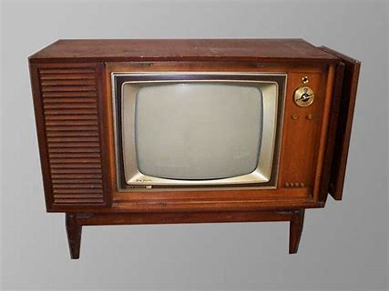
1960 -- Off the Field:
Television !
90% of households
52 million sets

Slide 13
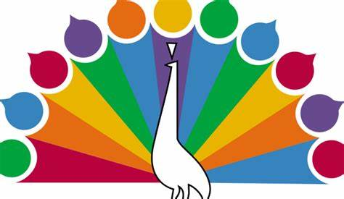
1960 -- Off the Field:
Television !
But we only had three networks

Slide 14
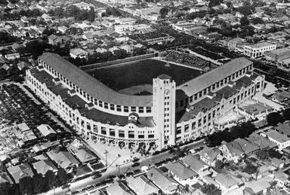
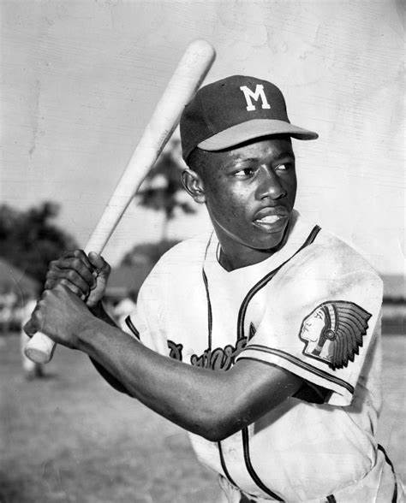
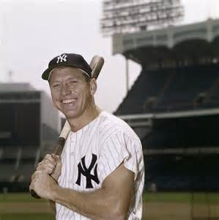
1960 -- Off the Field:
Television !
Home Run Derby
debuted
Notes:
The Home Run Derby is a staple today at the Major League Baseball All Star games; but did you know it was inspired by a TV show? Hank Aaron won the contest six times, while Mickey Mantle hit the most homers - 44

Slide 15
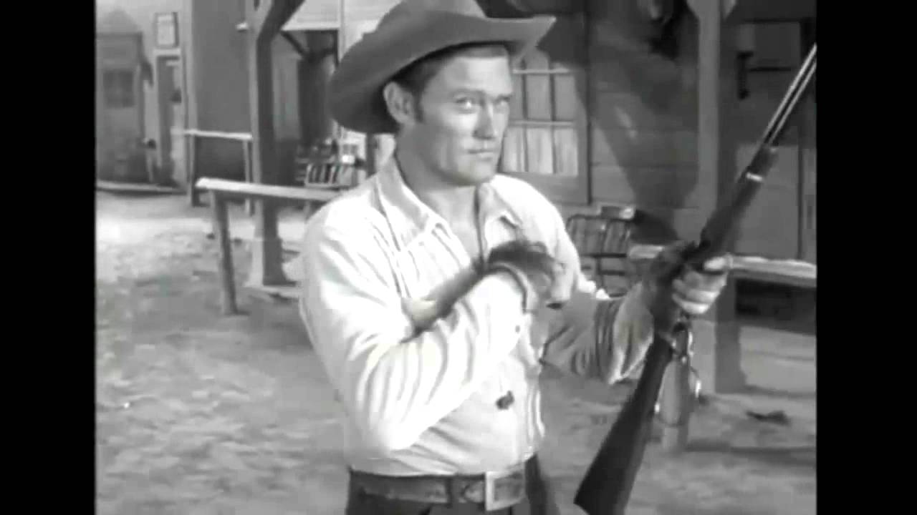
1960 -- Off the Field:
Television !
This former baseball and basketball player starred in
a popular Western
Chuck Conners as “The Rifleman”

Slide 16
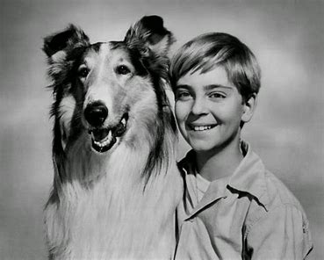
1960 -- Off the Field:
Television !
This popular show was inspired by a movie about a dog in Scotland
Lassie

Slide 17
1960 -- Off the Field:
Television !
The segments on this show always ended with “Smile, you’re on …. “

Slide 18
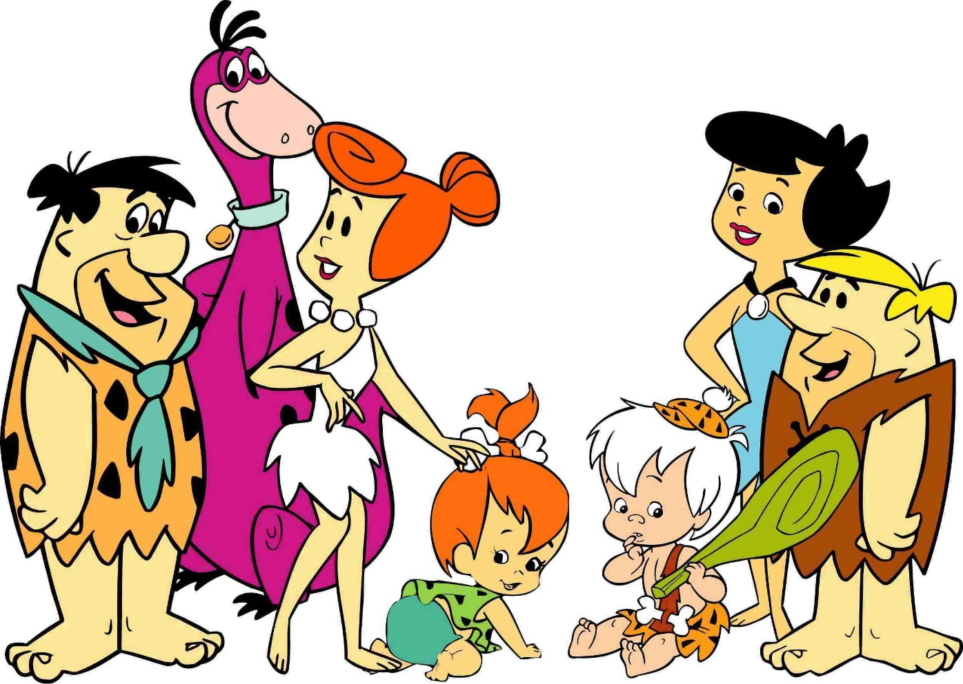
1960 -- Off the Field:
Television !
This show – set in the Stone Age - was the first animated cartoon series on prime-time TV
The Flintstones

Slide 19
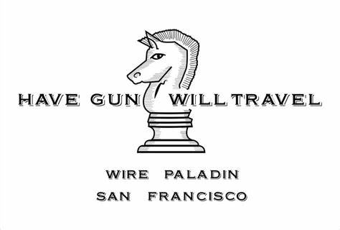
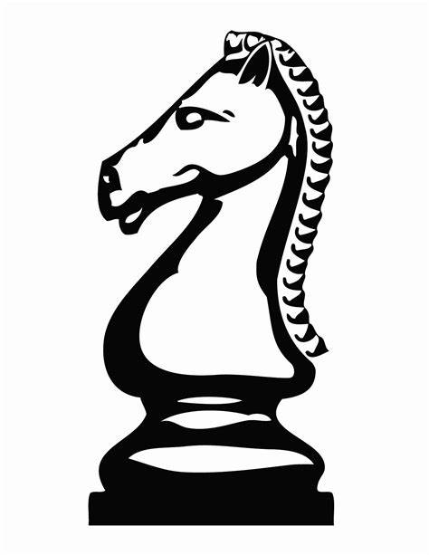
1960 -- Off the Field:
Television !
The hero in this Western had a unique business card displaying a chess piece

Slide 20
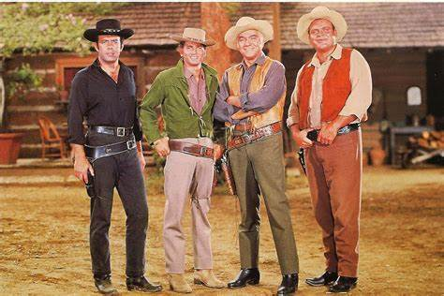
1960 -- Off the Field:
Television !
This Western was about a family that lived on a ranch in Nevada called
“The Ponderosa”
Bonanza

Slide 21
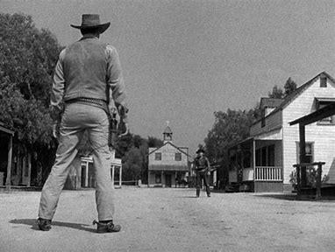
1960 -- Off the Field:
Television !
This Western was about the
U.S. Marshall in
Dodge City, Kansas
Gunsmoke

Slide 22
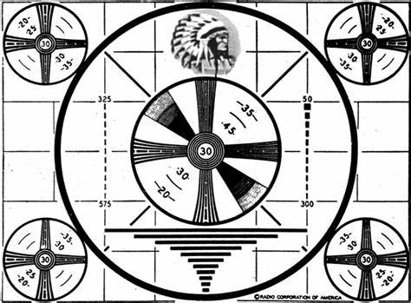
1960 -- Off the Field:
Television !
If you stayed up really late, you would see this image.

Slide 23
1960 -- Off the Field:
Cars !!
77% of all U.S. families owned a car
15% owned two or more cars

Slide 24
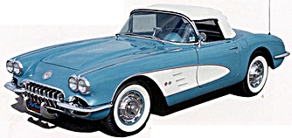
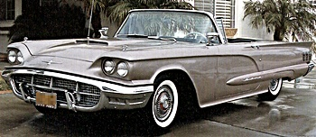
1960 -- Off the Field:
Popular Sports Cars
Chevy Corvette
Ford Thunderbird
Notes:
Base manufacturer’s suggested retail price for the ’60 Corvette was $3,872 !! $102 extra for “deluxe heater” and $147 extra for AM/FM radio.

Slide 25
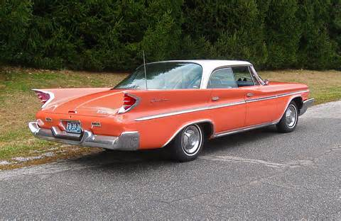
1960 -- Off the Field:
Big cars …
Check out those fins !
Cadillac Coupe de Ville
Chrysler DeSoto

Slide 26
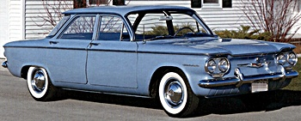
1960 -- Off the Field:
Small cars …
New models that were introduced in ‘60
Chevy Corvair

Slide 27
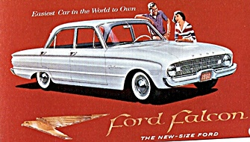
1960 -- Off the Field:
Small cars …
New models that were introduced in ‘60
Ford Falcon

Slide 28
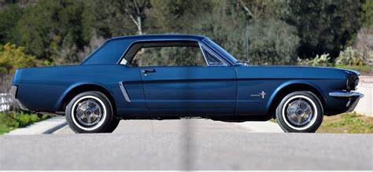
1960 -- Off the Field:
The Falcon frame and other components were used a few years later to launch a very popular Ford …
The Mustang

Slide 29
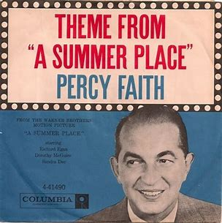
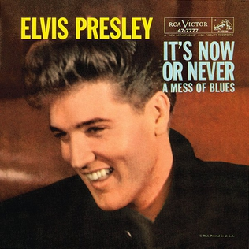
1960 – Off the Field
Music
#1
Hits
https://www.youtube.com/watch?v=rt7SPm7N6D8
https://www.youtube.com/watch?v=quosahdp8LM

Slide 30
1960 – Off the Field
This song topped the charts
for twelve weeks
and started a new dance
craze …
https://www.youtube.com/watch?v=pHGXwQeUk7M

Slide 31
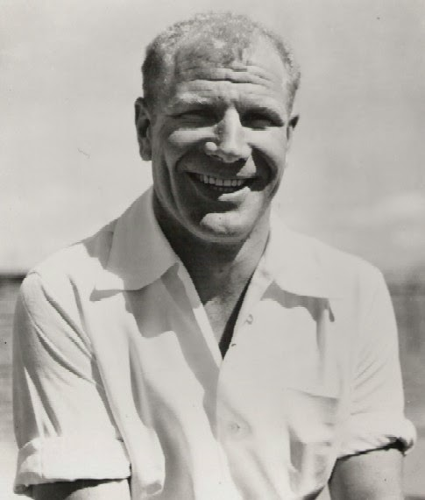
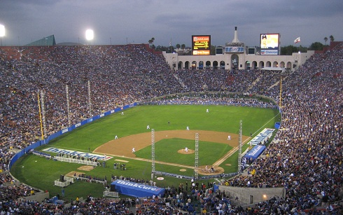
1960 -- On the Field: Some Highlights
Set a new all-time NL attendance record of 2,253,887 here
Put players’ names on White Sox uniforms
Notes:
Maverick owner Bill Veeck put players’ names on the back of uniforms. The Dodgers set an NL attendance record playing in the LA Coliseum.

Slide 32
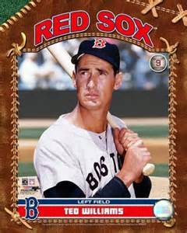
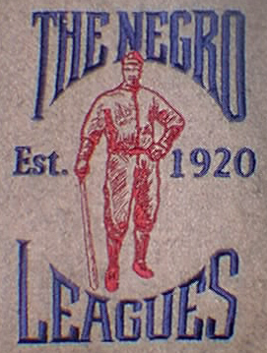
1960 -- On the Field: Some Highlights
The Sporting News “Player of the Decade”
Last organized black pro league folded
Notes:
Ted Williams was named Player of the Decade (the ‘50s) by The Sporting News. The Negro American League folded, although some teams played on as barn-stormers. The Indianapolis Clowns continued playing into the 1980s.

Slide 33
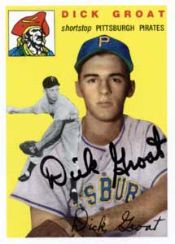
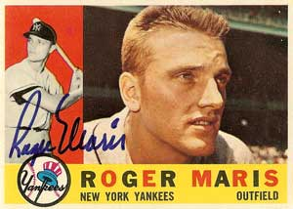
1960 -- On the Field:
League Most Valuable Players:
.283 batting avg, 39 HR, led AL with 112 RBI
led NL with .325 batting avg.

Slide 34
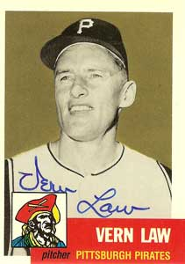
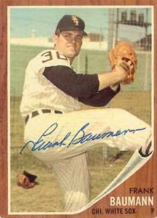
1960 -- On the Field:
League Pitching Leaders:
20-9 with 3.08 ERA in 271 innings
Cy Young Award (only one winner for all MLB)
13-6 with 2.67 ERA in 185 innings

Slide 35
1960 – On the Field:
League Leaders in HR
Ernie Banks – 41 HR
Mickey Mantle – 40 HR
Notes:
Mickey Mantle hit 37 homers to lead the AL. He also led the league in triples, walks, and SLG.

Slide 36
1960 -- On the Field: Final Regular Season Standings
1960 National League Team Standings
Team | Wins | Losses |  | GB
Pittsburgh | 95 | 59 |  | 0
Milwaukee | 88 | 66 |  | 7
St. Louis | 86 | 68 |  | 9
Los Angeles | 82 | 72 |  | 13
San Francisco | 79 | 75 |  | 16
Cincinnati | 67 | 87 |  | 28
Chicago | 60 | 94 |  | 35
Philadelphia | 59 | 95 |  | 36
1960 American League Team Standings
Team | Wins | Losses |  | GB
New York | 97 | 57 |  | 0
Baltimore | 89 | 65 |  | 8
Chicago | 87 | 67 |  | 10
Cleveland | 76 | 78 |  | 21
Washington | 73 | 81 |  | 24
Detroit | 71 | 83 |  | 26
Boston | 64 | 89 |  | 32
Kansas City | 58 | 96 |  | 39

Slide 37
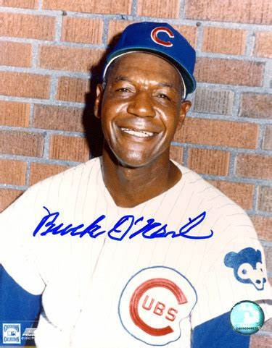
1960 -- On the Field:
https://www.youtube.com/watch?v=Yxf000X5G_8

Slide 38
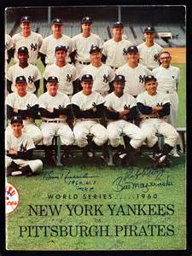
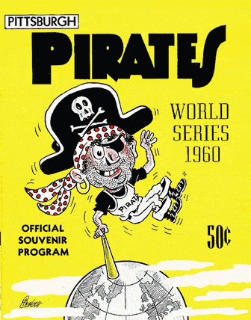
1960 World Series
vs.

Slide 39
1960 World Series
Game 7 starting lineup
New York Yankees
Bobby Richardson 2B
Mickey Mantle CF
Johnny Blanchard C
Tony Kubek SS
Yogi Berra LF
Clete Boyer 3B
Roger Maris RF
Moose Skowron 1B
Bob Turley P

Slide 40
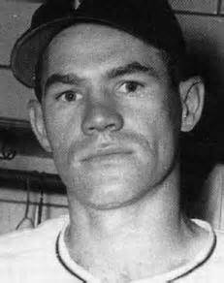
1960 World Series
Game 7 starting lineup
Pittsburgh Pirates
Rocky Nelson 1B
Don Hoak 3B
Bill Virdon CF
Roberto Clemente RF
Dick Groat SS
Bill Mazeroski 2B
Bob Skinner LF
Smoky Burgess C
Vern Law P

Slide 41
1960 World Series
Game 7 was played Thursday October 13 at Forbes Field in Pittsburgh
https://www.youtube.com/watch?v=65Og0gUKfvc

Slide 42
Extra Innings Things from the ‘60s we don’t use anymore

Slide 43
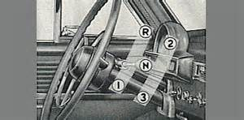
Things from the 1960s that we don’t use anymore …

Slide 44
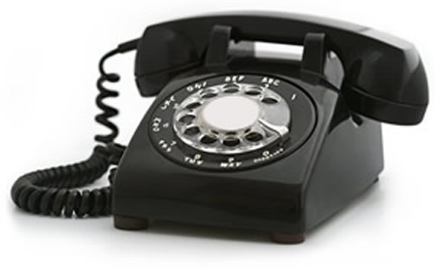
Things from the 1960s that we don’t use anymore …

Slide 45
Things from the 1960s that we don’t use anymore …

Slide 46
Things from the 1960s that we don’t use anymore …

Slide 47
Things from the 1960s that we don’t use anymore …

Slide 48
Things from the 1960s that we don’t use anymore …

Slide 49
Things from the 1960s
that we don’t use anymore …

Slide 50
Notes:
Gloves for as cheap as $3.84 – 1958 Sears spring/summer catalog

