Slide 1
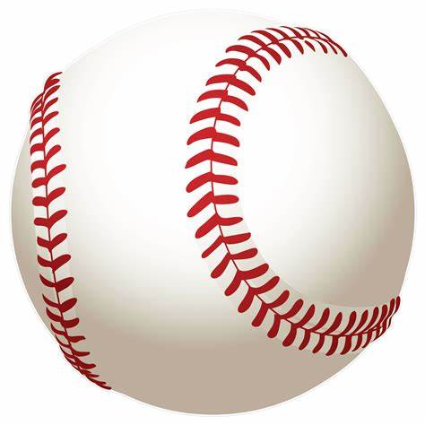
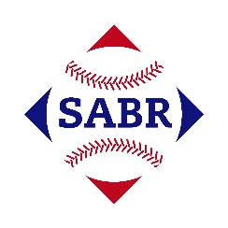

AGE Thrive with Baseball Memories
April 5, 2023
Agenda
Warm-up - Introductions
Gametime – The Year in Baseball – 1962
Seventh Inning Stretch - “Take Me Out to the Ball Game”
Extra Innings – More stuff from the ‘60s
Extra Innings - Memorabilia
Next Time – What would you like to talk about?

Slide 2
The Year in Baseball:
1962

Slide 3
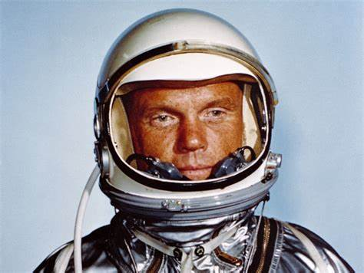
1962 -- Off the Field:
This Marine Corps pilot became the first American to orbit the Earth
John Glenn in Friendship 7

Slide 4
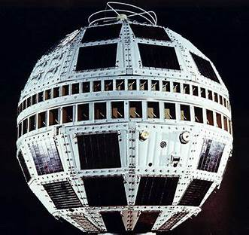
1962 -- Off the Field:
The first communications satellite was launched
Telstar 1
Notes:
Launched in July, 1962. Operational for only seven months – relayed live TV between U.S. and Europe. Still in orbit today!

Slide 5
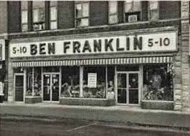
1962 -- Off the Field:
After his new marketing concept was rejected by Ben Franklin Stores, their most successful franchisee in Arkansas, Oklahoma and Missouri opened his own store in 1962.

Slide 6
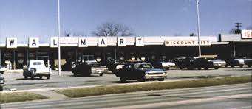
1962 -- Off the Field:
Sam Walton opened his first Wal-Mart on July 2, 1962 in
Rogers, Arkansas

Slide 7
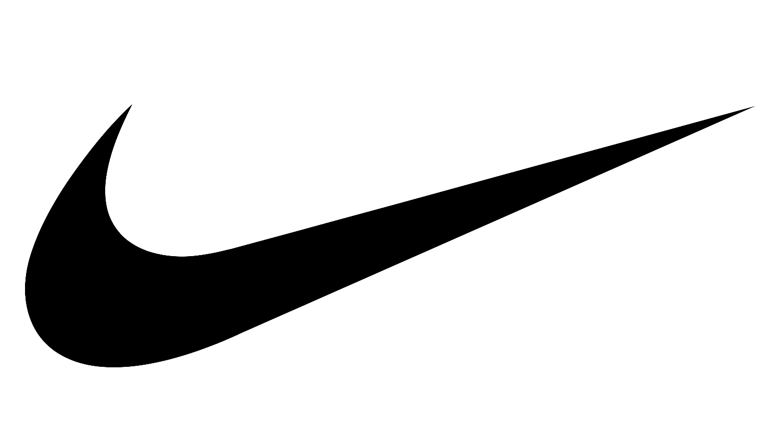
Just Do It !
This company’s first running shoe was imported from Japan in 1962
Nike
Notes:
Stanford grad student and former track team member Phil Knight saw the show on a trip to the Far East and began to import it to the U.S. in 1962. Tiger Brand shoes from Japan.

Slide 8
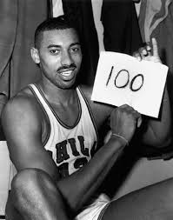
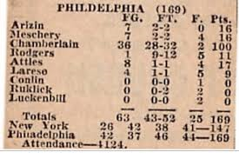
1962 – On the Court:
Wilt Chamberlain Scores 100 points
Notes:
March 2, 1962 – Philadelphia Warriors center Wilt Chamberlain scored 100 pts vs. New York Knicks at Hershey, Penn. Record still stands, as well as total points in a league game – 316. There was no TV coverage and no video has yet been found.

Slide 9
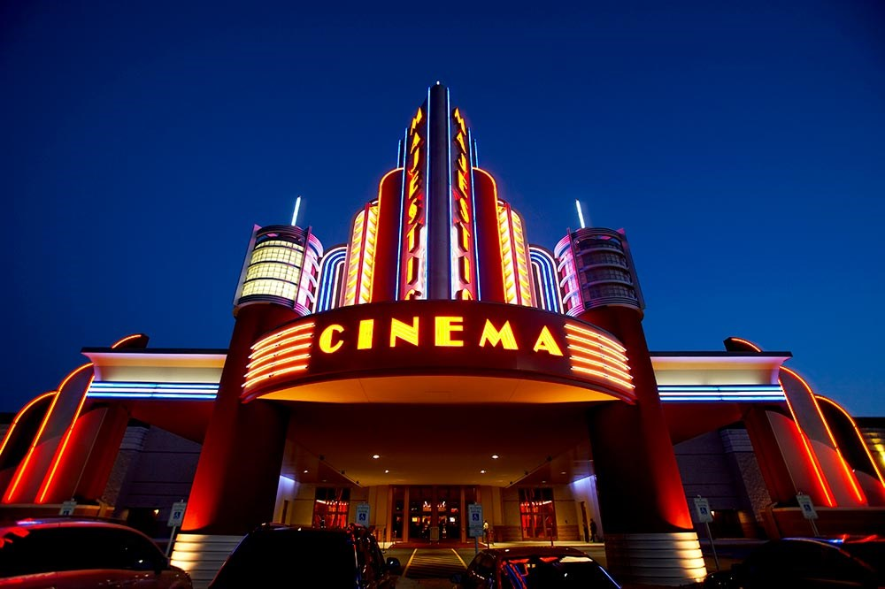
1962 at the Movies

Slide 10
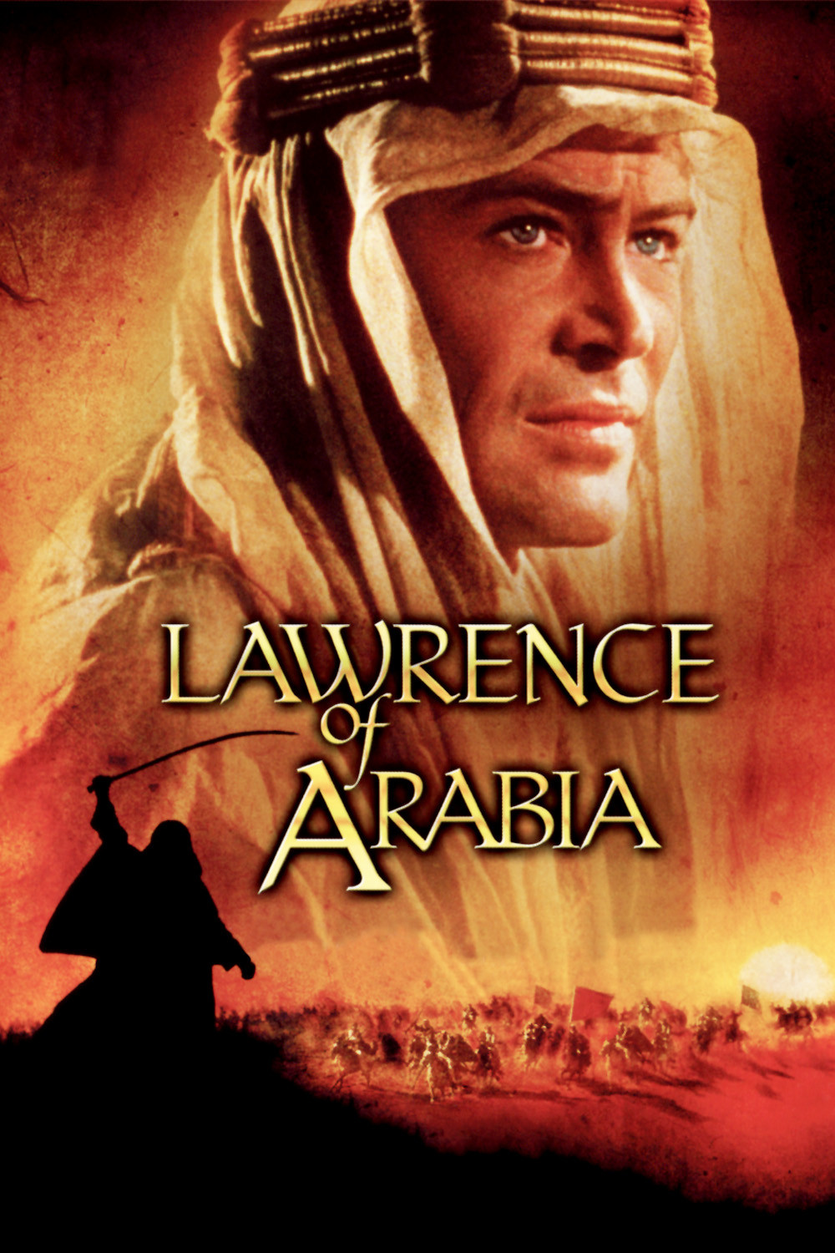
1962 at the Movies
The Academy Award for Best Picture went to a movie about World War I in the Middle East
It starred Peter O’Toole as a British officer and diplomat
It was set in what is now Saudi Arabia, Jordan, Palestine, and Syria
https://www.youtube.com/watch?v=lChJz2DSpsE

Slide 11
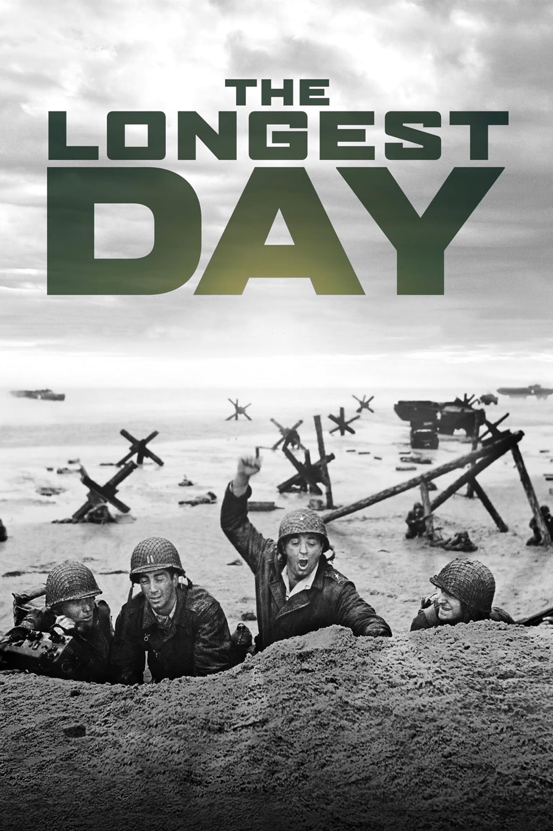
1962 at the Movies
This picture was a World War II story about D-Day
It starred John Wayne, Robert Ryan, and Richard Burton, among many others
It won two Academy Awards
A Scottish actor had a bit part as Pvt. Flanagan, but he went on to star as a famous spy in another 1962 movie …
Notes:
Academy Awards for Best Cinematography – B&W film; and best special effects.

Slide 12
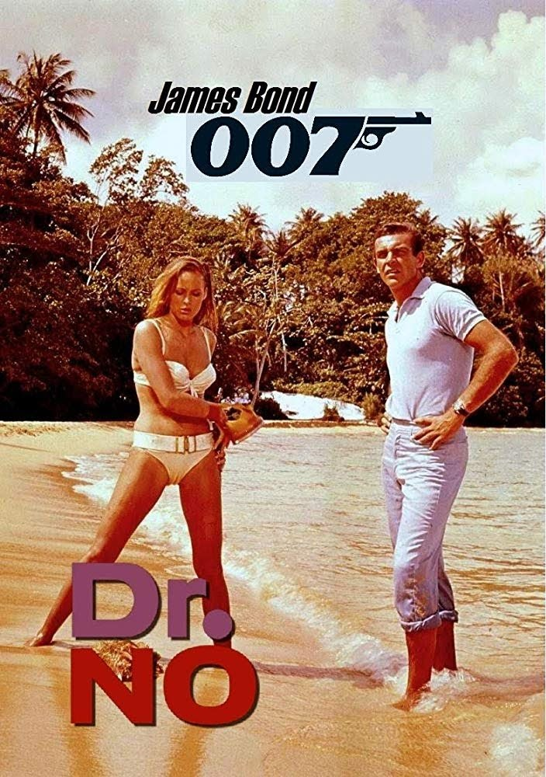
1962 at the Movies
This was the first movie based on author Ian Fleming’s novels about a British secret agent
It starred little-known Scottish actor Sean Connery as agent “007”, and Swiss-German actress Ursula Andress as the female lead.
https://youtu.be/avmKpdpKYm4
Notes:
Sean Connery was far from first choice to portray James Bond – they producers tried to sign Cary Grant (he would only commit to one film), Patrick McGoohan (Secret Agent), and David Niven – among others. The movie was a financial success, and set the tone (and cast) for the many James Bond movies to come – including the intro electric guitar set.

Slide 13
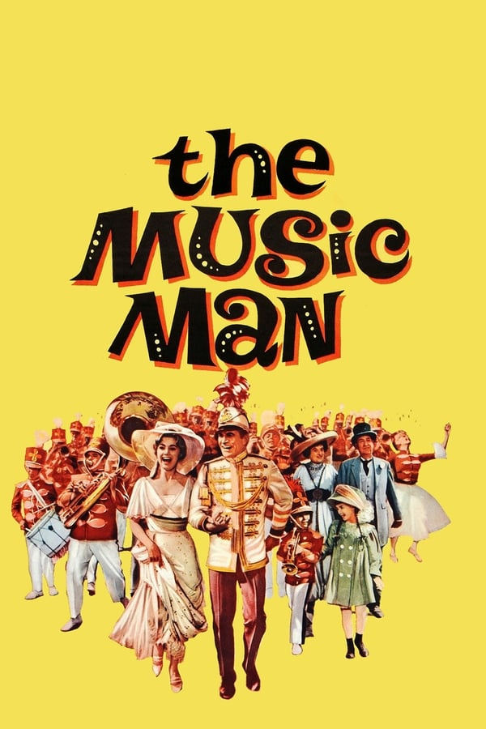
1962 at the Movies
This musical is set in fictional “River City” Iowa.
Actor Robert Preston plays a con man - “Professor” Harold Hill - a supposed music teacher.
The movie won the Academy Award for Best Music
https://www.youtube.com/watch?v=9r6XJi3HbHo
Notes:
Set video to 0:36 for lyrics

Slide 14

1962 -- Off the Field:
On January 1, 1962 – Decca Records held two auditions at their studios in West Hampstead, England.

Slide 15
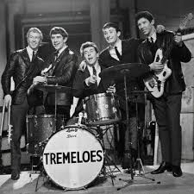
Decca Records opted to sign The Tremeloes to a contract. The other group was rejected because “guitar groups were on the way out”.

Slide 16
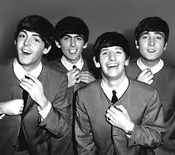
The group they rejected was The Beatles

Slide 17
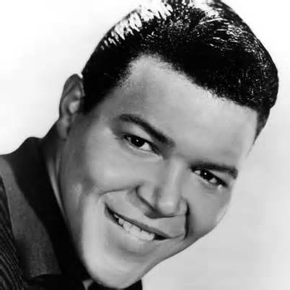
Rock & Roll
Let’s Twist Again …
https://www.youtube.com/watch?v=eh8eb_ACLl8
Notes:
Ernest Evans had the top hit song of 1960 and he made this “sequel” … we know him by his stage name “Chubby Checker”.

Slide 18
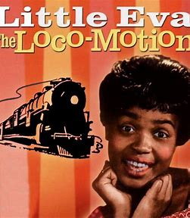
Rock & Roll
The Twist wasn’t the only dance craze in ‘62
https://www.youtube.com/watch?v=eKpVQm41f8Y
Notes:
The popularity of The Twist led to several new “dance moves” highlighted by hit songs

Slide 19
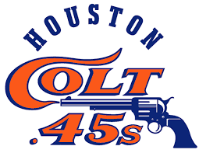
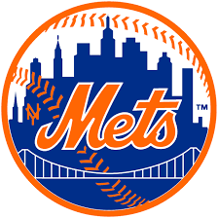
1962 -- On the Field:
NL Expansion

Slide 20
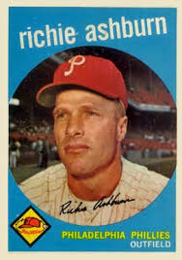
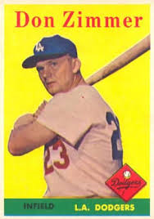
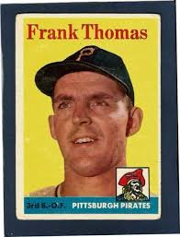
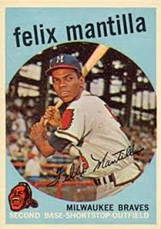
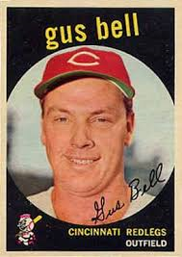
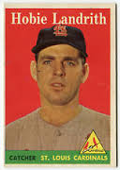
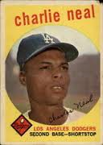
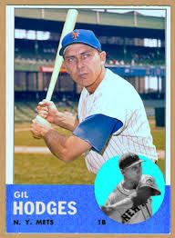
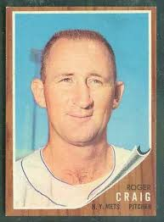
1962 Mets
Richie Ashburn CF
Don Zimmer 3B
Frank Thomas LF
Felix Mantilla SS
Gus Bell RF
Hobie Landrith C
Charlie Neal 2B
Gil Hodges 1B
Roger Craig P

Slide 21
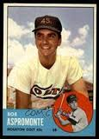
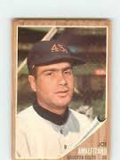
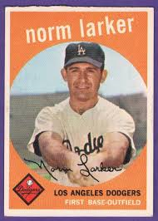
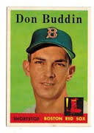
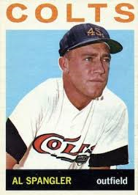
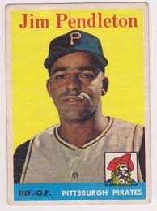
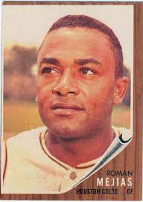
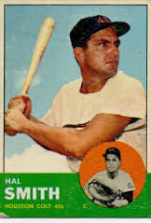
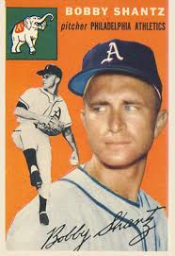
1962 Colt 45s
Bob Aspromonte 3B
Norm Larker 1B
Joe Amalfitano 2B
Al Spangler LF
Jim Pendleton RF
Don Buddin SS
Bobby Shantz P
Roman Mejias RF
Hal Smith C

Slide 22
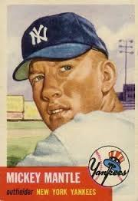
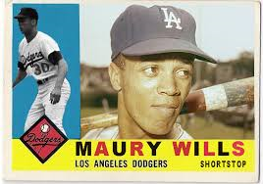
1962 -- On the Field:
League Most Valuable Players:
.299 batting avg., ML record 104 stolen bases
.321 batting avg. with 30 home runs

Slide 23
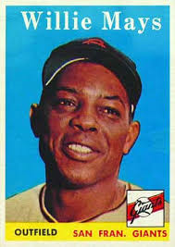
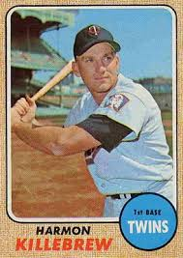
1962 – On the Field:
League Leaders in HR
Willie Mays– 49 HR
Harmon Killebrew– 48 HR
Notes:
Mickey Mantle hit 37 homers to lead the AL. He also led the league in triples, walks, and SLG.

Slide 24
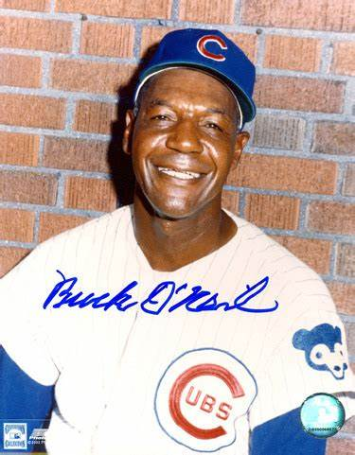
1962 -- On the Field:
Former Negro Leagues player and manager
Buck O’Neil
Became the first black coach in
Major League Baseball in 1962 with the Cubs
https://www.youtube.com/watch?v=Yxf000X5G_8

Slide 25
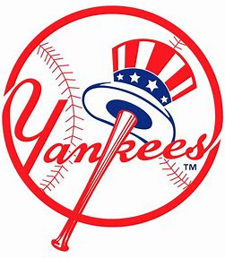
1962 -- On the Field:
Final Regular Season Standings
1962 American League Team Standings
Team | Wins | Losses |  | GB
New York | 96 | 66 |  | 0
Minnesota | 91 | 71 |  | 5
Los Angeles | 86 | 76
Detroit | 85 | 76
Chicago | 85 | 77
Cleveland | 80 | 82
Baltimore | 77 | 85
Boston | 76 | 84
Kansas City | 72 | 90
Washington | 60 | 91
The New York Yankees won the American League pennant.
It was their third consecutive AL title and 13th of the last
16 years!

Slide 26
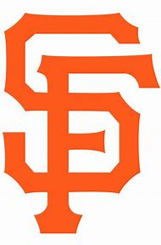
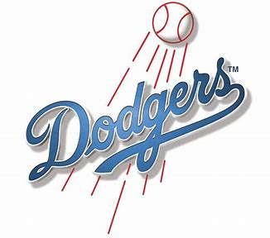
1962 -- On the Field:
Final Regular Season Standings
1962 National League Team Standings
Team | Wins | Losses |  | GB
San Francisco | 101 | 61 |  | 0
Los Angeles | 101 | 61 |  | 0
Cincinnati | 98 | 64 |  | 3
Pittsburgh | 93 | 68
Milwaukee | 86 | 76
St. Louis | 84 | 78
Philadelphia | 81 | 80
Houston | 64 | 96
Chicago | 59 | 103
New York | 40 | 120 |  | 60
But the National League ended in
a tie!!!

Slide 27
1962 -- On the Field:
National League Playoff Series
This was the fourth playoff series in the history of the National League.
The Dodgers were involved in all four of them!
The National League used a best-2-of-3 format.
The Giants won the deciding third game 6-4,
to advance to the 1962 World Series

Slide 28
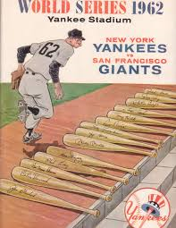
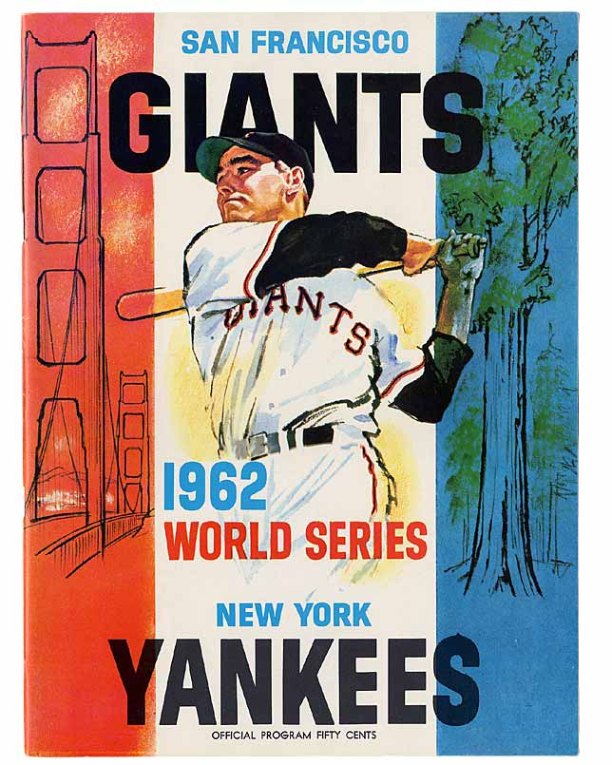
1962 World Series
vs.

Slide 29
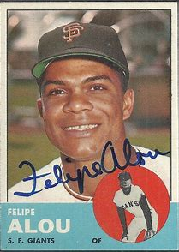
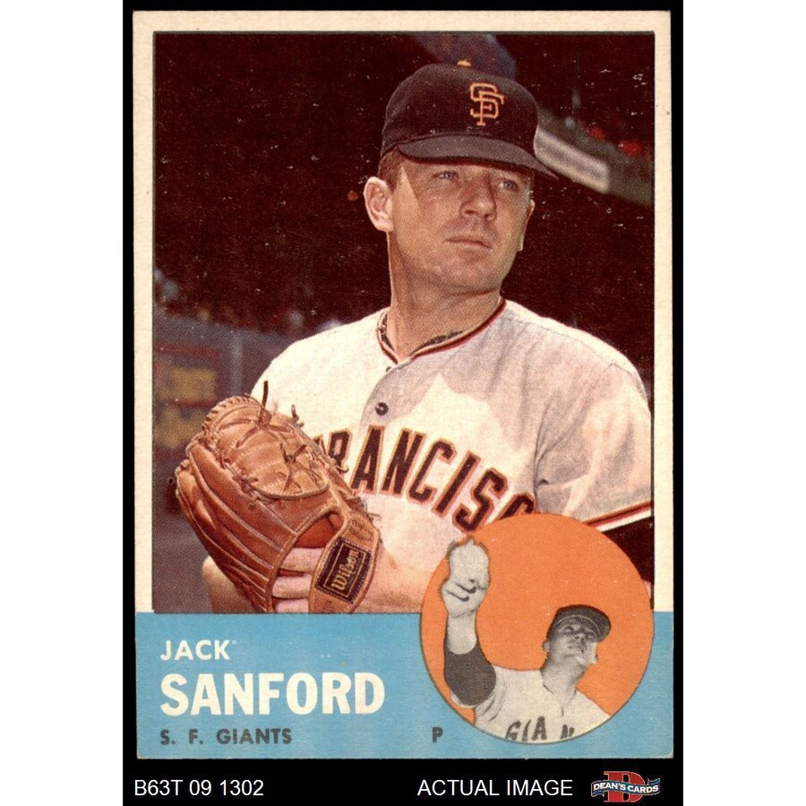




Key Giants Players

Slide 30







Key Yankees Players

Slide 31
1962 World Series
The Giants and Yankees split the first six games
The deciding game was played at San Francisco’s Candlestick Park on Tuesday, October 16
The Yankees scored a run in the 5th inning to take a 1-0 lead
The score was still 1-0 as the Giants came to bat in the bottom of the 9th inning:
Matty Alou bunted for a hit.
After two outs, Willie Mays doubled, sending Alou to third.
Giants outfielder and slugger Willie McCovey comes to the plate facing Yankee starting pitcher Ralph Terry …
https://youtu.be/HRwWIZ1ybk8
Notes:
Start at 14:39 of the video.

Slide 32


Charlie Brown must have been a Giants fan !

Slide 33

Extra Innings!
More Stuff from the 1960’s

Slide 34

Things from the 1960s that we don’t see anymore …

Slide 35

Things from the 1960s that we don’t use anymore …

Slide 36

Things from the 1960s that we don’t use anymore …

Slide 37

Things from the 1960s that we don’t use anymore …

Slide 38

Things from the 1960s that we don’t use anymore …

Slide 39

Things from the 1960s that we don’t use anymore …

Slide 40

Things from the 1960s that we don’t use anymore …

Slide 41

Things from the 1960s
that we don’t use anymore …

Slide 42

Things from the 1960s
that we don’t use anymore …

Slide 43

Things from the 1960s
that we don’t see anymore …

Slide 44

Things from the 1960s
that we don’t use anymore …

