Slide 1
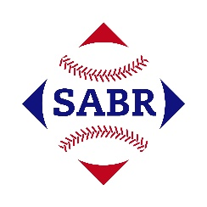
AGE Thrive with Baseball Memories
May 3, 2023
Agenda
Warm-up - Introductions
Gametime – The Year in Baseball – 1965
Seventh Inning Stretch - “Take Me Out to the Ball Game”
- Get Moving
Extra Innings – More stuff from the ‘60s
Extra Innings - Memorabilia

Slide 2
The Year in Baseball: 1965

Slide 3
1965 -- Off the Field:
U.S. President:
Notes:
LBJ – had just won a landslide re-election in November, 1964 over Barry Goldwater. He championed and pass the Civil Rights Act in 1964, and would go on to pass the Voting Rights Act in 1965.

Slide 4
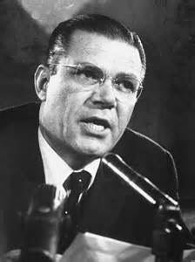
1965 -- Off the Field:
Secretary of State
Secretary of Defense
Notes:
Dean Rusk was a Kennedy appointee and is one of the longest-serving US Secty of State (behind Cordell Hull). Robert McNamara was president of Ford Motor Co. and was also a Kennedy appointee. He was also one of the longest-serving US Secty of Defense.

Slide 5
1965 -- Off the Field:
Technology … now and then …
Music – Now -- you can take your tunes everywhere; or stream them from anywhere..
iPod
Play 40 hours of music on a full charge.

Slide 6
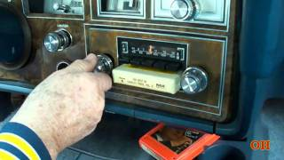
1965 -- Off the Field:
Technology … now and then …
Music – in ‘65, you could take your tunes with you … sort of …
8-track
Played 40 minutes of music
per cartridge … about enough
to store a 33rpm LP album.

Slide 7
1965 -- Off the Field:
Technology … now and then …
Telephone – Now – you can make a call, access the internet and take pictures & videos from your smart-phone
iPhone 14

Slide 8
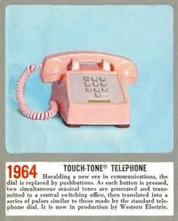
1965 -- Off the Field:
Technology … now and then …
Telephone – in ‘65 – you could make calls by pushbutton.
Western
Electric
Touch-tone

Slide 9
1965 -- Off the Field:
Technology … now and then …
Computing – Now – you can carry your processing power with you and connect via Wi-Fi to the ‘net
iPad
Notes:
Current models (2022) have 64GB of memory!

Slide 10
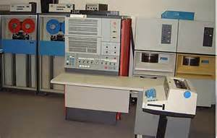
1965 -- Off the Field:
Technology … now and then …
Computing – in ‘65 – the latest and greatest ….
IBM
System/360
Model 30
Notes:
First shipment to McDonnell Aircraft in 1965. Had 64K of memory!

Slide 11
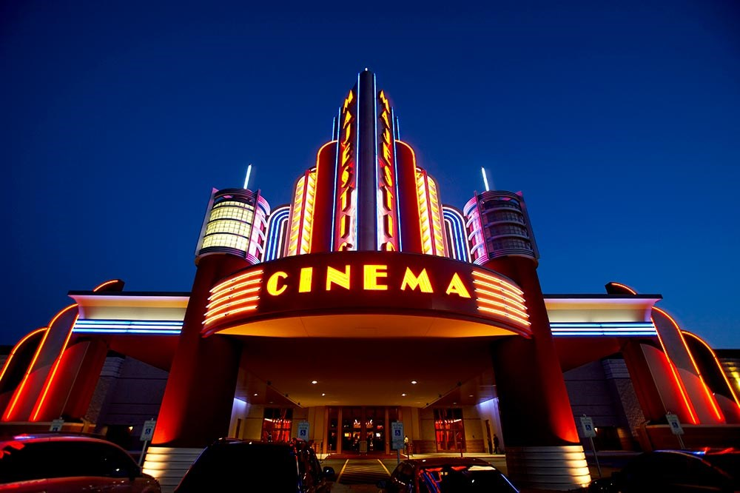
1965 at the Movies

Slide 12
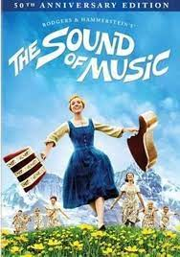
1965 at the Movies
The Academy Award for Best Picture went to this musical about a young Austrian girl taking care of the von Trapp children
The movie starred Julie Andrews and Christopher Plummer
It was also the top grossing movie of the year, and by 1966 became the all-time best selling movie.
https://www.youtube.com/watch?v=6f0T6UV-HiI
Notes:
Won five Oscars – best picture, best directing, best editing, best music adaptation, best sound; by 1966 had overtaken Gone with the Wind as top box office gross. It was the first movie to ever gross $100M in sales.

Slide 13
1965 at the Movies
This movie was set in Russia during World War I and the Revolution.
It starred Omar Sharif in the title role as a physician and poet; and Julie Christie as his love interest.
It won five Oscars including Best Screenplay and Best Original Score.
Notes:
Won five Oscars – best screenplay, best original score, best cinematography, best art direction, best costume design. Peter O’Toole was first choice for the lead, but he turned it down. As it was the Cold War, the movie was filmed mostly in Spain.

Slide 14
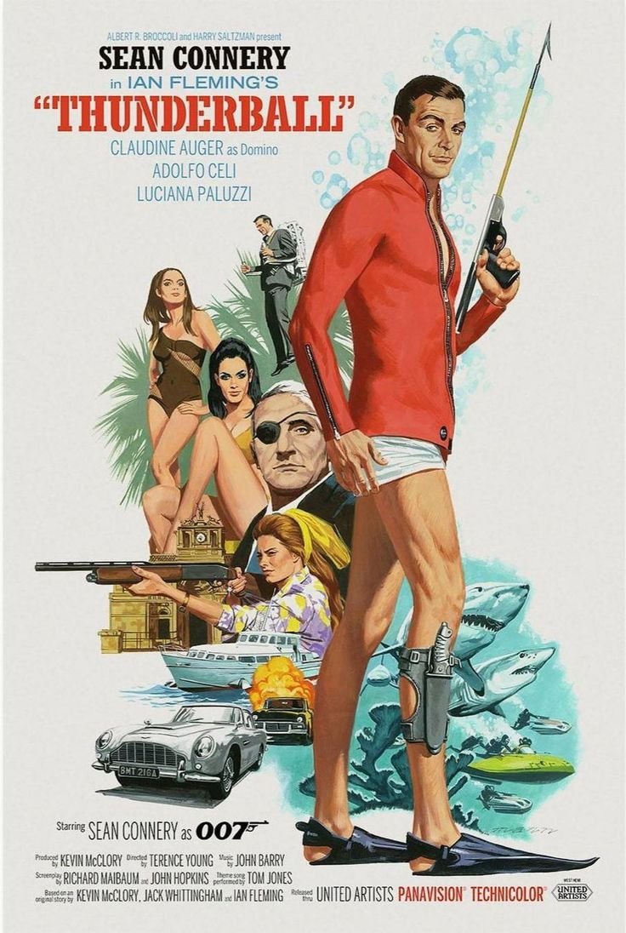
1965 at the Movies
This picture was the fourth movie based on Ian Fleming’s James Bond spy novels.
The movie is set in the Bahamas, with Bond searching for two stolen atomic bombs.
Sean Connery continued to play the lead role.
https://www.youtube.com/watch?v=dTMHrljIW0g
Notes:
Fourth of the James Bond movies – all starring Sean Connery.

Slide 15
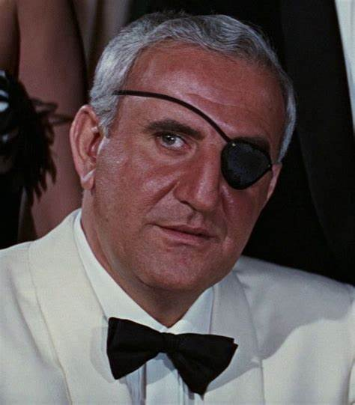
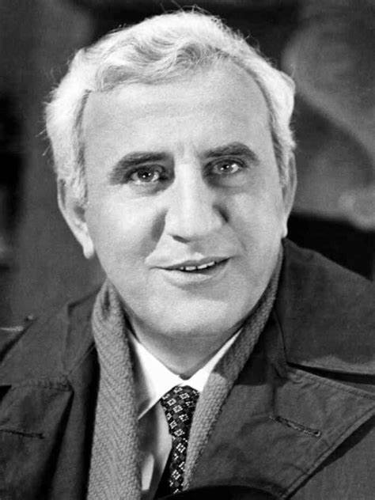
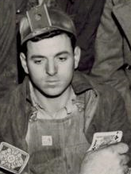
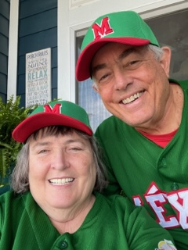
Thunderball – for genealogy fans
He was played by Italian actor Adolfo Celi
Adolfo’s cousin, Ortenzio Celi, emigrated to the U.S. and was a coal miner
Emilio Largo, SPECTRE #2, was the villain
Ortenzio is
Monte’s
Grandfather
Notes:
Celi was an actor and producer/director; played in over 100 movies, specializing as an international villain; did three movies in 1965 in the U.S. – Thunderball; Agony and Ecstasy; and Von Ryan’s Express.

Slide 16
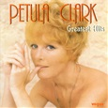
1965 Music
Top selling songs in ‘65:
https://www.youtube.com/watch?v=reSSvOnQEr8

Slide 17
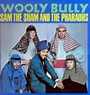
1965 – Music
Top selling songs in ‘65:
https://www.youtube.com/watch?v=wpjDcmgHCd4

Slide 18
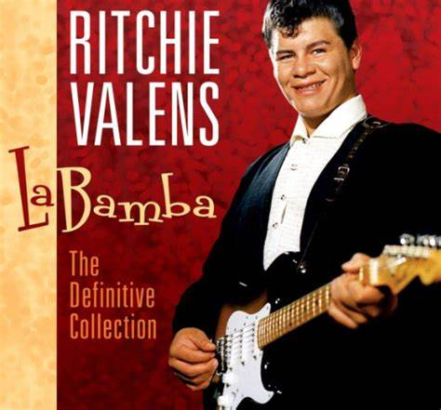
¡ Música !
https://www.youtube.com/watch?v=POSmz4p7gjs&t=152s
Notes:
First release in ‘58; still popular today; is a “son” in 4/6 time – believed to be from the Veracruz area of Mexico

Slide 19
1965 -- On the Field: Some Highlights
Played all nine positions in
a single game
Hit his 400th home run
Hit his 500th home run
And, on April 9th, with President Johnson and Texas Governor Connally in attendance, …
Notes:
Dagoberto “Bert” Campaneris became first player in modern era to play all nine positions in a single game (A’s vs. Angels) – A’s lost 5-3 in 13 innings. Ernie Banks hit his 400th home run in a game at Wrigley Field. Willie Mays hit #500 in a game against Houston; at the time he was only the fifth player to reach 500 career homers (can you name the others? (Ruth, Foxx, Williams, Ott). Houston P Don Nottebart gave up #500 to Mays.

Slide 20
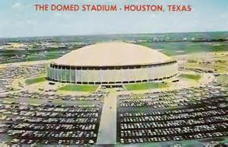
1965 -- On the Field:
the Astrodome opened !

Slide 21
1965 -- On the Field:
League MVPs:
led NL with 52 HR, 350 TB
led AL with 126 runs, 45 doubles, 12 triples, 308 TB

Slide 22
1965 -- On the Field:
League Pitching Leaders:
Sandy Koufax
26 – 8 2.05 ERA 335 IP 382 K perfect game
Cy Young Award (only one winner for all MLB)
Jim “Mudcat” Grant
21 – 7 6 shutouts

Slide 23
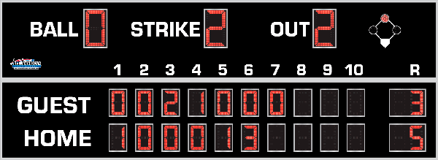
7th Inning Stretch

Slide 24
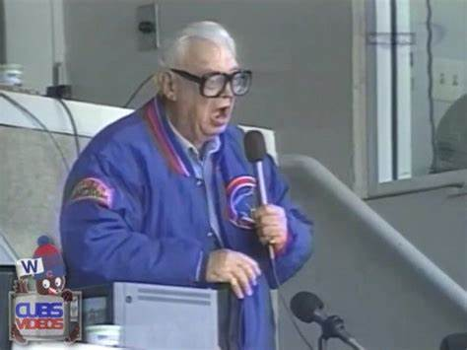
“Take Me Out to the Ballgame”
https://www.youtube.com/watch?v=HnHV5FaqvEs
Notes:
Mike has short “intro” to this …

Slide 25
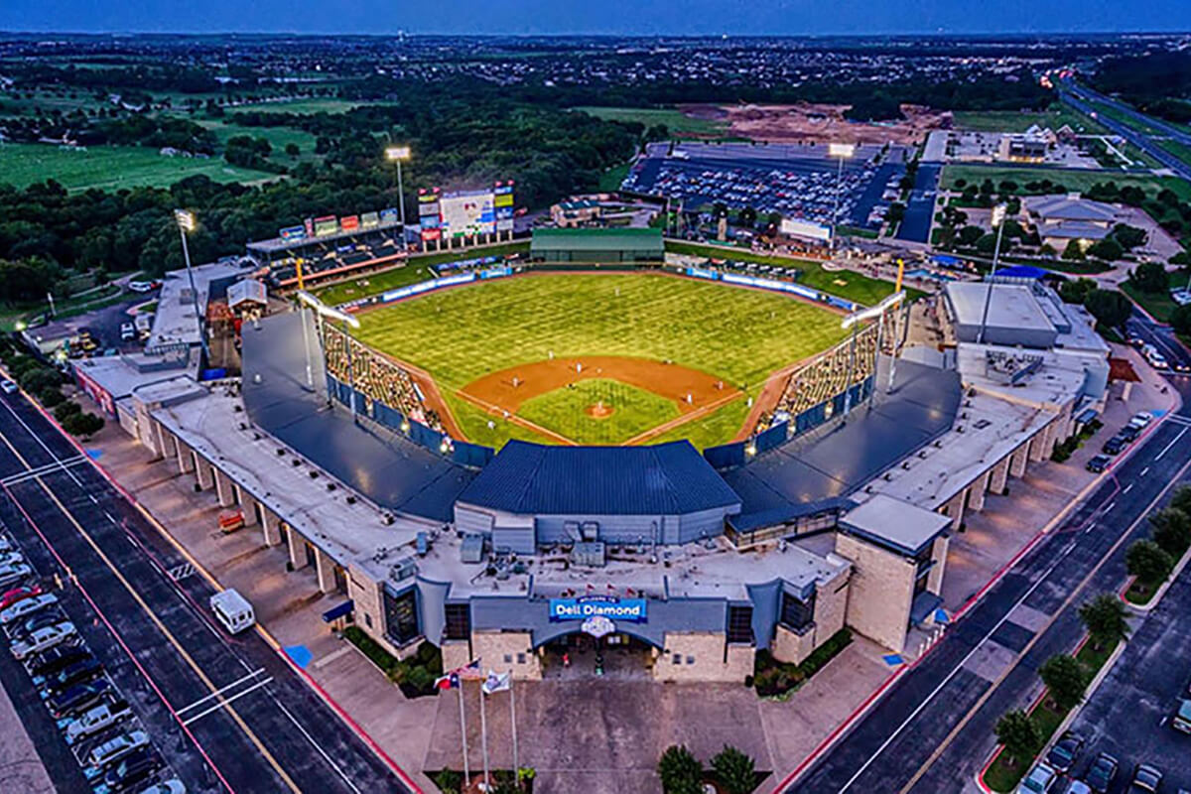
“Deep in the Heart of Texas
https://www.youtube.com/watch?v=VGF4ibgcHQE

Slide 26
1965 -- On the Field: Final Regular Season Standings
1965 American League Team Standings
Team | Wins | Losses |  | GB
Twins | 102 | 60 |  | 0
White Sox | 95 | 67 |  | 7
Orioles | 94 | 68 |  | 8
Tigers | 89 | 73 |  | 13
Indians | 87 | 75 |  | 15
Yankees | 77 | 85 |  | 25
Angels | 75 | 87 |  | 27
Senators | 70 | 92 |  | 32
Red Sox | 62 | 100 |  | 40
Athletics | 59 | 103 |  | 43

Slide 27
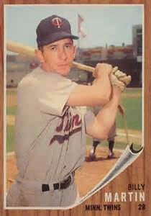
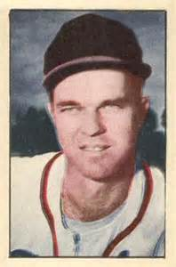
1965 – Top Twins
3B Coach
Zoilo Versalles
Tony Oliva
Harmon Killebrew
Pitching
Coach
Jim “Mudcat” Grant
Jim Kaat
Camilo Pasqual
Notes:
Mickey Mantle hit 37 homers to lead the AL. He also led the league in triples, walks, and SLG.

Slide 28
1965 -- On the Field: Final Regular Season Standings
1965 National League Team Standings
Team | Wins | Losses |  | GB
Dodgers | 97 | 65 |  | 0
Giants | 95 | 67 |  | 2
Pirates | 90 | 72 |  | 7
Reds | 89 | 73 |  | 8
Braves | 86 | 76 |  | 11
Phillies | 85 | 76 |  | 11 1/2
Cardinals | 80 | 81 |  | 16 1/2
Cubs | 72 | 90 |  | 25
Astros | 65 | 97 |  | 32
Mets | 50 | 112 |  | 47

Slide 29
1965 – Dodgers stars
Maury Wills
Ron Fairly
Wes Parker
Don Drysdale
Sandy Koufax
Claude Osteen
Notes:
Mickey Mantle hit 37 homers to lead the AL. He also led the league in triples, walks, and SLG.

Slide 30
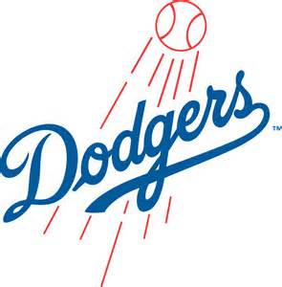
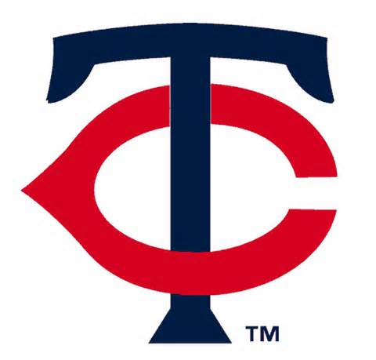
1965 World Series
vs.
Play began on October 6 at
Metropolitan Stadium in Minneapolis, Minn.

Slide 31
1965 World Series Game 7
vs.
https://www.youtube.com/watch?v=FEnyO2ShbEM

Slide 32
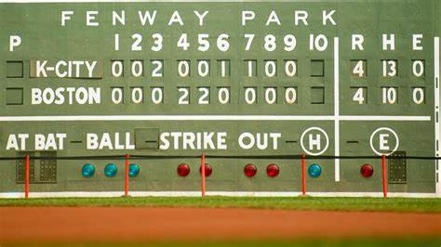
Extra Innings!
More Stuff from the 1960’s

Slide 33
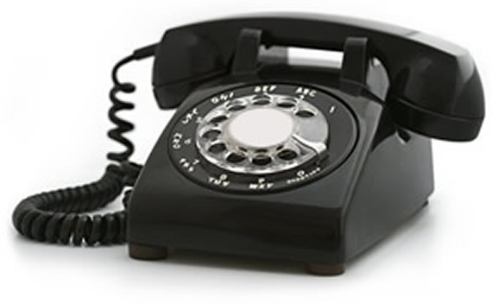
Things from the 1960s that we don’t use anymore …

Slide 34
Things from the 1960s that we don’t use anymore …

Slide 35
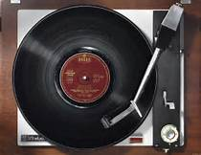
Things from the 1960s that we don’t use anymore …

Slide 36
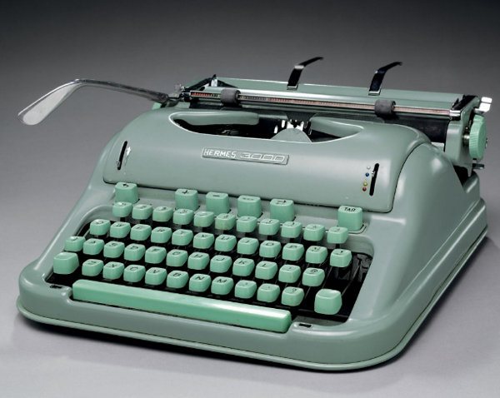
Things from the 1960s that we don’t use anymore …

Slide 37
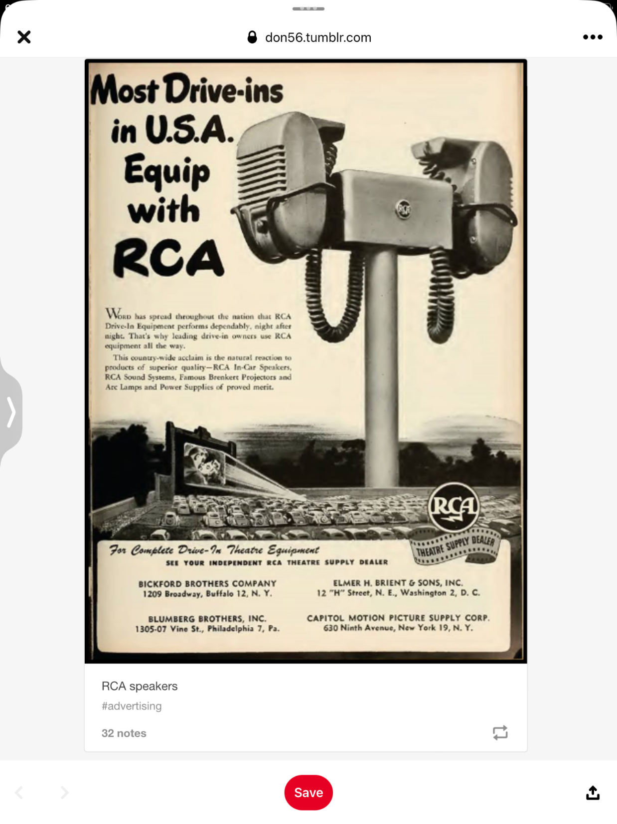
Things from the 1960s
that we don’t use anymore …

Slide 38
Things from the 1960s
that we don’t use anymore …

Slide 39
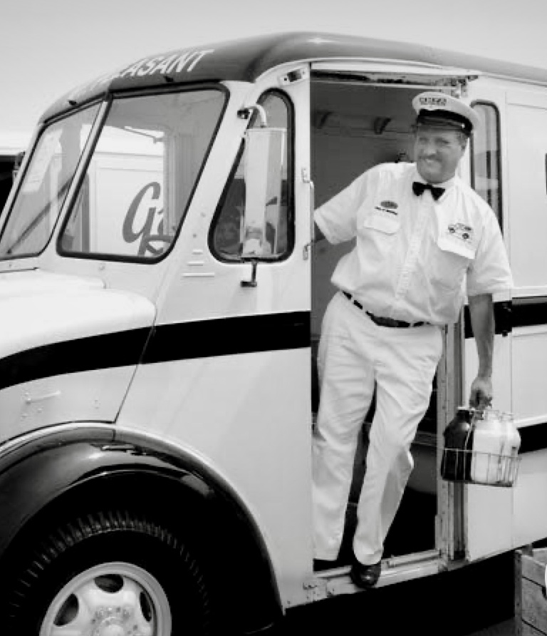
Things from the 1960s
that we don’t see anymore …

Slide 40
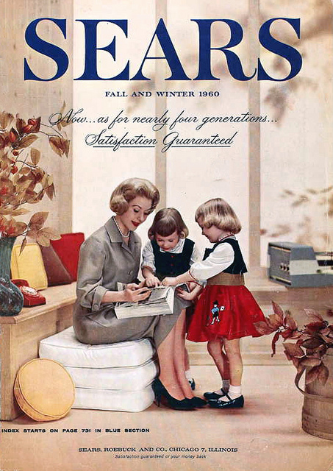
Things from the 1960s
that we don’t use anymore …

Slide 41
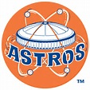
1965 Team Leaders
Who were top players for the
Houston Astros ?

Slide 42
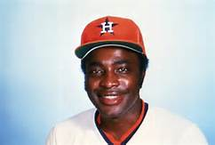
1965 Team Leaders
Houston Astros
Jimmy Wynn Joe Morgan Rusty Staub Turk Farrell Dave Giusti
22 HR 73 RBI .271 14 HR 97 BB* 14 HR 63 RBI 11-11 3.50 ERA 8-7
Notes:
Others – Bob Aspromonte, Bob Lillis, Lee Maye, Larry Dierker (first full year pitching)

Slide 43
1960s Team Leaders
Who were some top Texas Longhorns?

Slide 44
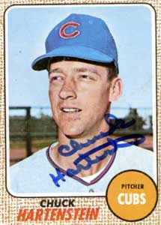
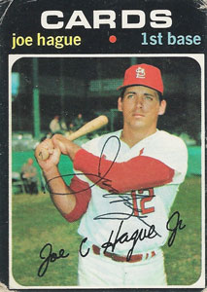
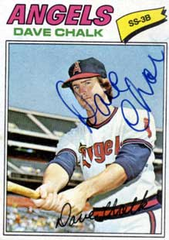
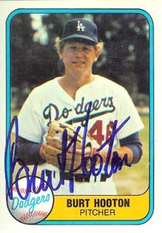
1960s Team Leaders
Some top Texas Longhorns from the ‘60s
Chuck Hartenstein Joe Hague Dave Chalk Burt Hooton
187 MLB games ‘66-’77 430 games, 163 RBI ‘68-’73 243 RBI, .252, ‘73-’81 151 wins, 15 seasons
Notes:
Hooton was 2nd overall pick in 1971 draft

