Slide 1
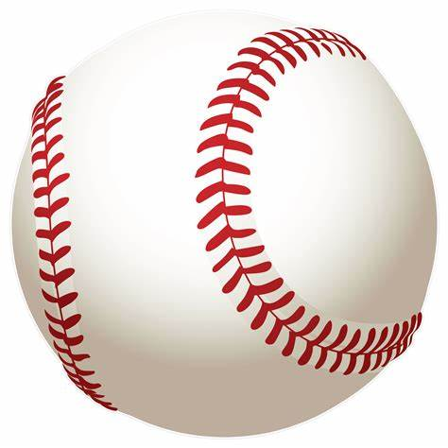
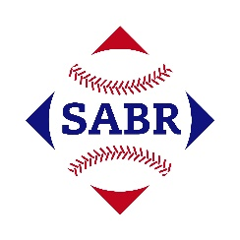
AGE Thrive with Baseball Memories
June 21, 2023
Agenda
Warm-up - Introductions
Gametime – The Year in Baseball – 1967
Seventh Inning Stretch - “Take Me Out to the Ball Game”
- Get Moving
Extra Innings – More stuff from the ‘60s
Extra Innings - Memorabilia

Slide 2
The Year in Baseball: 1967

Slide 3
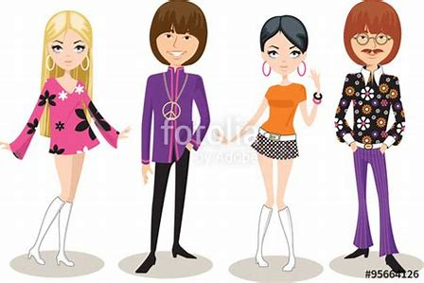
1967 - Fashion

Slide 4
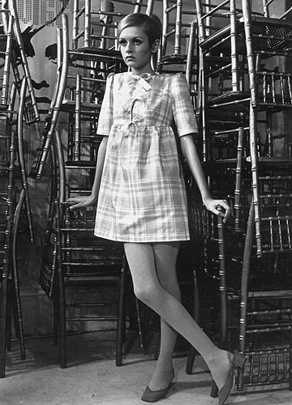
1967 -- Off the Field:
“Mod” fashion was in vogue
Leslie Hornby
aka
Twiggy
Notes:
Famous model in her mini-skirt. Leslie Hornby … better known as … Twiggy. Is currently worth $44M and was made a Dame of the British Empire by Q.Elizabeth.

Slide 5
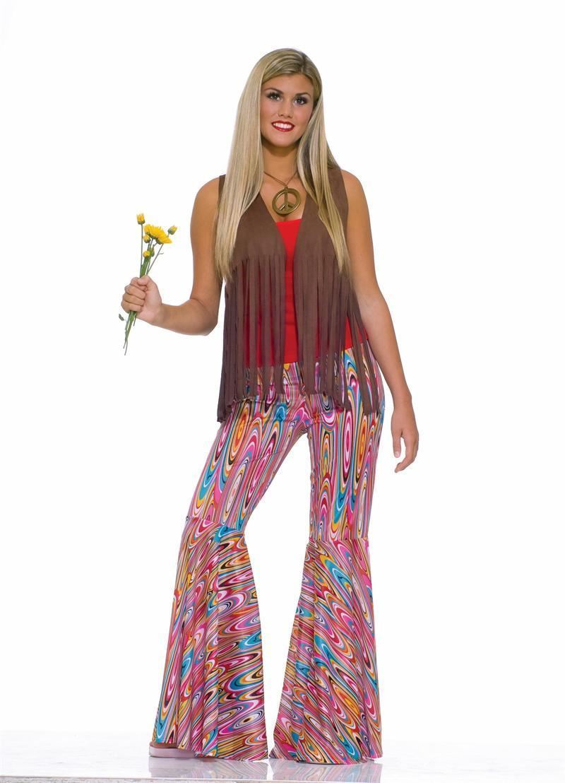
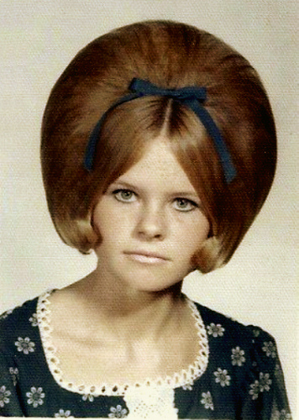
“Mod”
fashion:
Notes:
Mod– bell bottoms, peace symbol on her necklace; flower power; the bouffant hair-do.

Slide 6
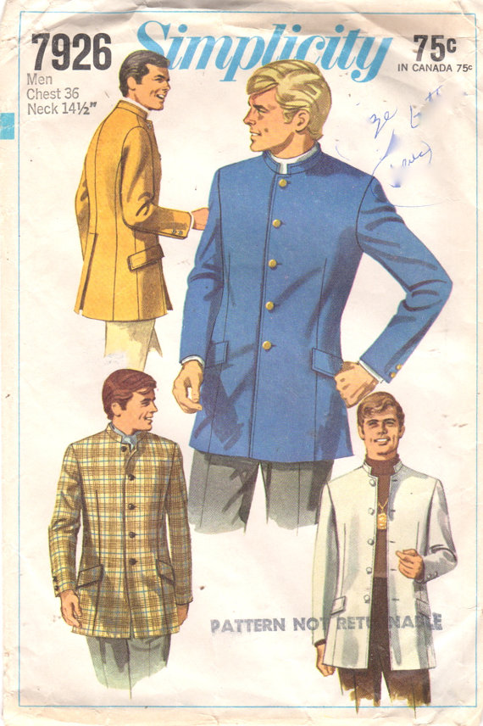
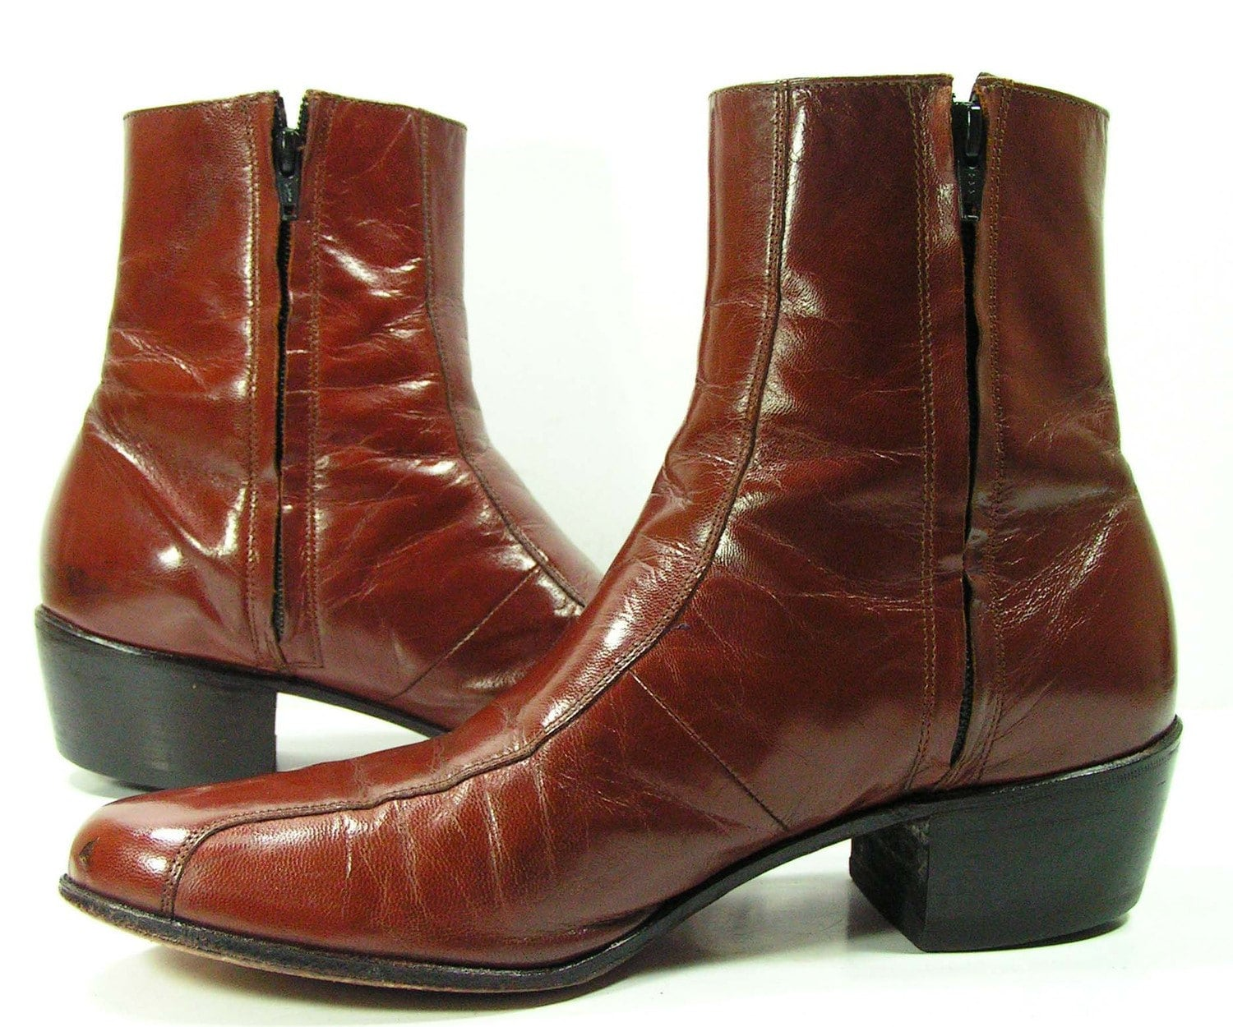
“Mod”
fashion:
Notes:
Beatle boots; Nehru jacket – both popularized by the Beatles.

Slide 7
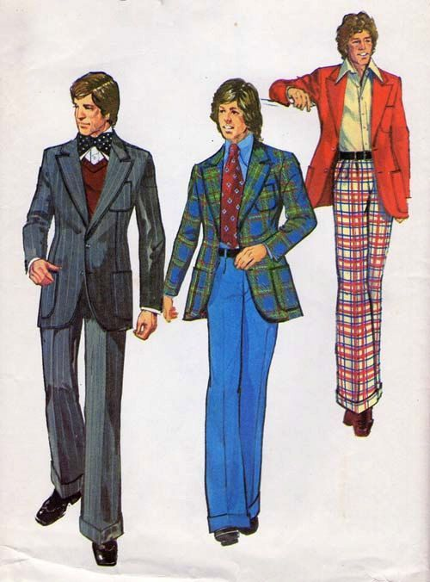
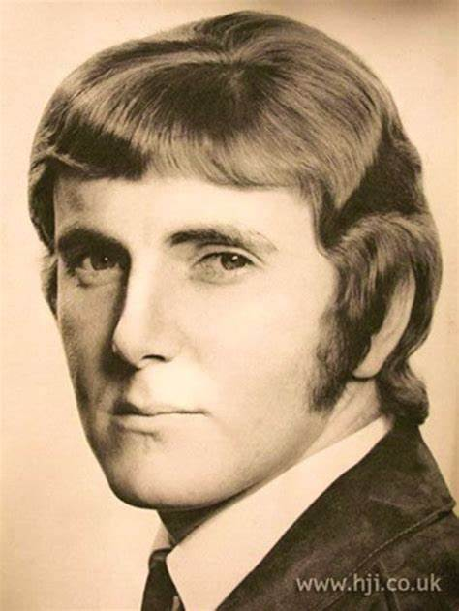
“Mod”
fashion:
Notes:
More men’s “MOD” fashion – plaid jackets and pants; wide lapels; wide ties; big collars on shirts; longer hair and sideburns

Slide 8
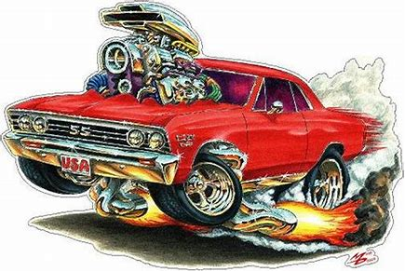
1967 - Cars

Slide 9
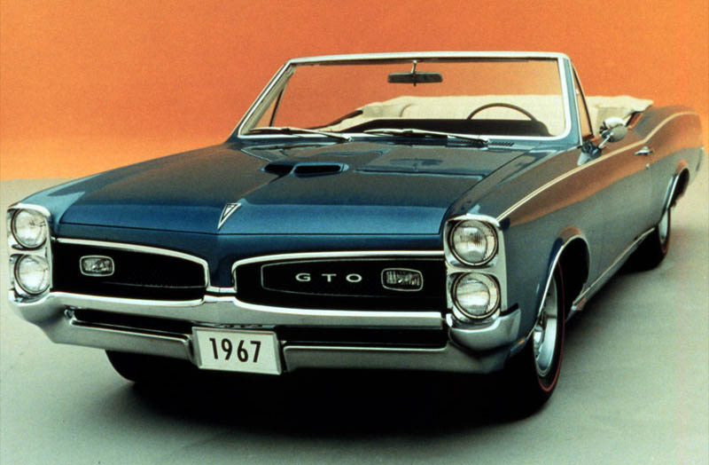
“Muscle cars” were popular in ‘67
The Pontiac GTO is generally considered to be the first production “muscle car”
It was introduced as an option of the 1964 LeMans
This 1967 model was probably the most stylish.

Slide 10
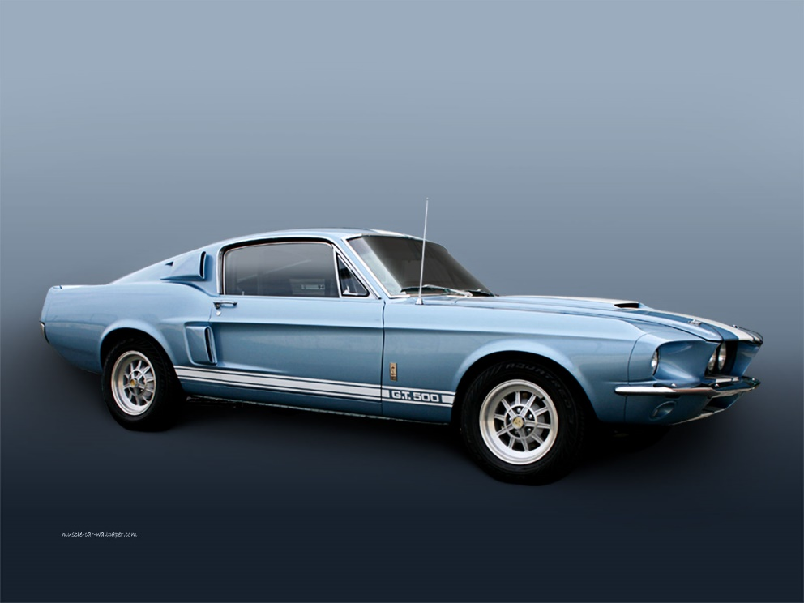
The Shelby GT500 Mustang
was introduced in ‘67.
The 428 ci. Engine was advertised to do 150 mph, but was clocked at 170 !
The prototype sold at auction in 2013 for $1.3M
Notes:
Developer Carroll Shelby – from Leesburg Texas – drove this car at a Goodyear tire demo in San Angelo, TX and it was clocked at 170 mph !

Slide 11
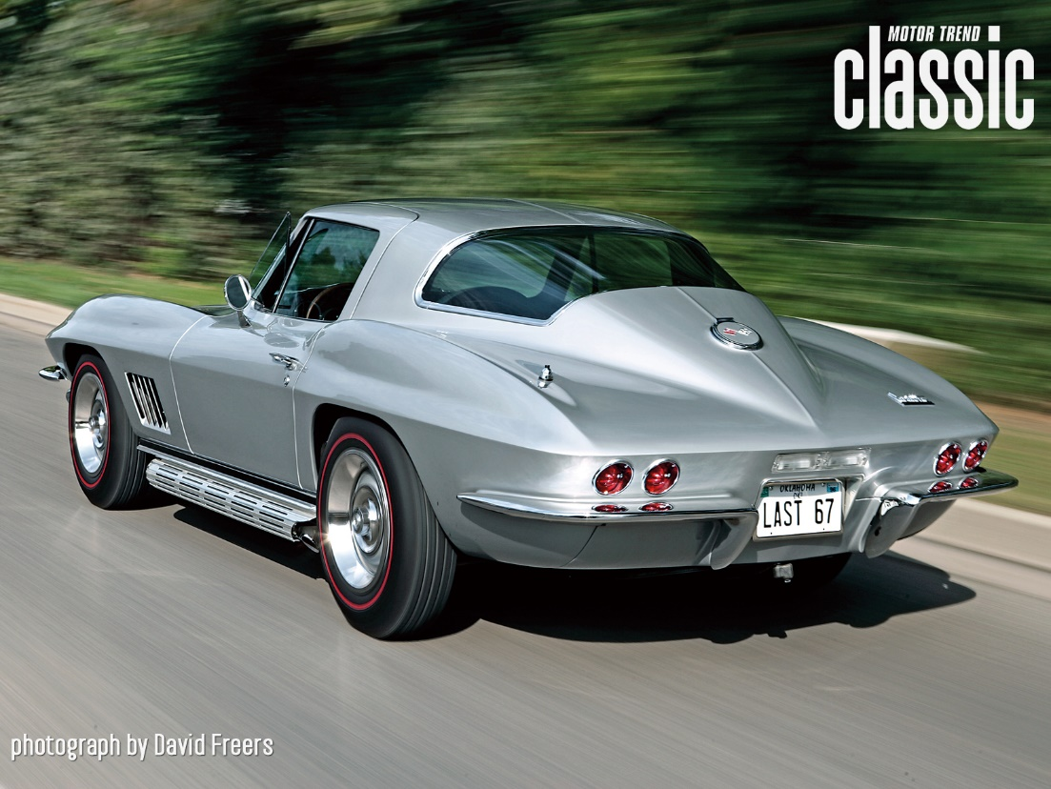
The Chevrolet Corvette
was first introduced in 1953 as a six-cylinder convertible.
Unique fiberglass body.
Gradually became more popular as high-performance engines were introduced.
Notes:
The largest engine on the ‘67 produced over 500 hp. ‘67 was the last year for the “Sting Ray” version, shown in this picture.

Slide 12
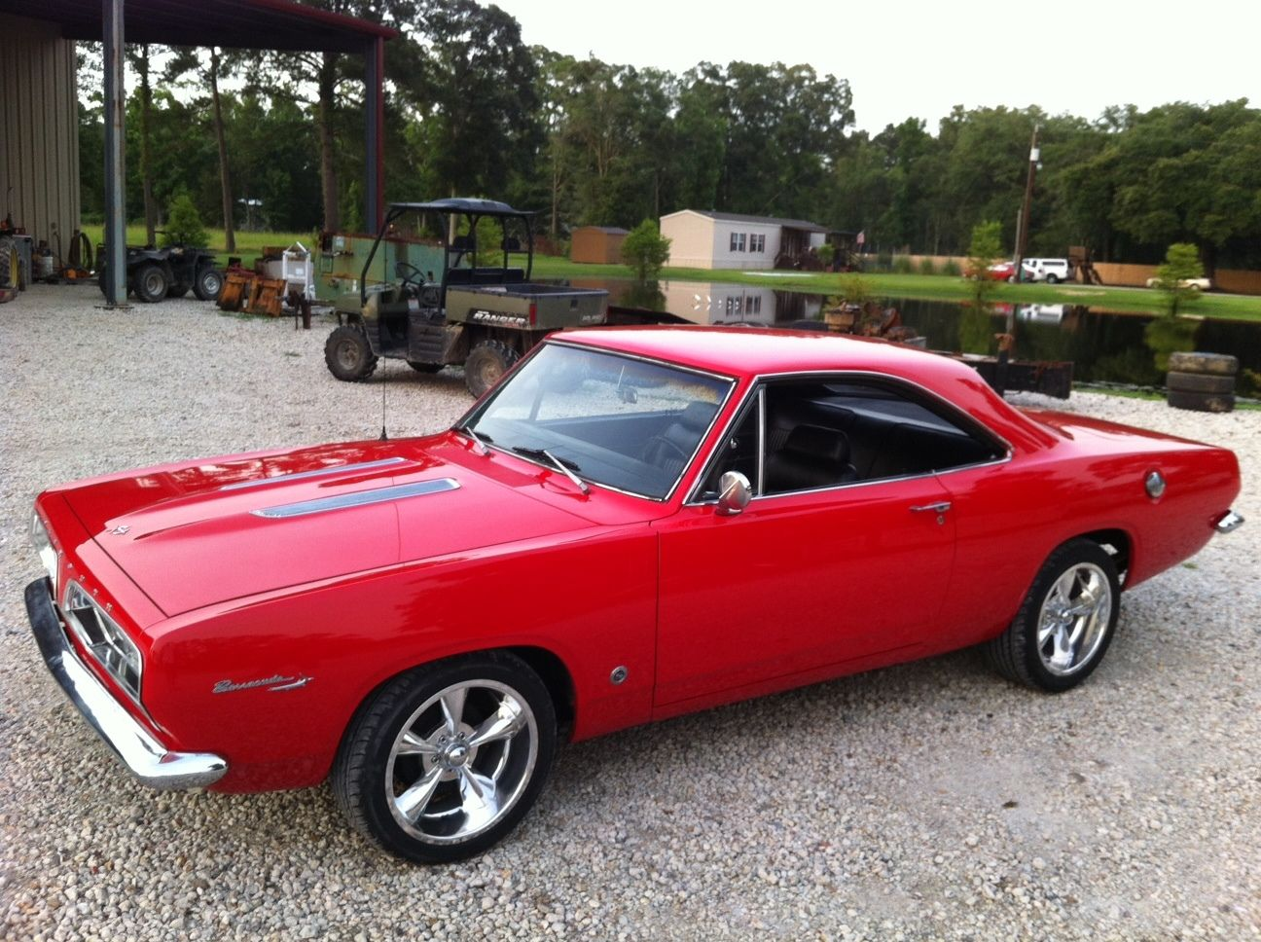
Plymouth Barracuda was one of Chrysler Corporation’s “muscle cars”.
It was first introduced in 1964 as a sporty alternative to the Plymouth Valiant.
It was redesigned in ‘67 to make it more “sleek” and introduce V8 engine options.

Slide 13
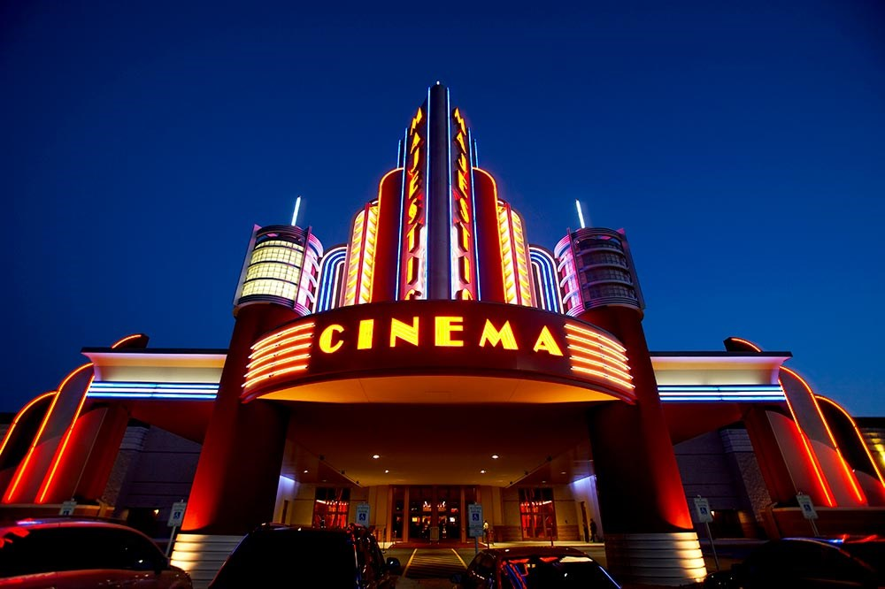
1967 at the Movies
Famous quotes from top
1967 movies.
See if you can name the movie based upon a famous line in the script

Slide 14
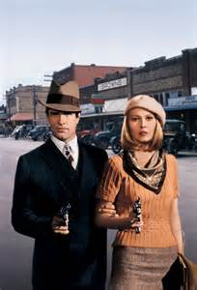
“We’re the Barrow Gang. We rob banks.”
Starred Warren Beatty and Faye Dunaway in the title roles
Nominated for 10 Oscars and won for Best Supporting Actress
and Best Cinematography
Bonnie and Clyde
Notes:
I’ll give you a famous line from the movie, and you tell me the movie’s name – Estelle Parsons won Best Supporting Actor as Blanche Barrow, Clyde’s sister-in-law

Slide 15
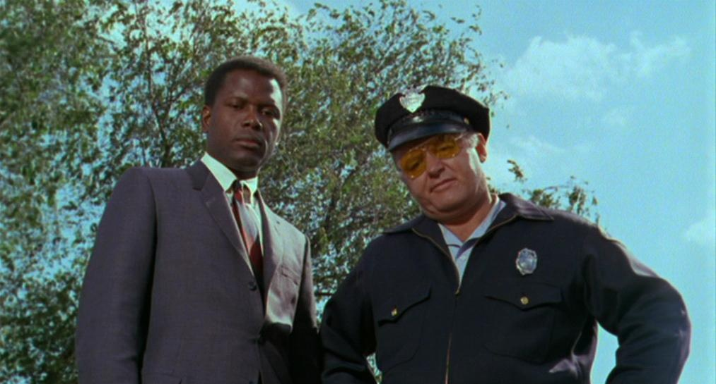
“What do they call you …?” “They call me Mister Tibbs!”
Sidney Poitier and Rod Stieger starred
Won 5 Academy Awards including Best Picture and Best Actor
In the Heat of the Night
Notes:
Rod Stieger won for Best Actor, although Sidney Poitier won the Golden Globe for best actor.

Slide 16
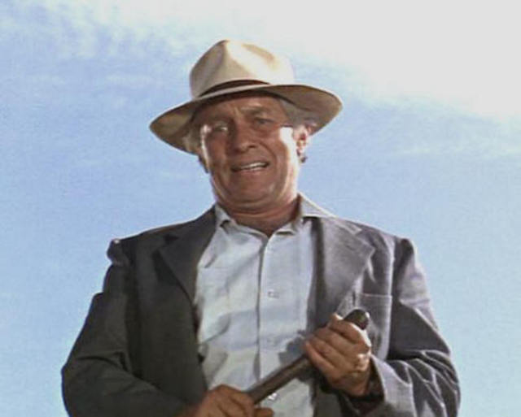
“What we’ve got here is a failure to communicate.”
Starred Paul Newman in the title role
Nominated for 4 Oscars and won for Best Supporting Actor
Cool Hand Luke
Notes:
George Kennedy won for Best Supporting Actor; Strother Martin was the Prison Warden

Slide 17
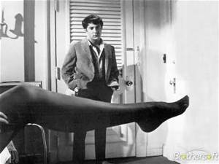
“Mrs. Robinson, are you trying to seduce me?”
Dustin Hoffman starred in the title role.
Simon and Garfunkel did most of the sound track including “Mrs. Robinson” with the baseball reference “Where have you gone Joe DiMaggio…”
The Graduate

Slide 18
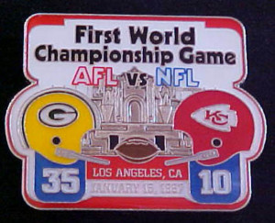
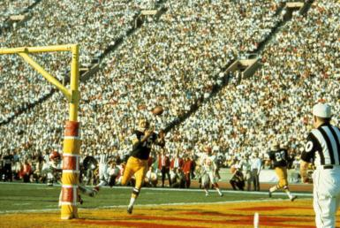
1967 -- On the Field: … the pro football field
Notes:
This was the first AFL vs NFL game to be held after the upstart AFL began operation in 1960. It was held at the LA Coliseum. Max McGee had two TD receptions.

Slide 19
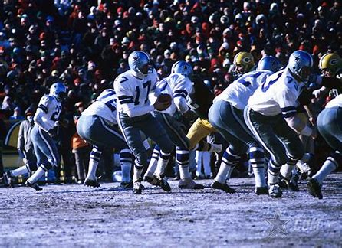
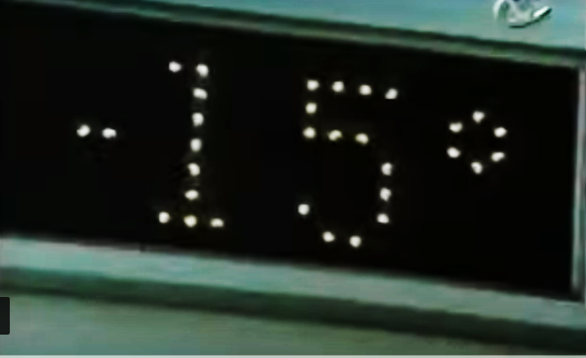
1967 -- On the Field: the “ Ice Bowl “
Cowboys vs. Packers at Lambeau Field
Coldest Game ever
Notes:
The 1967 NFL championship game was Dallas vs. Green Bay at Lambeau Field in Green Bay, Wisconsin. At the time, it was the coldest game ever – minus 15 at game time, wind chill minus 48. The field was heated, but when tarp was taken off, the moisture froze again and the field was a sheet of ice. Green Bay scored a TD with only 13 seconds remaining to win the game 21-17. Many feel this was the greatest football game every played!

Slide 20
1967 -- On the Field:
Mickey
Mantle
Reggie Jackson
Tom Seaver
Rod
Carew
Johnny
Bench
Hit his 500th
homer
Future Hall of Famers that were rookies in ’67
Notes:
Reggie Jackson, Tom Seaver, Rod Carew, and Johnny Bench were all rookies in 1967 … on their way to the Hall of Fame. Mickey Mantle hit his 500th HR.

Slide 21
League Most Valuable Players:
“Yaz”
“Cha Cha”
Won the triple crown hitting
.326, 44 HR, and 121 RBI.
Hit .325, had 25 HR
and led NL with 111 RBI
Notes:
Yaz won the triple crown with .326, 44 HR, and 121 RBI. Orlando Cepeda hit .325, had 25 HR and led NL with 111 RBI; was first-ever unanimous selection.

Slide 22
Cy Young Award Winners:
Jim Lonborg
22-9 3.16 ERA 273 IP 246 K
Mike McCormick
22-10 2.85 ERA 262 IP 150 K
Notes:
1967 was the first year that a Cy Young Award was given to pitchers in each league. From ‘56 to ‘66 was only given to one pitcher across all of MLB.

Slide 23
League Leaders in Stolen Bases
Lou Brock
52 steals
Dagoberto “Bert” Campaneris
55 steals
Notes:
Note Campaneris’ cap – this was the last year the Athletics played in Kansas City
Mickey Mantle hit 37 homers to lead the AL. He also led the league in triples, walks, and SLG.

Slide 24
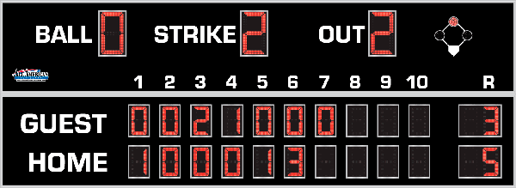
7th Inning Stretch

Slide 25
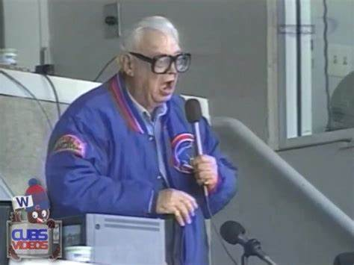
“Take Me Out to the Ballgame”
https://www.youtube.com/watch?v=HnHV5FaqvEs
Notes:
Mike has short “intro” to this …

Slide 26
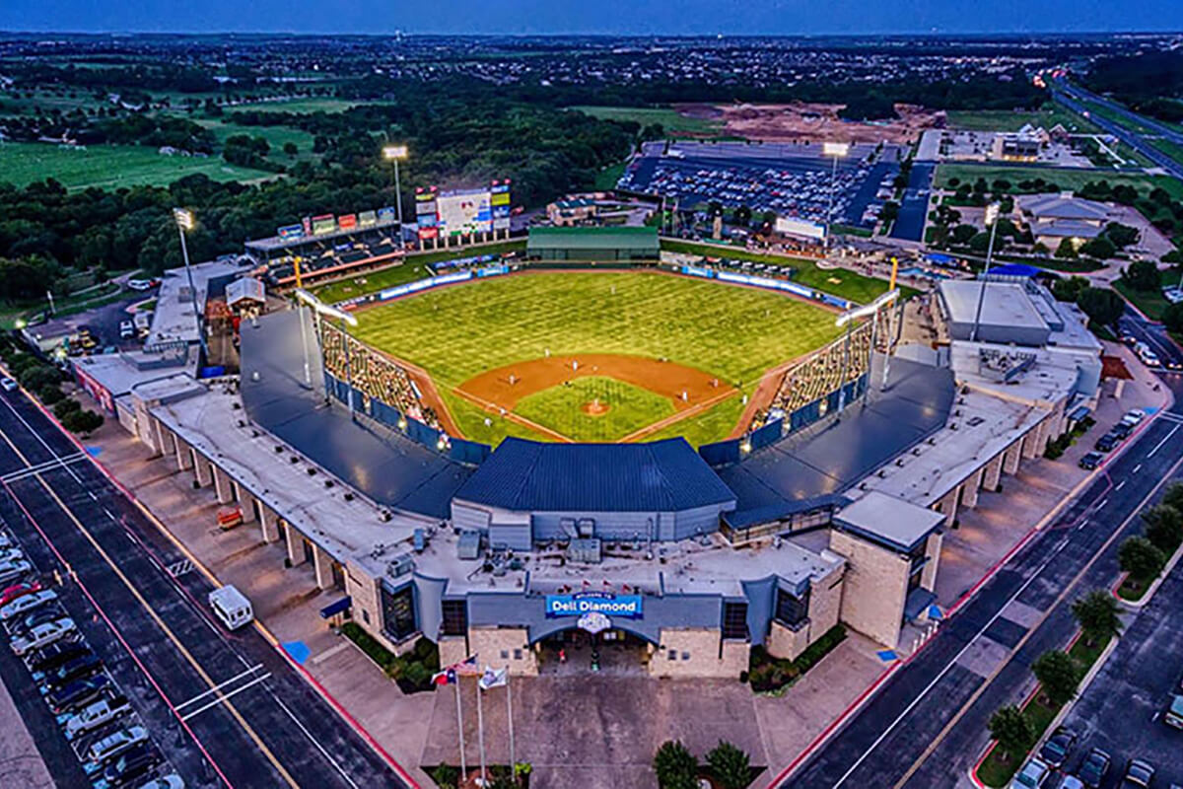
“Deep in the Heart of Texas
https://www.youtube.com/watch?v=VGF4ibgcHQE

Slide 27
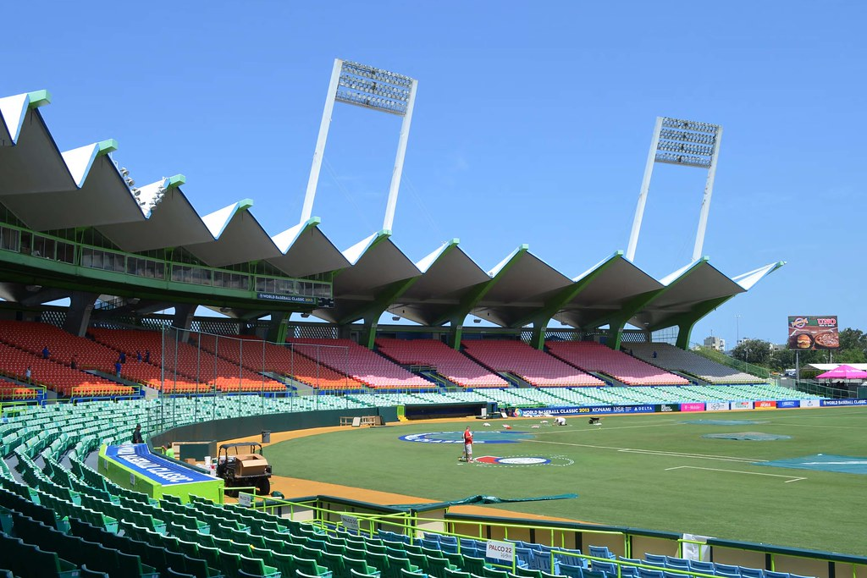
¡ Música al estadio !
It can be very loud at:
Estadio
Hiram Bithorn
in San Juan, Puerto Rico
Notes:
They don’t do the seventh inning stretch south of the border. But it is popular and fun to sing at the stadium in Latin America – usually between EVERY inning

Slide 28
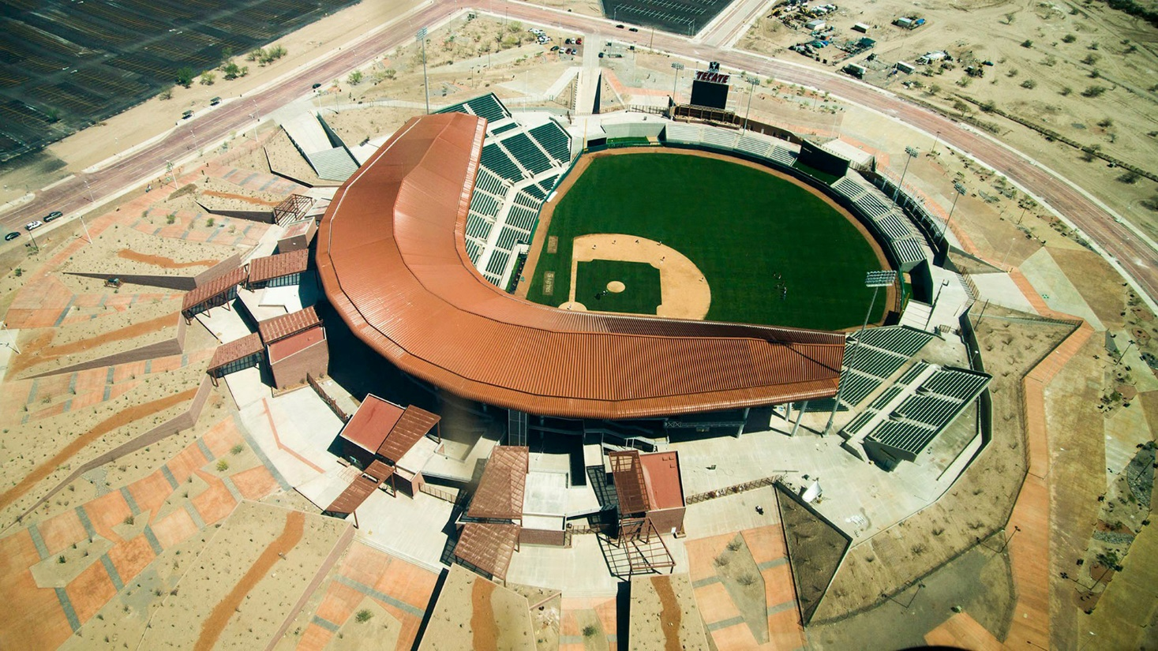
¡ Música al estadio !
Likewise at:
Estadio Sonora
in Hermosillo,
Sonora, Mexico
https://www.youtube.com/watch?v=QTCAbaJPWiw
Notes:
They like to sing “El Rey” at Estadio Sonora in Hermosillo, the capital of the state of Sonora in Mexico

Slide 29
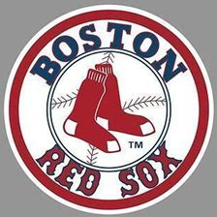
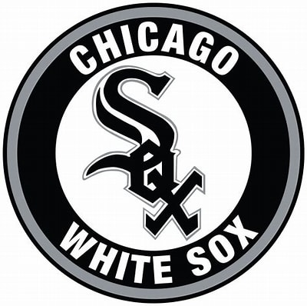
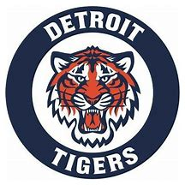
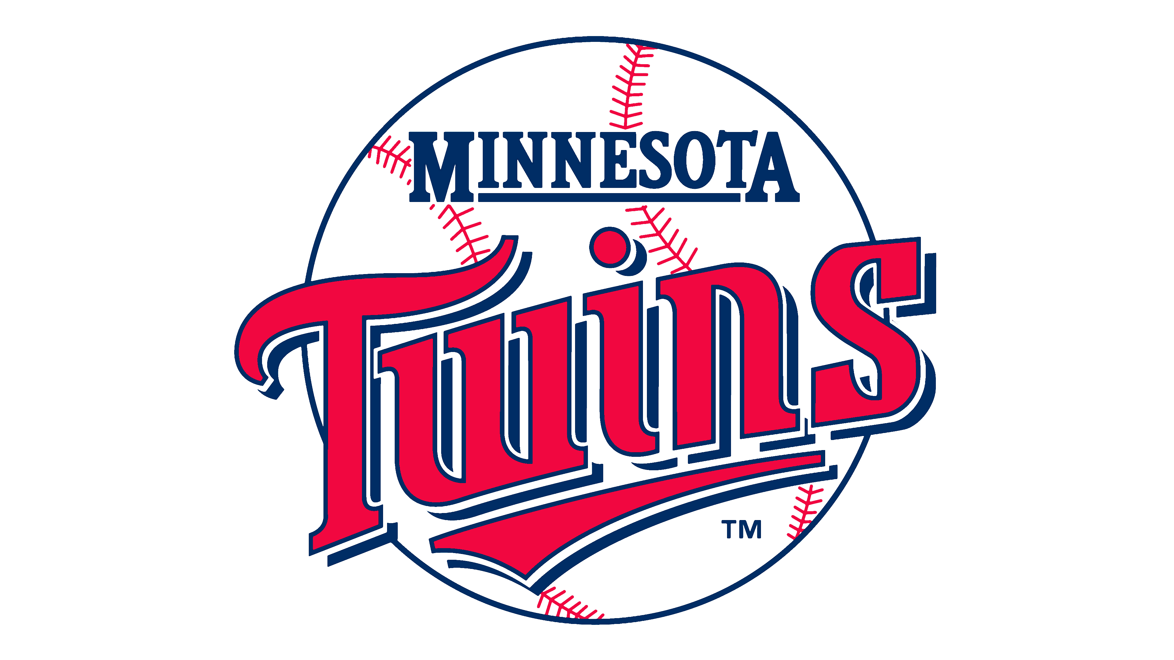
1967 -- On the Field: The American League had one of its closest pennant races ever!
Going into the last week of the regular season, any of these four teams could have won the pennant!

Slide 30
1967 -- On the Field: Final American League Season Standings
1967 American League Team Standings
Team | Wins | Losses |  | GB
Red Sox | 92 | 70 |  | 0
Tigers | 91 | 71 |  | 1
Twins | 91 | 71 |  | 1
White Sox | 89 | 73 |  | 3
Angels | 84 | 77 |  | 7 1/2
Senators | 76 | 85 |  | 15 1/2
Orioles | 76 | 85 |  | 15 1/2
Indians | 75 | 87 |  | 17
Yankees | 72 | 90 |  | 20
Athletics | 62 | 99 |  | 29 1/2

Slide 31
1967 A.L. champs – key Red Sox
Reggie
Smith
Yaz
Tony Oliva
George
Scott
Jim Lonborg
Mgr. Dick Williams
Rico
Petrocelli
Camilo Pasqual
Notes:
Key Red Sox – Yaz, Reggie Smith, George Scott, and Rico Petrocelli; pitcher Jim Lonborg; Mgr Dick Williams
Mickey Mantle hit 37 homers to lead the AL. He also led the league in triples, walks, and SLG.

Slide 32
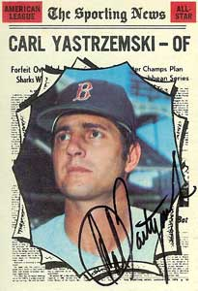
“Yaz” had a great year in 1967!
He won the A.L. Triple Crown, leading in batting average, home runs, and RBI
He was the last player to do so until Miguel Cabrera in 2012.

Slide 33
1967 -- On the Field: Final National League Standings
1967 National League Team Standings
Team | Wins | Losses |  | GB
Cardinals | 101 | 60 |  | 0
Giants | 91 | 71 |  | 10 1/2
Cubs | 87 | 74 |  | 14
Reds | 87 | 75 |  | 14 1/2
Phillies | 82 | 80 |  | 19 1/2
Pirates | 81 | 81 |  | 20 1/2
Braves | 77 | 85 |  | 24 1/2
Dodgers | 73 | 89 |  | 28 1/2
Astros | 69 | 93 |  | 32 1/2
Mets | 61 | 101 |  | 40 1/2

Slide 34
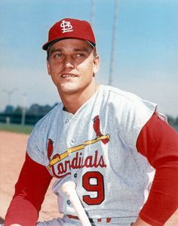
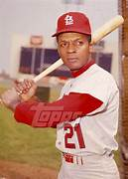
1967 N.L. champs – key Cardinals
Lou Brock Roger Maris Julian Javier Bob Gibson Mgr. Red Schoendienst
Maury Wills
Ron Fairly
Wes Parker
Orlando Cepeda
Curt Flood
Don Drysdale
Sandy Koufax
Claude Osteen
Notes:
Mickey Mantle hit 37 homers to lead the AL. He also led the league in triples, walks, and SLG.

Slide 35
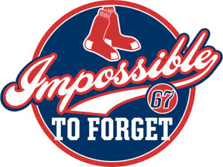
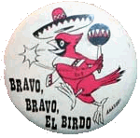
1967 World Series
vs.
“The Impossible Dream” collides with “El Birdos”

Slide 36
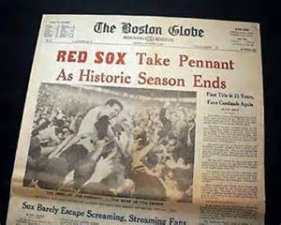
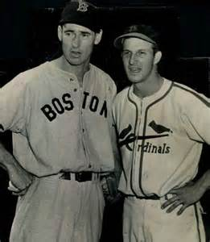
1967 World Series
“First Title in 21 Years,
Face Cardinals Again”
A rematch of the
1946 World Series

Slide 37
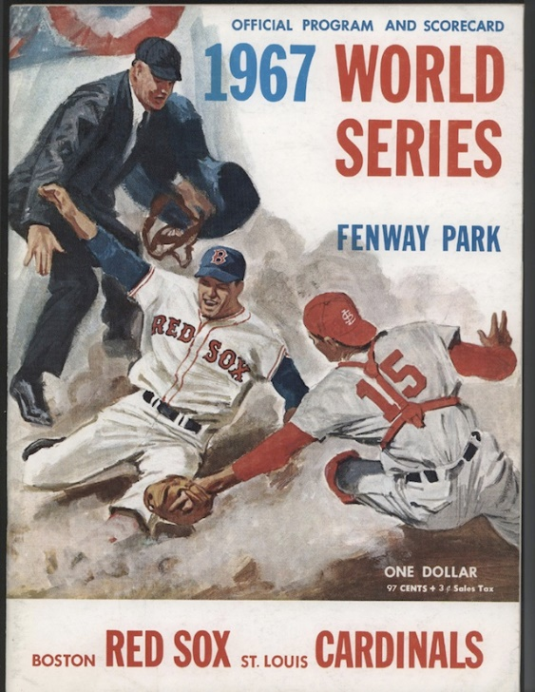
1967 World Series Game 7 Fenway Park
https://www.youtube.com/watch?v=H01Q1WMqQ_U
Notes:
Game 7 played at Fenway Park on Thursday, October 12, 1967

Slide 38
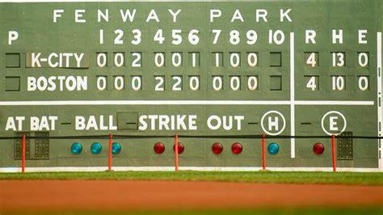
Extra Innings!
More Stuff from the 1960’s

Slide 39
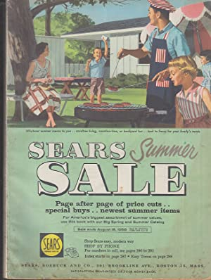
Things we don’t have anymore:
Sears
Summer catalog

Slide 40
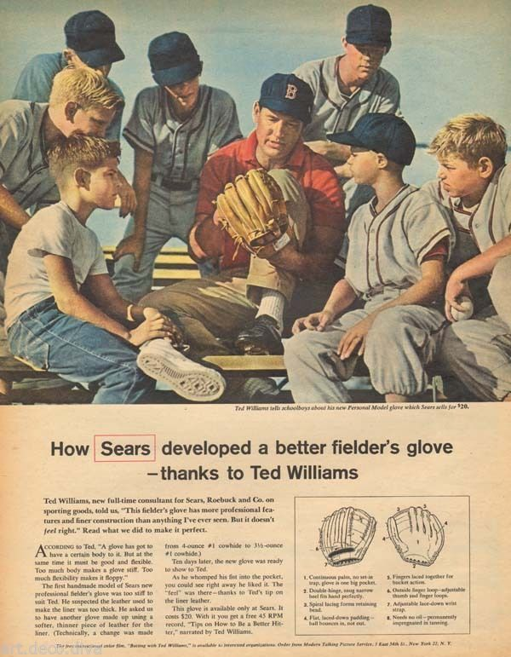
Baseball superstar
Ted Williams
promoted Sears’
“J.C. Higgins” sporting goods

Slide 41
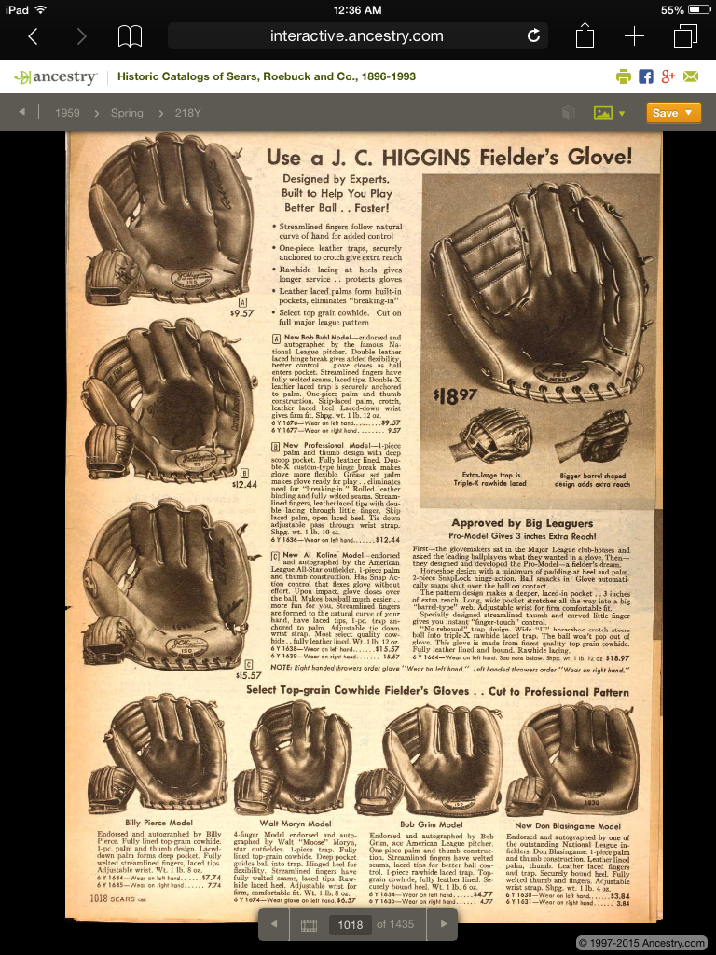
Sears
Summer catalog
J.C. Higgins
Baseball Gloves

Slide 42
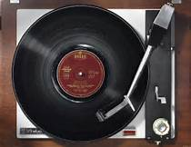
Things from the 1960s that we don’t use anymore …
The first 33rpm LP records were introduced
75 years ago TODAY –
June 21, 1948 !
Notes:
The first 33rpm LPs were introduced – today 75 years ago – on June 21, 1948 ! They could play about 40 minutes, a big improvement over 5-min 78rpm.

Slide 43
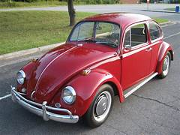
Automobile makes/models we don’t have anymore
Volkswagen “Beetle”

Slide 44
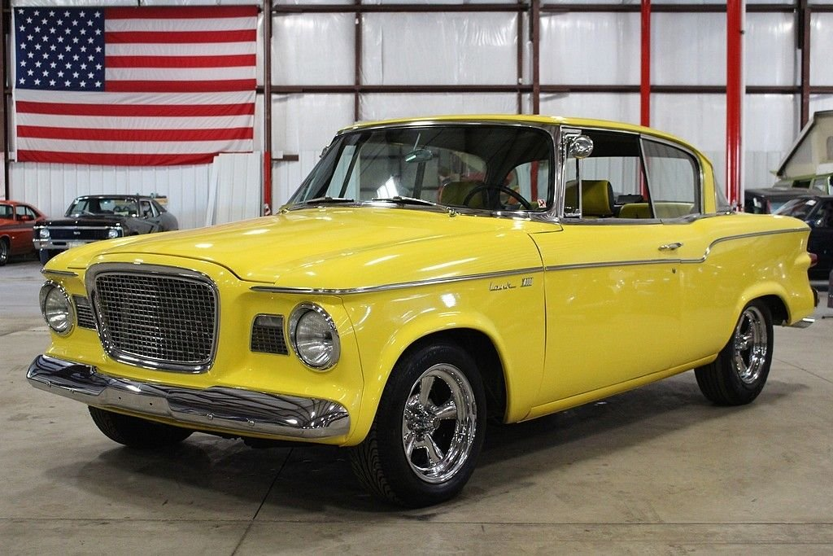
Automobile makes/models we don’t have anymore
Studebaker

Slide 45
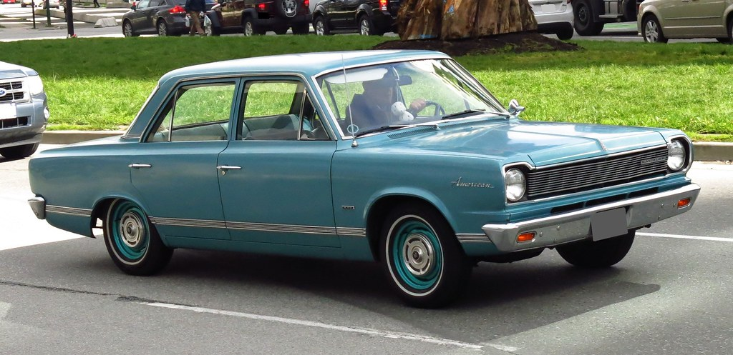
Automobile makes/models we don’t have anymore
Rambler

Slide 46
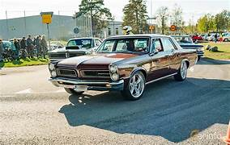
Automobile makes/models we don’t have anymore
Pontiac
Notes:
Pontiac Catalina four door

Slide 47
Automobile makes/models we don’t have anymore
Oldsmobile
Notes:
Oldmobile 98 – it was huge

Slide 48
Automobile makes/models we don’t have anymore
Mercury
Notes:
Mercury Monterey

Slide 49
Automobile makes/models we don’t have anymore
Plymouth
Notes:
Plymouth Belvedere – I did driver’s ed in one of these

Slide 50
Kitchen Items

Slide 51
Kitchen Items
Pink
and…
Avocado Green
Harvest Gold
Copper …

Slide 52
Kitchen Items
Some “vintage” kitchen tools

Slide 53
Kitchen Items
Some “vintage” kitchen tools

Slide 54
Kitchen Items

Slide 55
Thanks!!
We’ll see you again next month!

