Slide 1
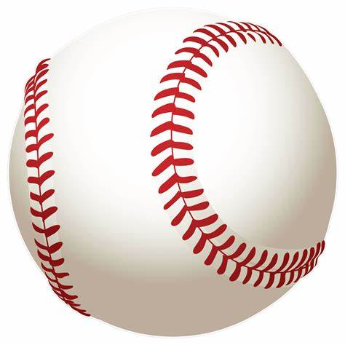
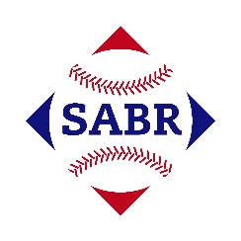

AGE Thrive with Baseball Memories
March 15, 2023
Agenda
Warm-up - Introductions
Gametime – The Year in Baseball – 1969
Seventh Inning Stretch - “Take Me Out to the Ball Game”
Extra Innings – More stuff from the ‘60s
Extra Innings - Memorabilia
Next Time – What would you like to talk about?

Slide 2
The Year in Baseball:
1969
Notes:
today we’re going to talk about 1969 – the end of the turbulent and exciting ‘60s … an important year in history and in baseball

Slide 3
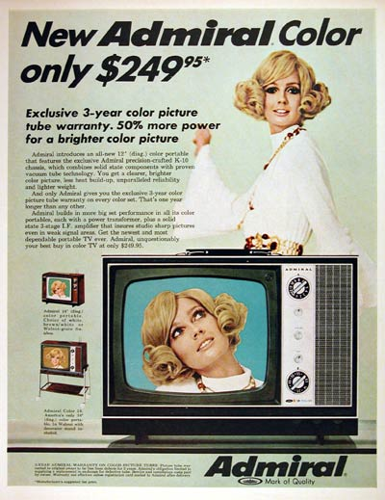
1969 – Color TV
Color TV sets passed 20 million during 1969
About one-third of all households had a color TV
Almost all prime-time TV shows were in color
Notes:
By 1972, half of all U.S. households had a color TV; a marketing study showed that households with color TV averaged one hour more viewing time per day than black-and-white

Slide 4
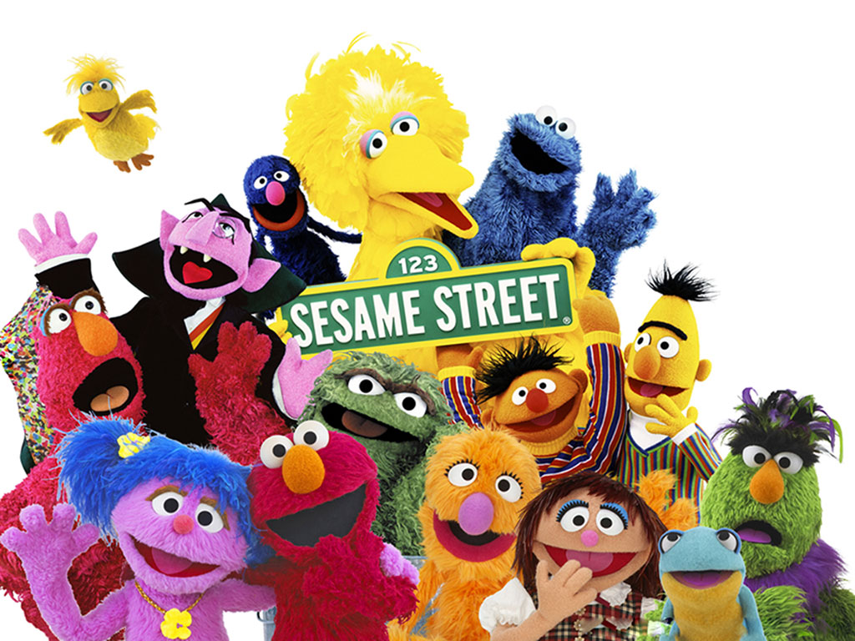
1969 – TV shows
This popular children’s
educational TV show
debuted on
Public Broadcasting
stations.
After over 4,600 episodes,
it’s still running today!
Notes:
Over 4,600 episodes as of Fall, 2022 season; is one of the most popular children’s TV shows ever – broadcast in over 150 countries and has won 167 Emmy Awards

Slide 5
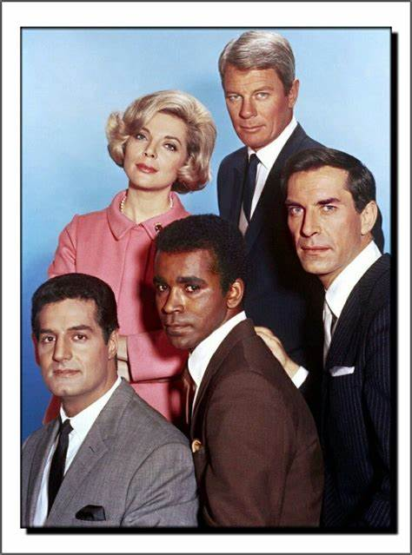
1969 – TV shows
This spy thriller opened with a fuse being lit by a match.
https://www.youtube.com/watch?v=wwpXUn2dF5c
Notes:
Secret agent shows were on TV, partly due to the popularity of the James Bond movies during the ‘60s

Slide 6
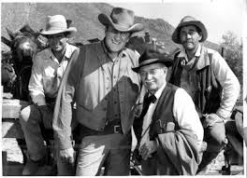
1969 – TV shows
This Western about the U.S.
Marshall in Dodge City, Kansas
was still running on TV – in its 15th season!
Gunsmoke
Notes:
Westerns were still very popular.

Slide 7
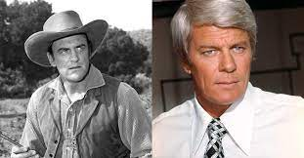
1969 – TV shows
What did the stars of Gunsmoke and Mission Impossible have in common?
In real life, they were brothers!
Notes:
Born James and Peter Aurness in Minnesota. They never acted together, although Peter Graves did direct an episode of Gunsmoke in 1955.

Slide 8
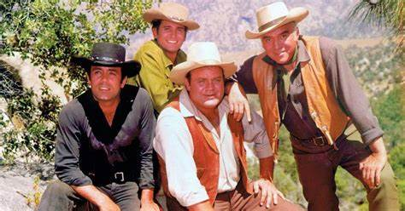
1969 – TV shows
This popular Western about a family on a ranch near Virginia City, Nevada was in its 10th season.
Bonanza
https://www.youtube.com/watch?v=iQjb_QiFbJE

Slide 9
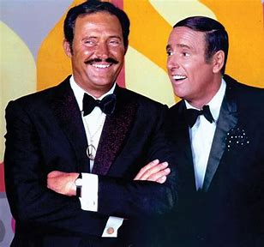
1969 – TV shows
This hip, campy comedy variety show was the #1 TV show in 1969.
Dan and Dick were the hosts.
Rowan and Martin’s Laugh-In
Notes:
We’ll talk more about Laugh-In later …

Slide 10
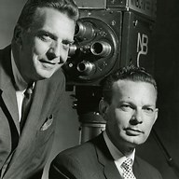
1969 – TV shows
These two newsmen were the co-anchors of the nightly NBC newscast.
Chet Huntley and David Brinkley
Notes:
News Anchors were well-known TV figures. Huntley from New York and Brinkley from Washington.

Slide 11
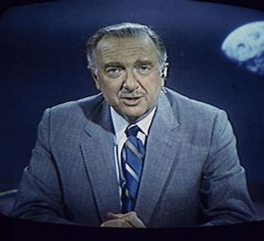
1969 – TV shows
This TV anchorman delivered the nightly news on CBS for 19 years and was often called “the most trusted man in America”.
Walter Cronkite
Notes:
Attended Univ. of Texas here in Austin; was a World War II war correspondent;

Slide 12
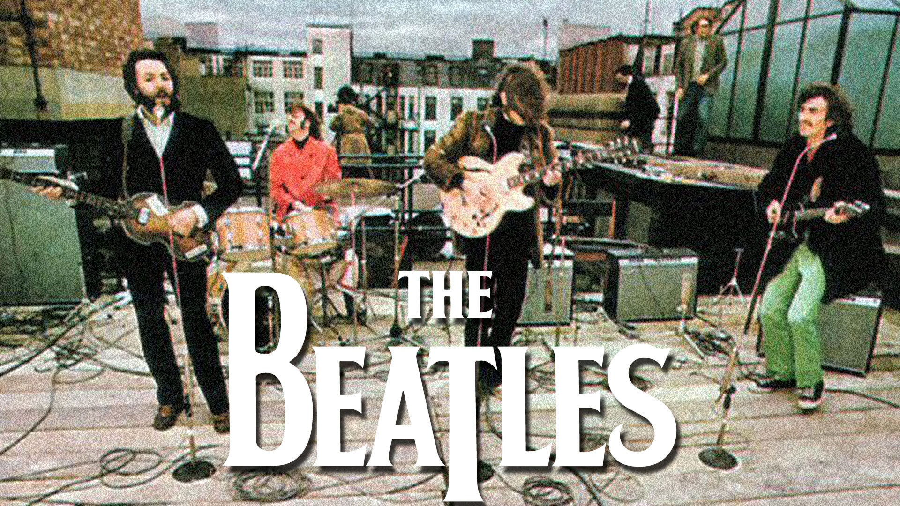
1969 – Popular Music
The Beatles’ last performance together:
https://www.youtube.com/watch?v=GKdl-GCsNJ0
Notes:
January 30, 1969 was the Beatles’ last performance together;

Slide 13
1969 -- Off the Field:
A Popular Music Event
“An Aquarian Exposition”
Held in White Lake, New York
On Max Yasgur’s dairy farm
Notes:
speaking of popular music, if I were to ask you for a one-word name for a music event that was officially called “An Aquarian Exposition” … what would you say?

Slide 14
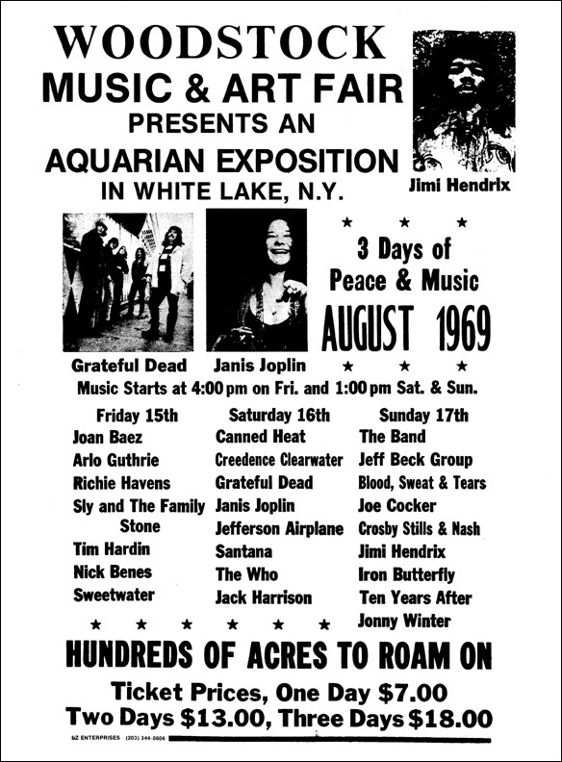
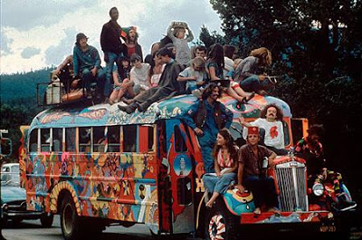
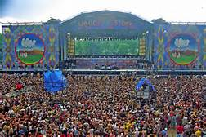
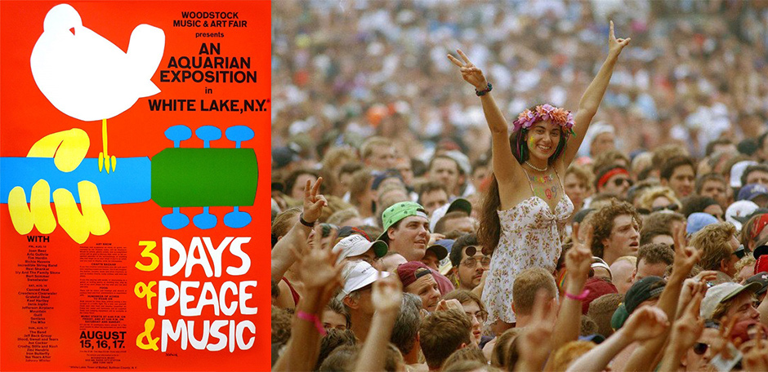
Woodstock
https://www.youtube.com/watch?v=nPauXWjY4T8
Notes:
it was Woodstock ! Held on August 15, 16, and 17 – actually did not finish until Monday morning August 18. Planners felt they could sell about 50,000 tickets, but by early August over 186,000 advance tickets had been sold. All told, over 400,000 were in attendance. Early on, the promoters had trouble signing bands – but when Credence Clearwater signed on – more top entertainers followed. Here are some of the top bands and singers that were there <<read from poster>>. Price -- $18 in advance, $24 at the gate although probably half of those in attendance got in free.

Slide 15

1969 – Popular Music:
Ernestine (Lilly Tomlin) the Telephone Operator calling Frank Sinatra
https://www.youtube.com/watch?v=dJCDQaZ6pjg

Slide 16
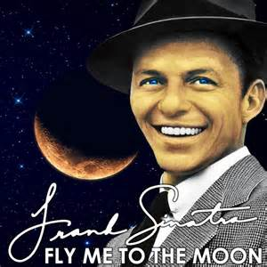
1969 – Popular Music:
https://www.youtube.com/watch?v=Cd_THG241GA
This song was a hit (again) in ‘69
Notes:
This song was written in 1954 and performed by many artists, but Frank Sinatra’s rendition from 1964 is the best known. It had another big upswing in popularity in 1969… why?

Slide 17
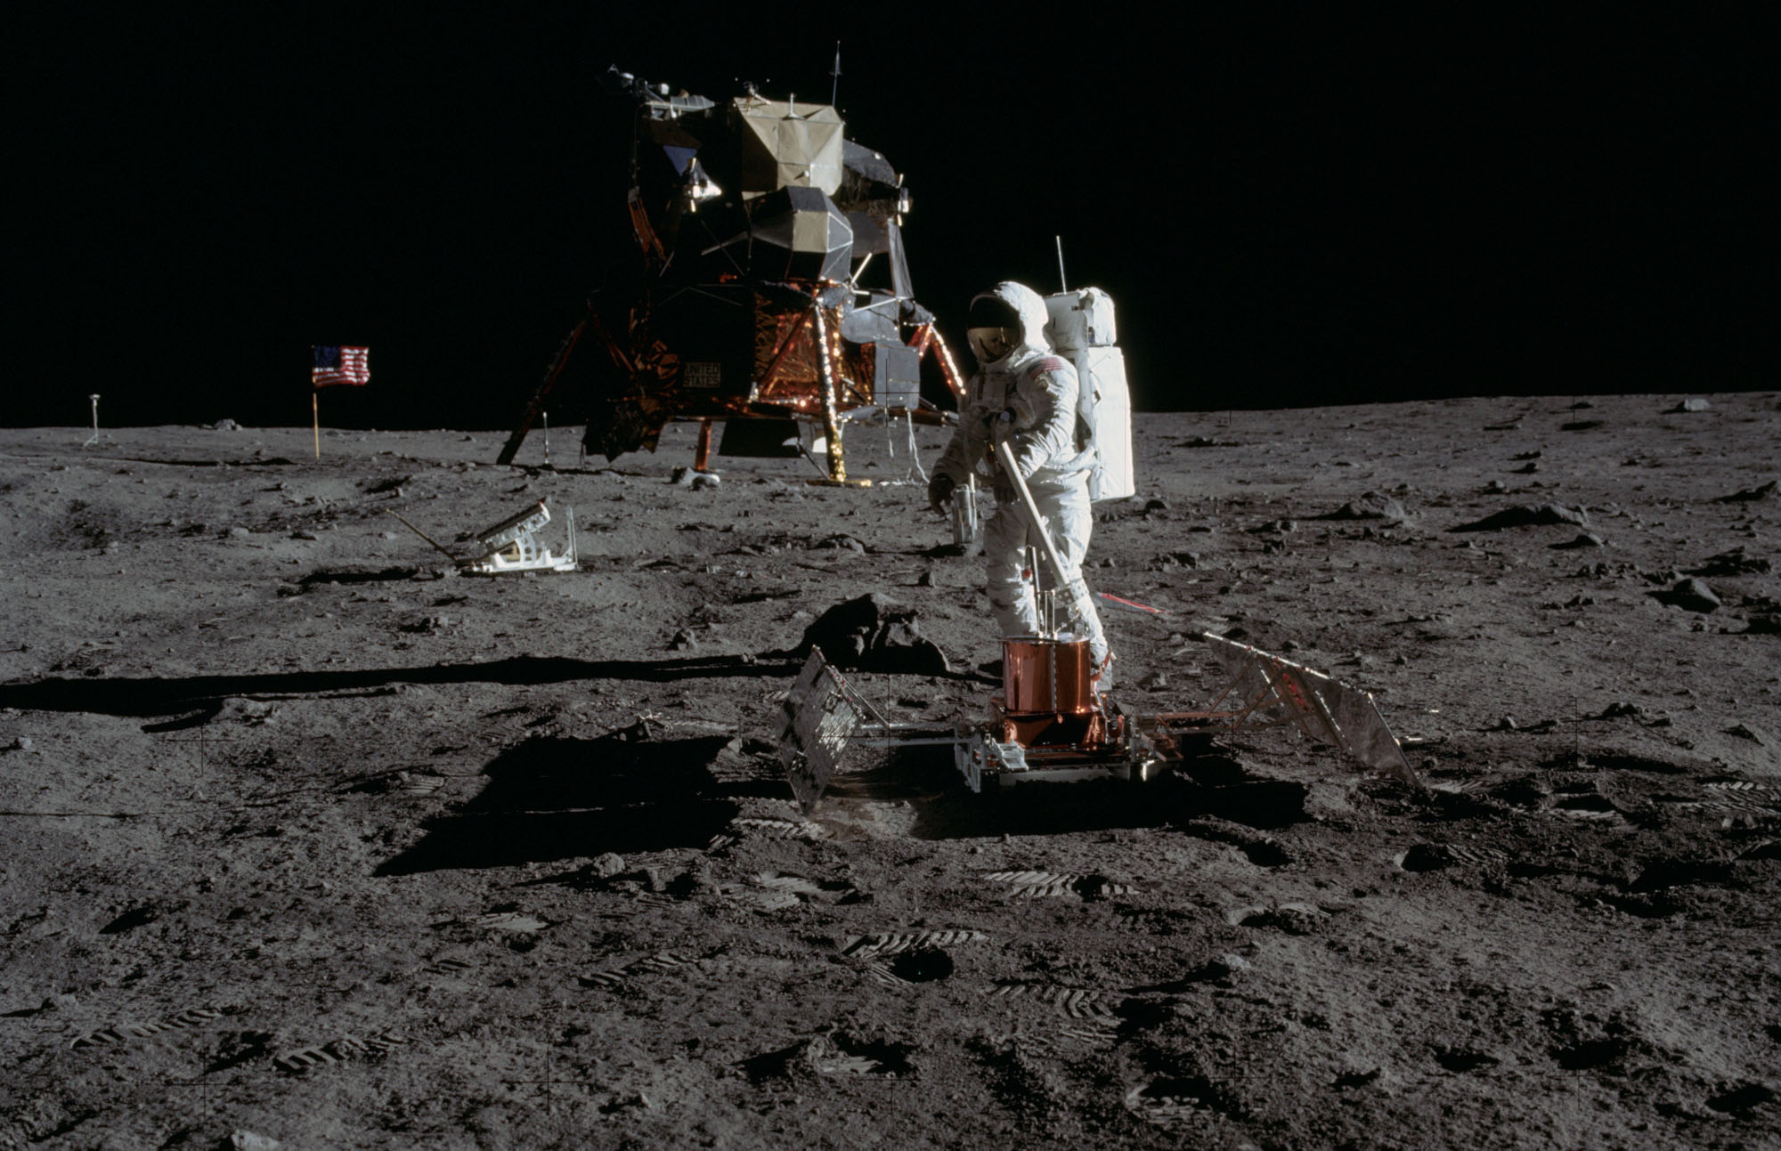
1969 – Way Off the Field:
July 20
Apollo 11
lands on the
Moon
https://www.youtube.com/watch?v=sTBIr65cL_E
Notes:
we went to the moon in 1969. How many of you watched the moon landing “live” on TV on July 20, 1969 ? Let’s watch it again… this is some of the original footage that we saw on TV. << position at 4:30 for landing and again at 7:05 for Armstrong coming down ladder>>

Slide 18
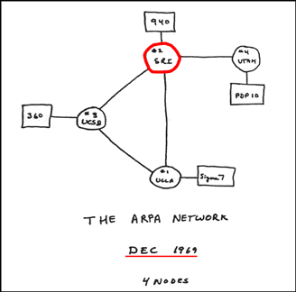
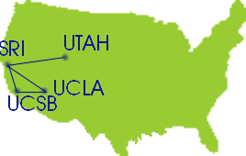
1969 – Technology
ARPANET – the grand-daddy of the Internet
Notes:
Of course, the moon landing was a huge technological achievement. Some other cool technology -- ARPAnet – this is what the “Internet” looked like in 1969 – the first transmissions were made among computers at these universities on October 29, 1969

Slide 19
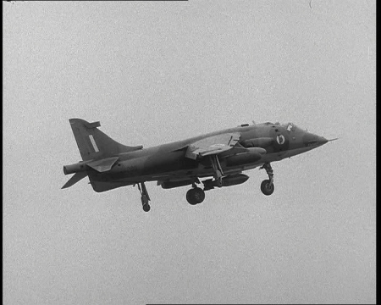
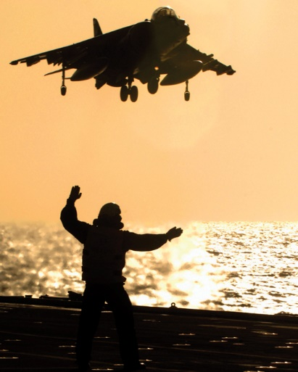
1969 – Technology
The “jump-jet”
(Hawker Harrier)
went into service
with the RAF in
April

Slide 20
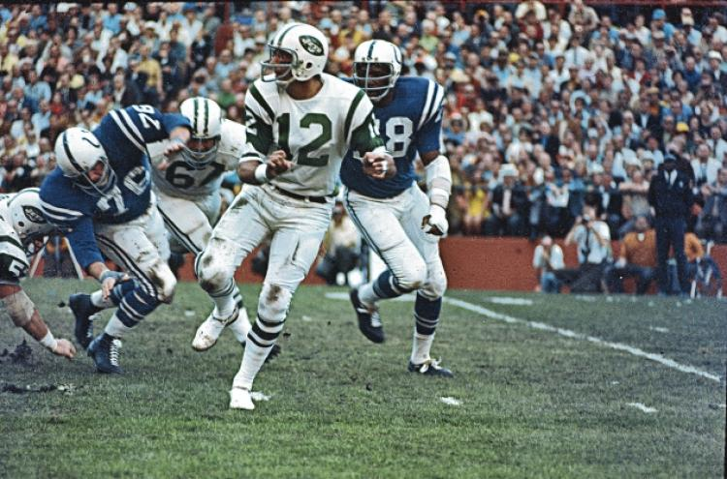
1969 -- On the Field:
NFL-AFL Championship Game III – the Super Bowl
“Broadway Joe” Namath and the AFL champ New York Jets upset the NFL’s Baltimore Colts 16-7
Notes:
The Third NFL-AFL Championship Game was the first game to officially be called the “Super Bowl”. The game was held January 12 at the Orange Bowl in Miami. Although heavy underdogs, Jet’s quarterback Joe Namath – appearing at the Miami Touchdown Club gathering three days before the game -- “guaranteed” a victory. Namath and his Jets teammates delivered with a 16-7 win over the Colts.

Slide 21
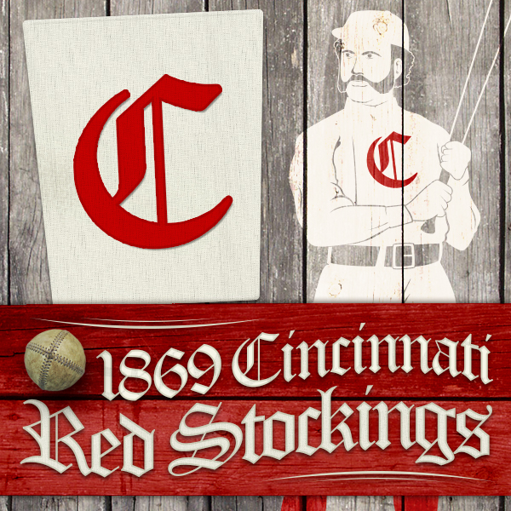
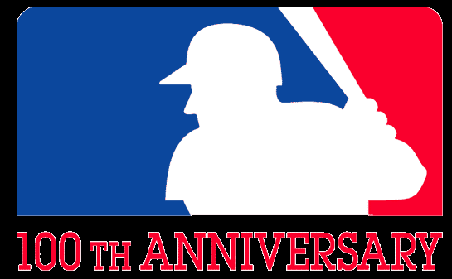
1969 – On the Field
Fifty years ago, in 1969, Major League Baseball celebrated its 100th anniversary.
Major League Baseball
celebrated its 100th anniversary
Notes:
The 1869 Cincinnati Red Stockings were the first fully professional team; won 57 games and lost none in their 1869 season – playing against amateur clubs.

Slide 22
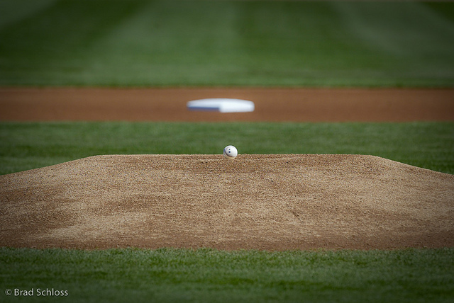
1969 -- On the Field:
Height of Pitcher’s Mound reduced
1968 – 15 inches max.
1969 - 10 inches max.
Notes:
Some significant changes were made prior to the 1969 season. The 60s featured some great pitching with low ERAs by the likes of Bob Gibson, Denny McLain, among others. As a result, offense in baseball reached a then-record low in 1968 -- .243 league-wide BA in NL and only .230 in the AL. In order to try to pump up the offense, the pitcher’s mound was lowered from 15 inches to 10 inches for the 1969 season.

Slide 23
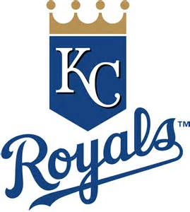
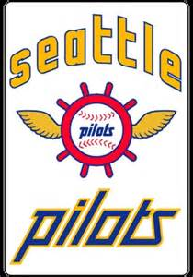
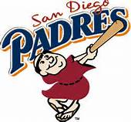
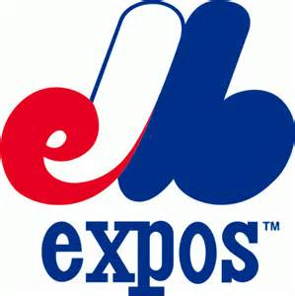
1969 -- On the Field:
Major League baseball added
four new teams and
began the era of
“Division Play”
Notes:
another big change in ’69 was another round of expansion. Each league added two teams, resulting in 12 teams in each league. Each league was then divided into two six-team “divisions”, bringing about a “league championship series” prior to the World Series. The Montreal Expos and San Diego Padres joined the NL, and the KC Royals and Seattle Pilots joined the AL.

Slide 24
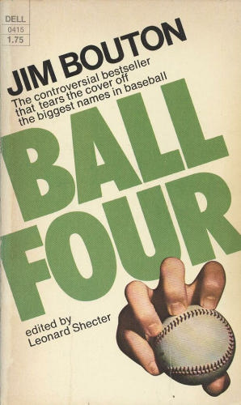
1969 – On and off the Field
“Ball Four” is based on Jim Bouton’s 1969 season with the Seattle Pilots
and Houston Astros.
Some quotes:
“Baseball players are smarter than football players. How often do you see
a baseball team penalized for too many men on the field?”
“It never hurts to apologize, especially when you don’t mean it.”
“Never forget Doubleday’s First Law of Baseball – if you throw a fastball
with insufficient speed, someone will smack it out of the park with a
stick.”
“A ballplayer spends a good piece of his life gripping a baseball, and in the
end it turns out it was the other way around all the time.”
Notes:
The Seattle Pilots only lasted one year in the AL, and then moved to Milwaukee and were renamed the Brewers. But that one year in Seattle will forever be remembered, as it was the setting for one of the greatest baseball books ever written…
Jim Bouton’s classic book, Ball Four, was set in 1969 as Bouton, a former Yankee, is struggling to stay in the majors with the expansion Seattle Pilots. Anyone read it? “Ball Four” is not only considered one of the best baseball books ever written, it is also the only sports-themed book to be listed in Time magazine’s list of the greatest non-fiction books of all time, and in the New York Library’s list of books-of-the-century. Some quotes from Bouton and from the book …

Slide 25



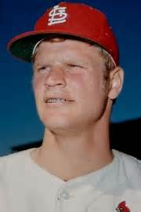
1969 -- On the Field:
Appeared in first Major League game
Announced his retirement
at age 37
“ If it stays fair …home run!! ”
“Designated Hebrew”
“ I wish Mr. Busch had not
traded this lefty …”
Mickey Mantle
Ron Blomberg
Carlton Fisk
Jerry Reuss
Notes:
some other key events – who are these guys ??
Mickey Mantle announced his retirement after 18 seasons in the majors, 536 HRs.
Carlton Fisk played his first games in a 24-year career. HOF and best known for that home run ..
This guy took the first-ever at-bat as a DH in 1974. Because he’s Jewish, he called himself the “Designated Hebrew”… Ron Blomberg.
Cardinals owner Gussie Busch traded this guy AND Steve Carlton in 1972. This guy won 220 major league games, while Carlton won 329, prompting Bob Gibson to comment “I wish Mr. Busch hadn’t traded those two lefties. With their 500 wins we might have won a few more pennants.”
Jerry Reuss.

Slide 26


1969 -- On the Field:
League Most Valuable Players:
Willie McCovey
45 HR, 126 RBI
Harmon Killebrew
49 HR, 140 RBI

Slide 27



1969 -- On the Field:
Cy Young Award Winners:
Tom Seaver
25 – 7 2.21 ERA
Mike Cuellar
23 – 11 2.38 ERA
Denny McLain
24 – 9 2.80 ERA
Notes:
Had a tie in Cy Young voting in the AL. First and only time there were three Cy Young winners! Made a change to voting procedures in 1970 to prevent in future. Mike Cuellar was the first foreign-born player to win a Cy Young Award.

Slide 28
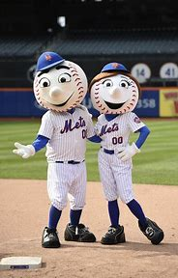
7th Inning Stretch
“Take Me Out to the Ballgame”
With Mr. and Mrs. Met
from
Shea Stadium in New York
https://www.youtube.com/watch?v=MPJ9l_aO9v4
Notes:
Mr. and Mrs. Met – from Shea Stadium

Slide 29
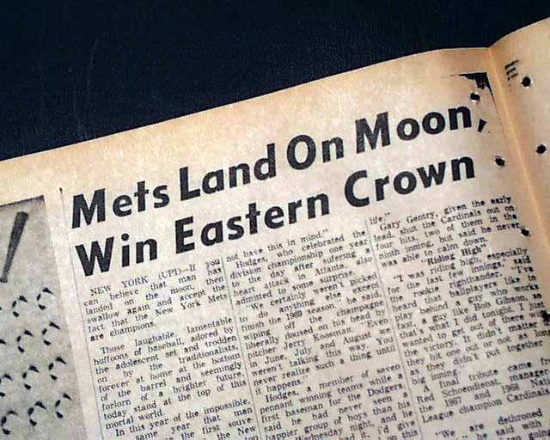
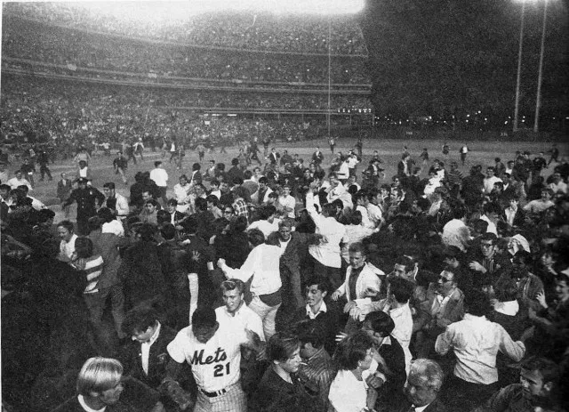
On September 24, 1969,
the impossible happened.
https://www.youtube.com/watch?v=rYHOM81SlfE

Slide 30
1969 -- On the Field:
Final Regular Season Standings
1969 National League Team Standings
East | Wins | Losses |  | GB
** Mets ** | 100 | 62 |  | -
Cubs | 92 | 70 |  | 8
Pirates | 88 | 74 |  | 12
Cardinals | 87 | 75 |  | 13
Phillies | 63 | 99 |  | 37
Expos | 52 | 110 |  | 48
West | Wins | Losses |  | GB
** Braves ** | 93 | 69 |  | -
Giants | 90 | 72 |  | 3
Reds | 89 | 73 |  | 4
Dodgers | 85 | 77 |  | 8
Astros | 81 | 81 |  | 12
Giants | 52 | 110 |  | 41
1969 American League Team Standings
East | Wins | Losses |  | GB
* Orioles * | 109 | 53 |  | -
Tigers | 90 | 72 |  | 19
Red Sox | 87 | 75 |  | 22
Senators | 86 | 76 |  | 23
Yankees | 80 | 81 |  | 28 1/2
Indians | 62 | 99 |  | 46 1/2
West | Wins | Losses |  | GB
** Twins ** | 97 | 65 |  | -
Athletics | 88 | 74 |  | 9
Angels | 71 | 91 |  | 26
Royals | 69 | 93 |  | 28
White Sox | 68 | 94 |  | 29
Pilots | 64 | 98 |  | 33
Notes:
First year of Division play – with the two leagues each divided into two divisions.

Slide 31
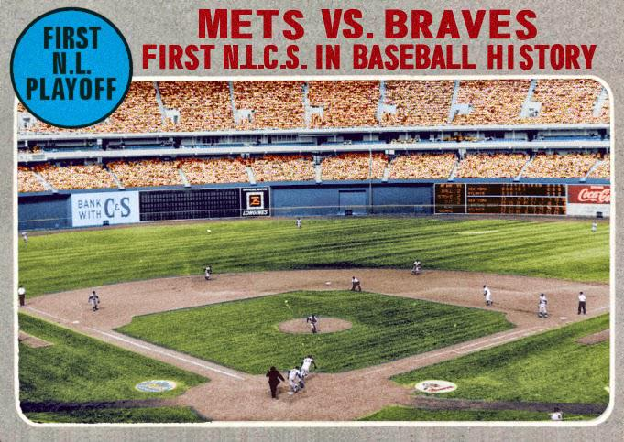
Because MLB had switched to divisional play in 1969, to reach the World Series, the Mets had to defeat the N.L. West champion Atlanta Braves, which they did, three games to none. This set up the World Series with the Baltimore Orioles, who had won 109 games, finished 19 games ahead in their division, and beaten the Twins three straight in the ALCS.
The Mets were heavy underdogs!

Slide 32
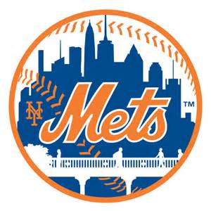
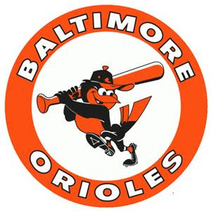
1969 World Series
“The Miracle Mets” vs. “The Lumber Company”

Slide 33
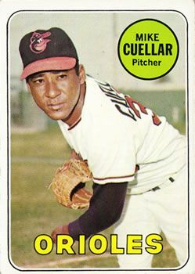
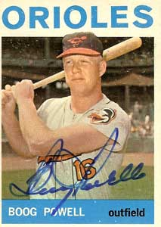
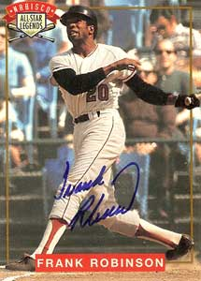


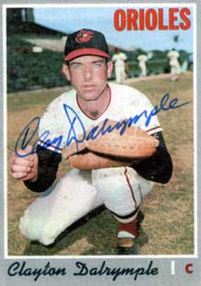

1969 World Series – key Orioles
Maury Wills
Ron Fairly
Wes Parker
Mgr. Earl Weaver
Don Drysdale
Sandy Koufax
Claude Osteen
Notes:
the Orioles were led by future Hall-of-Fame manager Earl Weaver. Boog Powell and Frank Robinson supplied the power and Brooks Robinson led the defense. Cuellar and McNally both won 20 games.
Mickey Mantle hit 37 homers to lead the AL. He also led the league in triples, walks, and SLG.

Slide 34
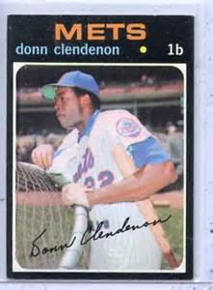

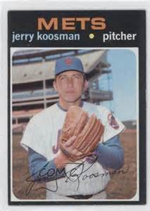
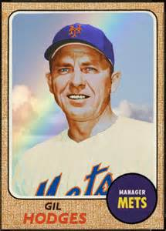
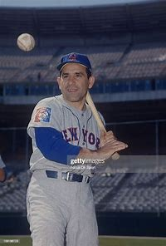
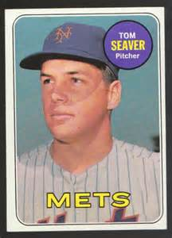
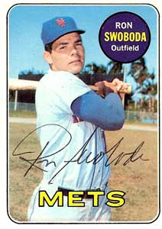
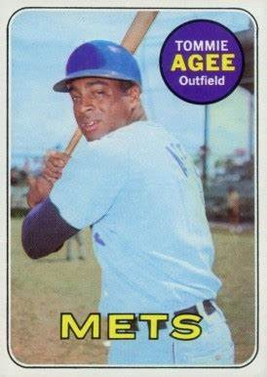
1969 World Series – key Mets
Tony Oliva
Camilo Pasqual
Notes:
the Mets were managed by former Brooklyn Dodgers star Gil Hodges, and former Yankee star Yogi Berra was the first base coach. No Met player had more than 76 RBIs in the regular season, but they succeeded with strong pitching led by Tom Seaver and Jerry Koosman.
Mickey Mantle hit 37 homers to lead the AL. He also led the league in triples, walks, and SLG.

Slide 35
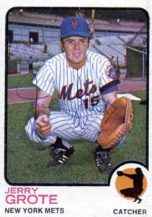

1969 World Series – Texas connections
Tony Oliva
Camilo Pasqual
Notes:
Jerry Grote was from San Antonio; Nolan Ryan was from Alvin, Texas and now lives in Georgetown
Mickey Mantle hit 37 homers to lead the AL. He also led the league in triples, walks, and SLG.

Slide 36

1969 World Series
Game 5 at Shea Stadium
Leading the Series
3 games to 1, the Mets
take the lead in Game 5,
scoring two runs in the bottom
of the 8th.
They take the field in
the top of the 9th at home, ahead
by a score of 5-3.
They need three outs to
win the World Series …
https://www.youtube.com/watch?v=JyDiuRDf918

Slide 37


New York City celebrated, as only New York City can do.

Slide 38

Extra Innings!
More Stuff from the 1960’s

Slide 39

Things from the 1960s that we don’t see anymore …

Slide 40

Things from the 1960s that we don’t use anymore …

Slide 41

Things from the 1960s that we don’t use anymore …

Slide 42

Things from the 1960s that we don’t use anymore …

Slide 43

Things from the 1960s that we don’t use anymore …

Slide 44

Things from the 1960s that we don’t use anymore …

Slide 45

Things from the 1960s that we don’t use anymore …

Slide 46

Things from the 1960s
that we don’t use anymore …

Slide 47

Things from the 1960s
that we don’t use anymore …

Slide 48

Things from the 1960s
that we don’t see anymore …

Slide 49

Things from the 1960s
that we don’t use anymore …

