Slide 1



AGE Thrive with Baseball Memories
August 16, 2023
Agenda
Warm-up - Introductions
Update on today’s baseball standings
Gametime – The Year in Baseball – 1971
Seventh Inning Stretch - “Take Me Out to the Ball Game”
Extra Innings – More stuff from the ‘60s and ’70s
Extra Innings - Memorabilia

Slide 2
The Year in Baseball: 1971

Slide 3

1971 - History

Slide 4
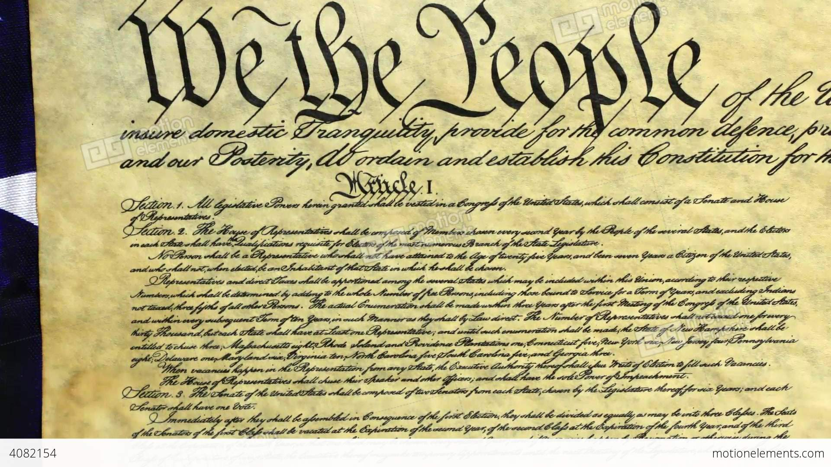
26th Amendment
Lowers voting age from 21 to 18
Notes:
Support for lowering the voting age dates back to World War II, with the rationale that the large numbers of 19-year-olds that were being drafted deserved the right to vote. FDR supported this, as well as Dwight Eisenhower when he became president. Efforts to attach this change to other legislation, such as the 1965 Voting Rights Act, were deemed unconstitutional. Congress then acted – it passed both houses and quickly was approved by ¾ of the states.

Slide 5
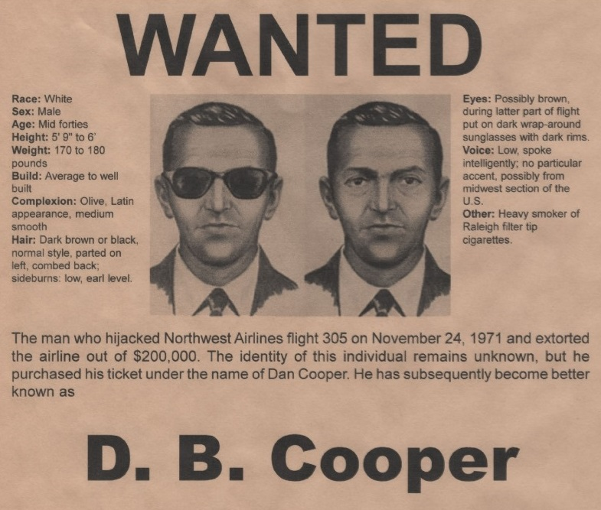
The only unsolved case of air piracy ever!
Notes:
A man identifying himself as “Dan Cooper” hijacked a N.W. Orient flight from from Portland to Seattle in Nov. 1971; he demanded parachutes and $200,000 ransom to release the passengers at Seattle. Plane then took off again, supposedly headed to Mexico City. He bailed out of the plan over wooded areas in Washington state. He was never identified nor found; some of the money was found in 1980. This is the only unsolved case of air piracy ever.

Slide 6

1971 - Business
Notes:
There were some key events in the Business World in 1971, including the establishment of a few of today’s prominent companies.

Slide 7
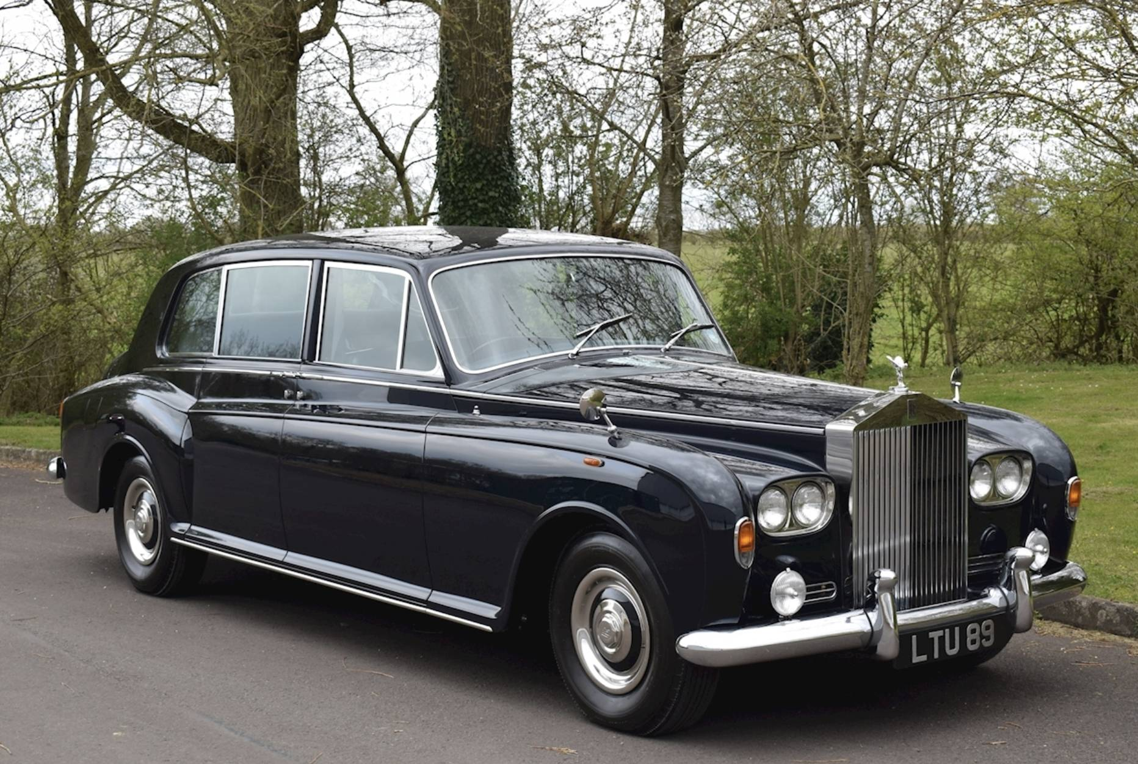
Rolls-Royce went bankrupt
Notes:
The famous British engineering and auto firm declared bankruptcy, mostly due to cost overruns in its aeronautics units. The government nationalized part of the company to save jobs and protect defense-related projects.

Slide 8
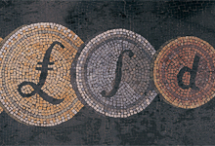

United Kingdom goes “decimal”
Before: 12 pence to the shilling; 20 shillings to the pound sterling
After: 100 “p” to the pound sterling
Notes:
As if that was not trauma-tizing enough for the British, they also converted from their centuries-old monetary system to a “decimal” system. The U.S. had gone decimal in the 1790s and many of the Commonwealth countries did likewise in the 1960s, many upon independence. A decimal system would make increased computerization easier. Banks were closed for four days during Feb. 1971 to effect the change-over.

Slide 9
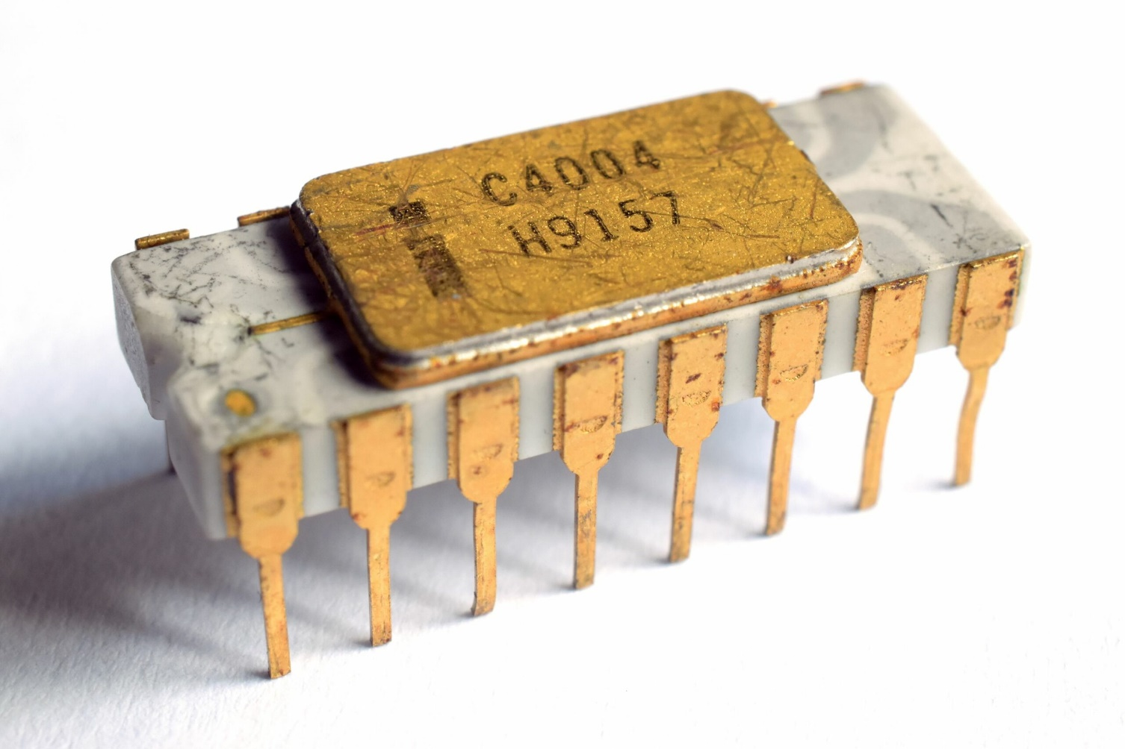
Intel Corp. releases their
first microprocessor
Early uses were calculators and high-end pinball games
Notes:
This was a four-bit processor that could only address 32K of memory.

Slide 10
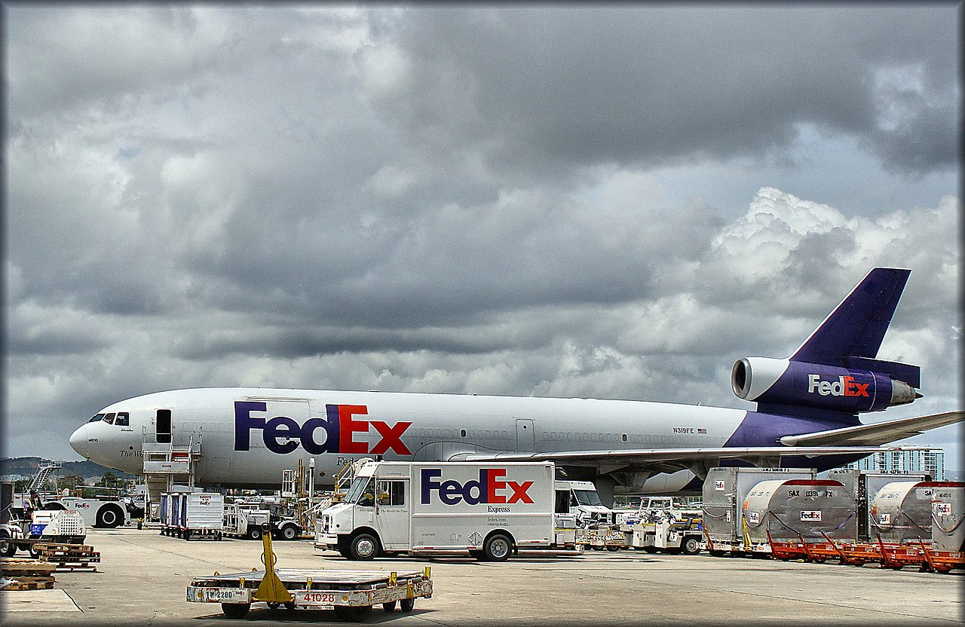
Federal Express
Founded in Little Rock, Ark. in 1971
Notes:
Founded by Fred Smith, a Yale Univ. graduate. He outlined the company’s concept in a term paper, but his professor did not think much of the idea. 2022 revenue was $93B.

Slide 11
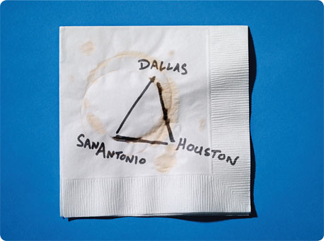

Southwest
Airlines
Began service from Dallas Love Field in 1971
Notes:
This is the business plan, literally on a napkin, of one of Texas’ most successful companies.

Slide 12
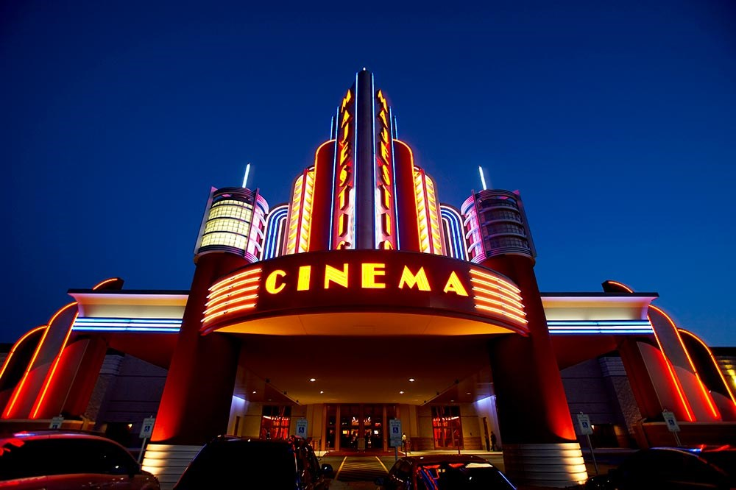
1971 at the Movies
Detective
Movies
See if you can name the movie based upon these clues …

Slide 13
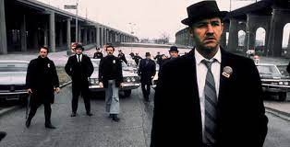
One of cinema’s greatest car chase scenes
The movie is about two N.Y. police detectives pursuing a French heroin smuggler
Gene Hackman won an Oscar
for his portrayal of
“Popeye” Doyle
It won five Academy Awards including Best Actor and Best Picture
The French
Connection
https://www.youtube.com/watch?v=2TVyJ-51jzc

Slide 14
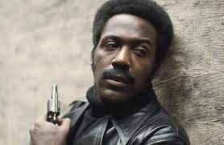
“You say that cat is a baaad motherf…”
The movie is about a private detective and is set in Harlem
Actor Richard Roundtree starred
in the title role
It was nominated for two
Academy Awards and musician/songwriter Isaac Hayes won for Best Song.
Shaft
https://www.youtube.com/watch?v=Q429AOpL_ds
Notes:
Today the song is probably better known than the movie. Start music at 2:30 of the youtube. – stop around 3:30 – lots of instrumental;

Slide 15
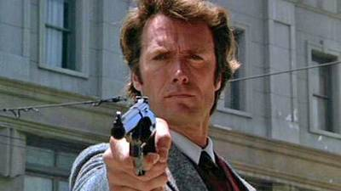
Do you feel lucky … punk ?
The plot is based loosely on the “Zodiac Killer”, an unsolved serial murder case from the late ‘60s.
Clint Eastwood starred as a S.F. cop
It was not nominated for any Academy Awards! But, it was a box office success and was followed by four sequels.
Dirty Harry
https://www.youtube.com/watch?v=38mE6ba3qj8
Notes:
Start video at 1:00

Slide 16
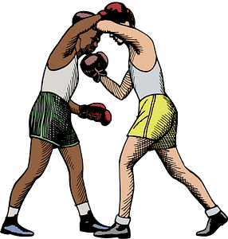


1971 Sporting News

Slide 17
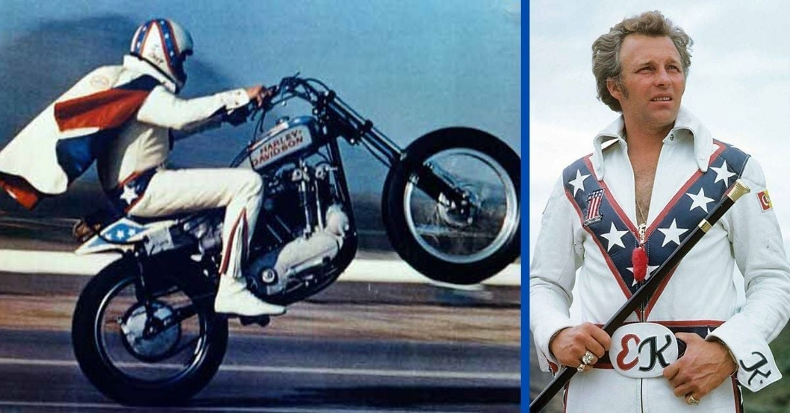
Evel Kneivel sets World’s Record for motorcycle stunt jump
https://www.youtube.com/watch?v=B-9DVgVRd60
Notes:
Jumped 19 cars at Ontario Motor Speedway in Calif; here’s a clip that was used in a movie about him. stop video at 1:10 …

Slide 18
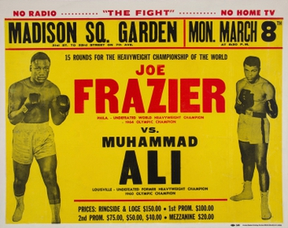
The Fight
of the
Century
Frazier vs. Ali
for the
Heavyweight
Title
Notes:
Both boxers were undefeated in their pro careers coming into the fight. There was no knockout – Ali scored early and won the first five rounds, but began to tire in the middle of the fight. Frazier knocked Ali down in the 15th round, but Ali recovered with a flurry of punches at the end. Frazier was declared the winner in a unanimous decision by the judges and ref.

Slide 19
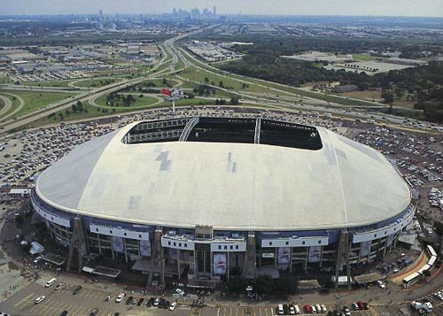
Texas Stadium opened
Notes:
Texas Stadium in Irving, TX – home to the Dallas Cowboys for 38 seasons. Known for its distinctive hole in the roof, the result of abandoned plans to construct a retractable roof (Cowboys linebacker D. D. Lewis once famously said that "Texas Stadium has a hole in its roof, so God can watch His favorite team play").

Slide 20
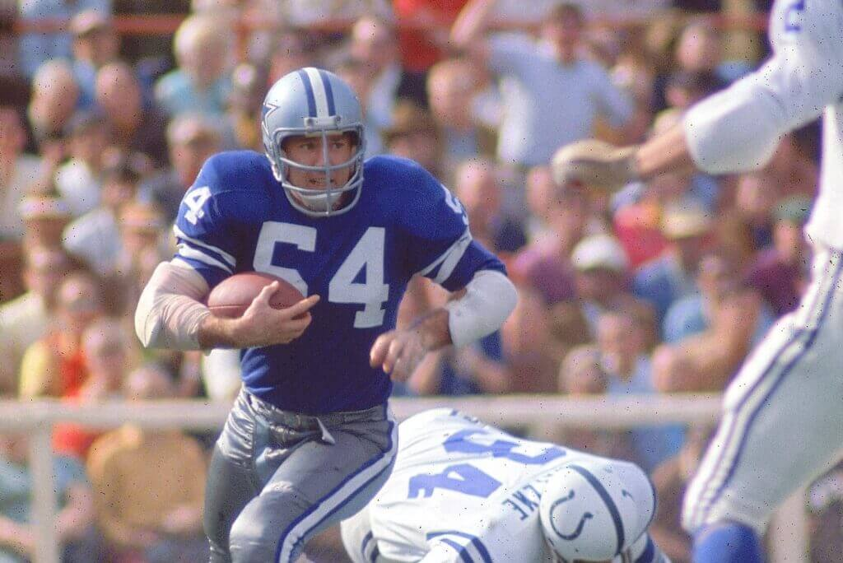
Cowboy wins 1971 Super Bowl MVP
He was a linebacker
He is the only MVP ever from the losing team
He was inducted to
the Pro Football
Hall of Fame in 2023
Chuck Howley
Notes:
Earned Super Bowl V MVP honors despite Cowboys losing to the Colts. He won Super Bowl VI with the Cowboys first title over Dolphins.
Other ‘71 Cowboys teammates in HOF - Roger Staubach, Bob Lilly, Mel Renfro and Bob Hayes, plus coach Tom Landry.

Slide 21

was founded in Cooperstown, N.Y.
SABR initially had 16 founding members in 1971
Today SABR has over 7,000 members world-wide
The Austin-San Antonio chapter has 125 members

Slide 22
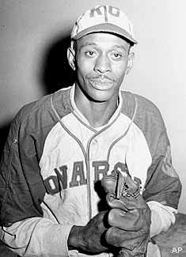
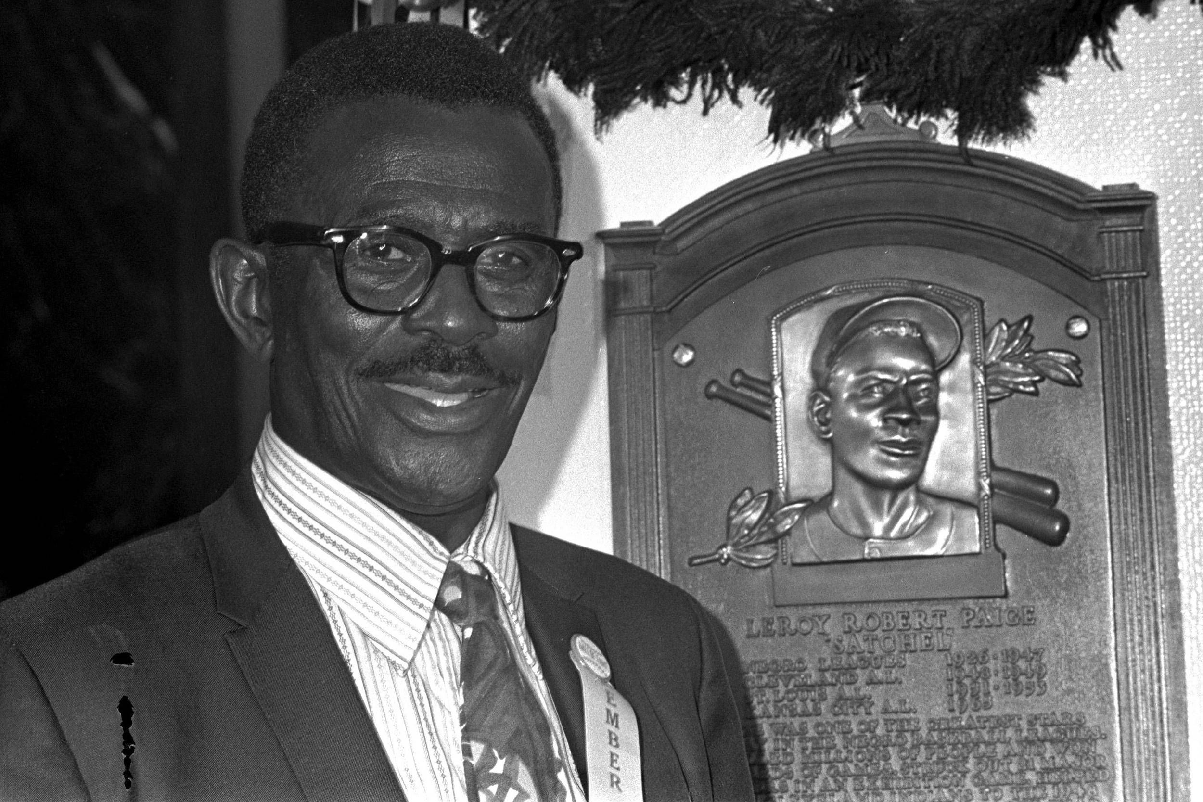
Satchel Paige was elected to the Hall of Fame
First Negro League star elected to National Baseball Hall of Fame; he also
played five seasons in the American League at the end of his career
Notes:
He played professional baseball from 1927 to 1953, plus a one-game appearance in 1965 at age 58. Commissioner Bowie Kuhn had stated that there would be a separate wing of the HOF for Negro League starts – this caused a lot of controversy, with Paige quoted saying privately – “I guess I’ve gone from a second class citizen to a second class immortal.” Kuhn reversed that decision a few months later, and Satchell’s plaque was hung with all the other Hall-of-Famers.

Slide 23
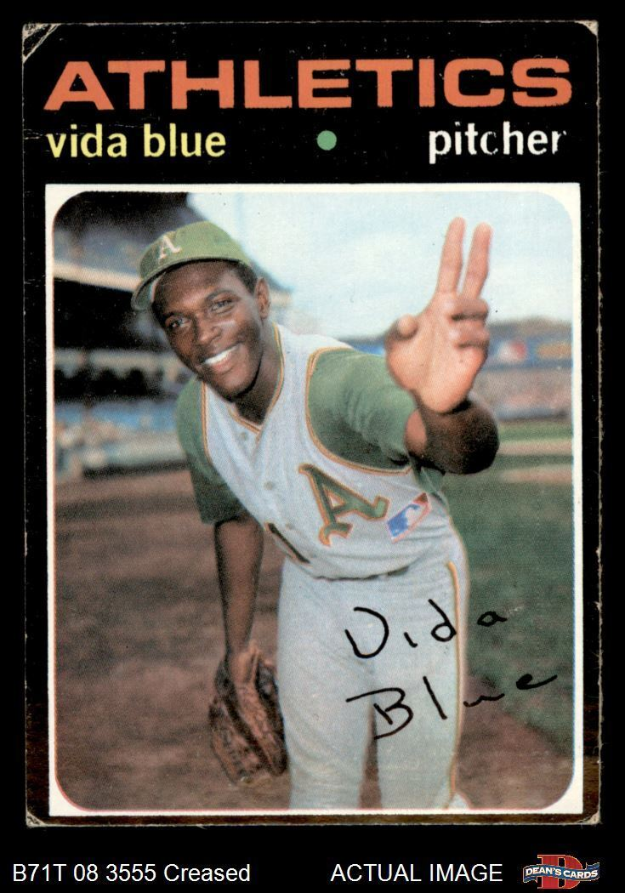
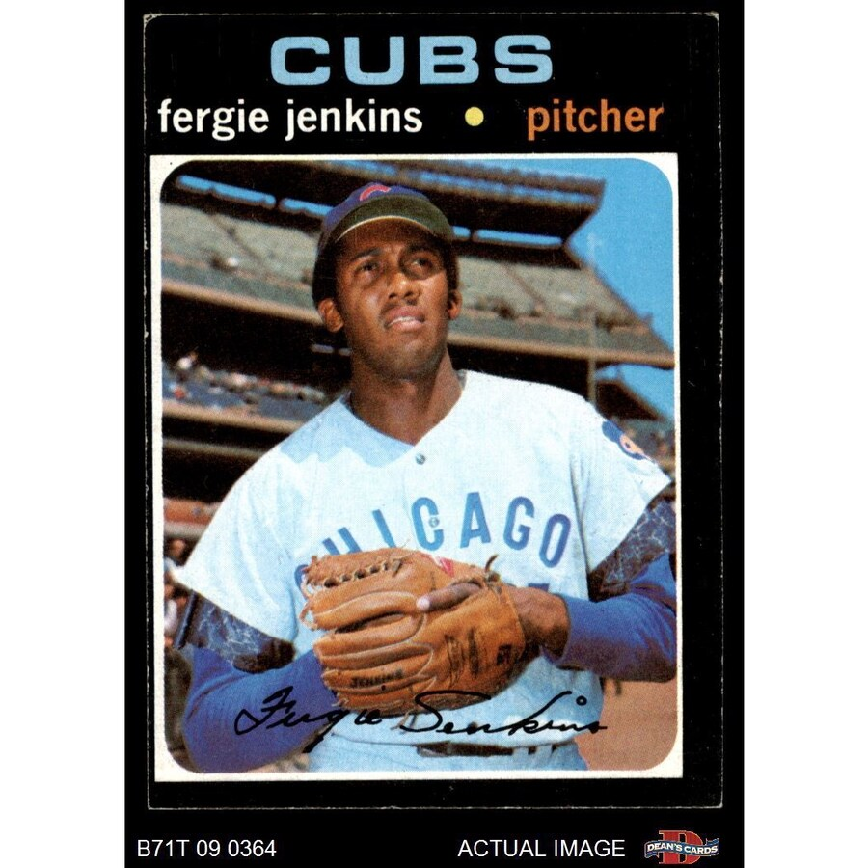
1971
Cy Young
Winners
23 - 8, ERA 1.82, 312 IP
24 – 13, ERA 2.77, 325 IP

Slide 24
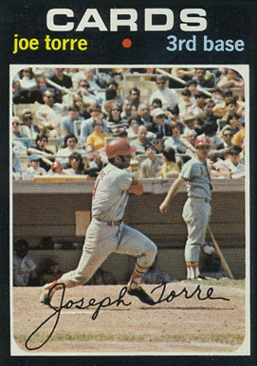
1971
MVP
Winners
23 - 8, ERA 1.82, 312 IP
.363 , 24 HR , 137 RBI
Notes:
Mickey Mantle hit 37 homers to lead the AL. He also led the league in triples, walks, and SLG.

Slide 25
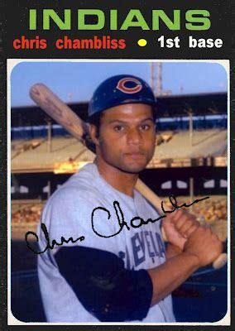
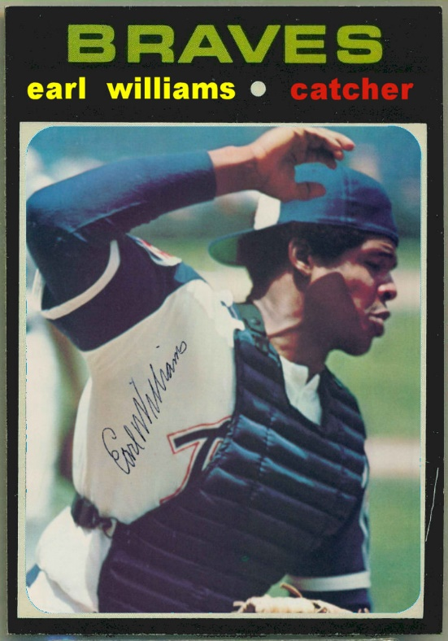
1971
Rookie of the
Year
Winners
.275, 9 HR, 48 RBI
.260, 33 HR, 87 RBI
Notes:
Mickey Mantle hit 37 homers to lead the AL. He also led the league in triples, walks, and SLG.

Slide 26
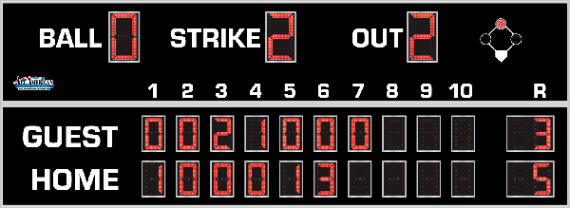
7th Inning Stretch

Slide 27
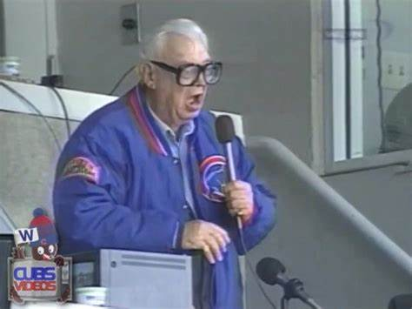
“Take Me Out to the Ballgame”
https://www.youtube.com/watch?v=HnHV5FaqvEs
Notes:
Mike has short “intro” to this …

Slide 28
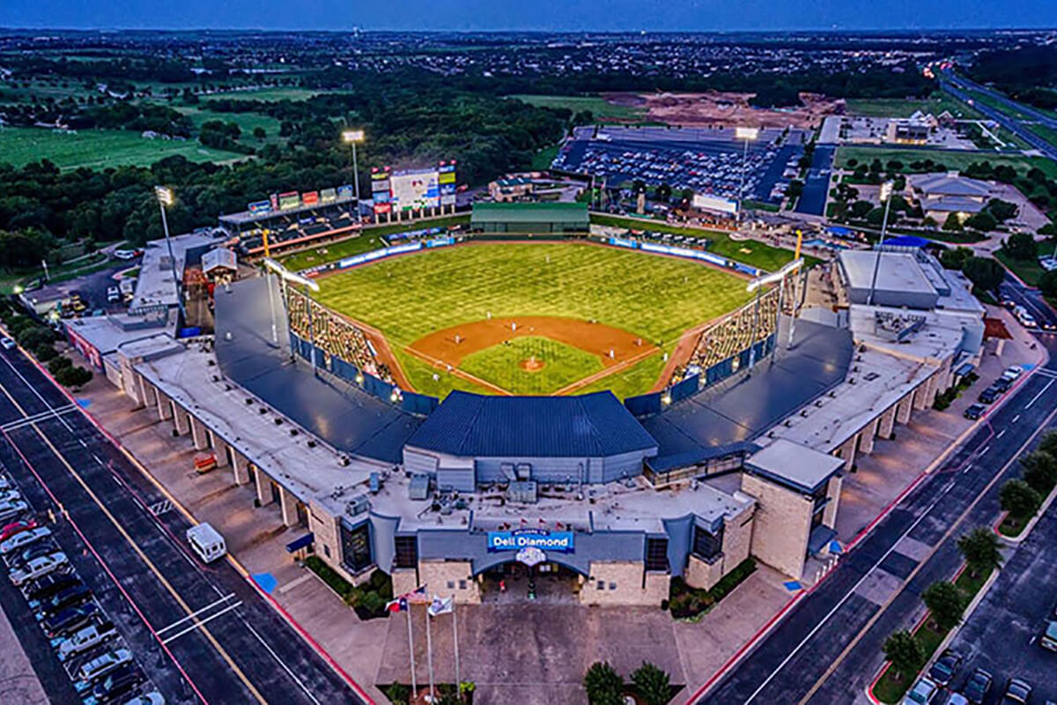
“Deep in the Heart of Texas”
https://www.youtube.com/watch?v=VGF4ibgcHQE

Slide 29
The Chicken Dance !
https://www.youtube.com/watch?v=WZJAIkmT3Rg

Slide 30
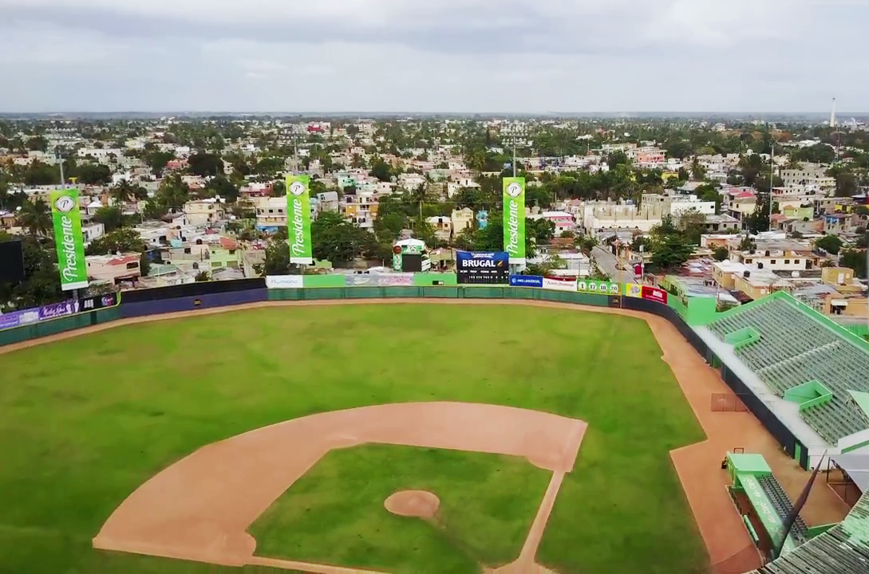
¡ Música al estadio !
It can get very
loud at:
Estadio
Tetelo Vargas
in
San Pedro de
Macoris,
DR
https://www.youtube.com/watch?v=Y6yao6BlAe0
“La Bamba” :

Slide 31
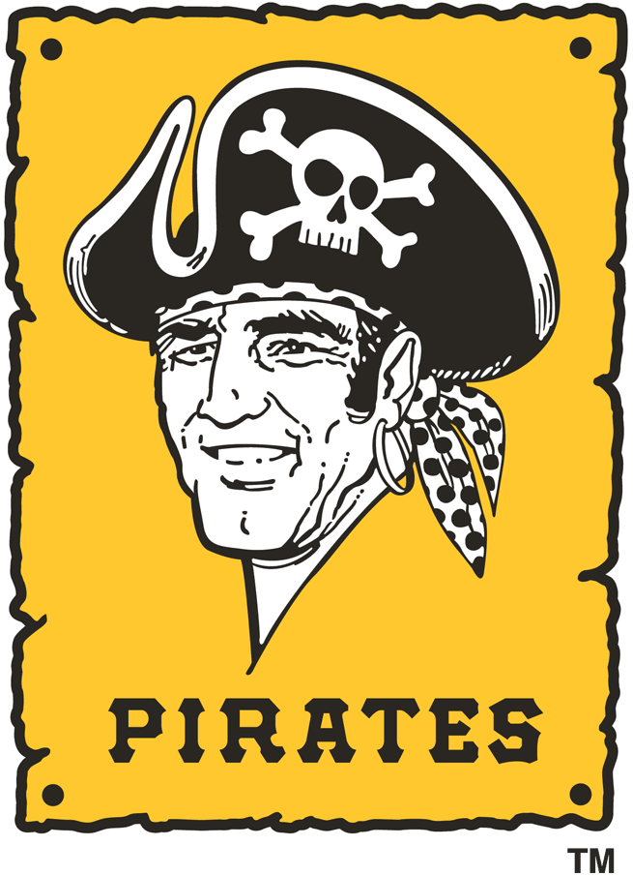
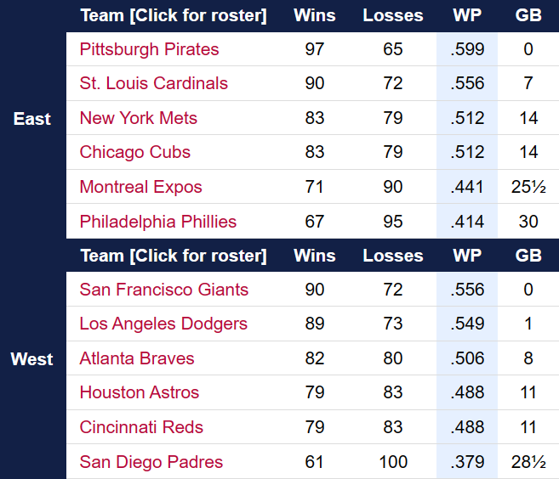
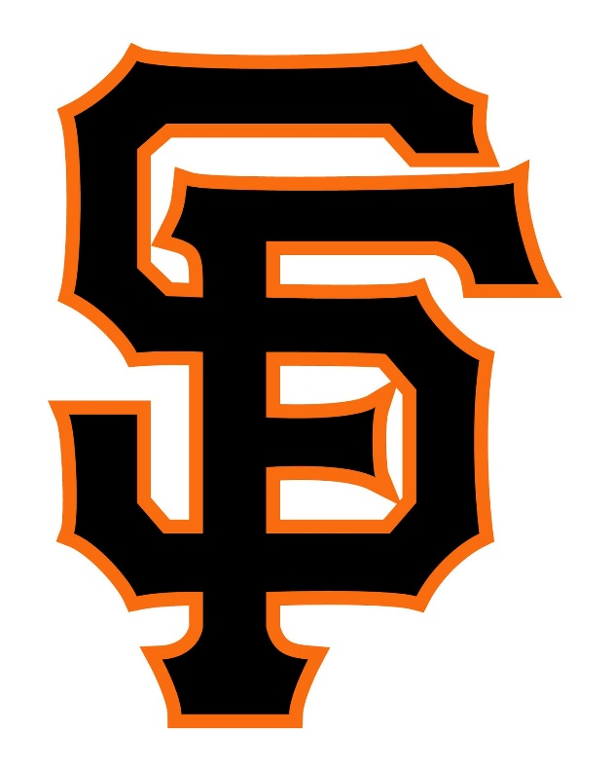
1971 National League
Notes:
The Giants led by 8.5 games on September 1 but the Dodgers chipped away. In mid September, the Dodgers won 8 in a row, including 5 over the Giants to narrow the gap to one game. But they could get no closer; ultimately both teams won on the final day of the season and the Giants won the division by 1 game.

Slide 32
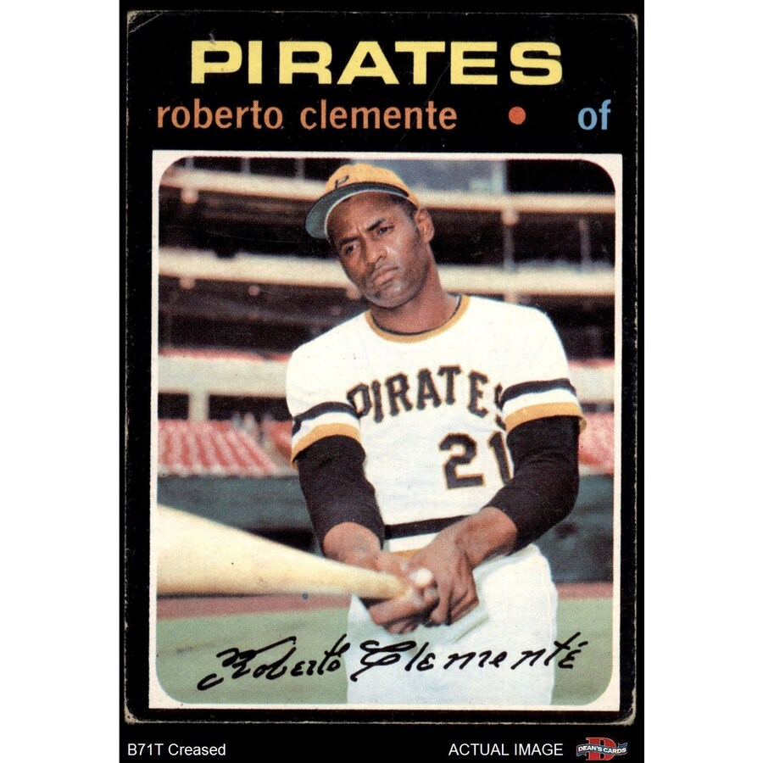
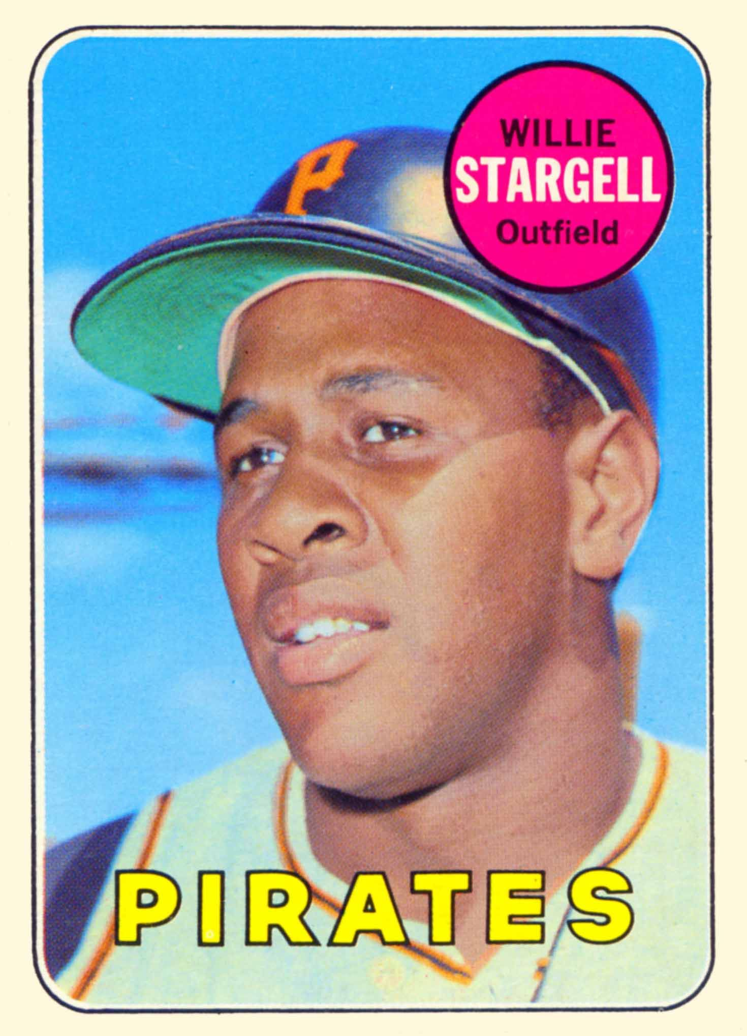
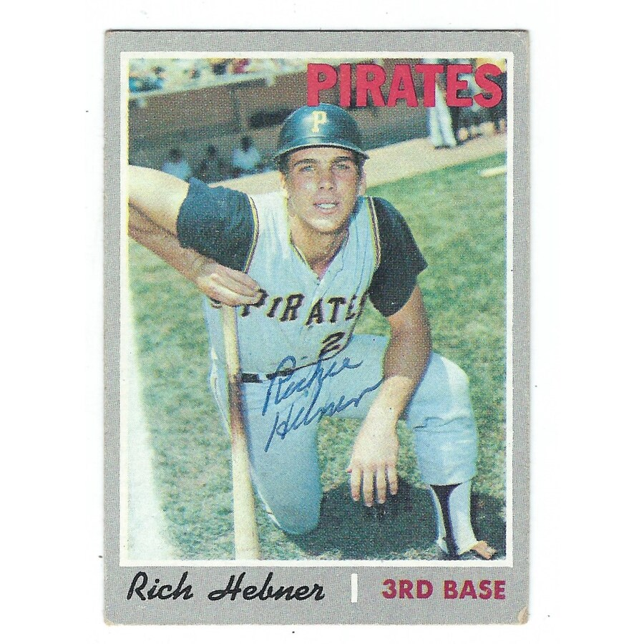
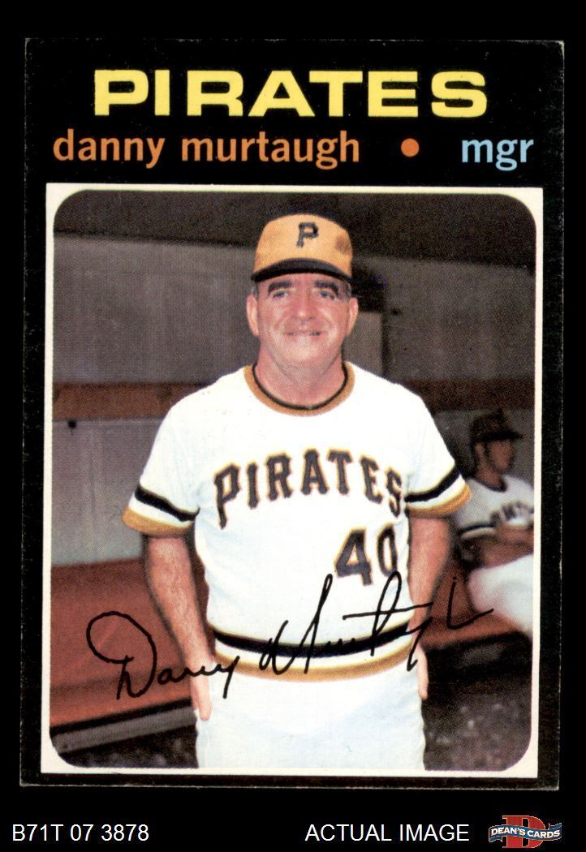
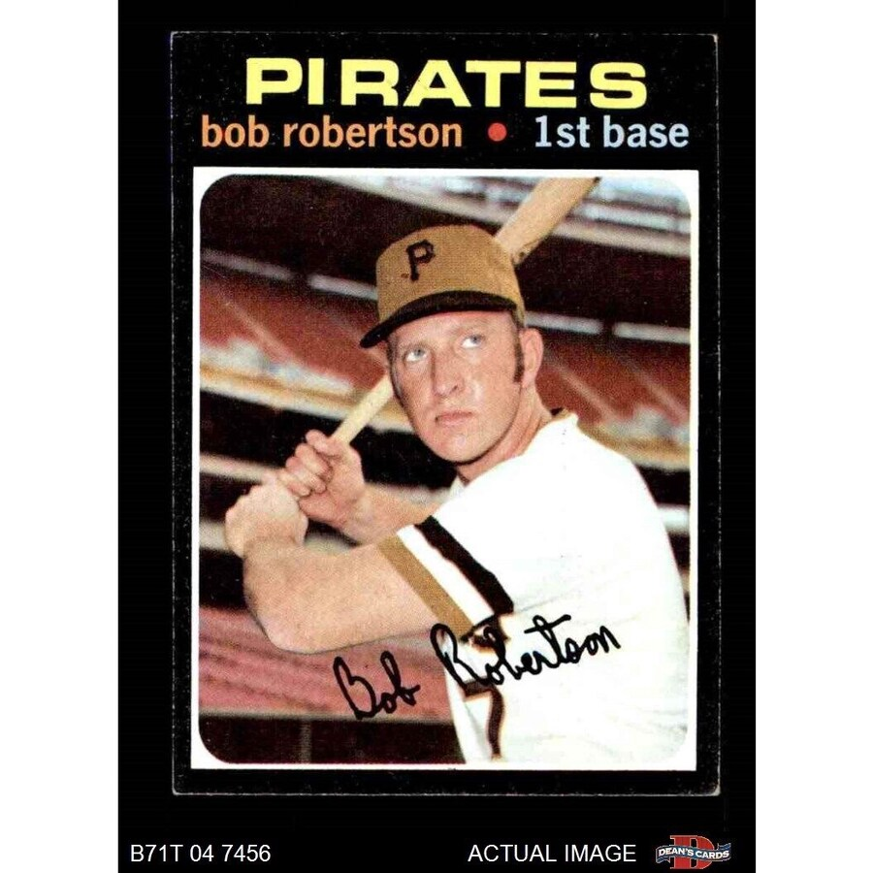
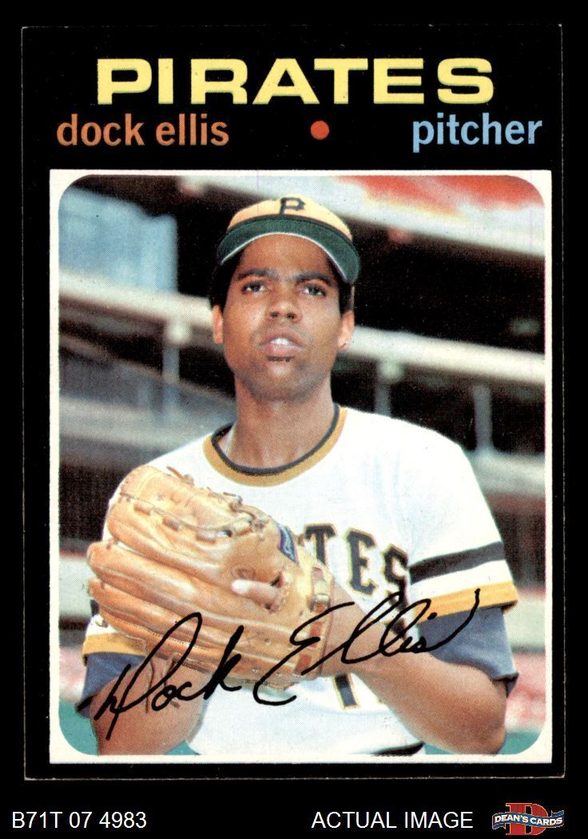
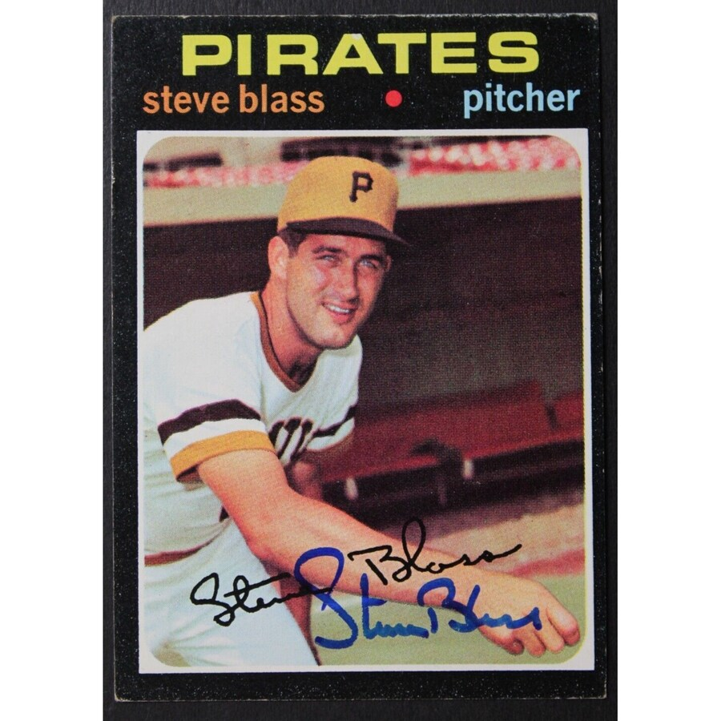
Pirates
Stars

Slide 33
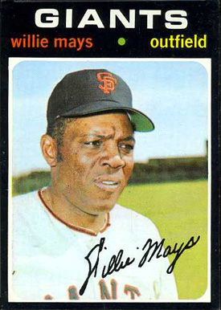
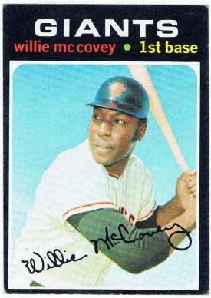
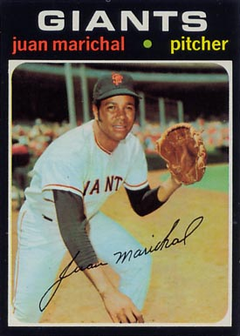
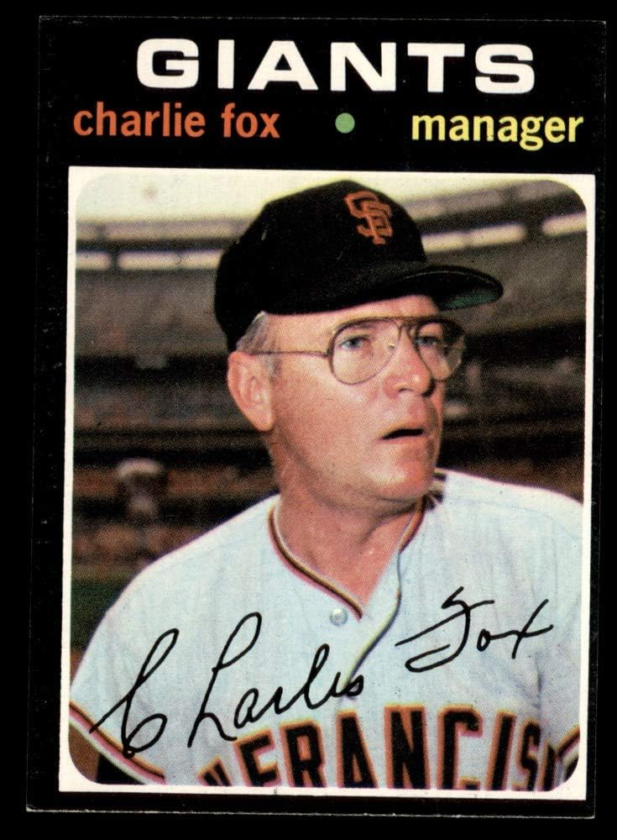
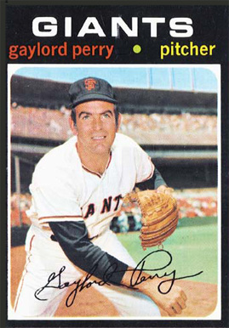
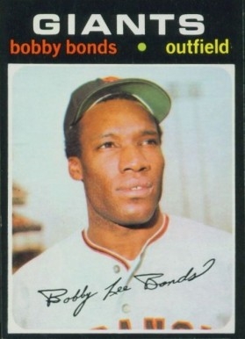
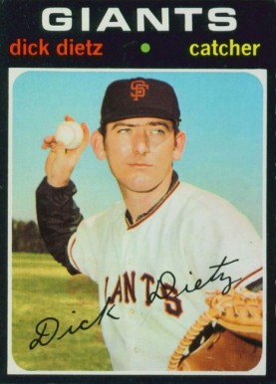
Key Giants

Slide 34

1971 NLCS
The NLCS opened at Candlestick Park in S.F.
on Sat. Oct. 2
Best 3-of-5 format
The Giants won the opener 5-4 behind starter Gaylord Perry and HR by 1B Willie McCovey and 2B Tito Fuentes
The Pirates rebounded in Game 2 with a 15 hit attack to win 9-4. 1B Bob Robertson had 3 HR and 5 RBI.
The Series moved to Three Rivers Stadium in Pittsburgh for the remaining games. 1B Robertson and 3B Richie Hebner hit solo HR to power the Pirates to a 2-1 victory. Pittsburgh leads the Series 2 games to 1.
The Pirates won Game 4 by a score of 9-5 and clinched the National League pennant.
Pirates CF Al Oliver hit a three-run homer in the bottom of the 6th that put the Pirates ahead to stay.
https://www.youtube.com/watch?v=enjypJWXVQs
Notes:
Over his HOF career, Clemente had 266 OF assists!

Slide 35
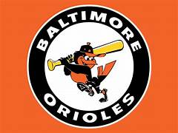
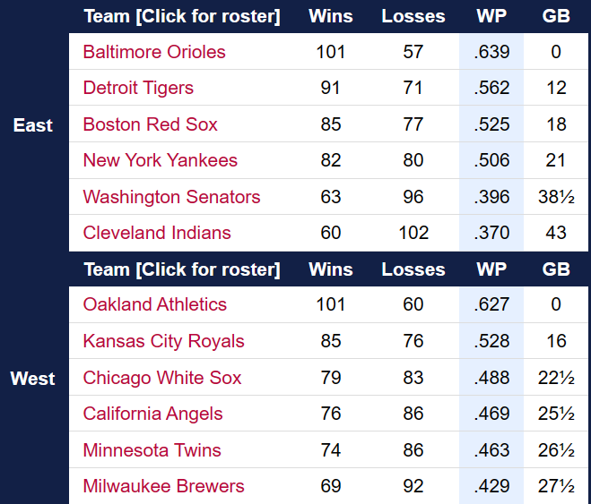
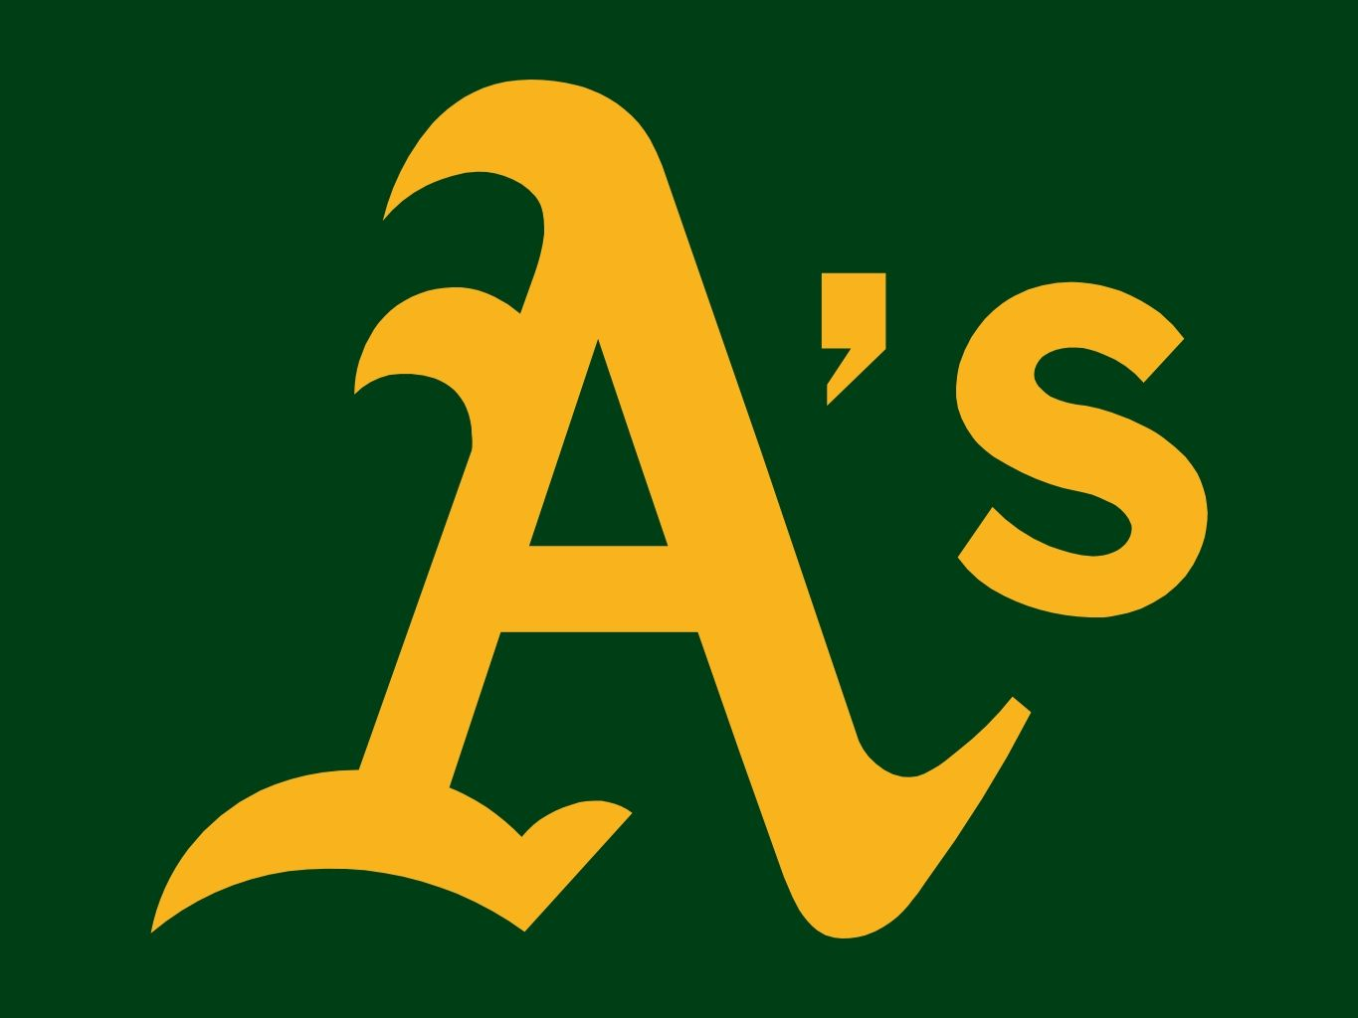
1971 American League

Slide 36
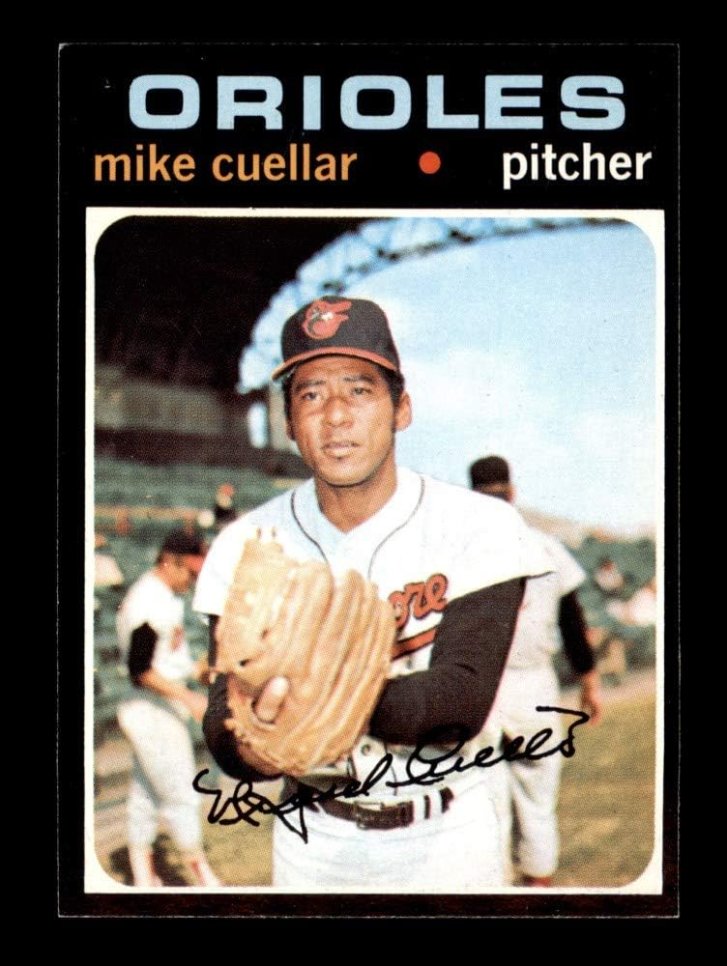
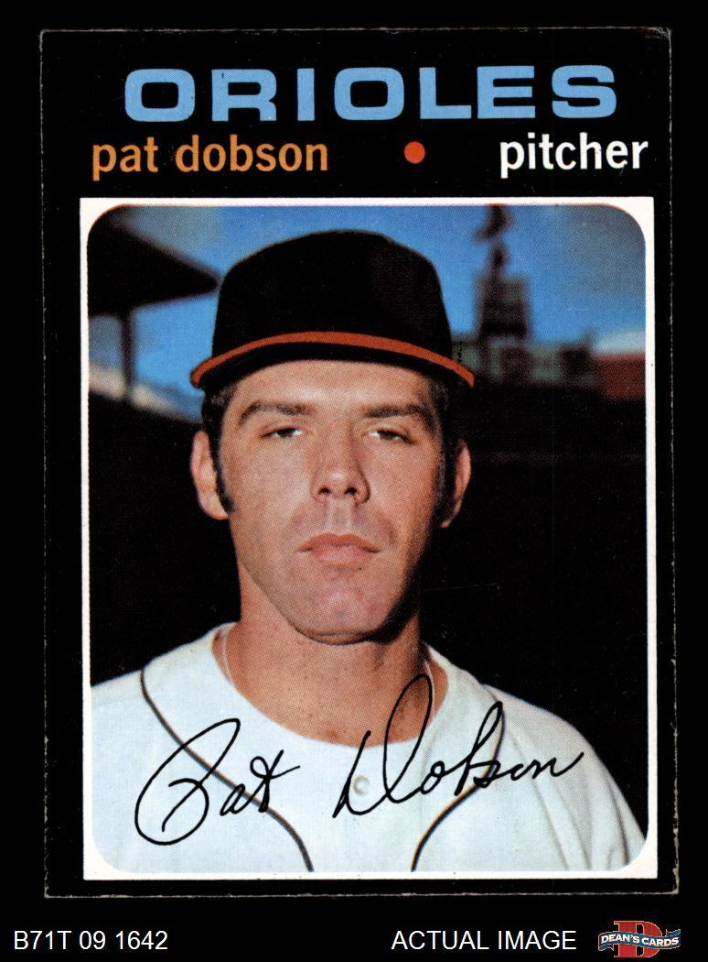
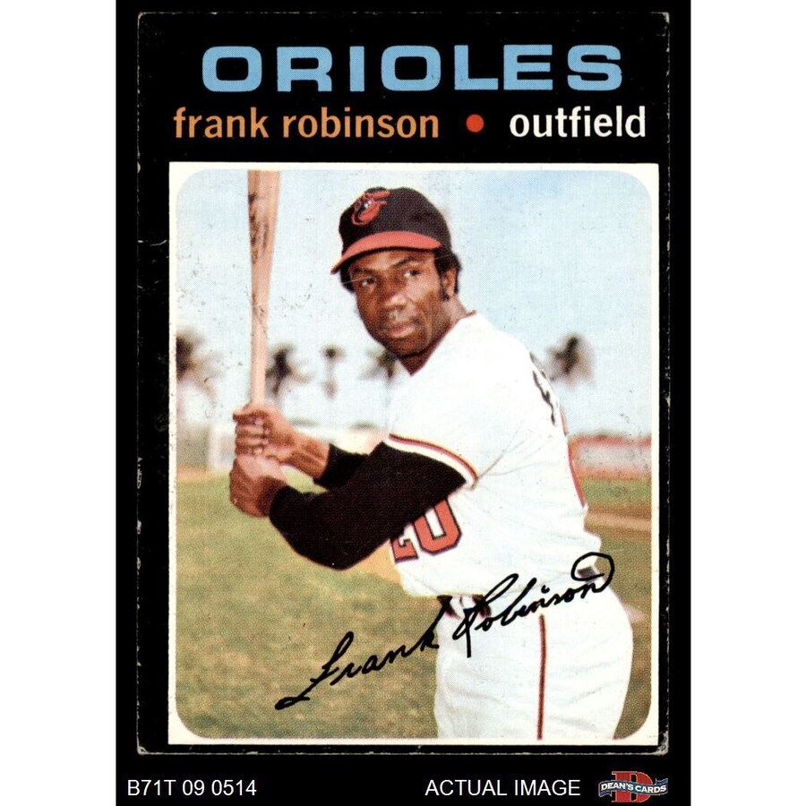





O
R
I
O
L
E
S
S
T
A
R
S
Notes:
All four Orioles starters won 20 games, McNally with 21 !

Slide 37





Key
Athletics

Slide 38
1971 ALCS
The ALCS opened
Sunday, Oct. 3
at Memorial Stadium
in Baltimore
The Orioles scored four runs in the bottom of the 7th inning to take the opener 5-3.
Orioles 1B Boog Powell hit two homers, powering Baltimore to a 5-1 victory in Game 2.
The Series moved to Oakland-Alameda County Stadium for Game 3.
The Orioles pounded out 12 hits for a 5-3 win, winning the AL Pennant with a sweep of the ALCS.

Slide 39
1971 World Series
VS.
The Series opened on October 9th at Memorial Stadium in Baltimore.

Slide 40
1971 World Series Highlights
The Orioles took the first two games at home by scores of 5-3 and 11-3.
The Series moved to Pittsburgh for the next three games.
Behind 1B Bob Robertson’s 3-run HR, the Pirates won Game 3 by score of 5-1.
Game 4 was the first World Series Game played at night!
The Pirates took the game 4-3 with a 14-hit attack.
Pirates reliever Nelson Briles started Game 5 and threw a 2-hitter. The Pirates win again 4-0.
The Series moves back to Baltimore for Game 6.
The Orioles win a nail-biter 3-2 in 10 innings, forcing a deciding Game 7.
In another tight game, the Pirates win 2-1 and clinch the World Series.
Roberto Clemente’s HR puts the Pirates ahead to stay:
https://www.youtube.com/watch?v=y3V6hfAUU9g

Slide 41

1971 World Series
The Pirates won their 4th World Series
Dating back to the first modern day
World Series in 1903
Roberto Clemente was the World Series MVP
He batted .414 with 12 hits, 2 HR, and 4 RBI.

Slide 42

Extra Innings!
More Stuff from the ‘60s and ‘70s

Slide 43

Things we don’t have anymore:
Sears
Summer catalog

Slide 44

Baseball superstar
Ted Williams
promoted Sears’
“J.C. Higgins” sporting goods

Slide 45

Sears
Summer catalog
J.C. Higgins
Baseball Gloves
Notes:
This is Monte’s first glove – a 1958 Don Blasingame model. It cost $3.84 back then!

Slide 46

Automobile makes/models we don’t have anymore
Volkswagen “Beetle”

Slide 47

Automobile makes/models we don’t have anymore
Studebaker

Slide 48

Automobile makes/models we don’t have anymore
Rambler

Slide 49

Automobile makes/models we don’t have anymore
Pontiac
Notes:
Pontiac Catalina four door

Slide 50

Automobile makes/models we don’t have anymore
Oldsmobile
Notes:
Oldmobile 98 – it was huge

Slide 51

Automobile makes/models we don’t have anymore
Mercury
Notes:
Mercury Monterey

Slide 52

Automobile makes/models we don’t have anymore
Plymouth
Notes:
Plymouth Belvedere – I did driver’s ed in one of these

Slide 53

Kitchen Items

Slide 54

Kitchen Items
  Pink
and…
Avocado Green
Harvest Gold
Copper …

Slide 55


Kitchen Items
Some “vintage” kitchen tools

Slide 56

Kitchen Items
Some “vintage” kitchen tools

Slide 57


Kitchen Items

Slide 58

Thanks!!
We’ll see you again next month!

