Slide 1
AGE Thrive with Baseball Memories
November 15, 2023
Agenda
Warm-up - Introductions
2023 World Series !!!
Gametime – The Year in Baseball – 1973
Seventh Inning Stretch - “Take Me Out to the Ball Game”
Extra Innings – More stuff from the ‘60s and ’70s
Extra Innings - Memorabilia

Slide 2
2023 World Series
VS.
… and the winner is …

Slide 3
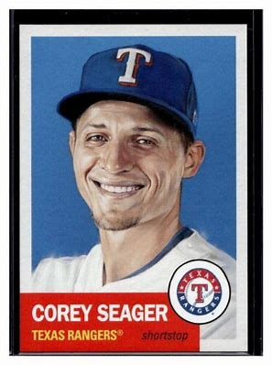
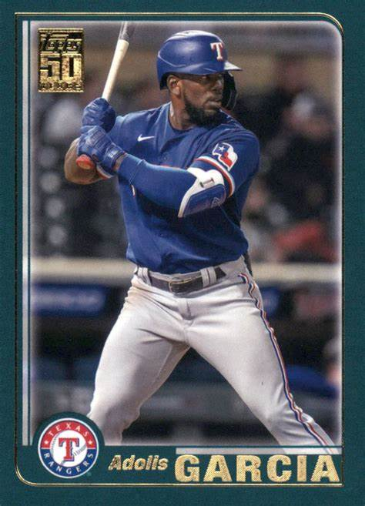
2023 World Series
The Rangers
won in 5 games!
World Series MVP
ALCS MVP

Slide 4
1973
History

Slide 5
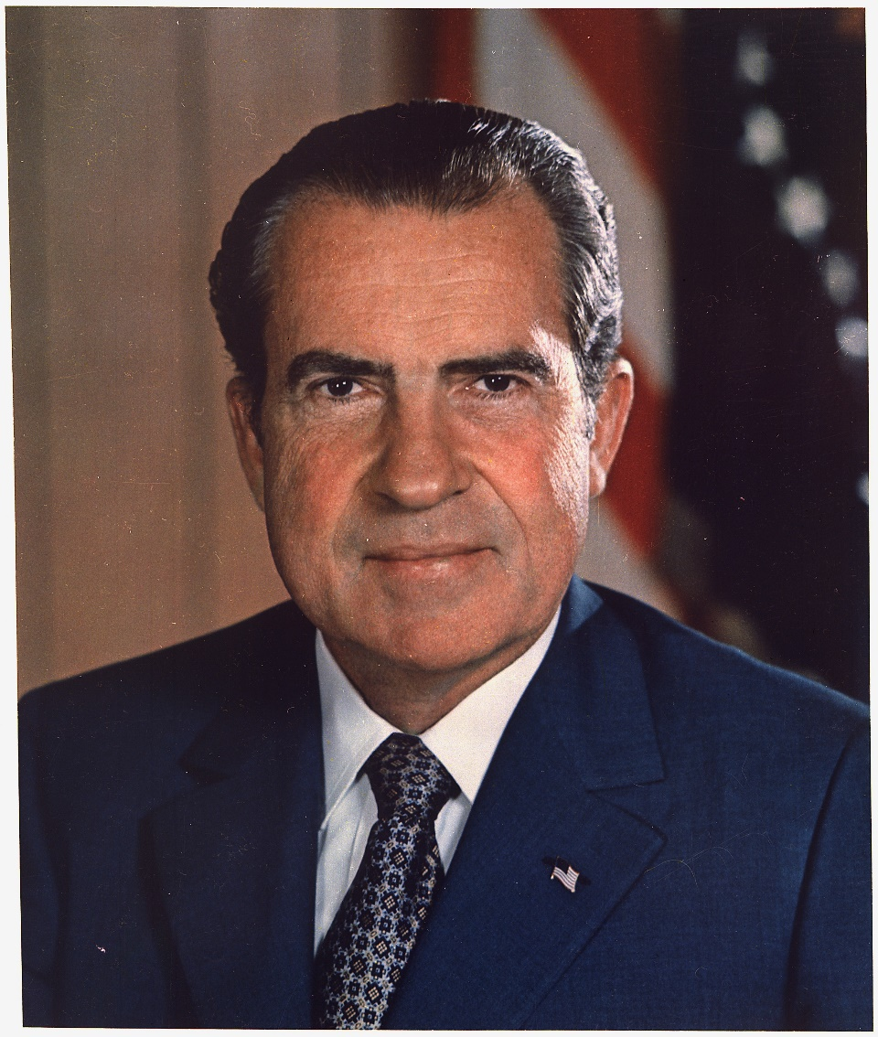
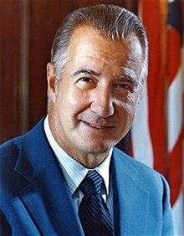
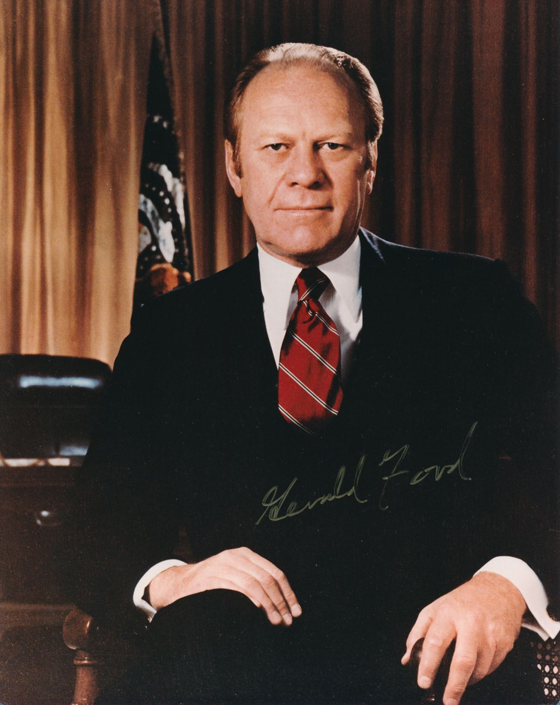
U.S. Leaders
President Richard Nixon
V.P. Spiro Agnew
V.P. Gerald Ford
Notes:
We had two VPs in the same administration! Nixon and Agnew were re-inaugurated after winning the 1972 general election. Agnew resigns on October 10 (Jerry’s 18th birthday) after pleading no-contest to income tax evasion. Gerald Ford from Michigan is then nominated for VP and confirmed by Congress in December (per 25th amendment).

Slide 6
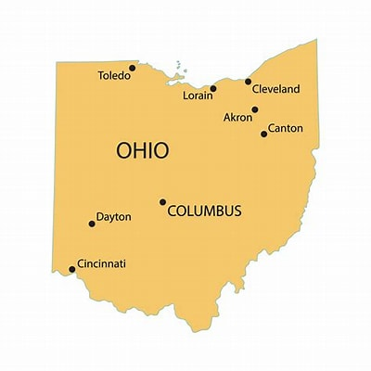
Metric?
First state to post distances in
Metric on road signs
Part of U.S. effort in the ‘60s – ’70s to convert to metric
It “was” 244 miles from
Cleveland to Cincinnati
“Now” it’s 393 kilometers

Slide 7
World’s
Tallest
Building
Sears Tower in Chicago
At 1,451 feet, was the world’s tallest in 1973
As of 2023, it is the 23rd tallest.
The “Burj Kalifa” building in Dubai is 2,722 feet high

Slide 8
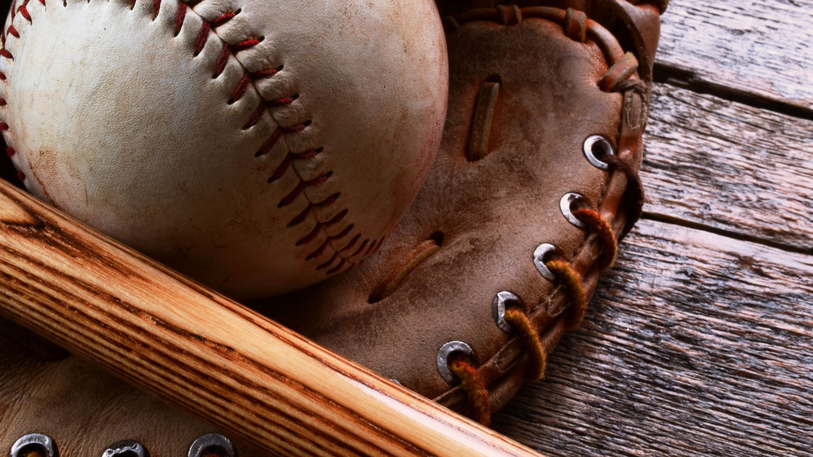
The Baseball Thanksgiving Menu

Slide 9
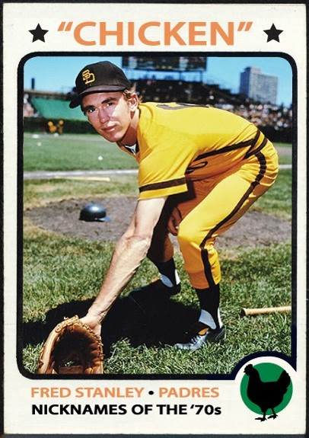
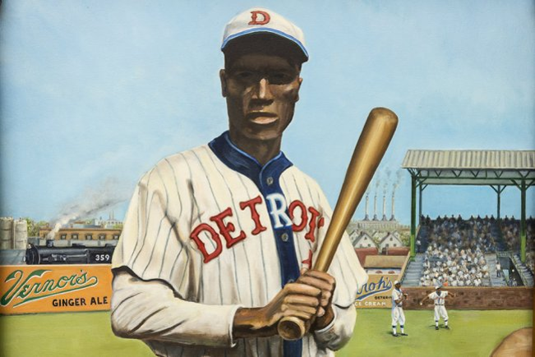
Main Courses
Norman Thomas “Turkey” Stearnes
Fred “Chicken” Stanley

Slide 10
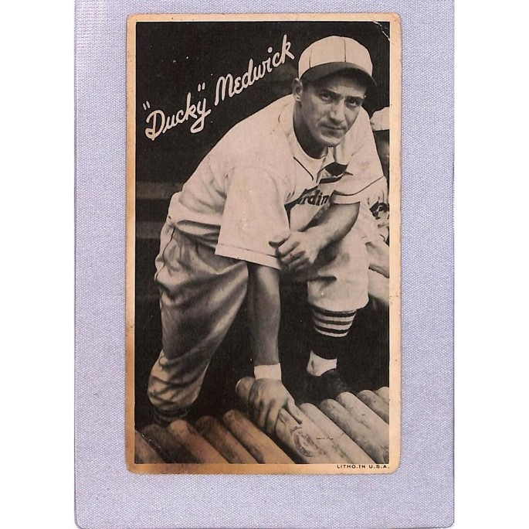
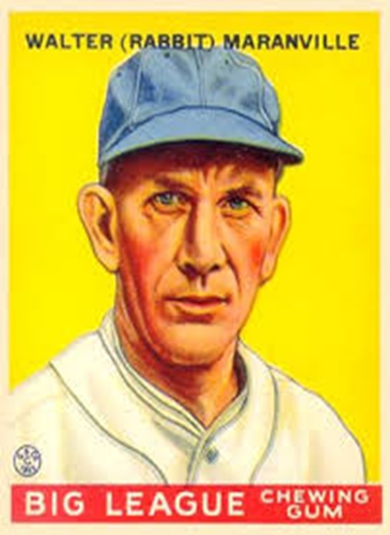
Joe “Ducky” Medwick
“Rabbit” Maranville

Slide 11
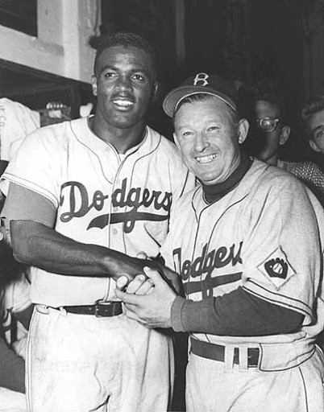
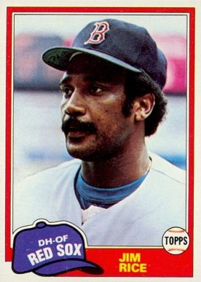
Side dishes
Charlie Dressen
Jim Rice

Slide 12
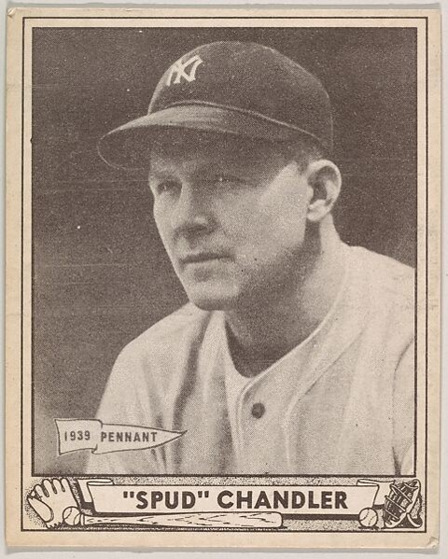
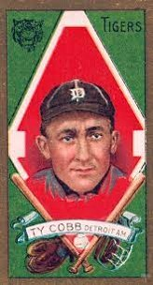
Spurgeon Ferdinand “Spud” Chandler
Ty Cobb

Slide 13
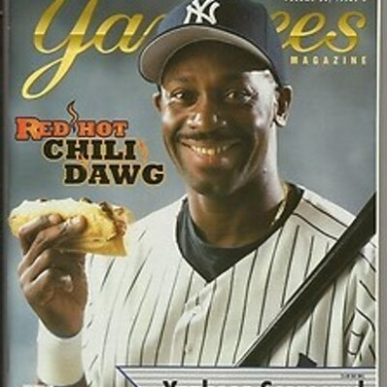
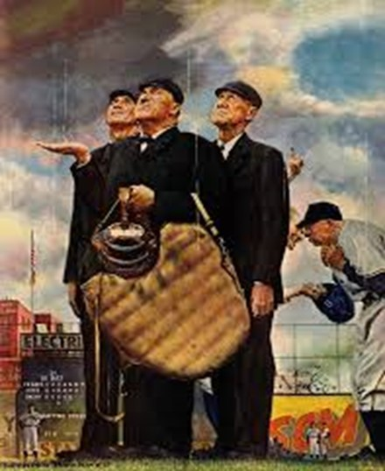
Chili Davis
John “Beans” Reardon

Slide 14
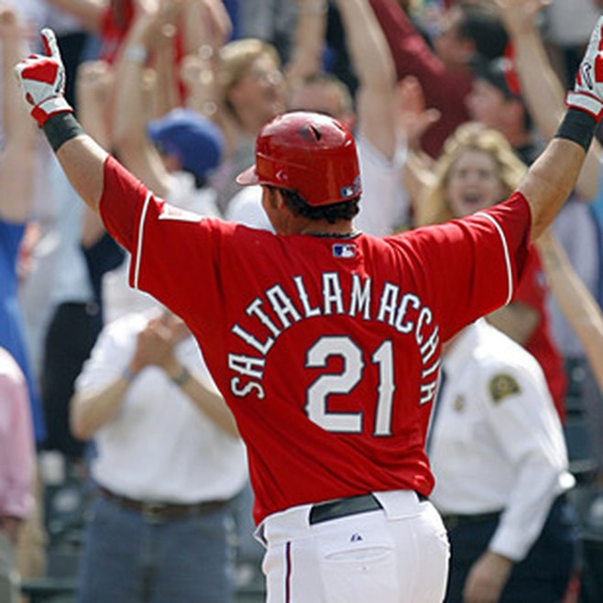
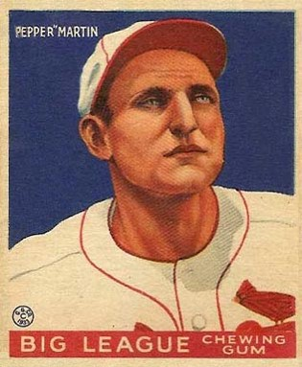
Condiments
Jarrod Saltalamacchia
Pepper Martin

Slide 15
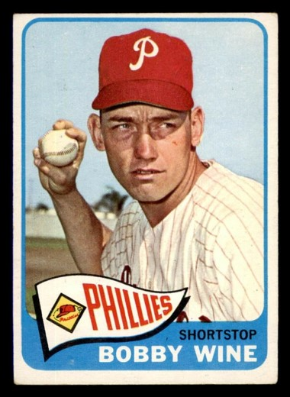
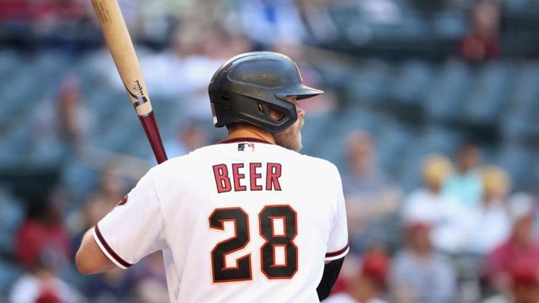
Beverages
Bobby Wine
Seth Beer

Slide 16
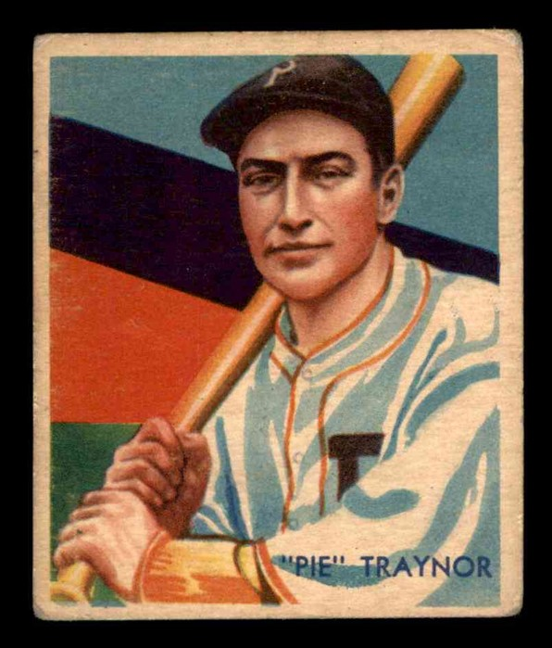
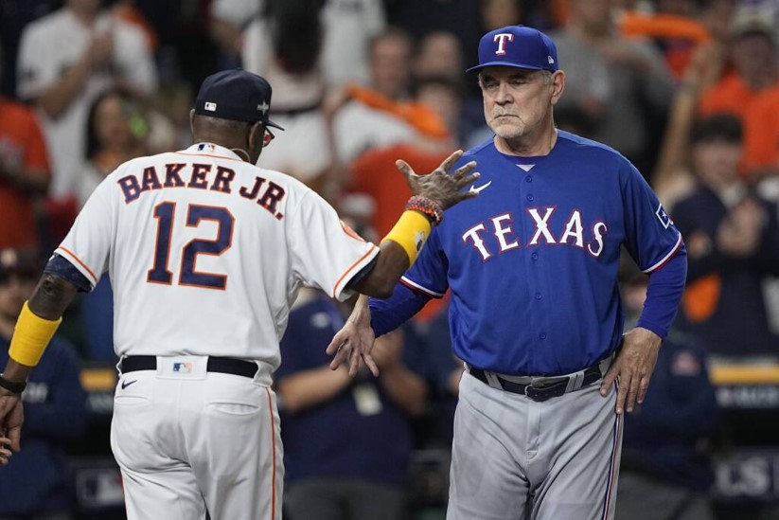
Dessert
Harold “Pie” Traynor
Dusty Baker

Slide 17
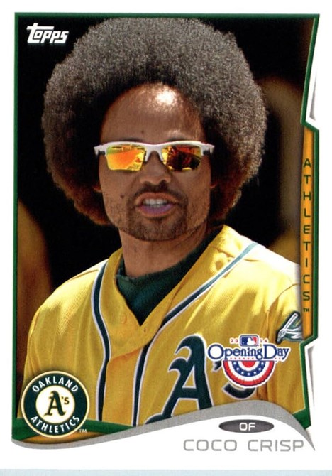
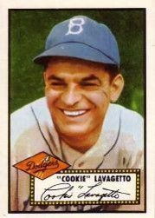
Harry “Cookie” Lavagetto
Coco Crisp

Slide 18
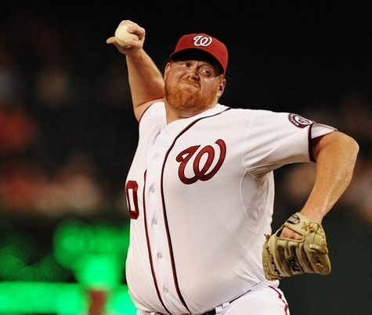
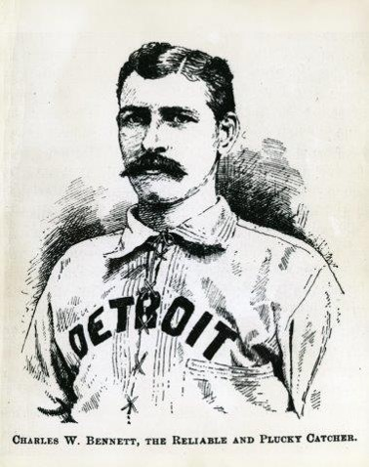
And finally, a nice cup of java. . .
Todd Coffey
George Creamer

Slide 19
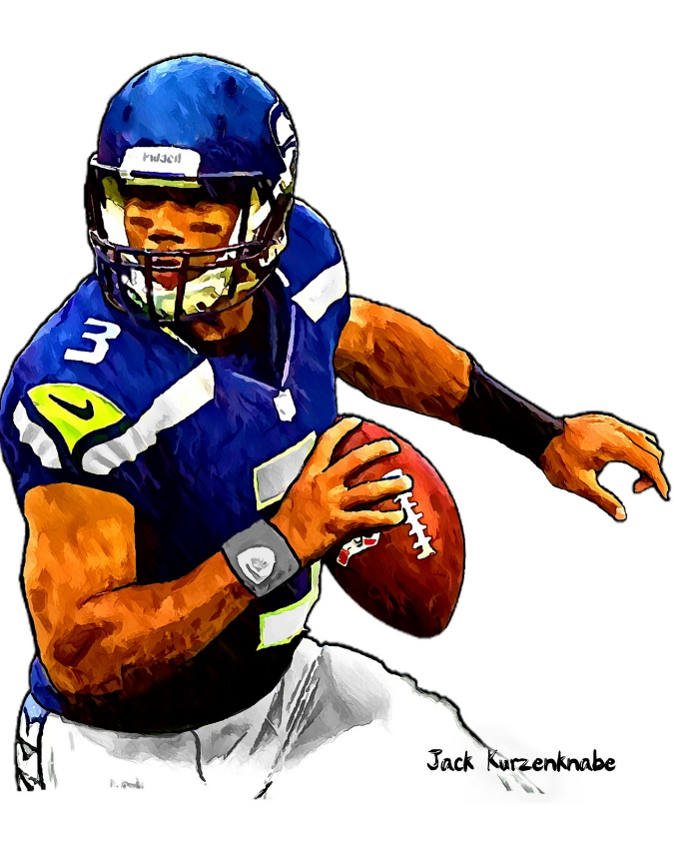
1973 Sporting News

Slide 20
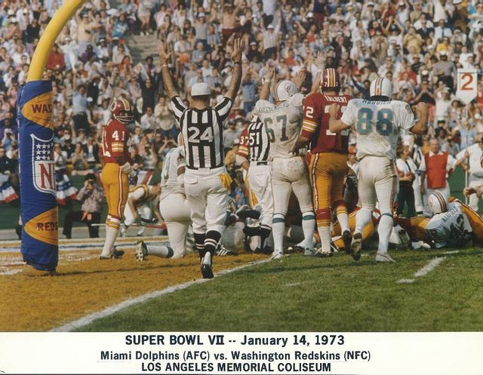
Super Bowl VII
Miami Dolphins come into game undefeated in the regular season at 14-0 and won both playoff games so far
A Miami field goal attempt goes wrong!
Final score: Miami 14
Washington 7
Miami completes an undefeated
17 – 0 season, still a record
https://www.youtube.com/watch?v=nWinVMN_ldc

Slide 21
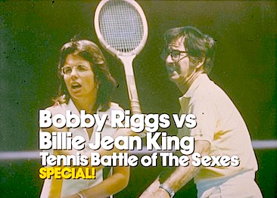
“Battle of the Sexes”
Sept. 20 at the
Astrodome in Houston
https://www.youtube.com/watch?v=T9zu7g2fjf0
Notes:
The term is most famously used for an internationally televised match in 1973 held at the Houston Astrodome between 55-year-old Bobby Riggs and 29-year-old Billie Jean King,^{[4]} which King won in three sets.^{[2][5]} The match was viewed by an estimated fifty million people in the United States and ninety million worldwide.^{[6]} King's win is considered a milestone in public acceptance of women's tennis.

Slide 22
The 1973 Athlete of the Year was ….
Secretariat
wins racing’s
Triple Crown
Set time records in the Kentucky Derby,
the Preakness, and the Belmont Stakes!
All those records still stand today.
Notes:
Many say the greatest racehorse ever! Set time records in all three legs of the Triple Crown that still stand today!! He won the Belmont Stakes by 31 lengths – the widest margin ever!

Slide 23
The Year in Baseball: 1973

Slide 24
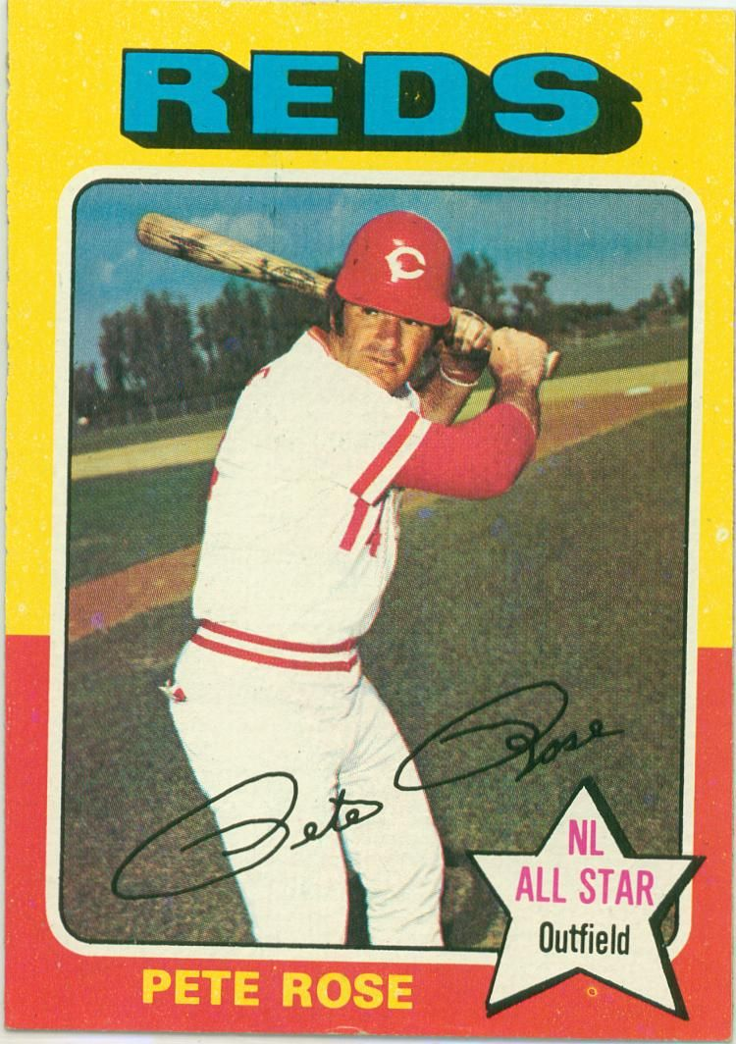
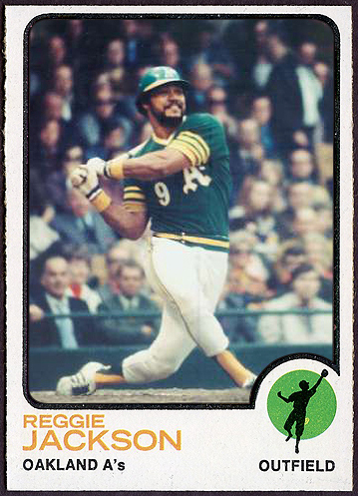
1973
MVP
Winners
.338 238 hits 115 R
.293 32 HR 117 RBI
Notes:
Originally a 2B, Rose played LF for the Reds in ‘73. He was a 17-time All Star and ROY in ’63. Reggie Jackson led the AL in HR, RBI, SLG, and On-Base-Plus Slugging; he’s a 14-time All Star and in the HOF.

Slide 25
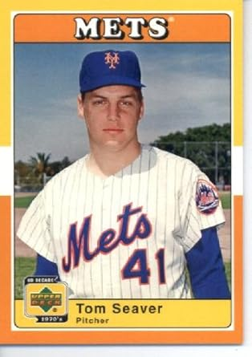
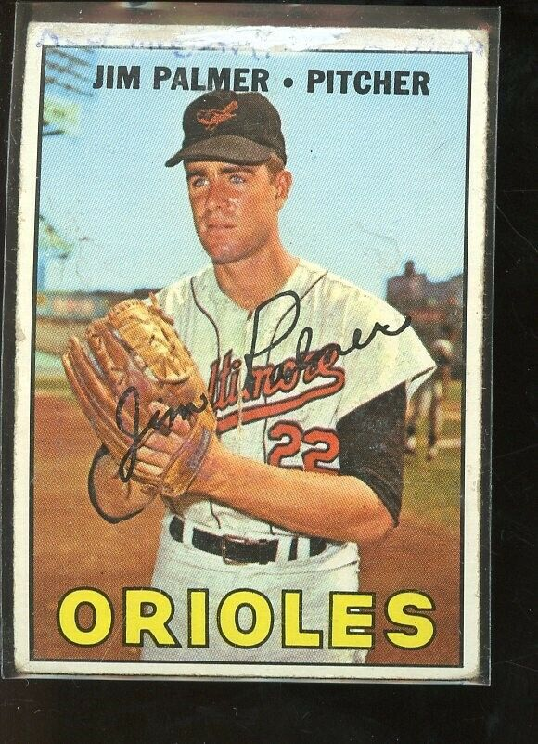
1973
Cy
Young
Winners
19 - 10, ERA 2.08, 251 SO
22 - 9, ERA 2.40, 296 IP
Notes:
Tom Seaver won his 2nd Cy Young Award; let the NL in ERA, SO, CG (18); we would be a 12-time All Star, win a 3rd Cy Young in ‘75, and be voted into HOF. Jim Palmer won his first of three AL Cy Young Awards. He led the AL in ERA. He would win 20 games 8 times, make All-Star team six times, win 4 Gold Gloves, and go into HOF.

Slide 26
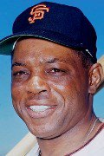
1973 was the final season for one of baseball’s all-time greats
Willie Mays

Slide 27
He was the ultimate FIVE-TOOL PLAYER:
He could RUN
He could FIELD
He could THROW
He could HIT
He could HIT WITH POWER
339 Stolen Bases
12 Gold Gloves
196 Assists
.301 – 3,293 hits
660 Home Runs
https://www.youtube.com/watch?v=7bLt2xKaNH0
Notes:
The ultimate five-tool player! His WAR was 156, third all-time among position players. “The Catch” in the 1954 World Series.

Slide 28
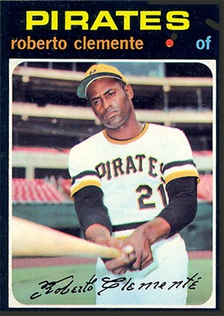
The “Great One” aka “Señor Arriba”
was elected to the Baseball Hall of Fame in 1973.
He was the first Latin American player to enter the Hall.
Notes:
Tragically died in a plane crash on Dec. 31, ‘72 on a humanitarian mission from Puerto Rico to victims of an earthquake in Nicaragua. The Baseball Writers waived the five-year waiting rule for Hall of Fame consideration and voted Clemente into the Baseball Hall of Fame in March.

Slide 29
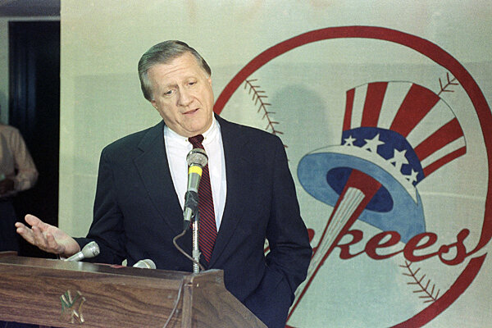
Cleveland-based shipping
magnate
George Steinbrenner
heads a 12-investor syndicate
to buy the Yankees from CBS.
He bought 2% of the team for a reported $168,000
When he passed away, he owned 57% of the team that was worth about
$3,500,000,000!
the “Boss” buys the N.Y. Yankees

Slide 30
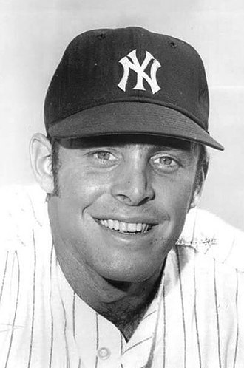
The A.L. adopts the designated hitter rule.
Ron Blomberg of the Yankees was the first-ever DH in a regular-season game, on April 6 at Fenway Park.
Batting with the bases loaded, he walked.
Blomberg was Jewish, so he liked to call himself the:
Designated Hebrew.

Slide 31
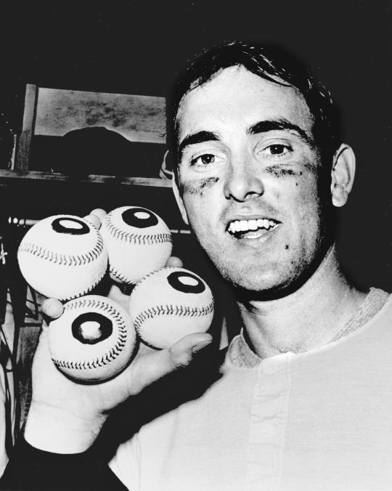
Nolan Ryan pitches two no-hitters during 1973 season.
The first two of his career, he finished with a total of seven no-hitters!
One of only six pitchers to throw two
no-no’s in the same season.
Notes:
Two no-nos same season: Johnny Vander Meer 1938 Reds – on back-to-back starts! Allie Reynolds 1951 Yankees; Virgil Trucks 1952 Tigers, Ryan 1973 Angels, Halladay 2010 Phillies, Scherzer 2015 Nats.

Slide 32
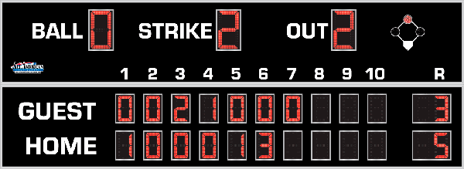
7th Inning Stretch

Slide 33
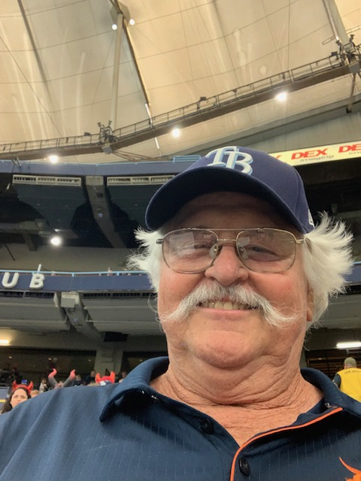
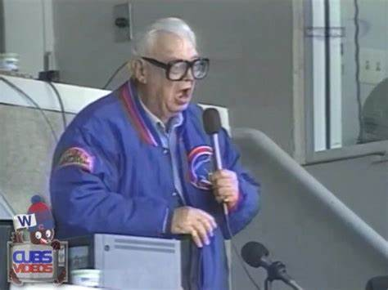
“Take Me Out to the Ballgame”
https://www.youtube.com/watch?v=HnHV5FaqvEs
Notes:
Mike has short “intro” to this …

Slide 34
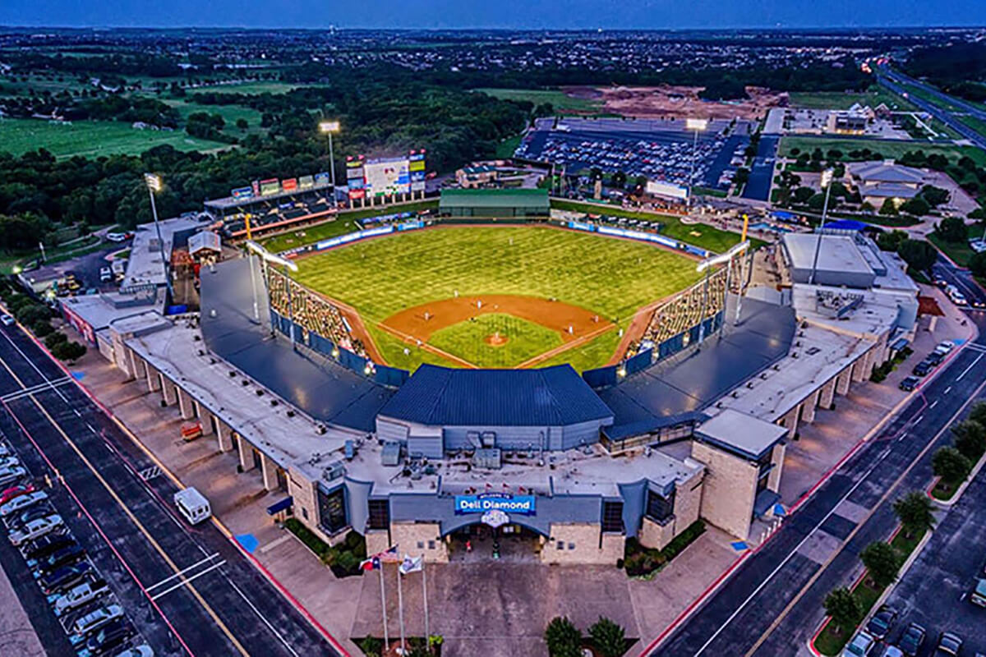
“Deep in the Heart of Texas”
https://www.youtube.com/watch?v=VGF4ibgcHQE

Slide 35
The Chicken Dance !
https://www.youtube.com/watch?v=WZJAIkmT3Rg

Slide 36
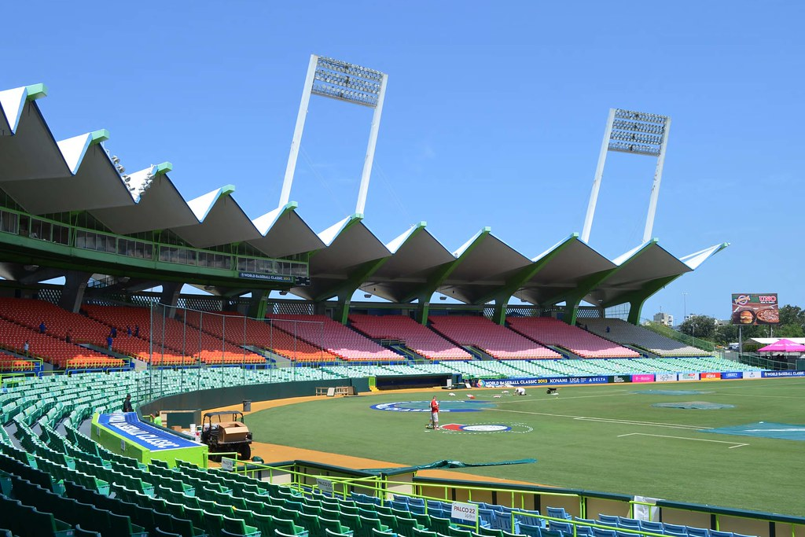
¡ Música al estadio !
Es muy
ruidoso en:
Estadio
Hiram
Bithorn
San Juan,
Puerto Rico
https://www.youtube.com/watch?v=rg0kwmJc4ts
Se canta – Llevame al juego de beisbol:

Slide 37
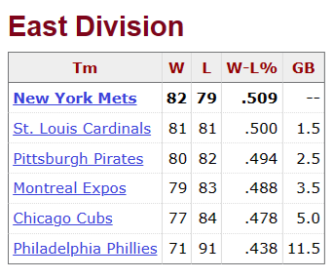
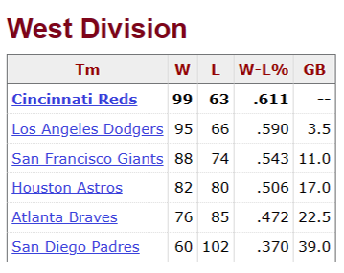
1973 N.L.

Slide 38
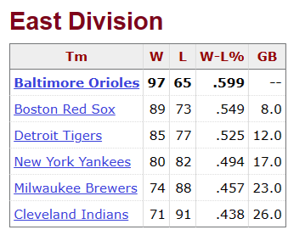
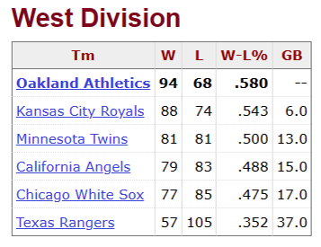
1973 A.L.

Slide 39
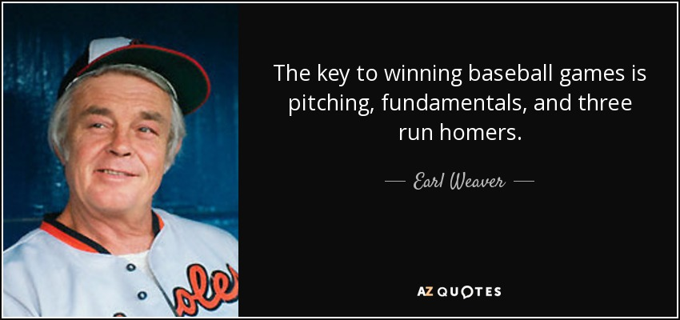
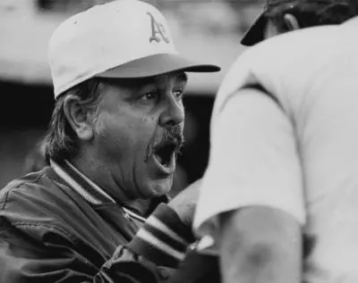
AL Championship Managers

Slide 40
1973 American League Championship A’s defeat Orioles three games to two

Slide 41
https://www.youtube.com/shorts/YTRwgcVKL6A

Slide 42
NL Championship Managers

Slide 43
1973 National League Championship Mets defeat Reds three games to two

Slide 44
Pete vs. Bud
https://www.youtube.com/watch?v=d0tIYGSl4Wg

Slide 45
Buddies

Slide 46
https://www.youtube.com/watch?v=We7VnjA2QQI

Slide 47
1973 World Series https://www.youtube.com/watch?v=DO4RYt3rnY4

Slide 48
https://www.youtube.com/watch?v=cZtx1tTqWrU

Slide 49
1973 World Series- Oakland A’s v. New York Mets Oakland Game 1 – October 13th A’s- 2 Mets-1

Slide 50
Game 2- October 14th ^{Oakland} Mets- 10 A’s-7 12 Innings

Slide 51
Shea Stadium https://www.youtube.com/watch?v=Fd4uZqP17Pk https://www.youtube.com/watch?v=ufVrmHg8TSY

Slide 52
Game 3- October 16th ^{New York} A’s- 3 Mets-2

Slide 53
Game 4- October 17th ^{New York} Mets- 6 A’s- 1

Slide 54
Game 5- October 18th ^{New York} Mets- 2 A’s- 0

Slide 55
Game 6- October 20th ^{Oakland} A’s- 3 Mets- 1

Slide 57
Legacy of the 1973 World Series https://www.youtube.com/watch?v=a_3pApb9H70 https://www.youtube.com/watch?v=U_vv24M6rZ8

Slide 58
Extra Innings!
More Stuff from the ‘60s and ‘70s

Slide 59
Yogi–isms
Wit and Wisdom from the great Baseball Philosopher
and Hall-of-Fame Catcher

Slide 60
Lawrence Peter
Berra
(aka Yogi)
One of MLB’s greatest catchers
Played 19 seasons in the Majors
Three time American League MVP
Played in 18 All-Star Games
Played in 14 World Series, won 10

Slide 61
Yogi managed
the 1964 Yankees &
1973 Mets

Slide 62
Yogi was also
famous for his
colorful statements
Which came to be called: “Yogi-isms”

Slide 63
Yogi on selecting a restaurant:
“Nobody goes there anymore, it’s too crowded”

Slide 64
Yogi on fine dining:
When asked if he wanted his pizza sliced into four or eight pieces, he said:
“Better make it four, I don’t think I can eat eight”

Slide 65
Yogi on inflation:
“A nickel ain’t
worth a dime
anymore”

Slide 66
Yogi on history
repeating itself:
“It’s deja vu all over again”

Slide 67
Yogi on geography:
“When you come to a fork in the road – take it!”

Slide 68
Yogi on condolences:
“Always go to other people’s funerals, otherwise they won’t go to yours.”

Slide 69
When asked if his many quotes were true:
“I didn’t really say everything that I said.”

Slide 70
Thanks !!!
We’ll see you again next month!

