Slide 1



AGE Thrive with Baseball Memories
October 18, 2023
Agenda
Warm-up - Introductions
Update on the baseball playoffs
Gametime – The Year in Baseball – 1975
Seventh Inning Stretch - “Take Me Out to the Ball Game”
Extra Innings – More stuff from the ‘60s and ’70s
Extra Innings - Memorabilia

Slide 2

1975 - History

Slide 3
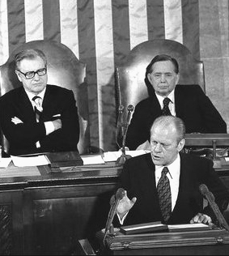
U.S.
Government
Leaders
VP Nelson Rockefeller
Speaker Carl Albert
President Gerald Ford
Notes:
President Gerald Ford; VP and President of the Senate Nelson Rockefeller; Speaker of the House Carl Albert (D-Oklahoma) – at 1975 State of the Union address

Slide 4
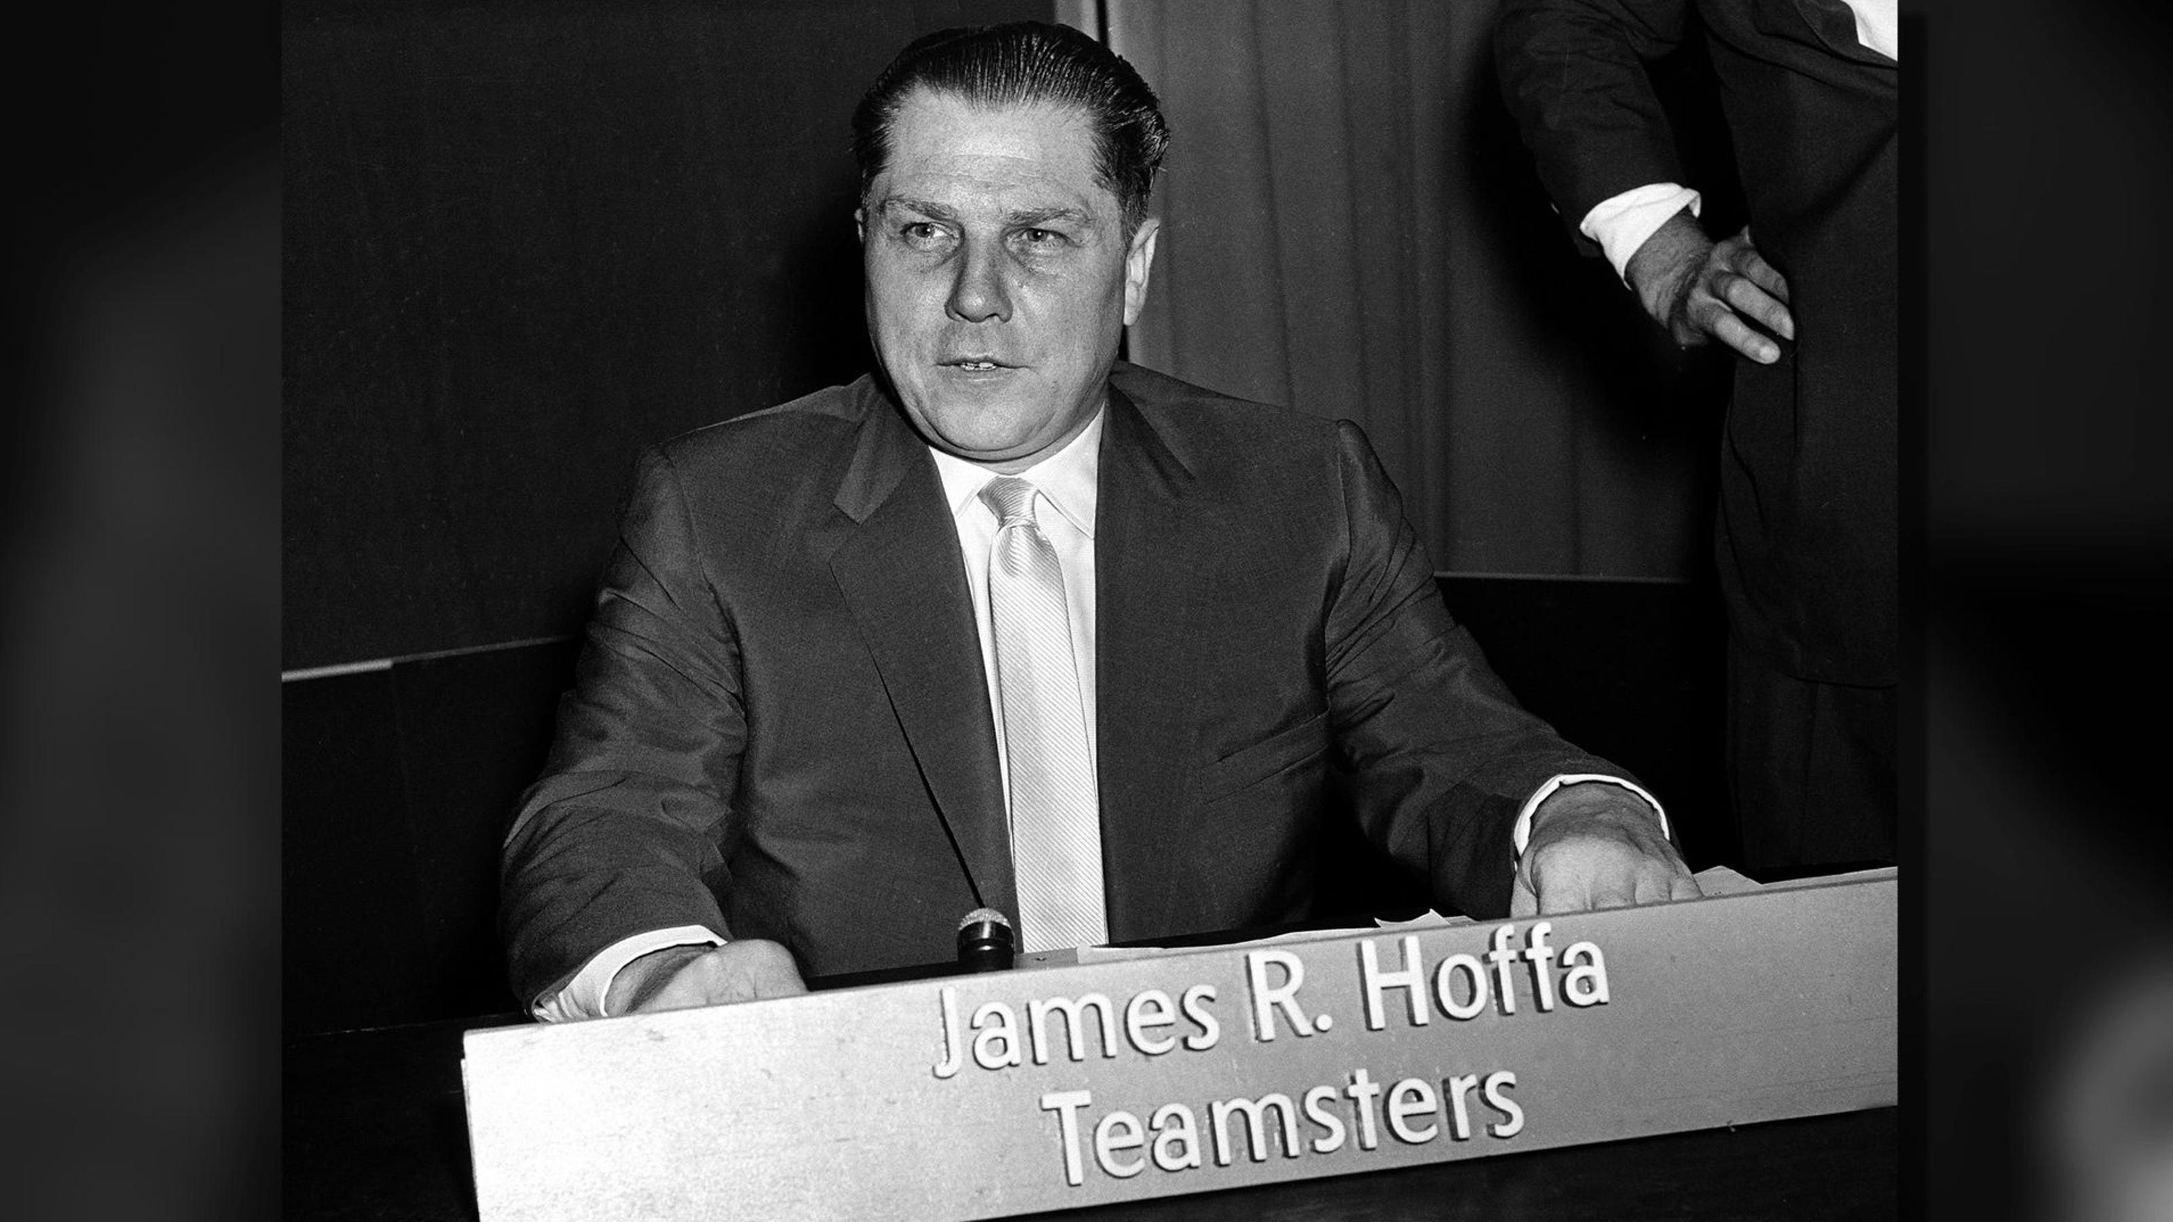
Teamsters Union boss disappears

Slide 5
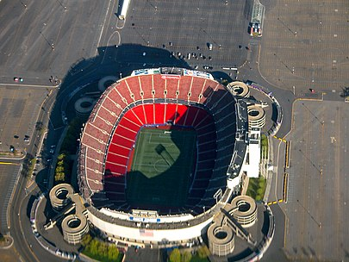
Teamsters Union boss disappears
It was rumored that Hoffa’s body
was buried under the end zone
of Giants Stadium at the Meadowlands
in East Rutherford, New Jersey – which
was being built in 1975.
But it was not found when the stadium
was demolished in 2010.

Slide 6
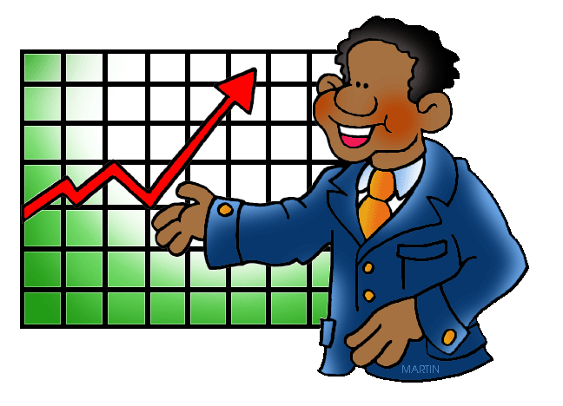
1975 - Business

Slide 7
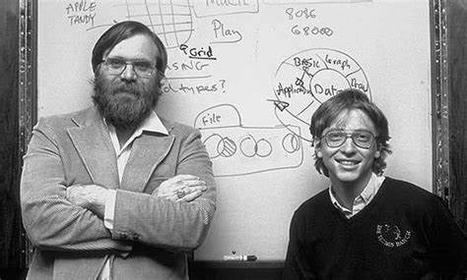
Microsoft Founded
Notes:
Paul Allen and Bill Gates started Microsoft—originally called Micro-Soft, for microprocessors and software—in order to produce software for the Altair 8800, an early personal computer. Allen quit his job as a programmer in Boston and Gates left Harvard University, where he was a student, to focus on their new company, which was based in Albuquerque because the city was home to electronics firm MITS, maker of the Altair 8800.

Slide 8
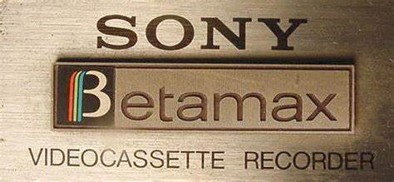

Dueling
Video Tape
formats
Notes:
Both introduced in 1975 – JVC VHS format and Sony Betamax format

Slide 9

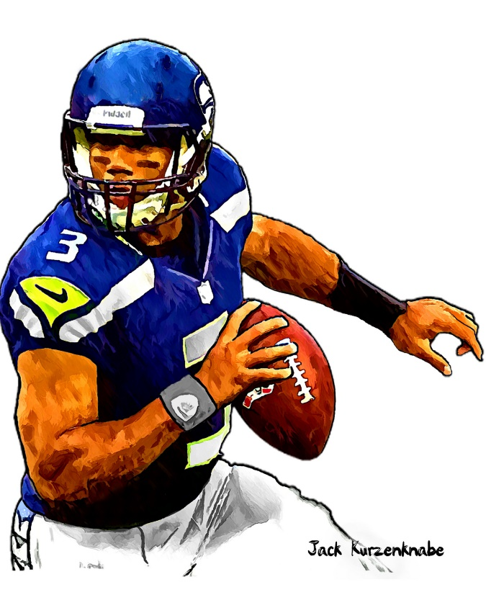

1975 Sporting News

Slide 10
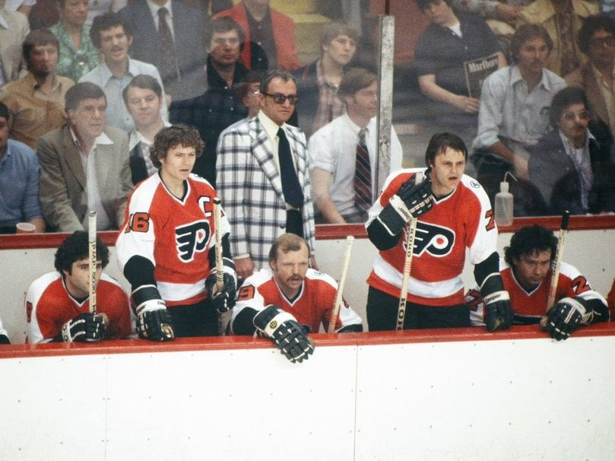
Broad Street Bullies
The Philadelphia Flyers win second Stanley Cup
Notes:
Won Stanley Cup in both 1974 and 1975. Known for tough, aggressive play.

Slide 11
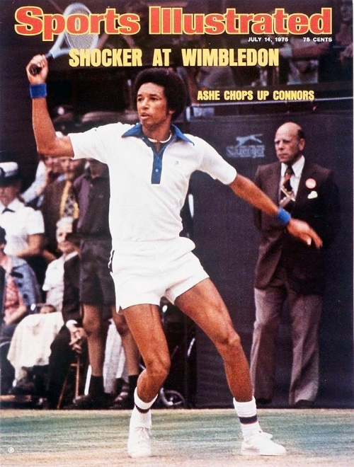
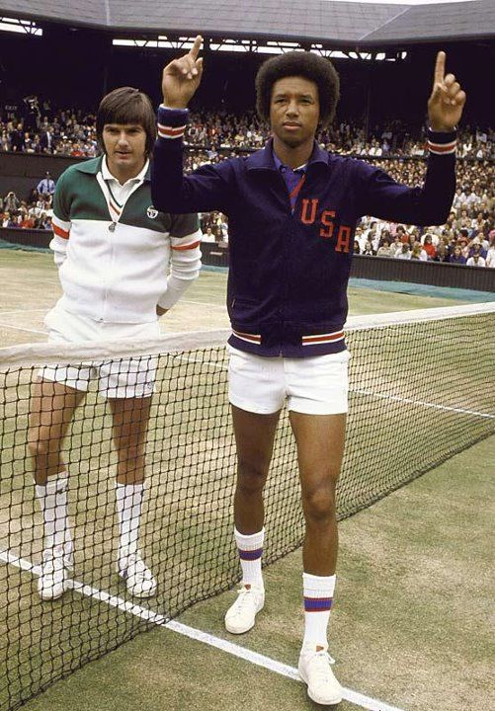
Arthur Ashe
wins Wimbledon
Notes:
32 year old Arthur Ashe was the first black man (Althea Gibson had won W. in 1957) to win the title at Wimbledon. He defeated the reigning Wimbledon champ and World #1 ranked Jimmy Connors, who was 10 years younger at 22.

Slide 12
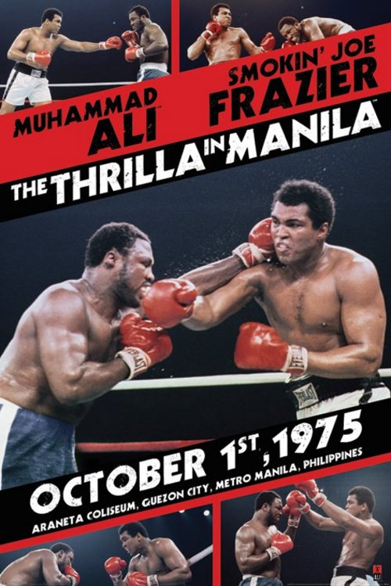
The
“Thrilla in Manila”
Notes:
Third of three championship bouts between Muhammad Ali and Joe Frazier – held in the capital of the Phillipines. The contest's name is derived from Ali's rhyming boast that the fight would be "a killa and a thrilla and a chilla, when I get that gorilla in Manila.“ It was a close fight, but Joe Frazier’s handlers threw in the towel in the 15th round as his eyes had swollen shut. One of the great boxing matches of all time.

Slide 13
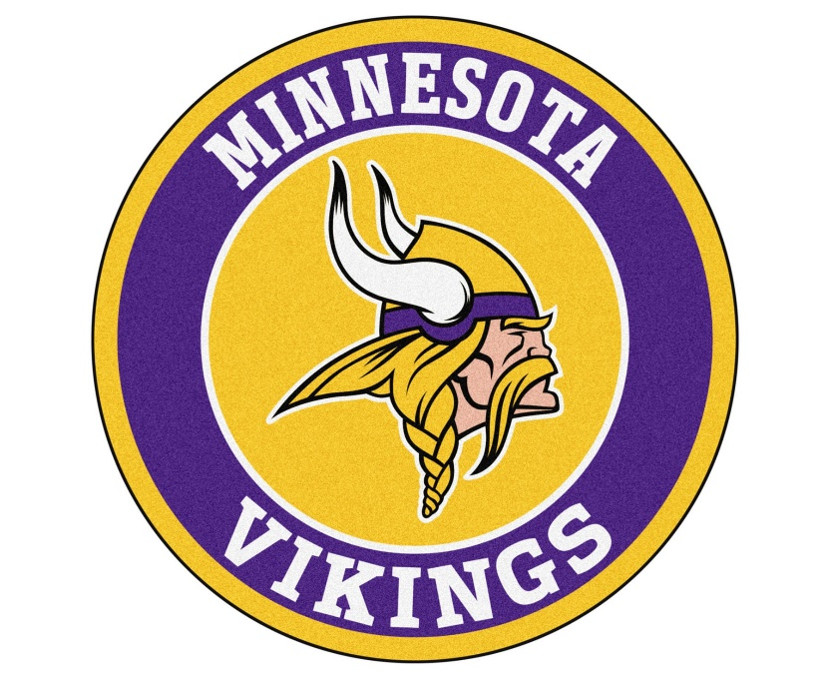

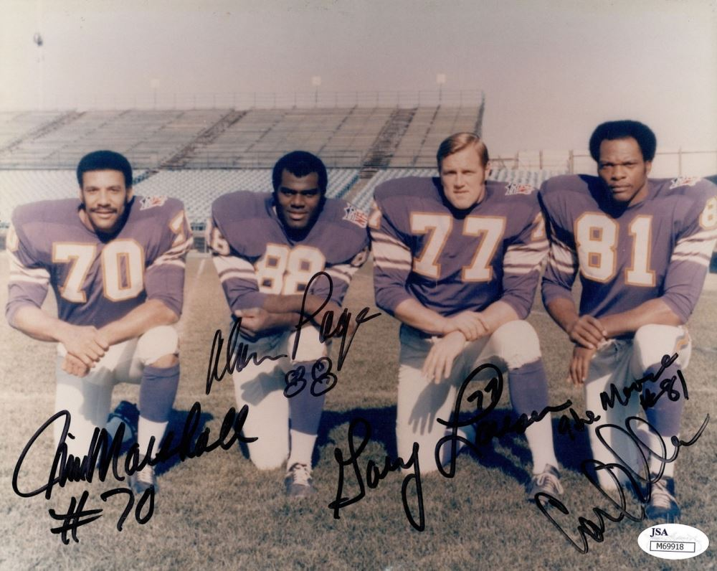
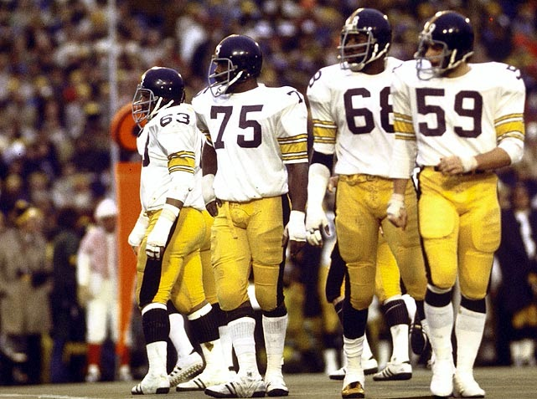
Super Bowl IX
Featured the NFL’s
two best defenses
https://www.youtube.com/watch?v=tE-Nj6cA5FY
The Steelers won 16-6
Notes:
Steelers win 16-6; game featured two of NFL’s storied defenses – the Steel Curtain and the Purple People Eaters. In total, the Steelers limited the Vikings to Super Bowl record lows of nine first downs, 119 total offensive yards, 17 rushing yards, and no offensive scores (Minnesota's only score came on a blocked punt, and they did not even score on the extra point attempt). 21 future Hall-of-Fame’ers participated, including QBs Terry Bradshaw and Fran Tarkenton.

Slide 14
The Year in Baseball: 1975

Slide 15
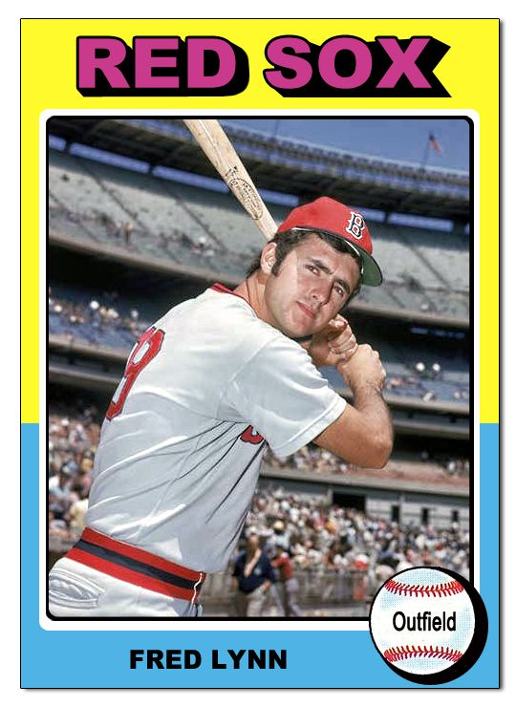
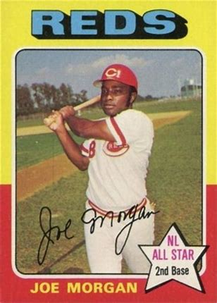
1975
MVP
Winners
.327 .466 OBP 101 R
.331 .566 SLG 103 R
Notes:
First of two consecutive NL MVPs for Joe Morgan. Fred Lynn was Rookie of the Year also! (21 HR, 47 2B, and 7 3B created league leading SLG)
Mickey Mantle hit 37 homers to lead the AL. He also led the league in triples, walks, and SLG.

Slide 16
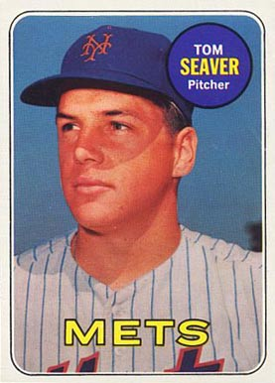
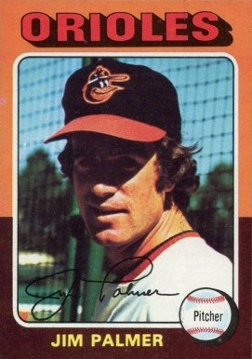
1975
Cy Young
Winners
22 - 9, ERA 2.38, 243 SO
23 - 11, ERA 2.09, 10 ShO

Slide 17
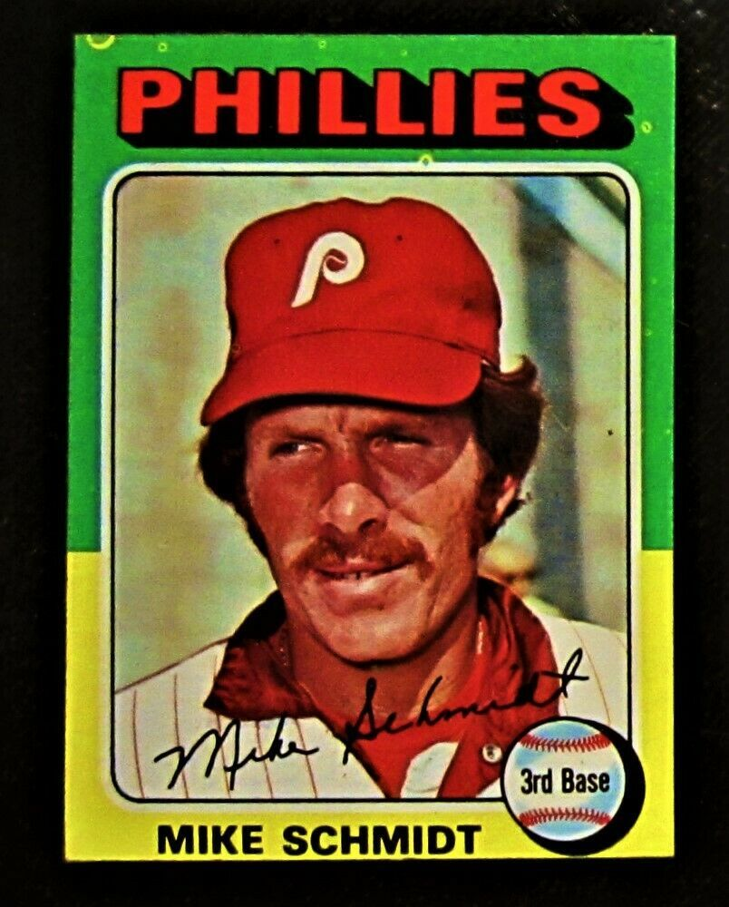
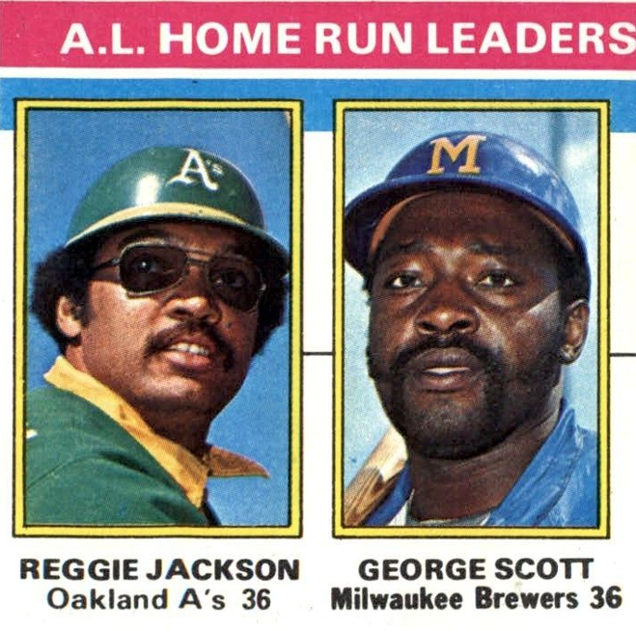
1975 HR Leaders
Led NL with 38 HR and 180 K
Notes:
Mickey Mantle hit 37 homers to lead the AL. He also led the league in triples, walks, and SLG.

Slide 18
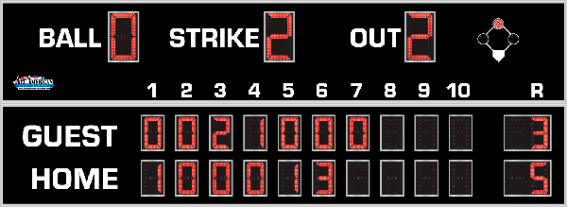
7th Inning Stretch

Slide 19
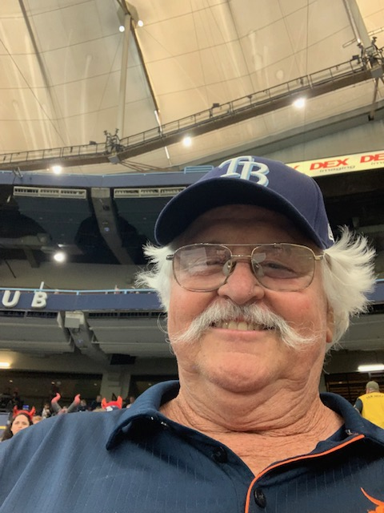
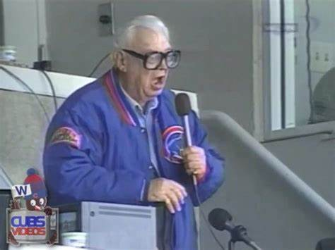
“Take Me Out to the Ballgame”
https://www.youtube.com/watch?v=HnHV5FaqvEs
Notes:
Mike has short “intro” to this …

Slide 20
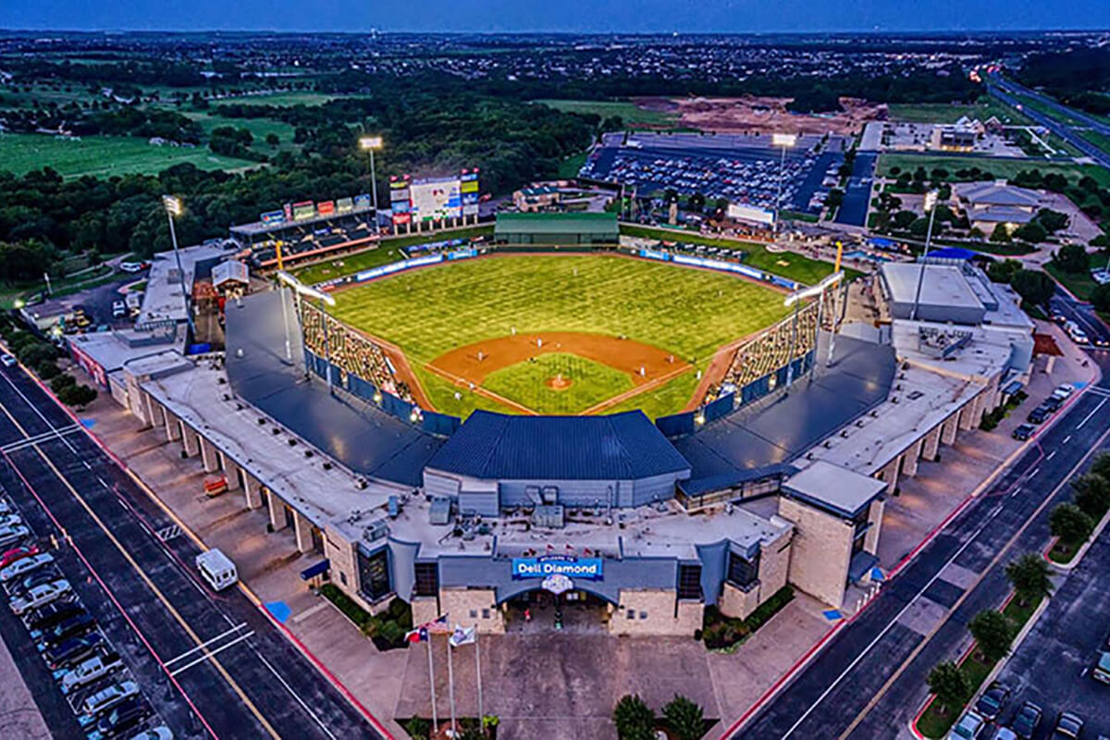
“Deep in the Heart of Texas”
https://www.youtube.com/watch?v=VGF4ibgcHQE

Slide 21
The Chicken Dance !
https://www.youtube.com/watch?v=WZJAIkmT3Rg

Slide 22
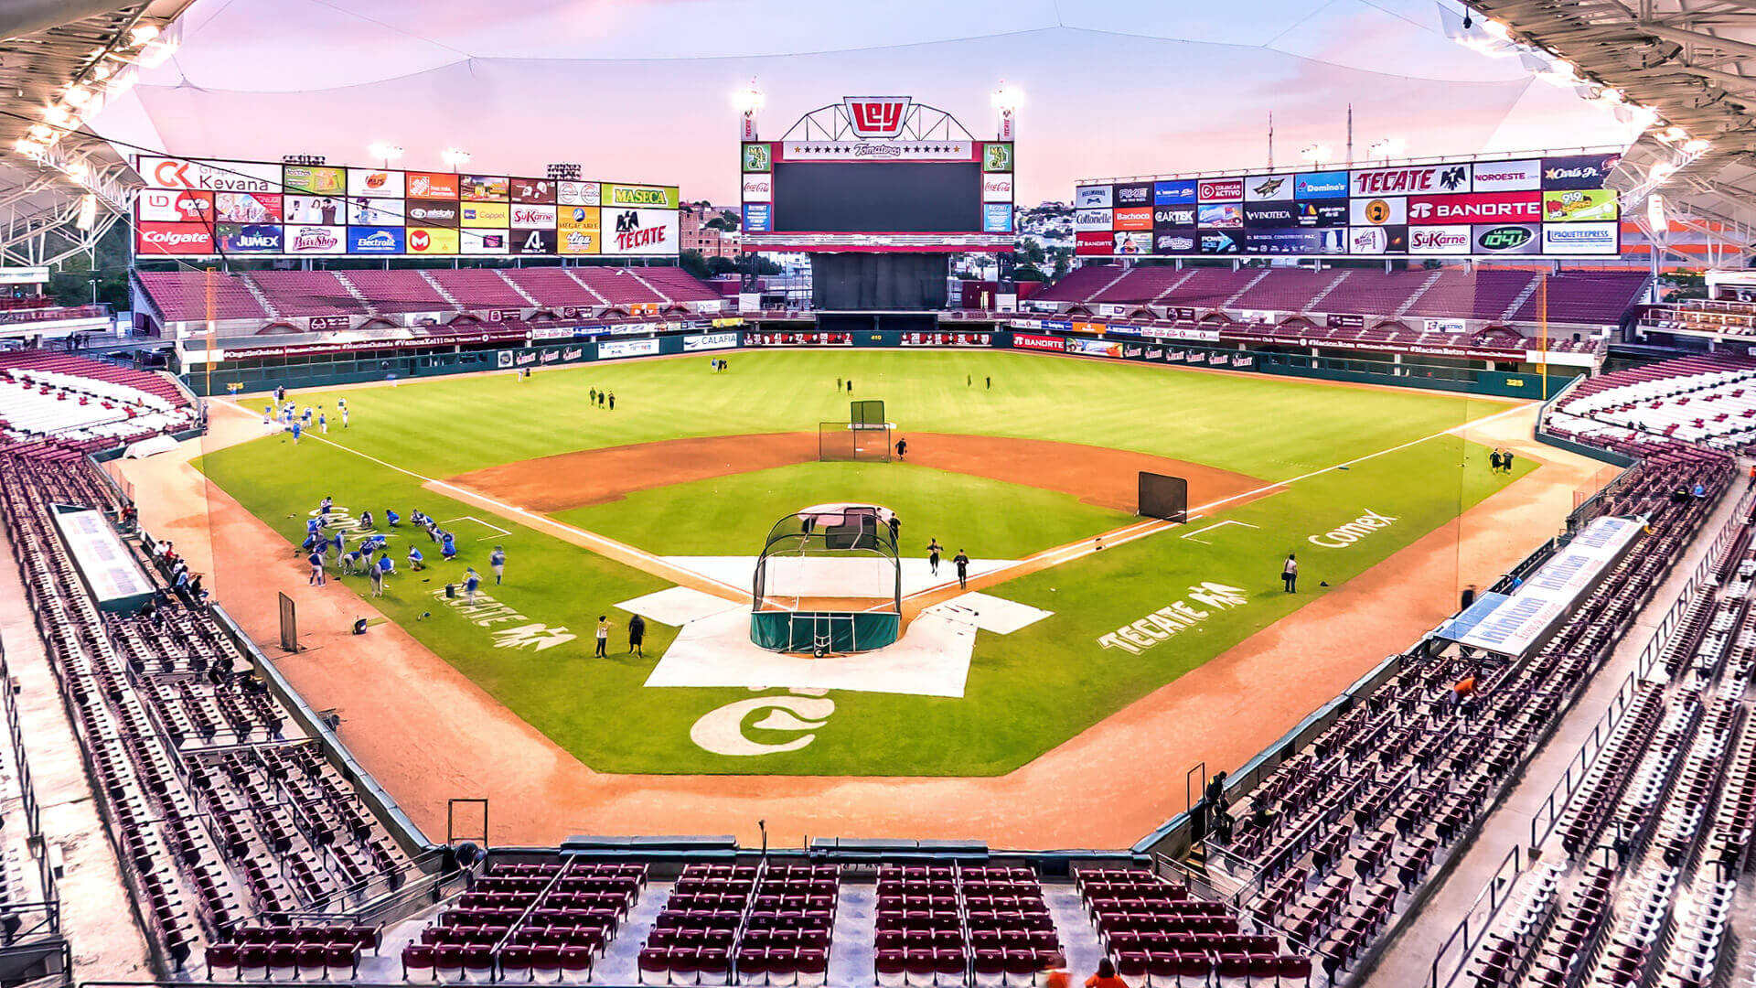
¡ Música al estadio !
Es muy
ruidoso en:
Estadio
Tomateros
Culiacan
Sinaloa,
Mexico
https://www.youtube.com/watch?v=Y6yao6BlAe0
Se canta – La Bamba :

Slide 23
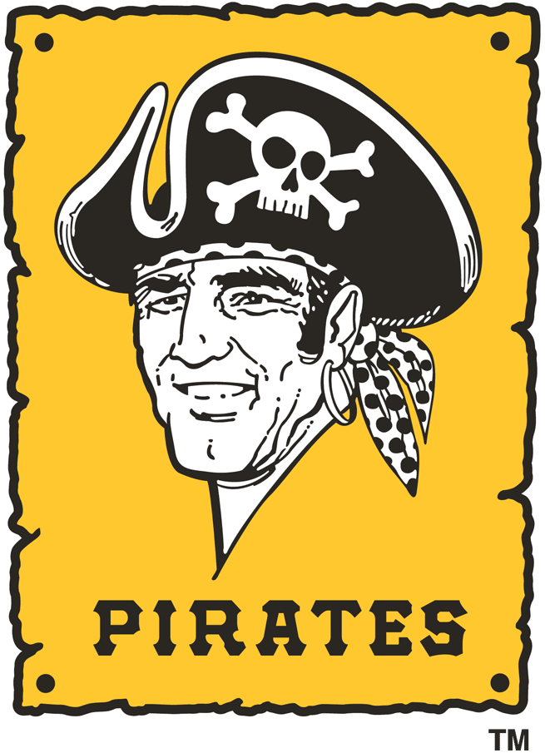

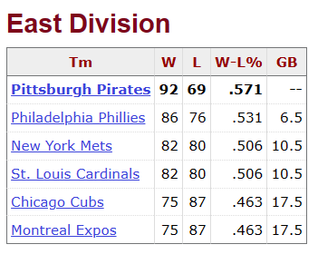
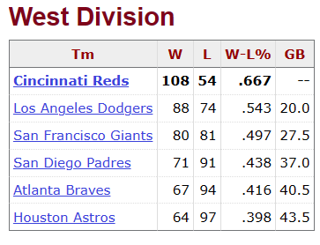
1975
N.L.

Slide 24
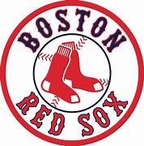
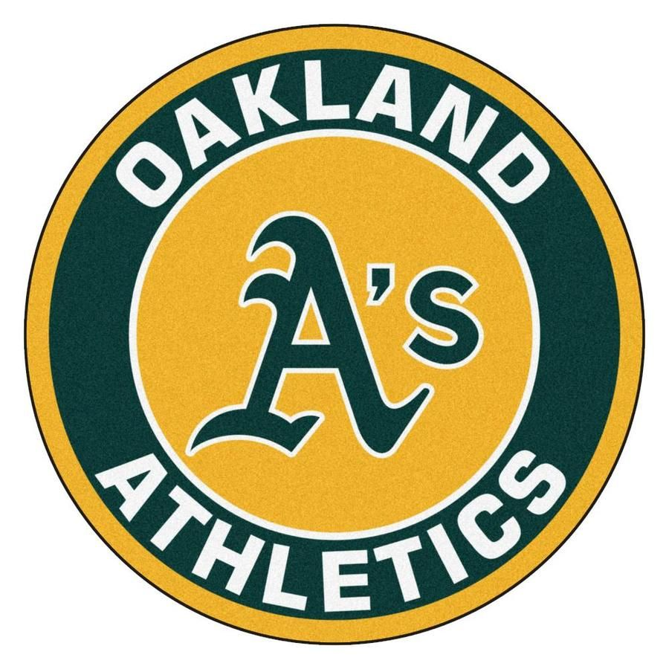
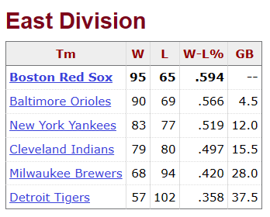
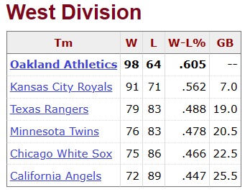
1975 A.L.

Slide 25
1975 League Championships
Best 3-of-5 format
3 - 0
3 - 0

Slide 26
1975 World Series
VS.

Slide 27
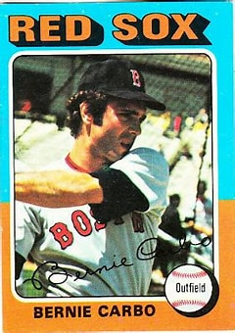
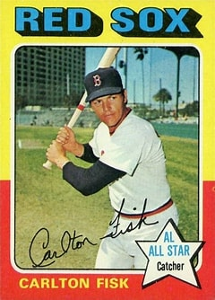
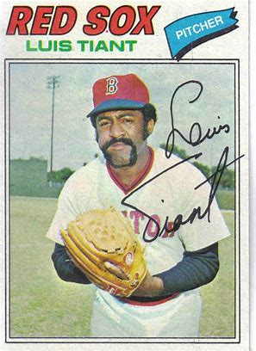
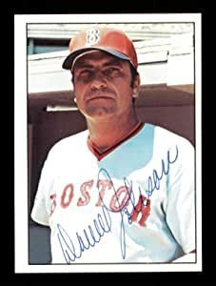
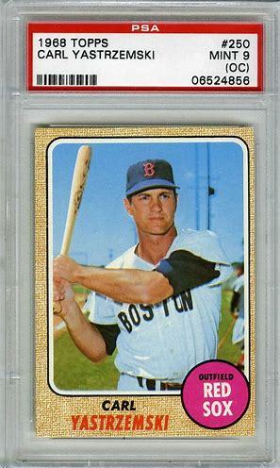
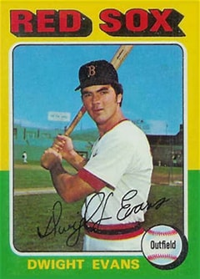
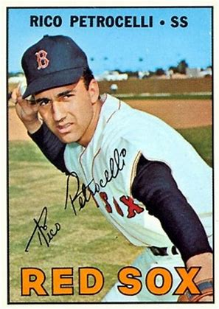
Key
Red Sox
Darrell Johnson - MGR

Slide 28
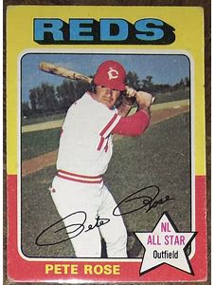
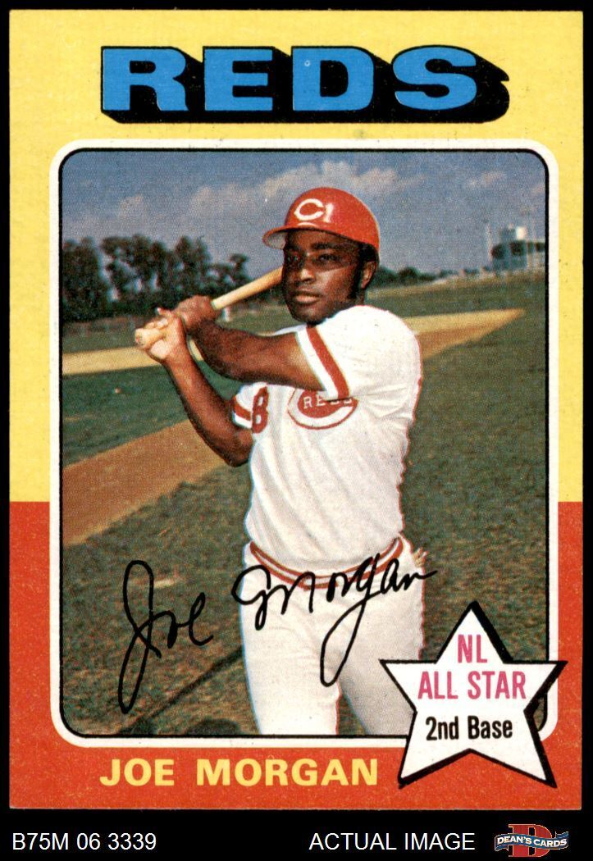
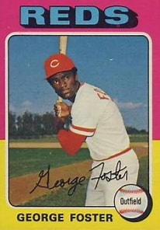
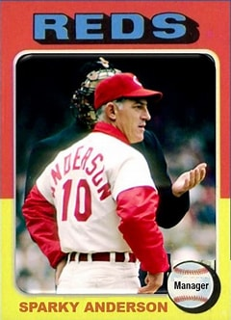
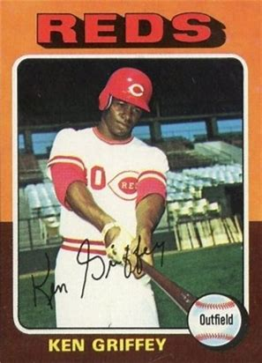
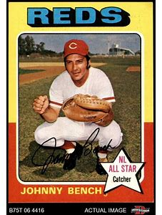
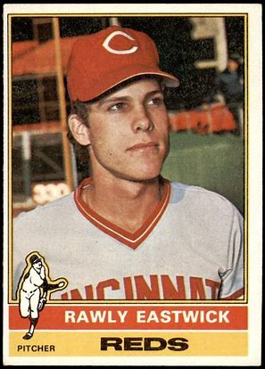
The
Big Red
Machine

Slide 29
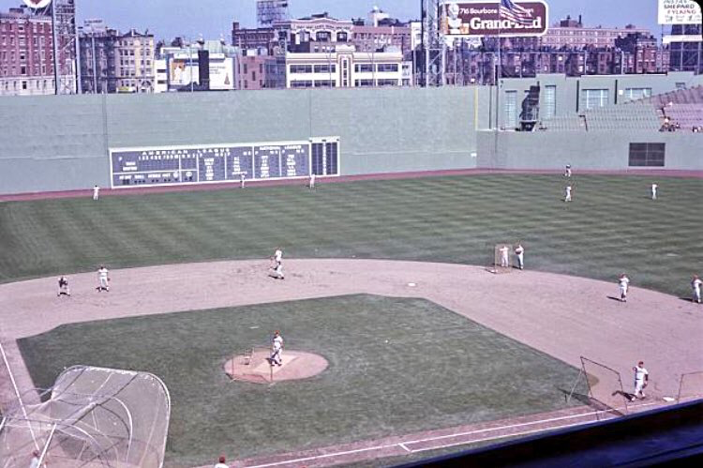
1975 World Series Highlights
Fenway Park, Boston
Game 1 – October 11, 1975
Red Sox 6 – Reds 0
Game 2 – October 12, 1975
Reds 3, Red Sox 2

Slide 30
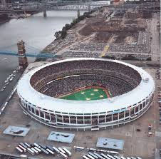
1975 World Series Highlights
Riverfront Stadium
Cincinnati
Game 3 – October 14, 1975
Reds 6 – Red Sox 5 (10 innings)
Game 4 – October 15, 1975
Red Sox 5 - Reds 4
Game 5 – October 16, 1975
Reds 6 – Red Sox 2

Slide 31
1975 World Series Highlights
The Series returns
to Boston
After a travel day and three days of heavy rain in Boston …
Game 6 – October 21, 1975
Red Sox 7 – Reds 6 (12 innings)
A dramatic homer ends this game:
https://www.youtube.com/watch?v=2WRi6iZAl-I
Game 7 – October 22, 1975
Reds 4, Red Sox 3
Yaz bats in bottom of ninth:
https://www.youtube.com/watch?v=n-7vz7l9Szg

Slide 32
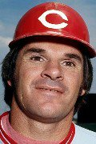
1975 World Series
One of the most exciting World Series ever!
The Reds won their 3rd World Series, and
would go on to win the 1976 Series as well.
Pete Rose was the World Series MVP

Slide 33
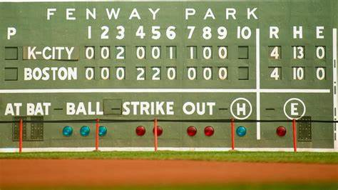
Extra Innings!
More Stuff from the ‘60s and ‘70s

Slide 34

Product Jingles & Slogans

Slide 35

“See the U.S.A. in your …”
What famous singer and TV personality
sang the jingle?
https://www.youtube.com/watch?v=qhR8GZ_WWMM
Notes:
She had a string of eighty charted popular hits, spanning from 1940 to 1957, and after appearing in a handful of feature films, she went on to a four-decade career in American television.

Slide 36

“You can trust your car
to the man who
wears the star …”
https://www.youtube.com/watch?v=b1zxOTDHIBQ

Slide 37


“Be all that you can be!”
Notes:
Army recruiting slogan from 1980 to 2001, and re-established in 2023.

Slide 38


Baseball star Ty Cobb (aka the Georgia Peach) was an early investor in this beverage company in Atlanta.
“Things go
better with ___-___, things go better with ____”
https://www.youtube.com/watch?v=cF9QbEUYINg
Notes:
In 1907, he bought 300 shares of stock in Coca-Cola. Over the next 20 years, he expanded that to 24,000 shares. When Cobb died in 1961, he owned $2.1 million worth of Coca-Cola stock. He was also a big investor in General Motors. Jingle from the ‘60s.

Slide 39

“The Breakfast
of Champions”
https://www.youtube.com/watch?v=CGaxdEwF4Ns

Slide 40

“Where’s the beef ?”
https://www.youtube.com/watch?v=U80ebi4AKgs

Slide 41

“Tastes great, less filling”
https://www.youtube.com/watch?v=Sp4RIITcOt0
Notes:
A lot of baseball players did ads for Miller Light – here’s Brewer’s announcer and former big league catcher Bob Uecker

Slide 42

“Here comes
the
King of Beers”
https://www.youtube.com/watch?v=onBHcQgHA4s
Notes:
A-B is a major sponsor of most sports programming in the U.S. A tradition on Opening Day in St. Louis.

Slide 43

“Plop, plop, fizz, fizz, oh
what a relief it is!”
Notes:
If you’ve drank too much Miller Lite or Budweiser, you may need this product …

Slide 44

“The best part of waking up is _______ in your cup.”

Slide 45

“Some times you feel like a nut, sometimes you don’t”

Slide 46

“Sorry Charlie, we don’t want tuna with good taste, we want tuna that tastes good”

Slide 47

“Give it to Mikey. He won’t eat it, he hates everything!”

Slide 48

“You deserve a break today, at ________ !”

Slide 49

“You’re in good hands”

Slide 50

“Like a good neighbor, ____ ____ is there”

Slide 51

“Don’t leave home without it”
https://www.youtube.com/watch?v=nMzNJkx1NoQ
Notes:
Karl Malden was known for the traveler’s check commercials; Mel Blanc

Slide 52

Thanks !!!
We’ll see you again next month!

