Slide 1
AGE Thrive with Baseball Memories
July 19, 2023
Agenda
Warm-up - Introductions
Gametime – The Year in Baseball – 1976
Seventh Inning Stretch - “Take Me Out to the Ball Game”
- Get Up and Move – “Shake Your Booty”
Extra Innings – More stuff from the ‘60s and ’70s
Extra Innings - Memorabilia

Slide 2
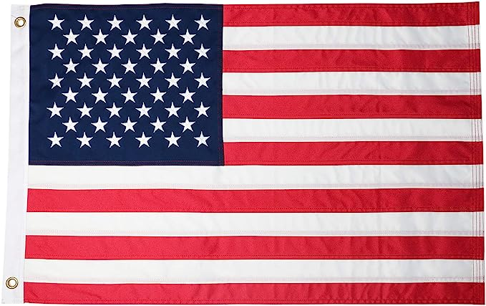
The Year in Baseball: 1976

Slide 3
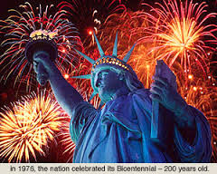
United States Bicentennial (1776 – 1976)

Slide 4
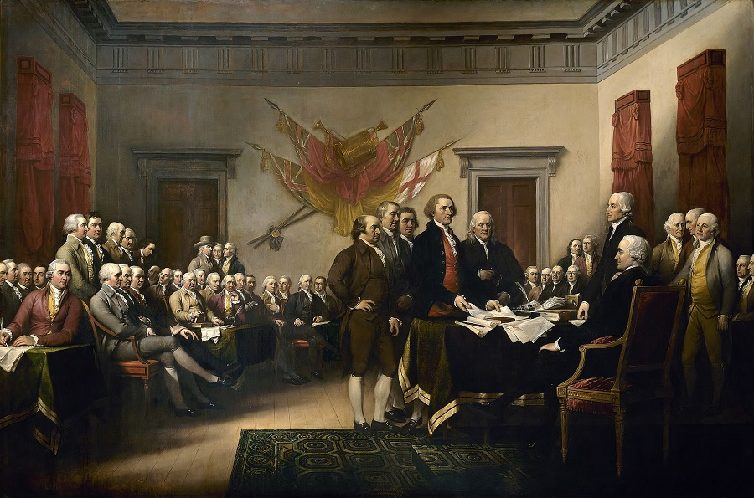
July 4, 1776 in Philadelphia
Notes:
The drafting committee – including Jefferson, Adams, and Franklin – present the Declaration to the chairman of the 2nd Continental Congress (more on him later …

Slide 5
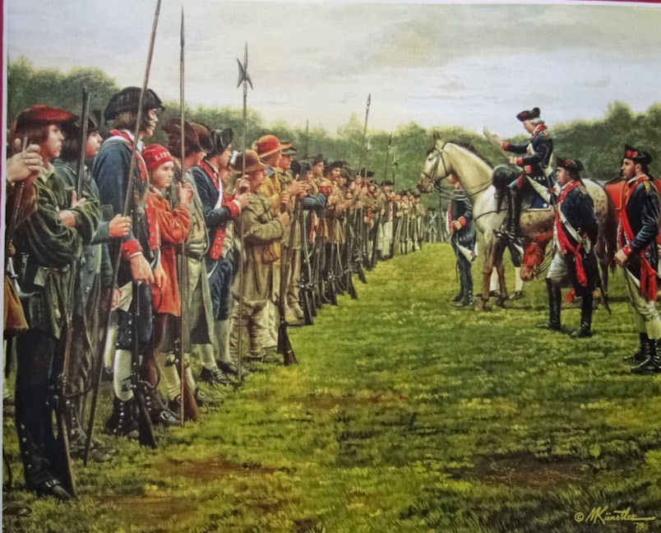
July 9, 1776 in New York
Notes:
When he received a copy of the Declaration, George Washington ordered it read to the assembled troops – then at New York. << READ EXCERPT >>

Slide 6
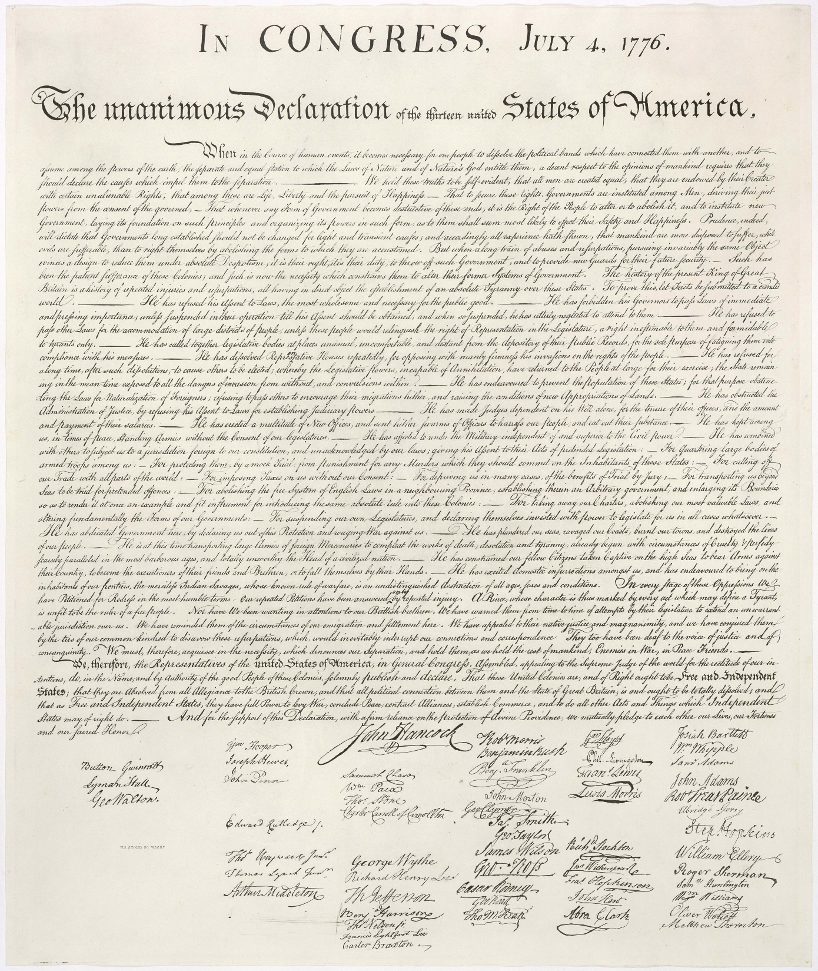
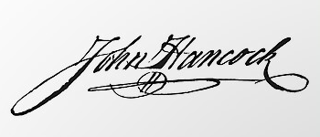
The Declaration of Independence
Notes:
Upon signing the Declaration, the Chairman of the 2nd Continental Congress said “There! John Bull can read my name without spectacles …”

Slide 7
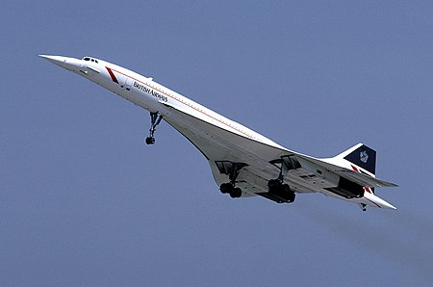
Sonic
Boom!
The Concorde supersonic passenger jet started trans-Atlantic service to New York and Washington, D.C.

Slide 8
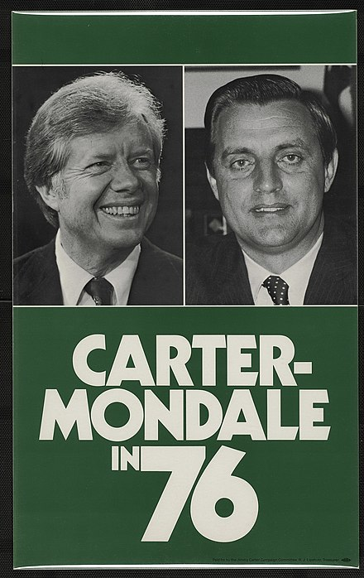
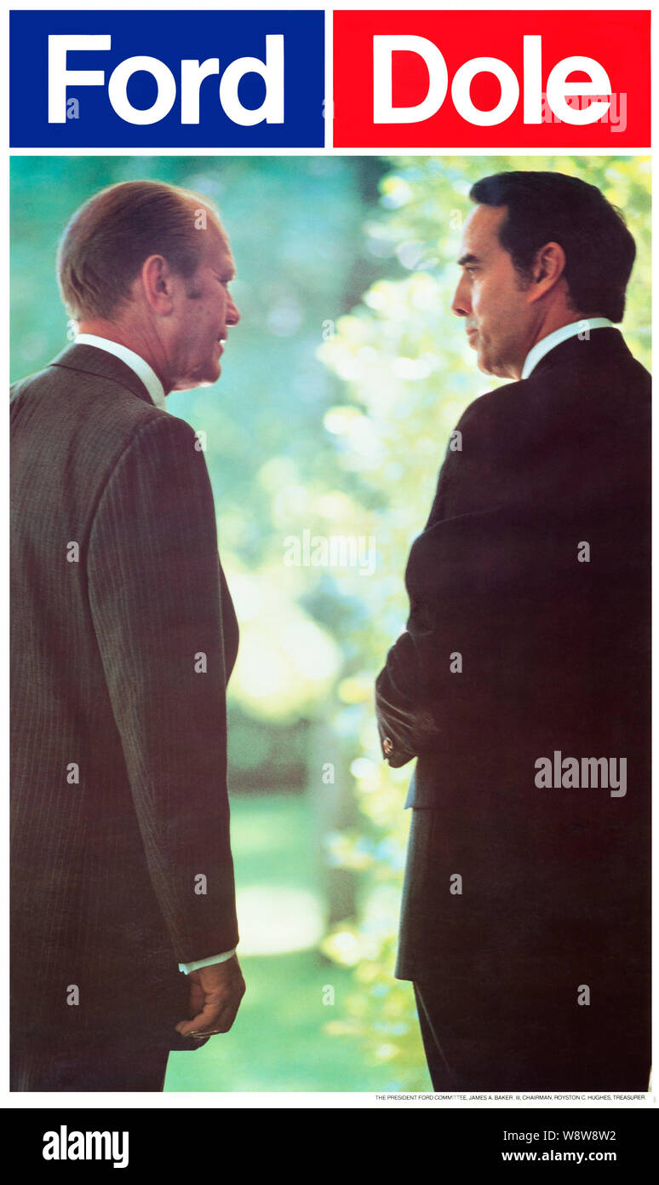
Election
Year
Notes:
Jimmy Carter and his wife just celebrated their 77th wedding anniversary! He’s the oldest ever living former president.

Slide 9
1976 - Business

Slide 10
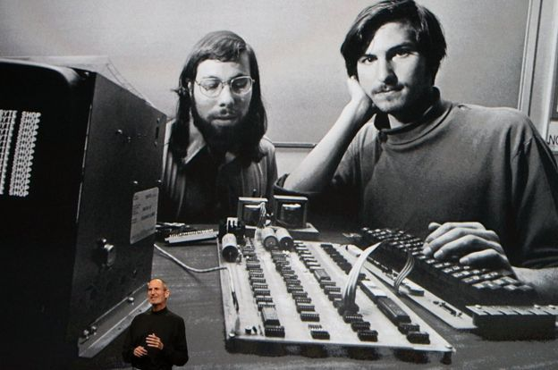
Apple Computer Company was founded
Notes:
Founded by partners Steve Wozniak and Steve Jobs in Cupertino, California. Jobs sold his VW hippie-van and Wozniak sold his HP calculator to provide capital. Its first product was the Apple I personal computer, which was hand-built by Wozniak. The company is now worth almost $3 trillion!

Slide 11
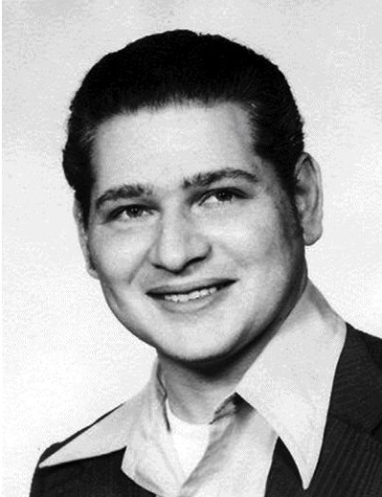
Apple Computer Company
There was a third founding partner,
who initially owned 10% of Apple.
Later in 1976, he sold his shares for $800. He later agreed to renounce any future claim to ownership of Apple for $1,500.
He made $2,300
His 10% share of Apple today would be worth
almost $300,000,000,000
Ron Wayne
Notes:
Ron Wayne . He missed out on another chance to cash in on Apple – he held the original partnership agreement signed by Jobs, Wozniak, and himself. He eventually sold it for $500 – it recently sold again at auction for $1.5 million.

Slide 12
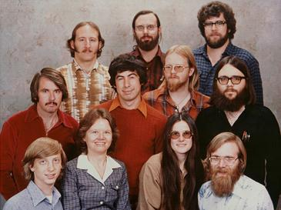
Microsoft was registered for business
Microsoft annual
revenue:
1976
$16,005
2002
$198,000,000,000
Notes:
Microsoft was registered as a New Mexico company in 1976. Their ’76 revenue was $16,005.

Slide 13
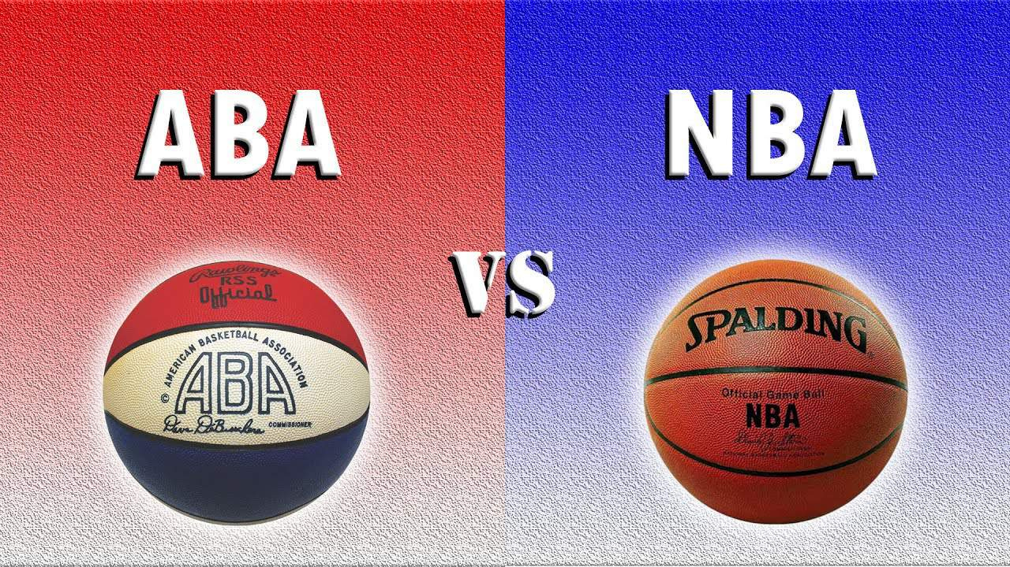
The two basketball leagues
agreed to merge
in 1976
Four ABA teams joined the NBA. Two teams were eliminated: Kentucky and St. Louis
The Kentucky and St. Louis owners were offered $3 Million each as termination fees.
The St. Louis owners instead cut a deal for 2% of NBA television rights. In perpetuity!
From 1977 to 2014, they received about $300,000,000
Finally, the NBA bought them out of this deal for an additional $500,000,000
Notes:
Ozzie and Daniel Silna – already wealthy due to investments in polyester clothing products. Many say this was the sports deal of the century!

Slide 14
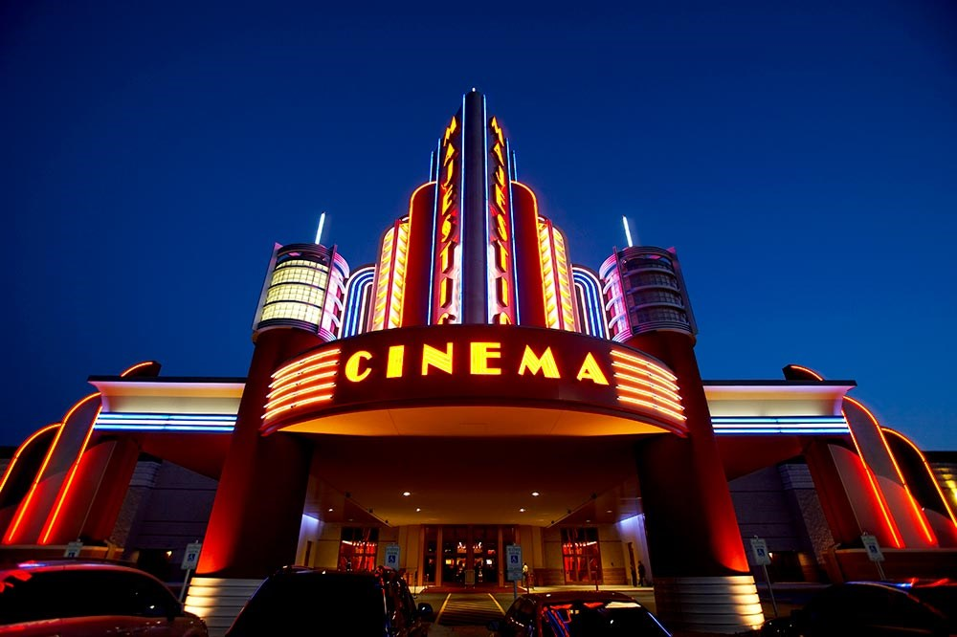
1976 at the Movies
Famous quote from the 1976
Best Picture
See if you can name the movie based upon a famous line in the script
Notes:
‘76 wasn’t a great year at the Cinema, but the film that won Best Picture was perfect for the Bicentennial.

Slide 15
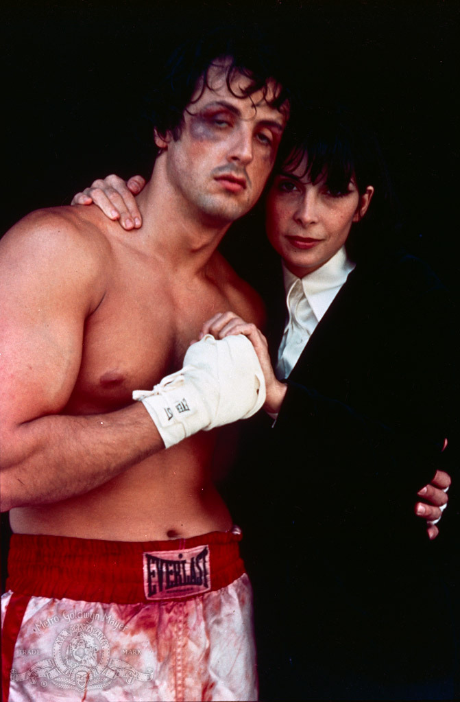
Yo Adrian! It’s me …
Talia Shire starred as Adrian
Sylvester Stallone played
the title role and wrote the
screenplay
It was nominated for
ten Academy Awards and won
three, including Best Picture
ROCKY
https://www.youtube.com/watch?v=9GR1mkwCF3g
Notes:
Stallone wrote the screenplay in four days after watching the Ali-Wepner fight; the film cost less than $1M to make and grossed over $200M

Slide 16
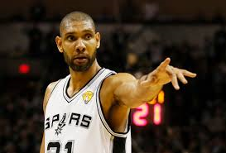
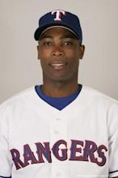
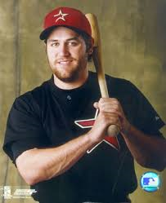
Born in 1976
Lance Berkman
Feb. 10
Tim Duncan
April 25
Alfonso Soriano
Jan. 7
Notes:
Lance Berkman – Waco; Tim Duncan – 1st overall pick by Spurs in 1997 draft; Alfonso Soriano born in San Pedro de Macoris, DR

Slide 17
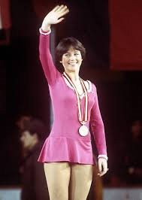
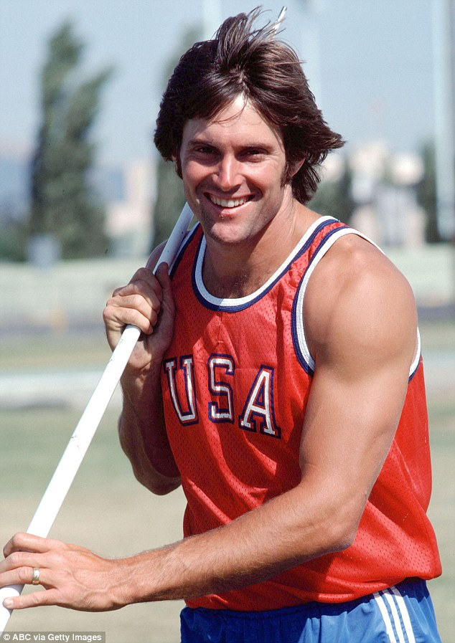
Winter and Summer Olympics
Notes:
Nadia Comenice a perfect ten – 14 years old; Bruce Jenner – decathalon; Dorothy Hamill – ladies single figure skating

Slide 18
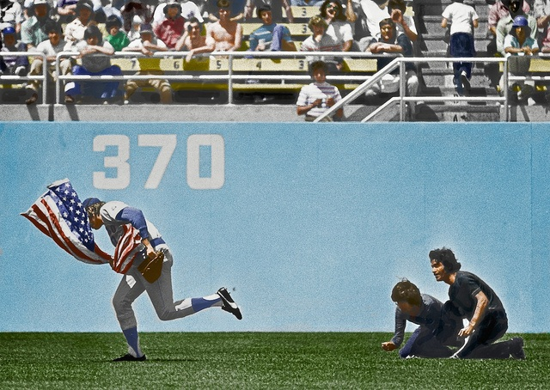
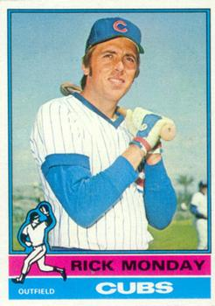
https://www.youtube.com/watch?v=vZzeEaBHUBM
Notes:
Cubs outfielder Rick Monday prevents two guys from burning the U.S. flag at Dodger Stadium in L.A. He was also the first overall pick in the first ever MLB amateur draft in 1965. Went on to a 19-year career in the major leagues with the A’s, Cubs and Dodgers. Also has had a long broadcasting career.

Slide 19
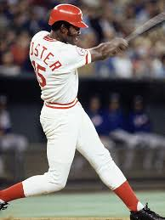
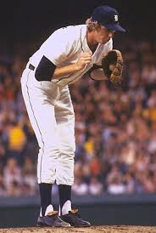
1976 – On the Field
All-Star Game
Notes:
Held in Philadelphia (1776) – also hosted NBA All Star game, NHL All Star game and NCAA Final Four. NL wins 7-1 behind three-run homer from George Foster. Rookie sensation Mark Fidrych starts for the A.L.

Slide 20
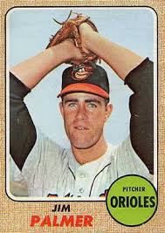
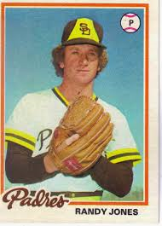
1976 Cy Young Winners
22 – 13, ERA 2.59, 315 IP
22 -14, ERA 2.74, 315 IP

Slide 21
1976 MVP Winners
.320 , 27 HR , 111 RBI
led league in OPB and SLG
.302 , 17 HR , 105 RBI
Notes:
Morgan also won the previous year’s (1975) MVP
Mickey Mantle hit 37 homers to lead the AL. He also led the league in triples, walks, and SLG.

Slide 22
1976 Rookie of the Year Winners
11 – 4 , 2.92 ERA , 16 saves
finished 62 games
19 – 9 , 2.34 ERA , 24 complete games
Notes:
Both of these guys had career years as a rookie and had short careers – both only pitched 5 years in the majors
Mickey Mantle hit 37 homers to lead the AL. He also led the league in triples, walks, and SLG.

Slide 23
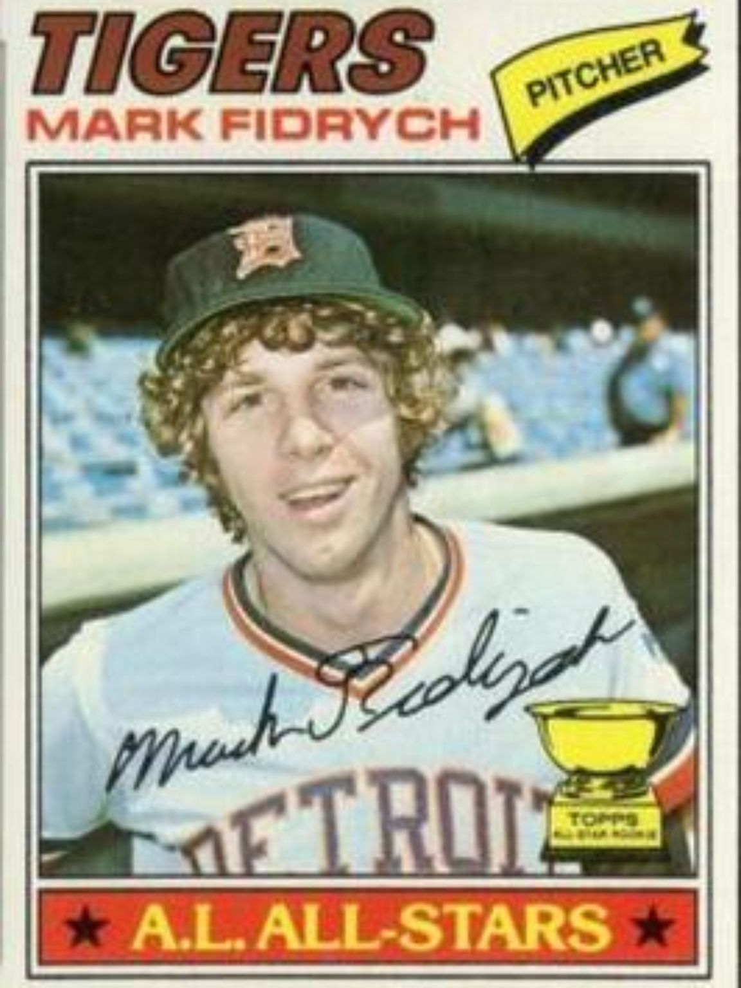
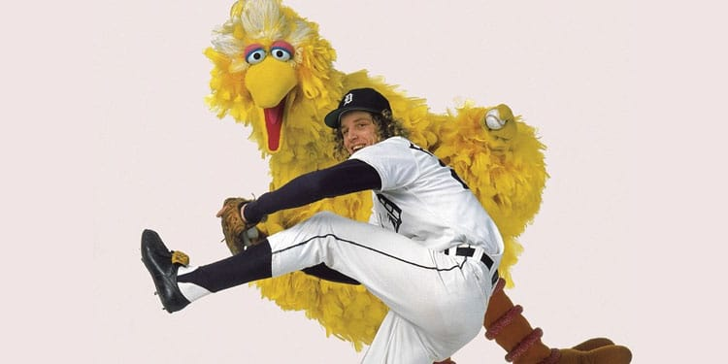
Mark “The Bird” Fidrych
https://youtu.be/RT9uoiaySRc
Notes:
Mickey Mantle hit 37 homers to lead the AL. He also led the league in triples, walks, and SLG.

Slide 24
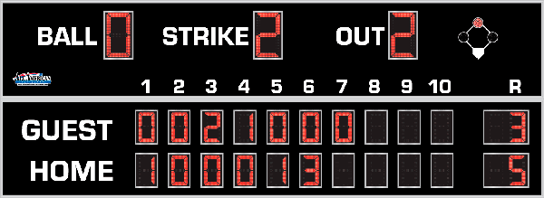
7th Inning Stretch

Slide 25
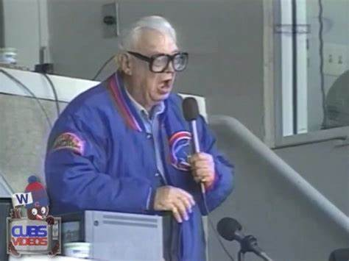
“Take Me Out to the Ballgame”
https://www.youtube.com/watch?v=HnHV5FaqvEs
Notes:
Mike has short “intro” to this …

Slide 26
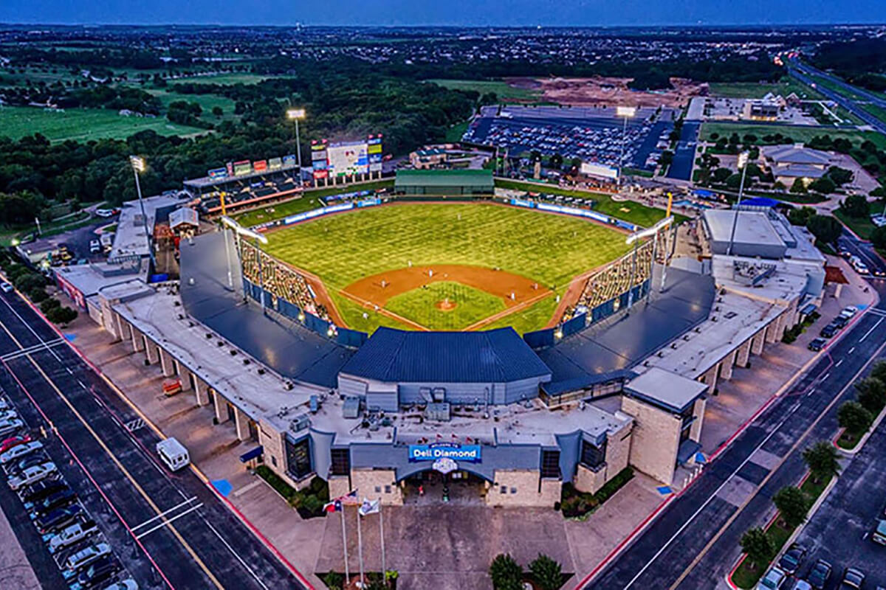
“Deep in the Heart of Texas
https://www.youtube.com/watch?v=VGF4ibgcHQE

Slide 27
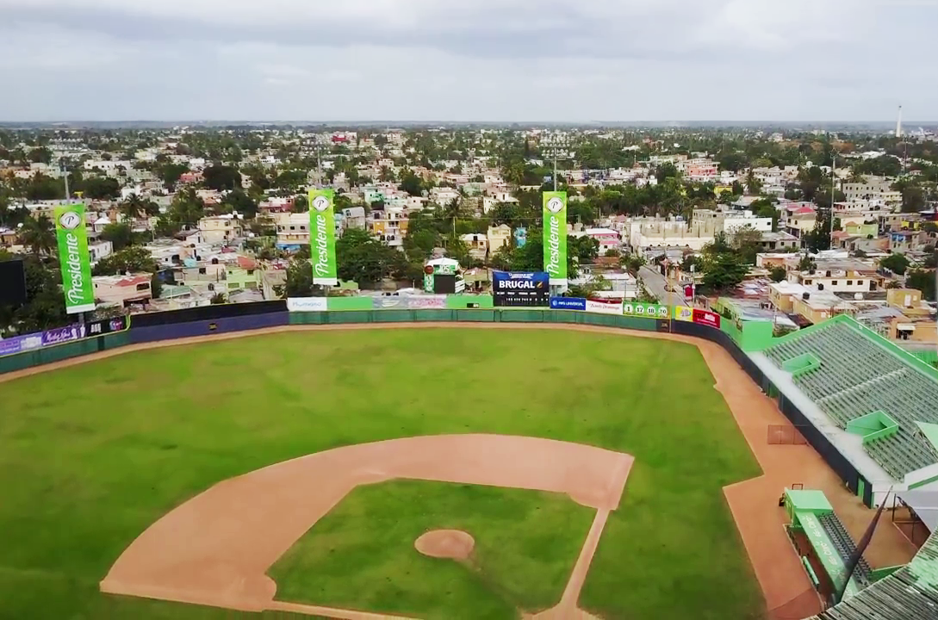
¡ Música al estadio !
It can get very
loud at:
Estadio
Tetelo Vargas
in
San Pedro de
Macoris,
DR
https://www.youtube.com/watch?v=rg0kwmJc4ts
Notes:
Tetelo Vargas was a famous Dominican ballplayer; he retired in 1953 after playing for 27 seasons in five countries. His last professional team was Estrellas Orientales (the Eastern Stars) in San Pedro de Macoris, and the stadium build there in 1959 is named in his honor.

Slide 28
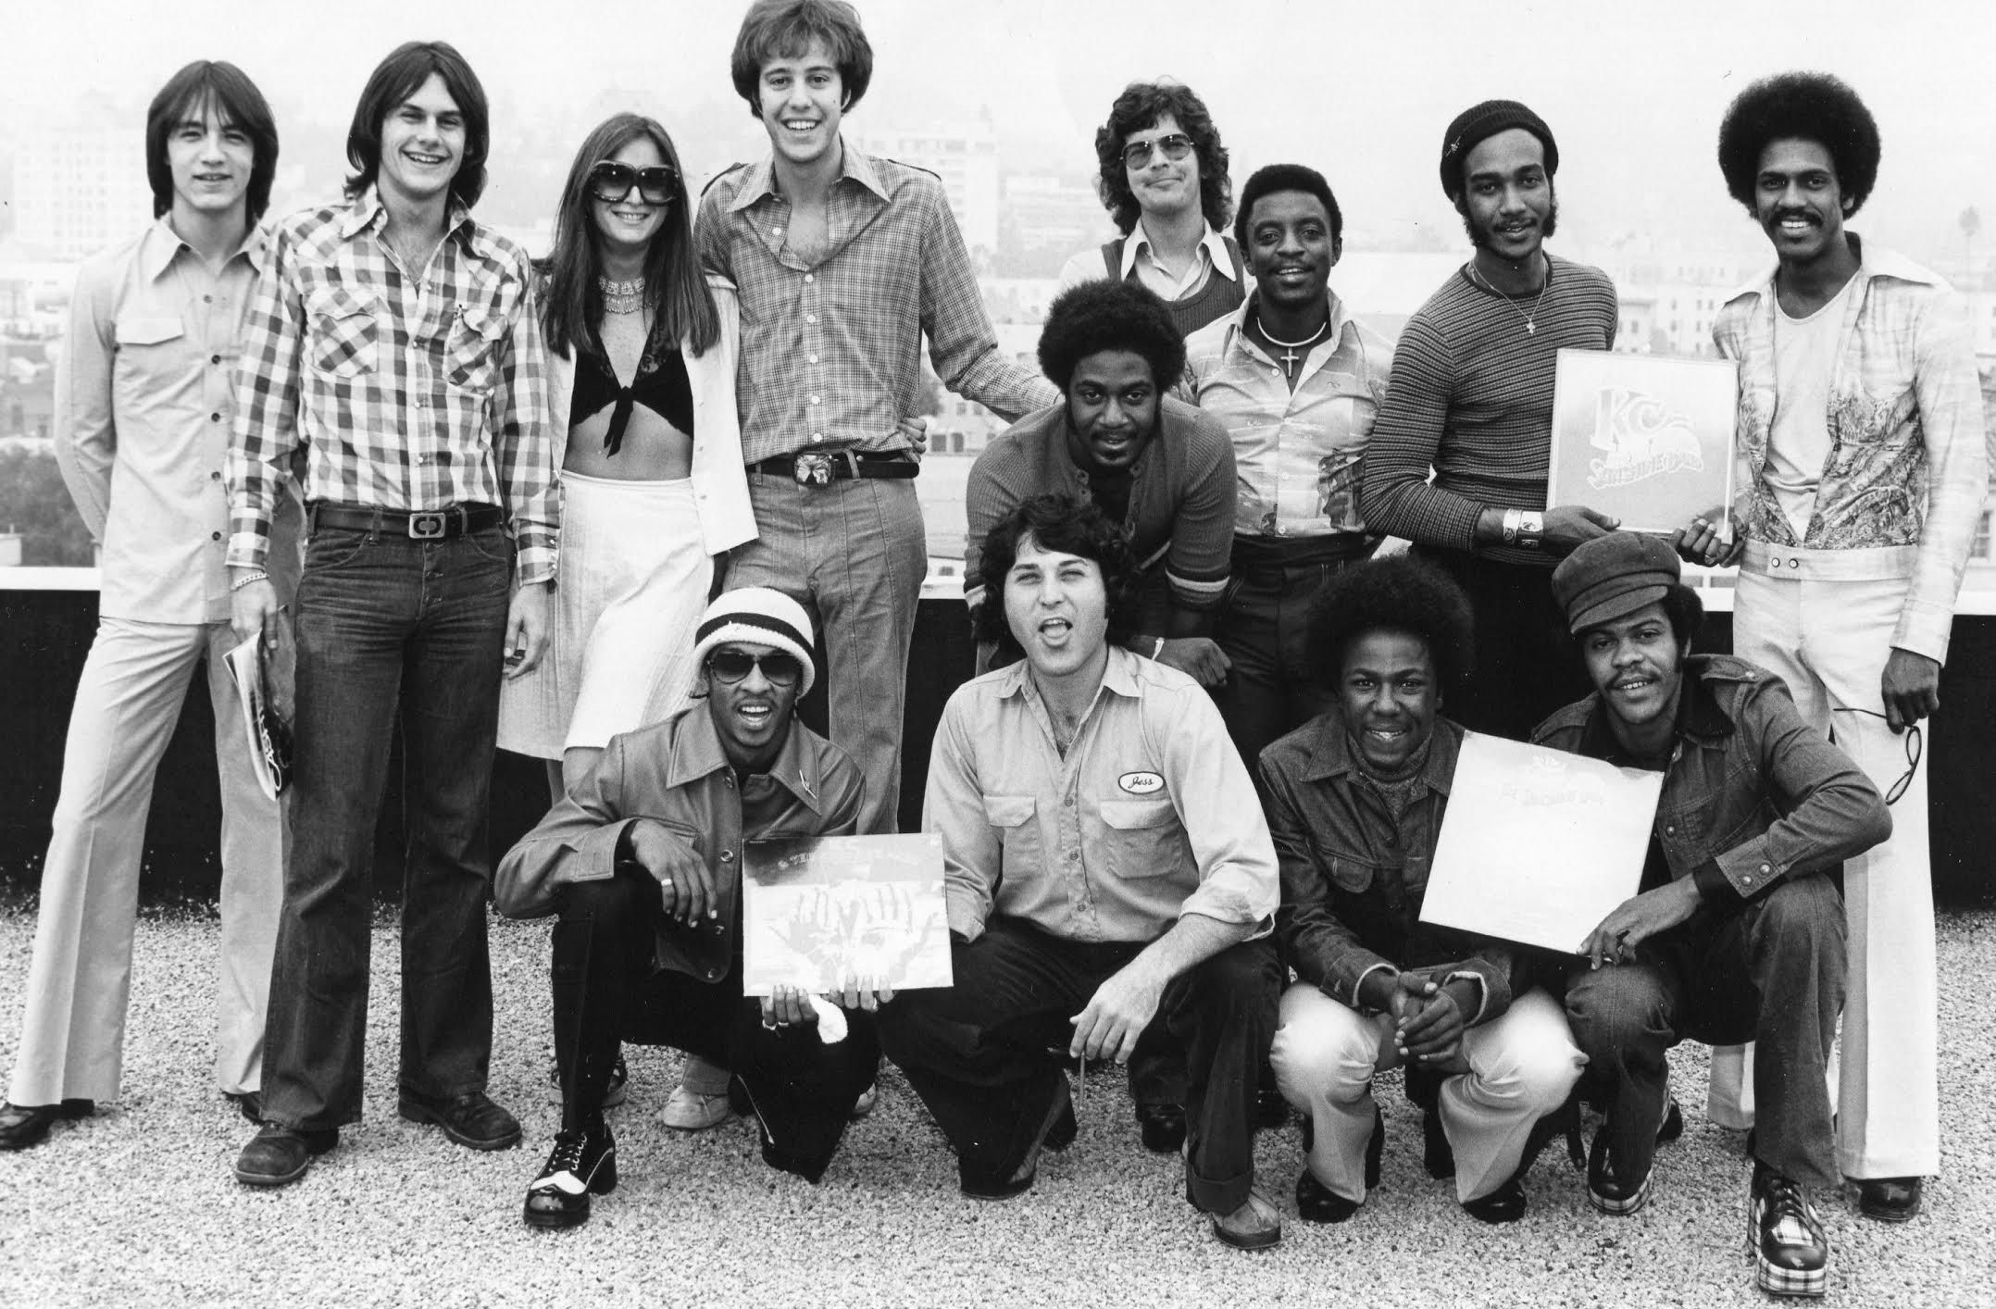
Some Movin’ Music from 1976
“Shake Your Booty” – KC and the Sunshine Band
https://www.youtube.com/watch?v=l3fZuW-aJsg

Slide 29
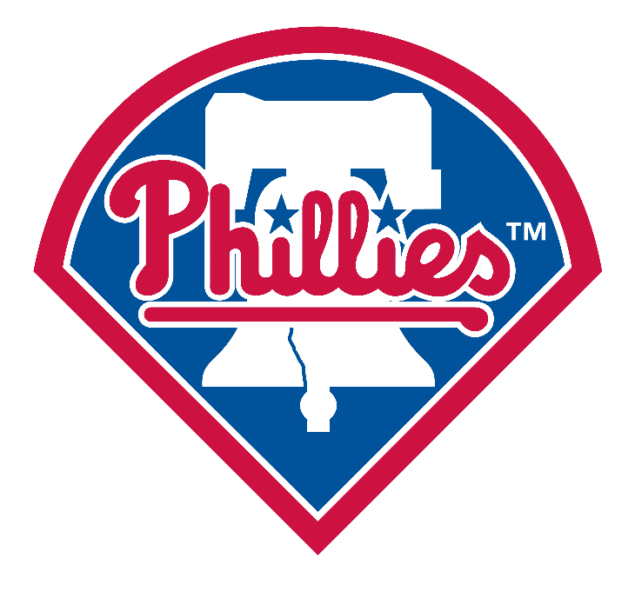
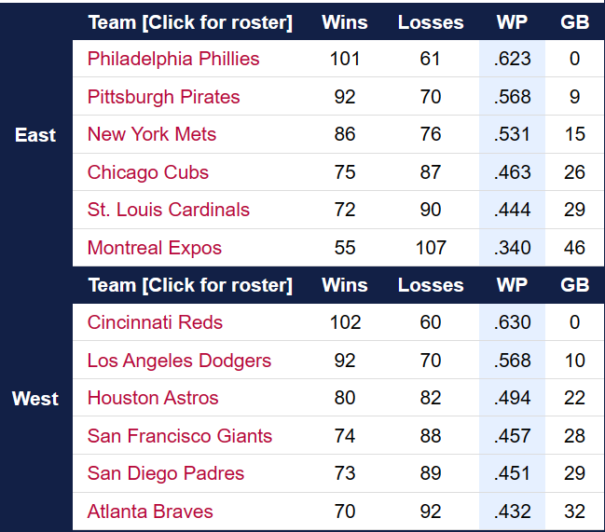
1976 National League

Slide 30
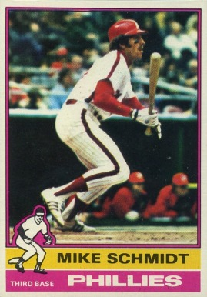
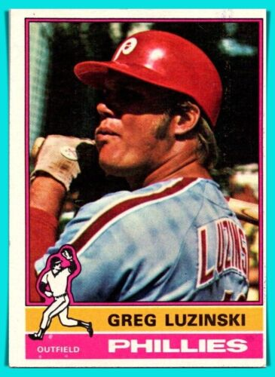
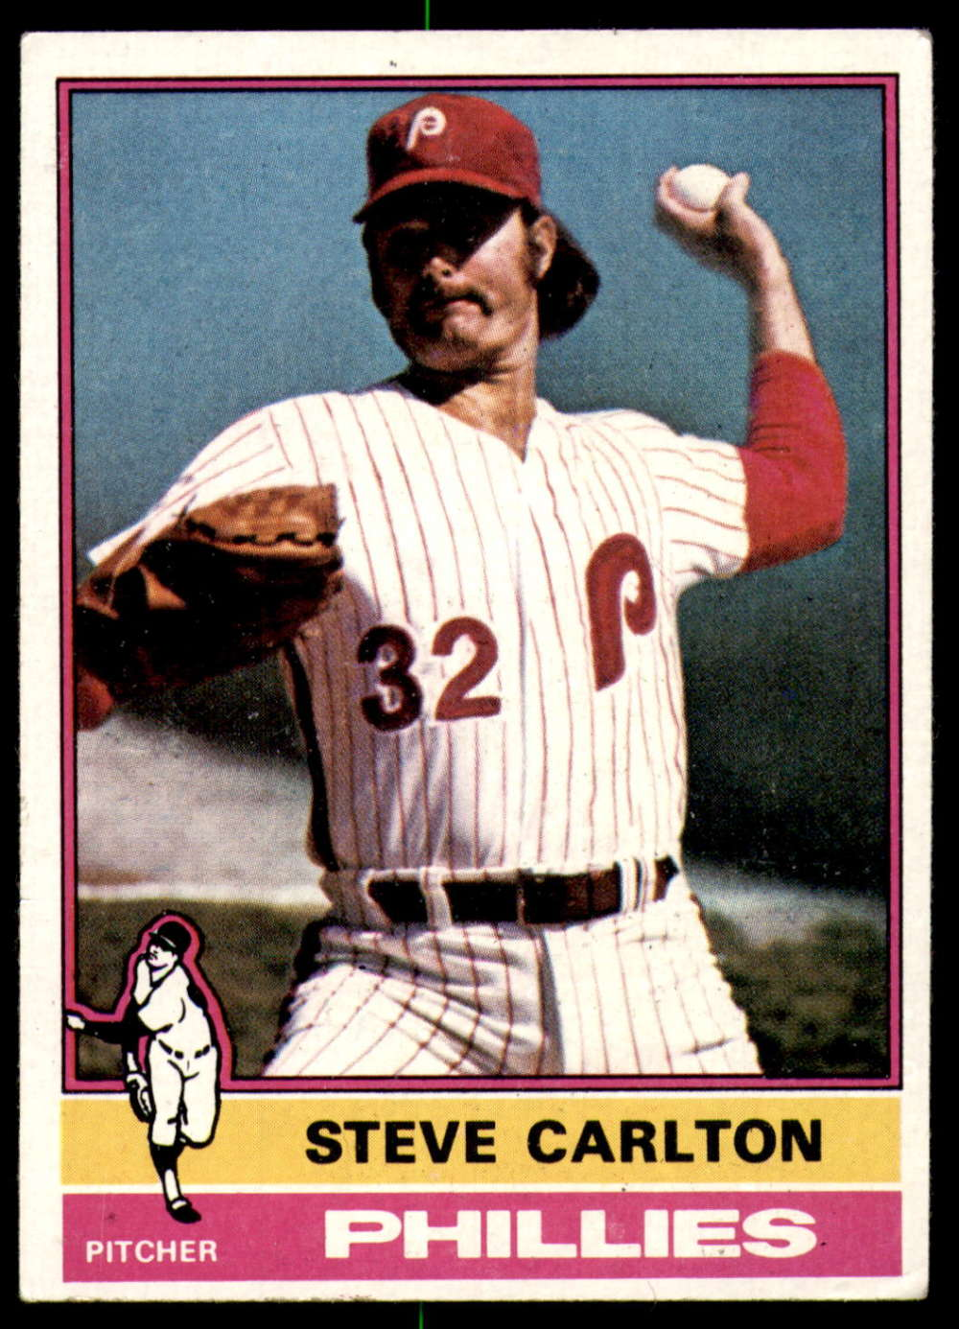
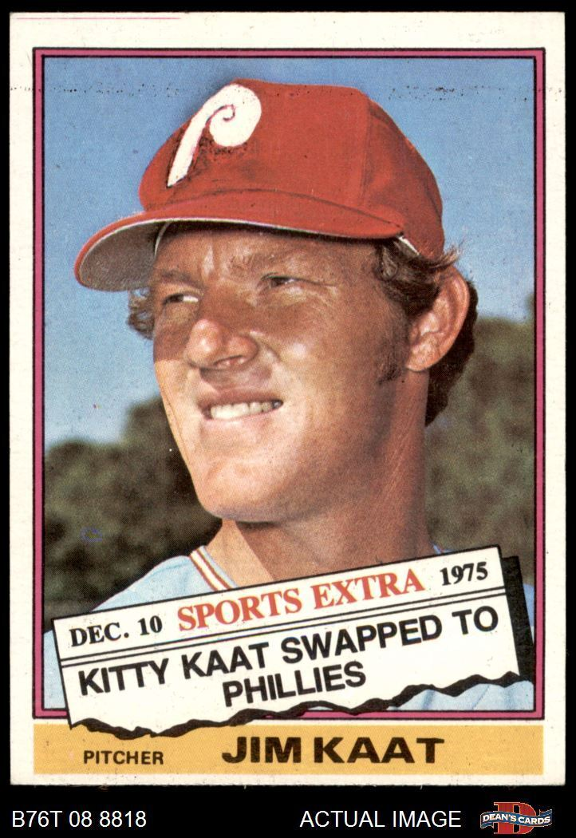
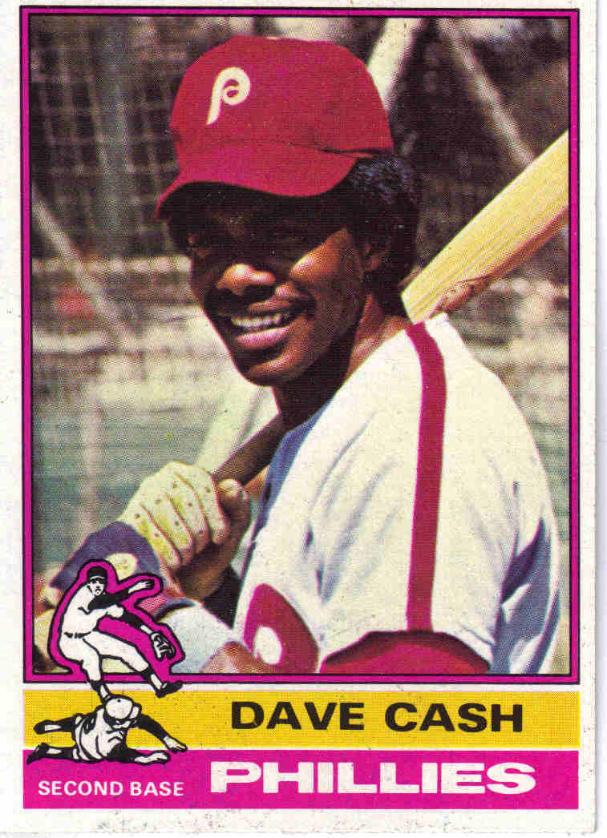
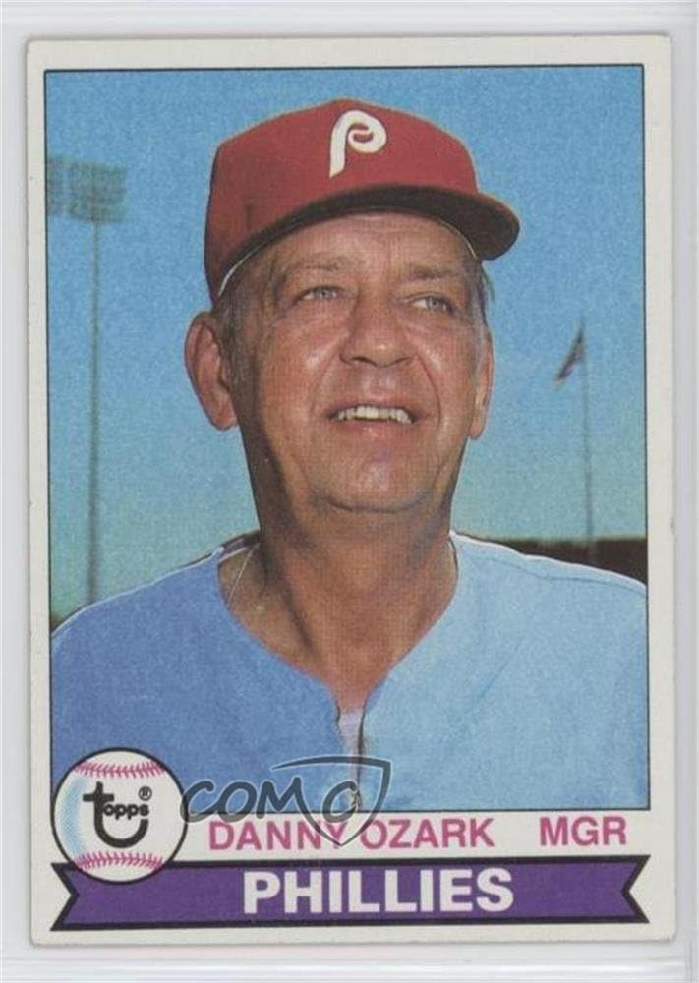
Key Phillies

Slide 31
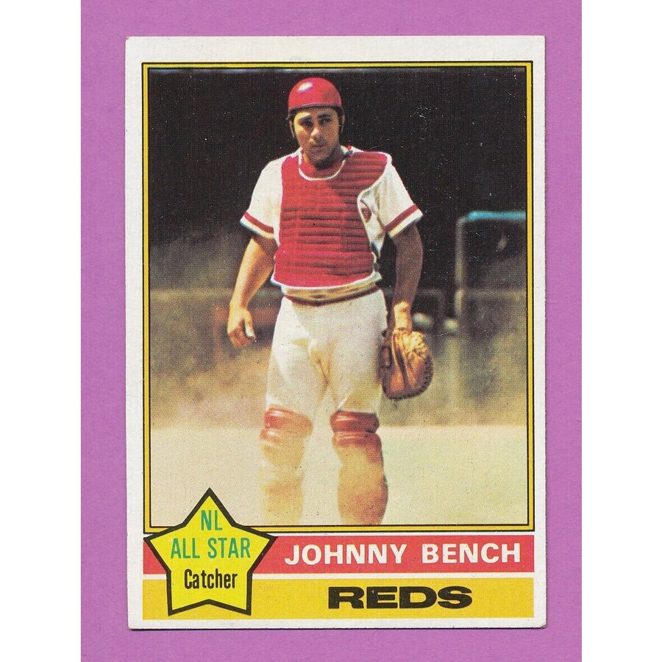
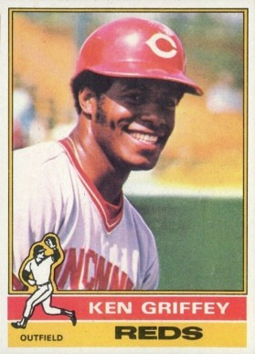
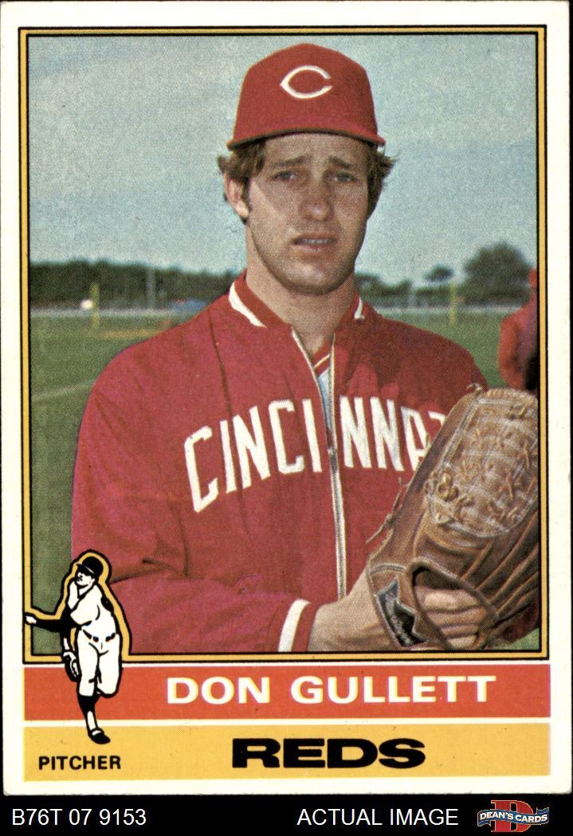
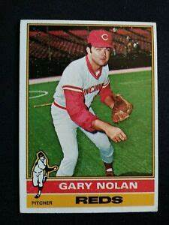
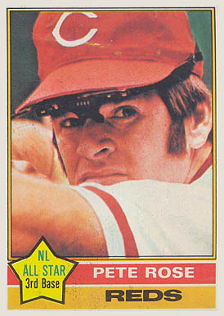
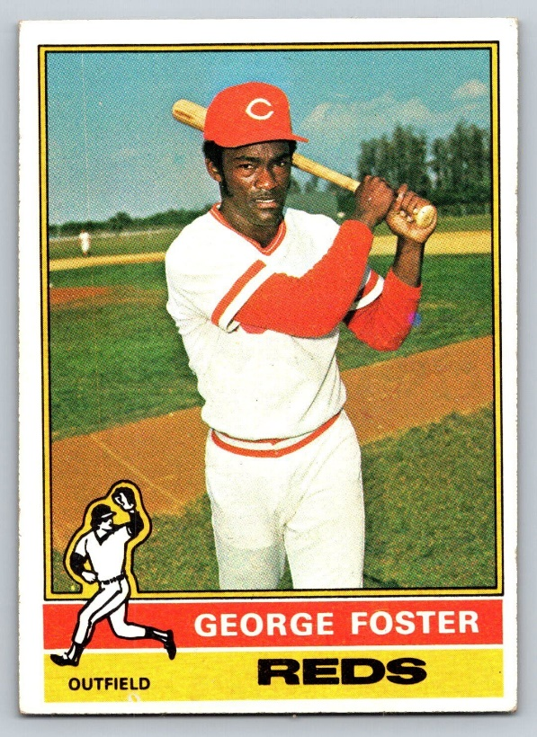
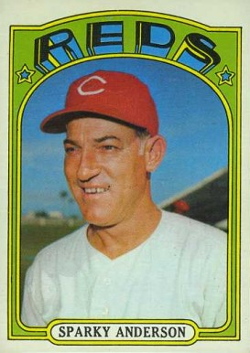
Key Reds

Slide 32
1976 NLCS
The Reds won the first two games on the road at
Veterans Stadium in Philadelphia.
They only need to win one more game back home to take the pennant
In game three, the Phillies led 6-4 going into the bottom of the 9th ….
https://www.youtube.com/watch?v=n9mdcW2BpPM
https://www.youtube.com/watch?v=pHqf0XEpmdw

Slide 33
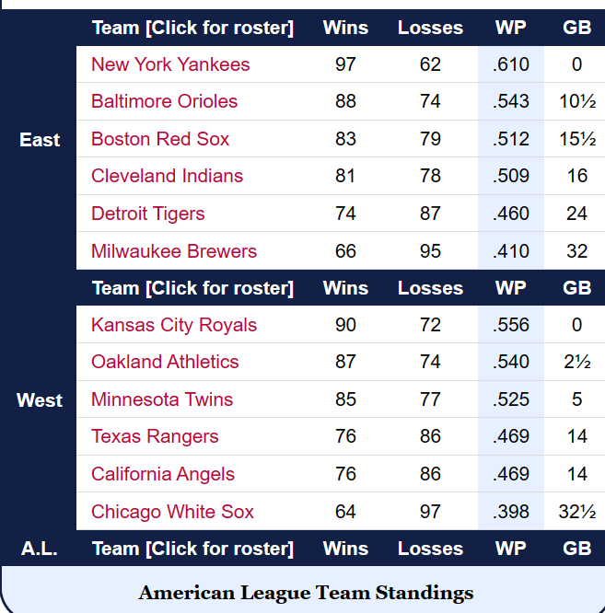
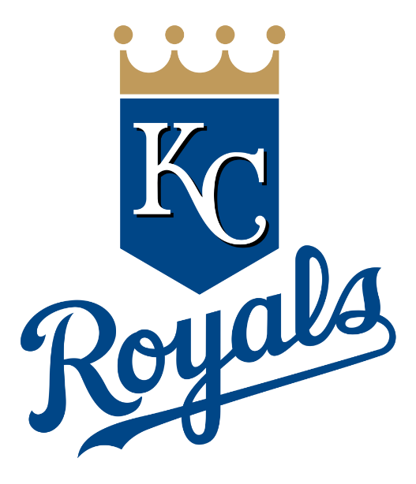
1976 American League

Slide 34
Key Royals

Slide 35
Key Yankees

Slide 36
1976 ALCS
The Yankees and Royals split the first four games
The deciding fifth game is at Yankee Stadium on October 14
George Brett hits a 3-run homer in the 8th to tie the game at 6-6
The game is still tied in the bottom of the ninth.
Yankee 1B Chris Chambliss leads off:
https://www.youtube.com/watch?v=gcRRFy_8Gzw&t=42s

Slide 37
1976 World Series
Big Red Machine
Bronx Bombers

Slide 38
Reds catcher Johnny Bench hit
.533 including two homers and
8 RBI
Bench was named World Series MVP
Cincinnati swept the Yankees
in four games, outscoring them
22 – 8.
This was the second consecutive
World Series win for
The Big Red Machine

Slide 39
1976 World Series
Big Red Machine
Bronx Bombers

Slide 40
Extra Innings!
More Stuff from the ‘60s and ‘70s

Slide 41
A momentous
occasion
October 16, 1976

Slide 42
Things we don’t have anymore:
Sears
Summer catalog

Slide 43
Baseball superstar
Ted Williams
promoted Sears’
“J.C. Higgins” sporting goods

Slide 44
Sears
Summer catalog
J.C. Higgins
Baseball Gloves
Notes:
This is Monte’s first glove – a 1958 Don Blasingame model. It cost $3.84 back then!

Slide 45
Things from the 1960s that we don’t use anymore …
The first 33rpm LP records were introduced
75 years ago
Notes:
The first 33rpm LPs were introduced – today 75 years ago – on June 21, 1948 ! They could play about 40 minutes, a big improvement over 5-min 78rpm.

Slide 46
Automobile makes/models we don’t have anymore
Volkswagen “Beetle”

Slide 47
Automobile makes/models we don’t have anymore
Studebaker

Slide 48
Automobile makes/models we don’t have anymore
Rambler

Slide 49
Automobile makes/models we don’t have anymore
Pontiac
Notes:
Pontiac Catalina four door

Slide 50
Automobile makes/models we don’t have anymore
Oldsmobile
Notes:
Oldmobile 98 – it was huge

Slide 51
Automobile makes/models we don’t have anymore
Mercury
Notes:
Mercury Monterey

Slide 52
Automobile makes/models we don’t have anymore
Plymouth
Notes:
Plymouth Belvedere – I did driver’s ed in one of these

Slide 53
Kitchen Items

Slide 54
Kitchen Items
Pink
and…
Avocado Green
Harvest Gold
Copper …

Slide 55
Kitchen Items
Some “vintage” kitchen tools

Slide 56
Kitchen Items
Some “vintage” kitchen tools

Slide 57
Kitchen Items

Slide 58
Thanks!!
We’ll see you again next month!

