Slide 1
AGE Thrive with Baseball Memories
September 20, 2023
Agenda
Warm-up - Introductions
Update on today’s baseball standings
Gametime – The Year in Baseball – 1979
Seventh Inning Stretch - “Take Me Out to the Ball Game”
Extra Innings – More stuff from the ‘60s and ’70s
Extra Innings - Memorabilia

Slide 2
The Year in Baseball: 1979

Slide 3
1979 - History

Slide 4
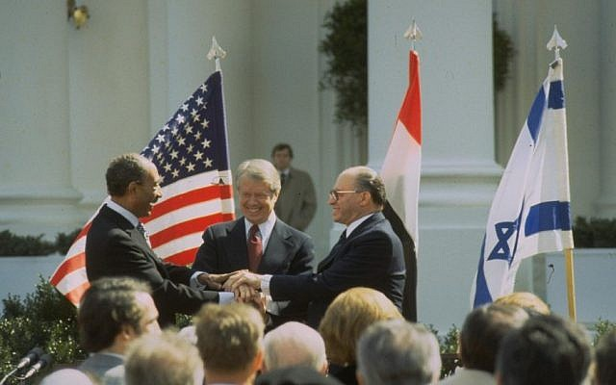
Egypt – Israel Peace Treaty signed
Notes:
Result of the “Camp David Accords” in 1978 – Anwar Sadat and Menachem Begin sign treaty at Washington, DC

Slide 5
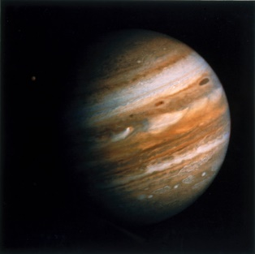
Voyager 1
arrives at
Jupiter
Notes:
Launched in 1977, V1 arrives at Jupiter in early March, 1979.

Slide 6
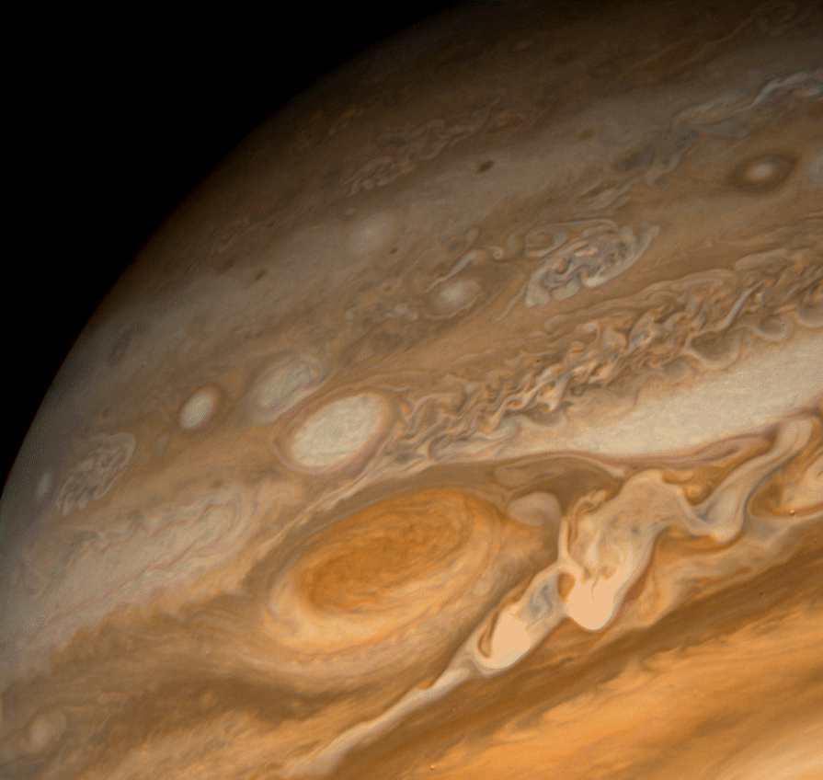
Voyager 1
arrives at
Jupiter

Slide 7
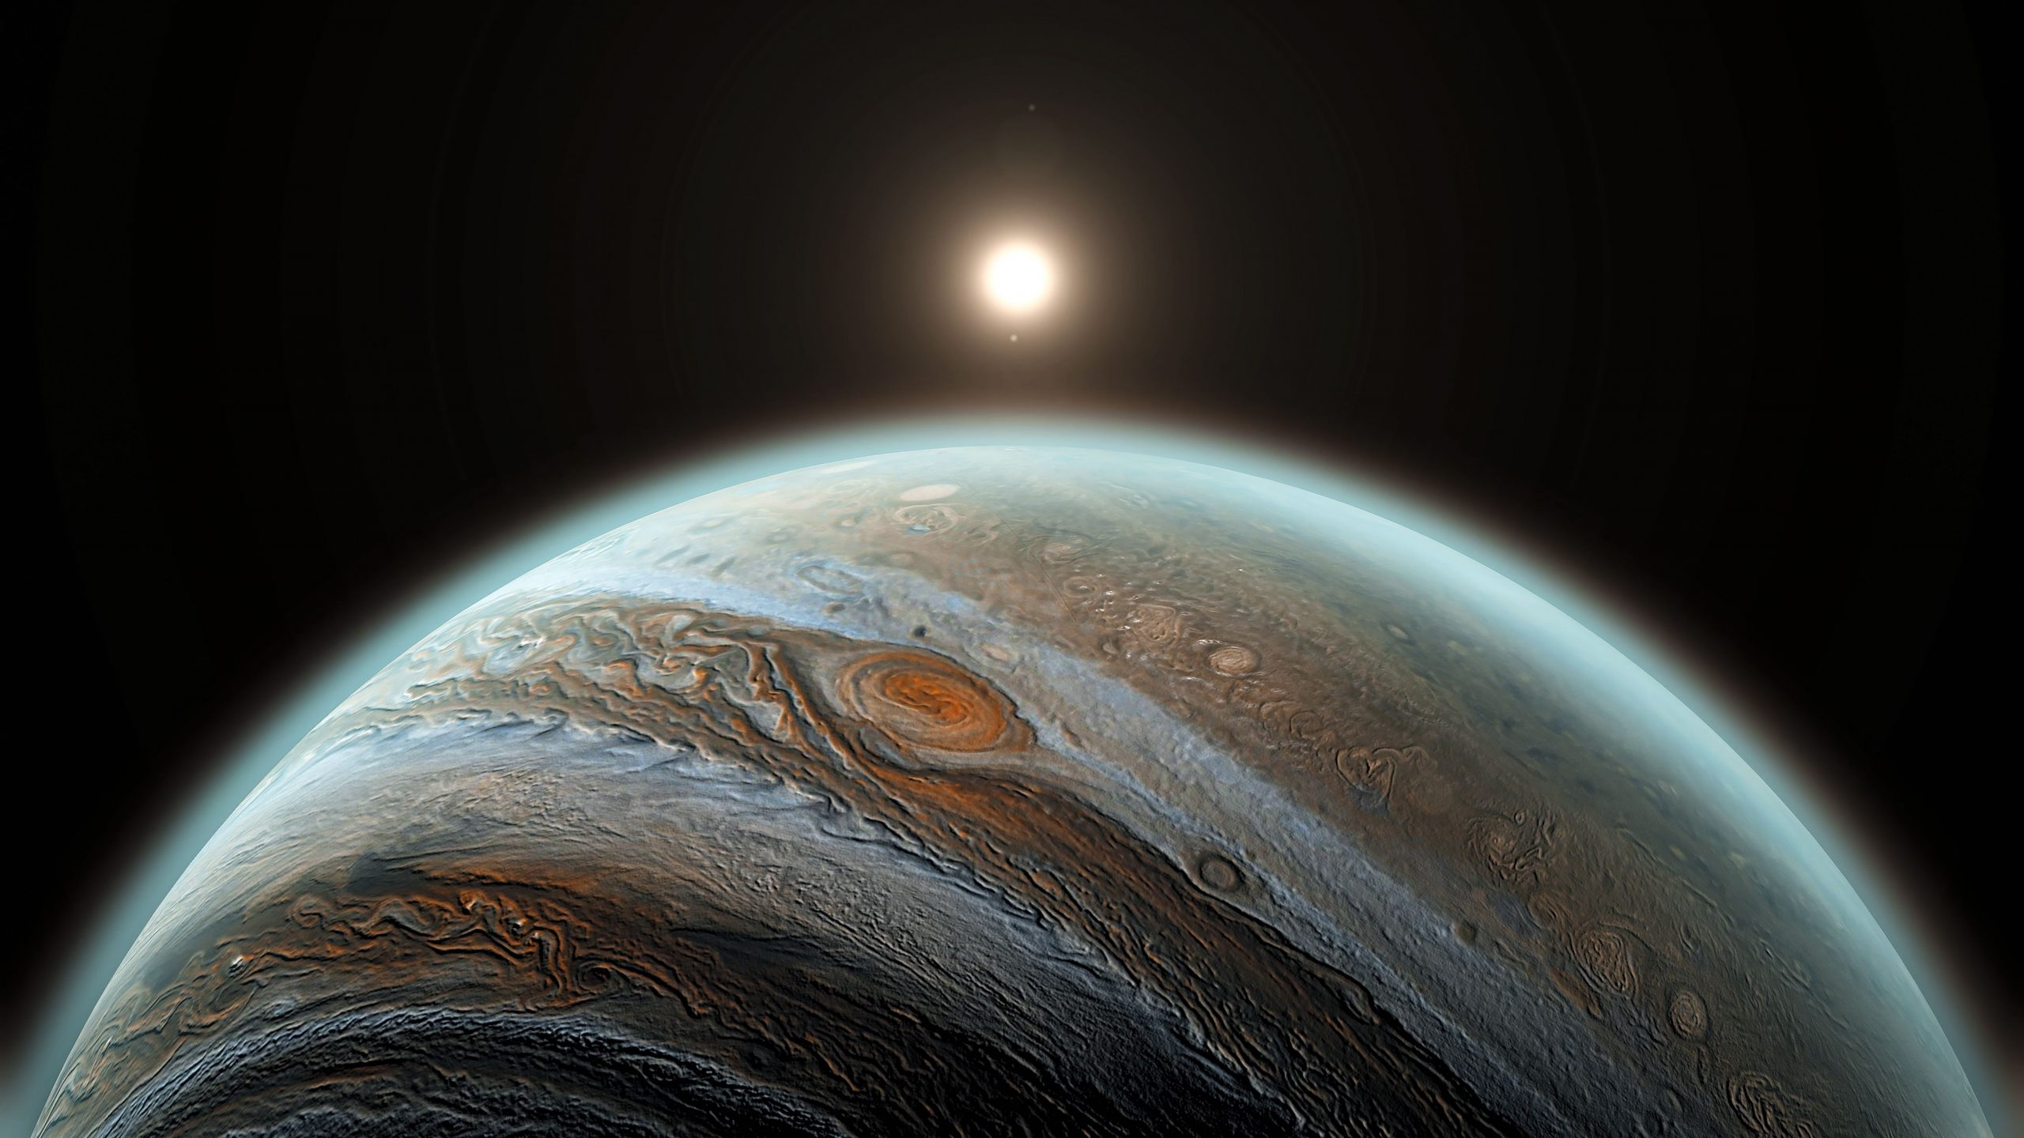
Voyager 1 arrives at Jupiter
Notes:
March 5, 1979 – view of our Sun from Jupiter

Slide 8
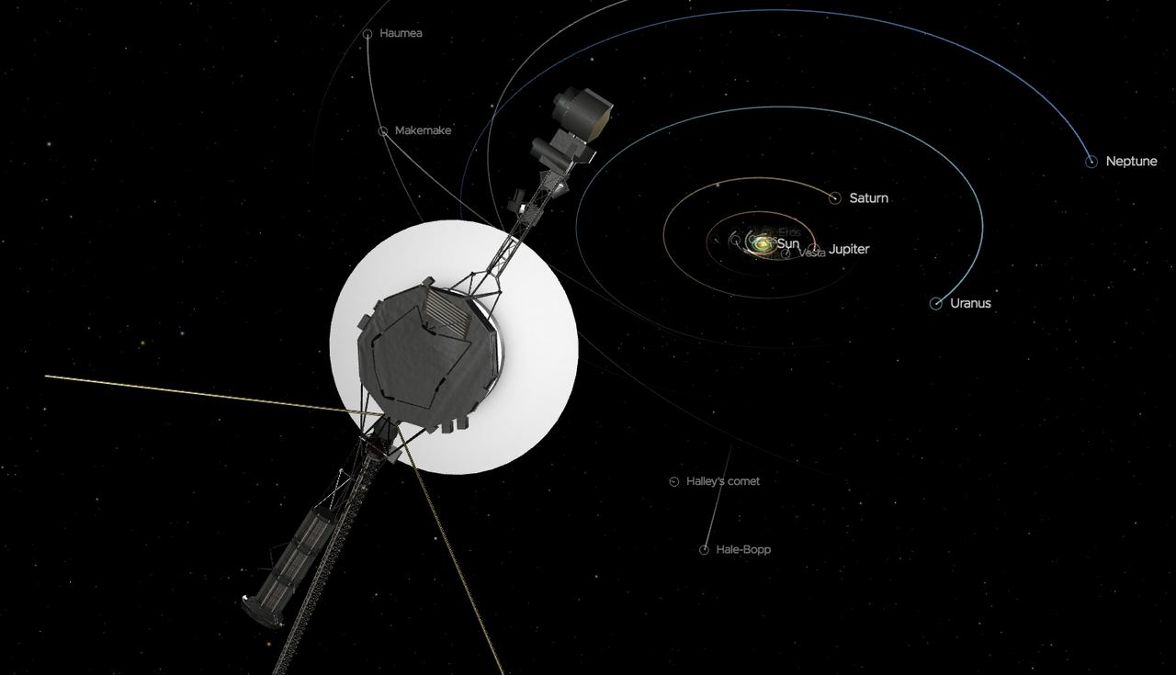
Voyager 1 is now 15 billion miles away
Notes:
Voyager 1 is the most distant man-made object from earth – left the solar system and is 15 billion miles away and traveling at 38,000 mi/hour. The closest star to our Sun is Proxima Centuari – which is 3 light years away at closest point. It would take Voyager another 60,000 years to reach it at current speed! It’s solar cells are expected to get enough power to run systems into 2025.

Slide 9
1979 - Business

Slide 10
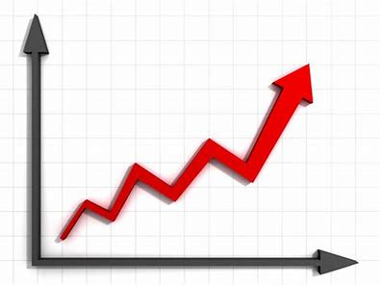
Inflation !
15%
Federal Reserve hikes rates to:

Slide 11
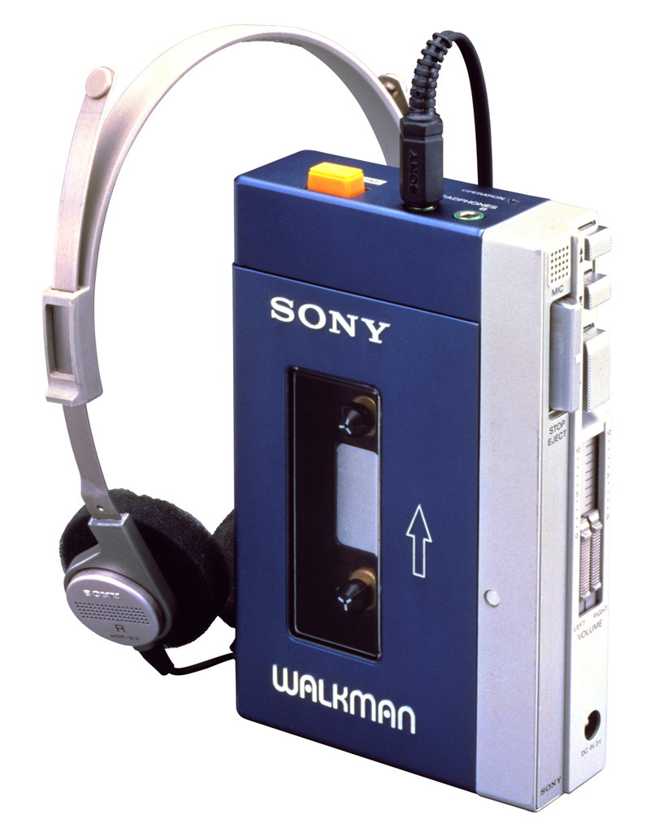
Sony Walkman
introduced
Original played
compact tape cassettes
Digital media models
introduced in 1999
Estimated sales to date:
over 400 million units
Notes:
Introduced in 1979 to play the compact tape cassette. Eventually lost market share to Apple iPod.

Slide 12
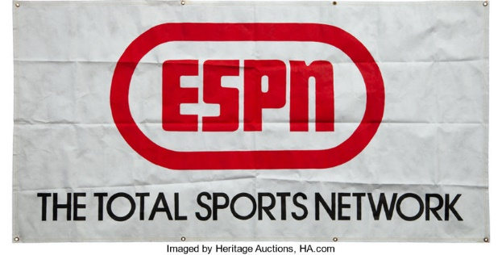
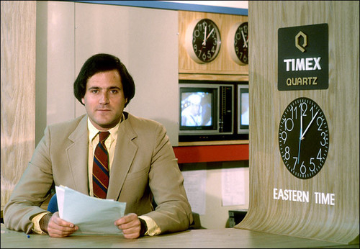
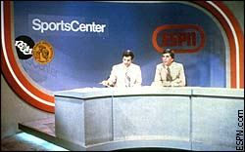
ESPN launched
on cable TV
https://youtu.be/trm7Xf14EnM

Slide 13
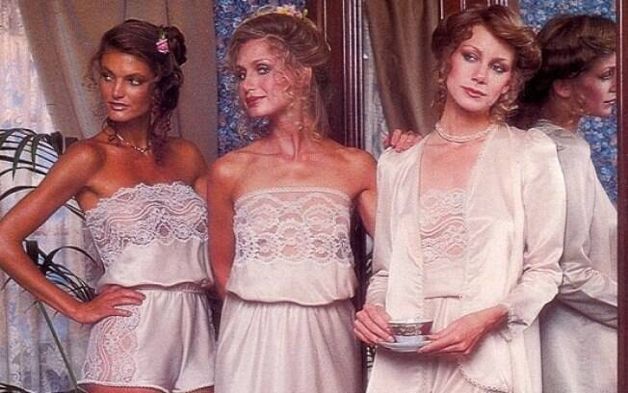
Victoria’s Secret was founded
Models from 1979 catalog

Slide 14
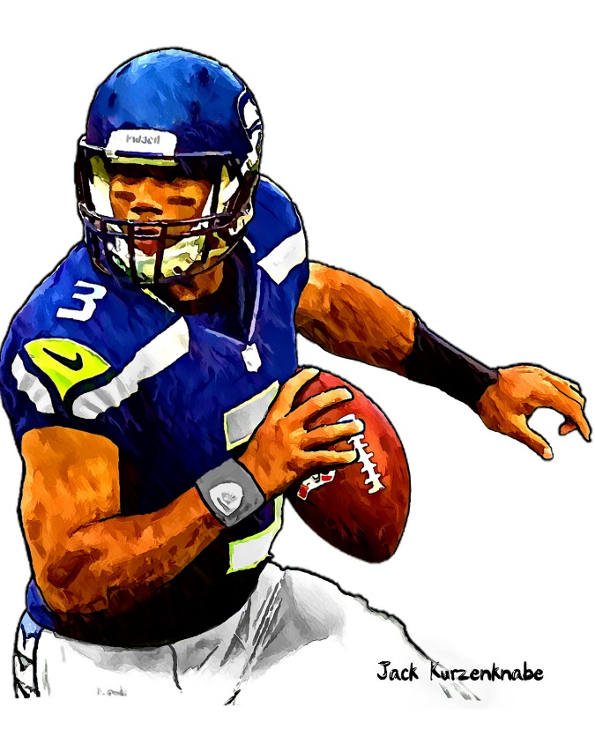
1979 Sporting News

Slide 15
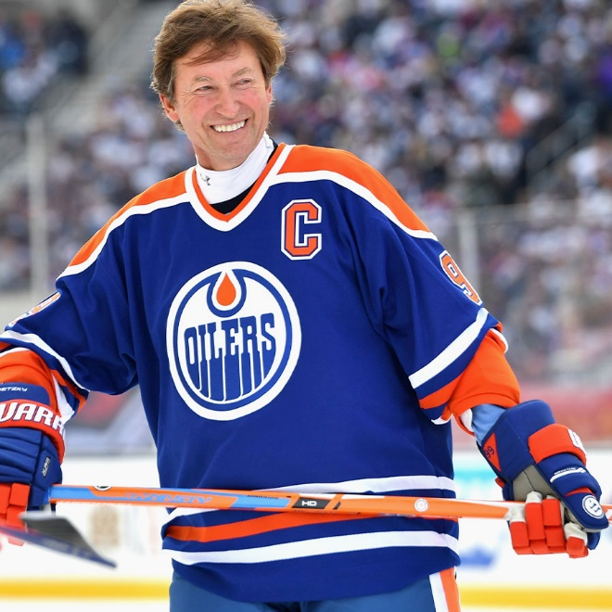
Wayne Gretzky rookie season
Played 20 seasons in NHL
Won 9 MVP awards and
10 scoring titles
Adept at assisting on team-
mates’ goals; area behind
opponent’s goal was called
“Gretzky’s Office”
“The Great One”
Notes:
Story of Gretzky assisting on all 6 goals in an early ‘80s game against Blues.

Slide 16
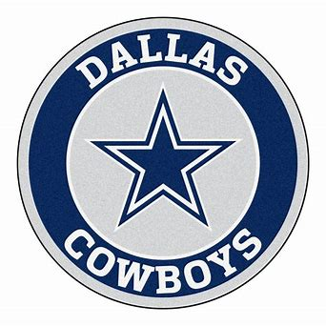
Super Bowl XIII
Played at the Orange Bowl
Both teams had won two previous Super Bowls, and the Cowboys were defending champs
The Steelers scored twice early in the 4th Q and went on to win the game 35-31
Notes:
Terry Bradshaw QB for the Steelers and Roger Staubach for the Cowboys. 25 future HOF players were involved in the game.

Slide 17
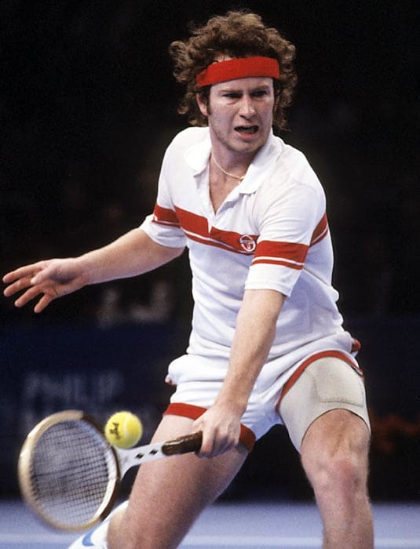
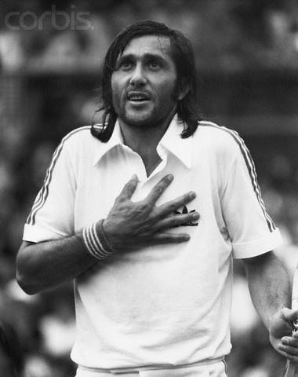
Bad Boys of Pro Tennis
John
McEnroe
Ilie
“Nasty”
Nastase
https://www.youtube.com/watch?v=FEDUlcvMQWo
Notes:
Outbursts at 1979 U.S. Open – Ilie Nastase and John McEnroe in a 2nd round match. McEnroe went on to win his first major title. Video – start at 0:15.

Slide 18
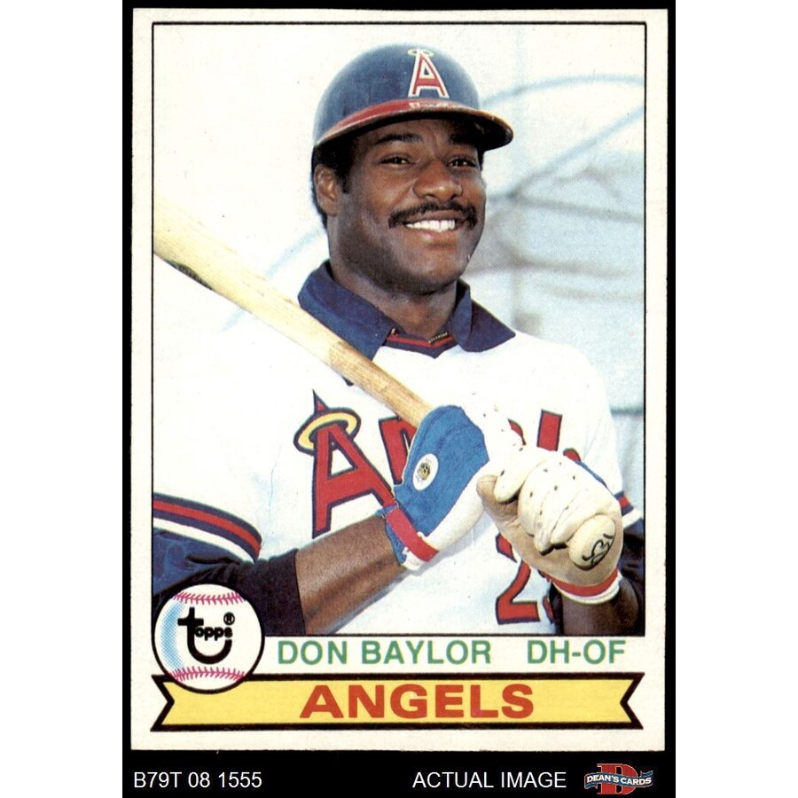
1979 American League MVP Winner
.296 36 HR 139 RBI
Notes:
He was born, and lived most of his life, in Austin, Texas !
Mickey Mantle hit 37 homers to lead the AL. He also led the league in triples, walks, and SLG.

Slide 19
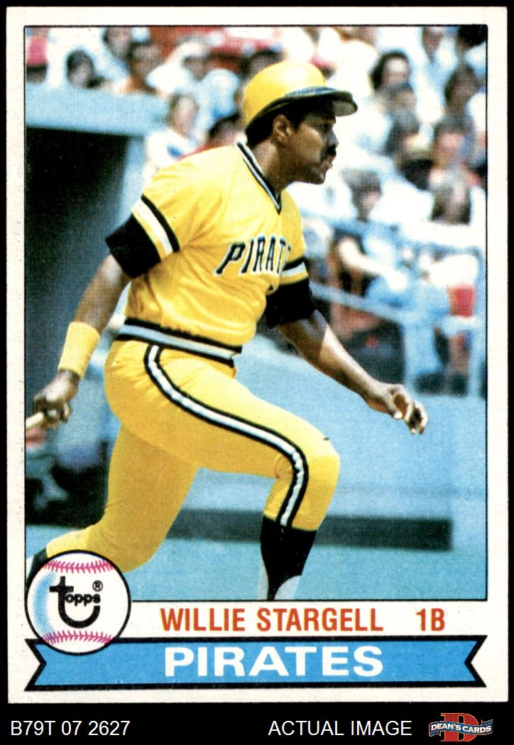
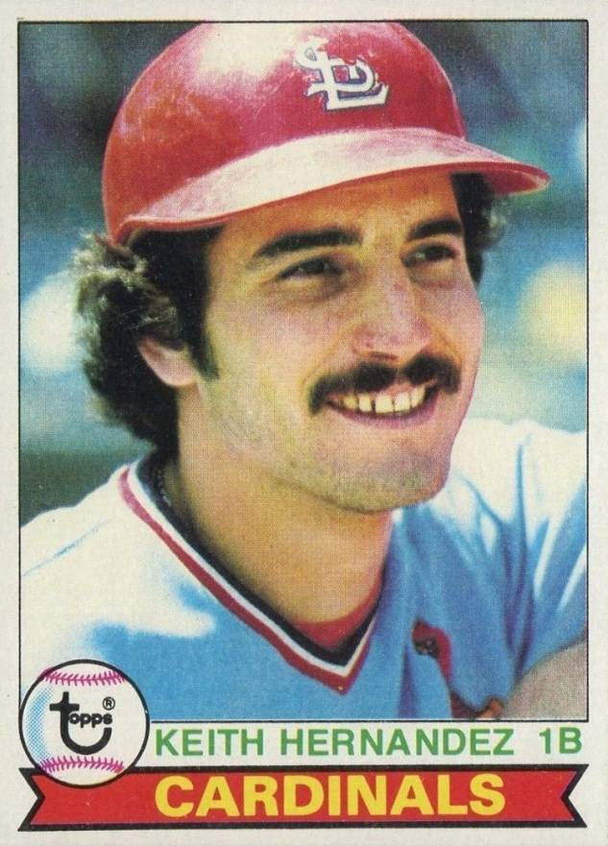
1979
National
League
MVP
First-ever
tie vote!
.281 32 HR .552 SLG
.344 105 RBI 116 R
Notes:
Hernandez had the traditional “numbers”; Stargell gained votes for intangibles such as his leadership of the Pirates.
Mickey Mantle hit 37 homers to lead the AL. He also led the league in triples, walks, and SLG.

Slide 20
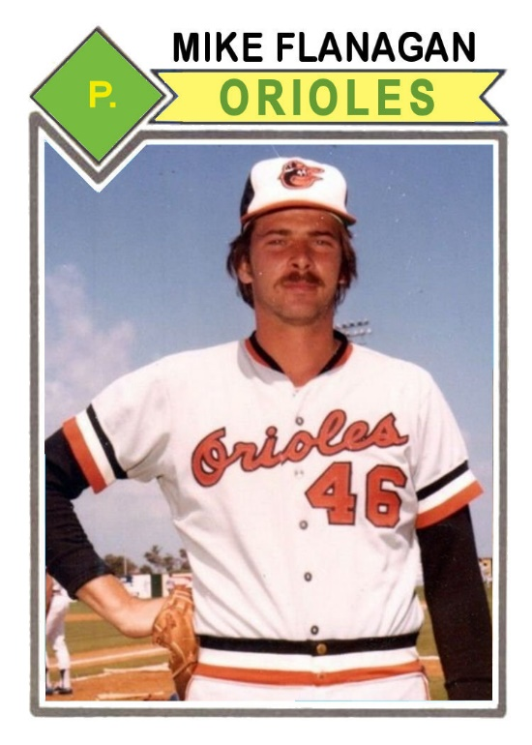
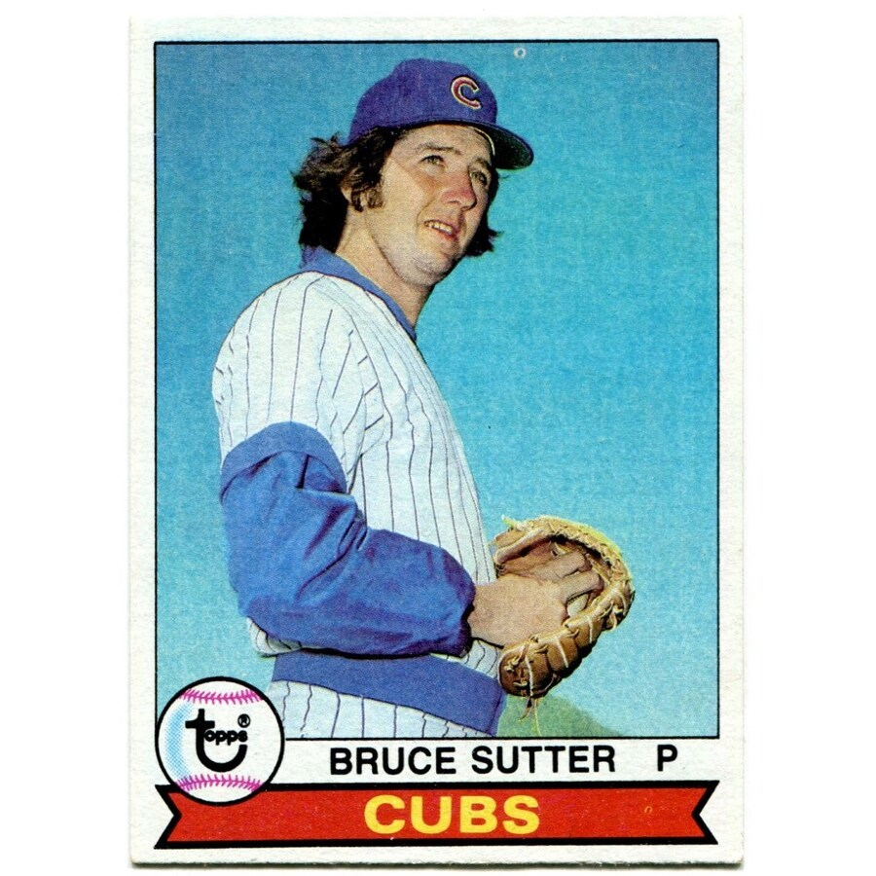
1979
Cy Young
Winners
23 - 9, ERA 3.08, 265 IP
37 Saves, ERA 2.22
Notes:
Sutter led in saves 5 of 6 seasons starting in 1979

Slide 21
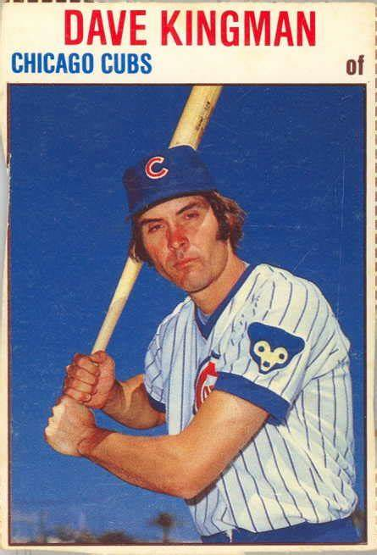
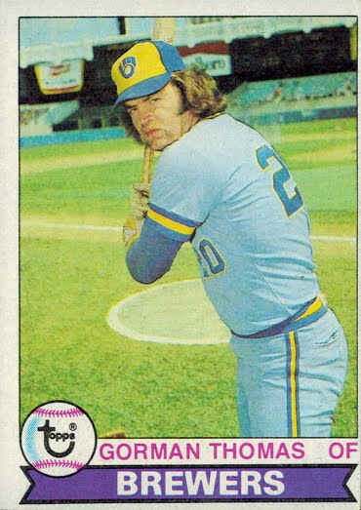
1979 HR Leaders
Led NL with 48 HR and 131 K
Led AL with 45 HR, also 175 K
Notes:
Mickey Mantle hit 37 homers to lead the AL. He also led the league in triples, walks, and SLG.

Slide 22
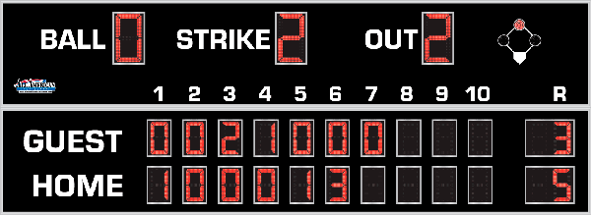
7th Inning Stretch

Slide 23
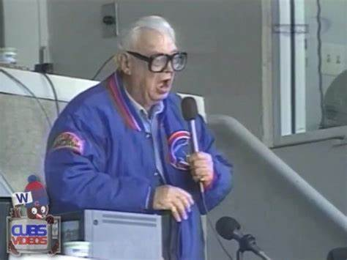
“Take Me Out to the Ballgame”
https://www.youtube.com/watch?v=HnHV5FaqvEs

Slide 24
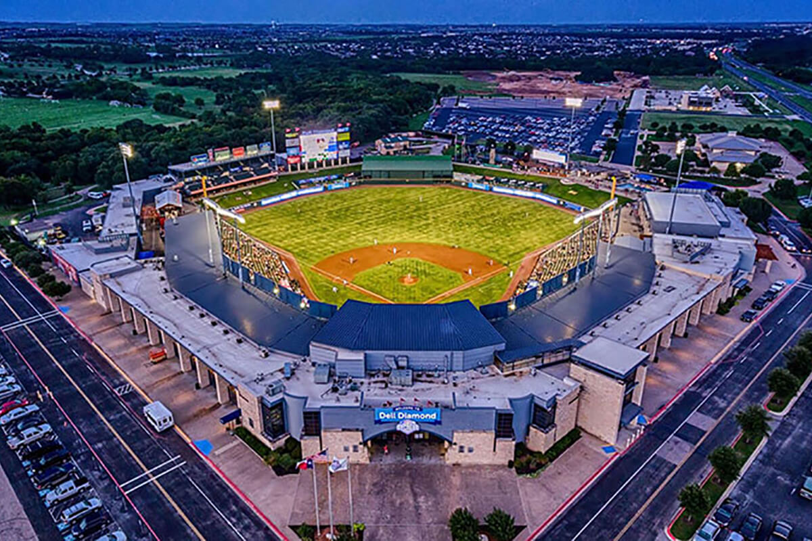
“Deep in the Heart of Texas”
https://www.youtube.com/watch?v=VGF4ibgcHQE

Slide 25
The Chicken Dance !
https://www.youtube.com/watch?v=WZJAIkmT3Rg

Slide 26
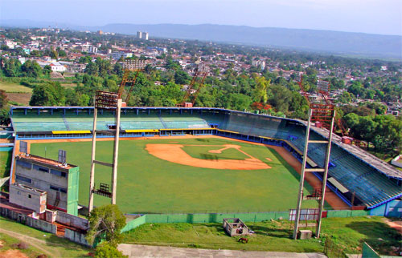
¡ Música al estadio !
It can get very
loud at the:
Estadio
in
Guantánamo,
Cuba
Sing – Guantanamera :
https://www.youtube.com/watch?v=zUs8PIJ2en8

Slide 27
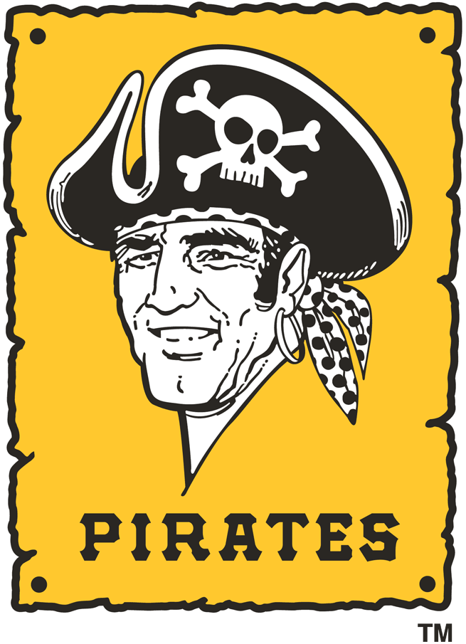
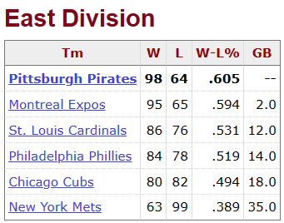
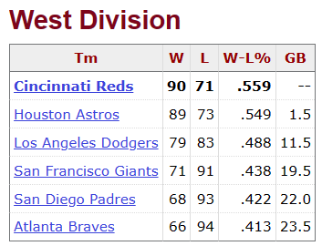
1979 N.L.

Slide 28
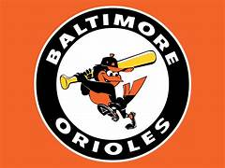
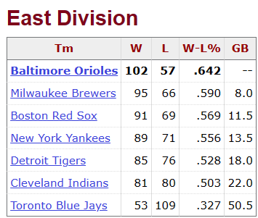
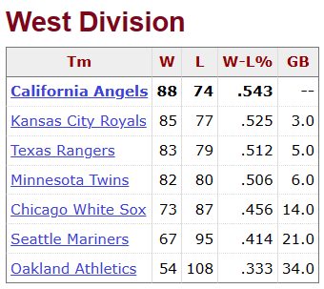
1979 A.L.

Slide 29
1979 League Championships
Best 3-of-5 format
In the NL, the Pirates swept the Cincinnati Reds, winning the first three games.
The California Angels made their first playoff appearance in franchise history.
The Orioles proved to be too strong for the Angels, and Baltimore clinched the AL pennant by winning three of the first four games.

Slide 30
1979 World Series
VS.
Notes:
A repeat of the 1971 Series that we talked about last month.

Slide 31
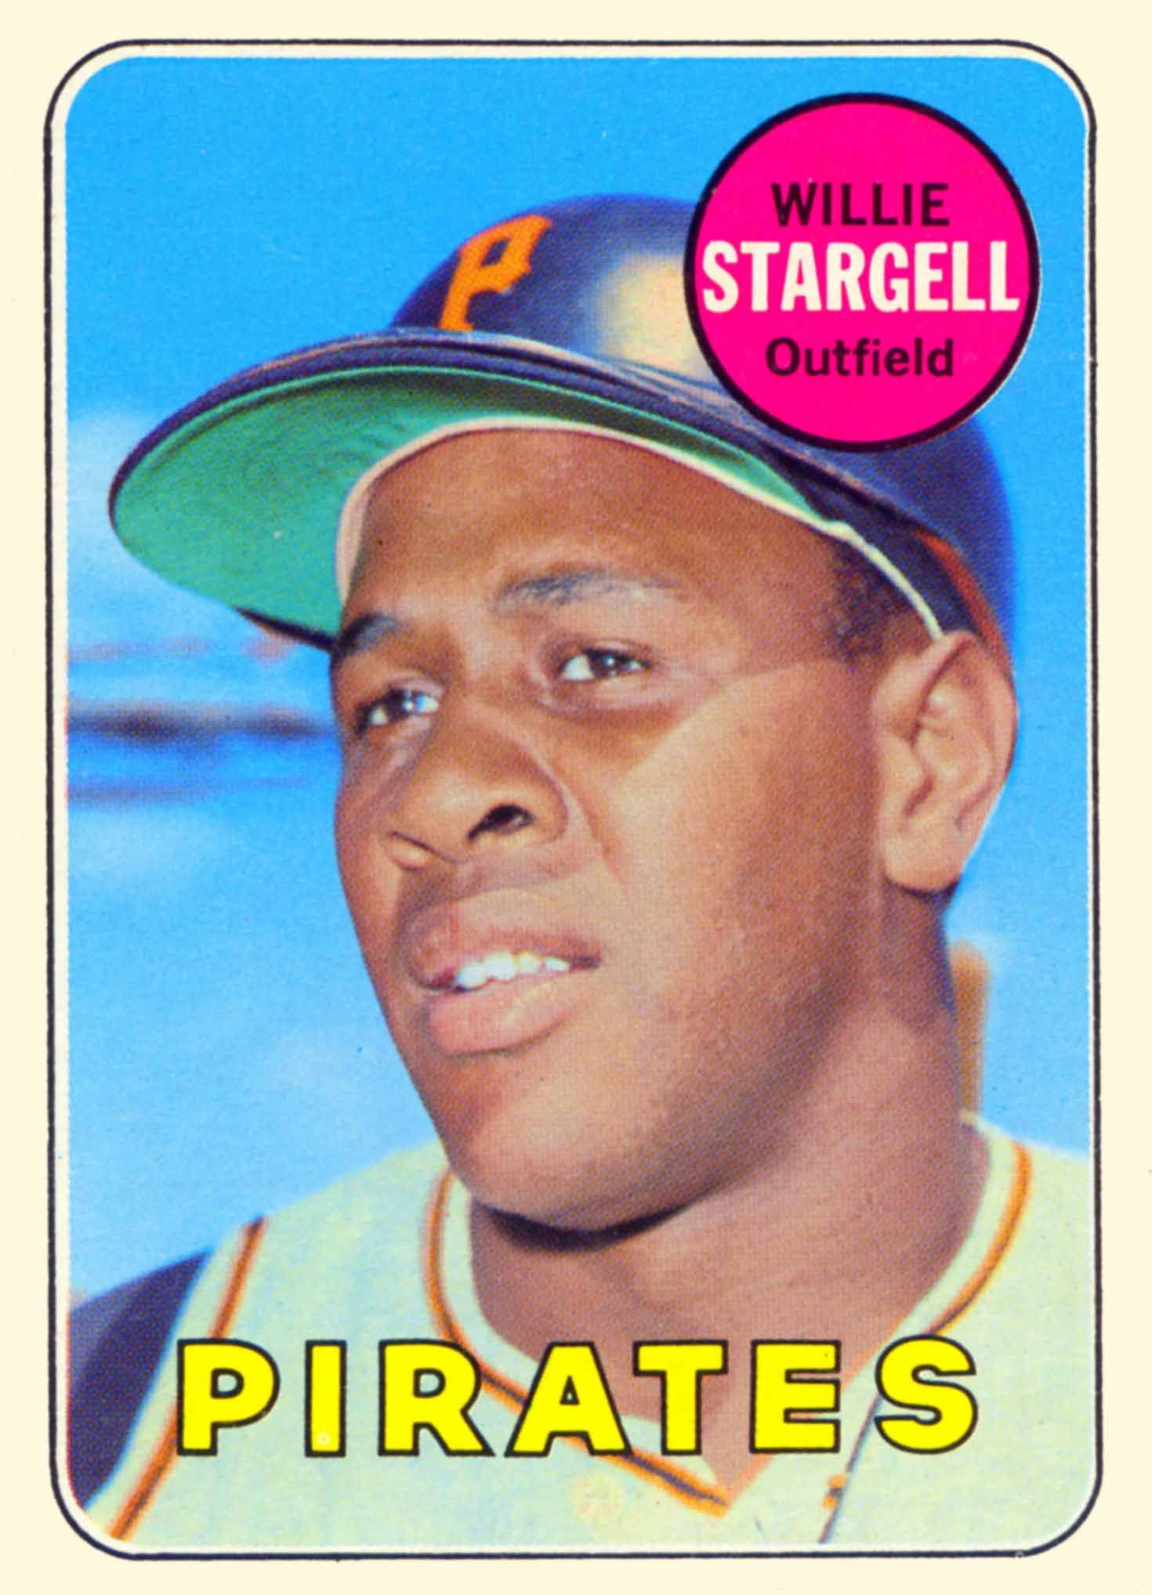
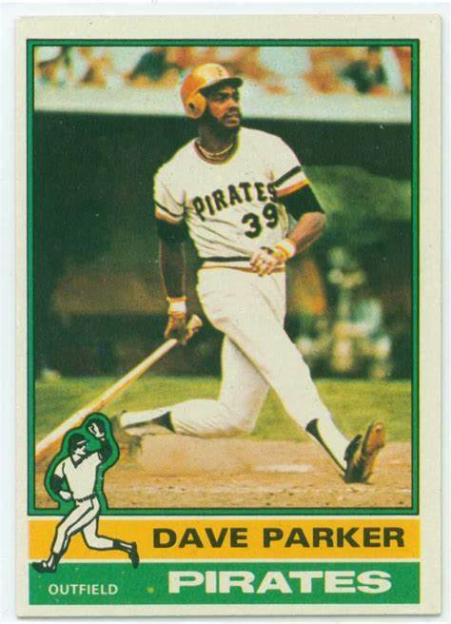
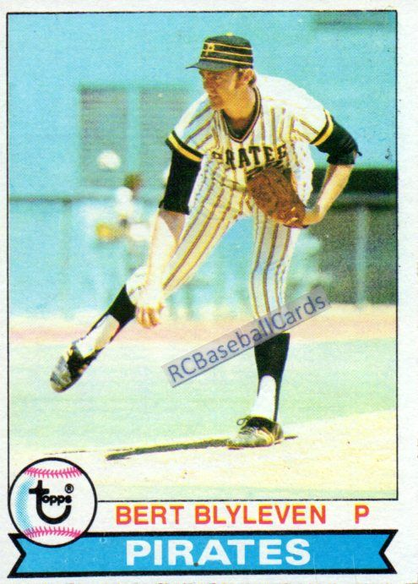
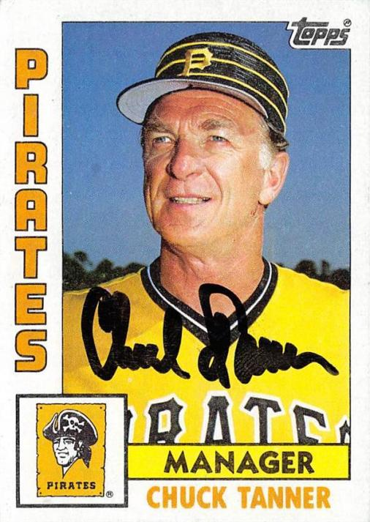
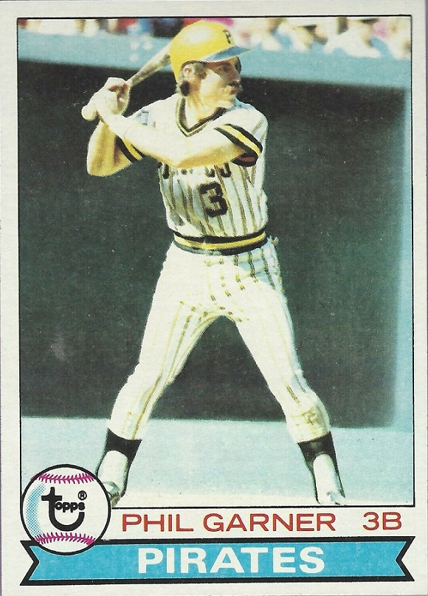
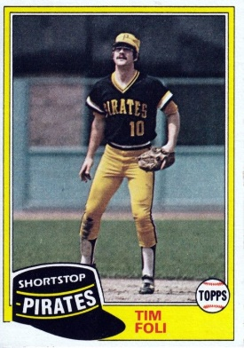
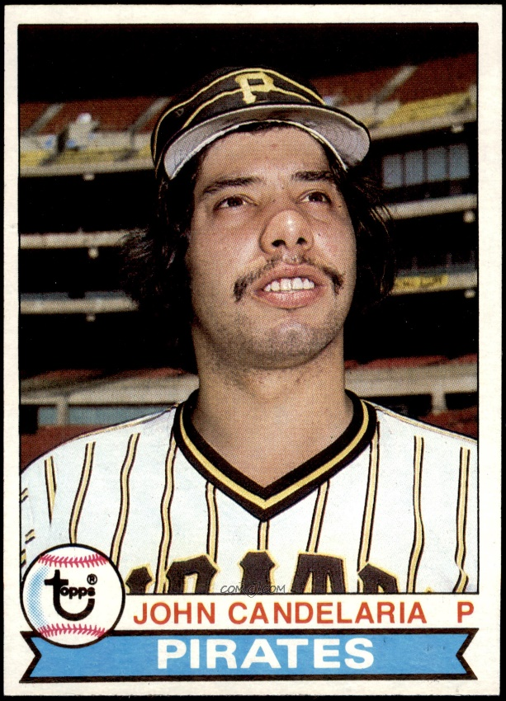
Pirates
Stars

Slide 32
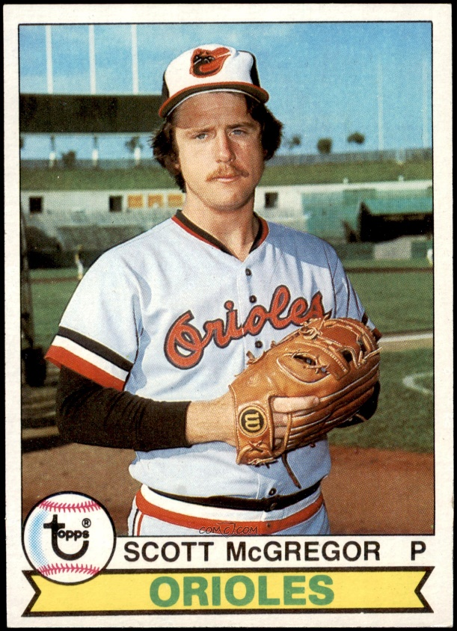
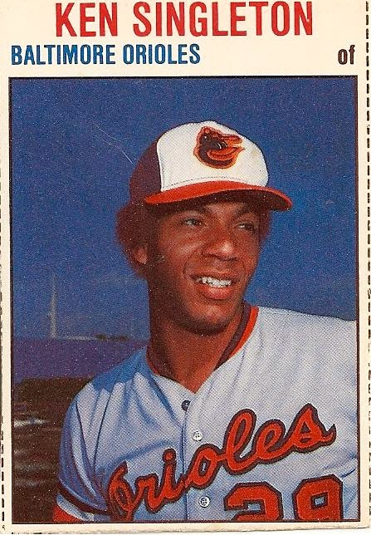
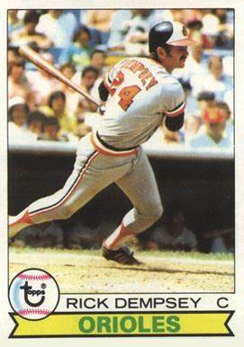
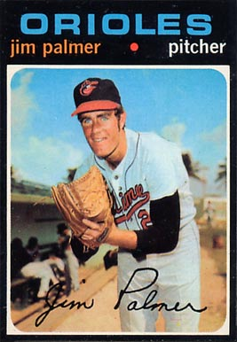
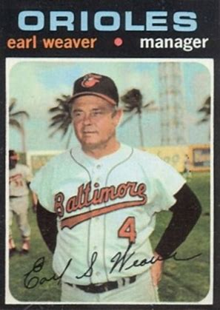
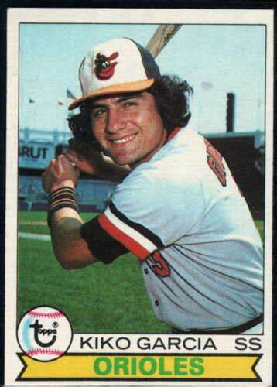
Key
Orioles

Slide 33
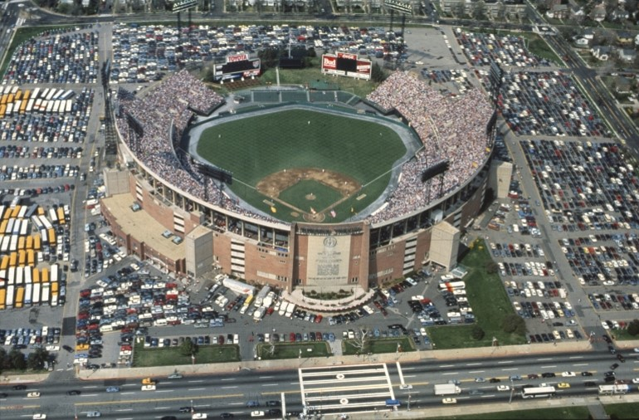
1979 World Series Highlights
Memorial Stadium, Baltimore
Game 1 – October 10, 1979
Orioles 5, Pirates 4
Orioles explode for 5 first inning runs
Cy Young winner Mike Flanagan pitches complete game
Game 2 – October 11, 1979
Pirates 3, Orioles 2
Pirates push across run in ninth to even Series

Slide 34
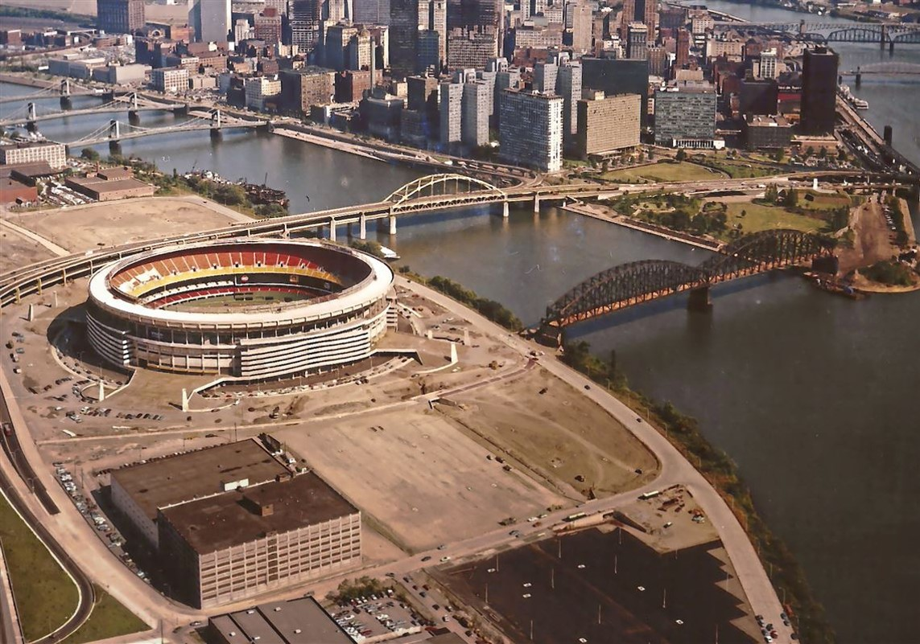
Three Rivers Stadium, Pittsburgh
Game 3 – October 12, 1979
Orioles 8, Pirates 4
Scott McGregor pitches complete game
Game 4 – October 13, 1979
Orioles 9, Pirates 6
Six run 8th inning helps Orioles take commanding 3-1 lead
Game 5 – October 14, 1979
Pirates 7, Orioles 1
Bucs stave off elimination, force return to Baltimore

Slide 35
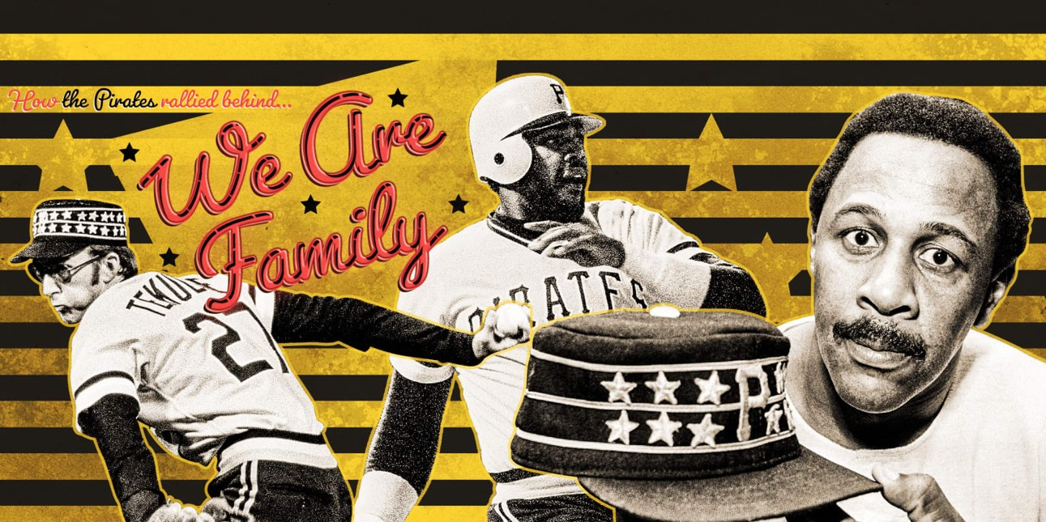
Memorial Stadium, Baltimore
Game 6 – October 15, 1979
Pirates 4, Orioles 0
Shutout evens Series, forces deciding Game 7
Game 7 – October 16, 1979
Pirates 4, Orioles 1
Pirates erase 3-1 deficit, win Series behind HR from MVP Stargell
https://www.youtube.com/watch?v=wDTLOmeW_38

Slide 36
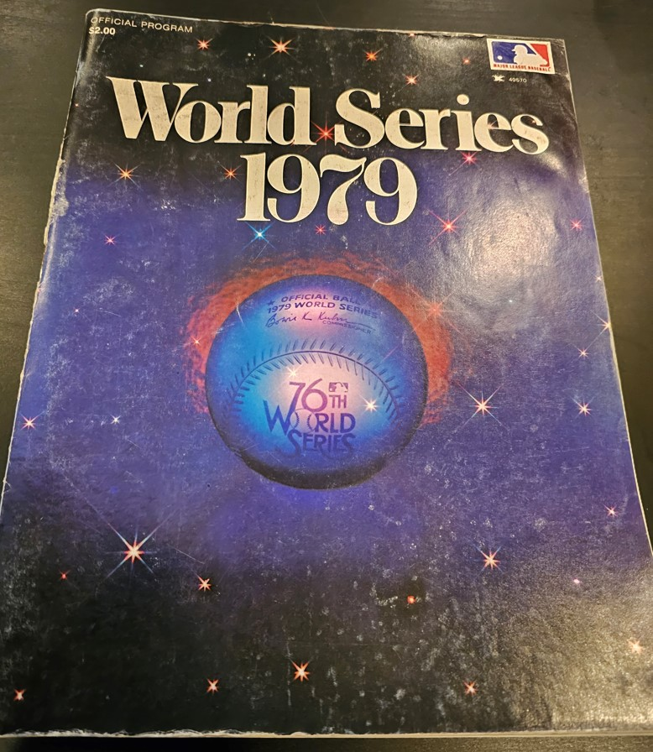
Souvenirs From A Freezing World Series

Slide 37
1979 World Series
The Pirates won their 5th World Series
Dating back to the first modern day
World Series in 1903
Willie Stargell was the World Series MVP

Slide 38
Extra Innings!
More Stuff from the ‘60s and ‘70s

Slide 39
Automobile makes/models we don’t have anymore
Volkswagen “Beetle”

Slide 40
Automobile makes/models we don’t have anymore
Studebaker

Slide 41
Automobile makes/models we don’t have anymore
Rambler

Slide 42
Automobile makes/models we don’t have anymore
Pontiac
Notes:
Pontiac Catalina four door

Slide 43
Automobile makes/models we don’t have anymore
Oldsmobile
Notes:
Oldmobile 98 – it was huge

Slide 44
Automobile makes/models we don’t have anymore
Mercury
Notes:
Mercury Monterey

Slide 45
Automobile makes/models we don’t have anymore
Plymouth
Notes:
Plymouth Belvedere – I did driver’s ed in one of these

Slide 46
… and one of the auto industry’s all-time worst “flops”
Edsel
Notes:
Edsel – 1958 to 1960 – new brand (at the time) from Ford. Named after Henry Ford’s son, Edsel Ford.

Slide 47
Product Jingles & Slogans

Slide 48
“See the U.S.A. in your …”
What famous singer and TV personality
sang the jingle?
https://www.youtube.com/watch?v=qhR8GZ_WWMM
Notes:
She had a string of eighty charted popular hits, spanning from 1940 to 1957, and after appearing in a handful of feature films, she went on to a four-decade career in American television.

Slide 49
“You can trust your car
to the man who
wears the star …”
https://www.youtube.com/watch?v=b1zxOTDHIBQ

Slide 50
“Be all that you can be!”
Notes:
Army recruiting slogan from 1980 to 2001, and re-established in 2023.

Slide 51
Baseball star Ty Cobb (aka the Georgia Peach) was an early investor in this beverage company in Atlanta.
“Things go
better with ___-___, things go better with ____”
https://www.youtube.com/watch?v=cF9QbEUYINg
Notes:
In 1907, he bought 300 shares of stock in Coca-Cola. Over the next 20 years, he expanded that to 24,000 shares. When Cobb died in 1961, he owned $2.1 million worth of Coca-Cola stock. He was also a big investor in General Motors. Jingle from the ‘60s.

Slide 52
“The Breakfast
of Champions”
https://www.youtube.com/watch?v=CGaxdEwF4Ns

Slide 53
“Where’s the beef ?”
https://www.youtube.com/watch?v=U80ebi4AKgs

Slide 54
“Tastes great, less filling”
https://www.youtube.com/watch?v=Sp4RIITcOt0
Notes:
A lot of baseball players did ads for Miller Light – here’s Brewer’s announcer and former big league catcher Bob Uecker

Slide 55
“Here comes
the
King of Beers”
https://www.youtube.com/watch?v=onBHcQgHA4s
Notes:
A-B is a major sponsor of most sports programming in the U.S. A tradition on Opening Day in St. Louis.

Slide 56
“Don’t leave home without it”
https://www.youtube.com/watch?v=nMzNJkx1NoQ
Notes:
Karl Malden was known for the traveler’s check commercials; Mel Blanc

Slide 57
Thanks !!!
We’ll see you again next month!

