Slide 1
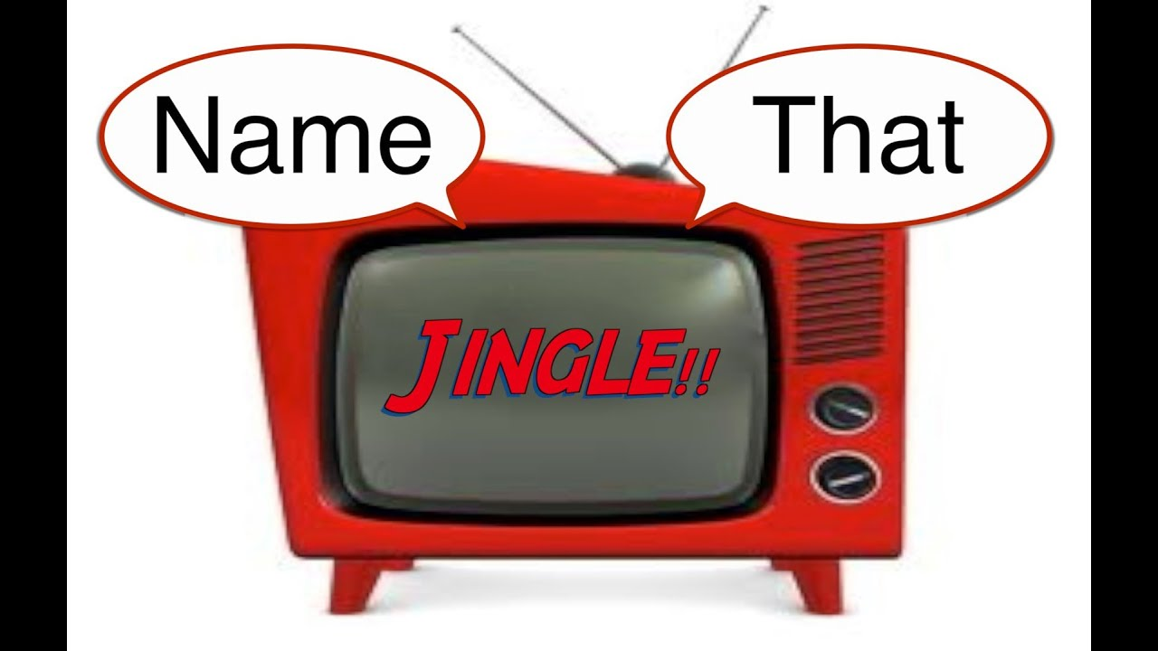
Product Jingles & Slogans

Slide 2

“See the U.S.A. in your …”
What famous singer and TV personality
sang the jingle?
https://www.youtube.com/watch?v=qhR8GZ_WWMM
Notes:
She had a string of eighty charted popular hits, spanning from 1940 to 1957, and after appearing in a handful of feature films, she went on to a four-decade career in American television.

Slide 3

“You can trust your car
to the man who
wears the star …”
https://www.youtube.com/watch?v=b1zxOTDHIBQ

Slide 4


“Be all that you can be!”
Notes:
Army recruiting slogan from 1980 to 2001, and re-established in 2023.

Slide 5
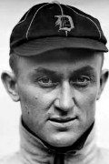
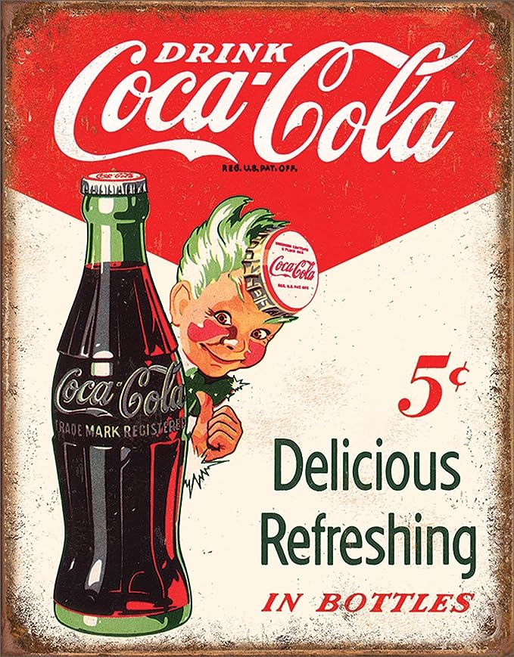
Baseball star Ty Cobb (aka the Georgia Peach) was an early investor in this beverage company in Atlanta.
“Things go
better with ___-___, things go better with ____”
https://www.youtube.com/watch?v=cF9QbEUYINg
Notes:
In 1907, he bought 300 shares of stock in Coca-Cola. Over the next 20 years, he expanded that to 24,000 shares. When Cobb died in 1961, he owned $2.1 million worth of Coca-Cola stock. He was also a big investor in General Motors. Jingle from the ‘60s.

Slide 6
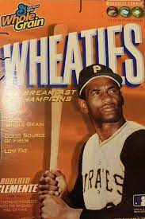
“The Breakfast
of Champions”
https://www.youtube.com/watch?v=CGaxdEwF4Ns

Slide 7
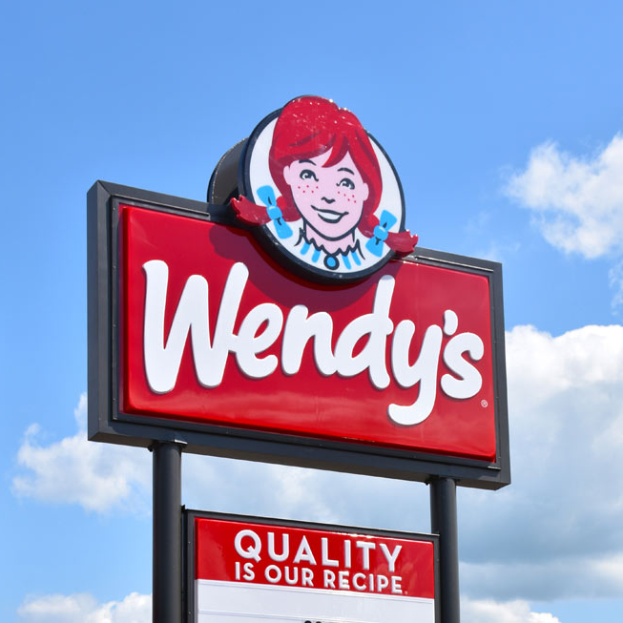
“Where’s the beef ?”
https://www.youtube.com/watch?v=U80ebi4AKgs

Slide 8
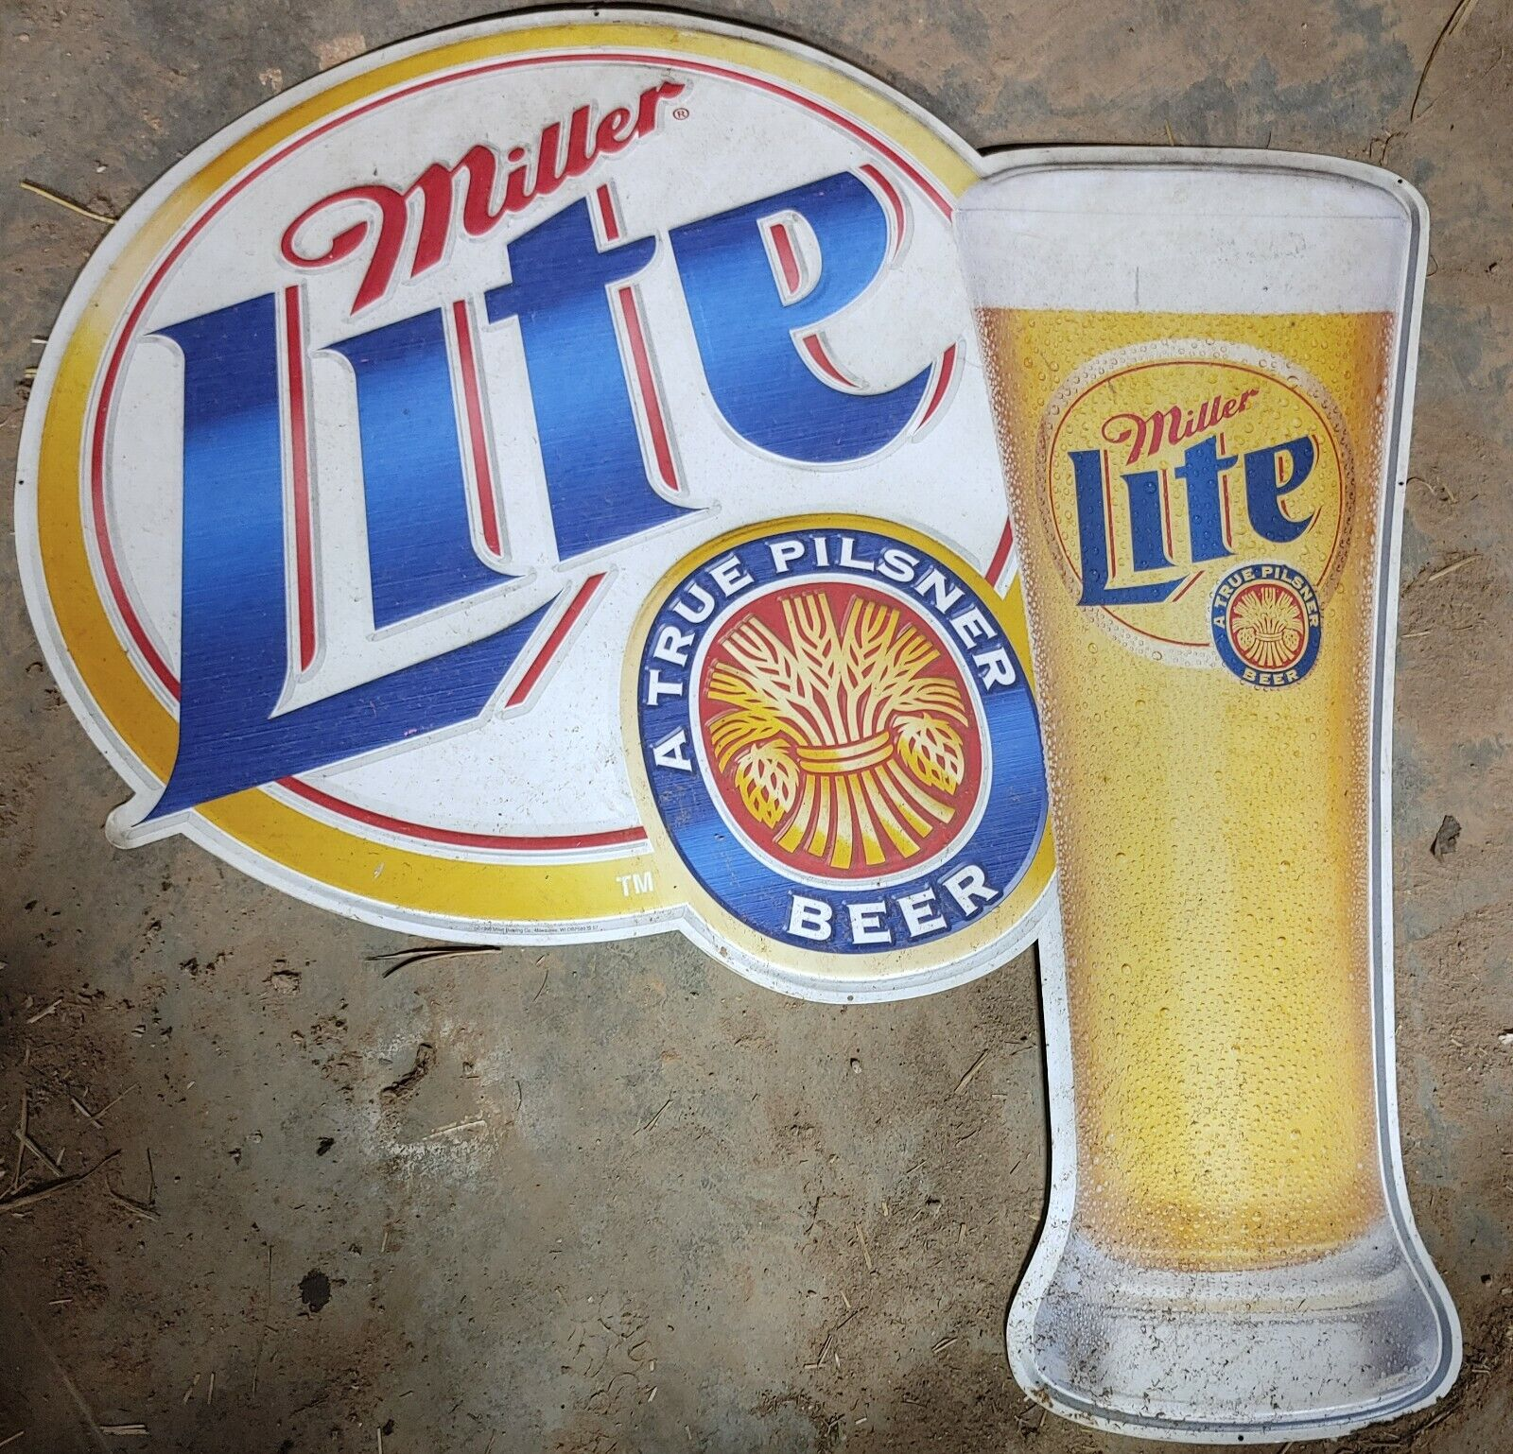
“Tastes great, less filling”
https://www.youtube.com/watch?v=Sp4RIITcOt0
Notes:
A lot of baseball players did ads for Miller Light – here’s Brewer’s announcer and former big league catcher Bob Uecker

Slide 9
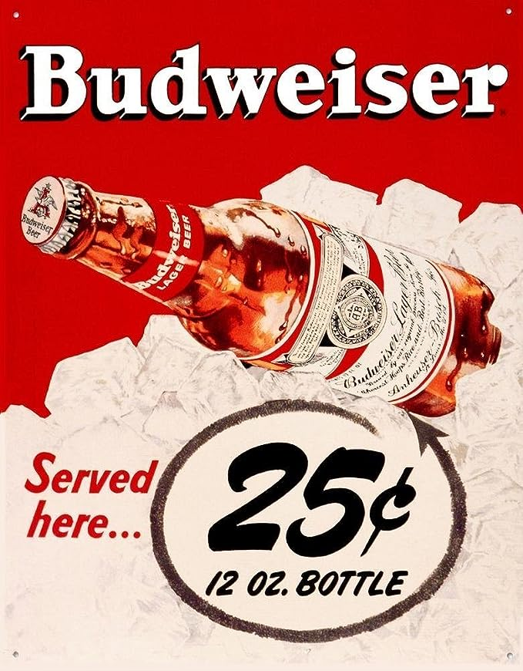
“Here comes
the
King of Beers”
https://www.youtube.com/watch?v=onBHcQgHA4s
Notes:
A-B is a major sponsor of most sports programming in the U.S. A tradition on Opening Day in St. Louis.

Slide 10
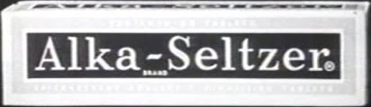
“Plop, plop, fizz, fizz, oh
what a relief it is!”
Notes:
If you’ve drank too much Miller Lite or Budweiser, you may need this product …

Slide 11
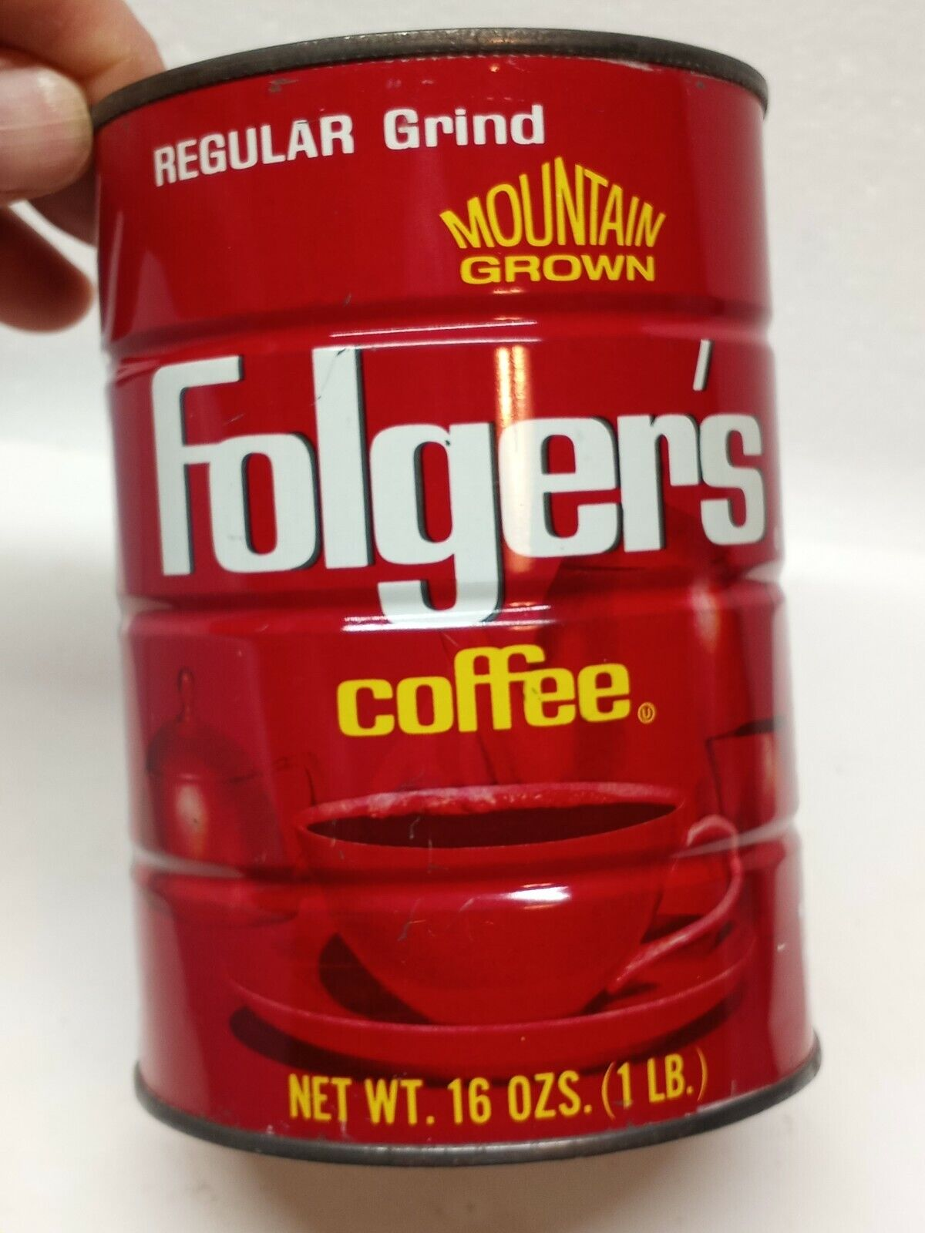
“The best part of waking up is _______ in your cup.”

Slide 12
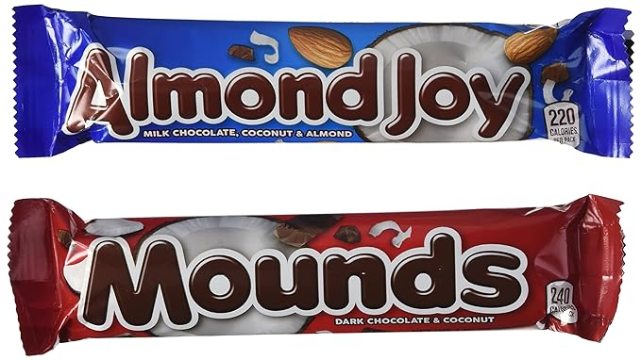
“Some times you feel like a nut, sometimes you don’t”

Slide 13
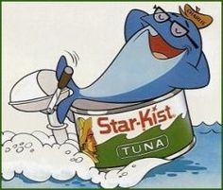
“Sorry Charlie, we don’t want tuna with good taste, we want tuna that tastes good”

Slide 14
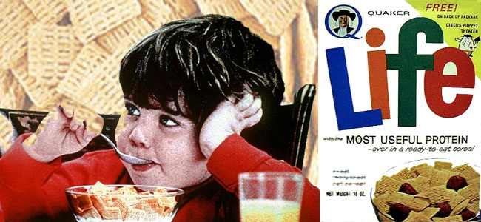
“Give it to Mikey. He won’t eat it, he hates everything!”

Slide 15
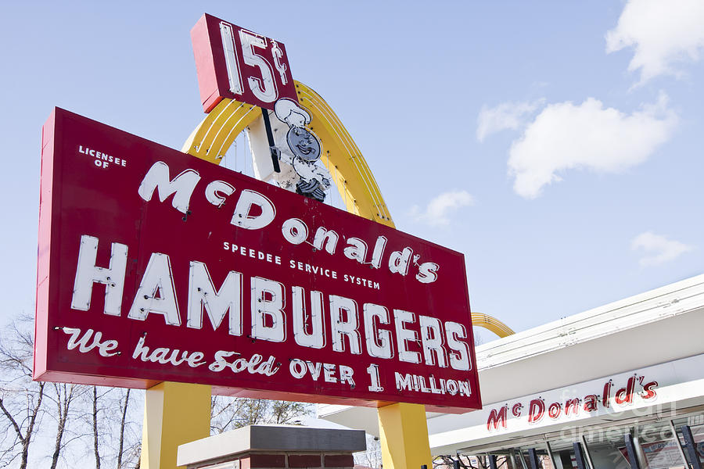
“You deserve a break today, at ________ !”

Slide 16

“You’re in good hands”

Slide 17
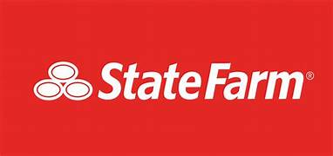
“Like a good neighbor, ____ ____ is there”

Slide 18
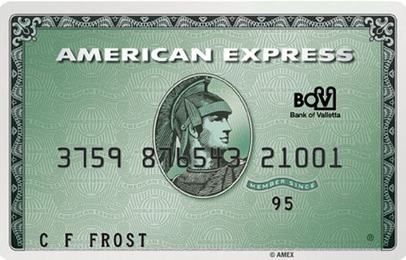
“Don’t leave home without it”
https://www.youtube.com/watch?v=nMzNJkx1NoQ
Notes:
Karl Malden was known for the traveler’s check commercials; Mel Blanc

