Slide 1
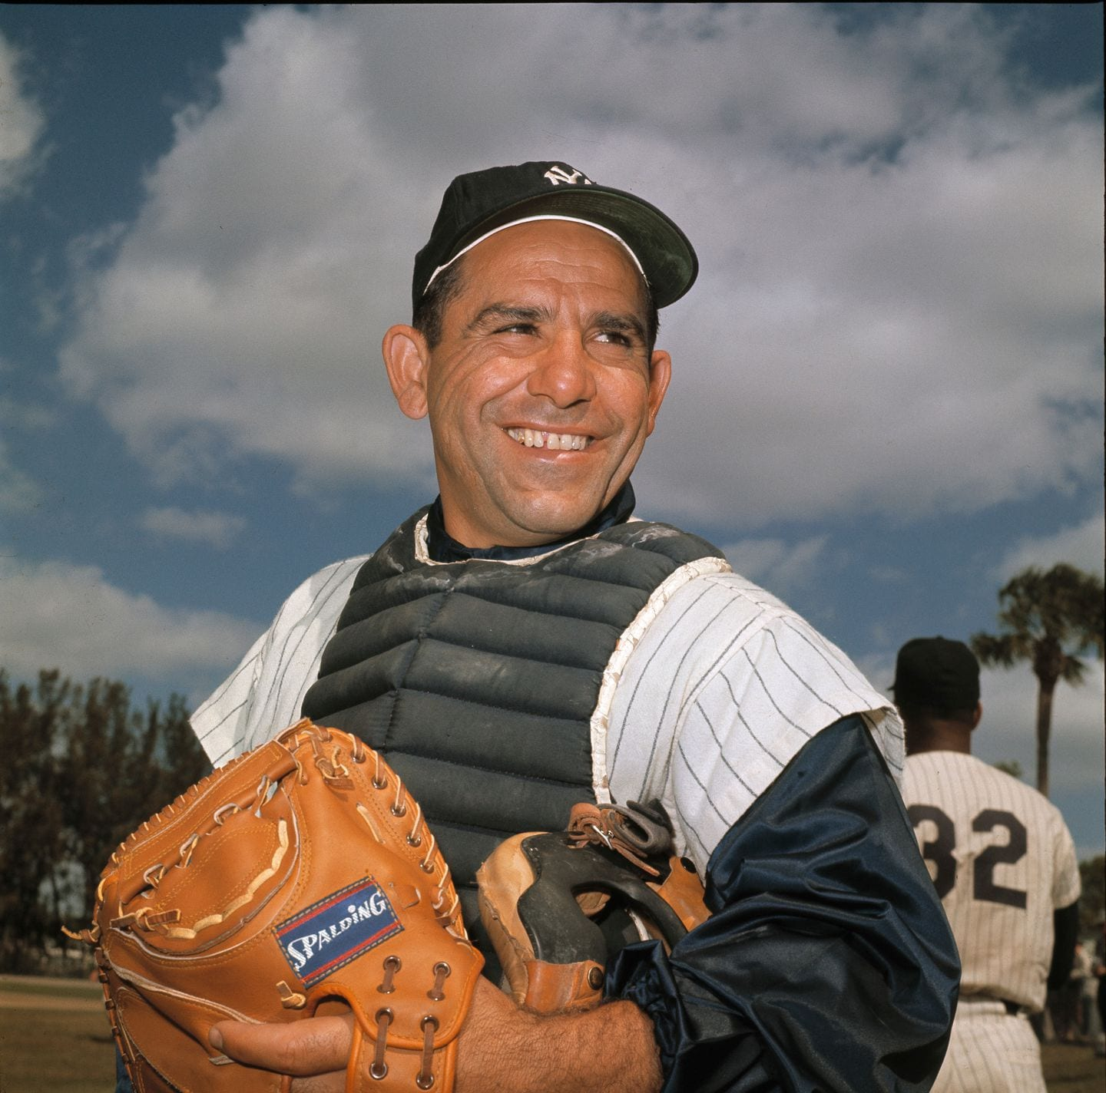
Yogi–isms
Wit and Wisdom from the great Baseball Philosopher
and Hall-of-Fame Catcher

Slide 2
Lawrence Peter
Berra
(aka Yogi)
One of MLB’s greatest catchers
Played 19 seasons in the Majors
Three time American League MVP
Played in 18 All-Star Games
Played in 14 World Series, won 10

Slide 3
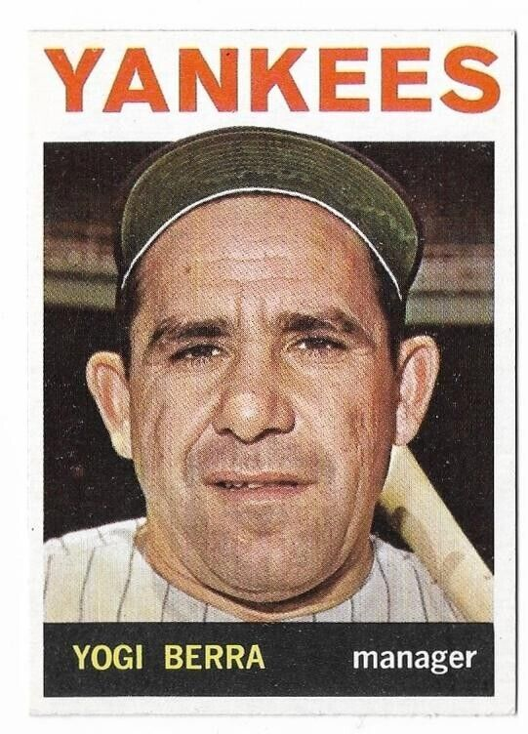
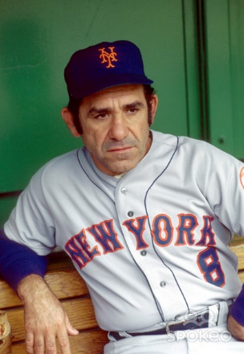
Yogi managed
the 1964 Yankees &
1973 Mets

Slide 4
Yogi was also
famous for his
colorful statements
Which came to be called: “Yogi-isms”

Slide 5
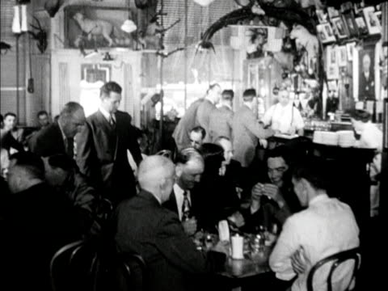
Yogi on selecting a restaurant:
“Nobody goes there anymore, it’s too crowded”

Slide 6
Yogi on fine dining:
When asked if he wanted his pizza sliced into four or eight pieces, he said:
“Better make it four, I don’t think I can eat eight”

Slide 7
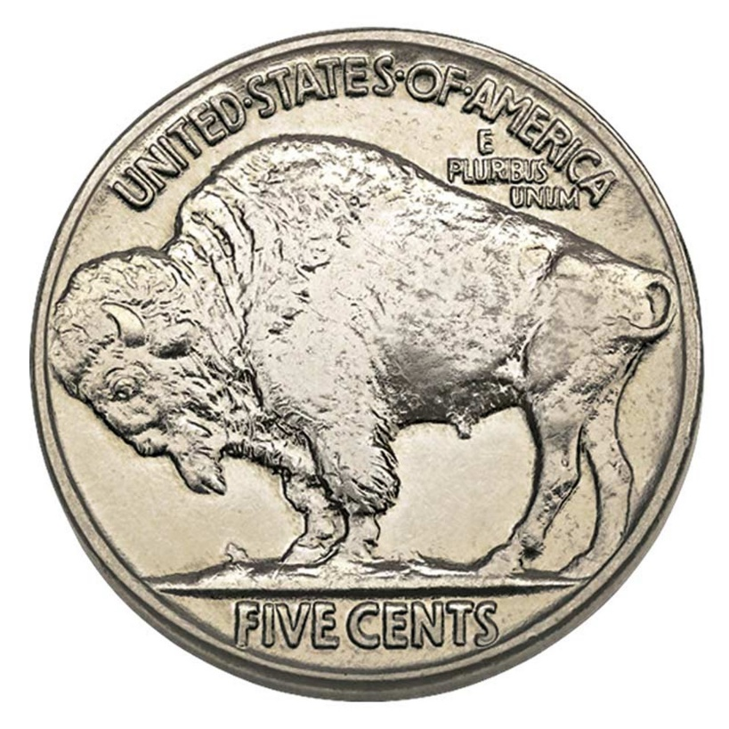
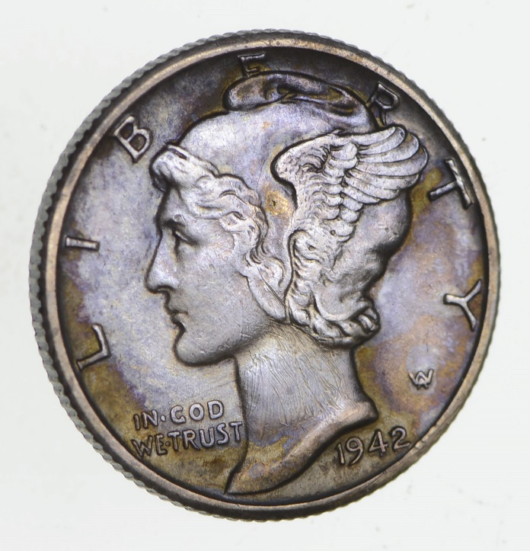
Yogi on inflation:
“A nickel ain’t
worth a dime
anymore”

Slide 8
Yogi on history
repeating itself:
“It’s deja vu all over again”

Slide 9
Yogi on geography:
“When you come to a fork in the road – take it!”

Slide 10
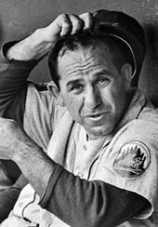
Yogi on his approach to playing baseball:
“Baseball is 90% mental, the other half is physical.”

Slide 11
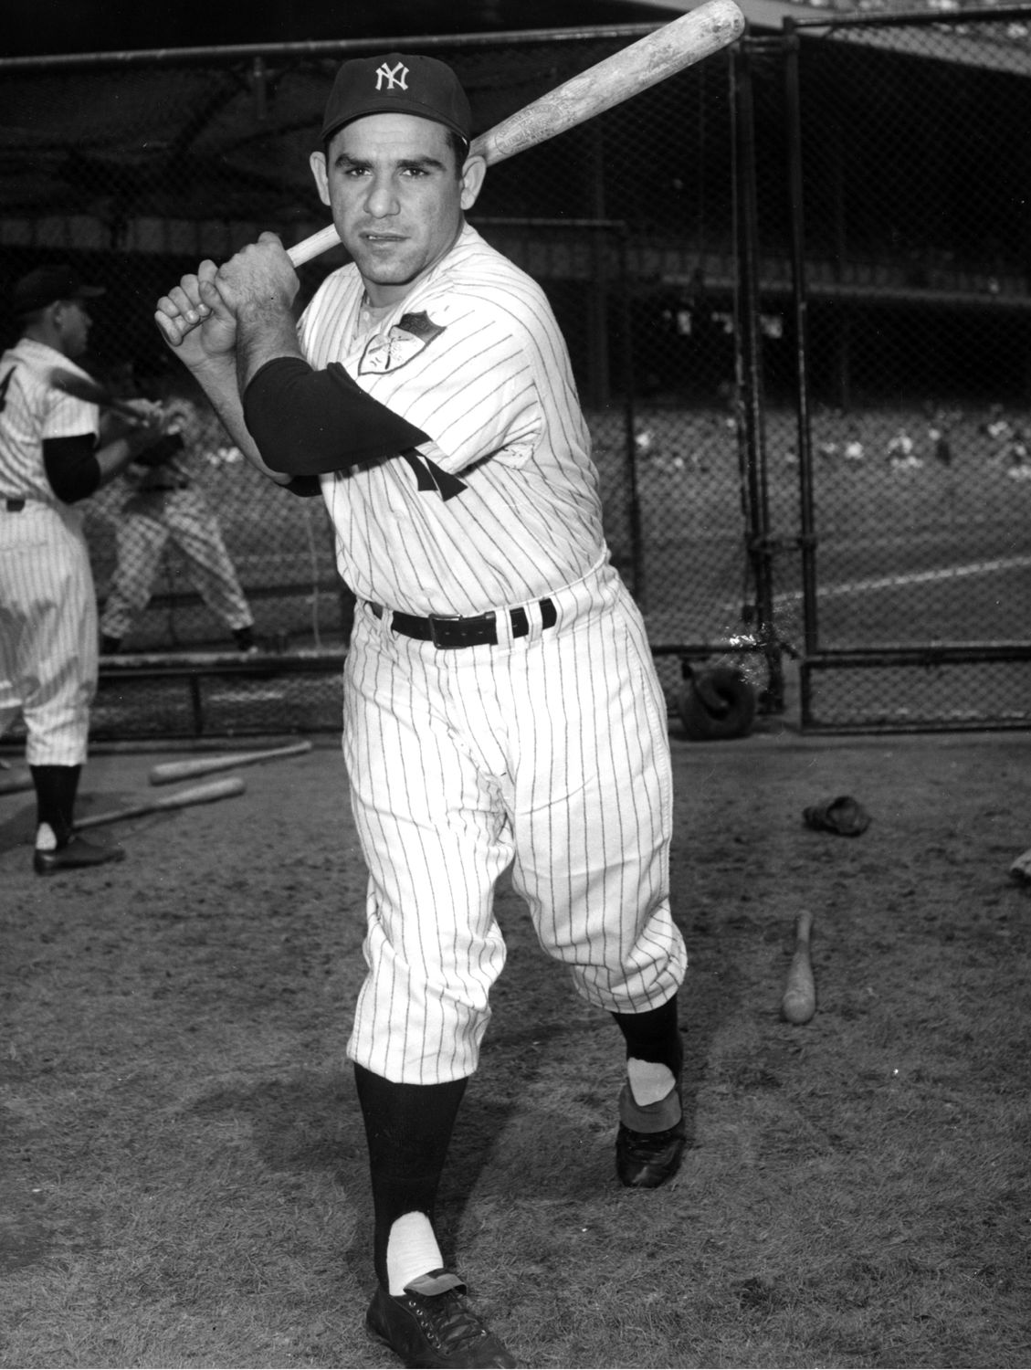
Yogi on hitting:
“You can’t think
and hit at the same time!”

Slide 12
Yogi on battling the left field shadows at Yankee Stadium:
“It gets late early out there”

Slide 13
Yogi on condolences:
“Always go to other people’s funerals, otherwise they won’t go to yours.”

Slide 14
When asked if his many quotes were true:
“I didn’t really say everything that I said.”

