Slide 1




AGE Thrive with Baseball Memories
December 18, 2024
Agenda
Warm-up – Introductions – Current Events
Baseball during the Winter?
Gametime – Christmas & Baseball

Slide 2


Slide 3
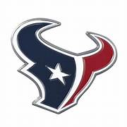


2024 Football !
and Volleyball
Notes:
Mention current won-loss for each team;

Slide 4

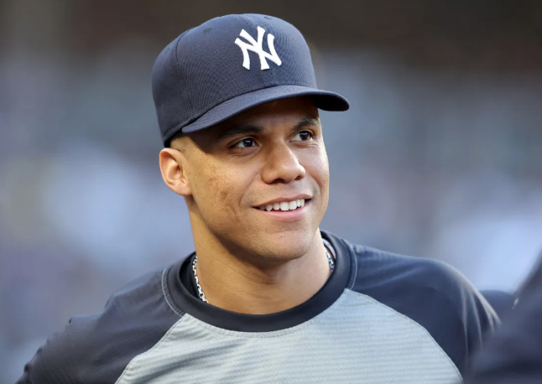

A Huge New Baseball Contract!
Juan Soto just signed with the New York Mets
for a 15-year, $765,000,000 contract !!!!!

Slide 5
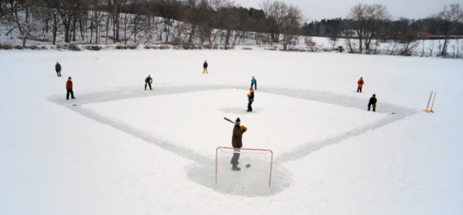
Is there Baseball in Winter?

Slide 6
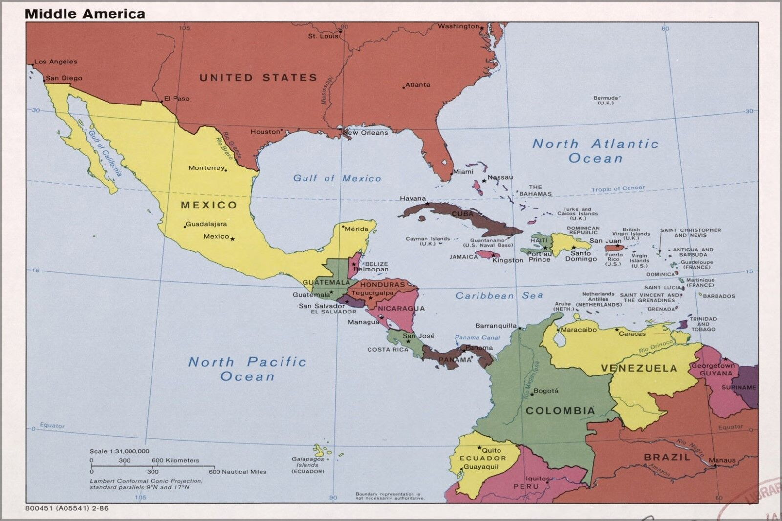

TOP PRO LEAGUES
Mexico – 10 teams
Cuba – 16
D.R. – 6
Puerto Rico - 6
Venezuela – 8
Plus smaller leagues
in:
Colombia
Panama’
Nicaragua
Curacao
Winter Baseball
Notes:
About 60 pro teams playing in Winter Leagues in Latin America and the Caribbean

Slide 7
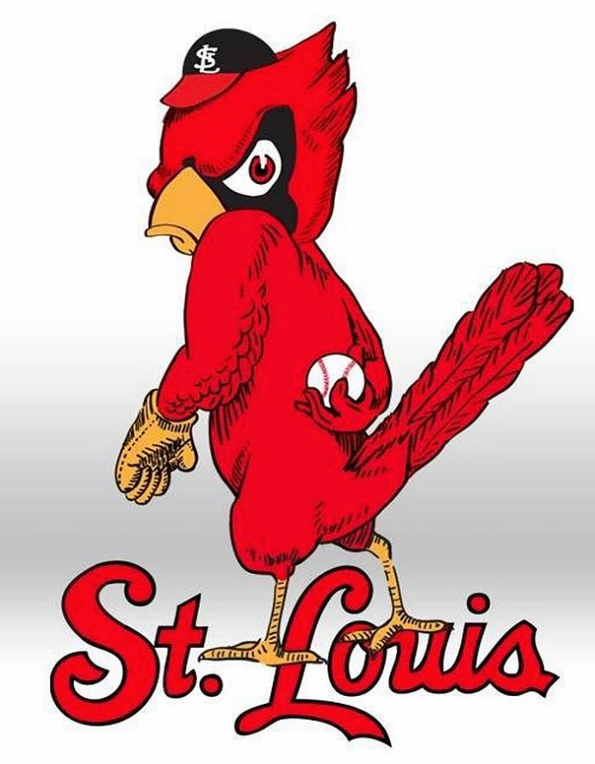

These two Cardinals play
2350 miles apart.
That’s the direct airline distance
from St. Louis to Barquisimeto
in Venezuela.
Cardenales de Lara play in the
Venezuelan Professional Winter
League

Slide 8
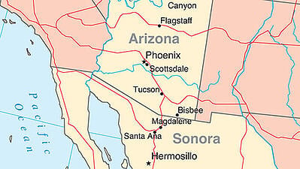

Hermosillo is directly south of Phoenix and is
the capital of the Mexican state of Sonora.
Their team, los Naranjeros, are a popular winter league
team in the Mexican Pacific League and have won 17
League championships.

Slide 9
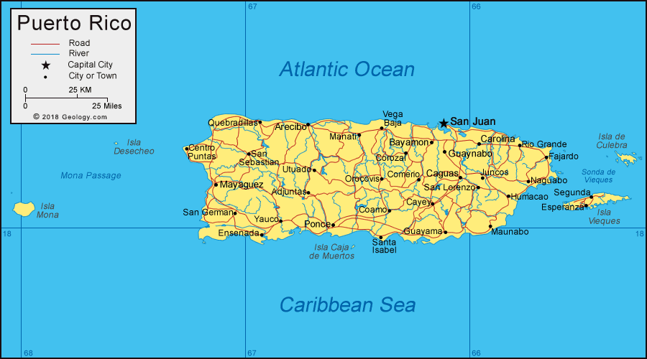

Ponce is the second largest city in Puerto Rico.
Los Leones (the Lions) baseball club was founded in 1937.
They have won 11 Puerto Rican Winter League championships; and won the Caribbean Series in 1972.

Slide 10
Christmas
and
Baseball

Slide 11
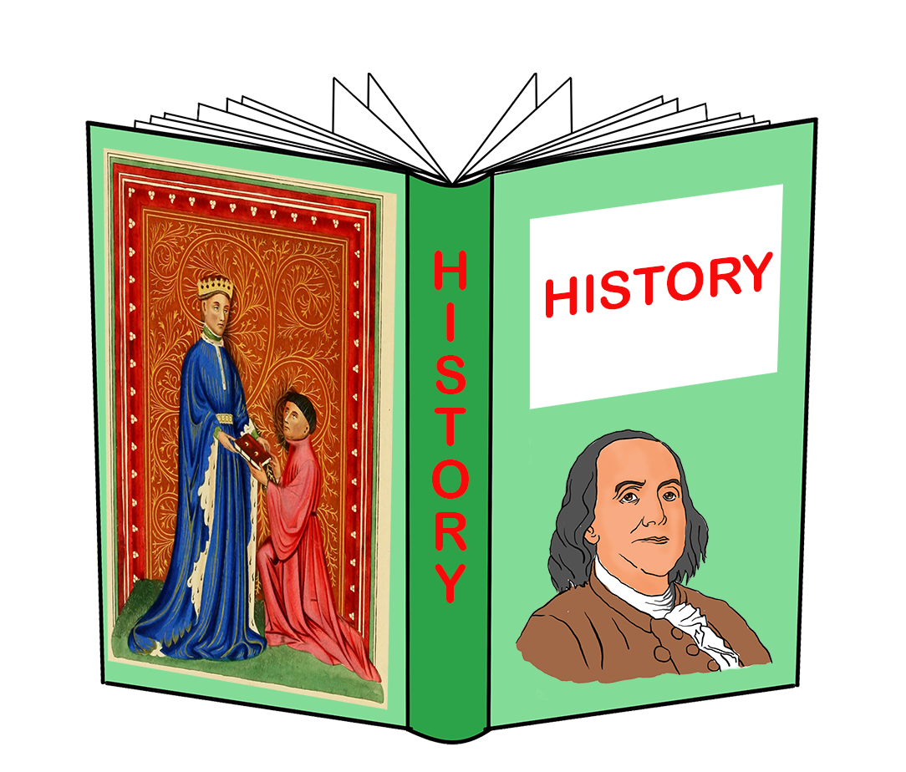
History
that happened
on
Christmas

Slide 12
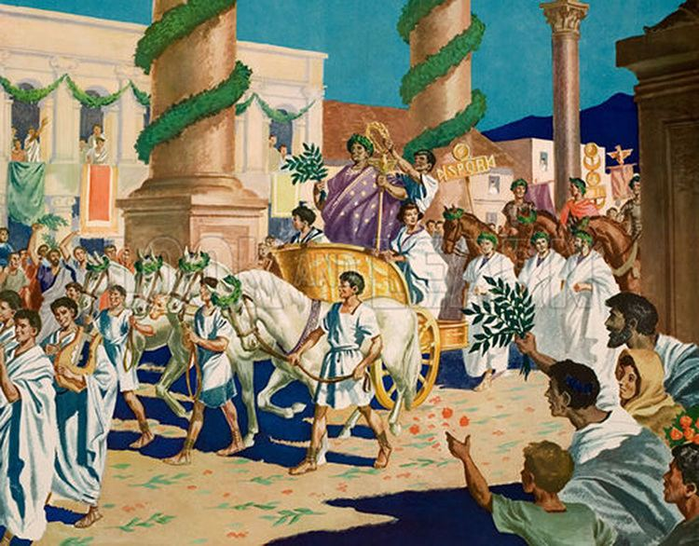
354 A.D.
Earliest recorded
reference that
the Romans
celebrated
Christmas on
Dec. 25
Notes:
The Feast of Saturn was celebrated in Rome during the advent of the Winter Solstice; once Emperor Constantine converted to Christianity in 312 AD it gradually became a celebration also of Christmas.

Slide 13
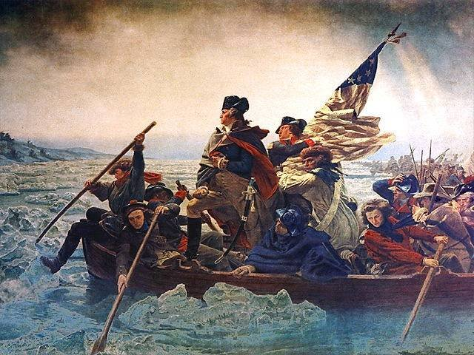
1776
Washington
and the
Continental Army cross the
Delaware
Notes:
Crossed the Delaware River on Christmas night – next morning to surprise the Hessian mercenaries at Trenton, NJ. A week later he defeated British reinforcements at Trenton and Princeton.

Slide 14
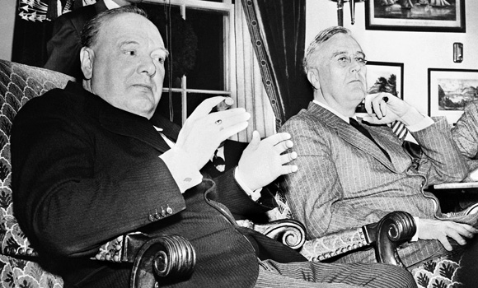
1941
Winston Churchill spends Christmas at the
White House with FDR
Notes:
PM Churchill came to the U.S. after the attack on Pearl Harbor and stayed three weeks at the White House with the President and his family.

Slide 15
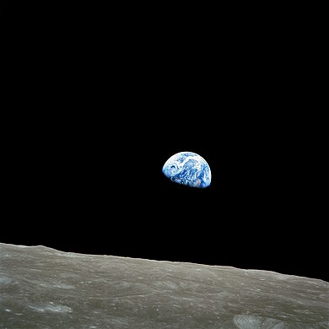
1968
Apollo 8
orbits the
Moon
Notes:
Apollo 8 was the first manned mission to leave Earth orbit and achieved orbit around the Moon. It orbited the Moon ten times and the astronauts made a Christmas Eve broadcast from there. This was a key preparation for Apollo 11 to land on the Moon only seven months later. This is a picture of an “Earth-rise” coming up over the surface of the Moon, taking by Apollo 8.

Slide 16
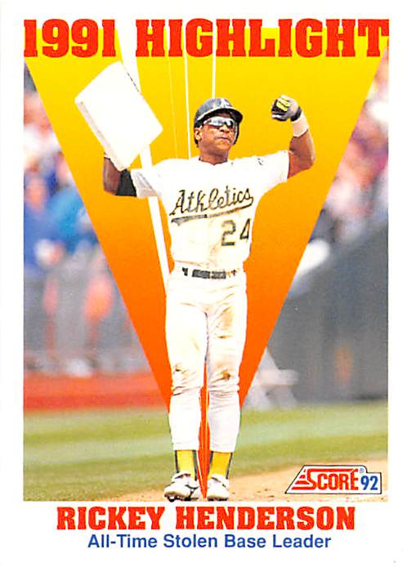
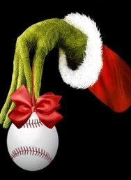
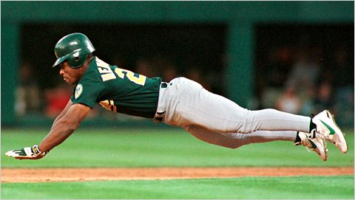
1958
The Greatest
Baseball Player to be born on Christmas
… He liked to steal things …

Slide 17
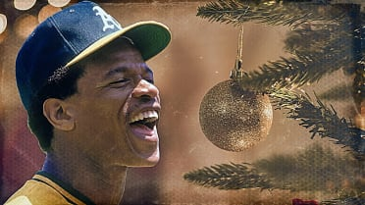
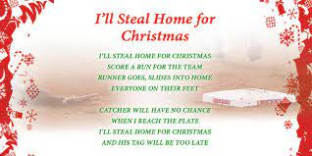

Slide 18

  Presenting. . .
  The 2024 All-Christmas Team

Slide 19
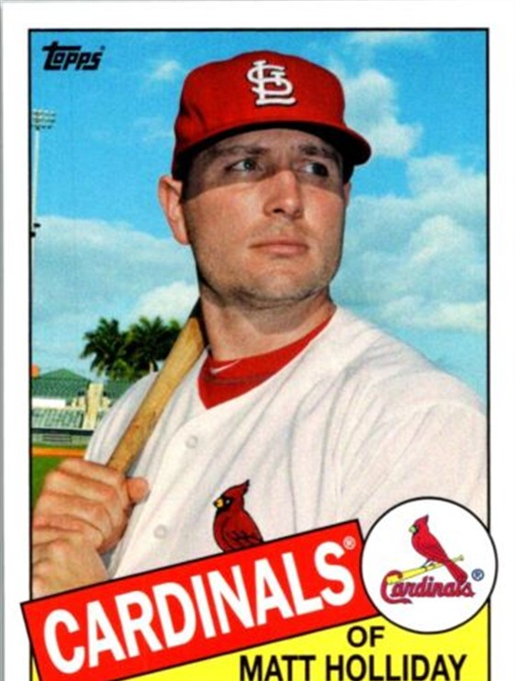
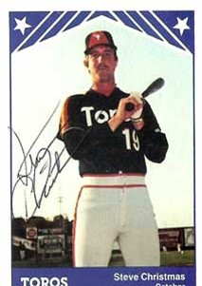
The SABR Hornsby Chapter wishes you a Merry. . .
and a Happy. . .
Steve Christmas OF

Slide 20
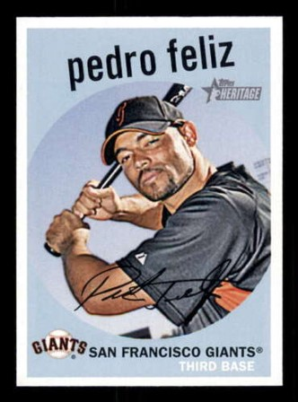
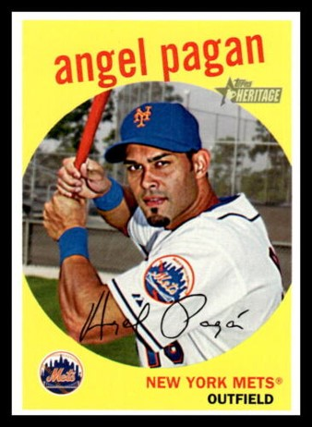
To our Spanish-speaking friends. . . Esperamos que vuestra navidad sea muy. . .
No matter how you celebrate. . .

Slide 21
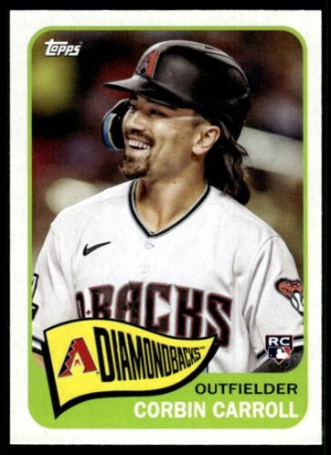
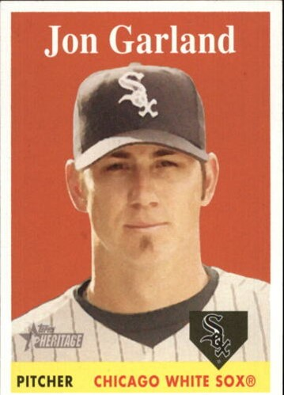
. . .and singing Christmas songs.
We hope you enjoy putting up holiday decorations. . .

Slide 22
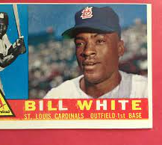
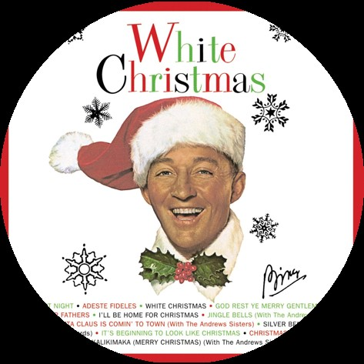
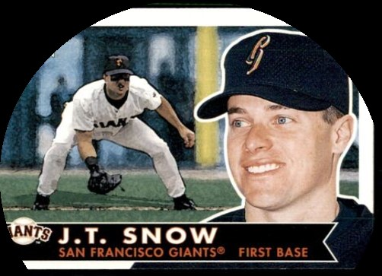
Perhaps it will even be a. . .

Slide 23
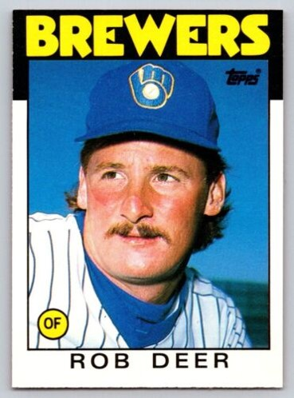
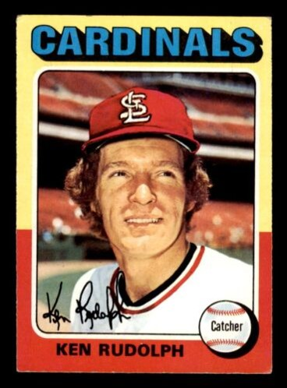
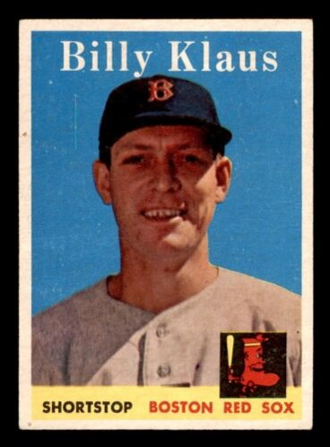
With a visit from Santa. . .
and his helpers. . .

Slide 24
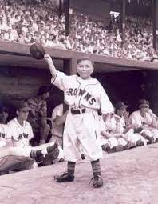
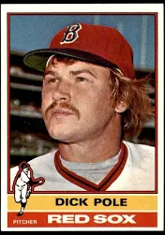
. . .including his elves.

Slide 25

Favorite Christmas Memories

Slide 26
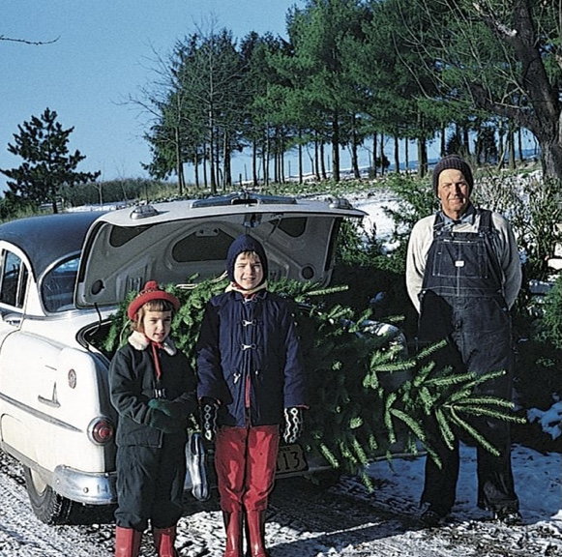
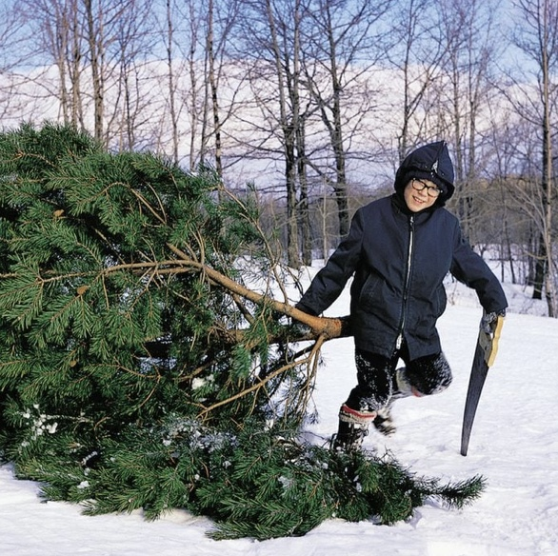
How did you get your Christmas Tree?
At a tree lot or farm?
Christmas Tree
Or did you cut it down yourself?

Slide 27
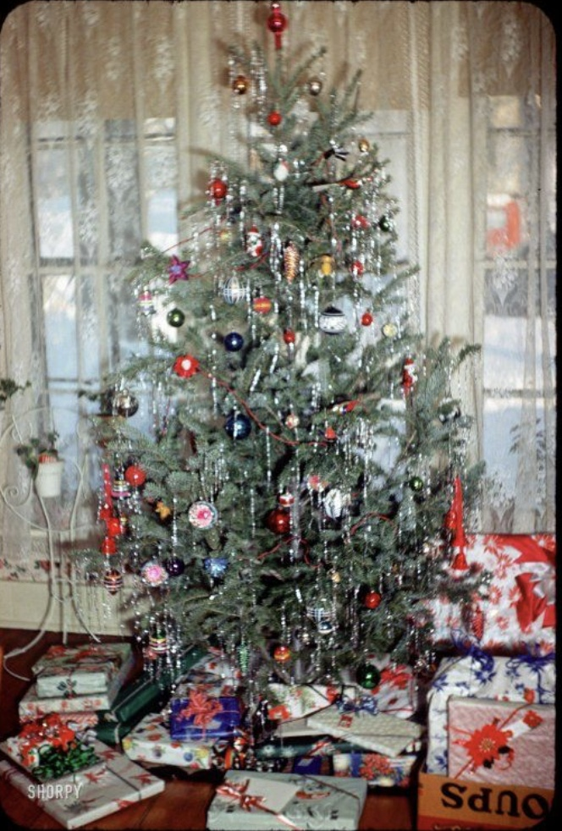
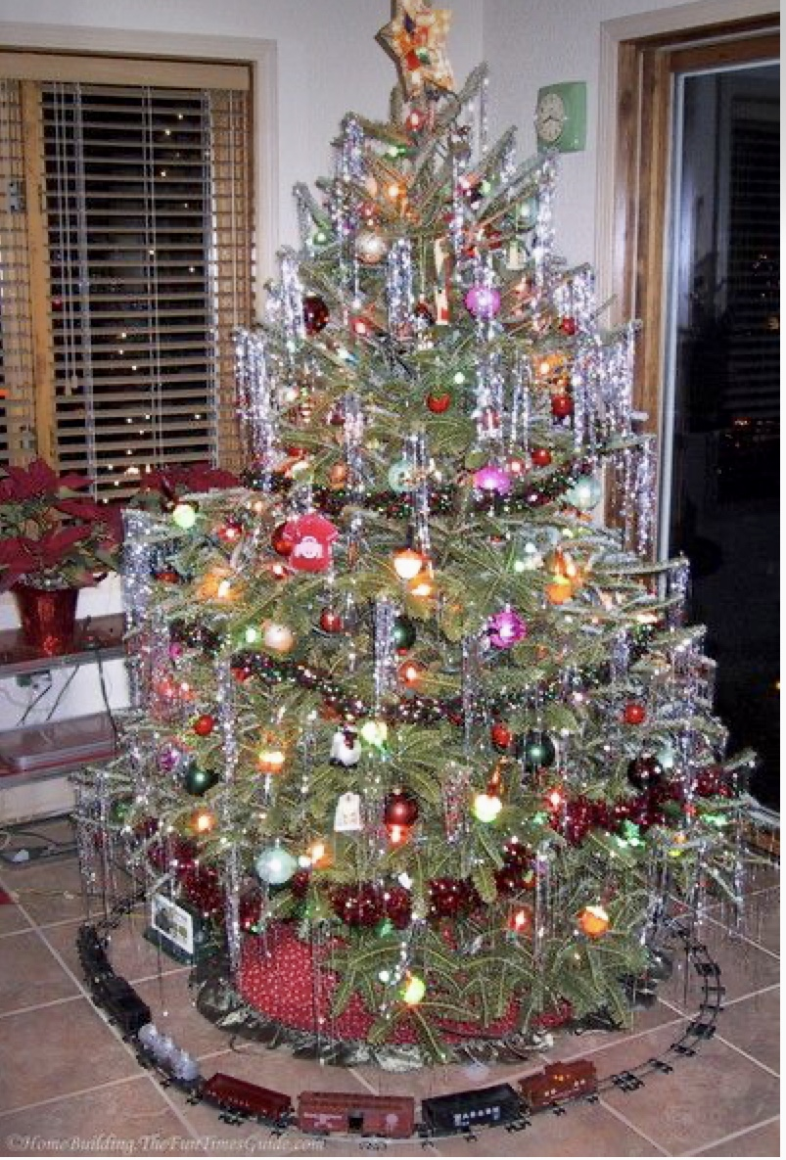
Did you have a tree that looked like this?
Or maybe with a
train around it?

Slide 28
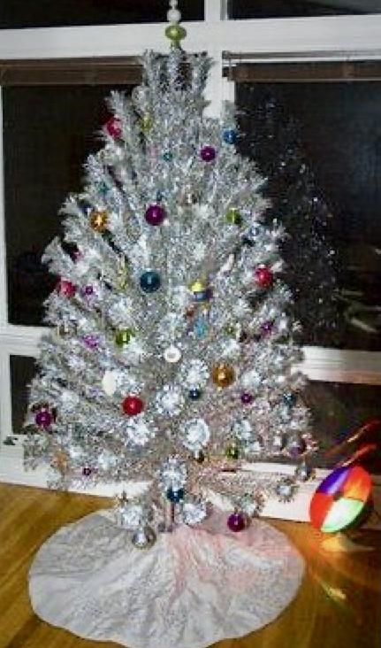
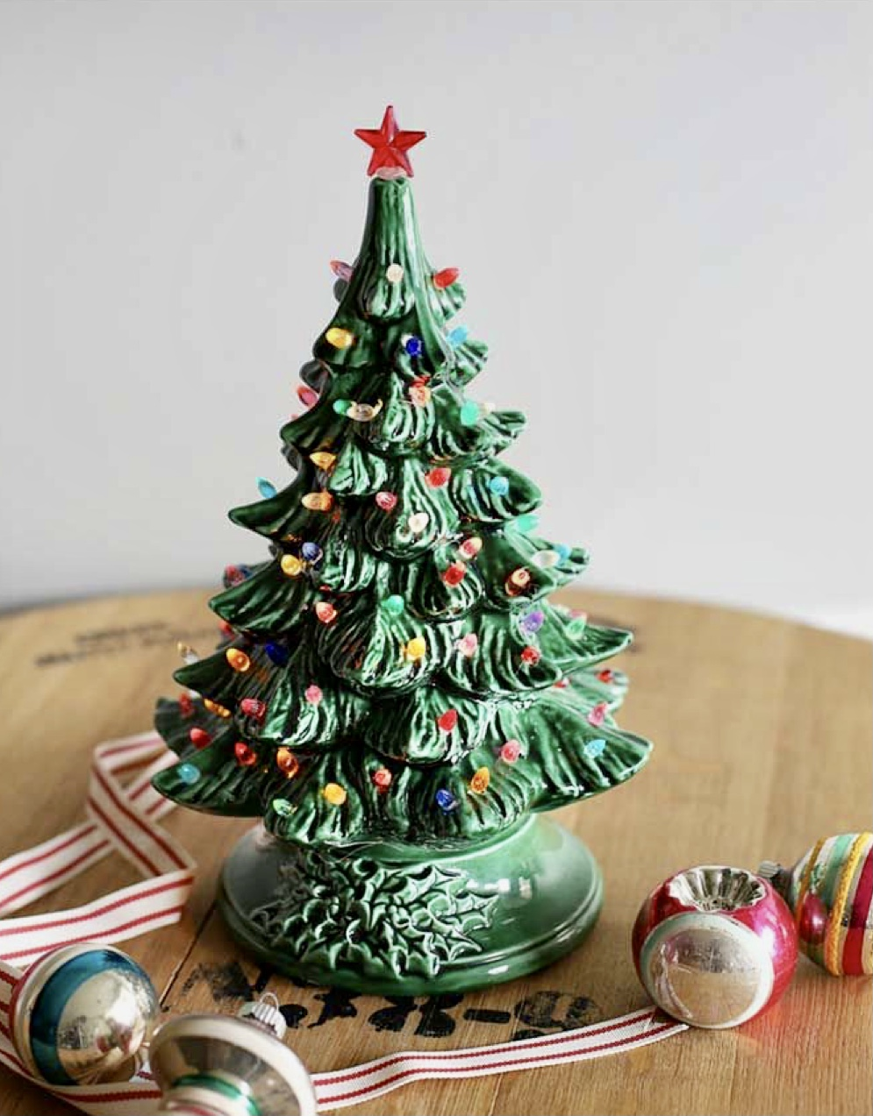
Did you ever have an aluminum tree?
.. or how about a ceramic tree?

Slide 29
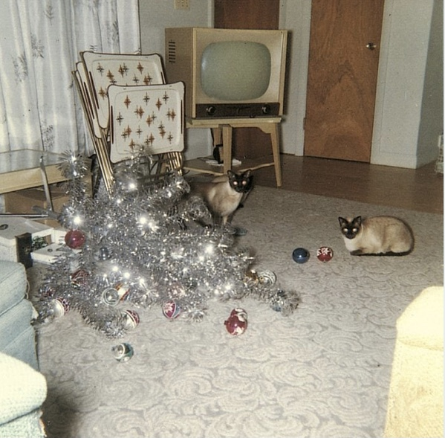
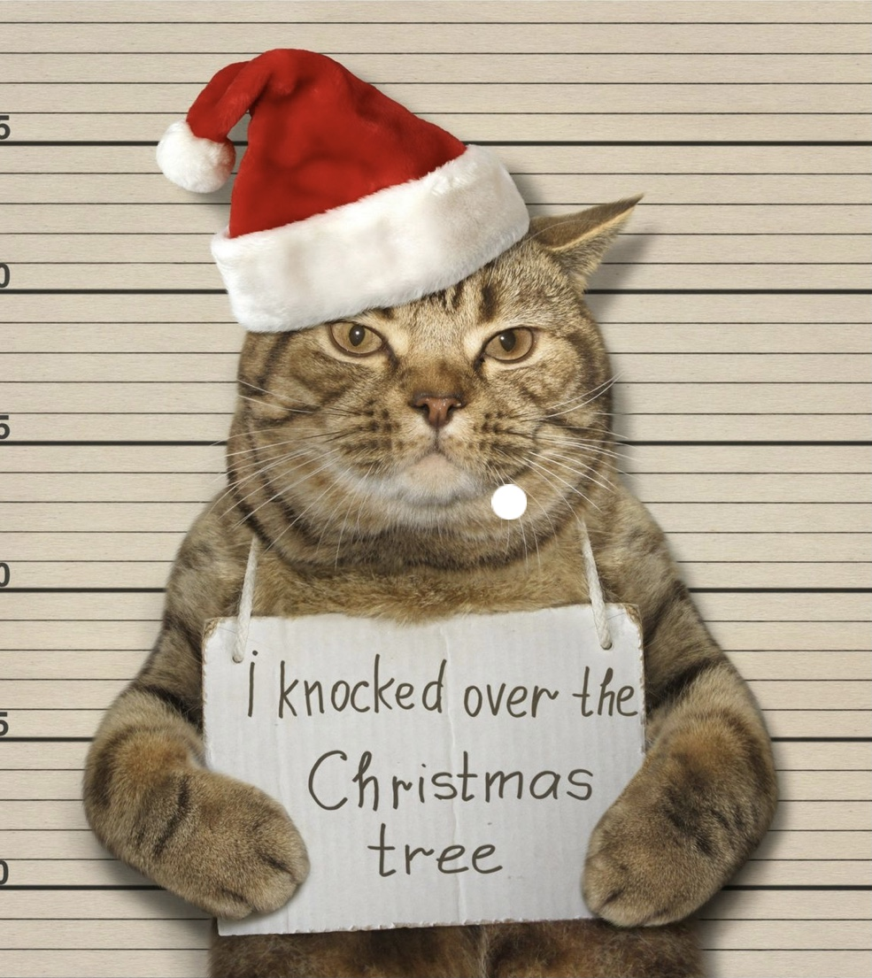
Did your tree ever mysteriously fall over?
Was the culprit your cat or dog?

Slide 30
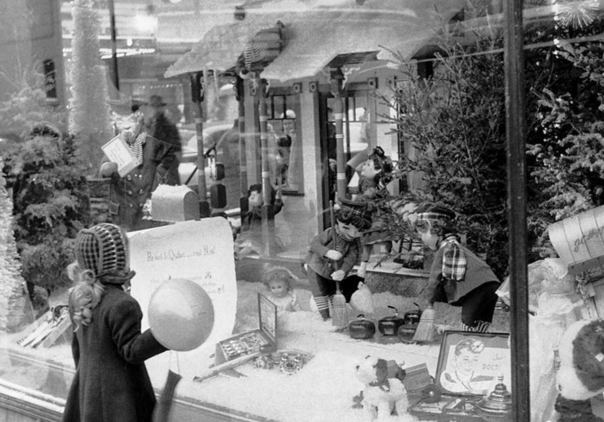
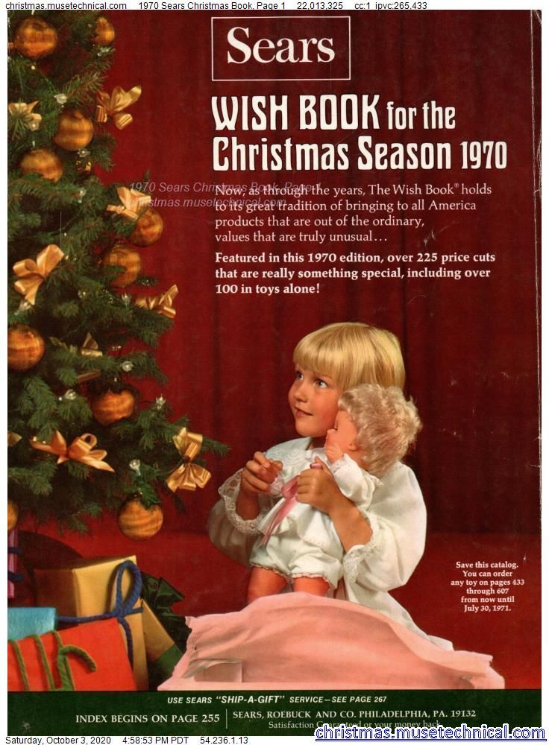
Where did you shop for Christmas?
Window shopping at a department store?
Or maybe from a catalog?

Slide 31
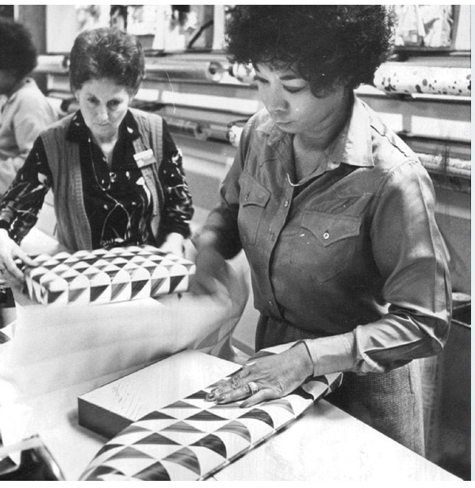
Once upon a time …
the stores would wrap your present
for you … FOR FREE!

Slide 32
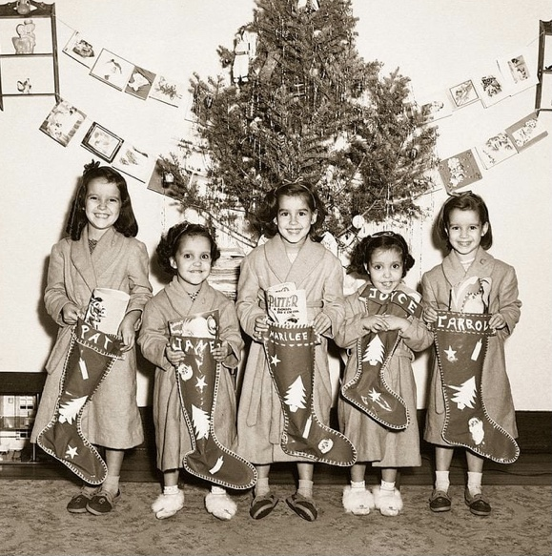
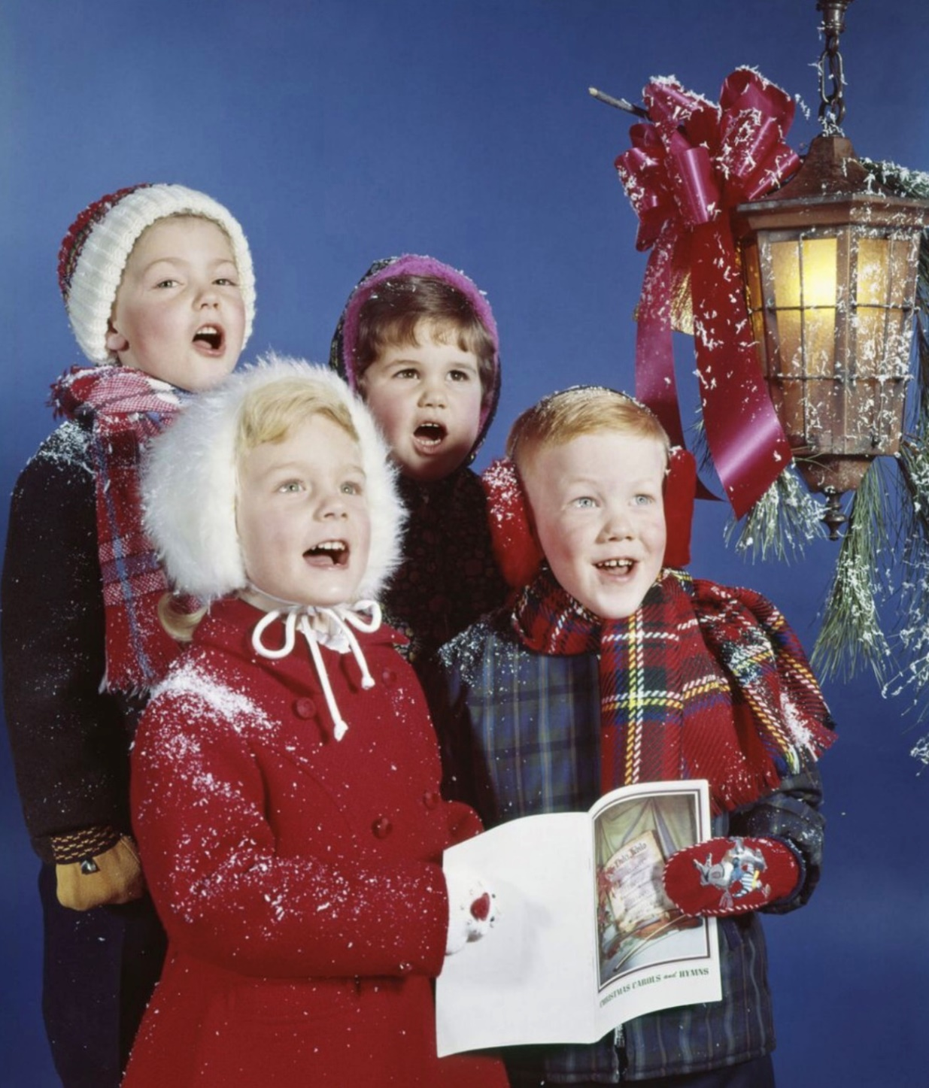
How did you celebrate Christmas?
Did you have a school play or
church pageant?
Celebrating Christmas
Did you go out caroling?

Slide 33
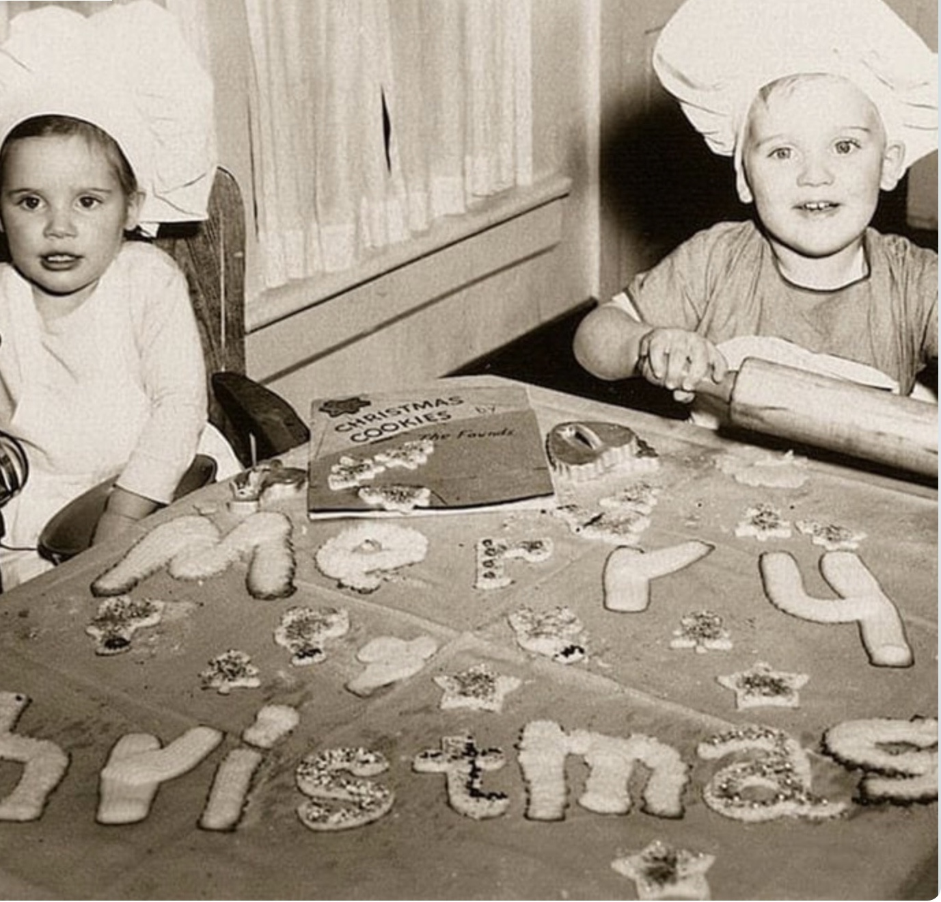
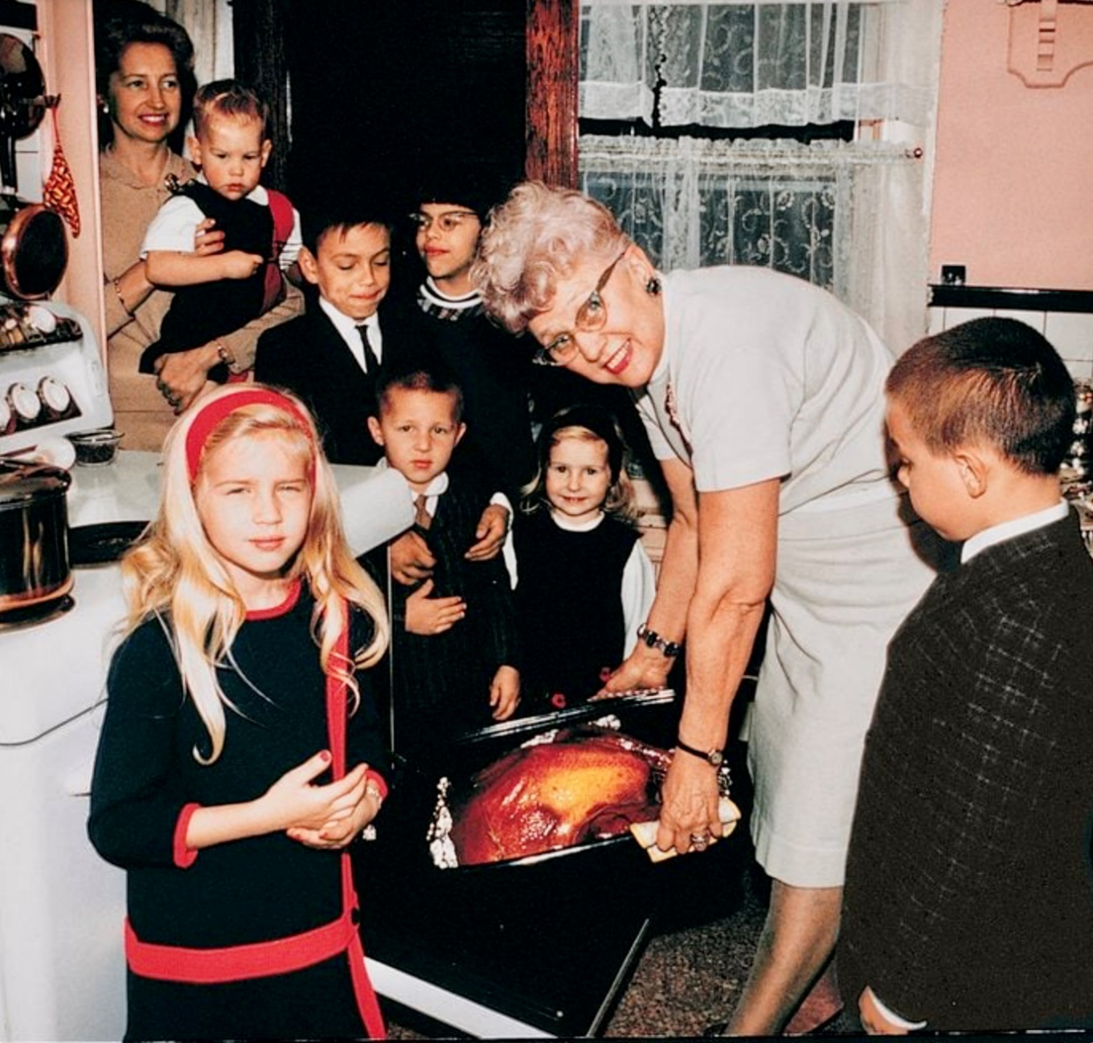
Did you help Mom bake cookies?
Celebrating Christmas
Did you go eat at Grandma’s house?

Slide 34
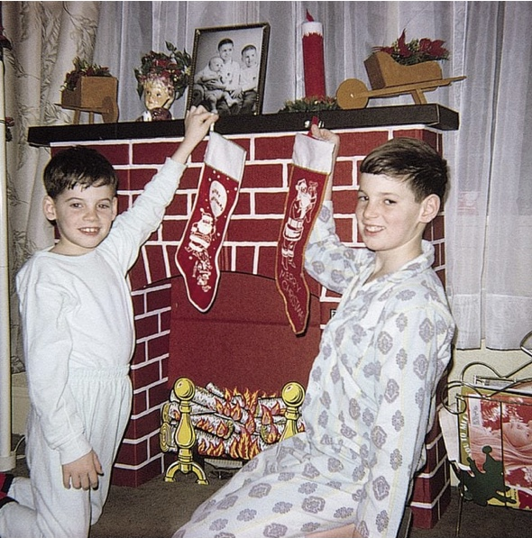
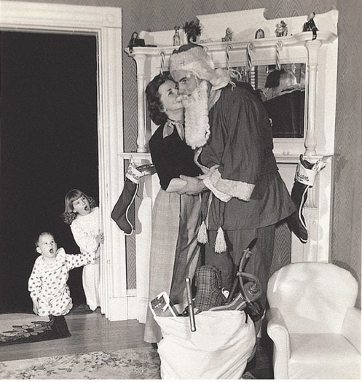
Where did you hang your Christmas Stockings?
A cardboard fake fireplace?
Christmas Stockings
Or a real fireplace with a chimney?

Slide 35
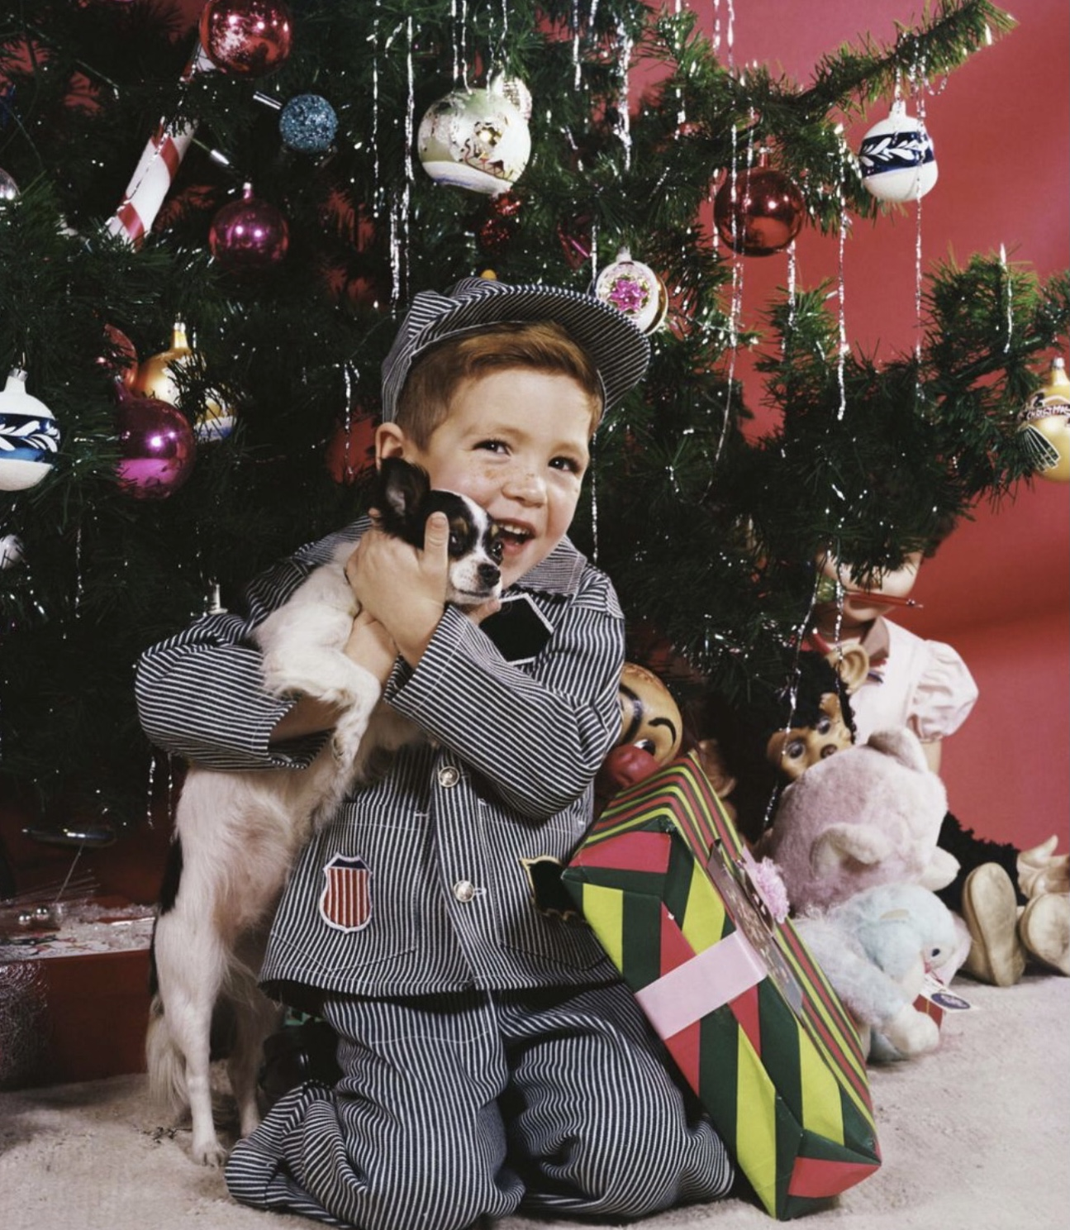
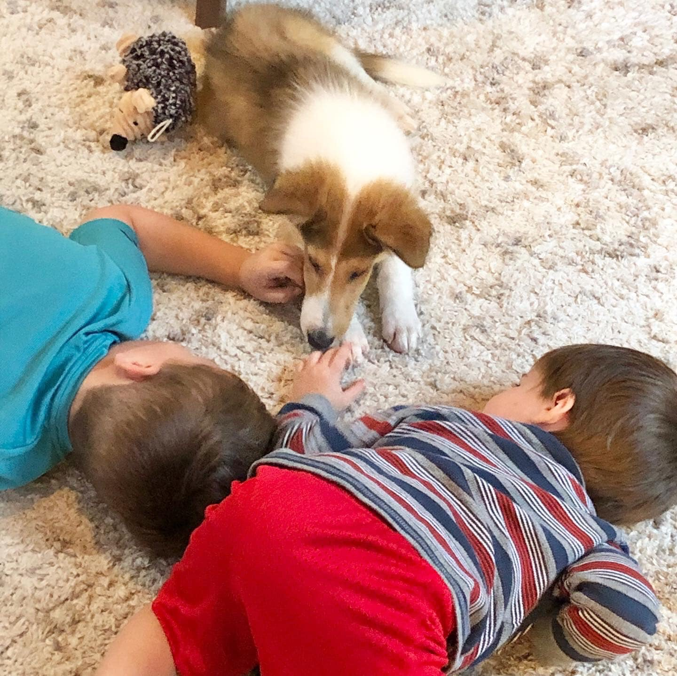
What were your favorite presents?
A puppy?
Favorite Presents
Maybe a Lassie pup?

Slide 36

Do you remember these
popular toys from the 1980s?
Cabbage
Patch
Dolls

Slide 37

Do you remember these
popular toys from the 1980s?
Teenage
Mutant
Ninja
Turtles

Slide 38

Do you remember these
popular toys from the 1980s?
Rainbow
Brite

Slide 39

Do you remember these
popular toys from the 1980s?
Nintendo

Slide 40


What were your favorite presents?
Dolls?
Favorite Presents
and accessories?

Slide 41


What were your favorite presents?
Cowboy Gear – and Six-shooter?
Favorite Presents
Cars and Trucks!

Slide 42

What were your favorite presents?
GI Joe?
(these were Action Figures, NOT dolls!)
Favorite Presents

Slide 43


What were your favorite presents?
A New Baseball Bat!
And maybe a new Glove!
Favorite Presents

Slide 44

Ballplayers at Christmas

Slide 45


Slide 46

Notes:
Joe DiMaggio

Slide 47

Notes:
Dinah Shore Christmas Special 12/22/57 – Dizzy Dean, Esther Williams, Actor John Raitt, Dinah Shore, Roy Rogers

Slide 48

Notes:
Willie Mays

Slide 49

7th Inning Stretch

Slide 50

Take Me Out
to the
Ballgame

Slide 51



Baseball
&
Christmas Carols

Slide 52




https://www.youtube.com/watch?v=y5YahVGoo0k

Slide 53





https://www.youtube.com/watch?v=3CWJNqyub3o

Slide 54



https://www.youtube.com/watch?v=_j9CgvvuXXE

Slide 55






https://www.youtube.com/watch?v=Eq5uBrDA-r0

Slide 56




https://www.youtube.com/watch?v=Nw5-7t85l0w

Slide 57




https://www.youtube.com/watch?v=RTtc2pM1boE

Slide 58




https://www.youtube.com/watch?v=-BgsA2sAuK0

Slide 59



https://www.youtube.com/watch?v=wOwXRp1JK1A

Slide 60




https://www.youtube.com/watch?v=BO_g0BgWiLI

Slide 61




https://www.youtube.com/watch?v=mUQ3mOs-nkQ

Slide 62





https://www.youtube.com/watch?v=iikUeWvZrTU

Slide 63



https://www.youtube.com/watch?v=NbixppRMiwo

Slide 64

Have a Great Christmas !
¡Feliz Navidad!
We’ll see you again next month!

