Slide 1



AGE Thrive with Baseball Memories
November 20, 2024
Agenda
Warm-up - Introductions
Current Events
Gametime – The Year in Baseball – 1981
Seventh Inning Stretch - “Take Me Out to the Ball Game”
Get Up and Move, Sing, Dance!
Extra Innings – More stuff from the ‘70s and ‘80s

Slide 2


Slide 3
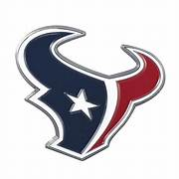

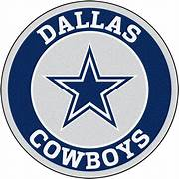
2024 Football !
and Volleyball
Notes:
Mention current won-loss for each team;

Slide 4

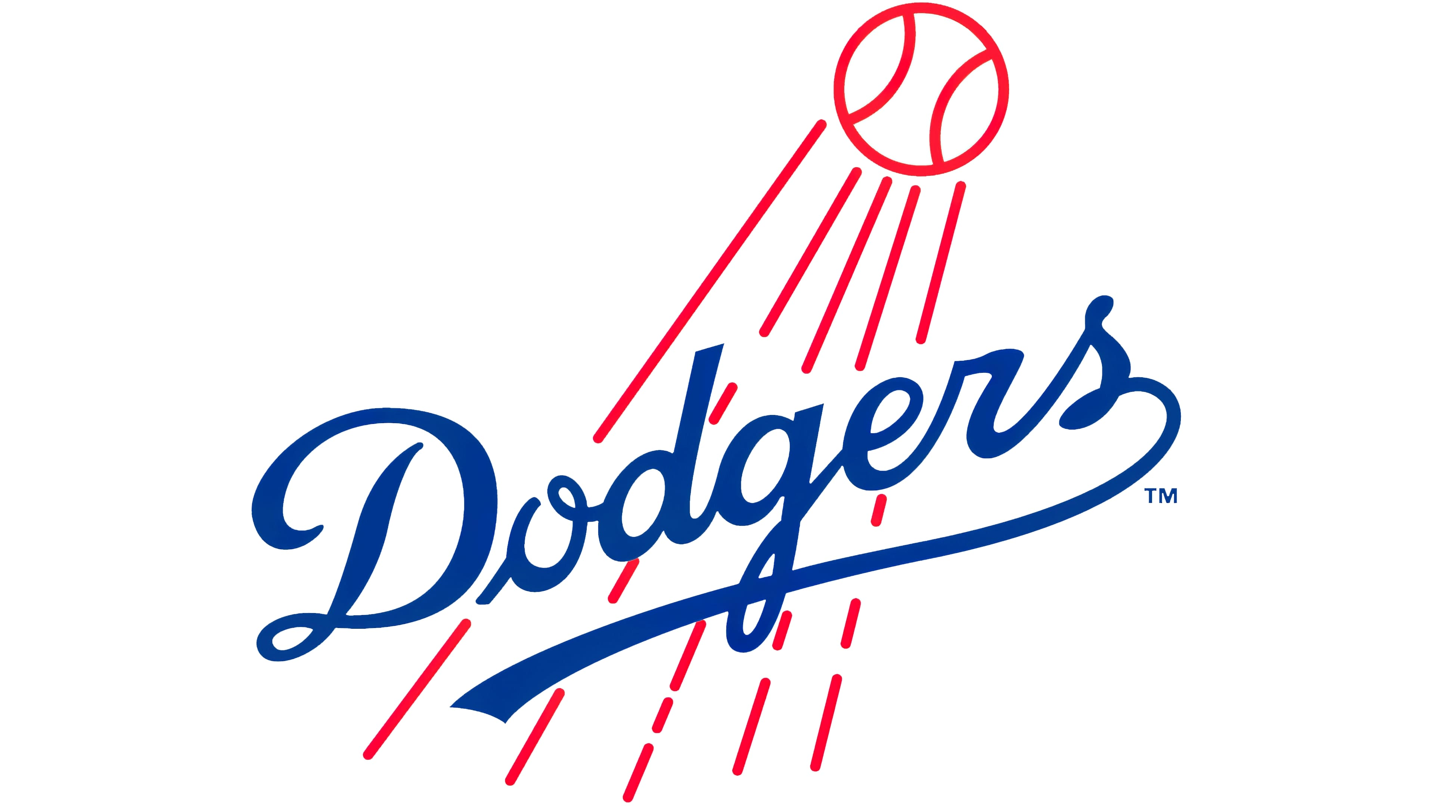
2024 Baseball Season – World Series!!

Slide 5
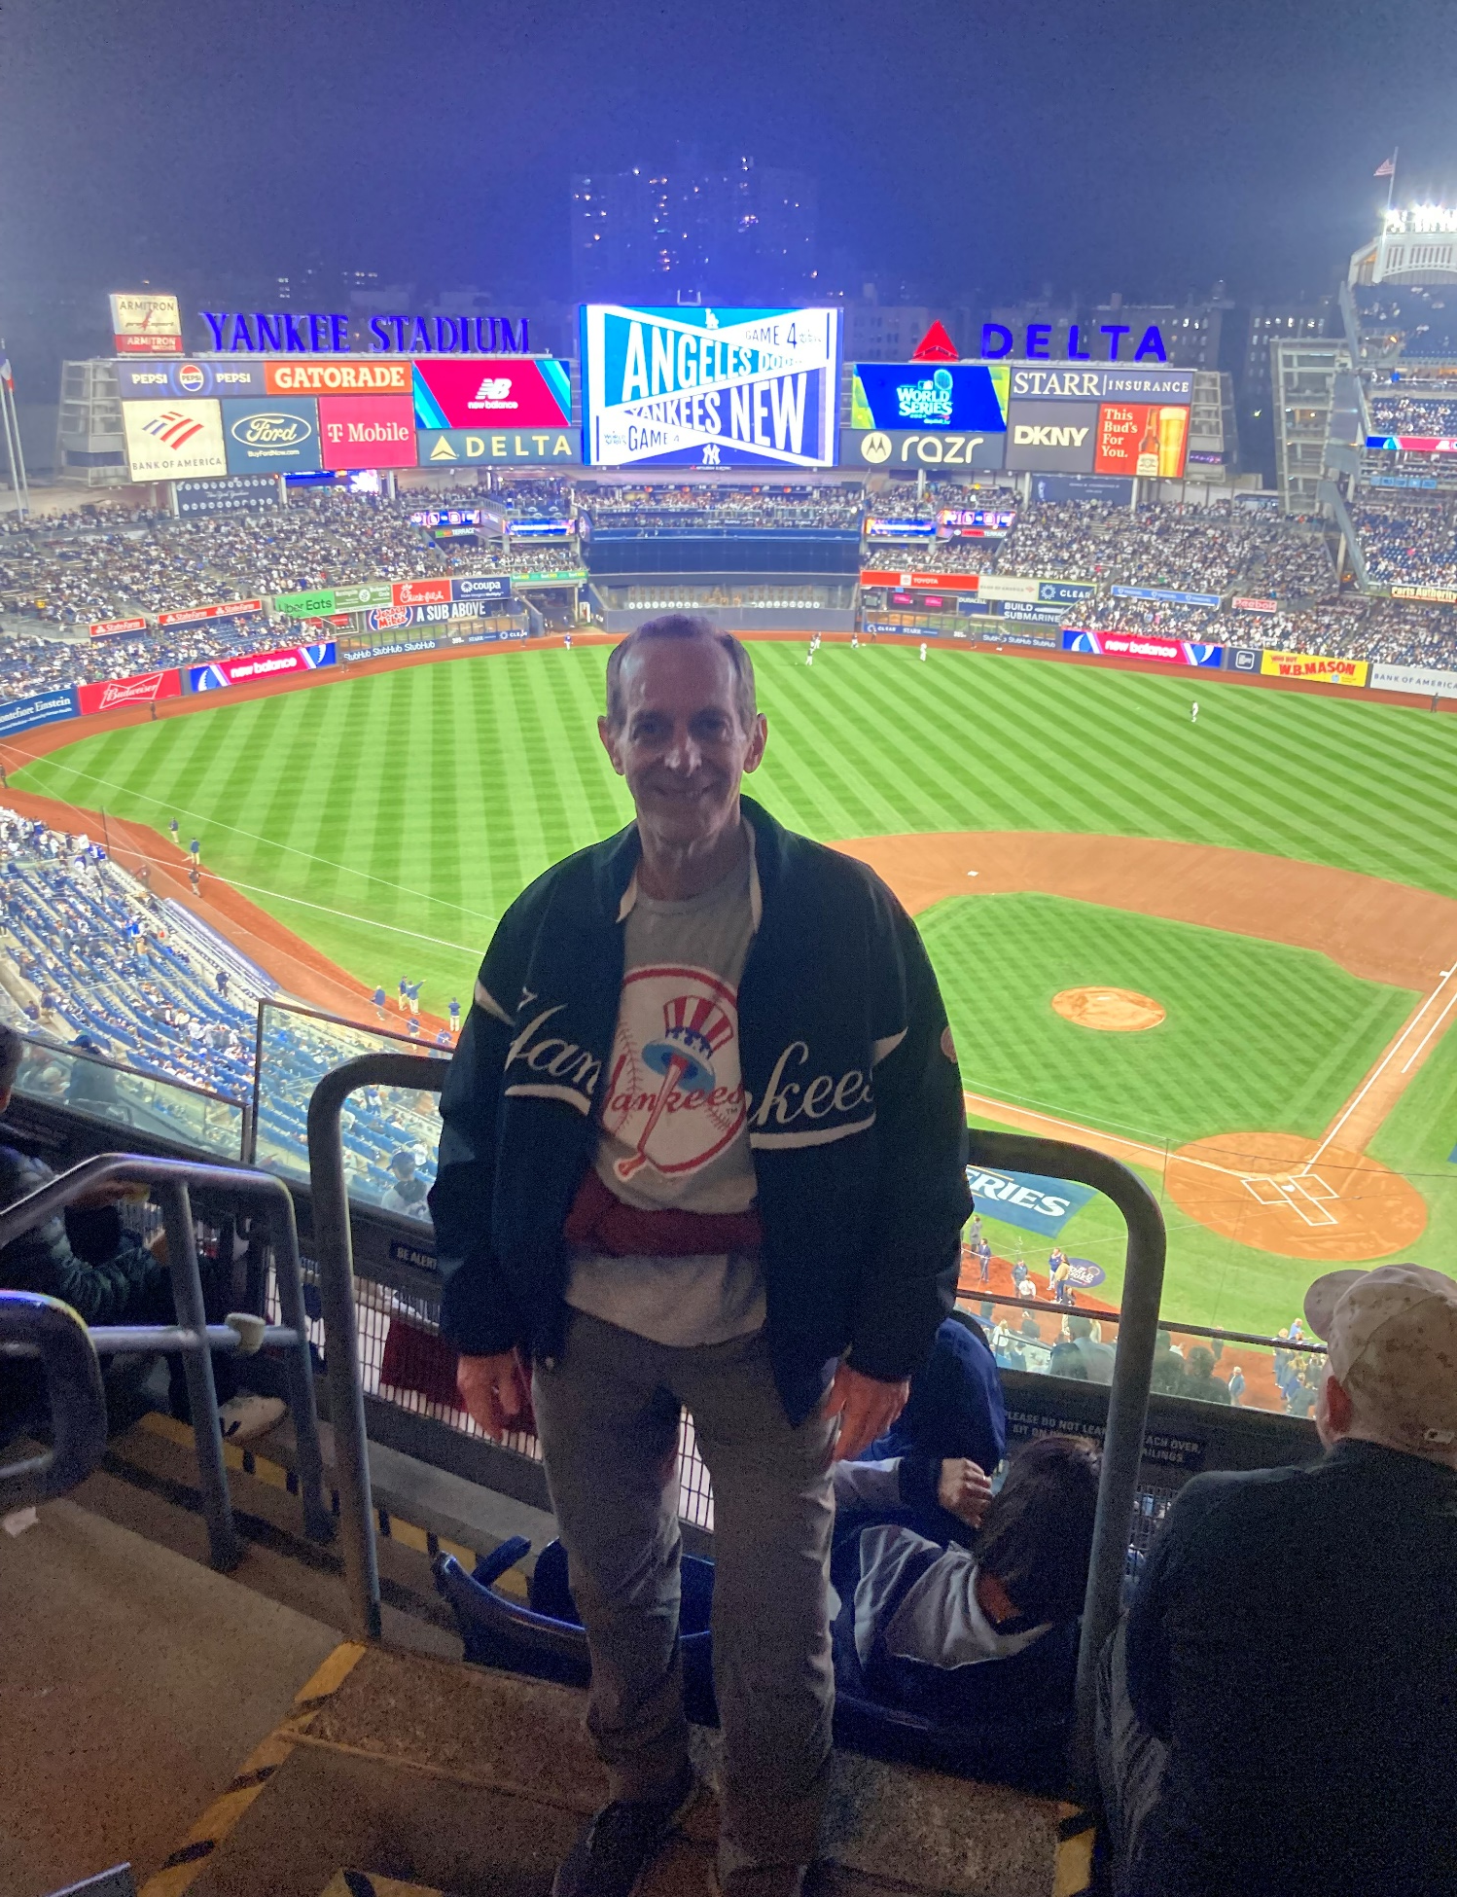
2024
World Series!!

Slide 6

History

Slide 7
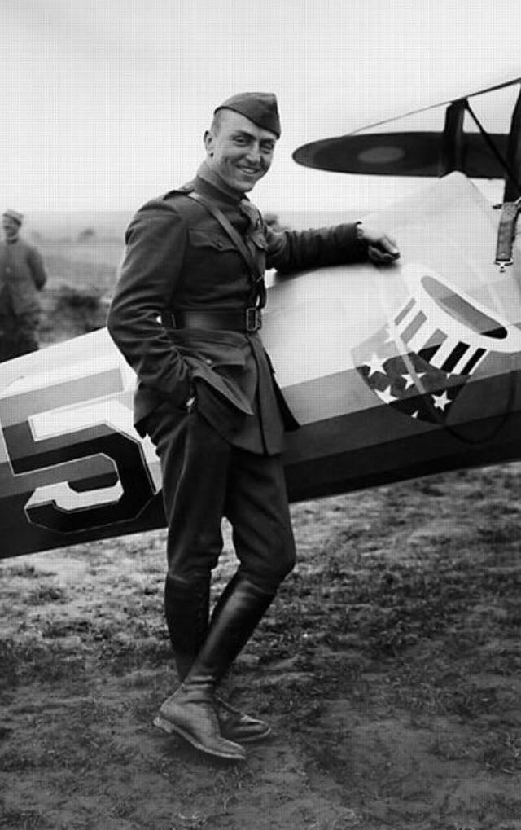
Where did that
logo come from?
Notes:
From the 94th Aero Squadron, one of the first US Army Air Services to see action in WWI in France. Eddie Rickenbacker, the leading U.S. ace (26 victories; Medal of Honor), was a member of this famous squadron. The unit was established a Kelly Field in San Antonio. The unit still exists today as the 94th Squadron, USAF.

Slide 8
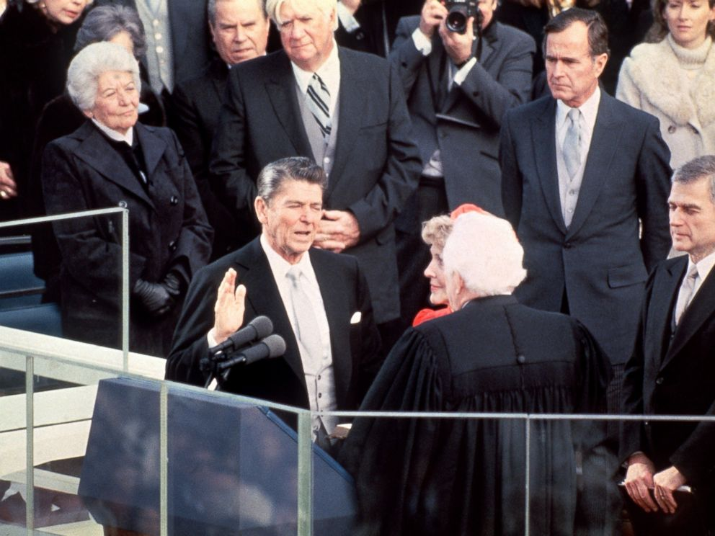
Inauguration
Day
The
“Great Communicator”
became the
40th President of the
United States
Ronald Reagan

Slide 9
Inauguration
Day
His Vice President
was from
Texas
George H.W. Bush

Slide 10
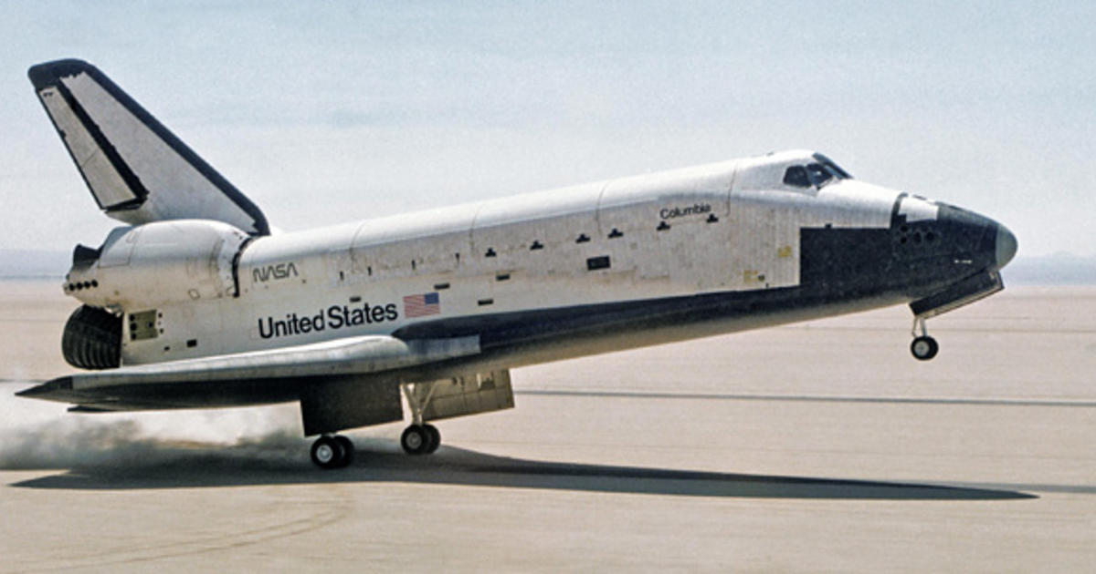
First successful Space Shuttle flight
Notes:
Columbia was the first operational SS that was launched and orbited the Earth. The SS program lasted from From 1981 to 2011 a total of 135 missions were flown, all launched from Kennedy Space Center (KSC) in Florida.

Slide 11
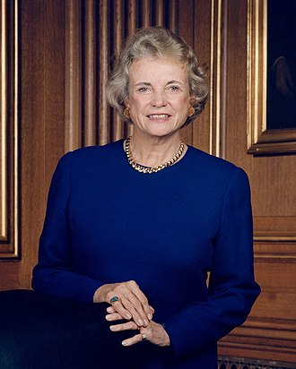
First Woman on
U.S.A.
Supreme Court
Sandra Day O’Conner

Slide 12
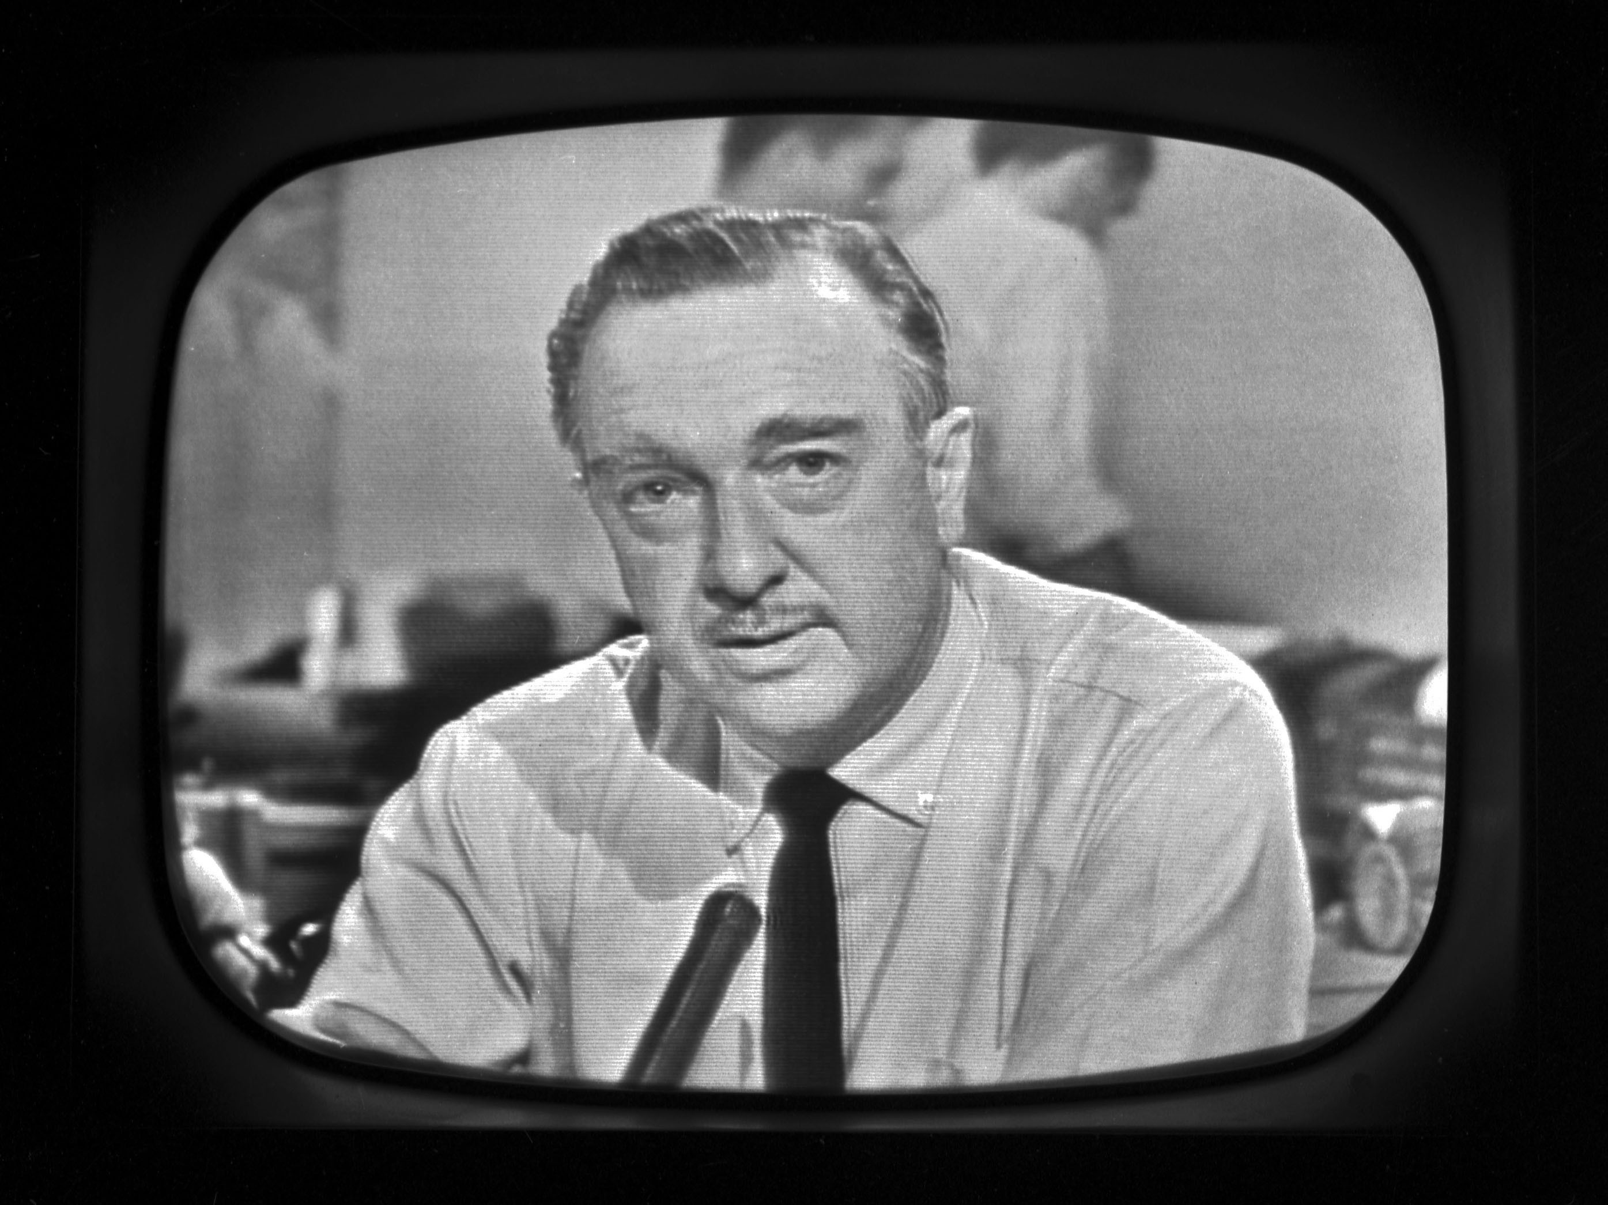
Walter Cronkite signs off …
https://www.youtube.com/watch?v=G5tdqojA26E

Slide 13

1981 - Business

Slide 14
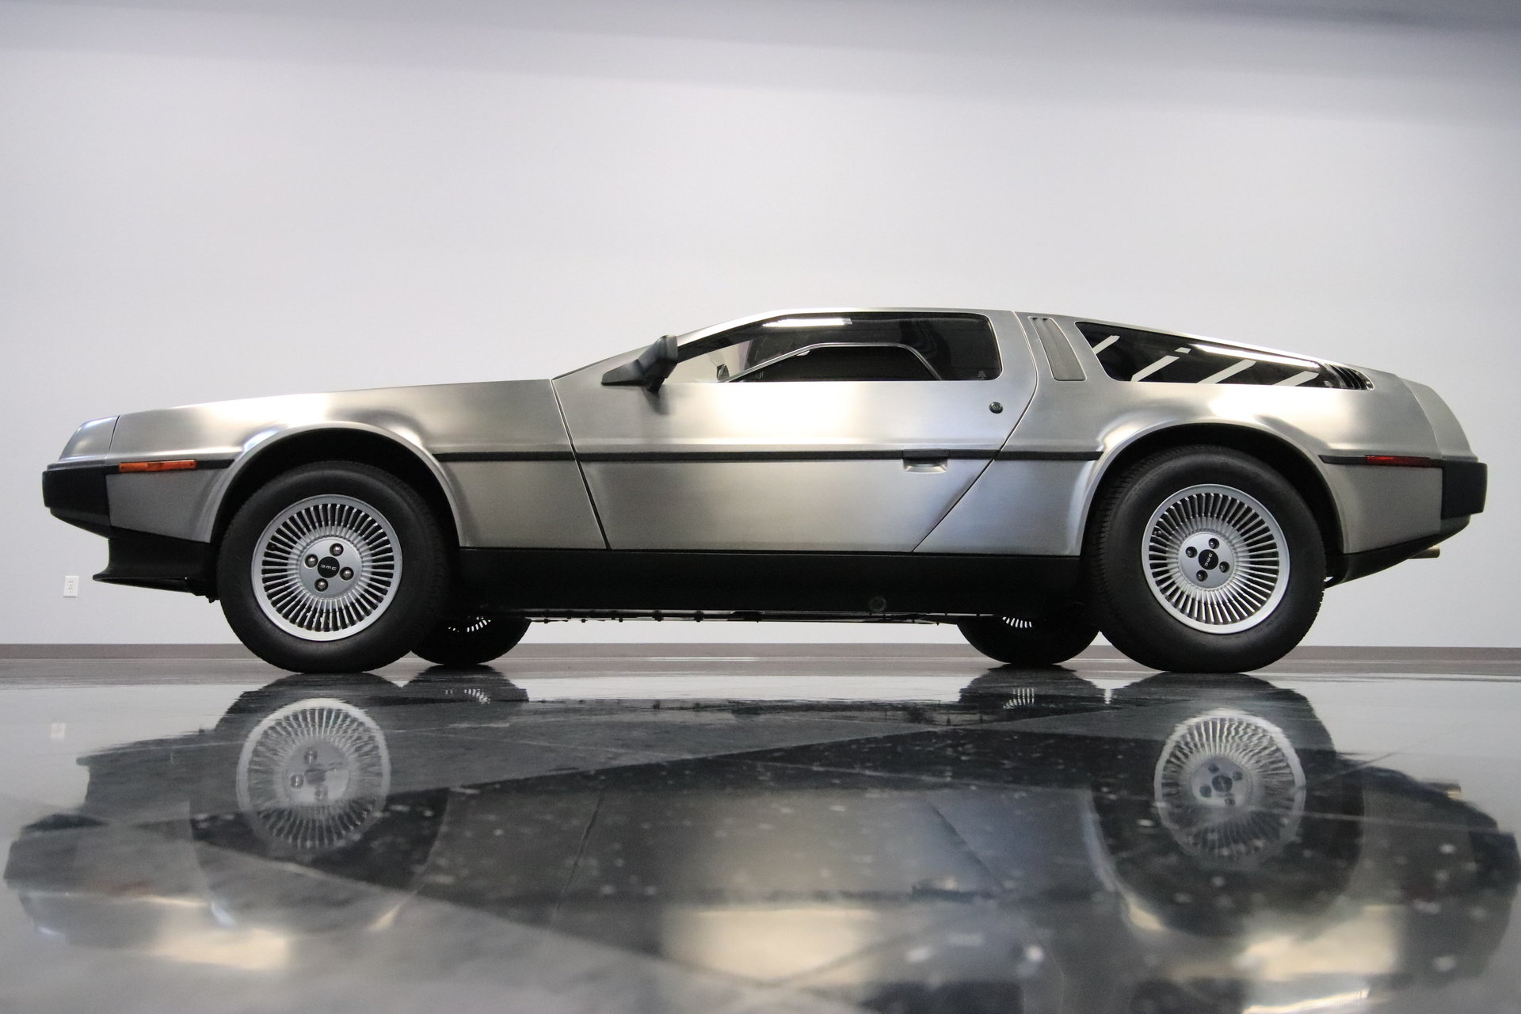
The first DeLorean autos roll off the assembly line
Notes:
This sports car was only produced for3 years – 1981 - 1983; but became famous as the “Time Machine” in the “Back to the Future” series of movies beginning in 1985.

Slide 15
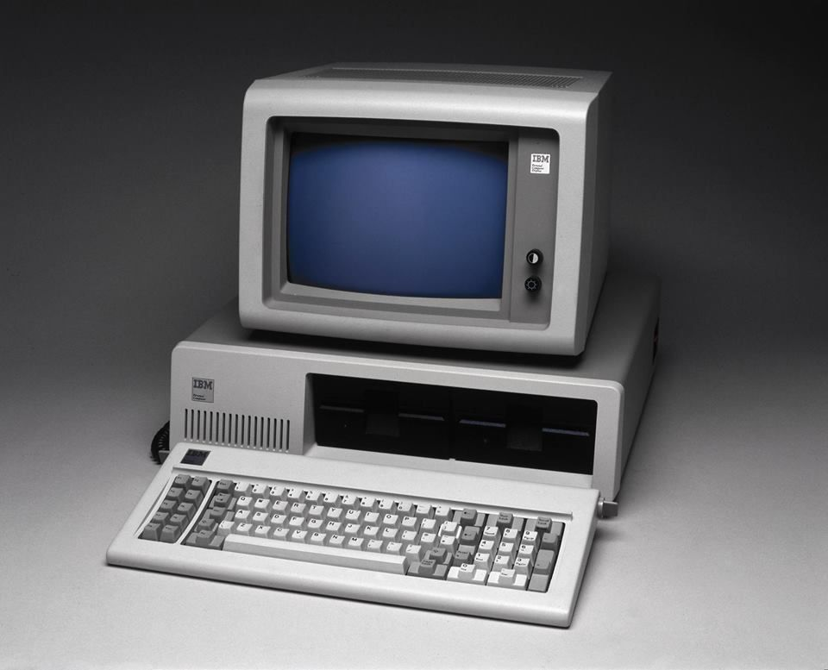
IBM
introduces
the
“PC”
Notes:
IBM introduced the model 5150, known as the “IBM PC”. It had ¼ of a Megabyte of memory. Cost $1500. For half the price today, you can get a Dell desktop computer with 128,000 times the memory!

Slide 16
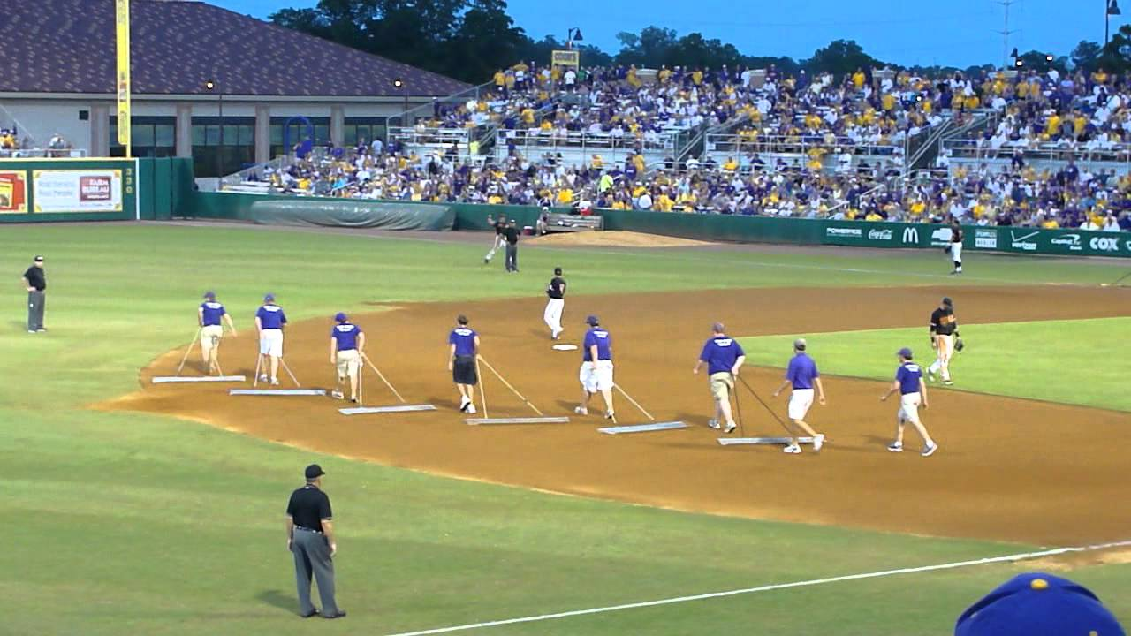
In Between Innings

Slide 17
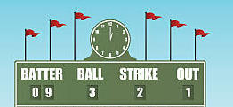
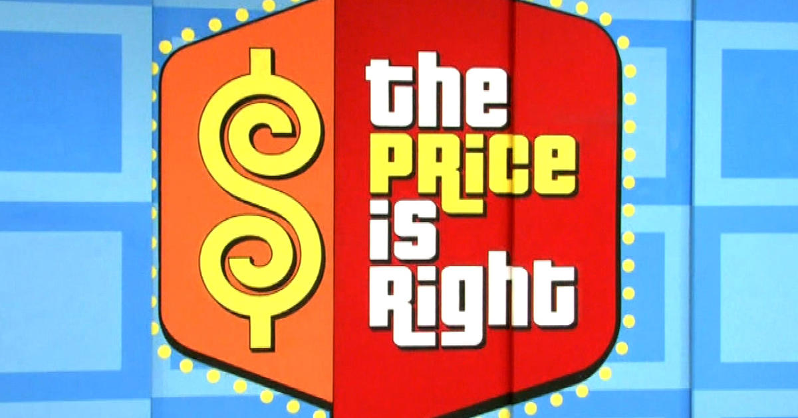
Scoreboard Quiz
h
1981
Prices
Notes:
First debuted in 1956. Bob Barker was the longest-running host; Drew Carey hosts today. Over 9000 episodes! “Come on Down”

Slide 18
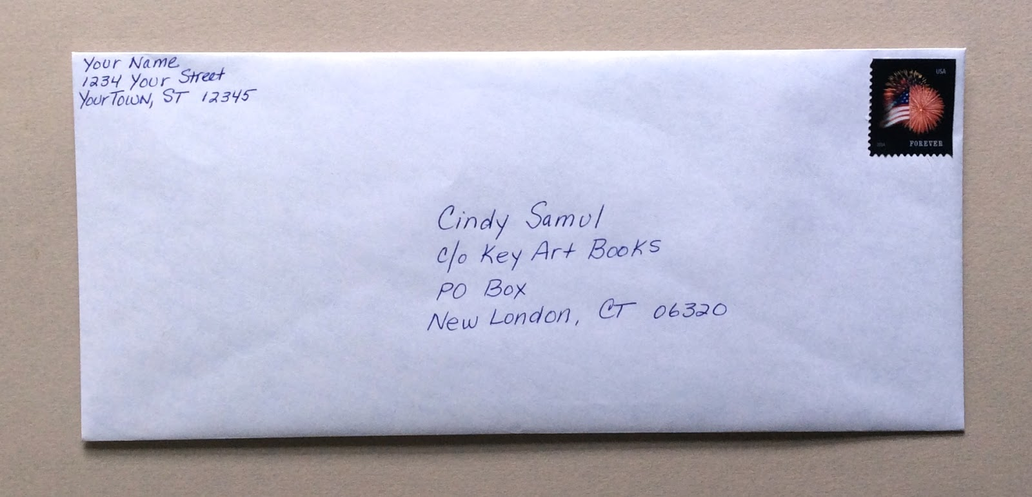
Scoreboard Quiz – 1981 Prices
h
Cost of a first class stamp?
A. 15 cents
B. 18 cents
C. 20 cents
Today – 73 cents
Notes:
There were two price hikes in 1981 to keep up with inflation – ending at 20 cents. TODAY – 73 CENTS !

Slide 19
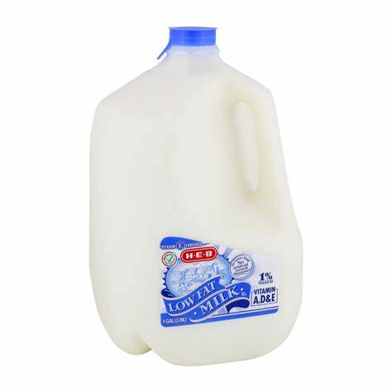
Scoreboard Quiz – 1981 Prices
h
One gallon of milk?
A. $1.00
B. $1.83
C. $2.49
Today
$3.31
Notes:
TODAY – $3.31

Slide 20
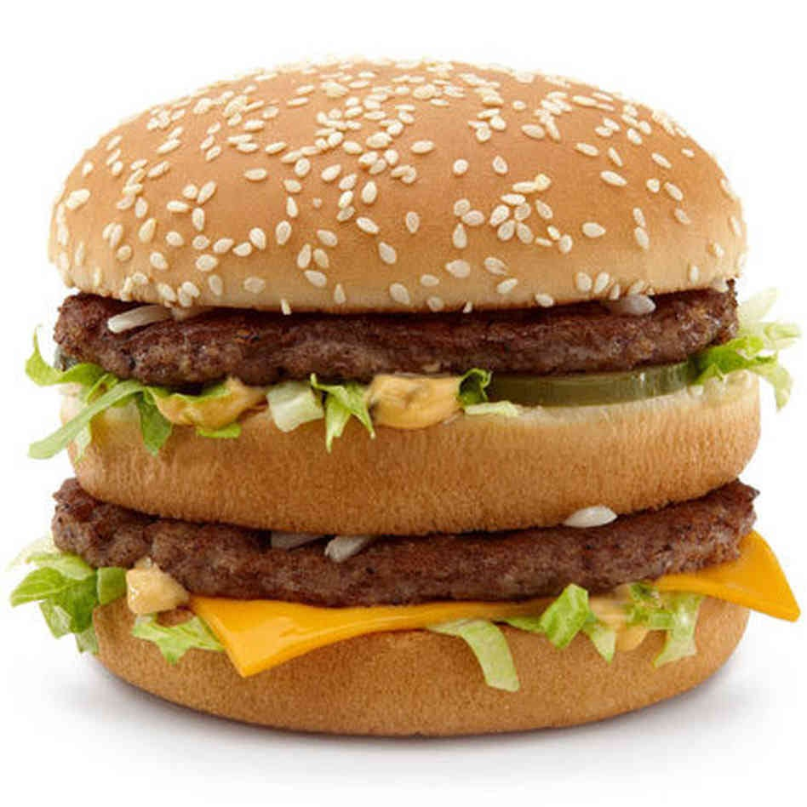
Scoreboard Quiz – 1981 Prices
h
A Big Mac at McDonalds?
A. 89 cents
B. $1.05
C. $1.30
Today – as high as $5.35
Notes:
TODAY – as high as $5.35 in the U.S.

Slide 21

Scoreboard Quiz – 1981 Prices
h
A gallon of gasoline ?
A. 99.9 cents
B. $1.31
C. $1.80
Today $2.40
Notes:
TODAY - $2.40

Slide 22
Scoreboard Quiz – 1981 Baseball Prices
h
Cost of a baseball?
A. $1.50
B. $2.50
C. $3.50
Today - $ 15.00
Notes:
TODAY - $2.40

Slide 23
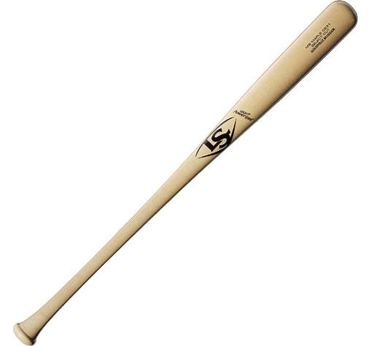
Scoreboard Quiz – 1981 Baseball Prices
h
Cost of an MLB baseball bat?
A. $25.00
B. $50.00
C. $75.00
Today - $ 159.00
Notes:
Pro style Louisville Slugger bat.

Slide 24
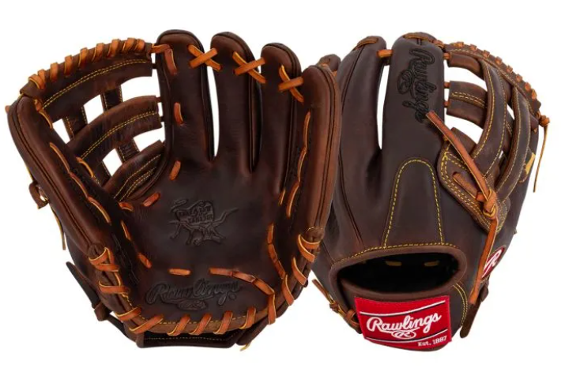
Scoreboard Quiz – 1981 Baseball Prices
h
Cost of a baseball glove?
A. $40
B. $75
C. $100
Today - $ 300.00
Notes:
Top of the line Rawlings “Heart of the Hide” baseball glove

Slide 25

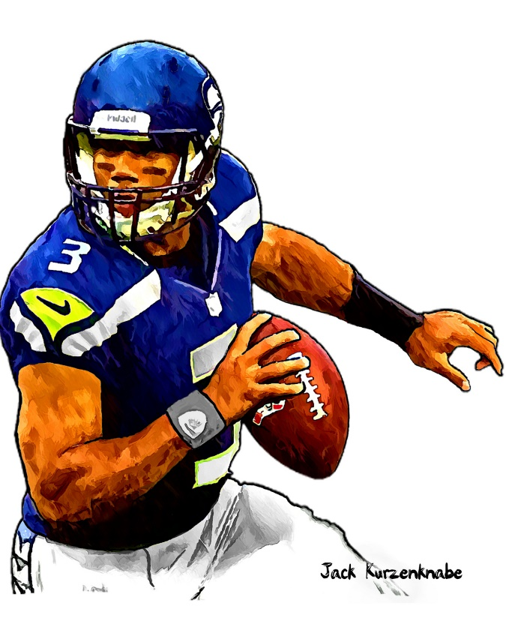

1981 Sporting News

Slide 26
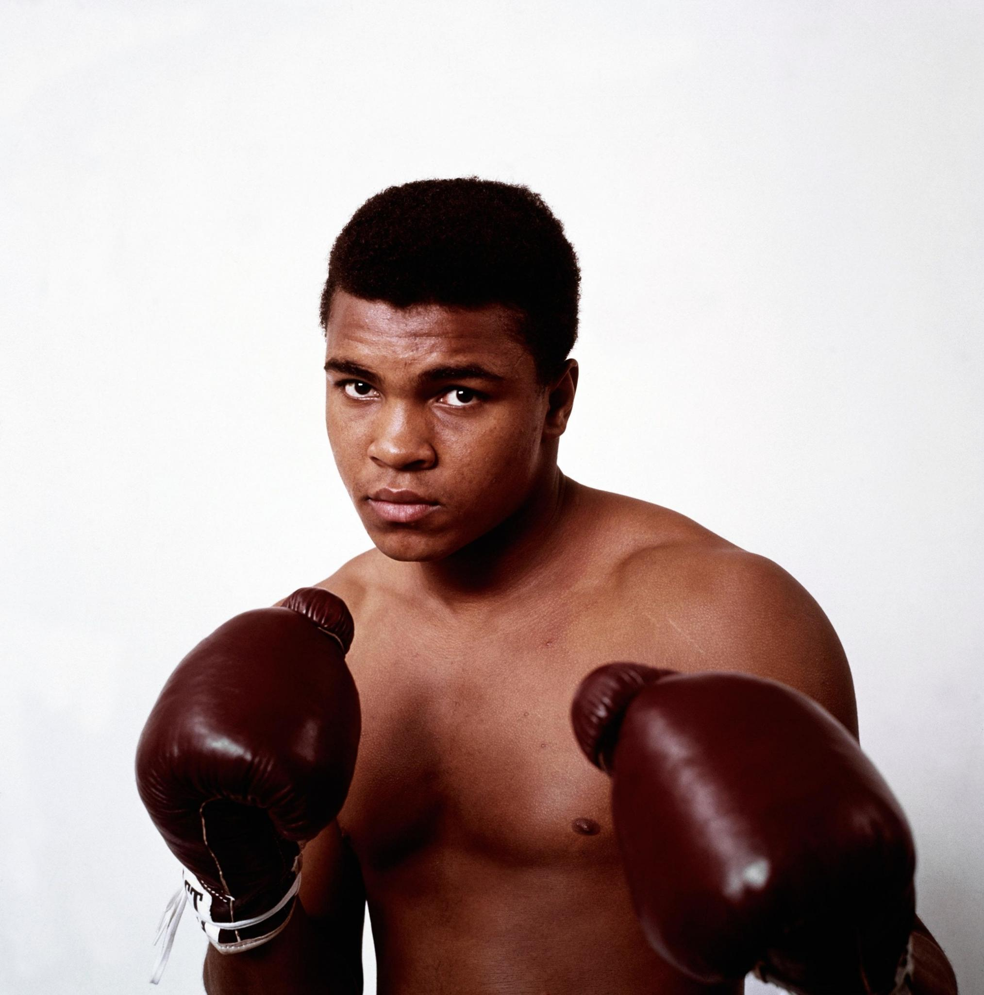
Muhammad Ali retires
Pro record of 56 wins and only 5 losses.
37 of his wins were “KOs”
He held a Heavyweight
title on three occasions
for a total of 12 years.
“The Greatest”

Slide 27


Super Bowl XV
Played at New Orleans Superdome
Oakland won 27-10
Raiders were first “wild card” team to win a Super Bowl
Raiders QB Jim Plunkett was the MVP

Slide 28
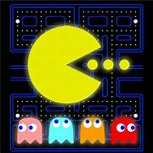
Video Gaming
Video Arcades were popular
This game was the
most popular
Estimated gross revenue in 1981 of over $1 billion
Over 30 million players and very popular with women
https://www.youtube.com/watch?v=i_OjztdQ8iw
Notes:
Was the highest-grossing arcade game in the US in 1981 – surpassing $1 billion dollars; estimated to have more than 30 million players in US in 1981 and was the only popular video game where the majority of players were women.

Slide 29
The Year in Baseball: 1981

Slide 30
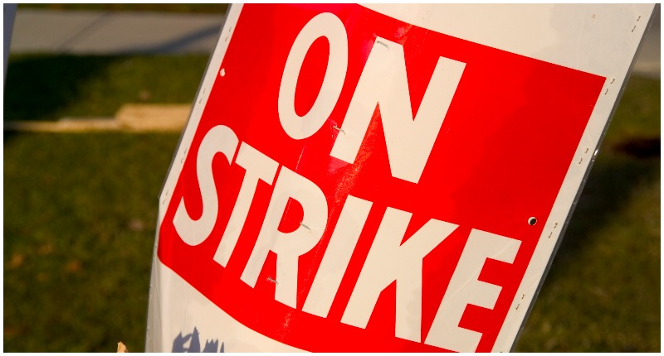
BASEBALL goes on STRIKE !
Notes:
Mickey Mantle hit 37 homers to lead the AL. He also led the league in triples, walks, and SLG.

Slide 31
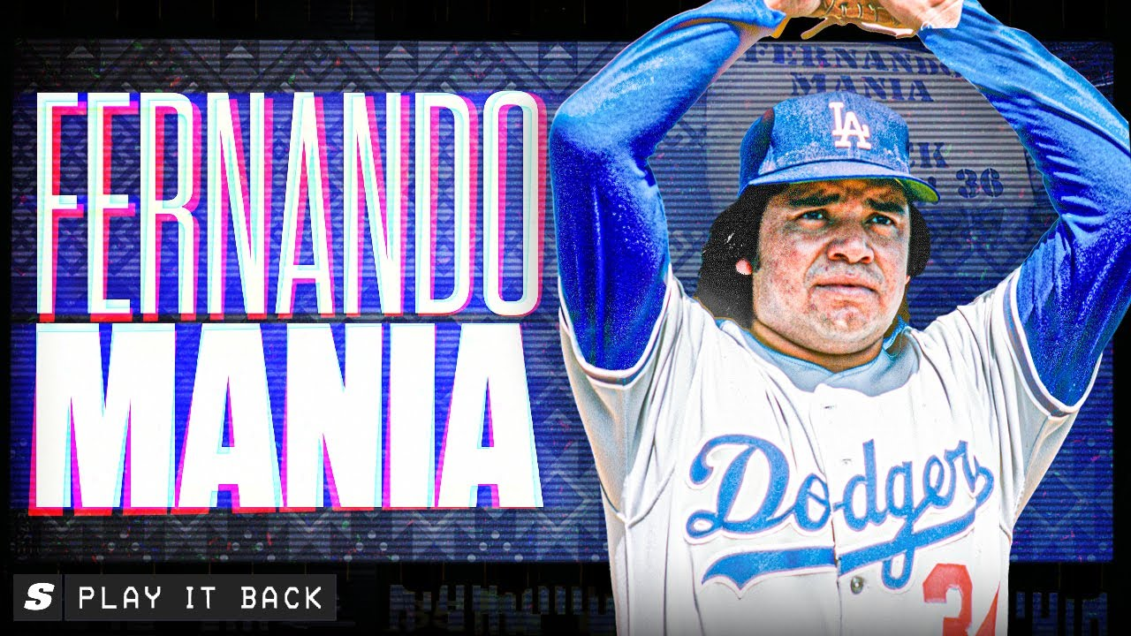
Notes:
Mickey Mantle hit 37 homers to lead the AL. He also led the league in triples, walks, and SLG.

Slide 32
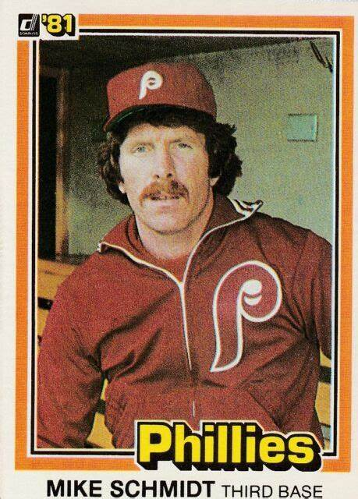
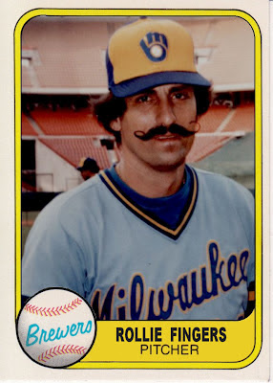
1981
Most
Valuable
Players
.316 31 HR 91 RBI
28 SAVES 1.04 ERA
Notes:
Mickey Mantle hit 37 homers to lead the AL. He also led the league in triples, walks, and SLG.

Slide 33
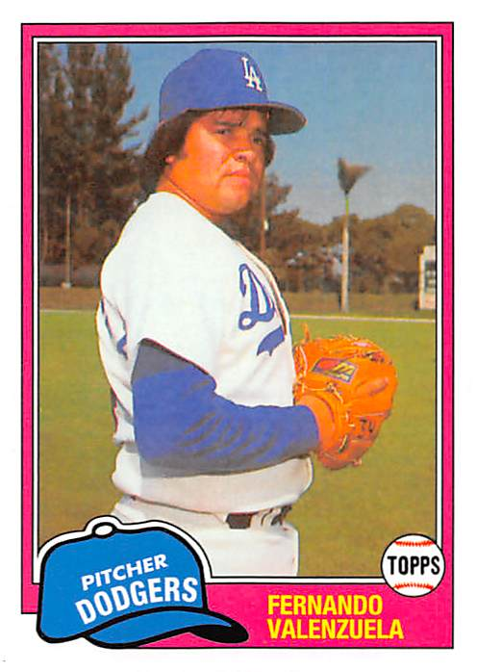
1981
Cy Young
Winners
13 - 7, ERA 2.48, 192 IP

Slide 34
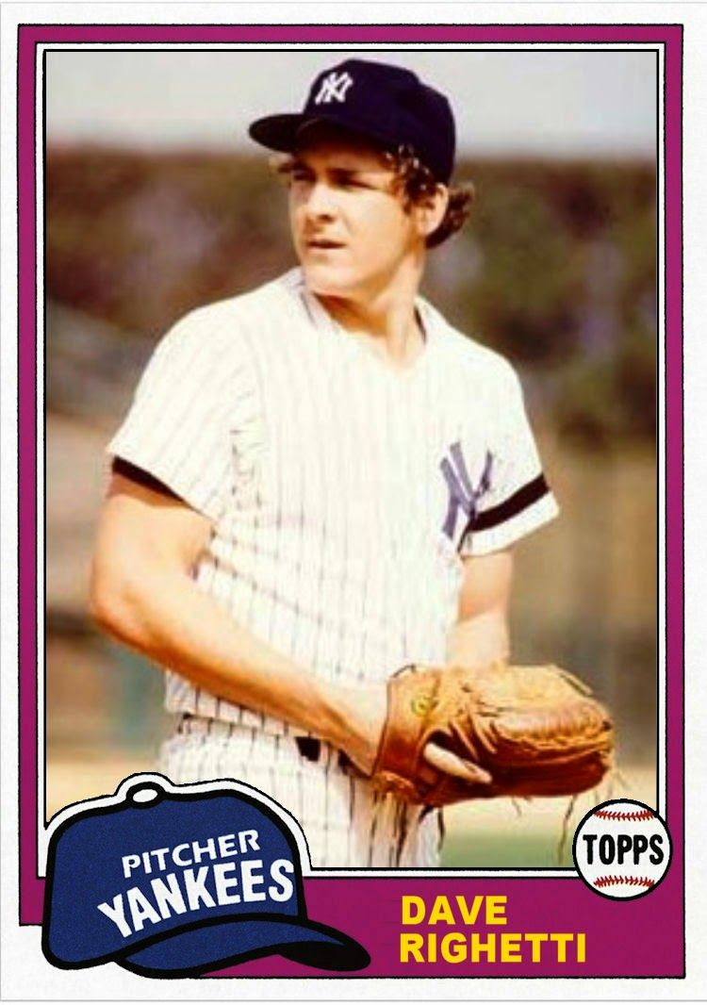
1981 Rookies of the Year
Led NL - 180 K, 11 CG, 8 SHO
8 - 4 , ERA 2.05
Notes:
Mickey Mantle hit 37 homers to lead the AL. He also led the league in triples, walks, and SLG.

Slide 35
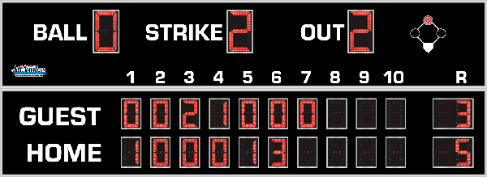
7th Inning Stretch

Slide 36
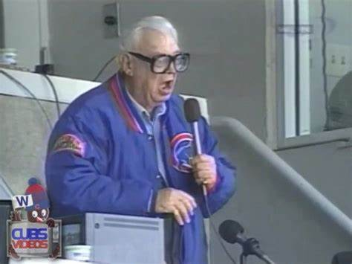
“Take Me Out to the Ballgame”

Slide 37
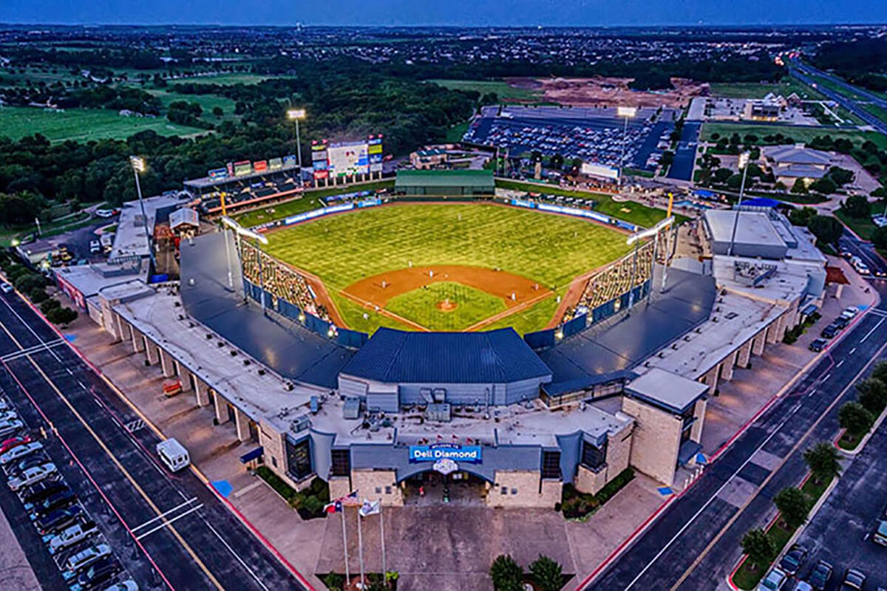
“Deep in the Heart of Texas
https://www.youtube.com/watch?v=rcrK0U7RDIk

Slide 38
“Do the Hokey Pokey”
https://www.youtube.com/watch?v=vpharBeg9XA

Slide 39
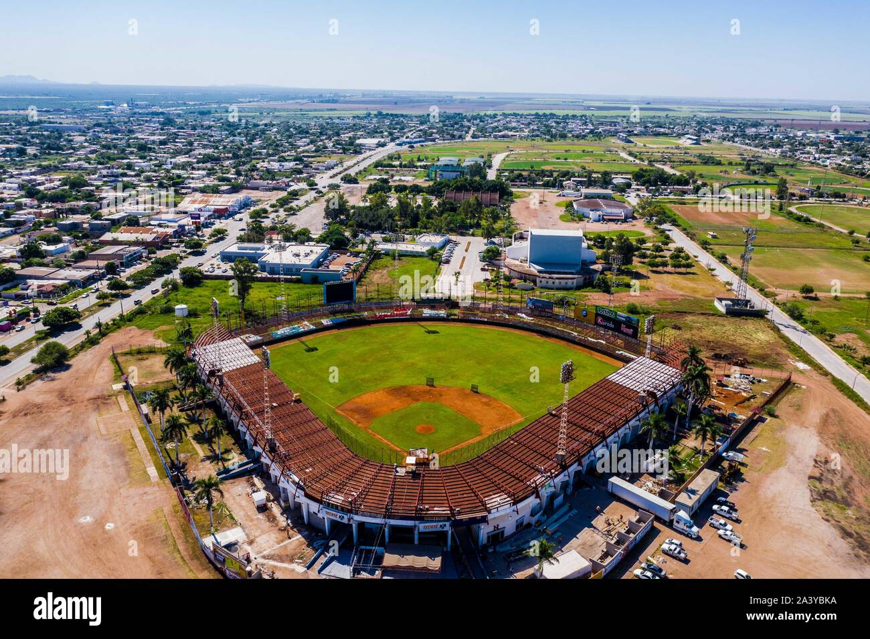
¡ Música al estadio !
It can get very
loud at the:
Estadio Mayos
In
Fernando’s hometown of
Navajoa,
Sonora, Mexico
Sing & Dance to: La Bamba :
https://www.youtube.com/watch?v=NH9K5YTR2k4

Slide 40
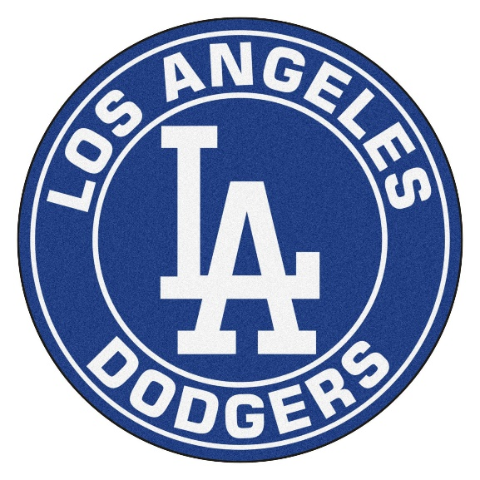
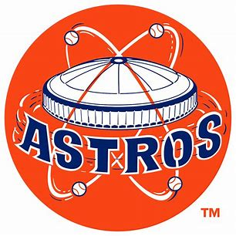
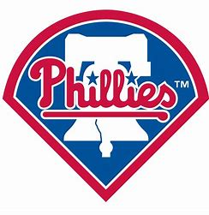

1981 N.L. – split season led to an extra round of playoffs
WEST DIVISION
Best of 5
Dodgers 3 – Astros 2
EAST DIVISION
Montreal 3 – Phillies 2

Slide 41

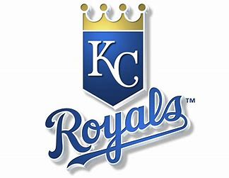
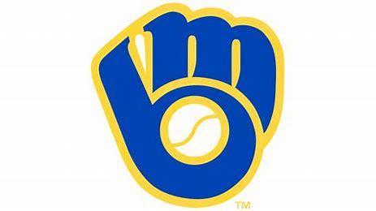
1981 A.L. – split season led to an extra round of playoffs
WEST DIVISION
Best of 5
Oakland 3 – Royals 0
EAST DIVISION
Yankees 3 – Milwaukee 2

Slide 42

1981 League Championships
Best 3-of-5 format
Dodgers won 3 - 2
Yankees
won
3-0

Slide 43
1981 World Series
VS.

Slide 44
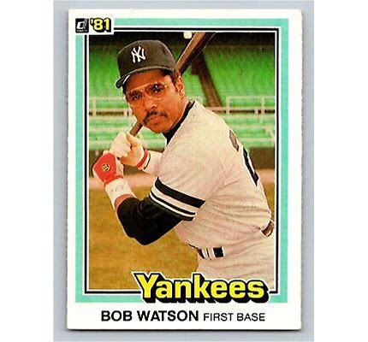
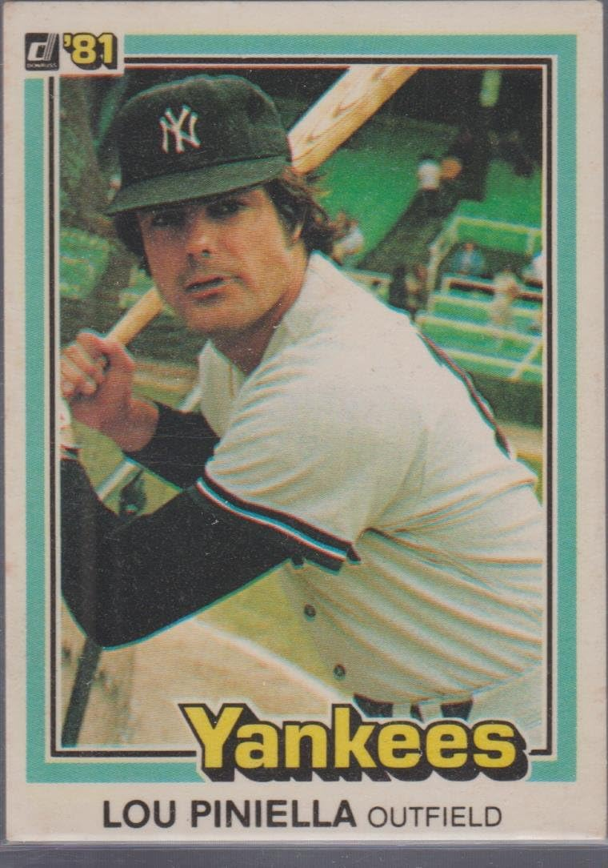
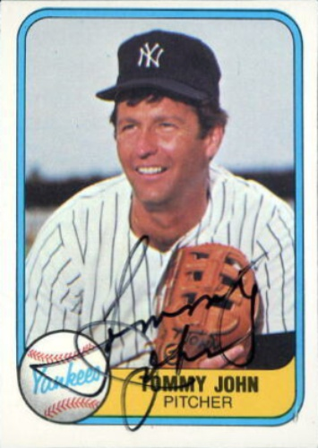
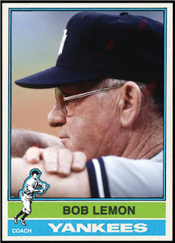
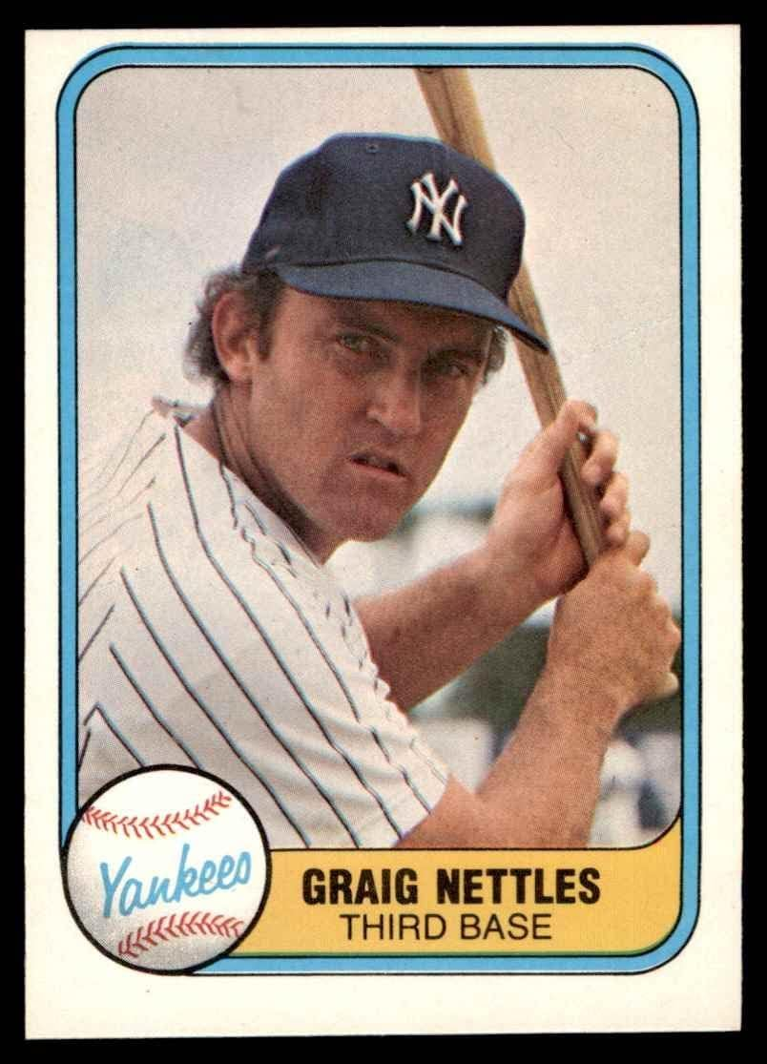
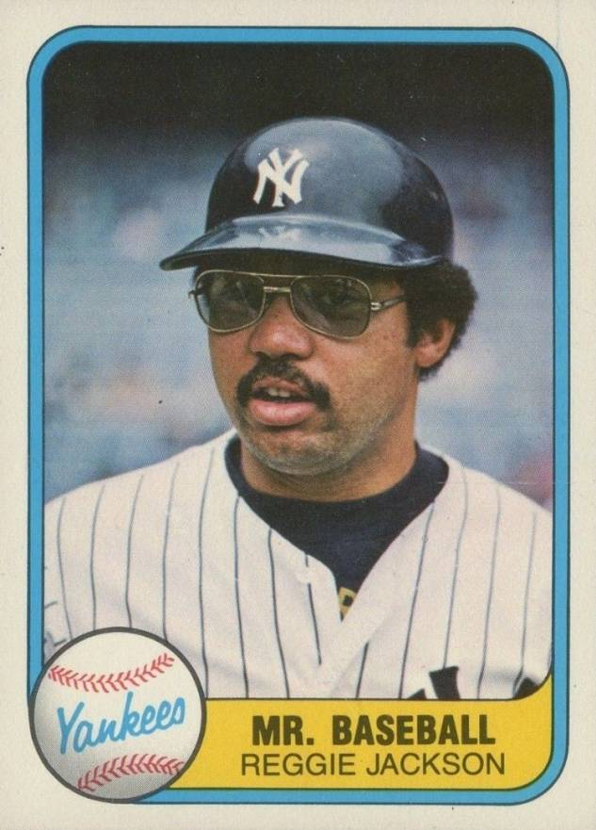
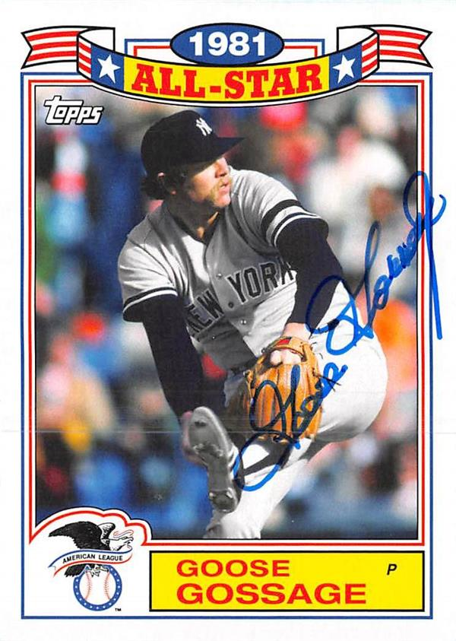
Yankees
Stars

Slide 45
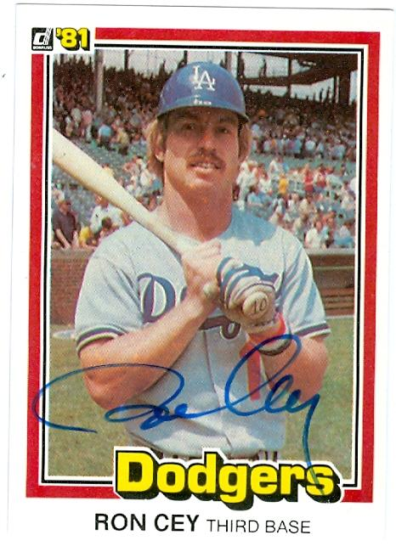
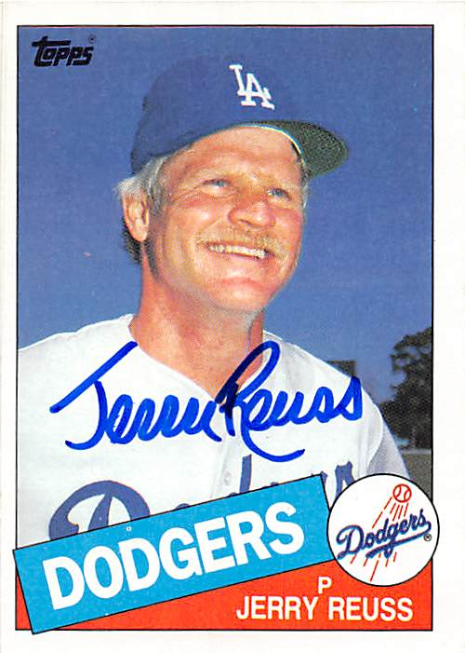
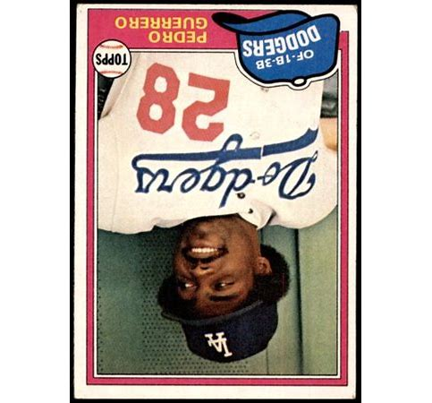
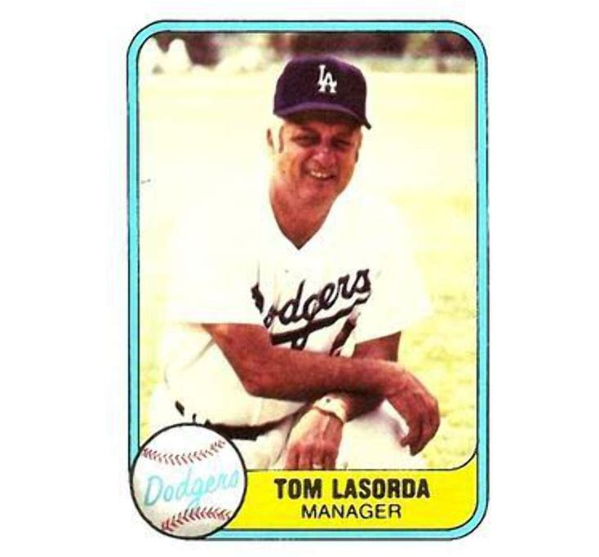
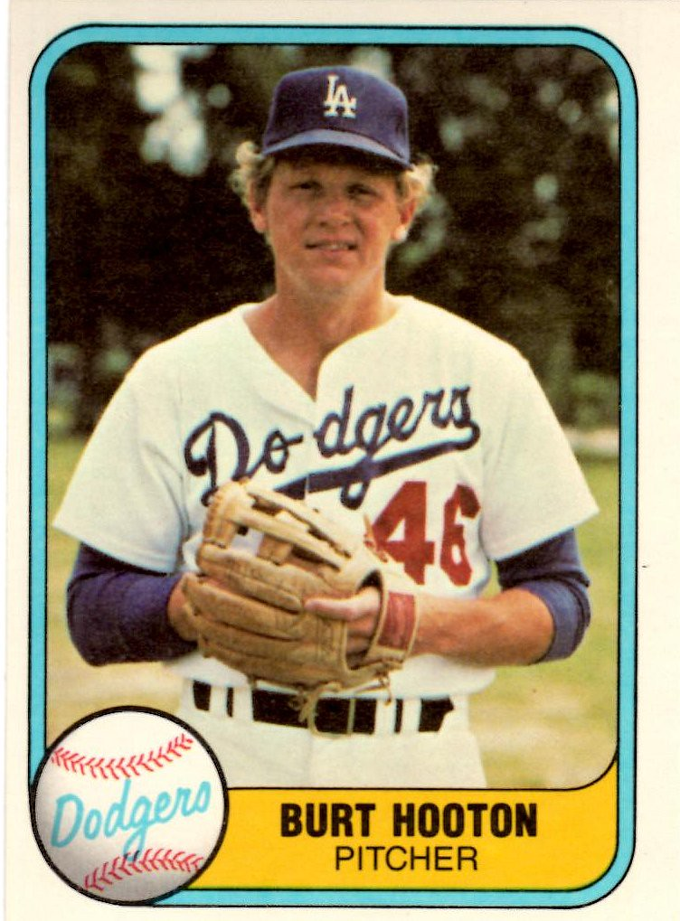
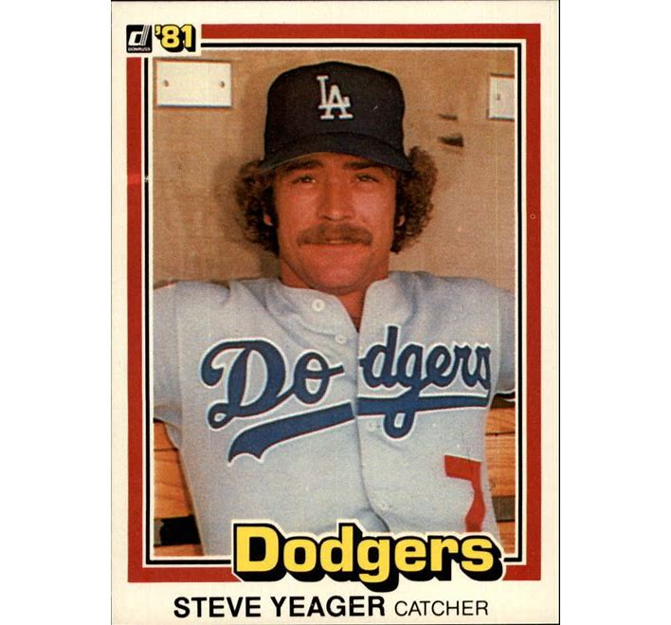

Key
Dodgers

Slide 46

1981 World Series Highlights
Yankee Stadium – New York, NY
Game 1 – October 20, 1981
Yankees 5 – Dodgers 3
Yankee 1B Bob Watson hits 3-run homer in bottom of 1st.
Yankees tack on single runs in 3rd and 4th innings.
Game 2 – October 21, 1981
Yankees 3 – Dodgers 0
Tommy John and Goose Gossage shut out the Dodgers on four hits
YANKEES LEAD SERIES 2 GAMES TO 0

Slide 47

Dodgers Stadium – Los Angeles, CA
Game 3 – October 23, 1981
Dodgers 5 – Yankees 4
LA 3B Ron Cey hits 3-run homer in bottom of 1st inning.
Game 4 – October 24, 1981
Dodgers 8 – Yankees 7
Dodgers fall behind early, but HR by Jay Johnstone in 6th helps tie the game. Dodgers go on to win.
Game 5 – October 25, 1981
Dodgers 2 – Yankees 1
Back-to-back solo homers by RF Pedro Guerrero and C Steve Yeager power Dodgers to the win.
DODGERS LEAD SERIES 3 GAMES TO 2
Notes:
The Series shifts to L.A.’s Dodger Stadium for games 3, 4, and – if necessary – game 5.

Slide 48
The Series returns to
Yankee Stadium for game 6
Game 6 – October 28, 1979
Dodgers 9 – Yankees 2
The Dodgers routed the Yankee bullpen for 8 runs in the last 5 innings to wrap up the World Series title.
DODGERS WIN THE 1981
WORLD SERIES
4 GAMES TO 2
https://www.youtube.com/watch?v=myPv92mjAUQ

Slide 49

Extra Innings!

Slide 50

1981 Top Hits

Slide 51

Top grossing picture
In search of the
Biblical Arc
Harrison Ford starred
https://www.youtube.com/watch?v=mC1ikwQ5Zgc
Notes:
Start video at 4:55

Slide 52

First box office hit of 1981
Three women deal with
a sexist, chauvinist boss
Jane Fonda, Lily Tomlin, and
Dolly Parton star
https://www.youtube.com/watch?v=UbxUSsFXYo4

Slide 53

1981 Top Hits

Slide 54

Top rated TV drama
About a wealthy
Texas oil family
Larry Hagman as “J.R.”
https://www.youtube.com/watch?v=8sKX3tWaOew

Slide 55

Top rated news program
A one hour “news
magazine” every Sunday evening
The intro showed a ticking stop watch
https://www.youtube.com/watch?v=I2_1ZZU4HUo

Slide 56

Top rated comedy
Spin-off of
All in the Family
About Archie Bunker’s neighbor George …
https://www.youtube.com/watch?v=_-OnRQ4P0VY

Slide 57


Slide 58

Thanks!!
We’ll see you again next month!
https://www.youtube.com/watch?v=_IJkbs1D5PU

