Slide 1



AGE Thrive with Baseball Memories
January 15, 2025
Agenda
Warm-up - Introductions
Current Events
Gametime – The Year in Baseball – 1982
Seventh Inning Stretch - “Take Me Out to the Ball Game”
Get Up and Move, Sing, Dance!
Extra Innings – More stuff from the ‘70s and ‘80s

Slide 2


Slide 3
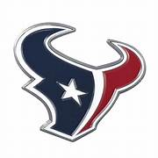


Football !
Notes:
Mention current won-loss for each team;

Slide 4

History from 1982

Slide 5
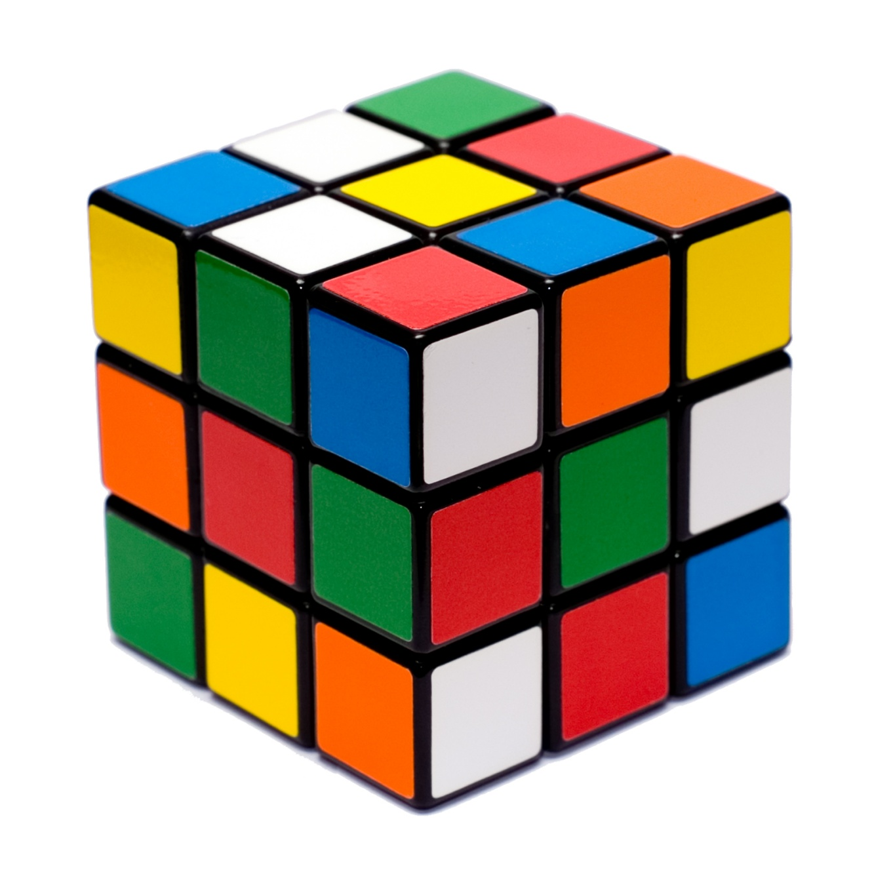
First Rubik’s Cube
World Championship
Held
American representative Minh Thai ,
a 16-year-old Vietnamese – American
high school student won the
title with a world-record time of:
22.95 seconds !
Notes:
The puzzle was invented by Erno Rubik, a Hungarian architect, in 1974. First championship held in Budapest Hungary in the summer of 1982 - competitors from 19 countries were in attendance.

Slide 6

AT&T ordered
to divest
22 wholly owned operating
companies spun off into
7 independent regionals
Southwestern Bell served
Texas and four other states
Notes:
In January 1982 AT&T entered into a consent decree with the U.S. DOJ; AT&T agreed to spin off its 22 local companies if it could retain Western Electric, Bell Labs and the long distance network – and be freed from an earlier decree that prevented it from entering the computer business. The 7 “Baby Bells” began independent operation on January 1, 1984.

Slide 7
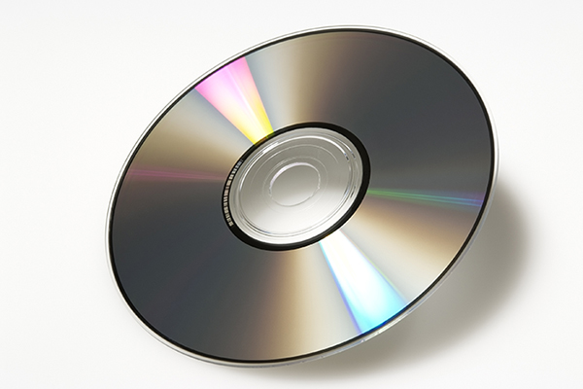
Compact
Disks
Introduced
Notes:
Introduced for commercial use in late 1982. Helped led the conversion of audio recording/distribution from analog formats (vinyl records;, magnetic cassettes) to digital format.
Developed by Sony and Phillips. The original optical digital format could hold 80 minutes of audio, about twice the capacity of an 8-track cartridge or tape cassette. Eventually use was expanded for all forms of data including video.

Slide 8
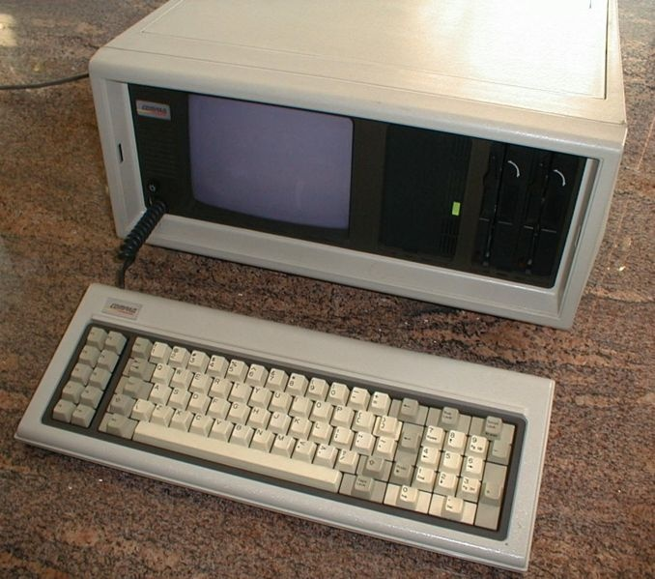
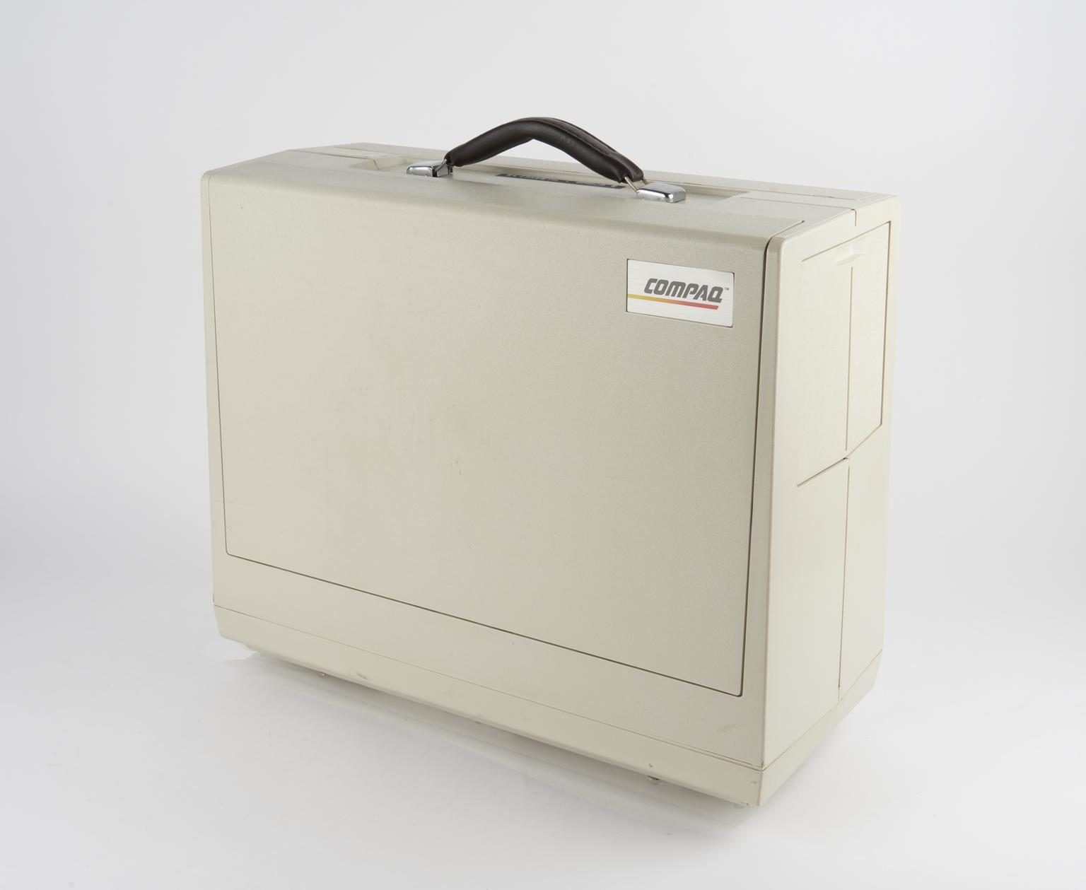
Compaq
Portable
Computer
Announced
Notes:
Developed by Compaq Computer Corp. in Houston. Prototypes were available in 1982 and sold to the general public in 1983. This was almost fully compatible with the new IBM PC and the MS-DOS operating system – so it could run software developed for use on the PC. It was “portable”, but weighed 28 POUNDS!

Slide 9
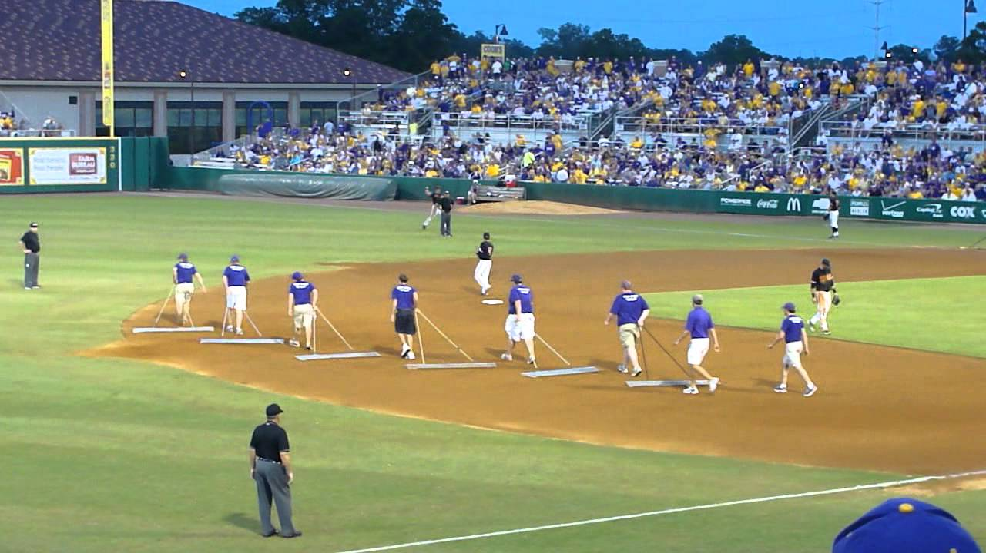
In Between Innings

Slide 10
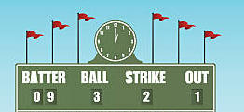

Scoreboard Quiz – 1982 TV
h
Larry Hagman starred as evil oil man J.R. Ewing.
The Ewing family lived on the Southfork Ranch.
What was the name of the show?
Black Gold
Dallas
Texas Oil

Slide 11
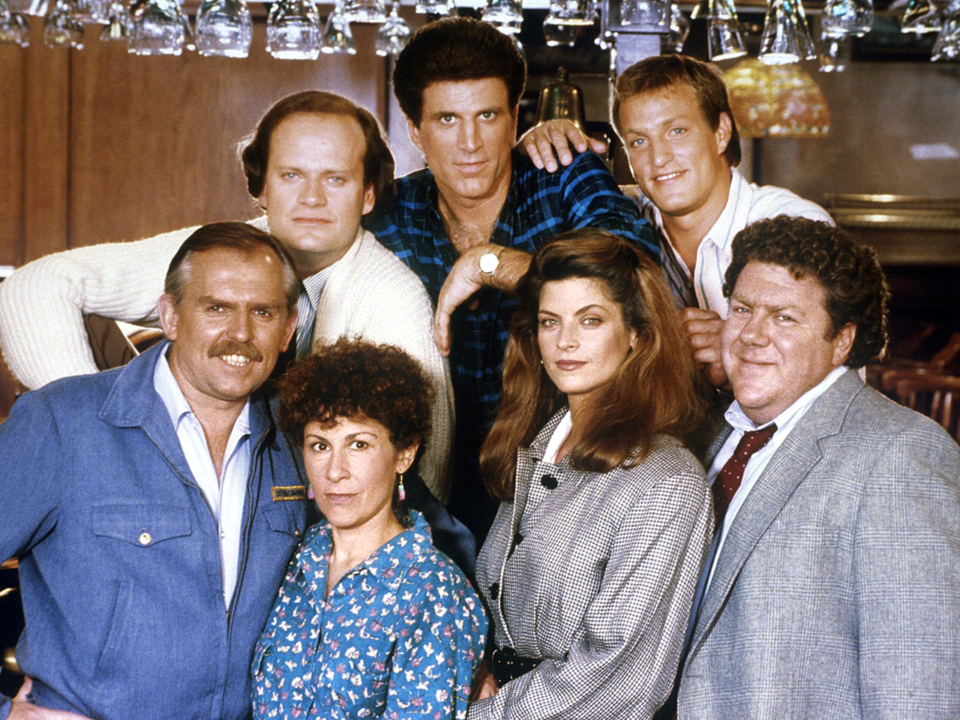
Scoreboard Quiz – 1982 TV
h
Ted Danson starred as the owner of a Boston bar
and former Red Sox pitcher.
This show premiered in 1982. What was the title?
Happy Hour
Boston Bar
Cheers
Notes:
Debuted in 1982 and ran for 11 seasons. One of TV’s most popular shows.

Slide 12
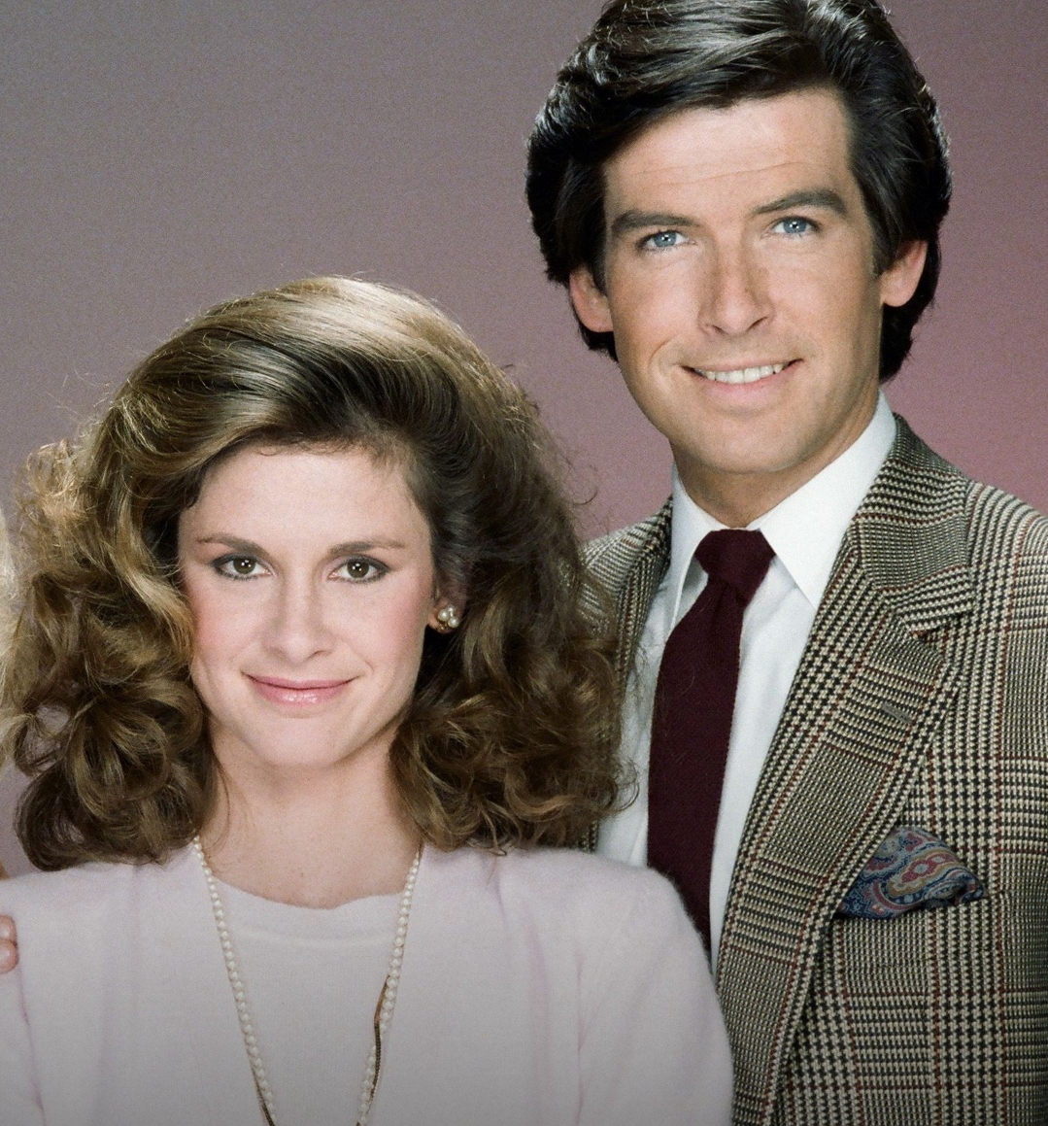
Scoreboard Quiz – 1982 TV
h
Stephanie Zimbalist plays a female detective that
invents a male co-owner played by Pierce Brosnan. The show is named for Brosnan’s character:
Remington Steele
Magnum P.I.
Ironside
Notes:
This show also debuted in 1982.

Slide 13
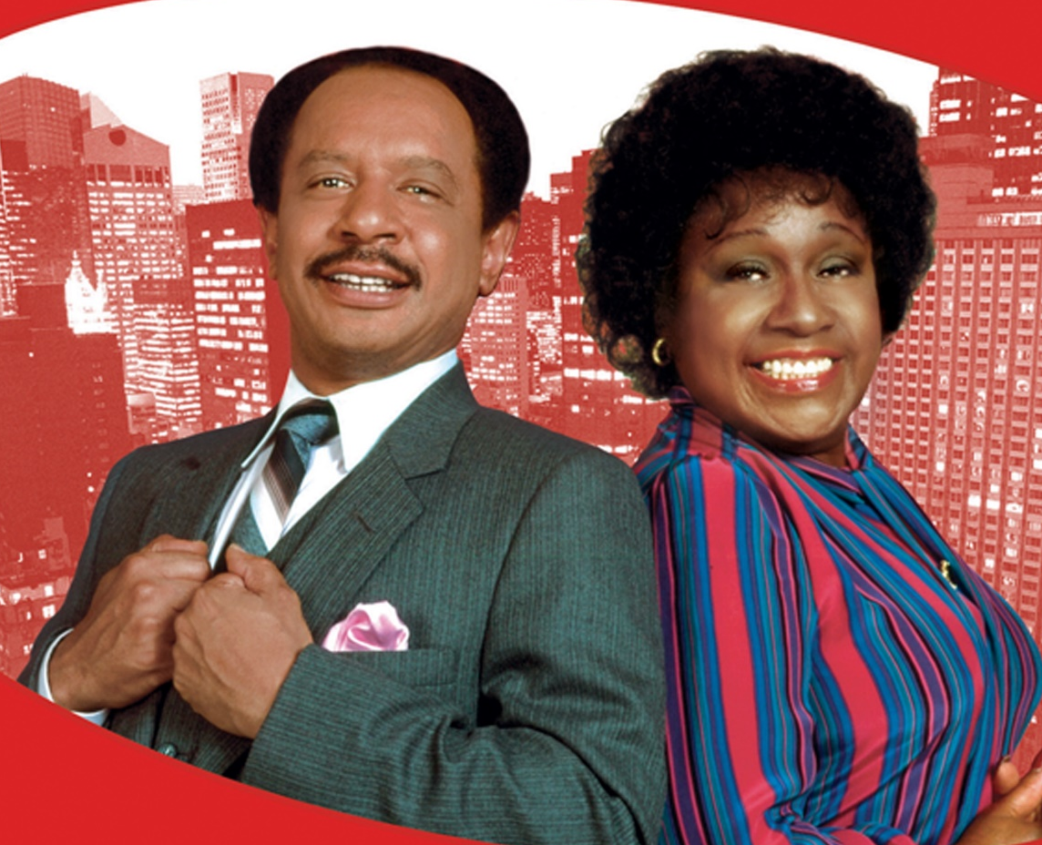
Scoreboard Quiz – 1982 TV
h
In this spin-off of “All in the Family”, Archie Bunker’s neighbors are “moving on up, to the East Side, to a deluxe apartment in the sky”:
Miami Sky
The Jeffersons
Peyton Place
Notes:
Sherman Hemsley and Isabel Sanford star as George and Louise “Wheezy” Jefferson

Slide 14
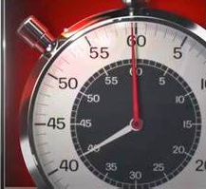
Scoreboard Quiz – 1982 TV
h
This popular Sunday “news magazine” show debuted in ‘81 and is still running today. Its intro featured a ticking stop watch:
Face the Nation
Meet the Press
60 Minutes

Slide 15
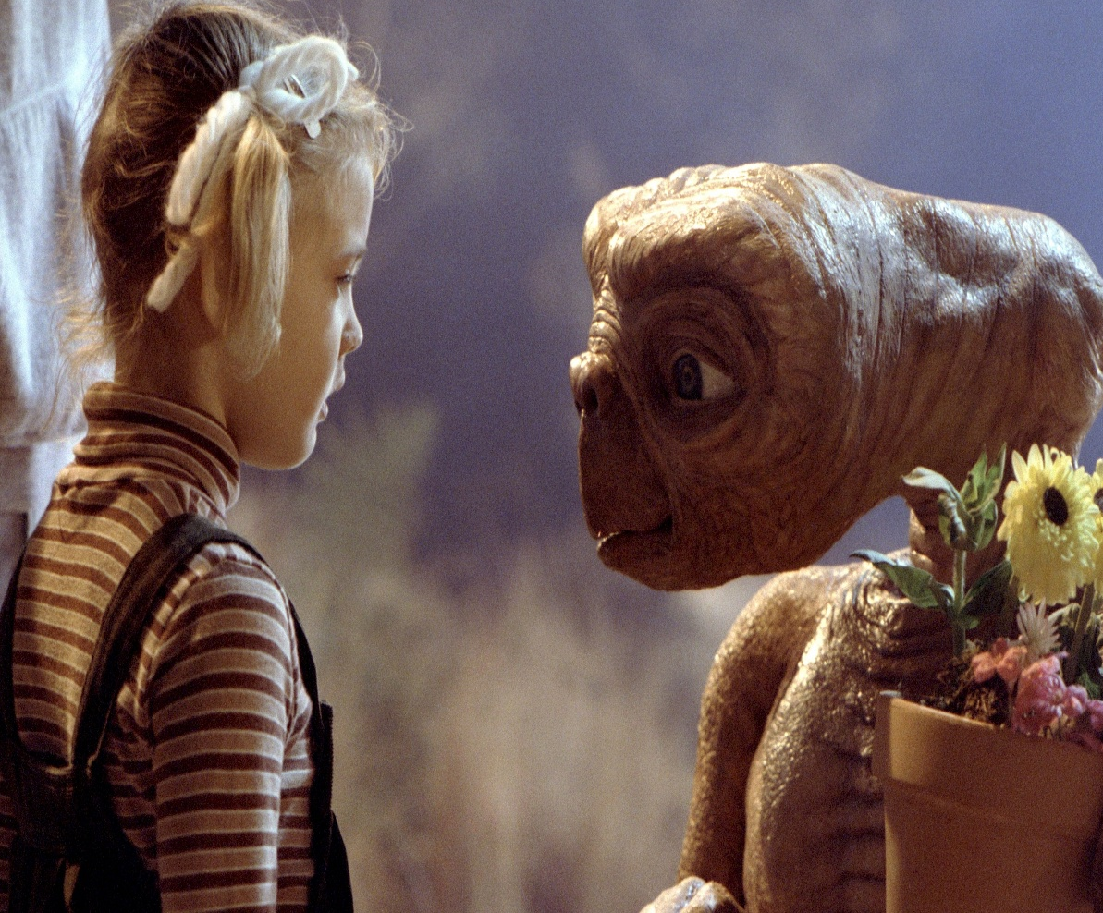
Scoreboard Quiz – 1982 Movies
h
In this science fiction movie, the alien wanted to “phone home”.
2001 a Space Odyssey
E.T. the Extra-terrestrial
Star Trek – the Movie
Notes:
Several of the top-grossing movies in 1982 were science fictions.

Slide 16
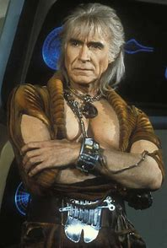
Scoreboard Quiz – 1982 Movies
h
Ricardo Montalban played the title role in this movie based on the Star Trek TV show:
Star Trek – the Movie
Star Trek II – the Wrath of Khan
Return of the Jedi
Notes:
Probably the best of the Star Trek – based movies.

Slide 17
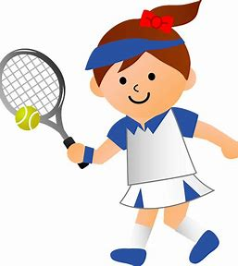
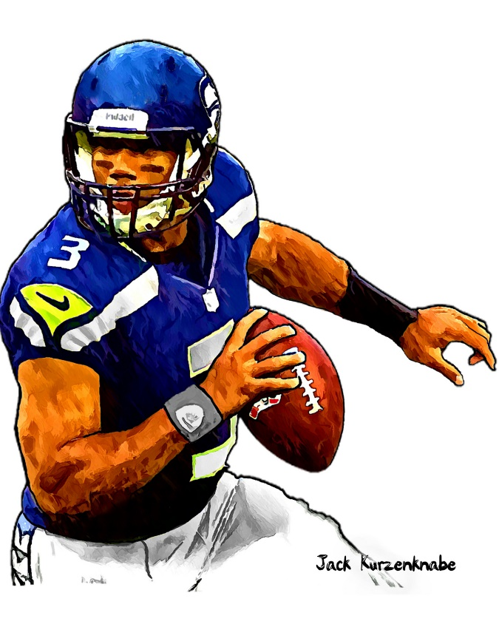

1982 Sporting News

Slide 18

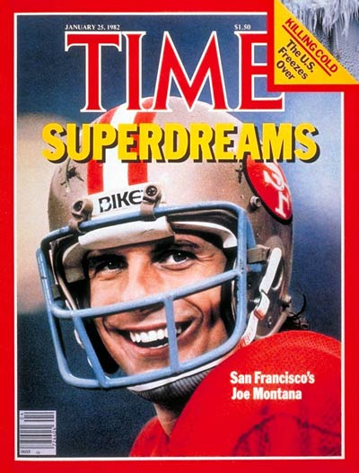
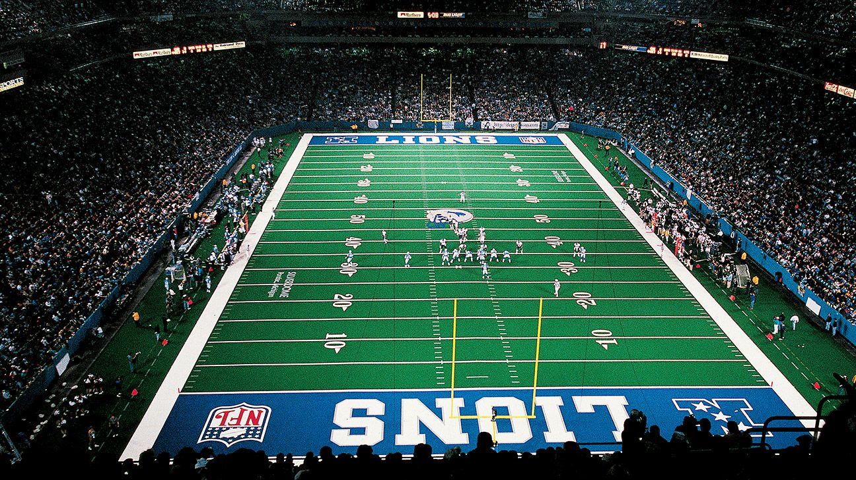

Super Bowl XVI
26
to
21
Played on January 24 at the Pontiac Silverdome
in suburban Detroit.
Notes:
Both teams were making their first appearance in a Super Bowl. Over 85 million watched on TV, one of the most-watched TV shows of its day. In a close game, the 49ers won – even thought the Bengals racked up more total yardage. SF QB Joe Montana was the games’s MVP. U of Texas quarterback legend Bobby Layne handled the coin toss.

Slide 19
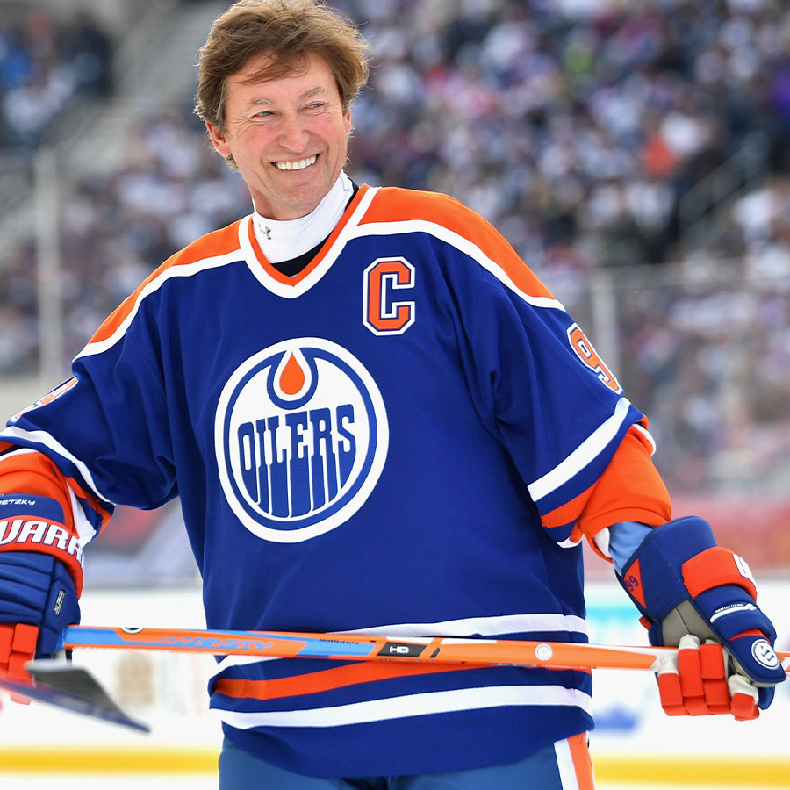
Wayne Gretzky
sets NHL season
scoring record
92 goals
120 assists
===
212 points

Slide 20
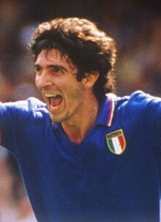

Italy Wins
World Cup
Italy 3 – West Germany 1
in the Final Game
Italian striker
Paolo Rossi
Scored the most goals (6)
and was selected as MVP
Notes:
Held in Spain in 1982. Italy won their third World Cup title – first since 1938. The field was expanded from 16 to 24 teams., allowing more participation for teams from Africa and Asia. This was also the first World Cup to use penalty kicks to decide a tie game during the knockout round. Italy defeated West Germany 3-1 for the title.

Slide 21
The Year in Baseball: 1982

Slide 22
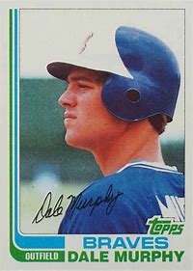
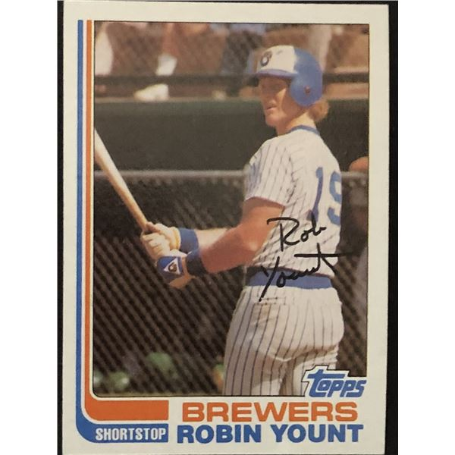
1982
Most
Valuable
Players
.281 36 HR 109 RBI
.331 29 HR .578 SLG
Notes:
1982 was the first of two consecutive MVPs for Dale Murphy. Robin Yount is in the HOF.
Mickey Mantle hit 37 homers to lead the AL. He also led the league in triples, walks, and SLG.

Slide 23
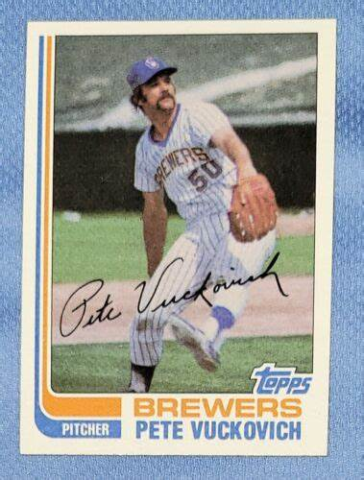
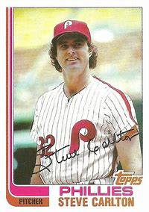
1982
Cy Young
Winners
23-11, 286 K, 295 IP
18-6, 3.34 ERA, 223 IP
Notes:
This was Carlton’s 4th (and last) Cy Young Award on the way to the Baseball Hall of Fame. Vuckovich had good years in both ’81 and ‘82., going 14-4 in ‘81 also.

Slide 24
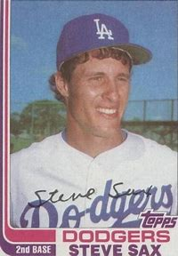
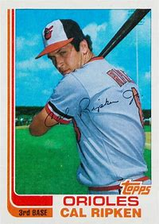
1982
Rookies of the
Year
.282 , 49 SB
.264 , 28 HR
Notes:
Mickey Mantle hit 37 homers to lead the AL. He also led the league in triples, walks, and SLG.

Slide 25
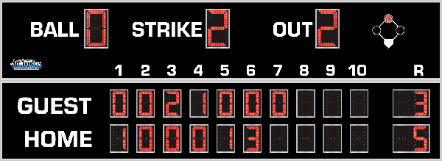
7th Inning Stretch

Slide 26
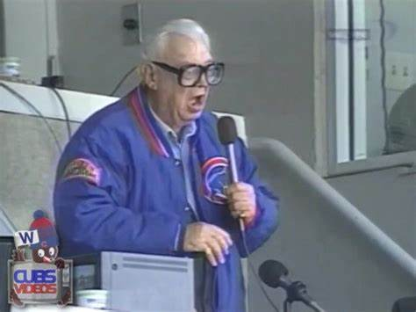
“Take Me Out to the Ballgame”

Slide 27
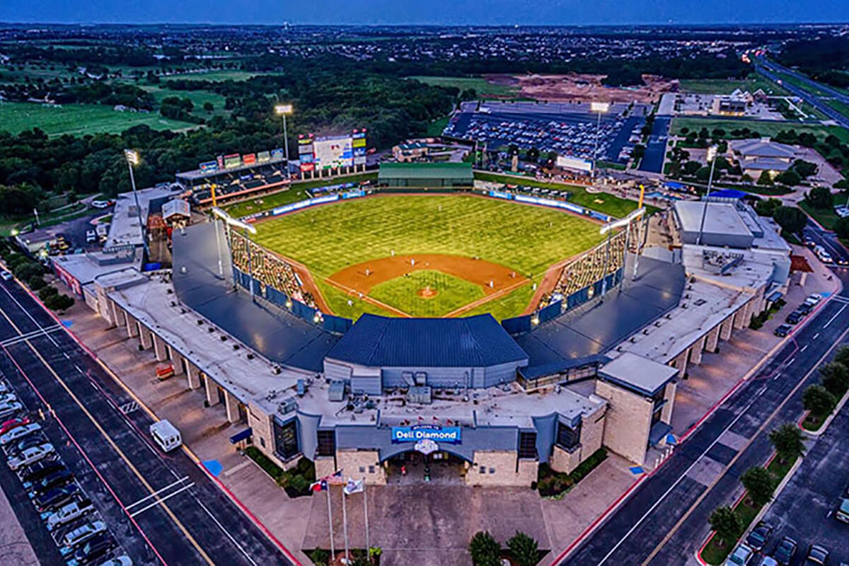
“Deep in the Heart of Texas
https://www.youtube.com/watch?v=rcrK0U7RDIk

Slide 28
“Do the Hokey Pokey”
https://www.youtube.com/watch?v=vpharBeg9XA

Slide 29
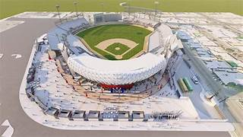
“El baile del sombrero mexicano”
The 2025 Caribbean Series
will be held in:
Mexicali, Baja California,
Mexico
at the stadium
“El Nido de los Aguilas”
the Eagles’ Nest
https://www.youtube.com/watch?v=XgRMRfQgslM

Slide 30




1982 League Championships
Best 3-of-5 format
St. Louis Cardinals
won 3-0
Milwaukee Brewers
Won 3-2

Slide 31


1982 World Series
“Whitey Ball” v. “Harvey’s Wallbangers”

Slide 32
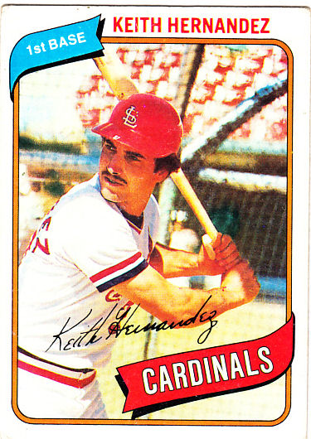
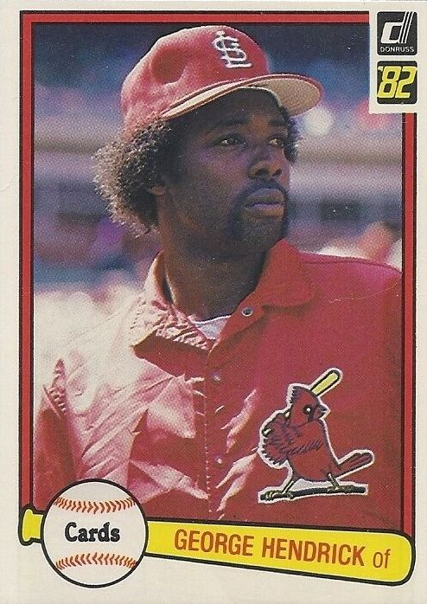
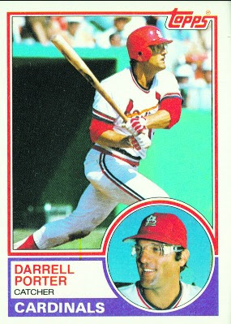
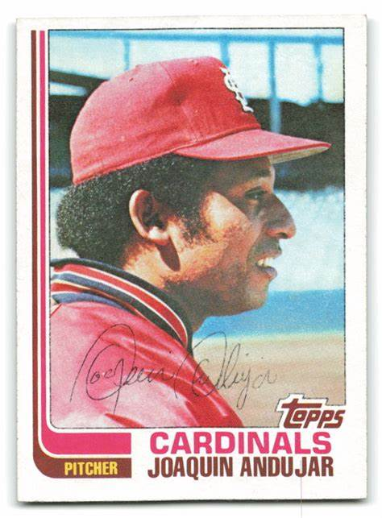
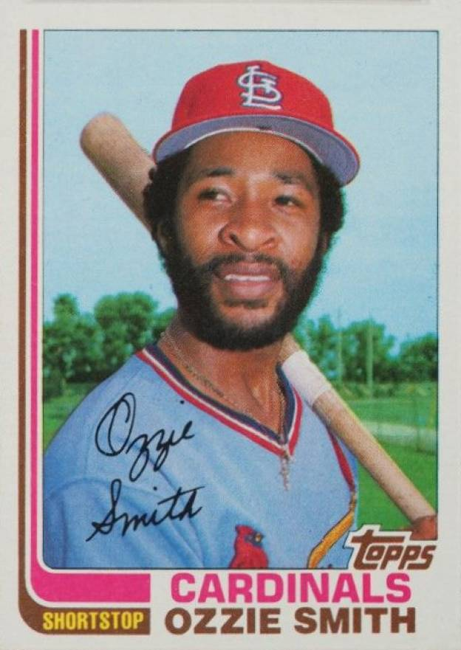
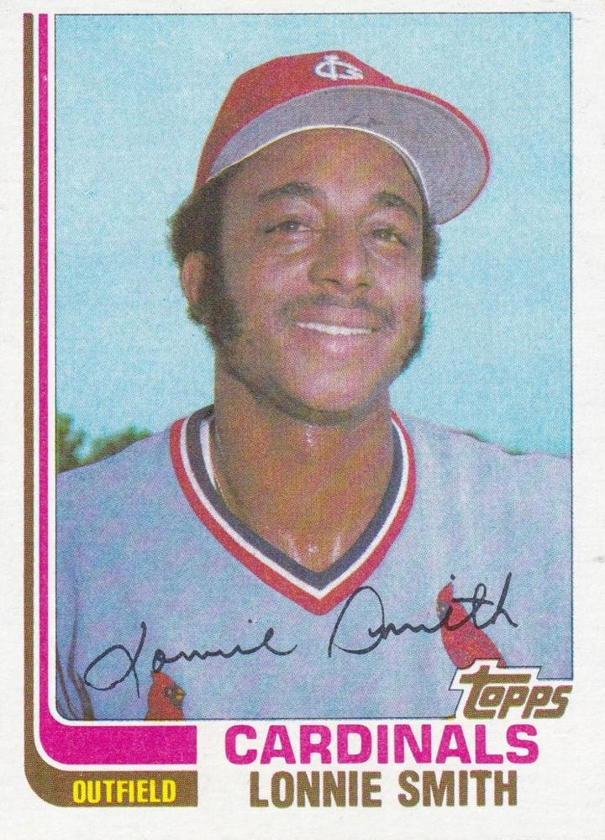
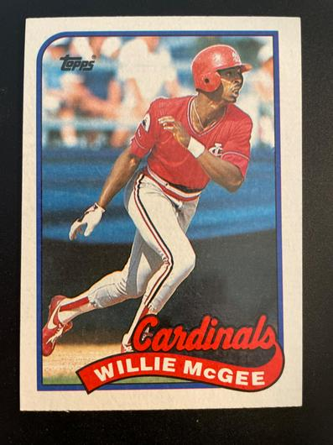
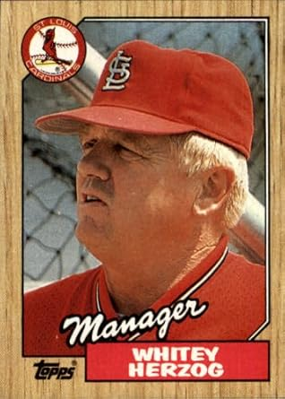
Cards’
Stars

Slide 33
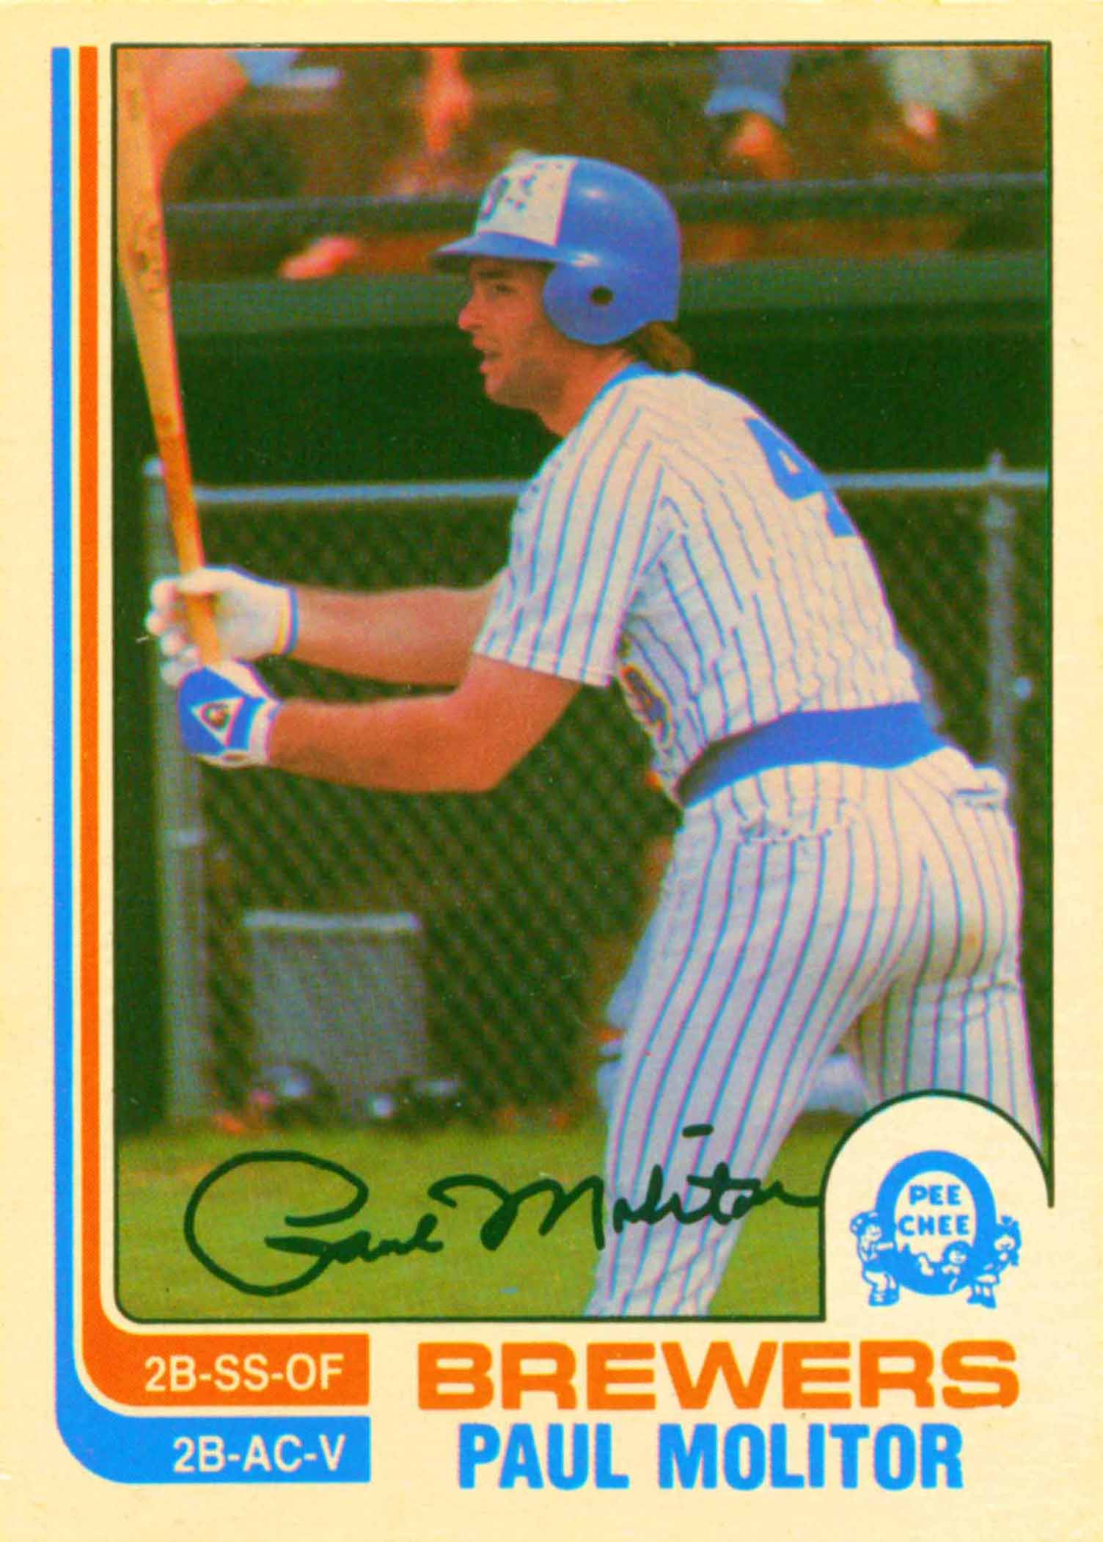
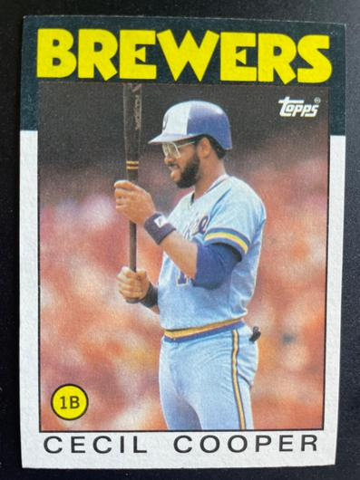
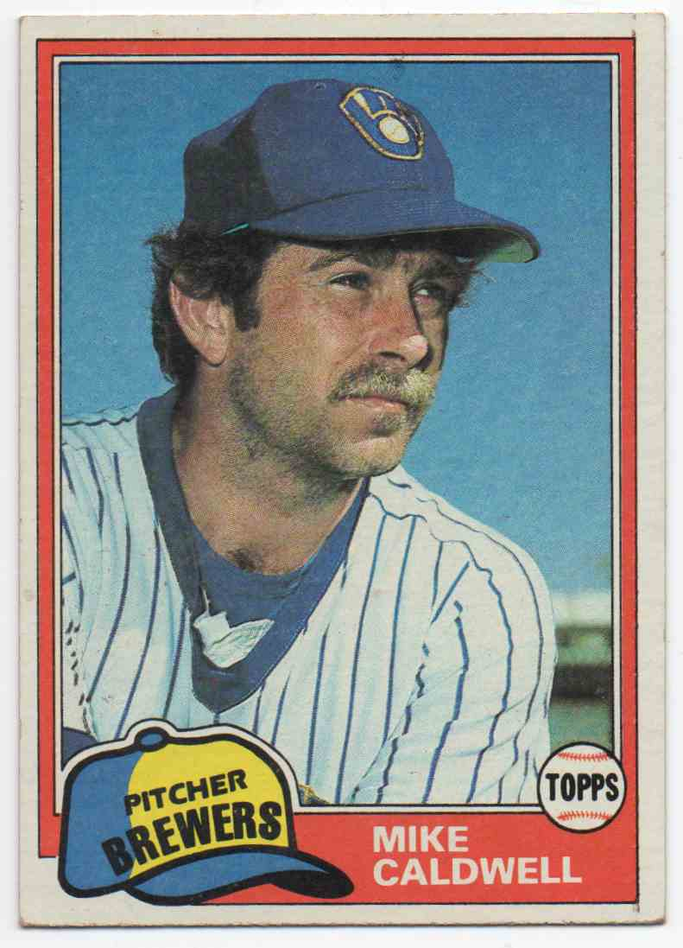
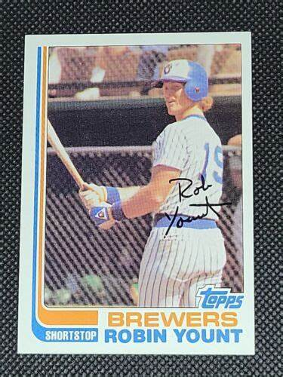
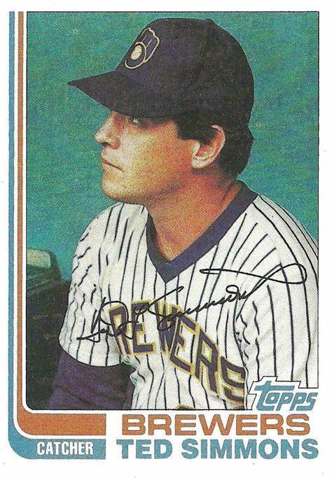
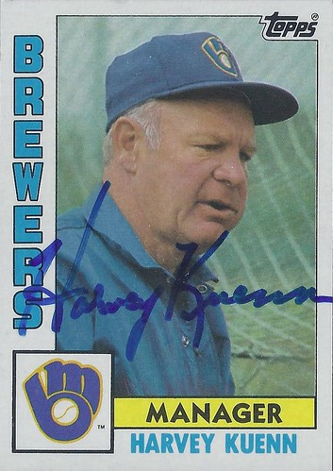
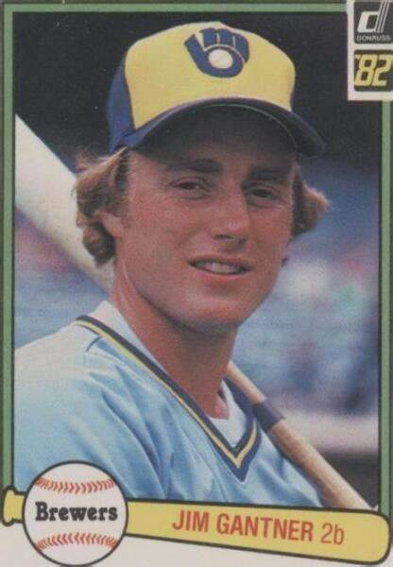
Key
Brewers

Slide 34
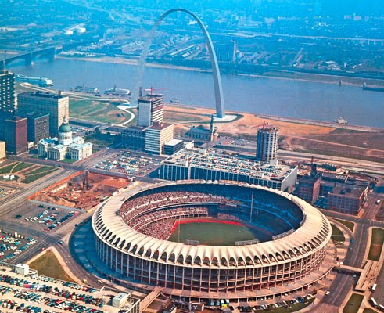
1982 World Series Highlights
Busch Stadium II in St. Louis
Game 1 – October 12, 1982
Brewers 10 – Cardinals 0
Brewers Paul Molitor had five hits (a WS record) and Robin Yount had four. Starter Mike Caldwell pitched a complete game shutout.
Game 2 – October 13
Cardinals 5– Brewers 4
Cards’ Darrell Porter had 2 RBI and PH Steve Braun walked w/ bases loaded to “drive in” the winning run in the 8th. RP Bruce Sutter went 2+ innings for the win.
SERIES TIED AT ONE WIN EACH

Slide 35
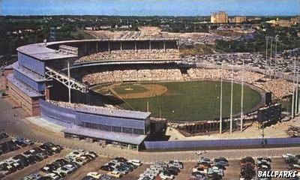
County Stadium in Milwaukee
Game 3 – October 15
Cardinals 6 – Brewers 2
Cards’ Willie McGee homered twice and had 4 RBI. Starting P Andujar pitched 6+ shutout innings.
Game 4 – October 16
Brewers 7 – Cardinals 5
Milwaukee rallied for 6 runs in the 7th inning to overcome early Cardinals lead. Yount and Gorman Thomas both had two RBI.
Cards 2B Tom Herr had a 2-RBI sac fly:
https://www.youtube.com/watch?v=er16052Q1VQ
Game 5 – October 17
Brewers 6 – Cardinals 4
Another 4-hit game by Yount helped overcome a 15 hit attack by Cardinals. Caldwell pitched 8+ inn. for the win.
BREWERS LEAD SERIES 3 GAMES TO 2

Slide 36
The Series returns to St. Louis for game 6
Game 6 – October 19
Cardinals 13 – Brewers 1
Rookie P John Stuper threw a 4-hit complete game. Keith Hernandez and Darrel Porter both homered – setting up a deciding game 7
Game 7 - October 20
Cardinals 6 – Brewers 3
Hernandez, Hendrick, and Porter all had RBI. Cards’ ace Andujar pitched 7 innings and reliever Bruce Sutter closed out the game with a 2 inning save:
CARDINALS WIN THE 1982
WORLD SERIES
IN 7 GAMES
https://www.youtube.com/watch?v=41vjWTL73kg
Cardinals catcher Darrell Porter was
named Series MVP.

Slide 37
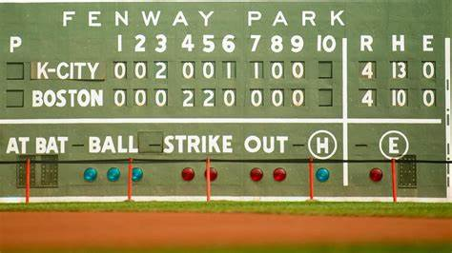
Extra Innings!

Slide 38

1982 Top Songs

Slide 39
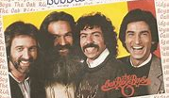
Bobbie Sue
Oak Ridge Boys
https://www.youtube.com/watch?v=JWBuVv8IQfI&list=RDJWBuVv8IQfI&start_radio=1

Slide 40

Centerfold
J. Geils Band
https://www.youtube.com/watch?v=pEf8Uj_Yc7U

Slide 41
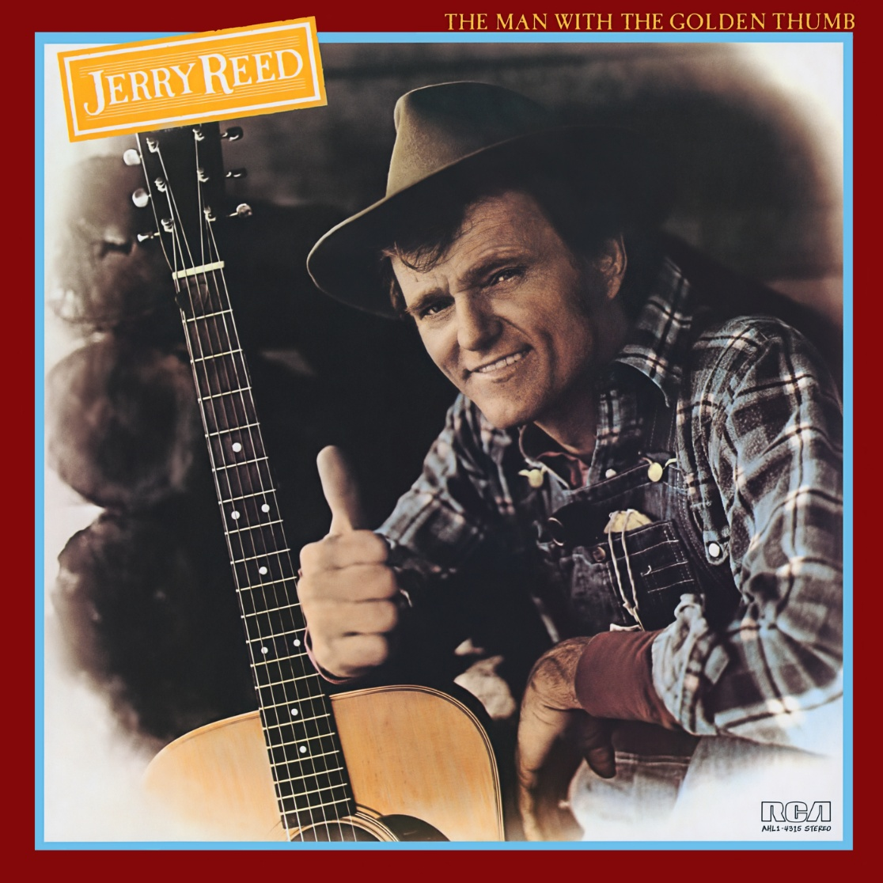
She Got the Goldmine
… I Got the Shaft
Jerry Reed
https://www.youtube.com/watch?v=kHvIcHbEHSU

Slide 42
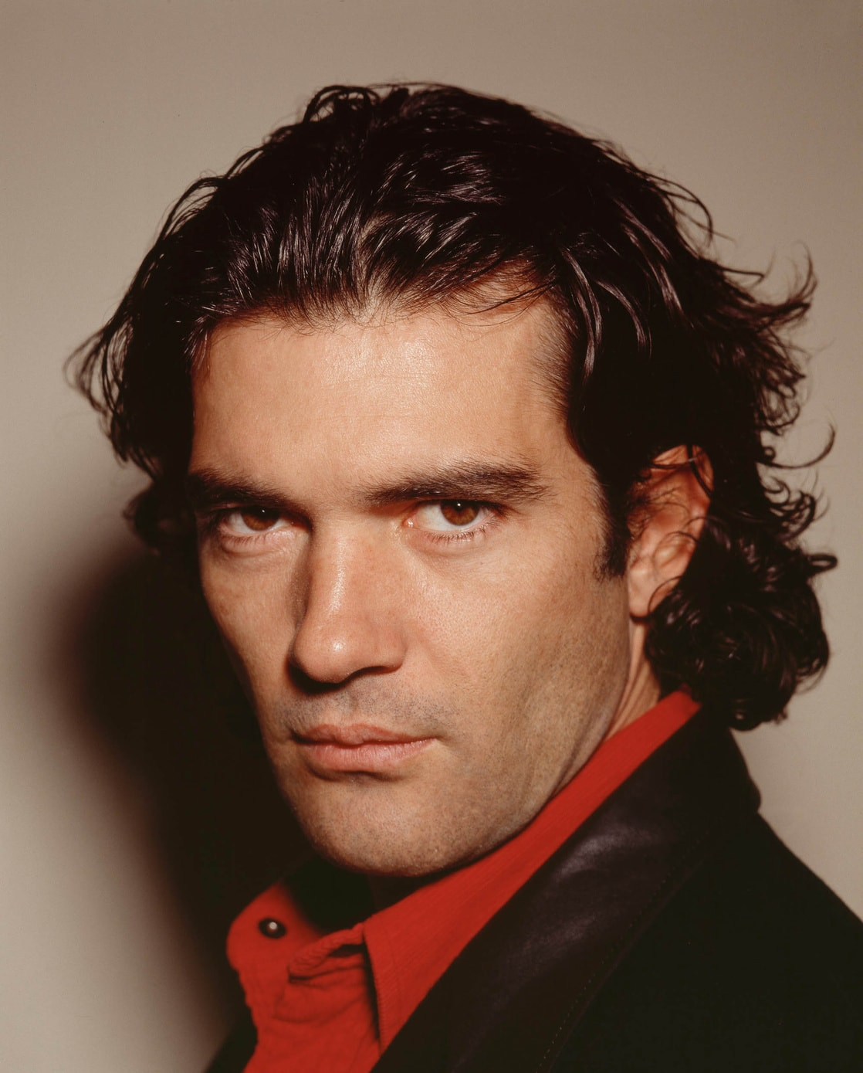
Canción del Mariachi
Morena de mi Corazón
Antonio Banderas y Los Lobos
https://www.youtube.com/watch?v=ATIK5ADxAH8

Slide 43

Always
on
My Mind
https://www.youtube.com/watch?v=NH-gMXb1byM

Slide 44

Thanks!!
We’ll see you again next month!
https://www.youtube.com/watch?v=_IJkbs1D5PU

