Slide 1



AGE Thrive with Baseball Memories
February 19, 2025
Agenda
Warm-up - Introductions
Current Events
Gametime – The Year in Baseball – 1984
Seventh Inning Stretch - “Take Me Out to the Ball Game”
Get Up and Move, Sing, Dance!
Extra Innings – More stuff from the ‘70s and ‘80s

Slide 2


Slide 3



Favorite Teams
Basketball !
Notes:
Mention current won-loss for each team;

Slide 4



40 - 22
Notes:
Who won?

Slide 5

History from 1984

Slide 6
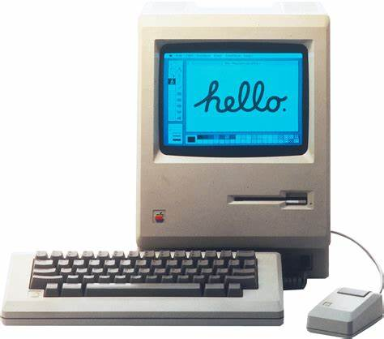
Apple Macintosh introduced
First to use a graphical user interface (GUI) and a
“mouse”
It cost $2,495
Notes:
Equivalent to about $8,000 in 2025 dollars!

Slide 7
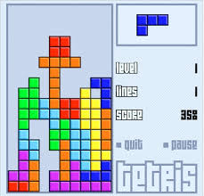
Tetris
video game
One of the most popular video games of the ‘80s.
520,000,000 copies sold!
Notes:
One of the most popular video games ever developed – would run an most platforms - Nintendo, Gameboy, Mac, PC, arcades, etc etc …

Slide 8
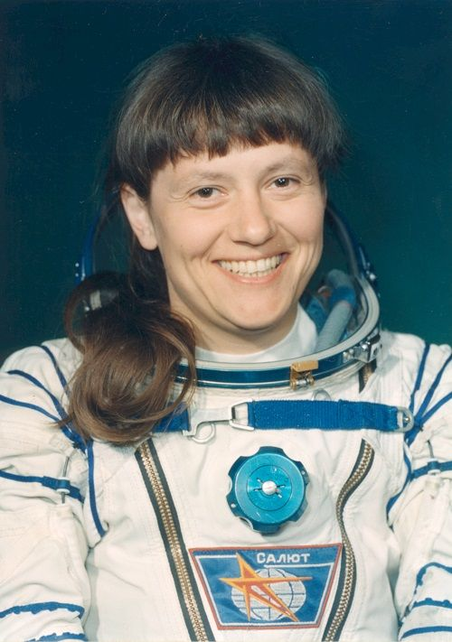
First woman
to walk in space
Cosmonaut
Svetlana
Saviskaya
Notes:
Walked in space as part of Soviet Salyut 7 mission

Slide 9

British Empire continues to shrink
Hong Kong will revert to China
but UK retains control of Gibralter
Notes:
Agreements were made with China that HK will revert to Chinese control in 1997; Britain entered into negotiations with Spain in 1984, but eventually Gibralter citizens overwhelmingly voted to remain a territory within the British Emprie.

Slide 10
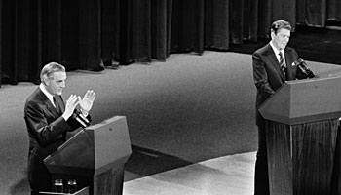
1984 was an election year
Former VP Walter Mondale challenged President Ronald Reagan in ‘84

Slide 11
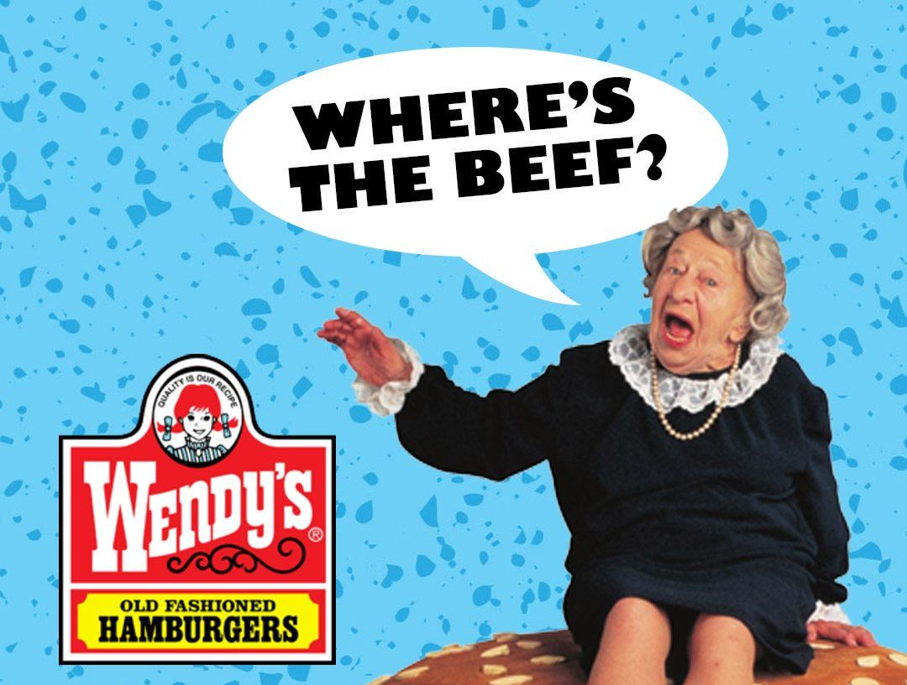
https://www.youtube.com/watch?v=u0aKKFybRNM
Notes:
Voice over the background behind Mondale’s use of this term …

Slide 12
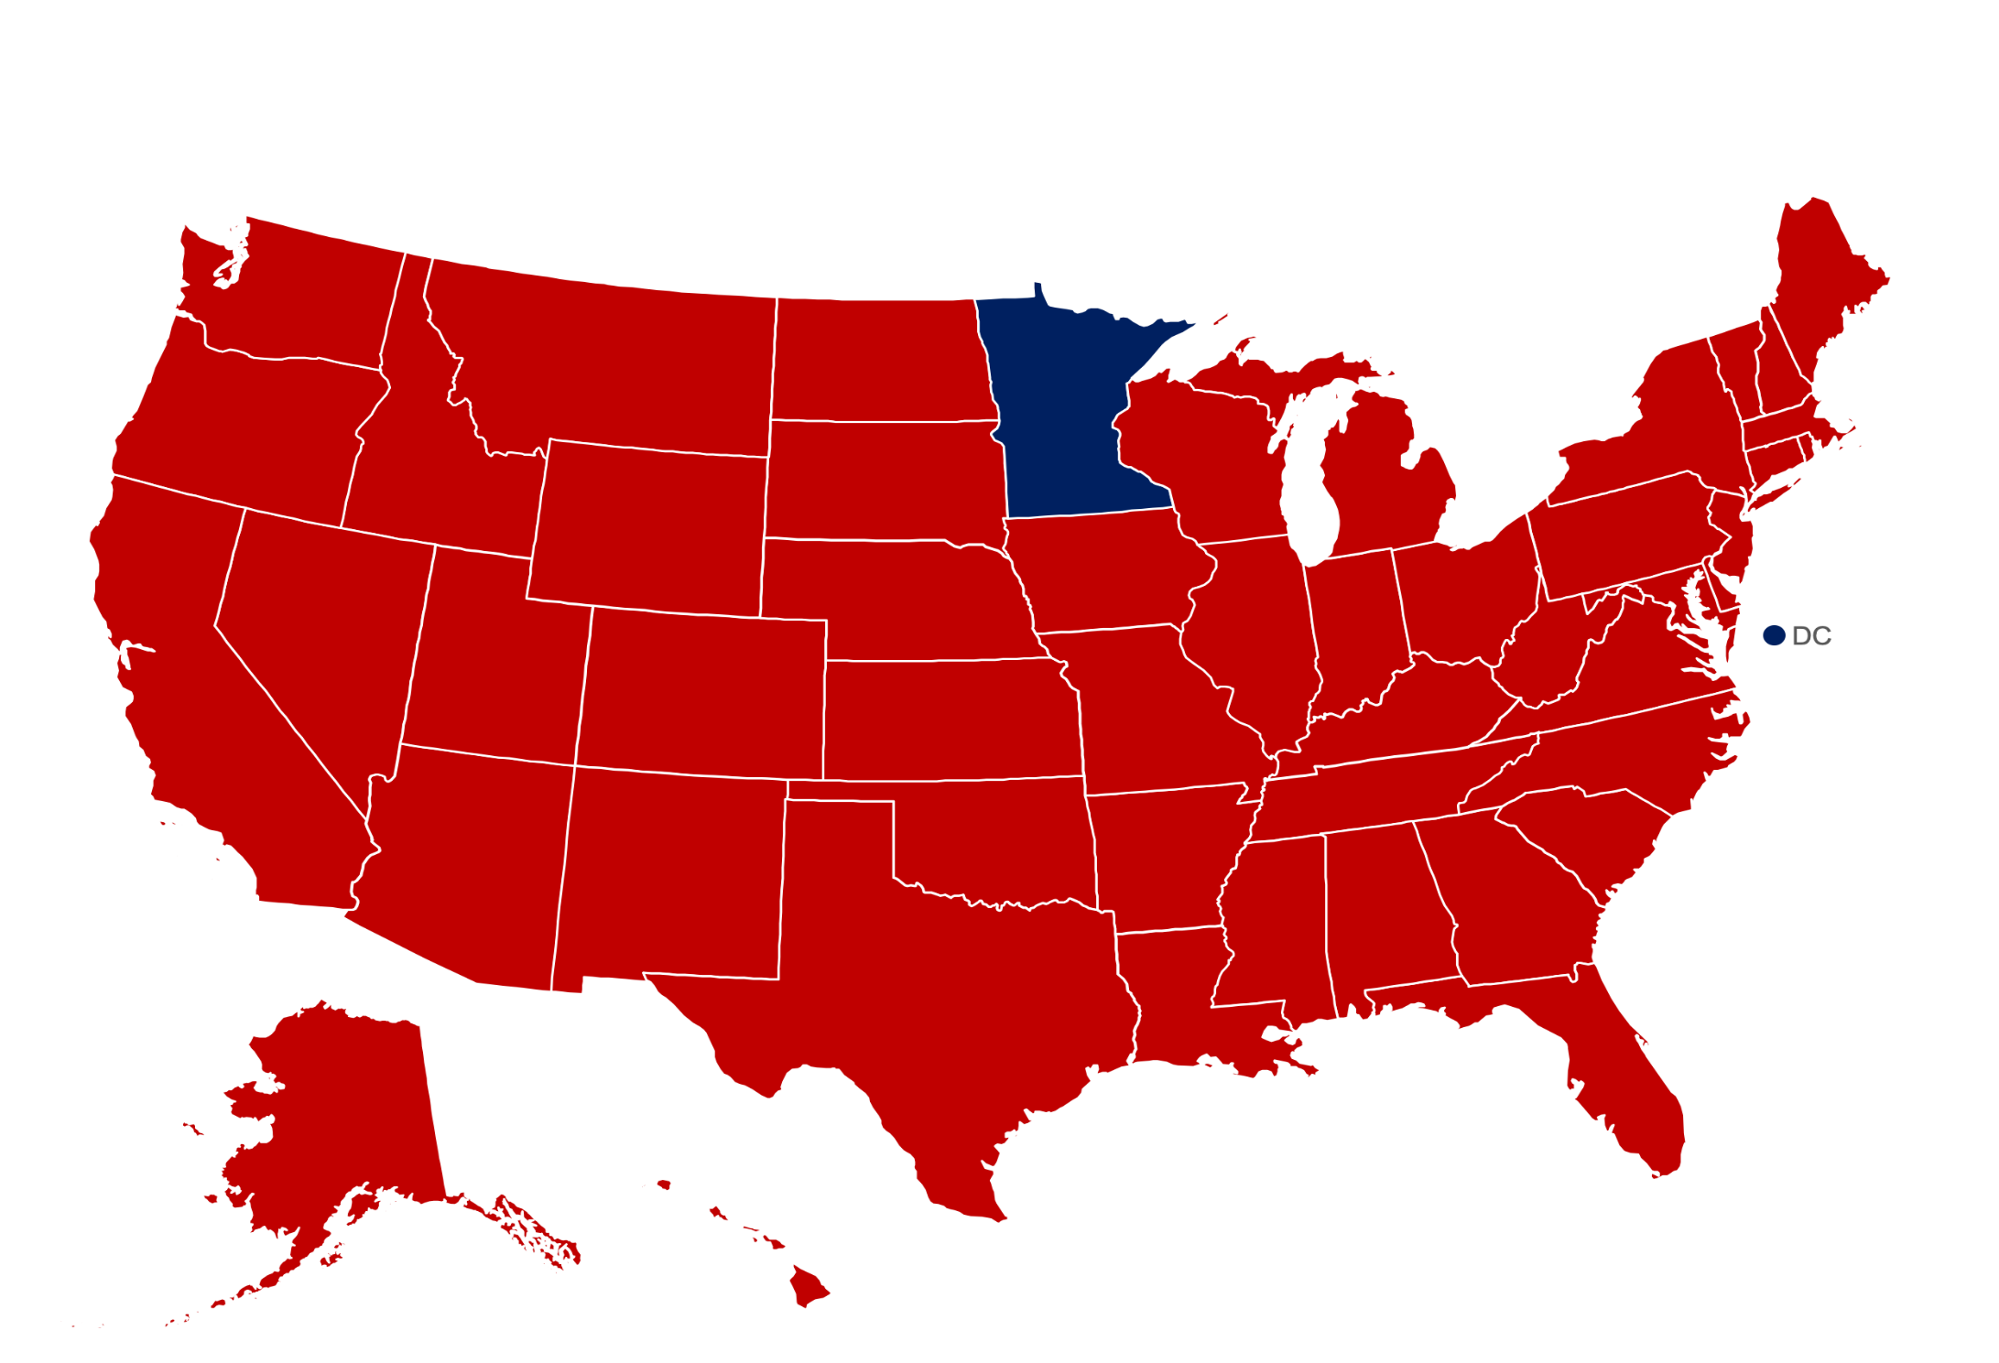
It was a landslide for Reagan – 525 to 13 electoral votes!

Slide 13
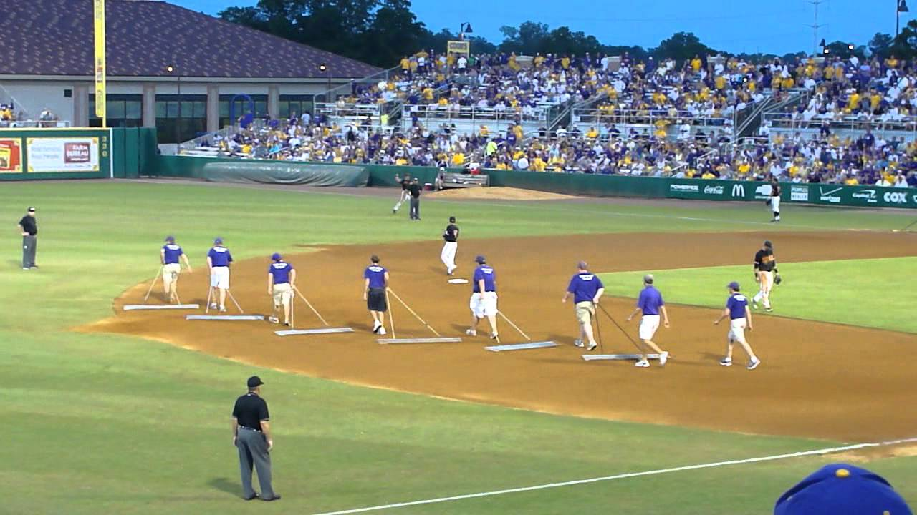
In Between Innings

Slide 14
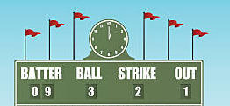
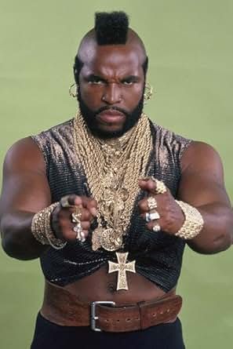
Scoreboard Quiz – 1984 TV
h
Mr. T. starred in this action drama about former Army Rangers that became soldiers of fortune.
T’s favorite line was “I pity the fool …”
Mission Impossible
A-Team
Riptide
Notes:
Mr. T. starred in Rocky ??? In 1982 prior to this series starting.

Slide 15
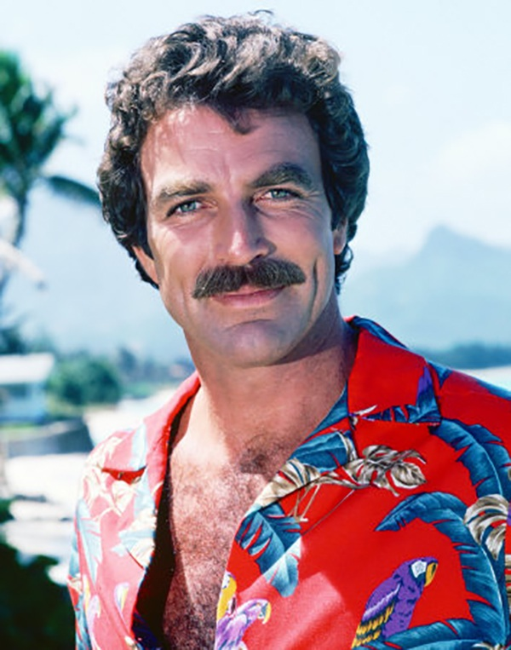
Scoreboard Quiz – 1984 TV
h
Tom Selleck starred in this detective movie about a private investigator in Hawaii.
Hawaii Five-O
Hawaiian Eye
Magnum P.I.

Slide 16
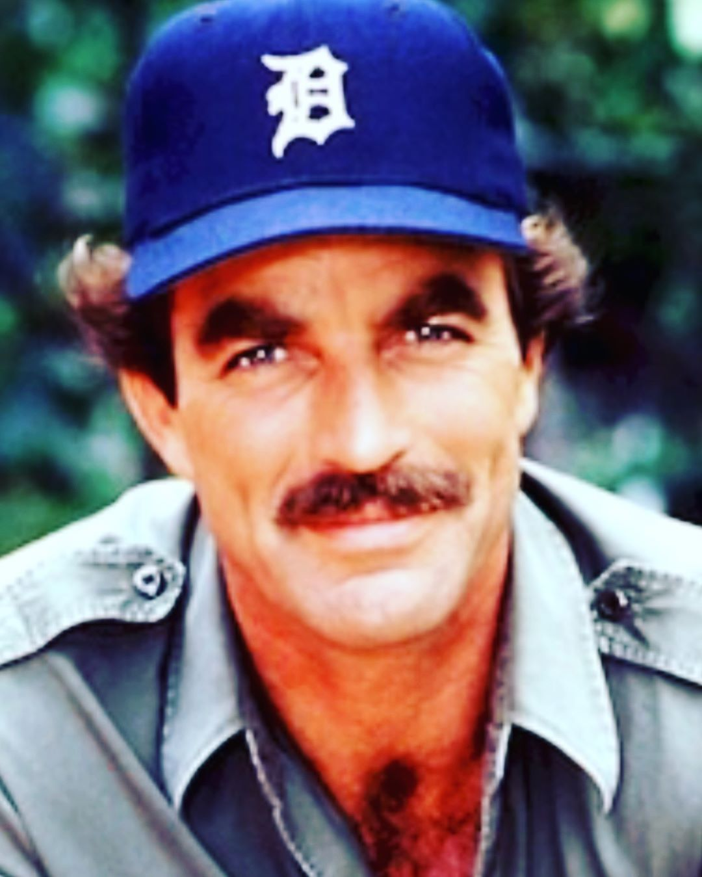
Scoreboard Quiz – 1984 TV
h
Actor Tom Selleck often wore a baseball cap during this series. What team was it from?
Detroit Tigers
New York Yankees
Los Angeles Dodgers

Slide 17
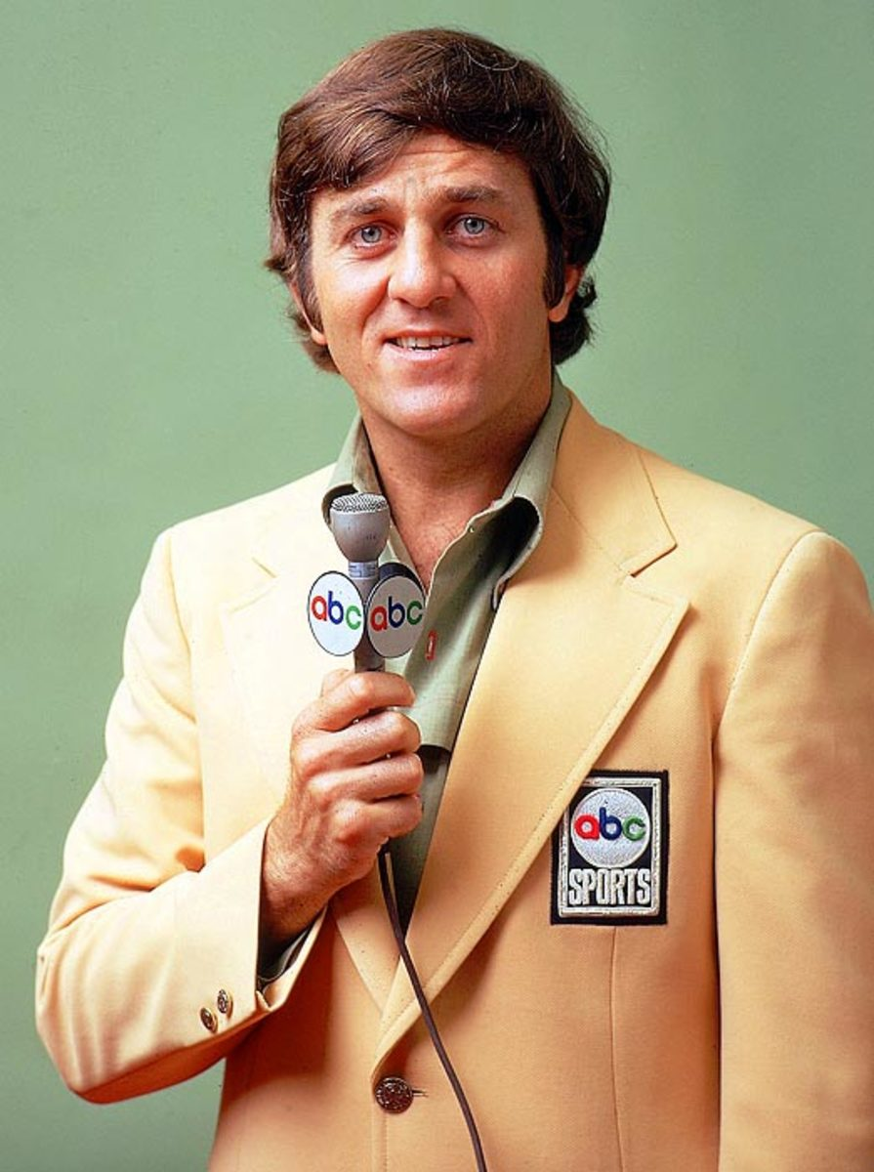
Scoreboard Quiz – 1984 TV
h
This Texas football legend quarterbacked the SMU Mustangs and the Dallas Cowboys. He went on to co-host Monday Night Football.
Roger Staubach
Don Meredith
Patrick Mahomes

Slide 18
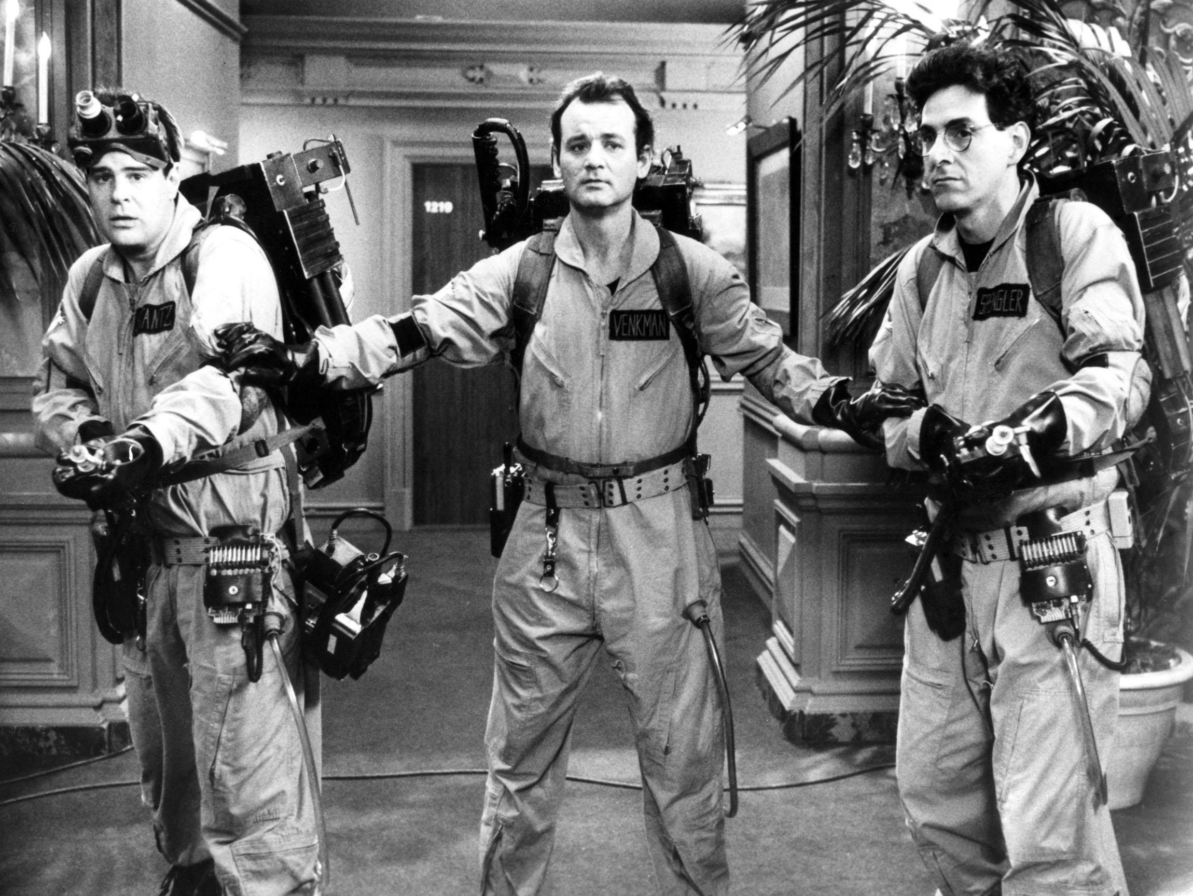
Scoreboard Quiz – 1984 Movies
h
This top-selling movie was a comedy about a
group that exterminated “para-normal”s. Several of the characters starred on or wrote for Saturday Night Live.
2001 a Space Odyssey
Star Trek III
Ghostbusters

Slide 19
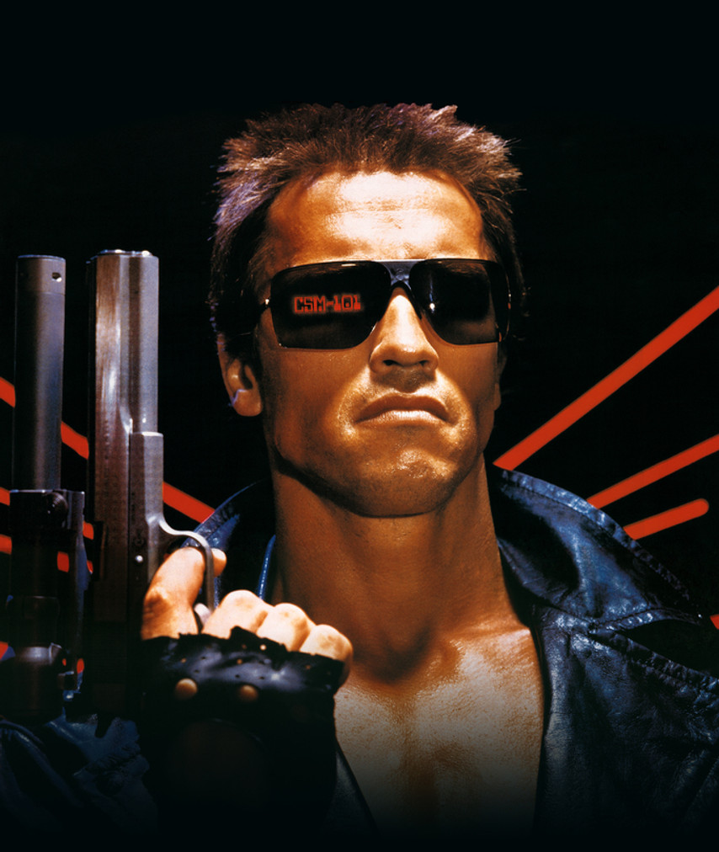
Scoreboard Quiz – 1984 Movies
h
Arnold Schwarzenegger starred in the title role as a cyborg assassin.
His famous line was “I’ll be baaaack …”
Dune
Independence Day
Terminator

Slide 20
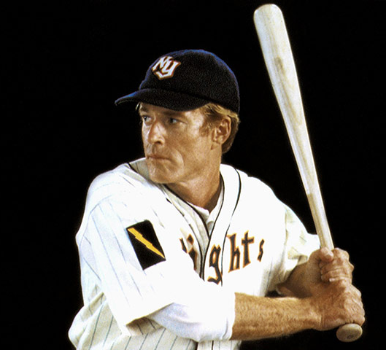
Scoreboard Quiz – 1984 Movies
h
Robert Redford stars as an unknown middle-aged rookie outfielder that comes to play major league baseball for the NY Knights
The Natural
Ball Four
Bull Durham

Slide 21

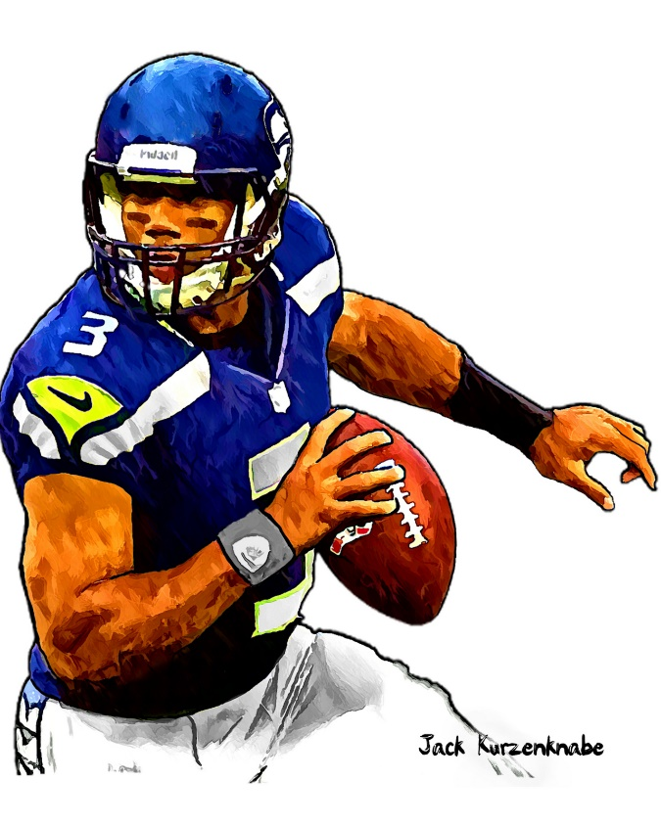

1984 Sporting News

Slide 22
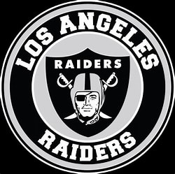
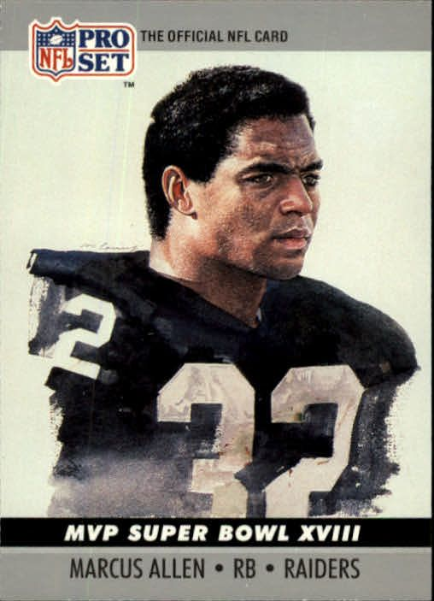
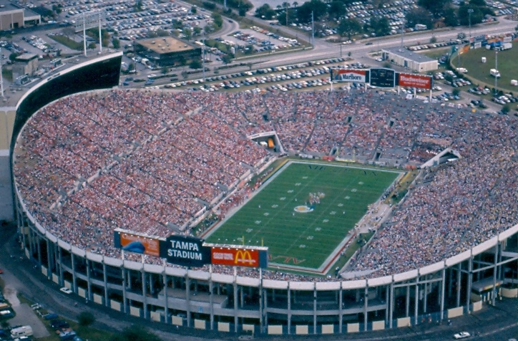

Super Bowl XVIII
38
to
9
Played on January 22 at Tampa Stadium
https://www.youtube.com/watch?v=SosBTeyH0ag
Notes:
Old Tampa Stadium – known as the “Sombrero” – RB Marcus Allen was the MVP– famous Macintosh promo ad playing on the book and movie “1984”

Slide 23
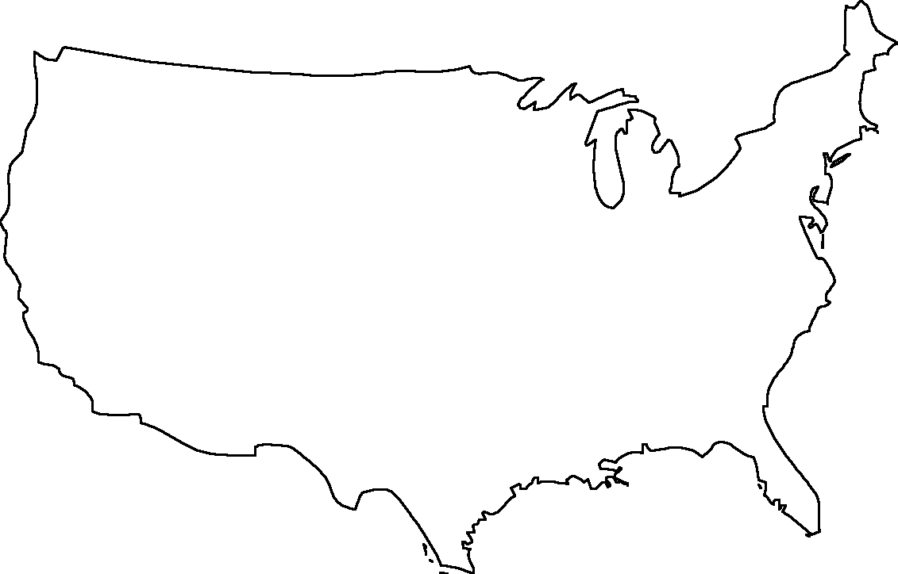
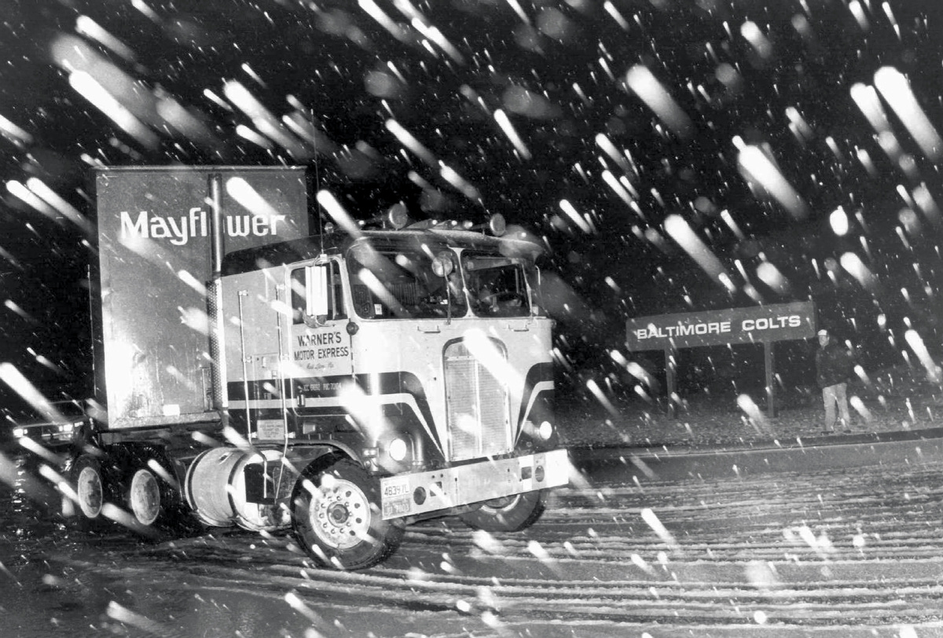

The NFL’s Colts
Moved from Baltimore to Indianapolis
Overnite!

Slide 24
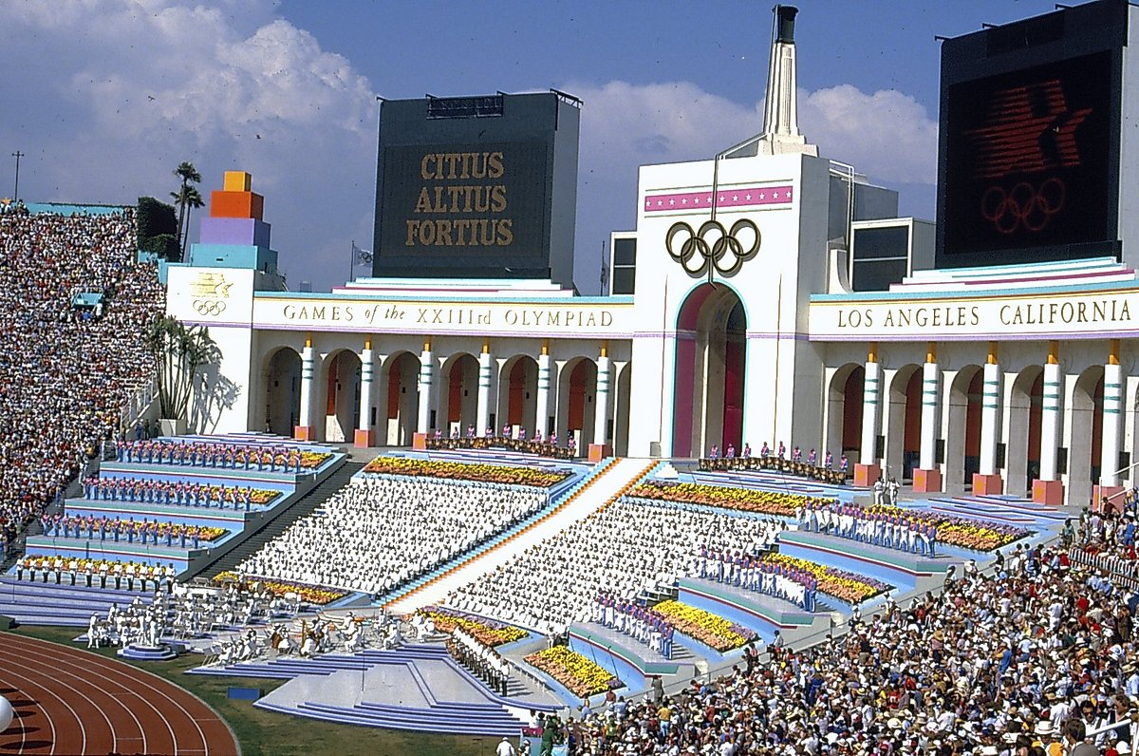
Summer Olympics held in Los Angeles
Notes:
Linda saw the torch go by in Ellisville, Missouri!

Slide 25
The Year in Baseball: 1984

Slide 26
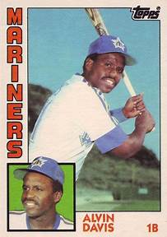
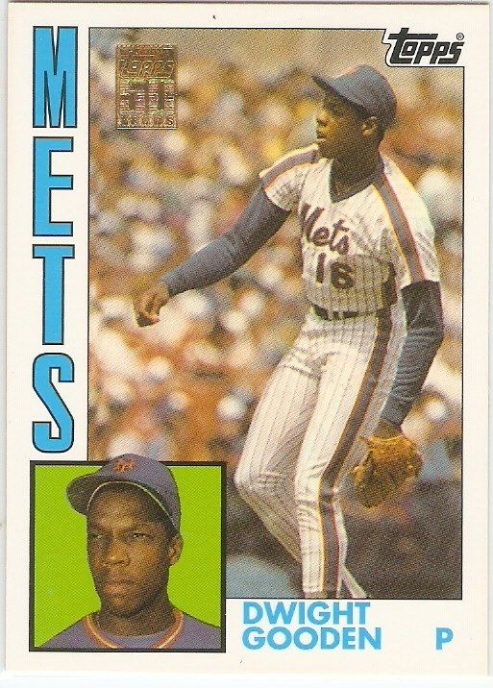
1984
Rookies
of the
Year
17 – 9, 2.60 ERA, 276 K
.284 27 HR 116 RBI
Notes:
Alvin Davis had a career year as a rookie. Dwight Gooden had a long successful career.
Mickey Mantle hit 37 homers to lead the AL. He also led the league in triples, walks, and SLG.

Slide 27
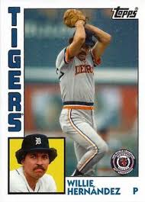
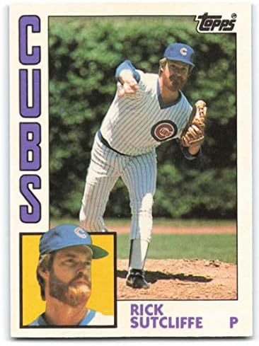
1984
Cy Young
Winners
32 saves, 1.92 ERA, 80 games
16-1 (NL), 3.64 ERA, 244 IP
Notes:
Hernandez won Cy Young and MVP as a reliever; Sutcliffe was traded from Cleveland to Cubs early in season – only lost one game for Cubs.

Slide 28
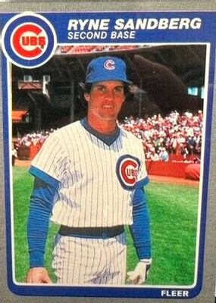
1984
Most
Valuable
Players
.314 , 19HR, 114 R
Notes:
Mickey Mantle hit 37 homers to lead the AL. He also led the league in triples, walks, and SLG.

Slide 29
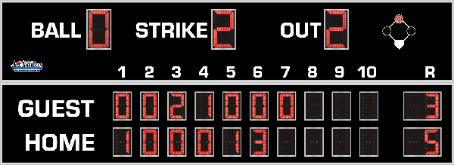
7th Inning Stretch

Slide 30
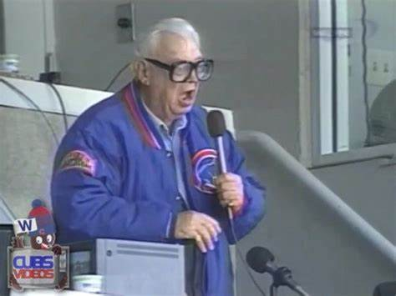
“Take Me Out to the Ballgame”

Slide 31
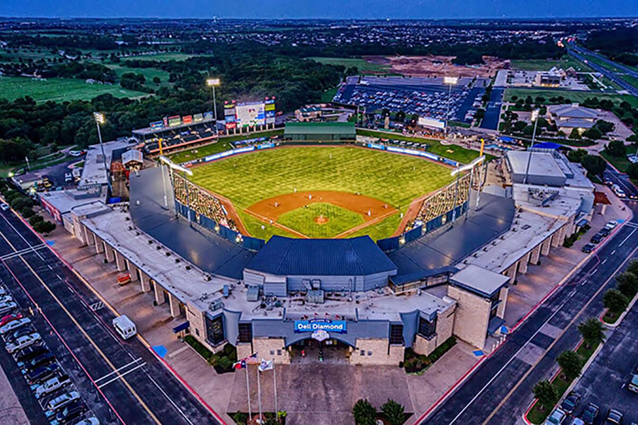
“Deep in the Heart of Texas
https://www.youtube.com/watch?v=rcrK0U7RDIk

Slide 32
“Do the Hokey Pokey”
https://www.youtube.com/watch?v=vpharBeg9XA

Slide 33
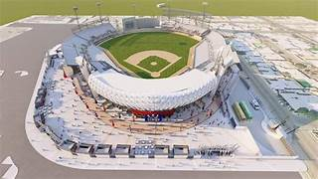
“El baile del sombrero mexicano”
The 2025 Caribbean Series
was held at:
Mexicali, Baja California,
Mexico
at the stadium
“El Nido de los Aguilas”
the Eagles’ Nest
Escogido from the Dominican
Republic Won !
https://www.youtube.com/watch?v=XgRMRfQgslM

Slide 34




1984 League Championships
Best 3-of-5 format
San Diego Padres
won 3-2
Detroit Tigers
Won 3-0

Slide 35

1984 World Series
Detroit Tigers vs. San Diego Padres

Slide 36
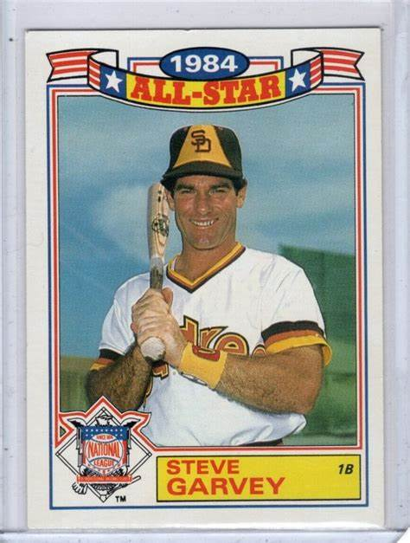
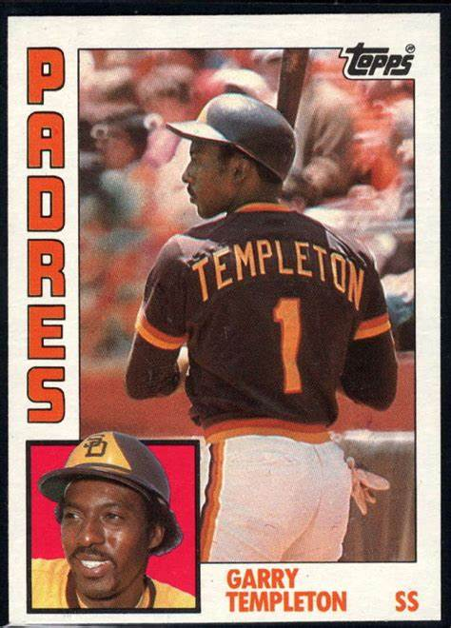
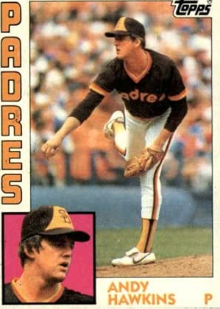
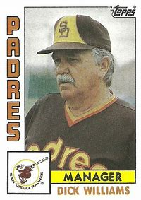
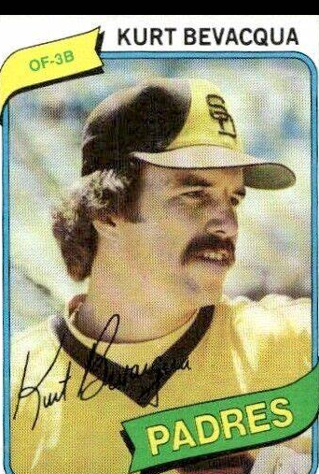
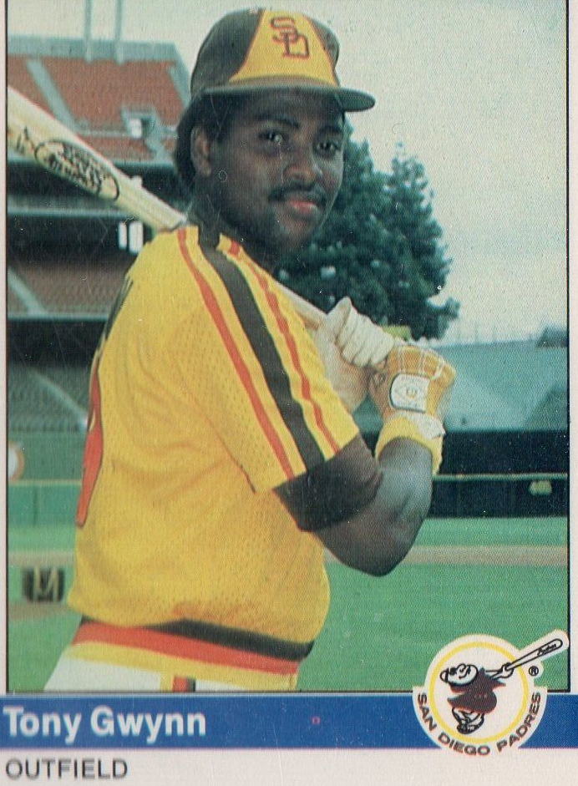
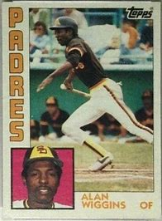
Padres

Slide 37
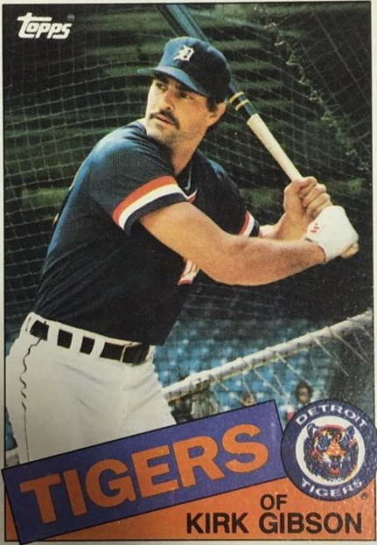
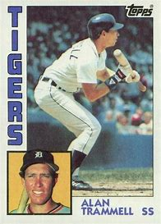
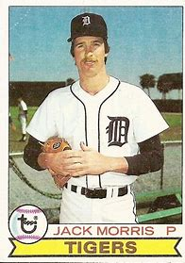
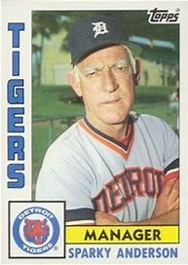
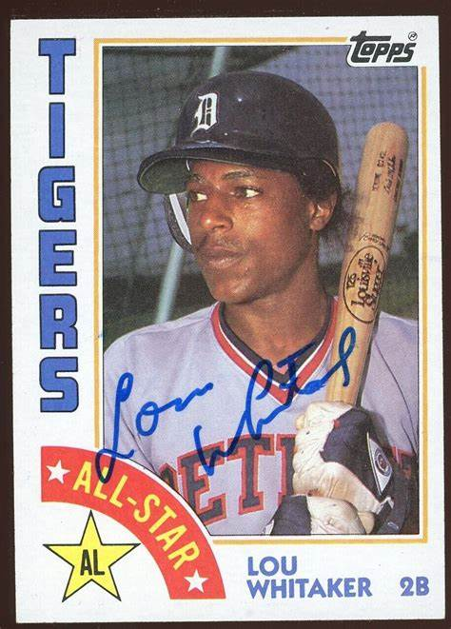
Tigers

Slide 38
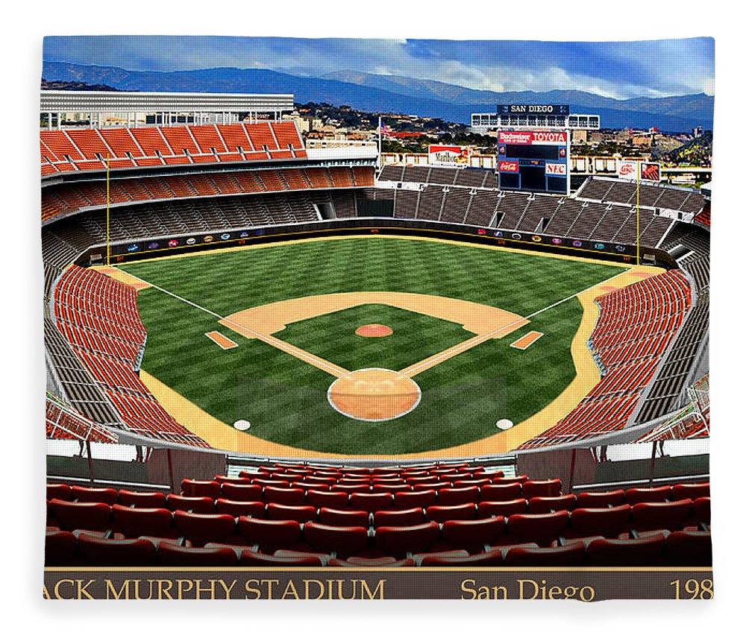
1984 World Series Highlights
Jack Murphy Stadium – San Diego
Game 1 – October 9, 1984
Tigers 3 – Padres 2
Tigers LF Larry Herndon’s 2-run HR in the 5th was the difference.
Jack Morris pitched complete game for the win.
Game 2 – October 10
Padres 5– Tigers 3
Padres’ 11-hit attack knocked out Tigers starter Dan Petry in the 5th. DH Kurt Bevacqua’s 3-run HR was the difference.
SERIES TIED AT ONE WIN EACH

Slide 39
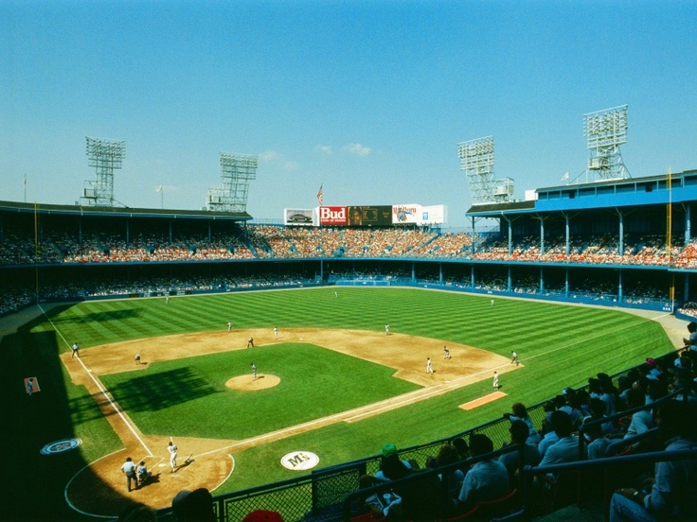
Tiger Stadium in Detroit
Game 3 – October 12
Tigers 5 – Padres 2
Tigers knock out SD starter Tim Lollar with a 4-run bottom of the 2nd. Trammel, Gibson, Herndon and Castillo (2) all have RBIs.
Game 4 – October 13
Tigers 4 – Padres 2
SS Alan Trammel hit 2 HR and drove in all 4 runs. P Jack Morris threw another complete game for his second win of the Series
Game 5 – October 14
Tigers 8 – Padres 4
RF Kirk Gibson had two homers and 5 RBI to lead Tigers’ offense.

Slide 40
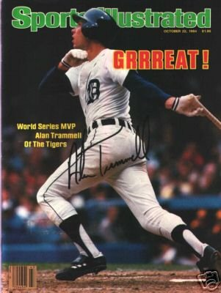
TIGERS WIN THE 1984
WORLD SERIES
4 GAMES TO 1
Tigers’ SS Alan Trammell was named World Series MVP.
Tigers’ Sparky Anderson becomes first-ever manager to win a World Series with both an AL and an NL team.
https://www.youtube.com/watch?v=x8-oWitrZQE

Slide 41
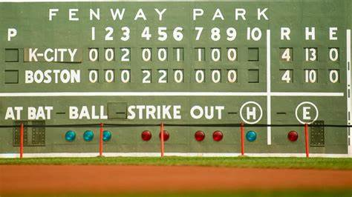
Extra Innings!

Slide 42

1984 Top Songs

Slide 43

https://www.youtube.com/watch?v=prdMsp-o1G0

Slide 44
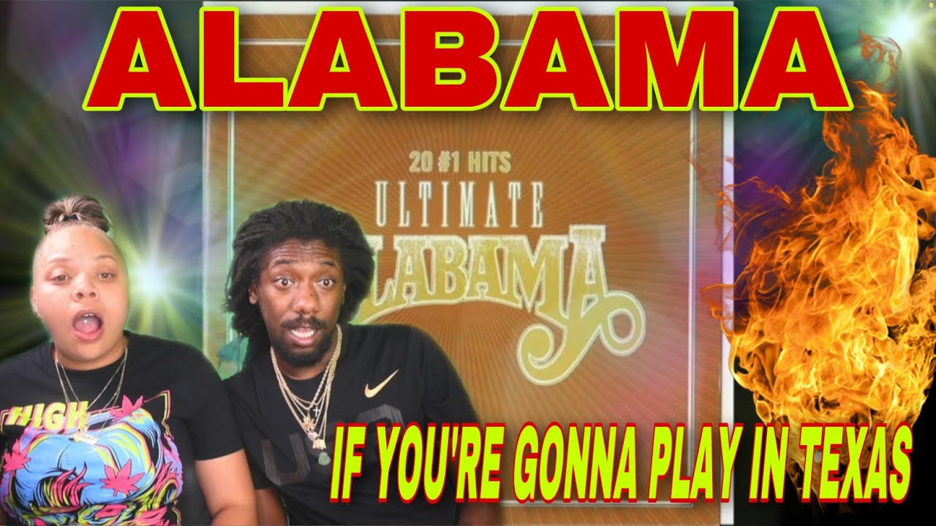
https://www.youtube.com/watch?v=CE5EQvdR_ko

Slide 45

https://www.youtube.com/watch?v=q0vd6D-WmGo

Slide 46

Thanks!!
We’ll see you again next month!
https://www.youtube.com/watch?v=_IJkbs1D5PU

