Slide 1



AGE Thrive with Baseball Memories
March 26, 2025
Agenda
Warm-up - Introductions
Current Events
Gametime – The Year in Baseball – 1986
Seventh Inning Stretch - “Take Me Out to the Ball Game”
Get Up and Move, Sing, Dance!
Extra Innings – More stuff from the ‘70s and ‘80s

Slide 2


Slide 3
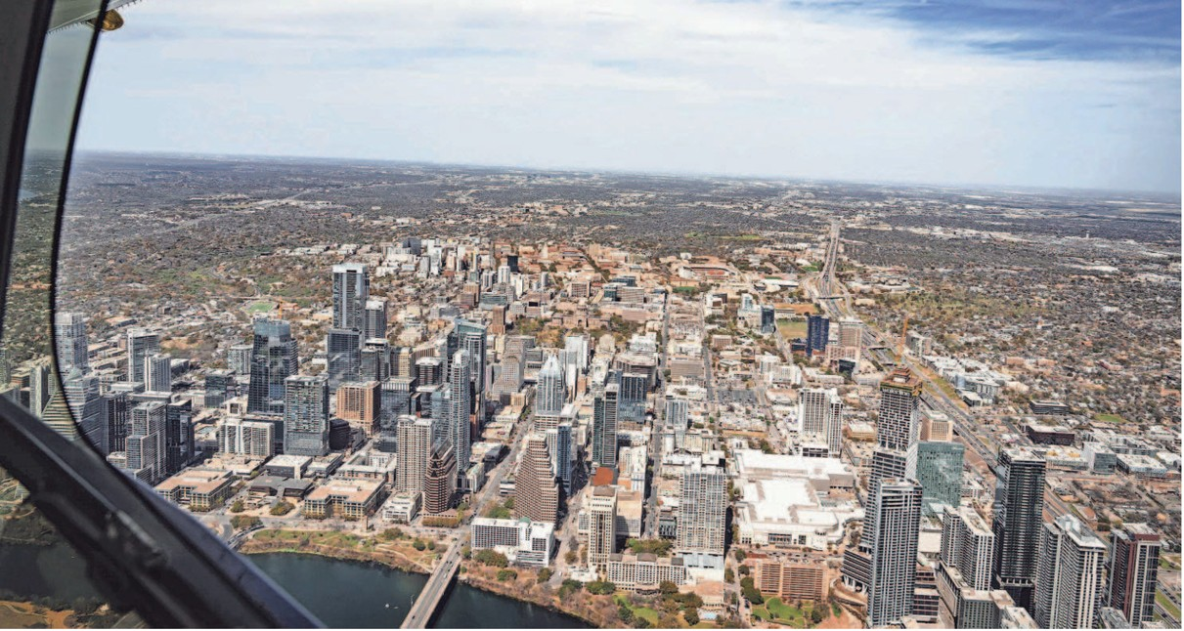
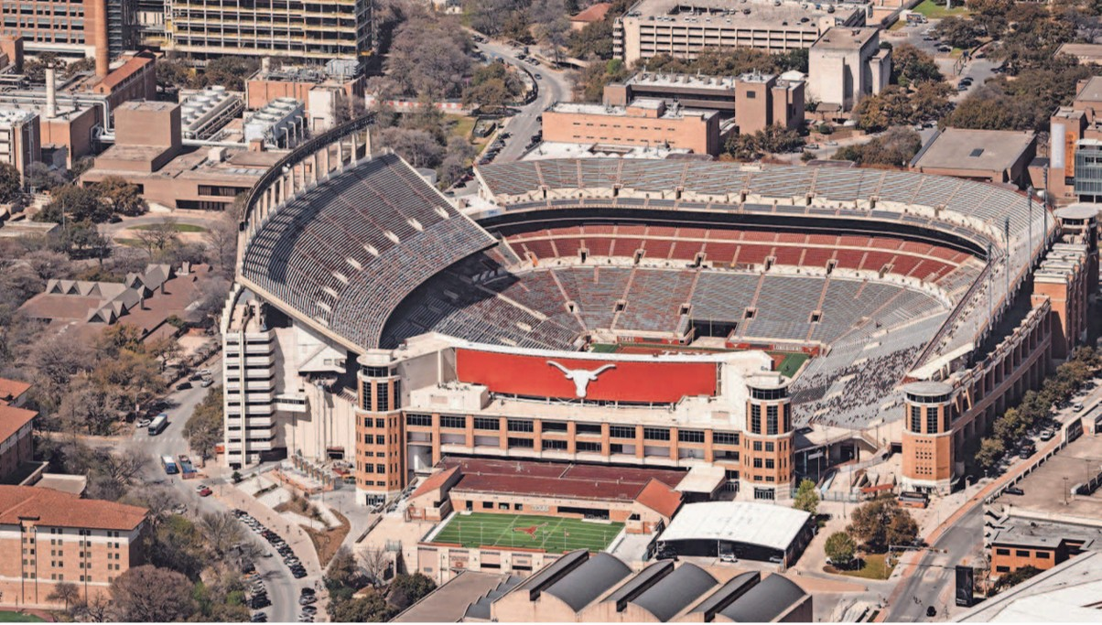
Goodyear Blimp Celebrates 100 year Anniversary
Visits Austin for SXSW
Notes:
One of the three Blimps visited Austin on March 13 as part of centennial tour across the U.S. All of the blimps are Zeppelin NT airships.

Slide 4


Favorite Teams
Basketball
Softball
Baseball
Notes:
Mention current won-loss for each team;

Slide 5

Four nations hockey tornament
The U.S. vs Canada final went into overtime!
https://www.youtube.com/watch?v=iGPdb7uOfow

Slide 6
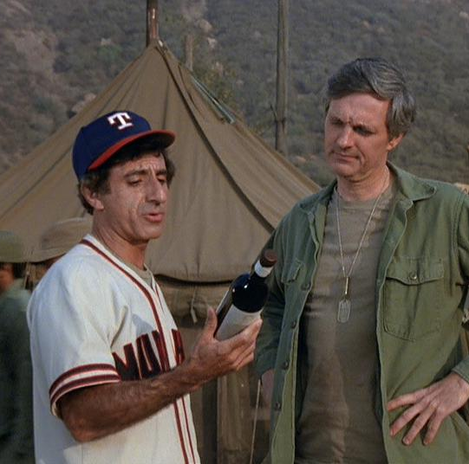
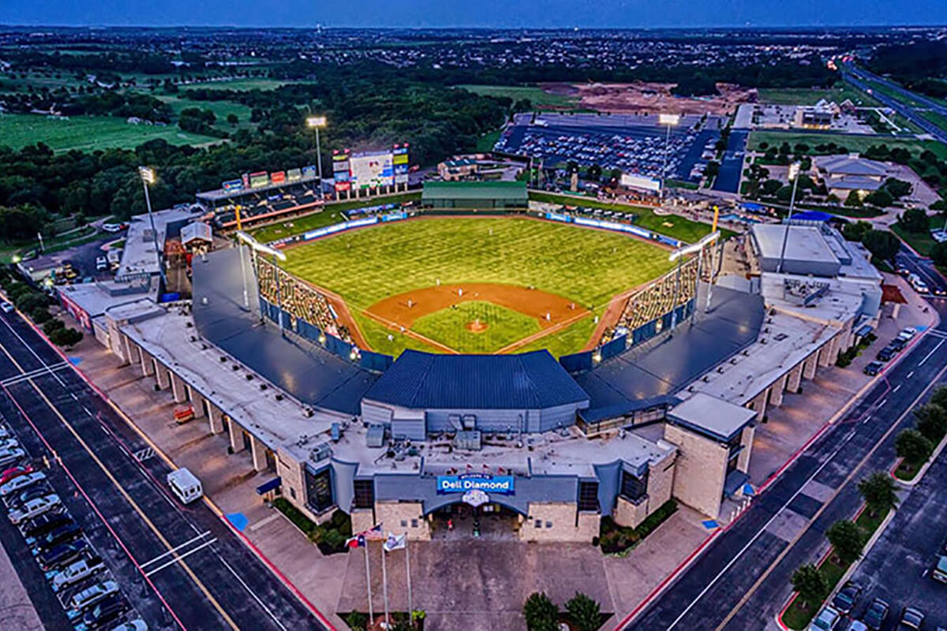
Opening Day @ Dell Diamond
Favorite team of a TV star
from M*A*S*H
Tuesday April 1 vs. Toledo Mud Hens

Slide 7

History from 1986

Slide 8
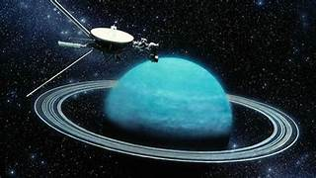
Voyager 2 close encounter with Uranus
Notes:
Voyager 2 had close fly-bys of Uranus in 1986 and Neptune in 1989. It’s the only spacecraft to have visited the outer two planets in our solar system. Discovered a new moon (the 5th ) and that Uranus has “rings”.

Slide 9
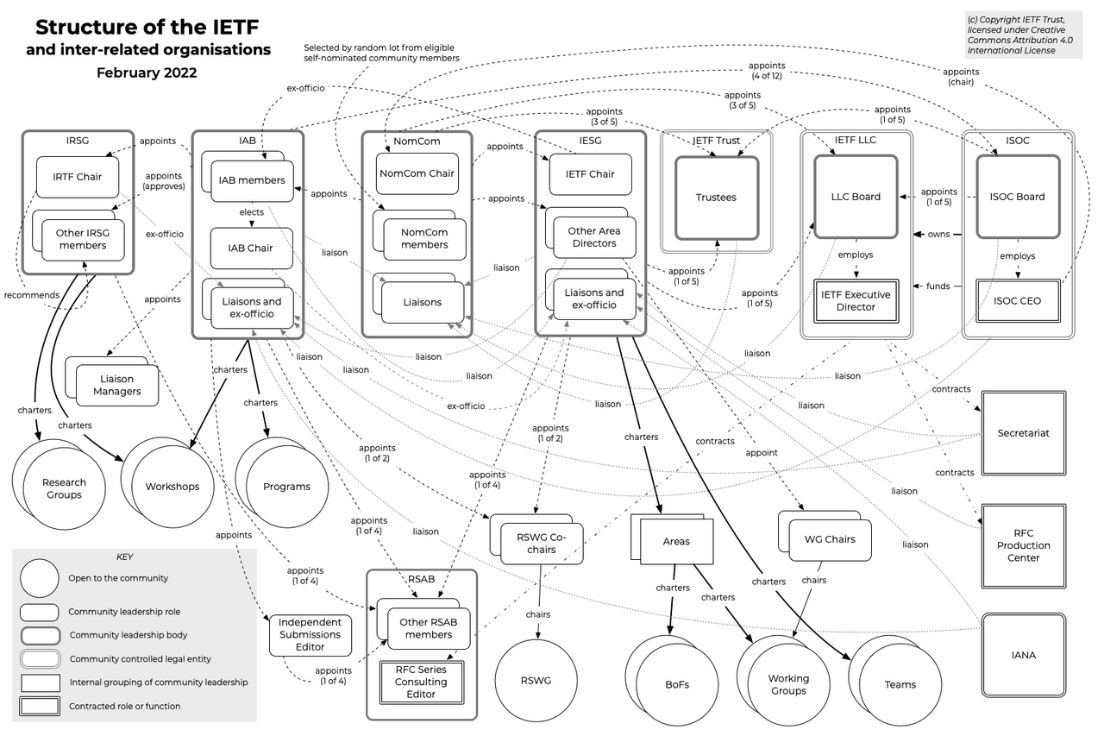
First meeting of the
Internet Engineering Task Force

Slide 10

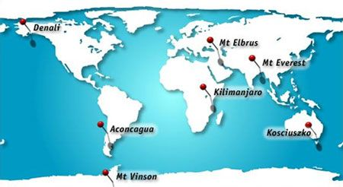
Canadian Patrick Morrow completes epic journey
He climbed the highest mountain on every continent

Slide 11
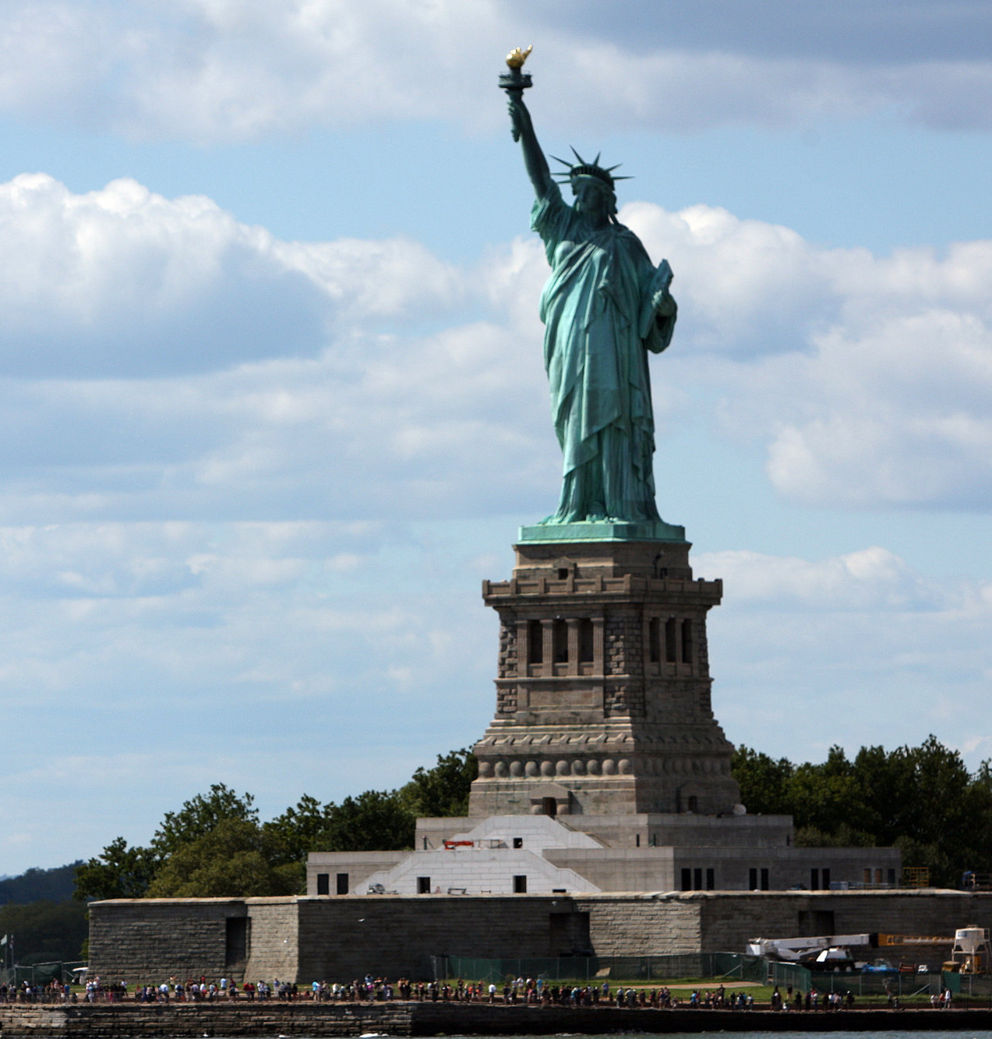
Statue of Liberty
re-opens
Notes:
Celebrated the 100th anniversary of the Statue being given by the French government to the U.S. in celebration of U.S. independence and as a symbol of freedom and democracy

Slide 12
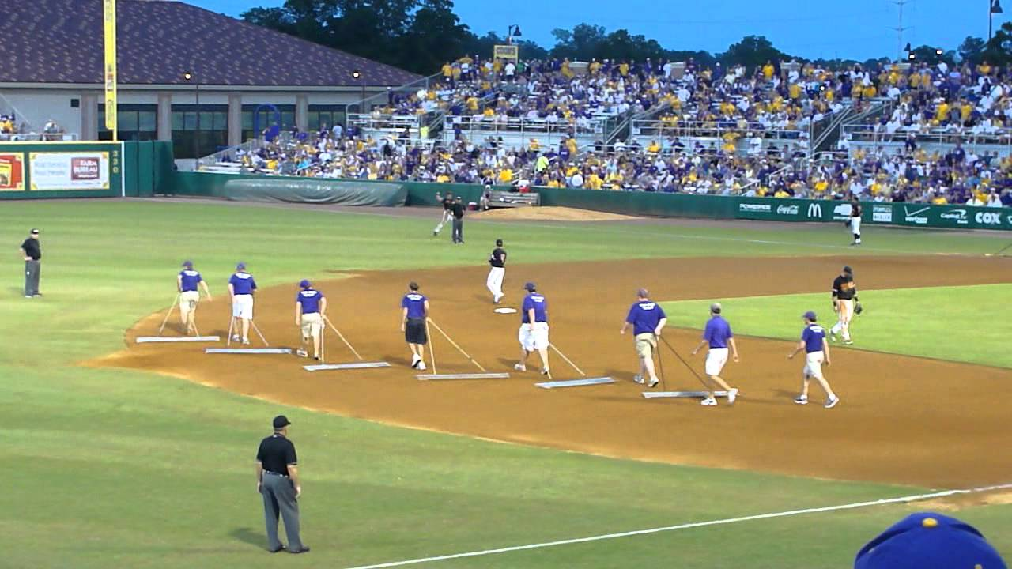
In Between Innings

Slide 13
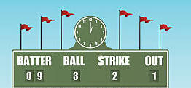
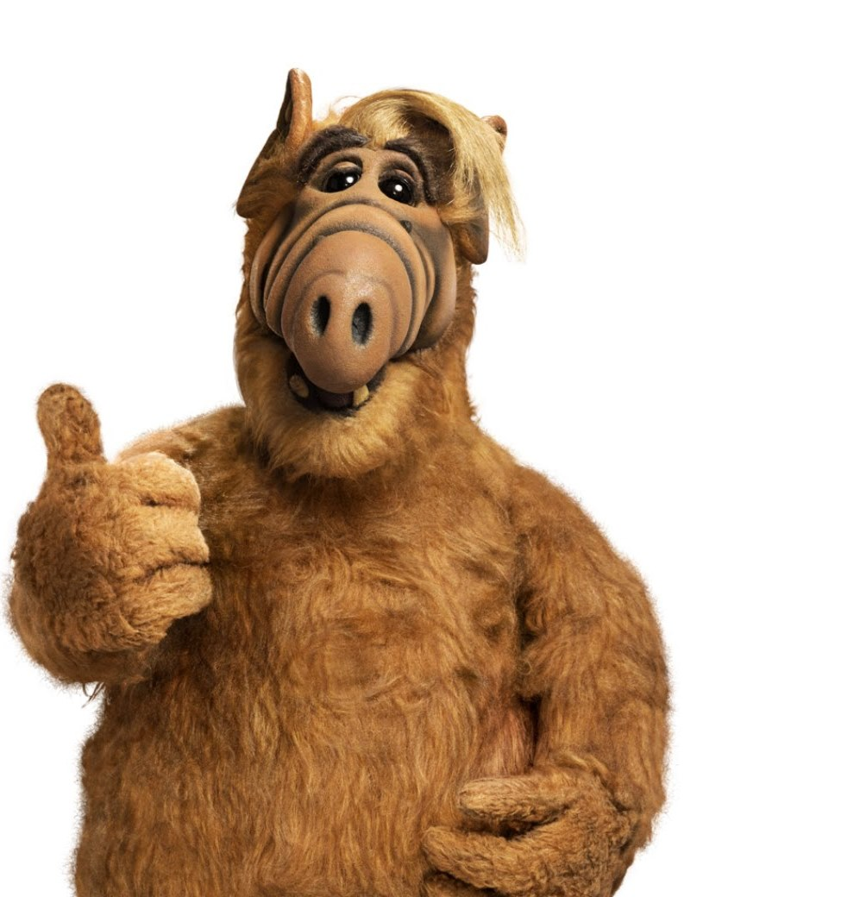
Scoreboard Quiz – 1986 TV
h
An alien spaceship crash lands on the garage of a suburban California family. The alien’s name is Gordon Shumway, otherwise known as:
E.T.
ALF
My Favorite Martian
Notes:
“ALF” stood for Alien Life Form.

Slide 14
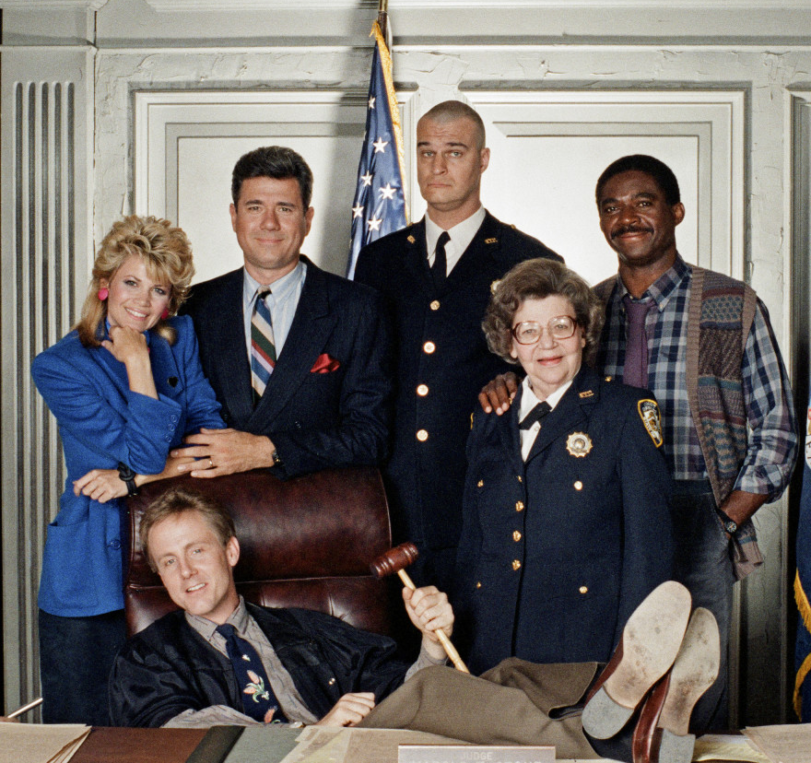
Scoreboard Quiz – 1986 TV
h
This show was a comedy about the night shift at a Manhattan Criminal Court and its unorthodox young judge:
Night Court
Ironside
Here Comes the Judge
Notes:
“ALF” stood for Alien Life Form.

Slide 15
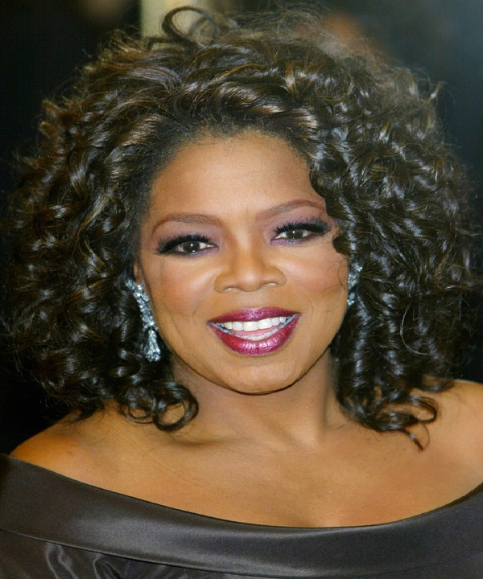
Scoreboard Quiz – 1986 TV
h
This syndicated talk show premiered in ’86 and was hosted by an iconic celebrity, businesswoman and philanthropist. She’s worth $5 Billion today :
Judge Judy
Dinah Shore Show
Oprah Winfrey Show
Notes:
“ALF” stood for Alien Life Form.

Slide 16
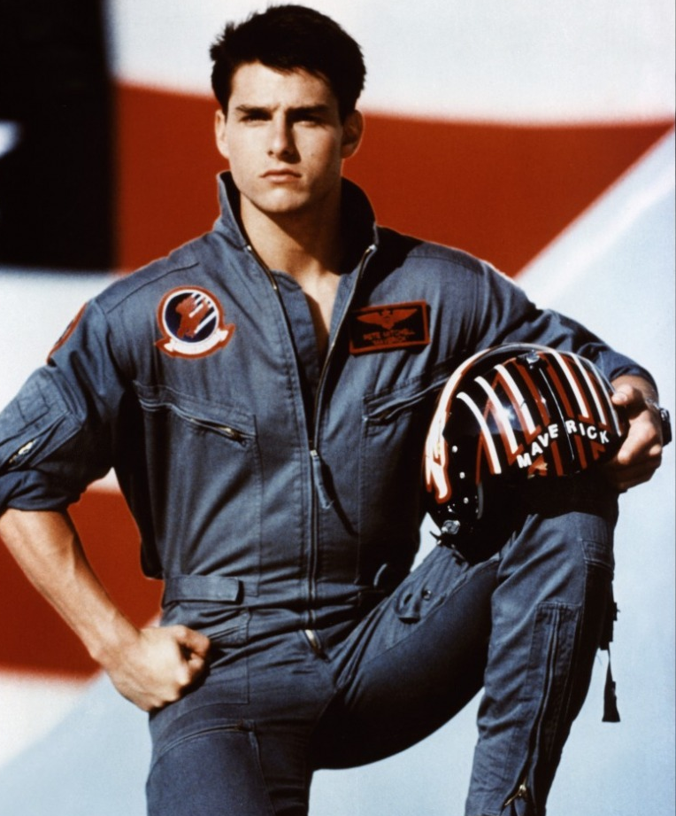
Scoreboard Quiz – 1986 at the Movies
h
Tom Cruise played the lead role in this movie about a hot-shot U.S. Navy fighter pilot:
Platoon
Top Gun
Winged Victory
Notes:
I feel the need, the need for speed!

Slide 17
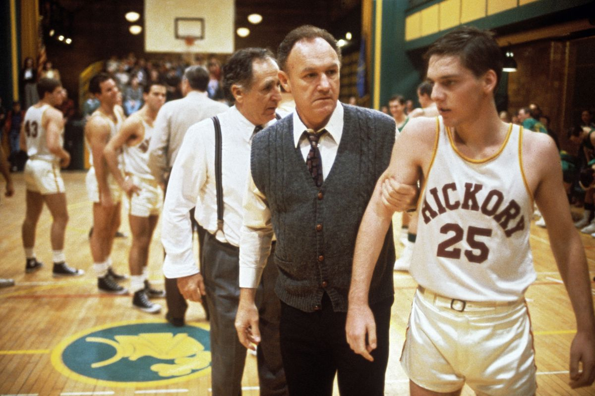
Scoreboard Quiz – 1986 at the Movies
h
Gene Hackman starred in this movie about a small-town high school basketball team in the 1950s:
Rudy
The Natural
Hoosiers

Slide 18
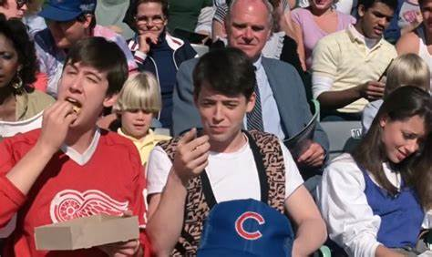
Scoreboard Quiz – 1986 at the Movies
h
Matthew Broderick starred in this movie about skipping high school and seeing the sights in Chicago – including a Cubs game.
Brighton Beach High
Ferris Bueller’s Day Off
Playin’ Hooky

Slide 19

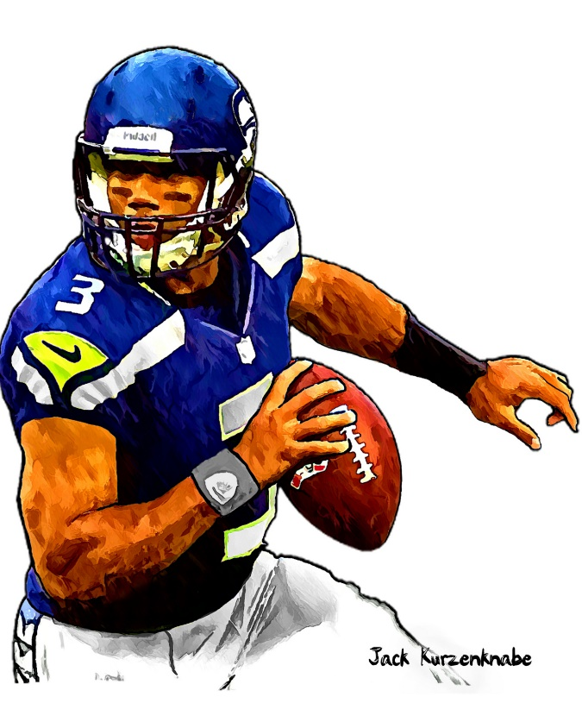

1986 Sporting News

Slide 20

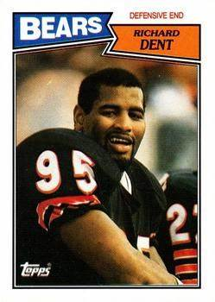
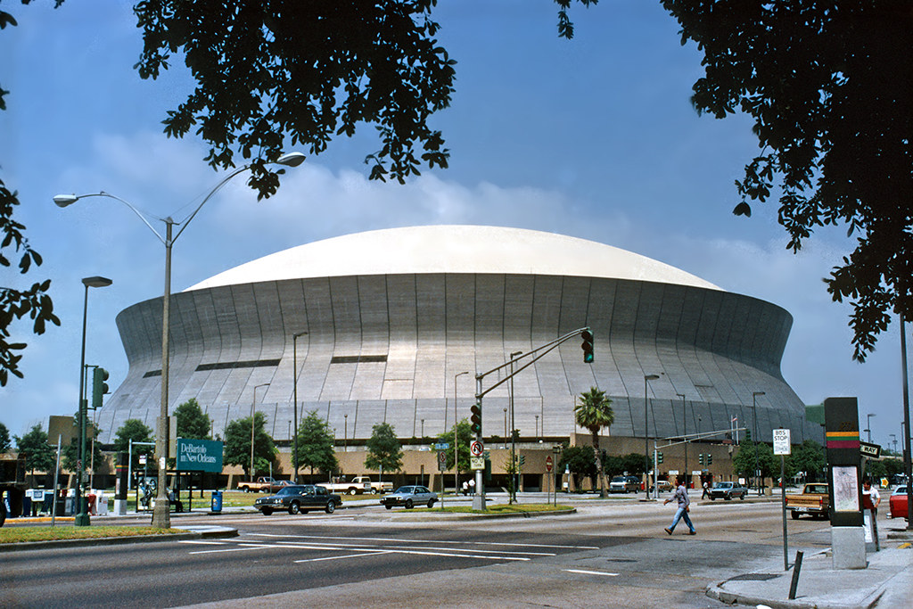

Super Bowl XX
46
to
10
Played on January 22 at Louisiana Superdome
https://www.youtube.com/watch?v=ITeozxHXzVE
Notes:
DE Richard Dent was the game’s MVP.. “The Refrigerator” Perry was a hit in this game.

Slide 21
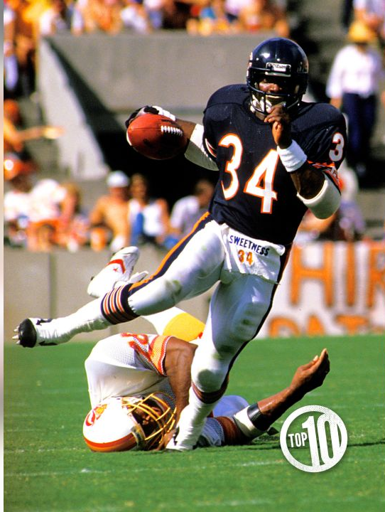
Bears running back
Walter Payton
scored the 100th touchdown
of his career

Slide 22
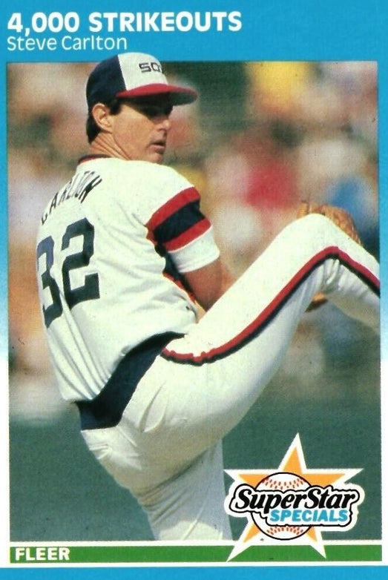
Notes:
HOF pitcher Steve Carlton notched his 4000th strikeout – on of only four pitchers to reach that figure – (Nolan Ryan, Randy Johnson, Roger Clemens)

Slide 23
The Year in Baseball: 1986

Slide 24
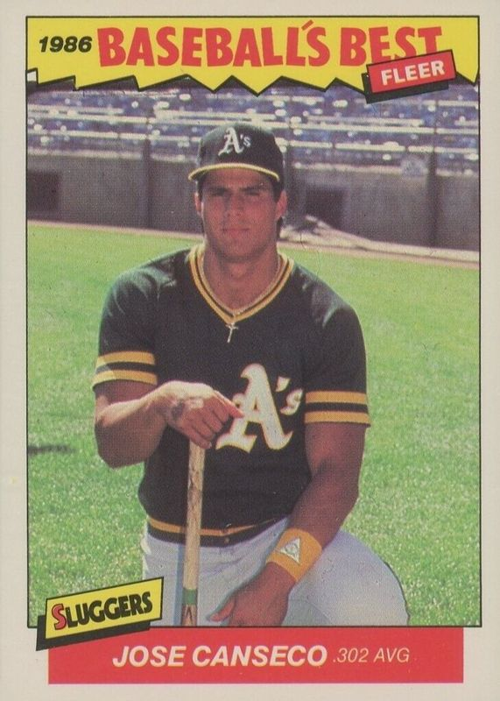
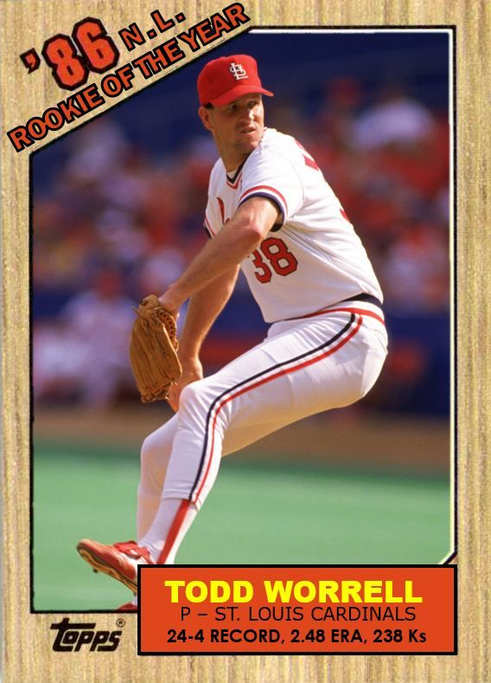
1986
Rookies
of the
Year
https://www.youtube.com/watch?v=QixQMUu4CKI
36 saves, 2.08 ERA, 74 G
.240 33 HR 117 RBI
Notes:
Video of fly ball bouncing off Canseco’s head into the stands for a HR
Mickey Mantle hit 37 homers to lead the AL. He also led the league in triples, walks, and SLG.

Slide 25
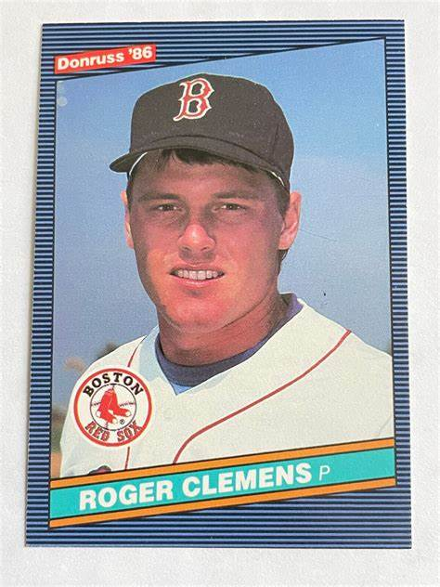
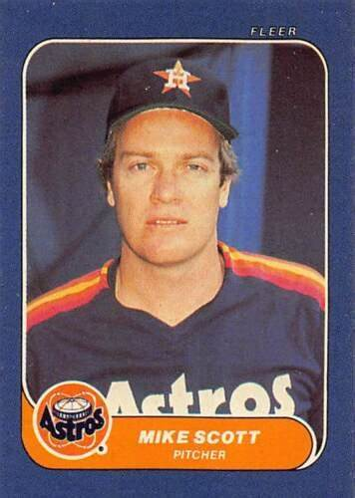
1986
Cy Young
Winners
24 – 4, 2.48 ERA, 254 IP
18 – 10, 2.22 ERA, 306 K
Notes:
Scott also led NL in IP with 275. Was Clemens 3rd season in MLB; Scott’s 8th season in MLB.

Slide 26
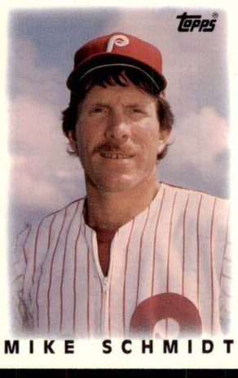
1986 Most Valuable Players
37 HR, 119 RBI, .290
Notes:
Clemens won both the Cy Young and the MVP in ‘86. This was Mike Schmidt’s 3rd MVP, at 36 years old! He won 10 Gold Gloves in his career.
Mickey Mantle hit 37 homers to lead the AL. He also led the league in triples, walks, and SLG.

Slide 27
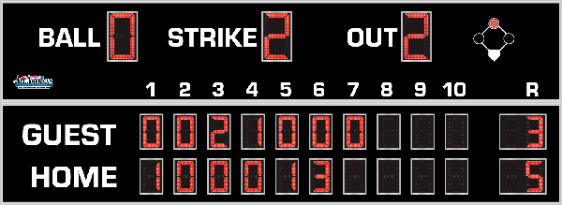
7th Inning Stretch

Slide 28
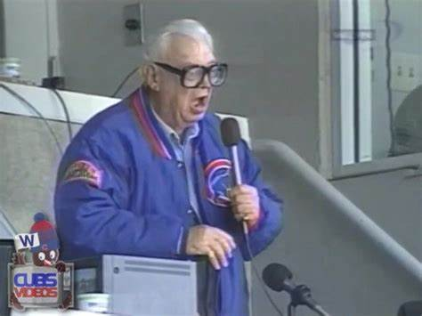
“Take Me Out to the Ballgame”

Slide 29
“Deep in the Heart of Texas
https://www.youtube.com/watch?v=rcrK0U7RDIk

Slide 30
“Do the Hokey Pokey”
https://www.youtube.com/watch?v=vpharBeg9XA

Slide 31


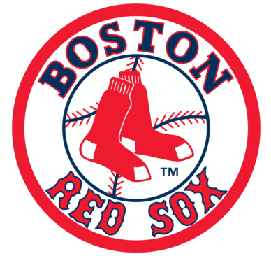

1986 League Championships
Best 4 of 7 format
New York Mets
won 4-2
Boston Red Sox
Won 4-3

Slide 32

1986 World Series
New York Mets vs. Boston Red Sox

Slide 33
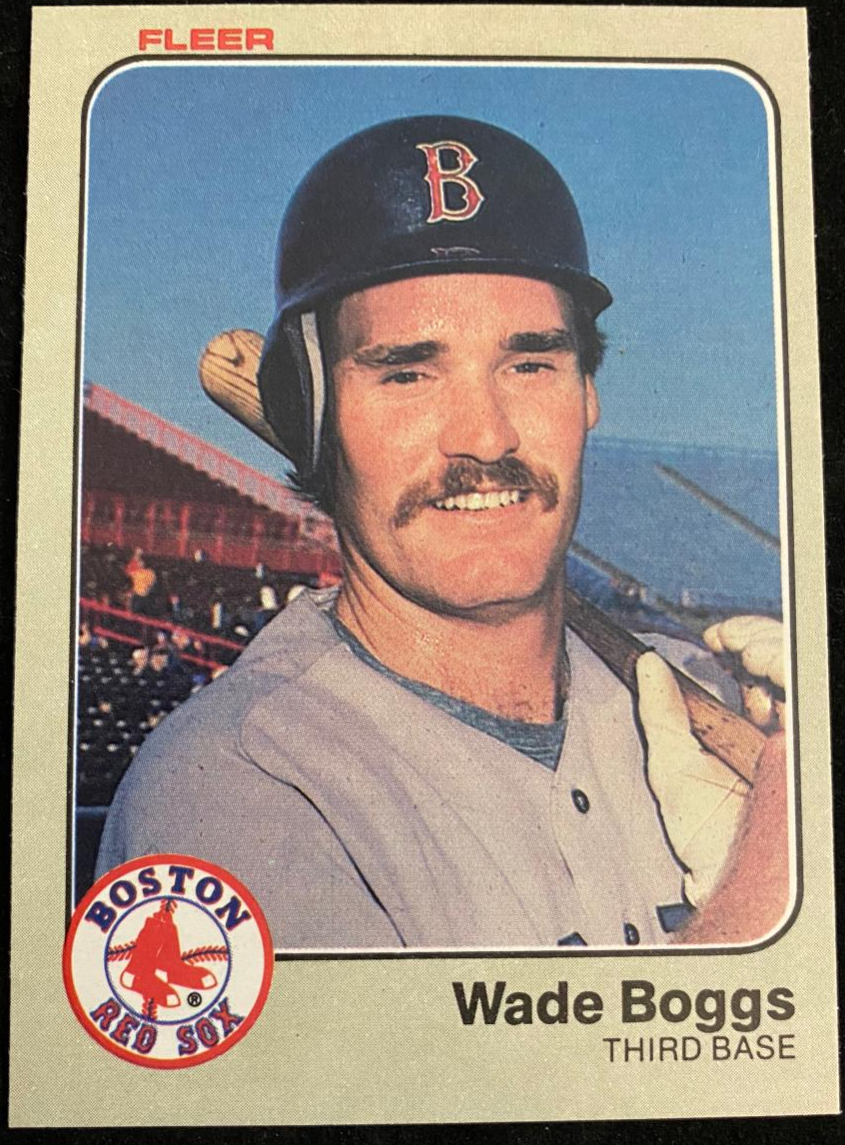
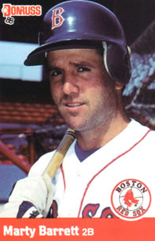
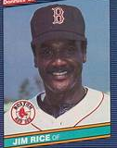
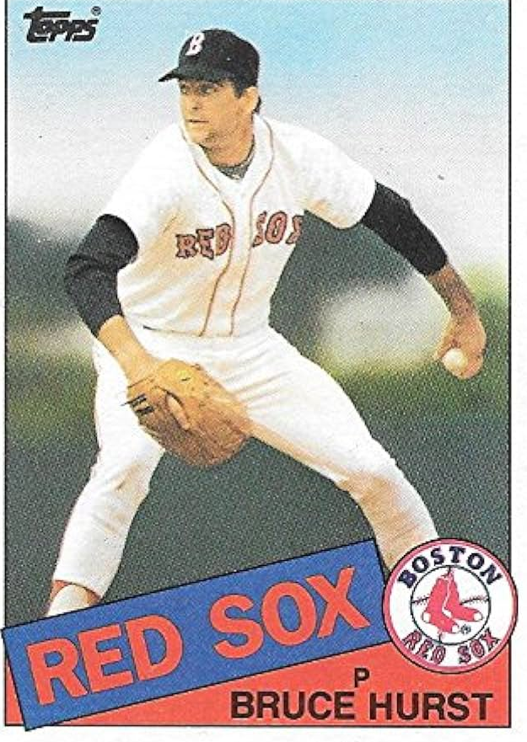
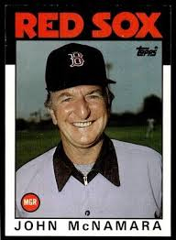
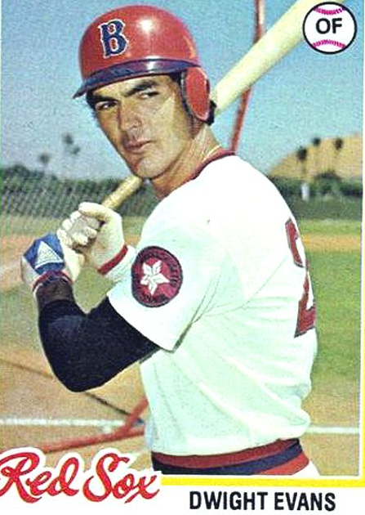
1986
Red Sox

Slide 34
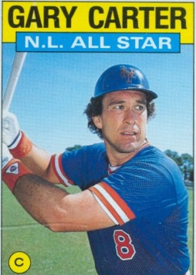
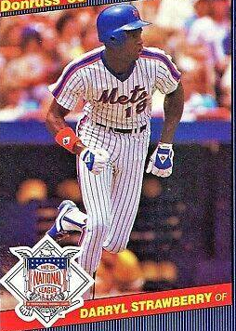
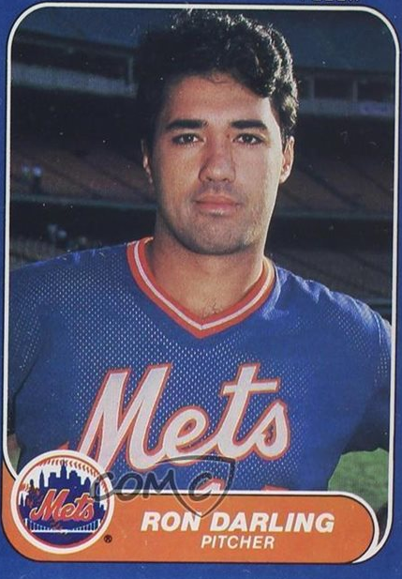
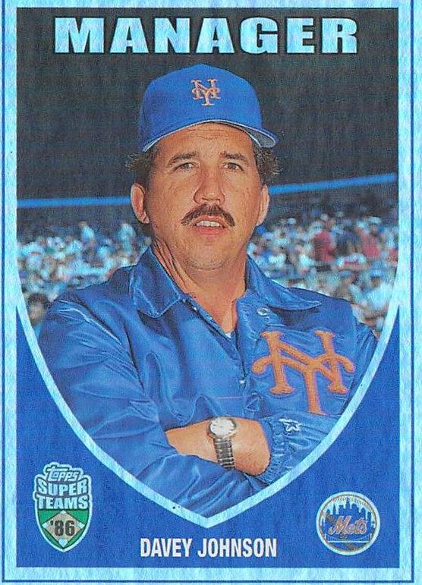
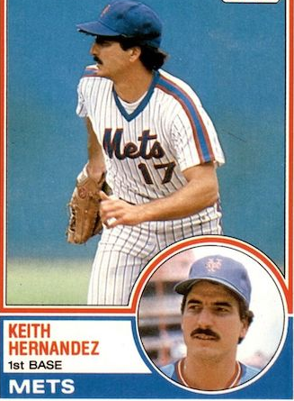
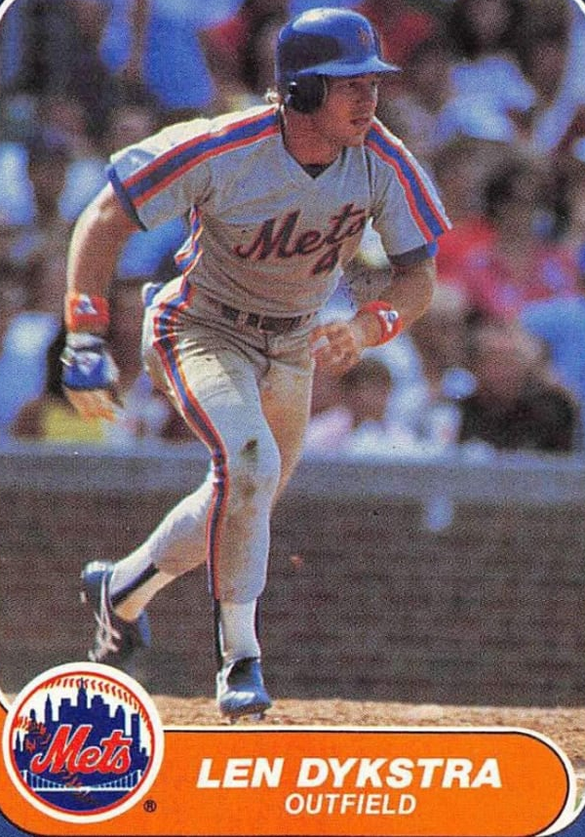
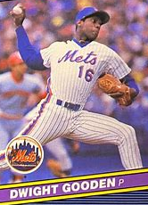
1986
Mets

Slide 35
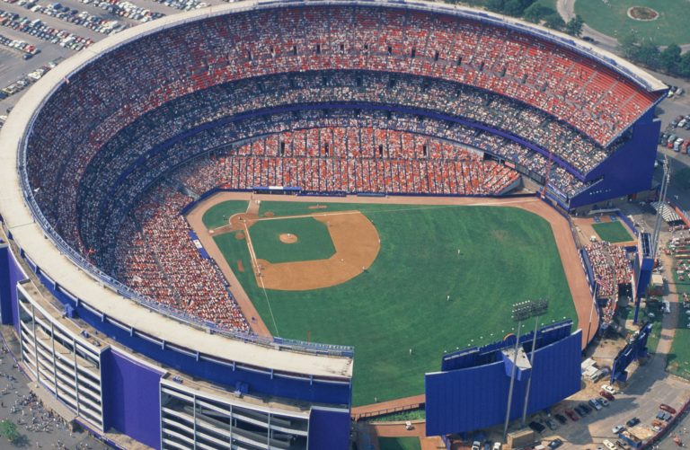
1986 World Series Highlights
Game 1 – October 18
Red Sox 1 – Mets 0
Boston starter Bruce Hurst bested Mets’ starter Ron Darling. Jim Rice scored an unearned run in the 7th.
Game 2 – October 19
Red Sox 9 – Mets 3
Met’s ace Dwight Gooden allowed 6 runs in five innings. Dave Henderson and Dwight Evans homered for the Red Sox.
RED SOX LEAD 2-0 AS THEY RETURN HOME TO BOSTON
Shea Stadium – New York

Slide 36
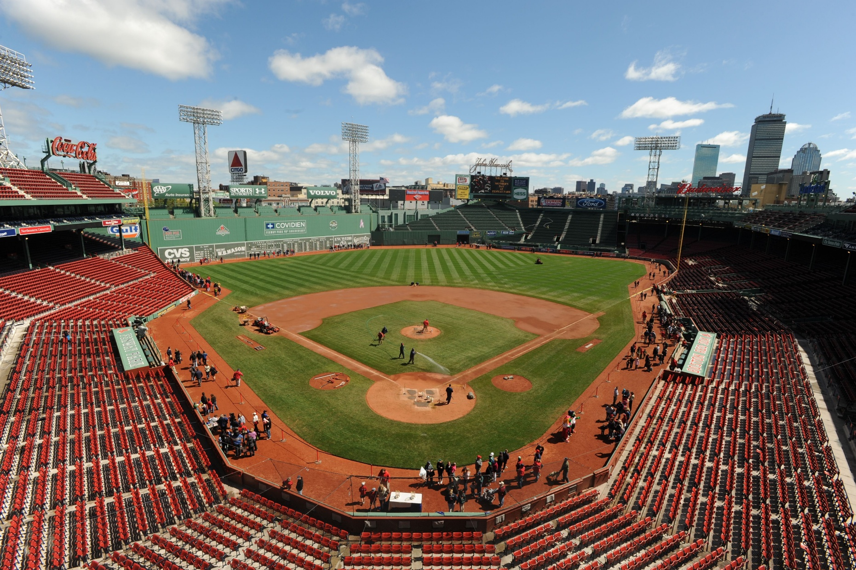
Game 3 – October 21
Mets 7 – Red Sox 1
The Mets scored 4 in the top of the 1st and cruised to a win.
Game 4 – October 22
Mets 6 – Red Sox 2
Ron Darling continued to pitch well for the Mets and C Gary Carter hit two homers to power the Mets win.
Game 5 – October 23
Red Sox 4 – Mets 2
The Red Sox got single RBI from Don Baylor, Dwight Evans, Dave Henderson and Spike Owen to best the Mets.
THE RED SOX LEAD 3-2 AS THE SERIES
RETURNS TO NEW YORK
Fenway Park - Boston

Slide 37
Game 6 – October 25
Mets 6 – Red Sox 5 (10 innings)
Boston led 5-3 going into the bottom of the tenth inning. The Mets scored one and then tied the game on a Bob Stanley wild pitch.
With Ray Knight on 2nd, Mookie Wilson hit a grounder to Bill Buckner at first …
https://www.youtube.com/watch?v=rpyJjecJnuI
Game 7 – October 27
Mets 8 – Red Sox 5
3 RBI by Mets 1B Keith Hernandez and late homers by Ray Knight and Darryl Strawberry powered the Mets past an early 3-0 deficit to take the game.

Slide 38
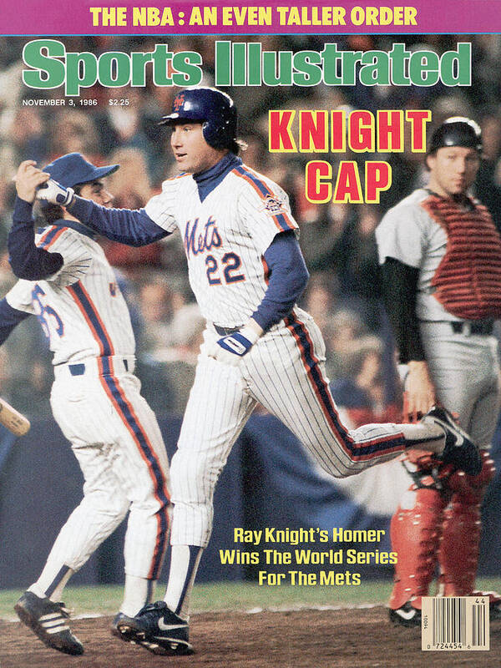
METS WIN 1986
WORLD SERIES
4 GAMES TO 3
Mets’ SS Ray Knight was named World Series MVP.
https://www.youtube.com/watch?v=IKKTTMBfYnI

Slide 39
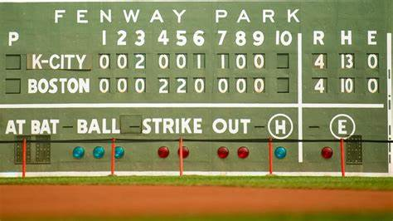
Extra Innings!

Slide 40
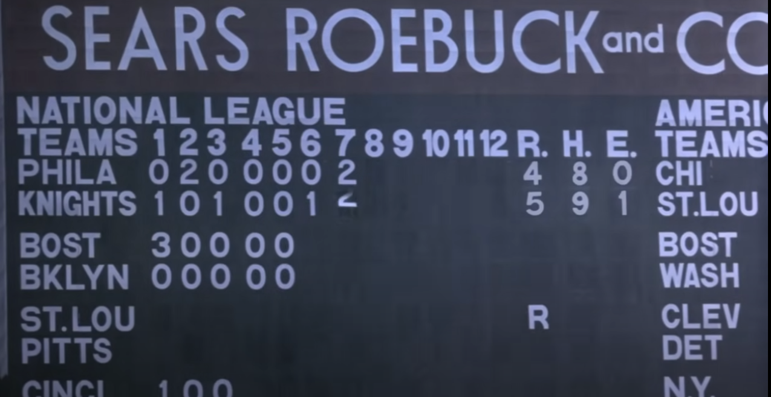
Knock the cover off the ball!
https://www.youtube.com/watch?v=tlNLhuxeDJQ

Slide 41

1980s
Fads & Fashion
FADS &
FASHION

Slide 42
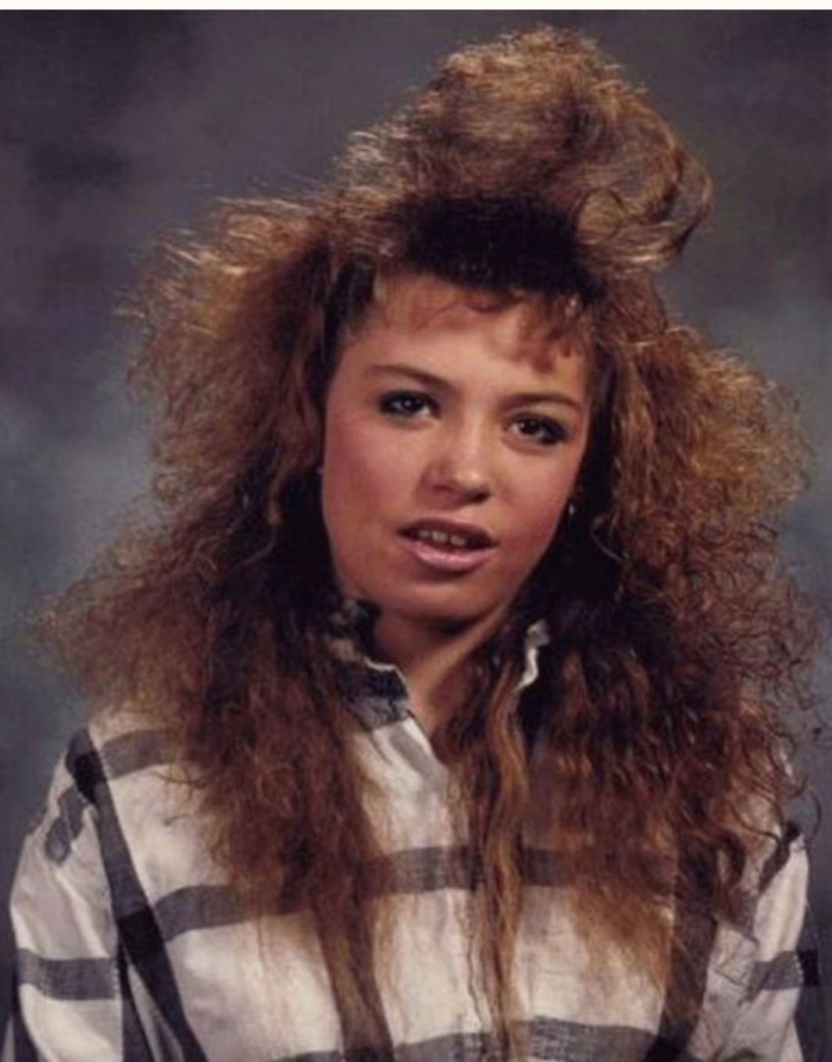
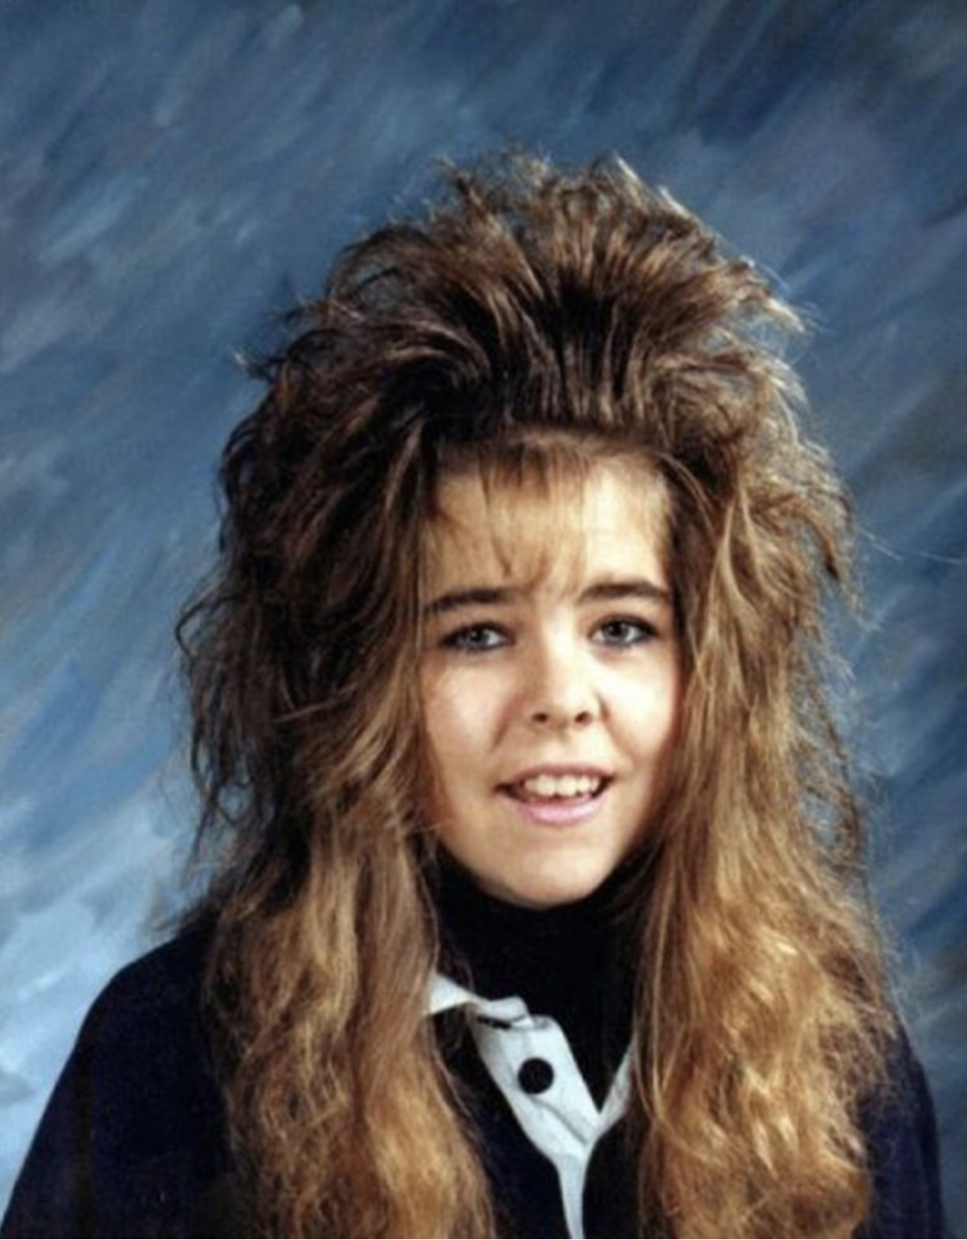
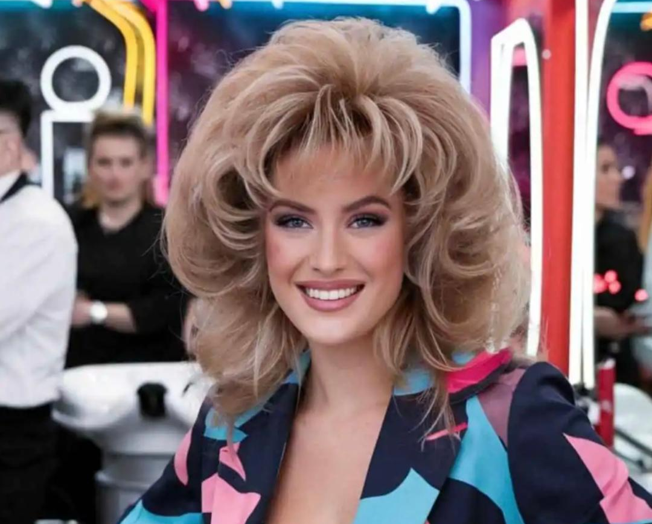
1980s FADS & FASHION
BIG
HAIR !

Slide 43

1980s FADS & FASHION
Sparkly
Prom Dresses
and more Big Hair

Slide 44





1980s FADS & FASHION
GLAMOUR
SHOTS
be your
own star!

Slide 45

1980s FADS & FASHION
Parachute Pants & Warm-ups

Slide 46

1980s FADS & FASHION
Leg Warmers
Exercise
Videos

Slide 47



1980s FADS & FASHION
Hot Pants

Slide 48

1980s FADS & FASHION
High-Waist
Blue Jeans

Slide 49

1980s FADS & FASHION
Stylish
Sweat
Bands

Slide 50

1980s FADS & FASHION
Women’s Padded Shoulders

Slide 51

1980s FADS & FASHION
Jelly
Shoes

Slide 52

1980s FADS & FASHION
THE
MULLET
“business
in front,
party in the back”

Slide 53

1980s FADS & FASHION
String
Ties

Slide 54

1980s FADS & FASHION
“Preppy”
Look

Slide 55

1980s FADS & FASHION
Bucket
Hat

Slide 56


1980s FADS & FASHION
BOOM BOX

Slide 57

1980s FADS & FASHION
BREAK
DANCING
https://youtu.be/8BOXJFF0jSg

Slide 58

1980s FADS & FASHION
Boy
Bands
and more Mullets

Slide 59

1980s FADS & FASHION
PRINCESS
DIANA

Slide 60

1980s FADS & FASHION
the
Video
Arcade

Slide 61

Thanks!!
We’ll see you again next month!
https://www.youtube.com/watch?v=_IJkbs1D5PU

