Slide 1



AGE Thrive with Baseball Memories
April 23, 2025
Agenda
Warm-up - Introductions
Current Events
Gametime – The Year in Baseball – 1987
Seventh Inning Stretch - “Take Me Out to the Ball Game”
Get Up and Move, Sing, Dance!
Extra Innings – More stuff from the ‘80s

Slide 2


Slide 3



Baseball Season is Underway!
Notes:
Mention current won-loss for each team;

Slide 4

Basketball
Softball
Baseball
Notes:
Mention current won-loss for each team;

Slide 5

History from 1987

Slide 6


Chrysler acquires American Motors

Slide 7
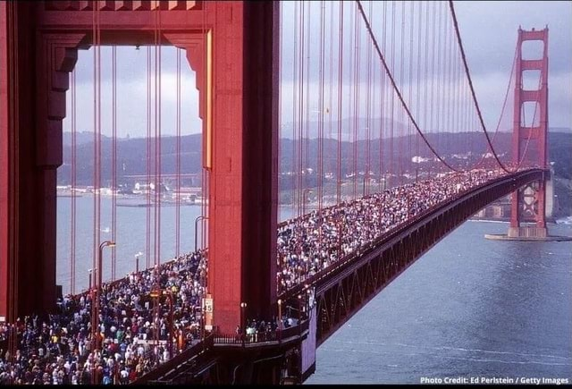
Golden Gate Bridge 50th anniversary
800,000 people walked across the
famous Golden Gate Bridge
The combined weight of the crowd
caused the deck to sag 7 FEET !

Slide 8
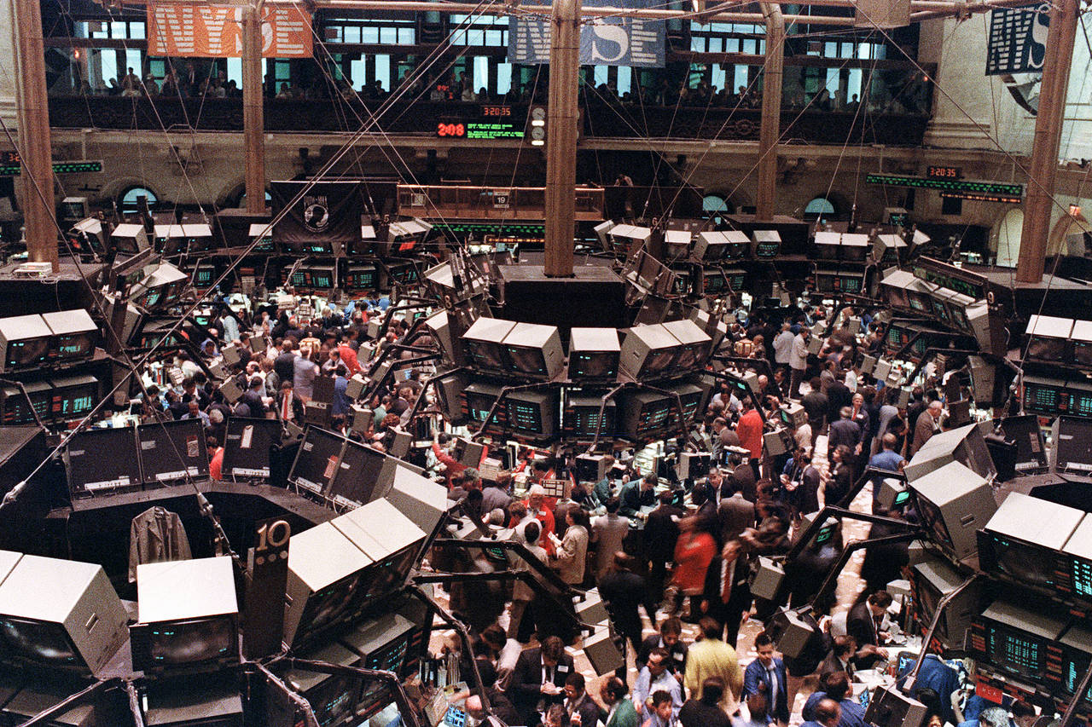
Dow Jones Industrial Average closes above 2500 !
In December
2024 the DJIA
closed over
45,000 !!

Slide 9
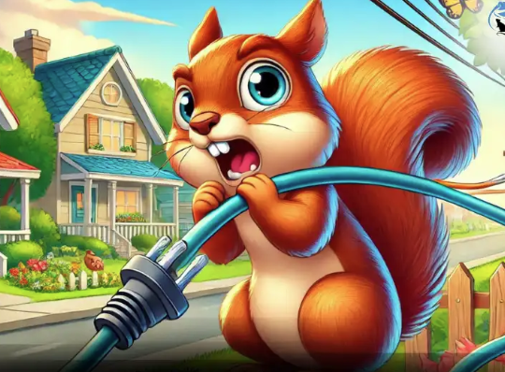
A squirrel shut down the stock exchange!
Notes:
December 1987 – a squirrel gnawed thru a wire that caused an electric substation in Connecticut to go offline; the resulting power outage took the NASDAQ exchange offline for 82 minutes

Slide 10
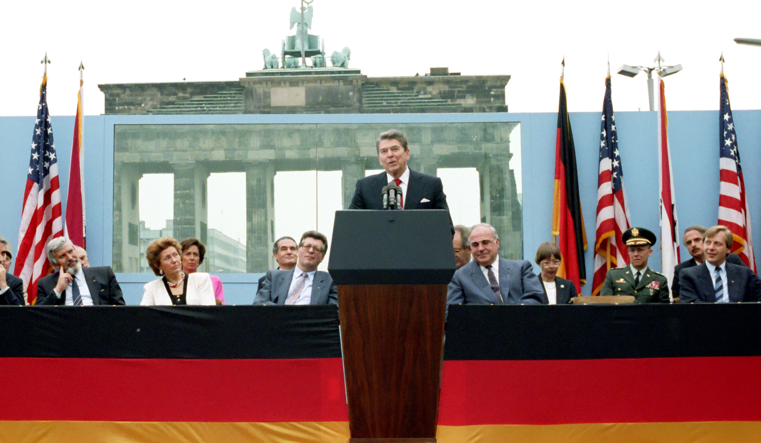
Mr. Gorbachev ...
Tear Down This Wall!
Notes:
On June 12, 1987 – President Reagan made a speech in West Berlin at the Brandenburg gate - where he made a famous request to the Soviet General Secretary

Slide 11
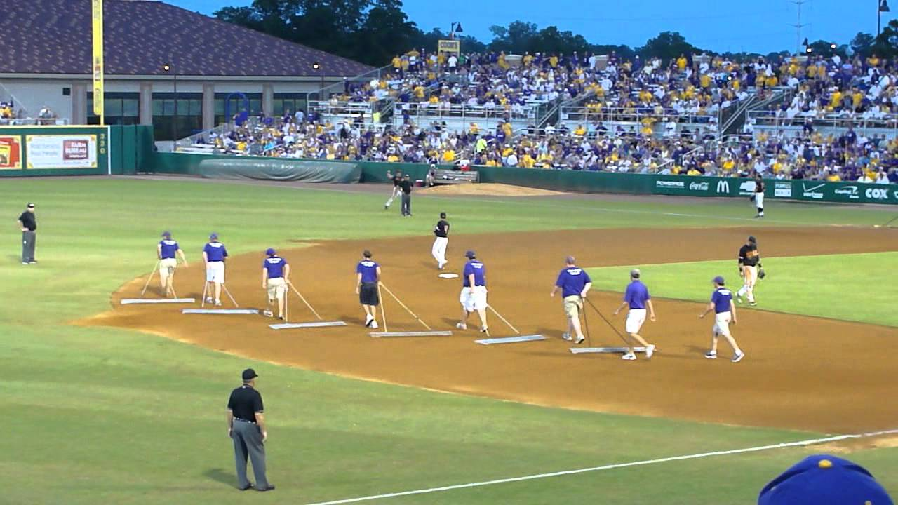
In Between Innings

Slide 12
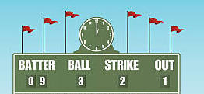
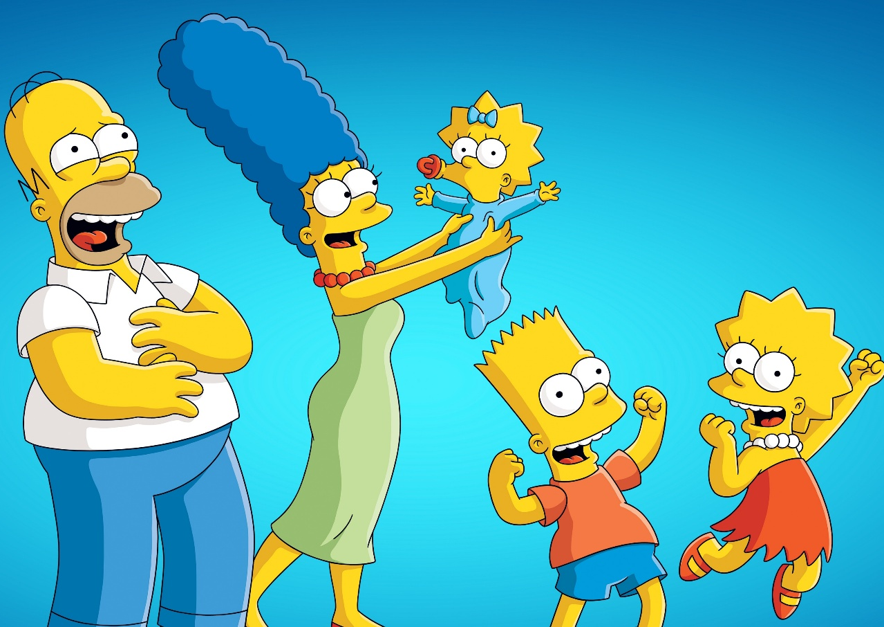
Scoreboard Quiz – 1987 TV
h
This cartoon family first appeared as a “short sketch” on the Tracey Ullman Show. Who are they?
The Jetsons
The Simpsons
The Flintstones
Notes:
Homer, Marge, Bart, Lisa and Maggie … the show is still in production after more than 780 episodes.

Slide 13
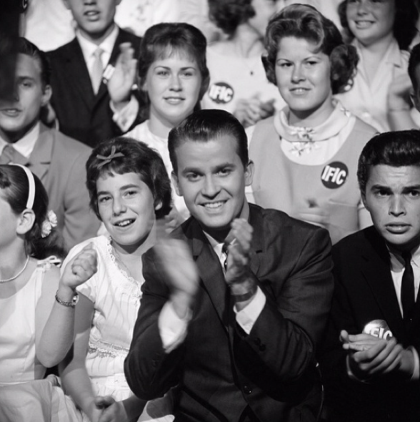
Scoreboard Quiz – 1987 TV
h
This dance & music show aired its last episode on ABC, after over 2700 shows dating back to its premier in 1952:
Let’s Rock and Roll
Kraft Music Hall
American Bandstand
Notes:
It ran in syndication for two more years. Dick Clark was the host.

Slide 14
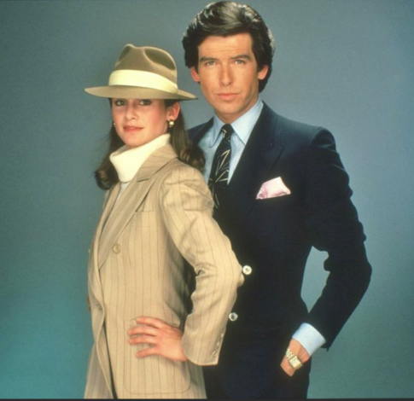
Scoreboard Quiz – 1987 TV
h
This “private eye” action show was cancelled and its star went on to portray 007 James Bond
Hawaii Five-O
Remington Steele
Ironside
Notes:
The male lead – Pierce Brosnan went on to start as James Bond. The female lead was Stephanie Zimbalist.

Slide 15
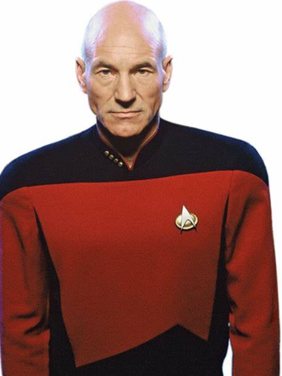
Scoreboard Quiz – 1987 TV
h
Star Trek Next Generation premiered, based on the original Star Trek TV show of the ‘60s. Patrick Stewart played the new captain:
Captain Kirk
Captain Pike
Captain Picard
Notes:
What was the order? Pike in the pilot episode of Star Trek; Kirk in the 1960s Star Trek; Picard in the 1980s-90s Next Generation. Jeffrey Hunter was original Pike; James Shatner as Kirk; Patrick Stewart as Picard.

Slide 16

Scoreboard Quiz – 1987 TV
h
For the first time in over 30 years, a new major over-the-air television network had its debut:
ABC
Fox
NBC

Slide 17
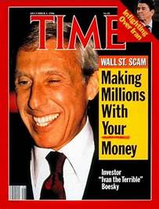
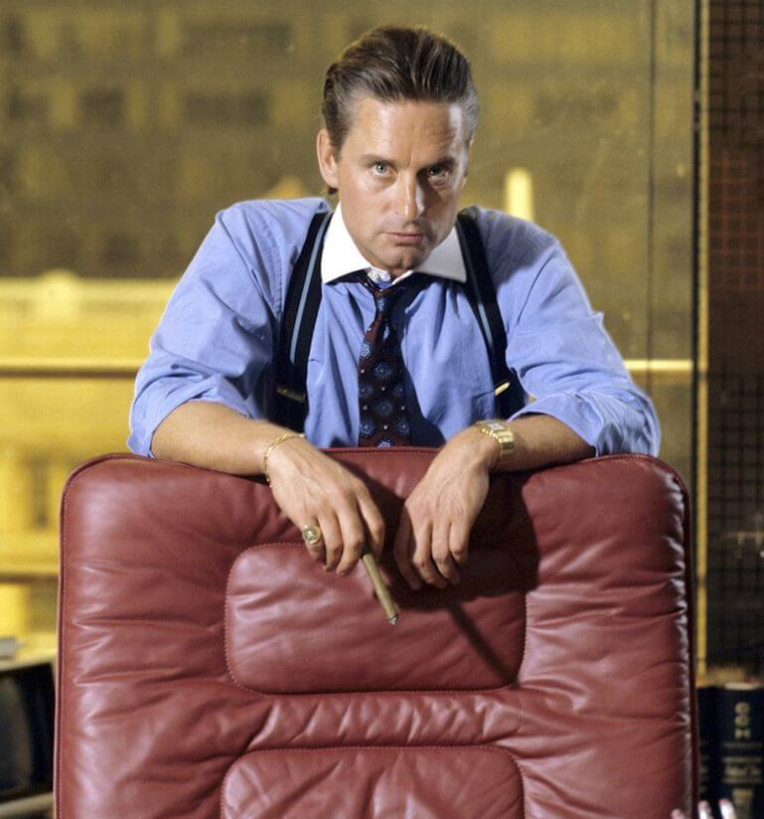
Scoreboard Quiz – 1987 Movies
h
Michael Douglas played corporate raider Gordon Gekko in Wall Street. His famous line was:
“Use Other People’s Money”
“Buy Low, Sell High”
“Greed is Good”
Notes:
The movie Wall Sreet and the character of Gordon Gekko was inspired by stock trader Ivan Boesky; who was convicted of fraud and insider trading . In a speech at the Univ. of California – Berkeley in 1986, Boesky said “ … greed is healthy; you can be greedy and still feel good about yourself …”

Slide 18

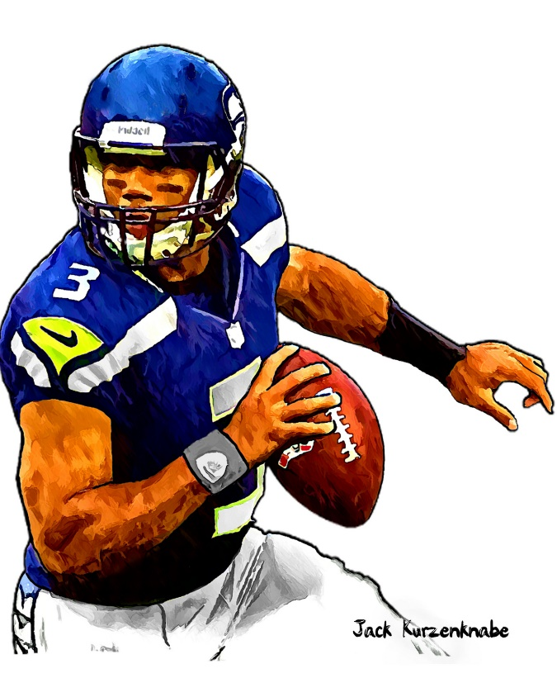

1987 Sporting News

Slide 19
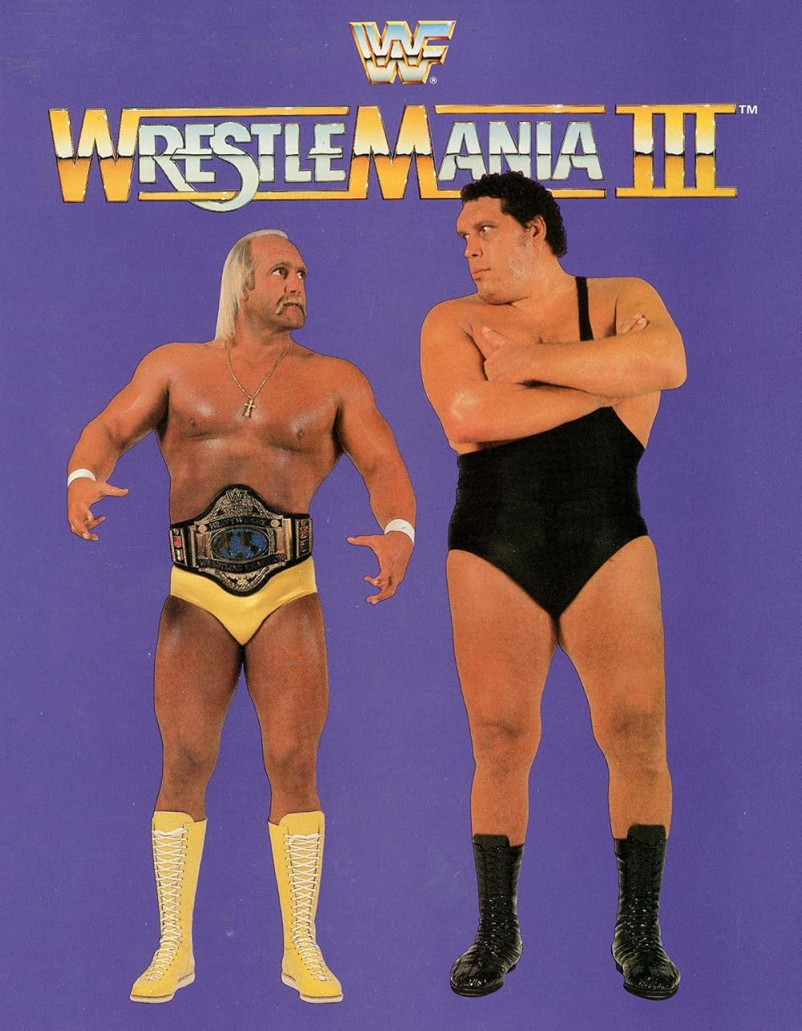
Hulk Hogan
defeats
Andre the Giant
in
WrestleMania III
https://www.youtube.com/watch?v=hWUDFp6xirw

Slide 20
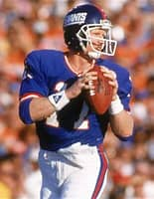

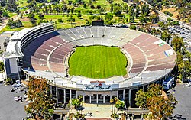

Super Bowl XXI
39
to
20
Played on January 25 at the Rose Bowl
Giants QB Phil Simms
was the MVP
https://www.youtube.com/watch?v=V8PtBeeCRWw
Notes:
The Broncos were leading 10-9 at halftime.

Slide 21
The Year in Baseball: 1987

Slide 22
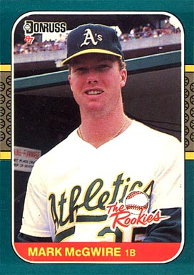
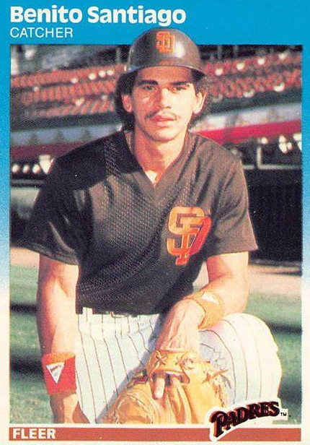
1987
Rookies
of the
Year
.289 49 HR 118 RBI
.300 18 HR NL Silver Slugger
Notes:
Mickey Mantle hit 37 homers to lead the AL. He also led the league in triples, walks, and SLG.

Slide 23
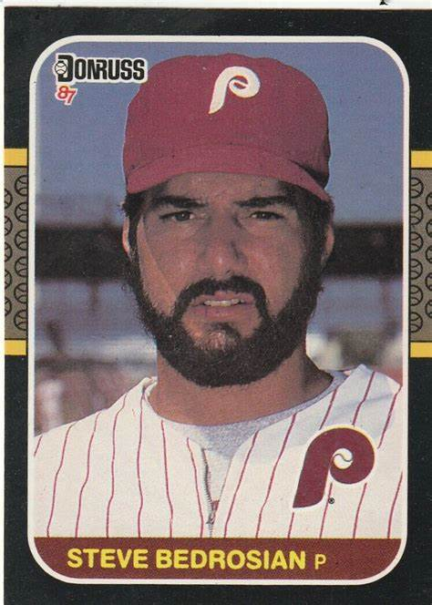
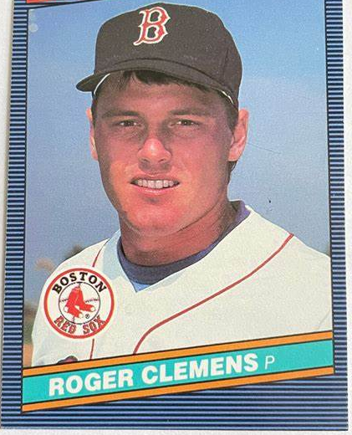
1987
Cy Young
Winners
20 – 9 18 CG 256K
40 Saves 2.83 ERA 65 games
Notes:
Clemens won CY for second year in a row.

Slide 24
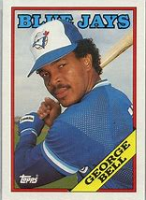
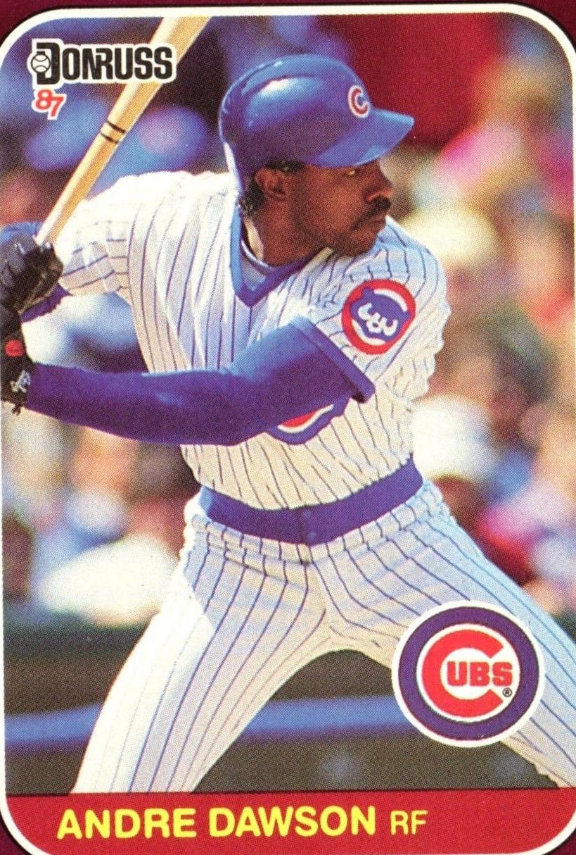
1987
Most
Valuable
Players
.308 47 HR 134 RBI
49 HR 137 RBI .287
Notes:
Mickey Mantle hit 37 homers to lead the AL. He also led the league in triples, walks, and SLG.

Slide 25
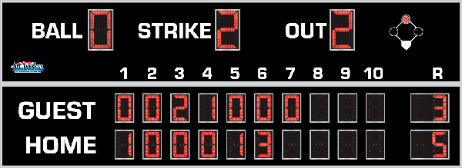
7th Inning Stretch

Slide 26
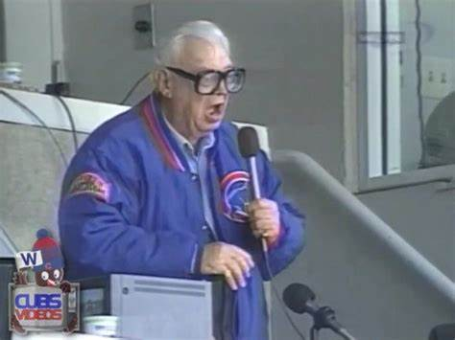
“Take Me Out to the Ballgame”

Slide 27
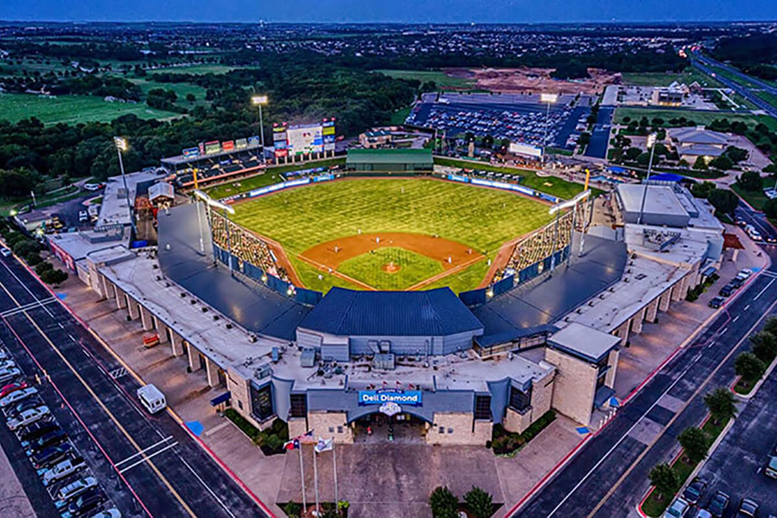
“Deep in the Heart of Texas
https://www.youtube.com/watch?v=rcrK0U7RDIk

Slide 28
“Do the Hokey Pokey”
https://www.youtube.com/watch?v=vpharBeg9XA

Slide 29




1987 LCS
Best 4 of 7 format
Cardinals
won 4-3
Twins
Won 4-1

Slide 30


1987 World Series
St. Louis Cardinals vs. Minnesota Twins

Slide 31
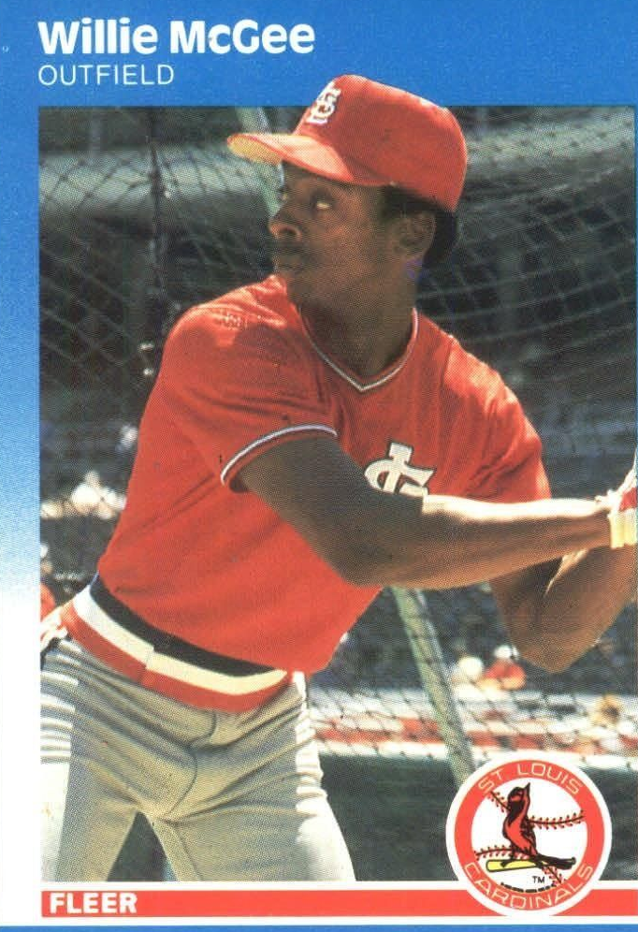
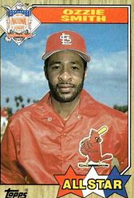
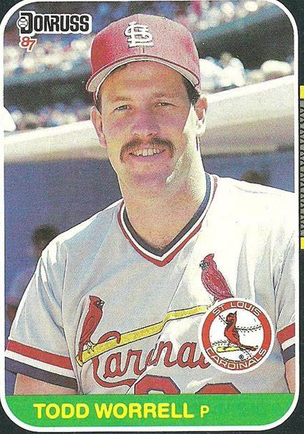
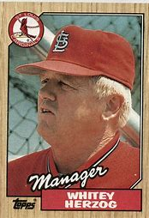
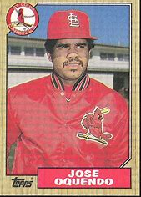
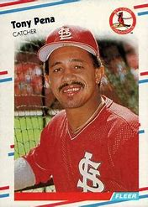
1987
Cardinals
Notes:
Cardinals starters were blasted for 31 runs in 36 innings of work! Worrell saved 2 of 3 wins.

Slide 32
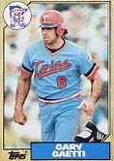
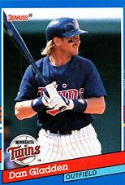
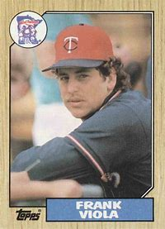
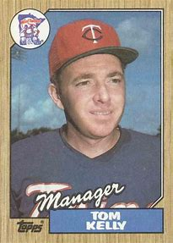
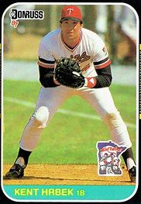
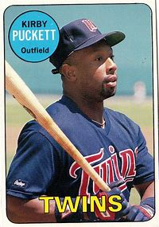
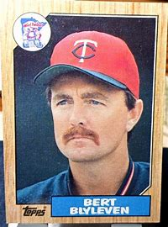
1987
Twins
Notes:
Viola was only pitcher in Series to get two wins (and also one loss)

Slide 33
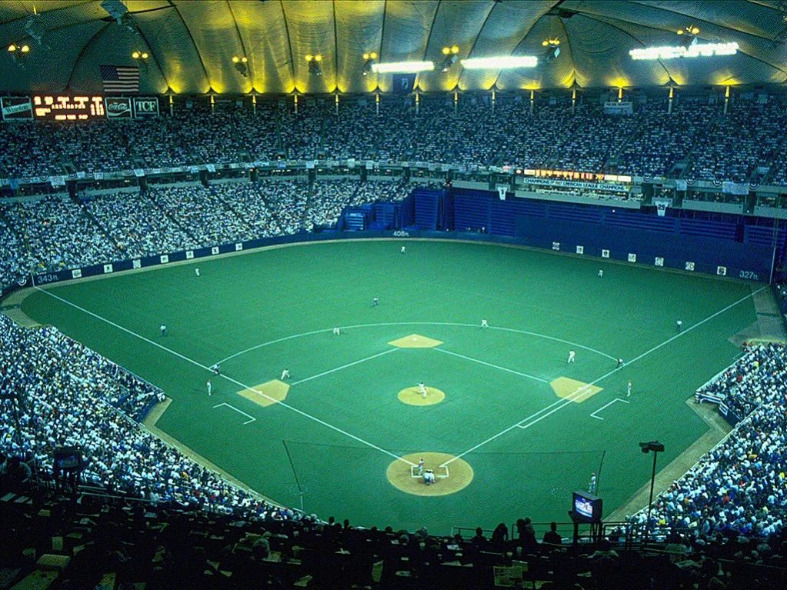
1987 World Series Highlights
Game 1 – October 17
Twins jumped on Cards starter Magrane and the bullpen for 7 runs in the 4th. Gladden’s grand slam was the key blow. Twins starter Frank Viola was the winner.
TWINS 10 – CARDINALS 1
Game 2 – October 18
Twins again pounded the Cards starter for 6 runs in the 4th. Twins C Laudner had a solo homer plus three more RBI to lead the offense. Twins starter Bert Blyleven got the Win.
TWINS 8 – CARDINALS 4
TWINS LEAD 2-0
AS THE SERIES MOVES
TO ST. LOUIS
HHH Metrodome - Minneapolis

Slide 34
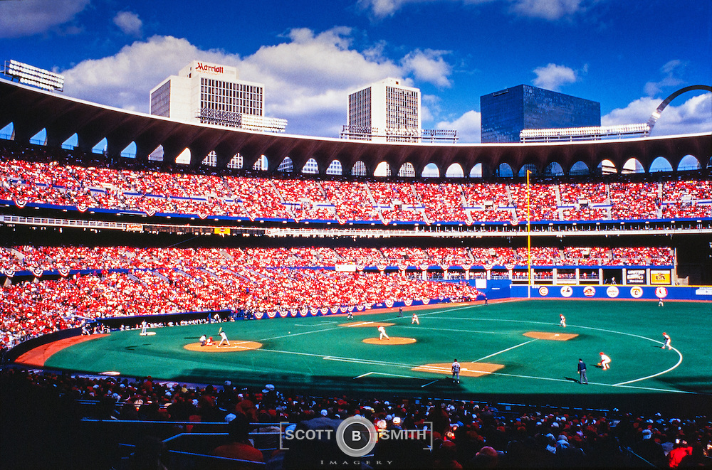
Game 3 – October 20
Cards starter John Tudor held the Twins’ offense in check and “Whiteyball” prevailed as Vince Coleman and Ozzie Smith had the RBI in the 7th inning.
CARDINALS 3 – TWINS 1
Game 4 – October 21
The Cardinals blew the game open with six runs in the 4th inning. Backup 3B Tom Lawless hit a 3-run HR and SS Ozzie Smith had two RBI. Veteran Cards pitcher Bob Forsch got the win in relief.
CARDINALS 7 – TWINS 2
Game 5 – October 22
Cards score three in the 6th and that was enough. CF Curt Ford had 2 RBI and Ozzie Smith 1.
CARDINALS 5 – TWINS 2
CARDINALS LEAD 3-2 …
BACK TO TWIN CITIES
Busch Stadium II – St. Louis

Slide 35
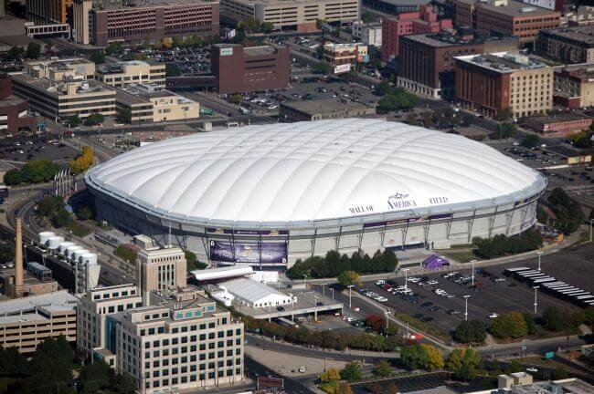
Game 6 – October 24
The Cards were ahead 5-2 in the middle of the 5th, but the Twins bats came alive and scored 9 unanswered runs the rest of the way. Twins 3B Hrbeck hit a grand slam in the 6th , following a Don Baylor HR in the 5th. The Twins bullpen allowed only one run over the last six innings.
TWINS 11 - CARDINALS 5
THIS SETS UP A DECIDING 7TH GAME!!
Game 7 – October 25
The Twins scored single runs in the 2nd, 5th, 6th, and 8th innings to prevail in the deciding game. Starter Frank Viola pitched 8 innings for the win, his second in the series.
TWINS 4 – CARDINALS 2
Notes:
It was loud !!!!!!!!!!! XX DECIBELS …

Slide 36
The Home Team won every game in the Series
The Metrodome was LOUD - as high as 114 decibels
(as loud as a jet engine at takeoff!)
At home theTwins outscored the Cardinals 33 – 12
At home the Cardinals outscored the Twins 14 – 5
Twins starting
pitcher Frank Viola
was the Series MVP
He won
Games 1 and 7
Minnesota Twins
win
1987 World Series

Slide 37
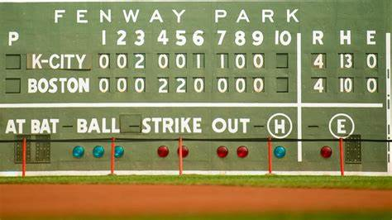
Extra Innings!

Slide 38

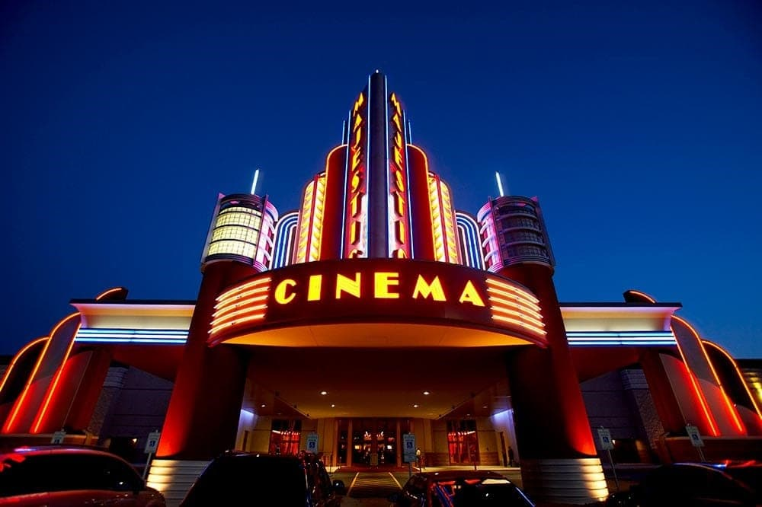
‘80s Top Movies & TV

Slide 39
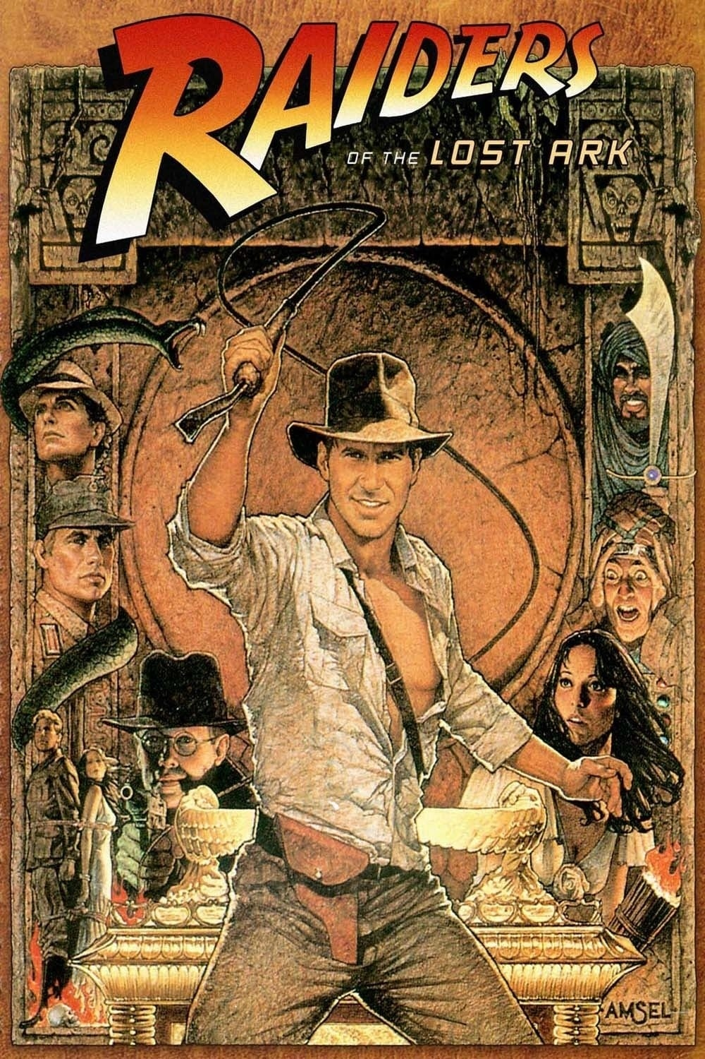
In search of the
Biblical Arc
Harrison Ford starred
as an archeologist
https://www.youtube.com/watch?v=mC1ikwQ5Zgc
Notes:
Start video at 3:05 and can skip forward

Slide 40
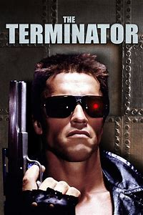
Arnold
Schwarzenegger
starred in this action
film
His famous line was
“Hasta la vista …
Baby”

Slide 41

In this science
fiction movie, the
alien wanted to:
… Phone Home

Slide 42

Leslie Nielsen
starred in this
spoof about
air disasters
“Don’t call me
Shirley!”
Notes:
“Surely you can’t be serious” … “I am serious, and don’t call me Shirley”

Slide 43
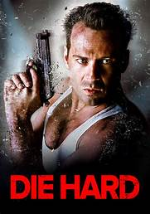
Bruce Willis stars as an off-duty L.A. cop that foils a criminal gang
“Yippee o ki-ay M.F.” (bad word abbreviated)

Slide 44
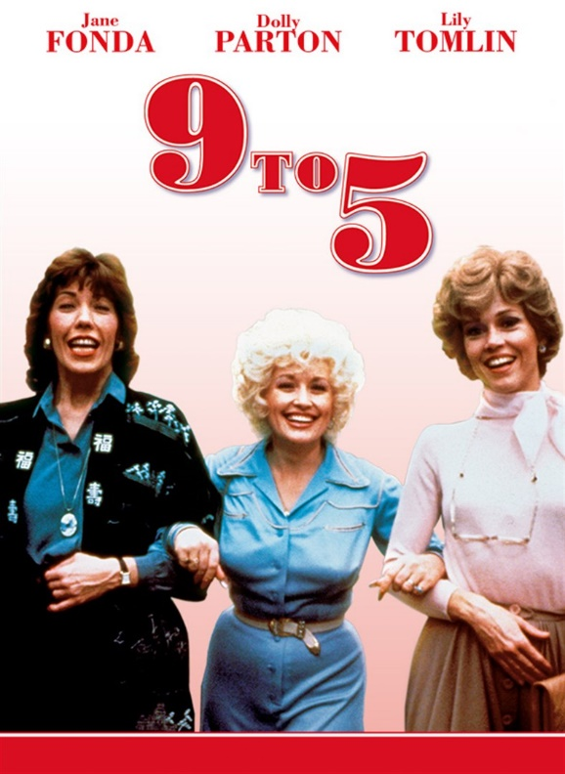
Three women deal with
a sexist, chauvinist boss
Jane Fonda, Lily Tomlin, and
Dolly Parton star
https://www.youtube.com/watch?v=UbxUSsFXYo4

Slide 45
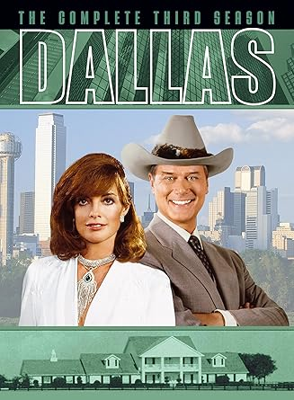
Long-running TV drama
about a wealthy
Texas oil family
Larry Hagman as “J.R.”
https://www.youtube.com/watch?v=8sKX3tWaOew

Slide 46
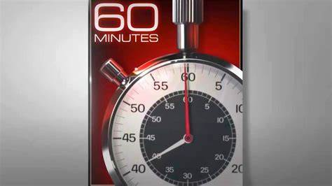
Top rated news program
A one hour “news
magazine” every Sunday evening
The intro showed a ticking stop watch
https://www.youtube.com/watch?v=I2_1ZZU4HUo

Slide 47
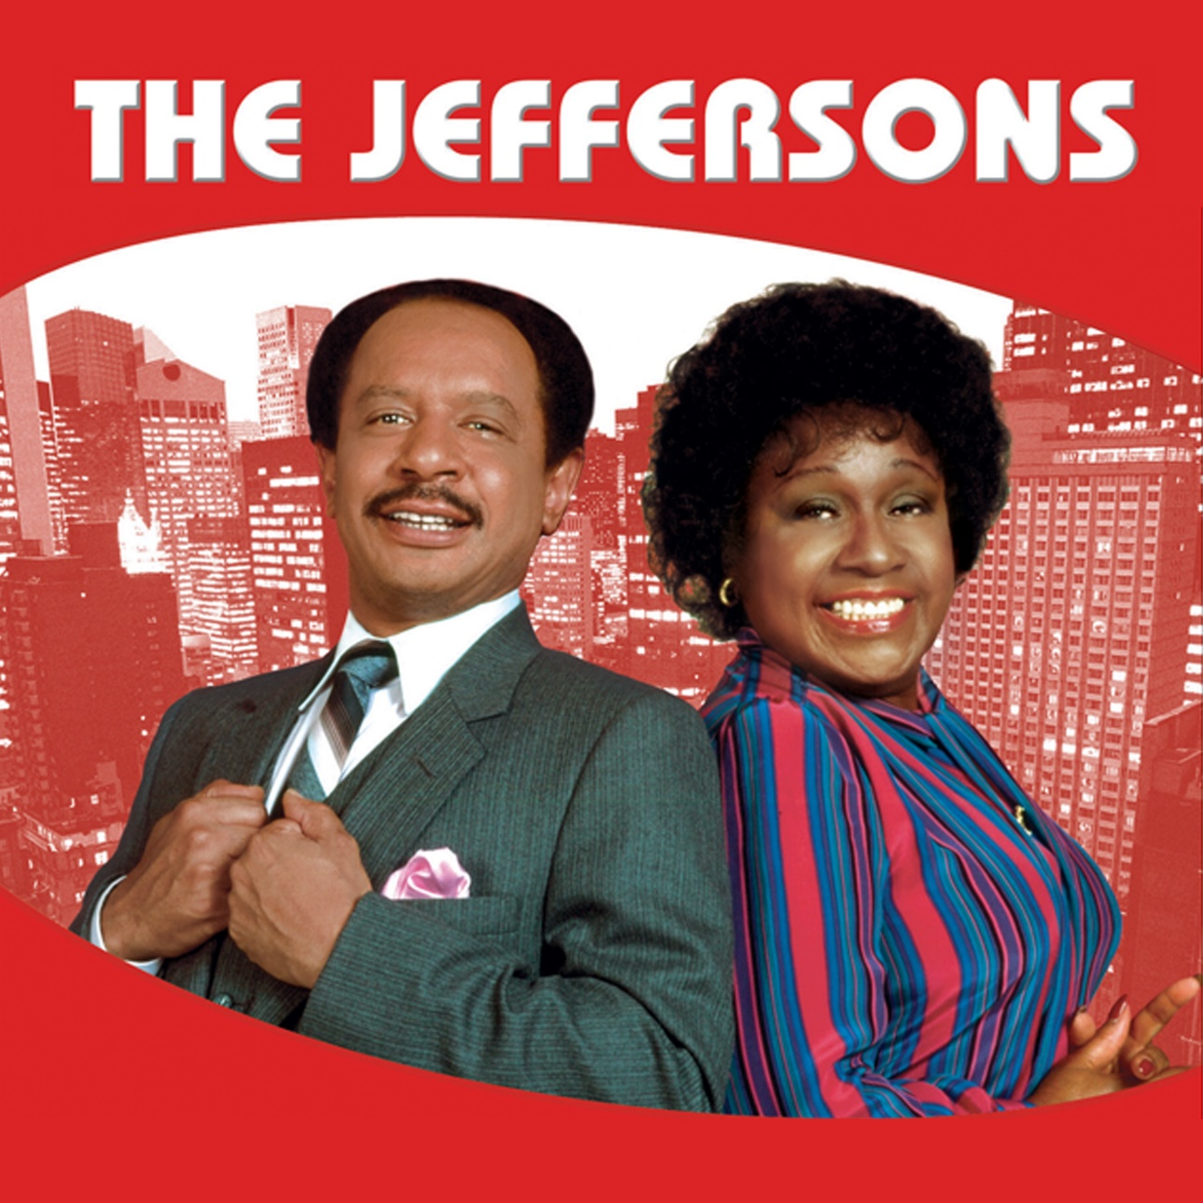
A top rated comedy
Spin-off of
All in the Family
About Archie Bunker’s neighbor George …
https://www.youtube.com/watch?v=_-OnRQ4P0VY

Slide 48

Thanks!!
We’ll see you again next month!
https://www.youtube.com/watch?v=_IJkbs1D5PU

