Slide 1



AGE Thrive with Baseball Memories
May 21, 2025
Agenda
Warm-up - Introductions
Current Events
Gametime – The Year in Baseball – 1988
Seventh Inning Stretch - “Take Me Out to the Ball Game”
Get Up and Move, Sing, Dance!
Extra Innings – More stuff from the ‘80s

Slide 2


Slide 3



Baseball Season is Underway!
Notes:
Mention current won-loss for each team;

Slide 4

Softball
Baseball
Notes:
Mention current won-loss for each team;

Slide 5

History from 1988

Slide 6

Tetris video-game
released
Over 520 Million copies
have been sold across the
multiple systems it runs on!
https://www.youtube.com/watch?v=-FAzHyXZPm0&t=21s
Notes:
First Soviet-made videogame to be imported to U.S. – Arcade versions in ‘88; Home video controller versions in ‘89.

Slide 7

First Major
Internet “Worm”
Created by Cornell
graduate student
Robert Morris
It infected about 6,000
of the 60,000 computers that
were connected to the infant Internet
The Morris Worm!
Notes:
.

Slide 8

Apple vs. Microsoft
Copyright infringement lawsuit claiming Microsoft
illegally copied design elements of the
graphical user interface (GUI) of the Apple Macintosh
Notes:
Apple sued for $5.5 Billion in damages – the courts rejected their arguments .. Eventually the Supreme Court rejected Apple’s appeal.

Slide 9
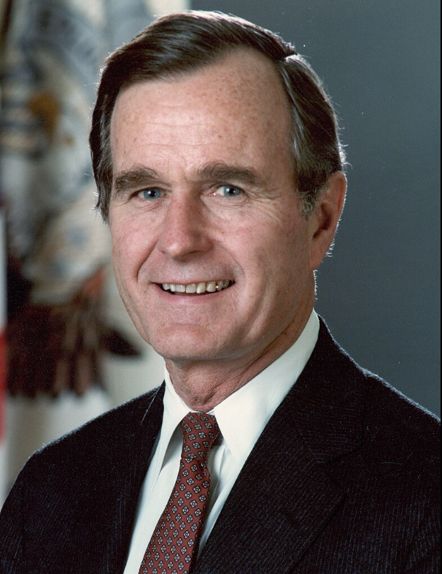
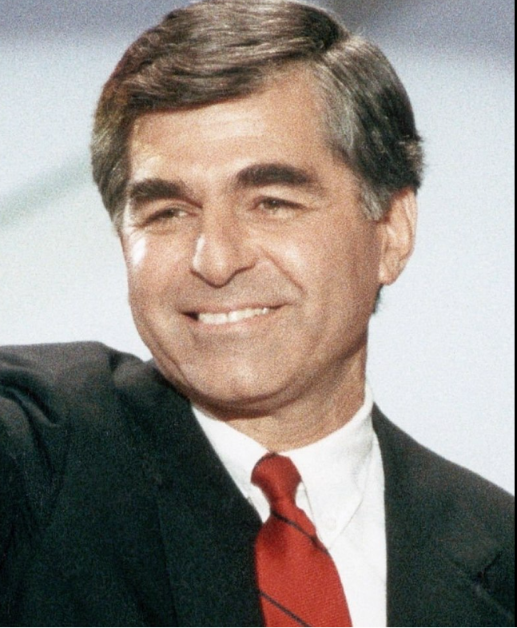
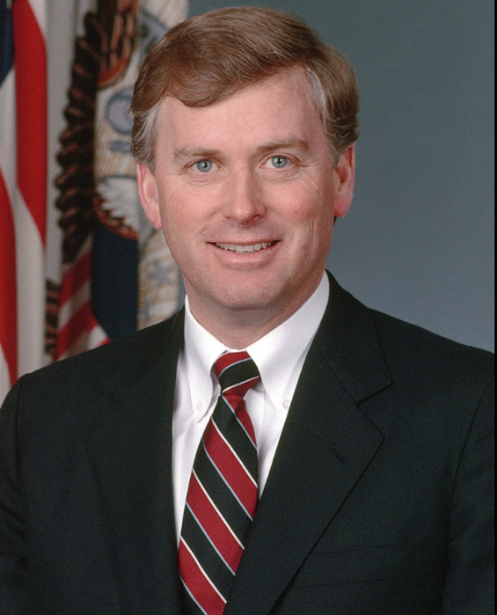
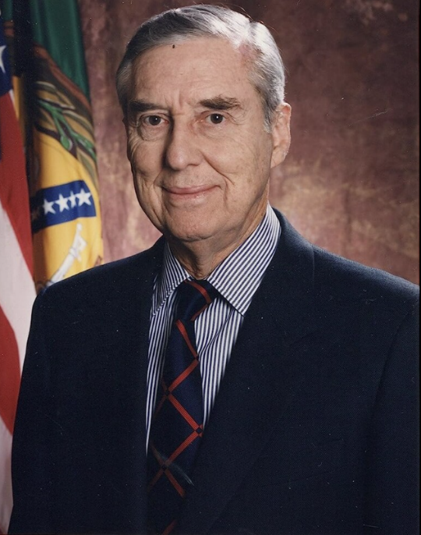
1988 Presidential Election
Gov. Michael Dukakis
(Mass.)
Former Sen. and Treasury
Sec. Lloyd Bentsen (Texas)
VP George H.W. Bush
(Texas)
Sen. Dan Quayle (Indiana)

Slide 10
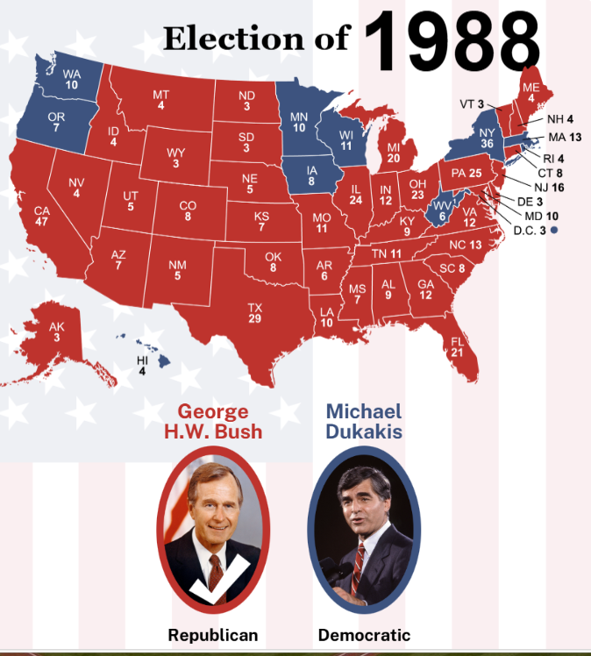
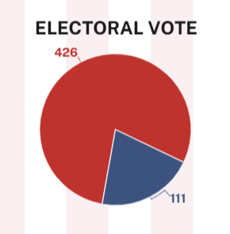
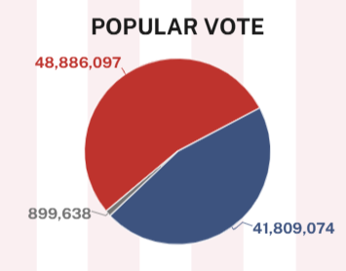
Notes:
It was a landslide!

Slide 11
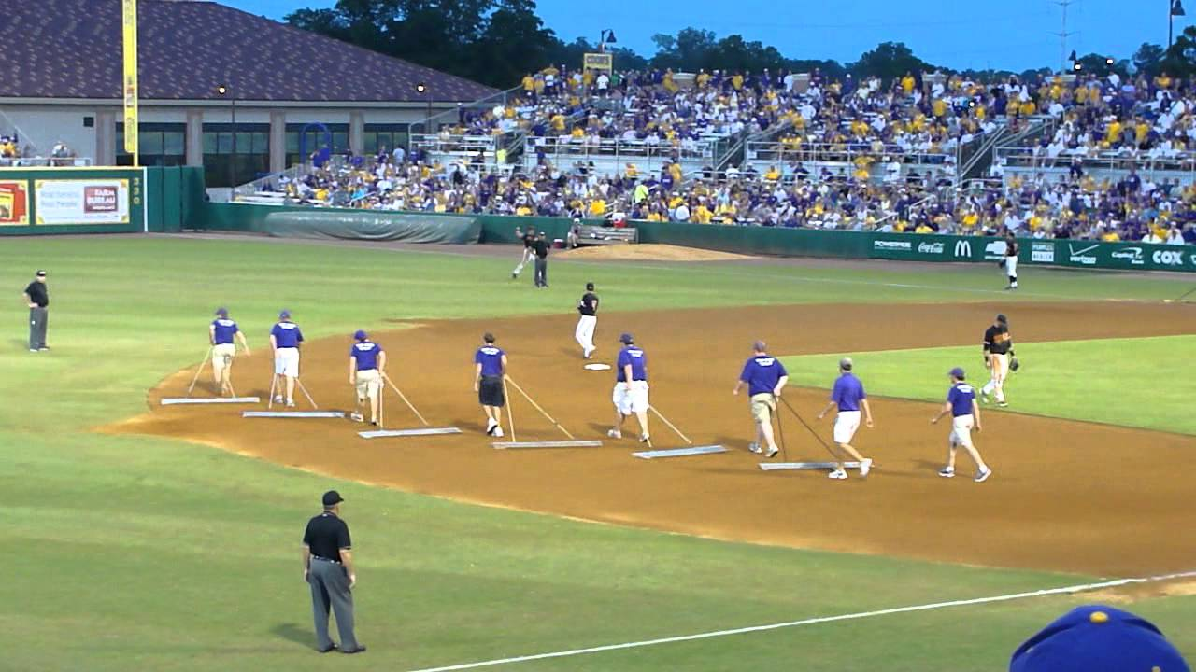
In Between Innings

Slide 12
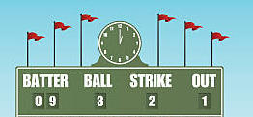
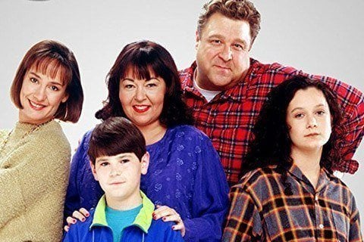
Scoreboard Quiz – 1988 TV
h
This was the Conner Family – living in Lansford, Illinois - on a long-running TV show that debuted in ‘88.
Father Knows Best
Roseanne
Bill Cosby Show

Slide 13
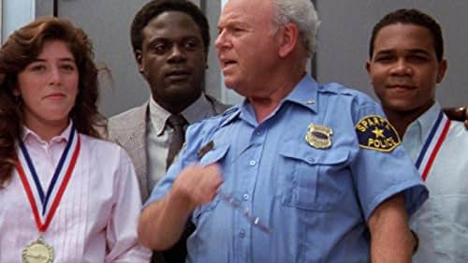
Scoreboard Quiz – 1988 TV
h
This TV show was based on the award-winning movie about a black detective in a Southern town:
Heat of the Night
Perry Mason
77 Sunset Strip

Slide 14
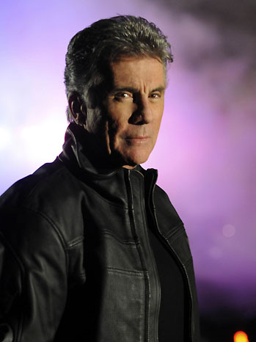
Scoreboard Quiz – 1988 TV
h
John Walsh hosted this TV show that featured reenactments about real fugitives that were wanted for their crimes:
Dragnet
The Defenders
America’s Most Wanted
Notes:
More than 1100 fugitives were captured after being profiled on this show. It began a new season in April, 2025.

Slide 15
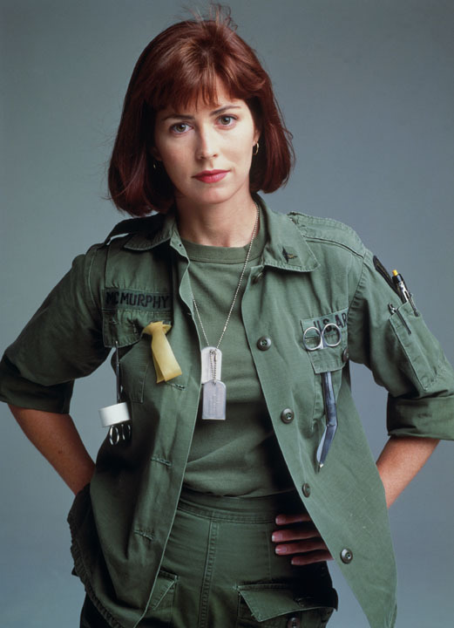
Scoreboard Quiz – 1988 TV
h
This show was a drama set at an Army evacuation hospital during the Vietnam War:
Hello Vietnam
M.A.S.H.
China Beach

Slide 16
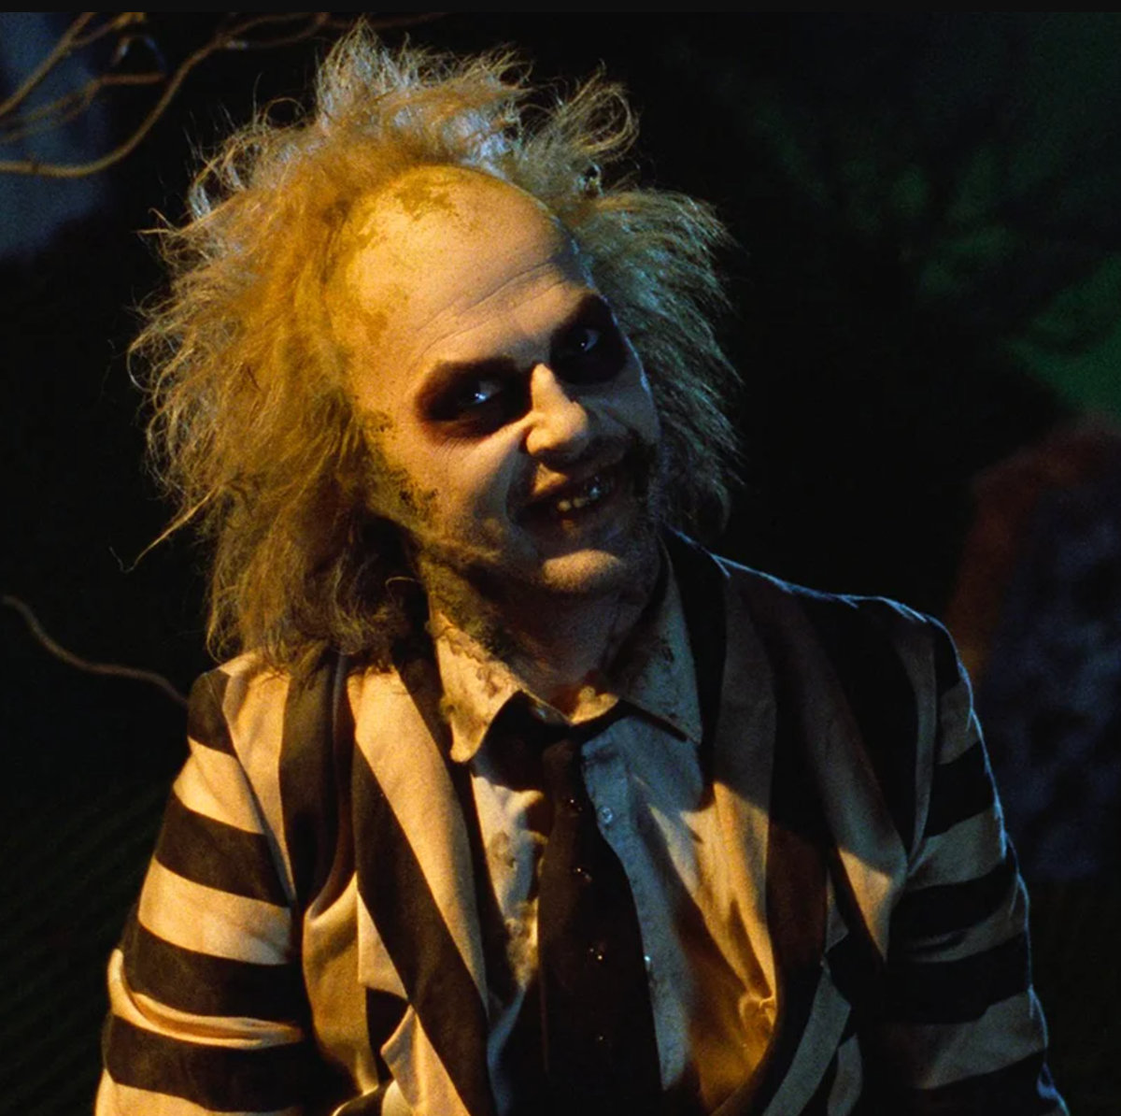
Scoreboard Quiz – 1988 Movies
h
Michael Keaton played the title role in this dark comedy about a lively, foul-mouthed ghost:
Ghostbusters
Beetlejuice
The Exorcism

Slide 17
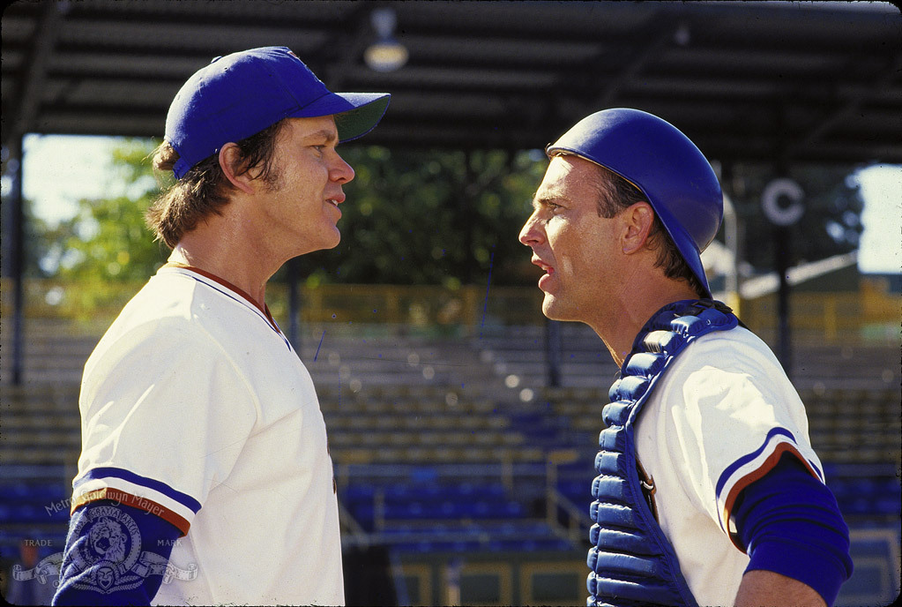
Scoreboard Quiz – 1988 Movies
h
Kevin Costner played the lead role as a minor-league catcher tasked with helping the team’s pitching phenom:
Catcher in the Rye
Yogi
Bull Durham
https://www.youtube.com/watch?v=euHfP6X_axY

Slide 18

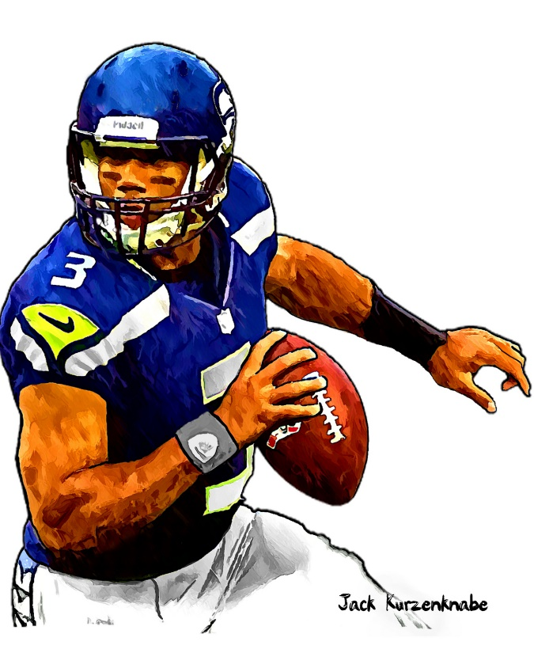

1988 Sporting News

Slide 19

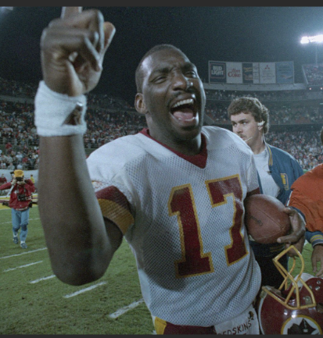
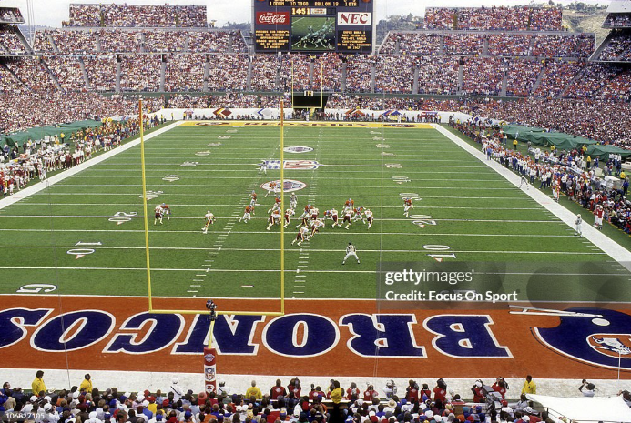

Super Bowl XXII
42
to
10
Washington QB Doug Williams
was the Super Bowl MVP
Played in San Diego for the first time
Notes:
The Broncos were leading 10-0 at end of 1Q.

Slide 20

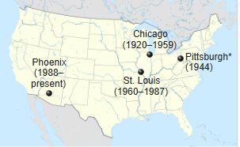
NFL’s Football Cardinals relocate
AGAIN!

Slide 21
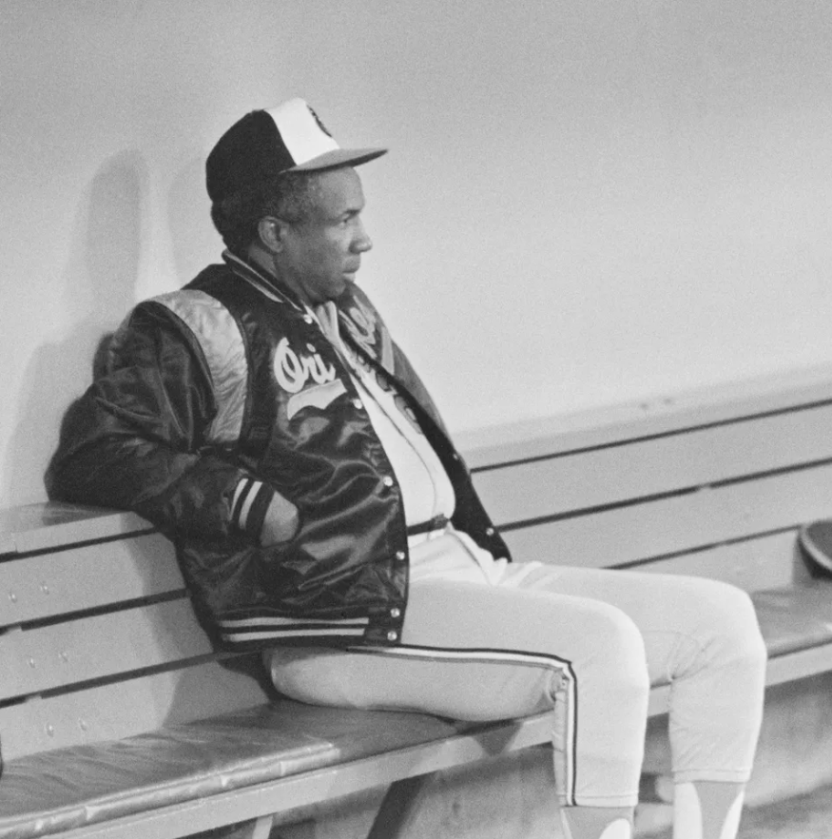
Orioles lose the
first 21 games
of the
1988 season !

Slide 22
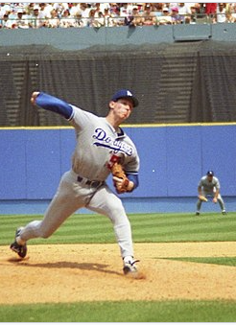
Dodgers’ pitcher
Orel Hershiser
sets MLB record pitching
59 consecutive scoreless innings

Slide 23
The Year in Baseball: 1988

Slide 24
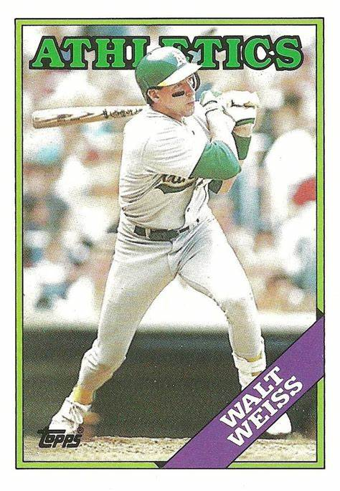
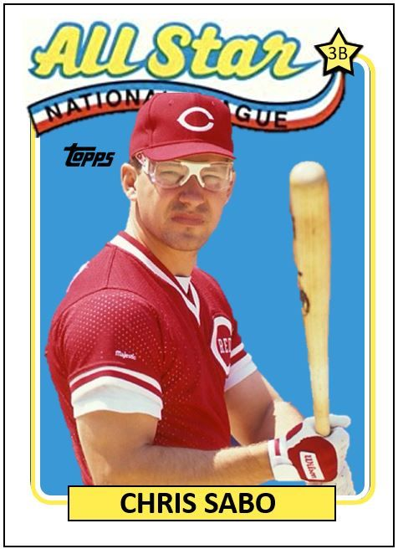
1988
Rookies
of the
Year
.250 44 R 39 RBI
.271 11 HR 74 R
Notes:
Must not have been a strong year for rookies!
Mickey Mantle hit 37 homers to lead the AL. He also led the league in triples, walks, and SLG.

Slide 25
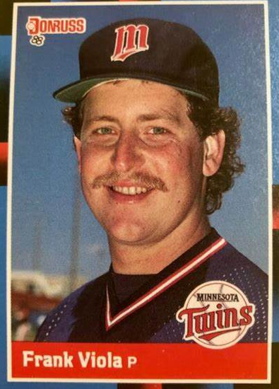
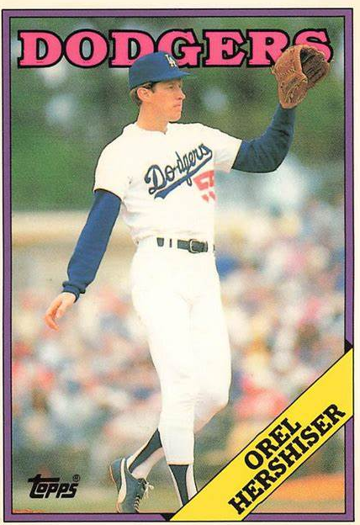
1988
Cy Young
Winners
24 – 7 2.64 ERA 255 IP
23 – 8 8 SHO 267 IP
Notes:
Clemens won CY for second year in a row.

Slide 26
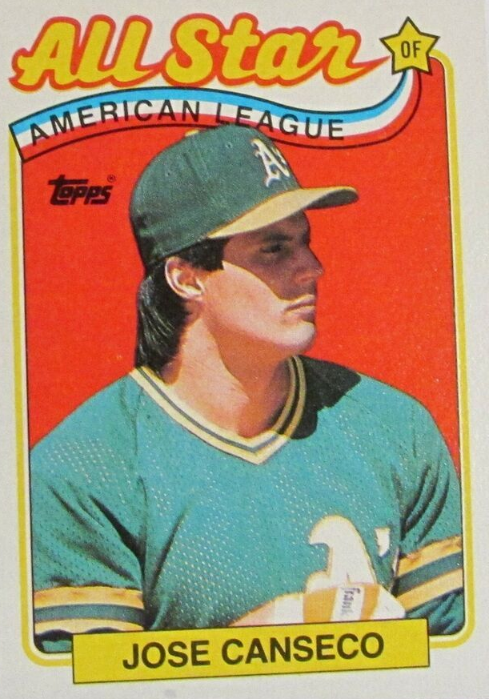
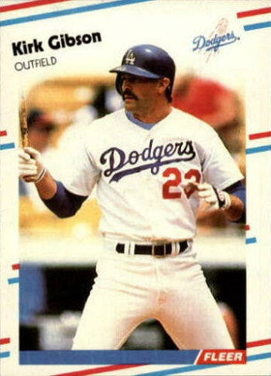
1988
Most
Valuable
Players
.307 42 HR 124 RBI
25 HR 76 RBI .290
Notes:
Mickey Mantle hit 37 homers to lead the AL. He also led the league in triples, walks, and SLG.

Slide 27
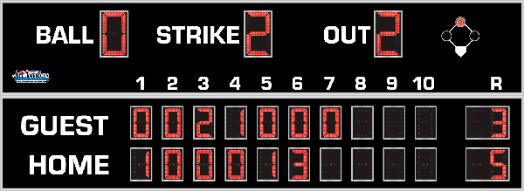
7th Inning Stretch

Slide 28
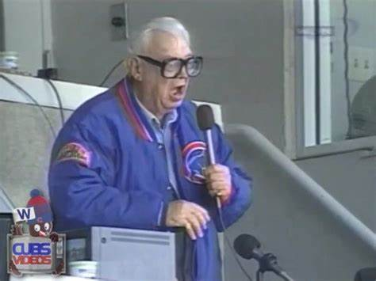
“Take Me Out to the Ballgame”

Slide 29
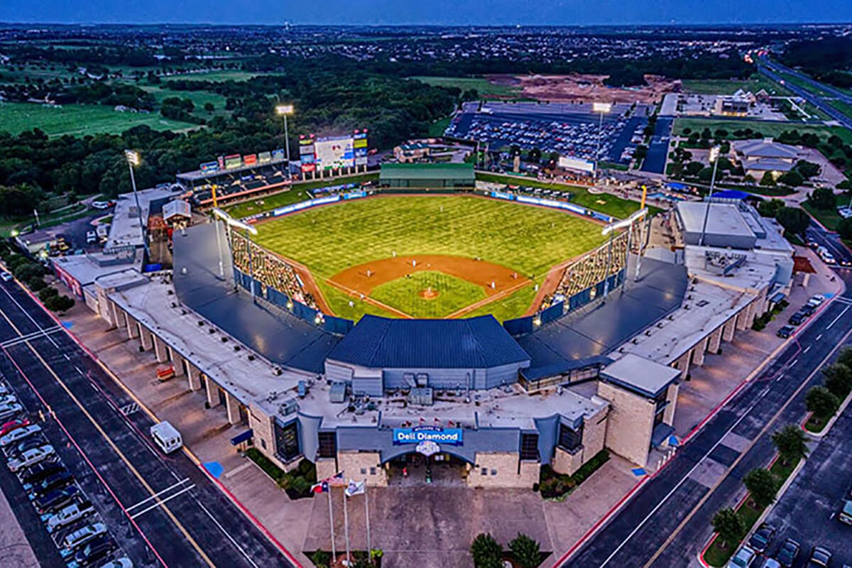
“Deep in the Heart of Texas
https://www.youtube.com/watch?v=rcrK0U7RDIk

Slide 30
“Do the Hokey Pokey”
https://www.youtube.com/watch?v=vpharBeg9XA

Slide 31



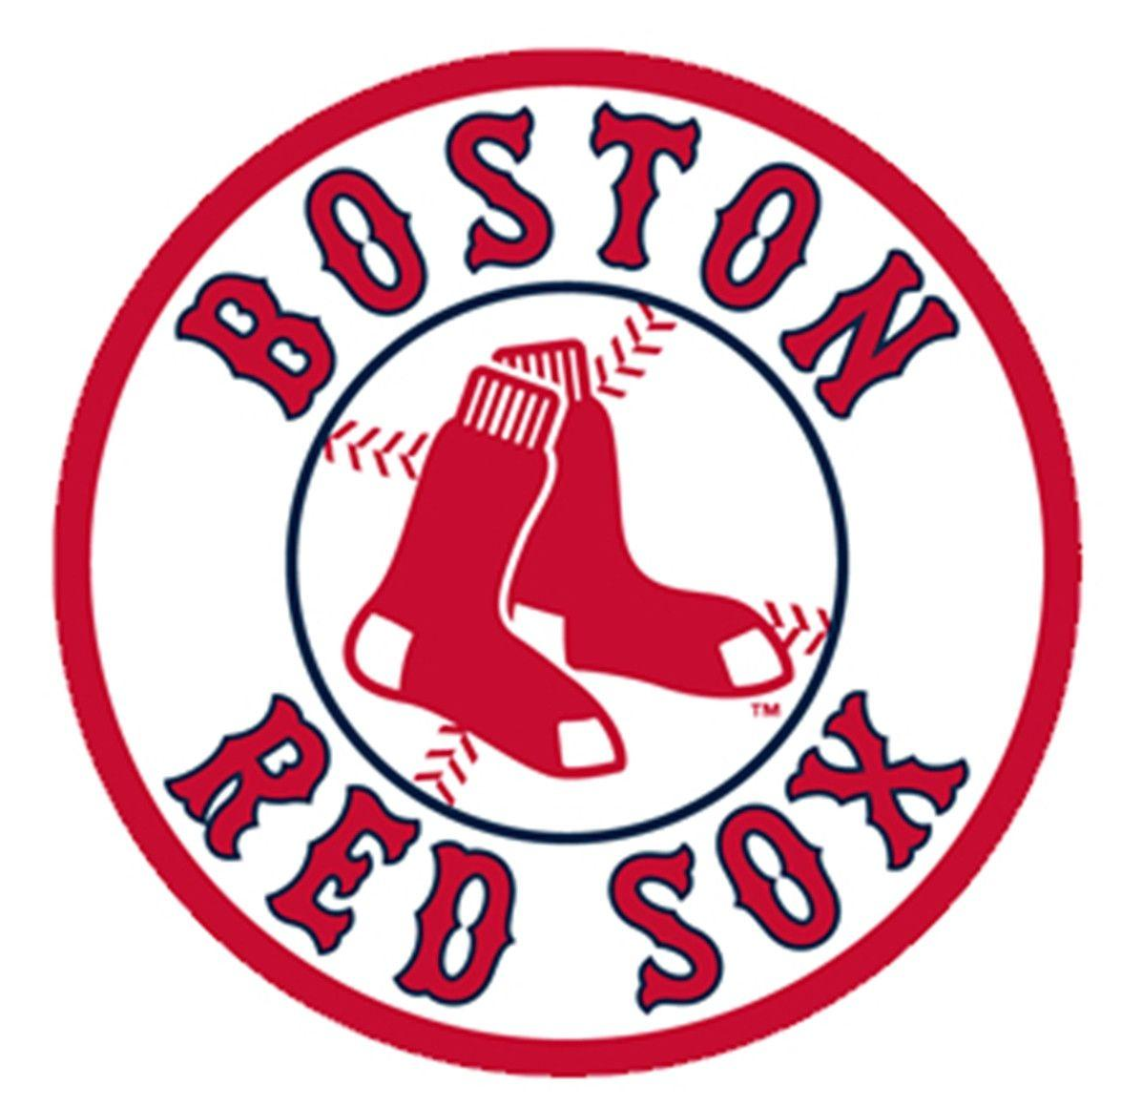
1988 LCS
Best 4 of 7 format
Dodgers
won 4-3
A’s
swept 4-0

Slide 32

1988 World Series
L.A. Dodgers vs. Oakland Athletics

Slide 33
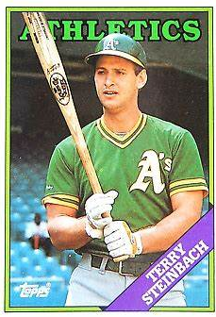
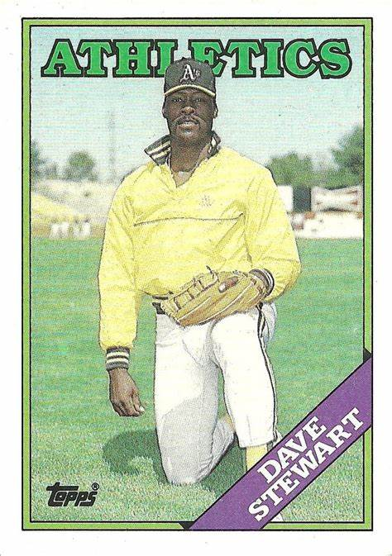
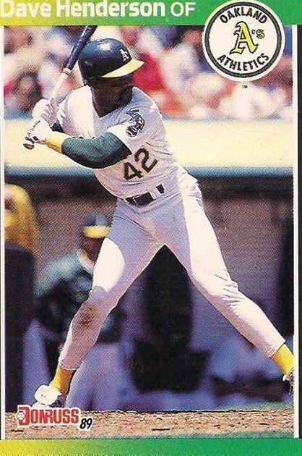
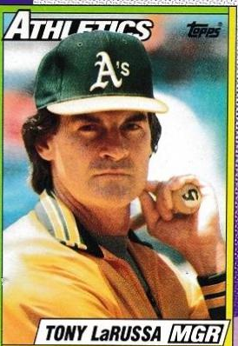
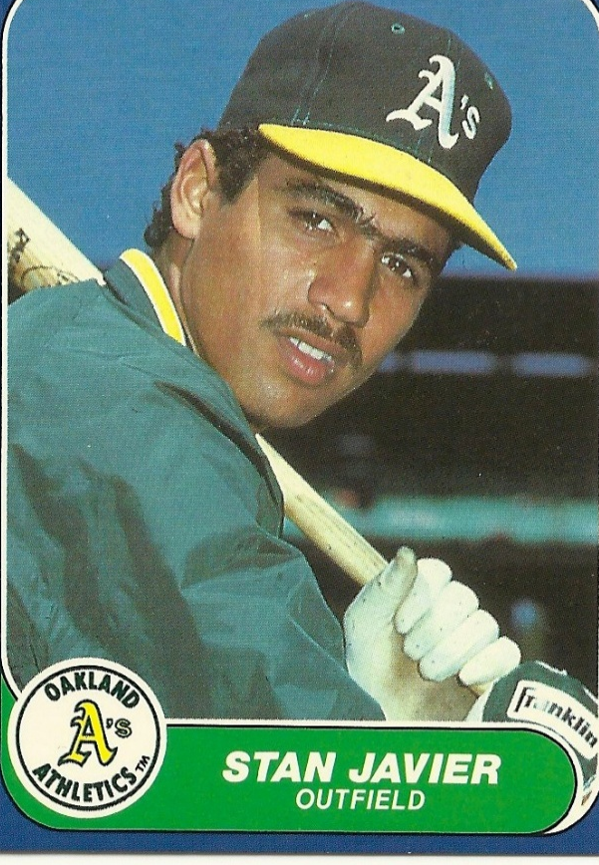
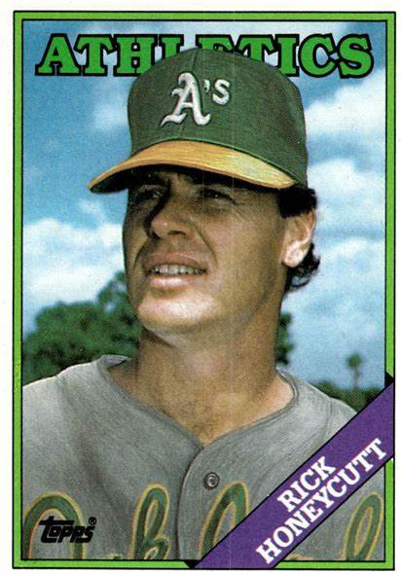
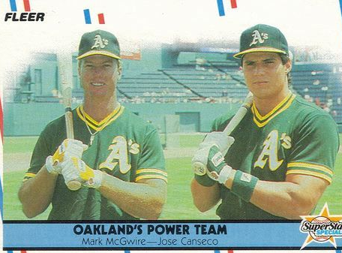
1988
Athletics
Notes:
The Bash Brothers both hit under .100 for the Series. McGwire had the A’s only HR.

Slide 34
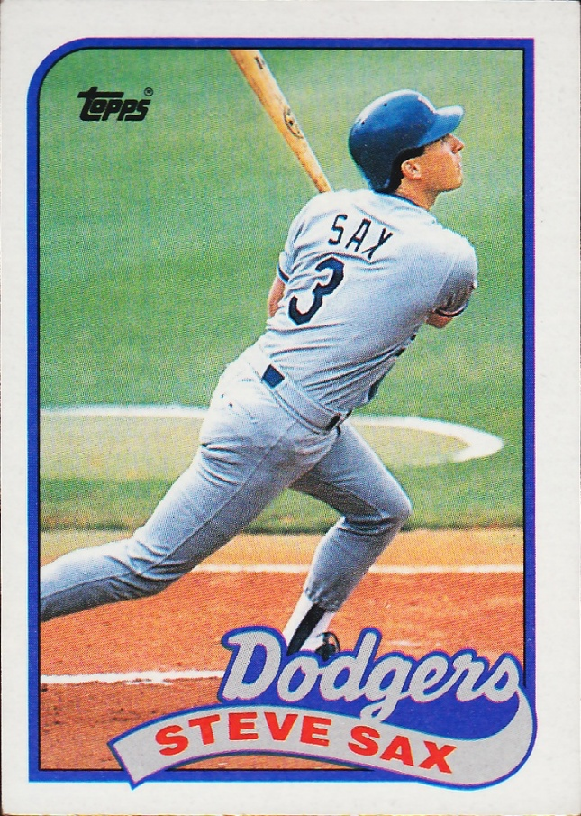
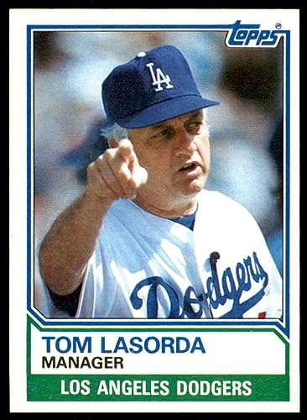
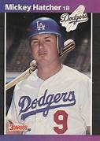
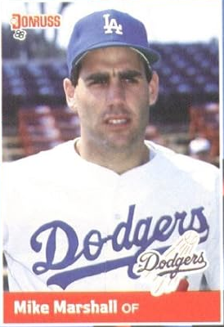
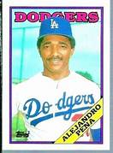
1988
Dodgers
Notes:
Kirk Gibson had only one AB, but it was a famous homer as we’ll see …

Slide 35
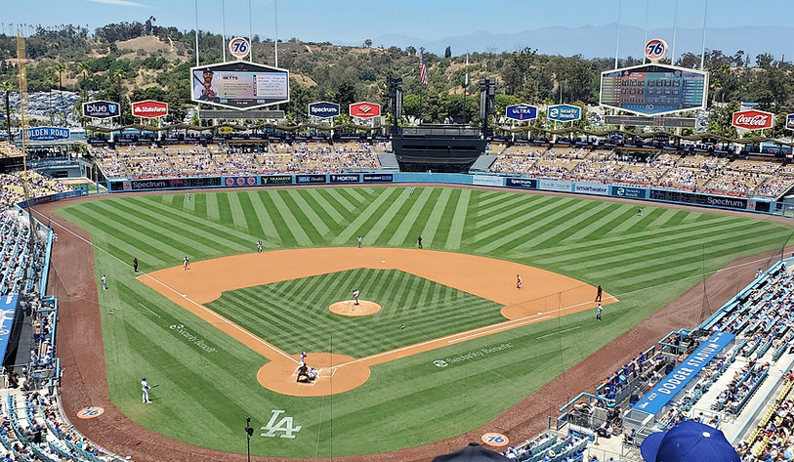
1988 World Series Highlights
Game 1 – October 15
Canseco hit a 2nd inning slam to put the A’s up 4-2. The Dodgers scored on in the 6th and were down by a run in the bottom of the ninth:
https://www.youtube.com/watch?v=N4nwMDZYXTI
DODGERS 5 – A’s 4
Game 2 – October 16
Mike Marshall hit a 3-run homer in the 3rd and the Dodgers never trailed. Ace Hershiser pitched a three-hit complete game shutout.
DODGERS 6 – A’s 0
DODGERS LEAD 2-0
AS THE SERIES MOVES
TO OAKLAND
Dodger Stadium – Los Angeles
Notes:
Trim down the length of the Vin Scully video/audio a the end of game one.

Slide 36
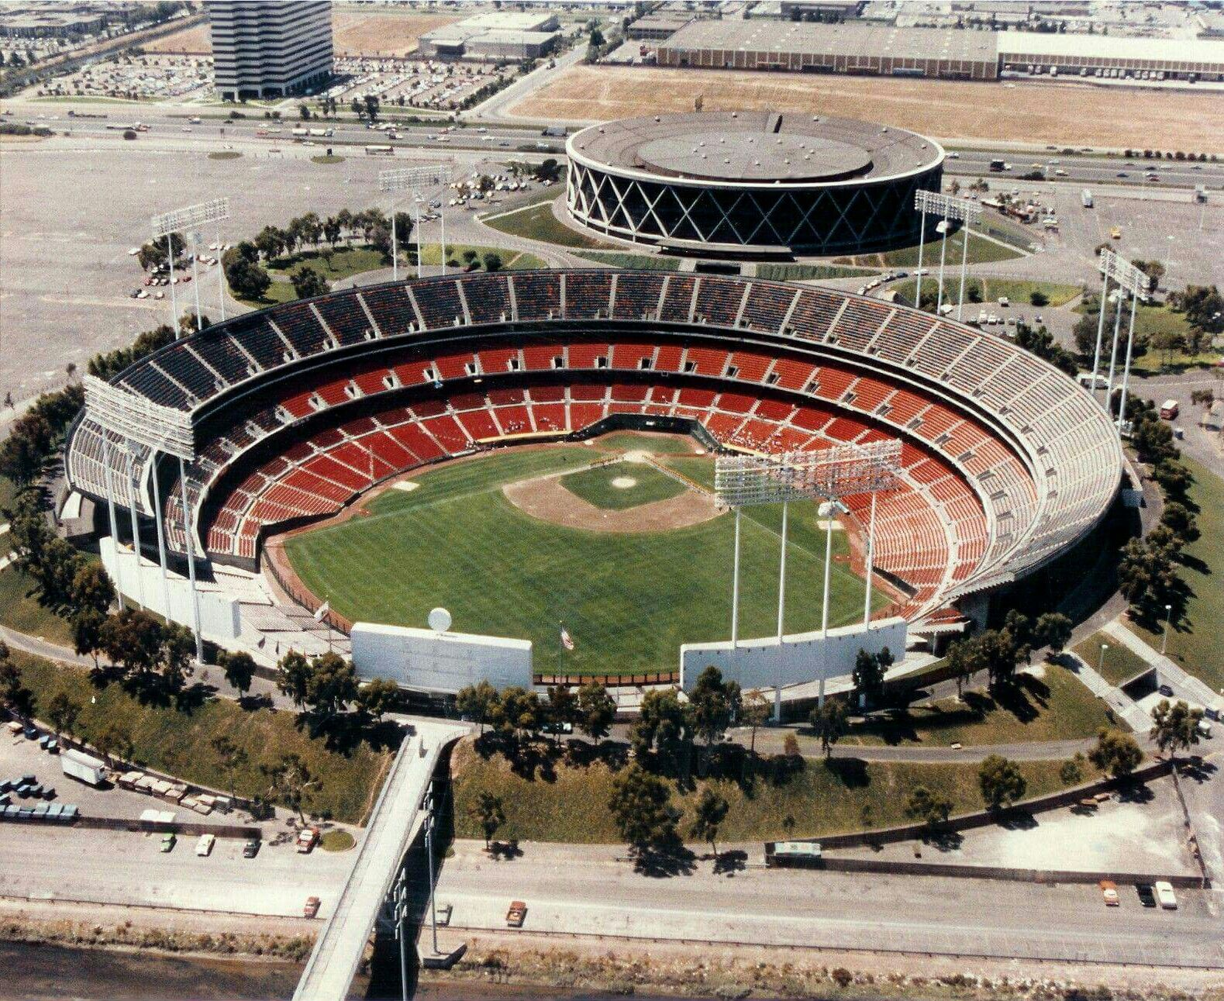
Game 3 – October 18
Mark McGwire hit a walk-off homer in the 9th inning to give the A’s a win in this pitcher’s duel:
OAKLAND 2 - DODGERS 1
Game 4 – October 19
LA scored two in the top of the 1st and never trailed in another close game. Two unearned runs cost A’s starter Stewart a win.
DODGERS 4 - A’s 3
Game 5 – October 20
Dodgers ace Hershiser pitched another complete game – allowing only 2 runs on 4 hits. Two-run homers by Hatcher and Davis provided the Dodgers four of their five runs.
DODGERS 5 – ATHLETICS 2
Oakland-Alameda County
Coliseum

Slide 37
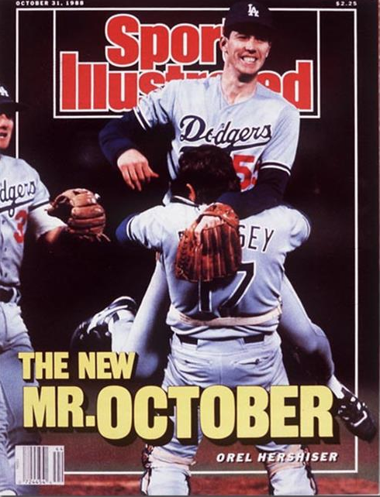
L. A. Dodgers win
1988 World Series
Dodgers starter Orel Hershiser
was the Series MVP
he won Games 2 and 5;
both wins were complete games

Slide 38
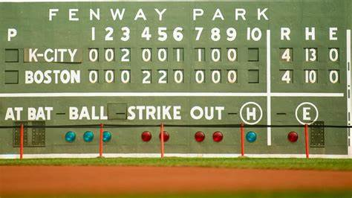
Extra Innings!

Slide 39

Product Jingles & Slogans

Slide 40

“See the U.S.A. in your …”
What famous singer and TV personality
sang the jingle?
https://www.youtube.com/watch?v=qhR8GZ_WWMM
Notes:
She had a string of eighty charted popular hits, spanning from 1940 to 1957, and after appearing in a handful of feature films, she went on to a four-decade career in American television.

Slide 41

“You can trust your car
to the man who
wears the star …”
https://www.youtube.com/watch?v=b1zxOTDHIBQ

Slide 42


“Be all that you can be!”
Notes:
Army recruiting slogan from 1980 to 2001, and re-established in 2023.

Slide 43
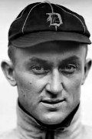
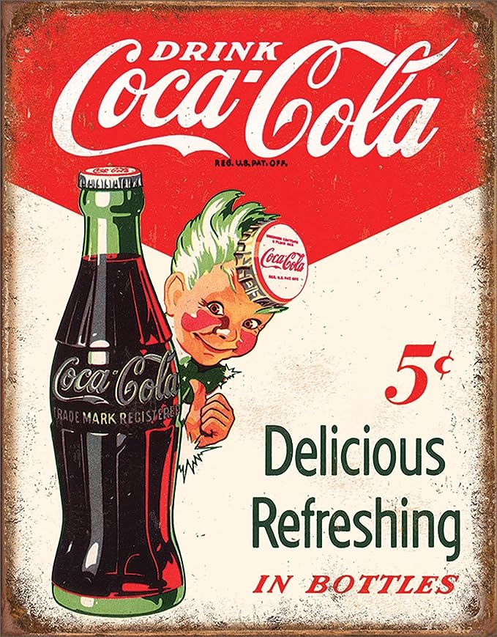
Baseball star Ty Cobb (aka the Georgia Peach) was an early investor in this beverage company in Atlanta.
“Things go
better with ___-___, things go better with ____”
https://www.youtube.com/watch?v=cF9QbEUYINg
Notes:
In 1907, he bought 300 shares of stock in Coca-Cola. Over the next 20 years, he expanded that to 24,000 shares. When Cobb died in 1961, he owned $2.1 million worth of Coca-Cola stock. He was also a big investor in General Motors. Jingle from the ‘60s.

Slide 44
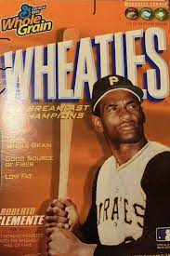
“The Breakfast
of Champions”
https://www.youtube.com/watch?v=CGaxdEwF4Ns

Slide 45

“Where’s the beef ?”
https://www.youtube.com/watch?v=U80ebi4AKgs

Slide 46

“Tastes great, less filling”
https://www.youtube.com/watch?v=Sp4RIITcOt0
Notes:
A lot of baseball players did ads for Miller Light – here’s Brewer’s announcer and former big league catcher Bob Uecker

Slide 47

“Here comes
the
King of Beers”
https://www.youtube.com/watch?v=onBHcQgHA4s
Notes:
A-B is a major sponsor of most sports programming in the U.S. A tradition on Opening Day in St. Louis.

Slide 48

“Plop, plop, fizz, fizz, oh
what a relief it is!”
Notes:
If you’ve drank too much Miller Lite or Budweiser, you may need this product …

Slide 49

“The best part of waking up is _______ in your cup.”

Slide 50

“Some times you feel like a nut, sometimes you don’t”

Slide 51

“Sorry Charlie, we don’t want tuna with good taste, we want tuna that tastes good”

Slide 52

“Give it to Mikey. He won’t eat it, he hates everything!”

Slide 53

“You deserve a break today, at ________ !”

Slide 54

“You’re in good hands”

Slide 55

“Like a good neighbor, ____ ____ is there”

Slide 56

“Don’t leave home without it”
https://www.youtube.com/watch?v=nMzNJkx1NoQ
Notes:
Karl Malden was known for the traveler’s check commercials; Mel Blanc

Slide 57

Thanks!!
We’ll see you again next month!
https://www.youtube.com/watch?v=_IJkbs1D5PU

