Slide 1



AGE Thrive with Baseball Memories
June 18, 2025
Agenda
Warm-up - Introductions
Current Events
Gametime – The Year in Baseball – 1989
Seventh Inning Stretch - “Take Me Out to the Ball Game”
Get Up and Move, Sing, Dance!
Extra Innings – More stuff from the past

Slide 2


Slide 3



Baseball Season is Underway!
Notes:
Mention current won-loss for each team;

Slide 4


Women’s College Softball !!!!
Notes:
The FINALS of the 2025 WCWS featured two teams from Texas universitites in the best-of-three faceoff. The Longhorns won game 1, the Red Raiders won game 2, setting up a one-game final shootout.

Slide 5
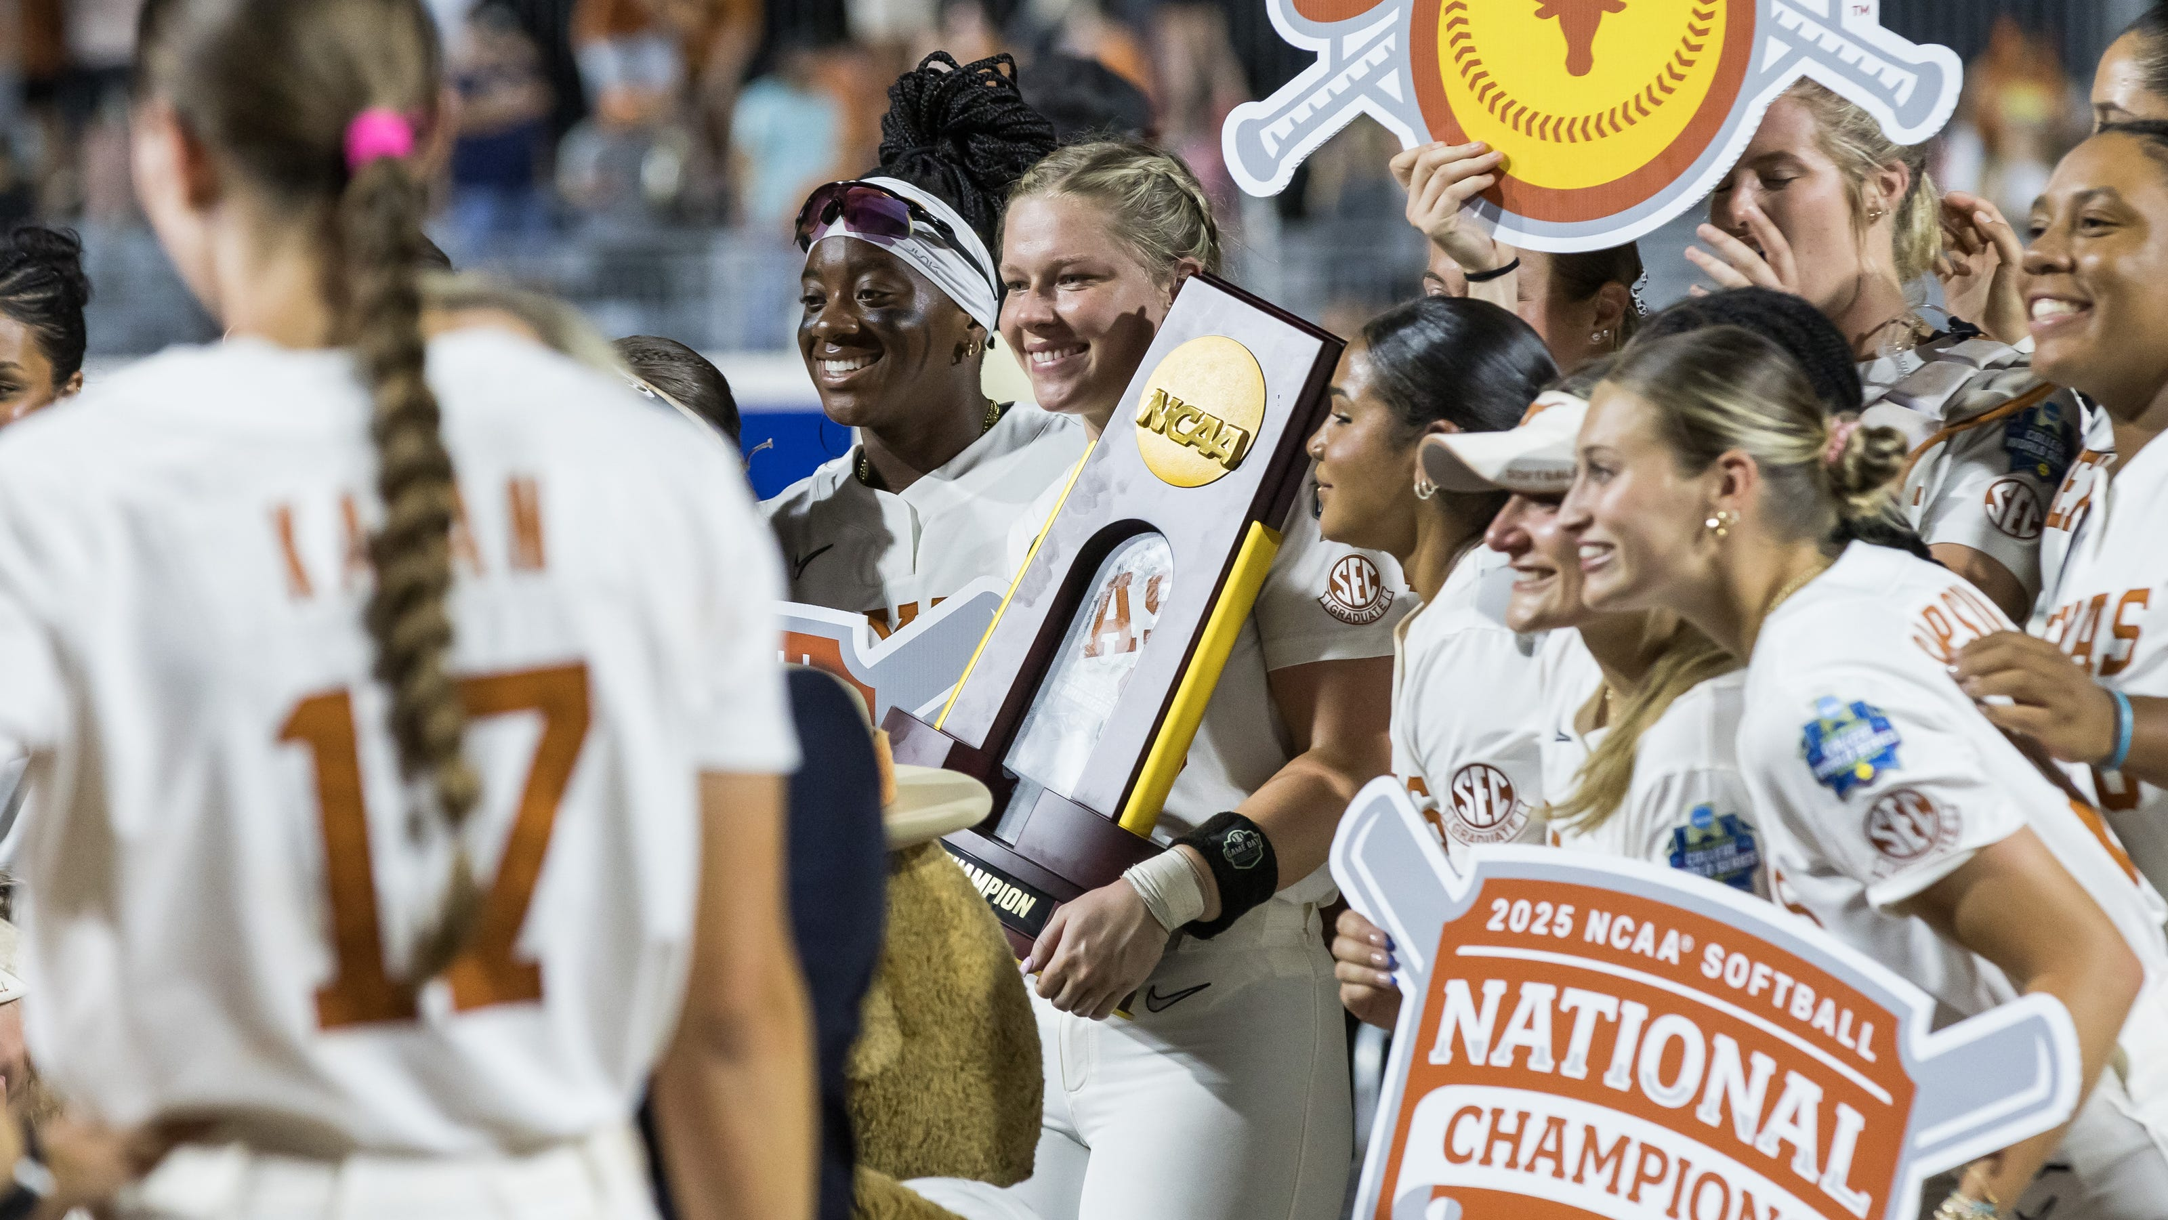
Longhorns win the 2025
Women’s College World Series!
Notes:
The Longhorns won the final game in convincing fashion 10-3; to win their first national championship in Softball.

Slide 6

History from 1989

Slide 7
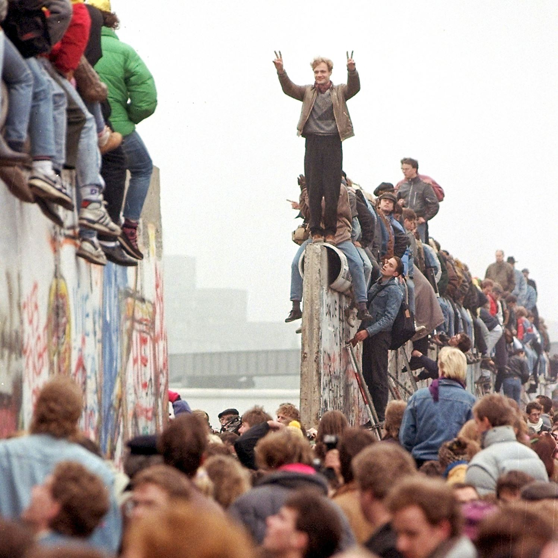
Fall of the
Berlin Wall
The Berlin Wall was opened and then torn down.
Similar events took place in the other Soviet bloc nations
Notes:
.

Slide 8
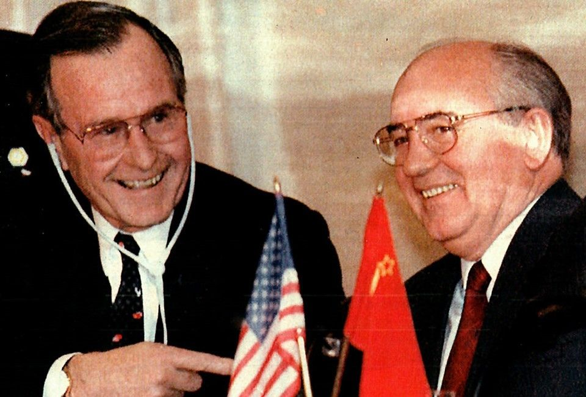
Cold War
Ends
Bush and Gorbachev meet at Malta
Post conference they declared that the “Cold War” was over
Notes:
.

Slide 9
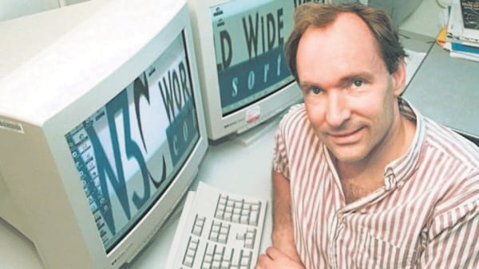
Proposed by Tim Berners-Lee
that www. on internet sites
World Wide Web
Notes:
.

Slide 10
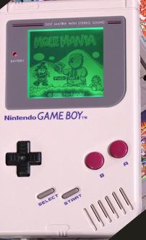
Nintendo GameBoy
released
Popular Handheld game console
More than 118 Million have been sold worldwide
Notes:
.the new Nintendo game console - SWITCH2 – has sold 3.5M units just this month – June 2025 !!

Slide 11
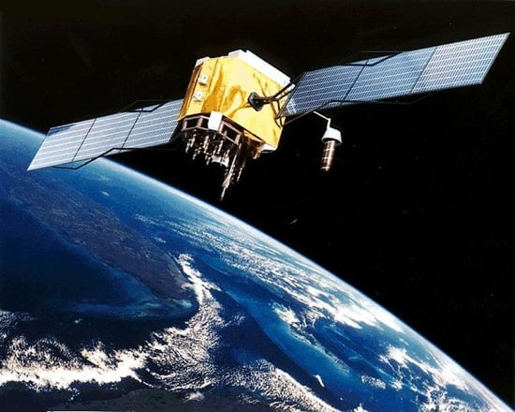
First operational
GPS Satellite
put into orbit
Notes:
24 is the nominal number of GPS in orbit concurrently; there are 31 aloft now.

Slide 12
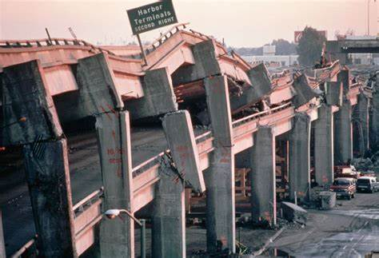
The Loma Prieta Earthquake
Notes:
The “San Francisco Earthquake” – a 6.9 strength centered about 60 miles SE of San Francisco

Slide 13
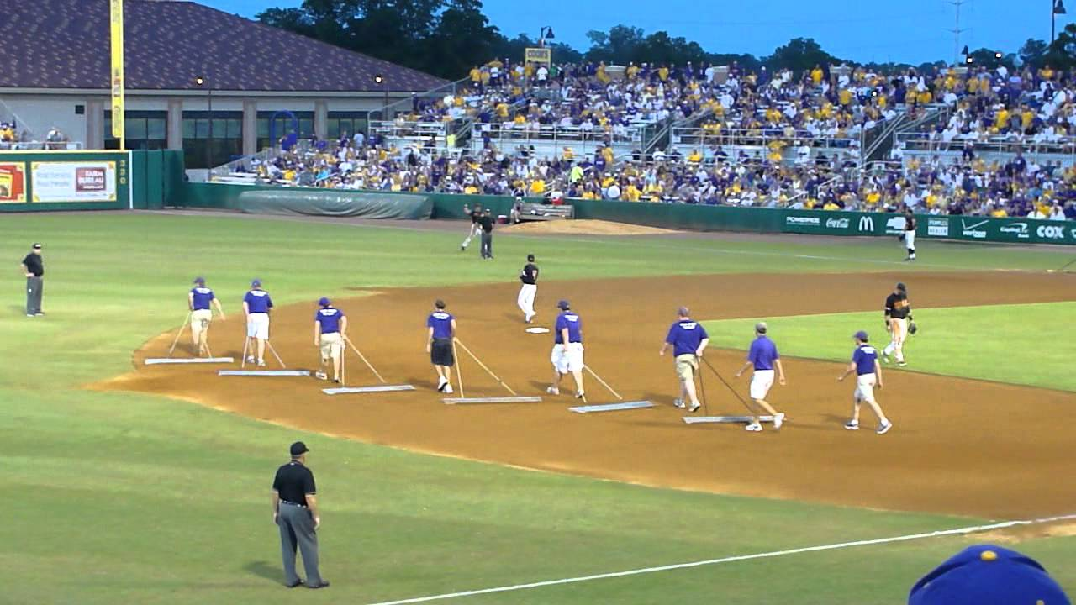
In Between Innings

Slide 14
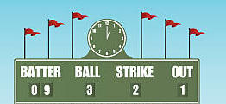
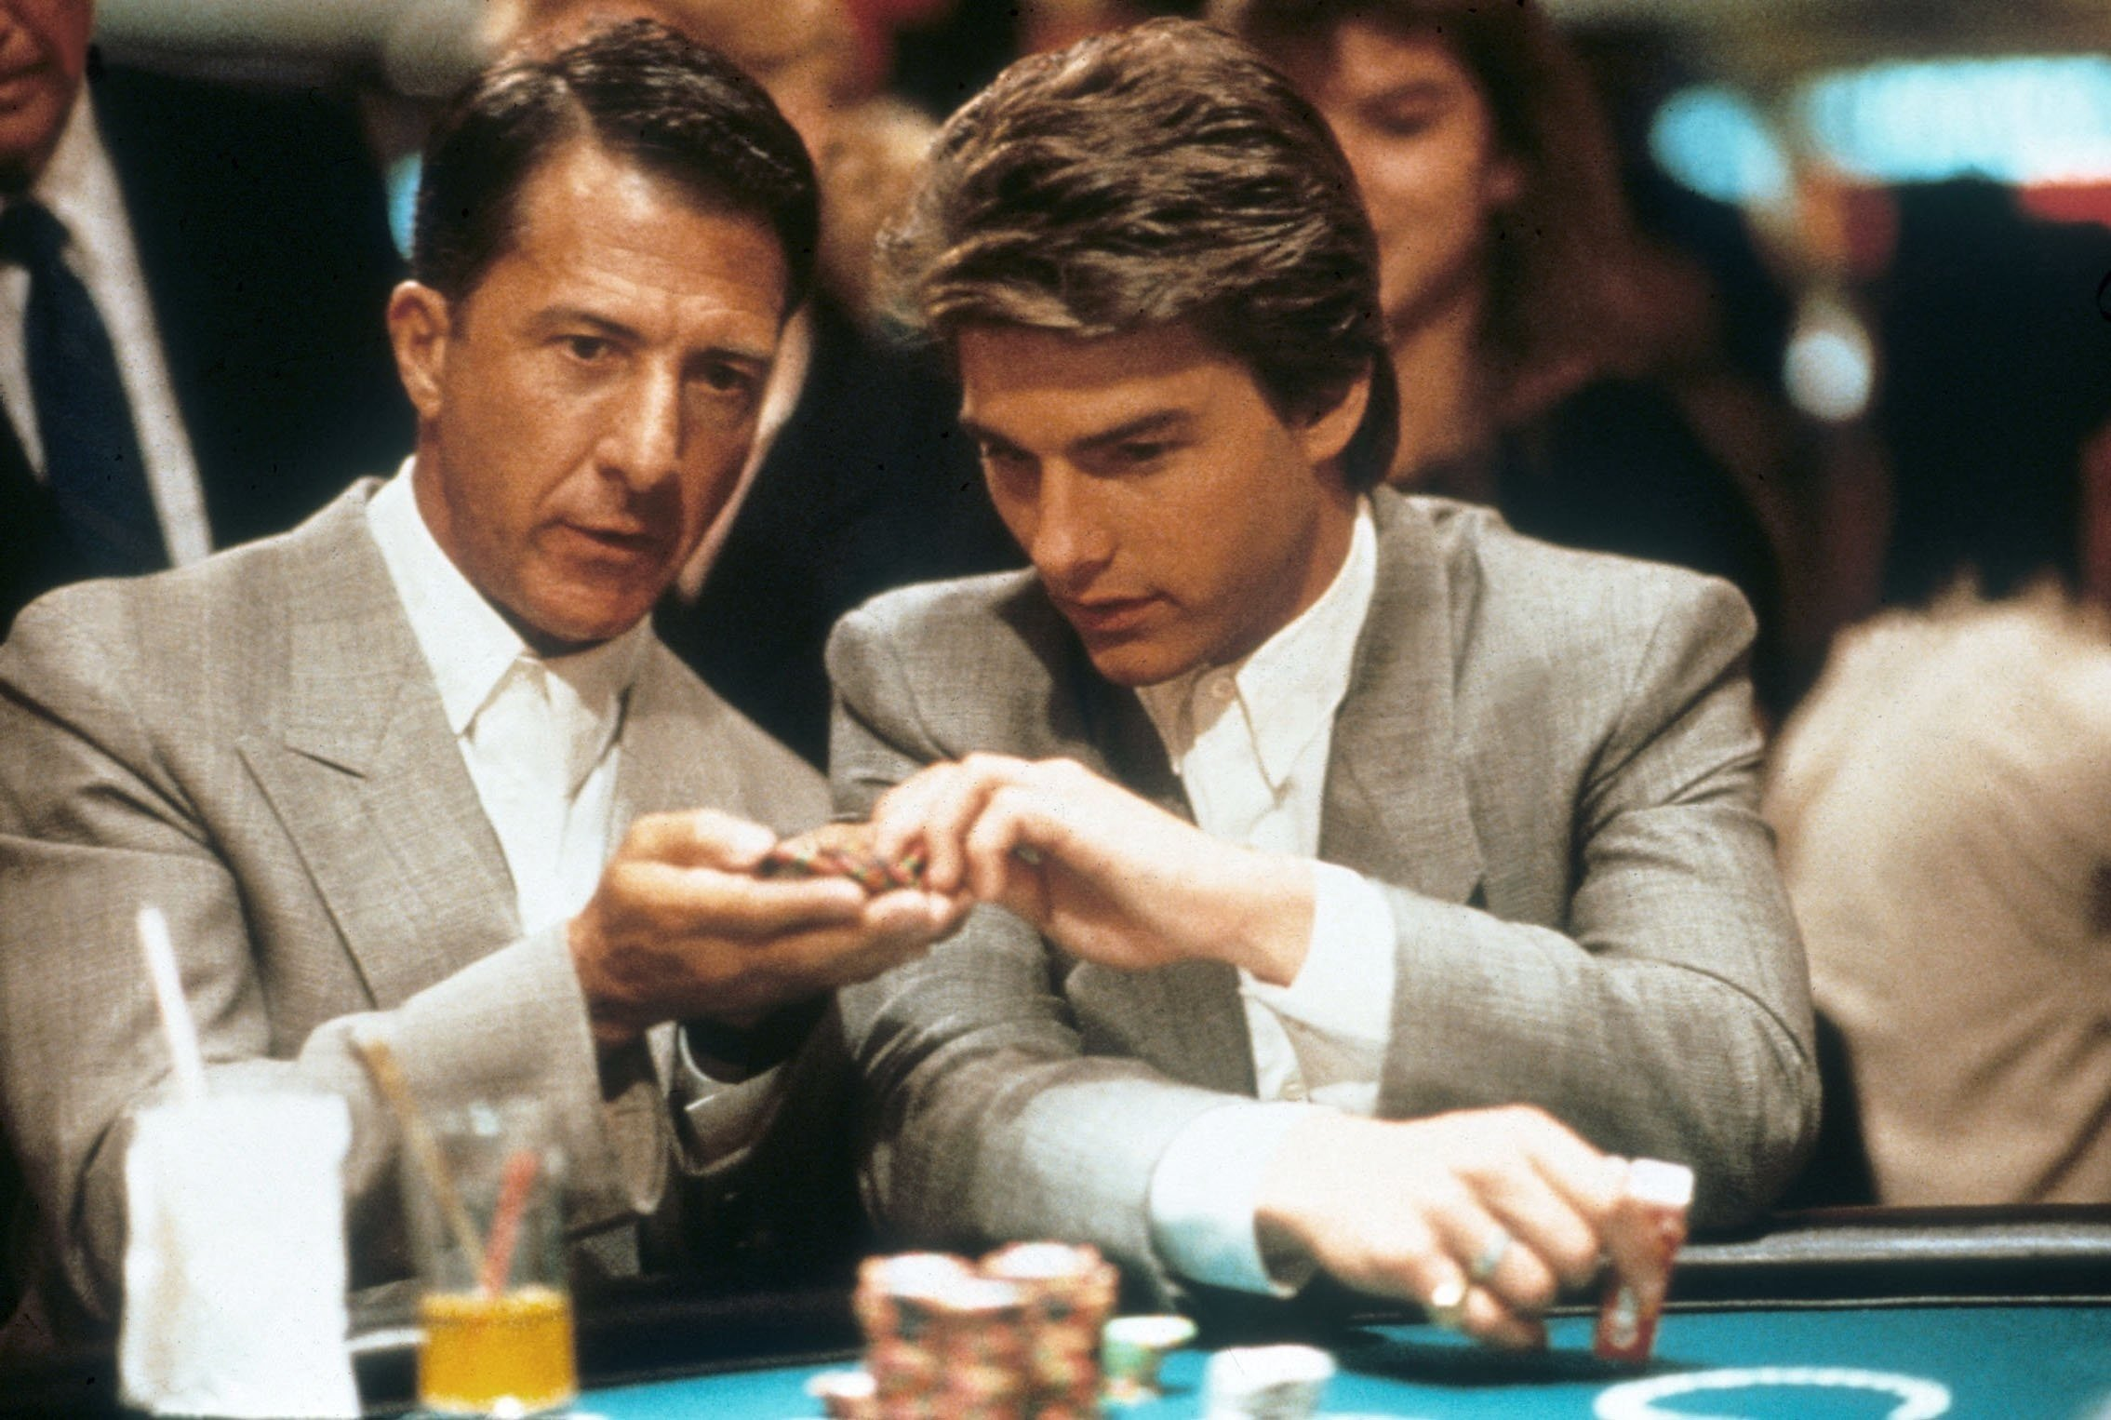
Scoreboard Quiz – 1989 Movies
h
Dustin Hoffman and Tom Cruise starred as brothers; Hoffman had an affliction that made him a blackjack savant.
Viva Las Vegas
Rain Man
Blackjack Brothers
Notes:
Hoffman’s character, Raymond Babbitt, had autism and Savant Syndrome. Won Academy Award for Best Movie. Based on true life story of Kim Peek.

Slide 15
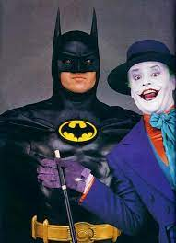
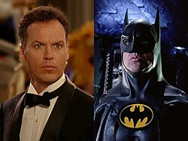
Scoreboard Quiz – 1989 Movies
h
Michael Keaton starred as millionaire Bruce Wayne in this superhero movie set in “Gotham City”. Jack Nicholson played the super-villain.
Superman
Spiderman
Batman

Slide 16
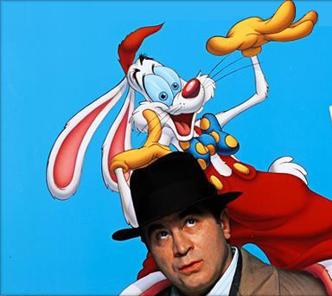
Scoreboard Quiz – 1989 Movies
h
Bob Hoskins stars as a detective that must exonerate a cartoon character accused of murder. This Disney movie was part animation and part live-action.
Free Daffy Duck
Who Framed Roger Rabbit?
Bugs Bunny Arrested

Slide 17
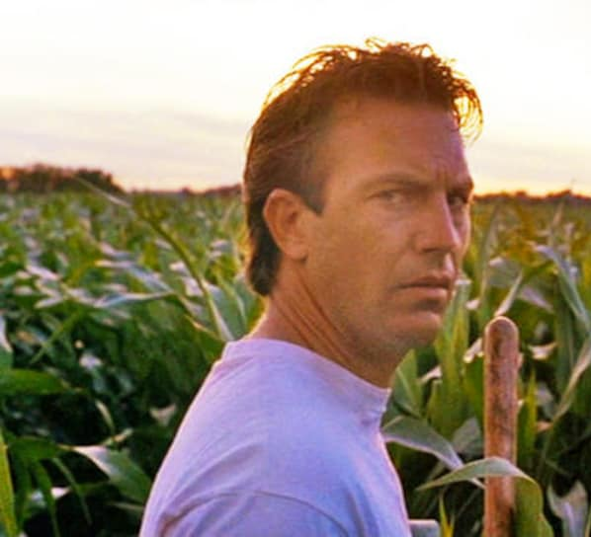
Scoreboard Quiz – 1989 Movies
h
Kevin Costner starred as an Iowa farmer who builds a baseball diamond in part of his corn field.
Bull Durham
For the Love of the Game
Field of Dreams

Slide 18
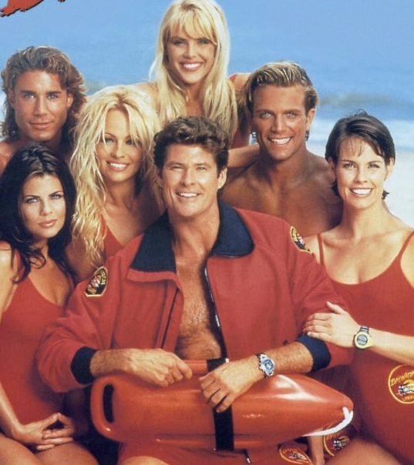
Scoreboard Quiz – 1989 TV Premiers
h
This TV show about a group of lifeguards starred Pamela Anderson, Carmen Electra and David Hasselhoff, among others.
Baywatch
Hawaii Five - O
CHIPS

Slide 19
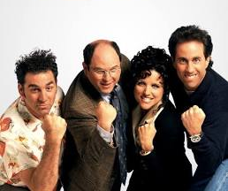
Scoreboard Quiz – 1989 TV Premiers
h
This situation comedy featured Kramer, George, Elaine and Jerry in the “little show about nothing”.
Friends
Cheers
Seinfeld

Slide 20

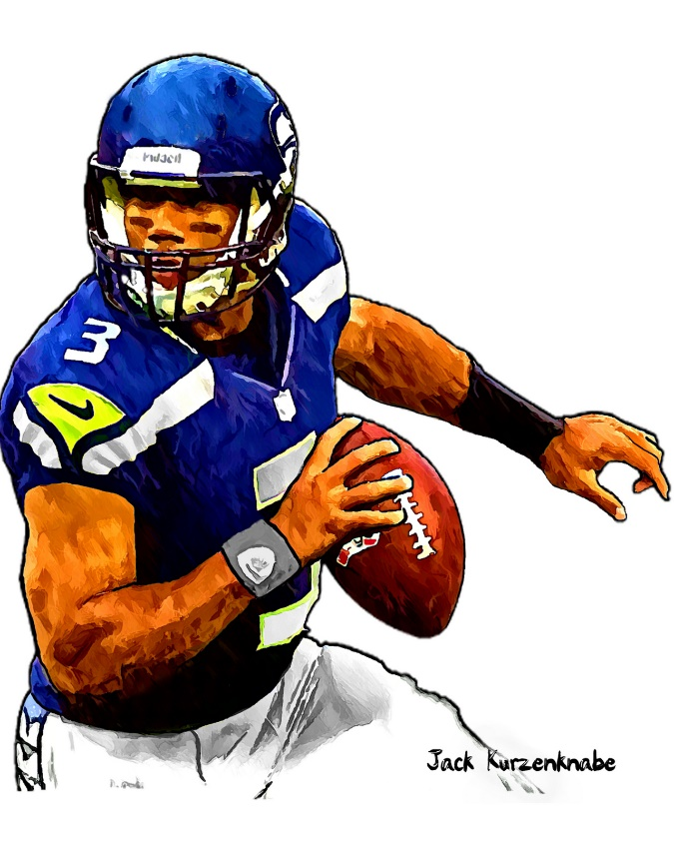

1989 Sporting News

Slide 21

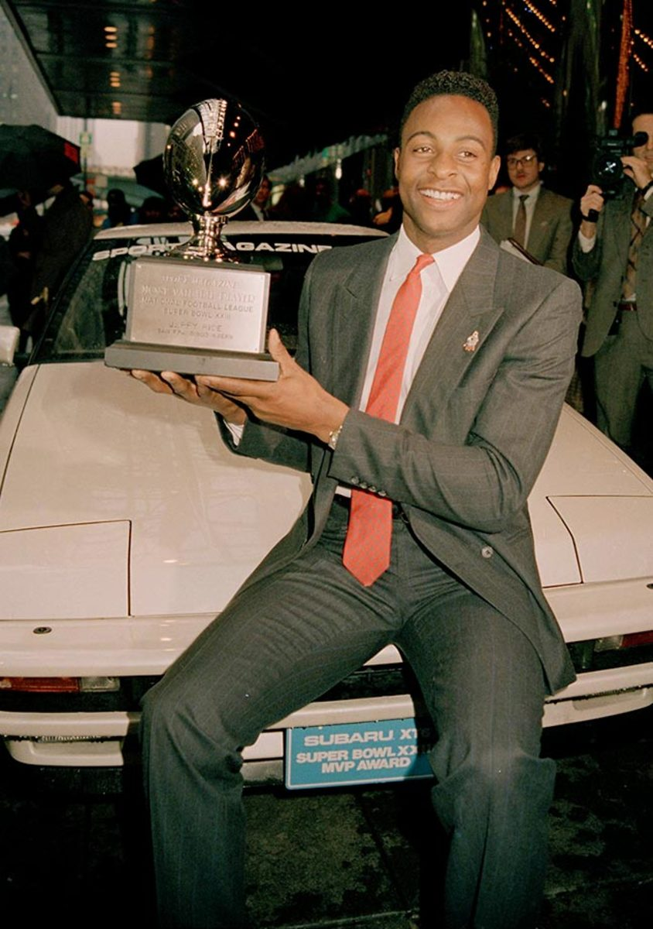
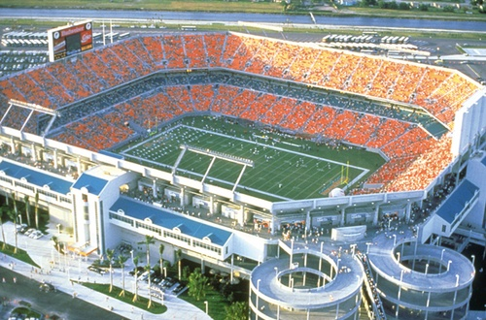

Super Bowl XXIII
20
to
16
Joe Robbie Stadium - Miami
https://www.youtube.com/watch?v=-TXY7VMKcoU
49ers receiver Jerry Rice was MVP
Notes:
Down 16–13, San Francisco got the ball on their own 8-yard line with 3:10 on the clock and marched 92 yards down the field in under three minutes. They then scored the winning touchdown on a Joe Montana pass to John Taylor with just 34 seconds left in the game.

Slide 22
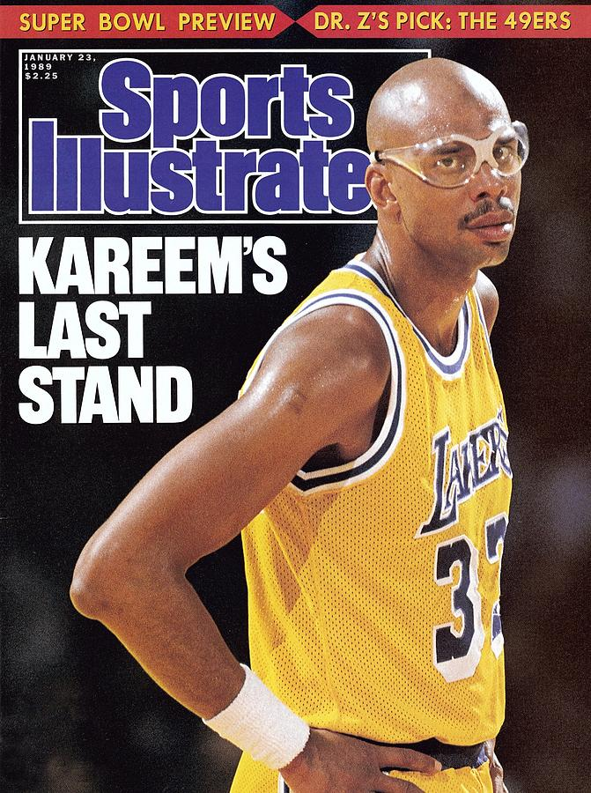
Kareem Abdul-Jabbar
retired at the end of the
1988-89 NBA season
He was 42 years old
At that time, he was the NBA record-holder for:
TOTAL POINTS - 38,387
GAMES PLAYED – 1,560 among others
He is considered the best-ever at Center and one of the
ALL TIME GREATS

Slide 23
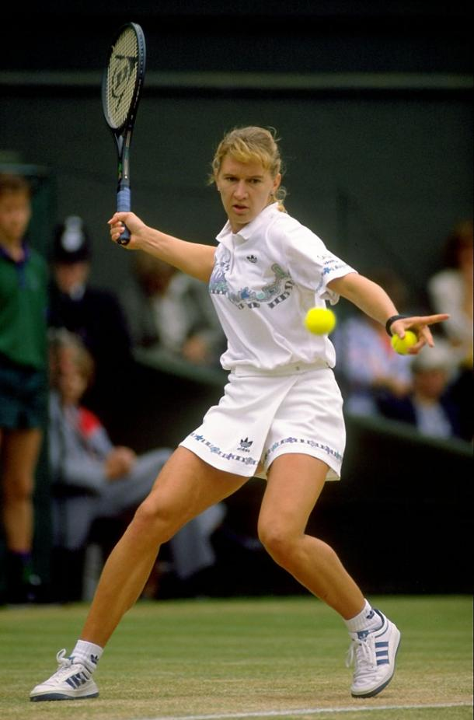
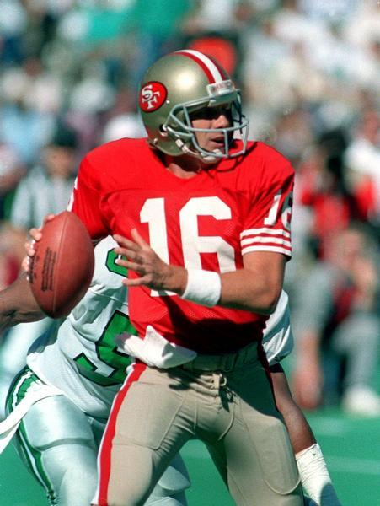
AP
Athletes of the Year
Steffi Graf
Joe Montana

Slide 24
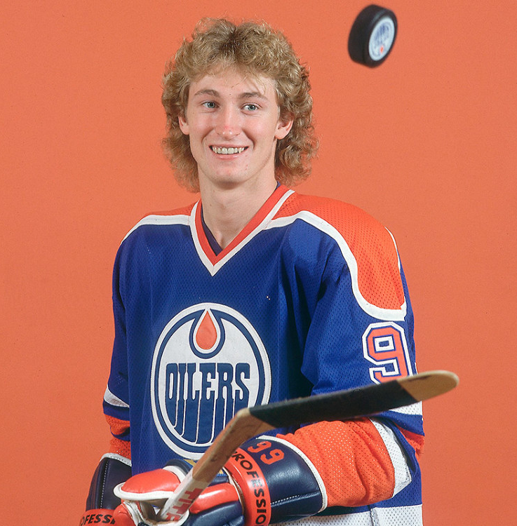
AP
Athlete of the Decade
“The Great One”
Wayne Gretzky

Slide 25
The Year in Baseball: 1989

Slide 26
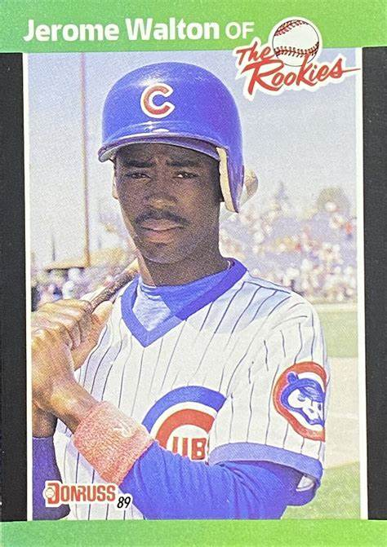
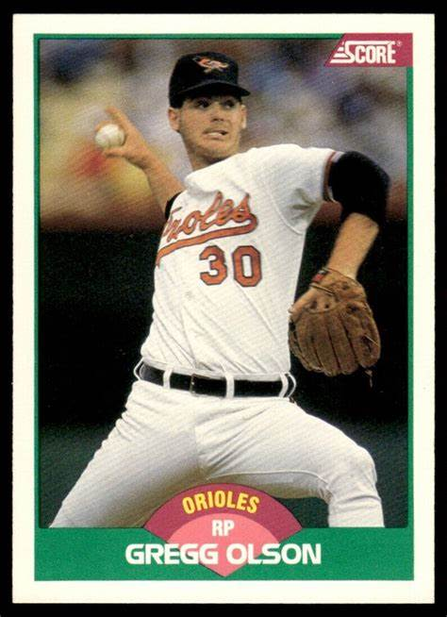
1989
Rookies
of the
Year
.293 64 R 24 SB
1.69 ERA 27 Saves
Notes:
Mickey Mantle hit 37 homers to lead the AL. He also led the league in triples, walks, and SLG.

Slide 27
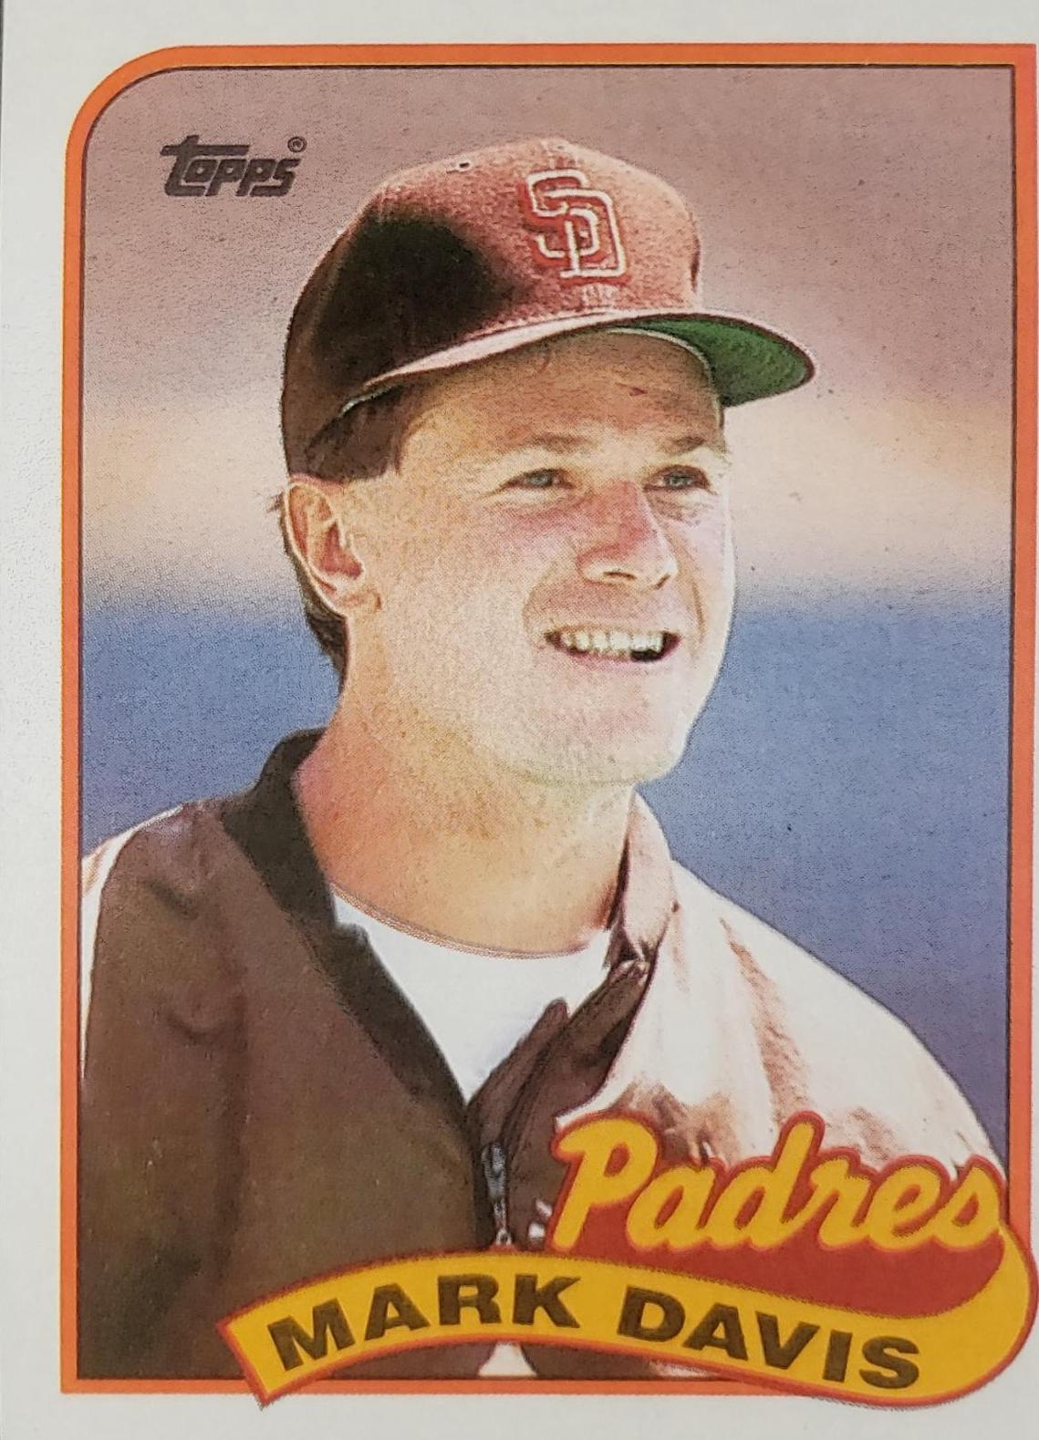
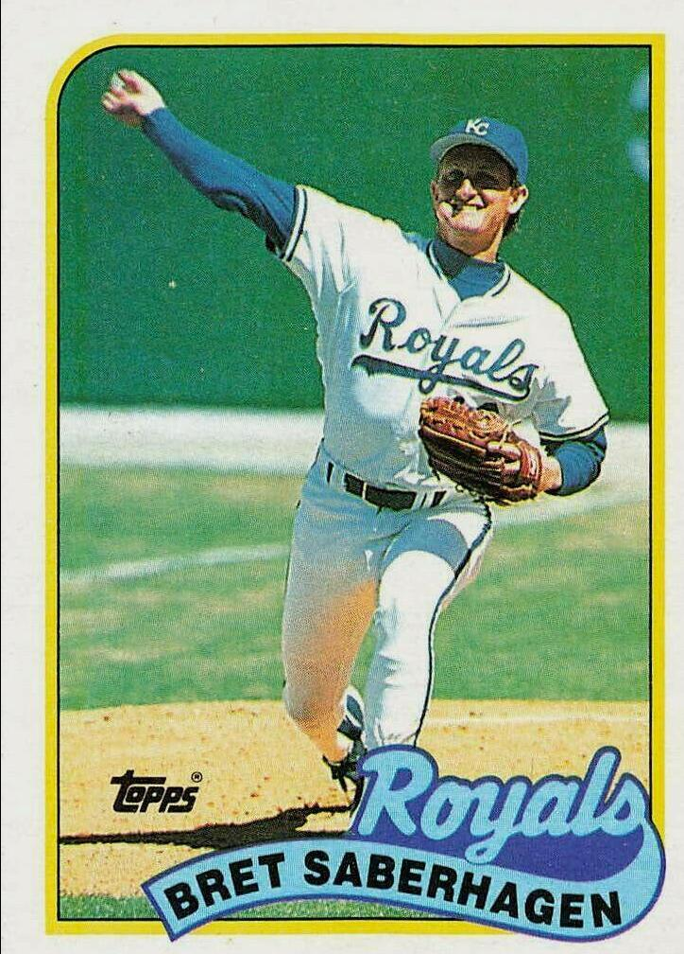
1989
Cy Young
Winners
1.85 ERA 44 Saves
23 – 6 2.16 ERA 262 IP
Notes:
.

Slide 28
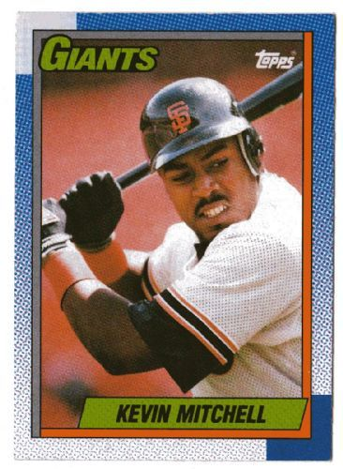
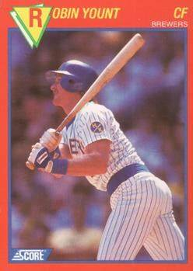
1989 Most Valuable Players
.291 47 HR 125 RBI
21 HR 103 RBI .318
Notes:
Yount’s 2nd MVP – started career as a SS and eventually moved to outfield
Mickey Mantle hit 37 homers to lead the AL. He also led the league in triples, walks, and SLG.

Slide 29
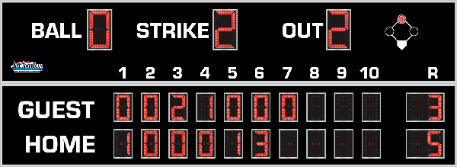
7th Inning Stretch

Slide 30
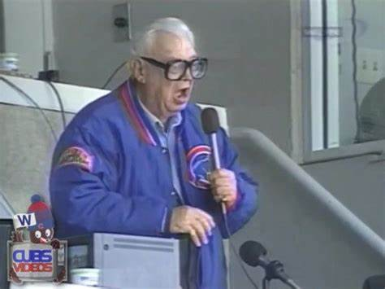
“Take Me Out to the Ballgame”

Slide 31
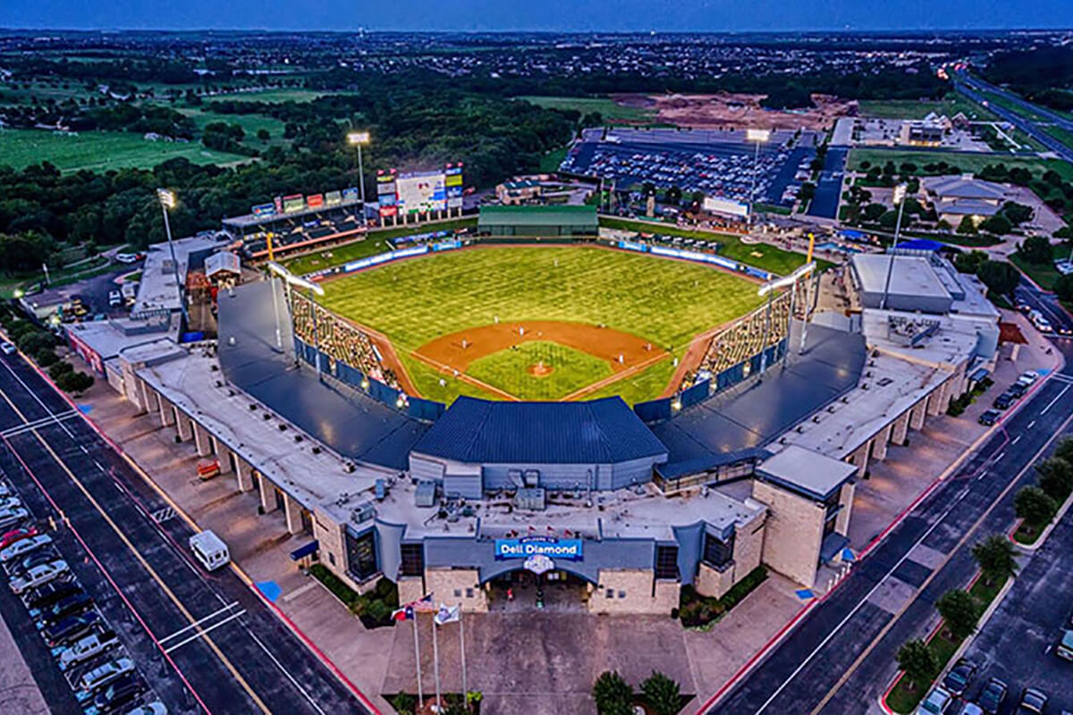
“Deep in the Heart of Texas
https://www.youtube.com/watch?v=rcrK0U7RDIk

Slide 32
“Do the Hokey Pokey”
https://www.youtube.com/watch?v=vpharBeg9XA

Slide 33




1989 LCS
Best 4 of 7 format
Giants
won 4-1
A’s
won 4-1

Slide 34

1989 World Series
vs.
Battle of the Bay

Slide 35
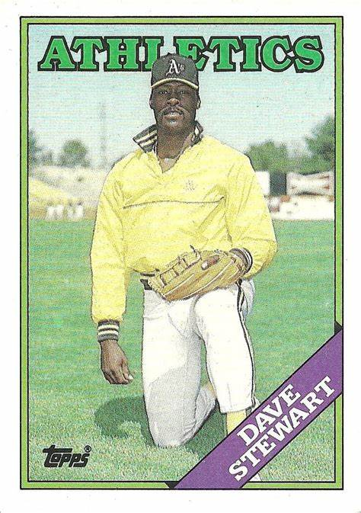
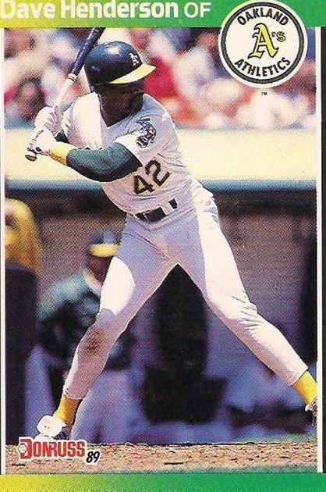
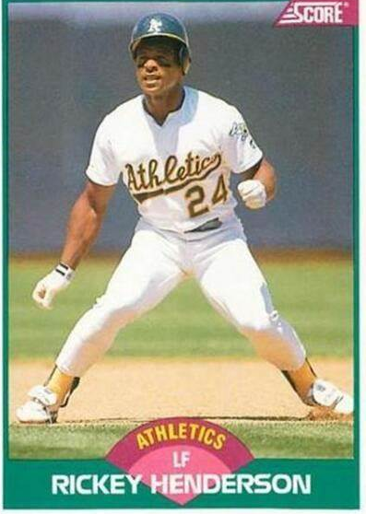
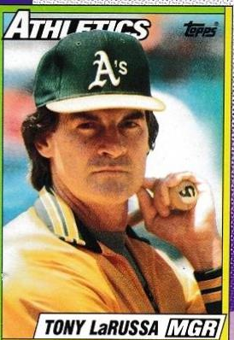
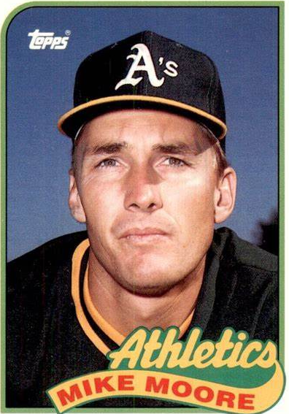
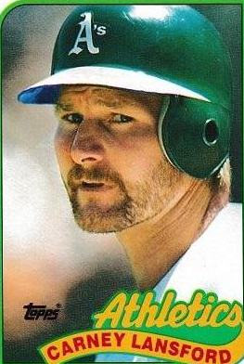
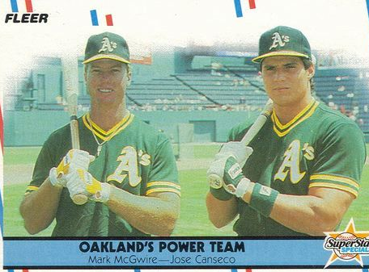
1989
Athletics

Slide 36
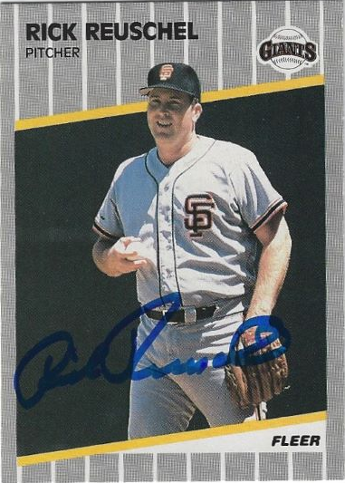
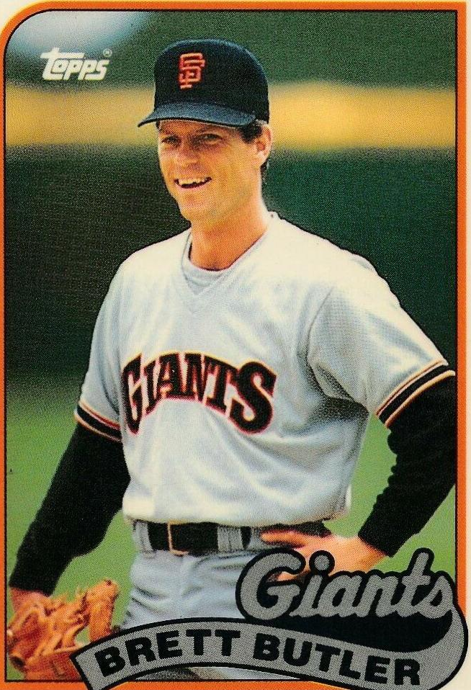
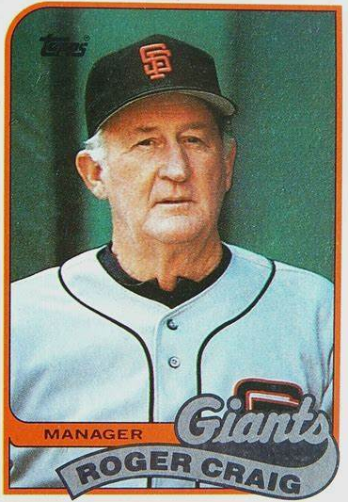
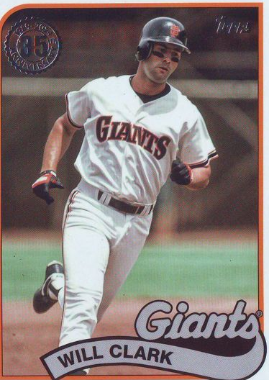
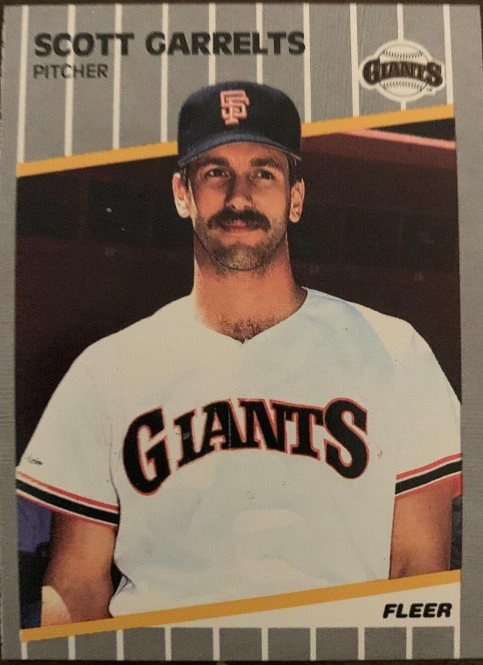
1989
Giants

Slide 37
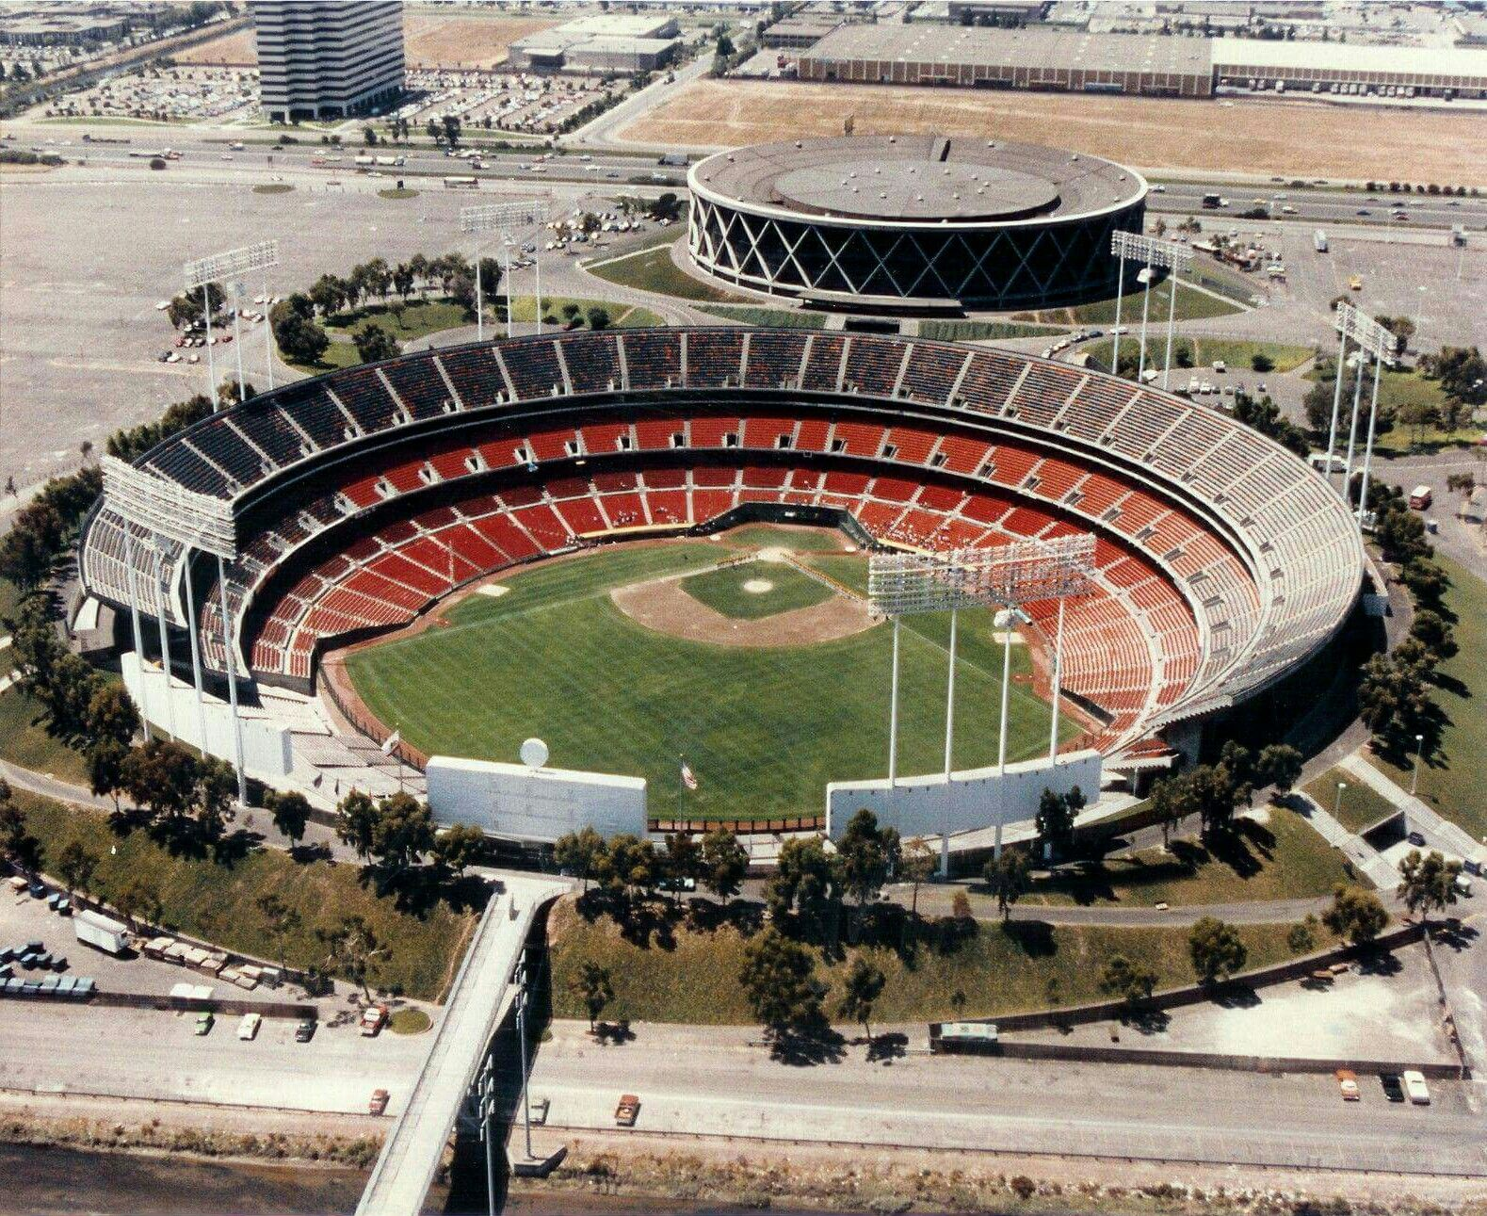
1989 World Series Highlights
Game 1 – October 14
The A’s scored early and were up by five runs by the end of the 4th inning. Starter Dave Stewart cruised to a complete game shutout.
A’s 5 – Giants 0
Game 2 – October 15
The A’s scored 4 in the 4th inning to take command of the game. A 3-run homer by C Terry Steinbach sealed the victory.
A’s 5 – Giants 1
ATHLETICS LEAD 2-0
AS THE SERIES MAKES A
SHORT HOP ACROSS THE
BAY TO SAN FRANCISCO
Oakland-Alameda Coliseum

Slide 38
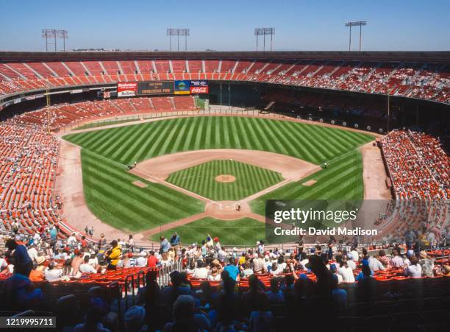
Game 3 – October 17
Disaster hit :
https://www.youtube.com/watch?v=YUKNvoAAa8s&list=PLKG46EhQsrxCIH1UUnvJ5HHMNcdUzkI9o&index=3
Game 3 – resumes October 27
Powered by homers from Henderson (2), Canseco, Phillips and Lansford, the A’s led throughout. Dave Stewart got his 2nd win.
A’s 13 – GIANTS 7
Game 4 – October 28
A’s CF Rickey Henderson led off with a homer and Oakland continued to score early and often. They were up 8-0 by the time the Giants bats warmed up. A’s P Mike Moore won his second game of the Series.
A’s 9 – GIANTS 6
Candlestick Park – S.F.
Notes:
Run video zero – 1:15; then pick up at 2:00 then fast-forward to 3:00

Slide 39
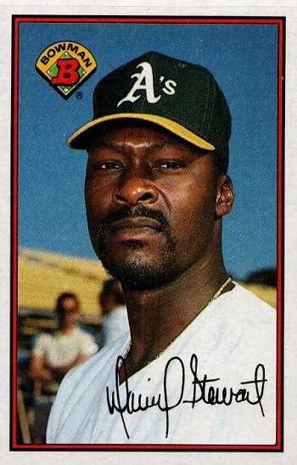
Oakland Athletics
win
1989 World Series
A’s ace pitcher
Dave Stewart was the Series MVP
He was 2-0 in Series (and 2-0 in NLCS)

Slide 40
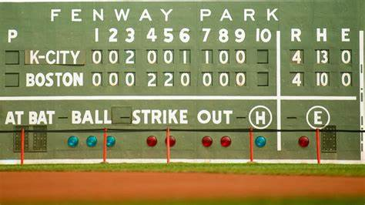
Extra Innings!

Slide 41

Popular TV Shows of the 1980s

Slide 42
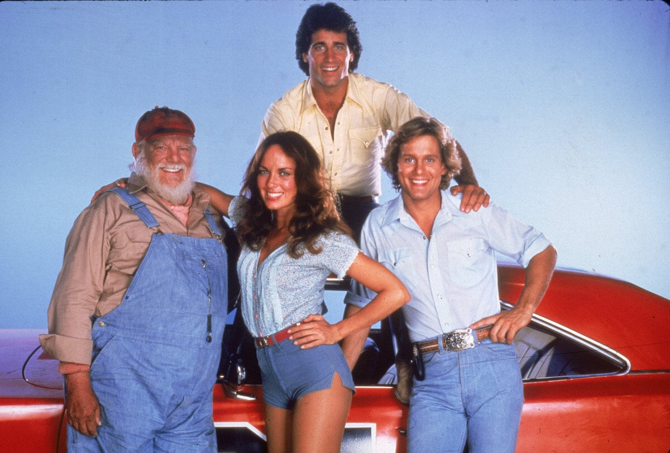
This popular action comedy centered around the Duke family (Uncle Jesse, Bo, Luke, and
Daisy).
Other characters were
“Boss Hogg”,
“Sheriff Roscoe P. Coltrane”, “Cooter”, and “Cletus”.
Their car was a 1969 Dodge Charger called the “General Lee”.
Dukes of Hazzard
https://www.youtube.com/watch?v=67gig0f4HLo
Notes:
Waylon Jennings sang the intro. They lived outside of Hazzard, Georgia. Ran for 147 episodes over 7 seasons; highly rated, some years second only to Dallas in viewership.

Slide 43
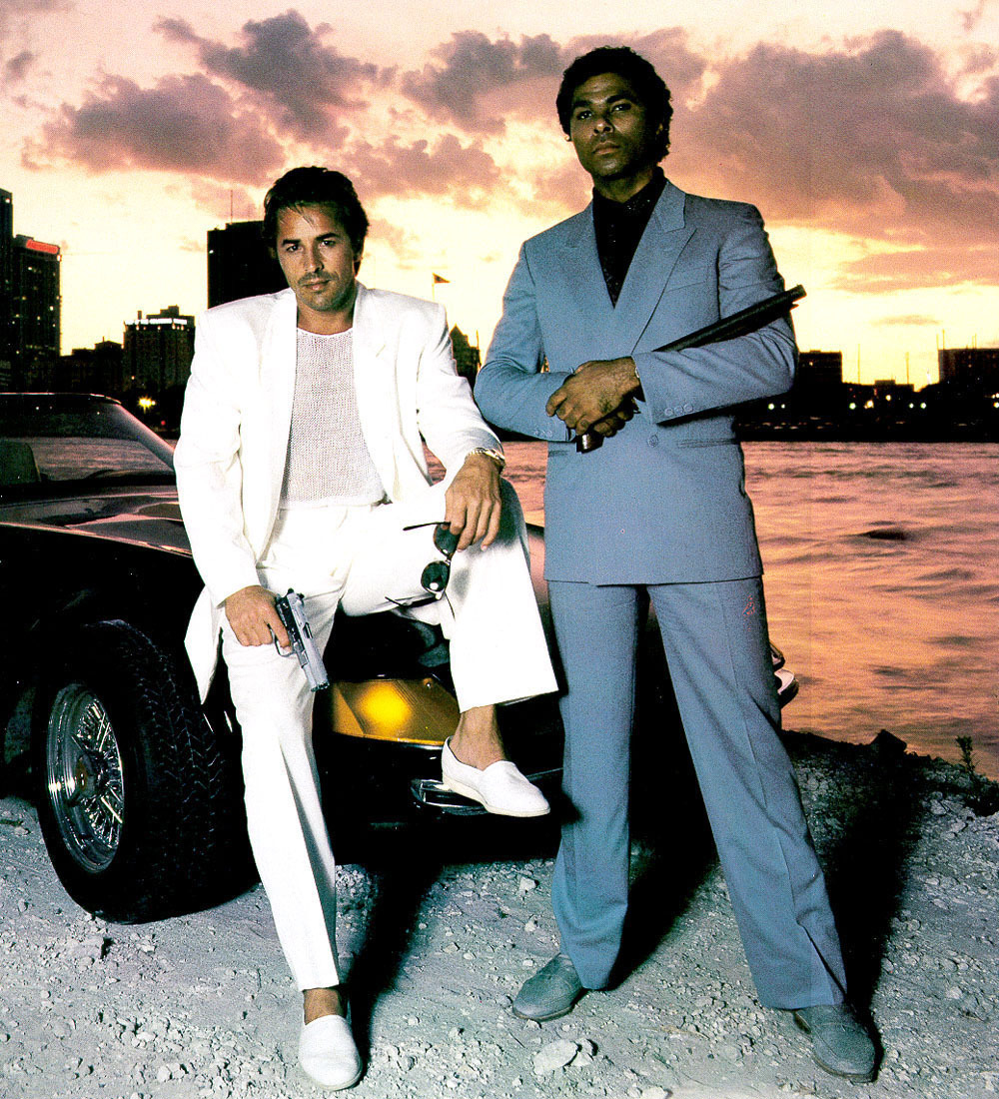
This action crime story centered around two Dade County detectives played by Don Johnson and Philip Michael Thomas.
The show was originally slated to be named “Gold Coast”, but was renamed after the pilot to:
Miami Vice
https://www.youtube.com/watch?v=2qZOmcMwpgM
Notes:
Visuals, clothing and music followed the hip “New Age” genre. Rock bands from the ‘80s wanted to have their music played on the show.

Slide 44

This gritty cops-and-robbers series was set in a police station in a large unnamed American city.
Actor Daniel J. Travanti played the precinct’s Captain Furillo. His love interest, played by actress Veronica Hamill, often calls him “Pizza Man”.
Desk Sergeant Esterhaus opened the show with a roll call and finished his briefing with a famous phrase …
https://www.youtube.com/watch?v=G6hzHEdDJ2o
Hill Street Blues

Slide 45


This crime drama was set in Hawaii and starred popular actor Tom Selleck. He portrayed a private investigator, who lives a plush life-style on the estate of a wealthy benefactor.
Selleck’s character often wears a baseball cap from his favorite major league team …
Magnum P.I.

Slide 46

Actresses Sharon Gless and Tyne Daly starred in this police drama as New York City police detectives.
Beginning with the show’s second season in 1983, and for the next six seasons, one or the other of these two actresses won the Emmy Award for
Best Lead Actress in a Drama !
Cagney & Lacey

Slide 47

This sitcom starred Bea Arthur, Betty White, Rue McClanahan, and Estelle Getty. The plot centered around the four older single women that shared a house in Miami.
The series won numerous awards as an outstanding comedy.
All four of the actresses won at least one Emmy Award.
Golden Girls

Slide 48

This farcical sitcom starred John Ritter, Suzanne Somers, and Joyce DeWitt as unlikely roommates.
The landlord had a rule against unmarried singles living together, but relented when the women convinced him that the John Ritter character was gay.
The series ranked in the Top 10 of TV shows for 6 of its 8 seasons.
Three’s Company

Slide 49

Thanks!!
We’ll see you again next month!
https://www.youtube.com/watch?v=_IJkbs1D5PU

