Slide 1



AGE Thrive with Baseball Memories
July 16, 2025
Agenda
Warm-up - Introductions
Current Events
Gametime – The Year in Baseball – 1991
Seventh Inning Stretch - “Take Me Out to the Ball Game”
Get Up and Move, Sing, Dance!
Extra Innings – More stuff from the past

Slide 2


Slide 3



Baseball Season is Underway!
Notes:
Mention current won-loss for each team;

Slide 4
50 years ago this movie was a huge
Summer Blockbuster
(and scary!)
https://www.youtube.com/watch?v=BX3bN5YeiQs&list=RDBX3bN5YeiQs&start_radio=1
Notes:
Play intro/trailer music from start to about 0:58. What instrument is playing that tune – a TUBA !

Slide 5

History from 1991

Slide 6
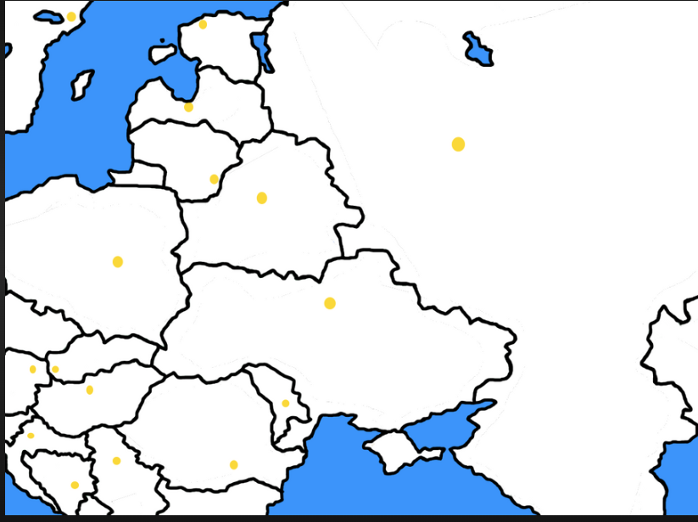
Soviet Republics Declare Independence
ESTONIA
The 3 Baltic States
on September 2
Ukraine on December 1
LATVIA
LITHUANIA
UKRAINE
Notes:
.

Slide 7

Soviet Union ceases to exist
ESTONIA
LATVIA
Moscow
LITHUANIA
RUSSIAN FEDERATION
UKRAINE
Notes:
On Christmas Day, 1991 the Soviet flag was hauled down at the Kremlin and the new/old Russian Flag hoisted up.

Slide 8
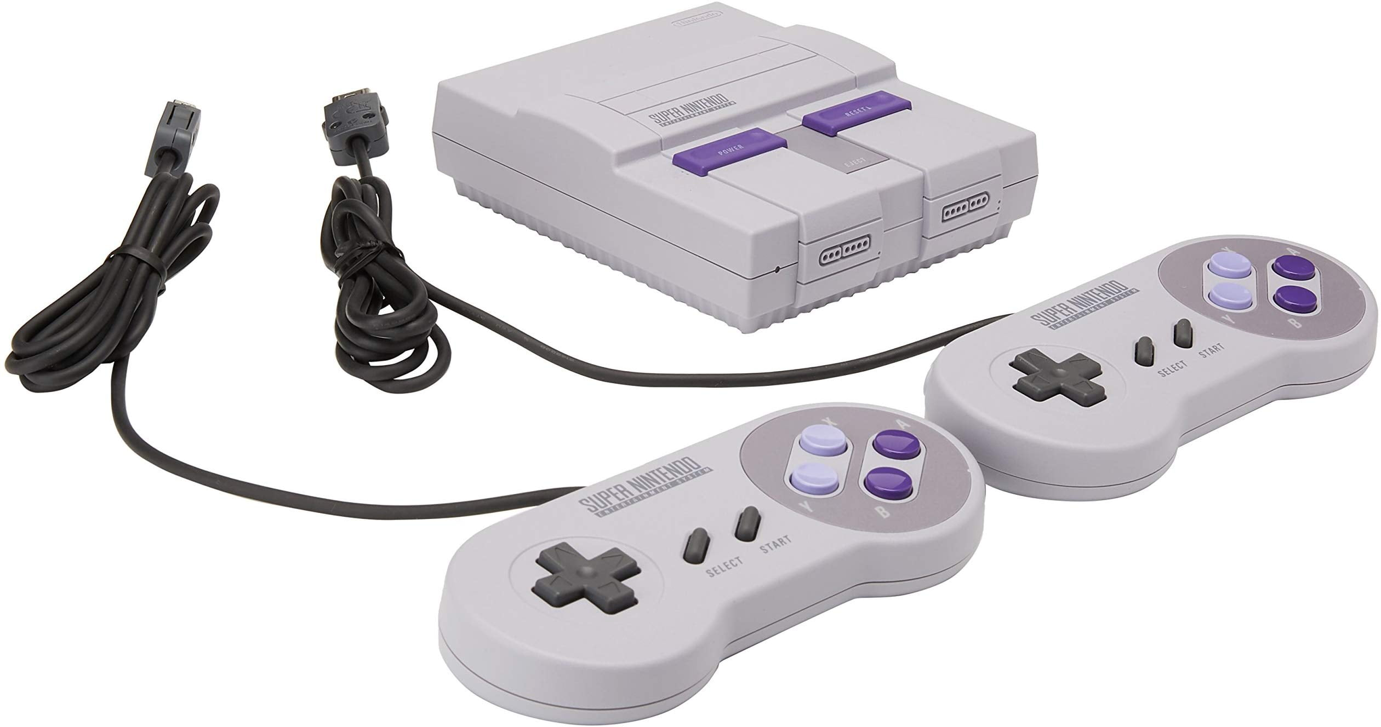
Super Nintendo released
Retailed for $199.95 in 1991, 50 million sold
Super Mario Brothers could be included
Notes:
recently - a new Nintendo game console - SWITCH2 was just released – has sold 5M units so far this year --- 1.5M so far in July!

Slide 9
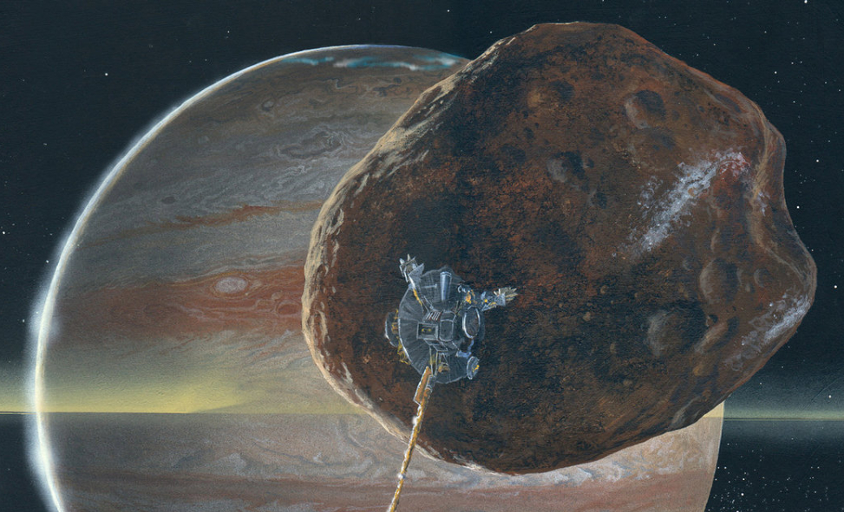
Galileo probe visits asteroid
passed within 1,000 miles of Gaspra
Notes:
It took a year for NASA/JPL to actually view the pictures because the main antenna array failed to open, so the had to wait until Galileo returned closer to Earth and used a secondary antenna

Slide 10
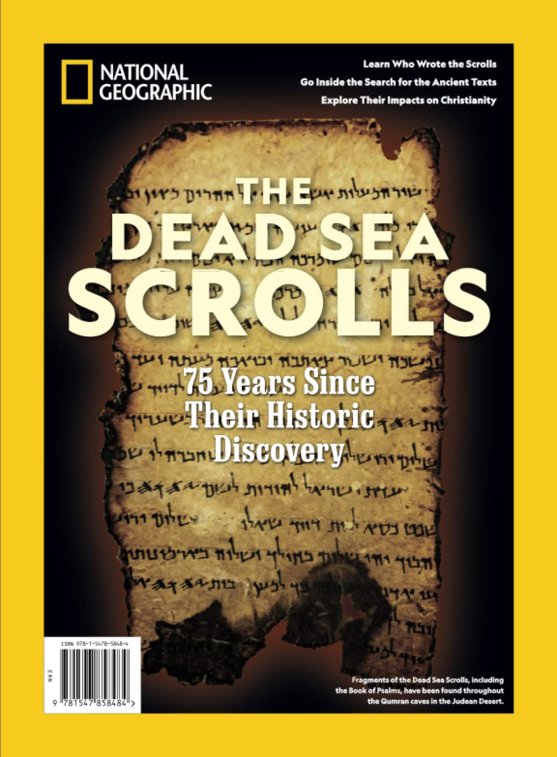
Dead Sea Scrolls
go public
These were photographic copies of the originals kept in Israel

Slide 11
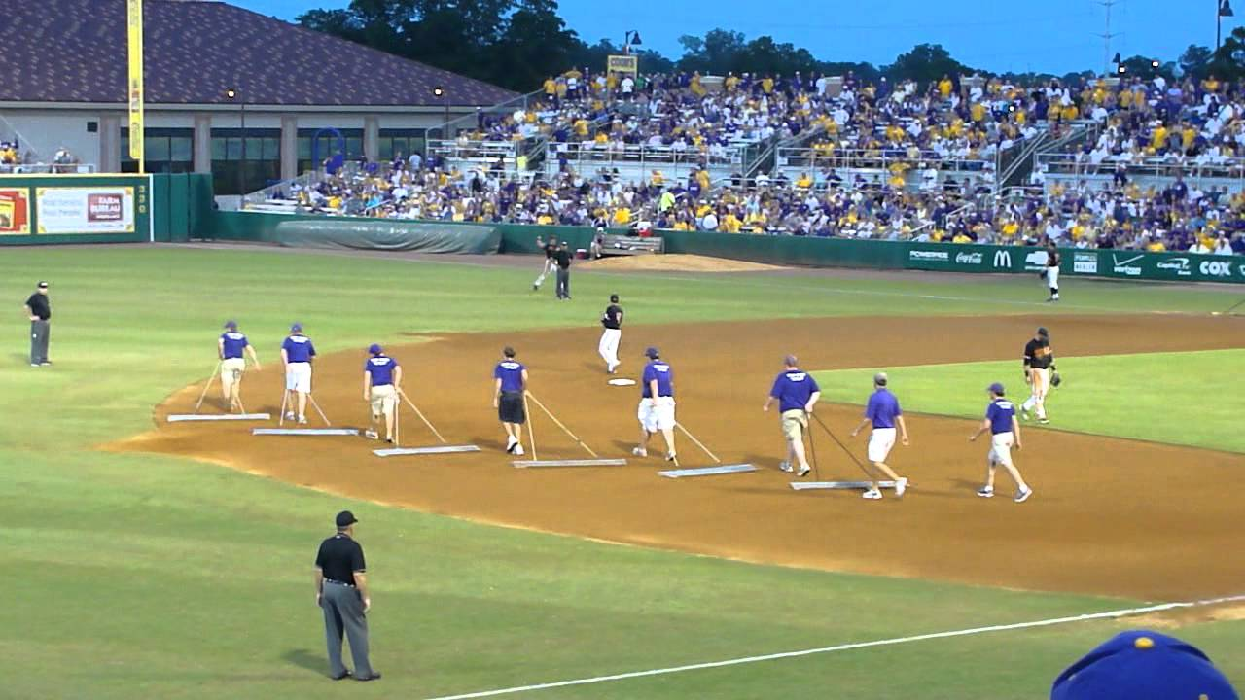
In Between Innings

Slide 12
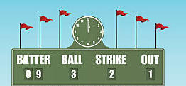
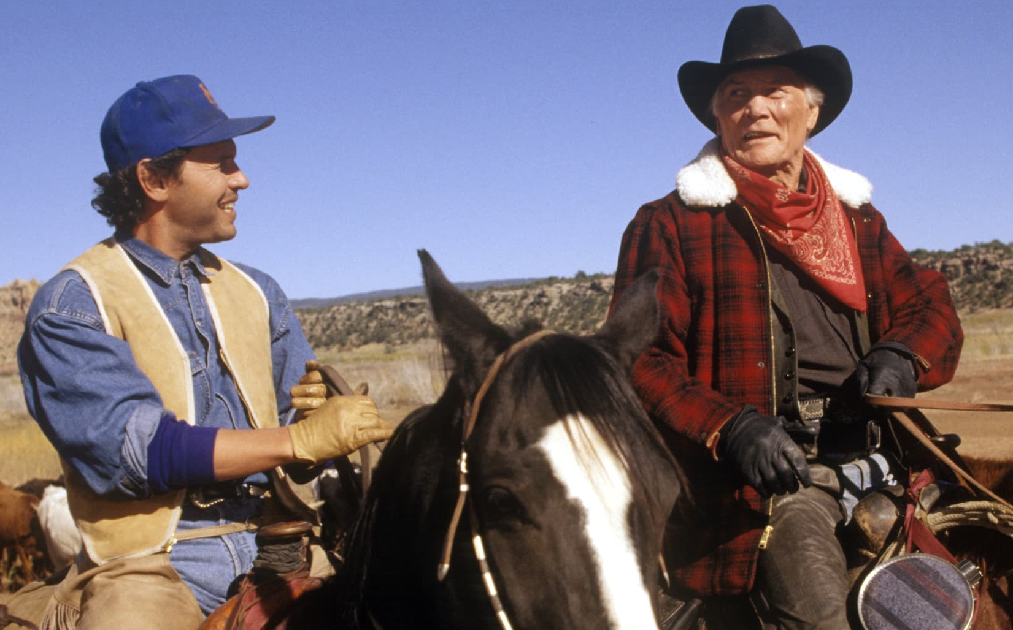
Scoreboard Quiz – 1991 Movies
h
This Western comedy about some New Yorkers on a cattle drive starred baseball fan Billy Crystal and tough-guy Jack Palance.
City Slickers
Dances with Wolves
Cowboy Dudes
Notes:
Jack Palance won an Academy Award for Best Supporting Actor for this role.

Slide 13
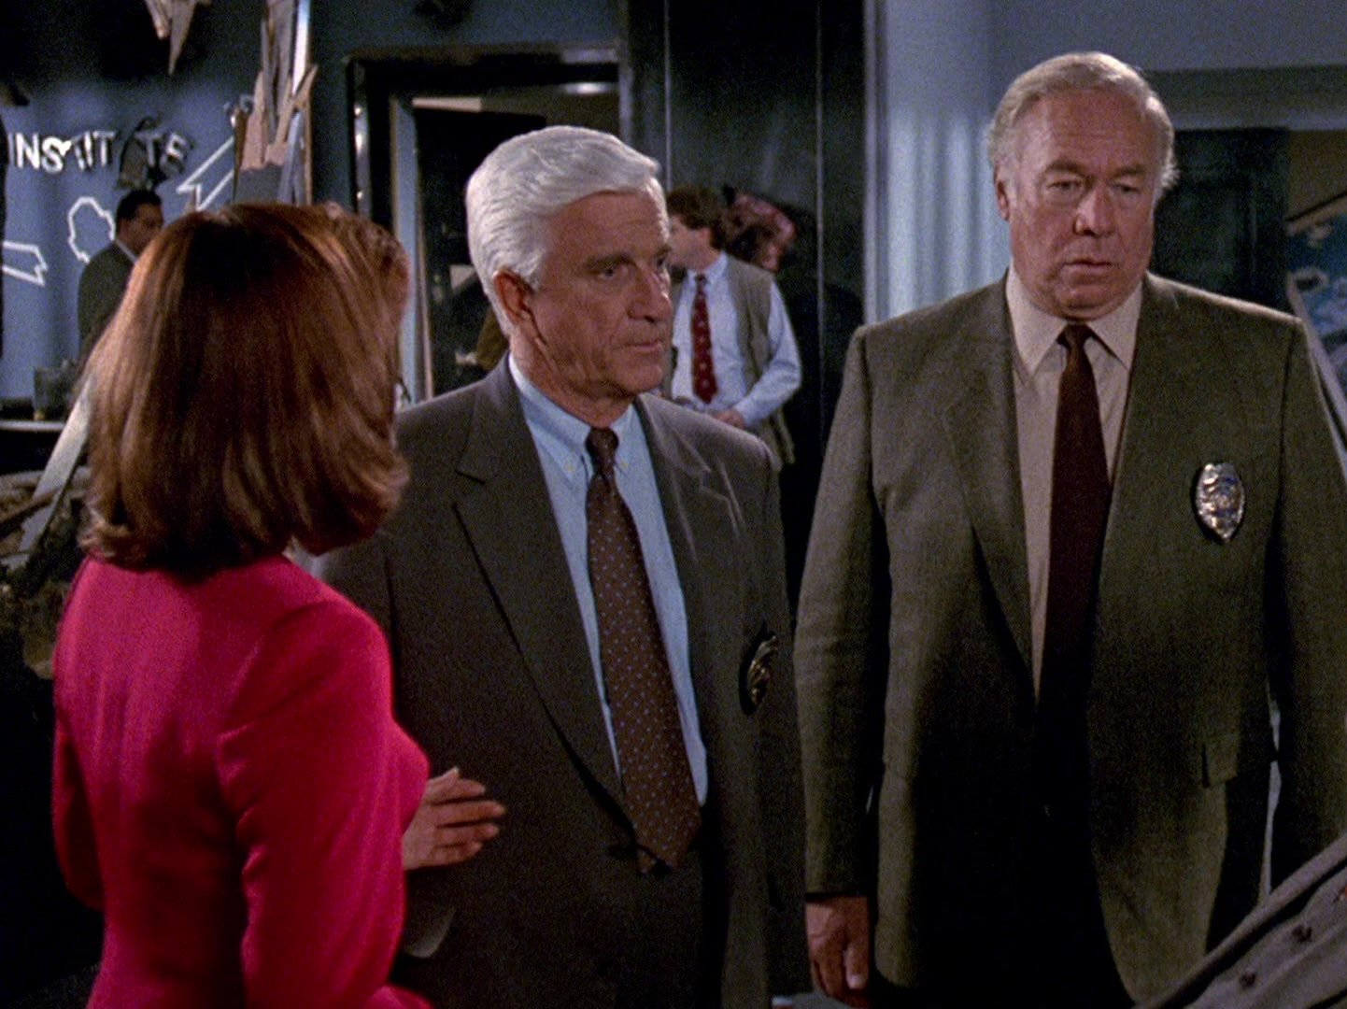
Scoreboard Quiz – 1991 Movies
h
This detective comedy starred Leslie Nielsen at the bumbling Lt. Frank Drebin. Priscilla Presley and George Kennedy also starred.
Dragnet
Naked Gun 2 ½
Highway Patrol

Slide 14
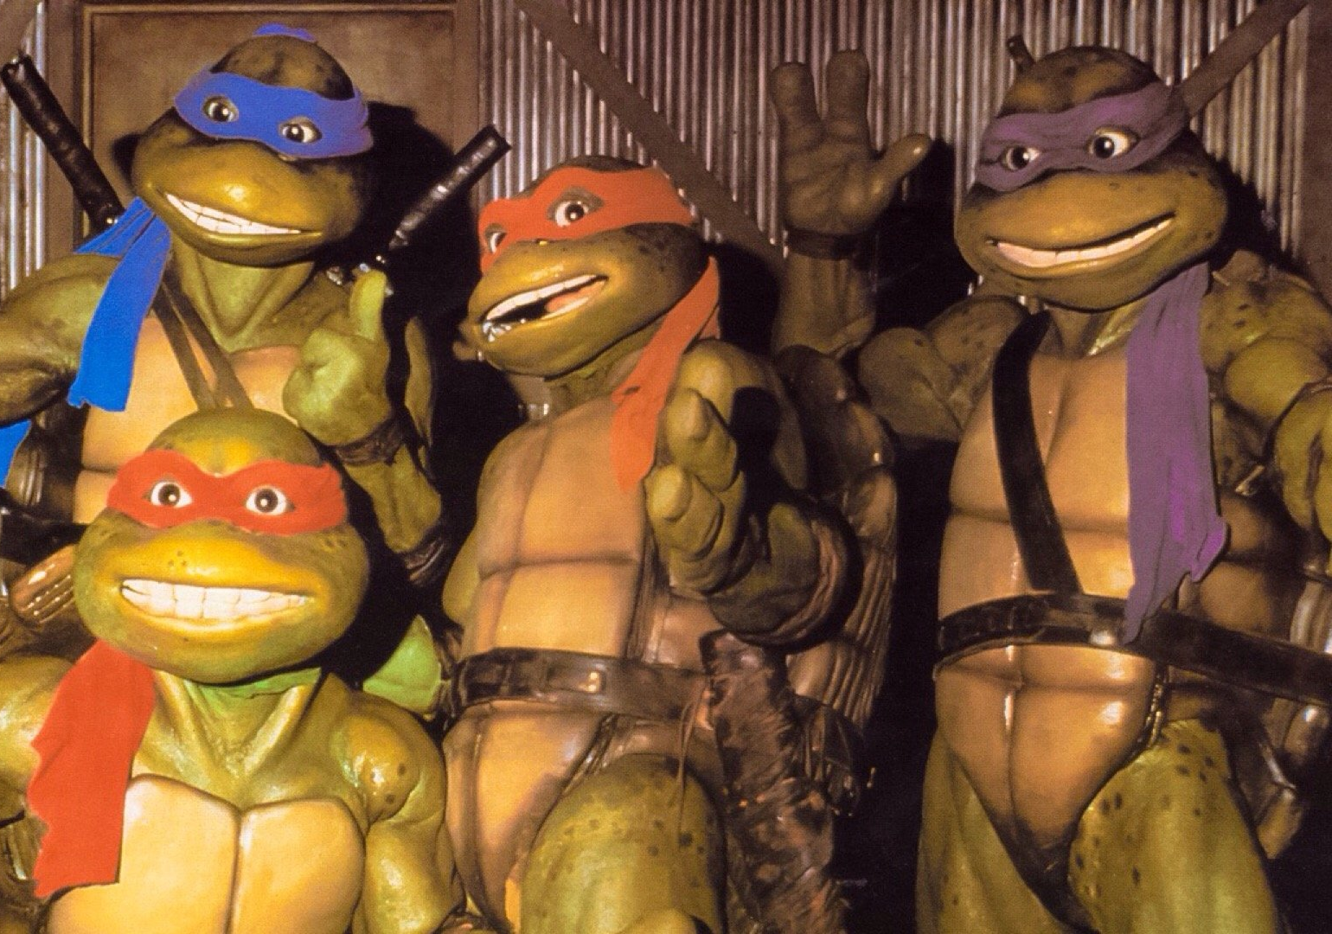
Scoreboard Quiz – 1991 Movies
h
This movie’s superheros were Leonardo, Donatello, Raphael & Michaelangelo.
The Great Artists
Fantastic Four
Teenage Mutant Ninja Turtles II

Slide 15
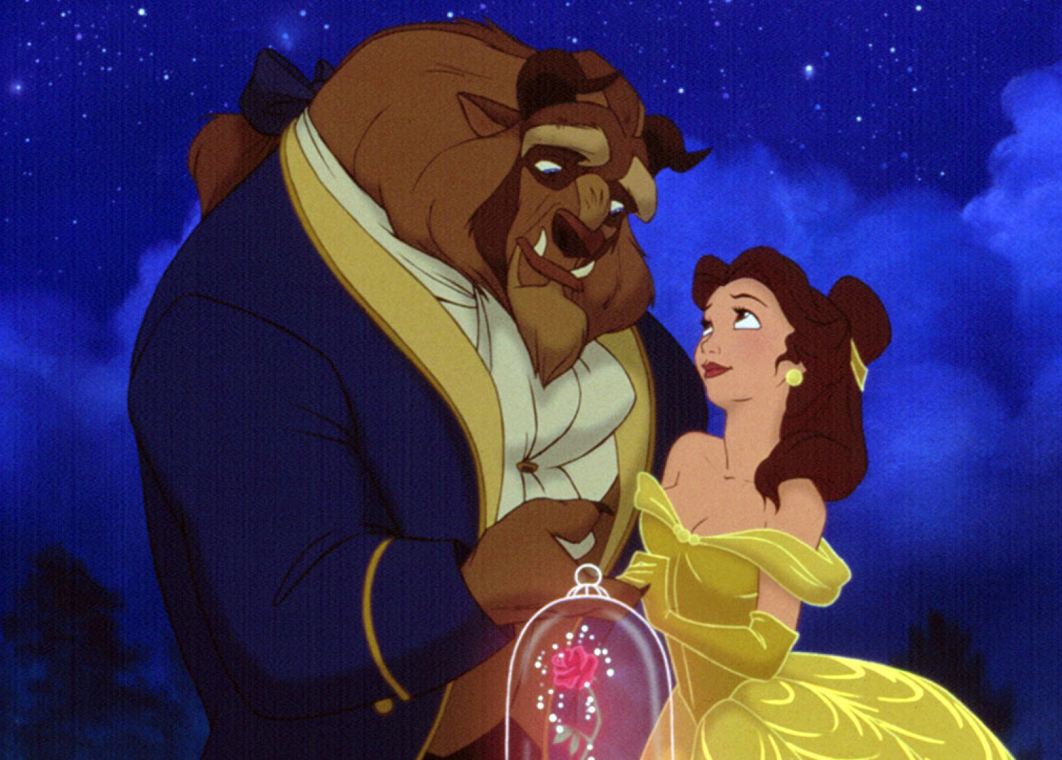
Scoreboard Quiz – 1991 Movies
h
This animated Disney romantic fable was based on a French fairy tale about a prince that was being punished for his past cruelty.
Hunchback of Notre Dame
Beauty and the Beast
Snow White

Slide 16
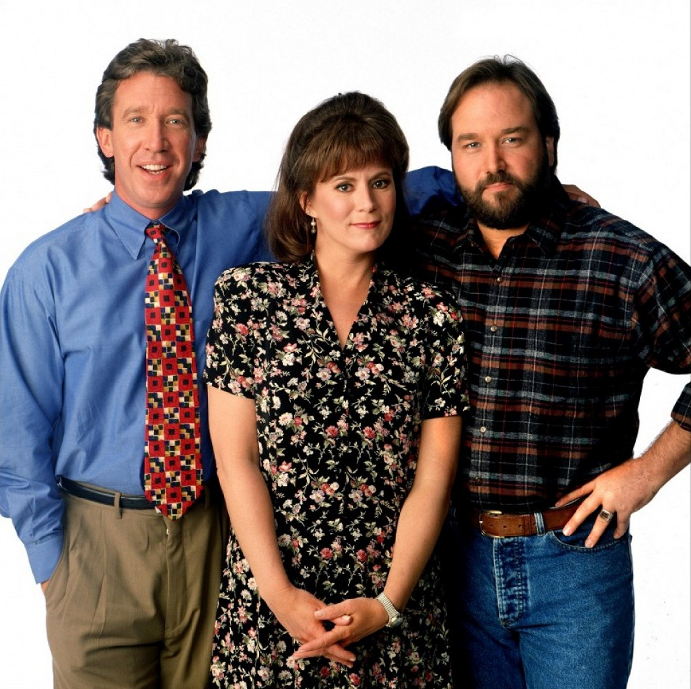
Scoreboard Quiz – 1991 TV Premiers
h
This TV comedy starred Tim Allen who was the host of a TV show called Tool Time. Richard Karn played his good friend “Al”.
Do-It-Yourself
This Old House
Home Improvement
Notes:
This show was a parady of the popular PBS show “The Old House”. It was a top rated comedy for all of the 1990s.

Slide 17
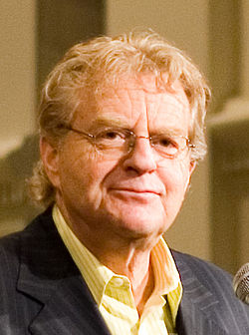
Scoreboard Quiz – 1991 TV Premiers
h
This British-born broadcaster, journalist, author, politician and lawyer hosted a sensationalist “trash TV tabloid talk show” that bore his name.
Jerry Springer
Dr. Phil
Steve Bannon

Slide 18

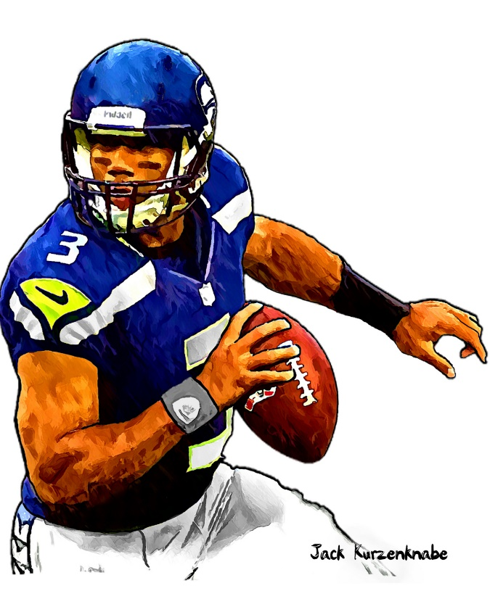

1991 Sporting News

Slide 19
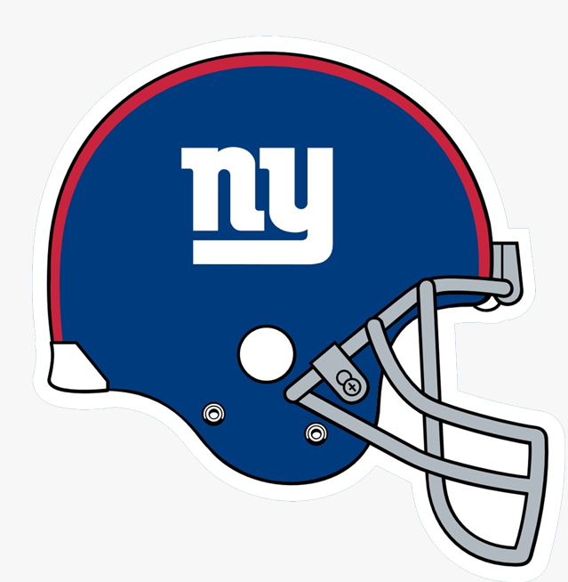
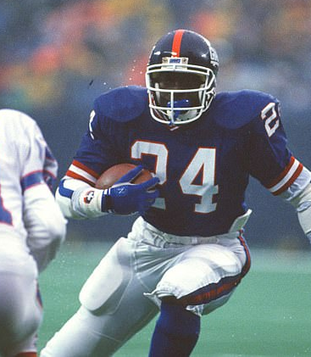
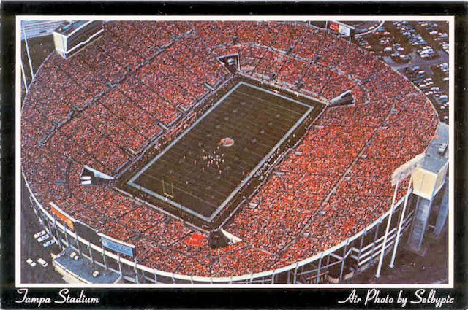

Super Bowl XXV
20
to
19
Giants’ running back
Ottis Anderson
MVP
Played at Tampa Stadium, Florida
https://www.youtube.com/watch?v=QkCC-crdXXE
Notes:
First of four consecutive Super Bowl appearances for Buffalo. (they lost all of them). Start video at 1:50

Slide 20
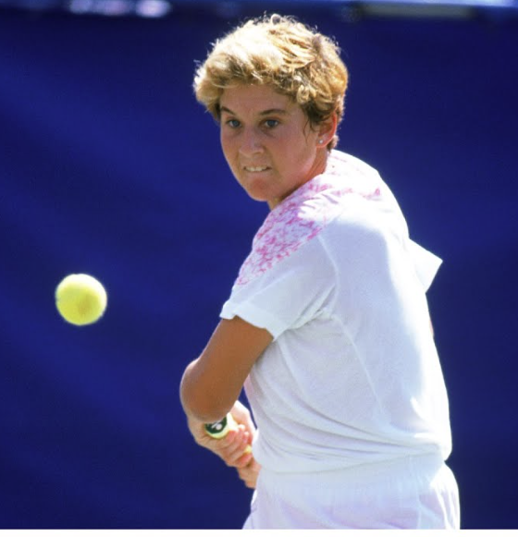
1991 Tennis
Monica Seles
Won the Australian Open, French Open, and
U.S. Open.
3 of the 4 “grand slam” tournaments
At age 18 !!

Slide 21
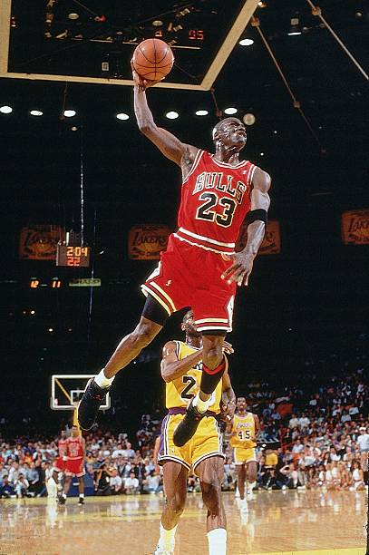
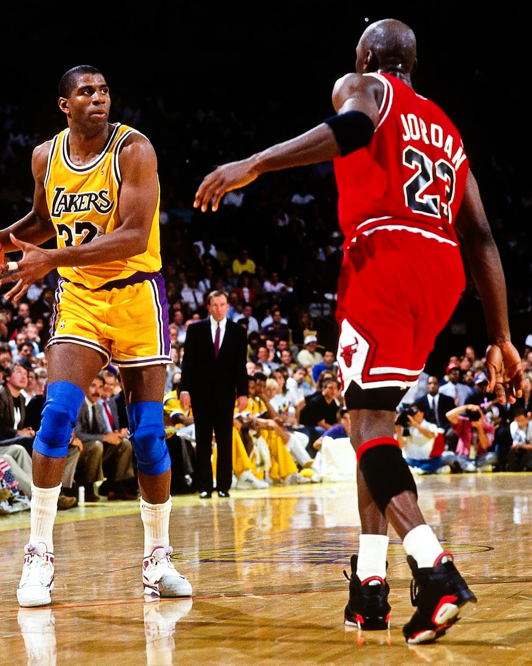
1991 NBA Finals
Chicago Bulls win their first title
and will go on to two “three-peats”
They won six championships during the 1990s!
Michael Jordon was the league MVP for the second time.
He would go on to win 5 in total.

Slide 22
The Year in Baseball: 1991

Slide 23
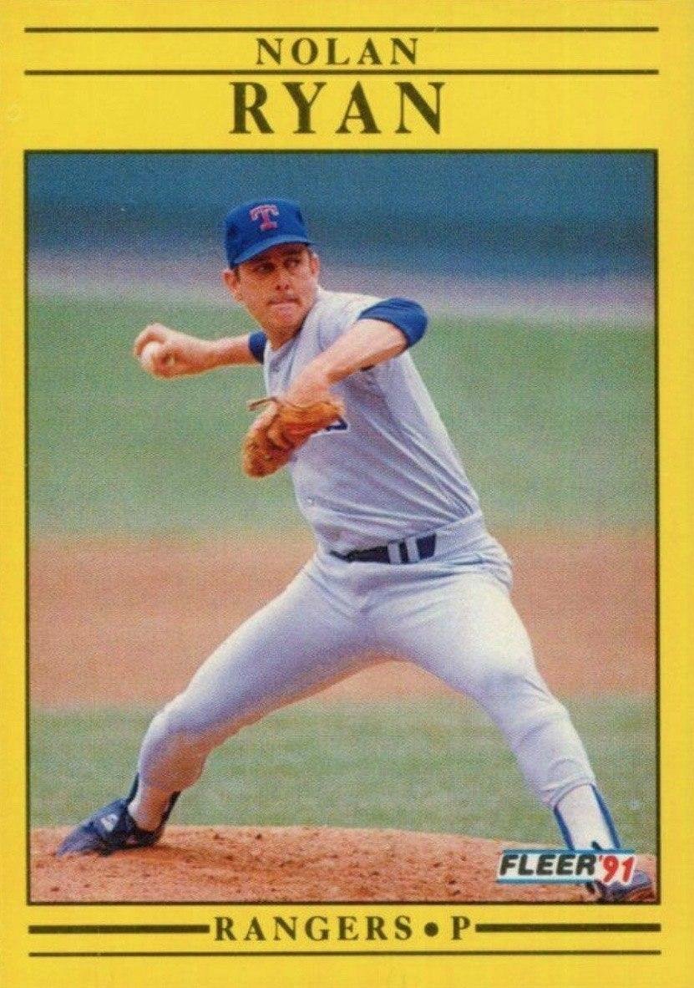
At age 44
Nolan Ryan throws his 7th career no-hitter!!

Slide 24
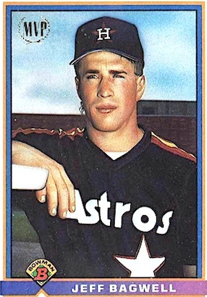
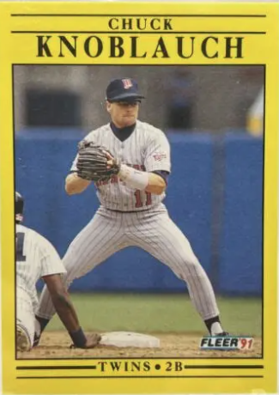
1991
Rookies
of the
Year
.294 15 HR 82 RBI
.281 2 5 SB 78 R
Notes:
Mickey Mantle hit 37 homers to lead the AL. He also led the league in triples, walks, and SLG.

Slide 25
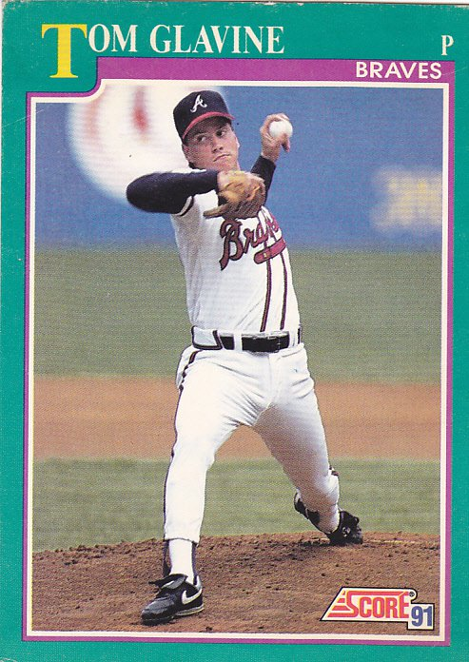
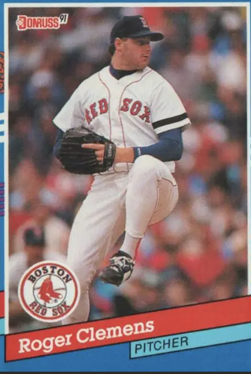
1991
Cy Young
Winners
20-11 2.55 ERA 9 CG
18-10 2.62 ERA 241 K
Notes:
This was Clemens’ 3rd CYA (at age 28)

Slide 26
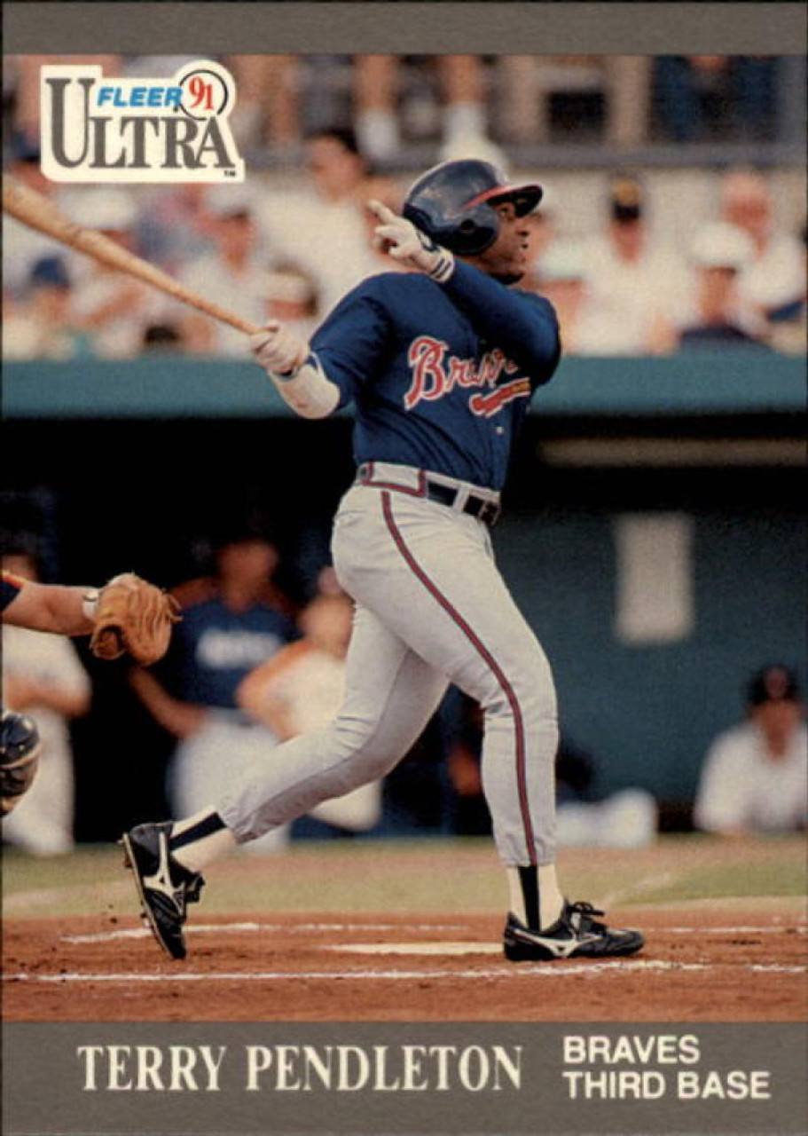
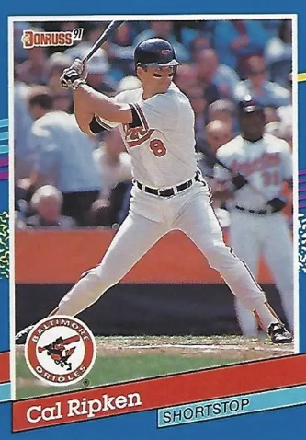
1991 Most Valuable Players
.319 22 HR 86 RBI
34 HR 114 RBI .323
Notes:
Mickey Mantle hit 37 homers to lead the AL. He also led the league in triples, walks, and SLG.

Slide 27
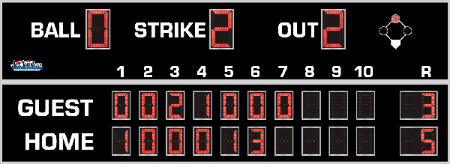
7th Inning Stretch

Slide 28
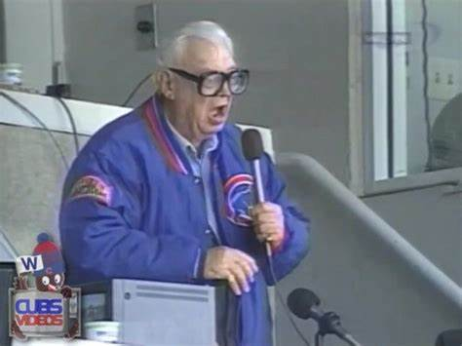
“Take Me Out to the Ballgame”

Slide 29
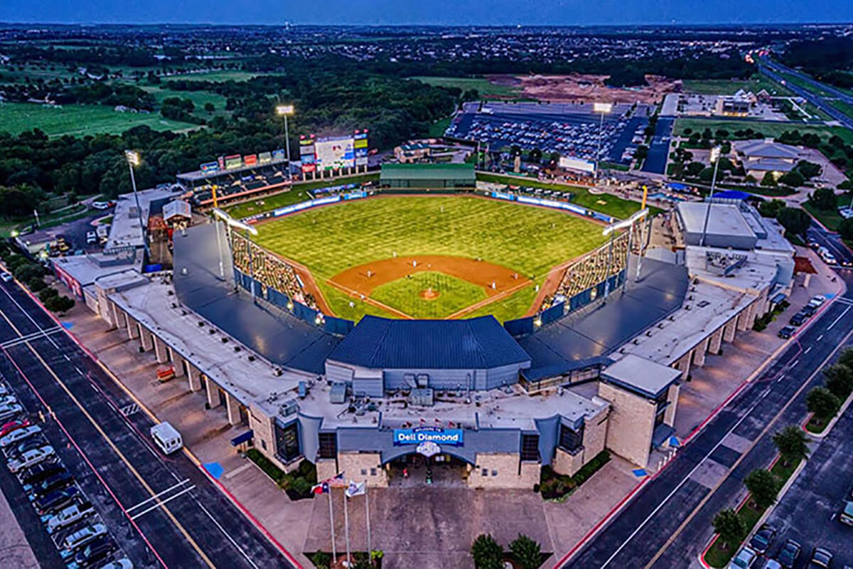
“Deep in the Heart of Texas
https://www.youtube.com/watch?v=rcrK0U7RDIk

Slide 30
“Do the Hokey Pokey”
https://www.youtube.com/watch?v=vpharBeg9XA

Slide 31

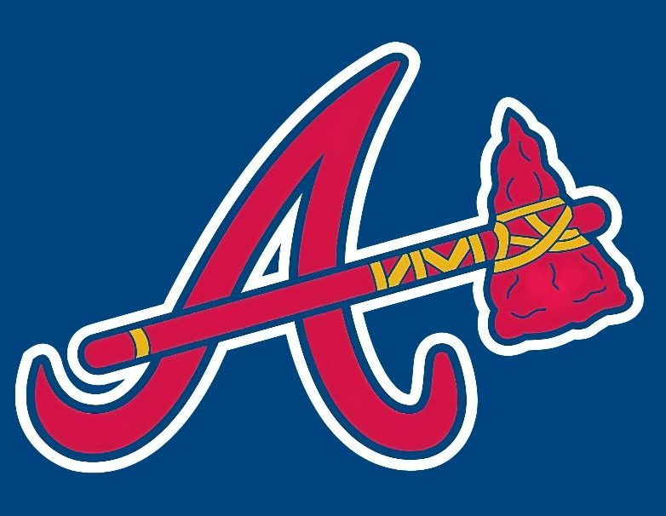


1991 LCS
Best 4 of 7 format
Braves
won 4-3
Twins
won 4-1

Slide 32


1991 World Series
vs.

Slide 33
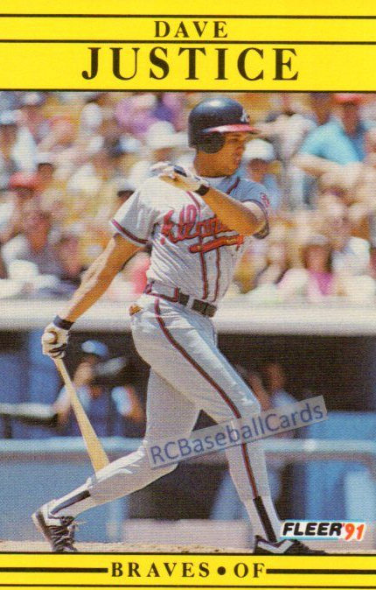
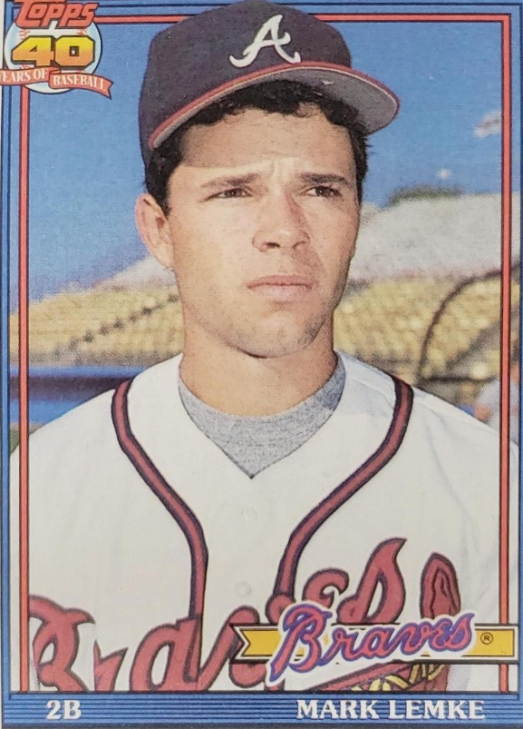
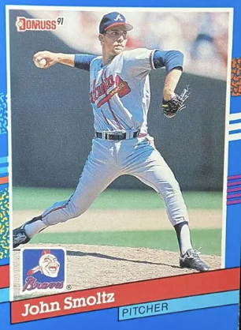
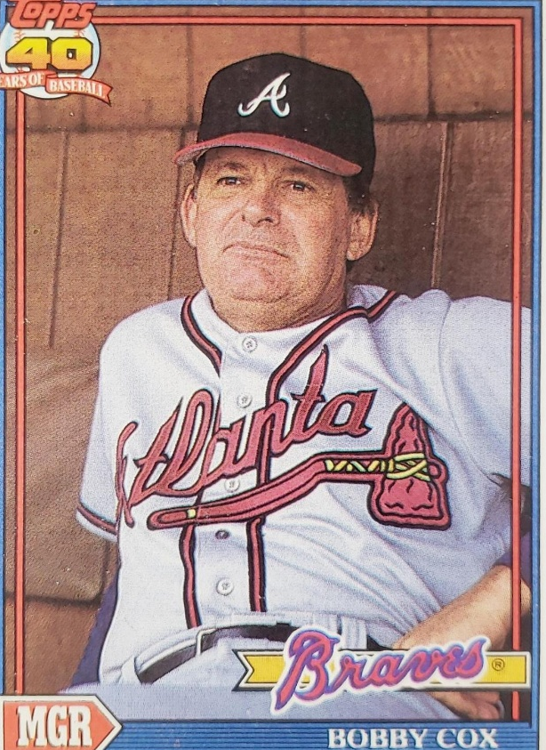
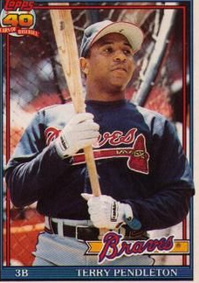
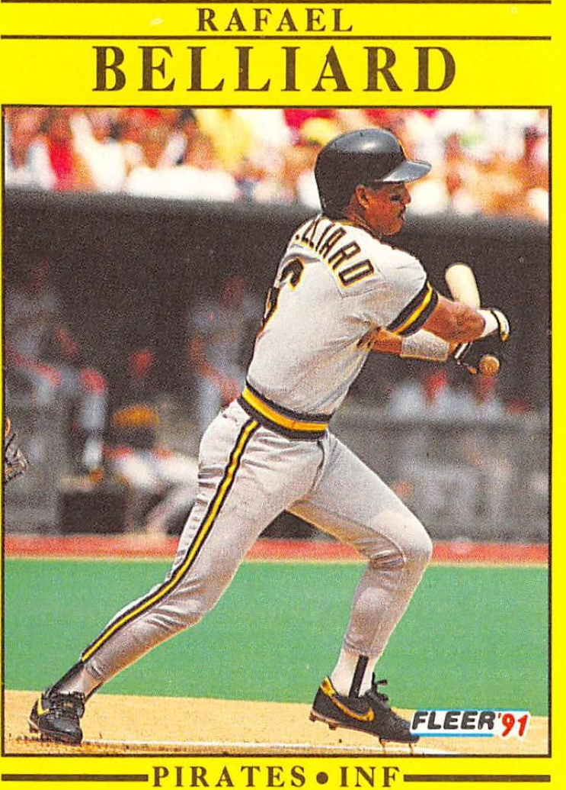
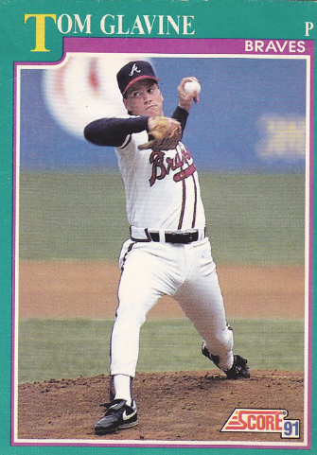
1991
Braves

Slide 34
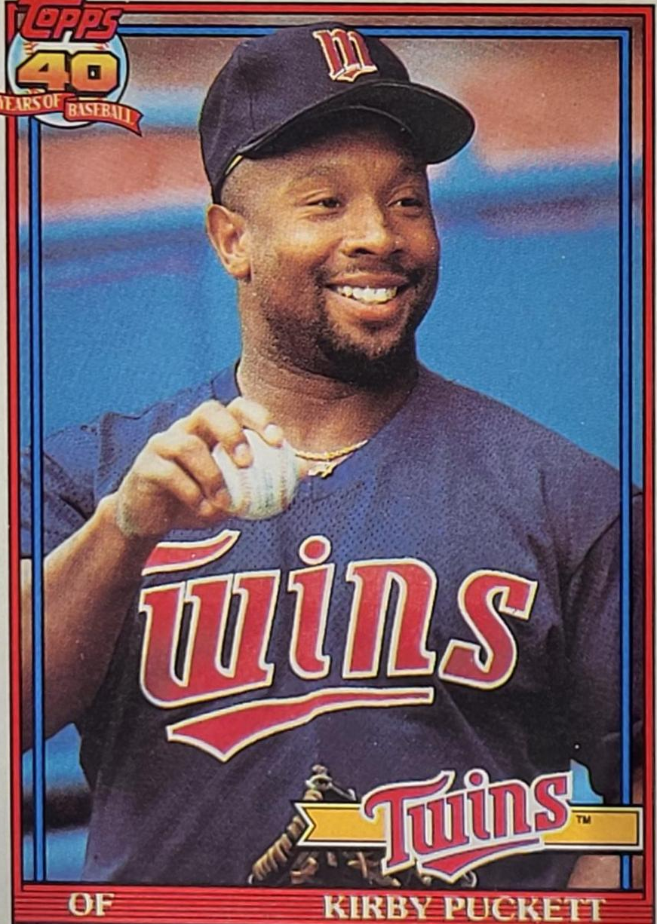
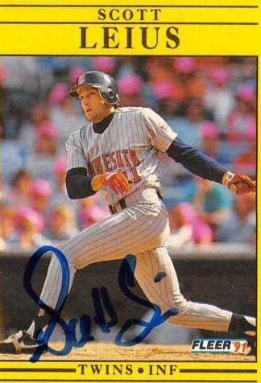
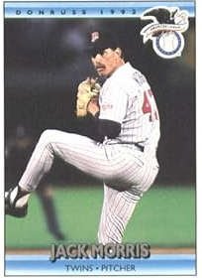
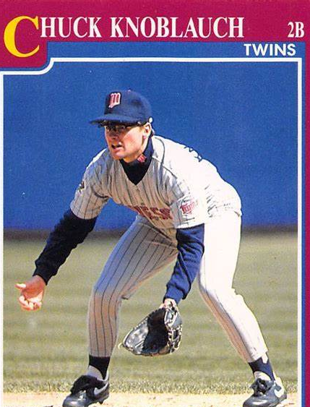
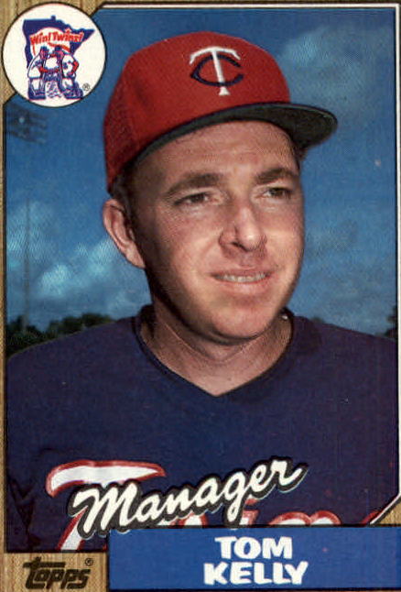
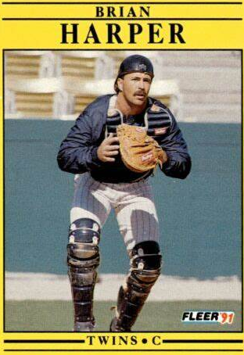
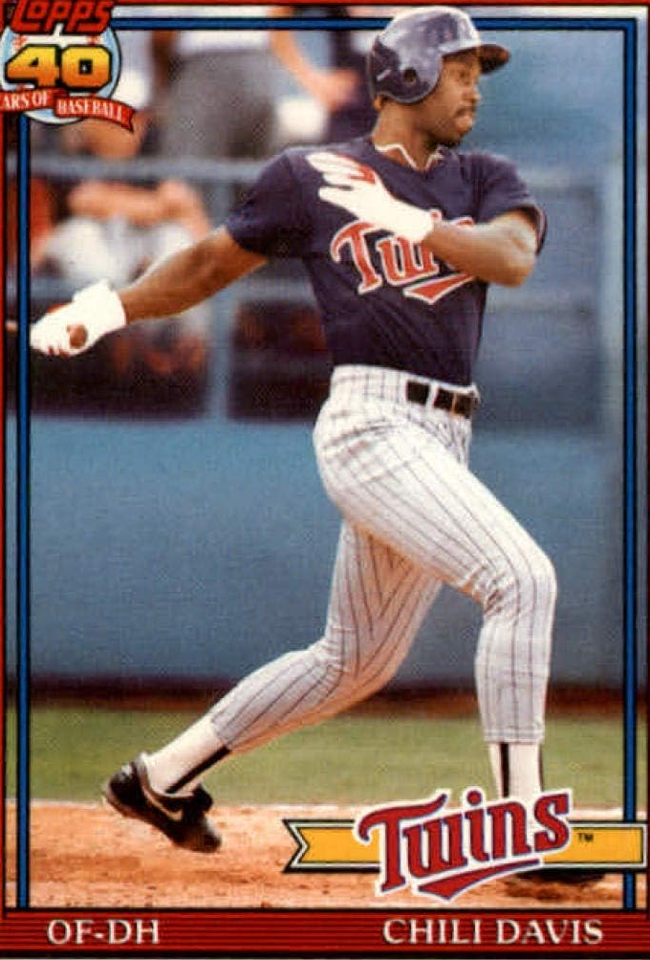
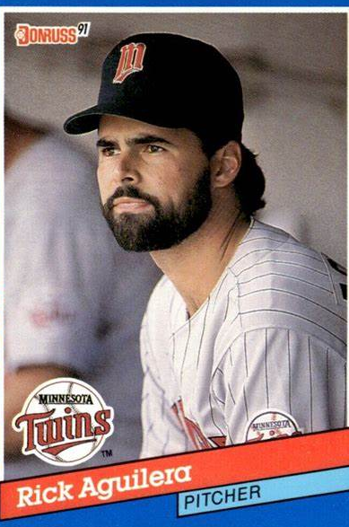
1991
Twins

Slide 35
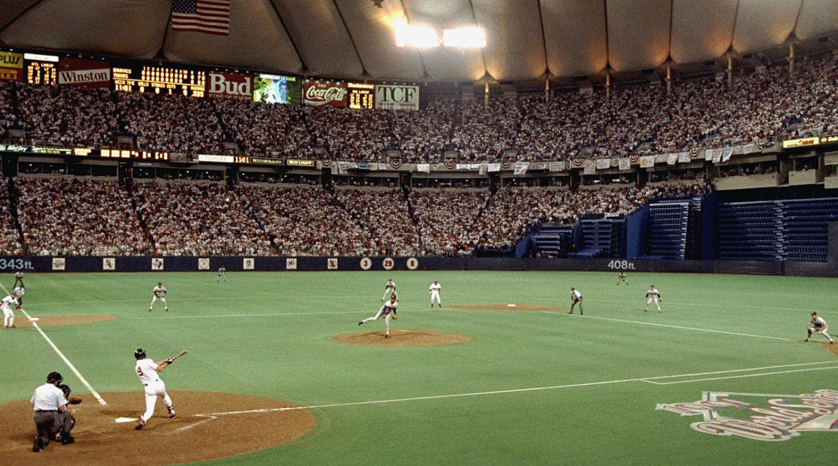
1991 World Series Highlights
Game 1 – October 19
Twins’ SS Greg Gagne hit a 3-run homer in the 5th. Ace Jack Morris pitched seven innings for the win.
Twins 5 – Braves 2
Game 2 – October 20
Twins managed only 4 hits but homers by DH Chili Davis and 3B Scott Leius made the difference.
Twins 3 – Braves 2
TWINS LEAD THE SERIES 2-0 AS THE ACTION SHIFTS TO ATLANTA
HHH Metrodome, Minneapolis
Notes:
Metrodome opened in ‘82 and was home to the Twins and NFL Vikings.

Slide 36
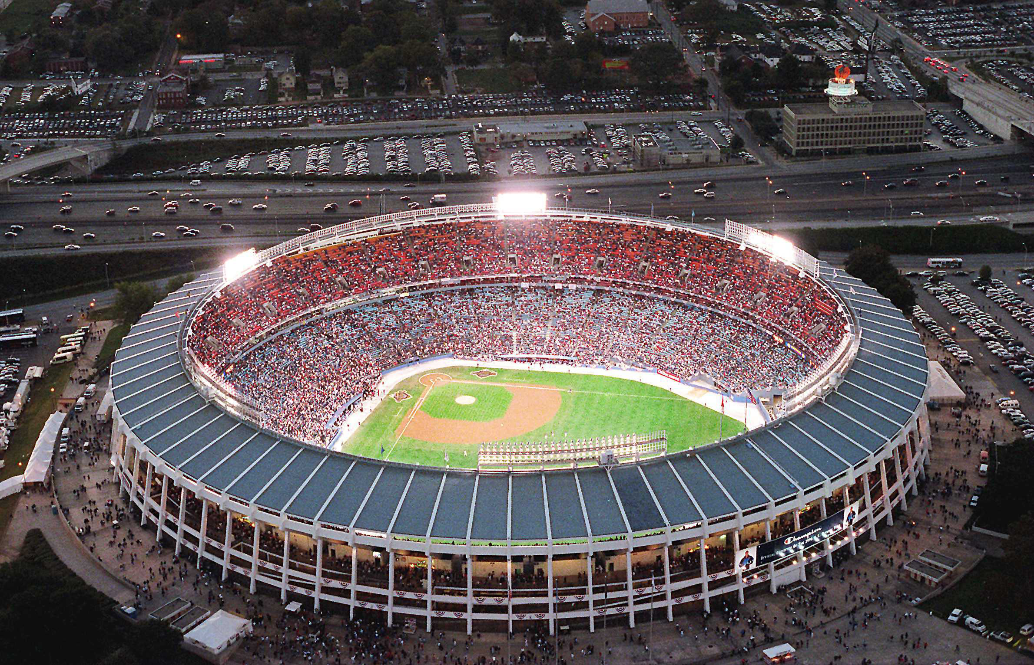
Game 3 – October 22
This game went 12 innings. Braves 2B Mark Lemke drove home David Justice for the game-winning run. Justice barely beat the tag .
BRAVES 5 – TWINS 4
Game 4 – October 23
The Braves Mark Lemke was again the key man as he tripled in the bottom of the 9th inning and then scored the winning run on a sac fly.
BRAVES 3 - TWINS 2
Game 5 – October 24
The Braves brought out the heavy lumber in this lopsided game. Braves’ RF David Justice had 5 RBI; hot Mark Lemke added 3 more.
BRAVES 14 - TWINS 5
BRAVES LEAD THE SERIES 3-2 AS IT MOVES BACK TO MINNESOTA
Atlanta-Fulton County Stadium

Slide 37
1991 World Series Highlights
Game 6 – October 26
This game went 11 innings. Twins’ CF Kirby Puckett took charge:
https://www.youtube.com/watch?v=6iPB6i57nm0
Twins 4 – Braves 3
Game 7 – October 27
Another extra inning game!
The Twins Dan Gladden doubled to open the bottom of the 10th. He was sacrificed to third. The Braves then walked the next two batters. With the bases now loaded, Gene Larkin comes to the plate:
https://www.youtube.com/watch?v=QYuWVArJbBM
Twins starter Jack Morris pitched 10 shutout innings for the win.
Twins 1 – Braves 0
Notes:
Puckett catch and then homer – start video 10:58; great catch robbing a homer plus the walk-off homer in the 11th inning

Slide 38
Minnesota Twins
win
1991 World Series
One of the most exciting World Series Ever!
Three extra innings games!!
Game 3 was the longest World Series game up to that time.
Four games decided by one run!!!
First time since 1924 that a World Series game was ended by a homer in extra innings!!!!
P Jack Morris was the Series MVP
He was 2-0 in Series (and 2-0 in NLCS)

Slide 39
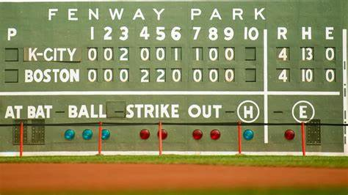
Extra Innings!

Slide 40

Popular TV Shows of the 1980s-1990s

Slide 41
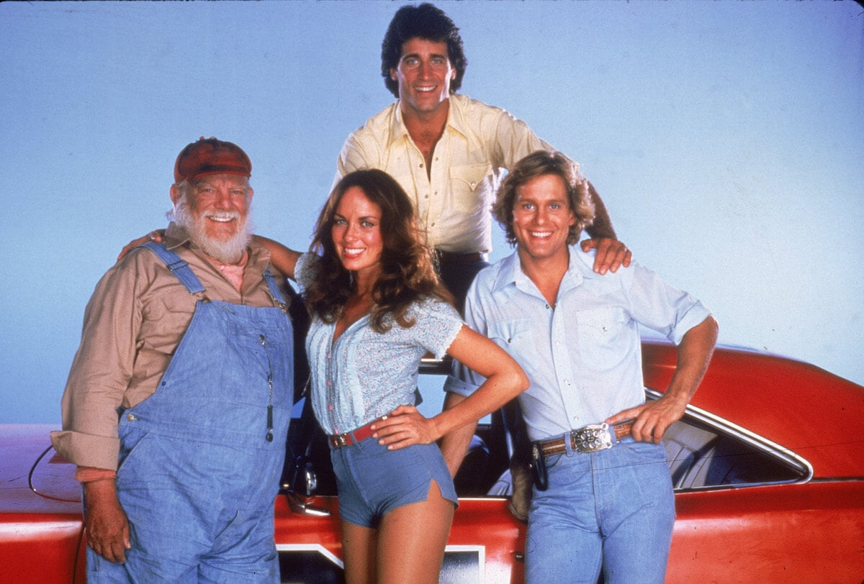
This popular action comedy centered around the Duke family (Uncle Jesse, Bo, Luke, and
Daisy).
Other characters were
“Boss Hogg”,
“Sheriff Roscoe P. Coltrane”, “Cooter”, and “Cletus”.
Their car was a 1969 Dodge Charger called the “General Lee”.
Dukes of Hazzard
https://www.youtube.com/watch?v=67gig0f4HLo
Notes:
Waylon Jennings sang the intro. They lived outside of Hazzard, Georgia. Ran for 147 episodes over 7 seasons; highly rated, some years second only to Dallas in viewership.

Slide 42
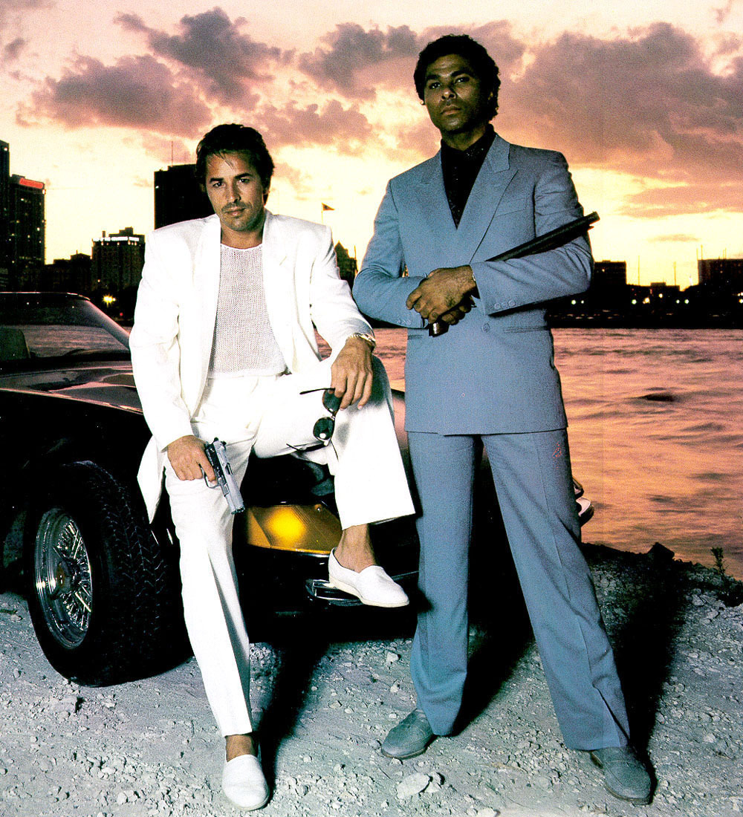
This action crime story centered around two Dade County detectives played by Don Johnson and Philip Michael Thomas.
The show was originally slated to be named “Gold Coast”, but was renamed after the pilot to:
Miami Vice
https://www.youtube.com/watch?v=2qZOmcMwpgM
Notes:
Visuals, clothing and music followed the hip “New Age” genre. Rock bands from the ‘80s wanted to have their music played on the show.

Slide 43

This gritty cops-and-robbers series was set in a police station in a large unnamed American city.
Actor Daniel J. Travanti played the precinct’s Captain Furillo. His love interest, played by actress Veronica Hamill, often calls him “Pizza Man”.
Desk Sergeant Esterhaus opened the show with a roll call and finished his briefing with a famous phrase …
https://www.youtube.com/watch?v=G6hzHEdDJ2o
Hill Street Blues

Slide 44


This crime drama was set in Hawaii and starred popular actor Tom Selleck. He portrayed a private investigator, who lives a plush life-style on the estate of a wealthy benefactor.
Selleck’s character often wears a baseball cap from his favorite major league team …
Magnum P.I.

Slide 45

Actresses Sharon Gless and Tyne Daly starred in this police drama as New York City police detectives.
Beginning with the show’s second season in 1983, and for the next six seasons, one or the other of these two actresses won the Emmy Award for
Best Lead Actress in a Drama !
Cagney & Lacey

Slide 46

This sitcom starred Bea Arthur, Betty White, Rue McClanahan, and Estelle Getty. The plot centered around the four older single women that shared a house in Miami.
The series won numerous awards as an outstanding comedy.
All four of the actresses won at least one Emmy Award.
Golden Girls

Slide 47

This farcical sitcom starred John Ritter, Suzanne Somers, and Joyce DeWitt as unlikely roommates.
The landlord had a rule against unmarried singles living together, but relented when the women convinced him that the John Ritter character was gay.
The series ranked in the Top 10 of TV shows for 6 of its 8 seasons.
Three’s Company

Slide 48

Thanks!!
We’ll see you in September !

