Slide 1



AGE Thrive with Baseball Memories
September 17, 2025
Agenda
Warm-up - Introductions
WE’RE HAPPY TO BE BACK WITH YOU !!!
Current Events
Gametime – The Year in Baseball – 1992
Seventh Inning Stretch - “Take Me Out to the Ball Game”
Get Up and Move, Sing, Dance!
Extra Innings – More stuff from the past

Slide 2


Slide 3



Just a few weeks left in the season !
Notes:
Standings; playoff potential for each team

Slide 4



… and FOOTBALL is underway !!

Slide 5

History from 1992

Slide 6
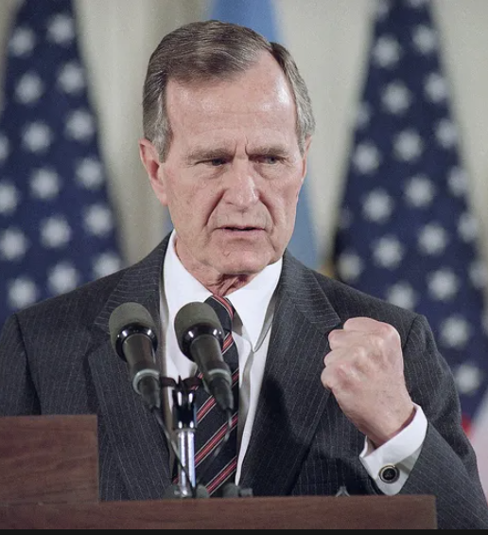
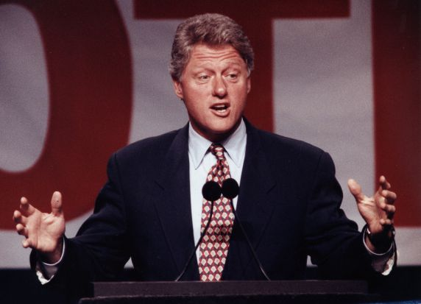
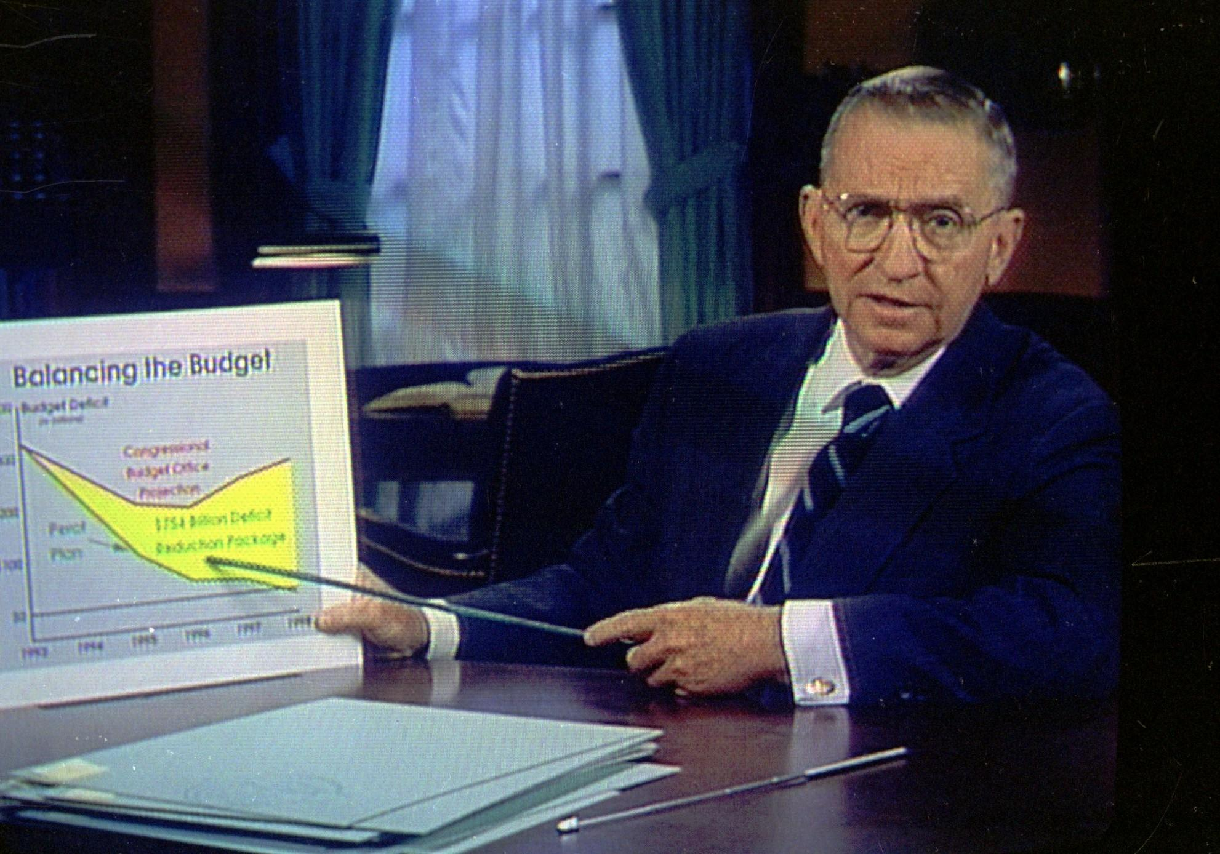
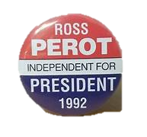

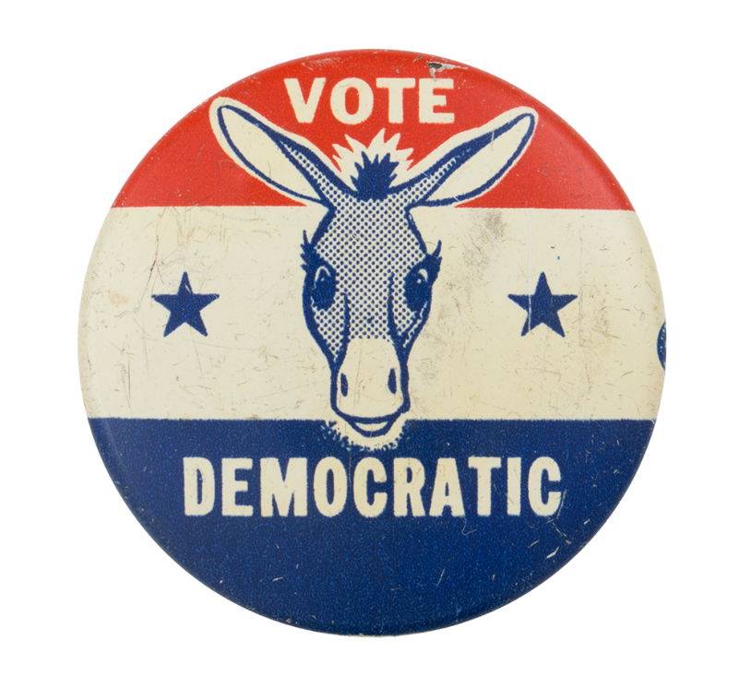
1992 was an Election Year

Slide 7
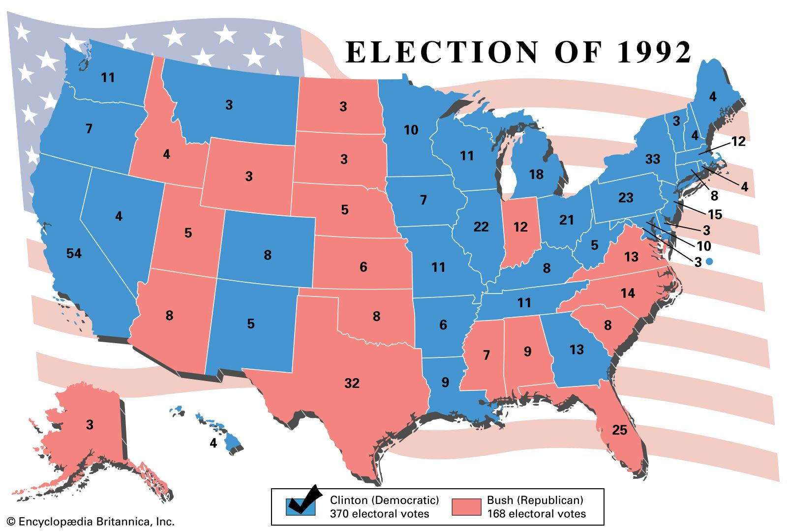
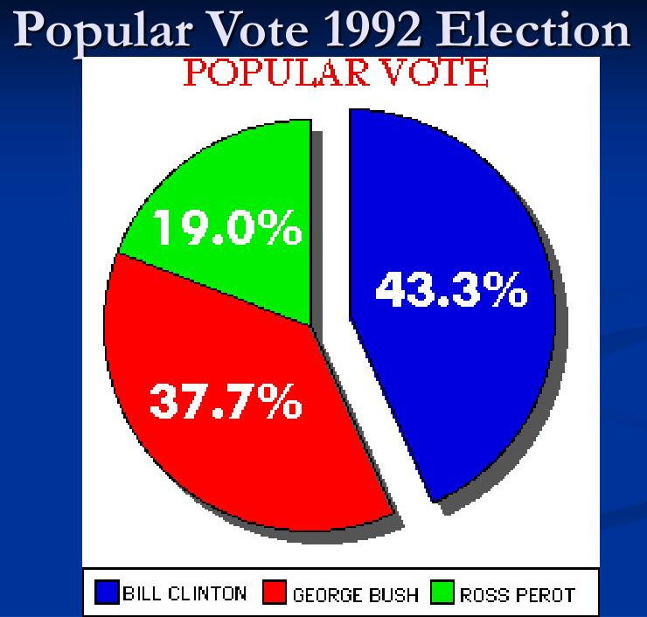
1992 was an Election Year

Slide 8

North Atlantic Free Trade
Agreement
Notes:
Ross Perot referred to NAFTA as the “a giant sucking sound pulling jobs and money south of the border”. It created tremendous growth in trade among the three countries, but did move 2-3 million US manufacturing jobs to Mexico.

Slide 9
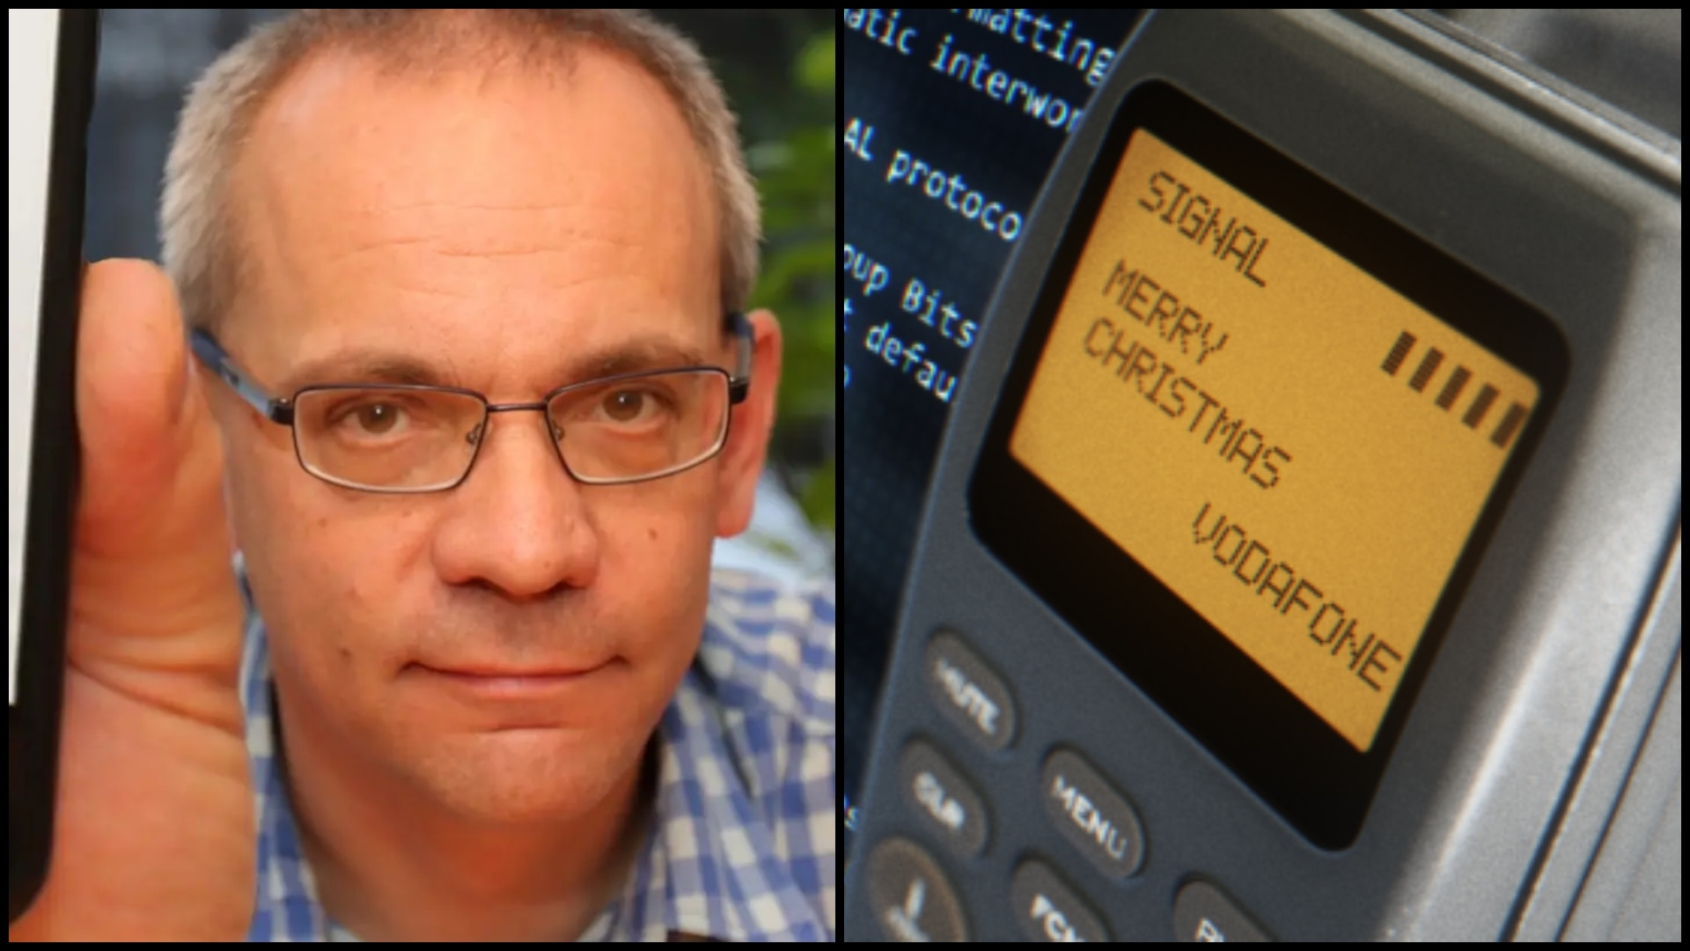
First Text Message Sent
Notes:
Dec. 3, 1992 -- British software engineer Neil Papworth sent the first SMS message from his desktop computer to a friend’s Nokia cell phone via the Vodafone network in the UK. It said “Merry Christmas”

Slide 10
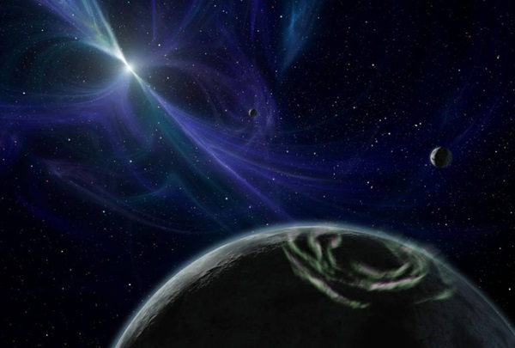
First planets outside our solar
system discovered
5983
How many do we know of now in 2025?
Notes:
Astronomers Aleksander Wolszczan and Dale Frail made a groundbreaking scientific discovery by announcing the first confirmed extrasolar planets, identifying two planets orbiting the pulsar PSR 1257+12. The variations in the pulses from the pulsar identified that two planets were there 3x and 4x the size of earth .
Today we know of how many?

Slide 11
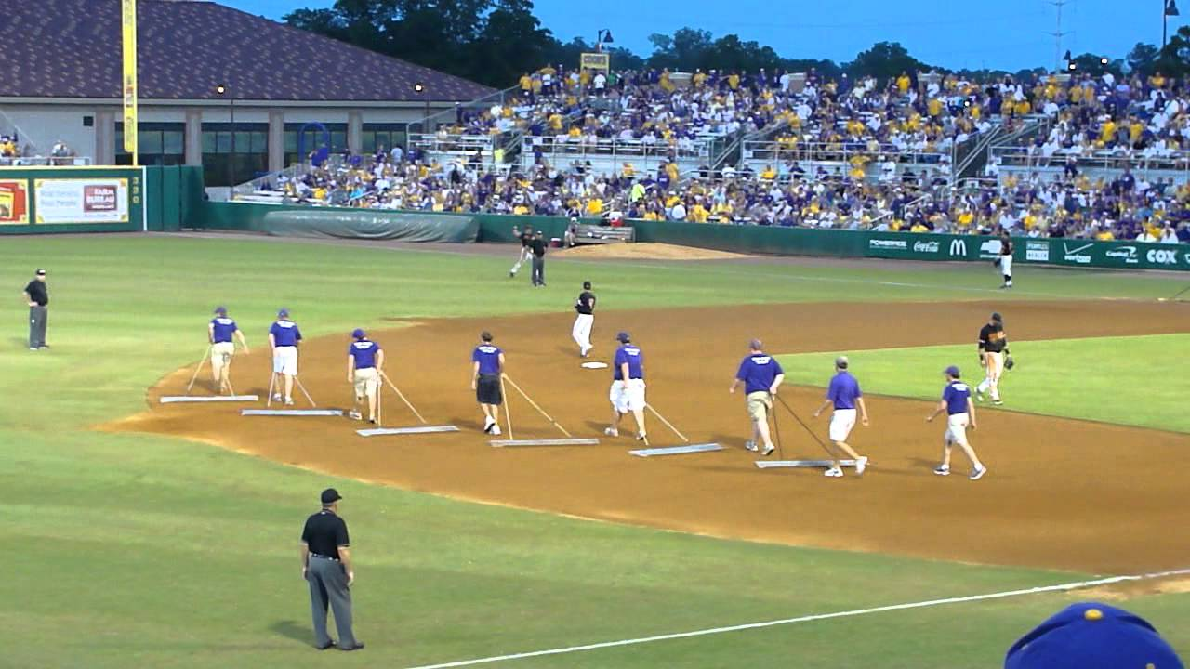
In Between Innings

Slide 12
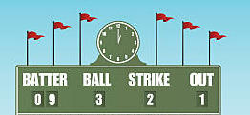
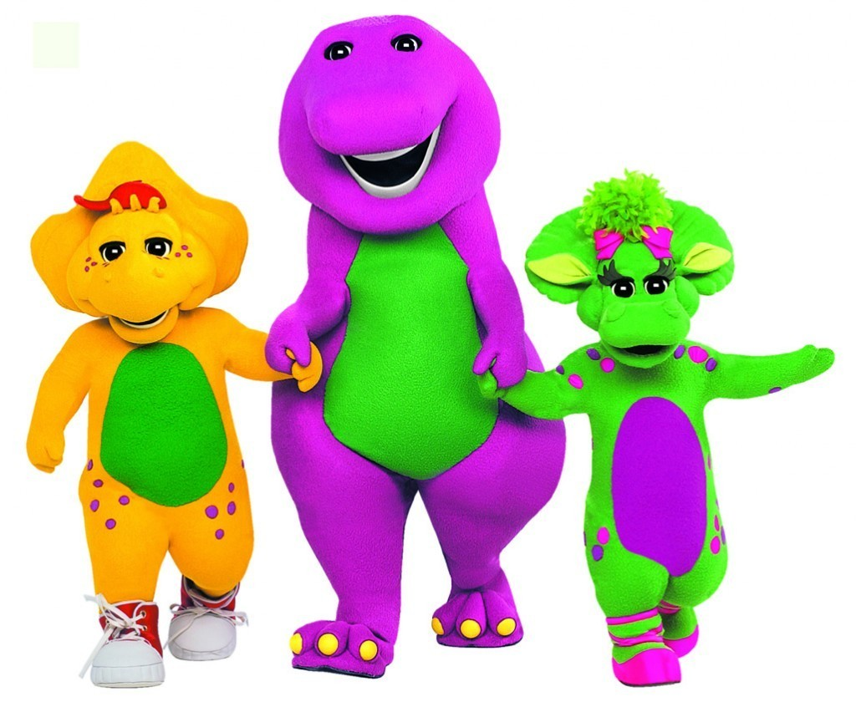
Scoreboard Quiz – 1992 TV
h
This animated children’s show debuted on PBS. It was produced in Dallas, Texas and ran for 19 seasons.
Captain Kangaroo
Barney and Friends
I Love You

Slide 13
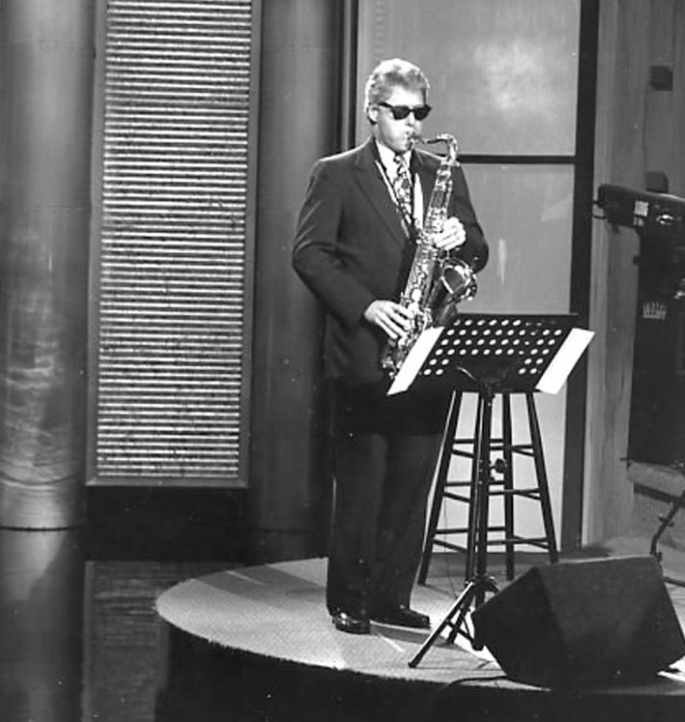
Scoreboard Quiz – 1992 TV
h
Arkansas governor and presidential candidate Bill Clinton played his saxophone on this syndicated TV show.
Arsenio Hall
Tonight Show
Late Night with Letterman
https://www.youtube.com/watch?v=a_WuGDYawFQ

Slide 14
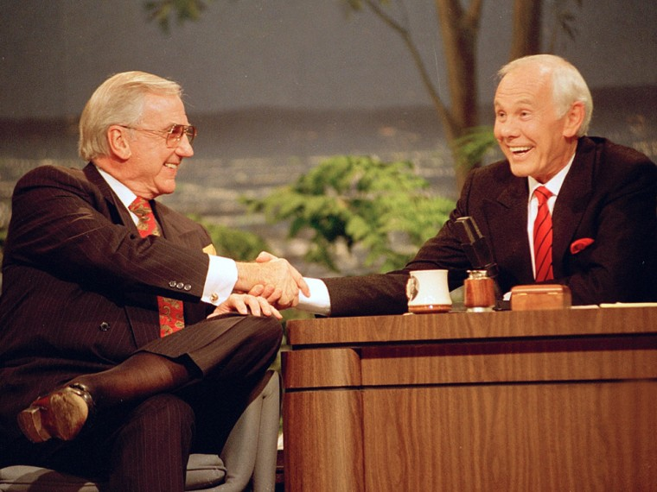
Scoreboard Quiz – 1992 TV
h
Johnny Carson made his last appearance on what popular late night TV show?
Arsenio Hall
Tonight Show
Late Night
Notes:
Carson hosted Tonight from 1962 to 1992 - 6,688 shows in all. Who was his sidekick - pictured here?

Slide 15
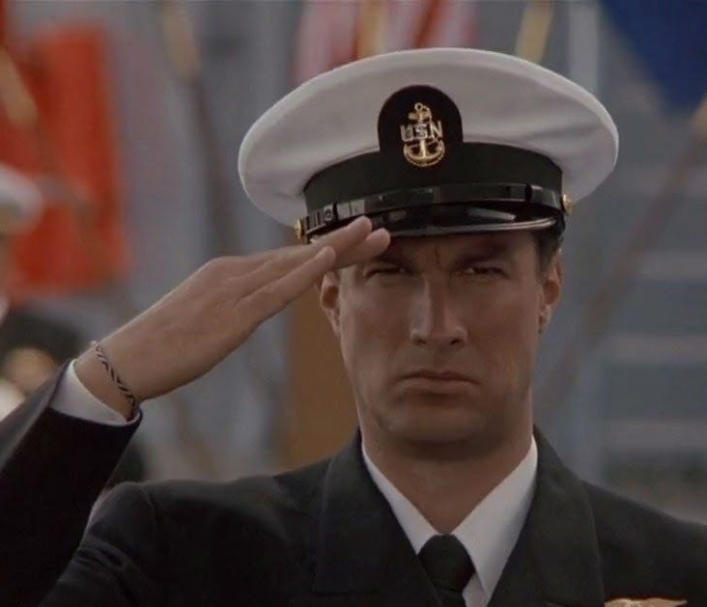
Scoreboard Quiz – 1992 Movie Premiers
h
Steven Seagal portrayed a Navy seaman in this action film set on the U.S.S. Missouri
Top Gun
Up Periscope
Under Siege

Slide 16
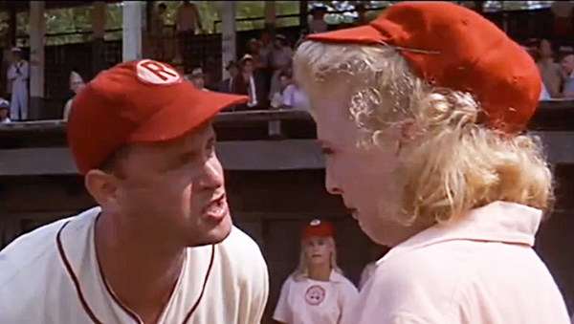
Scoreboard Quiz – 1992 Movie Premiers
h
Tom Hanks plays a washed-up manager in charge of a women’s team in the wartime All-American Girls Baseball League:
A League of Their Own
Baseball Dolls
Strikeout Queens
https://www.youtube.com/watch?v=ZNhyLI3VXmg

Slide 17

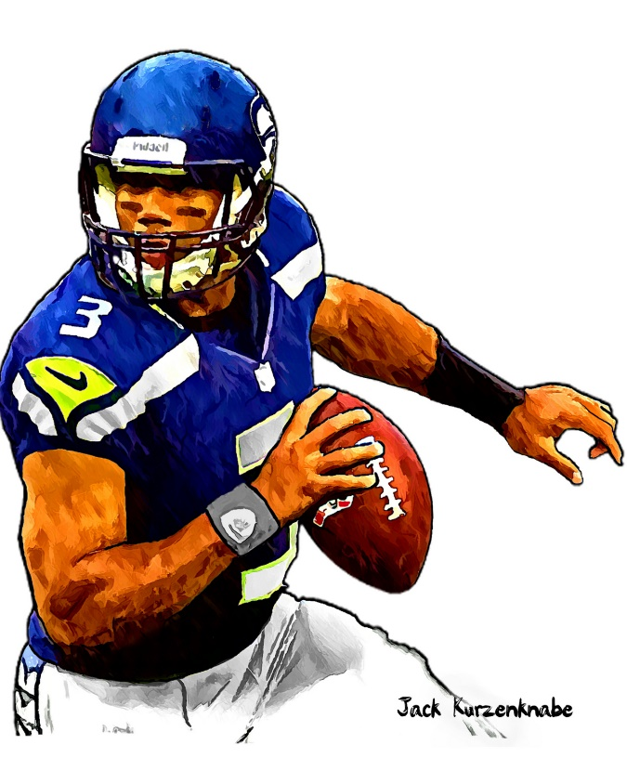

1992 Sporting News

Slide 18


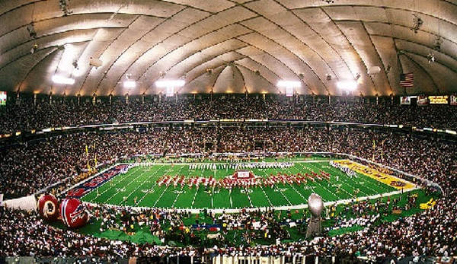

37
to
24
Washington QB
Mark Rypien was MVP
Played at HHH Metrodome
Notes:
Previous October, the Metrodome hosted the World Series! This was the first Super Bowl held at this venue.

Slide 19
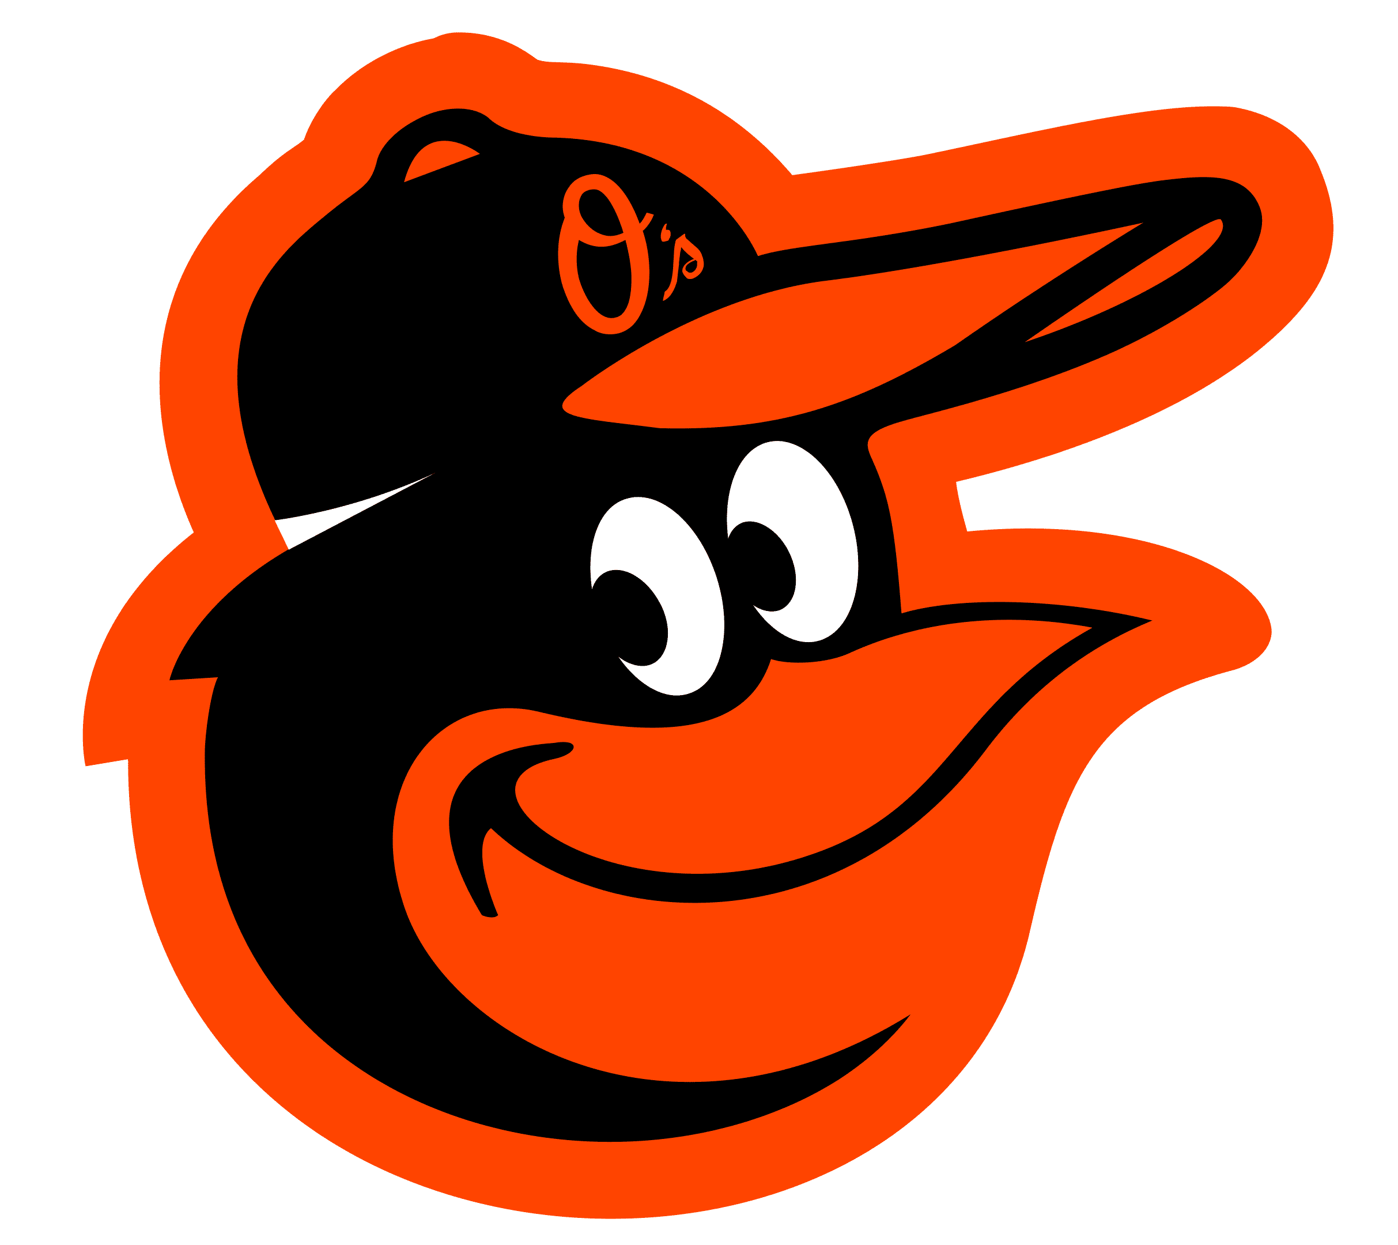
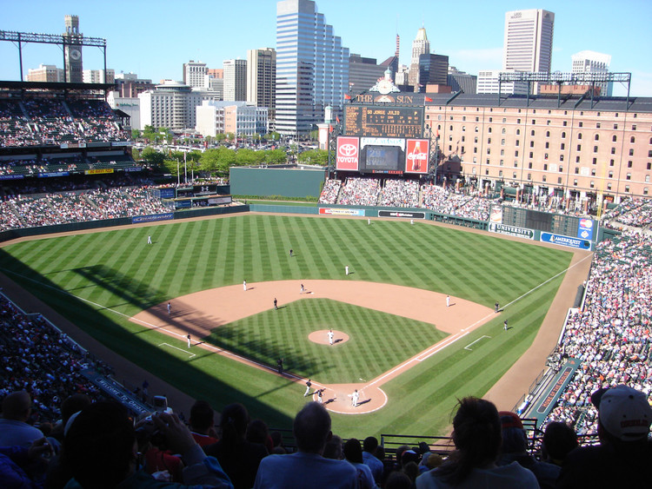
Orioles Park
at
Camden Yards
Opens
Notes:
First of the “new” retro-style ballparks opens in Baltimore in 1992 - This venue would later be recognized as a revolutionary design that influenced modern ballpark architecture, emphasizing intimate fan experiences and urban integration.

Slide 20

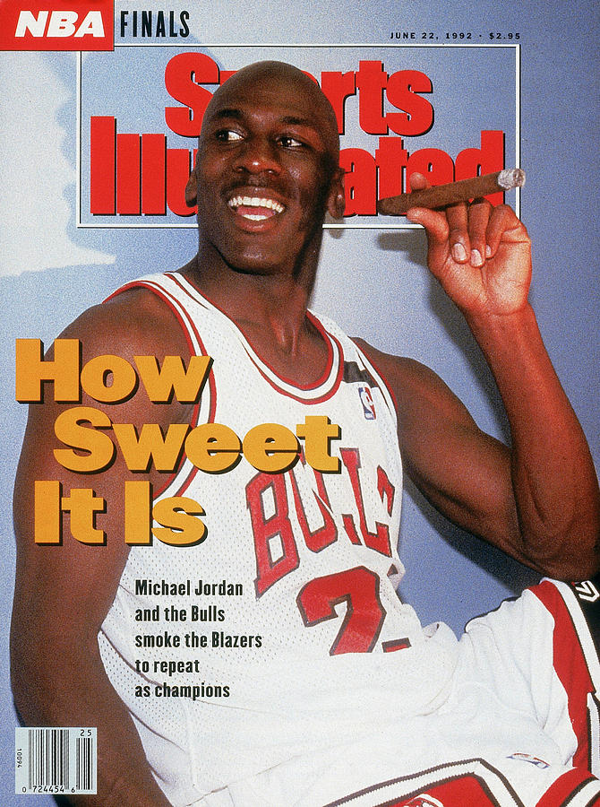
Win 2nd consecutive
NBA Title
Michael Jordan is
Finals MVP for 2nd year
Notes:
The Chicago Bulls won the NBA Finals against the Portland Trail Blazers with a decisive 97-93 victory in Game 6, securing back-to-back titles. Michael Jordan was named MVP for the second consecutive year, further cementing his legendary status in basketball history.

Slide 21
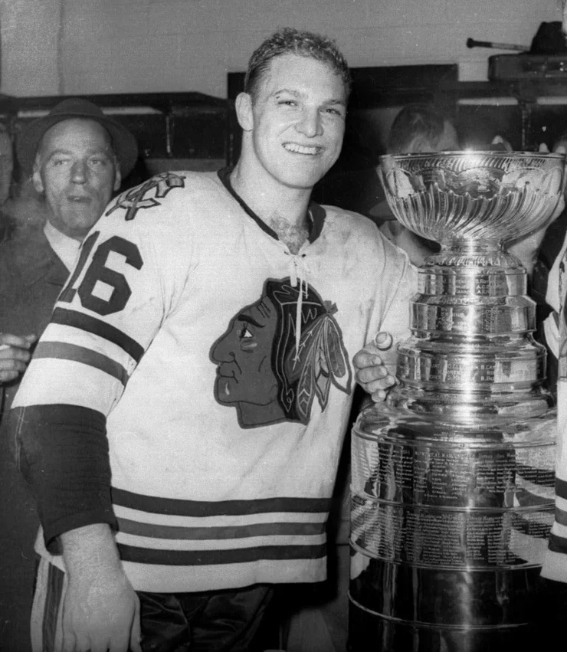
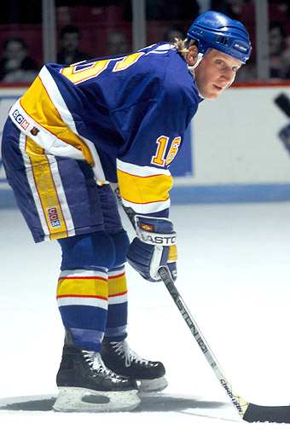
back to back seasons
50 goals in 50 games!
Brett Hull becomes only 2nd NHL player to achieve
(after Wayne Gretzky)
Brett’s father was
hockey superstar
Bobby Hull
Notes:
Brett Hull NHL Milestone: St. Louis Blues right wing Brett Hull became the second player in NHL history, after Wayne Gretzky, to record back-to-back seasons of 50 goals in 50 games, scoring his 50th goal in a 3-3 tie against the Los Angeles Kings.

Slide 22
The Year in Baseball: 1992

Slide 23
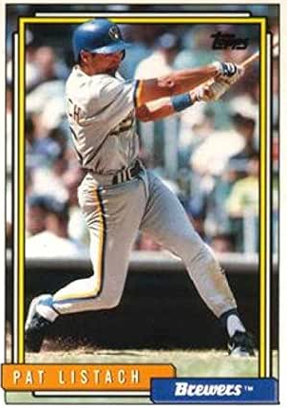
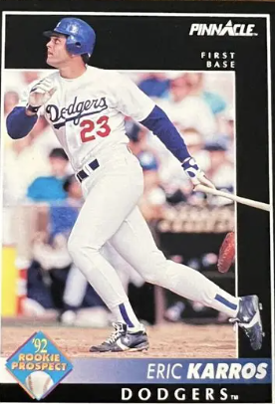
1992
Rookies
of the
Year
.290 54 SB 93 R
.257 20 HR 88 RBI
Notes:
Mickey Mantle hit 37 homers to lead the AL. He also led the league in triples, walks, and SLG.

Slide 24
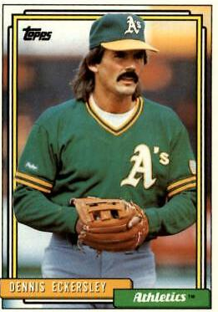
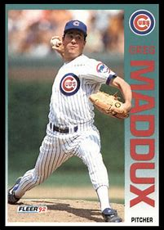
1992
Cy Young
Winners
51 Saves 1.91 ERA
20-11 2.18 ERA 268 IP
Notes:
First of Maddux’s four Cy Young Award wins; and he finished 9 times in the top 5 of CYA voting. Plus 18 gold gloves.

Slide 25
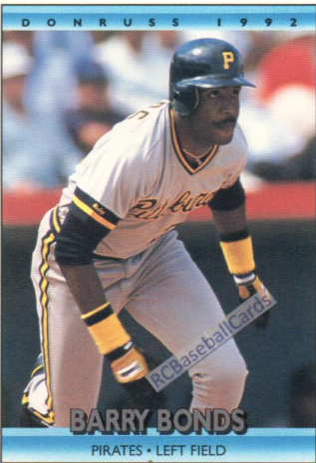
1992 Most Valuable Players
34 HR 103 RBI .311
Notes:
Eck won the MVP as well as the CYA in ’92 – at age 37! This was the 2nd of Bonds’ 7 MVPs!

Slide 26
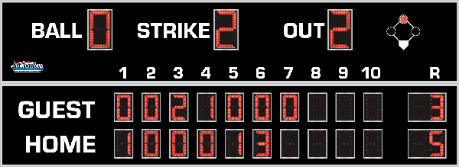
7th Inning Stretch

Slide 27
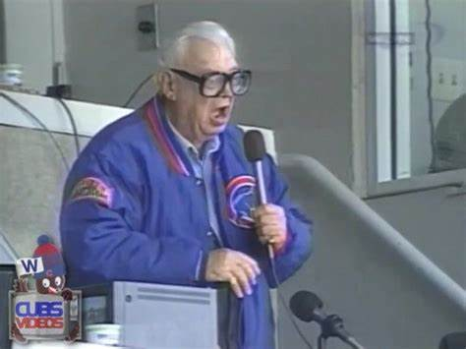
“Take Me Out to the Ballgame”

Slide 28
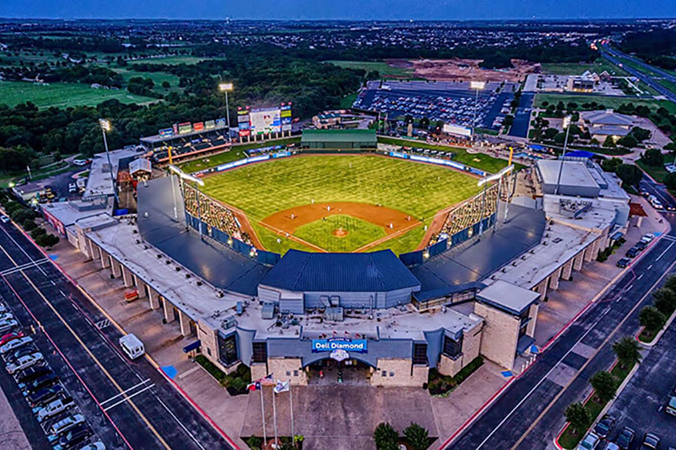
“Deep in the Heart of Texas
https://www.youtube.com/watch?v=rcrK0U7RDIk

Slide 29
“Do the Hokey Pokey”
https://www.youtube.com/watch?v=vpharBeg9XA

Slide 30

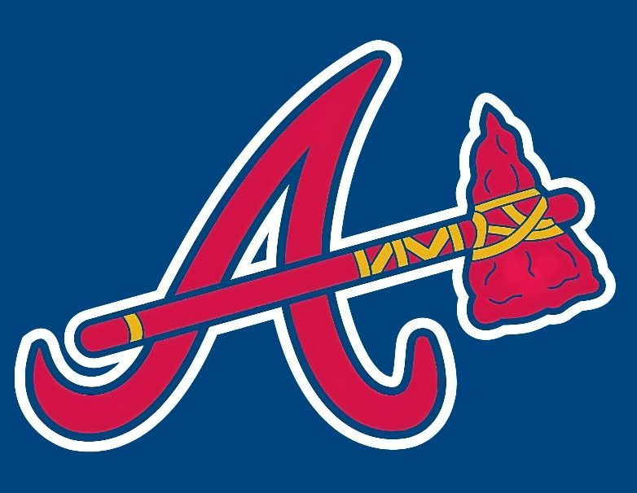

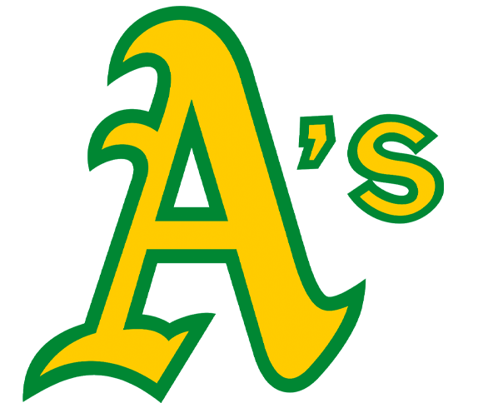
1992 LCS
Best 4 of 7 format
Braves
won 4 - 3
Blue Jays
won 4 - 2

Slide 31

1992 World Series
vs.

Slide 32
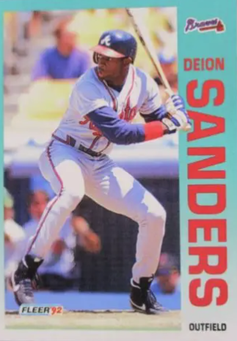
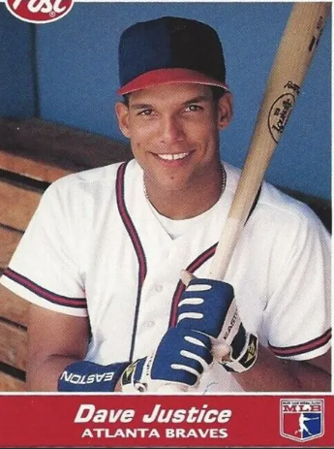
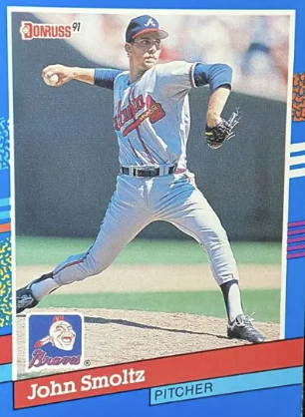
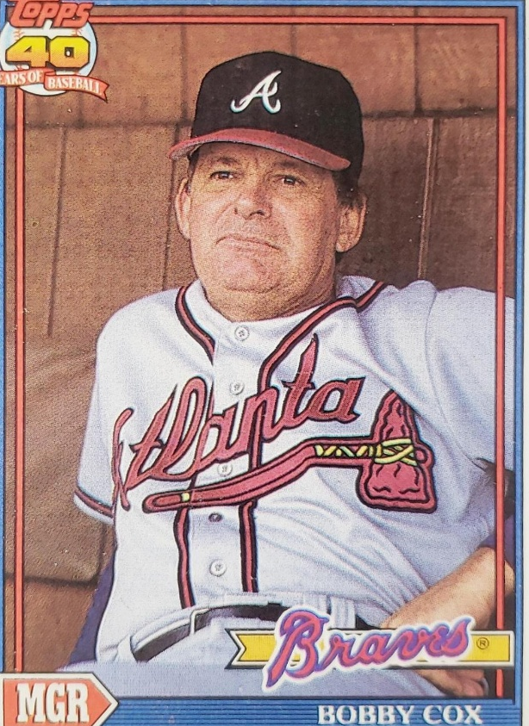
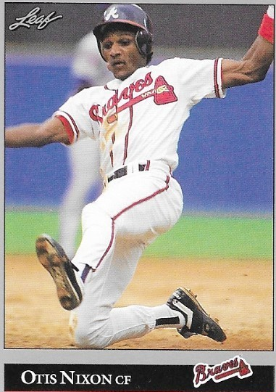
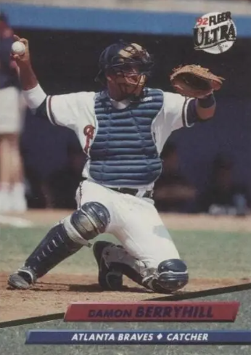
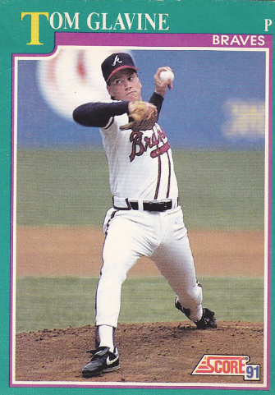
1992
Braves

Slide 33
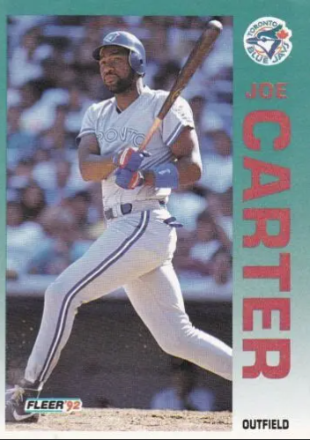
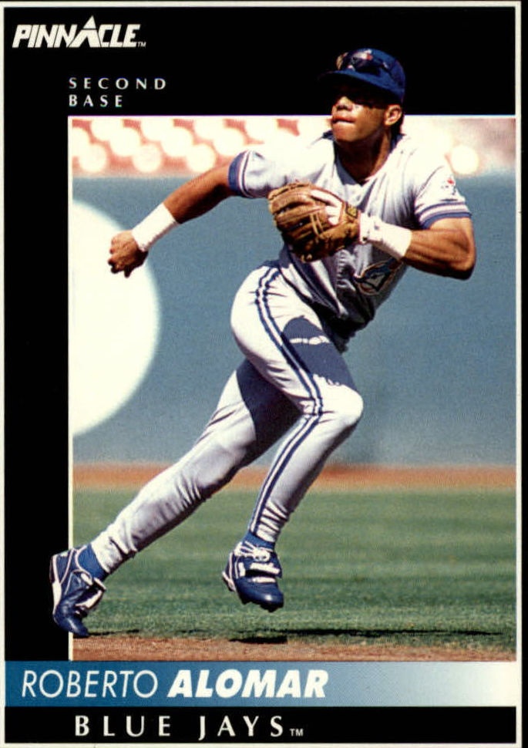
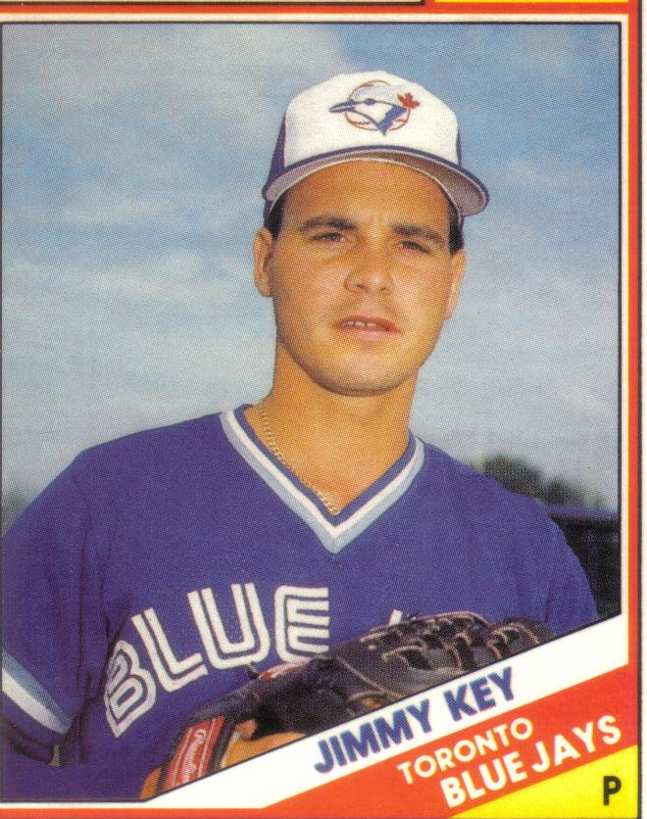
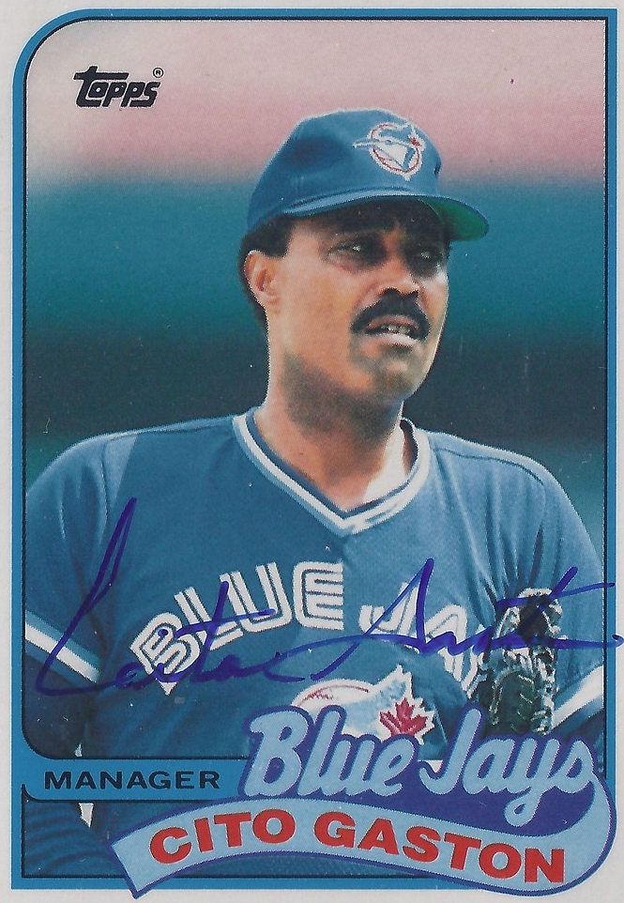
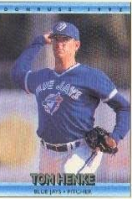
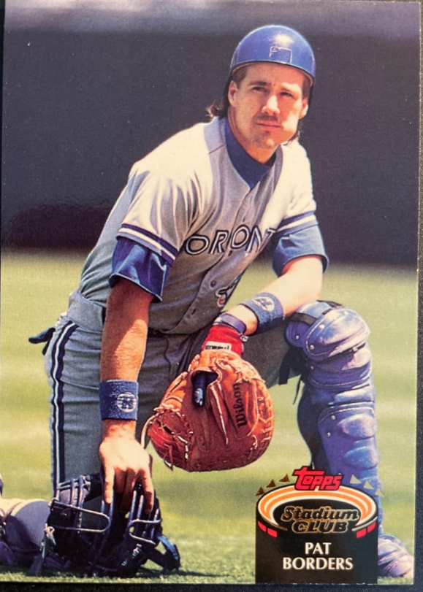
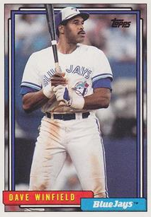
1992
Blue Jays

Slide 34
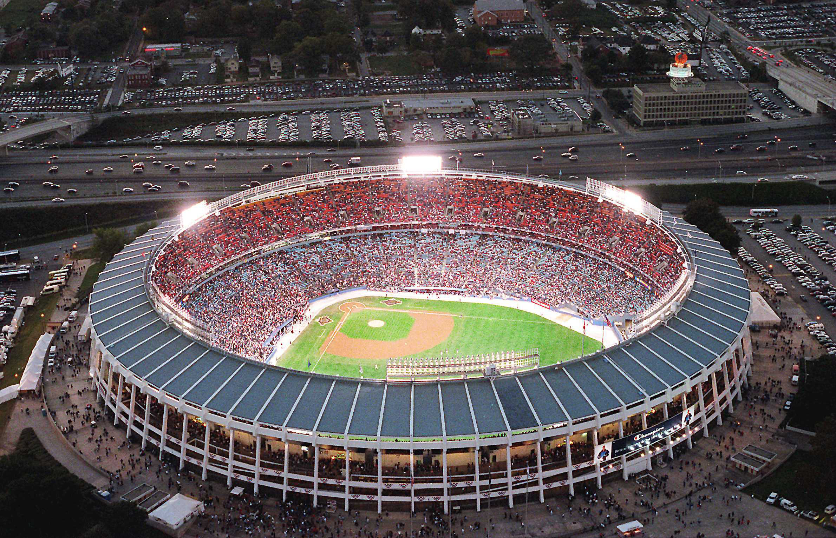
1992 World Series Highlights
Game 1 – October 17
Braves P Tom Glavine went the distance and C Damon Berryhill hit a 3-run homer in the 6th inning to give Atlanta the win:
Atlanta 3 – Toronto 1
Game 2 – October 20
BlueJays pinch hitter Ed Sprague ‘s 2R homer in the 9th was the difference as Toronto came from behind to even the Series.
Toronto 5 – Atlanta 4
SERIES TIED 1-1
AS THEY MOVE TO TORONTO
Atlanta-Fulton County Stadium

Slide 35
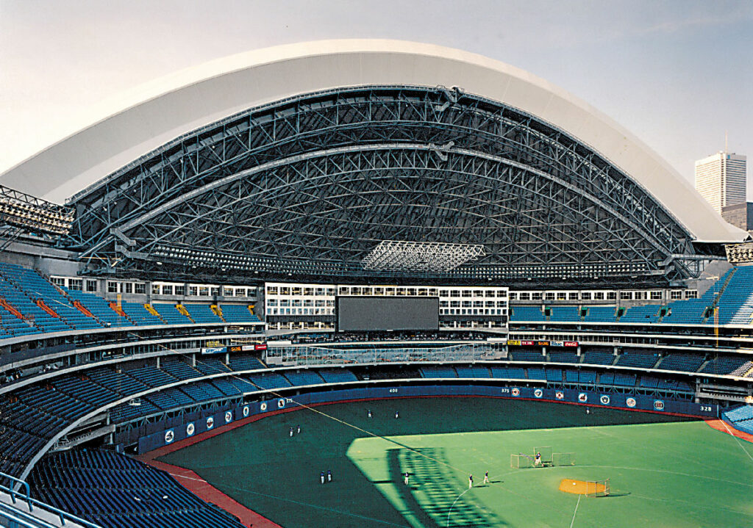
Game 3 – October 20
BlueJays LF Candy Maldonado singled in the bottom of the 9th to drive in Roberto Alomar with the winning run:
TORONTO 3 – ATLANTA 2
Game 4 – October 21
BlueJays C Pat Borders homered and CF Devon White drove in another run to give the ‘Jays the lead. Jimmy Key and the Braves Tom Glavine were locked in another pitchers’ duel:
TORONTO 2 - ATLANTA 1
Game 5 – October 22
Braves DH Lonnie Smith hit a 5th inning Grand Slam to put Atlanta ahead for good. Future HOFer John Smoltz started and got the win.
BRAVES 7 - BLUE JAYS 2
BLUE JAYS LEAD THE SERIES
3-2 AS THEY MOVE BACK TO
ATLANTA
Toronto SkyDome
Notes:
The SkyDome (now called the Rogers Center) was build in 1989 and was the first stadium with a fully-retractable roof. Also became first venue outside the U.S. to host a World Series.

Slide 36
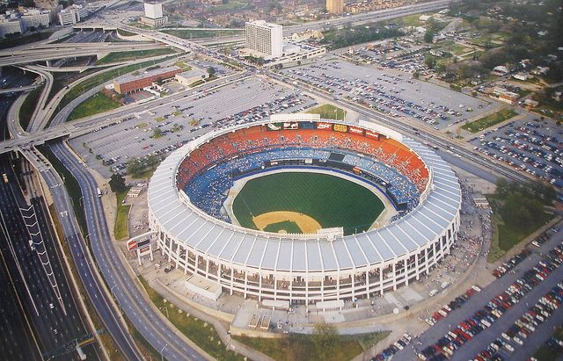
1992 World Series Highlights
Game 6 – October 26
Twelve pitchers were used in this extra-innings thriller. ‘Jays RF Dave Winfield doubled in two runs in the top of the 11th to put Toronto up 4-2.
The Braves still had an at-bat. They scored one run in the bottom of the 11th and had the tying run on 3rd base with two outs:
https://www.youtube.com/watch?v=U9pCrFxwjeo
Toronto 4 – Braves 3 (11 inn)

Slide 37

Toronto Blue Jays
win
1992 World Series
Another exciting World Series:
Four games were decided by one run
The final game was decided in the 11th inning
First World Series games played in Canada
First World Series won by a Canada-based team
‘Jays Catcher Pat Borders was MVP

Slide 38

Extra Innings!

Slide 39

Popular TV Shows of the 1980s-1990s

Slide 40

This popular action comedy centered around the Duke family (Uncle Jesse, Bo, Luke, and
Daisy).
Other characters were
“Boss Hogg”,
“Sheriff Roscoe P. Coltrane”, “Cooter”, and “Cletus”.
Their car was a 1969 Dodge Charger called the “General Lee”.
Dukes of Hazzard
https://www.youtube.com/watch?v=67gig0f4HLo
Notes:
Waylon Jennings sang the intro. They lived outside of Hazzard, Georgia. Ran for 147 episodes over 7 seasons; highly rated, some years second only to Dallas in viewership.

Slide 41

This action crime story centered around two Dade County detectives played by Don Johnson and Philip Michael Thomas.
The show was originally slated to be named “Gold Coast”, but was renamed after the pilot to:
Miami Vice
https://www.youtube.com/watch?v=2qZOmcMwpgM
Notes:
Visuals, clothing and music followed the hip “New Age” genre. Rock bands from the ‘80s wanted to have their music played on the show.

Slide 42

This gritty cops-and-robbers series was set in a police station in a large unnamed American city.
Actor Daniel J. Travanti played the precinct’s Captain Furillo. His love interest, played by actress Veronica Hamill, often calls him “Pizza Man”.
Desk Sergeant Esterhaus opened the show with a roll call and finished his briefing with a famous phrase …
https://www.youtube.com/watch?v=G6hzHEdDJ2o
Hill Street Blues

Slide 43


This crime drama was set in Hawaii and starred popular actor Tom Selleck. He portrayed a private investigator, who lives a plush life-style on the estate of a wealthy benefactor.
Selleck’s character often wears a baseball cap from his favorite major league team …
Magnum P.I.

Slide 44

Actresses Sharon Gless and Tyne Daly starred in this police drama as New York City police detectives.
Beginning with the show’s second season in 1983, and for the next six seasons, one or the other of these two actresses won the Emmy Award for
Best Lead Actress in a Drama !
Cagney & Lacey

Slide 45

This sitcom starred Bea Arthur, Betty White, Rue McClanahan, and Estelle Getty. The plot centered around the four older single women that shared a house in Miami.
The series won numerous awards as an outstanding comedy.
All four of the actresses won at least one Emmy Award.
Golden Girls

Slide 46

This farcical sitcom starred John Ritter, Suzanne Somers, and Joyce DeWitt as unlikely roommates.
The landlord had a rule against unmarried singles living together, but relented when the women convinced him that the John Ritter character was gay.
The series ranked in the Top 10 of TV shows for 6 of its 8 seasons.
Three’s Company

Slide 47

Thanks!
We’ll see you again next month!!

