Slide 1



AGE Thrive with Baseball Memories
October 15, 2025
We’re happy to be with you today!
AGENDA
Warm-up - Introductions
Current Events
Gametime – The Year in Baseball – 1993 and 1994
Seventh Inning Stretch - “Take Me Out to the Ball Game”
Get Up and Move, Sing, Dance!
Extra Innings – More stuff from the past

Slide 2


Slide 3




The baseball playoffs are in progress!!
Notes:
Standings; playoff potential for each team

Slide 4




The baseball playoffs are in progress!!
National League American League
Notes:
Standings; playoff potential for each team

Slide 5




FOOTBALL is underway !!
Volleyball too!

Slide 6

History from 1993/94

Slide 7
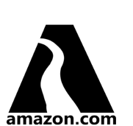

The “web” opens for business
Notes:
started attracting business applications (rather than just researchers) Amazon and Yahoo were early entrants. Note how simple the logos were due to limited bandwidth available to most homes. Yahoo! originally meant "Yet Another Hierarchical Officious Oracle". It was coined by founders Jerry Yang and David Filo when they created the web directory in 1994. Amazon orginally sold ... books!

Slide 8
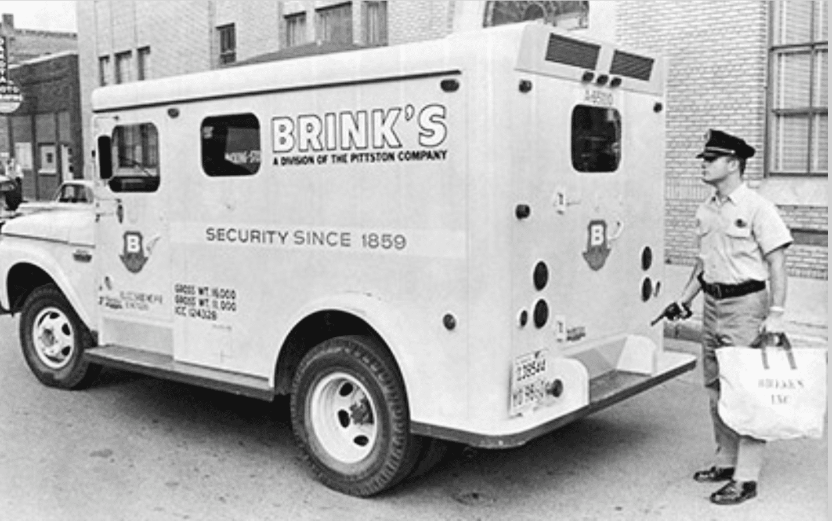
Brinks is Robbed!
Notes:
The Brinks depot in Rochester, NY was robbed of over $7M. It had an unusual group of perpetrators … a Rochester cop moonlighting as a security guard, a Catholic priest, and an Irish rebel.

Slide 9

The Channel
Tunnel opens
aka
“the Chunnel”
connecting
Britain and France
Notes:
It’s a railroad tunnel – approx. 31 miles long connecting England and France; it then connects to high speed rail lines on either side for further travel. Stats for 2024 are 1.2 million trucks, 2.2 million cars, and approx. 20 million passengers

Slide 10
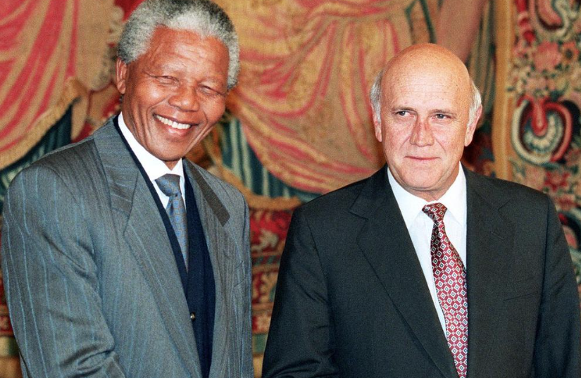
Nelson Mandela and F.W. deKlerk
Win Nobel Peace Prize
Notes:
For bringing peaceful end to apartheid in South Africa. Mandel would go on to win presidency of South Africa in ‘94

Slide 11
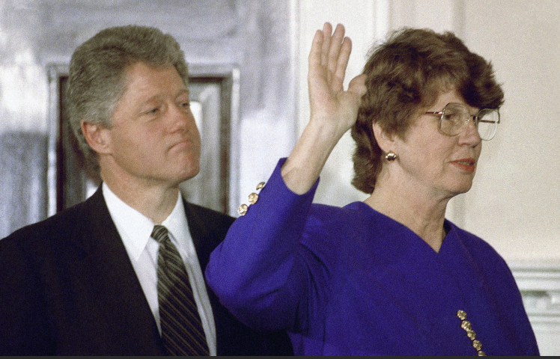
Women Moving Up !
Janet Reno sworn in as the first female U.S. Attorney General

Slide 12
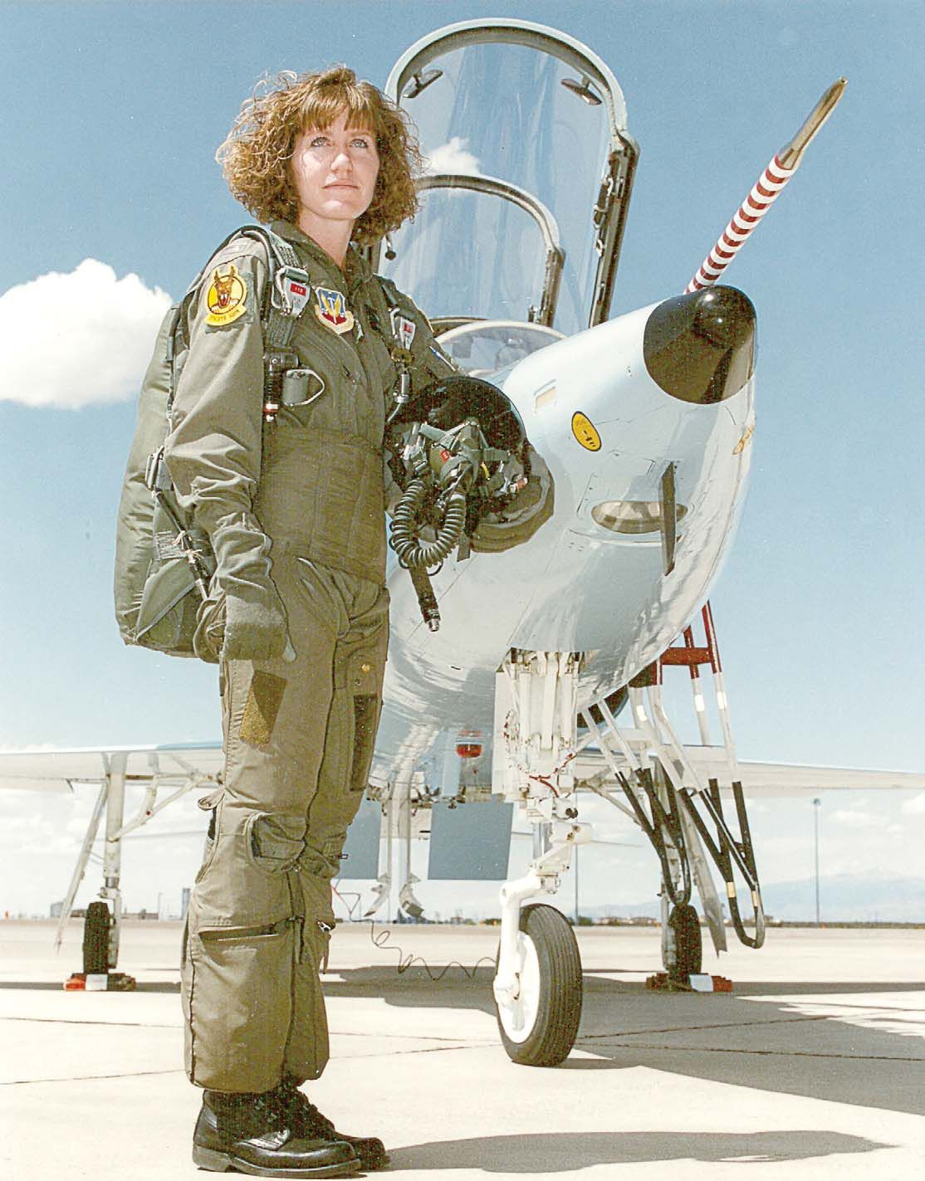
Women
Moving Up !
Congress approves USAF female
pilots can fly combat missions!
Notes:
Jeannie Levitt (pictured here) was the first combat pilot, flying an F-15; she attended UT-Austin and earned a BS in Aeronautical Engineering’; she went on to become the first woman to command a USAF combat wing (as Major General)

Slide 13
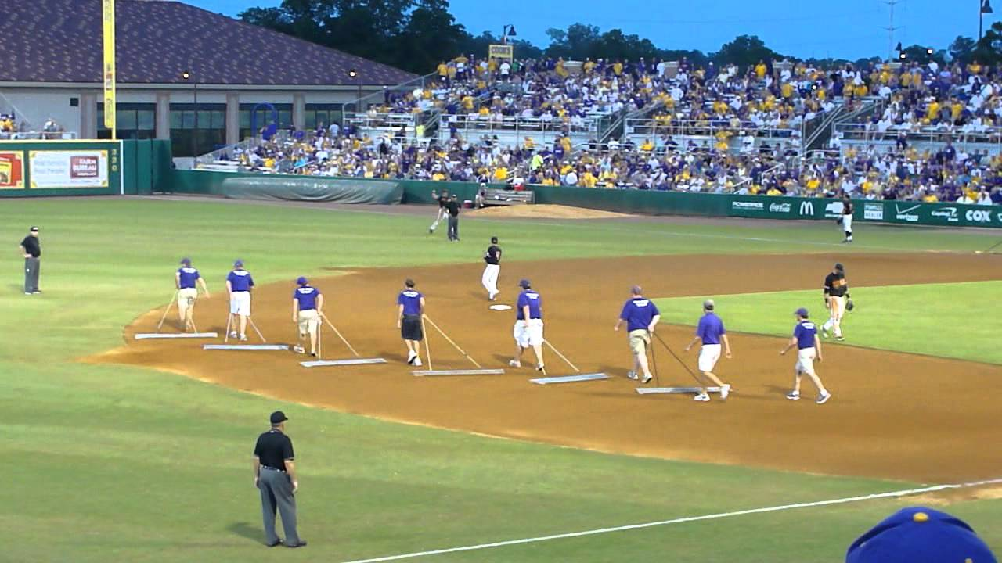
In Between Innings

Slide 14
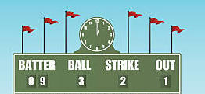

Scoreboard Quiz – At the Movies
h
This science fiction movie was a thriller about bringing dinosaurs back to life. It won three Oscars and grossed almost $1 billion.
Godzilla
Jurassic Park
The Land Before Time

Slide 15

Scoreboard Quiz – At the Movies
h
Tom Hanks starred in this movie about the life adventures of a slow-witted Southern boy. It won six Oscars and was top seller in 1994.
The Million Dollar Man
Jimmy Dolittle
Forrest Gump
https://www.youtube.com/watch?v=gAw9Ps-jwzM
Notes:
His mom was played by Sally Field and his commander in Vietnam (“Lt. Dan”) was played by Gary Sinise . Tom Hanks won Best Actor Academy Award.

Slide 16
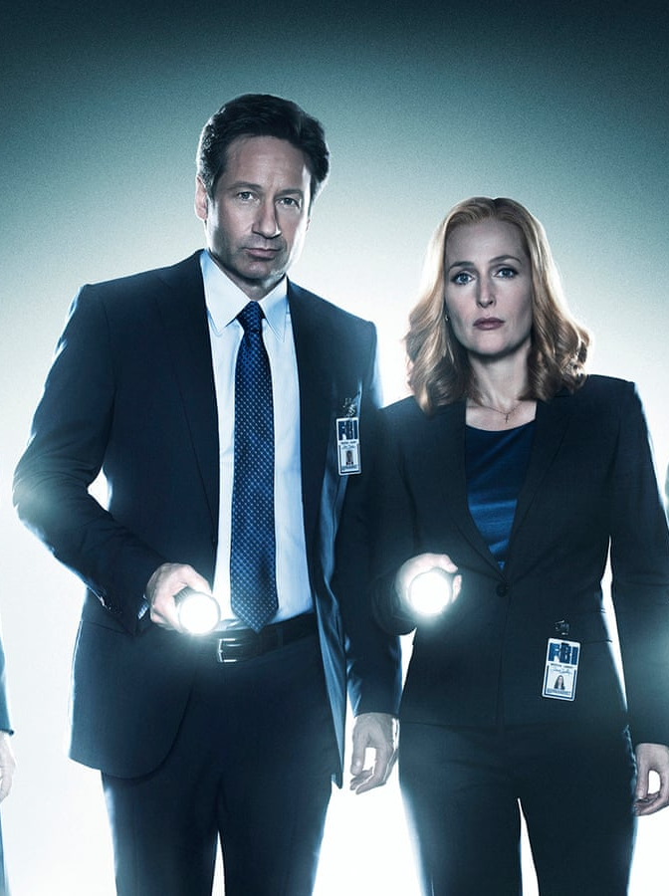
Scoreboard Quiz – TV debuts
h
This TV science fiction series was about FBI agents (Mulder and Scully) investigating unsolved paranormal reports. David Duchovny and Gillian Anderson starred in the two roles.
X-Files
Ghostbusters
Twilight Zone

Slide 17
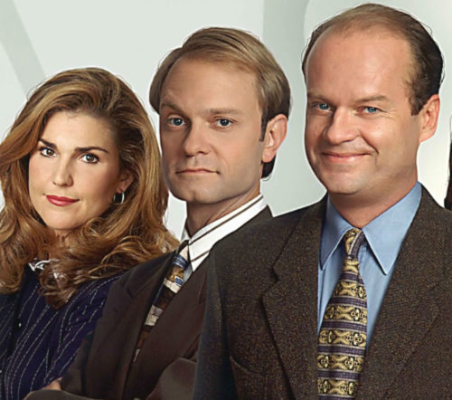
Scoreboard Quiz – TV debuts
h
This TV comedy series was a spin-off from “Cheers” and featured Kelsey Grammer in the lead role as a psychiatrist dealing with his father and pretentious brother , along with patients, love interests and many others.
Frasier
Seinfeld
Doogie Howser

Slide 18

Scoreboard Quiz – TV debuts
h
This TV animated comedy series featured two teenage slackers and their mis-adventures in their hometown of Highland, Texas. The two quickly became pop-culture icons and starred in several spin-off movies.
Rocky and Bullwinkle
Lone Ranger & Tonto
Beavis and Butthead

Slide 19

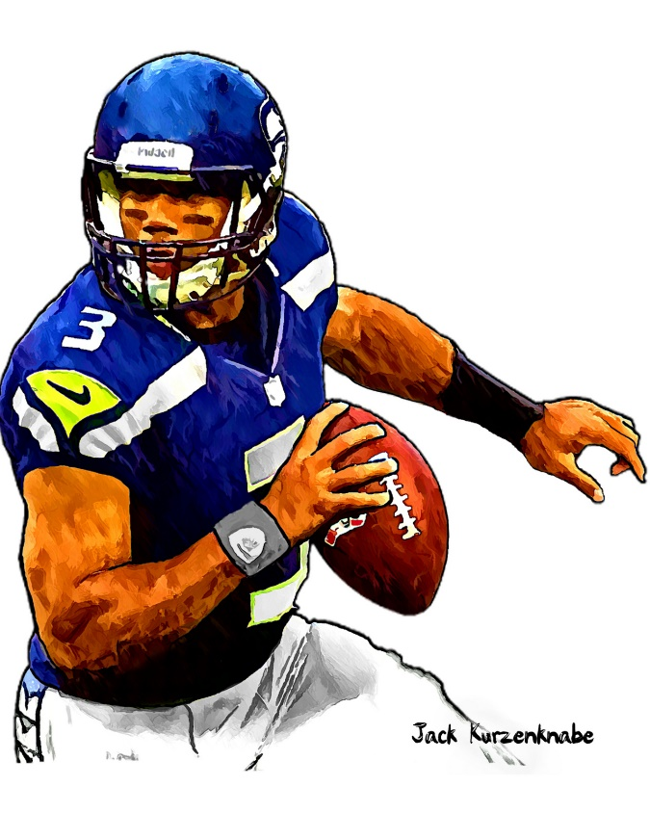

1993-1994 Sporting News

Slide 20
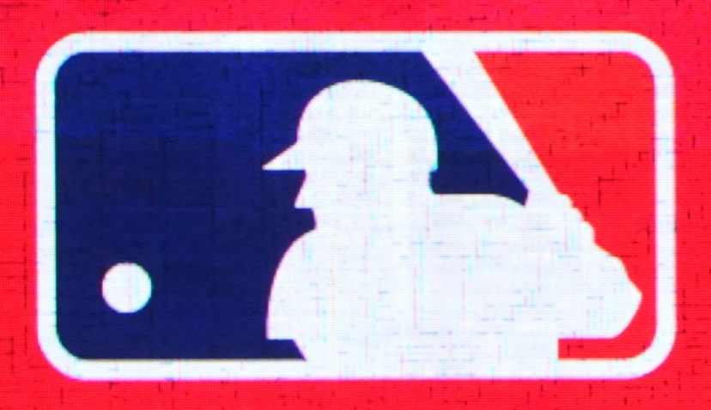


Major League Baseball Expands
Two more teams are added, both in the National League

Slide 21

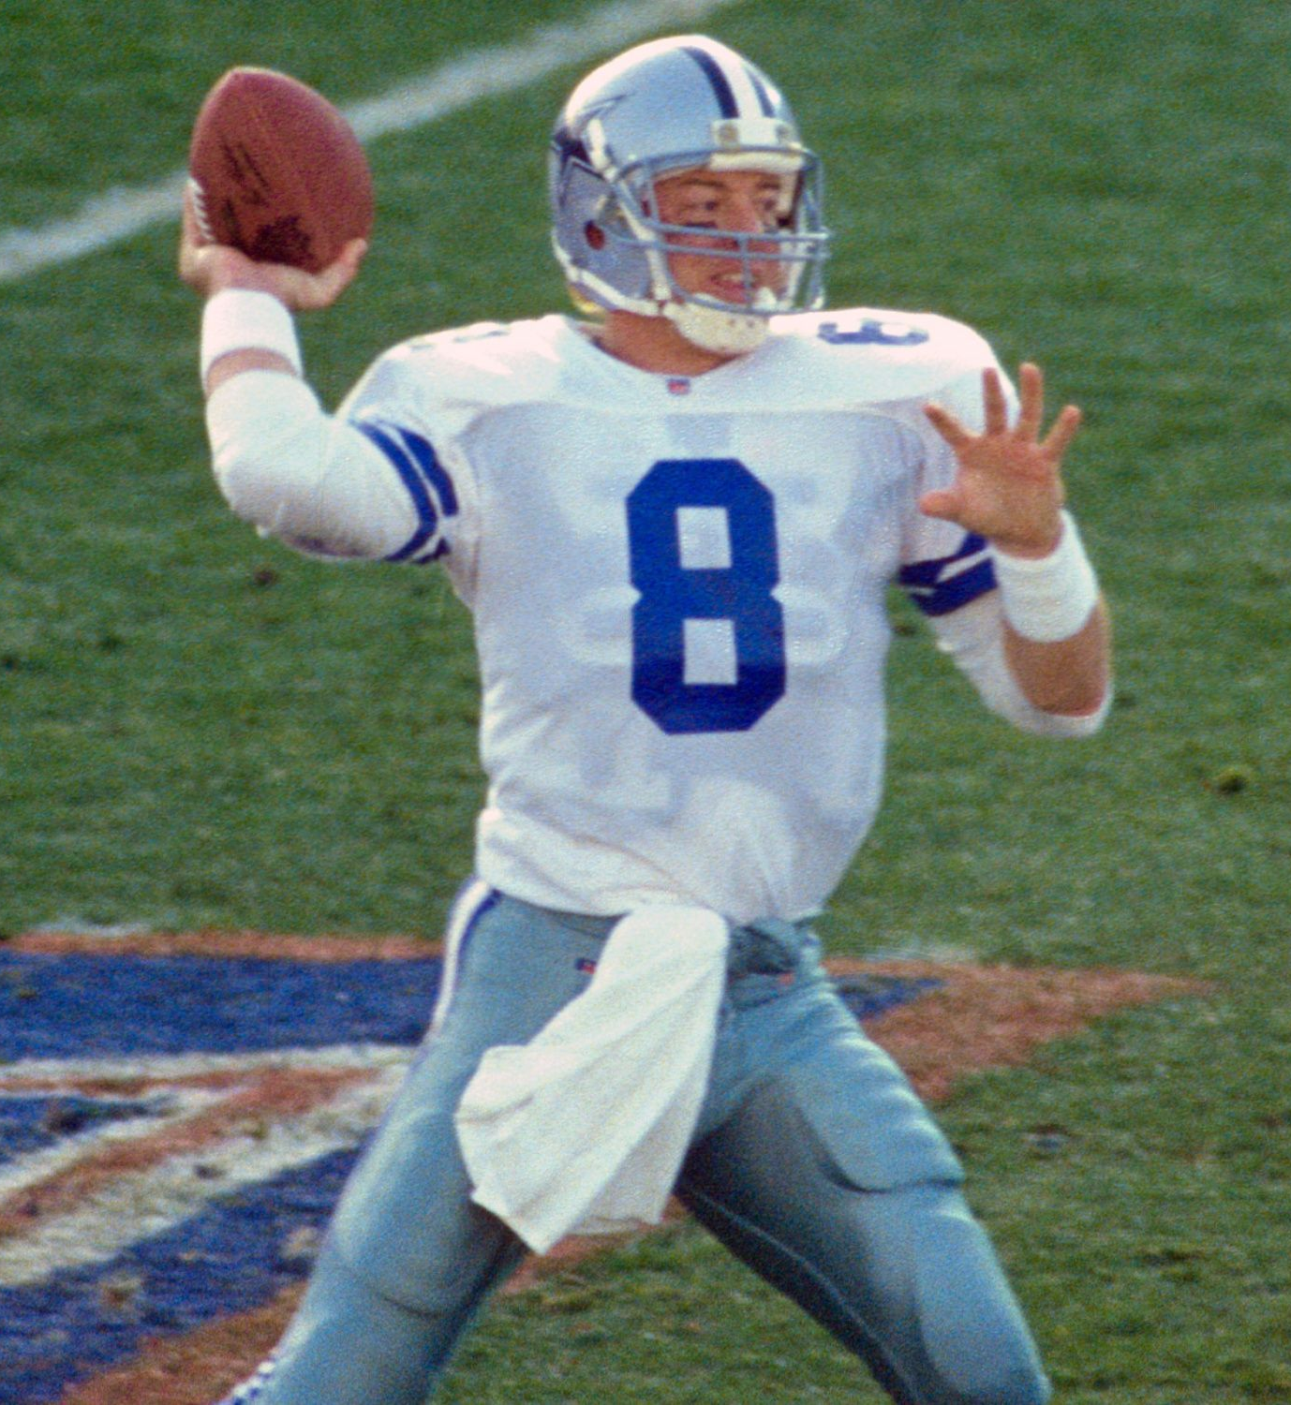

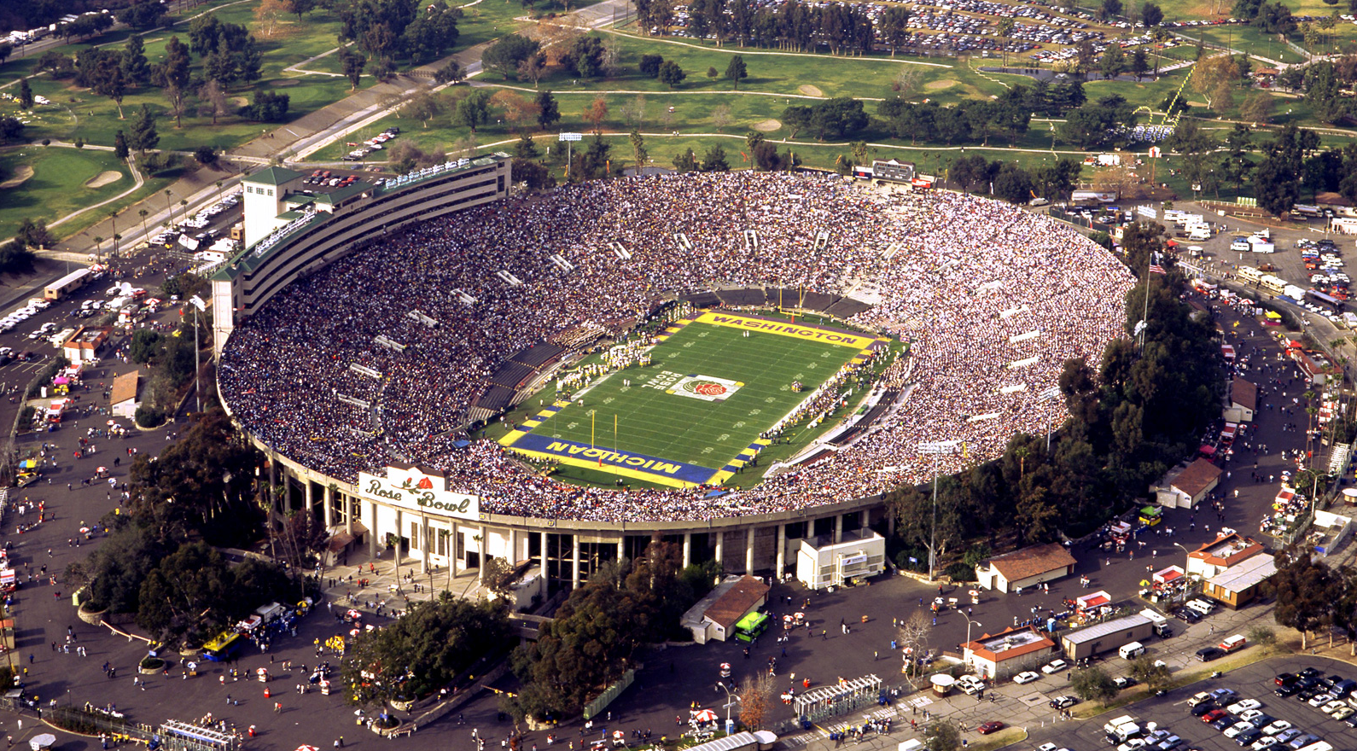

52
to
17
Dallas QB
Troy Aikman was MVP
Played at the Rose Bowl

Slide 22


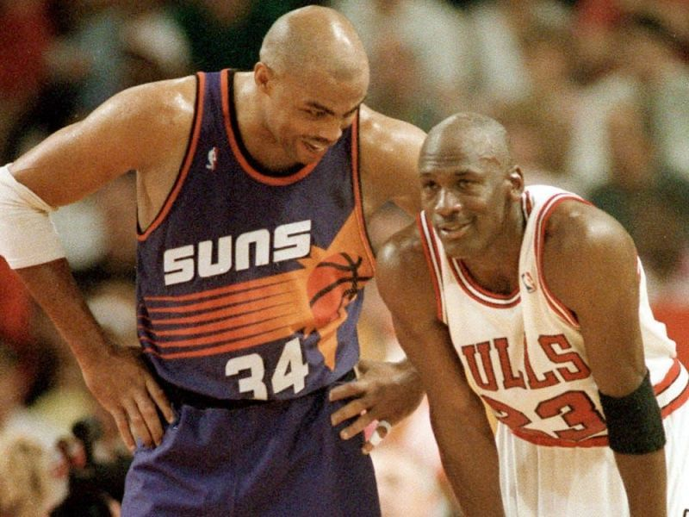
The Bulls faced off against the Phoenix Suns
The Bulls won their 3rd consecutive Finals!
https://www.youtube.com/watch?v=4lL54S8Ww6A
Notes:
The Bulls were ahead 3 games to 2, but were down 98-96 in Game 6 and have to inbound the ball 14 seconds left in the game! The Bulls became the first team since the 1961 Boston Celtics to win three consecutive titles.

Slide 23
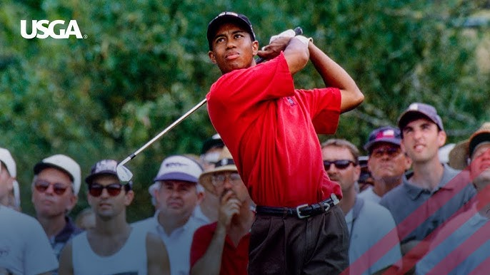
Tiger Woods wins 3rd consecutive U.S. Junior Amateur Championship

Slide 24
The Year in Baseball: 1993

Slide 25
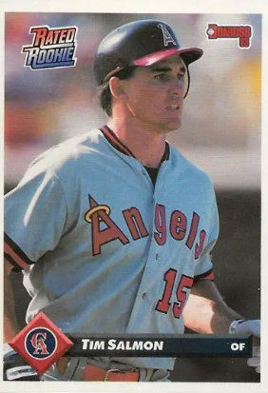
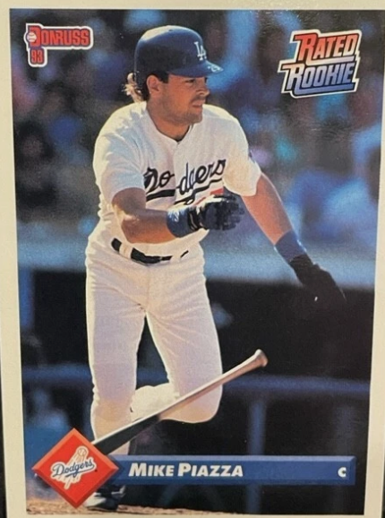
1993
Rookies
of the
Year
.283 31 HR 95 RBI
.318 35 HR 112 RBI
Notes:
Mickey Mantle hit 37 homers to lead the AL. He also led the league in triples, walks, and SLG.

Slide 26
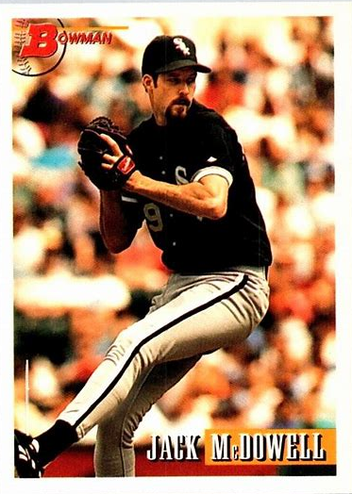
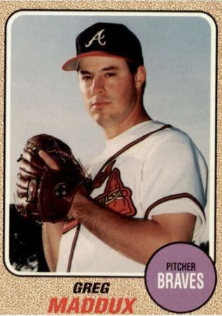
1993
Cy Young
Winners
22 – 10 3.37 ERA 256 IP
20-10 2.36 ERA 267 IP

Slide 27
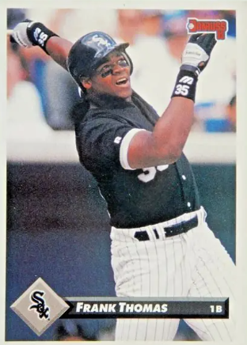
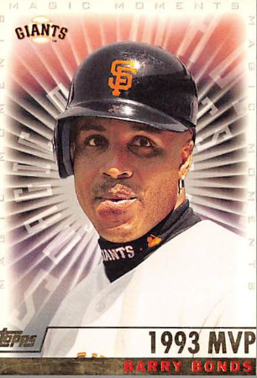
1993 Most Valuable Players
46 HR 123 RBI .336
.317 36 HR 112 RBI
Notes:
Frank Thomas “The Big Hurt”

Slide 28
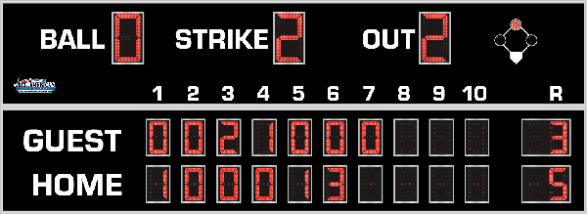
7th Inning Stretch

Slide 29
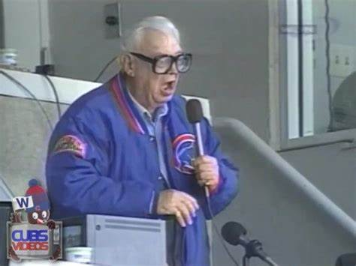
“Take Me Out to the Ballgame”

Slide 30
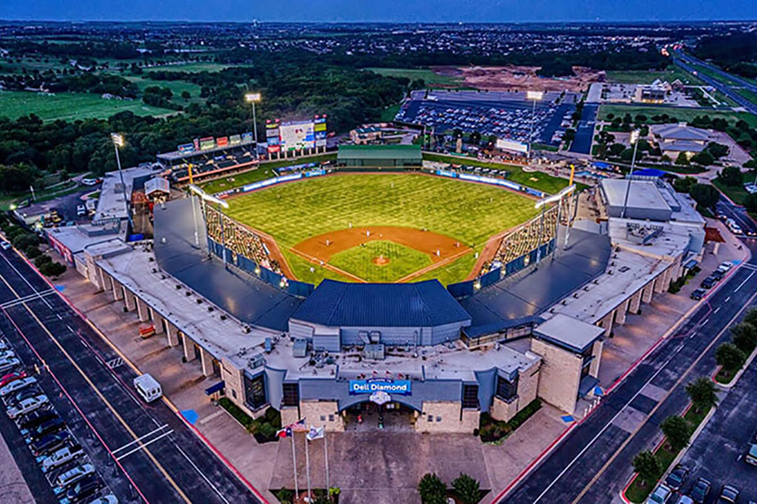
“Deep in the Heart of Texas
https://www.youtube.com/watch?v=rcrK0U7RDIk

Slide 31
“Do the Hokey Pokey”
https://www.youtube.com/watch?v=vpharBeg9XA

Slide 32



1993 LCS
Best 4 of 7 format
Phillies
won 4 - 2
Blue Jays
won 4 - 2

Slide 33

1993 World Series
vs.
The BlueJays are the defending
World Series Champs

Slide 34
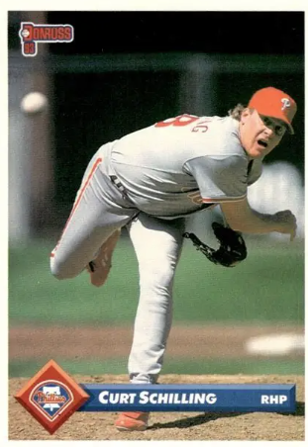
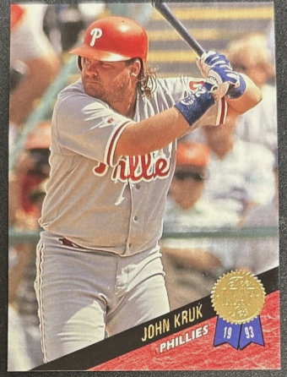
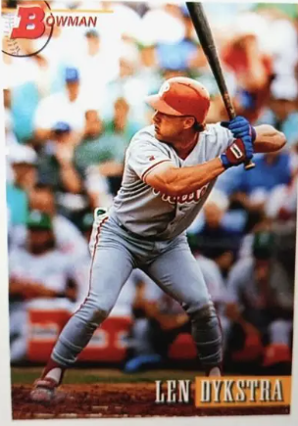
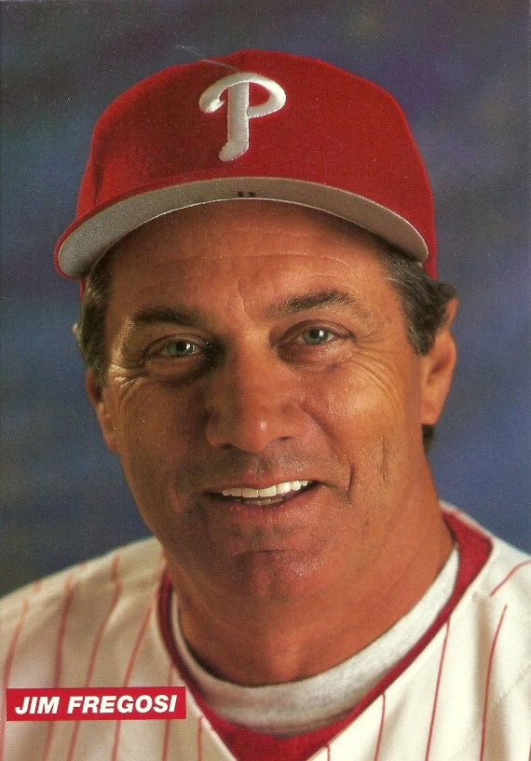
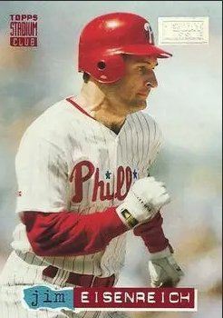
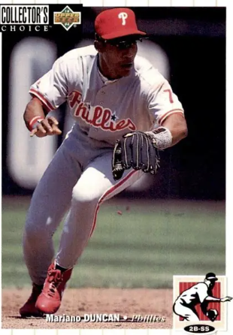
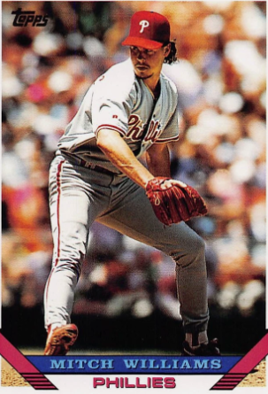
1993
Phillies

Slide 35
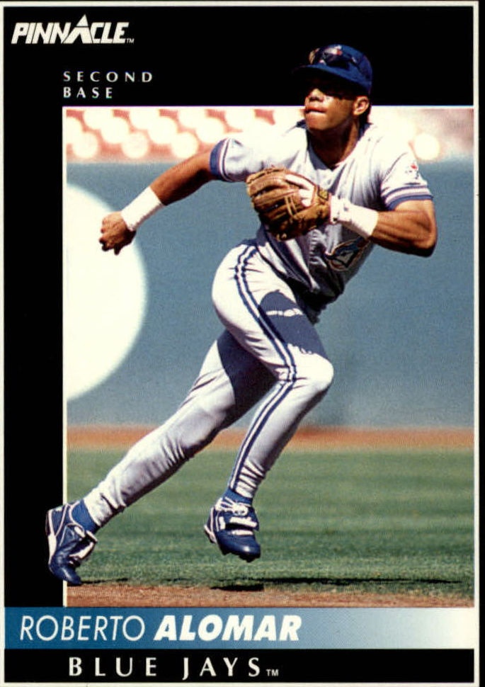
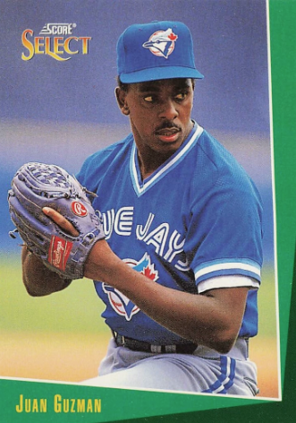
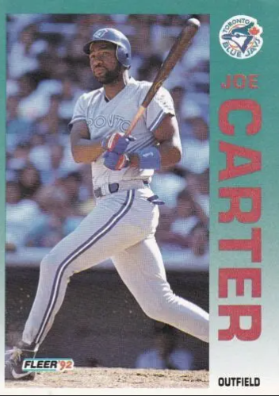
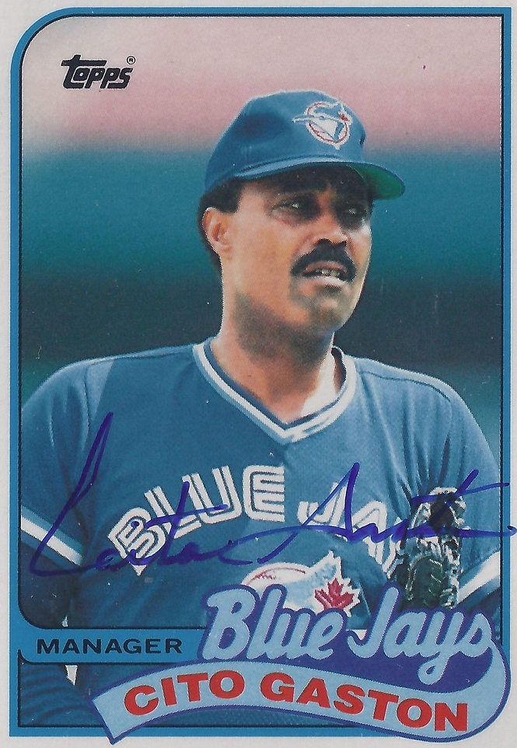
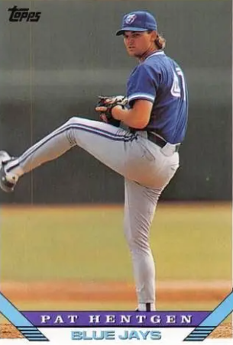
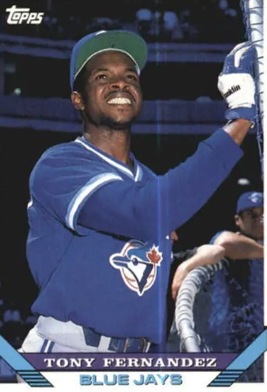
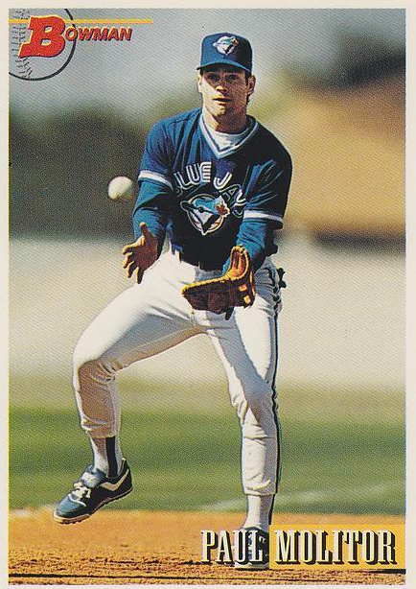
1993
Blue Jays

Slide 36

1993 World Series Highlights
Game 1 – October 16
The game was tied at 4-4 thru the 5th inning. The ‘Jays went ahead to stay with a three-run 7th inning . CF Devon White had a HR, 2 RBI and scored 3 times to lead the offense.
Toronto 8 – Phillies 5
Game 2 – October 17
RF Jim Eisenreich hit a 3R homer during the Phillies 5-run 3rd inning. That was all the scoring they needed to tie the series.
Phillies 6 – Toronto 4
SERIES TIED 1-1
AS THEY MOVE TO PHILADELPHIA
Toronto SkyDome

Slide 37

Game 3 – October 19
Toronto scored 3 in the top of the 1st and never looked back. 1B Paul Molitor drove in 3 and 2B Roberto Alomar had 4 hits.
TORONTO 10 – PHILLIES 3
Game 4 – October 20
BlueJays scored 6 runs in the top of the 8th to win this slugfest. CF Devon White had 4 RBI and SS Tony Fernandez had 5. There were a total of 31 hits in the game!
TORONTO 15 - PHILLIES 14
Game 5 – October 21
Phillies starter Curt Shilling pitched a 5-hit, complete game shutout to keep his team alive.
PHILLIES 2 - BLUE JAYS 0
BLUE JAYS LEAD THE SERIES
3-2 AS PLAY MOVES BACK TO TORONTO
Veterans Stadium
Philadelphia

Slide 38
1993 World Series Highlights
Game 6 – October 23
Powered by a Lenny Dykstra 3R homer, the Phillies scored 5 in the top of the 7th inning to take a 6-5 lead.
In the bottom of the 9th inning, the ‘Jays have runners on 1st and 2nd, one out, and clean-up hitter Joe Carter comes to the plate…
https://www.youtube.com/watch?v=6JaG9FQSzLY
Toronto 8 – Phillies 6

Slide 39
Toronto Blue Jays
win
1993 World Series
One of the most exciting World Series of all time!!
Lots of offense: a total of 122 hits and 81 runs
The Blue Jays repeated as World Series champs
Joe Carter hit only the second World Series winning “walk off” home run !!
(Bill Mazeroski of the Pirates was the first in 1960)
‘Jays DH/1B Paul Molitor was MVP

Slide 40
The Year in Baseball: 1994

Slide 41
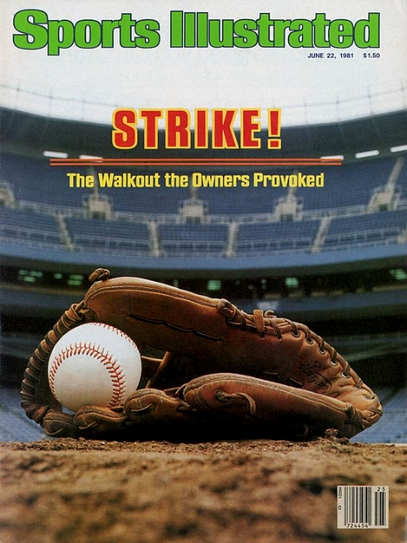
The Year in Baseball 1994

Slide 42
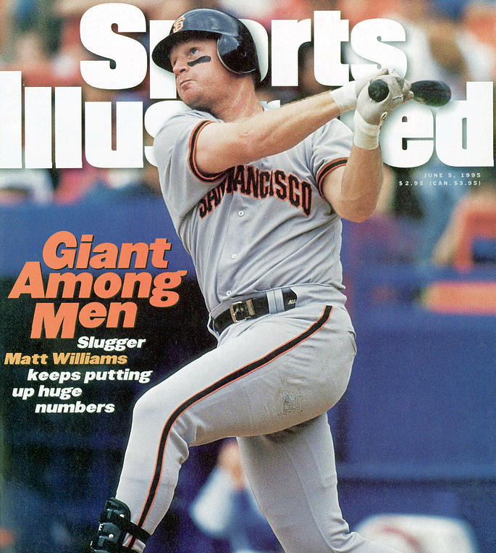

The Year in Baseball 1994
Would of, could of, should a’ !!

Slide 43



Slide 44
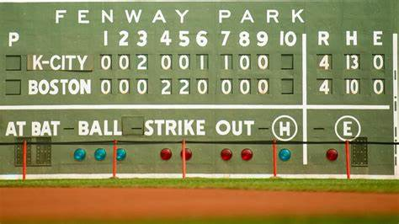
Extra Innings!

Slide 45

Popular TV Shows of the 1980s-1990s

Slide 46
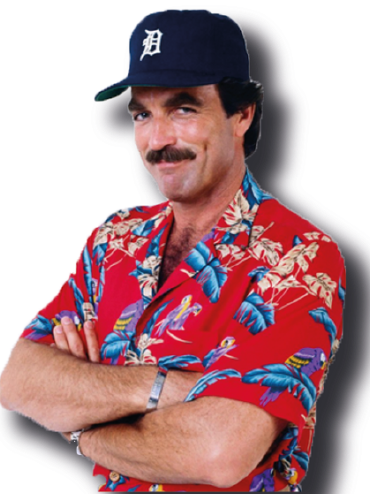
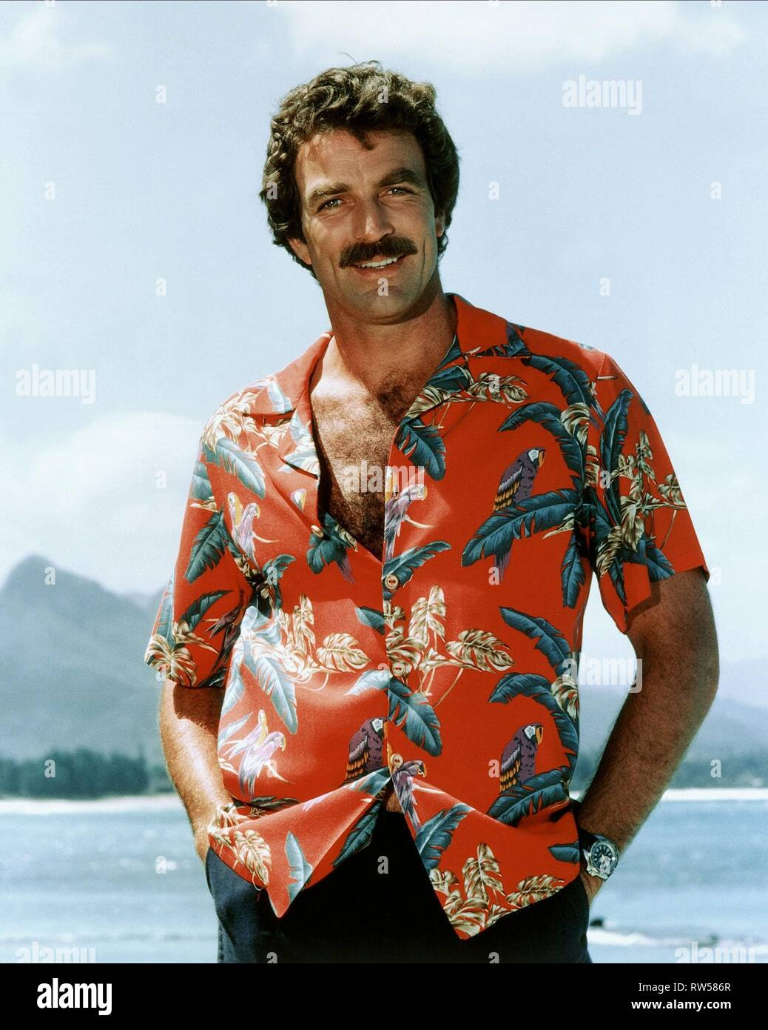
This crime drama was set in Hawaii and starred popular actor Tom Selleck. He portrayed a private investigator, who lives a plush life-style on the estate of a wealthy benefactor.
Selleck’s character often wears a baseball cap from his favorite major league team …
Magnum P.I.

Slide 47
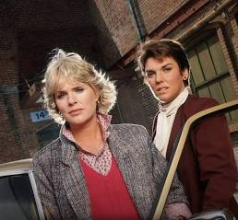
Actresses Sharon Gless and Tyne Daly starred in this police drama as New York City police detectives.
Beginning with the show’s second season in 1983, and for the next six seasons, one or the other of these two actresses won the Emmy Award for
Best Lead Actress in a Drama !
Cagney & Lacey

Slide 48
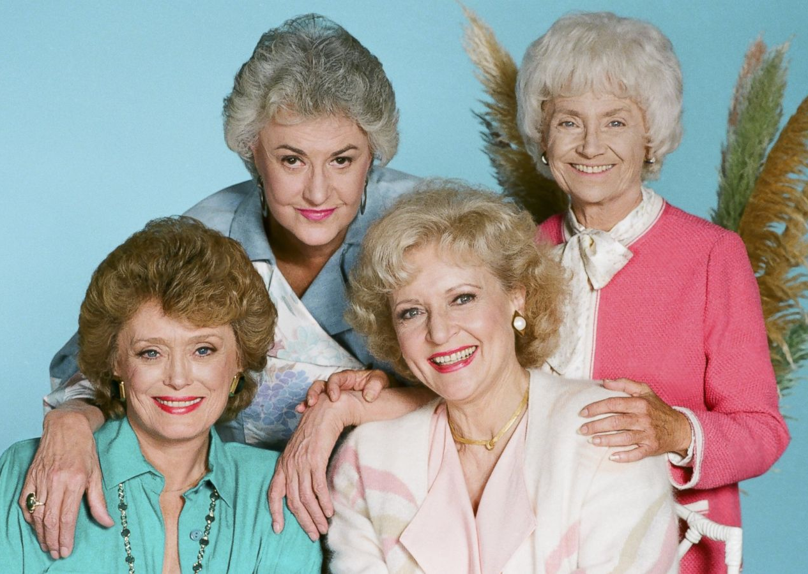
This sitcom starred Bea Arthur, Betty White, Rue McClanahan, and Estelle Getty. The plot centered around the four older single women that shared a house in Miami.
The series won numerous awards as an outstanding comedy.
All four of the actresses won at least one Emmy Award.
Golden Girls

Slide 49
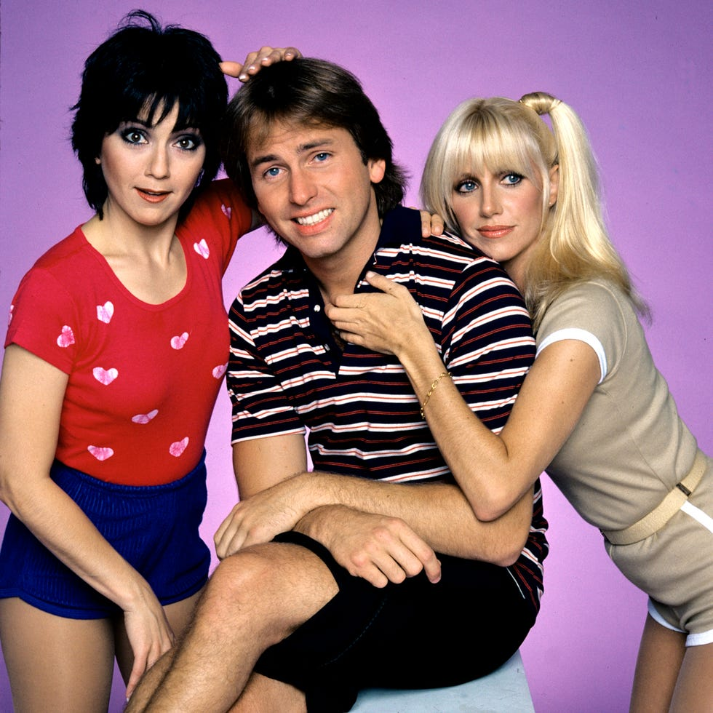
This farcical sitcom starred John Ritter, Suzanne Somers, and Joyce DeWitt as unlikely roommates.
The landlord had a rule against unmarried singles living together, but relented when the women convinced him that the John Ritter character was gay.
The series ranked in the Top 10 of TV shows for 6 of its 8 seasons.
Three’s Company

Slide 50

Thanks!
We’ll see you again next month!!

