Slide 1

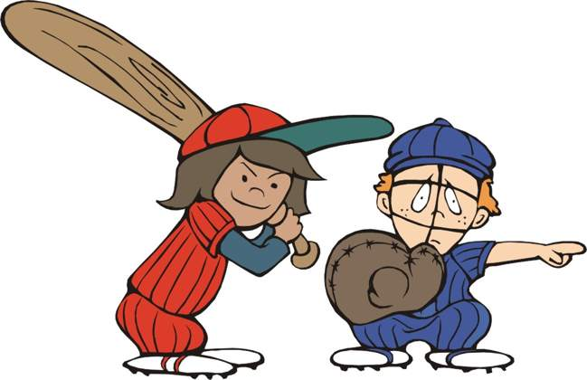


AGE Thrive
with
Baseball Memories

Slide 2

AGE Thrive with Baseball Memories
November 19, 2025
We’re happy to be with you today!
AGENDA
Warm-up - Introductions
Current Events
Gametime – The Year in Baseball – 1997
Seventh Inning Stretch - “Take Me Out to the Ball Game”
Get Up and Move, Sing, Dance!
Extra Innings – More stuff from the past

Slide 3


Slide 4


The 2025 World Series !
Dodgers
win 4 games to 3
Have won back-to-back titles
(2024 and 2025)
Another exciting World Series
Dodgers win their 9th World Series title

Slide 5





FOOTBALL
Volleyball too!

Slide 6

History from 1997

Slide 7
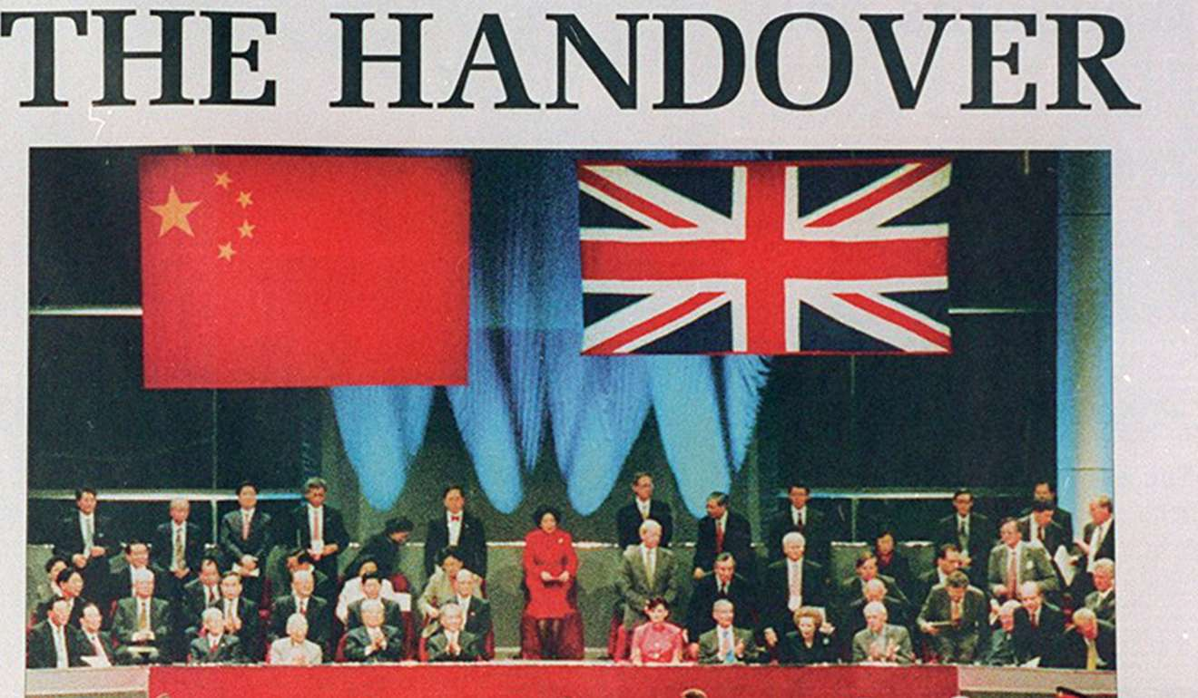
Hong Kong reverts to China
Notes:
Hong Kong Handover: On July 1, the United Kingdom transferred sovereignty of Hong Kong to China, ending 156 years of British colonial rule – first as a territory acquired during the 1st Opium War (1841-2) and then leased to Britain in 1898 for a term of 99 years.

Slide 8
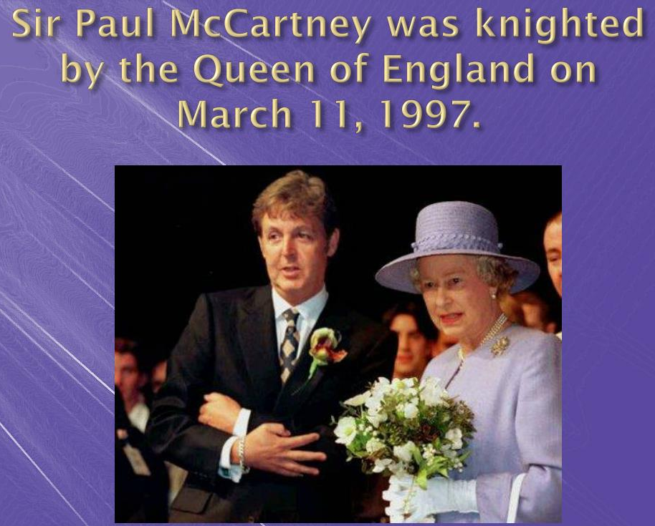
A
knighthood
for one of
The Beatles
Notes:
The former Beatle was knighted by Queen Elizabeth for "services to music". He dedicated his honor to his former band mates John, George and Ringo. Ringo said from this day forward we'll call Paul "His Holiness". Ringo was later knighted in 2018.

Slide 9
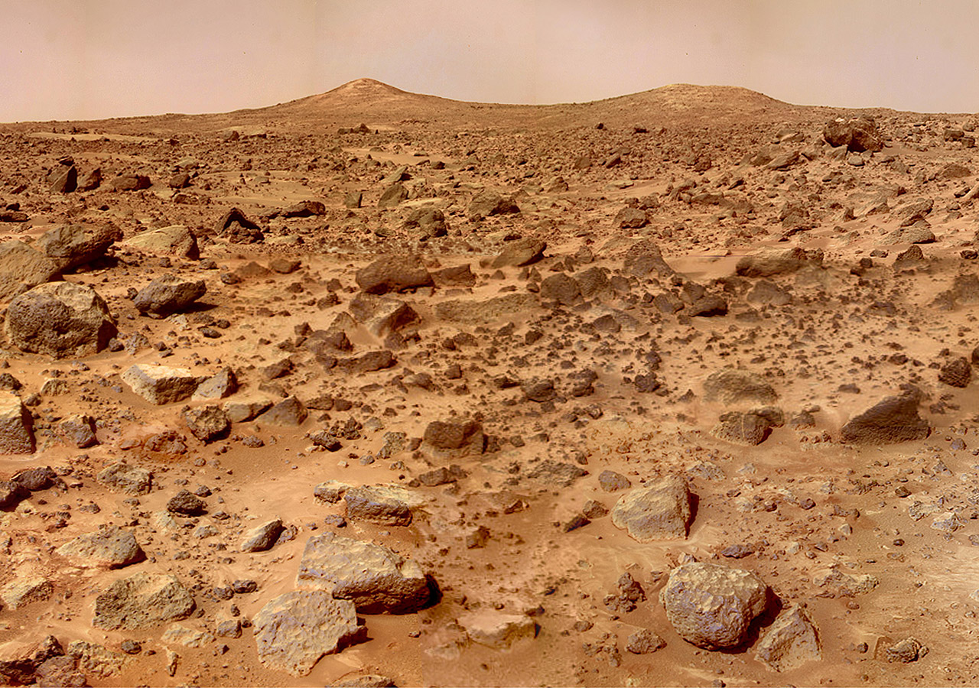
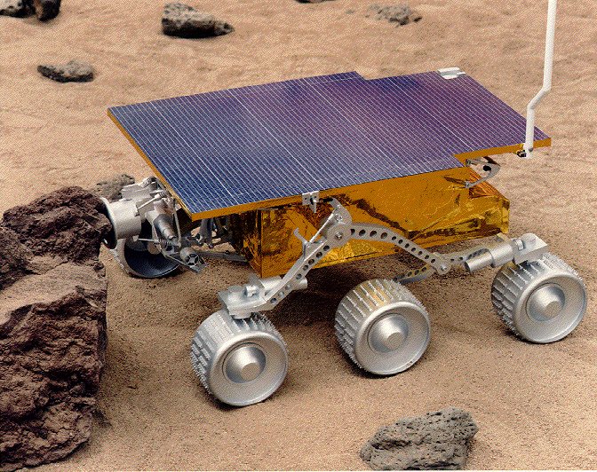
Pathfinder lands on Mars
Notes:
Mars Pathfinder lands on Mars: NASA's Mars Pathfinder successfully landed on July 4, deploying the Sojourner rover and marking a major milestone in planetary exploration. This was the first rover deployed beyond the Moon. Sojourner was only 26 in long and 12 in high!

Slide 10
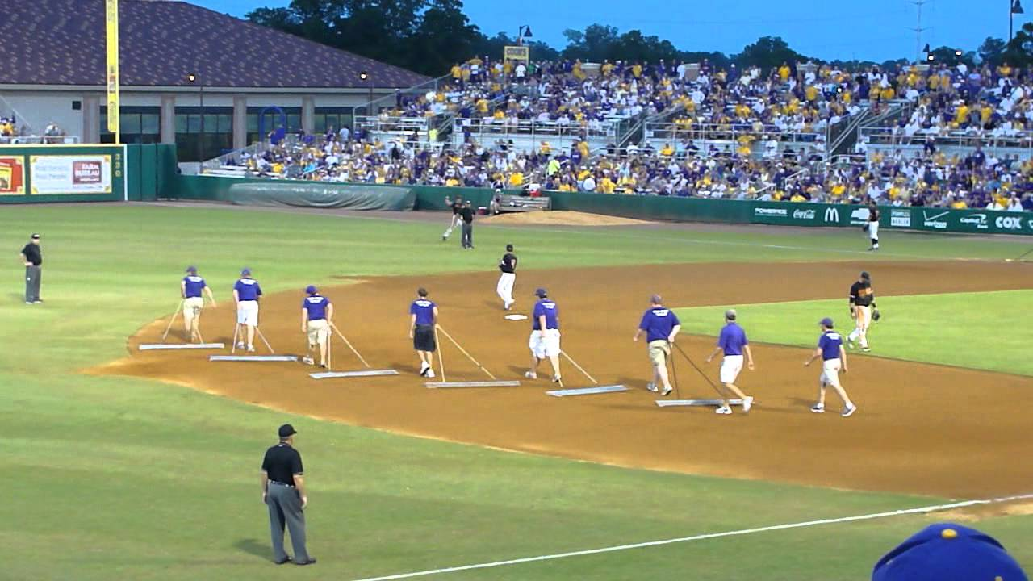
In Between Innings

Slide 11
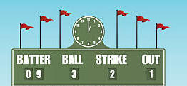
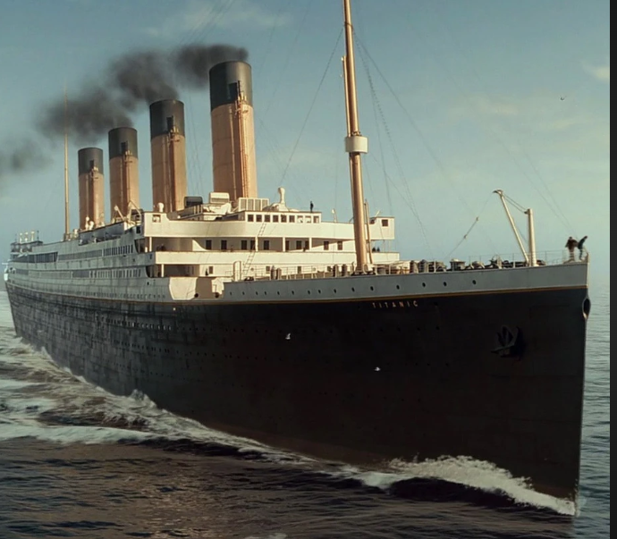
Scoreboard Quiz – 1997 At the Movies
h
This film about a famous sinking was the first to gross over $1 billion in sales. It starred Leonardo DiCaprio and Kate Winslet and won 11 Oscars.
Bismarck
Titanic
Edmund Fitzgerald

Slide 12

Scoreboard Quiz – 1997 At the Movies
h
This science fiction movie starred Will Smith and Tommy Lee Jones as secret agents chasing extra-terrestrials. It was nominated for three Oscars.
Danger Men
Dr. No
Men in Black
Notes:
Won Oscar for Best Makeup. Grossed over ½ Billion dollars.

Slide 13
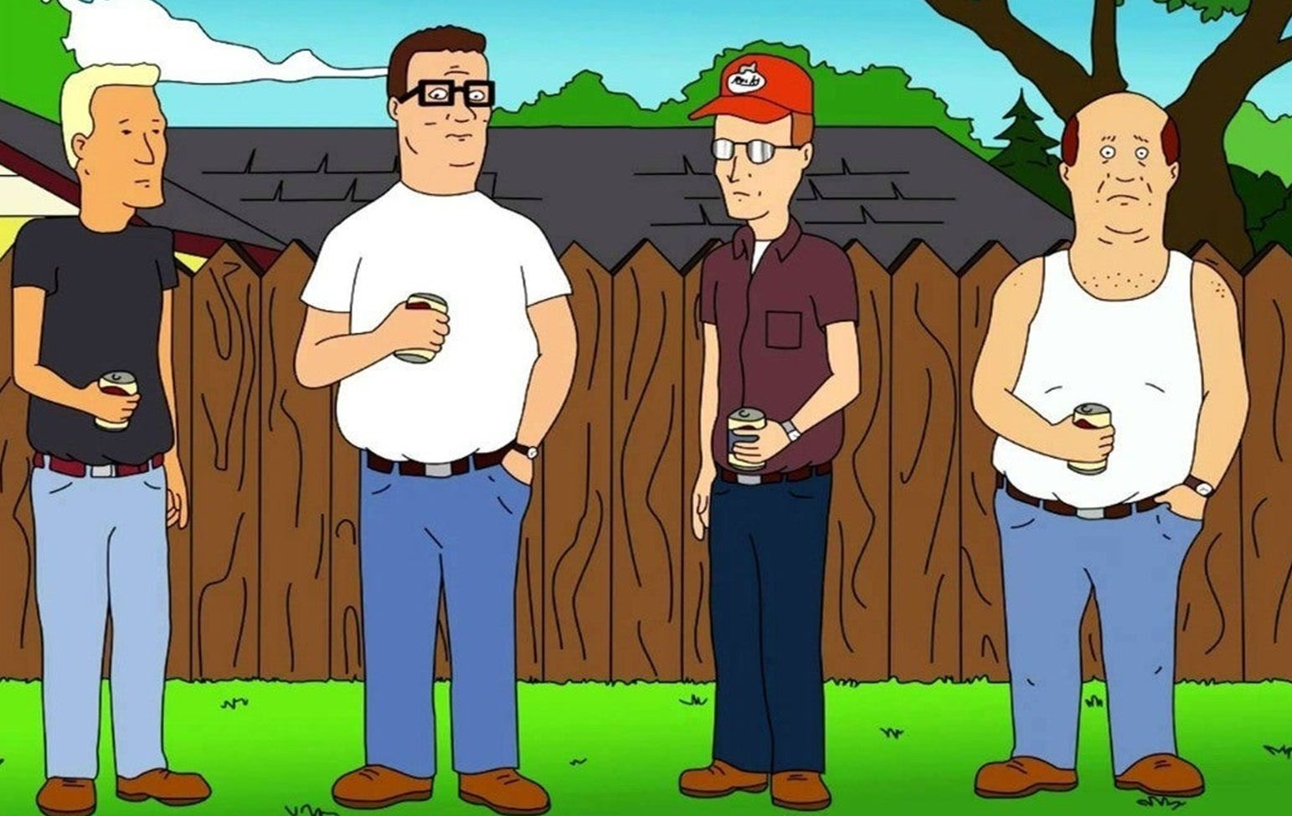
Scoreboard Quiz – 1997 TV Premier
h
This animated comedy centers around a family and friends in fictional Arlen, Texas. It has run for over 270 episodes.
King of the Hill
The Jetsons
The Flintstones

Slide 14
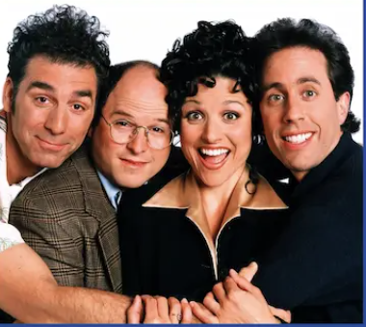
Scoreboard Quiz – 1997 TV Hits
h
This popular comedy featured characters Kramer, George, Elaine, and Jerry in the “little show about nothing”:
Friends
Seinfeld
Cheers

Slide 15

Scoreboard Quiz – 1997 TV Hits
h
This popular TV show starred comedian Tim Allen as the host of a fictional do-it-yourself TV show called “Tool Time”:
This Old House
Fixer Upper
Home Improvement
Notes:
It was inspired by the PBS TV show “This Old House”

Slide 16

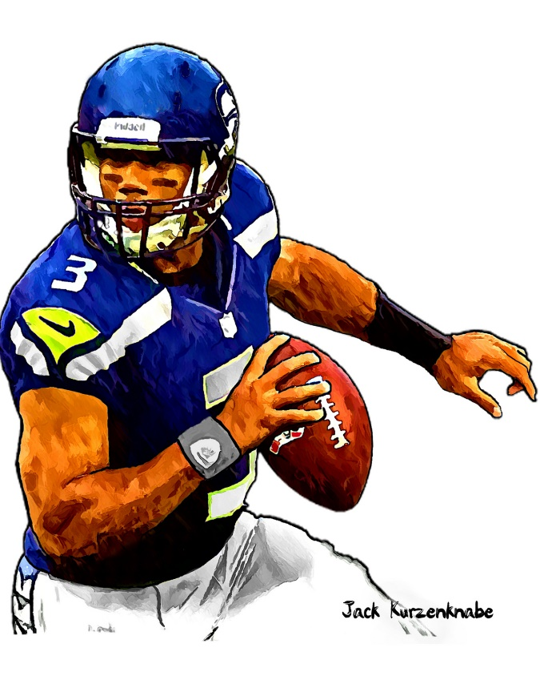

1997 Sporting News

Slide 17

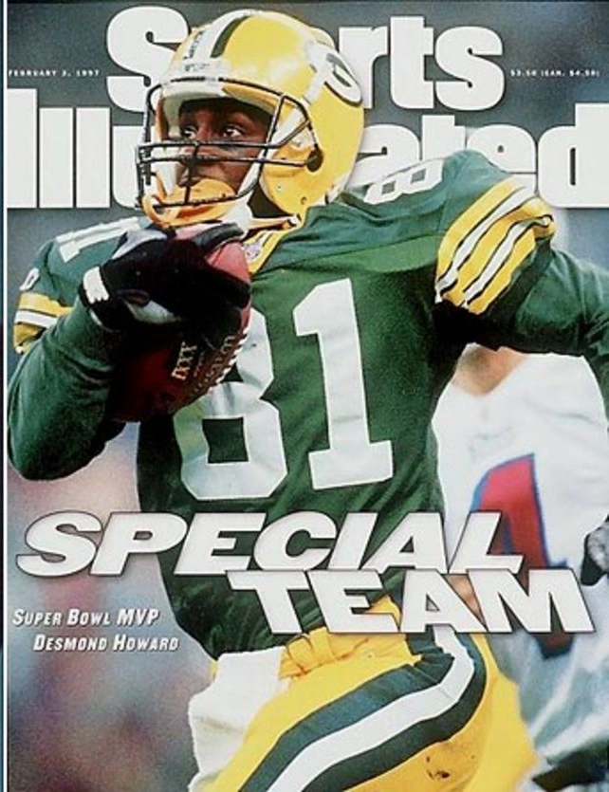
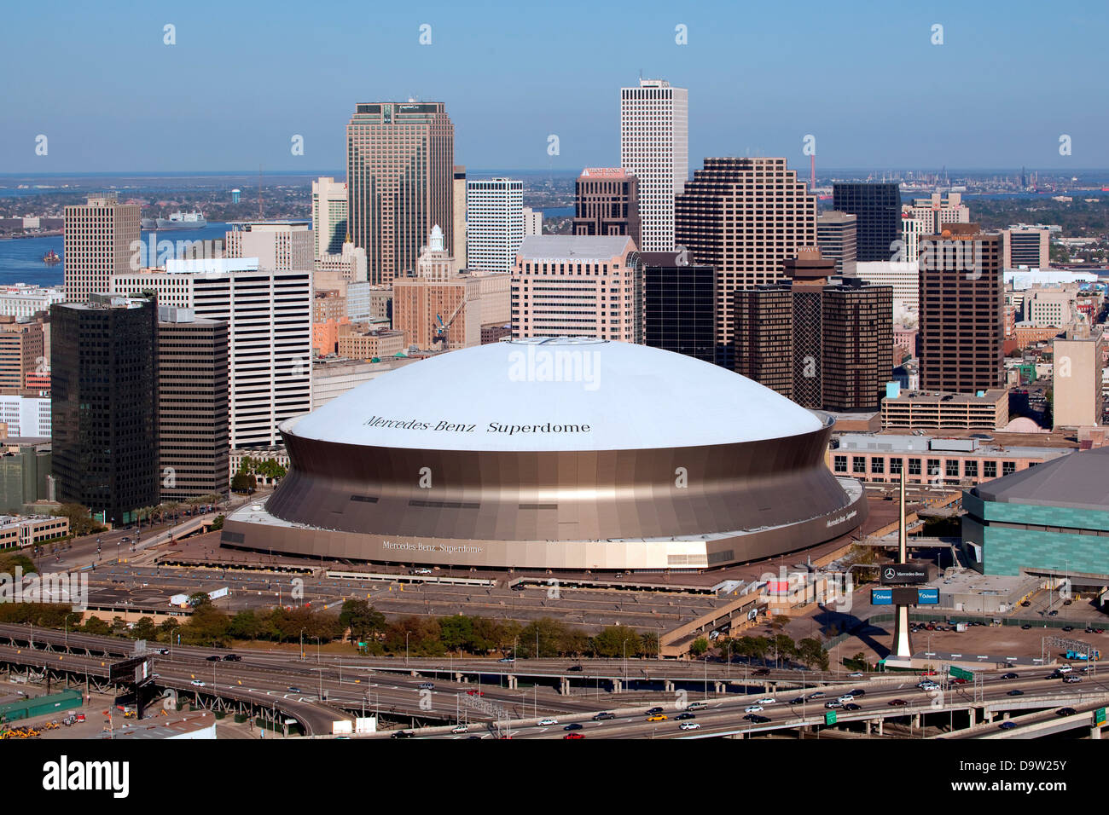


35
to
21
Played at the Louisiana Superdome
Packers return specialist
Desmond Howard was MVP

Slide 18


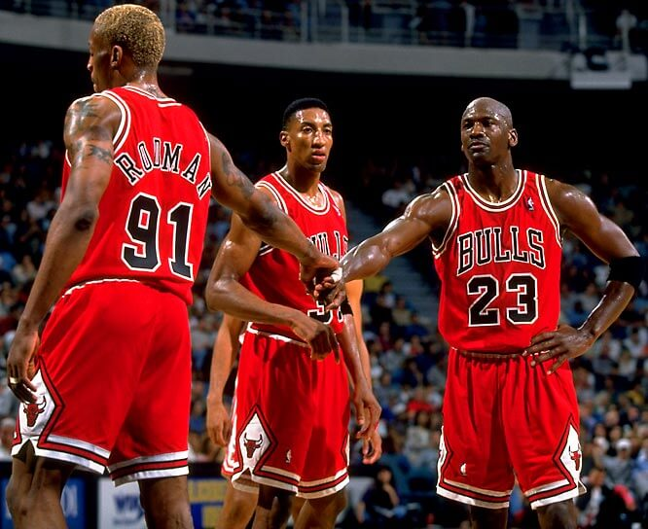
The Bulls faced off against the Utah Jazz
The Bulls won their 5th Finals of the 1990s !

Slide 19
The Year in Baseball: 1997

Slide 20
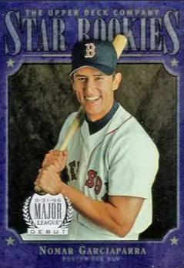
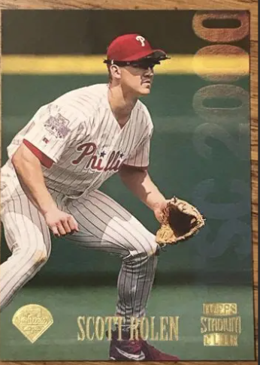
1997
Rookies
of the
Year
.306 30 HR 11 triples
.283 21 HR 92 RBI
Notes:
Nomar is married to soccer star Mia Hamm. Rolen was elected to the Baseball Hall of Fame.
Mickey Mantle hit 37 homers to lead the AL. He also led the league in triples, walks, and SLG.

Slide 21
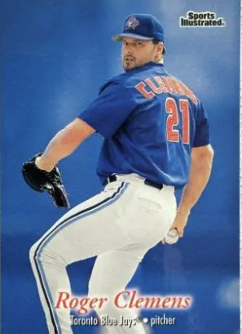
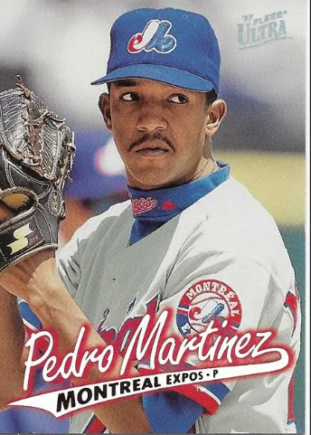
1997
Cy Young
Award
Winners
21 – 7 2.05 ERA 292 K
17 - 8 1.90 ERA 13 CG

Slide 22
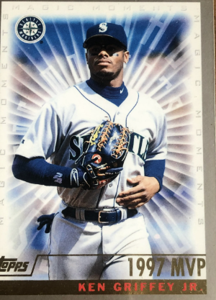
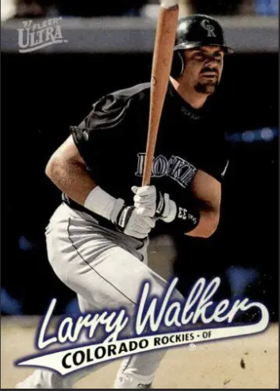
1997 Most Valuable Players
49 HR 130 RBI .366
56 HR 147 RBI 125 R
Notes:
Frank Thomas “The Big Hurt”

Slide 23
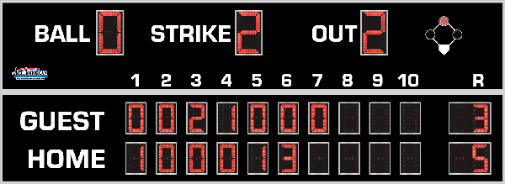
7th Inning Stretch

Slide 24
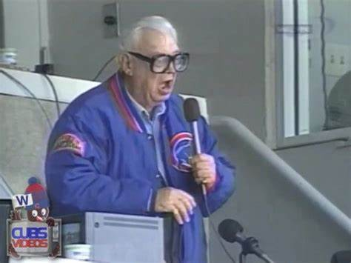
“Take Me Out to the Ballgame”

Slide 25
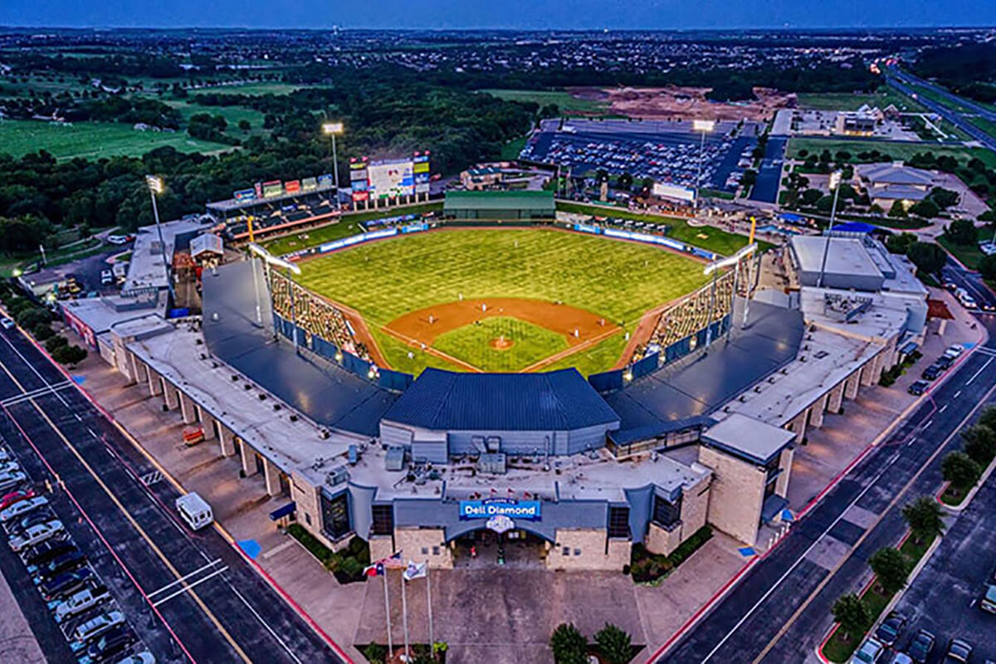
“Deep in the Heart of Texas
https://www.youtube.com/watch?v=rcrK0U7RDIk

Slide 26
“Do the Hokey Pokey”
https://www.youtube.com/watch?v=vpharBeg9XA

Slide 27




1997 LCS
Best 4 of 7 format
Cleveland
won 4 - 2
Florida
won 4 - 2

Slide 28

1997 World Series
vs.

Slide 29
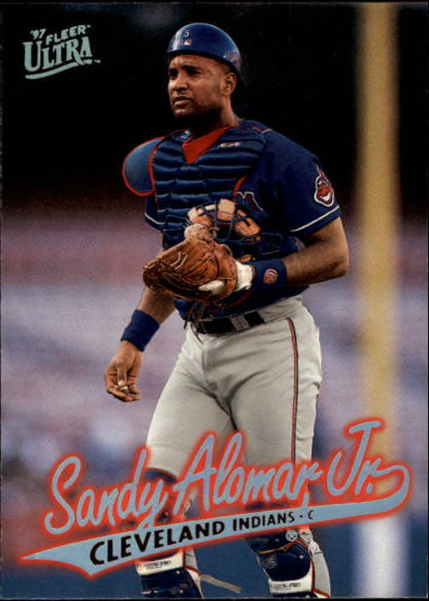
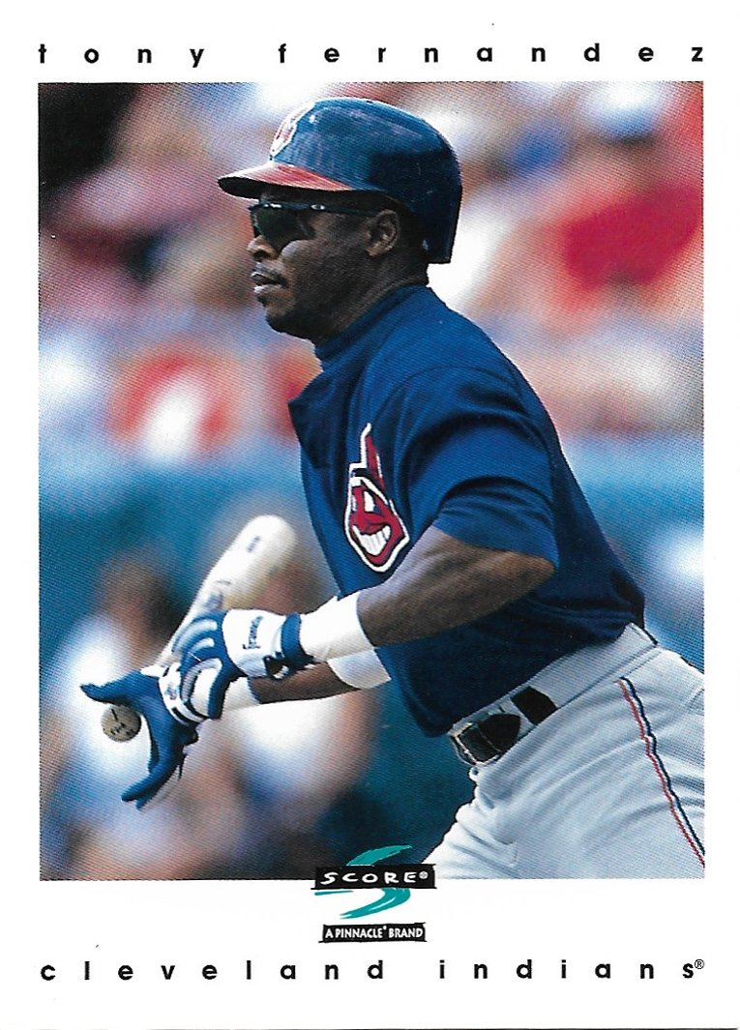
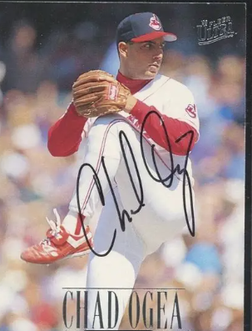
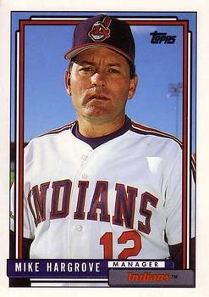
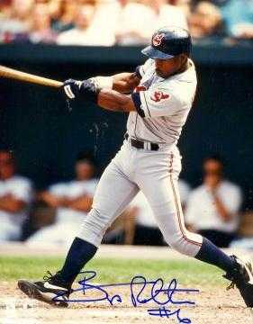
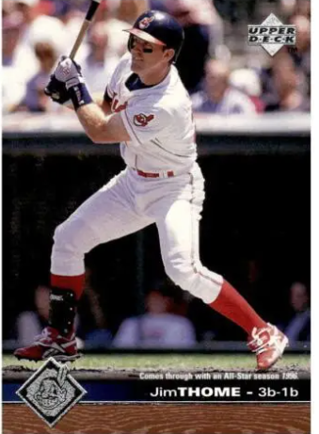
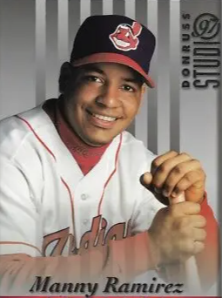
1997
Indians

Slide 30
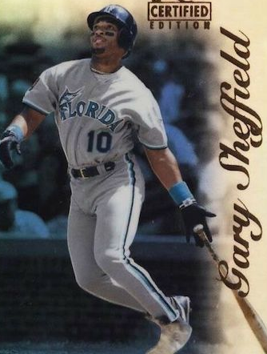
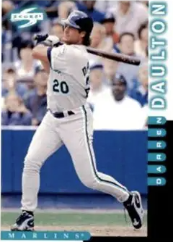
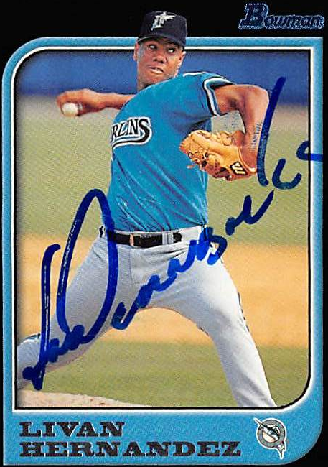
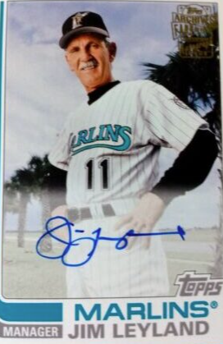
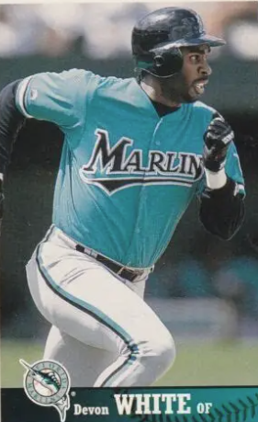
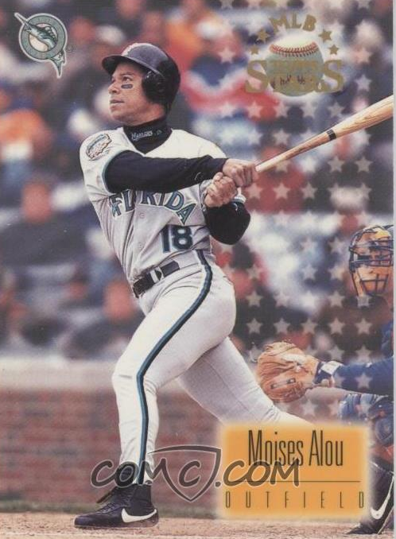
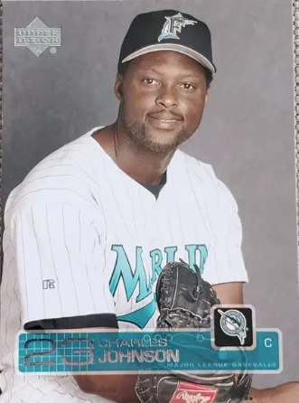
1997
Marlins

Slide 31
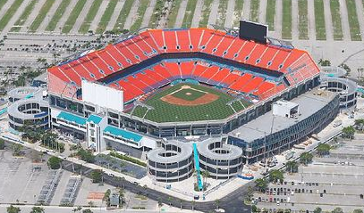
1997 World Series Highlights
Game 1 – October 18
Moises Alou’s 3 run homer in the bottom of the 4th put the Marlins ahead to stay. Livan Hernandez was the winning pitcher.
MARLINS 7 – INDIANS 4
Game 2 – October 19
Bip Roberts singled in two runs in the top of the 5th and Sandy Alomar hit a 2 run homer in the top of the 6th to power the Tribe’s offense. Indians’ starter Chad Ogea got the win.
INDIANS 6 – MARLINS 1
SERIES TIED 1-1
AS THEY MOVE TO CLEVELAND
Pro Player Stadium - Miami

Slide 32
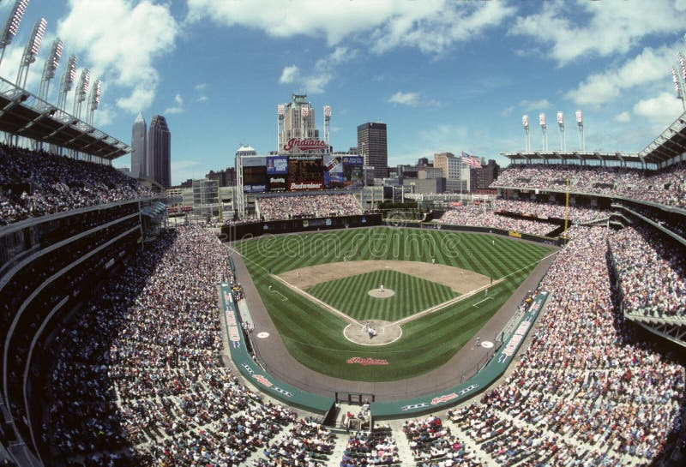
Game 3 – October 21
Marlins’ OF Gary Sheffield drove in 5 runs and 8 of 9 Indians starters had RBIs. This game was a slugfest with a total of 26 hits, 17 walks, and 6 errors. Final score:
MARLINS 14 – INDIANS 11
Game 4 – October 22
OF Manny Ramirez and 3B Matt Williams homered and C Sandy Alomar drove in 3 to help the Tribe even the Series. Indians starting P Jaret Wright got the win, his third in the playoffs.
INDIANS 10 - MARLINS 3
Game 5 – October 23
Florida LF Moises Alou hit a 3-run homer in the top of the 6th to put the Marlins ahead. Livan Hernandez got the win, his 4th in the post-season.
MARLINS 8 – INDIANS 7
The Series moves back to Miami with the Marlins up 3-2
Jacobs Field - Cleveland

Slide 33
1997 World Series Highlights
Game 6 – October 25
Cleveland starting P Chad Ogea helped himself with a two-RBI single in the 2nd inning and the Tribe never trailed. Ogea won his second game this World Series.
INDIANS 4 – MARLINS 1
Game 7 – October 26
Cleveland 2B Tony Fernandez singled in 2 runs in the top of the 3rd to start the scoring. The Tribe led until the bottom of the ninth, when Marlins LF Moises Alou scored on a SAC fly by 2B Craig Counsell.
The game lasted until the 11th inning:
https://www.youtube.com/watch?v=Io5W-X76HT8
MARLINS 3 – INDIANS 2
Notes:
Check in at the bottom of the 11th inning … Pick up video at 1:32 – Marlins are batting in the bottom of the 11th, runner on first -

Slide 34
Florida Marlins
win
1997 World Series!!
Another Exciting World Series:
The Marlins 1st World Series win
Two extra innings games
The Series ended on the “walk off” single in the bottom of the 11th in Game 7
Marlins starter Livan Hernandez was MVP

Slide 35
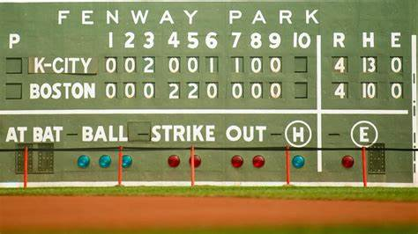
Extra Innings!

Slide 36

Popular TV Shows of the 1980s-1990s

Slide 37
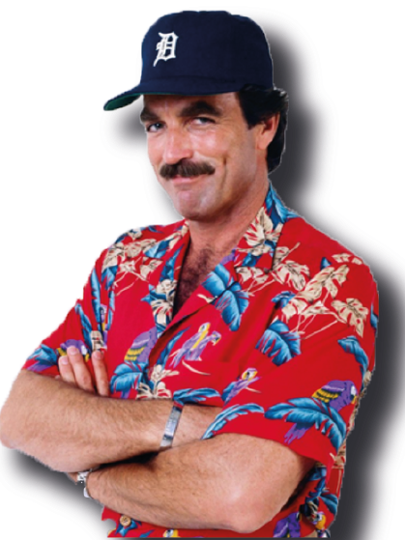
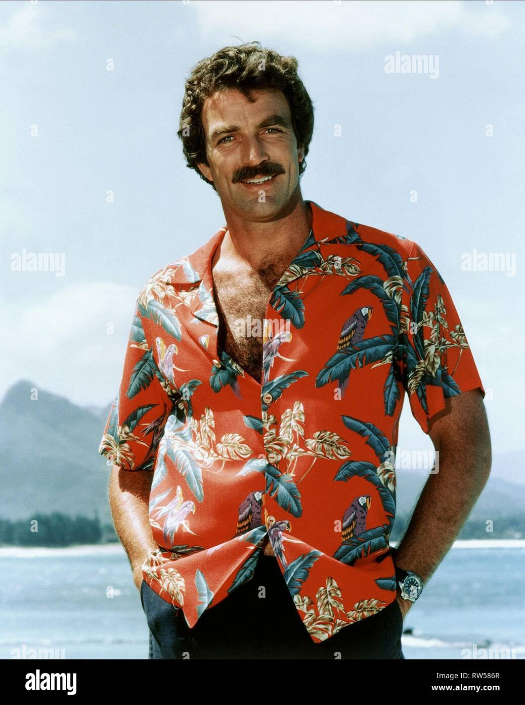
This crime drama was set in Hawaii and starred popular actor Tom Selleck. He portrayed a private investigator, who lives a plush life-style on the estate of a wealthy benefactor.
Selleck’s character often wears a baseball cap from his favorite major league team …
Magnum P.I.

Slide 38
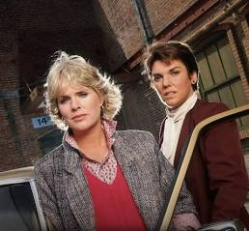
Actresses Sharon Gless and Tyne Daly starred in this police drama as New York City police detectives.
Beginning with the show’s second season in 1983, and for the next six seasons, one or the other of these two actresses won the Emmy Award for
Best Lead Actress in a Drama !
Cagney & Lacey

Slide 39
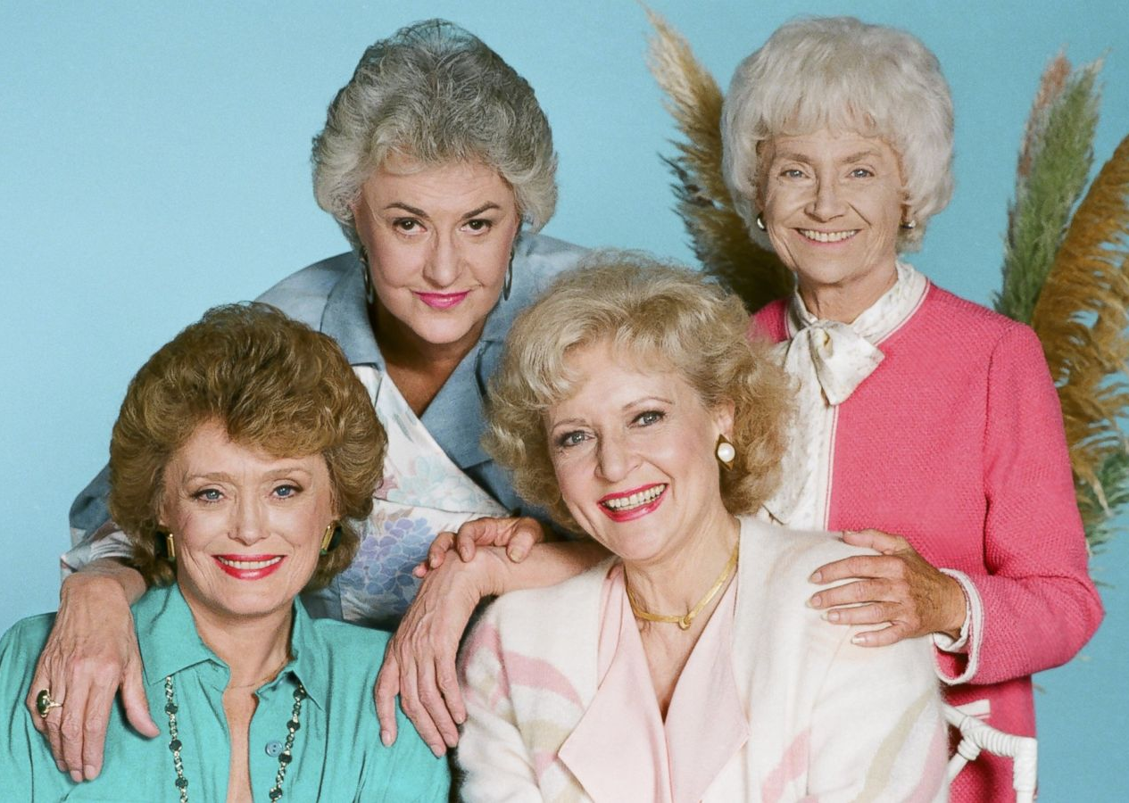
This sitcom starred Bea Arthur, Betty White, Rue McClanahan, and Estelle Getty. The plot centered around the four older single women that shared a house in Miami.
The series won numerous awards as an outstanding comedy.
All four of the actresses won at least one Emmy Award.
Golden Girls

Slide 40
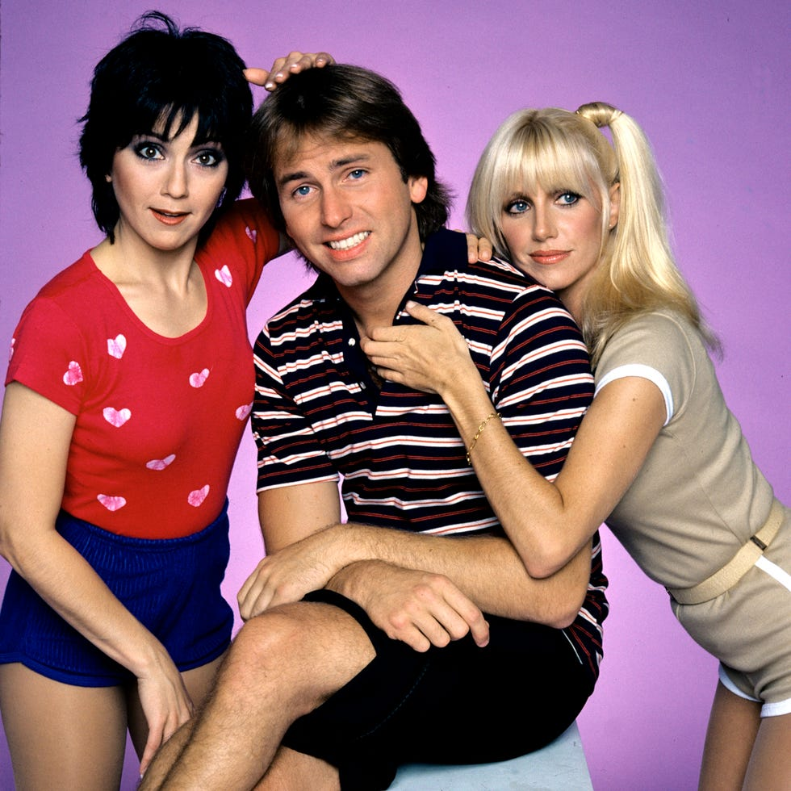
This farcical sitcom starred John Ritter, Suzanne Somers, and Joyce DeWitt as unlikely roommates.
The landlord had a rule against unmarried singles living together, but relented when the women convinced him that the John Ritter character was gay.
The series ranked in the Top 10 of TV shows for 6 of its 8 seasons.
Three’s Company

Slide 41

Thanks!
We’ll see you again next month!!

Slide 42

Have
a great
Thanksgiving !

