Slide 1
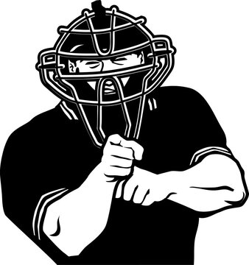
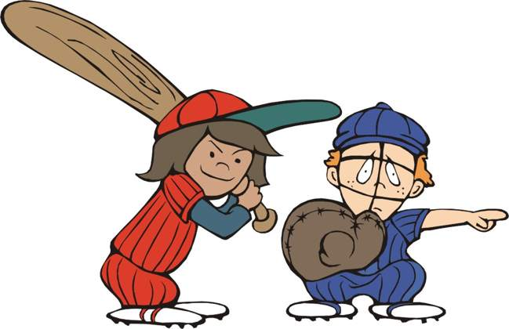


AGE Thrive
with
Baseball Memories

Slide 2


AGE Thrive with Baseball Memories
December 19, 2025
Agenda
Warm-up – Introductions – Current Events
Baseball during the Winter?
Gametime -- Christmas & Baseball
-- 1998 – Homeruns!
Christmas Carols – Sing & Dance

Slide 3


Slide 4





FOOTBALL
Volleyball too!

Slide 5
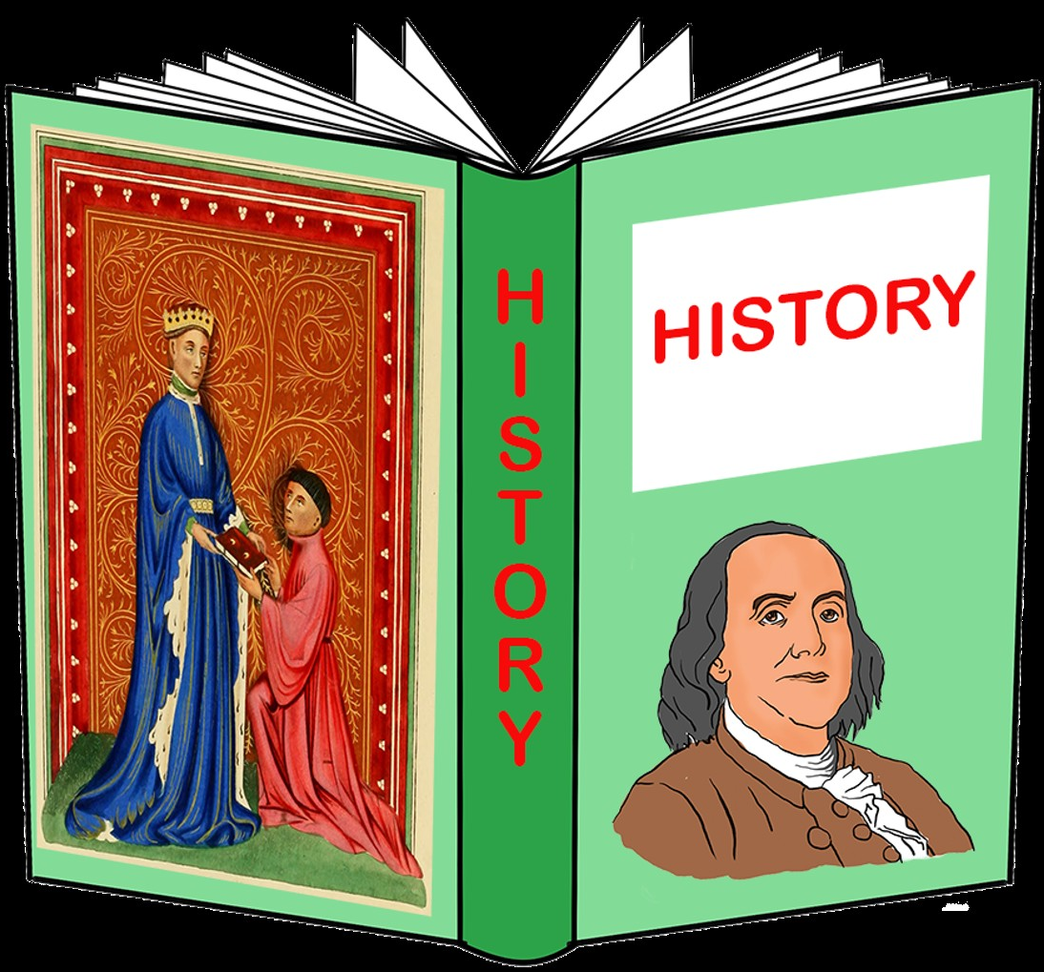
History
that happened
on
Christmas

Slide 6
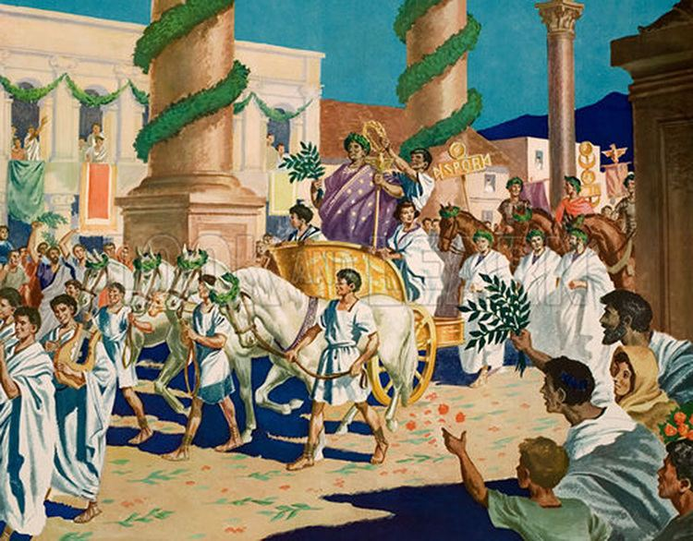
354 A.D.
Earliest recorded
reference that
the Romans
celebrated
Christmas on
Dec. 25
Notes:
The Feast of Saturn was celebrated in Rome during the advent of the Winter Solstice; once Emperor Constantine converted to Christianity in 312 AD it gradually became a celebration also of Christmas.

Slide 7
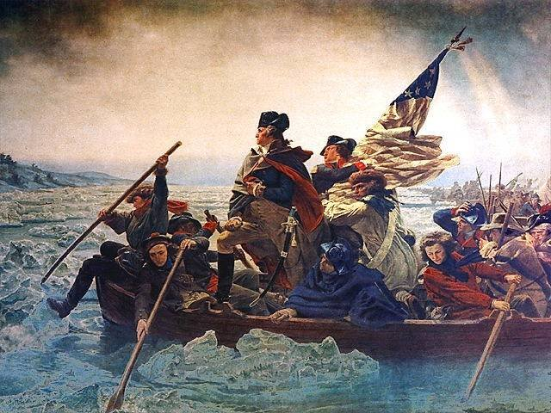
1776
Washington
and the
Continental Army cross the
Delaware
Notes:
Crossed the Delaware River on Christmas night – next morning to surprise the Hessian mercenaries at Trenton, NJ. A week later he defeated British reinforcements at Trenton and Princeton.

Slide 8
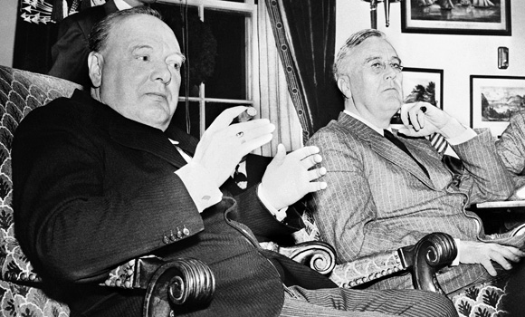
1941
Winston Churchill spends Christmas at the
White House with FDR
Notes:
PM Churchill came to the U.S. after the attack on Pearl Harbor and stayed three weeks at the White House with the President and his family.

Slide 9
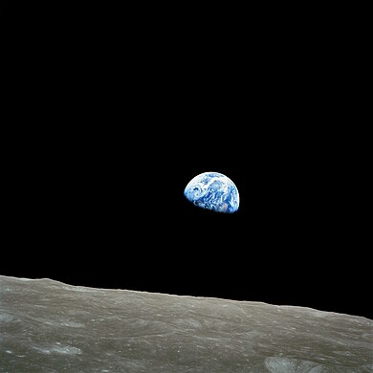
1968
Apollo 8
orbits the
Moon
Notes:
Apollo 8 was the first manned mission to leave Earth orbit and achieved orbit around the Moon. It orbited the Moon ten times and the astronauts made a Christmas Eve broadcast from there. This was a key preparation for Apollo 11 to land on the Moon only seven months later. This is a picture of an “Earth-rise” coming up over the surface of the Moon, taking by Apollo 8.

Slide 10
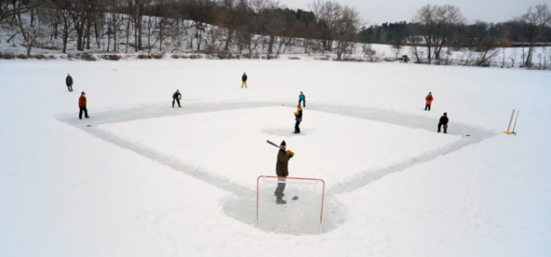
Is there Baseball in Winter?

Slide 11
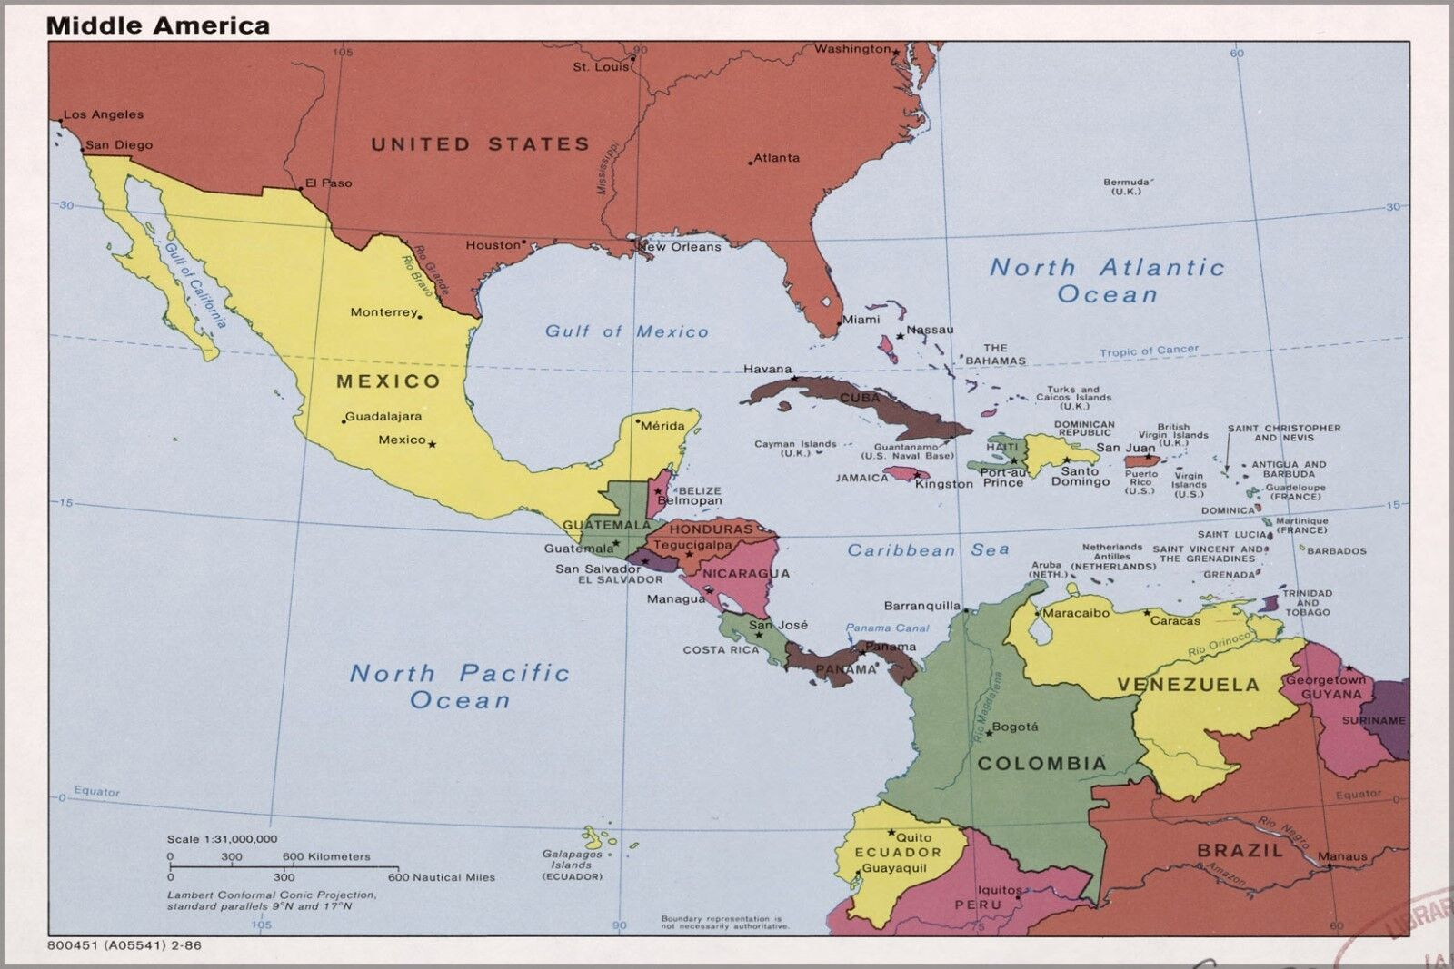

TOP PRO LEAGUES
Mexico – 10 teams
Cuba – 16
D.R. – 6
Puerto Rico - 6
Venezuela – 8
Plus smaller leagues
in:
Colombia
Panama’
Nicaragua
Curacao
Winter Baseball
Notes:
About 60 pro teams playing in Winter Leagues in Latin America and the Caribbean

Slide 12
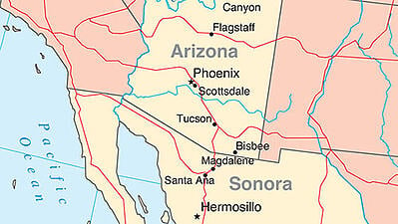
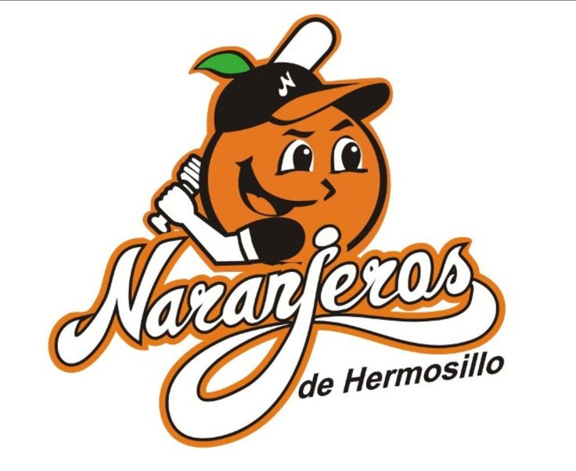
Hermosillo is directly south of Phoenix and is
the capital of the Mexican state of Sonora.
Their team, los Naranjeros, are a popular winter league
team in the Mexican Pacific League and have won 17
League championships.

Slide 13
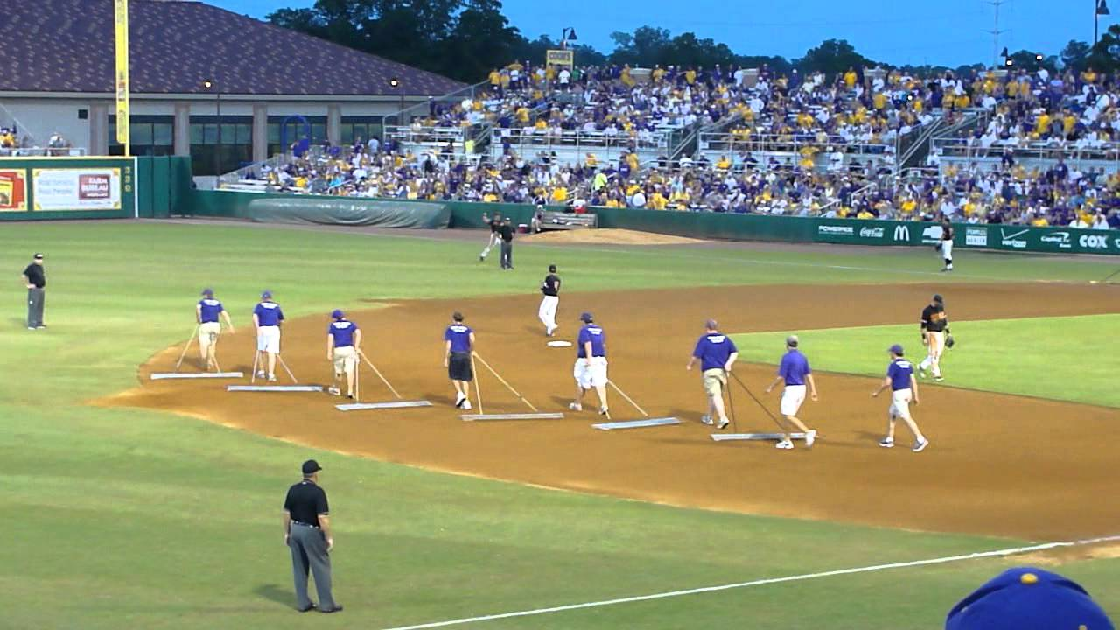
In Between Innings

Slide 14
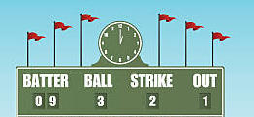
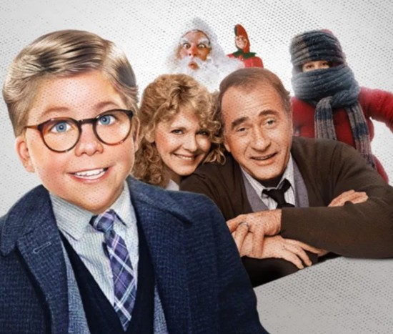
Scoreboard Quiz – Movies & TV about Christmas
h
Nine year old Ralphie wants a BB gun for Christmas. His Dad finally gifts him one and Ralphie breaks his glasses on a ricochet shot.
A Christmas Story
You’ll Poke Your Eye Out
1940 Family Christmas
Notes:
1983 movie about a family’s xmas misadventures during Christmas 1940. He wanted a Red Ryder 200 shot air rifle.

Slide 15
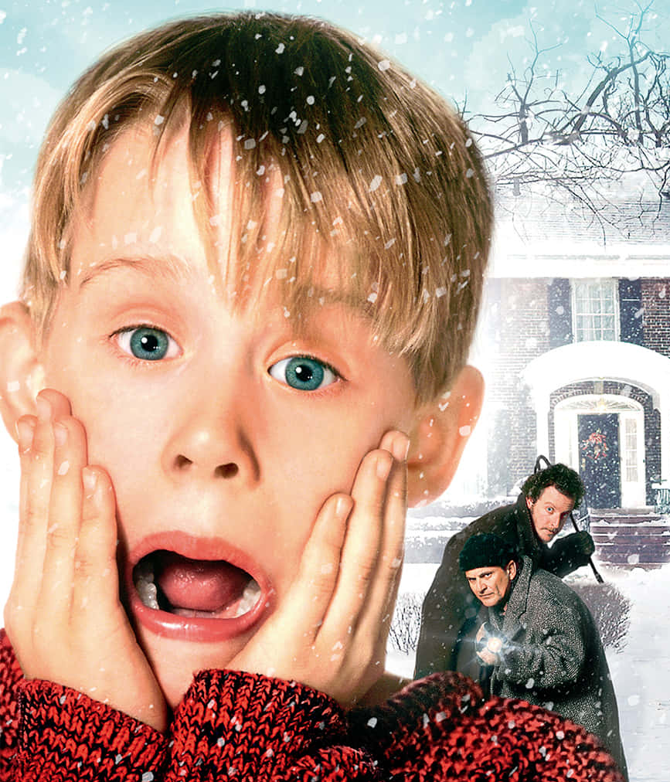
Scoreboard Quiz – Movies & TV about Christmas
h
Then child actor Macaulay Culkin starred in this movie about a stranded kid in Chicago. It was the first in a series of four movies.
Charley Brown Christmas
Home Alone
The Cat in the Hat
Notes:
1990 movie - was the second-highest grossing film of the year at $476M.

Slide 16
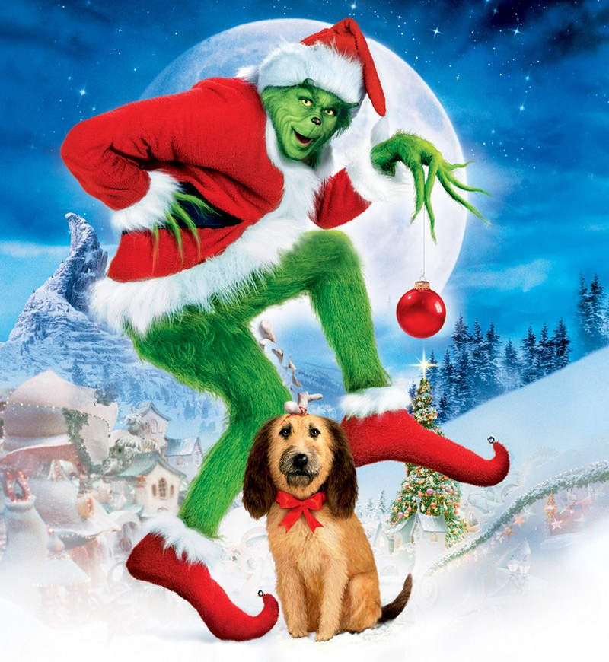
Scoreboard Quiz – Movies & TV about Christmas
h
Based on the Dr. Suess book, this story was adapted as both a TV and movie offering. The title character had a cold heart and planned to ruin Christmas for the Who’s in Whoville.
How the Grinch stole Christmas
Bad Santa
The Cat in the Hat
Notes:
1966 animated comedy – based on the 1957 children’s book by the same name. Boris Karloff did the voice-over. Was later made into a live movie in 1990

Slide 17
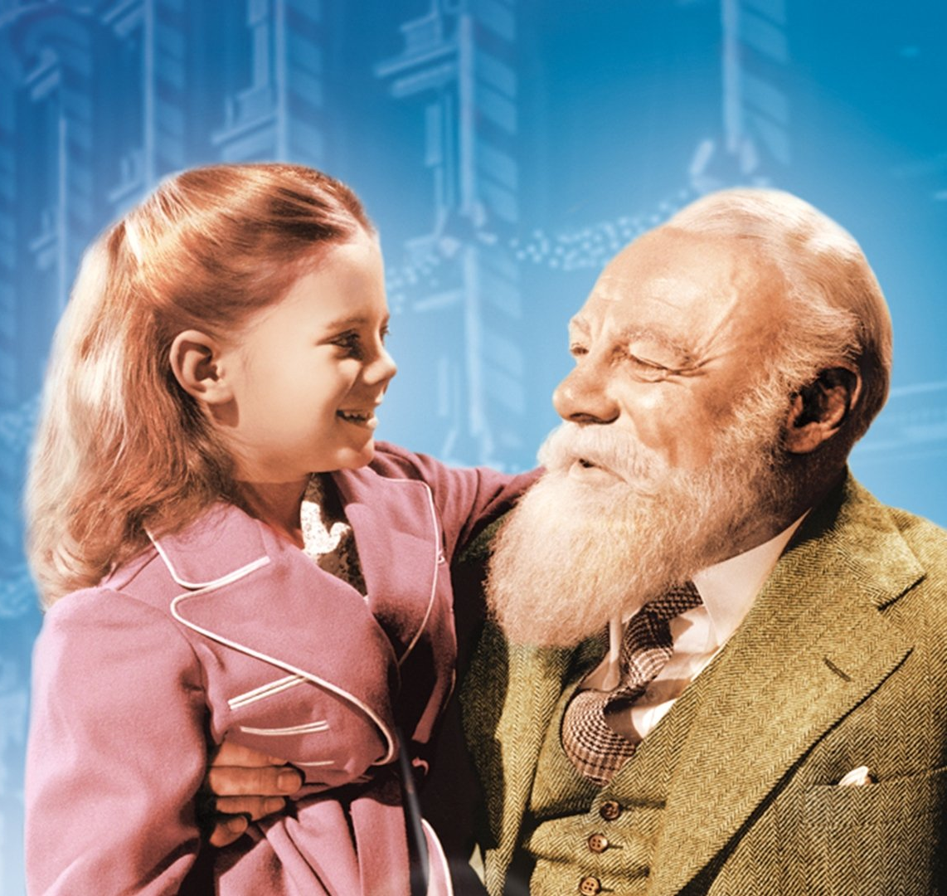
Scoreboard Quiz – Movies & TV about Christmas
h
In this movie, an elderly department store Santa Claus claims to be the real St. Nick. Edmund Gwenn won an Oscar playing Kris (pictured here)
A Christmas Carol
Come Shop at Macy’s
Miracle on 34th Street
Notes:
Miracle on 34th Street - 1947 movie - won three Oscars including Best Supporting Actor for Edmund Gwenn's role as Kris Kringle. In the movie, he was the store Santa Claus at Macy's flagship store on 34th St. in NYC.

Slide 18
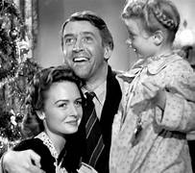
Scoreboard Quiz – Movies & TV about Christmas
h
This film starred Jimmy Stewart as a small-town banker and Donna Reed as his wife. Stewart’s character is saved by Clarence, his guardian angel
A Christmas Carol
It’s a Wonderful Life
Santa Comes Calling
Notes:
It's a Wonderful Life - 1946 - this film was not a financial success when released right after WWII. Consequently, its copyright was not renewed when it expired in 1974 and it entered the public domain. It was then often shown as there was no licensing to be paid. It then became a popular hit - often polling as the #1 holiday film ever made.

Slide 19

  Presenting. . .
  The 2025 All-Christmas Team

Slide 20
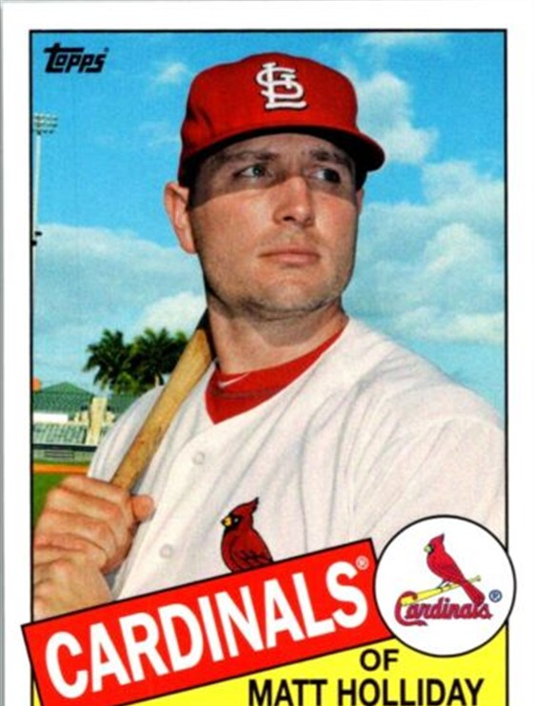
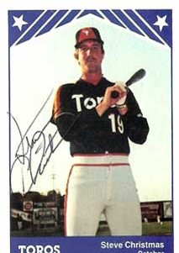
The SABR Hornsby Chapter wishes you a Merry. . .
and a Happy. . .
Steve Christmas OF

Slide 21
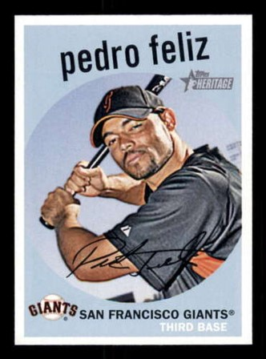
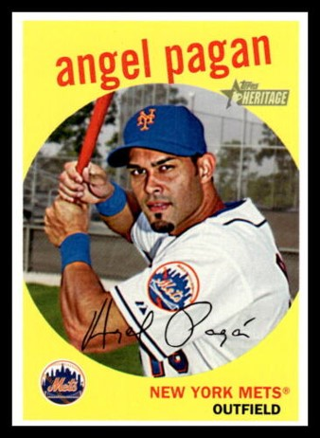
To our Spanish-speaking friends. . . Esperamos que nuestra navidad sea muy. . .
No matter how you celebrate. . .

Slide 22
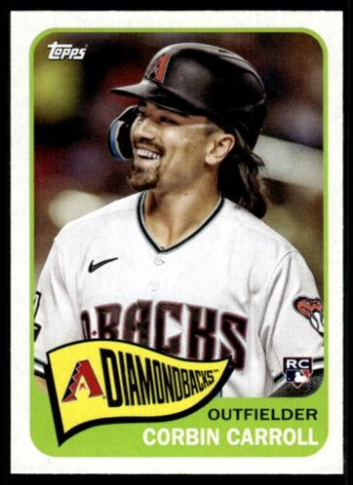
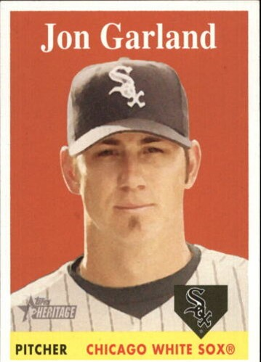
. . .and singing Christmas songs.
We hope you enjoy putting up holiday decorations. . .

Slide 23
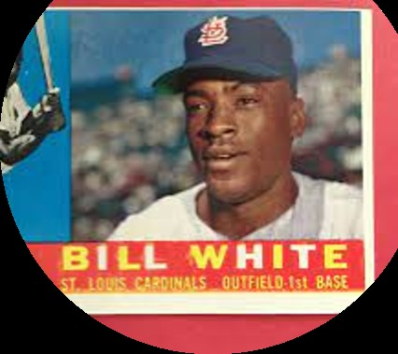
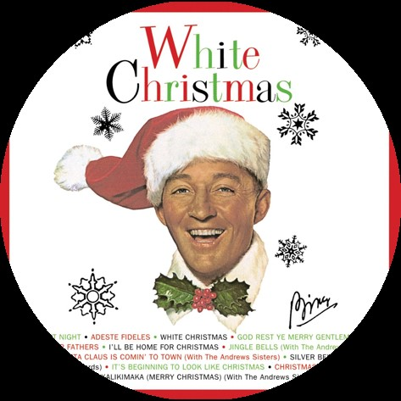
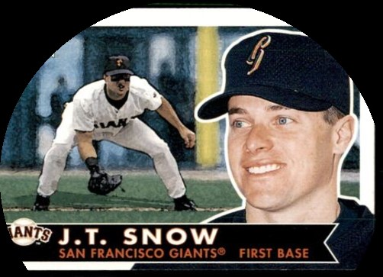
Perhaps it will even be a. . .

Slide 24
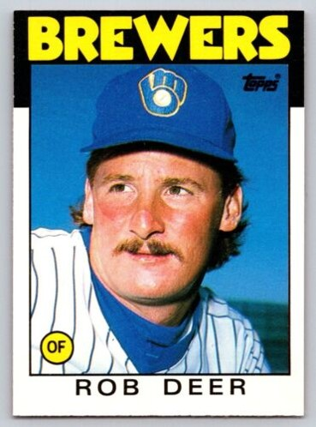
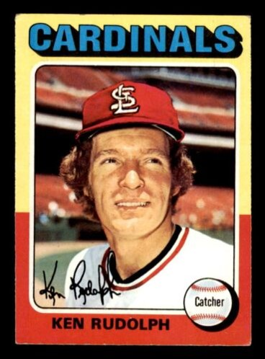
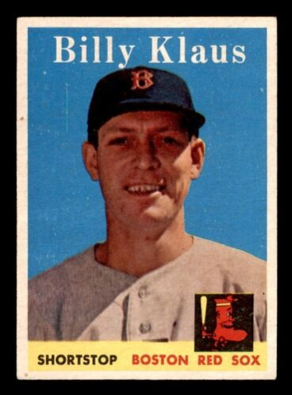
With a visit from Santa. . .
and his helpers. . .

Slide 25
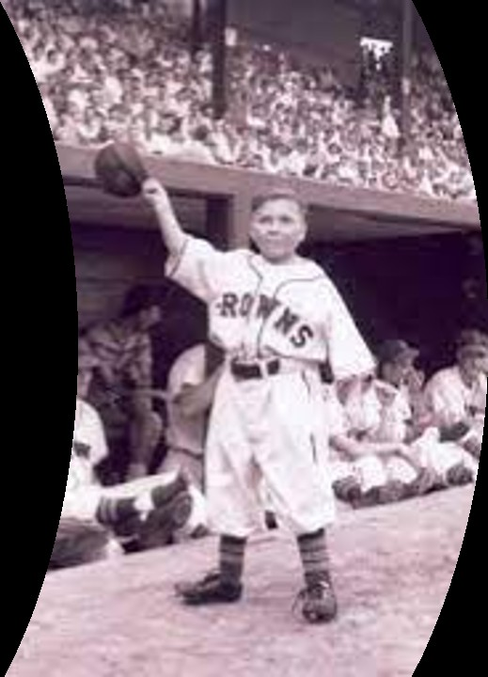
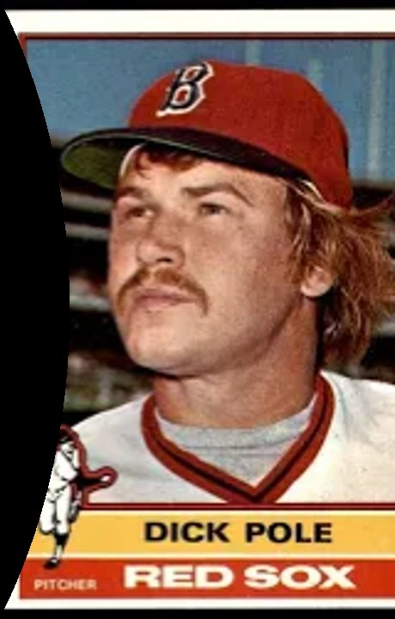
. . .including
his elves.

Slide 26
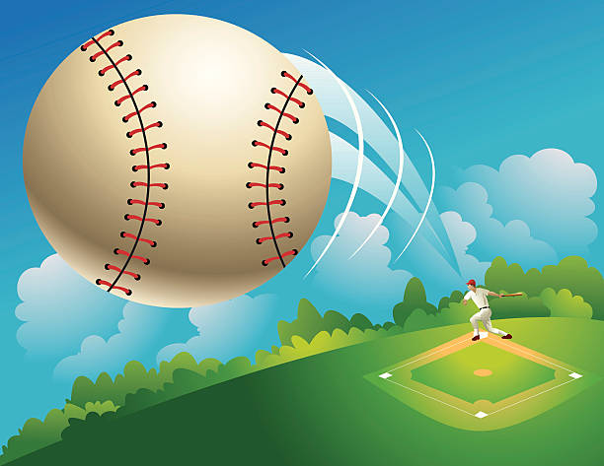
Baseball in 1998
The Big Story was the Home Run race!

Slide 27
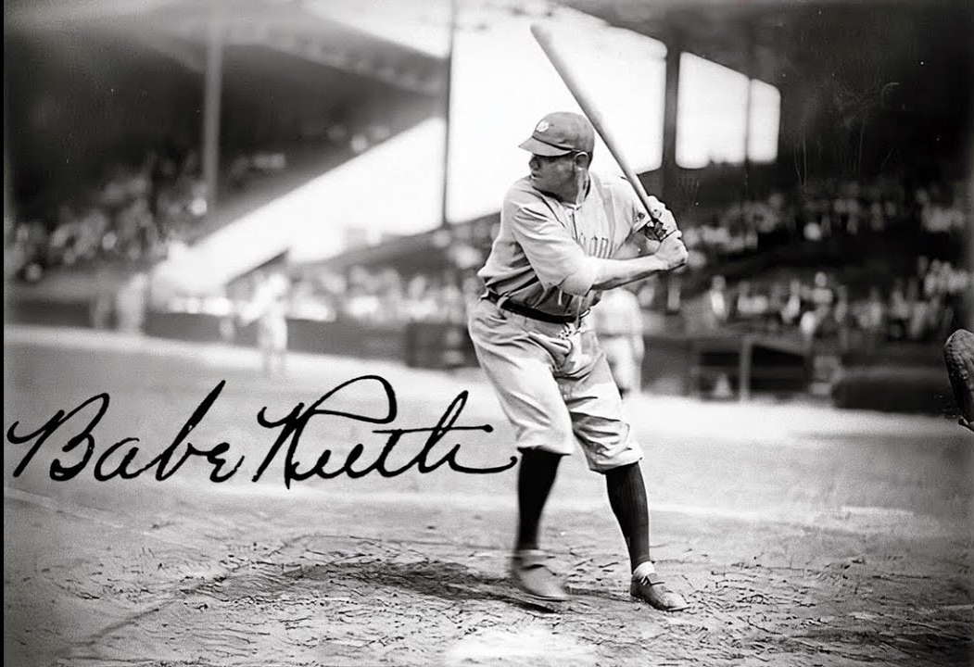
Home Run milestones
1927 - Babe Ruth hit 60 home runs

Slide 28
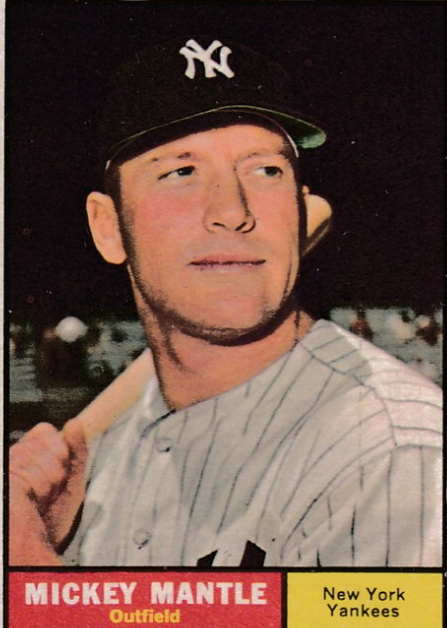
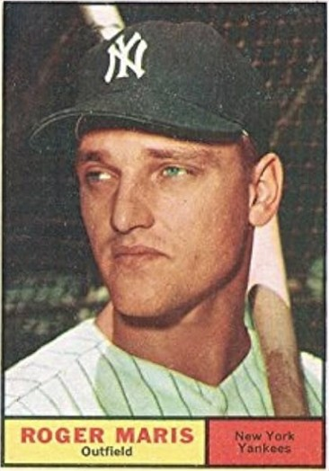
Home Run milestones
Maris ended the season
with 61 home runs
to
Mantle’s 54
1961 – a race between Yankees teammates

Slide 29
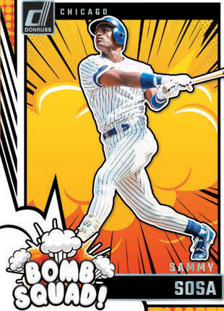
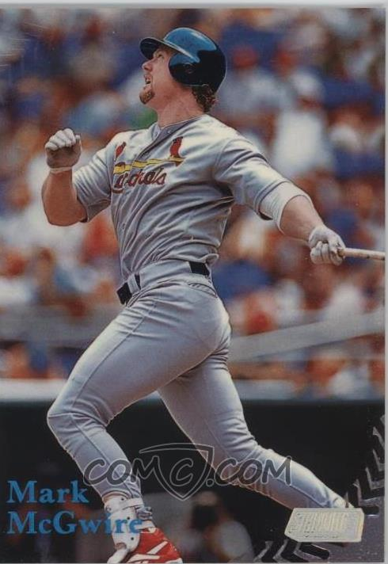
Home Run milestones
McGwire ended the season
with 70 home runs
to
Sosa’s 66
1998 – a race between NL rivals

Slide 30
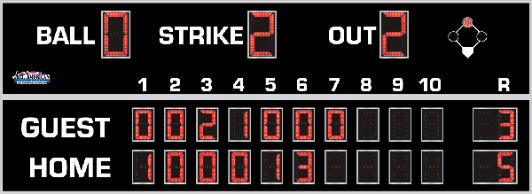
7th Inning Stretch

Slide 31
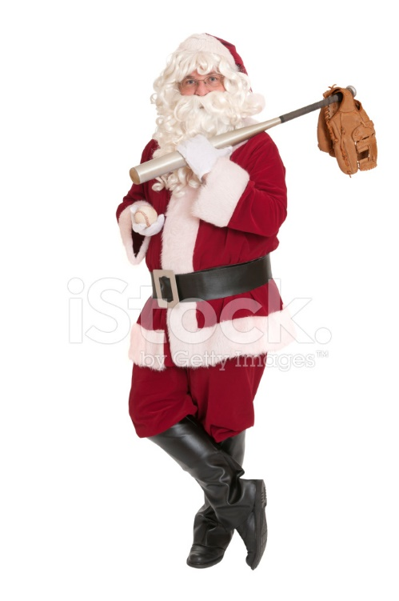
Take Me Out
to the
Ballgame

Slide 32
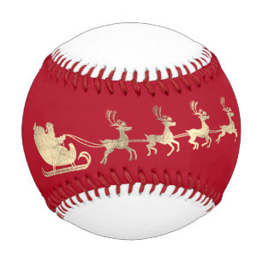
Baseball
&
Christmas Carols

Slide 33
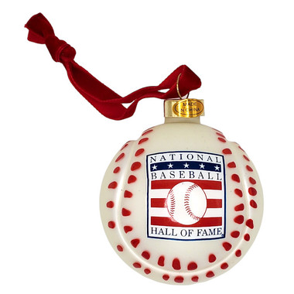

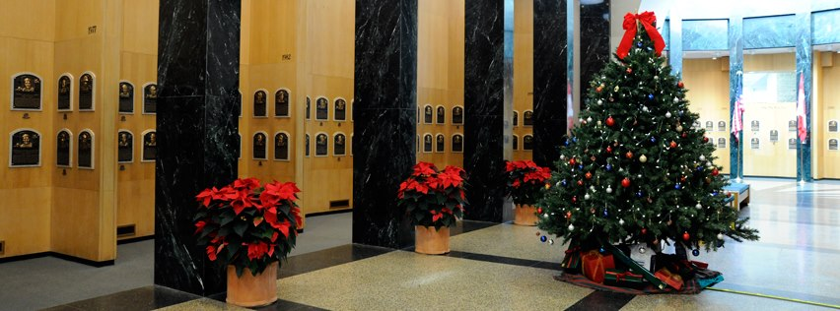
https://www.youtube.com/watch?v=SIFqnEoctI4

Slide 34
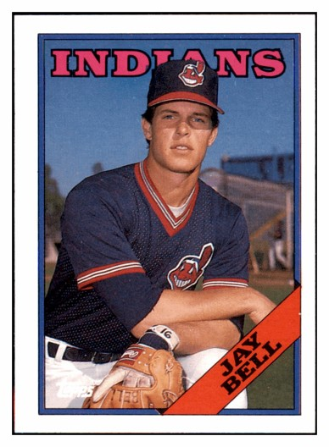
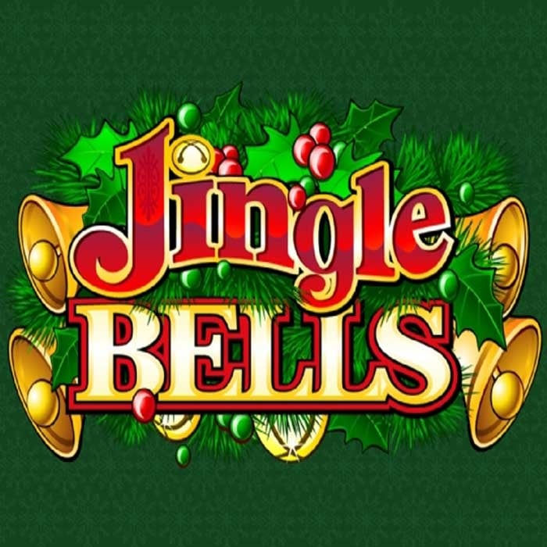
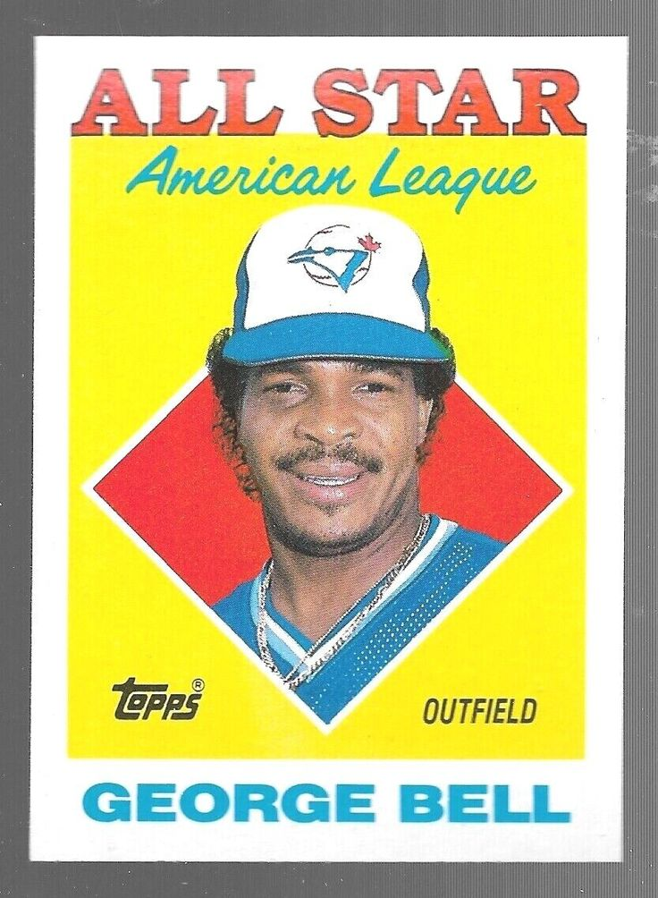
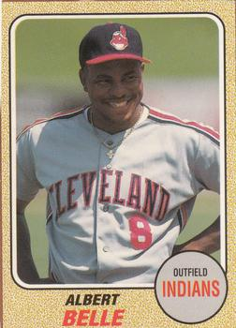
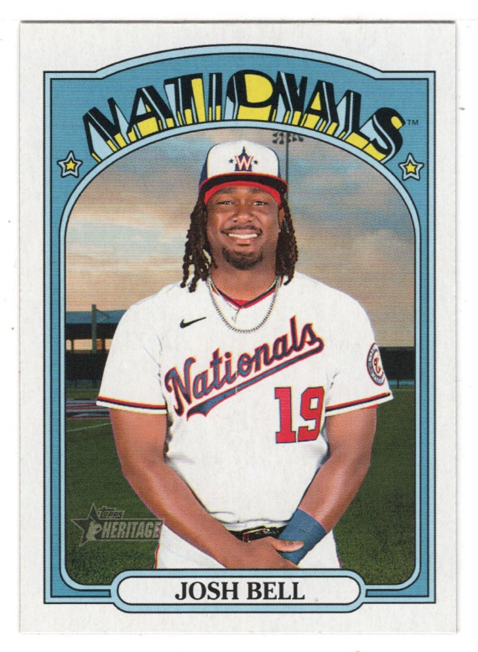
https://www.youtube.com/watch?v=3CWJNqyub3o

Slide 35
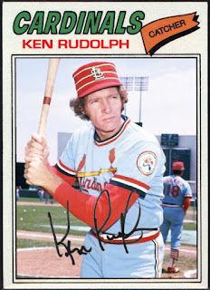
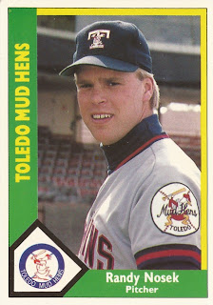




https://www.youtube.com/watch?v=fJQqOzkcHjg

Slide 36



https://www.youtube.com/watch?v=cRbLtqbPYjU&list=RDcRbLtqbPYjU&start_radio=1

Slide 37




https://www.youtube.com/watch?v=-se7zpa71DY&list=RD-se7zpa71DY&start_radio=1

Slide 38


https://www.youtube.com/watch?v=g-OF7KGyDis&list=RDg-OF7KGyDis&start_radio=1

Slide 39

Extra Innings!

Slide 40

Christmas Memories

Slide 41


How did you get your Christmas Tree?
At a tree lot or farm?
Christmas Tree
Or did you cut it down yourself?

Slide 42


Did you have a tree that looked like this?
Or maybe with a
train around it?

Slide 43


Did you ever have an aluminum tree?
.. or how about a ceramic tree?

Slide 44


Did your tree ever mysteriously fall over?
Was the culprit your cat or dog?

Slide 45


Where did you shop for Christmas?
Window shopping at a department store?
Or maybe from a catalog?

Slide 46

Once upon a time …
the stores would wrap your present
for you … FOR FREE!

Slide 47


How did you celebrate Christmas?
Did you have a school play or
church pageant?
Celebrating Christmas
Did you go out caroling?

Slide 48


Did you help Mom bake cookies?
Celebrating Christmas
Did you go eat at Grandma’s house?

Slide 49


Where did you hang your Christmas Stockings?
A cardboard fake fireplace?
Christmas Stockings
Or a real fireplace with a chimney?

Slide 50


What were your favorite presents?
A puppy?
Favorite Presents
Maybe a Lassie pup?

Slide 51

Do you remember these popular toys?
Cabbage
Patch
Dolls

Slide 52

Teenage
Mutant
Ninja
Turtles

Slide 53

Rainbow
Brite

Slide 54

Nintendo

Slide 55


What were your favorite presents?
Dolls?
Favorite Presents
and accessories?

Slide 56


What were your favorite presents?
Cowboy Gear – and Six-shooter?
Favorite Presents
Cars and Trucks!

Slide 57

What were your favorite presents?
GI Joe?
(these were Action Figures, NOT dolls!)
Favorite Presents

Slide 58


What were your favorite presents?
A New Baseball Bat!
And maybe a new Glove!
Favorite Presents

Slide 59

Ballplayers at Christmas

Slide 60

Notes:
Joe DiMaggio

Slide 61

Notes:
Willie Mays

Slide 62

Have a Great Christmas !
¡Feliz Navidad!
We’ll see you again next month!

