Slide 1
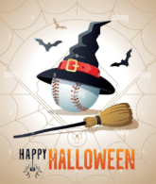
Baseball Memories
October 2025

Slide 2
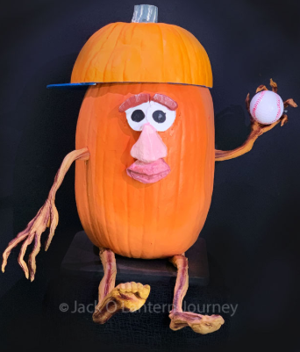
First Pitch

Slide 3
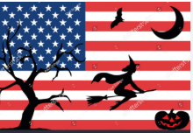
The National Anthem

Slide 4
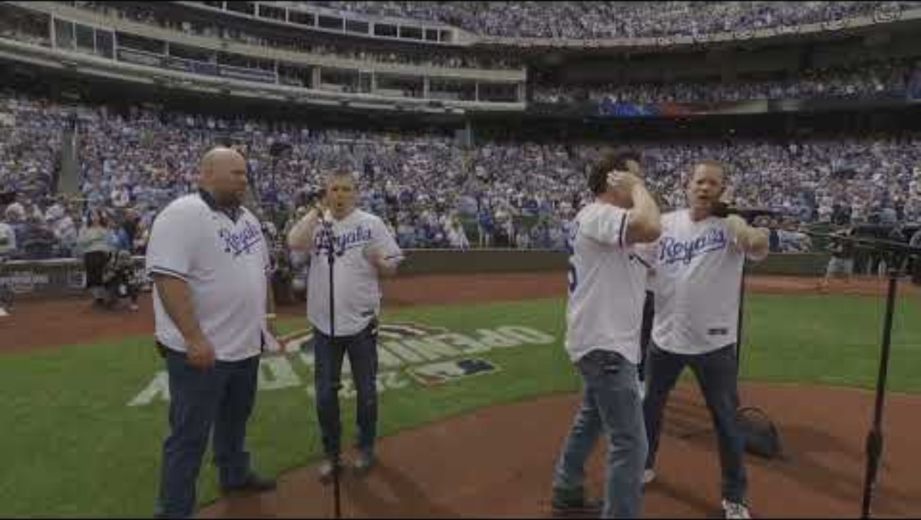

Slide 5
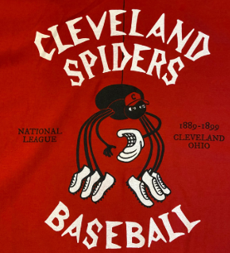
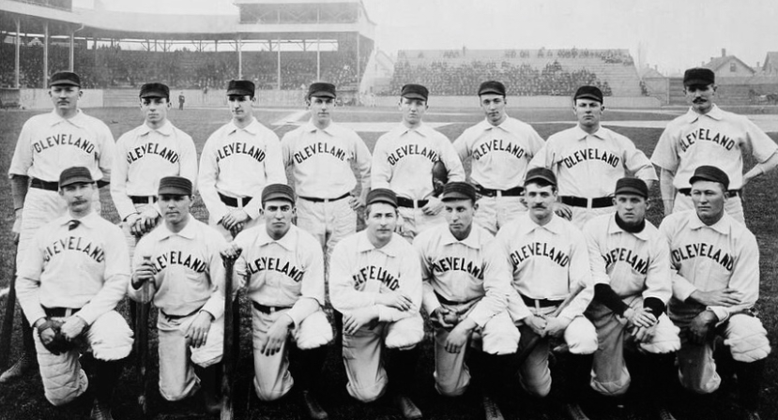
Halloween’s Major League Team

Slide 6

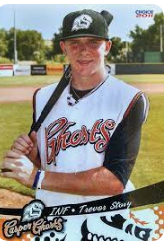
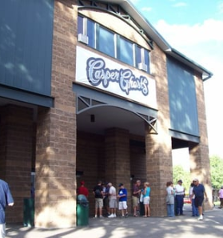
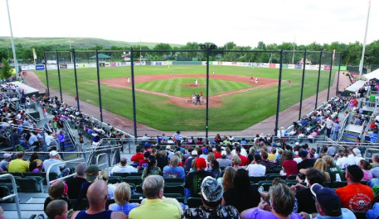
Halloween’s Minor League Team

Slide 7
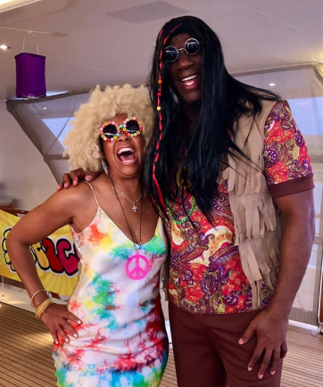
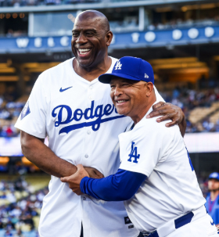
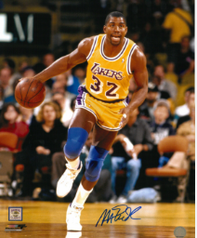
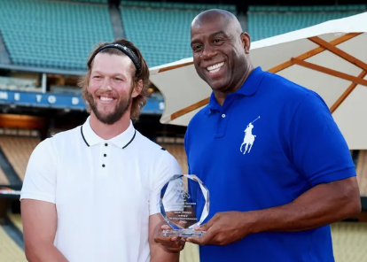
Owner- Magic Johnson

Slide 8
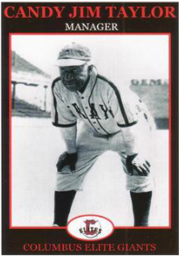
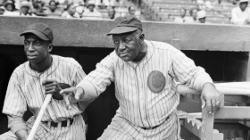
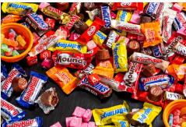
Manager- Candy Jim Taylor

Slide 9
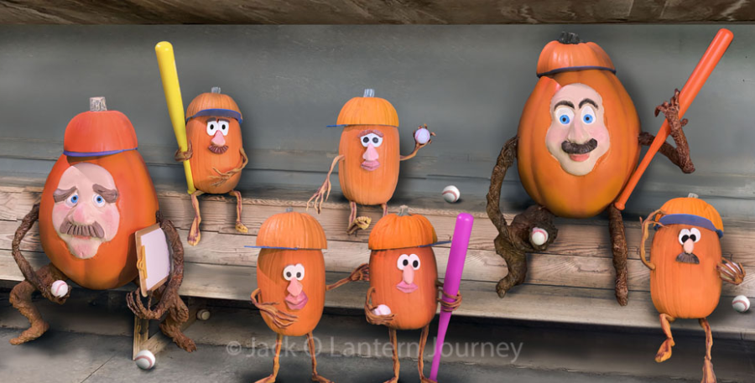
The Lineup

Slide 10
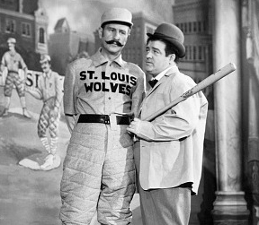
Who’s on First

Slide 11
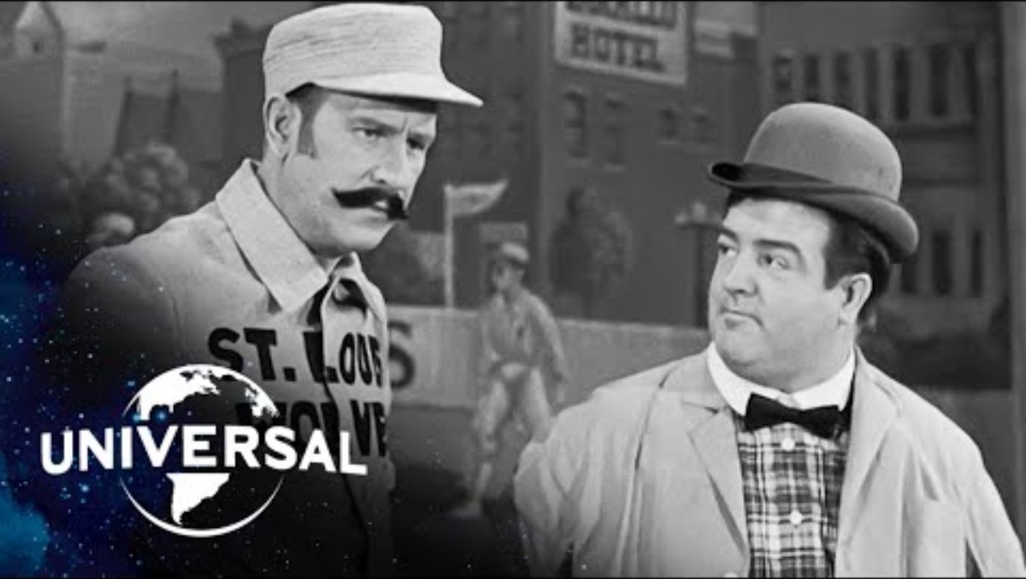

Slide 12

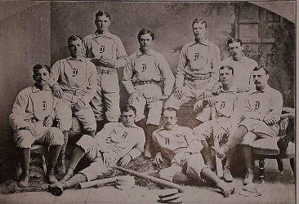
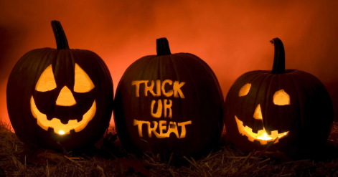
First Baseman- Trick McSorley

Slide 13
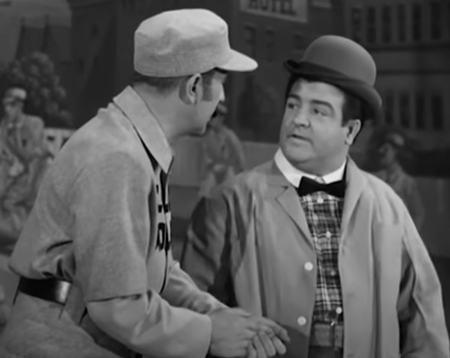
What’s on Second

Slide 14
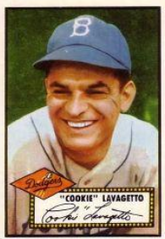
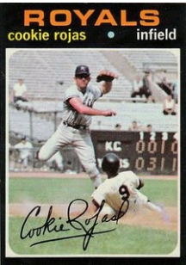
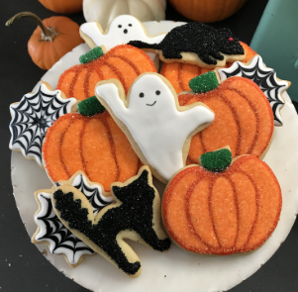
Second Basemen-
Cookie Lavagetto & Cookie Rojas

Slide 15
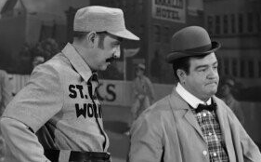
Third Baseman- I Don’t Know

Slide 16
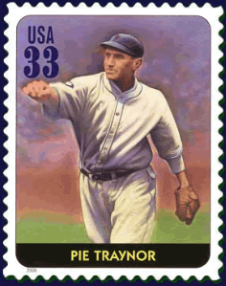
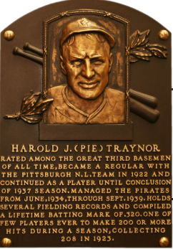
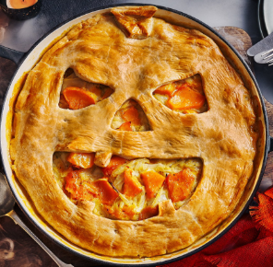
Third Baseman- Pie Traynor

Slide 17
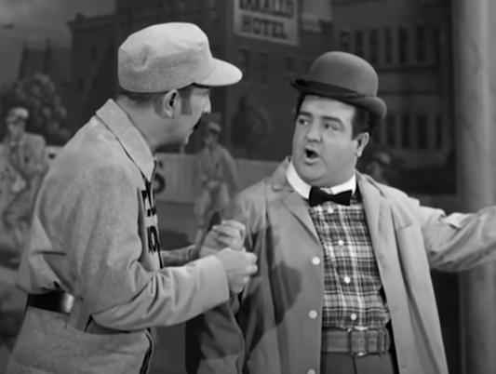
Left Fielder- Why

Slide 18
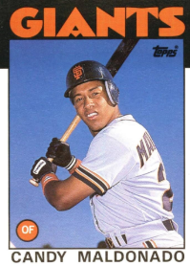
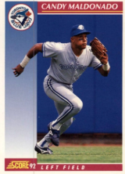
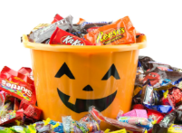
Left Fielder- Candy Maldonado

Slide 19
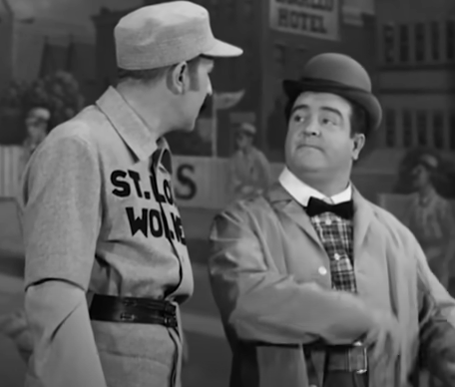
Center Fielder- Because

Slide 20
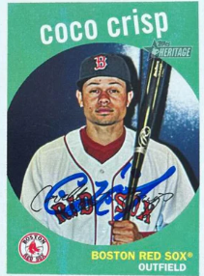
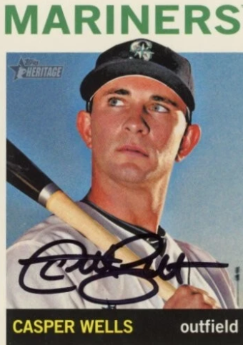
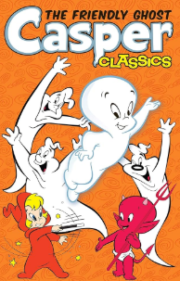
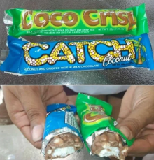
Center Fielders- Coco Crisp & Casper Wells

Slide 21
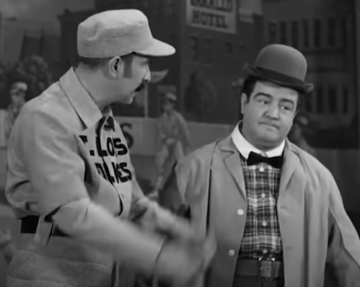
Pitcher- Today

Slide 22
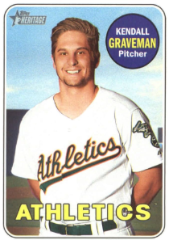
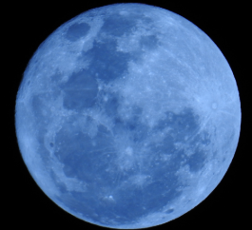
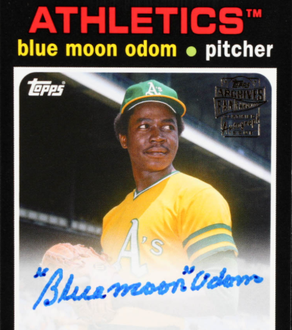
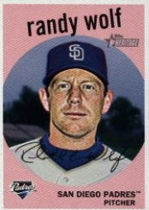
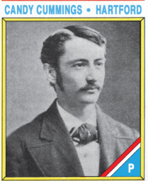
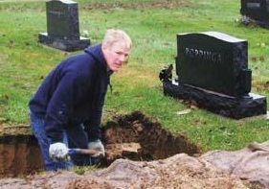
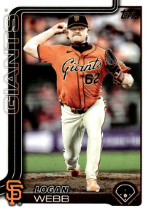
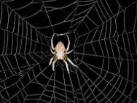
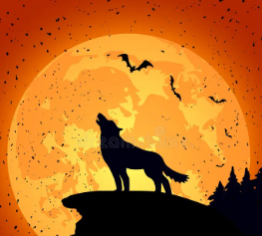
Starting Pitchers

Slide 23
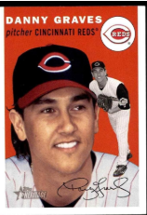
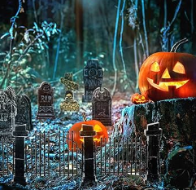

Relief Pitcher

Slide 24




Trick Pitches

Slide 25


Slide 26

Catcher- Tomorrow

Slide 27



Catcher- Rick Sweet

Slide 28

Shortstop- I Don’t Care

Slide 29



Shortstop- Ozzie “The Wiz” Smith

Slide 30





Pinch Hitter- Archibald Wright “Moonlight” Graham

Slide 31




Right Fielder- Babe Ruth

Slide 32


Slide 33





Candy Bars

Slide 34


Slide 35


Slide 36



Mickey & Roger

Slide 37





Butterfingers

Slide 38


Slide 39

What is your favorite candy?

Slide 40



Seventh Inning Stretch

Slide 41


Slide 42



Baseball Costumes

Slide 43
What book made J.K. Rowling famous?
Goosebumps
Magic Tree House
Harry Potter
Good Night Moon

Slide 44



Harry Potter

Slide 45
What was the ruler of Egypt called?
Czar
Emperor
Prime Minister
Pharoah

Slide 46



The Pharoah

Slide 47
Lurch was a character in this TV show.
The Munsters
Twilight Zone
Lost in Space
The Addams Family

Slide 48



Lurch

Slide 49
Danny and Sandy were characters in this musical.
Singing in the Rain
Annie
Fiddler on the Roof
Grease

Slide 50




Danny & Sandy

Slide 51


Did you have a favorite Halloween costume?

Slide 52

Mascots are Always Ready for Halloween!!

Slide 53

Lou Seal is the mascot for this team.
Seattle Mariners
Florida Marlins
San Francisco Giants
Cleveland Guardians

Slide 54

Which team has a Parrot as a mascot?
Chicago Cubs
New York Mets
Philadelphia Phillies
Pittsburgh Pirates

Slide 55

Fred Bird is the mascot for this team.
Toronto Blue Jays
St. Louis Cardinals
Baltimore Orioles
Tampa Bay Rays

Slide 56

Orbit is the mascot for this team.
Houston Astros
Texas Rangers
Minnesota Twins
Chicago White Sox

Slide 57

The Phanatic is the mascot for this team.
Kansas City Royals
Los Angeles Dodgers
Philadelphia Phillies
New York Yankees

Slide 58

What team has Dinger as a mascot?

Slide 59


Slide 60



Halloween Birthday

Slide 61




Halloween R.I.P.

Slide 62


Slide 63


