Slide 1
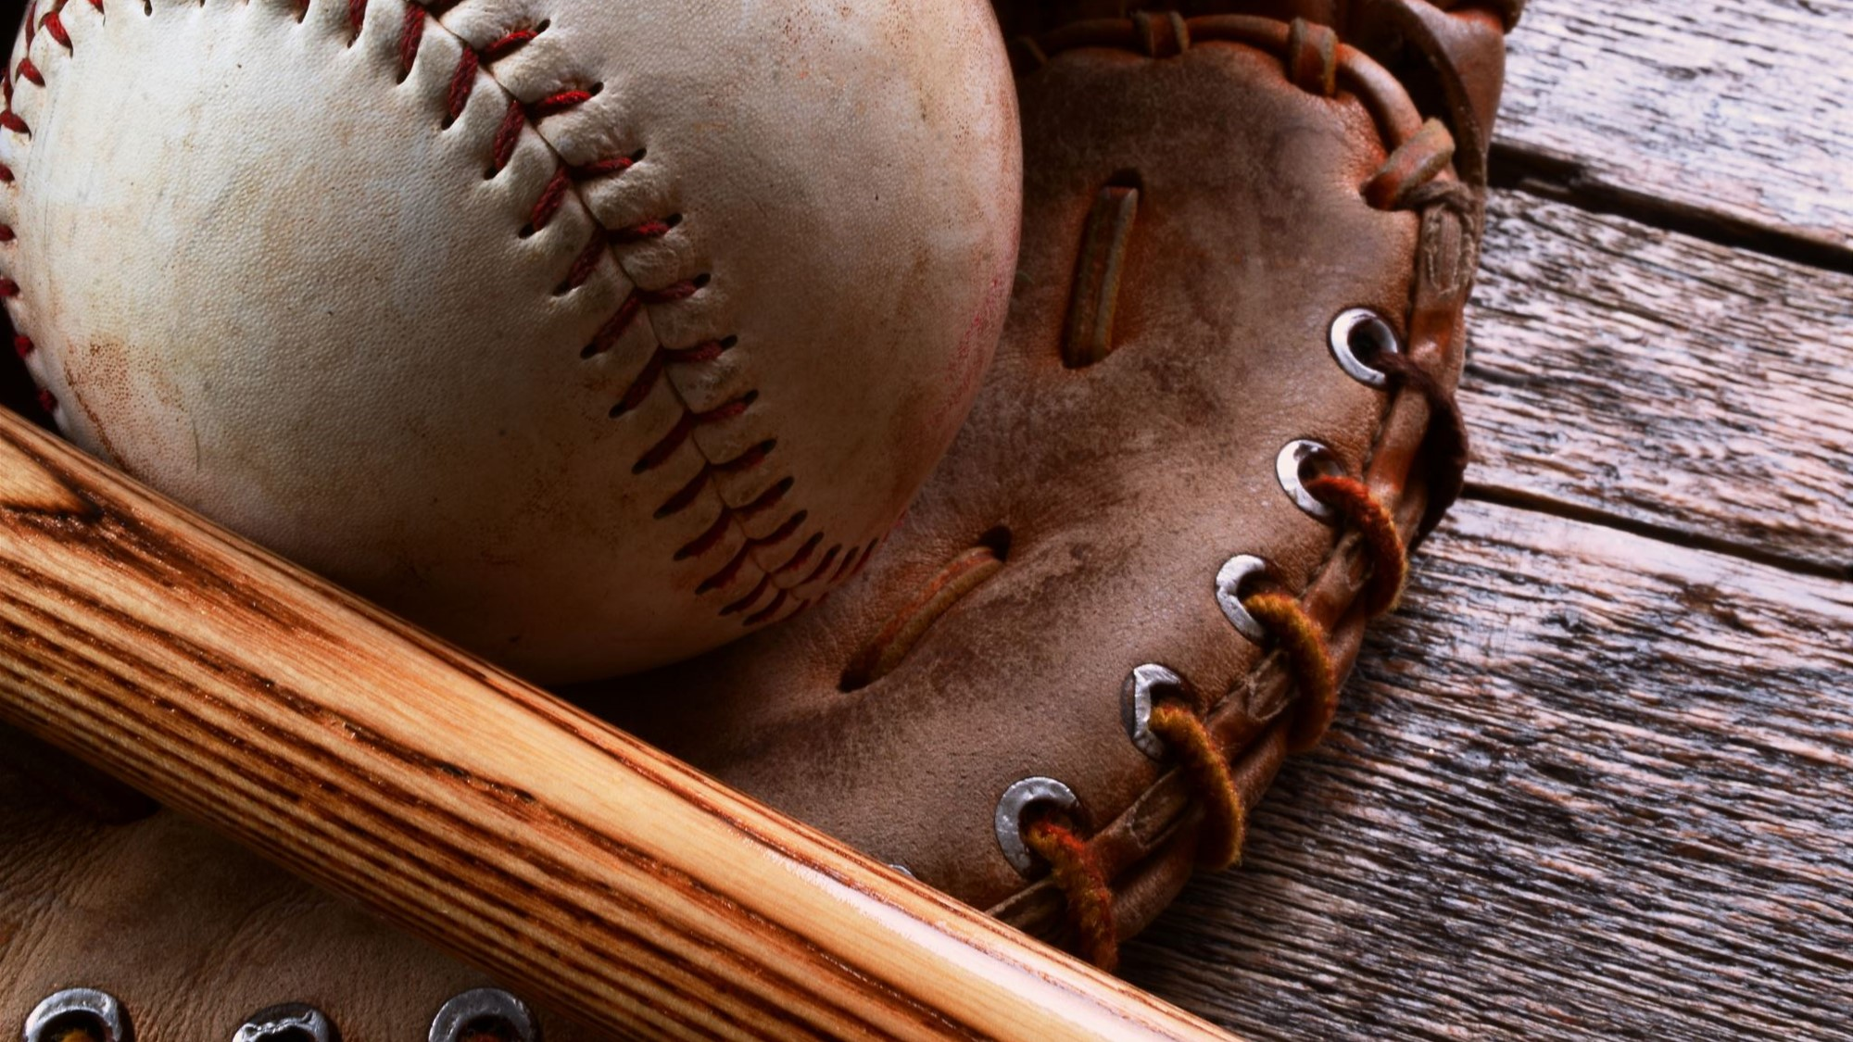
The Baseball Thanksgiving Menu

Slide 2
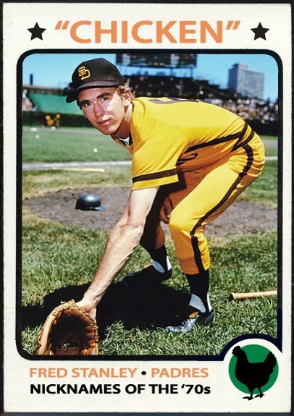
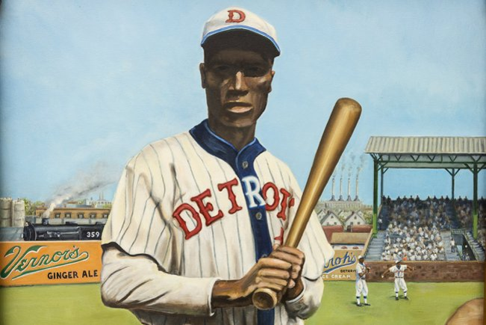
Main Courses
Norman Thomas “Turkey” Stearnes
Fred “Chicken” Stanley

Slide 3
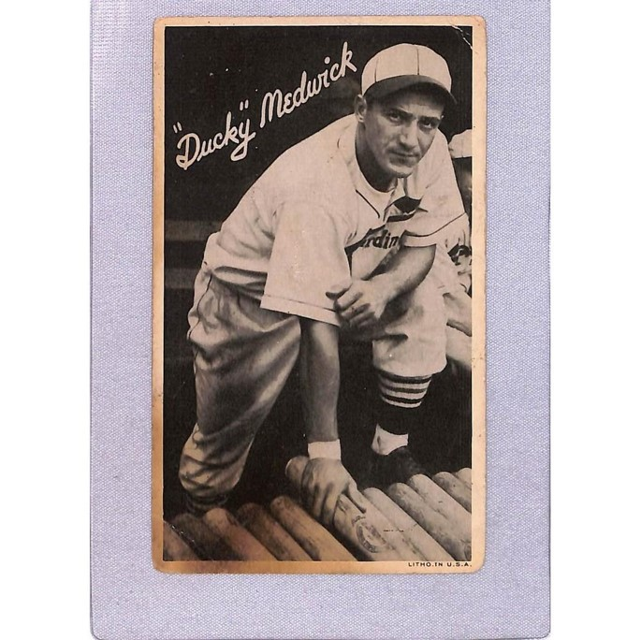
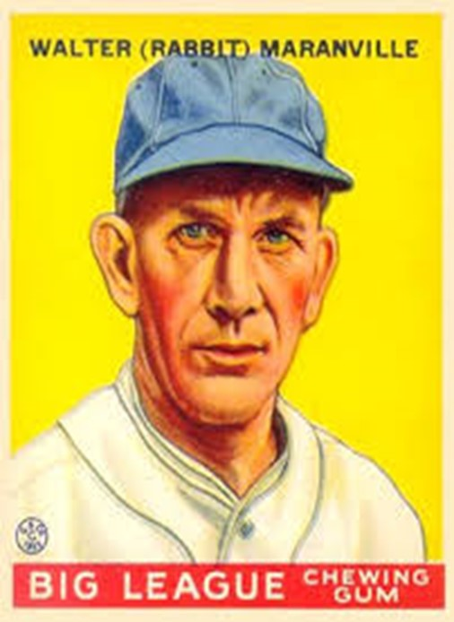
Joe “Ducky” Medwick
“Rabbit” Maranville

Slide 4
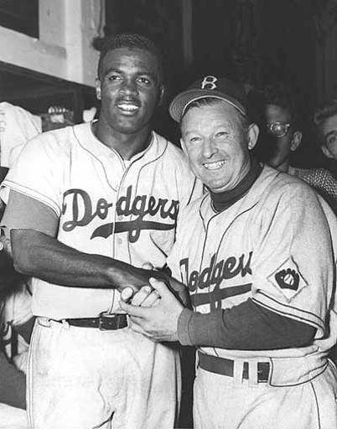
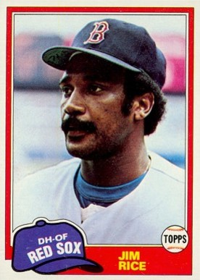
Side dishes
Charlie Dressen
Jim Rice

Slide 5
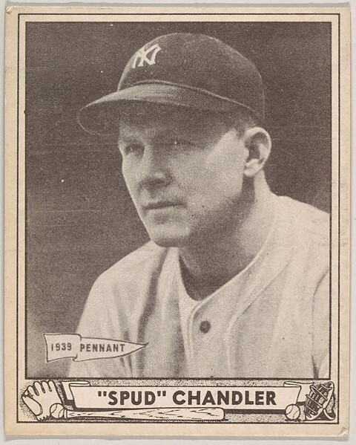
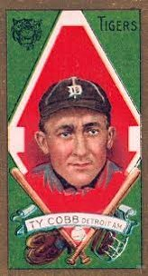
Spurgeon Ferdinand “Spud” Chandler
Ty Cobb

Slide 6
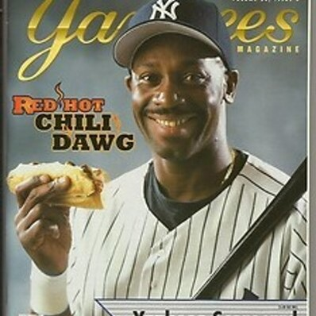
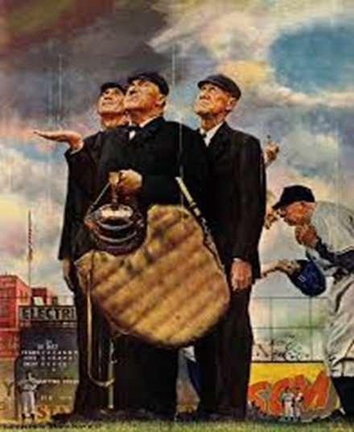
Chili Davis
John “Beans” Reardon

Slide 7
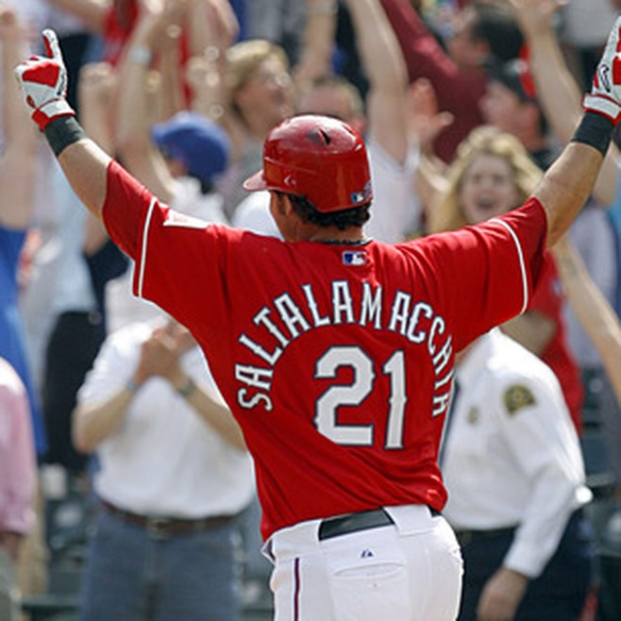
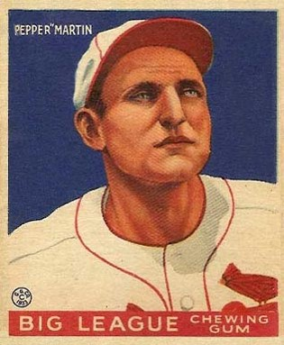
Condiments
Jarrod Saltalamacchia
Pepper Martin

Slide 8
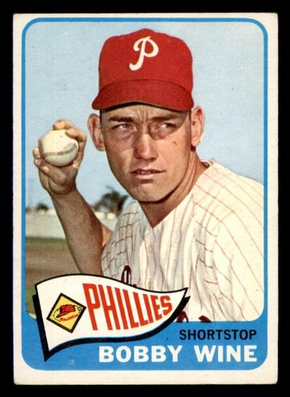
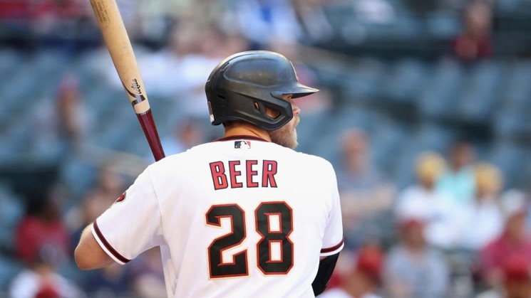
Beverages
Bobby Wine
Seth Beer

Slide 9
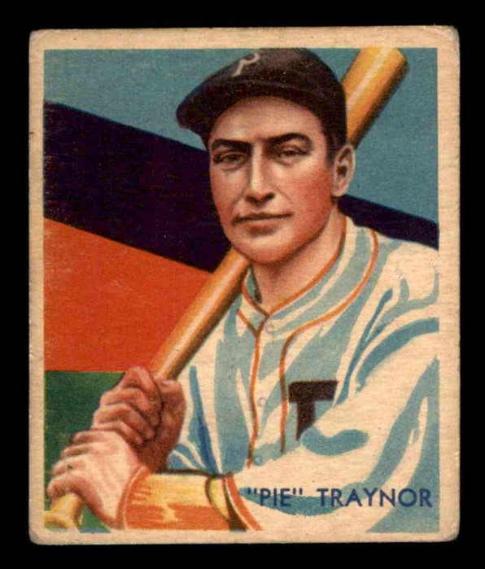
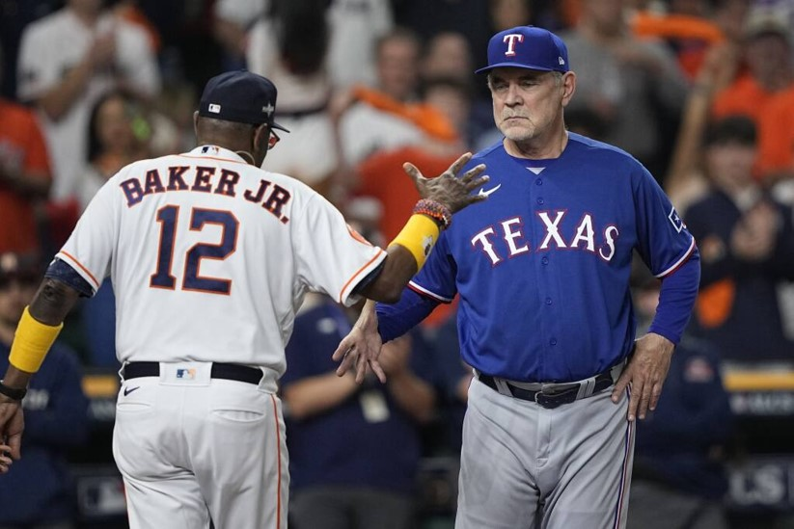
Dessert
Harold “Pie” Traynor
Dusty Baker

Slide 10
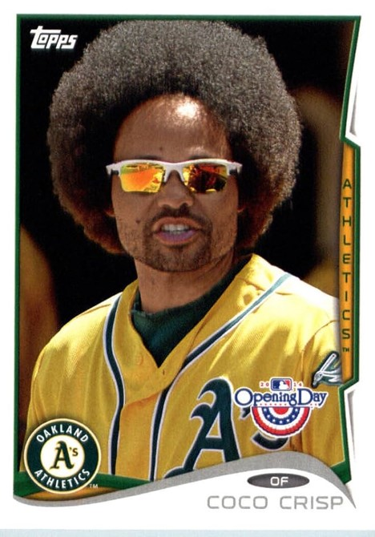
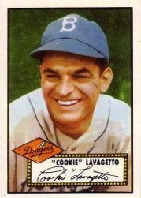
Harry “Cookie” Lavagetto
Coco Crisp

Slide 11
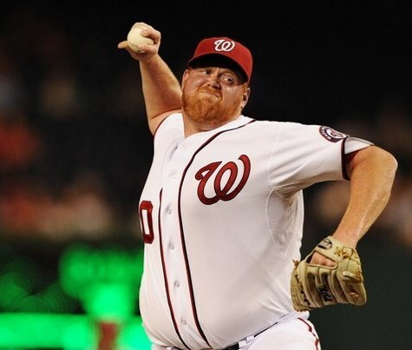
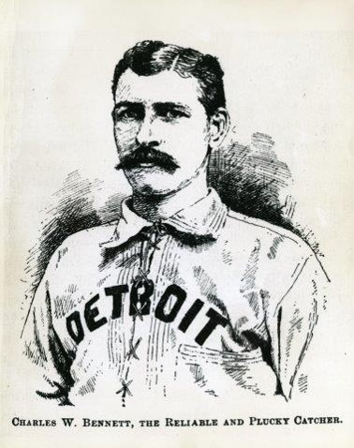
And finally, a nice cup of java. . .
Todd Coffey
George Creamer

