Slide 1

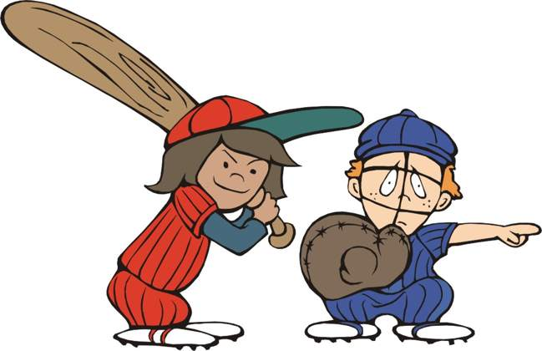


AGE Thrive
with
Baseball Memories

Slide 2

AGE Thrive with Baseball Memories
January 14, 2026
We’re happy to be with you today!
AGENDA
Warm-up - Introductions
Current Events
Gametime – The Year in Baseball – 1999
Seventh Inning Stretch - “Take Me Out to the Ball Game”
Get Up and Move, Sing, Dance!
Extra Innings – Where did you hang out?

Slide 3


Slide 4





FOOTBALL
Volleyball and
Basketball too!

Slide 5

History from 1999

Slide 6
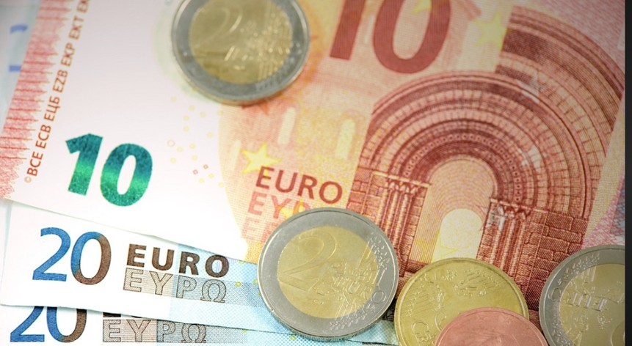


The “euro” currency was adopted
Currently: 1 equals $1.16
Notes:
The euro created a single currency across most countries in the European Union. It was intended to promote trade and inter-exchange among the EU nations. It was originally adopted by 11 countries in 1999 and today is used by 21 (more or less) as of 1/1/2026. The Euro was used electronically in 1999 and paper/coins were used widely starting in 2002. It fluctuates on the open currency markets – currently (Monday Jan 12) worth approximately $1.16 .

Slide 7
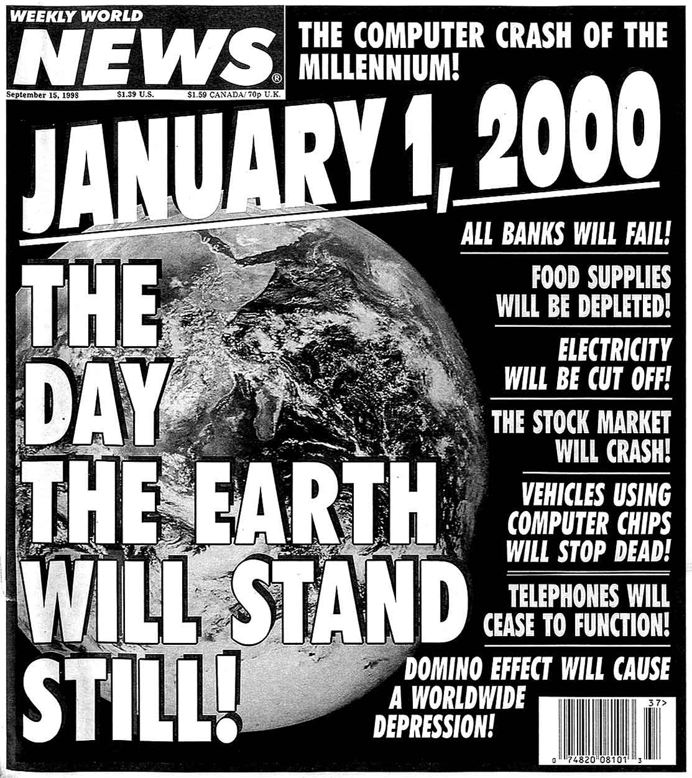

Y2K !

Slide 8
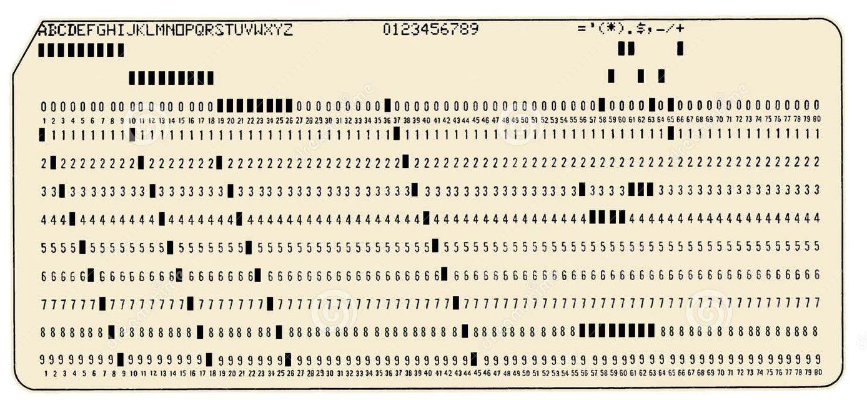
Y2K !
What was it really ??
The computer “punched card” that was used for inputting data in the 1950s – 60s, only had 80 characters for data.

Slide 9
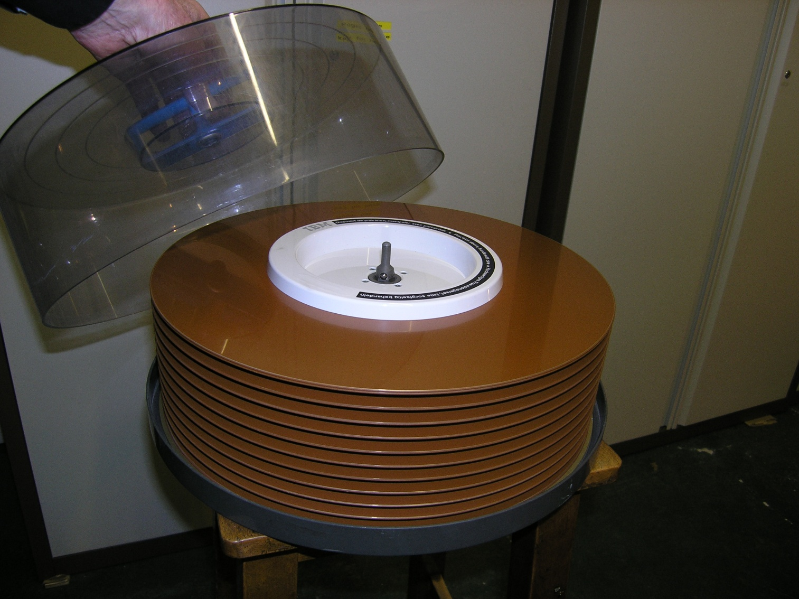
Y2K !
What was it really ??
A 1960s disk drive had only 29 megabytes to store large amounts of data.
Your smartphone today has around 512 GB of data storage .
That smartphone in your pocket or purse has about 17,000 times more storage than this disk drive.
IBM 2314 removable disk storage

Slide 10
Y2K !
What was it really ??
So … storage for data was at a premium.
Early programmers just used just two digits for the year:
5
2
Monte was born in 1952, so his birth year looked like this:
9
9
5
2
47
In 1999, Monte’s age would be:
minus
equals
0
5
2
equals negative 52
0
minus
But in 2000:

Slide 11
Y2K !
What was it really ??
The solution was to reprogram the software
to use four-digit years:
1
9
5
9
2
Monte was born in 1952, so now that is stored as:
So now Monte’s age could be correctly calculated as:
2
0
0
0
1
9
5
2
equals 48
minus

Slide 12
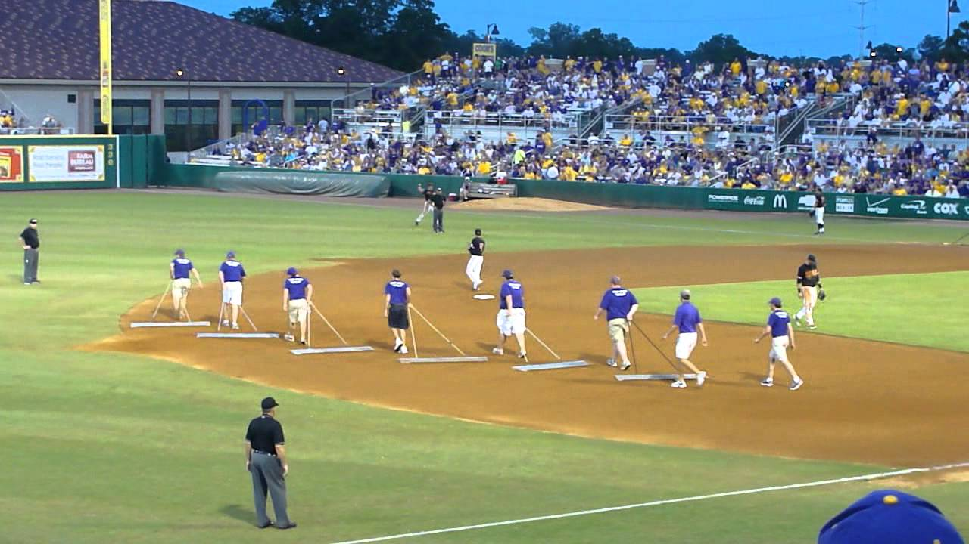
In Between Innings

Slide 13
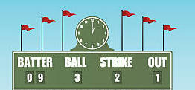
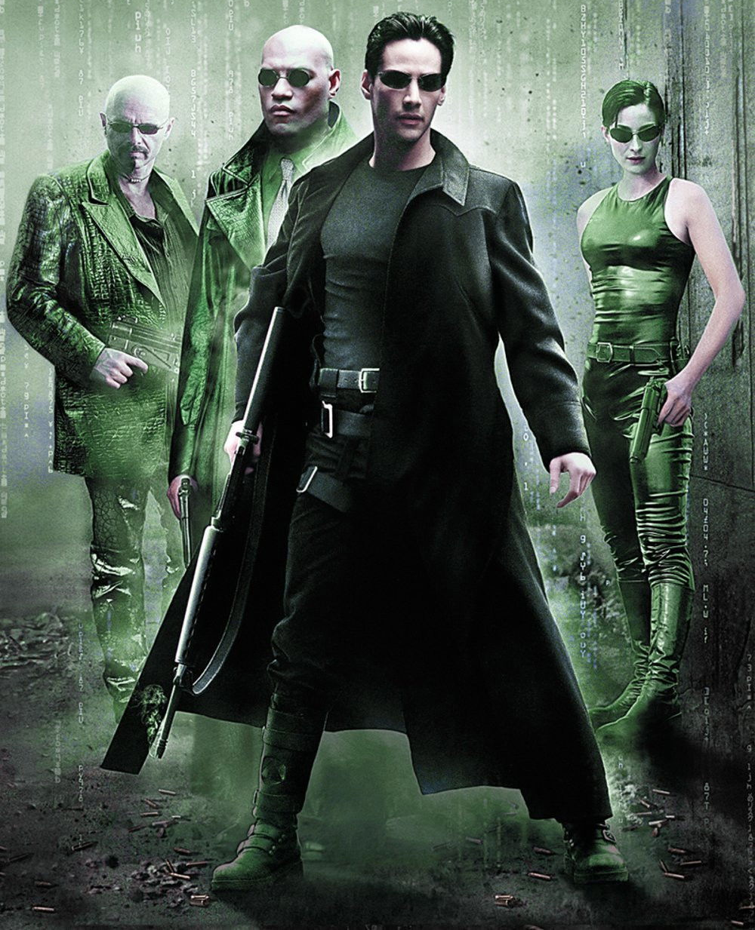

Scoreboard Quiz – 1999 At the Movies
h
This science fiction blockbuster starred Keanu Reeves as “Neo” in a dystopian future. The film won 4 Academy Awards and had two sequels.
Fight Club
Dr. No
The Matrix

Slide 14
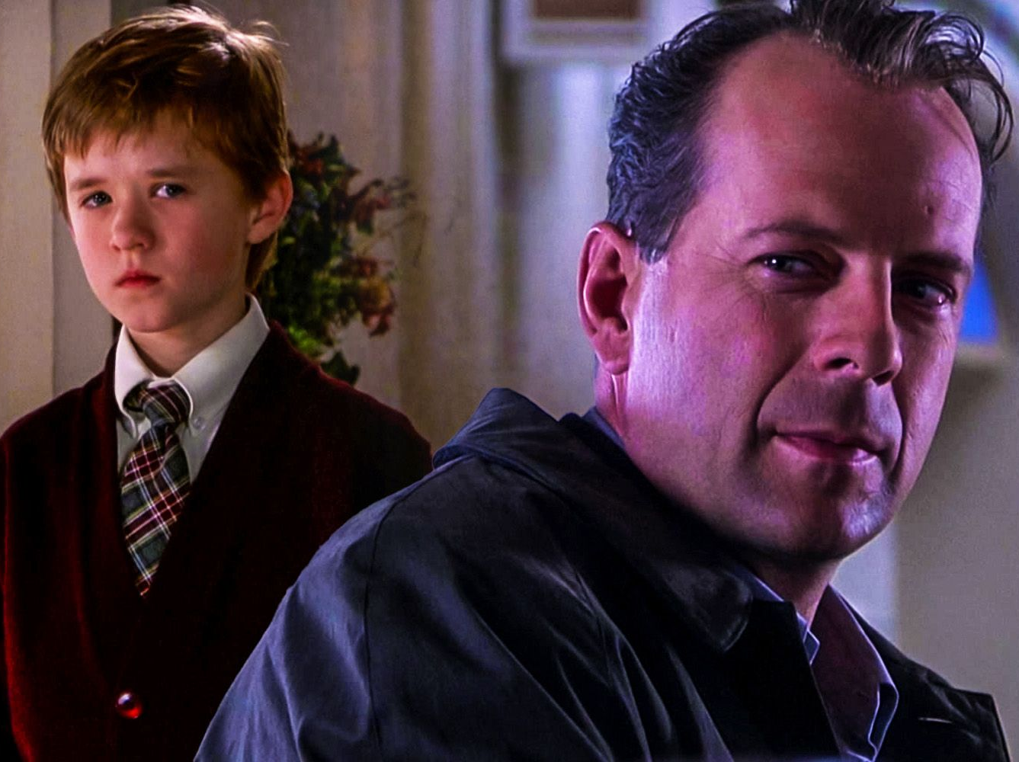

Scoreboard Quiz – 1999 At the Movies
h
This thriller starred Bruce Willis as a child psychologist and Haley Joel Osment as his patient, who claims “I see dead people.”
The Blair Witch Project
The Sixth Sense
The Stepford Wives
Notes:
was nominated for six Academy Awards, including Best Picture, Best Director and Best Original Screenplay for Shyamalan, Best Supporting Actor for Osment, and Best Supporting Actress

Slide 15

Scoreboard Quiz – 1999 TV Premiers
h
This kids’ animated cartoon features the title character and his aquatic friends living in the underwater city of Bikini Bottom.
The Atlantis Cartoon
Little Mermaid
SpongeBob SquarePants
Notes:
Created by marine science educator and animator Stephen Hillenburg for Nickelodeon. It was intended to teach children about aquatic life. It is still in production after 330 episodes.

Slide 16

Scoreboard Quiz – 1999 TV Premiers
h
This animated series stars the Griffin family living in fictional Quahog, R.I. The clueless family’s antics poke fun at modern culture.
The Jetsons
Family Guy
The Flintstones
Notes:
In 2009, it was nominated for a Primetime Emmy Award for Outstanding Comedy Series, the first time an animated series had been nominated for the award since The Flintstones in 1961. It is still in production after 24 years and 446 episodes.

Slide 17
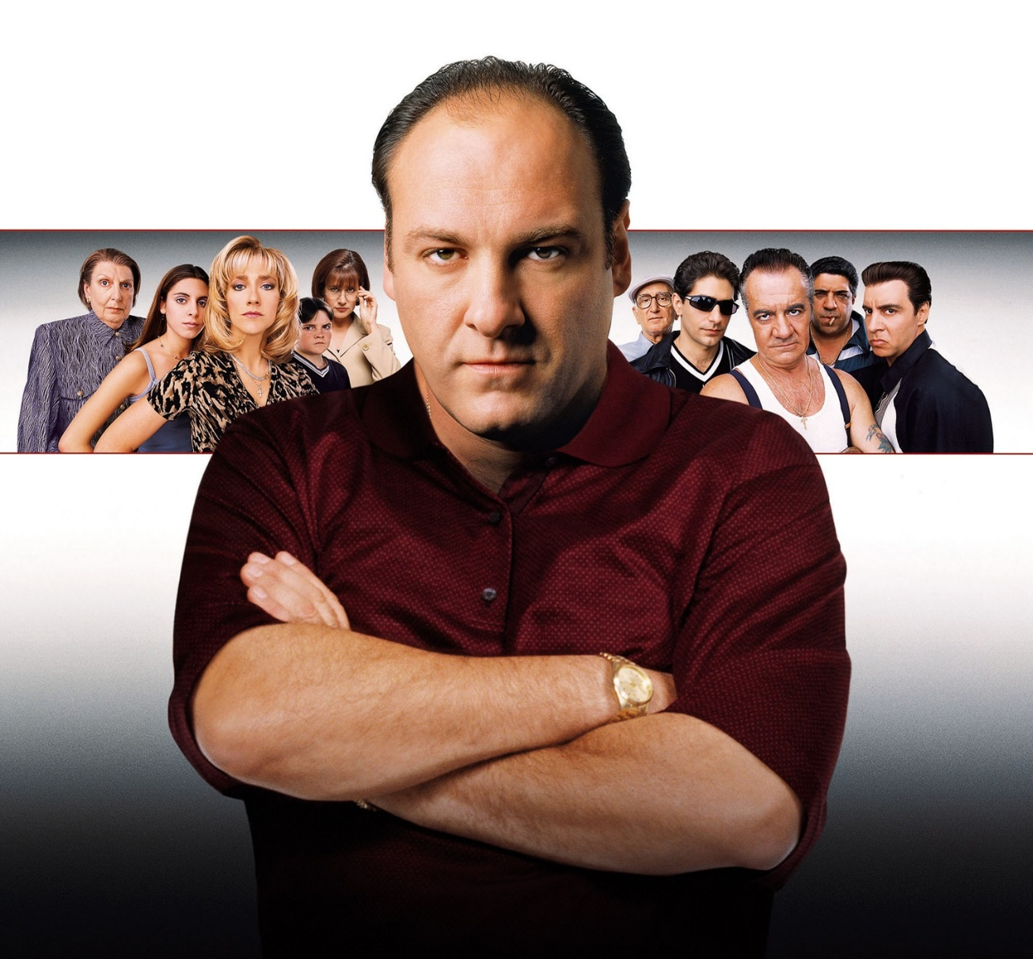
Scoreboard Quiz – 1999 On TV
h
This show debuted in ‘99 and featured “Tony”, a New Jersey Mafia boss and his family. Tony suffers from panic attacks.
Dragnet
Law and Order
The Sopranos
Notes:
This show ran for six seasons starting in 1999 and won 21 Primetime Emmy awards as well as 6 Golden Globes. Most of the actors were Italian-Americans from the New York City area, which made the show seem even more realistic.

Slide 18

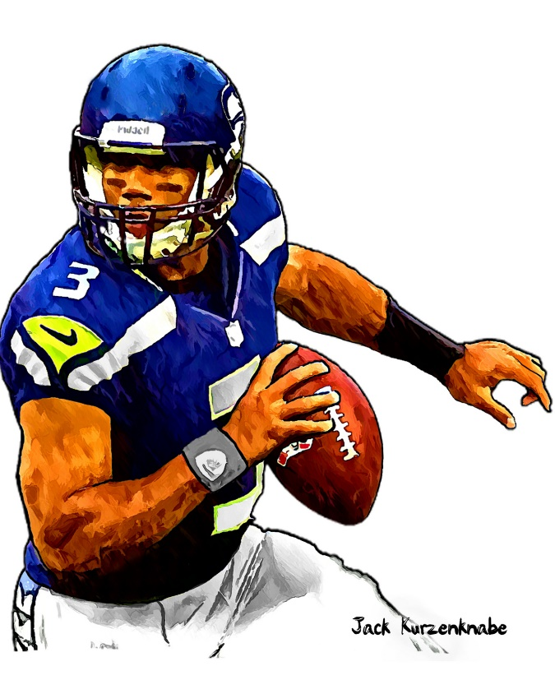

1999 Sporting News

Slide 19
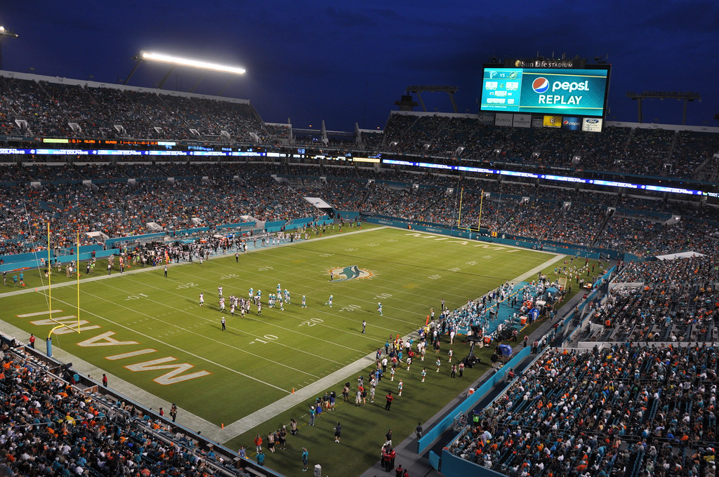
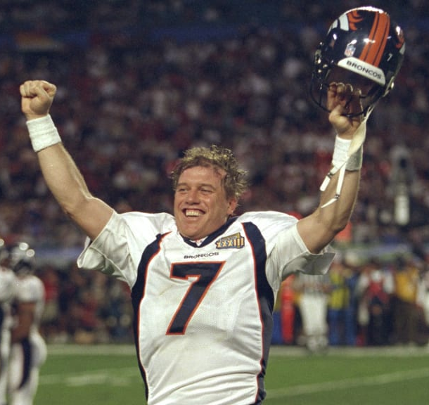

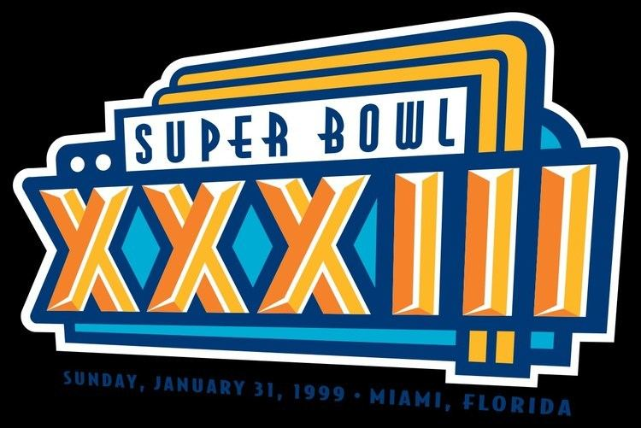

34
to
19
Played at Miami’s
Pro Player Stadium
Broncos QB John Elway
was the MVP

Slide 20

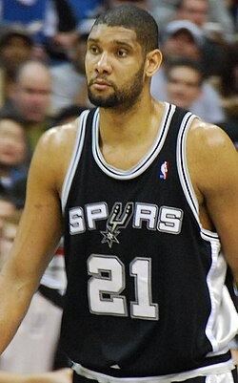

vs
The Spurs won their
1st NBA Title !
The Spurs’ Tim Duncan was the MVP
of the NBA finals

Slide 21
The Year in Baseball: 1999

Slide 22
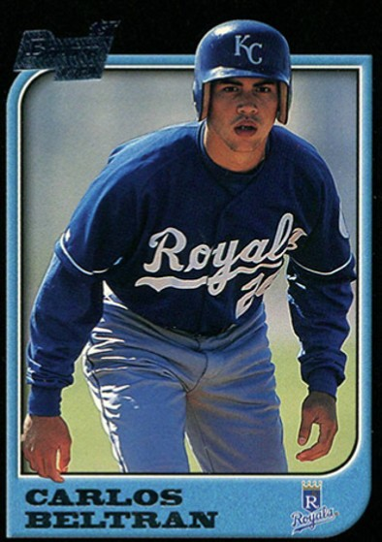
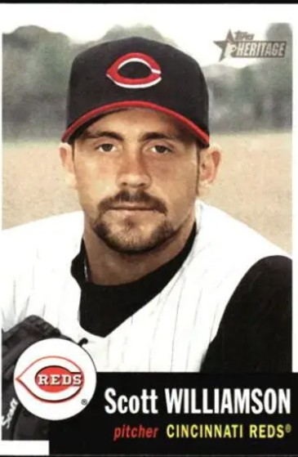
1999
Rookies
of the
Year
.293 22 HR 108 RBI
12 – 7 19 SV 2.41 ERA
Notes:
Mickey Mantle hit 37 homers to lead the AL. He also led the league in triples, walks, and SLG.

Slide 23
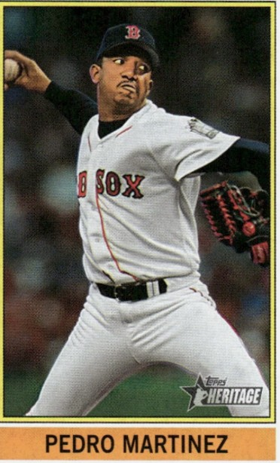
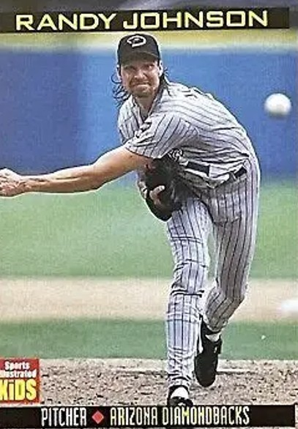
1999
Cy Young
Award
Winners
17 - 9 2.48 ERA 364 K
23 – 4 2.07 ERA 313 K
https://www.youtube.com/watch?v=DYXTV51GdUs
Notes:
1999 was 2nd of 3 CYA for Pedro. ‘99 was second of 5 CYA for Johnson; and first of four in a row. Johnson was 6’10” tall and intimidating (show Kruk video from 1993 AS game)

Slide 24
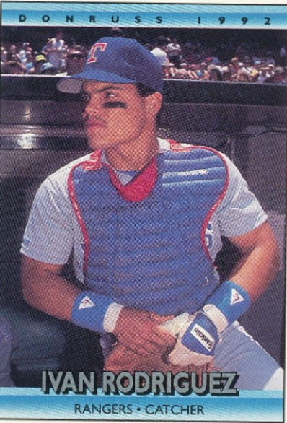
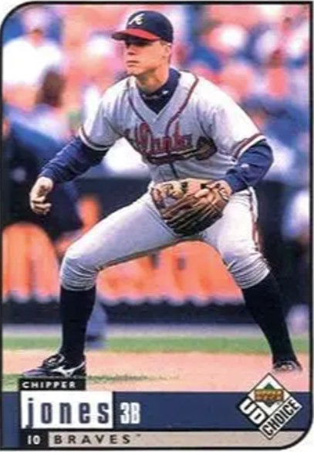
1999 Most Valuable Players
.332 35 HR 113 RBI
.319 45 HR 110RBI
Notes:
Both Hall of Fame players

Slide 25
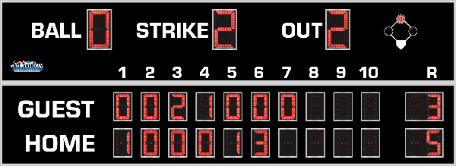
7th Inning Stretch

Slide 26
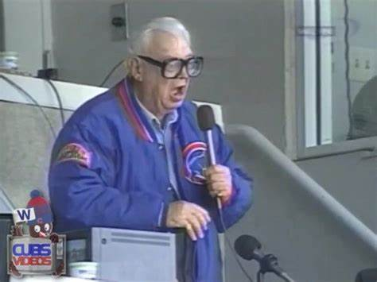
“Take Me Out to the Ballgame”

Slide 27
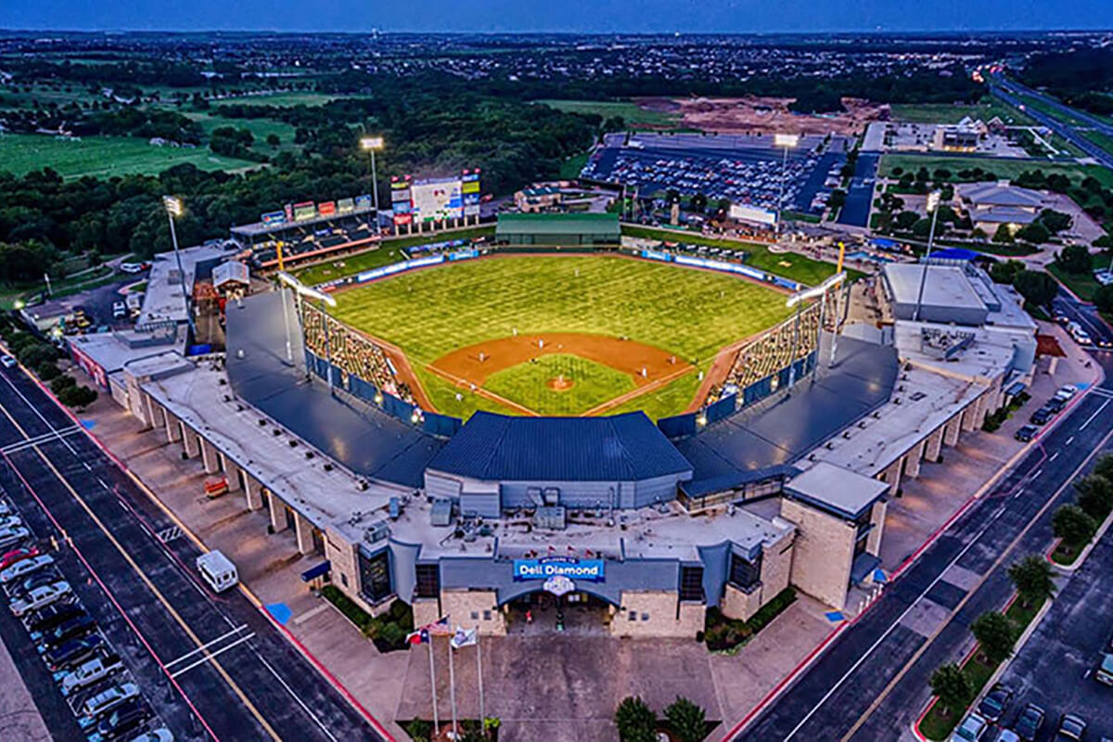
“Deep in the Heart of Texas
https://www.youtube.com/watch?v=rcrK0U7RDIk

Slide 28
“Do the Hokey Pokey”
https://www.youtube.com/watch?v=vpharBeg9XA

Slide 29




1999 LCS
Best 4 of 7 format
N.Y. Yankees
won 4 - 1
Atlanta Braves
won 4 - 2

Slide 30
1999 World Series
vs.
Defending Champions
having also won in 1998

Slide 31
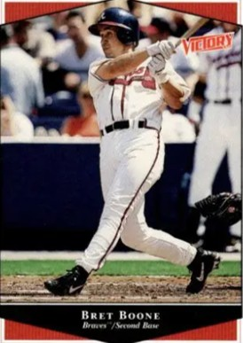
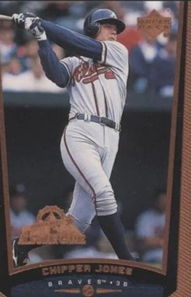
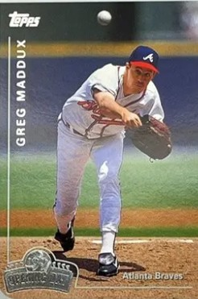
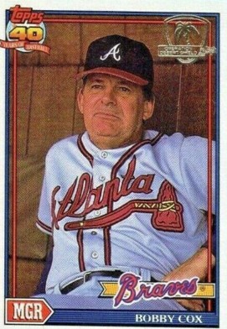
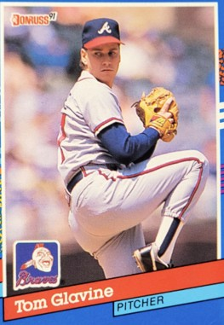
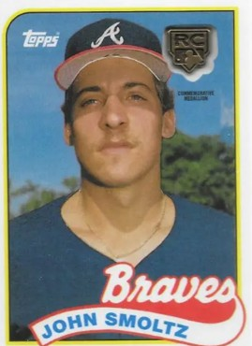
1999
Braves

Slide 32
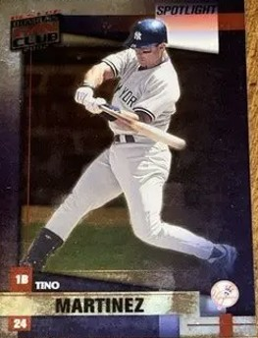
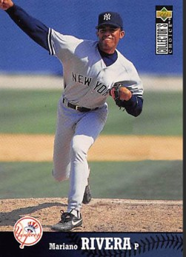
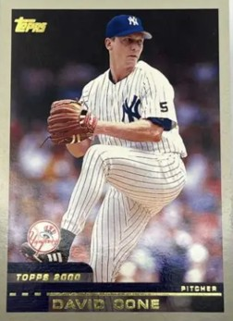
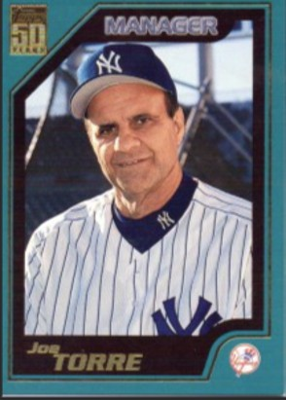
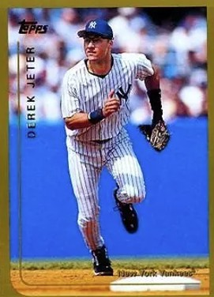
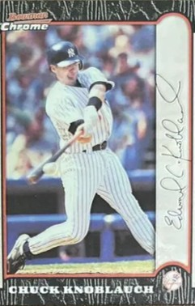
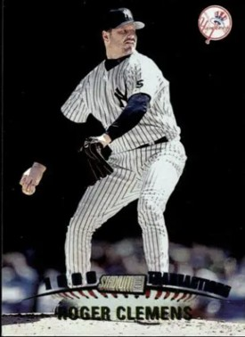
1999
Yankees

Slide 33
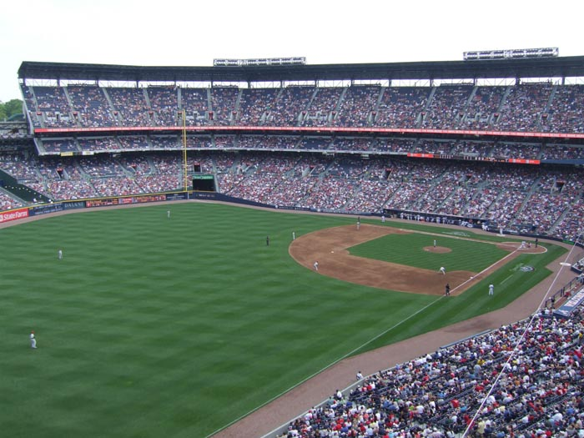
1999 World Series Highlights
Game 1 – October 23
Braves 3B Chipper Jones homered in the 4th to put the Braves ahead. That was the only run allowed by Yankees starter Orlando Hernandez. New York tallied 4 runs in the 8th , with RF Paul O’Neill driving in two.
YANKEES 4 – BRAVES 1
Game 2 – October 24
The Yankees scored early and often, and were leading 7-0 by the 5th inning. They coasted to the win behind SP David Cone’s one-hit pitching over 7 innings.
YANKEES 7 – BRAVES 2
Yankees lead 2-0 as they return home to New York
Turner Field - Atlanta

Slide 34
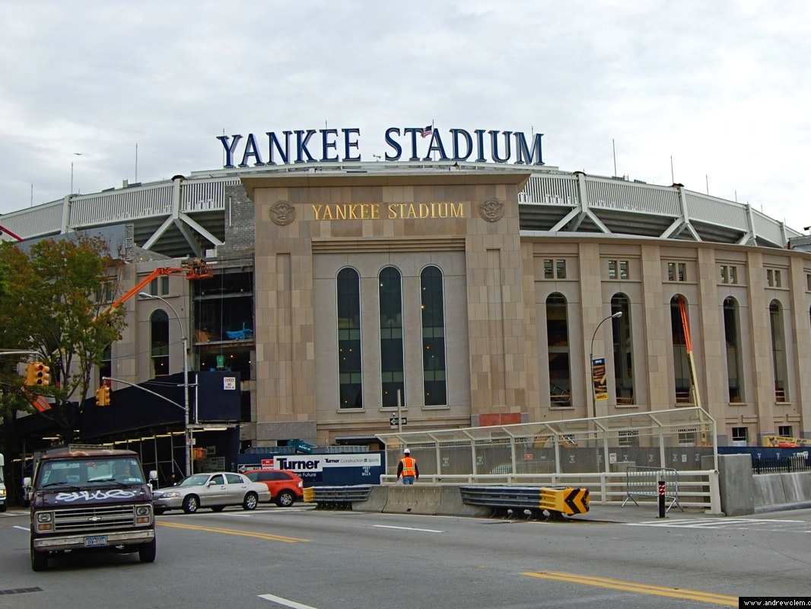
Game 3 – October 26
Atlanta knocked out Yankees’ SP Andy Pettitte in the 4th inning and built a 5-1 lead. However, the Yankees bullpen shut out the Braves the rest of the way. Powered by homers from 1B Tino Martinez, 2B Chuck Knoblauch, and two from LF Chad Curtis the New York offense rallied to win in extra innings.
YANKEES 6 – BRAVES 5 (10 inn)
Game 4 – October 27
The Yankees opened the scoring with 3 runs in the bottom of the 3rd inning and SP Roger Clemens allowed only one Atlanta run in 7.2 IP. Yankees closer Mario Rivera locked down the win with 1.1 innings of no-hit pitching.
YANKEES 4 - BRAVES 1
Yankee Stadium II – New York

Slide 35
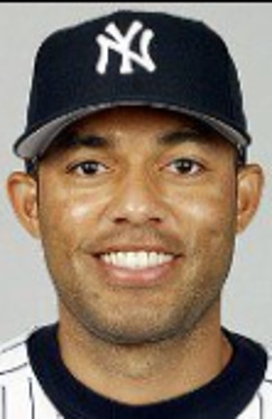
New York Yankees
win
1999 World Series!!
The Bronx Bombers swept Atlanta 4-0:
This was the Yankees 25th World Series victory!
This was the Yankees’ second straight World Series “sweep” – neither the Padres in 1998 nor the Braves in 1999 won a single game!!
Yankees closer Mariano Rivera was MVP
Notes:
Mariano Rivera won 1 game and saved 2 others during the 4-game series. He did not allow a run in 4.1 IP across his three appearances. He was elected to the HOF in 2019 by a unanimous vote of the BBWAA and was only the second Panamanian player elected (Rod Carew) was the first.

Slide 36
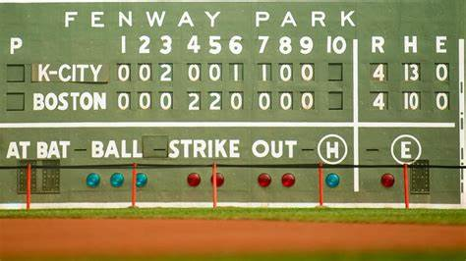
Extra Innings!

Slide 37

Where did you hang out ?
(with your friends)

Slide 38
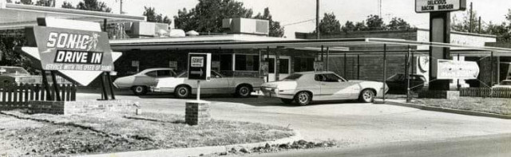
Drive-In & Fast Food Joints
This is a Sonic – what was your favorite ?

Slide 39
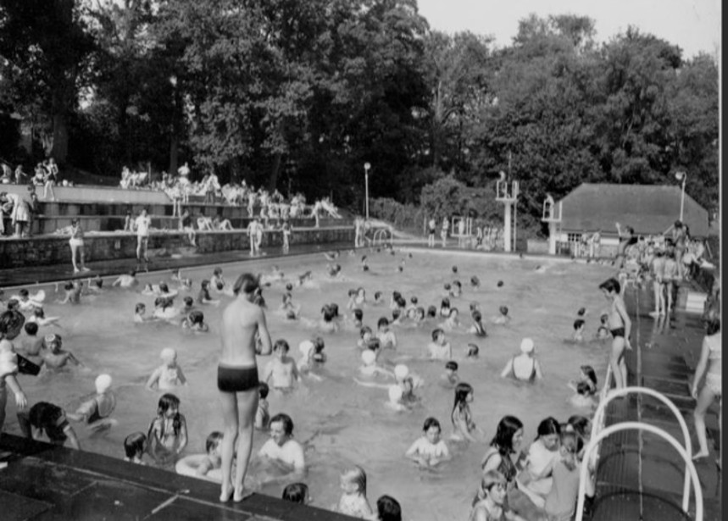
The Local
Swimming
Pool
or did you swim at a beach or lake?

Slide 40

The Local
Park
Maybe a picnic?

Slide 41
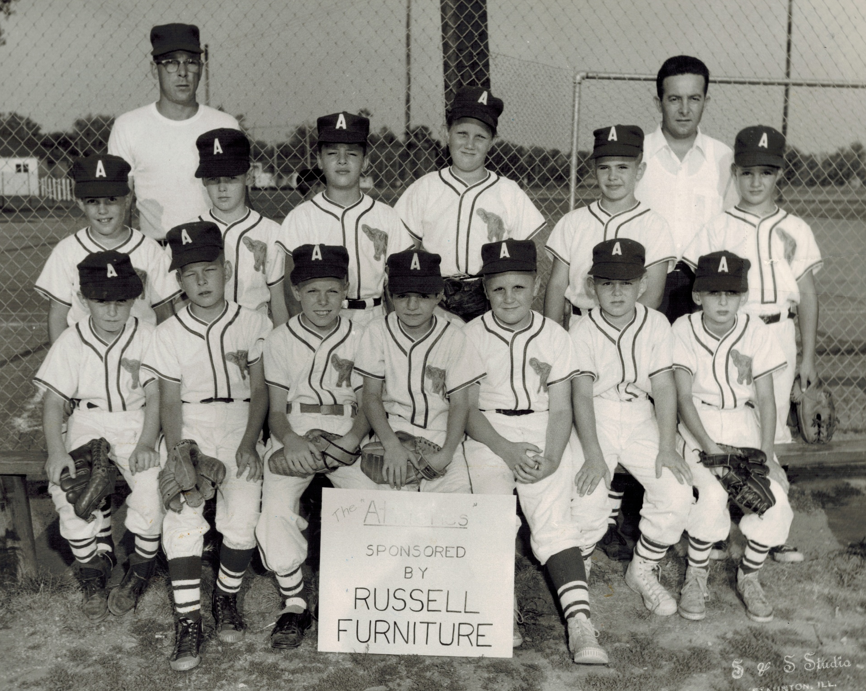
The Local
Ball Park
Notes:
Where’s Monte?

Slide 42
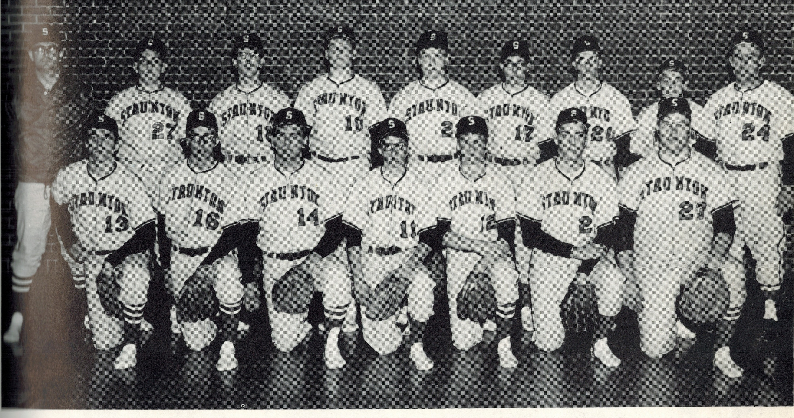
Notes:
Where’s Monte?

Slide 43
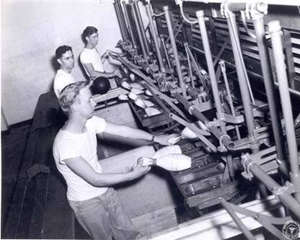

Bowling Alleys
What
are
these
guys
doing?
What was your best score?

Slide 44
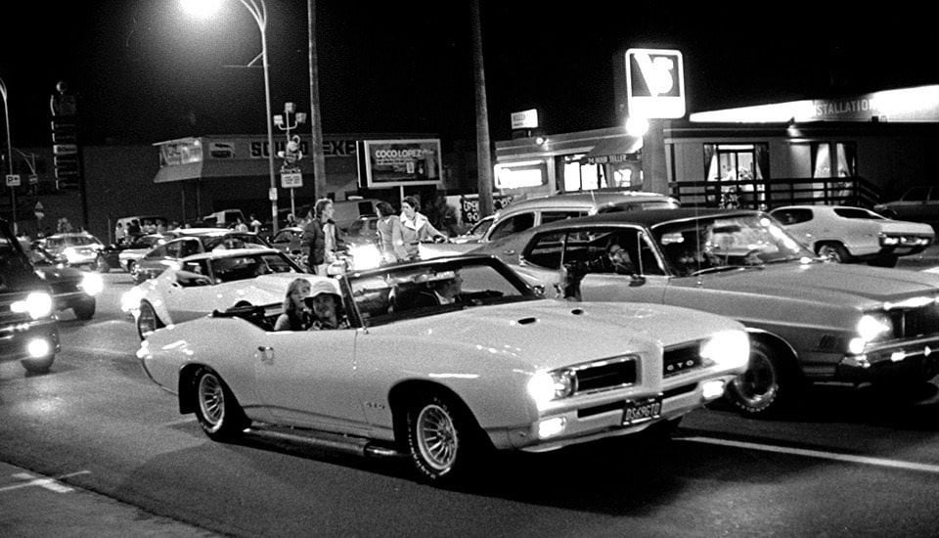
Cruisin’ Main Street
What was your favorite car when growing up?

Slide 45

Thanks!
We’ll see you again next month!!

